Slide 1
OLD TESTAMENT HISTORY
Lesson 1, 1st Quarter, 1888

Slide 2

Living the Light

Slide 3
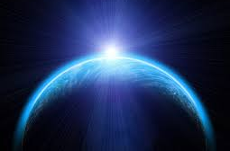
1. What did God do in the beginning?
Genesis 1:1
In the beginning God created the heaven and the earth.

Slide 4
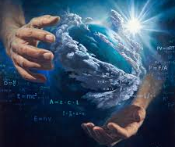
2. By what means was this accomplished?
Psalm 33:6, 9
By the word of the Lord were the heavens made; and all the host of them by the breath of his mouth…

Slide 5

2. By what means was this accomplished?
Psalm 33:6, 9
…For he spake, and it was done; he commanded, and it stood fast.

Slide 6
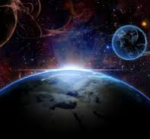
3. Are we to understand from these words that the matter of the earth was not in existence before He spoke?
Hebrews 11:33
Through faith we understand that the worlds were framed by the word of God, so that things which are seen were not made of things which do appear.

Slide 7
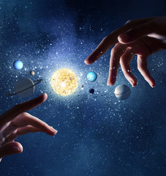
Discussion:
SDABC V7
God was not indebted to preexisting matter. By His mighty power God called matter into being, and then by that same power imparted life to creatures formed from it.

Slide 8
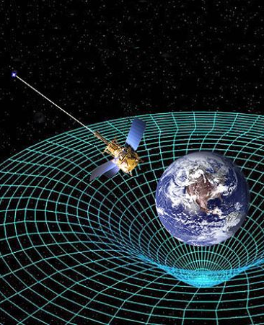
Discussion:
SDABC V7
Prior to the dawn of the so-called Atomic Age it was one of the prime tenets of science that matter is eternal, that it can be neither created nor destroyed. But now scientists declare that matter and energy are interchangeable.

Slide 9
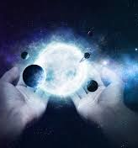
Discussion:
SDABC V7
Why, then, should it be thought strange that an almighty God can create matter that did not previously exist? The world and everything in it were made out of nothing, by the exercise of infinite power.

Slide 10
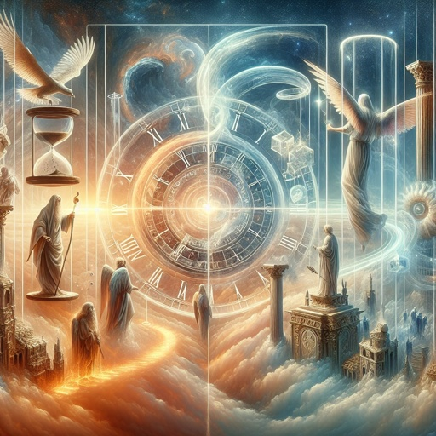
4. Who was the active agent in creation?
Hebrews 1:1,2
God, who at sundry times and in divers manners spake in time past unto the fathers by the prophets,..

Slide 11
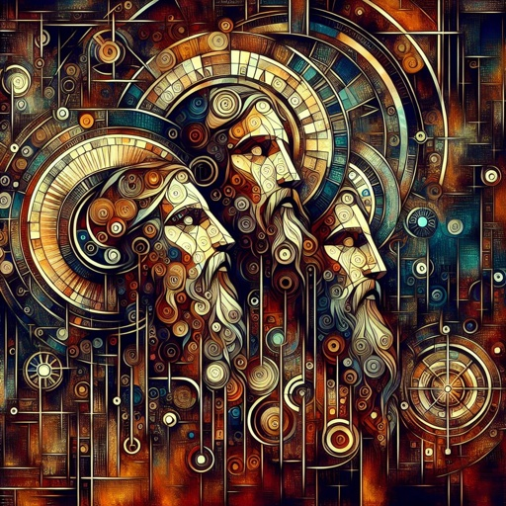
4. Who was the active agent in creation?
Hebrews 1:1,2
…Hath in these last days spoken unto us by his Son, whom he hath appointed heir of all things, by whom also he made the worlds;

Slide 12
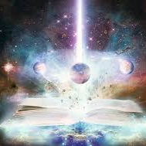
Discussion:
SDABC V7
The “worlds” here made by God probably represent the whole system of things brought into existence by Christ in time, the “all things” of Heb. 1:3, the things “visible and invisible, whether they be thrones, or dominions, or principalities, or powers” (1:16, 17).

Slide 13
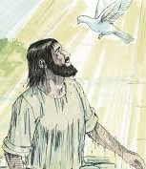
Discussion:
SDABC V7
Through Christ, God made the worlds. God used Him, not as a tool, but as a fellow worker. There is an indication here of division of activity in the Godhead. He who was to be man’s Redeemer was his Creator.

Slide 14
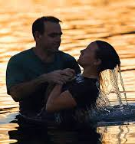
Discussion:
SDABC V7
And, indeed, because He is the Creator, He is able to create a man “a new creature” (2 Cor. 5:17).When we consider the magnitude of God’s creation, the unnumbered millions of worlds circling the throne of Deity,

Slide 15
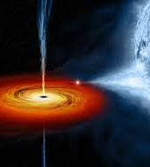
Discussion:
SDABC V7
not only do we gain an enlarged concept of God; we are led to say with the psalmist, “What is man, that thou art mindful of him? and the son of man, that thou visitest him?” (Ps. 8:4).

Slide 16
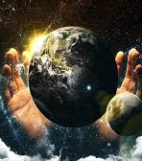
Discussion:
SDABC V7
Wonderful in wisdom, knowledge, and power must our God be; and with this, wonderful must be the love of Him who created and upholds all things and invites man to become a partaker with Him in glory.

Slide 17
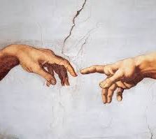
5. Is there anything that the Son did not make?
Colossians 1:16, 17
For by him were all things created, that are in heaven, and that are in earth, visible and invisible, whether they be thrones, or dominions, or principalities, or powers: all things were created by him, and for him:

Slide 18
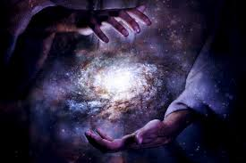
5. Is there anything that the Son did not make?
Colossians 1:16, 17
And he is before all things, and by him all things consist.

Slide 19
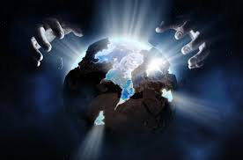
6. Since it was by the Son that the Father created all things, what is His rightful title?
John 1: 1, 3
In the beginning was the Word, and the Word was with God, and the Word was God.

Slide 20
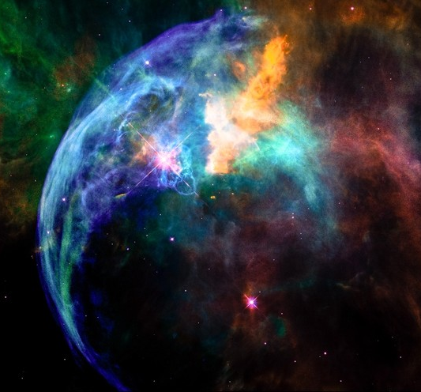
6. Since it was by the Son that the Father created all things, what is His rightful title?
John 1: 1, 3
All things were made by him; and without him was not any thing made that was made.

Slide 21
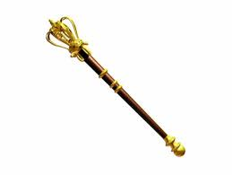
7. How has the Father addressed the Son?
Hebrews 1:8,10
But unto the Son he saith, Thy throne, O God, is for ever and ever: a sceptre of righteousness is the sceptre of thy kingdom.

Slide 22
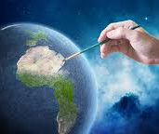
7. How has the Father addressed the Son?
Hebrews 1:8,10
And, Thou, Lord, in the beginning hast laid the foundation of the earth; and the heavens are the works of thine hands:

Slide 23
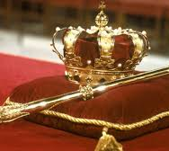
Discussion:
Psalm 45:6
Verse 8 cites Psalm 45:6, where it says:
Thy throne, O God, is for ever and ever: the sceptre of thy kingdom is a right sceptre.

Slide 24
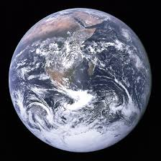
Discussion:
Psalm 102:25-27
Verse 10 cites Psalm 102:25-27,
Of old hast thou laid the foundation of the earth: and the heavens are the work of thy hands.

Slide 25
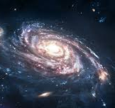
Discussion:
Psalm 102:25-27
²⁶ They shall perish, but thou shalt endure: yea, all of them shall wax old like a garment; as a vesture shalt thou change them, and they shall be changed:
²⁷ But thou art the same, and thy years shall have no end.

Slide 26
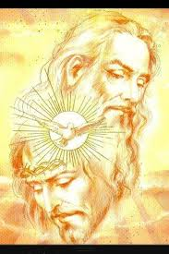
Discussion:
SDABC V7
Here the Father addresses the Son reverently, calling Him God. This may be considered the climax in the argument on the position and dignity of Christ. There can be no higher testimony to the deity of Christ than this address of the Father to the Son. In the most solemn manner Christ’s Godhood is affirmed, and this by the Father Himself.

Slide 27
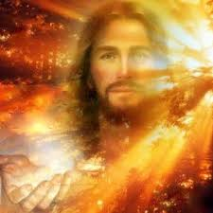
Discussion:
SDABC V7
Man’s salvation and the whole plan of redemption are based on the deity of Christ. If Christ is not God in the highest sense and in His own right, our faith is in vain and salvation becomes impossible.

Slide 28
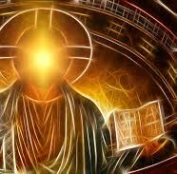
Discussion:
SDABC V7
Many of the Jews had seen Jesus in the flesh. It was probably harder for them than for later generations to believe in Christ as divine. Did they not know His supposed father and His mother, and were not some of the family still living? How could this man be God? This stumbling block the author sought to remove.

Slide 29
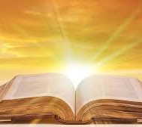
Discussion:
SDABC V7
Hence he summons the testimony of Scripture to confirm his position. It would be of little use to present the vital subjects with which Hebrews deals, until this one point was settled and fully accepted.

Slide 30
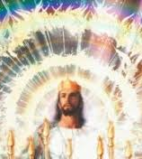
Discussion:
SDABC V7
As we consider the history of the church since the days of the apostles, we see the need of emphasis on the deity of Christ. Many there are today who revere Christ and in their own way esteem Him highly, who nevertheless refuse to give Him the place that is rightly His.

Slide 31
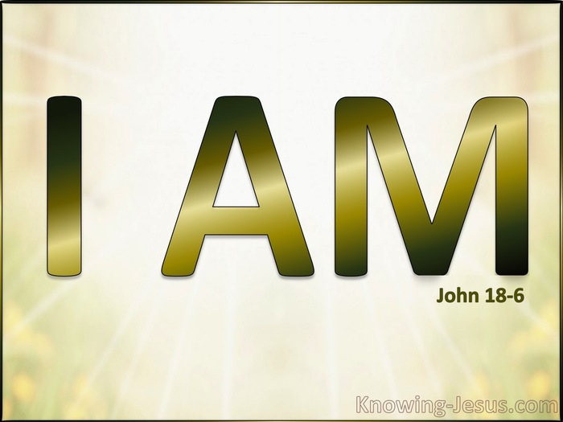
Discussion:
SDABC V7
They fail to understand that the deity of Christ is the central fact in the plan of redemption, and that there is “none other name under heaven given among men,” whereby we may be saved (Acts 4:12).

Slide 32
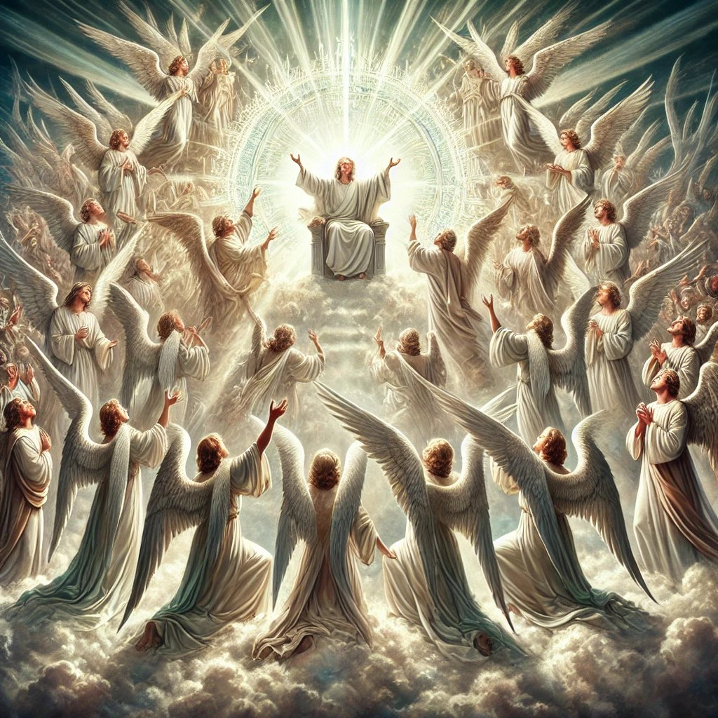
8. Then how should He be regarded by all creatures?
Hebrews 1:6
And again, when he bringeth in the firstbegotten into the world, he saith, And let all the angels of God worship him.

Slide 33
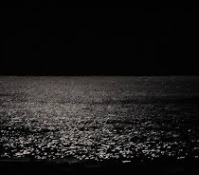
9. In what condition was the earth when it was first spoken into existence?
Genesis 1:2
And the earth was without form, and void; and darkness was upon the face of the deep. And the Spirit of God moved upon the face of the waters.

Slide 34
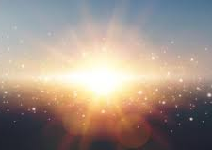
10. After the creation of the substance of the earth, what was the first thing done?
Genesis 1:3
And God said, Let there be light: and there was light.

Slide 35
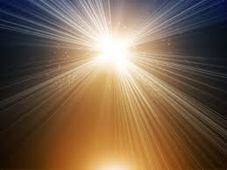
Discussion:
God first created LIGHT…
And light underpins our physical universe!
The speed of light, c, isn't just about "light" as we experience it (visible electromagnetic waves).
It’s a fundamental constant that appears across the laws of physics—it's woven into the structure of reality itself.

Slide 36
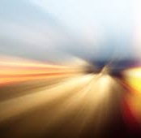
Discussion:
E = mc²: Shows how mass and energy are interchangeable, with c² (speed of light squared) being the conversion factor.
Special Relativity: The speed of light sets the maximum possible speed for information, matter, and causality.

Slide 37
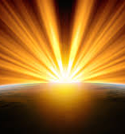
Discussion:
Space-Time Geometry: The structure of space and time depends on c—it's not just a number for photons, but a measure that shapes how space and time relate.

Slide 38
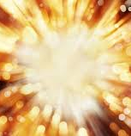
Discussion:
At the quantum level, light consists of photons—massless particles that always travel at c in a vacuum. But the deeper significance is that:

Slide 39
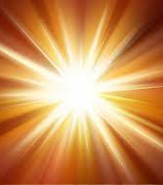
Discussion:
Light represents the exchange of energy, the propagation of information, and even how we perceive time and space.
Other massless fields (like gravitational waves) also propagate at c, showing it's not limited to "visible light."

Slide 40
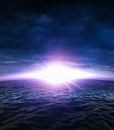
Discussion:
Many physicists suggest light and its speed are a bridge between the tangible and intangible, including:
  Albert Einstein
  James Clerk Maxwell
  Hendrik Lortenz
  Hermann Minkowski
  Richard Feynman
  Max Planck
  Arthur Eddington

Slide 41
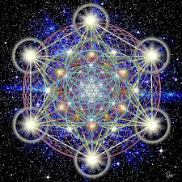
Discussion:
Time and Space are linked by c (space-time continuum).
Energy and Matter are linked by c².
In this way, light is not just a phenomenon—it's a manifestation of the underlying architecture of the universe. The whole of quantum physics is rooted in the need to understand the dichotomy of light.

Slide 42
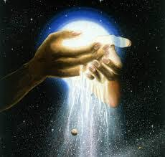
Discussion:
Many renowned physicists have reflected on the deep, almost philosophical role that light (and especially the speed of light) plays in the structure of reality.
While physics can't "prove" theology, it is striking that light occupies both a scientific and symbolic foundation in understanding reality.

Slide 43
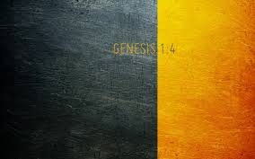
11. What next? (After the light!)
Genesis 1:4
And God saw the light, that it was good: and God divided the light from the darkness.

Slide 44
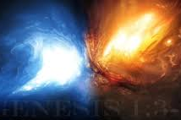
12. What did God call the light and the darkness?
Genesis 1:5
And God called the light Day, and the darkness he called Night. And the evening and the morning were the first day.

Slide 45

13. What do a period of darkness and a period of light together constitute?
Genesis 1:5
And God called the light Day, and the darkness he called Night. And the evening and the morning were the first day.

Slide 46
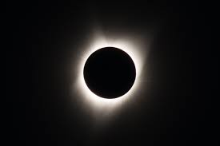
14. Which always comes first in the formation of a day? Can you explain why?
The DARKNESS!

Slide 47
14. Which always comes first in the formation of a day? Can you explain why?
The DARKNESS!
Time began with darkness. Genesis 1:1, “In the beginning…” marks the start of the first day of time, which began in darkness.

Slide 48
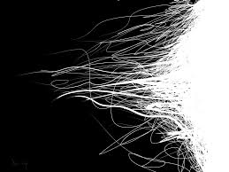
14. Which always comes first in the formation of a day? Can you explain why?
Since the first portion of the first day was darkness, each day thereafter begins with evening, or darkness, followed by morning, or light.

Slide 49
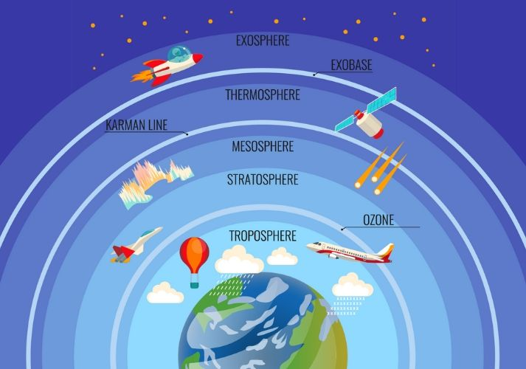
15. What was done on the second day?
Genesis 1:6-8
And God said, Let there be a firmament in the midst of the waters, and let it divide the waters from the waters.

Slide 50
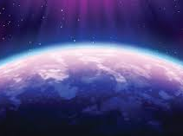
15. What was done on the second day?
Genesis 1:6-8
And God made the firmament, and divided the waters which were under the firmament from the waters which were above the firmament: and it was so.

Slide 51
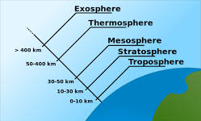
15. What was done on the second day?
Genesis 1:6-8
And God called the firmament Heaven. And the evening and the morning were the second day.

Slide 52
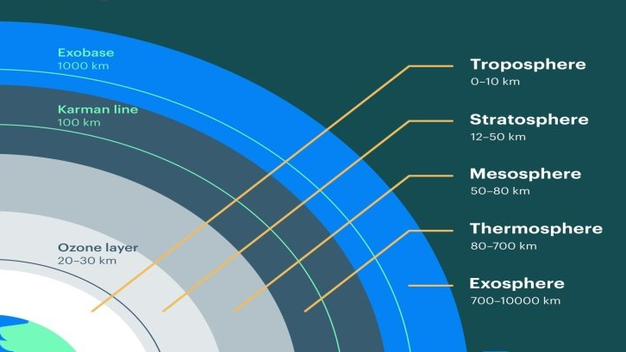

Slide 53
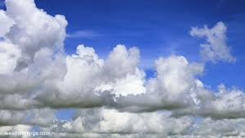
16. How is this day’s work referred to by Job?
Job 26:8
He bindeth up the waters in his thick clouds; and the cloud is not rent under them.

Slide 54
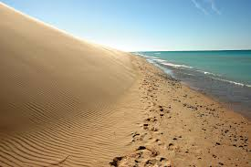
17. What was done on the third day?
Genesis 1:9-13
And God said, Let the waters under the heaven be gathered together unto one place, and let the dry land appear: and it was so.

Slide 55
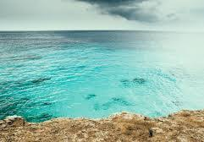
17. What was done on the third day?
Genesis 1:9-13
And God called the dry land Earth; and the gathering together of the waters called he Seas: and God saw that it was good.

Slide 56

17. What was done on the third day?
Genesis 1:9-13
And God said, Let the earth bring forth grass, the herb yielding seed, and the fruit tree yielding fruit after his kind, whose seed is in itself, upon the earth: and it was so.

Slide 57

17. What was done on the third day?
Genesis 1:9-13
And the earth brought forth grass, and herb yielding seed after his kind, and the tree yielding fruit, whose seed was in itself, after his kind: and God saw that it was good.

Slide 58

17. What was done on the third day?
Genesis 1:9-13
And the evening and the morning were the third day.

Slide 59

18. What was made upon the fourth day?
Genesis 1:14
And God said, Let there be lights in the firmament of the heaven to divide the day from the night; and let them be for signs, and for seasons, and for days, and years:

Slide 60

19. What were these lights to govern?
Genesis 1:16
And God made two great lights; the greater light to rule the day, and the lesser light to rule the night: he made the stars also.

Slide 61

20. Then what kind of days were these days of creation?
The days of creation were literal, regular-length days—composed of a period of darkness (evening) and a period of light (morning), together making one complete day.

Slide 62

20. Then what kind of days were these days of creation?
The Bible specifies this structure in Genesis 1:5, where it says, “And the evening and the morning were the first day.” Each day was marked by the earth's rotation on its axis, with each full revolution constituting one day.

Slide 63

20. Then what kind of days were these days of creation?
The creation days were not indefinite periods or symbolic eras but actual, measurable days, consistent in length with the days we experience now.

Slide 64

21. Does the sun make the day, or simply rule the day?
The sun does not create the day; it simply governs or rules over it, as clarified in the Hebrew translation of Genesis 1:18.

Slide 65

22. Tell what makes the day, and how there could be days before the sun was?
A day is made by the revolution of the earth on its axis. Each complete rotation of the earth constitutes one day, which we commonly divide into 24 hours for convenience.

Slide 66

22. Tell what makes the day, and how there could be days before the sun was?
There could be days before the sun was created because the existence of a "day" does not depend on the sun itself, but on the earth’s rotation. According to Genesis 1:2-5, when God created the earth, it was without form, void, and covered in darkness.

Slide 67

22. Tell what makes the day, and how there could be days before the sun was?
Yet, the earth existed, and as soon as God spoke light into existence, He divided the light from the darkness, calling the light "Day" and the darkness "Night." This established the first day of time.

Slide 68

22. Tell what makes the day, and how there could be days before the sun was?
Thus, days existed from the beginning of time, independent of the sun, because they are determined by the movement of the earth, not by the presence of the sun itself.

Slide 69


Slide 70
THANK YOU and
Happy sabbath!!

