Slide 1
OLD TESTAMENT HISTORY: Creation and the Sabbath
Lesson 2, 1st Quarter, 1888

Slide 2

Living the Light

Slide 3
… A Minor Digression
What’s in a NAME?

Slide 4
What’s in a NAME?
Testimonies Volume 1, p. 223-224
No name which we can take will be appropriate but that which accords with our profession and expresses our faith and marks us a peculiar people. The name Seventh-day Adventist is a standing rebuke to the Protestant world.

Slide 5
What’s in a NAME?
Testimonies Volume 1, p. 223-224
The name Seventh-day Adventist carries the true features of our faith in front, and will convict the inquiring mind. Like an arrow from the Lord’s quiver, it will wound the transgressors of God’s law, and will lead to repentance toward God and faith in our Lord Jesus Christ. …

Slide 6
What’s in a NAME?
Testimonies Volume 1, p. 223-224
I was shown that almost every fanatic who has arisen, who wishes to hide his sentiments that he may lead away others, claims to belong to the church of God. Such a name would at once excite suspicion; for it is employed to conceal the most absurd errors.

Slide 7
What’s in a NAME?
Testimonies Volume 1, p. 223-224
This name is too indefinite for the remnant people of God. It would lead to the supposition that we had a faith which we wished to cover up.

Slide 8
What’s in a NAME?
God’s Remnant Church, p. 51 (Letter 110, 1902)
We are Seventh-day Adventists. Are we ashamed of our name?
We answer, No, no! We are not. It is the name the Lord has given us. It points out the truth that is to be the test of the churches.

Slide 9
What’s in a NAME?
God’s Remnant Church, p. 51 (Letter 106, 1903)
We are Seventh-day Adventists, and of this name we are never to be ashamed. As a people we must take a firm stand for truth and righteousness. Thus we shall glorify God. We are to be delivered from dangers, not ensnared and corrupted by them. That this may be, we must look ever to Jesus, the Author and Finisher of our faith.

Slide 10

1. Who was the direct agent in the creation of the earth?
?

Slide 11
1. Who was the direct agent in the creation of the earth?
The Lord Jesus Christ was the divine Word through whom all things were made. "All things were made by him; and without him was not any thing made that was made" (John 1:3). Jesus was the active Creator!

Slide 12
2. State briefly what was done on each of the first four days.
?

Slide 13
2. State briefly what was done on each of the first four days.
Day 1: God created light.
Day 2: God made the firmament.
Day 3: He gathered the seas, revealed dry land, and created vegetation.
Day 4: God made the sun, moon, and stars.

Slide 14
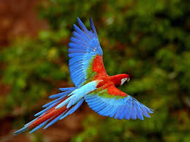
3. What was made on the fifth day?
Genesis 1:20-23
And God said, Let the waters bring forth abundantly the moving creature that hath life, and fowl that may fly above the earth in the open firmament of heaven.

Slide 15
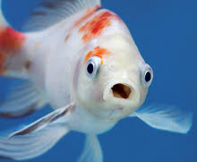
3. What was made on the fifth day?
Genesis 1:20-23
And God created great whales, and every living creature that moveth, which the waters brought forth abundantly, after their kind, and every winged fowl after his kind: and God saw that it was good.

Slide 16
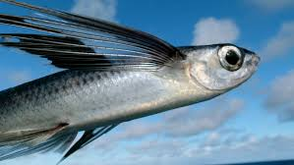
3. What was made on the fifth day?
Genesis 1:20-23
And God blessed them, saying, Be fruitful, and multiply, and fill the waters in the seas, and let fowl multiply in the earth.

Slide 17
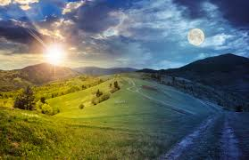
3. What was made on the fifth day?
Genesis 1:20-23
And the evening and the morning were the fifth day.

Slide 18
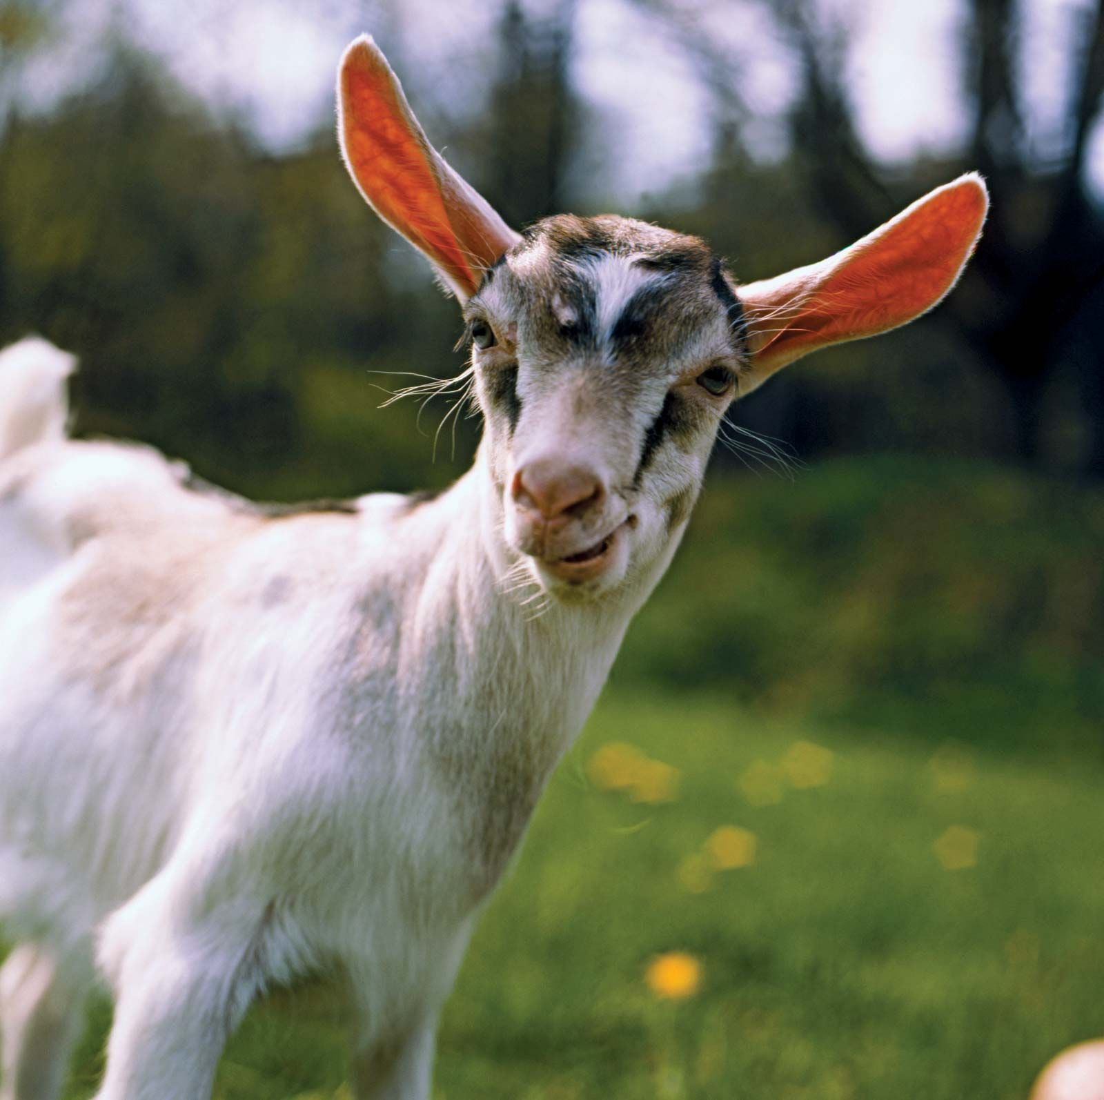
4. What upon the sixth day?
Genesis 1:24-27
And God said, Let the earth bring forth the living creature after his kind, cattle, and creeping thing, and beast of the earth after his kind: and it was so.

Slide 19
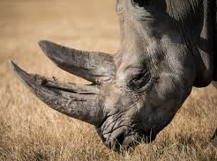
4. What upon the sixth day?
Genesis 1:24-27
And God made the beast of the earth after his kind, and cattle after their kind, and every thing that creepeth upon the earth after his kind: and God saw that it was good.

Slide 20
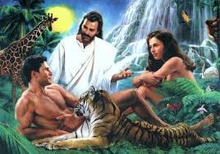
4. What upon the sixth day?
Genesis 1:24-27
And God said, Let us make man in our image, after our likeness: and let them have dominion over the fish of the sea, and over the fowl of the air, and over the cattle, and over all the earth, and over every creeping thing that creepeth upon the earth.

Slide 21
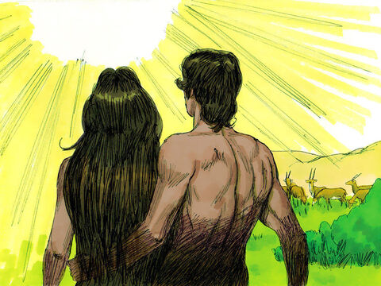
4. What upon the sixth day?
Genesis 1:24-27
So God created man in his own image, in the image of God created he him; male and female created he them.

Slide 22
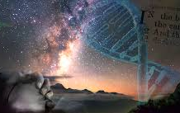
5. How did God regard His work when it was done?
Genesis 1:31
And God saw every thing that he had made, and, behold, it was very good. And the evening and the morning were the sixth day.

Slide 23
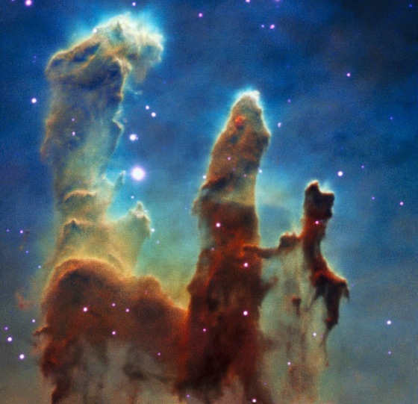
6. How did He spend the seventh day?
Genesis 2:1-2
Thus the heavens and the earth were finished, and all the host of them.

Slide 24
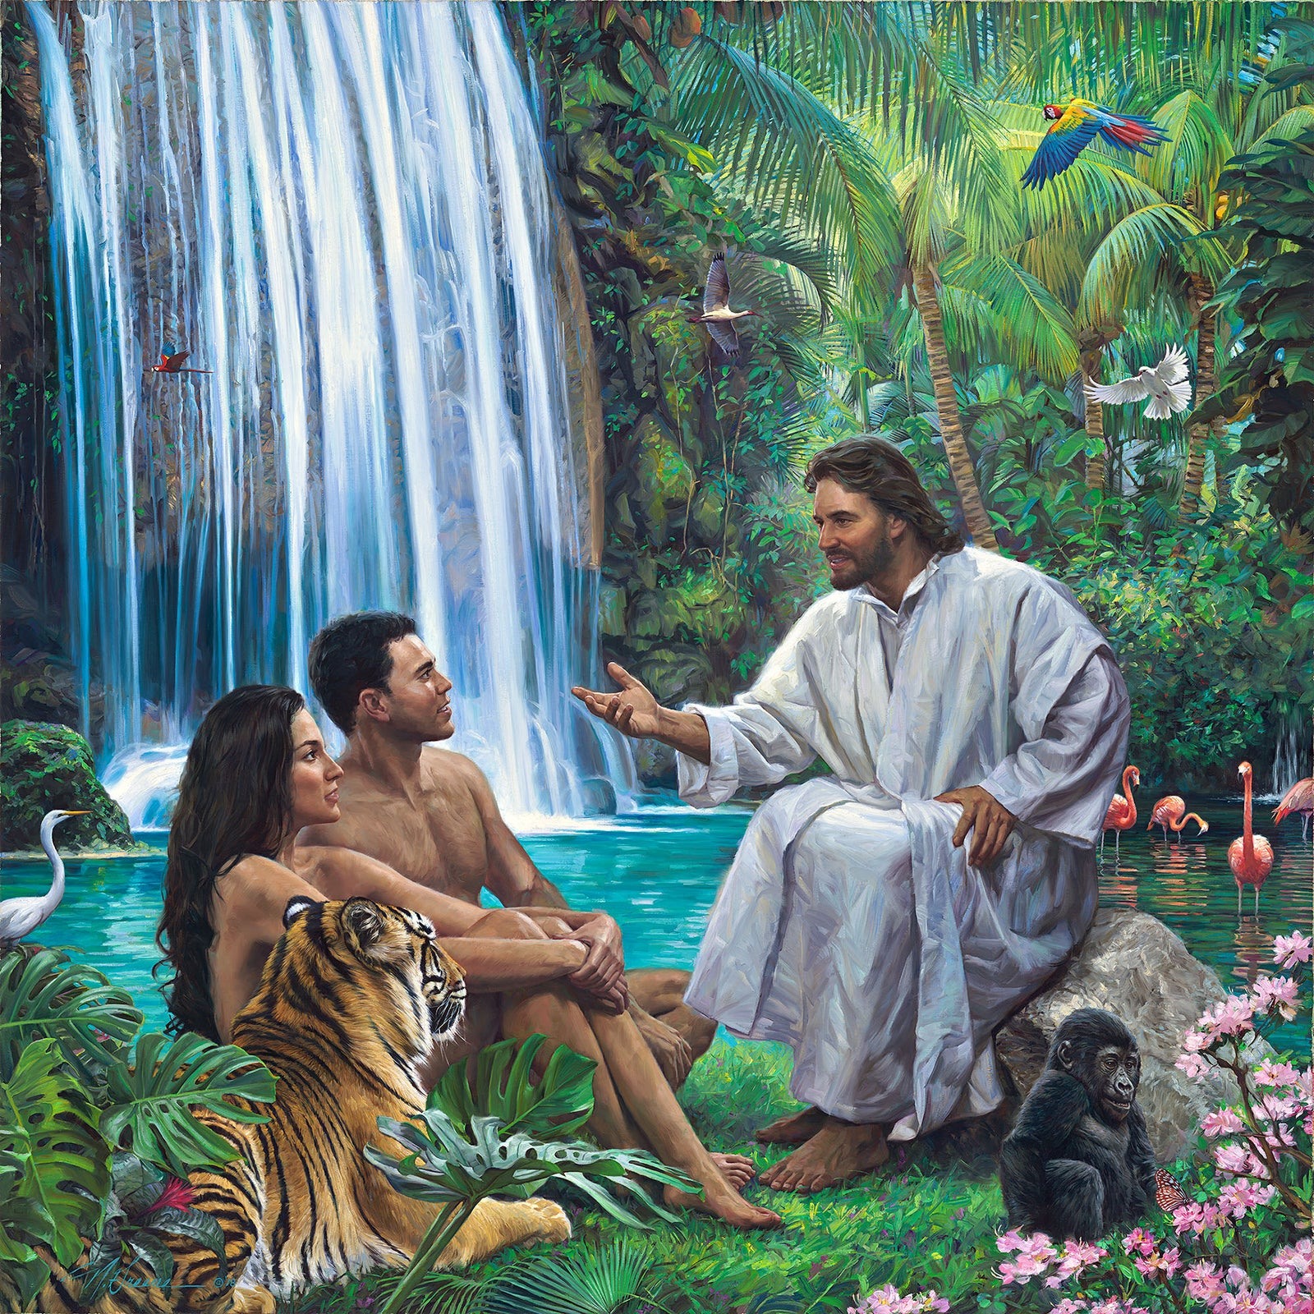
6. How did He spend the seventh day?
Genesis 2:1-2
And on the seventh day God ended his work which he had made; and he rested on the seventh day from all his work which he had made.

Slide 25
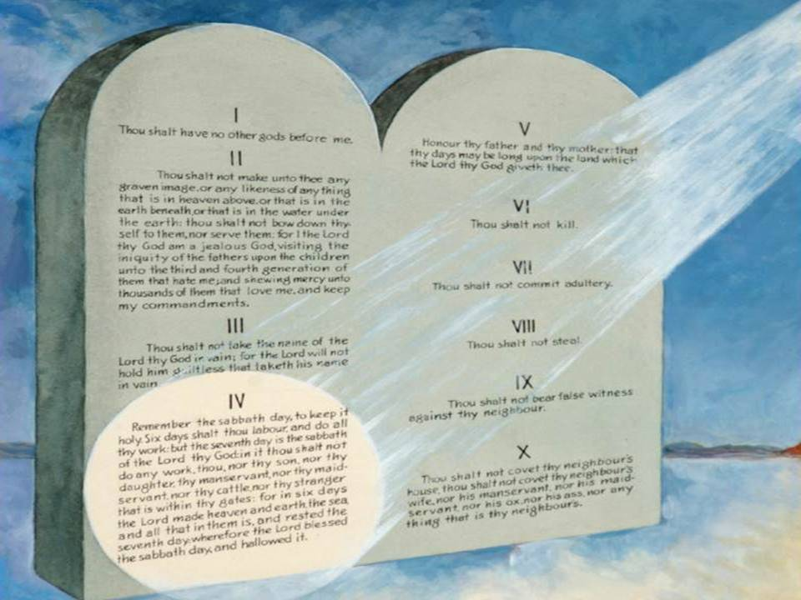
7. After He had rested on the seventh day, what did He do?
Genesis 2:3
And God blessed the seventh day, and sanctified it: because that in it he had rested from all his work which God created and made.

Slide 26
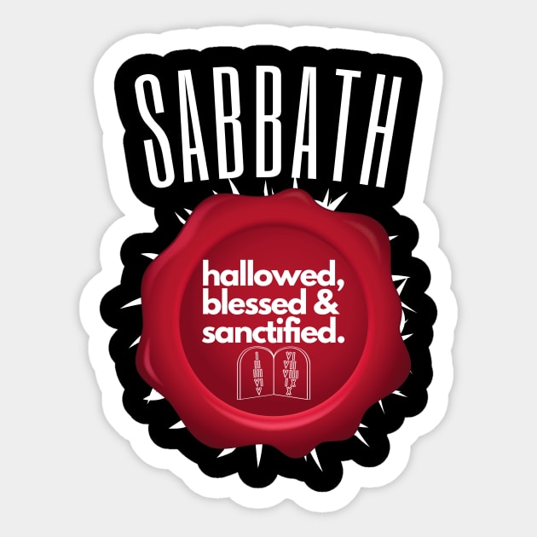
8. What is the meaning of "sanctify"?
Answer: "To set apart for a holy or religious use." — Webster

Slide 27
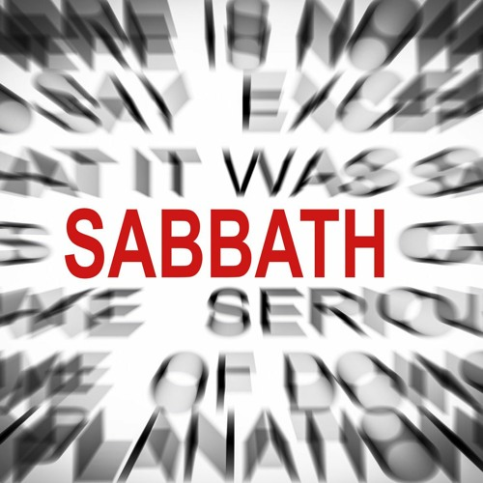
9. What is the name of the seventh day?
Exodus 20:10
But the seventh day is the sabbath of the Lord thy God: in it thou shalt not do any work, thou, nor thy son, nor thy daughter, thy manservant, nor thy maidservant, nor thy cattle, nor thy stranger that is within thy gates.

Slide 28
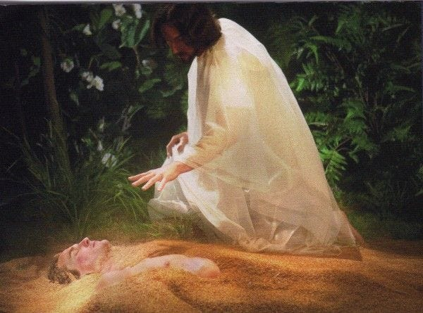
10. For whom was the Sabbath made?
Mark 2:27
And he said unto them, The sabbath was made for man, and not man for the sabbath:

Slide 29
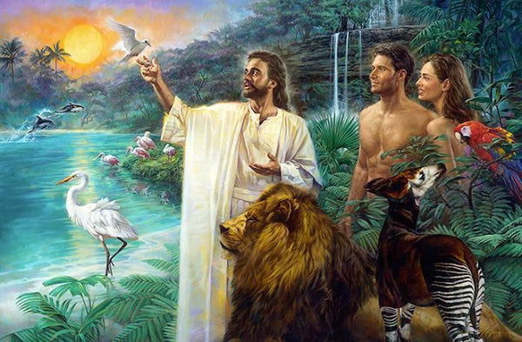
11. What is necessarily implied in the statement that after God had rested upon the seventh day He sanctified or set it apart?
Answer: That He told man what He had done, and commanded him to keep it holy.

Slide 30
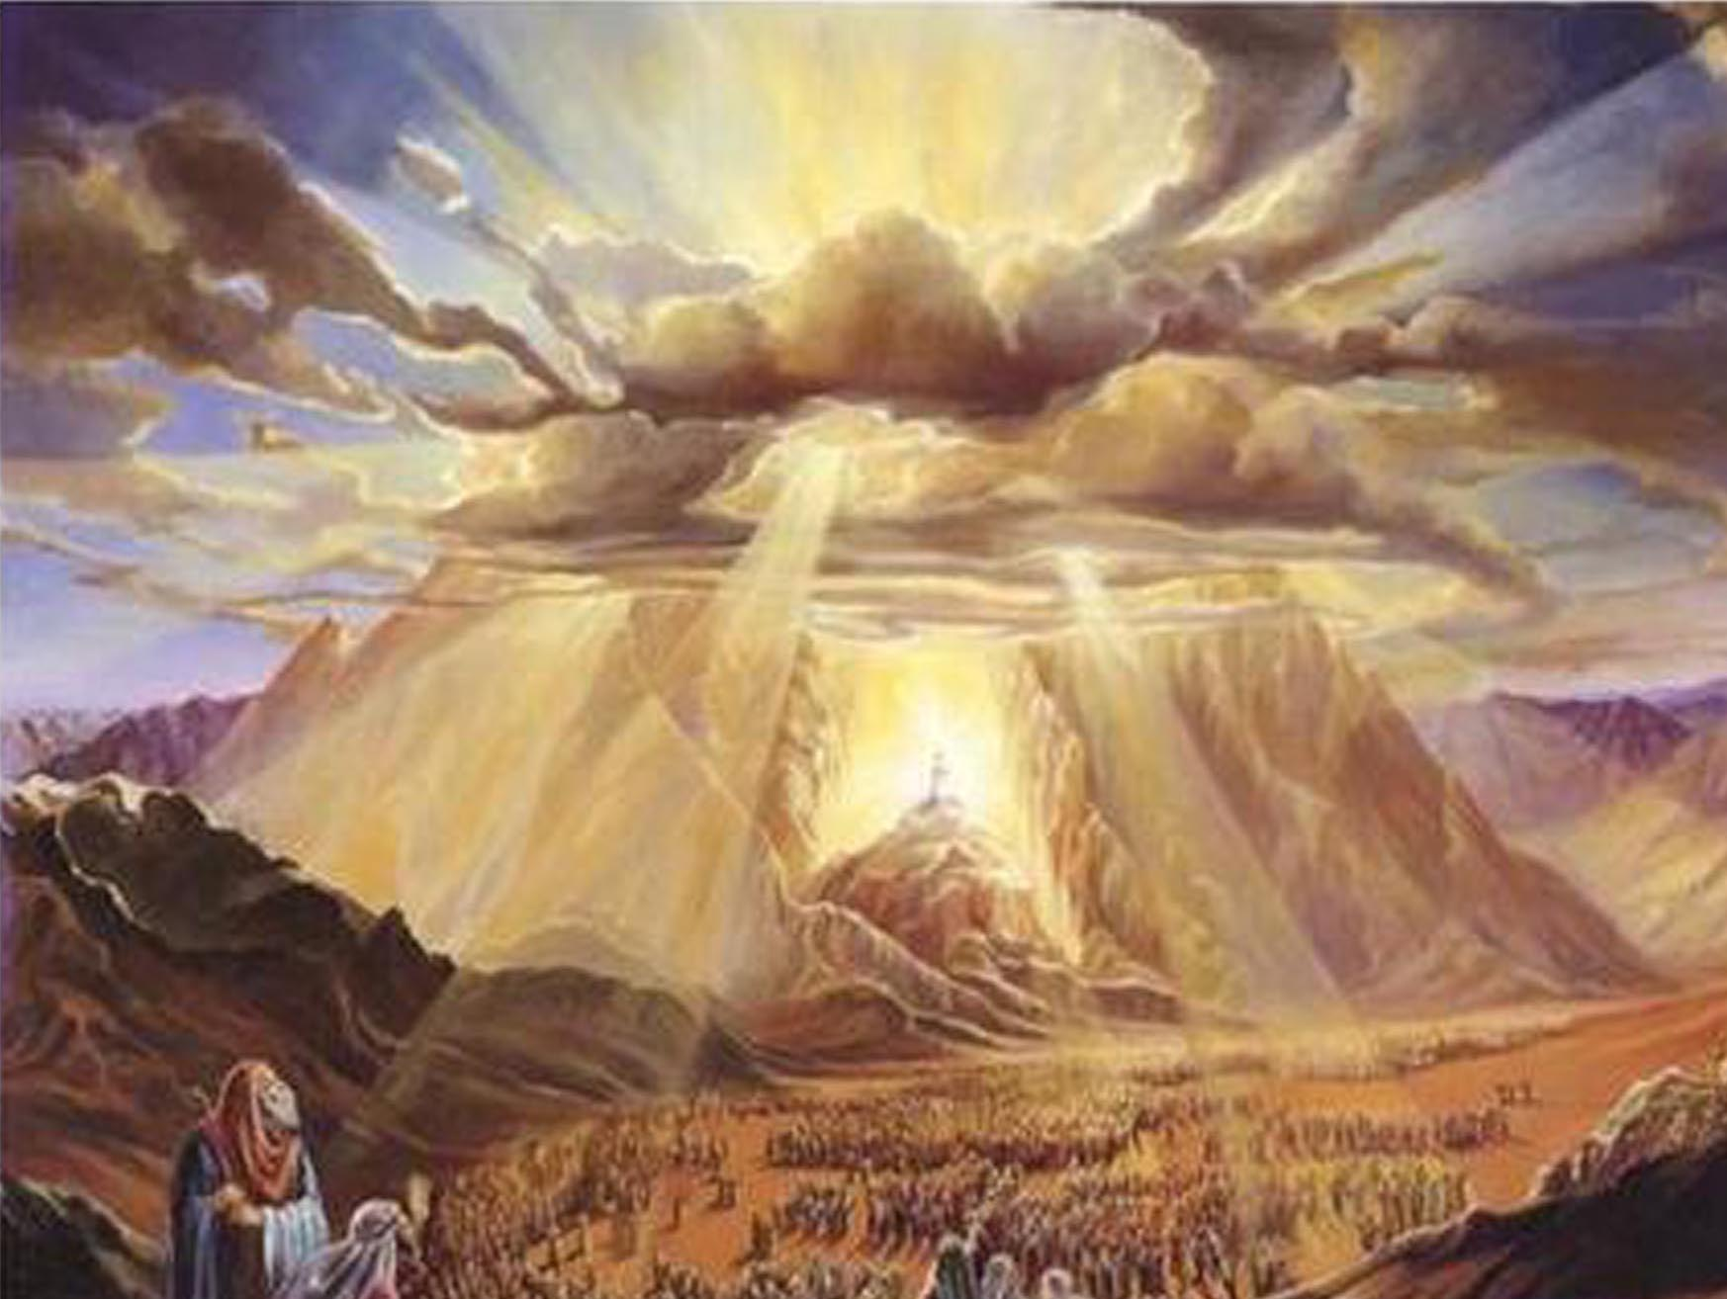
12. Give two instances of the use of the word 'sanctify,' which confirm this:
Exodus 19:12,23; Joshua 20:7
And thou shalt set bounds unto the people round about, saying, Take heed to yourselves, that ye go not up into the mount, or touch the border of it: whosoever toucheth the mount shall be surely put to death:

Slide 31
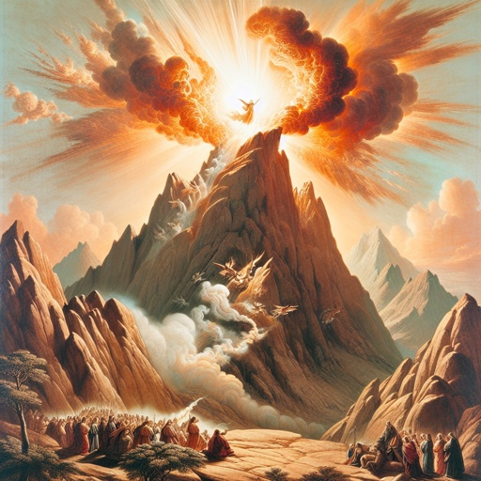
12. Give two instances of the use of the word 'sanctify,' which confirm this:
Exodus 19:12,23; Joshua 20:7
And Moses said unto the Lord, The people cannot come up to mount Sinai: for thou chargedst us, saying, Set bounds about the mount, and sanctify it.

Slide 32
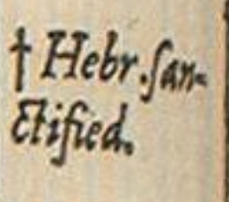
12. Give two instances of the use of the word 'sanctify,' which confirm this:
Exodus 19:12,23; Joshua 20:7 (margin)
And they appointed Kedesh in Galilee in mount Naphtali, and Shechem in mount Ephraim, and Kirjatharba, which is Hebron, in the mountain of Judah.

Slide 33
12. Give two instances of the use of the word 'sanctify,' which confirm this:
The marginal reading here is “Hebr. Sanctified.” It indicates that an alternate translation for “appointed” here would be “sanctified.
Exodus 19:12,23; Joshua 20:7 (margin)
And they appointed Kedesh in Galilee in mount Naphtali, and Shechem in mount Ephraim, and Kirjatharba, which is Hebron, in the mountain of Judah.

Slide 34

13. What is the great object of the Sabbath?
Ezekiel 20:12
Moreover also I gave them my sabbaths, to be a sign between me and them, that they might know that I am the Lord that sanctify them.

Slide 35
A "sign" or seal in the Bible is a visible reminder of a spiritual reality, a covenant marker indicating a relationship. Signs mark agreements and identify God’s people.
Genesis 9:13
“I do set my bow in the cloud, and it shall be for a token of a covenant between me and the earth.”
Romans 4:11
“And he received the sign of circumcision, a seal of the righteousness of the faith…”

Slide 36
The Sabbath is a special sign between God and His people. It points back to Creation and forward to Sanctification, reminding us that God made us and that He’s progressively re-making us holy.
Ezekiel 20:20
“And hallow my sabbaths; and they shall be a sign between me and you, that ye may know that I am the Lord your God.”
Exodus 31:13 –
“Verily my sabbaths ye shall keep: for it is a sign between me and you throughout your generations…”

Slide 37
But what does this sign mean?
“That they might know that I am the Lord that sanctify them.” (Ezekiel 20:12)
This sign isn’t about going to church—it’s about knowing God personally:
He is Creator (Exodus 20:11)
He is Redeemer (Deuteronomy 5:15)
He is our Sanctifier (Ezekiel 20:12)
The Sabbath teaches us to trust in God’s directions rather than our own reason. Keeping Sabbath is an act of faith and evidence of our relationship with Him.

Slide 38
WHY IT MATTERS:
In a world that forgets the Creator and redefines right and wrong, God’s sign remains a counter-cultural testimony. It shows:
Whose voice we listen to (God’s Word vs. man’s tradition)
Whose authority we honor (The Lord our God)
Whose power transforms us (Not self-improvement but God’s sanctifying grace)
Revelation 14:12 describes God’s end-time people:
"Here is the patience of the saints: here are they that keep the commandments of God, and the faith of Jesus."

Slide 39
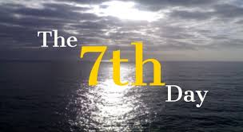
14. How does the Sabbath serve as a 'sign' to make us know the true God?
Exodus 31:15,17
Six days may work be done; but in the seventh is the sabbath of rest, holy to the Lord: whosoever doeth any work in the sabbath day, he shall surely be put to death.

Slide 40
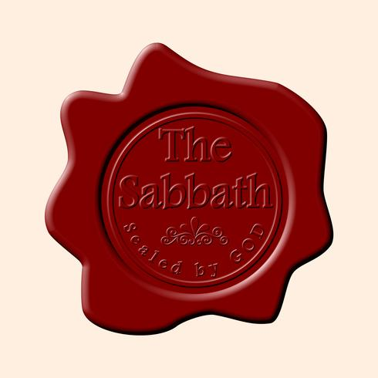
14. How does the Sabbath serve as a 'sign' to make us know the true God?
Exodus 31:15,17
It is a sign between me and the children of Israel for ever: for in six days the Lord made heaven and earth, and on the seventh day he rested, and was refreshed.

Slide 41
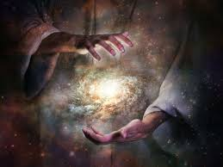
15. What is God's distinguishing characteristic?
Psalm 96:4,5; Jeremiah 10:10-12
For the Lord is great, and greatly to be praised: he is to be feared above all gods.

Slide 42
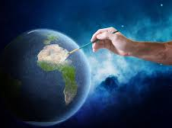
15. What is God's distinguishing characteristic?
Psalm 96:4,5; Jeremiah 10:10-12
For all the gods of the nations are idols: but the Lord made the heavens.

Slide 43
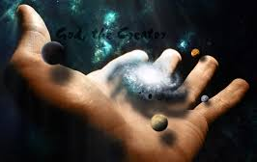
15. What is God's distinguishing characteristic?
Psalm 96:4,5; Jeremiah 10:10-12
But the Lord is the true God, he is the living God, and an everlasting king: at his wrath the earth shall tremble, and the nations shall not be able to abide his indignation.

Slide 44
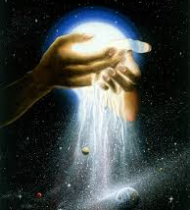
15. What is God's distinguishing characteristic?
Psalm 96:4,5; Jeremiah 10:10-12
Thus shall ye say unto them, The gods that have not made the heavens and the earth, even they shall perish from the earth, and from under these heavens.

Slide 45
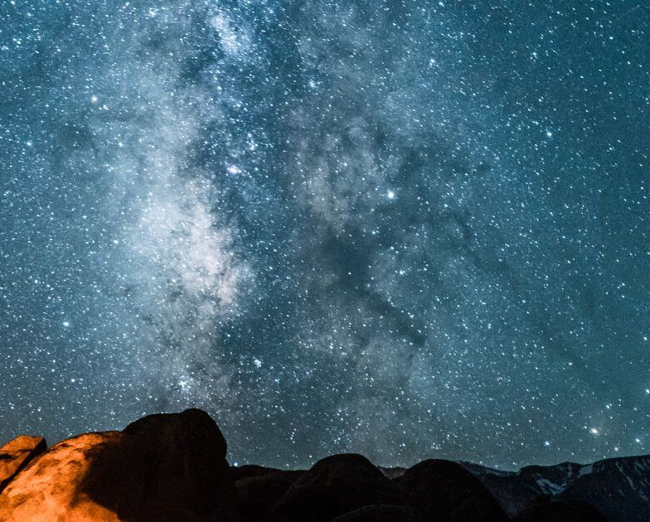
15. What is God's distinguishing characteristic?
Psalm 96:4,5; Jeremiah 10:10-12
He hath made the earth by his power, he hath established the world by his wisdom, and hath stretched out the heavens by his discretion.

Slide 46
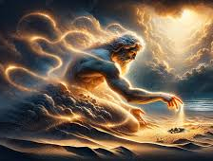
16. What is the difference between God and men?
Psalm 100:3; Isaiah 40:15,17; 55:9
Know ye that the Lord he is God: it is he that hath made us, and not we ourselves; we are his people, and the sheep of his pasture.

Slide 47
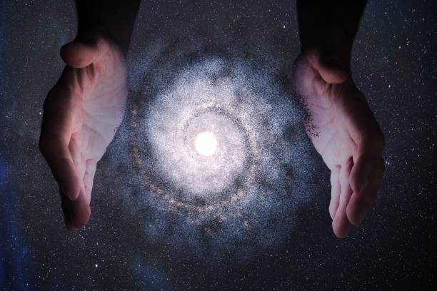
16. What is the difference between God and men?
Psalm 100:3; Isaiah 40:15,17; 55:9
Behold, the nations are as a drop of a bucket, and are counted as the small dust of the balance: behold, he taketh up the isles as a very little thing.

Slide 48
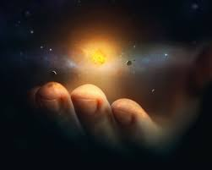
16. What is the difference between God and men?
Psalm 100:3; Isaiah 40:15,17; 55:9
All nations before him are as nothing; and they are counted to him less than nothing, and vanity.

Slide 49
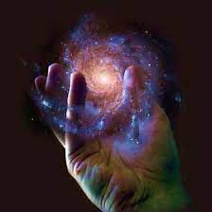
16. What is the difference between God and men?
Psalm 100:3; Isaiah 40:15,17; 55:9
For as the heavens are higher than the earth, so are my ways higher than your ways, and my thoughts than your thoughts.

Slide 50
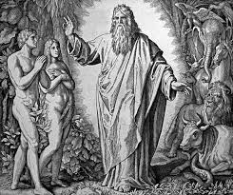
17. Then what was the Sabbath designed to do for men?
Answer: To be a continual reminder of God's greatness, of their dependence upon Him, and of their duty to serve Him with humility.

Slide 51
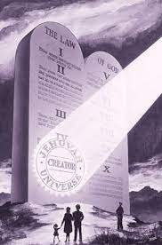
18. If Christ created the heavens and the earth, who must have made the Sabbath?
Christ is Lord of the Sabbath, because He is the Creator. It belongs to Him, and through Him we receive its true meaning and blessing.

Slide 52
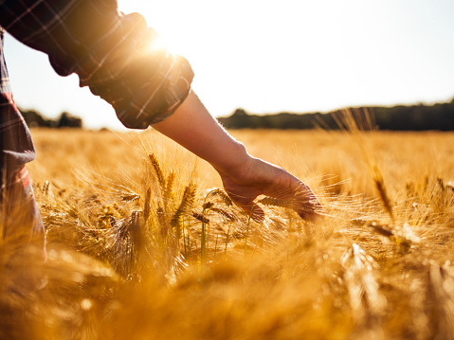
19. Then what relation does He sustain to it?
Mark 2:28
Therefore the Son of man is Lord also of the sabbath.

Slide 53
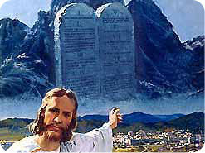
20. Then in keeping the Sabbath, whom do we honor?
We honor both the Father and the Son. We acknowledge Christ as Creator and King… and we honor His Father even as He did, by keeping His Father’s commandments (John 15:10).

Slide 54
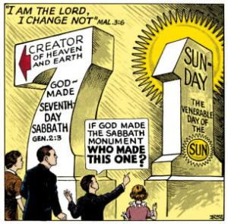

Slide 55
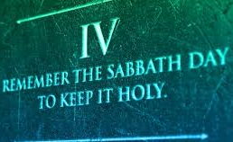
21. And when the Sabbath is not kept, who is dishonored?
To neglect the Sabbath is to dishonor the One who made it — the Lord of Creation. We rob Him of glory and lose the blessing He intended. We dishonor God: Father, Son, and Holy Spirit, in defying His Law.

Slide 56
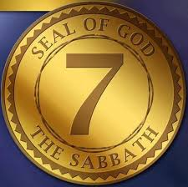
21. And when the Sabbath is not kept, who is dishonored?
BUT we particularly deny the ‘sign’ between Jesus Christ and ourselves, the one where we recognize His divinity and He recognizes us as His people. In disregarding Christ’s Sabbath, we would be dishonoring His special connection to us as Creator, Savior, and King.

Slide 57


Slide 58
THANK YOU and
Happy Sabbath!!

