Slide 1
OLD TESTAMENT HISTORY: The Fall of Man
Lesson 3, 1st Quarter, 1888

Slide 2

1. In what condition was the whole creation when it came from the hand of God?
Genesis 1:31
And God saw every thing that he had made, and, behold, it was very good. And the evening and the morning were the sixth day.

Slide 3
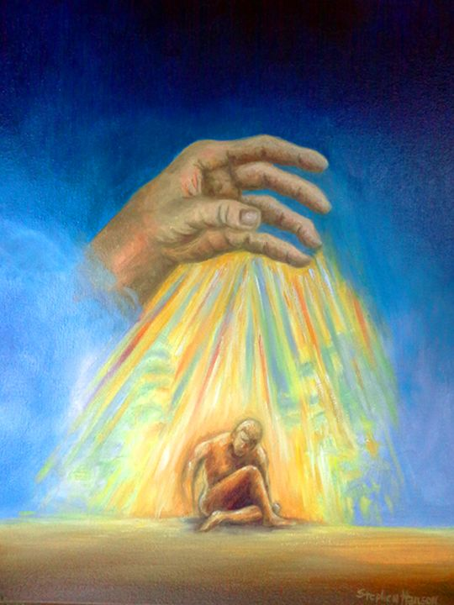
2. Did this include man also?
Ecclesiastes 7:29
Lo, this only have I found, that God hath made man upright; but they have sought out many inventions.

Slide 4
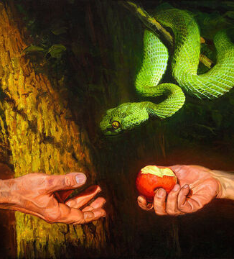
3. Did man retain his uprightness?
Romans 5:12
Wherefore, as by one man sin entered into the world, and death by sin; and so death passed upon all men, for that all have sinned:

Slide 5
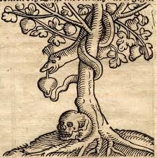
4. What prohibition had God laid upon the pair in the garden of Eden?
Genesis 2:17
But of the tree of the knowledge of good and evil, thou shalt not eat of it: for in the day that thou eatest thereof thou shalt surely die.

Slide 6
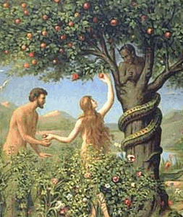
5. Who first partook of this forbidden fruit?
Genesis 3:6
And when the woman saw that the tree was good for food, and that it was pleasant to the eyes, and a tree to be desired to make one wise, she took of the fruit thereof, and did eat, and gave also unto her husband with her; and he did eat.

Slide 7
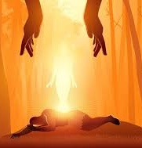
Patriarchs and prophets, p. 58
“And the Lord said, “Thy desire shall be to thy husband, and he shall rule over thee.” In the creation God had made her the equal of Adam.”

Slide 8
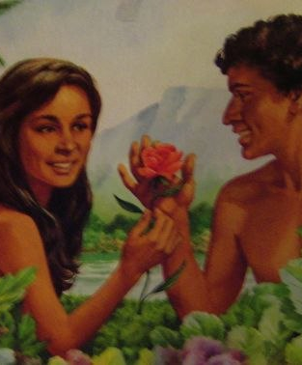
Patriarchs and prophets, p. 58
“Had they remained obedient to God—in harmony with His great law of love—they would ever have been in harmony with each other;”

Slide 9
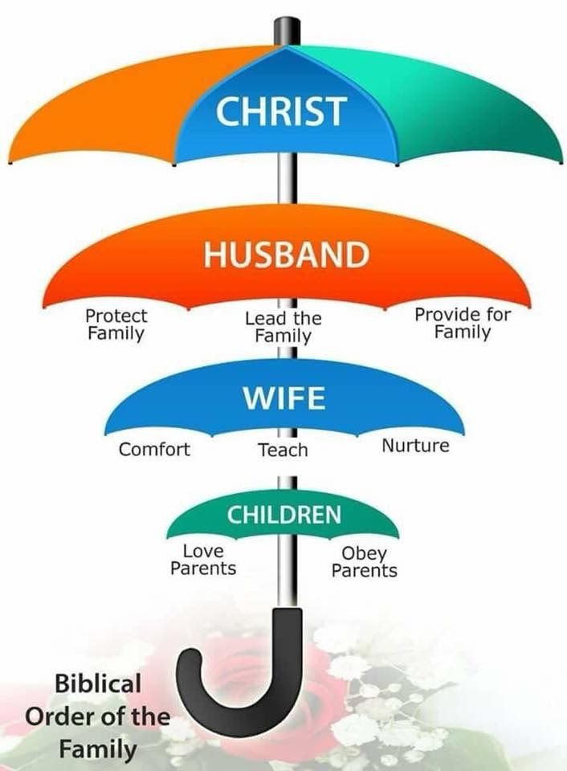
Patriarchs and prophets, p. 58
“but sin had brought discord, and now their union could be maintained and harmony preserved only by submission on the part of the one or the other.”

Slide 10
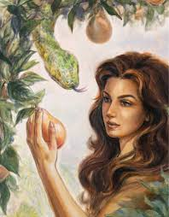
Patriarchs and prophets, p. 58
“Eve had been the first in transgression; and she had fallen into temptation by separating from her companion, contrary to the divine direction.”

Slide 11
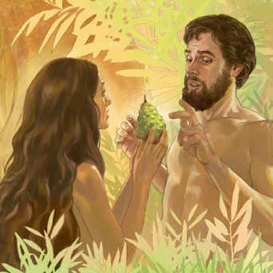
Patriarchs and prophets, p. 58
“It was by her solicitation that Adam sinned, and she was now placed in subjection to her husband. ”

Slide 12

Patriarchs and prophets, p. 59
“Eve had been perfectly happy by her husband's side in her Eden home; but, like restless modern Eves, she was flattered with the hope…”

Slide 13
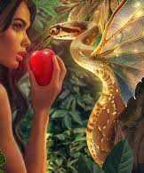
Patriarchs and prophets, p. 59
“…of entering a higher sphere than that which God had assigned her. In attempting to rise above her original position, she fell far below it.”

Slide 14
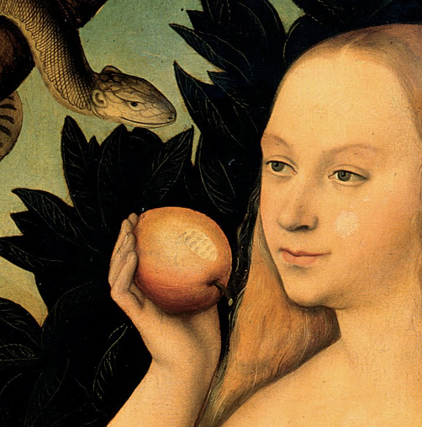
Patriarchs and prophets, p. 59
“A similar result will be reached by all who are unwilling to take up cheerfully their life duties in accordance with God's plan.”

Slide 15
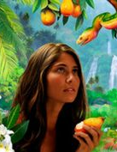
Patriarchs and prophets, p. 59
“In their efforts to reach positions for which He has not fitted them, many are leaving vacant the place where they might be a blessing.”

Slide 16

Patriarchs and prophets, p. 59
“In their desire for a higher sphere, many have sacrificed true womanly dignity and nobility of character, and have left undone the very work that Heaven appointed them.”

Slide 17

6. Was Adam deceived as to the consequences of the act?
1 Timothy 2:14
And Adam was not deceived, but the woman being deceived was in the transgression.

Slide 18

7. How was Eve deceived?
2 Corinthians 11:3
But I fear, lest by any means, as the serpent beguiled Eve through his subtilty, so your minds should be corrupted from the simplicity that is in Christ.

Slide 19
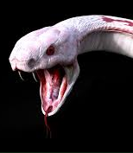
8. Who was the serpent?
Revelation 20:2
And he laid hold on the dragon, that old serpent, which is the Devil, and Satan, and bound him a thousand years,

Slide 20
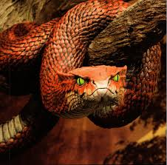
9. How did he begin his work?
Genesis 3:1
Now the serpent was more subtil than any beast of the field which the Lord God had made. And he said unto the woman, Yea, hath God said, Ye shall not eat of every tree of the garden?

Slide 21

SDABC V1 on Genesis 3:1
The word “subtil,” ‘arum, is used in the Bible a few times to indicate an unfavorable tendency of character (Job 5:12; 15:5),

Slide 22

SDABC V1 on Genesis 3:1
with the connotation of being “clever” or “cunning,” but usually in the favorable sense of being prudent (see Prov. 12:16, 23; 13:16; 14:8, 15, 18; 22:3; 27:12).

Slide 23
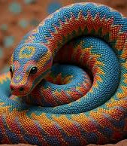
SDABC V1 on Genesis 3:1
The latter, favorable meaning would seem preferable here because the serpent was one of the created beings God had pronounced “good,” even “very good.”

Slide 24
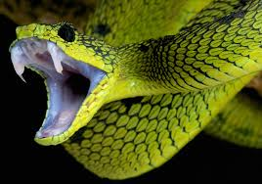
SDABC V1 on Genesis 3:1
The evil character of serpents today is a result of the Fall and subsequent curse, and not a trait of that animal when it was created.

Slide 25
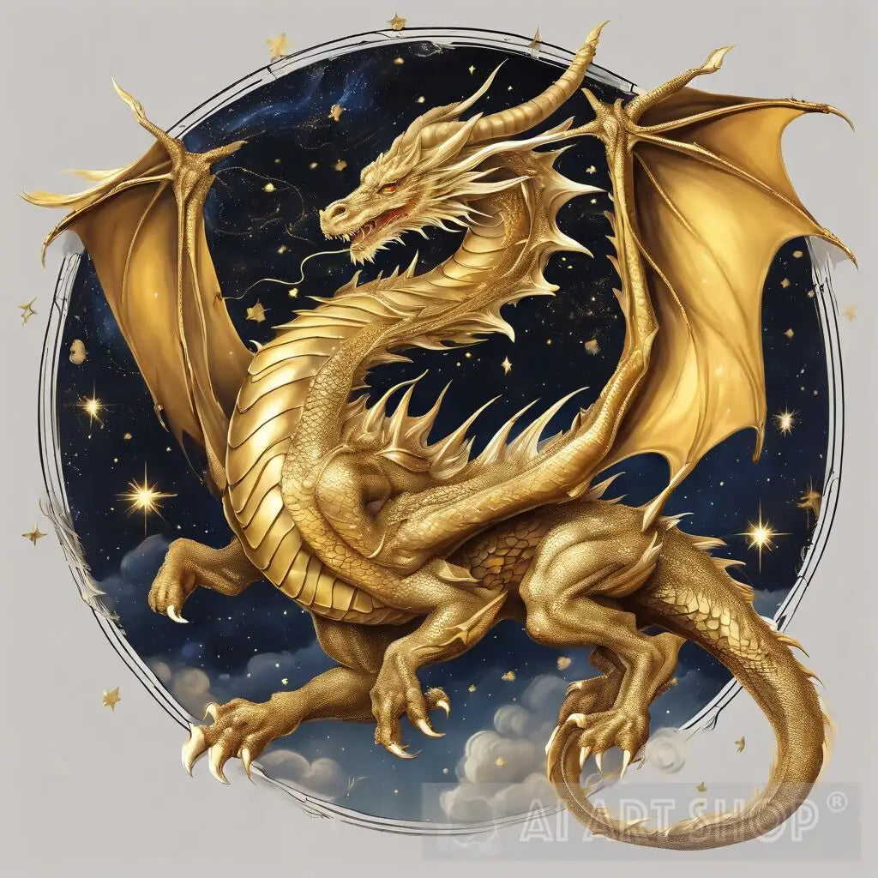
Patriarchs and prophets, p. 53
In order to accomplish his work unperceived, Satan chose to employ as his medium the serpent—a disguise well adapted for his purpose of deception.

Slide 26

Patriarchs and prophets, p. 53
The serpent was then one of the wisest and most beautiful creatures on the earth. It had wings, and while flying through the air presented an appearance of dazzling brightness,

Slide 27

Patriarchs and prophets, p. 53
having the color and brilliancy of burnished gold. Resting in the rich-laden branches of the forbidden tree and regaling itself with the delicious fruit, it was an object to arrest the attention and delight the eye of the beholder.

Slide 28
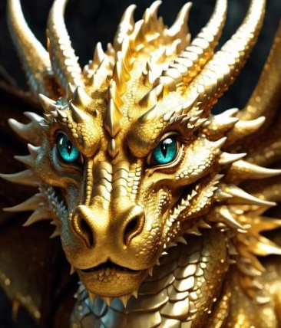
10. When Eve repeated the prohibition, what did the serpent reply?
Genesis 3:4
And the serpent said unto the woman, Ye shall not surely die:

Slide 29
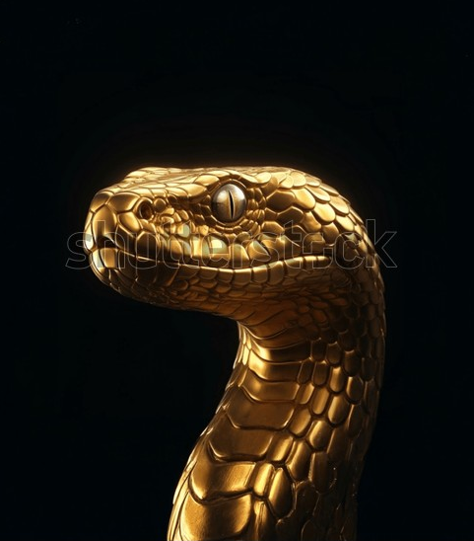
11. What did he say that eating from the tree would do for them?
Genesis 3:5
For God doth know that in the day ye eat thereof, then your eyes shall be opened, and ye shall be as gods, knowing good and evil.

Slide 30
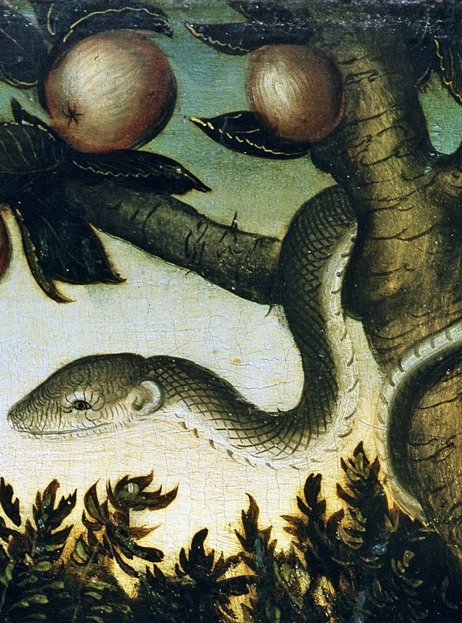
12. In so saying, what imputation did he cast upon God?
Satan implied that God was withholding something good from Adam and Eve—that He was unjust, insecure, and untrustworthy.

Slide 31
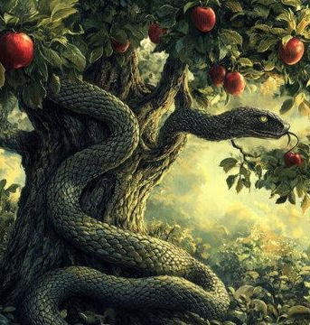
12. In so saying, what imputation did he cast upon God?
By suggesting they would become like gods if they ate the fruit, Satan accused God of selfishly limiting their development and freedom.

Slide 32
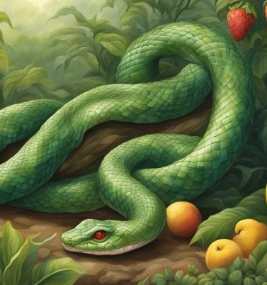
12. In so saying, what imputation did he cast upon God?
This was a direct attack on God's character, portraying Him as restrictive and arbitrary rather than loving and wise.

Slide 33
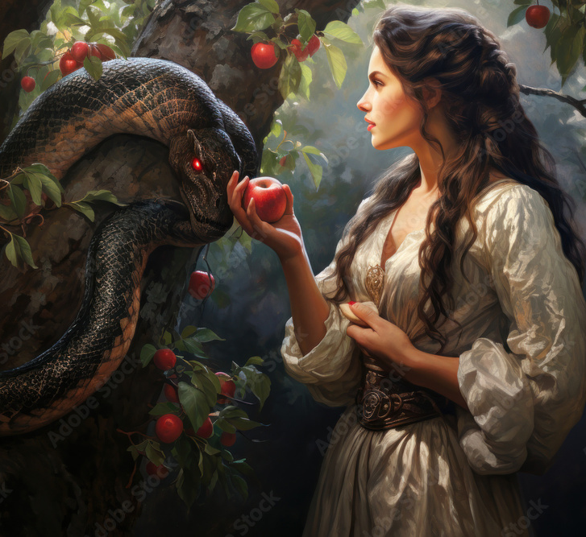
13. In telling them that by eating the forbidden fruit they should be like God, what was Satan instilling into their minds?
Answer:
Pride

Slide 34
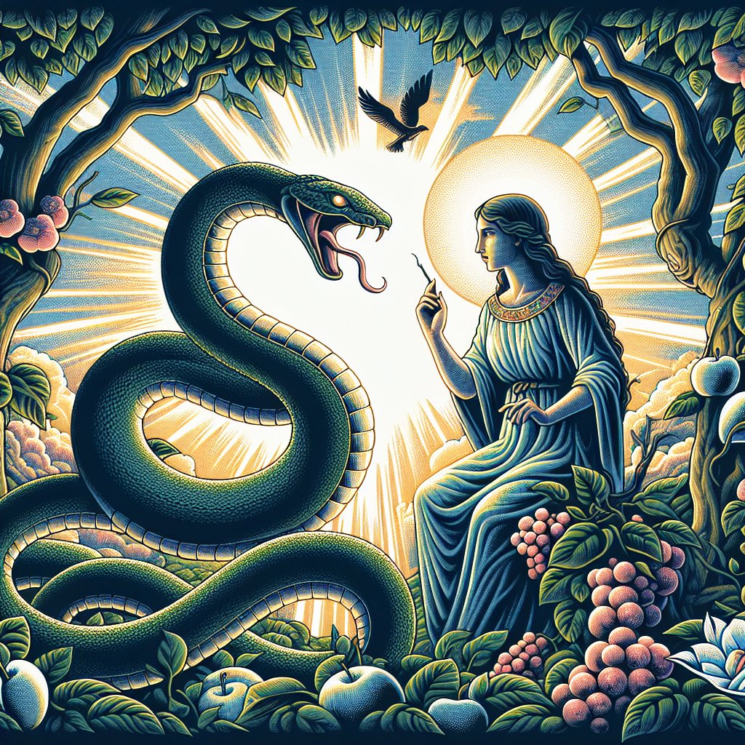
13. In telling them that by eating the forbidden fruit they should be like God, what was Satan instilling into their minds?
Satan tempted them to believe they could rise above their created position and become equal with God. This prideful ambition mirrored his own fall and led Eve to distrust God’s Word and seek wisdom on her own terms.

Slide 35
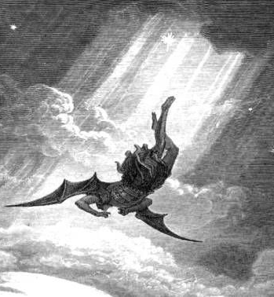
14. What was the cause of Satan's fall?
Isaiah 14:12-14
How art thou fallen from heaven, O Lucifer, son of the morning! how art thou cut down to the ground, which didst weaken the nations!

Slide 36
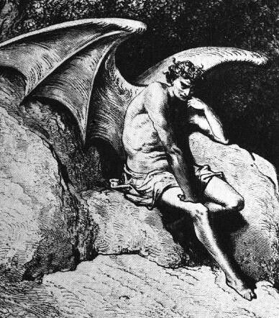
14. What was the cause of Satan's fall?
Isaiah 14:12-14
For thou hast said in thine heart, I will ascend into heaven, I will exalt my throne above the stars of God: I will sit also upon the mount of the congregation, in the sides of the north:

Slide 37
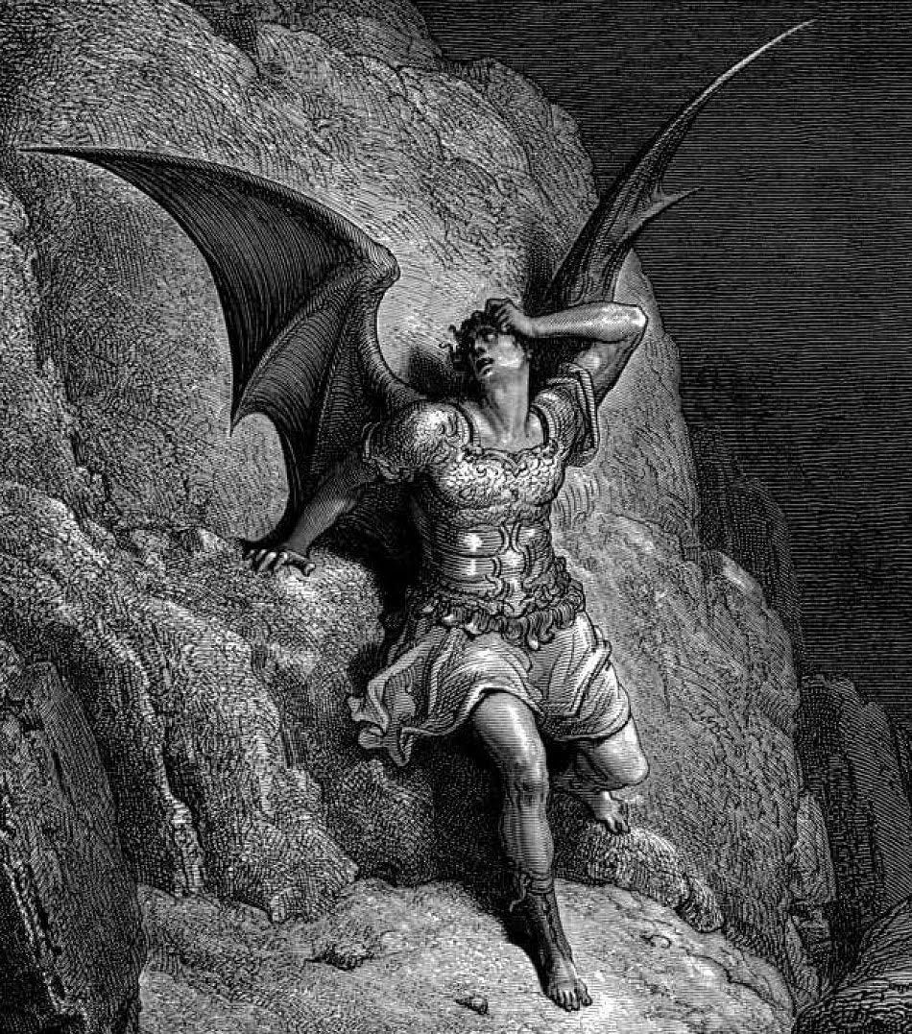
14. What was the cause of Satan's fall?
Isaiah 14:12-14
I will ascend above the heights of the clouds; I will be like the most High.

Slide 38
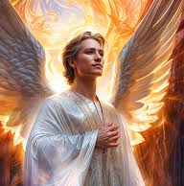
15. What always follows pride?
Proverbs 11:2; Proverbs 16:18
When pride cometh, then cometh shame: but with the lowly is wisdom.

Slide 39
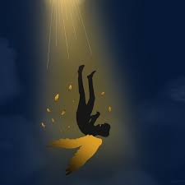
15. What always follows pride?
Proverbs 11:2; Proverbs 16:18
Pride goeth before destruction, and an haughty spirit before a fall.

Slide 40
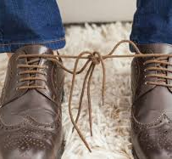
16. What was it that brought the heathen nations into their deplorable condition?
Romans 1:22, 23
Professing themselves to be wise, they became fools,

Slide 41
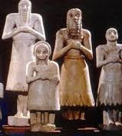
16. What was it that brought the heathen nations into their deplorable condition?
Romans 1:22, 23
And changed the glory of the uncorruptible God into an image made like to corruptible man, and to birds, and fourfooted beasts, and creeping things.

Slide 42
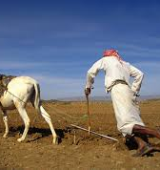
17. What was the result of Adam's transgression?
Genesis 3:17-19
And unto Adam he said, Because thou hast hearkened unto the voice of thy wife, and hast eaten of the tree, of which I commanded thee, saying, Thou shalt not eat of it: cursed is the ground for thy sake; in sorrow shalt thou eat of it all the days of thy life;

Slide 43
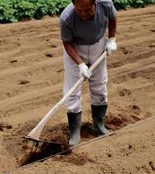
17. What was the result of Adam's transgression?
Genesis 3:17-19
Thorns also and thistles shall it bring forth to thee; and thou shalt eat the herb of the field;

Slide 44
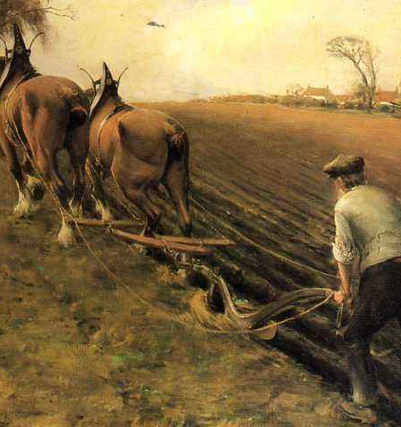
17. What was the result of Adam's transgression?
Genesis 3:17-19
In the sweat of thy face shalt thou eat bread, till thou return unto the ground; for out of it wast thou taken: for dust thou art, and unto dust shalt thou return.

Slide 45
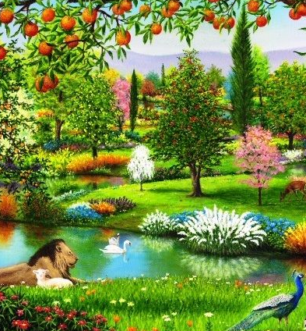
SDABC V1 on Genesis 3:18
Prior to the Fall, only plants that were either useful for food or beautiful to the eye grew from the earth;

Slide 46
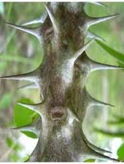
SDABC V1 on Genesis 3:18
now it was to produce “thorns and thistles” also. The increased labor necessary to the cultivation of the soil would increase the misery of man’s existence.

Slide 47
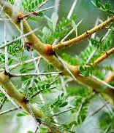
SDABC V1 on Genesis 3:18
He was to learn by bitter experience that life independent of God can at best be one of sorrow and affliction.

Slide 48
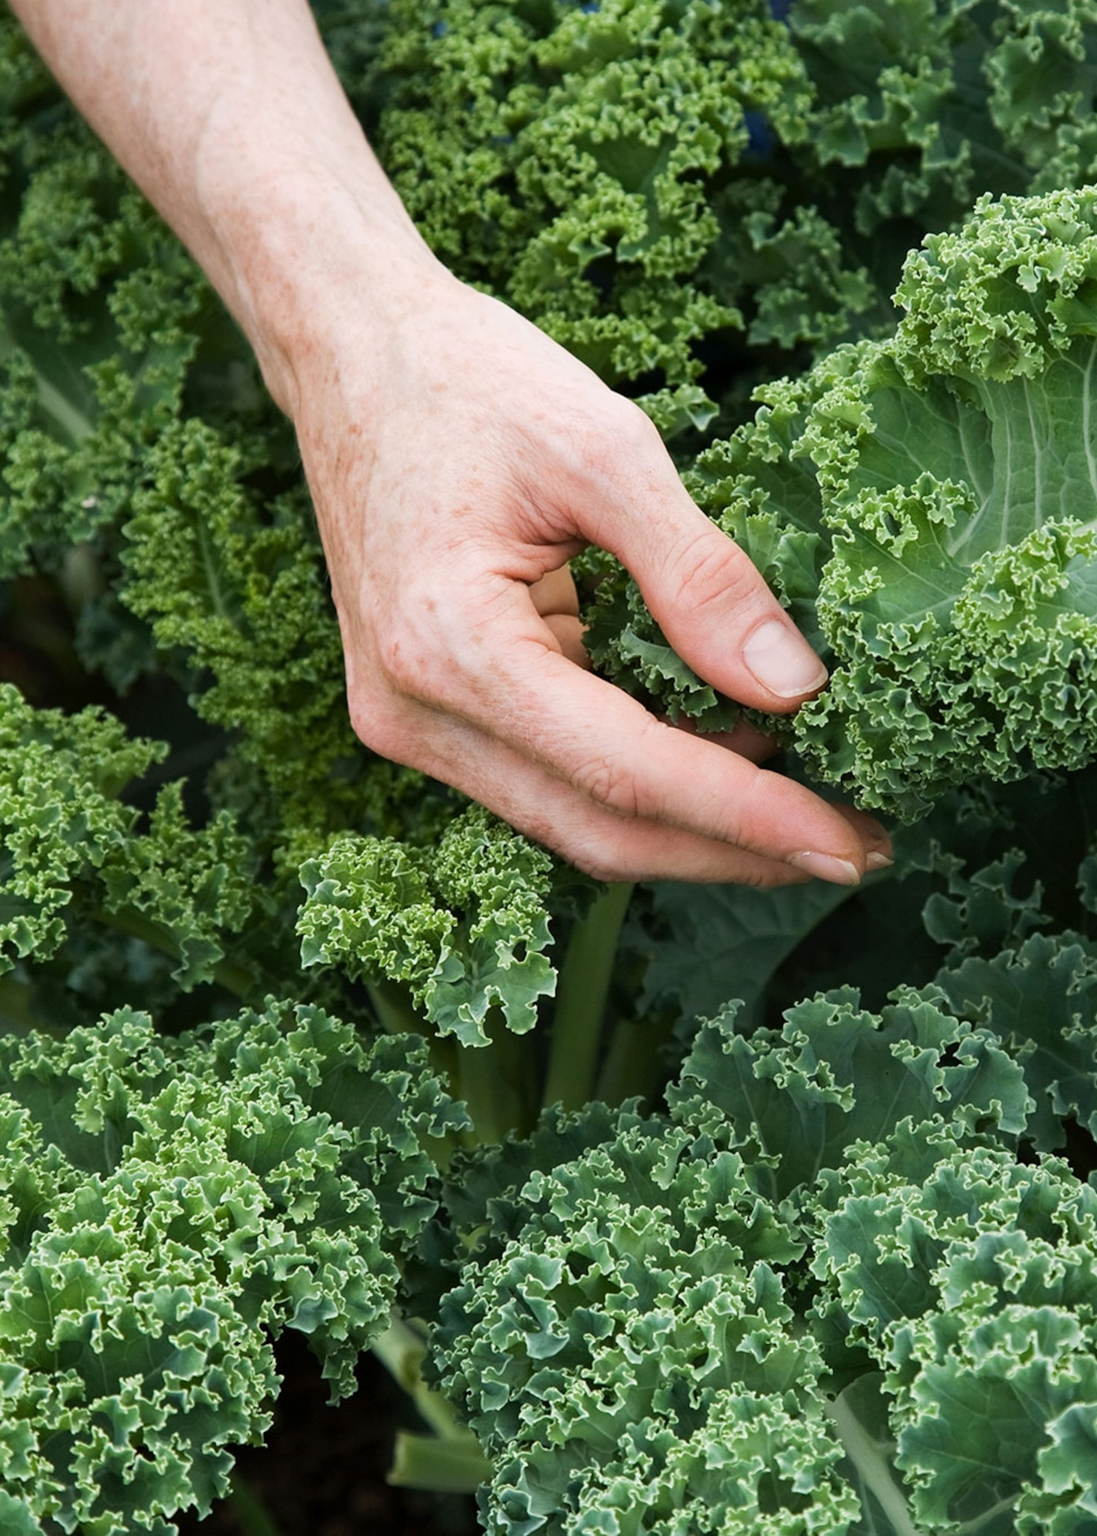
SDABC V1 on Genesis 3:18
The divine punishment provided also a partial change in diet. We evidently are to conclude that the quantity and quality of grains and nuts and fruits originally given to man were, as a

Slide 49
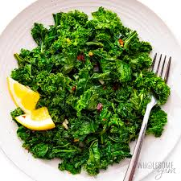
SDABC V1 on Genesis 3:18
result of the curse, reduced to such an extent that man would be required to look to the herbs for a portion of his daily food. This change may also have been due in part to the loss

Slide 50
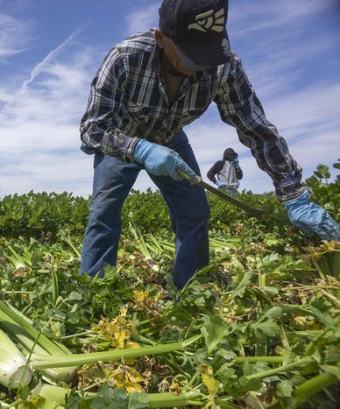
SDABC V1 on Genesis 3:18
of certain elements from the tree of life, to a change in climate, and perhaps most of all to man’s sentence to hard labor in the process of earning a livelihood.

Slide 51

18. Was he allowed to remain in the garden?
Genesis 3:23, 24
Therefore the Lord God sent him forth from the garden of Eden, to till the ground from whence he was taken.

Slide 52
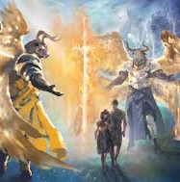
18. Was he allowed to remain in the garden?
Genesis 3:23, 24
So he drove out the man; and he placed at the east of the garden of Eden Cherubims, and a flaming sword which turned every way, to keep the way of the tree of life.

Slide 53
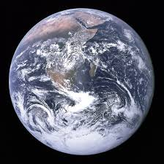
19. How extensive were the consequences of his fall?
Romans 5:12
Wherefore, as by one man sin entered into the world, and death by sin; and so death passed upon all men, for that all have sinned:

Slide 54
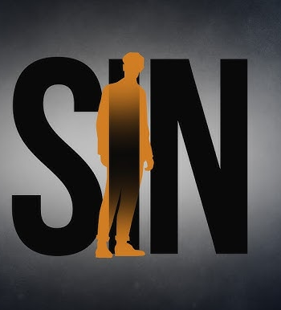
20. Did death pass upon all men regardless of their character, just because Adam sinned?
Romans 5:12
Wherefore, as by one man sin entered into the world, and death by sin; and so death passed upon all men, for that all have sinned:

Slide 55

SDABC V6 on Romans 5:12
In this passage the main points of comparison that Paul is emphasizing are that as sin and death, as a principle and power, proceeded from Adam to the whole human race,

Slide 56

SDABC V6 on Romans 5:12
so righteousness and life, as a counteracting and conquering principle and power, proceed from Christ to all mankind.

Slide 57

SDABC V6 on Romans 5:12
And as death has been passed on to all men who participate in Adam’s sin, so life is passed on to all those who participate in the righteousness of Christ.

Slide 58
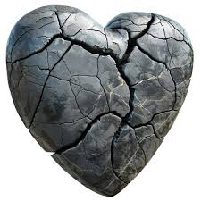
21. What kind of nature do all men inherit?
Mark 7:21-23
For from within, out of the heart of men, proceed evil thoughts, adulteries, fornications, murders,

Slide 59

21. What kind of nature do all men inherit?
Mark 7:21-23
Thefts, covetousness, wickedness, deceit, lasciviousness, an evil eye, blasphemy, pride, foolishness:

Slide 60

21. What kind of nature do all men inherit?
Mark 7:21-23
All these evil things come from within, and defile the man.

Slide 61
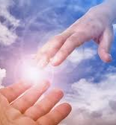
22. By what means may we get rid of this evil nature and have a better one?
2 Peter 1:4; 1 John 5:4
Whereby are given unto us exceeding great and precious promises: that by these ye might be partakers of the divine nature, having escaped the corruption that is in the world through lust.

Slide 62
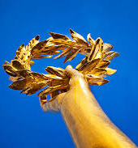
22. By what means may we get rid of this evil nature and have a better one?
2 Peter 1:4; 1 John 5:4
For whatsoever is born of God overcometh the world: and this is the victory that overcometh the world, even our faith.

Slide 63
Thank You &
HAPPY SABBATH!!

