Slide 1
Old Testament History:
Abel’s Sacrifice
Lesson 4, 1st Quarter, 1888

Slide 2

Living the Light

Slide 3
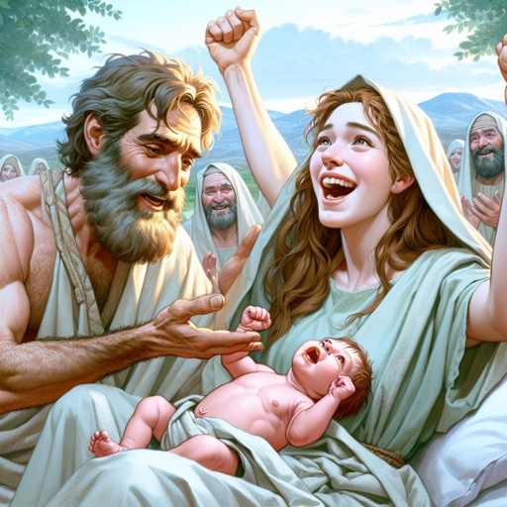
1. What was the name of the first son of Adam and Eve?
Genesis 4:1
And Adam knew Eve his wife; and she conceived, and bare Cain, and said, I have gotten a man from the Lord.

Slide 4
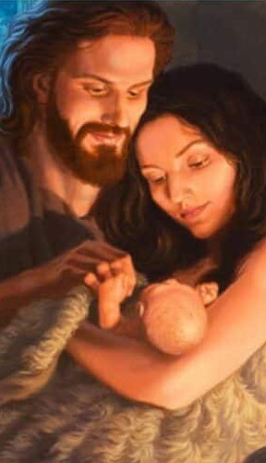
The Hebrew reads literally, “I have gotten a man, the Lord.” When Eve held her first-born in her arms she apparently remembered the divine promise of ch. 3:15, and entertaining the hope that he was to be the promised Deliverer, named him Qayin, “gotten” (DA 31).
SDABC V1 on Genesis 4:1

Slide 5
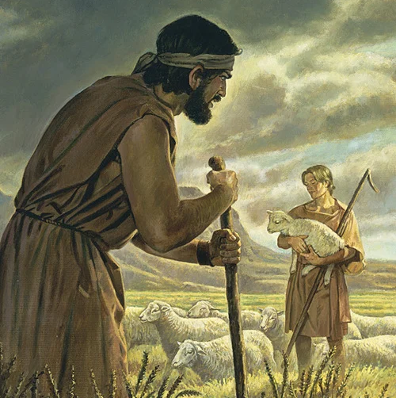
2. What was the name of the second son?
Genesis 4:2
And she again bare his brother Abel. And Abel was a keeper of sheep, but Cain was a tiller of the ground.

Slide 6
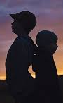
Abel’s name means “vanity” or “nothingness.” It reflects the fact that either a mother’s hopes had already met with disappointment in her elder son or that Abel personified for her the miseries of human life.
SDABC V1 on Genesis 4:1

Slide 7
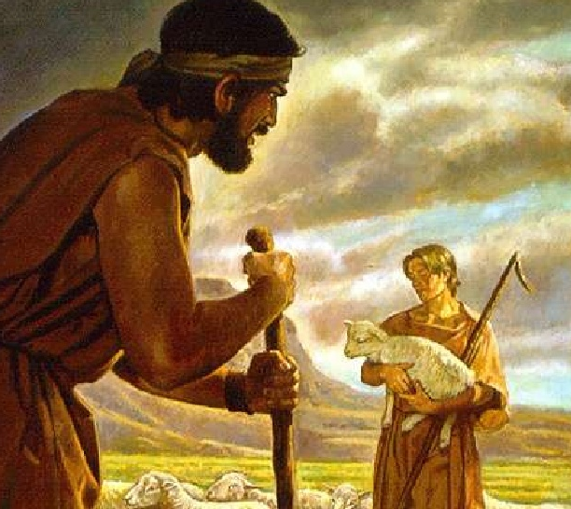
3. What occupation did each follow?
Cain was a tiller of the ground (farmer), and Abel was a keeper of sheep (shepherd).

Slide 8
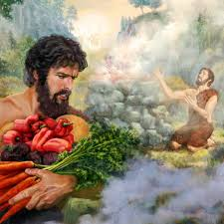
4. What offering did Cain bring to the Lord?
Genesis 4:3
And in process of time it came to pass, that Cain brought of the fruit of the ground an offering unto the Lord.

Slide 9
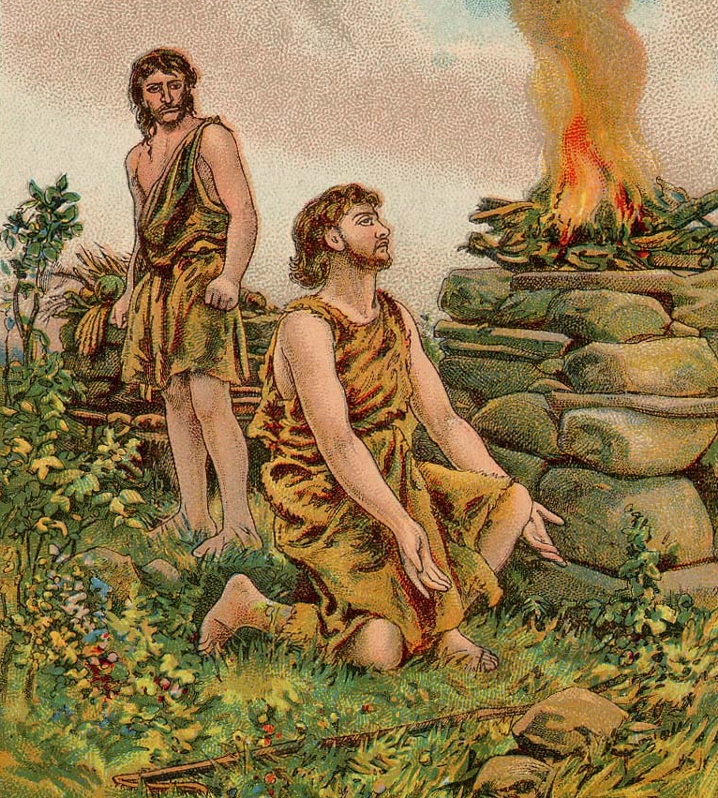
5. What was Abel's offering?
Genesis 4:4
And Abel, he also brought of the firstlings of his flock and of the fat thereof. And the Lord had respect unto Abel and to his offering:

Slide 10
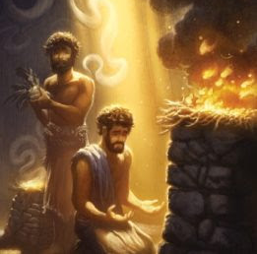
6. How did the Lord regard Abel's offering?
Genesis 4:4
And Abel, he also brought of the firstlings of his flock and of the fat thereof. And the Lord had respect unto Abel and to his offering:

Slide 11
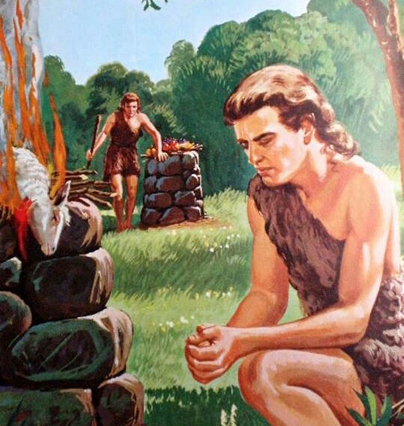
7. How did the Lord regard Cain's offering?
Genesis 4:5
But unto Cain and to his offering he had not respect. And Cain was very wroth, and his countenance fell.

Slide 12
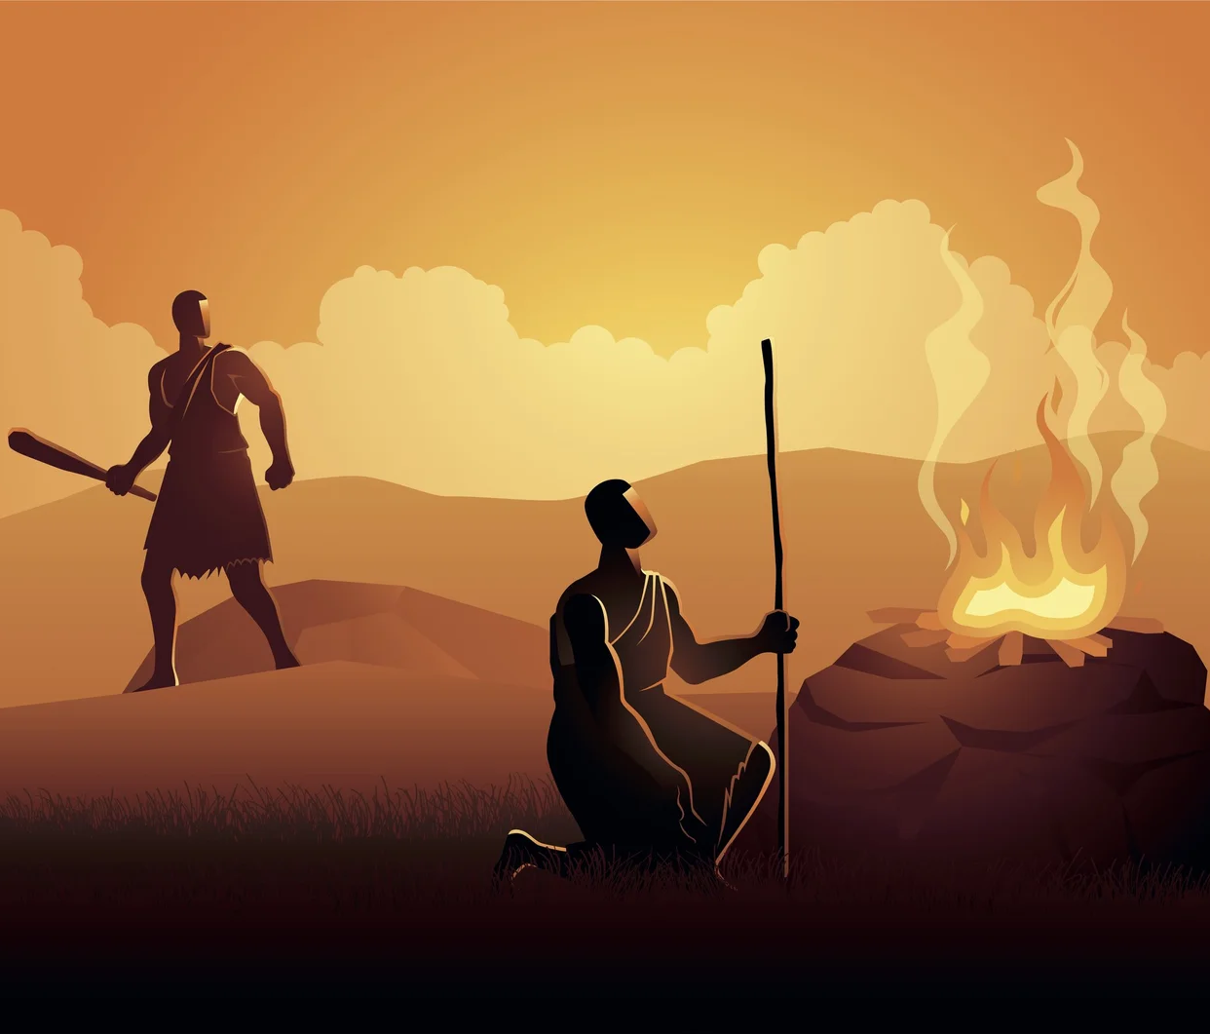
8. What made Abel's offering more acceptable than Cain's?
Hebrews 11:4
By faith Abel offered unto God a more excellent sacrifice than Cain, by which he obtained witness that he was righteous, God testifying of his gifts: and by it he being dead yet speaketh.

Slide 13
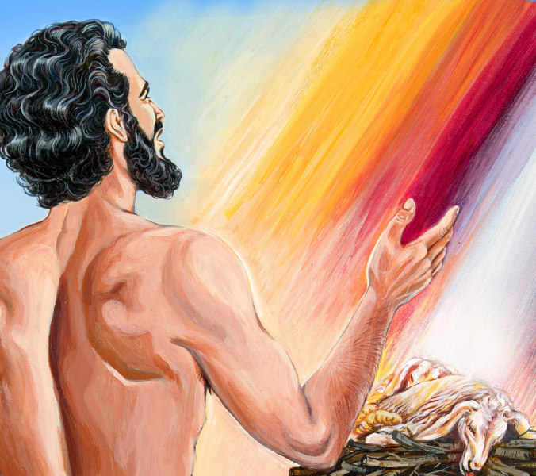
9. What did Abel obtain by his offering?
Hebrews 11:4
By faith Abel offered unto God a more excellent sacrifice than Cain, by which he obtained witness that he was righteous, God testifying of his gifts: and by it he being dead yet speaketh.

Slide 14
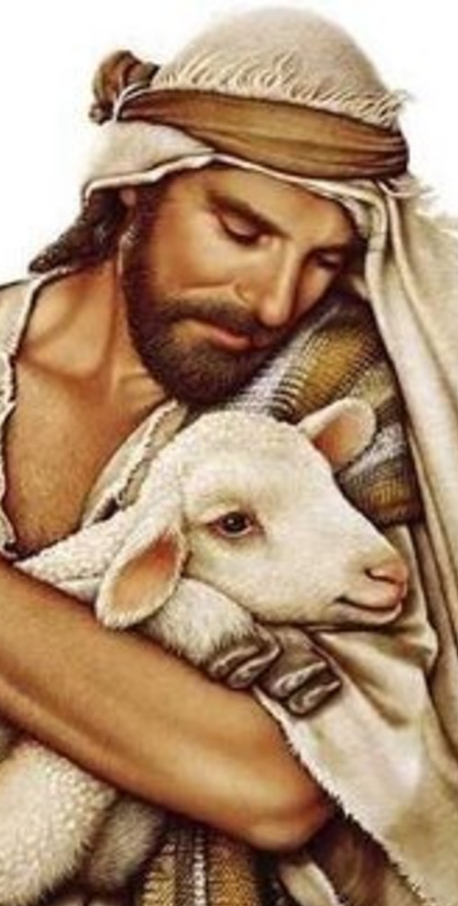
Abel grasped the great principles of redemption. He saw himself a sinner, and he saw sin and its penalty, death, standing between his soul and communion with God. He brought the slain victim, the sacrificed life, thus acknowledging the claims of the law that had been transgressed.
Patriarchs and Prophets, pg. 72

Slide 15
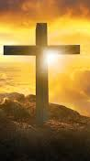
Through the shed blood he looked to the future sacrifice, Christ dying on the cross of Calvary; and trusting in the atonement that was there to be made, he had the witness that he was righteous, and his offering accepted.
Patriarchs and Prophets, pg. 72

Slide 16
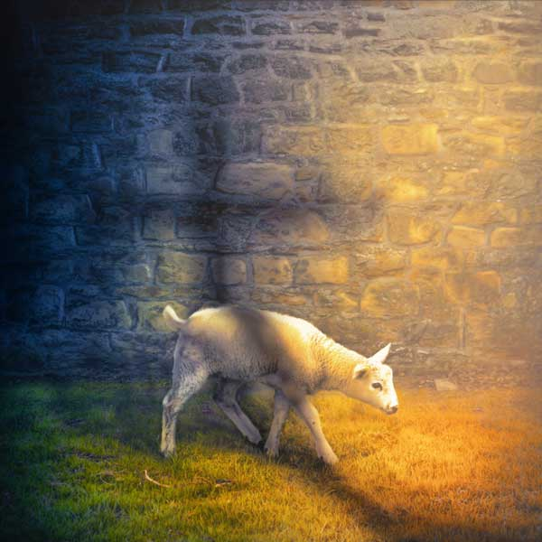
10. What was the defect in Cain's offering?
Hebrews 9:22
And almost all things are by the law purged with blood; and without shedding of blood is no remission.

Slide 17
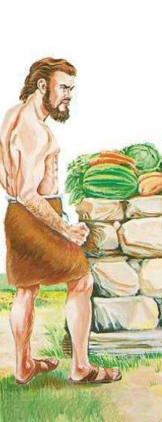
Cain came before God with murmuring and infidelity in his heart in regard to the promised sacrifice and the necessity of the sacrificial offerings. His gift expressed no penitence for sin. He felt, as many now feel, that it would be an acknowledgment of weakness to follow the exact plan marked out by God, of trusting his salvation wholly to the atonement of the promised Saviour.
Patriarchs and Prophets, pg. 72

Slide 18
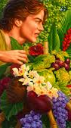
He chose the course of self-dependence. He would come in his own merits. He would not bring the lamb, and mingle its blood with his offering, but would present his fruits, the products of his labor. He presented his offering as a favor done to God, through which he expected to secure the divine approval.
Patriarchs and Prophets, pg. 72

Slide 19
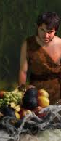
Cain obeyed in building an altar, obeyed in bringing a sacrifice; but he rendered only a partial obedience. The essential part, the recognition of the need of a Redeemer, was left out.
Patriarchs and Prophets, pg. 72

Slide 20
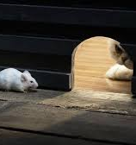
11. Then since Cain did not take the proper steps to secure the remission of sins, what lay at his door?
Genesis 4:7
If thou doest well, shalt thou not be accepted? and if thou doest not well, sin lieth at the door. And unto thee shall be his desire, and thou shalt rule over him.

Slide 21
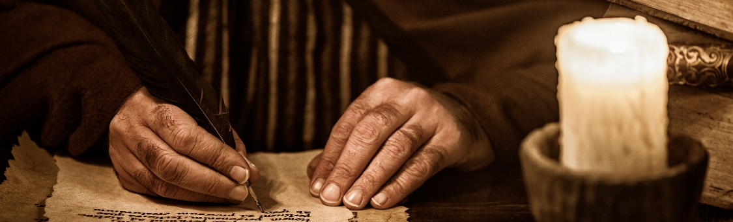
This verse presents certain linguistic difficulties that have led some modem commentators to think that a copyist’s error has changed the Hebrew text. That the translators of the LXX found its meaning obscure even in their time is apparent from their garbled translation of it.
SDABC V1 on Genesis 4:7

Slide 22
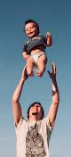
The first clause reads literally, “Is there not lifting up if thou doest well?” What will be lifted up? The burden of guilt or the countenance? The expression “to lift up one’s face” for “to be joyful or innocent” is common in Hebrew, and probably appears here in an abbreviated form as a complement to the preceding statement that Cain’s countenance had fallen.
SDABC V1 on Genesis 4:7

Slide 23

God wished Cain to understand that if he would mend his ways and live according to the divine precepts, there would be no more reason for God to show His displeasure and no more reason for Cain to show a disappointed and angry face.
SDABC V1 on Genesis 4:7

Slide 24
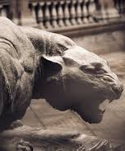
However, if Cain would not change, but would continue in the pathway of evil, sin would overwhelm him. The phrase “sin lieth at the door” (like a wild beast) is probably a proverbial one.
SDABC V1 on Genesis 4:7

Slide 25
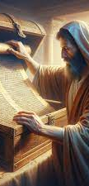
The phrase “Unto thee shall be his desire” cannot refer to Abel as having a “desire” toward his elder brother in the same sense as Eve toward her husband, that is, to accept his supremacy. Such an explanation would seem to be at variance with the context and with divine principles.
SDABC V1 on Genesis 4:7

Slide 26
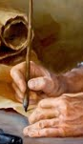
If sin is personified as a wild beast lying in wait for Cain, it would be appropriate to continue the comparison by translating, as does the RSV, “its desire is for you, but you must master it.”
SDABC V1 on Genesis 4:7

Slide 27
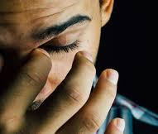
12. Through whose blood alone may remission of sins be obtained?
Romans 3:23-25
For all have sinned, and come short of the glory of God;

Slide 28
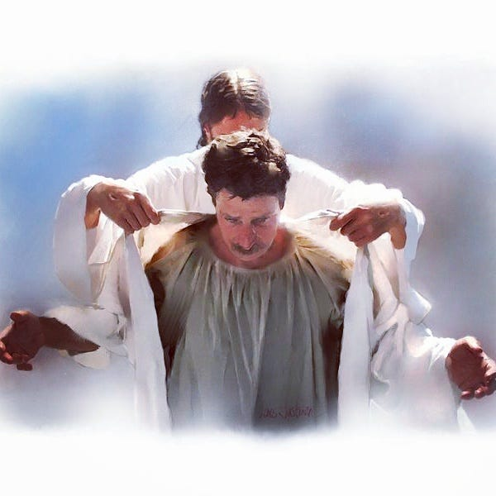
12. Through whose blood alone may remission of sins be obtained?
Romans 3:23-25
Being justified freely by his grace through the redemption that is in Christ Jesus:

Slide 29
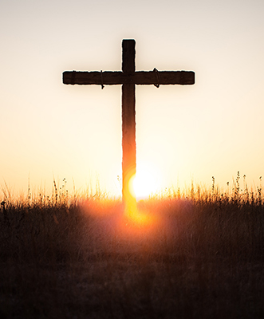
12. Through whose blood alone may remission of sins be obtained?
Romans 3:23-25
Whom God hath set forth to be a propitiation through faith in his blood, to declare his righteousness for the remission of sins that are past, through the forbearance of God;

Slide 30
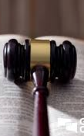
Since men have nothing by which they may set themselves right with God, justification must come as a free gift. Only when in all humility a man is prepared to acknowledge that he is destitute of the glory of God and that he has nothing in himself that would commend him to God is he enabled by faith to accept justification as a free gift.
SDABC V6 on Romans 3:24

Slide 31
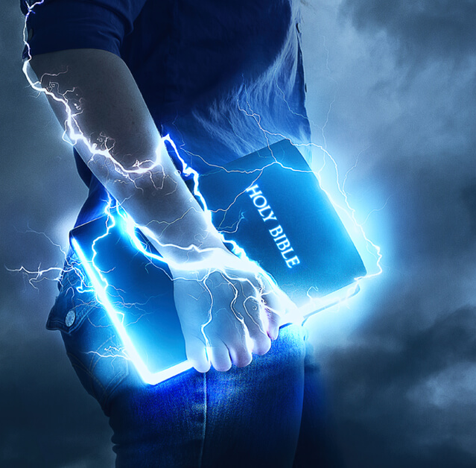
13. Then since Abel was accepted, in whom must he have had faith?
Acts 4:10-12
This is the stone which was set at nought of you builders, which is become the head of the corner.

Slide 32

13. Then since Abel was accepted, in whom must he have had faith?
Acts 4:10-12
Be it known unto you all, and to all the people of Israel, that by the name of Jesus Christ of Nazareth, whom ye crucified, whom God raised from the dead, even by him doth this man stand here before you whole.

Slide 33

13. Then since Abel was accepted, in whom must he have had faith?
Acts 4:10-12
Neither is there salvation in any other: for there is none other name under heaven given among men, whereby we must be saved.

Slide 34
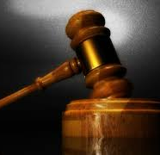
14. What is the highest attainment of faith?
Romans 5:1; 1 John 5:4
Therefore being justified by faith, we have peace with God through our Lord Jesus Christ:

Slide 35
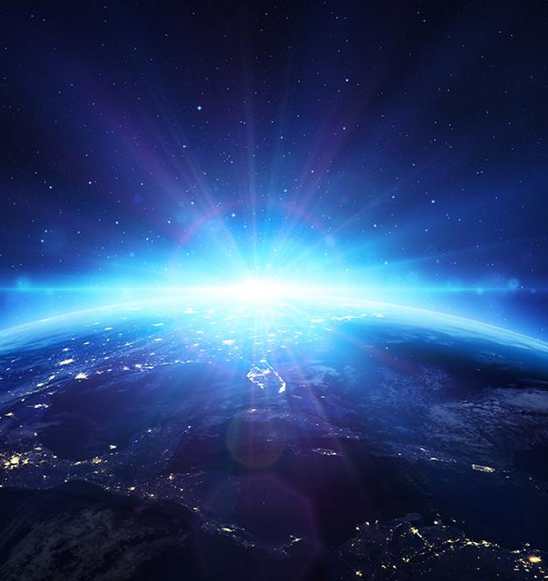
14. What is the highest attainment of faith?
Romans 5:1; 1 John 5:4
For whatsoever is born of God overcometh the world: and this is the victory that overcometh the world, even our faith.

Slide 36
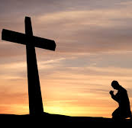
15. Since Abel was justified, was not his faith in Christ as perfect as ours can be?
Yes. Abel's faith in the promised Redeemer was genuine and accepted by God. Though Christ had not yet come in the flesh, Abel trusted in the same Savior we do—demonstrating that justification has always been by faith in Christ!

Slide 37
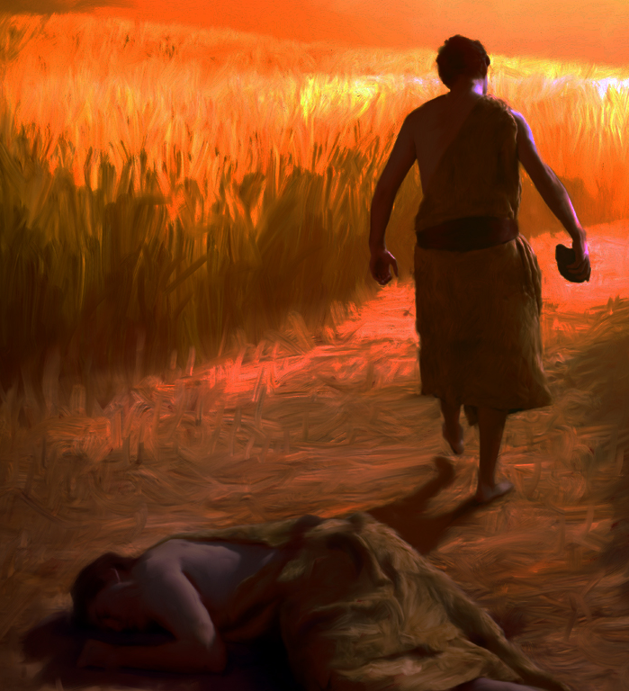
16. What did Cain do to Abel?
Genesis 4:8
And Cain talked with Abel his brother: and it came to pass, when they were in the field, that Cain rose up against Abel his brother, and slew him.

Slide 38

17. Why did he do this?
1 John 3:11, 12
For this is the message that ye heard from the beginning, that we should love one another.

Slide 39
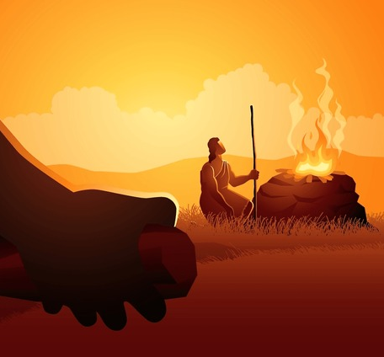
17. Why did he do this?
1 John 3:11, 12
Not as Cain, who was of that wicked one, and slew his brother. And wherefore slew he him? Because his own works were evil, and his brother's righteous.

Slide 40
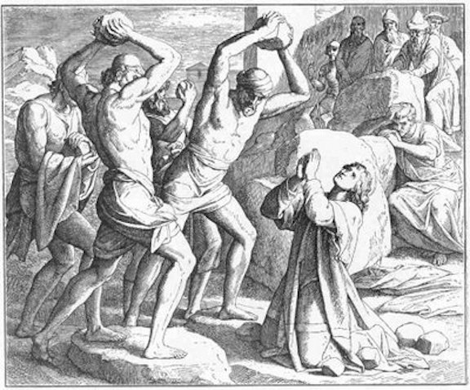
18. Of what scripture was Abel the first to demonstrate the truth?
2 Timothy 3:12
Yea, and all that will live godly in Christ Jesus shall suffer persecution.

Slide 41
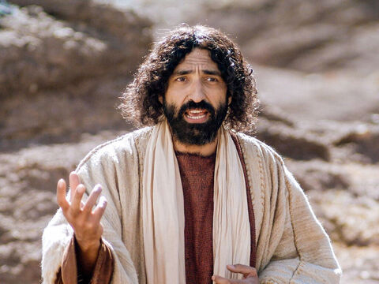
19. Is it any wonder if the world hates the righteous?
John 15:18-20
If the world hate you, ye know that it hated me before it hated you.

Slide 42
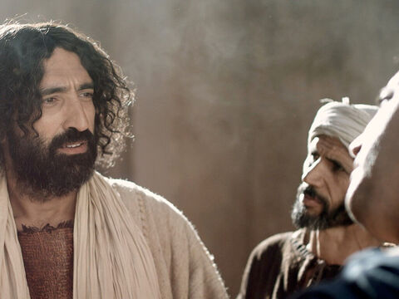
19. Is it any wonder if the world hates the righteous?
John 15:18-20
If ye were of the world, the world would love his own: but because ye are not of the world, but I have chosen you out of the world, therefore the world hateth you.

Slide 43
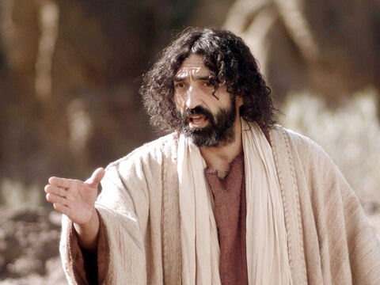
19. Is it any wonder if the world hates the righteous?
John 15:18-20
Remember the word that I said unto you, The servant is not greater than his lord. If they have persecuted me, they will also persecute you; if they have kept my saying, they will keep yours also.

Slide 44
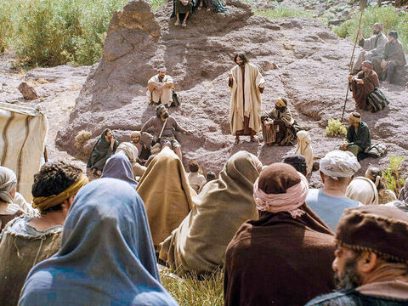
20. How should the righteous feel when they are persecuted for their faith?
Matthew 5:11-12
Blessed are ye, when men shall revile you, and persecute you, and shall say all manner of evil against you falsely, for my sake.

Slide 45
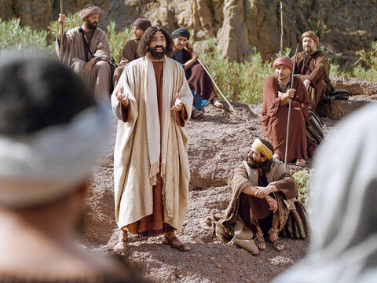
20. How should the righteous feel when they are persecuted for their faith?
Matthew 5:11-12
Rejoice, and be exceeding glad: for great is your reward in heaven: for so persecuted they the prophets which were before you.

Slide 46
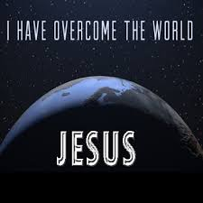
21. What consolation has the Christian in all tribulation?
John 16:33
These things I have spoken unto you, that in me ye might have peace. In the world ye shall have tribulation: but be of good cheer; I have overcome the world.

Slide 47


Slide 48
Thank You &
HAPPY SABBATH!!

