Slide 1
Old Testament History:
The Earth Corrupted
Lesson 5, 1st Quarter, 1888

Slide 2

Living the Light

Slide 3

1. When men became very numerous on the earth, what did they do?
Genesis 6:1, 2
And it came to pass, when men began to multiply on the face of the earth, and daughters were born unto them,

Slide 4
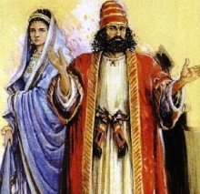
1. When men became very numerous on the earth, what did they do?
Genesis 6:1, 2
That the sons of God saw the daughters of men that they were fair; and they took them wives of all which they chose.

Slide 5
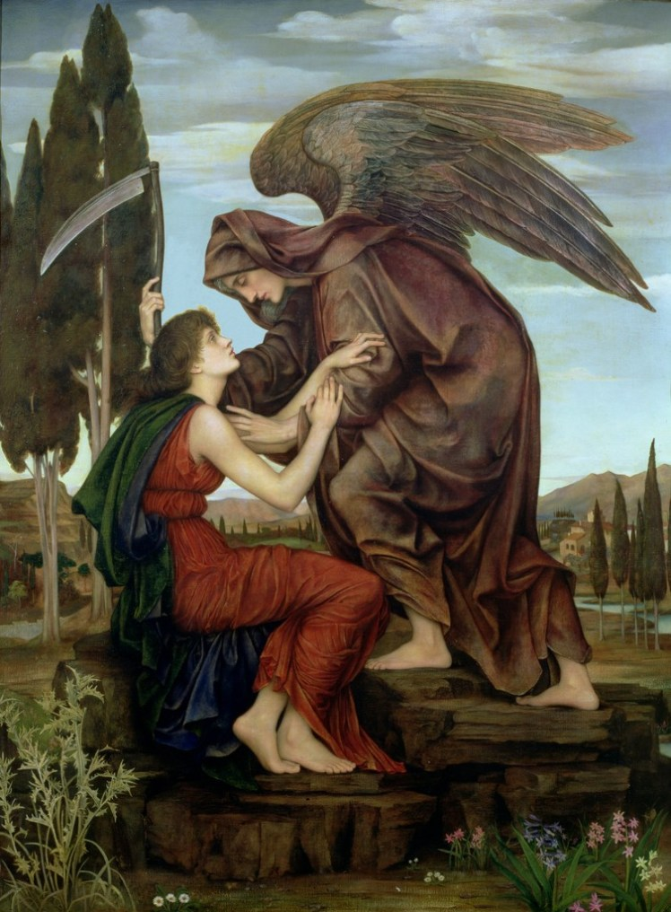
Jewish Interpretations of Genesis Over Time: An Attempt at Exegesis
“When men began to increase on earth and daughters were born to them, the divine beings saw how beautiful the daughters of men were and took wives from among those that pleased them” (Genesis 6:1-2, NJPS).
NJPS: New Jewish Publication Society of America, 1985

Slide 6
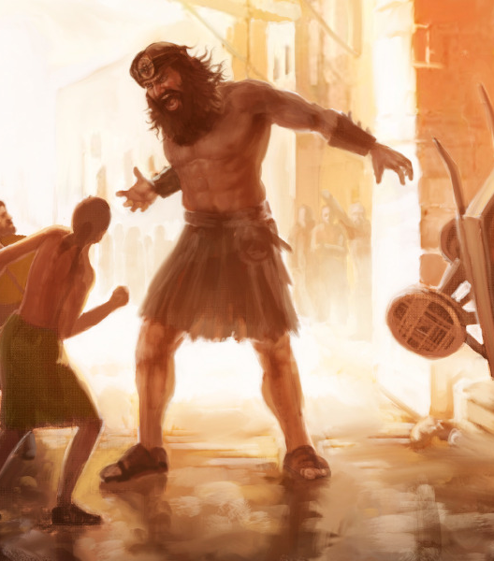
Jewish Interpretations of Genesis Over Time: An Attempt at Exegesis
This passage is followed by a mention of the Nephilim, described as “the heroes of old, the men of renown” (Genesis 6:4).

Slide 7
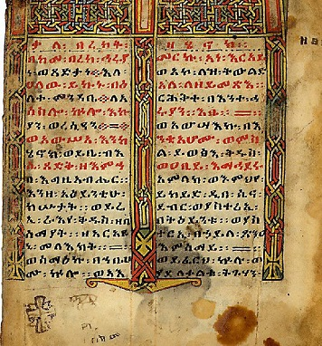
Jewish Interpretations of Genesis Over Time: An Attempt at Exegesis
Second Temple period literature, including the Book of Enoch and the Book of Jubilees, offers expanded interpretations of Genesis 6. These texts depict the “sons of God” as fallen angels who descended to earth and married human women, leading to the birth of giants, the Nephilim.

Slide 8
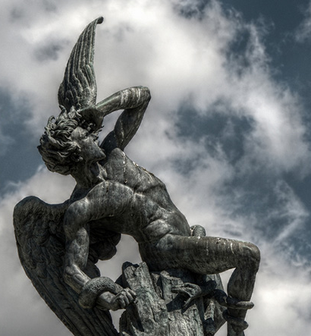
Jewish Interpretations of Genesis Over Time: An Attempt at Exegesis
In the Book of Enoch, the fallen angels are called Watchers. They teach humans forbidden knowledge, leading to widespread corruption and prompting divine punishment through the flood.

Slide 9
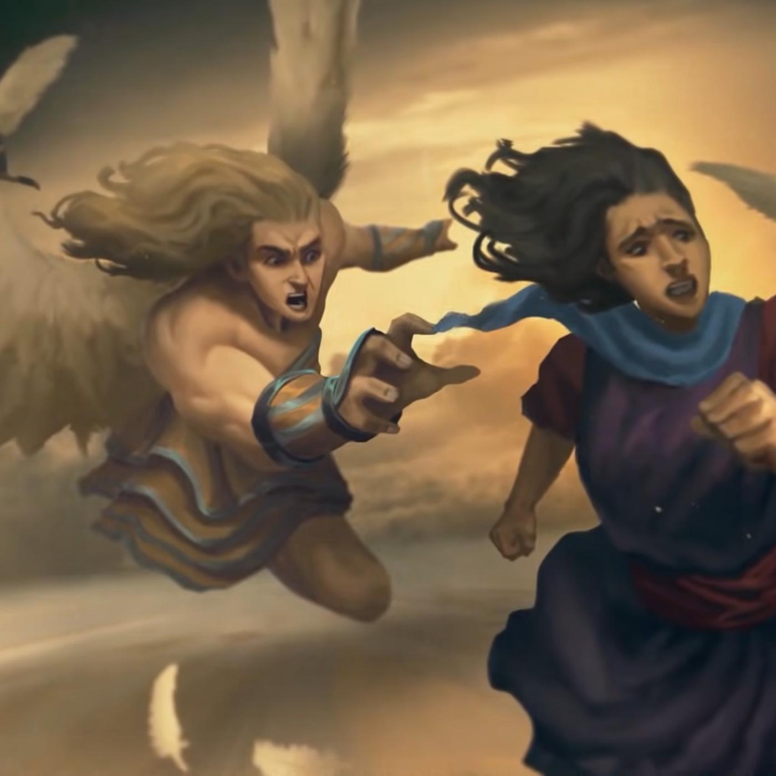
Jewish Interpretations of Genesis Over Time: An Attempt at Exegesis
The Book of Jubilees echoes this narrative but emphasizes the genetic corruption resulting from these unions, contributing to the proliferation of evil on earth​​​​.

Slide 10
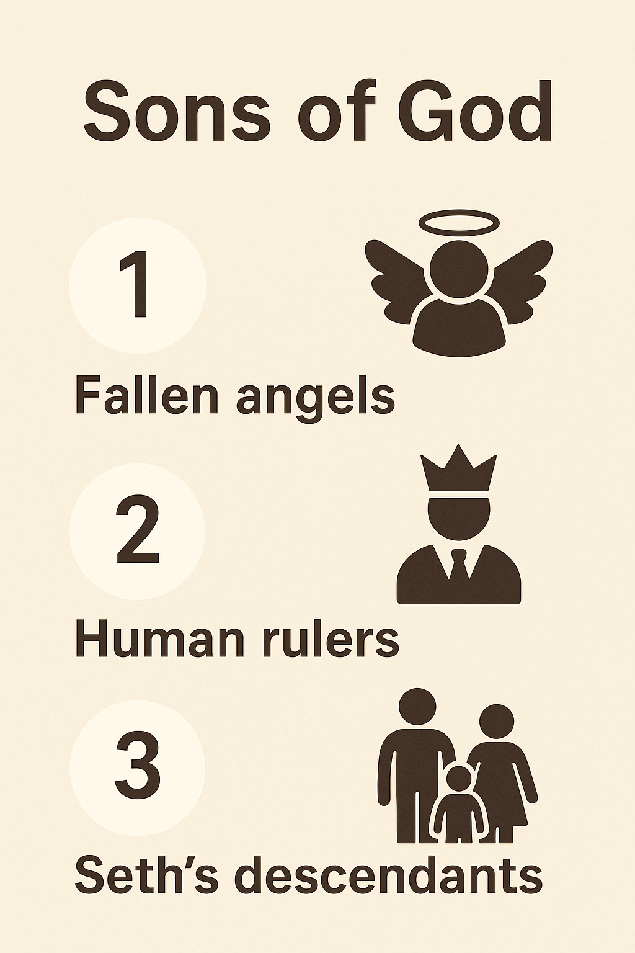
The website “Got Questions,” a “Christian, Protestant, evangelical, theologically conservative, non-denominational” group.
The three primary views on the identity of the sons of God are 1) they were fallen angels, 2) they were powerful human rulers, or 3) they were godly descendants of Seth intermarrying with wicked descendants of Cain.

Slide 11
The website “Got Questions,” a “Christian, Protestant, evangelical, theologically conservative, non-denominational” group.
Giving weight to the first theory is the fact that in the Old Testament the phrase “sons of God” always refers to angels (Job 1:6; 2:1; 38:7).

Slide 12
The website “Got Questions,” a “Christian, Protestant, evangelical, theologically conservative, non-denominational” group.
A potential problem with this is in Matthew 22:30, which indicates that angels do not marry. The Bible gives us no reason to believe that angels have a gender or are able to reproduce. The other two views do not present this problem.

Slide 13
The website “Got Questions,” a “Christian, Protestant, evangelical, theologically conservative, non-denominational” group.
The weakness of views 2) and 3) is that ordinary human males marrying ordinary human females does not account for why the offspring were “giants” or “heroes of old, men of renown.”

Slide 14
The website “Got Questions,” a “Christian, Protestant, evangelical, theologically conservative, non-denominational” group.
Further, why would God decide to bring the flood on the earth (Genesis 6:5-7) when God had never forbidden powerful human males or descendants of Seth to marry ordinary human females or descendants of Cain?

Slide 15
The website “Got Questions,” a “Christian, Protestant, evangelical, theologically conservative, non-denominational” group.
The oncoming judgment of Genesis 6:5-7 is linked to what took place in Genesis 6:1-4. Only the obscene, perverse marriage of fallen angels with human females would seem to justify such a harsh judgment.

Slide 16
The website “Got Questions,” a “Christian, Protestant, evangelical, theologically conservative, non-denominational” group.
As previously noted, the weakness of the first view is that Matthew 22:30 declares, “At the resurrection people will neither marry nor be given in marriage; they will be like the angels in heaven.” However, the text does not say “angels are not able to marry.”

Slide 17
The website “Got Questions,” a “Christian, Protestant, evangelical, theologically conservative, non-denominational” group.
Rather, it indicates only that angels do not marry. Second, Matt. 22:30 is referring to the “angels in heaven.” It is not referring to fallen angels, who do not care about God’s created order and actively seek ways to disrupt God’s plan.

Slide 18
The website “Got Questions,” a “Christian, Protestant, evangelical, theologically conservative, non-denominational” group.
The fact that God’s holy angels do not marry or engage in sexual relations does not mean the same is true of Satan and his demons.
View 1) is the most likely position.

Slide 19
The website “Got Questions,” a “Christian, Protestant, evangelical, theologically conservative, non-denominational” group.
Yes, it is an interesting “contradiction” to say that angels are sexless and then to say that the “sons of God” were fallen angels who procreated with human females.

Slide 20
The website “Got Questions,” a “Christian, Protestant, evangelical, theologically conservative, non-denominational” group.
However, while angels are spiritual beings (Hebrews 1:14), they can appear in human, physical form (Mark 16:5). The men of Sodom and Gomorrah wanted to have sex with the two angels who were with Lot (Genesis 19:1-5)…

Slide 21
Identifying the “Sons of God”
CONTEXT
The context (Gen. 4-6) emphasizes a contrast between two human lineages:
Cain’s line culminates in increasing violence and rebellion (Gen. 4:17-24).
Seth’s line is described as godly, calling on the name of the Lord. (Gen 4:26).
Notes:
Genesis 5 begins the “toledoth of Adam,” Noah later in Gen. 6 referred to as “perfect in his generations”

Slide 22
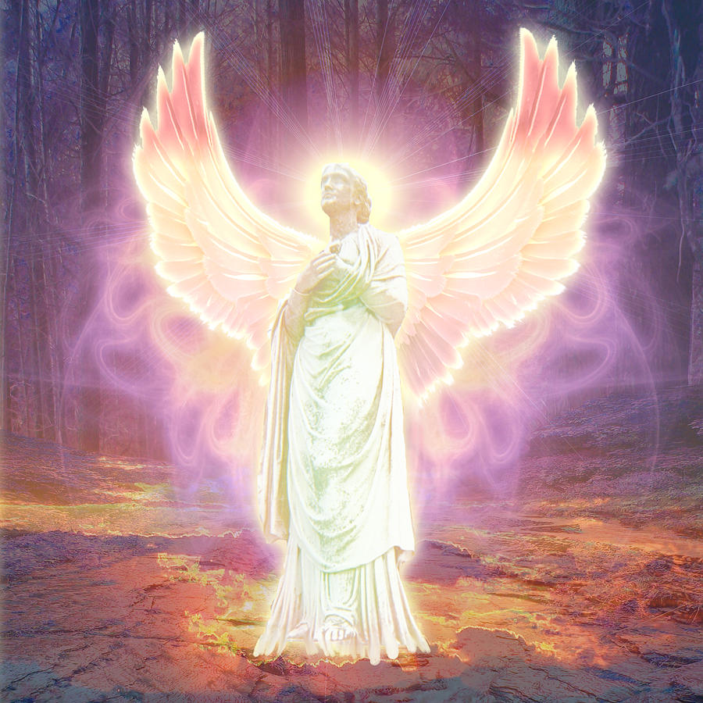
Identifying the “Sons of God”
VERSE UPON VERSE
“Sons of God” does NOT always mean angels! Yes, in Job 1:6 and 2:1 the phrase does refer to heavenly beings in the poetic heavenly courtroom scene. But that does not make it a rule for every use we might find.

Slide 23
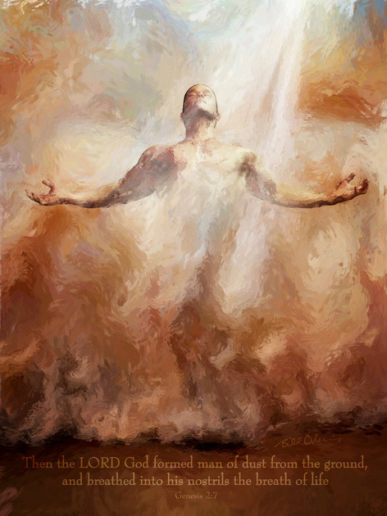
Identifying the “Sons of God”
VERSE UPON VERSE
Deuteronomy 14:1 – “Ye are the children of the Lord your God.”
Hosea 1:10 – “...it shall be said unto them, Ye are the sons of the living God.”
Luke 3:38 – Adam is called “the son of God.”

Slide 24
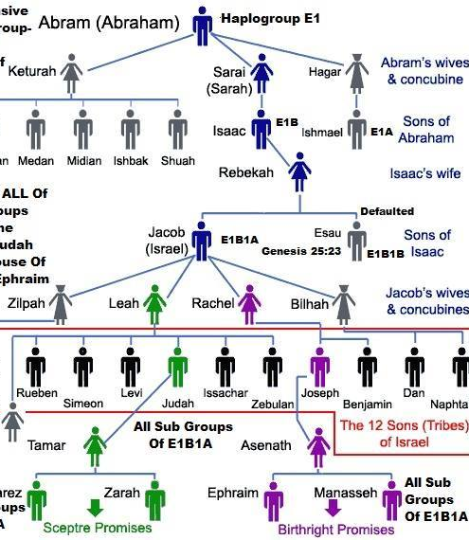
Identifying the “Sons of God”
VERSE UPON VERSE
Scripture uses "sons of" to reflect character and allegiance—not merely origin (John 8:39–44). Jesus taught that true sons do the works of their father—thus, rebellious demons could not rightly be called “sons of God.”

Slide 25
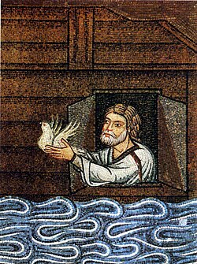
Identifying the “Sons of God”
VERSE UPON VERSE
“Sons of God” then fits the pattern of a faithful human lineage, not wicked fallen angels. Noah being “perfect in his generations” (Gen. 6:9) reinforces the theme of preserving a godly human line.

Slide 26
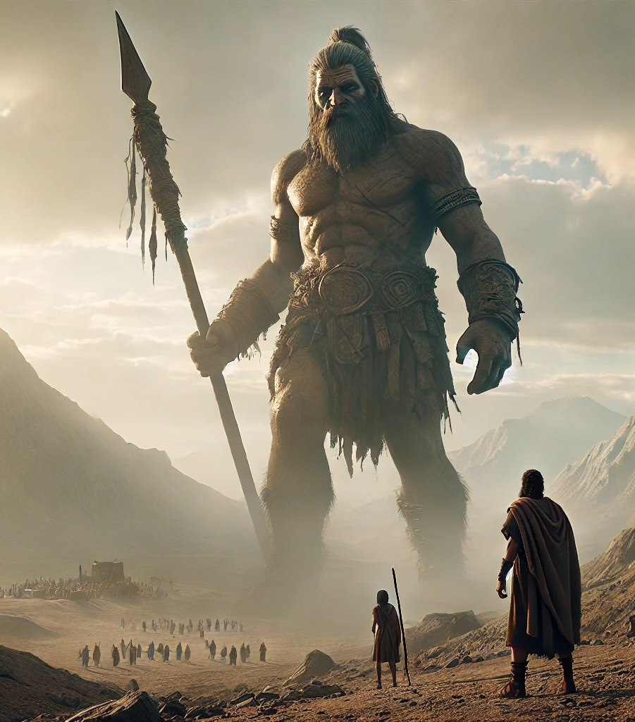
Identifying the “Sons of God”
…AND the NEPHILIM
The word “giants” (Nephilim) doesn’t require angelic parents. The word “Nephilim” is from a root meaning “to fall,” which also refers to violent (read scary) warriors. But fearsomeness doesn’t require angelic heritage.

Slide 27
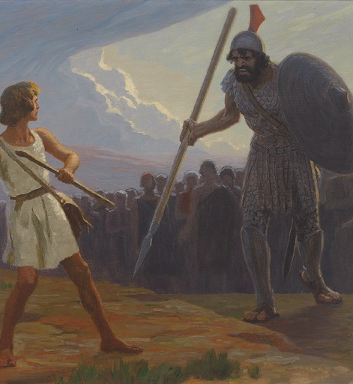
Identifying the “Sons of God”
…AND the NEPHILIM
Numbers 13:33 calls some tall men "Nephilim"—but that doesn’t mean they had angelic ancestry. It’s a description of fearsome warriors being given by frightened spies.

Slide 28
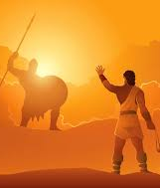
Identifying the “Sons of God”
…AND the NEPHILIM
The phrase “mighty men... men of renown” (Genesis 6:4) can easily describe powerful, wicked, or violent but very human leaders.

Slide 29
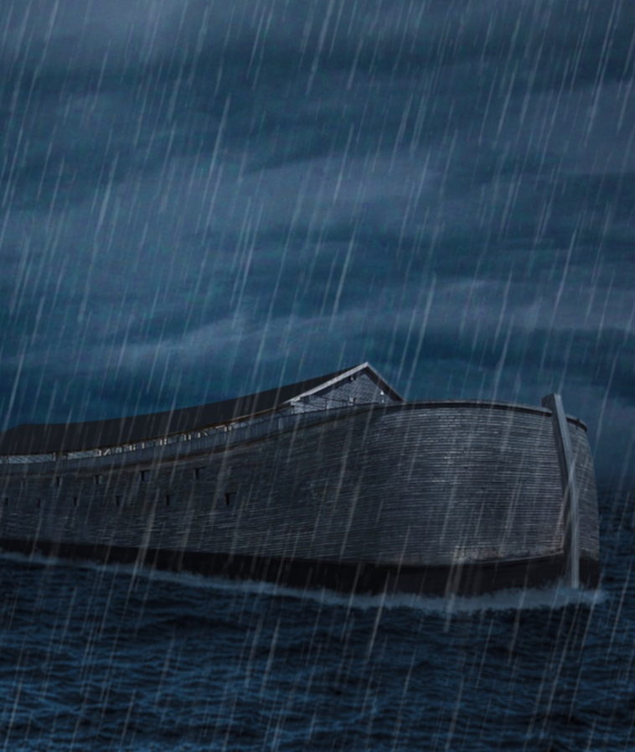
Identifying the “Sons of God”
THE JUDGEMENT
God explains why the “harsh” judgement of the flood was necessary… and it didn’t have anything to do with perverse matings between people and demons.

Slide 30
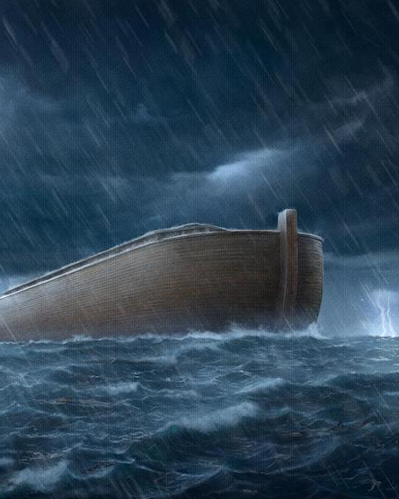
Identifying the “Sons of God”
THE JUDGEMENT
Genesis 6:5–7 says: “And God saw that the wickedness of man was great in the earth…”
The cause of the flood was human evil, not angelic misbehavior.

Slide 31
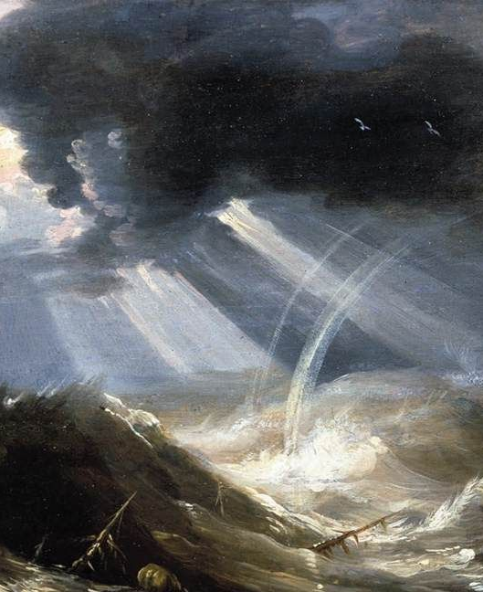
Identifying the “Sons of God”
THE JUDGEMENT
“...that every imagination of the thoughts of his heart was only evil continually.”
If the judgment was due to fallen angels, why does the text repeatedly emphasize man's sin?

Slide 32
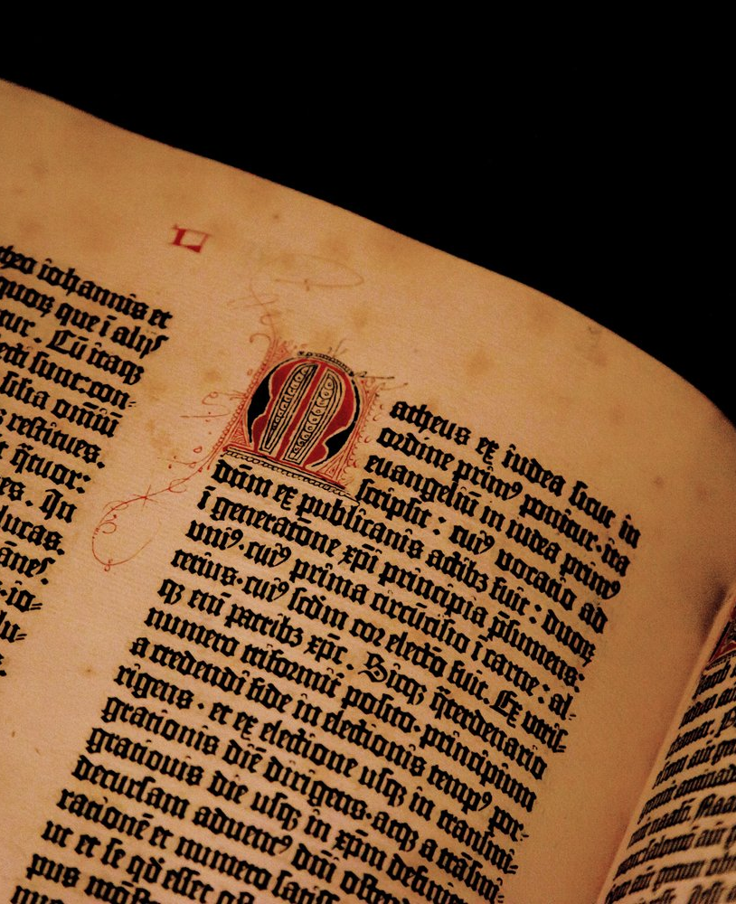
Identifying the “Sons of God”
READING THE TEXT
Nowhere in Gen. 6:1–4 is the word “angel” used. To interpret "sons of God" as angels:
Reads external assumptions into the text.
Breaks the natural, genealogical flow of the passage.

Slide 33

Identifying the “Sons of God”
UNCHANGING STANDARDS
Throughout Scripture, God repeatedly warns against intermarriage with unbelievers due to its corrupting influence (e.g., Deut. 7:3–4; 1 Kings 11:1–4; Ezra 9:1–2; 2 Cor. 6:14). God’s character and moral standards do not change (Mal. 3:6).

Slide 34
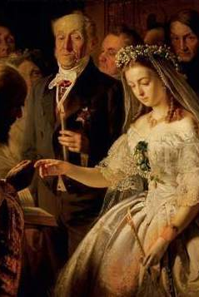
Identifying the “Sons of God”
UNCHANGING STANDARDS
It is reasonable to believe that the antediluvians were aware of this. The intermarriages described in Genesis 6:2 reflect this timeless danger—faithful believers compromising by joining with the ungodly, leading to widespread moral decay and divine judgment.

Slide 35
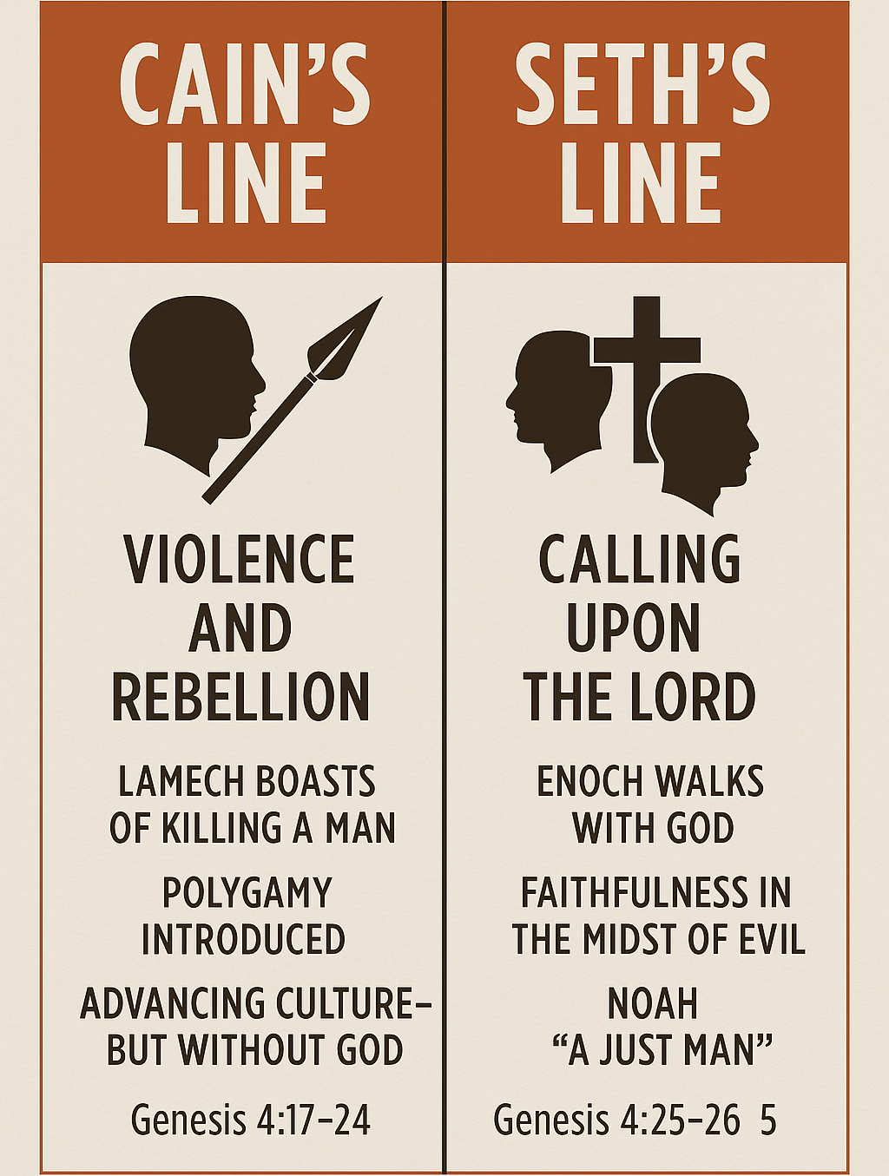
Identifying the “Sons of God”
CONCLUSIONS
The view that the “Sons of God” are simply the descendants of the godly line of Seth is the most consistent, with itself and (most importantly) with the Bible. The whole context of Genesis 4-6 involves setting up a contrast between the godly and the rebellious.

Slide 36
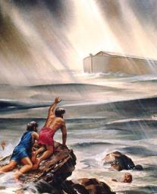
Identifying the “Sons of God”
CONCLUSIONS
Genesis 6 describes the spiritual compromise of godly descendants intermarrying with the ungodly.
The flood came because of the complete moral corruption of mankind—not some mythic half-angel abomination.

Slide 37
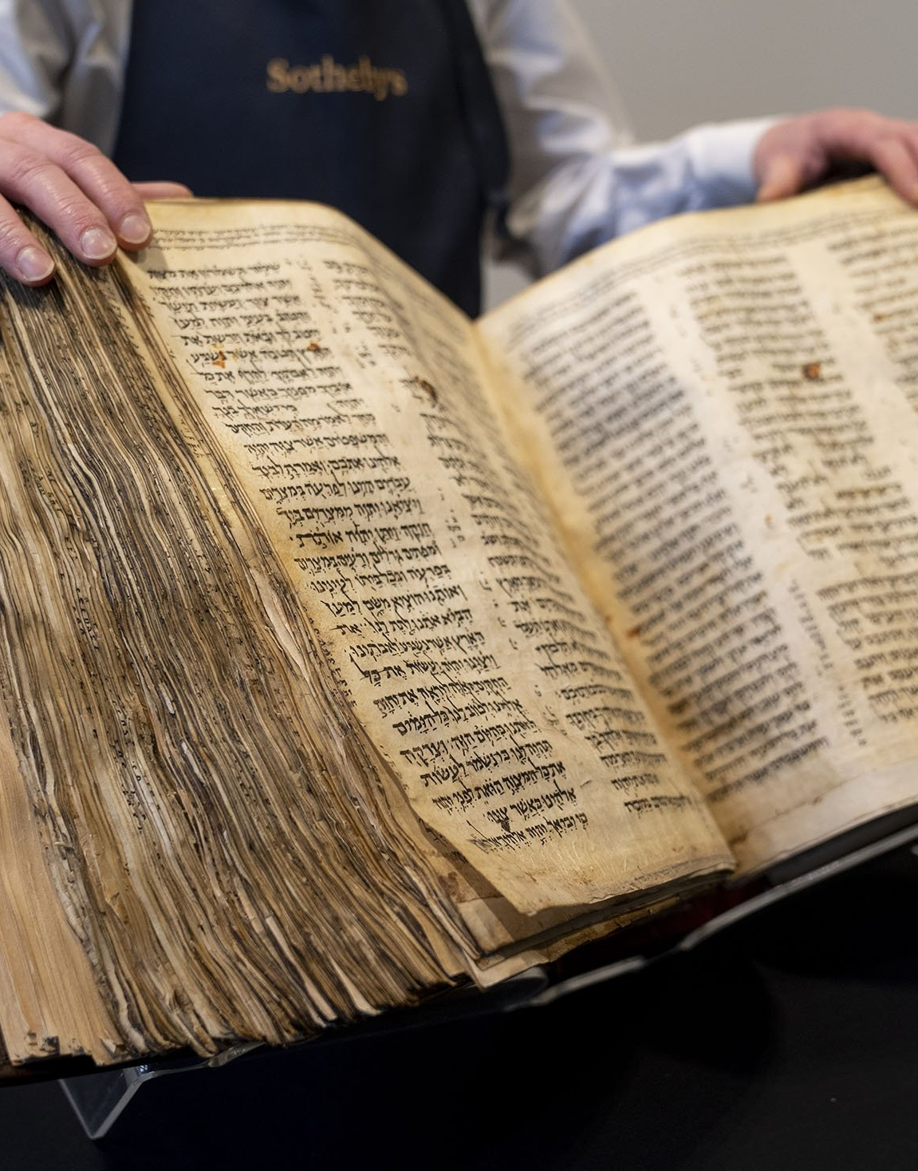
Identifying the “Sons of God”
CONCLUSIONS
Scripture gives no evidence that angels—fallen or not—can or ever did reproduce with humans.
And it is absolutely unnecessary to imagine such a thing in order to produce large, violent, or frightening offspring. Plain wickedness can account for this.

Slide 38
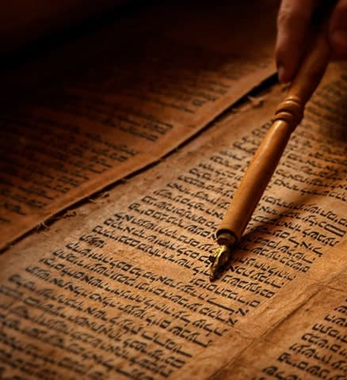
Identifying the “Sons of God”
CONCLUSIONS
The “sons of God = fallen angels” theory is unsupported by Genesis, inconsistent with Jesus’ teaching, and introduces speculative theology where Scripture is otherwise clear.

Slide 39
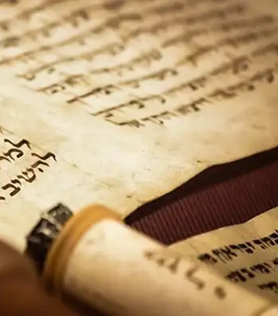
Identifying the “Sons of God”
CONCLUSIONS
“Thy word is lamp unto my feet, and a light unto my path.” Psalm 119:105
Let’s walk by what the Word says—not by myths, assumptions, or creative writing.

Slide 40
2. What commandment, then, was specially disregarded?

Slide 41
2. What commandment, then, was specially disregarded?
And it came to pass, when men began to multiply on the face of the earth, and daughters were born unto them,
² That the sons of God saw the daughters of men that they were fair; and they took them wives of all which they chose.

Slide 42
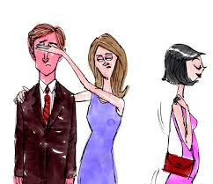
2. What commandment, then, was specially disregarded?
Answer: The seventh commandment
Thou shalt not commit adultery.

Slide 43
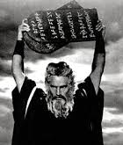
2. What commandment, then, was specially disregarded?
The seemingly simple statement of Genesis 6:1-2 reveals a breakdown of the divine pattern for marriage and purity. Rather than honoring God's principles, the people followed their own desires, choosing partners based on physical attraction rather than spiritual fidelity.

Slide 44
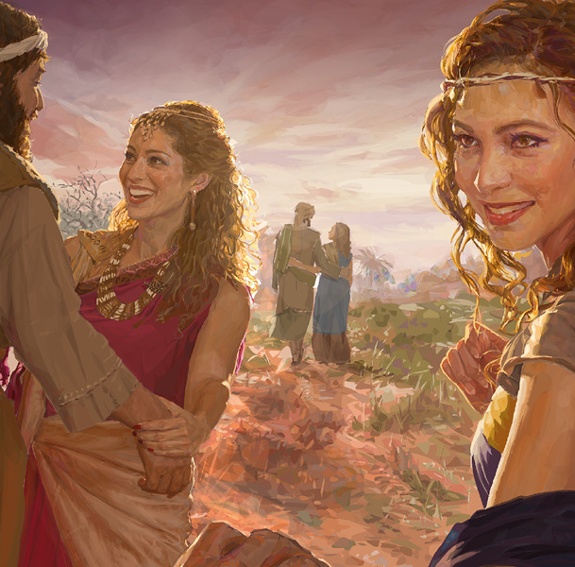
2. What commandment, then, was specially disregarded?
This resulted in widespread corruption of the marriage institution—including polygamy, likely also promiscuity, and alliances between the faithful and the wicked, all of which violate the spirit (and often the letter) of the seventh commandment.

Slide 45
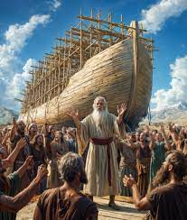
3. In pursuing this wicked course, what good influence were they resisting?
Genesis 6:3
And the Lord said, My spirit shall not always strive with man, for that he also is flesh: yet his days shall be an hundred and twenty years.

Slide 46
The fact that this statement follows immediately after the reference to these unsanctified marriages would suggest that God’s displeasure was most particularly displayed toward this evil practice. Captive to their passions, they were no longer subject to God’s Spirit.
My spirit shall not always strive …
SDABC V1 on Genesis 6:3

Slide 47
This expression may also be translated, “in their going astray man is flesh.” By following after the lusts of the flesh, says God, men have surrendered themselves to its desires to the extent that they are no longer responsive to the control of the Holy Spirit. Insensibility to divine influence is complete; hence, the Spirit of God is to be withdrawn. There is no further use in “striving” to restrain or improve them.
…for that he also is flesh.
SDABC V1 on Genesis 6:3

Slide 48
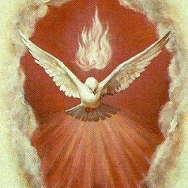
4. What is the special office of the Spirit in connection with sinners?
John 16:8
And when he is come, he will reprove the world of sin, and of righteousness, and of judgment:

Slide 49
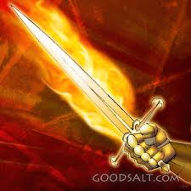
5. By what means does the Spirit reprove the world of sin?
Ephesians 6:17
And take the helmet of salvation, and the sword of the Spirit, which is the word of God:

Slide 50

6. What two things always necessarily work together in producing a perfect character?
2 Thessalonians 2:13, 1 Peter 1:22
But we are bound to give thanks alway to God for you, brethren beloved of the Lord, because God hath from the beginning chosen you to salvation through sanctification of the Spirit and belief of the truth:
Notes:
1. Sanctification of the Spirit / Obedience through the Spirit 2. Belief of the Truth / Obedience to the Truth

Slide 51
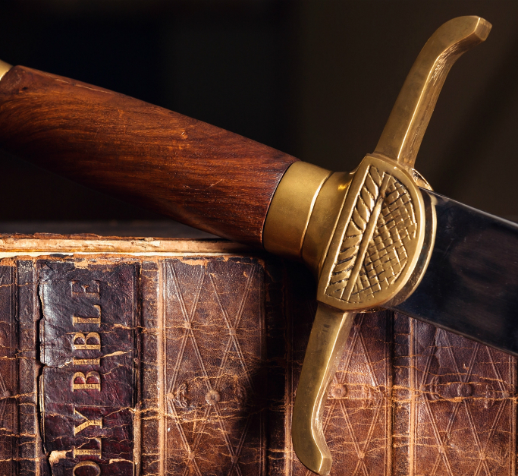
6. What two things always necessarily work together in producing a perfect character?
2 Thessalonians 2:13, 1 Peter 1:22
Seeing ye have purified your souls in obeying the truth through the Spirit unto unfeigned love of the brethren, see that ye love one another with a pure heart fervently:
Notes:
1. Sanctification of the Spirit / Obedience through the Spirit 2. Belief of the Truth / Obedience to the Truth

Slide 52
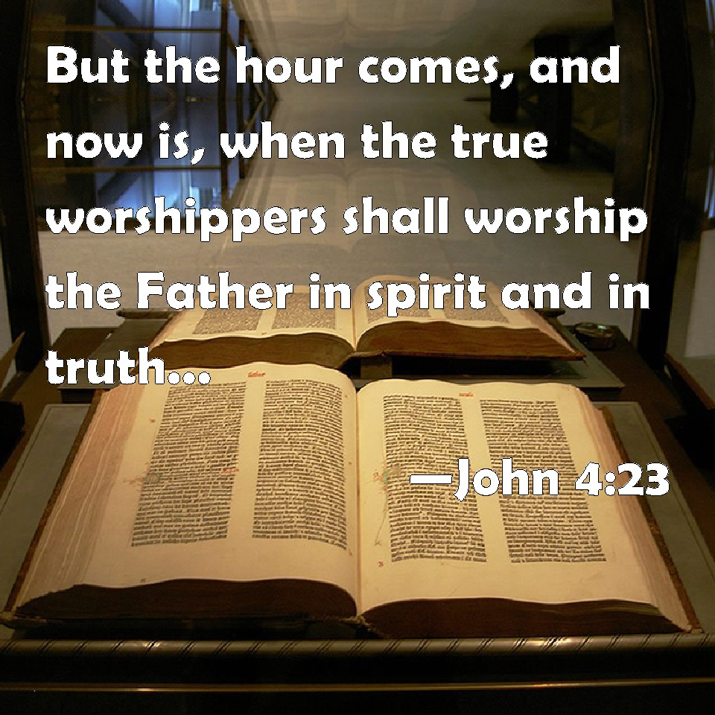
BONUS VERSE!
John 4:23

Slide 53
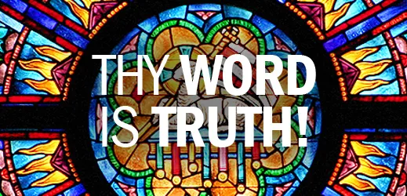
BONUS VERSE! John 17:17

Slide 54

7. Then how must the Lord have striven with the antediluvians by His Spirit?
Answer: By keeping continually before them the right way

Slide 55
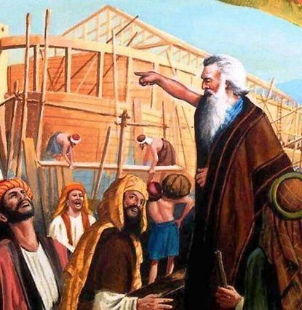
8. By whom was the right way presented to them?
2 Peter 2:5
And spared not the old world, but saved Noah the eighth person, a preacher of righteousness, bringing in the flood upon the world of the ungodly;

Slide 56

9. How long did God say that He would bear with them?
Genesis 6:3
And the Lord said, My spirit shall not always strive with man, for that he also is flesh: yet his days shall be an hundred and twenty years.

Slide 57
This divine prediction cannot mean that man’s life span would henceforth be restricted to 120 years. (Compare ages of men after the Flood.) They predict, rather, that God’s patience would come to an end and probation close within the period of time here specified. In the meantime, divine mercy lingered.
yet his days shall be an hundred and twenty years.
SDABC V1 on Genesis 6:3

Slide 58
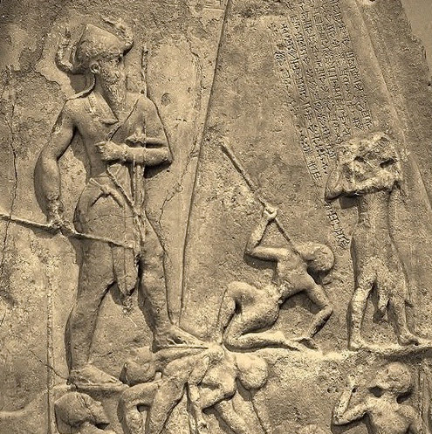
10. At the end of that time, how great was the wickedness of men?
Genesis 6:5
And God saw that the wickedness of man was great in the earth, and that every imagination of the thoughts of his heart was only evil continually.

Slide 59
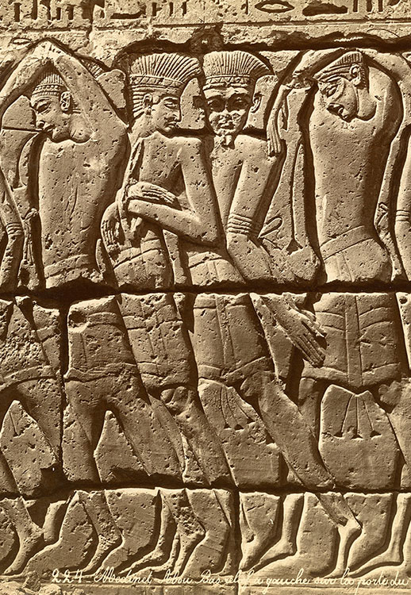
11. What was the condition of the whole earth?
Genesis 6:12
And God looked upon the earth, and, behold, it was corrupt; for all flesh had corrupted his way upon the earth.

Slide 60
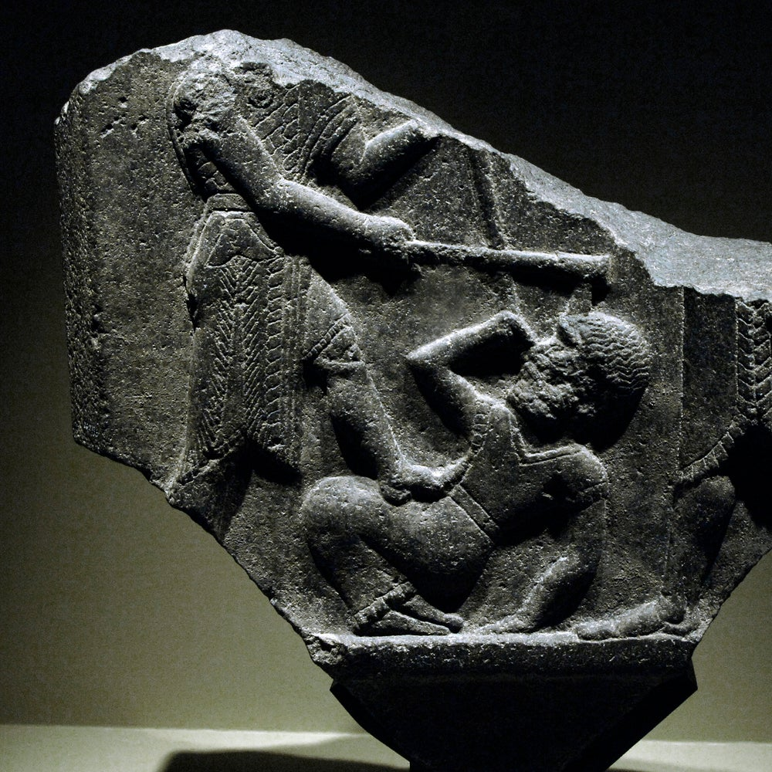
12. With what was it filled in consequence?
Genesis 6:11
The earth also was corrupt before God, and the earth was filled with violence.

Slide 61

13. What was the only consistent thing that God could then do?
Genesis 6:13
And God said unto Noah, The end of all flesh is come before me; for the earth is filled with violence through them; and, behold, I will destroy them with the earth.

Slide 62
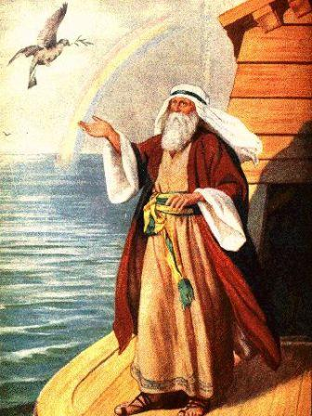
14. Upon whom alone did the Lord look with favor?
Genesis 6:8
But Noah found grace in the eyes of the Lord.

Slide 63
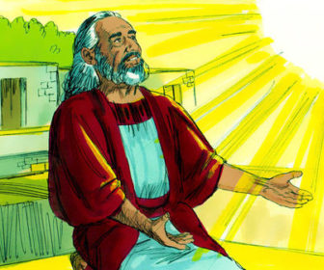
15. Why did the Lord regard Noah with special favor?
Genesis 6:9; Genesis 7:1
These are the generations of Noah: Noah was a just man and perfect in his generations, and Noah walked with God.

Slide 64
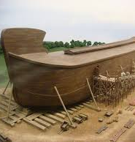
15. Why did the Lord regard Noah with special favor?
Genesis 6:9; Genesis 7:1
And the Lord said unto Noah, Come thou and all thy house into the ark; for thee have I seen righteous before me in this generation.

Slide 65
To live an exemplary life in Noah’s time required a man who could stand fearlessly and steadfastly against evil inducements, subtle temptations, and vile mockery. He was no weakling, void of judgment or will power; he was a “man,” strong of conviction, straight in thinking and action.
Noah was a just man.
SDABC V1 on Genesis 6:9

Slide 66
This does not mean that he lived in a state of sinlessness, but rather of moral integrity. It refers not only to Noah’s lifetime of piety but also to the constancy of his religion amid the miasma of iniquity in which he lived. To be sure, he was of pure descent, and in that respect also distinct from his contemporaries, many of whom were the offspring of promiscuous marriages between the godly and the ungodly.
Perfect in his generations.
SDABC V1 on Genesis 6:9

Slide 67

16. Upon what alone does the Lord look in His estimation of men?
1 Samuel 16:7
But the Lord said unto Samuel, Look not on his countenance, or on the height of his stature; because I have refused him: for the Lord seeth not as man seeth; for man looketh on the outward appearance, but the Lord looketh on the heart.

Slide 68
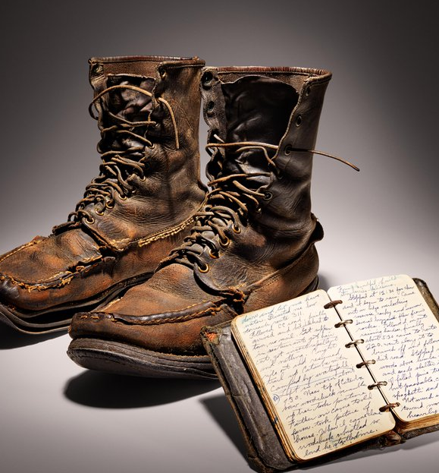
17. How was it possible for Noah to remain upright in the midst of the universal corruption?
Genesis 6:9
These are the generations of Noah: Noah was a just man and perfect in his generations, and Noah walked with God.

Slide 69

18. What is the extent of God's requirement of man?
Micah 6:8
He hath shewed thee, O man, what is good; and what doth the Lord require of thee, but to do justly, and to love mercy, and to walk humbly with thy God?

Slide 70
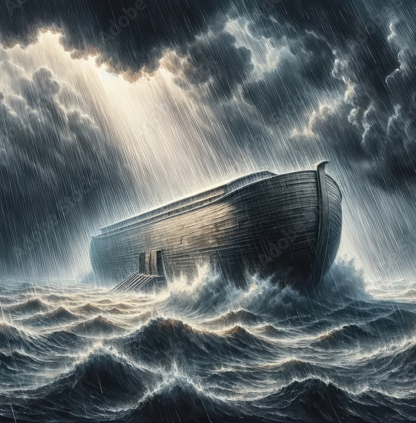
19. What effect did Noah's godly life have upon the world?
Hebrews 11:7
By faith Noah, being warned of God of things not seen as yet, moved with fear, prepared an ark to the saving of his house; by the which he condemned the world, and became heir of the righteousness which is by faith.

Slide 71


Slide 72
Thank You &
HAPPY SABBATH!!

