Slide 1
Old Testament History:
The Flood
Lesson 6, 1st Quarter, 1888

Slide 2

Living the Light

Slide 3
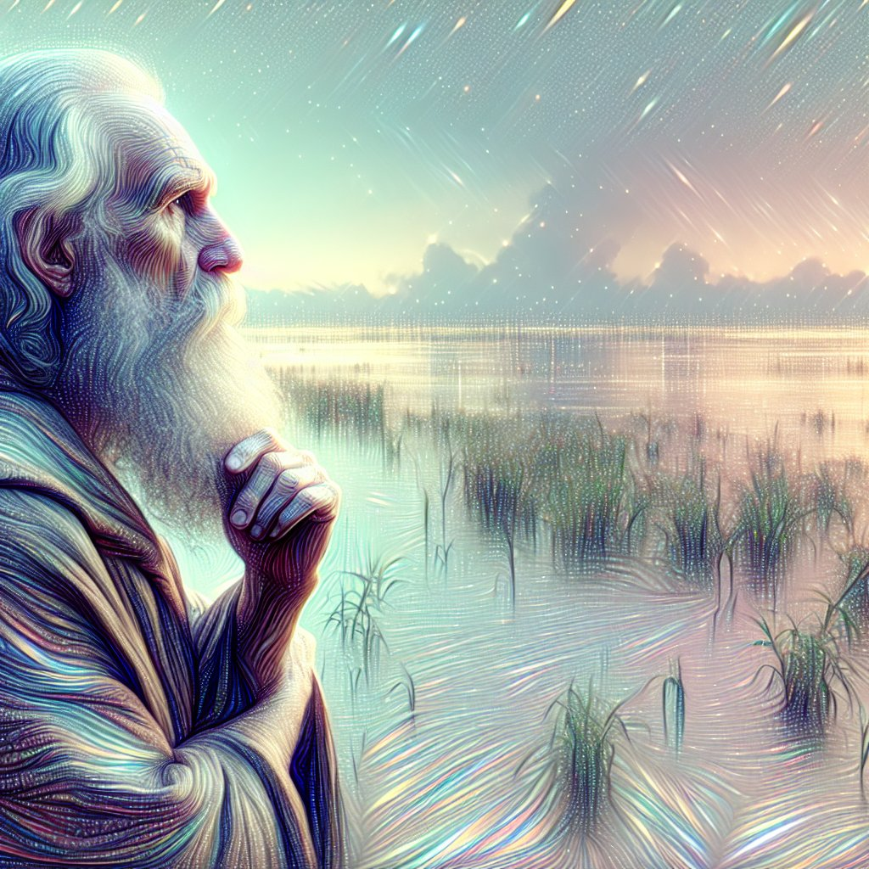
1. When the world became wholly corrupt, what did God determine to do?
Genesis 6:13
And God said unto Noah, The end of all flesh is come before me; for the earth is filled with violence through them; and, behold, I will destroy them with the earth.

Slide 4
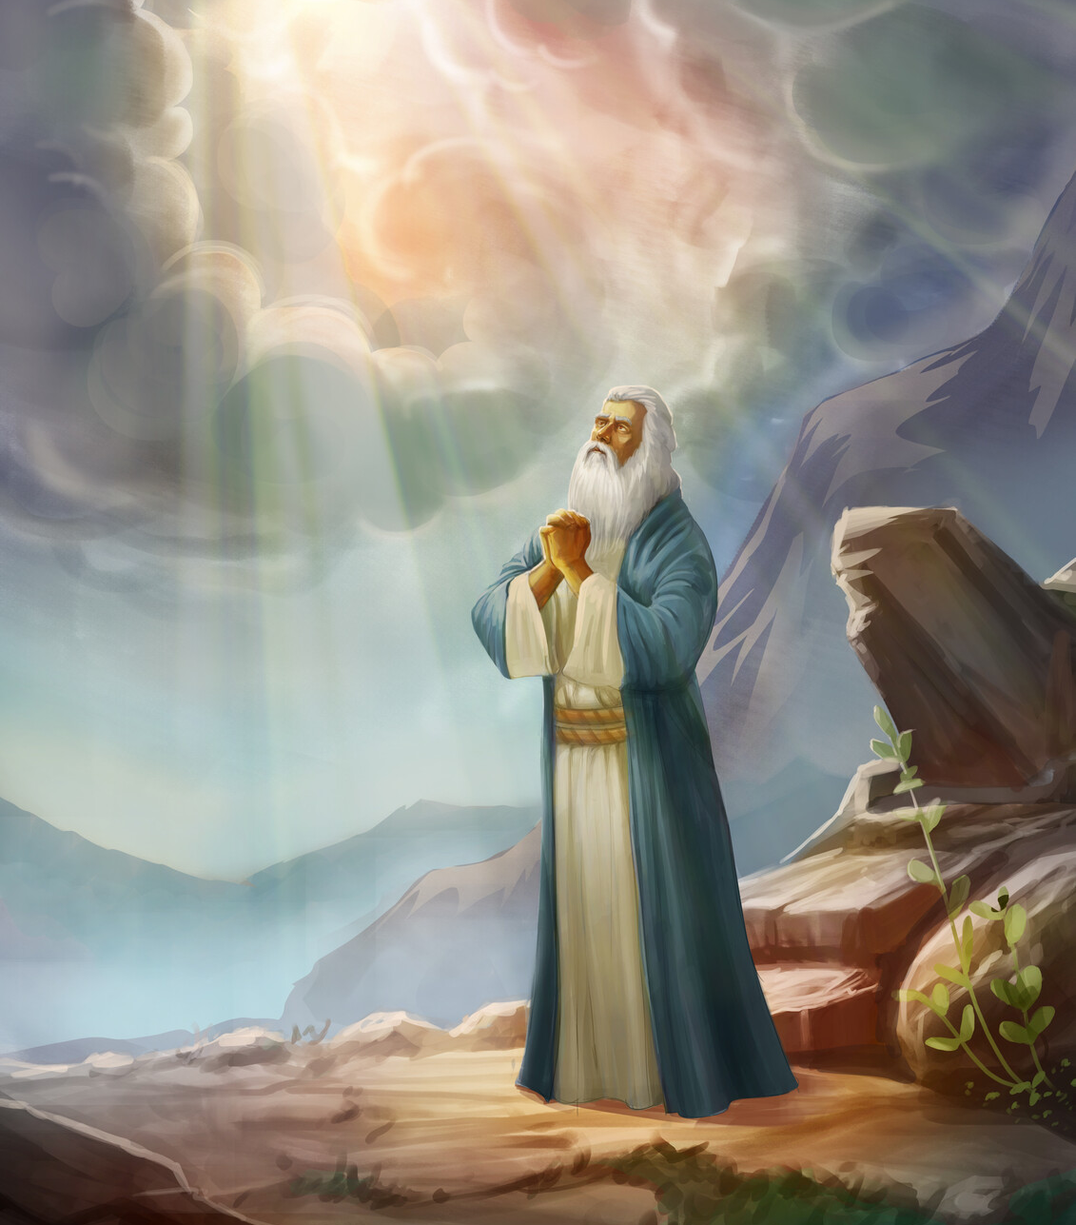
SDABC V1 on Genesis 6:13
God’s introductory words must have been shocking to Noah, but the reason for His fateful decision follows. Instead of filling the earth with a people who would attempt to live according to God’s will, man had “filled the earth with violence.”

Slide 5
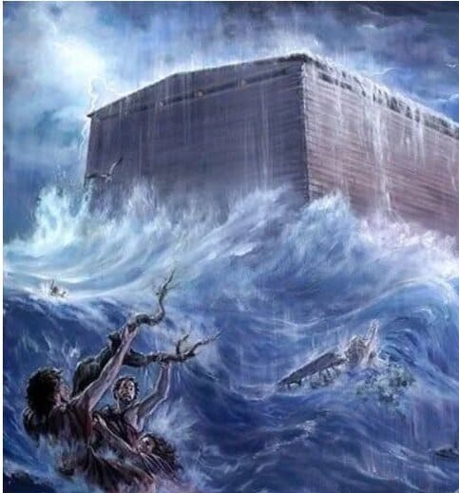
Patriarchs and Prophets p. 100
Love, no less than justice, demanded that God's judgments should put a check on sin. The avenging waters swept over the last retreat, and the despisers of God perished in the black depths.

Slide 6
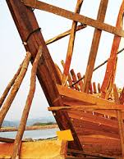
2. What provision did the Lord make for the preservation of righteous Noah?
Genesis 6:14, 17, 18
Make thee an ark of gopher wood; rooms shalt thou make in the ark, and shalt pitch it within and without with pitch.

Slide 7
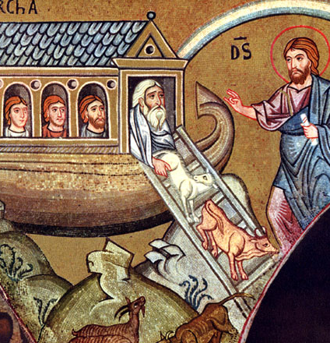
2. What provision did the Lord make for the preservation of righteous Noah?
Genesis 6:14, 17, 18
And, behold, I, even I, do bring a flood of waters upon the earth, to destroy all flesh, wherein is the breath of life, from under heaven; and every thing that is in the earth shall die.

Slide 8
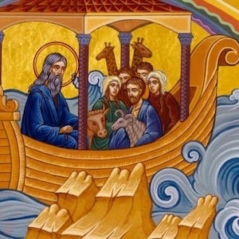
2. What provision did the Lord make for the preservation of righteous Noah?
Genesis 6:14, 17, 18
But with thee will I establish my covenant; and thou shalt come into the ark, thou, and thy sons, and thy wife, and thy sons' wives with thee.

Slide 9

3. Had there ever been anything to indicate the possibility of a flood?
Genesis 2:5
And every plant of the field before it was in the earth, and every herb of the field before it grew: for the LORD God had not caused it to rain upon the earth, and there was not a man to till the ground.

Slide 10
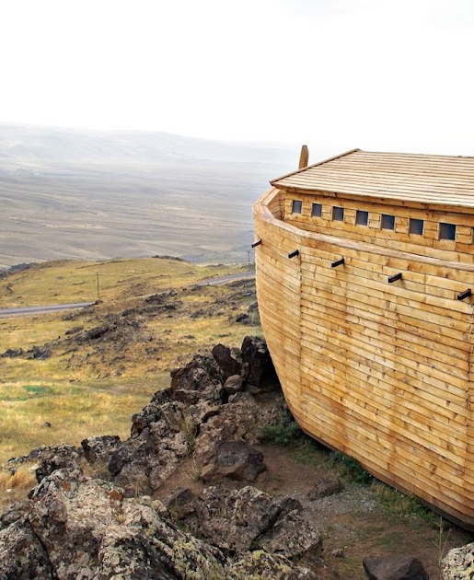
4. In obeying the command of the Lord to make an ark, what grace did Noah manifest?
Hebrews 11:7
By faith Noah, being warned of God of things not seen as yet, moved with fear, prepared an ark to the saving of his house; by the which he condemned the world, and became heir of the righteousness which is by faith.

Slide 11
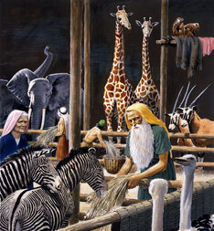
5. After the ark was completed, and Noah and his family had gone into it, what wonderful thing took place to convince the people of the truth of what Noah had preached?
Genesis 7:7-9
And Noah went in, and his sons, and his wife, and his sons' wives with him, into the ark, because of the waters of the flood.

Slide 12
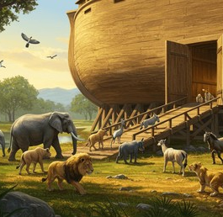
5. After the ark was completed, and Noah and his family had gone into it, what wonderful thing took place to convince the people of the truth of what Noah had preached?
Genesis 7:7-9
Of clean beasts, and of beasts that are not clean, and of fowls, and of every thing that creepeth upon the earth,

Slide 13
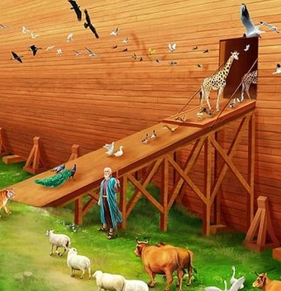
5. After the ark was completed, and Noah and his family had gone into it, what wonderful thing took place to convince the people of the truth of what Noah had preached?
Genesis 7:7-9
There went in two and two unto Noah into the ark, the male and the female, as God had commanded Noah.

Slide 14
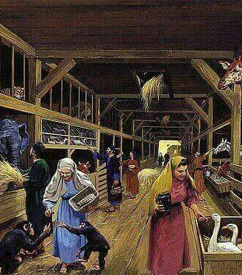
6. How long after this before the flood began?
Genesis 7:10
And it came to pass after seven days, that the waters of the flood were upon the earth.

Slide 15
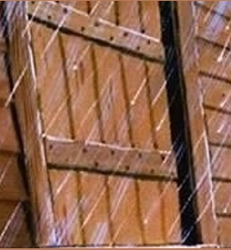
7. Was it possible then for Noah to do anything more for the people?
Genesis 7:16
And they that went in, went in male and female of all flesh, as God had commanded him: and the LORD shut him in.

Slide 16
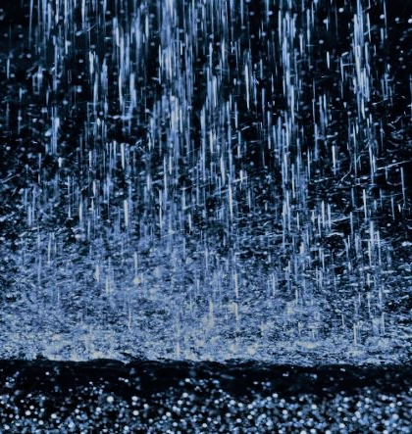
8. How long did it rain?
Genesis 7:12
And the rain was upon the earth forty days and forty nights.

Slide 17
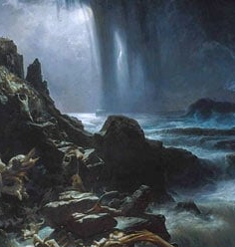
9. What besides rain from heaven helped to make the flood?
Genesis 7:11
In the six hundredth year of Noah's life, in the second month, the seventeenth day of the month, the same day were all the fountains of the great deep broken up, and the windows of heaven were opened.

Slide 18
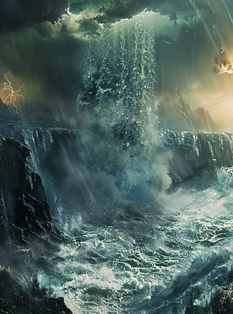
A Remaking of Earth’s Ecosystem
Genesis 7:11 records a violent, world-shaping upheaval. The “fountains of the great deep” bursting open points to massive tectonic shifts, splitting the earth’s crust, rearranging continents. The way the earth was watered was permanently altered. From that moment, the climate, the water cycle, and the very shape of the planet were transformed. This was not simply a flood—it was the remaking of the earth’s entire ecosystem.

Slide 19
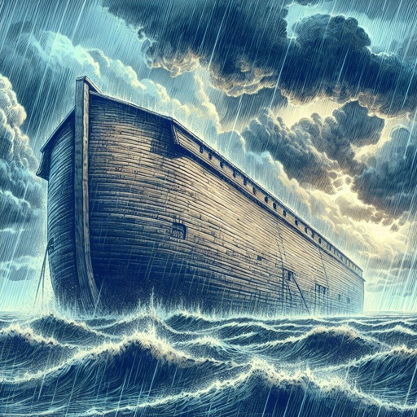
10. How extensive was the flood?
Genesis 7:17-23; 2 Peter 3:6
And the flood was forty days upon the earth; and the waters increased, and bare up the ark, and it was lift up above the earth.

Slide 20

10. How extensive was the flood?
Genesis 7:17-23; 2 Peter 3:6
And the flood was forty days upon the earth; and the waters increased, and bare up the ark, and it was lift up above the earth.

Slide 21


the primary purpose of the Noah story seems to be to contrast the monotheistic, merciful God of Israel with the multiple, vengeful gods of the competing religions in the ancient Near East.
Bryan Ness is a Professor of Biology at Pacific Union College

Slide 22
In Seventh-day Adventist theology the Noachian flood story has been drafted for two additional purposes:
Bryan Ness is a Professor of Biology at Pacific Union College

Slide 23
1) to stand as an apocalyptic warning of last day conditions on earth, where mankind becomes ever more sinful and degraded,
Bryan Ness is a Professor of Biology at Pacific Union College

Slide 24
and 2) to support a short-term age of the earth by using the flood to explain the fossil record.
Bryan Ness is a Professor of Biology at Pacific Union College

Slide 25
The latter use of this story is especially critical because standard geological evidence suggests the fossil record formed over hundreds of million years, which makes the traditional belief in a 7-day literal creation week a mere 6,000 years ago impossible to defend.
Bryan Ness is a Professor of Biology at Pacific Union College

Slide 26
Finding scientific evidence for a worldwide flood less than 6,000 years ago is also critical because Adventist theology teaches that God’s second book (i.e., nature) will always agree with scripture.
Bryan Ness is a Professor of Biology at Pacific Union College

Slide 27
Throughout our history Adventists have steadfastly defended a purely literal reading of Genesis. But as more and more geological and paleontological data have accumulated, it has become harder and harder to use science to defend a worldwide flood.
Bryan Ness is a Professor of Biology at Pacific Union College

Slide 28
Many aspects of the story are not scientifically feasible, and the geological record is especially problematic.
Bryan Ness is a Professor of Biology at Pacific Union College

Slide 29
Although evidence of extremely large and destructive floods is found in the geologic record in some geographic regions, there is no sign of a worldwide flood.
Bryan Ness is a Professor of Biology at Pacific Union College

Slide 30
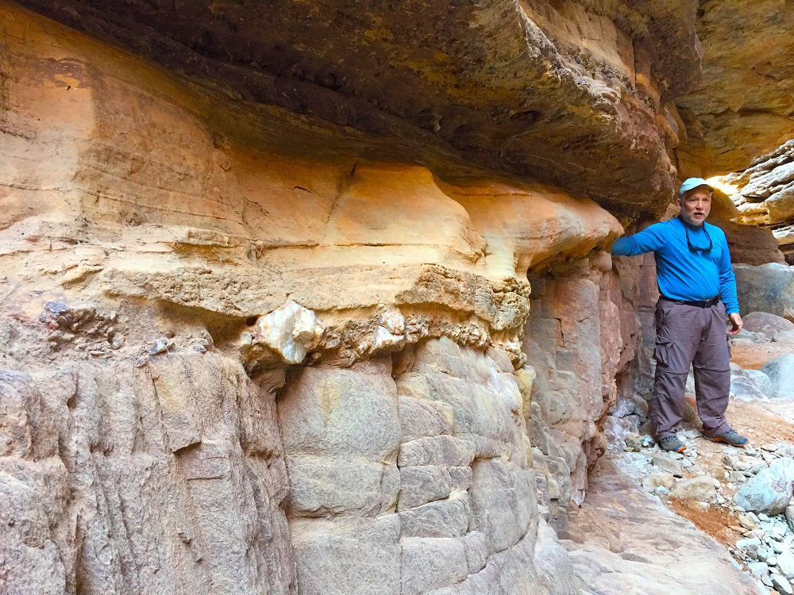
Although evidence of extremely large and destructive floods is found in the geologic record in some geographic regions, there is no sign of a worldwide flood.
The Great Unconformity shows massive, continent-wide erosion and deposition—consistent with rapid, global Flood, not slow local processes.
Bryan Ness is a Professor of Biology at Pacific Union College

Slide 31
There is archaeological evidence of civilizations that predate the flood, one of the most notable being the unbroken record of Egyptian civilization going back at least 8,000 years.
Bryan Ness is a Professor of Biology at Pacific Union College

Slide 32

There is archaeological evidence of civilizations that predate the flood, one of the most notable being the unbroken record of Egyptian civilization going back at least 8,000 years.
Gaps in the record – The THREE “Intermediate Periods” were marked by political collapse, foreign invasions, and loss of centralized record-keeping. Surviving inscriptions are sparse and fragmentary.
Overlapping kingdoms – Different dynasties ruled parts of Egypt simultaneously, making the timeline difficult to harmonize and open to revision.
Dating uncertainty – Ancient Egyptian chronology relies heavily on later king lists, astronomical assumptions, and cross-dating with other regions—all of which are debated among Egyptologists.
Revision in modern scholarship – Even secular historians acknowledge large uncertainties of several centuries in early Egyptian dates, meaning “8,000 years” is an interpretive model, not hard data.
Bryan Ness is a Professor of Biology at Pacific Union College

Slide 33
Bristlecone pine tree ring dates go back more than 12,000 years and correlate closely with dates obtained from carbon dating.
Bryan Ness is a Professor of Biology at Pacific Union College

Slide 34
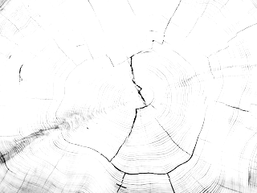
Bristlecone pine tree ring dates go back more than 12,000 years and correlate closely with dates obtained from carbon dating.
Cross-dating Assumptions: Tree-ring chronologies that supposedly go back 12,000 years aren’t from one tree. They’re stitched together from living trees, dead wood, and subfossil pieces found in the area. The matchups between samples aren’t perfect and require subjective judgment.
Missing or Extra Rings: Bristlecone pines can produce more than one ring per year under certain stress conditions, or skip a year entirely in poor growing seasons. This means “ring count” ≠ “year count.”
Bryan Ness is a Professor of Biology at Pacific Union College

Slide 35

Carbon dating, specifically radiocarbon dating, is effective for dating organic materials up to approximately 50,000 years old. After 50,000 years, the amount of carbon-14 remaining in a sample becomes too small for accurate measurement. So the 12,000-year results? Meaningless.

Slide 36
The oldest bristlecone pine still alive is 4,765 years old, which means it began growing before the date of Noah’s flood that is accepted by most fundamentalist theologians (2,348 BCE).
Bryan Ness is a Professor of Biology at Pacific Union College

Slide 37
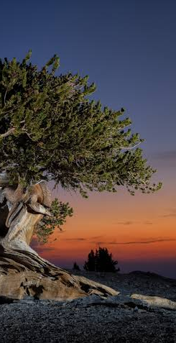
Even if it has 4,765 rings, that doesn’t mean it’s 4,765 years old! These pines can form extra rings during sudden warm/cold cycles. Right after the Flood, the Ice Age likely brought extreme seasonal shifts. Those could have caused bristlecones to grow extra rings in the first centuries, quickly inflating their apparent age.

Slide 38
There are unbroken ice core records going back 800,000 years and lake sediment records extending more than 1.4 million years.
Bryan Ness is a Professor of Biology at Pacific Union College

Slide 39
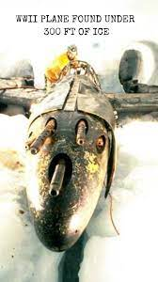
Ice and sediment layers aren’t annual clocks — WWII planes in Greenland were buried under hundreds of “annual” ice layers in just 50 years, proving multiple layers can form in a single year. The 800,000-year and 1.4-million-year claims rely on uniformitarian assumptions.

Slide 40
If there had been a worldwide flood about 4,500 years ago, these records would have shown evidence of such a large disturbance.
Bryan Ness is a Professor of Biology at Pacific Union College

Slide 41
It is past time for Adventist theologians and scientists to reckon with these things and face up to the physical evidence and realize that science cannot “prove” that a literal worldwide flood as described in Genesis happened.
Bryan Ness is a Professor of Biology at Pacific Union College

Slide 42
It is possible science could provide evidence for a more localized flood that was the basis for the Near Eastern flood narratives, including Noah’s flood, but continuing to claim that science supports a worldwide flood is dishonest.
Bryan Ness is a Professor of Biology at Pacific Union College

Slide 43
If Adventist theologians believe we must maintain a belief in a worldwide flood, then so be it, but it will have to be based on faith alone, invoking God’s miraculous interventions on multiple levels.
Bryan Ness is a Professor of Biology at Pacific Union College

Slide 44
If a literal reading of scripture is made essential to one’s salvation, and incontrovertible scientific evidence shows that the story cannot possibly be historically accurate,
Bryan Ness is a Professor of Biology at Pacific Union College

Slide 45
believers are left in the position of either renouncing the Bible entirely or ignoring what appears to be objective reality.
Bryan Ness is a Professor of Biology at Pacific Union College

Slide 46
Many rational individuals in such a quandary will just leave the church, and maybe even Christianity entirely.
Bryan Ness is a Professor of Biology at Pacific Union College

Slide 47
Many rational individuals in such a quandary will just leave the church, and maybe even Christianity entirely.
OH NO!! We’ll become UNPOPULAR!!
Bryan Ness is a Professor of Biology at Pacific Union College

Slide 48
10. How extensive was the flood?
Genesis 7:17-23; 2 Peter 3:6
And the flood was forty days upon the earth; and the waters increased, and bare up the ark, and it was lift up above the earth.

Slide 49

10. How extensive was the flood?
Genesis 7:17-23; 2 Peter 3:6
And the waters prevailed, and were increased greatly upon the earth; and the ark went upon the face of the waters.

Slide 50

10. How extensive was the flood?
Genesis 7:17-23; 2 Peter 3:6
And the waters prevailed exceedingly upon the earth; and all the high hills, that were under the whole heaven, were covered.

Slide 51
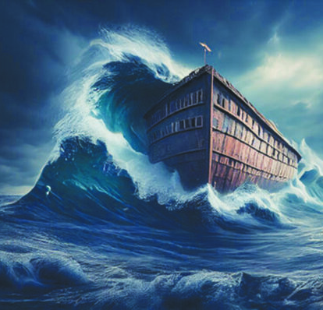
10. How extensive was the flood?
Genesis 7:17-23; 2 Peter 3:6
Fifteen cubits upward did the waters prevail; and the mountains were covered.

Slide 52
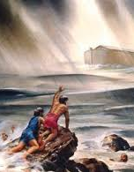
10. How extensive was the flood?
Genesis 7:17-23; 2 Peter 3:6
And all flesh died that moved upon the earth, both of fowl, and of cattle, and of beast, and of every creeping thing that creepeth upon the earth, and every man:

Slide 53
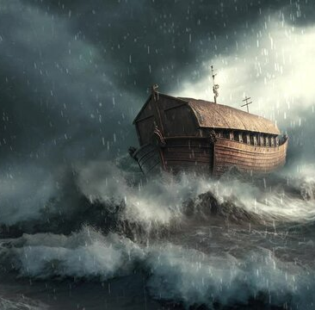
10. How extensive was the flood?
Genesis 7:17-23; 2 Peter 3:6
All in whose nostrils was the breath of life, of all that was in the dry land, died.

Slide 54

10. How extensive was the flood?
Genesis 7:17-23; 2 Peter 3:6
And every living substance was destroyed which was upon the face of the ground, both man, and cattle, and the creeping things, and the fowl of the heaven; and they were destroyed from the earth: and Noah only remained alive, and they that were with him in the ark.

Slide 55
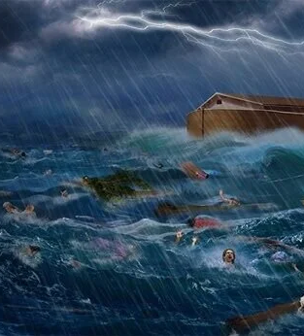
10. How extensive was the flood?
Genesis 7:17-23; 2 Peter 3:6
Whereby the world that then was, being overflowed with water, perished:

Slide 56
Why a “Literal reading” of the World-Wide Genesis Flood Story is Non-Negotiable

Slide 57

It Forms a Foundation:
Isaiah 54:8-10
⁸ In a little wrath I hid my face from thee for a moment; but with everlasting kindness will I have mercy on thee, saith the Lord thy Redeemer.

Slide 58

It Forms a Foundation:
Isaiah 54:8-10
⁹ For this is as the waters of Noah unto me: for as I have sworn that the waters of Noah should no more go over the earth; so have I sworn that I would not be wroth with thee, nor rebuke thee.

Slide 59

It Forms a Foundation:
Isaiah 54:8-10
¹⁰ For the mountains shall depart, and the hills be removed; but my kindness shall not depart from thee, neither shall the covenant of my peace be removed, saith the Lord that hath mercy on thee.

Slide 60
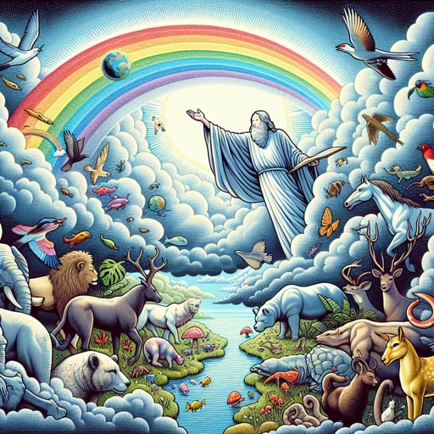
It Forms a Foundation:
Isaiah 54:8-10
Would God base the assurance of His mercy and kindness to His people on an event that never happened? God is comparing the reliability of His covenant, His mercy, and His love to the reliability of His promise in Genesis not to send another flood.

Slide 61
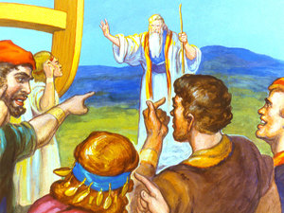
Jesus Believed It
Matthew 24:37-39
³⁷ But as the days of Noah were, so shall also the coming of the Son of man be.

Slide 62
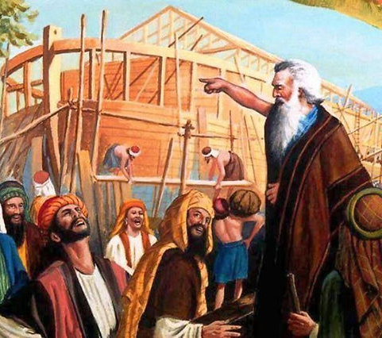
Jesus Believed It
Matthew 24:37-39
³⁸ For as in the days that were before the flood they were eating and drinking, marrying and giving in marriage, until the day that Noe entered into the ark,

Slide 63
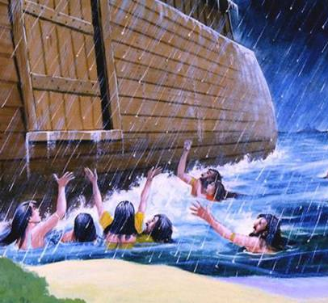
Jesus Believed It
Matthew 24:37-39
³⁹ And knew not until the flood came, and took them all away; so shall also the coming of the Son of man be.

Slide 64
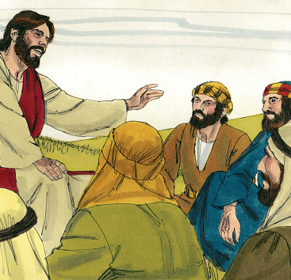
Jesus Believed It
Matthew 24:37-39
it would make no sense for Jesus to warn His followers of the ultimate, very real fate of the finally impenitent based on something that didn’t actually occur.

Slide 65

Does it HAVE to be a Global Flood?
In His promise, God declares that “all flesh” will never again be destroyed by a flood (Gen. 9:11), just as “all flesh died that moved upon the earth” because of the Flood that had just occurred (Gen. 7:21).

Slide 66
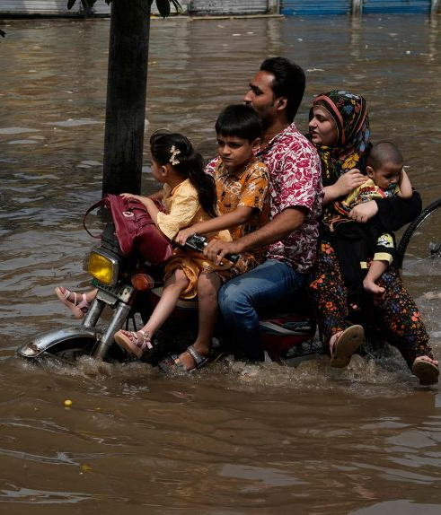
Does it HAVE to be a Global Flood?
If the Flood of Noah had only been a local event, God has obviously broken His promise many times to both humans and animals, as untold thousands, even millions of humans and other creatures have died in countless floods across the ages.

Slide 67
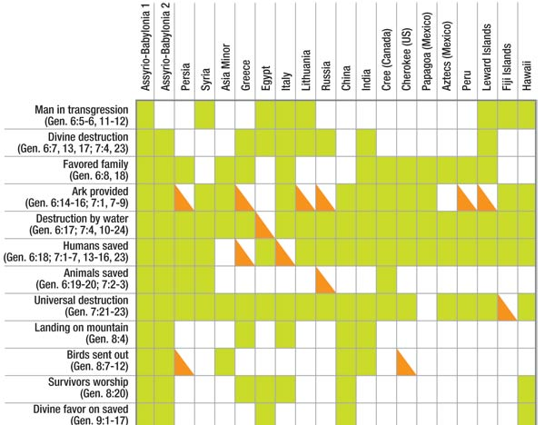

Slide 68
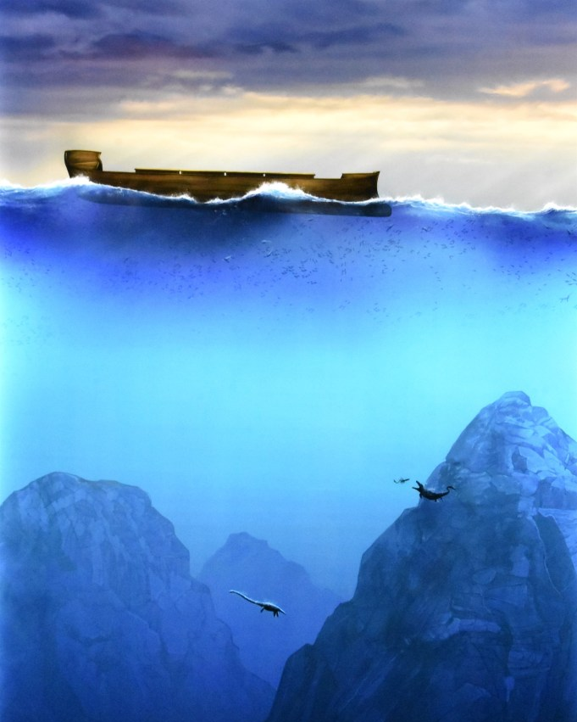
11. How long did the waters remain at their height?
Genesis 7:24
And the waters prevailed upon the earth an hundred and fifty days.

Slide 69
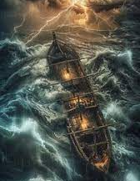
12. How long did Noah have to remain in the ark?
Genesis 7:11
In the six hundredth year of Noah's life, in the second month, the seventeenth day of the month, the same day were all the fountains of the great deep broken up, and the windows of heaven were opened.

Slide 70
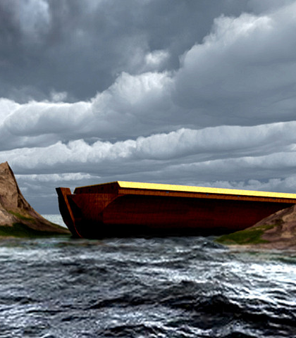
12. How long did Noah have to remain in the ark?
Genesis 8:13-16
And it came to pass in the six hundredth and first year, in the first month, the first day of the month, the waters were dried up from off the earth: and Noah removed the covering of the ark, and looked, and, behold, the face of the ground was dry.

Slide 71
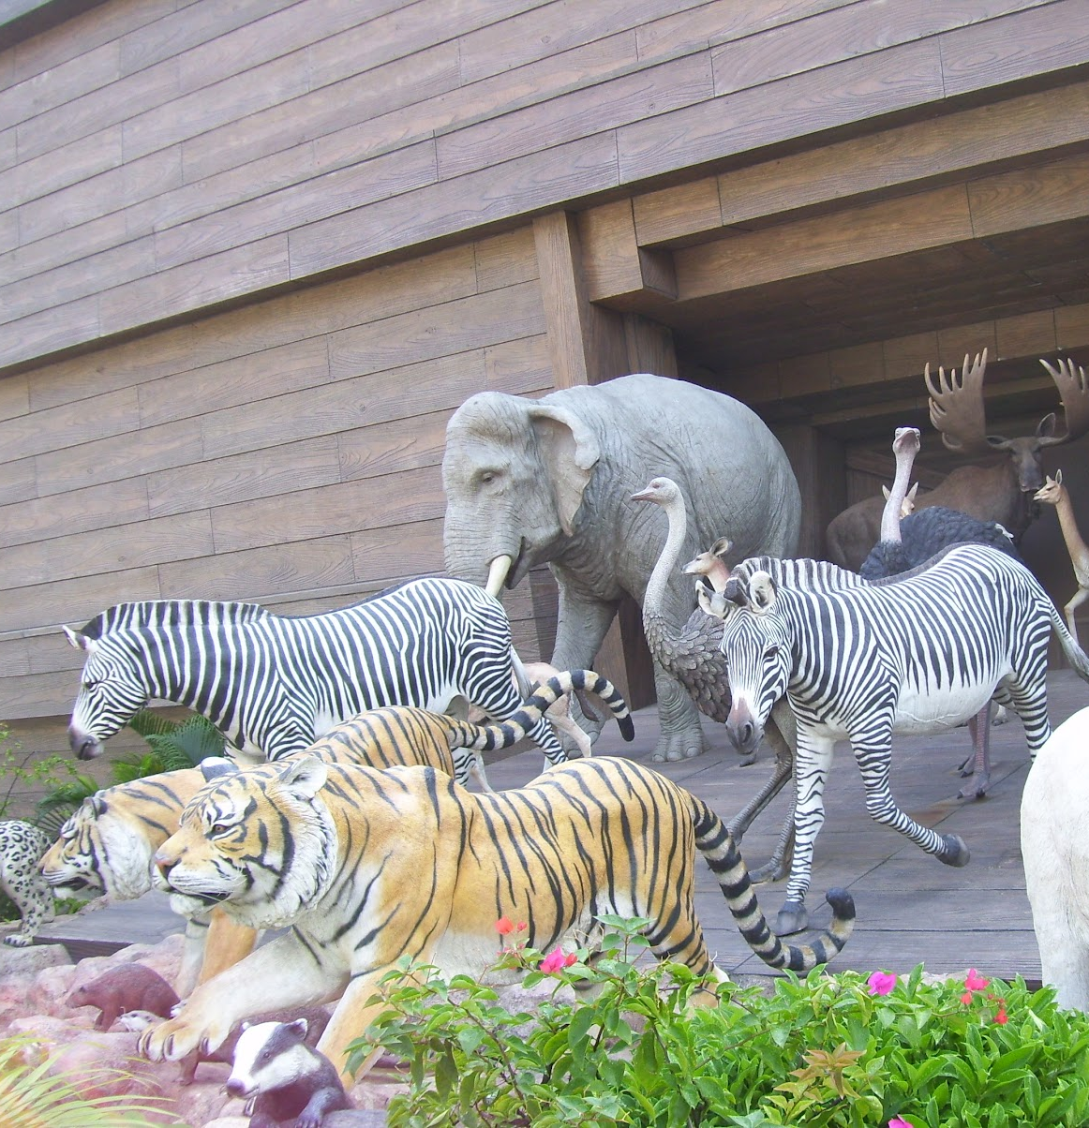
12. How long did Noah have to remain in the ark?
Genesis 8:13-16
And in the second month, on the seven and twentieth day of the month, was the earth dried.

Slide 72

12. How long did Noah have to remain in the ark?
Genesis 8:13-16
And God spake unto Noah, saying,

Slide 73
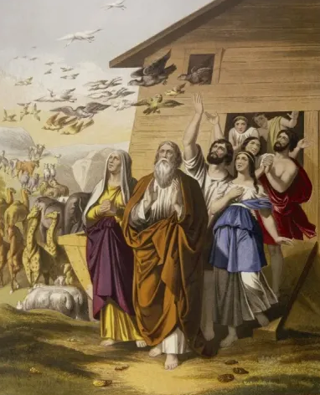
12. How long did Noah have to remain in the ark?
Genesis 8:13-16
Go forth of the ark, thou, and thy wife, and thy sons, and thy sons' wives with thee.

Slide 74
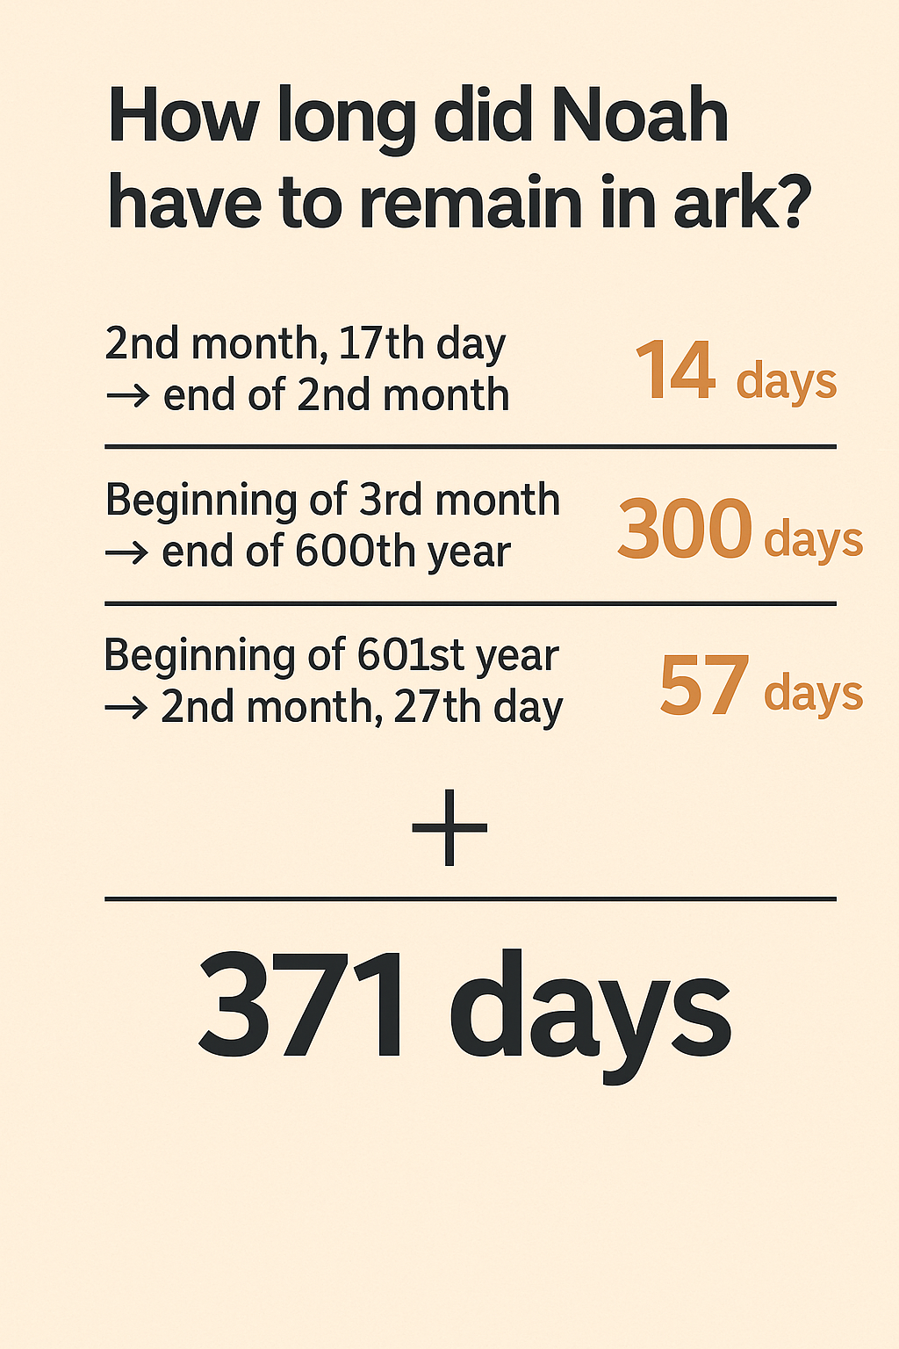

Slide 75
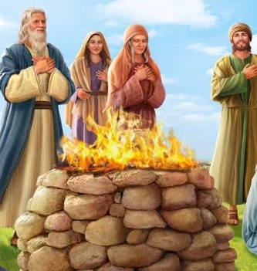
13. When Noah came out, what did he do?
Genesis 8:20
And Noah builded an altar unto the LORD; and took of every clean beast, and of every clean fowl, and offered burnt offerings on the altar.

Slide 76
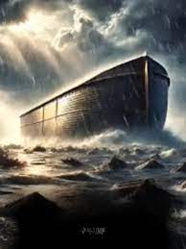
14. What did the Lord say about floods in the future?
Genesis 9:11
And I will establish my covenant with you, neither shall all flesh be cut off any more by the waters of a flood; neither shall there any more be a flood to destroy the earth.

Slide 77
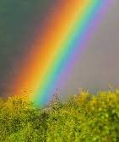
15. What pledge did He give to confirm this promise?
Genesis 9:12-15
And God said, This is the token of the covenant which I make between me and you and every living creature that is with you, for perpetual generations:

Slide 78
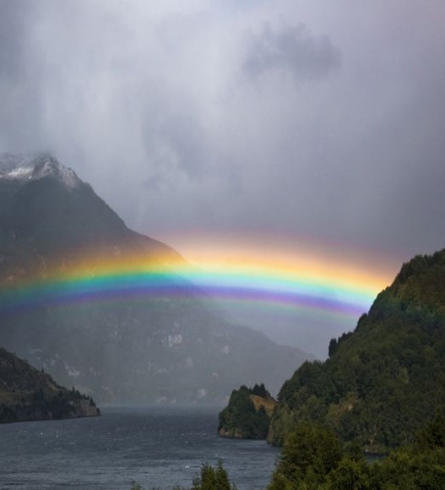
15. What pledge did He give to confirm this promise?
Genesis 9:12-15
I do set my bow in the cloud, and it shall be for a token of a covenant between me and the earth.

Slide 79
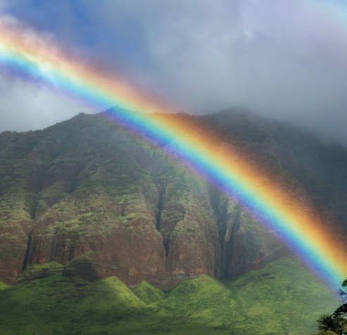
15. What pledge did He give to confirm this promise?
Genesis 9:12-15
And it shall come to pass, when I bring a cloud over the earth, that the bow shall be seen in the cloud:

Slide 80
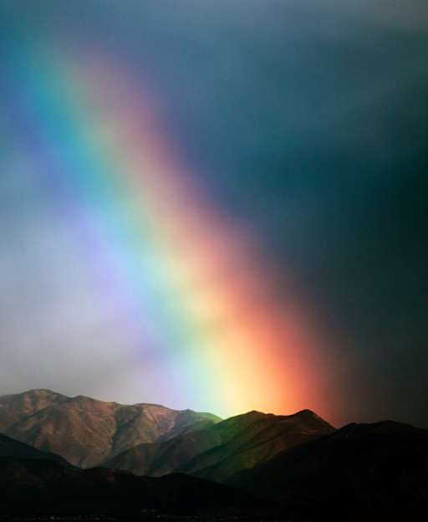
15. What pledge did He give to confirm this promise?
Genesis 9:12-15
And I will remember my covenant, which is between me and you and every living creature of all flesh; and the waters shall no more become a flood to destroy all flesh.

Slide 81
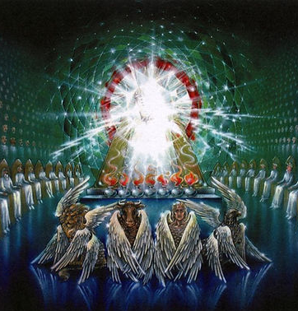
16. What peculiar force is there in the expression, "I do set my bow in the cloud"?
Revelation 4:3
And he that sat was to look upon like a jasper and a sardine stone: and there was a rainbow round about the throne, in sight like unto an emerald.

Slide 82

16. What peculiar force is there in the expression, "I do set my bow in the cloud"?
Ezekiel 1:28
As the appearance of the bow that is in the cloud in the day of rain, so was the appearance of the brightness round about. This was the appearance of the likeness of the glory of the LORD. And when I saw it, I fell upon my face, and I heard a voice of one that spake.

Slide 83
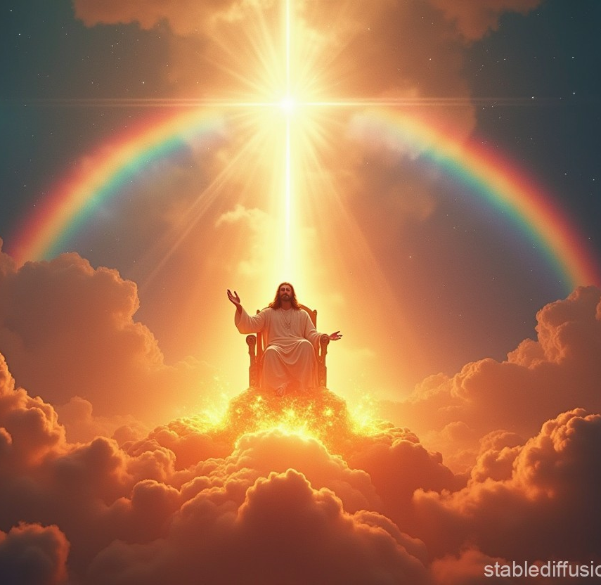
17. Then how strong was the assurance that there should never be another universal flood?
Answer: God has pledged His own glory that it shall not be.

Slide 84
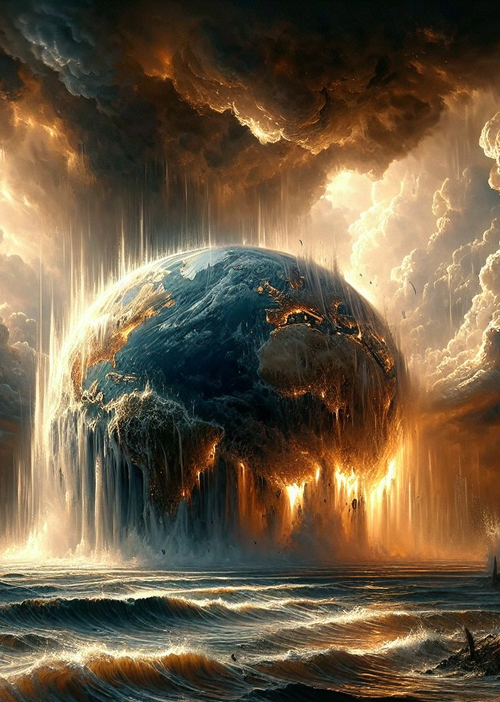
18. Will this earth never be destroyed by any means?
2 Peter 3:10
But the day of the Lord will come as a thief in the night; in the which the heavens shall pass away with a great noise, and the elements shall melt with fervent heat, the earth also and the works that are therein shall be burned up.

Slide 85

19. What word has decreed this?
2 Peter 3:5, 7
For this they willingly are ignorant of, that by the word of God the heavens were of old, and the earth standing out of the water and in the water:

Slide 86
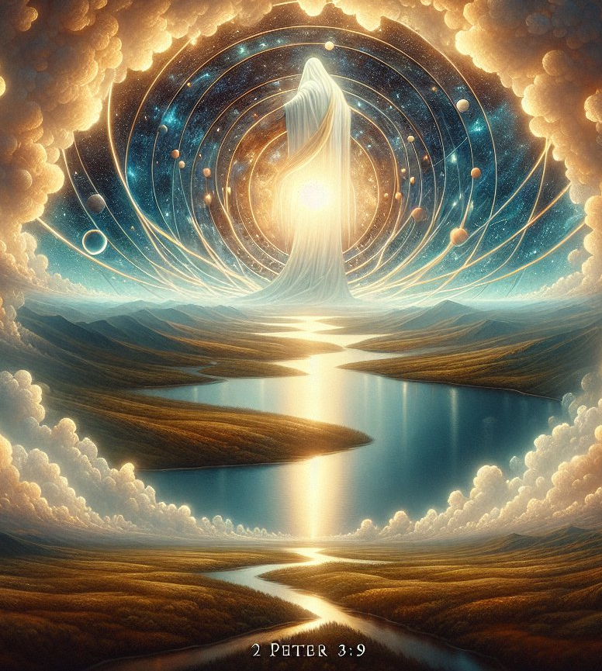
19. What word has decreed this?
2 Peter 3:5, 7
But the heavens and the earth, which are now, by the same word are kept in store, reserved unto fire against the day of judgment and perdition of ungodly men.

Slide 87
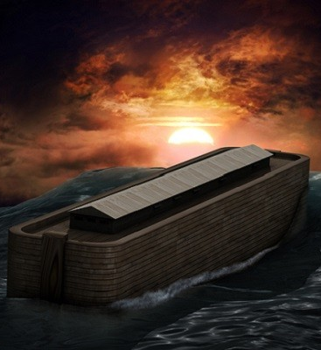
20. Why will this destruction take place?
Luke 17:26, 27
And as it was in the days of Noe, so shall it be also in the days of the Son of man.

Slide 88

20. Why will this destruction take place?
Luke 17:26, 27
They did eat, they drank, they married wives, they were given in marriage, until the day that Noe entered into the ark, and the flood came, and destroyed them all.

Slide 89

21. What description have we of the wickedness that shall be in the last days?
2 Timothy 3:1-5
This know also, that in the last days perilous times shall come.

Slide 90
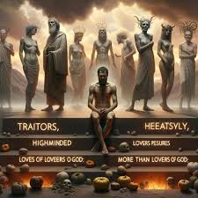
21. What description have we of the wickedness that shall be in the last days?
2 Timothy 3:1-5
For men shall be lovers of their own selves, covetous, boasters, proud, blasphemers, disobedient to parents, unthankful, unholy,

Slide 91

21. What description have we of the wickedness that shall be in the last days?
2 Timothy 3:1-5
Without natural affection, trucebreakers, false accusers, incontinent, fierce, despisers of those that are good,

Slide 92

21. What description have we of the wickedness that shall be in the last days?
2 Timothy 3:1-5
Traitors, heady, highminded, lovers of pleasures more than lovers of God;

Slide 93

21. What description have we of the wickedness that shall be in the last days?
2 Timothy 3:1-5
Having a form of godliness, but denying the power thereof: from such turn away.

Slide 94
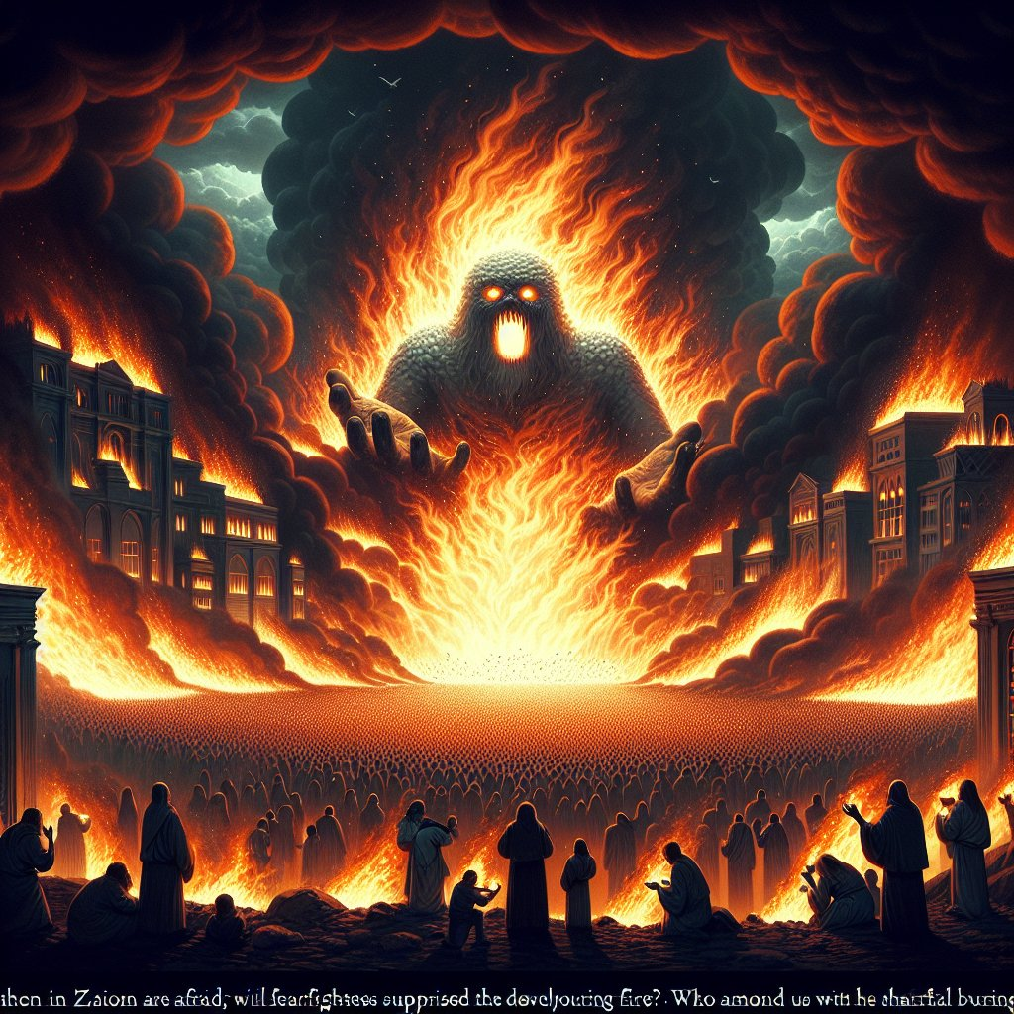
23. Who alone will be saved from the destruction that comes because of this wickedness?
Isaiah 33:14-17
The sinners in Zion are afraid; fearfulness hath surprised the hypocrites. Who among us shall dwell with the devouring fire? who among us shall dwell with everlasting burnings?

Slide 95

23. Who alone will be saved from the destruction that comes because of this wickedness?
Isaiah 33:14-17
He that walketh righteously, and speaketh uprightly; he that despiseth the gain of oppressions, that shaketh his hands from holding of bribes, that stoppeth his ears from hearing of blood, and shutteth his eyes from seeing evil;

Slide 96

23. Who alone will be saved from the destruction that comes because of this wickedness?
Isaiah 33:14-17
He shall dwell on high: his place of defence shall be the munitions of rocks: bread shall be given him; his waters shall be sure.

Slide 97

23. Who alone will be saved from the destruction that comes because of this wickedness?
Isaiah 33:14-17
Thine eyes shall see the king in his beauty: they shall behold the land that is very far off.

Slide 98


Slide 99
Thank You &
HAPPY SABBATH!!

