Slide 1


Slide 2

Living the Light

Slide 3
Old Testament History:
The Patriarchs
Lesson 7
1st Quarter, 1888

Slide 4
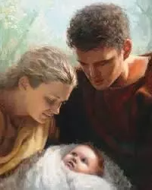
1. How long was it from the creation of Adam till the birth of Seth?
Genesis 5:3
And Adam lived an hundred and thirty years, and begat a son in his own likeness, after his image; and called his name Seth:
RUNNING TOTAL: 130 years since Creation

Slide 5
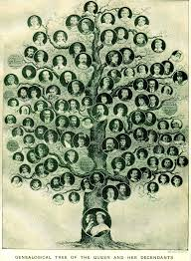
2. How long from the birth of Seth till the birth of Enos?
Genesis 5:6
And Seth lived an hundred and five years, and begat Enos:
RUNNING TOTAL: 235 years since Creation

Slide 6
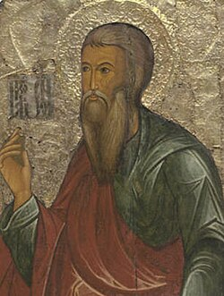
3. How long from the birth of Enos till the birth of Cainan?
Genesis 5:9
And Enos lived ninety years, and begat Cainan:
RUNNING TOTAL: 325 years since Creation

Slide 7
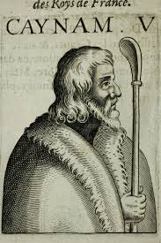
4. How long from then till the birth of Mahalaleel?
Genesis 5:12
And Cainan lived seventy years, and begat Mahalaleel:
RUNNING TOTAL: 395 years since Creation

Slide 8
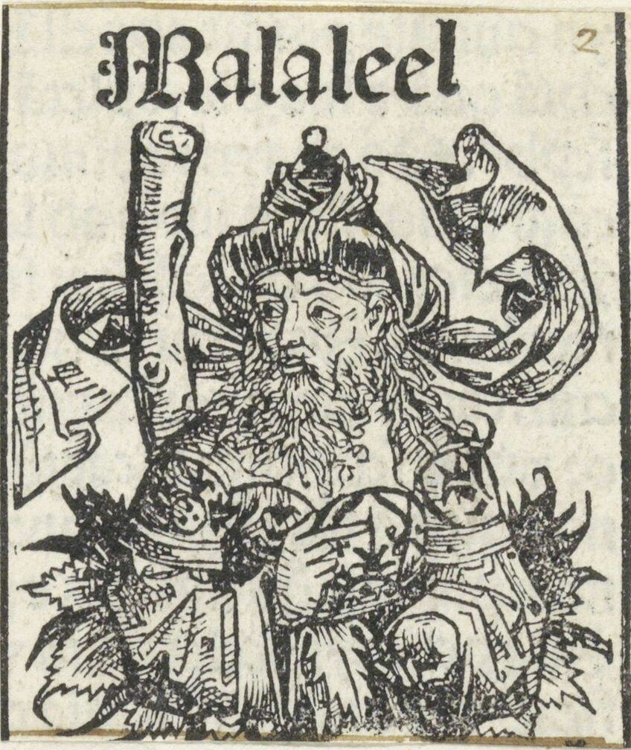
5. How long after the birth of Mahalaleel was Jared born?
Genesis 5:15
And Mahalaleel lived sixty and five years, and begat Jared:
RUNNING TOTAL: 460 years since Creation

Slide 9
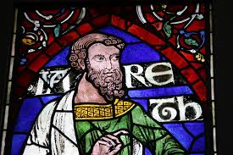
6. How old was Jared when Enoch was born?
Genesis 5:18
And Jared lived an hundred sixty and two years, and he begat Enoch:
RUNNING TOTAL: 622 years since Creation

Slide 10
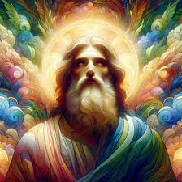
7. How long did Enoch live before the birth of Methuselah?
Genesis 5:21
And Enoch lived sixty and five years, and begat Methuselah:
RUNNING TOTAL: 687 years since Creation

Slide 11
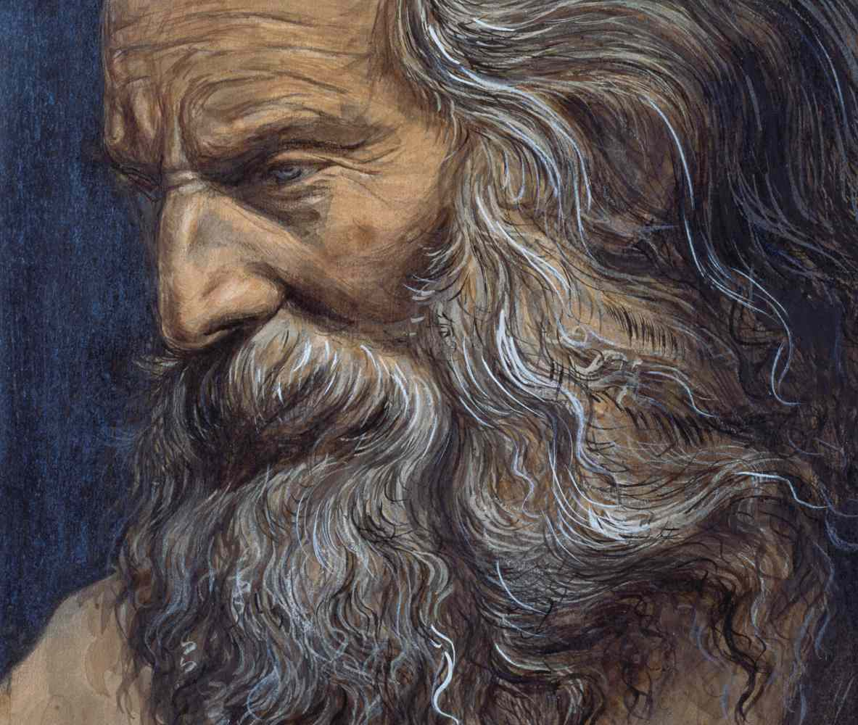
8. How long did Methuselah live before Lamech was born?
Genesis 5:25
And Methuselah lived an hundred eighty and seven years, and begat Lamech:
RUNNING TOTAL: 874 years since Creation

Slide 12
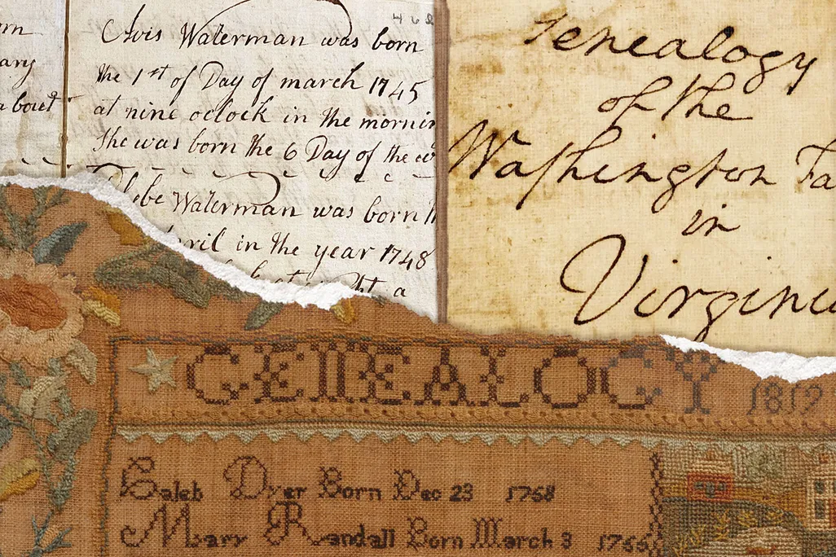

9. Then how long was it from the creation of Adam till the birth of Lamech?
130
105
90
70
65
162
65
+ 187
874 years
LAMECH is Noah’s father, EIGHT generations down
RUNNING TOTAL: 874 years since Creation

Slide 13
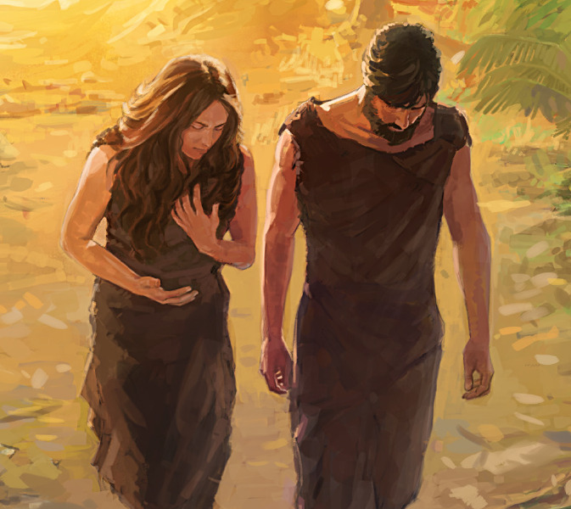
10. How long did Adam live?
Genesis 5:5
And all the days that Adam lived were nine hundred and thirty years: and he died.
RUNNING TOTAL: 930 years since Creation

Slide 14
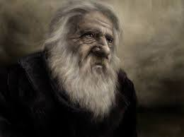
11. Then how long did he (ADAM) live after Lamech was born?
930
- 874
56 years

Slide 15
12. How long did Adam live contemporary with Methuselah?
Adam lived 930 years
So, for
930
687
243 years,
Adam was contemporary with
Methuselah
Methuselah was BORN 687 years after Creation
And HE lived 969 years
So between 687 years after Creation, and 930 years after Creation, both were living!

Slide 16

13. Was there not, then, ample opportunity for Methuselah to learn of Adam all about the institution of the Sabbath, the fall, etc.?
Certainly! Assuming both were in close proximity and communication was possible. It’s surprising how few human links were needed to pass original history from Adam down to later generations!

Slide 17
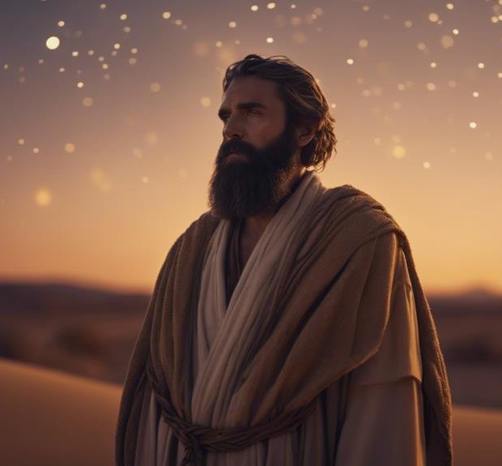
14. How long did Lamech live before Noah was born?
Genesis 5:28-29
And Lamech lived an hundred eighty and two years, and begat a son:
RUNNING TOTAL: 1,056 years since Creation

Slide 18

14. How long did Lamech live before Noah was born?
Genesis 5:28-29
And he called his name Noah, saying, This same shall comfort us concerning our work and toil of our hands, because of the ground which the Lord hath cursed.
RUNNING TOTAL: 1,056 years since Creation

Slide 19
15. How old was Methuselah when Noah was born?
Methusaleh was Noah’s Grandfather
187
+ 182
369 years,
Methuselah was 369 when Noah was born!
Methuselah was 187 when Lamech was born
(Genesis 5:25)
And Lamech was 182 when Noah was born
(Genesis 5:28)
RUNNING TOTAL: 1,056 years since Creation

Slide 20
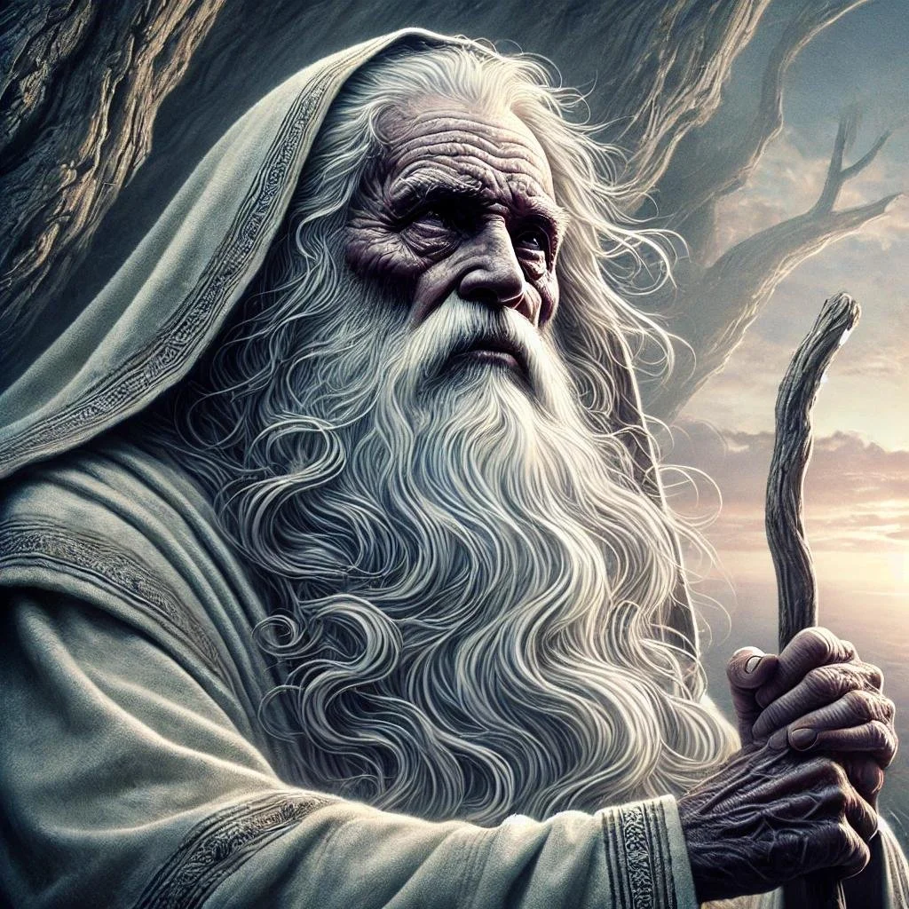
16. How old was Methuselah when he died?
Genesis 5:27
And all the days of Methuselah were nine hundred sixty and nine years: and he died.
RUNNING TOTAL: 1,656 years since Creation

Slide 21
17. Then how long did Methuselah live contemporary with Noah?
Methuselah was 369 when Noah was born
So, for
969
369
600 years,
Noah was contemporary with
Methuselah
Methuselah lived 969 years
And Noah lived 950 years
So between the age of 369, when Noah was born and the age of 969 (when Noah was 600), both were living! Methuselah died the year of the flood.

Slide 22
18. How long did he (Methuselah) live contemporary with Shem?
So for
98 years,
Methuselah was contemporary with his great-grandson Shem.
Methusaleh was Shem’s Great-Grandfather
Shem was 98 the year of the flood (Genesis 11:10)
Methuselah died the year of the flood!

Slide 23
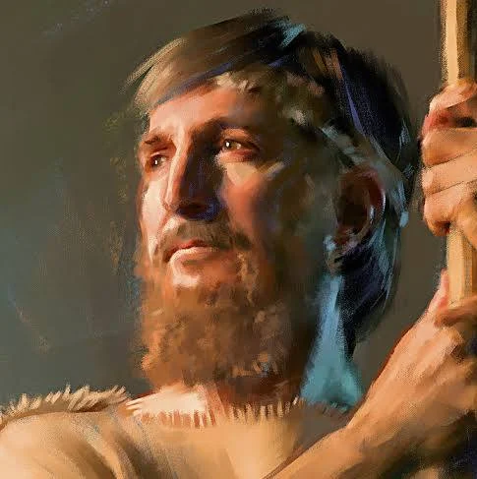
19. How long did Shem live after the flood?
Genesis 11:10-11
These are the generations of Shem: Shem was an hundred years old, and begat Arphaxad two years after the flood:
Year of the FLOOD: 1656 yrs since Creation

Slide 24
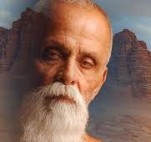
19. How long did Shem live after the flood?
Genesis 11:10-11
And Shem lived after he begat Arphaxad five hundred years, and begat sons and daughters.
RUNNING TOTAL: 2158 years since Creation

Slide 25
19. How long did Shem live after the flood?
2
+ 500
502
Yrs after the
Flood
Genesis 11:10-11
And Shem lived after he begat Arphaxad five hundred years, and begat sons and daughters.
RUNNING TOTAL: 2158 years since Creation

Slide 26
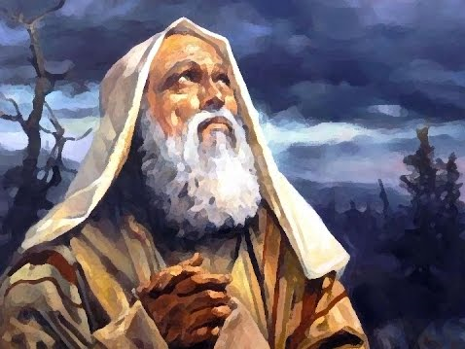
20. How long after the flood was Abraham born?
2
35
30
34
30
32
30
29
+ 70
Answer: 292 years
RUNNING TOTAL: 1948 years since Creation

Slide 27
20. How long after the flood was Abraham born?
2
35
30
34
30
32
30
29
+ 70
292 years
RUNNING TOTAL: 1948 years since Creation

Slide 28
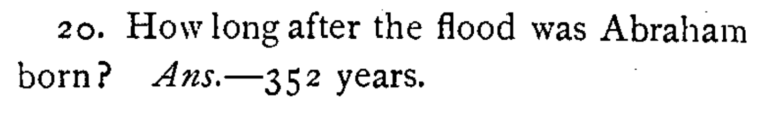
20. How long after the flood was Abraham born?
NOTE: 292 ≠ 352

Slide 29
20. How long after the flood was Abraham born?
2 | 2 years after the flood, Arphaxad is born (Gen. 11:10)
35 | Arphaxad is 35 when Salah is born (Gen. 11:12)
30 | Salah is 30 when Eber is born (Gen. 11:14)
34 | Eber is 34 when Peleg is born (Gen. 11:16)
30 | Peleg is 30 when Reu is born (Gen. 11:18)
32 | Reu is 32 when Serug is born (Gen. 11:20)
30 | Serug is 30 when Nahor is born (Gen. 11:22)
29 | Nahor is 29 when Terah is born (Gen. 11:24)
70 | Terah lived 70 yrs and begat Abram, Nahor, and Haran.
292

Slide 30
20. How long after the flood was Abraham born?
Genesis 5:32
And Noah was five hundred years old: and Noah begat Shem, Ham, and Japheth.
Genesis 11:26
And Terah lived seventy years, and begat Abram, Nahor, and Haran.

Slide 31
20. How long after the flood was Abraham born?
TRIPLETS?!!!
Genesis 5:32
And Noah was five hundred years old: and Noah begat Shem, Ham, and Japheth.
Genesis 11:26
And Terah lived seventy years, and begat Abram, Nahor, and Haran.

Slide 32
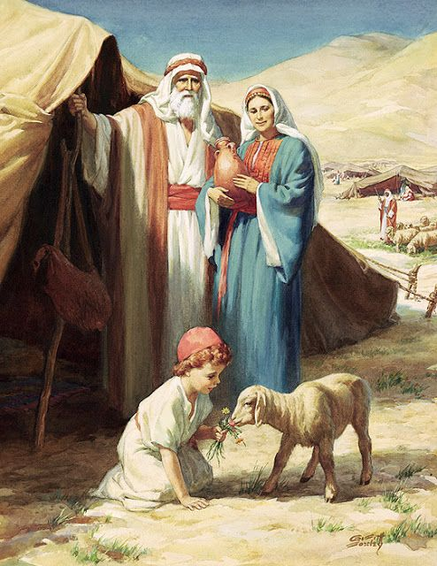
20. How long after the flood was Abraham born?
Genesis 12:4
So Abram departed, as the Lord had spoken unto him; and Lot went with him: and Abram was seventy and five years old when he departed out of Haran.

Slide 33
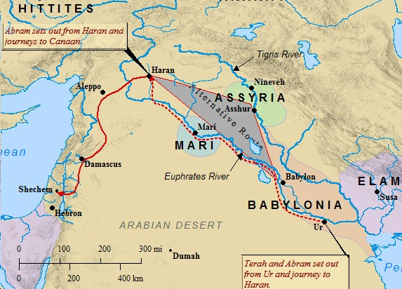

20. How long after the flood was Abraham born?
IF Abram was born when his father Terah was 70 years old, Terah would have been
$70+75=145$
when Abram was called to leave Haran.

Slide 34
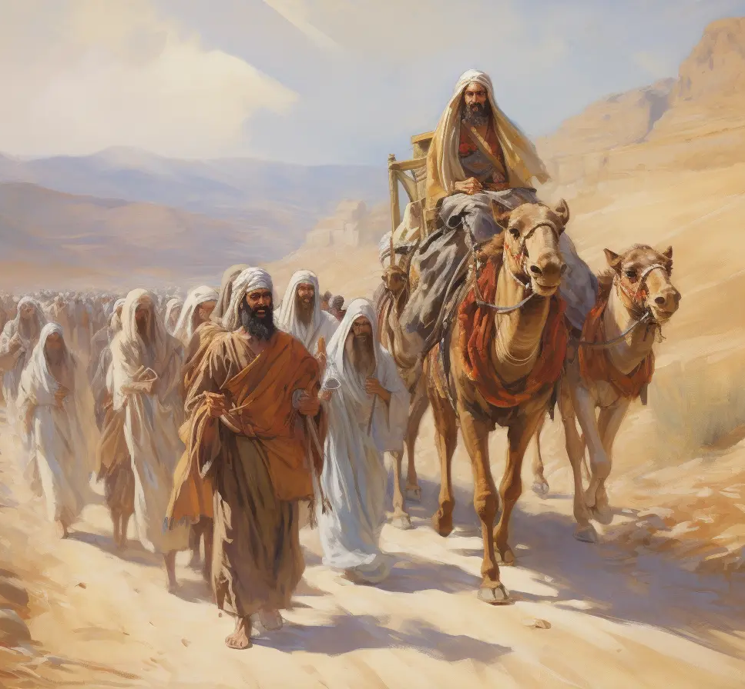
20. How long after the flood was Abraham born?
Acts 7:4
Then came he out of the land of the Chaldaeans, and dwelt in Charran: and from thence, when his father was dead, he removed him into this land, wherein ye now dwell.

Slide 35
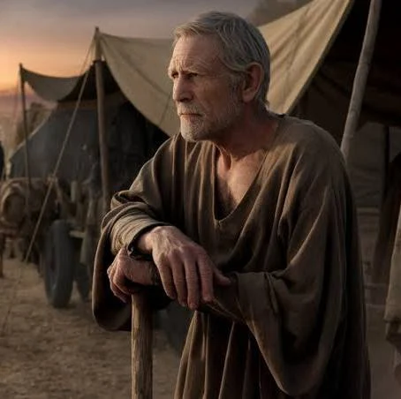
20. How long after the flood was Abraham born?
Genesis 11:32
And the days of Terah were two hundred and five years: and Terah died in Haran.

Slide 36
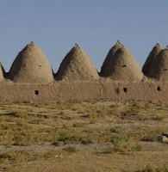

20. How long after the flood was Abraham born?
Abram was 75 when he left Haran, and his father (who died at the age of 205) had already passed away.
$205−75=130$
Terah was at least 130 when Abram was born!

Slide 37
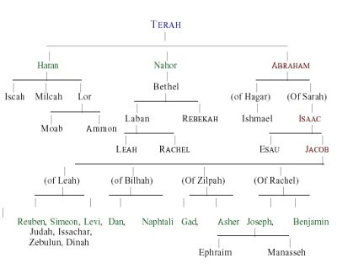
20. How long after the flood was Abraham born?
Okay, so Terah had 3 sons – Abram, Nahor, and Haran. The eldest (not Abram) was born when Terah was 70 years old.

Slide 38
20. How long after the flood was Abraham born?
Genesis 11:28-29
And Haran died before his father Terah in the land of his nativity, in Ur of the Chaldees.

Slide 39
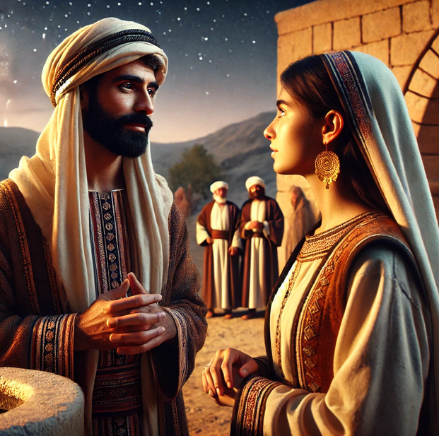
20. How long after the flood was Abraham born?
Genesis 11:28-29
And Abram and Nahor took them wives: the name of Abram's wife was Sarai; and the name of Nahor's wife, Milcah, the daughter of Haran, the father of Milcah, and the father of Iscah.

Slide 40
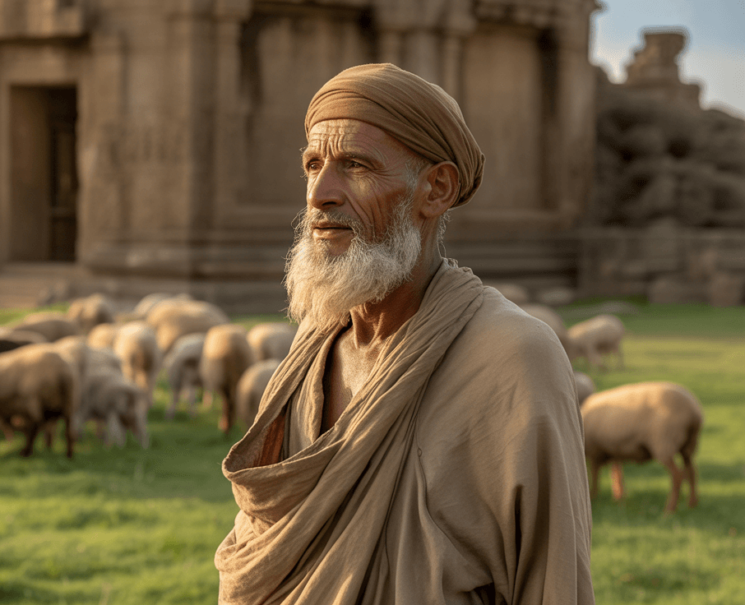
20. How long after the flood was Abraham born?
We don’t know whether Nahor or Haran was the eldest. But it’s interesting that Nahor married Haran’s daughter, suggesting perhaps Haran was older.

Slide 41
20. How long after the flood was Abraham born?
2 | 2 years after the flood, Arphaxad is born (Gen. 11:10)
35 | Arphaxad is 35 when Salah is born (Gen. 11:12)
30 | Salah is 30 when Eber is born (Gen. 11:14)
34 | Eber is 34 when Peleg is born (Gen. 11:16)
30 | Peleg is 30 when Reu is born (Gen. 11:18)
32 | Reu is 32 when Serug is born (Gen. 11:20)
30 | Serug is 30 when Nahor is born (Gen. 11:22)
29 | Nahor is 29 when Terah is born (Gen. 11:24)
130 | Terah was at least 130 when Abram was born!
352 | ← ANSWER!

Slide 42
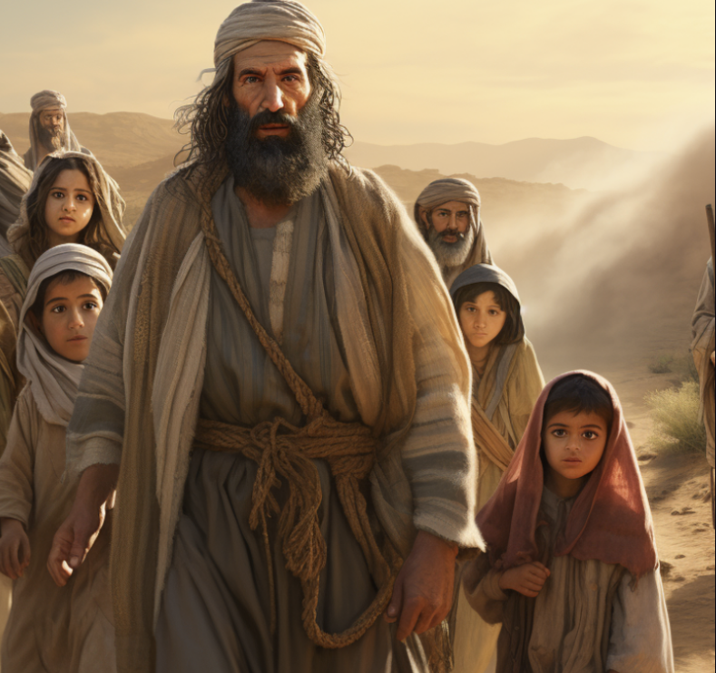
21. Then what opportunity had Abraham to learn all the events of the antediluvian world?
Answer: He lived 150 years contemporary with Shem, who had lived 98 years with one who had lived 243 years with Adam

Slide 43

22. Before the flood, had there been more than one language?
Genesis 11:1
And the whole earth was of one language, and of one speech.

Slide 44
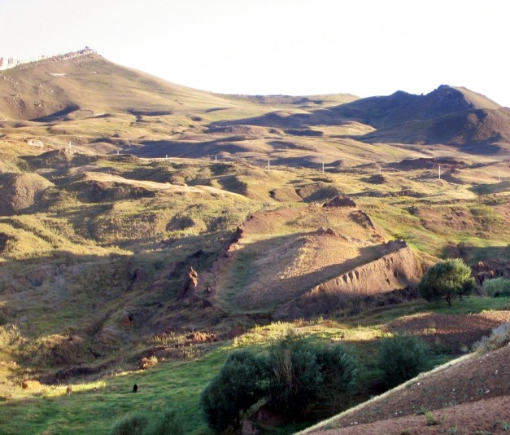
23. Soon after the flood what did the people begin to do?
Genesis 11:2-4
And it came to pass, as they journeyed from the east, that they found a plain in the land of Shinar; and they dwelt there.

Slide 45
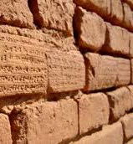
23. Soon after the flood what did the people begin to do?
Genesis 11:2-4
And they said one to another, Go to, let us make brick, and burn them throughly. And they had brick for stone, and slime had they for morter.

Slide 46
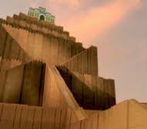
23. Soon after the flood what did the people begin to do?
Genesis 11:2-4
And they said, Go to, let us build us a city and a tower, whose top may reach unto heaven; and let us make us a name, lest we be scattered abroad upon the face of the whole earth.

Slide 47
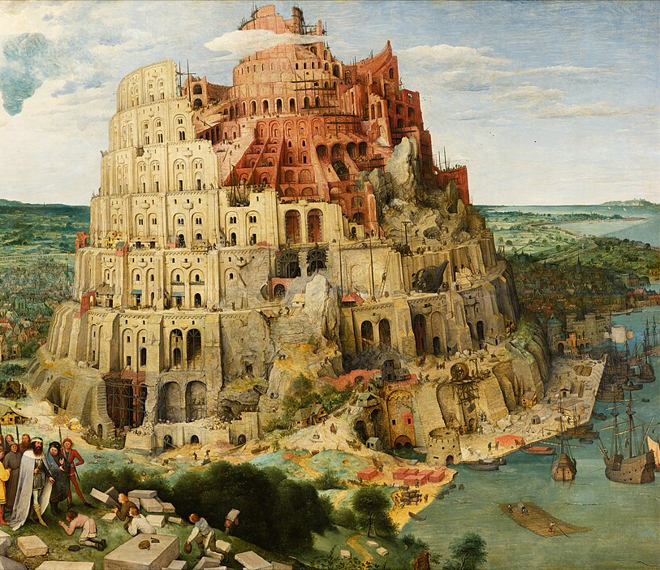
24. What was their object in doing this?
Genesis 11:4
And they said, Go to, let us build us a city and a tower, whose top may reach unto heaven; and let us make us a name, lest we be scattered abroad upon the face of the whole earth.

Slide 48
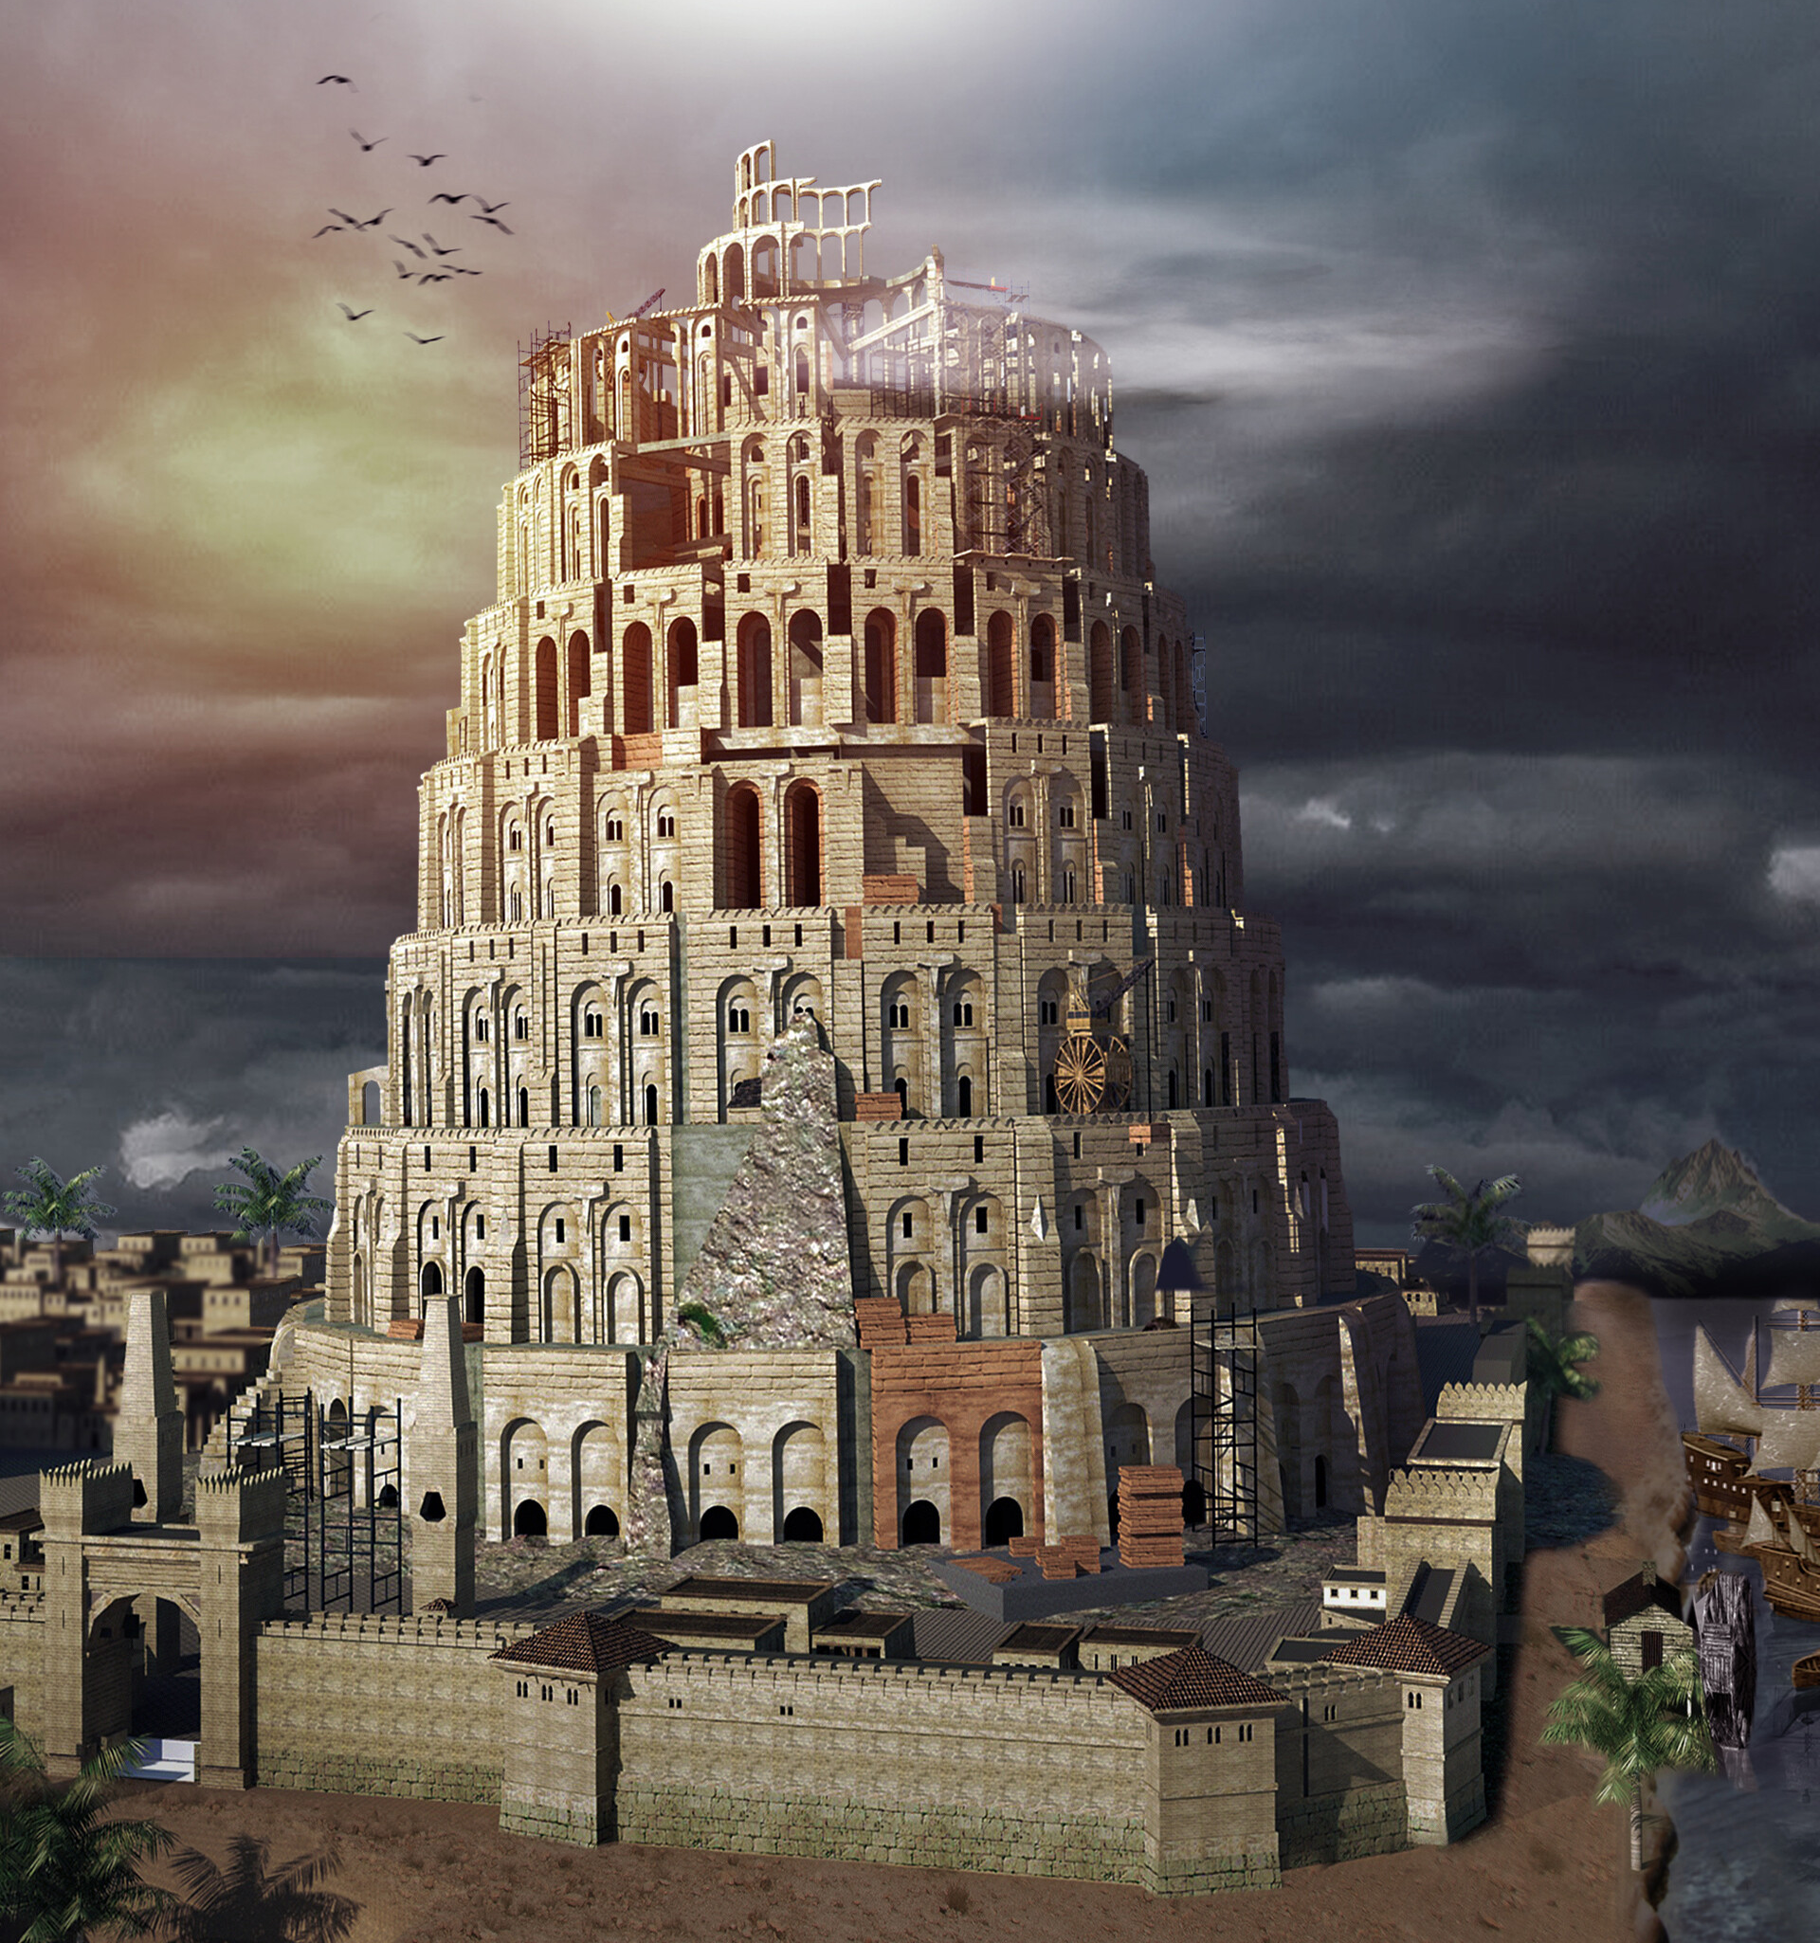
25. What evil motives prompted them to do this?
Answer: Pride and presumption. They thought that by their own efforts they could frustrate any possible attempt on the part of God to punish them for their wickedness

Slide 49
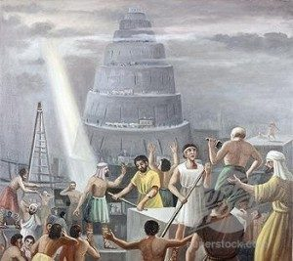
26. What did the Lord do?
Genesis 11:7-8
Go to, let us go down, and there confound their language, that they may not understand one another's speech.

Slide 50
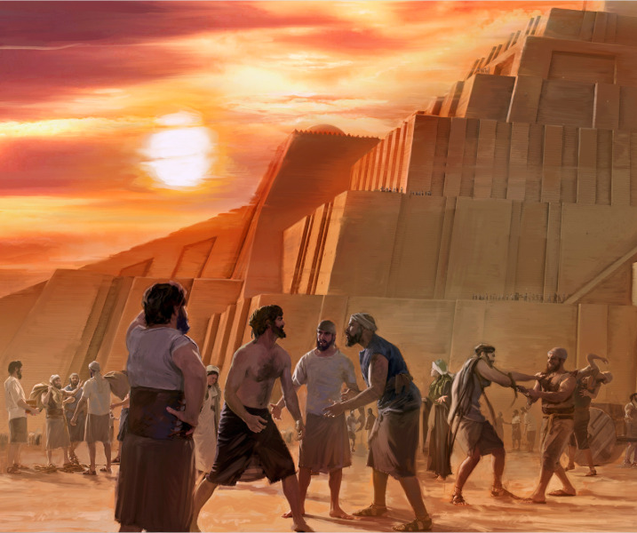
26. What did the Lord do?
Genesis 11:7-8
So the Lord scattered them abroad from thence upon the face of all the earth: and they left off to build the city.

Slide 51
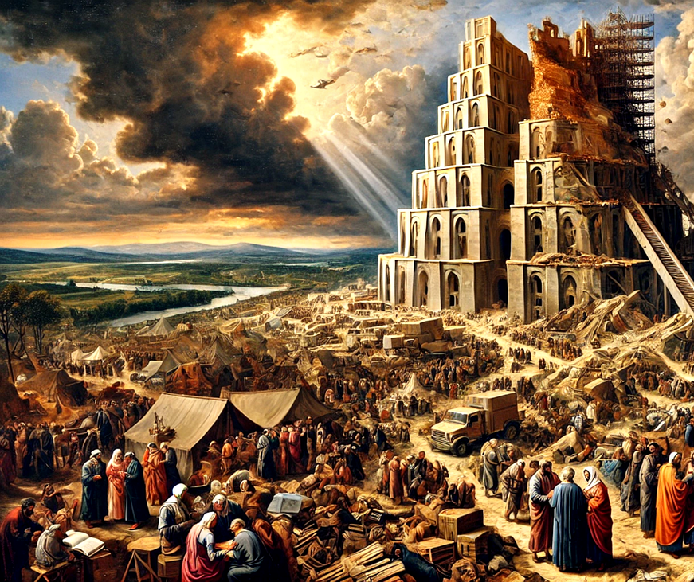
27. What was the tower called, and why?
Genesis 11:9
Therefore is the name of it called Babel; because the Lord did there confound the language of all the earth: and from thence did the Lord scatter them abroad upon the face of all the earth.

Slide 52

28. Is it possible for men by combining together to avert the judgments of God?
Proverbs 11:21
Though hand join in hand, the wicked shall not be unpunished: but the seed of the righteous shall be delivered.

Slide 53


Slide 54
Thank You &
HAPPY SABBATH!!

