Slide 1


Slide 2

Living the Light

Slide 3
Old Testament History:
The Patriarchs
Lesson 8,1st Quarter, 1888

Slide 4
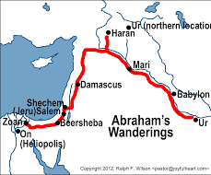
1. Where did Abraham live when the Lord first appeared to him?
Acts 7:2
And he said, Men, brethren, and fathers, hearken; The God of glory appeared unto our father Abraham, when he was in Mesopotamia, before he dwelt in Charran,

Slide 5
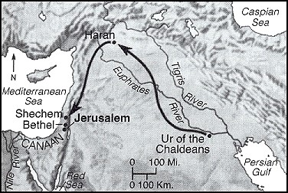

Slide 6
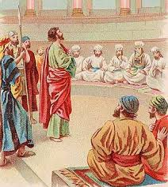
2. What did the Lord say to him?
Acts 7:3
And said unto him, Get thee out of thy country, and from thy kindred, and come into the land which I shall shew thee.

Slide 7
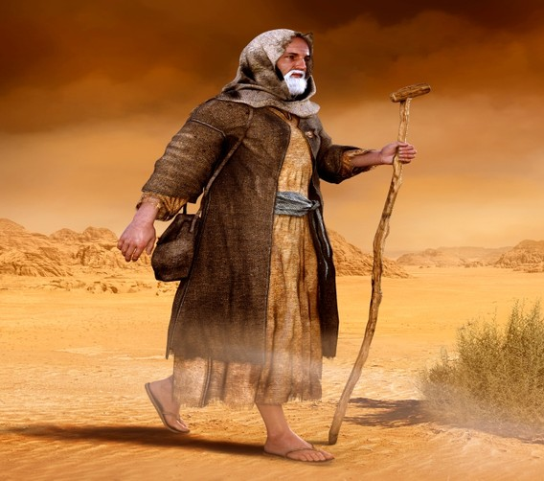
3. What promise did the Lord then make to him?
Genesis 12:1-3
Now the Lord had said unto Abram, Get thee out of thy country, and from thy kindred, and from thy father's house, unto a land that I will shew thee:

Slide 8
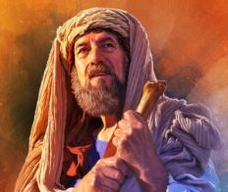
3. What promise did the Lord then make to him?
Genesis 12:1-3
And I will make of thee a great nation, and I will bless thee, and make thy name great; and thou shalt be a blessing:

Slide 9
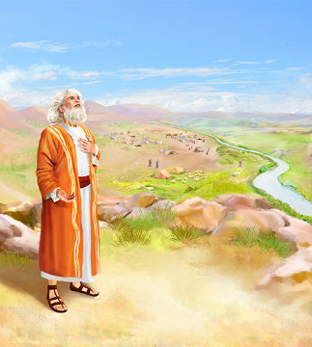
3. What promise did the Lord then make to him?
Genesis 12:1-3
And I will bless them that bless thee, and curse him that curseth thee: and in thee shall all families of the earth be blessed.

Slide 10
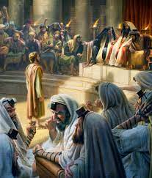
4. What did Abraham then do?
Acts 7:4
Then came he out of the land of the Chaldaeans, and dwelt in Charran: and from thence, when his father was dead, he removed him into this land, wherein ye now dwell.

Slide 11
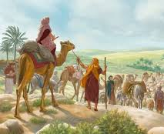
5. How old was he when he went to the land of Canaan?
Genesis 12:4-5
So Abram departed, as the Lord had spoken unto him; and Lot went with him: and Abram was seventy and five years old when he departed out of Haran.

Slide 12
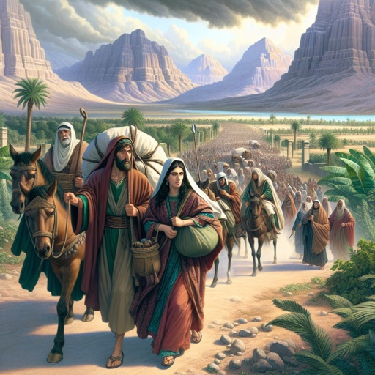
5. How old was he when he went to the land of Canaan?
Genesis 12:4-5
And Abram took Sarai his wife, and Lot his brother's son, and all their substance that they had gathered, and the souls that they had gotten in Haran; and they went forth to go into the land of Canaan; and into the land of Canaan they came.

Slide 13
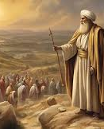
Patriarchs and Prophets, pg. 127
“Yet it was a large company that set out from Mesopotamia. Abraham already possessed extensive flocks and herds, the riches of the East, and he was surrounded by a numerous body of servants and retainers. He was departing from the land of his fathers, never to return, and he took with him all that he had, “their substance that they had gathered, and the souls that they had gotten in Haran.”

Slide 14
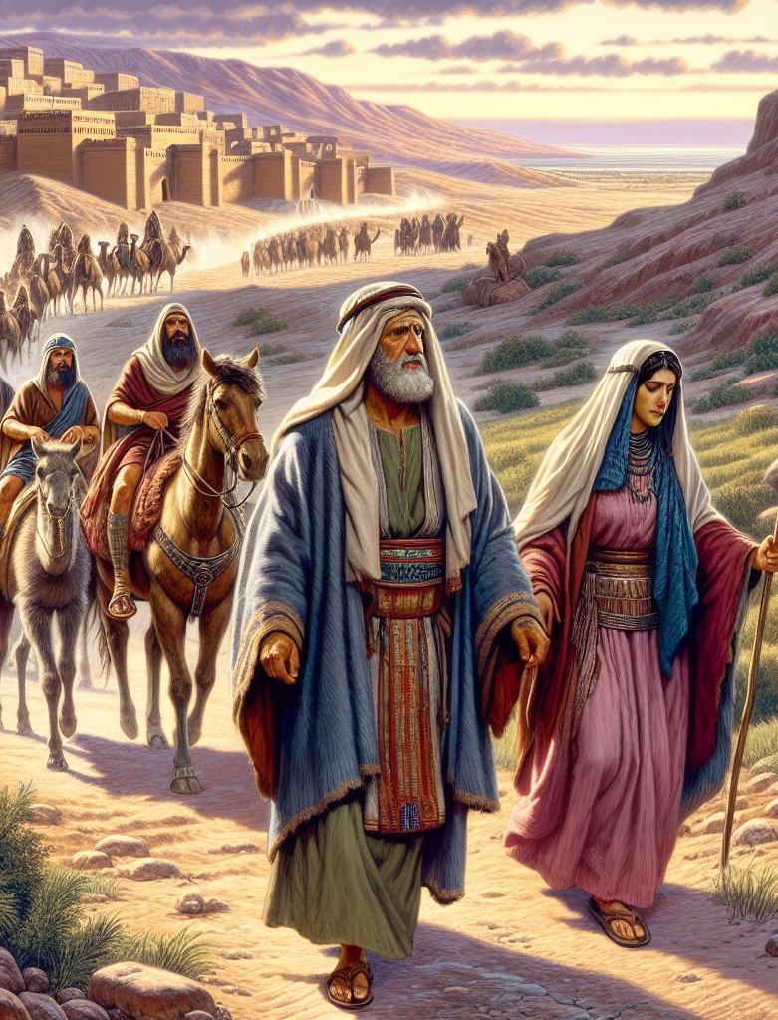
Patriarchs and Prophets, pg. 127
“Among these were many led by higher considerations than those of service and self-interest. During their stay in Haran, both Abraham and Sarah had led others to the worship and service of the true God. These attached themselves to the patriarch’s household, and accompanied him to the land of promise.”

Slide 15
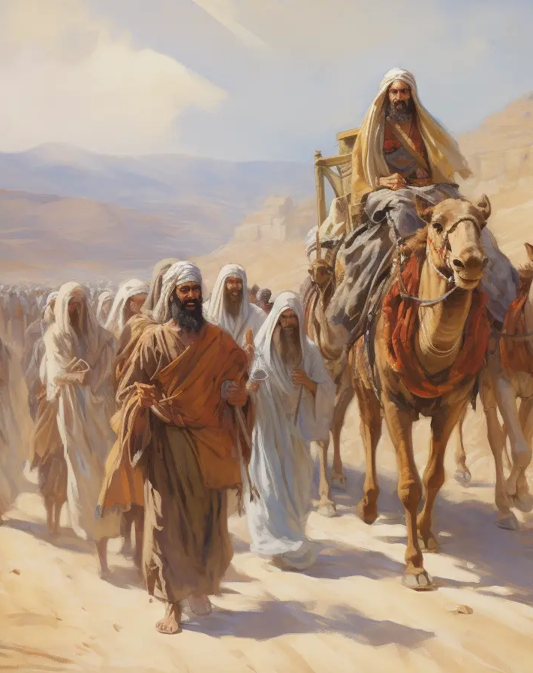
SDABC V1 on Gen. 12:5
Both Abram and Lot are mentioned as possessing herdsmen (Gen. 13 :7). That Abram could later rescue Lot with the help of 318 armed and trained retainers (Gen. 14:14) clarifies still further the fact that these “souls” were the members of his household, the “retainers” of Genesis 14:14.

Slide 16
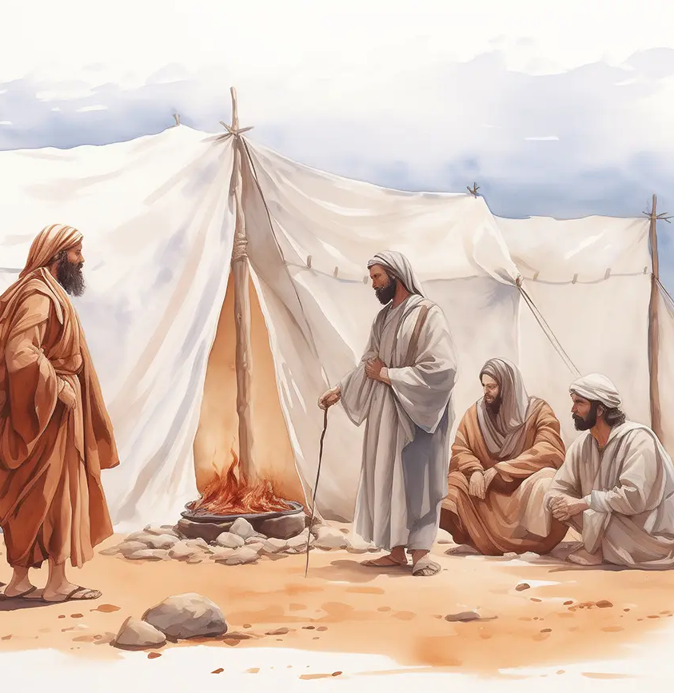
6. Did he know before he started where he was going?
Genesis 12:1; Acts 7:3
Now the Lord had said unto Abram, Get thee out of thy country, and from thy kindred, and from thy father's house, unto a land that I will shew thee:

Slide 17
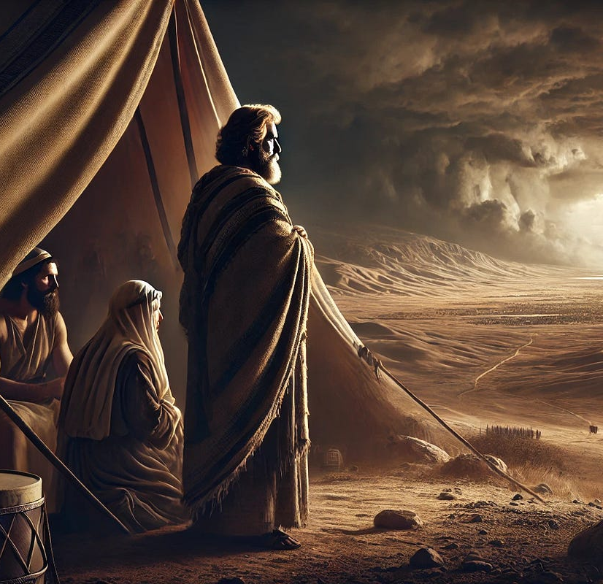
6. Did he know before he started where he was going?
Genesis 12:1; Acts 7:3
And said unto him, Get thee out of thy country, and from thy kindred, and come into the land which I shall shew thee.

Slide 18
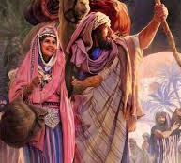
7. In thus going at God's word, what did he manifest?
Hebrews 11:8
By faith Abraham, when he was called to go out into a place which he should after receive for an inheritance, obeyed; and he went out, not knowing whither he went.

Slide 19
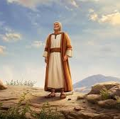
8. What promise did the Lord afterward make him?
Genesis 13:14-15
And the Lord said unto Abram, after that Lot was separated from him, Lift up now thine eyes, and look from the place where thou art northward, and southward, and eastward, and westward:

Slide 20
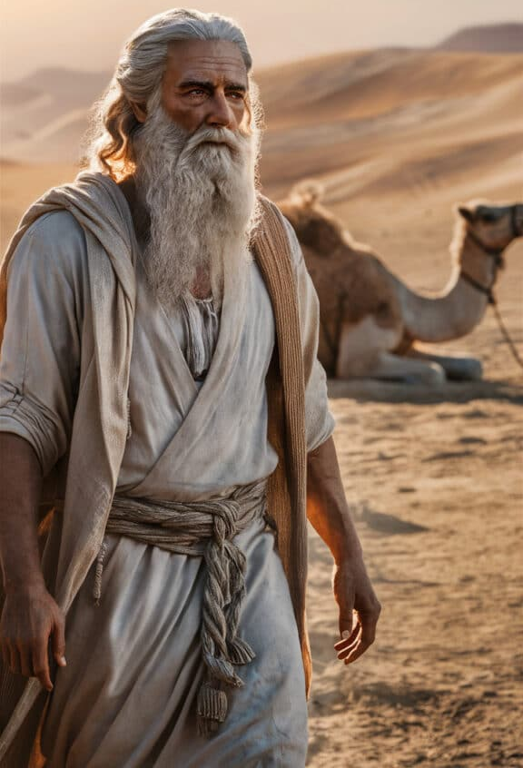
8. What promise did the Lord afterward make him?
Genesis 13:14-15
For all the land which thou seest, to thee will I give it, and to thy seed for ever.

Slide 21
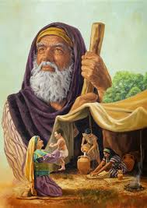
9. To whom besides himself was the promise made?
Genesis 13:15
For all the land which thou seest, to thee will I give it, and to thy seed for ever.

Slide 22
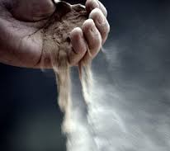
10. How numerous did the Lord say that his seed should be?
Genesis 13:16
And I will make thy seed as the dust of the earth: so that if a man can number the dust of the earth, then shall thy seed also be numbered.

Slide 23
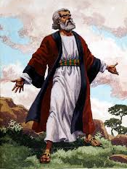
11. Had Abraham any children at this time?
Genesis 15:2
And Abram said, Lord God, what wilt thou give me, seeing I go childless, and the steward of my house is this Eliezer of Damascus?

Slide 24
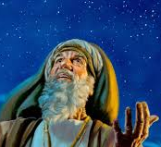
12. What did the Lord again say as to the number of his posterity?
Genesis 15:5
And he brought him forth abroad, and said, Look now toward heaven, and tell the stars, if thou be able to number them: and he said unto him, So shall thy seed be.

Slide 25
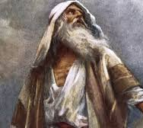
13. How did Abraham regard the word of the Lord?
Genesis 15:6
And he believed in the Lord…

Slide 26
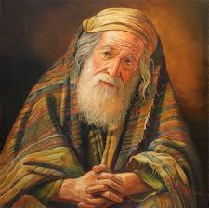
14. How did God regard Abraham's faith?
Genesis 15:6
…and he counted it to him for righteousness.

Slide 27
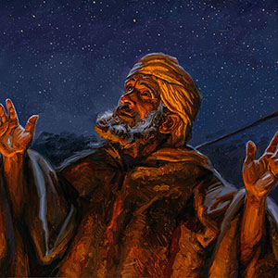
15. What is meant by faith being counted for righteousness?
Romans 4:1-8
What shall we say then that Abraham our father, as pertaining to the flesh, hath found?

Slide 28
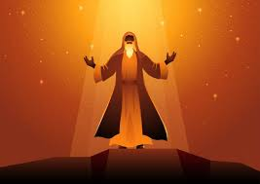
15. What is meant by faith being counted for righteousness?
Romans 4:1-8
² For if Abraham were justified by works, he hath whereof to glory; but not before God.

Slide 29
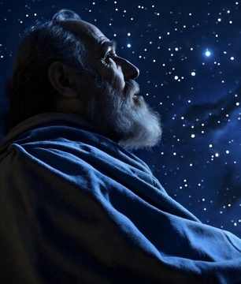
SDABC V6 on Romans 4:2
If Abraham had been justified as a reward for his works of obedience, he indeed would have had something to be proud of. But actually, Abraham had nothing to boast about in the sight of God.

Slide 30
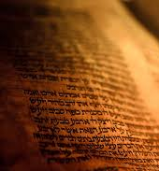
15. What is meant by faith being counted for righteousness?
Romans 4:1-8
³ For what saith the scripture? Abraham believed God, and it was counted unto him for righteousness.

Slide 31

15. What is meant by faith being counted for righteousness?
Romans 4:1-8
⁴ Now to him that worketh is the reward not reckoned of grace, but of debt.

Slide 32

15. What is meant by faith being counted for righteousness?
Romans 4:1-8
⁵ But to him that worketh not, but believeth on him that justifieth the ungodly, his faith is counted for righteousness.

Slide 33
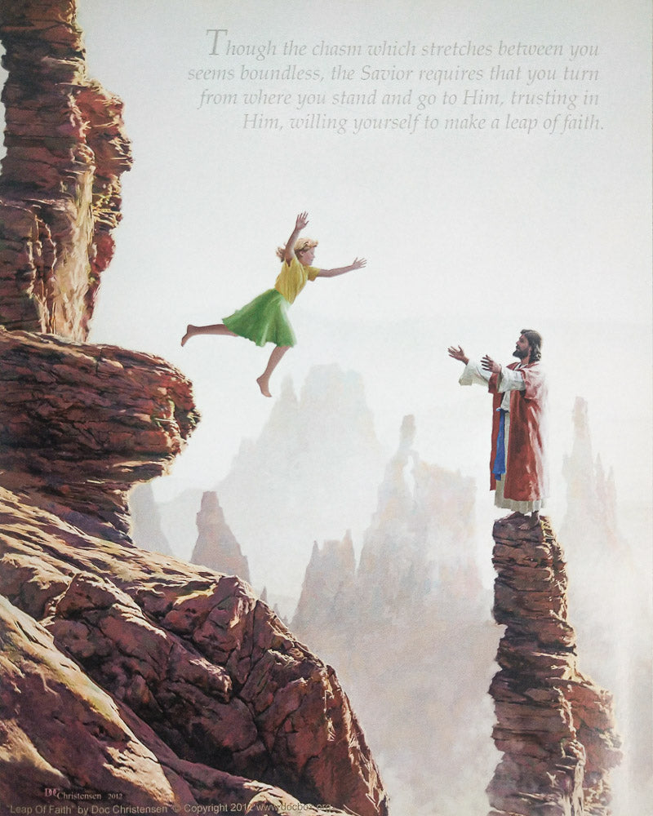
SDABC V6 on Romans 4:3
The fact that Abraham’s faith was reckoned to him as righteousness does not mean that faith possesses in itself some merit that can earn justification. It was Abraham’s faith in God that was accounted as righteousness. Such faith is a relation, an attitude, a disposition of man toward God. It implies a readiness to receive with joy whatever God may reveal, and to do with joy whatever God may direct. Abraham loved and trusted and obeyed God because he knew Him and was His friend. His faith was a genuine relationship of love, confidence, and submission.

Slide 34
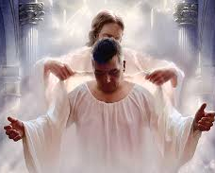
15. What is meant by faith being counted for righteousness?
Romans 4:1-8
⁶ Even as David also describeth the blessedness of the man, unto whom God imputeth righteousness without works,

Slide 35
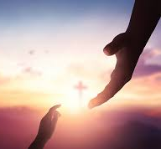
15. What is meant by faith being counted for righteousness?
Romans 4:1-8
⁷ Saying, Blessed are they whose iniquities are forgiven, and whose sins are covered.

Slide 36

15. What is meant by faith being counted for righteousness?
Romans 4:1-8
⁸ Blessed is the man to whom the Lord will not impute sin.

Slide 37
But what about WORKS?
James 2:21-26
²¹ Was not Abraham our father justified by works, when he had offered Isaac his son upon the altar?
Wasn’t Paul just arguing that Abraham was saved by faith without works???

Slide 38

A Conflict?

Slide 39
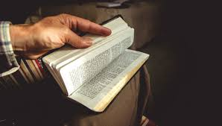
NO! Just a need for CONTEXT…

Slide 40
WHAT about WORKS?
James 2:21-26
²² Seest thou how faith wrought with his works, and by works was faith made perfect?
Okay… faith and works are working together?

Slide 41
WHAT about WORKS?
James 2:21-26
²³ And the scripture was fulfilled which saith, Abraham believed God, and it was imputed unto him for righteousness: and he was called the Friend of God.
Abraham believed… and TOOK ACTION (works) because he believed.

Slide 42
WHAT about WORKS?
James 2:21-26
²⁴ Ye see then how that by works a man is justified, and not by faith only.
Mere profession of faith alone cannot justify a man. Good works accompany faith and prove its validity.

Slide 43
WHAT about WORKS?
James 2:21-26
If there are no “works,” it is evident that genuine faith does not exist, and that as a result a man cannot be justified… since he LACKS a saving faith in Christ.
²⁴ Ye see then how that by works a man is justified, and not by faith only.
Mere profession of faith alone cannot justify a man. Good works accompany faith and prove its validity.

Slide 44
WHAT about WORKS?
James 2:21-26
²⁵ Likewise also was not Rahab the harlot justified by works, when she had received the messengers, and had sent them out another way?
Rahab’s belief in the God of Israel is immediately reflected in her deeds… which makes it a true faith.

Slide 45
WHAT about WORKS?
James 2:21-26
²⁶ For as the body without the spirit is dead, so faith without works is dead also.
There is no life in the body if the breath is absent, and no saving in “faith” if the deeds that show it true are absent.

Slide 46
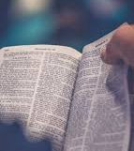
Justification by Faith
Paul emphasizes that Abraham was justified by faith. But James reminds us that true faith never stands alone. In other words: Paul shows the root of justification, James shows the fruit.”

Slide 47
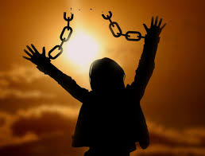
15. What is meant by faith being counted for righteousness?
Answer: The forgiveness of sins
JUSTIFICATION

Slide 48
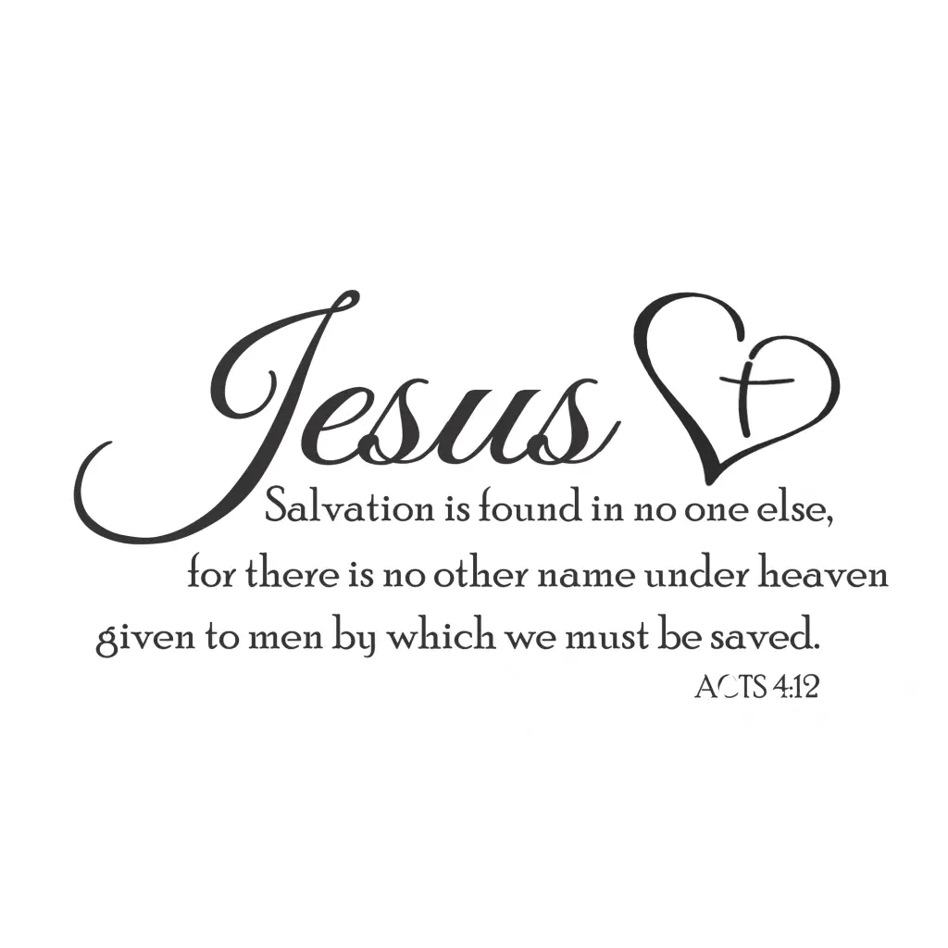

Slide 49
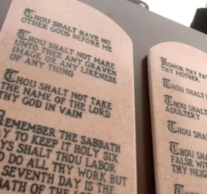
16. Through whom were the promises confirmed to Abraham?
Galatians 3:17
And this I say, that the covenant, that was confirmed before of God in Christ, the law, which was four hundred and thirty years after, cannot disannul, that it should make the promise of none effect.

Slide 50
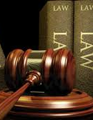
SDABC V6 on Galatians 3:17
The legal system ordained by God at Mt. Sinai cannot replace, or in any wise alter, the provisions of the covenant. Specifically, “the law” did not provide a new means of salvation; it did not establish a system of righteousness by works to take the place of, or to compete with, the promise of righteousness by faith in the coming Messiah. Accordingly, men were saved by faith between Sinai and the cross.

Slide 51

17. And who are the promised seed?
Galatians 3:29
And if ye be Christ's, then are ye Abraham's seed, and heirs according to the promise.

Slide 52
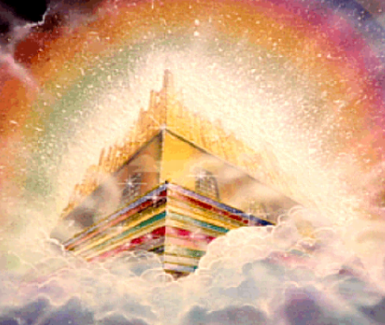
18. What is the inheritance of which they, with him, are heirs?
Romans 4:13
For the promise, that he should be the heir of the world, was not to Abraham, or to his seed, through the law, but through the righteousness of faith.

Slide 53
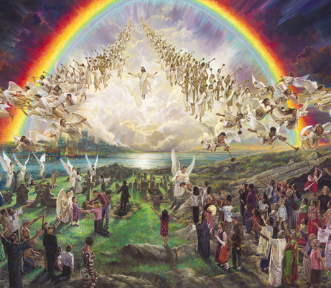
18. What is the inheritance of which they, with him, are heirs?
2 Peter 3:13
Nevertheless we, according to his promise, look for new heavens and a new earth, wherein dwelleth righteousness.

Slide 54


Slide 55
Thank You &
HAPPY SABBATH!!

