Slide 1


Slide 2

Living the Light

Slide 3
Old Testament History:
Abraham and Lot
Lesson 9,1st Quarter, 1888

Slide 4
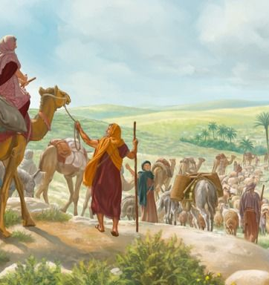
1. When Abraham left his native land, whom did he take with him?
Genesis 12:5
And Abram took Sarai his wife, and Lot his brother's son, and all their substance that they had gathered, and the souls that they had gotten in Haran; and they went forth to go into the land of Canaan; and into the land of Canaan they came.

Slide 5
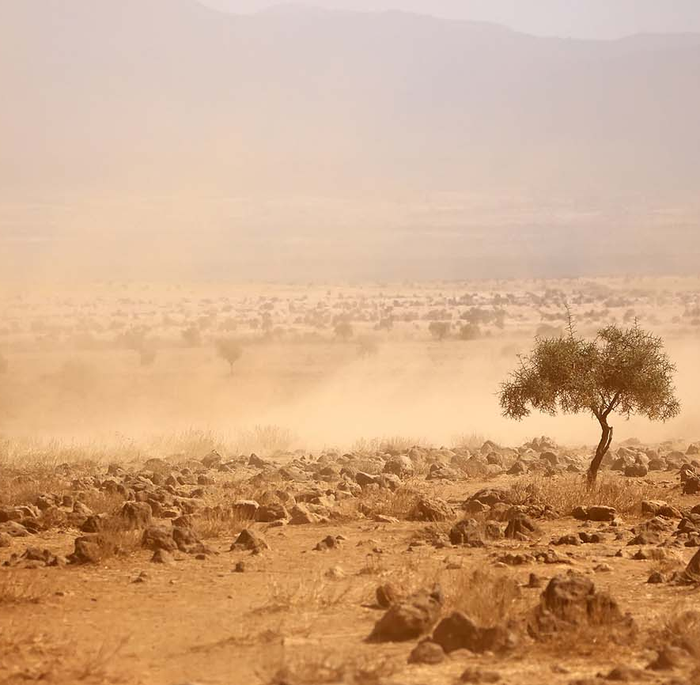
2. After his sojourn in Canaan, where did he go?
Genesis 12:10
And there was a famine in the land: and Abram went down into Egypt to sojourn there; for the famine was grievous in the land.

Slide 6
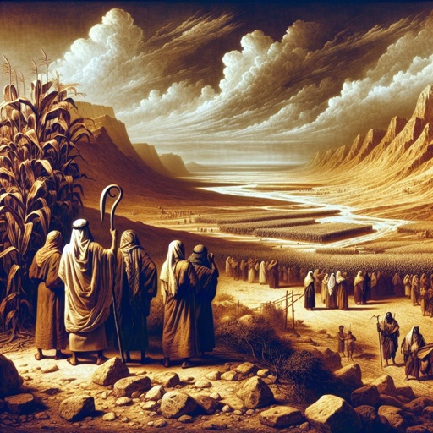
A Famine in Canaan
Abram obeys God’s call, leaves everything behind, and arrives in Canaan—only to find a famine waiting for him (Genesis 12:10).
On a symbolic level, this almost feels like a contradiction: Canaan = promise, heaven, abundance… so why famine?

Slide 7
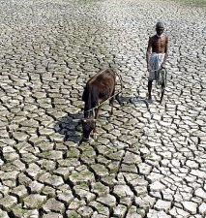
A Famine in Canaan
Canaan, though naturally fertile, was subject to visitations of drought, especially in those years when the November and December rains, on which the country depended, either failed or were scanty.
SDABC Vol. 1 on Genesis 12:10

Slide 8
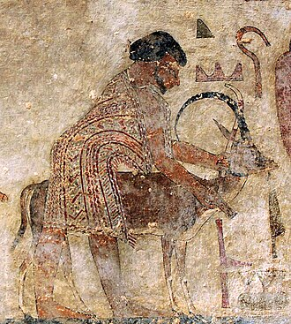
A Famine in Canaan
Egyptian records confirm waves of Semitic nomads entering Egypt in search of food and water for their cattle.

Slide 9
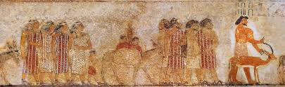
A Famine in Canaan
A famous tomb painting under Senusret II (ca. 1897–1879 B.C.) depicts 37 Semitic Bedouins arriving with their families, garments, weapons, and instruments — a visual window into the very world of Abram.

Slide 10
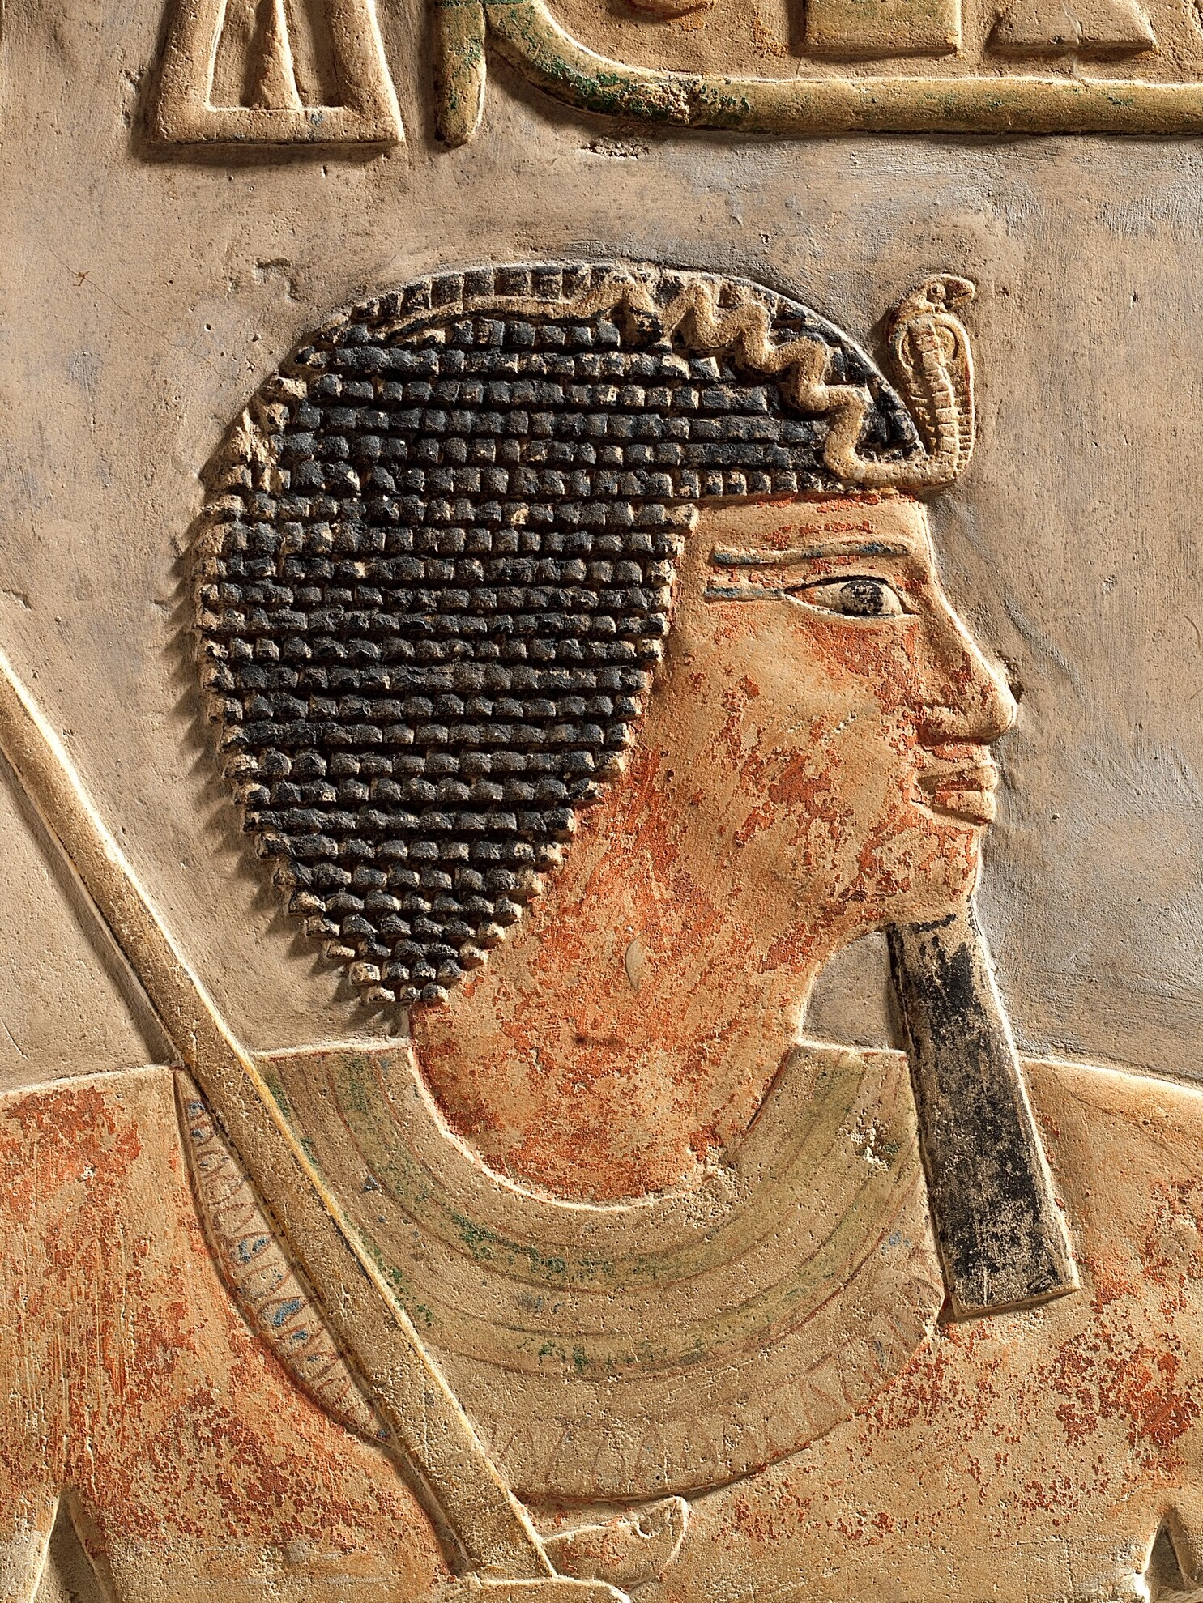
A Famine in Canaan
Amenemhet I (1991-1962 B.C.), first king of the Twelfth Dynasty, walled off his eastern frontier with the avowed purpose “not to allow the Asiatics to go down into Egypt, that they may beg for water after [their] customary manner so as to give their cattle to drink.”
SDABC Vol. 1 on Genesis 12:10

Slide 11
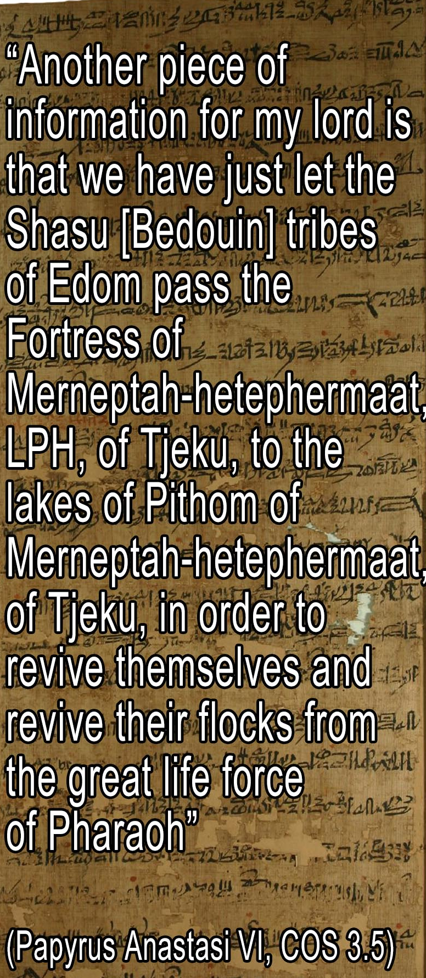
A Famine in Canaan
A later document, the report of a frontier official of the time of the Hebrew judges, mentions that Bedouins of Edom had been allowed to enter Egypt to keep themselves and their cattle alive.

Slide 12
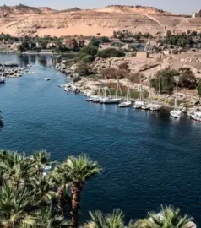
3. Why did he go there?
This documentary evidence about Asiatics entering Egypt for trading purposes or to acquire food in times of want makes it easy to visualize Abram going down to the valley of the Nile to keep his herds and flocks alive.
SDABC Vol. 1 on Genesis 12:10

Slide 13
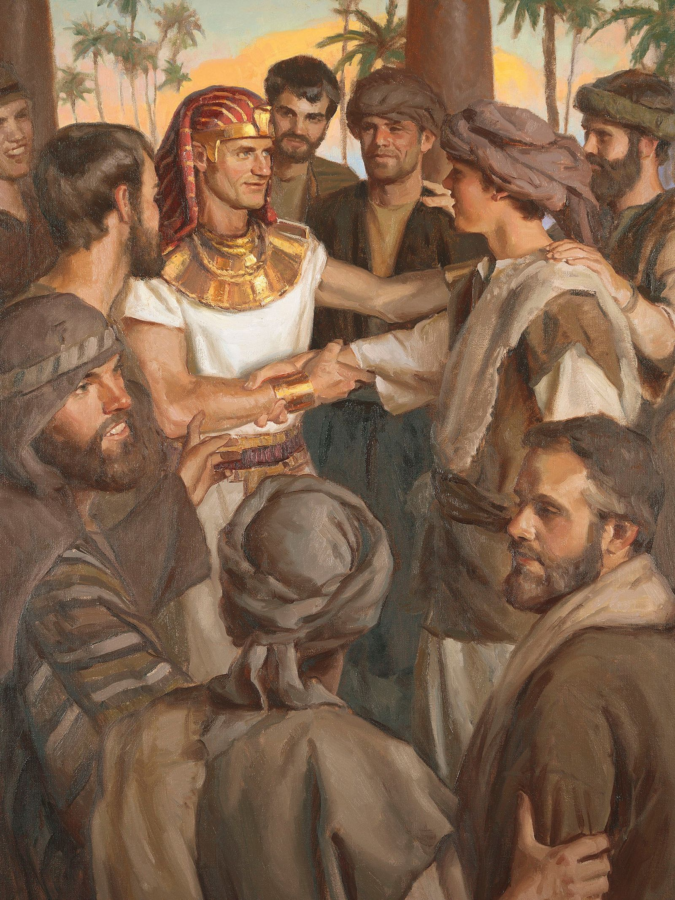
A Famine in Canaan
It’s a reminder that sometimes we fall into oversimplifying symbols. Egypt is not only “bad”; God uses Egypt as a place of preservation (Joseph storing grain, Christ as an infant fleeing Herod).
So the lesson: Don’t flatten symbols into clichés. They are living, flexible teaching devices, not cartoons.

Slide 14
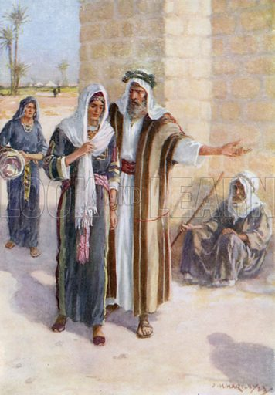
A Famine in Canaan
The real difference isn’t the geography, but trust. Abram’s stumbled in Egypt (lying about Sarai) not because it was Egypt per se, but because he failed to trust God there.

Slide 15
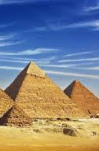
A Famine in Canaan
Centuries later, Joseph’s family found Egypt a refuge, and even Jesus as a child was taken to Egypt to escape Herod (Matt. 2:14). Egypt represents worldliness, but God rules our world and He uses it to preserve His faithful people.

Slide 16
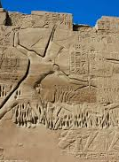
A Famine in Canaan
What matters is whether we go in fear—as Abram did in this instance, fearing that Sarai would be taken from him, or as the Israelites did generations later, fearing wandering to their deaths in the desert—or whether we go in faithful obedience.

Slide 17
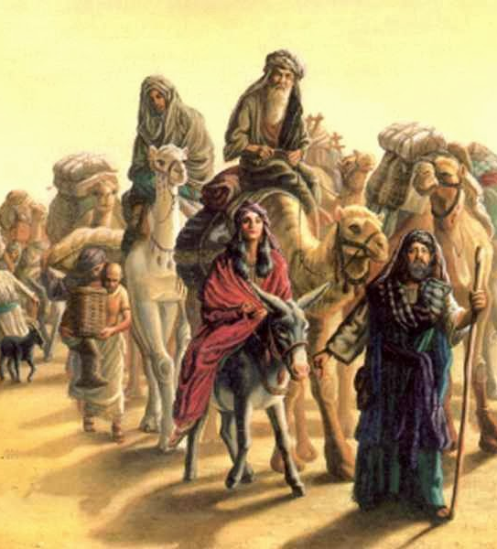
4. How was he prospered while there?
Genesis 12:16; Genesis 13:1-2
And he entreated Abram well for her sake: and he had sheep, and oxen, and he asses, and menservants, and maidservants, and she asses, and camels.

Slide 18
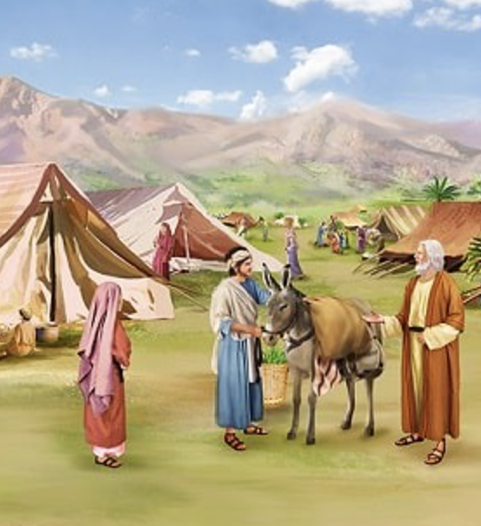
4. How was he prospered while there?
Genesis 12:16; Genesis 13:1-2
And Abram went up out of Egypt, he, and his wife, and all that he had, and Lot with him, into the south.

Slide 19
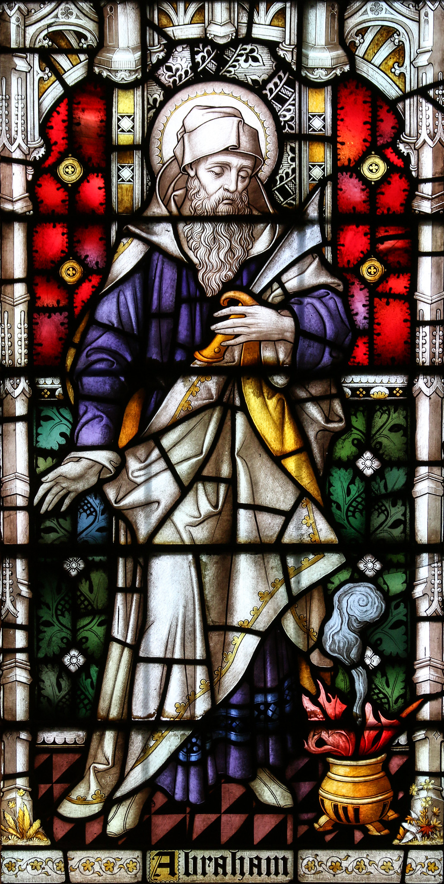
4. How was he prospered while there?
Genesis 12:16; Genesis 13:1-2
And Abram was very rich in cattle, in silver, and in gold.

Slide 20
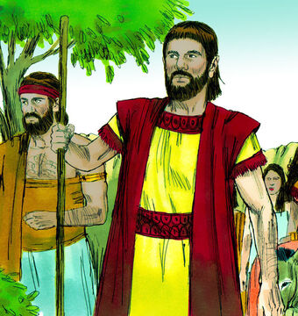
5. How was Lot situated as regards wealth?
Genesis 13:5
And Lot also, which went with Abram, had flocks, and herds, and tents.

Slide 21
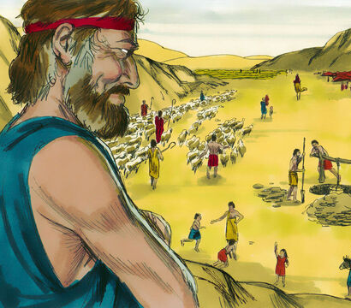
6. What was the consequence of the great wealth of both Abraham and Lot?
Genesis 13:6-7
And the land was not able to bear them, that they might dwell together: for their substance was great, so that they could not dwell together.

Slide 22
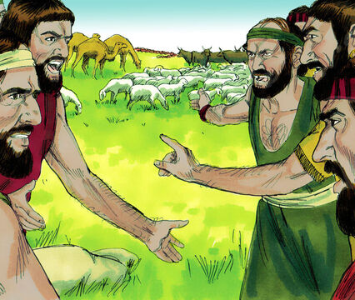
6. What was the consequence of the great wealth of both Abraham and Lot?
Genesis 13:6-7
And there was a strife between the herdmen of Abram's cattle and the herdmen of Lot's cattle: and the Canaanite and the Perizzite dwelled then in the land.

Slide 23
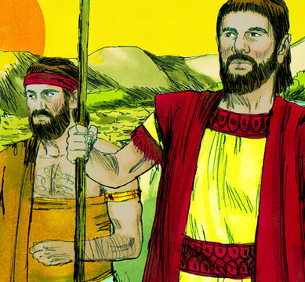
7. How was Abraham affected by this strife?
Genesis 13:8
And Abram said unto Lot, Let there be no strife, I pray thee, between me and thee, and between my herdmen and thy herdmen; for we be brethren.

Slide 24
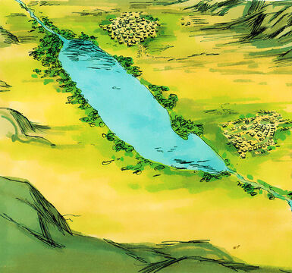
8. What generous part did Abraham act?
Genesis 13:9
Is not the whole land before thee? separate thyself, I pray thee, from me: if thou wilt take the left hand, then I will go to the right; or if thou depart to the right hand, then I will go to the left.

Slide 25
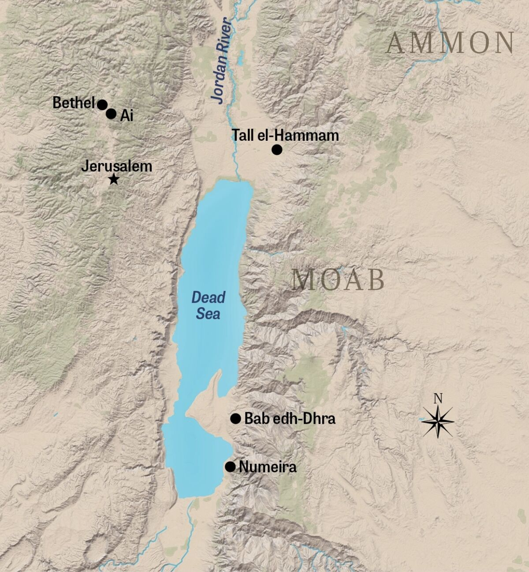
9. How did Lot respond to this generous offer?
Genesis 13:10-11
And Lot lifted up his eyes, and beheld all the plain of Jordan, that it was well watered every where, before the Lord destroyed Sodom and Gomorrah, even as the garden of the Lord, like the land of Egypt, as thou comest unto Zoar.

Slide 26
9. How did Lot respond to this generous offer?
Genesis 13:10-11
Then Lot chose him all the plain of Jordan; and Lot journeyed east: and they separated themselves the one from the other.

Slide 27
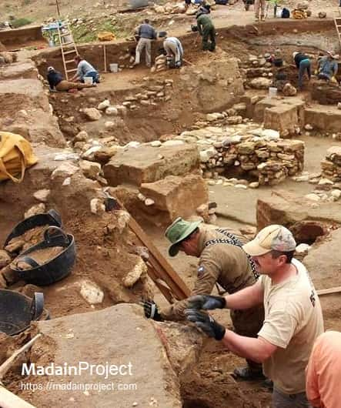
What About Sodom??
“Lot chose the plain of Jordan … and pitched his tent toward Sodom.”
Archaeology today is uncovering fortified cities in this very region.
Some evidence even points to a sudden catastrophic destruction.

Slide 28
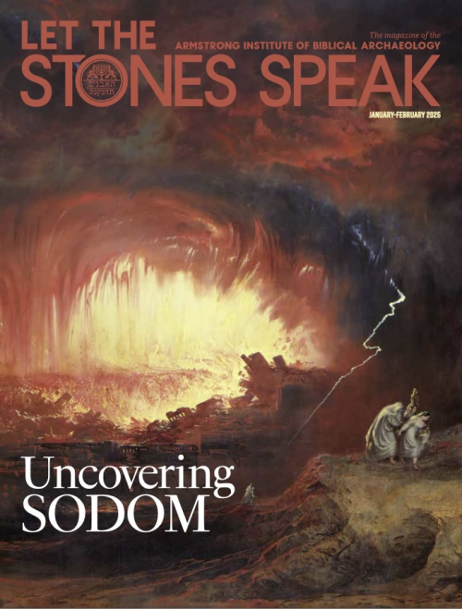
What About Sodom??
“Lot chose the plain of Jordan … and pitched his tent toward Sodom.”
Archaeology today is uncovering fortified cities in this very region.
Some evidence even points to a sudden catastrophic destruction.

Slide 29
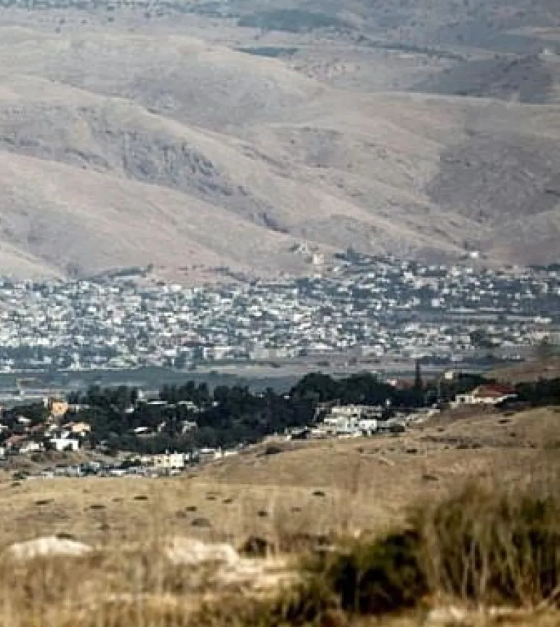
10. What alone seemed to influence Lot in his choice?
Lot lifted his eyes and saw the plain of Jordan, “well watered every where… even as the garden of the Lord.
He chose the land that looked richest and most prosperous.
His choice was guided by appearance and material advantage, not by spiritual values

Slide 30
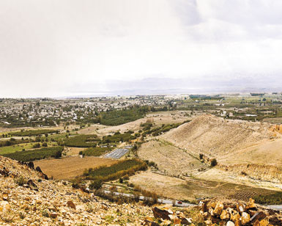
11. Near what city did Lot pitch his tent?
Genesis 13:12
Abram dwelled in the land of Canaan, and Lot dwelled in the cities of the plain, and pitched his tent toward Sodom.

Slide 31
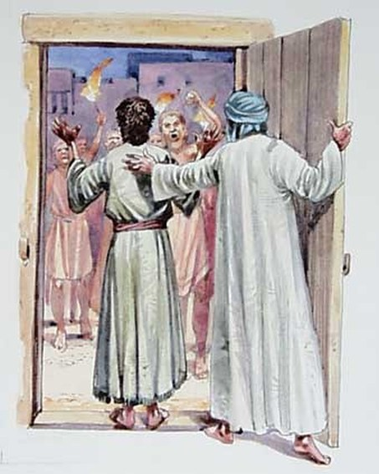
12. What was the character of the men of Sodom?
Genesis 13:13
But the men of Sodom were wicked and sinners before the Lord exceedingly.

Slide 32
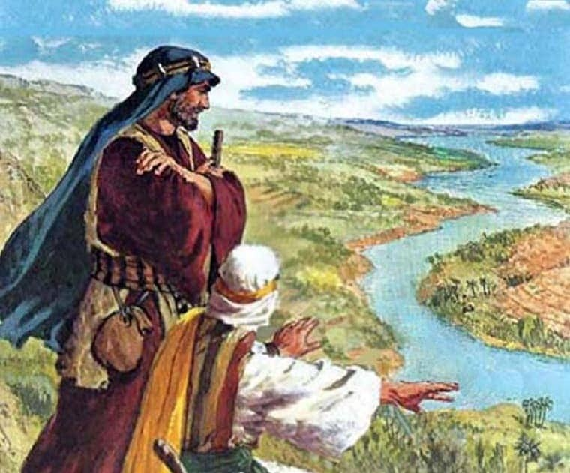
13. Did Abraham lose anything by his generosity?
Genesis 13:14-17
And the Lord said unto Abram, after that Lot was separated from him, Lift up now thine eyes, and look from the place where thou art northward, and southward, and eastward, and westward:

Slide 33
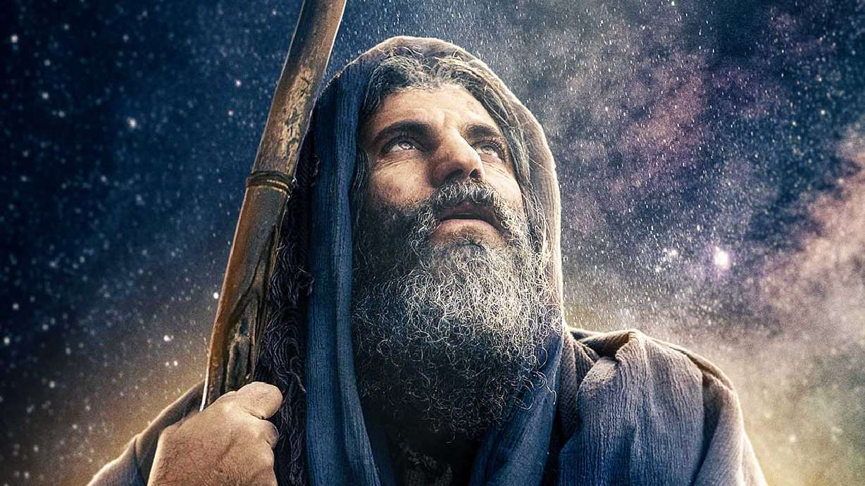
13. Did Abraham lose anything by his generosity?
Genesis 13:14-17
For all the land which thou seest, to thee will I give it, and to thy seed for ever.

Slide 34
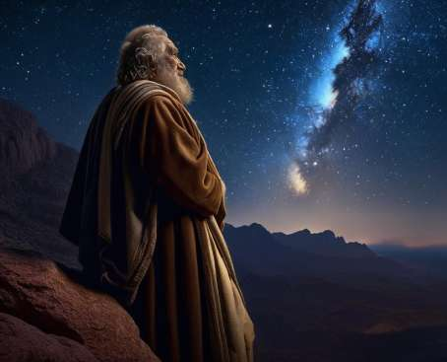
13. Did Abraham lose anything by his generosity?
Genesis 13:14-17
And I will make thy seed as the dust of the earth: so that if a man can number the dust of the earth, then shall thy seed also be numbered.

Slide 35
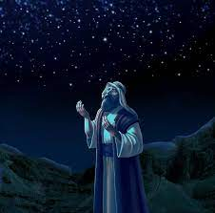
13. Did Abraham lose anything by his generosity?
Genesis 13:14-17
Arise, walk through the land in the length of it and in the breadth of it; for I will give it unto thee.

Slide 36
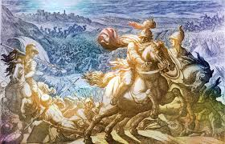
14. What great battle was fought some years after?
Genesis 14:8-9
And there went out the king of Sodom, and the king of Gomorrah, and the king of Admah, and the king of Zeboiim, and the king of Bela (the same is Zoar;) and they joined battle with them in the vale of Siddim;

Slide 37
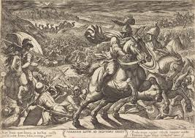
14. What great battle was fought some years after?
Genesis 14:8-9
With Chedorlaomer the king of Elam, and with Tidal king of nations, and Amraphel king of Shinar, and Arioch king of Ellasar; four kings with five.

Slide 38
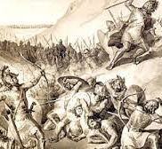
15. What happened to the kings of Sodom and Gomorrah and their people?
Genesis 14:10-11
And the vale of Siddim was full of slimepits; and the kings of Sodom and Gomorrah fled, and fell there; and they that remained fled to the mountain.

Slide 39
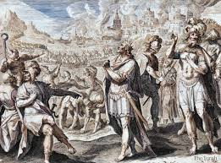
15. What happened to the kings of Sodom and Gomorrah and their people?
Genesis 14:10-11
And they took all the goods of Sodom and Gomorrah, and all their victuals, and went their way.

Slide 40
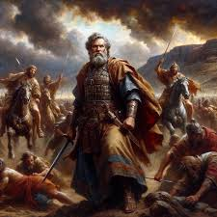
16. Who else was taken captive?
Genesis 14:12
And they took Lot, Abram's brother's son, who dwelt in Sodom, and his goods, and departed.

Slide 41
17. What do you think was the indirect cause of Lot's misfortune?
Lot chose the plain of Jordan, beautiful and well watered.
But that land was near wicked Sodom.
Indirectly, Lot’s desire for prosperity and convenience drew him into dangerous associations.
At first, Lot merely “pitched his tent toward Sodom.”
Later, he was dwelling in Sodom.
Proximity → participation. This choice placed Lot in harm’s way when war broke out.

Slide 42

18. What charge is given to the rich?
1 Timothy 6:17-19
Charge them that are rich in this world, that they be not highminded, nor trust in uncertain riches, but in the living God, who giveth us richly all things to enjoy;

Slide 43

18. What charge is given to the rich?
1 Timothy 6:17-19
That they do good, that they be rich in good works, ready to distribute, willing to communicate;

Slide 44
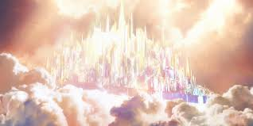
18. What charge is given to the rich?
1 Timothy 6:17-19
Laying up in store for themselves a good foundation against the time to come, that they may lay hold on eternal life.

Slide 45
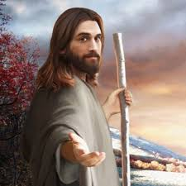
19. How sure may a man be of retaining riches?
Proverbs 23:4-5
Labour not to be rich: cease from thine own wisdom.

Slide 46

19. How sure may a man be of retaining riches?
Proverbs 23:4-5
Wilt thou set thine eyes upon that which is not? for riches certainly make themselves wings; they fly away as an eagle toward heaven.

Slide 47
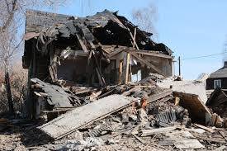
20. What proverb was fulfilled in the case of Lot?
Proverbs 15:27
He that is greedy of gain troubleth his own house; but he that hateth gifts shall live.

Slide 48


Slide 49
Thank You &
HAPPY SABBATH!!

