Slide 1


Slide 2

Living the Light

Slide 3
Old Testament History:
Abraham and MELCHIZEDEK
Lesson 10,1st Quarter, 1888

Slide 4
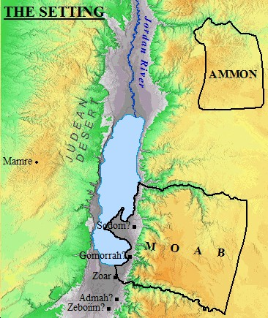
1. Where did Abraham dwell when Lot was taken captive?
Genesis 14:13
And there came one that had escaped, and told Abram the Hebrew; for he dwelt in the plain of Mamre the Amorite, brother of Eshcol, and brother of Aner: and these were confederate with Abram.

Slide 5
1. Where did Abraham dwell when Lot was taken captive?
Genesis 14:13
And there came one that had escaped, and told Abram the Hebrew; for he dwelt in the plain of Mamre the Amorite, brother of Eshcol, and brother of Aner: and these were confederate with Abram.
Abram the What?
This is the first time in Scripture that Abram is referenced as a “Hebrew.” There’s a political situation brewing here. What does it mean that they came and told “Abram the Hebrew” rather than “Abram the Uncle”?

Slide 6
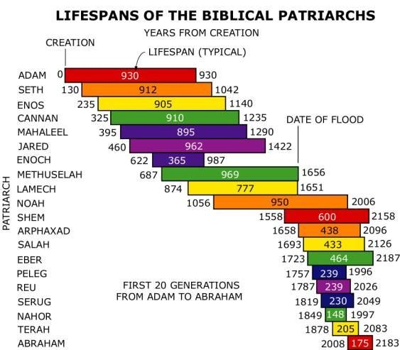
Abraham the HeBreW
Genesis 14:13 calls Abram 'the Hebrew'—literally 'descendant of Eber.’
Eber’s line is highlighted in Genesis 10–11, bridging Shem to Abram.

Slide 7
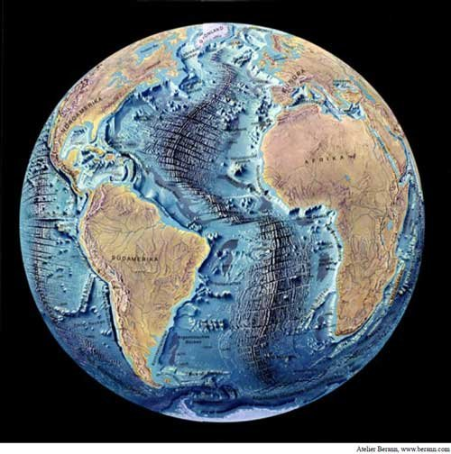
Abraham the HeBreW
Genesis 10:25
And unto Eber were born two sons: the name of one was Peleg; for in his days was the earth divided; and his brother's name was Joktan.

Slide 8
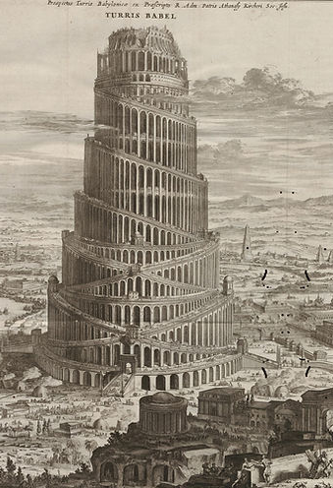
Abraham the Hebrew
Peleg means “division.” Moses here anticipates the events described in the next chapter, the confusion of tongues and the resulting dispersion of peoples. If the confusion of tongues took place about the time of Peleg’s birth, we can easily understand why he received the name Peleg, “division.” “In his days was the earth divided.”

Slide 9
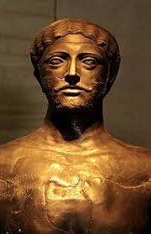
Abraham the Hebrew
Peleg ’s brother Joktan was the ancestor of an important group, the Joktan Arabs. The descent of the western, or Cushite, Arabs is given in v. 7, whereas the genealogy of the Arab descendants of Abraham is given in later chapters of Genesis. A third group of Arabs, described here, seems to have settled in the central, eastern, and southeastern parts of Arabia. Much less is known about them than about the other two Arabian groups.

Slide 10
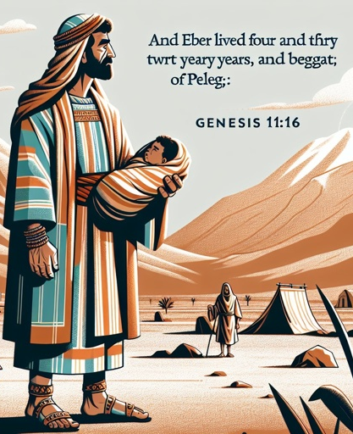
Abraham the Hebrew
Jewish tradition later viewed Eber as the preserver of the “pure language.”
It’s from his line, specifically through PELEG, that the godly line continued.
But Joktan founded a large, important group!

Slide 11
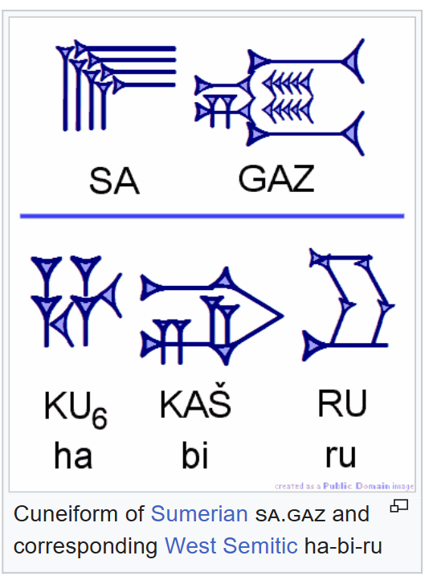
Abraham the Ḫabiru/‘Apiru
Second-millennium B.C. texts from Mesopotamia, Mari, Amarna, and Egypt mention groups called Ḫabiru/‘Apiru — semi-nomadic outsiders, mercenaries, or migrant peoples living on the margins of society.

Slide 12
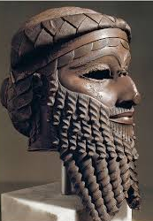
Abraham the Ḫabiru/‘Apiru
Ḫabiru/‘Apiru is term used in 2nd-millennium BC texts throughout the Fertile Crescent for a social status of people who were variously described as rebels, outlaws, raiders, mercenaries, bowmen, servants, slaves, and laborers.

Slide 13
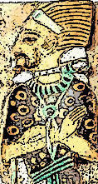
Abraham the Ḫabiru/‘Apiru
The similarity between “Habiru/‘Apiru” and “Hebrew” (ʿibrî) has long intrigued scholars.
They weren’t a single ethnic group but a social class of “outsiders.”
Abram, a wandering herdsman with armed retainers, would have looked very much like an ‘Apiru chieftain to Canaanite city kings.

Slide 14
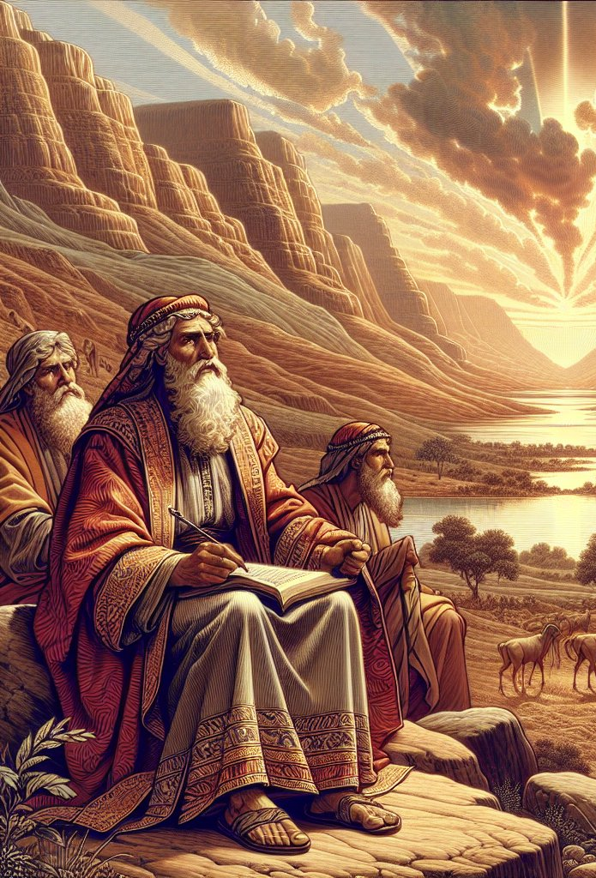
Abraham the Ḫabiru/‘Apiru
Genesis wants us to see Abram as part of a stream of faith that stretches from Shem → Eber → Abram.
Ancient neighbors may have seen him as an “outsider, a Habiru,” but Scripture reframes that identity: not a rootless mercenary, but a man called by God, carrying the covenant line.

Slide 15

To Be Ḫabiru/‘Apiru
Deuteronomy 7:6 — Israel called “a peculiar people” (segullah, treasured possession).
Titus 2:14 — Christ redeems us to be “a peculiar people, zealous of good works.”
1 Peter 2:9 — “a chosen generation, a royal priesthood, an holy nation, a peculiar people.”

Slide 16
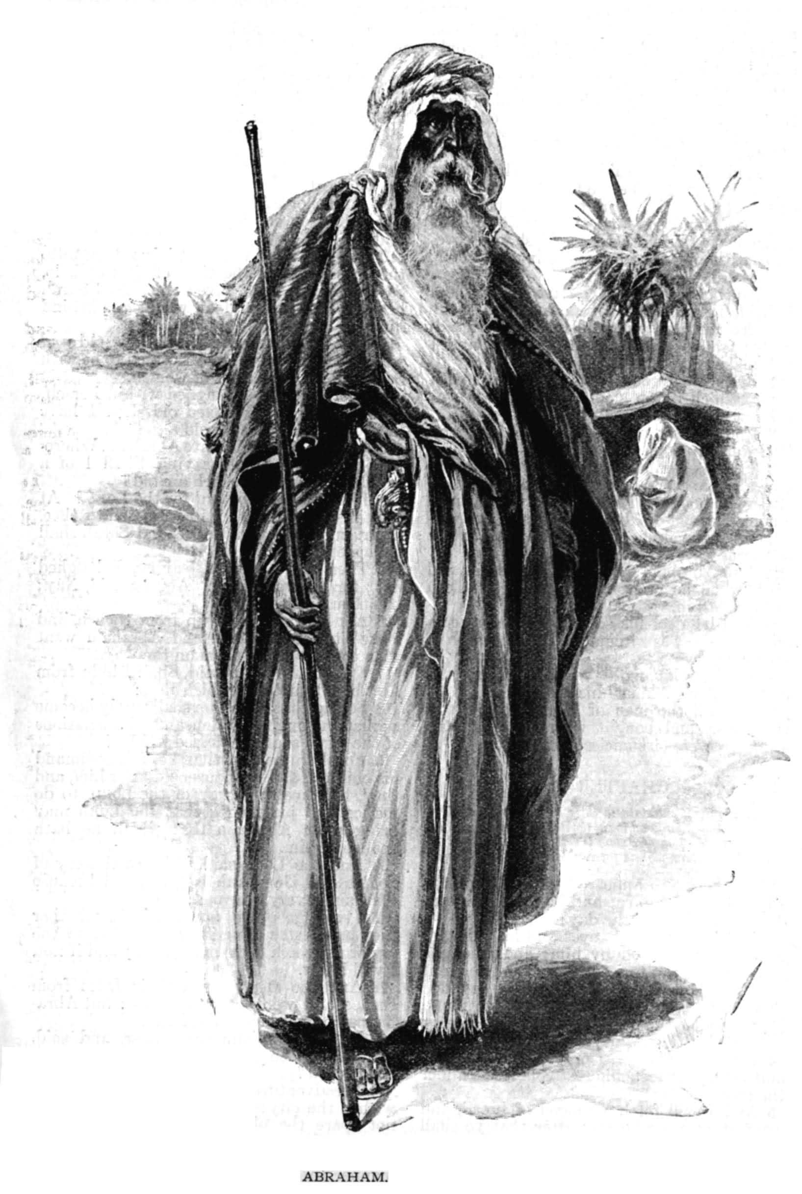
Abram the Chieftan
Genesis 14 depicts Abram with 318 trained men “born in his house.” That’s not a household — that’s a private army.
Add the retainers of his Amorite allies (Mamre, Aner, Eshcol), and you have a respectable fighting coalition.
This is exactly how the Apiru appear in ancient texts: small but mobile armed bands under a leader.

Slide 17
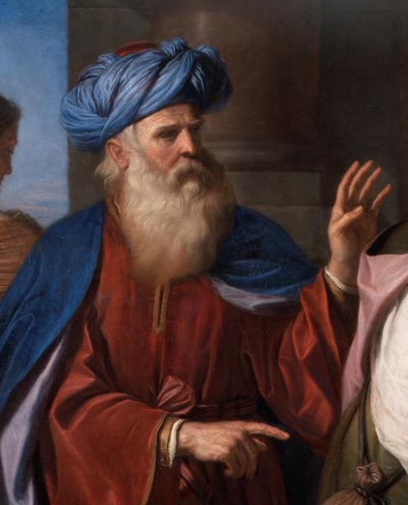
Abram the Chieftan
Abram is called “confederate” (literally “men of Abram’s covenant”) with Amorite chieftains — a political alliance.
In the 2nd millennium B.C., city-states relied on such pacts with semi-nomadic clans for defense, trade, and military campaigns.
Abram is functioning as a regional player, a clan leader who negotiates treaties, fields warriors, and wages war.

Slide 18
1. Where did Abraham dwell when Lot was taken captive?
Genesis 14:13
And there came one that had escaped, and told Abram the Hebrew; for he dwelt in the plain of Mamre the Amorite, brother of Eshcol, and brother of Aner: and these were confederate with Abram.

Slide 19
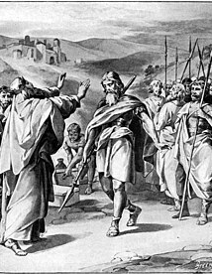
The Bigger Picture
Abram isn’t an isolated “holy man.” He’s integrated into the web of Canaanite politics, with Amorite allies who benefit from his strength, and whom he includes in sharing the spoils (Gen. 14:24).

Slide 20
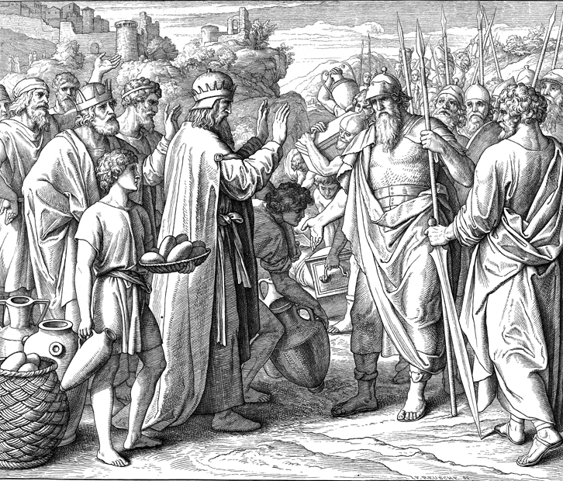
The Bigger Picture
Abram’s “confederacy” = a formal treaty, common in the politics of the age.
Abram’s faith shaped his politics — he honored alliances, shared spoils, but still kept his greater allegiance to God.

Slide 21
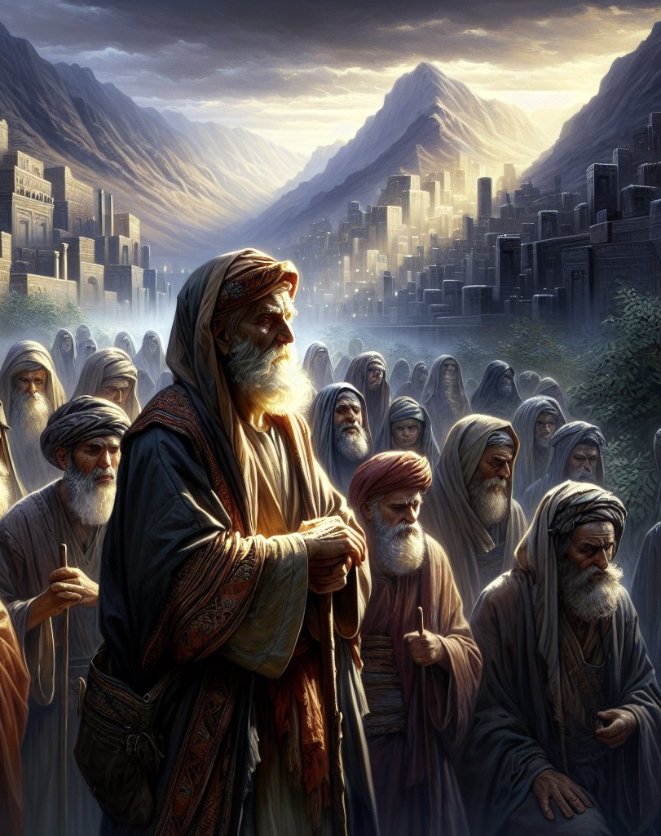
2. When he heard of Lot's misfortune, what did he do?
Genesis 14:14
And when Abram heard that his brother was taken captive, he armed his trained servants, born in his own house, three hundred and eighteen, and pursued them unto Dan.

Slide 22
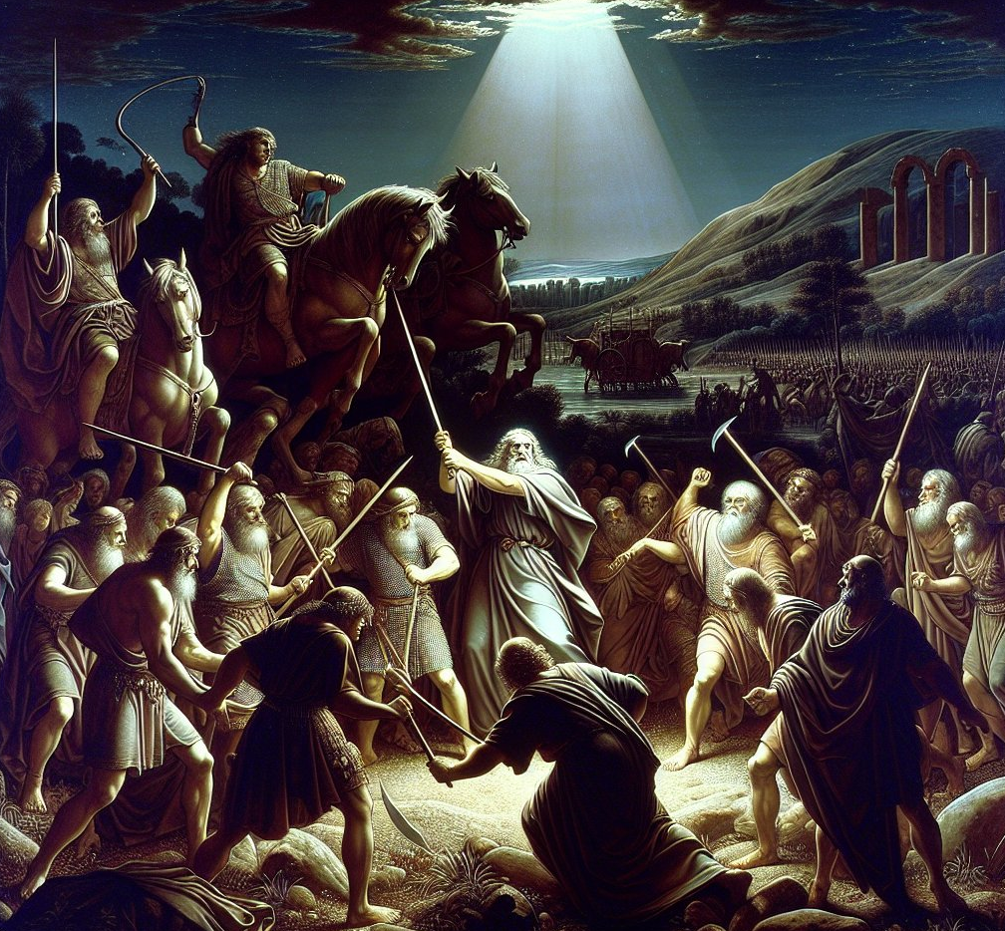
3. What success did he have?
Genesis 14:15-16
And he divided himself against them, he and his servants, by night, and smote them, and pursued them unto Hobah, which is on the left hand of Damascus.

Slide 23
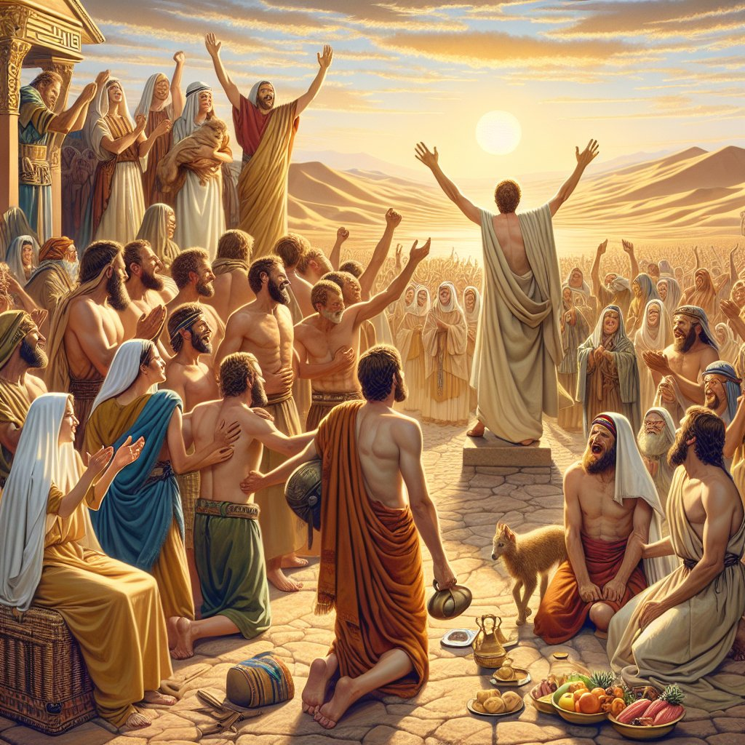
3. What success did he have?
Genesis 14:15-16
And he brought back all the goods, and also brought again his brother Lot, and his goods, and the women also, and the people.

Slide 24
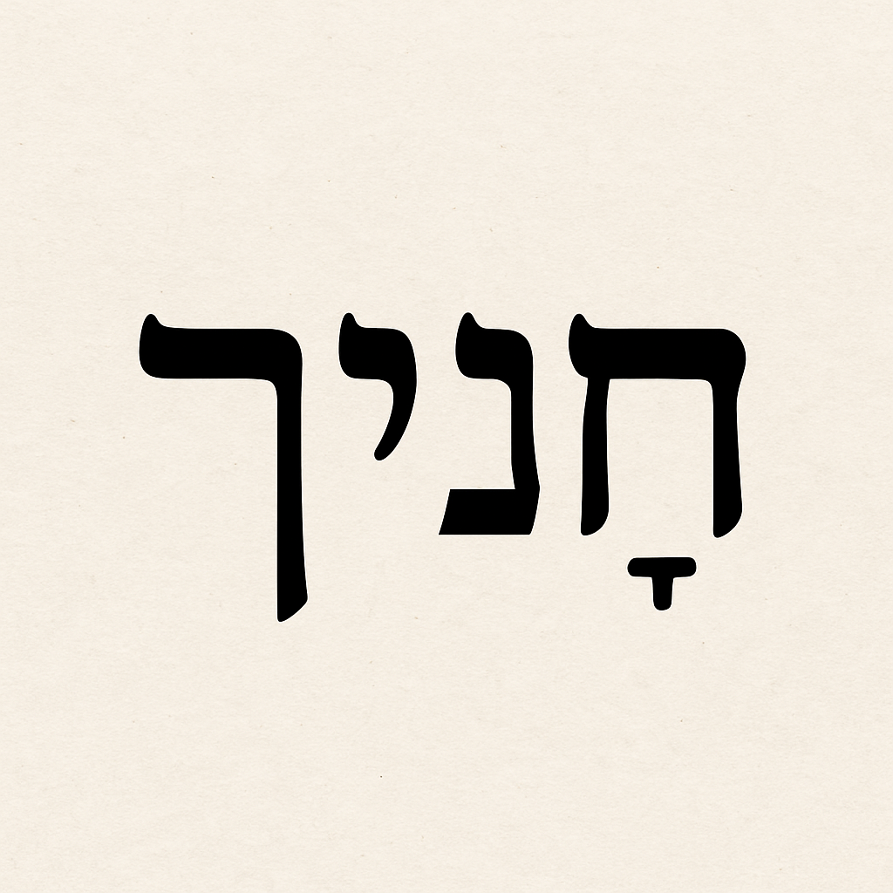
The Military Leader
Abram is the only patriarch shown as a military leader.
Hebrew word for “trained servants” = rare; in 15th c. B.C. Taanach texts it means “retainers.”

Slide 25
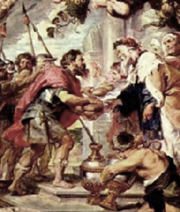
The Military Leader
Abram’s 318 household men were born in his house = loyal, trusted, battle-ready.
Likely had more than 318 male servants, since those from his recent sojourn in Egypt were not included (plus Amorite allies).

Slide 26
The Military Leader
Ancient armies were often very small by modern standards:

Slide 27
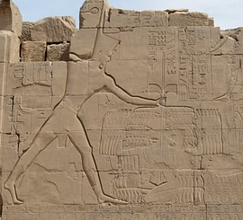
The Military Leader
Ancient armies were often very small by modern standards:
Thutmose III at Megiddo (15th c. B.C.) — 83 killed, 340 captives counted as a major victory.
Megiddo Battle Relief at Temple of Karnak

Slide 28
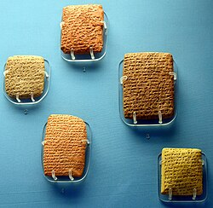
The Military Leader
Ancient armies were often very small by modern standards:
Amarna Letters (14th c. B.C.): city-states sometimes fielded forces of only 20–50 men.
Five Amarna Letters at the British Museum

Slide 29
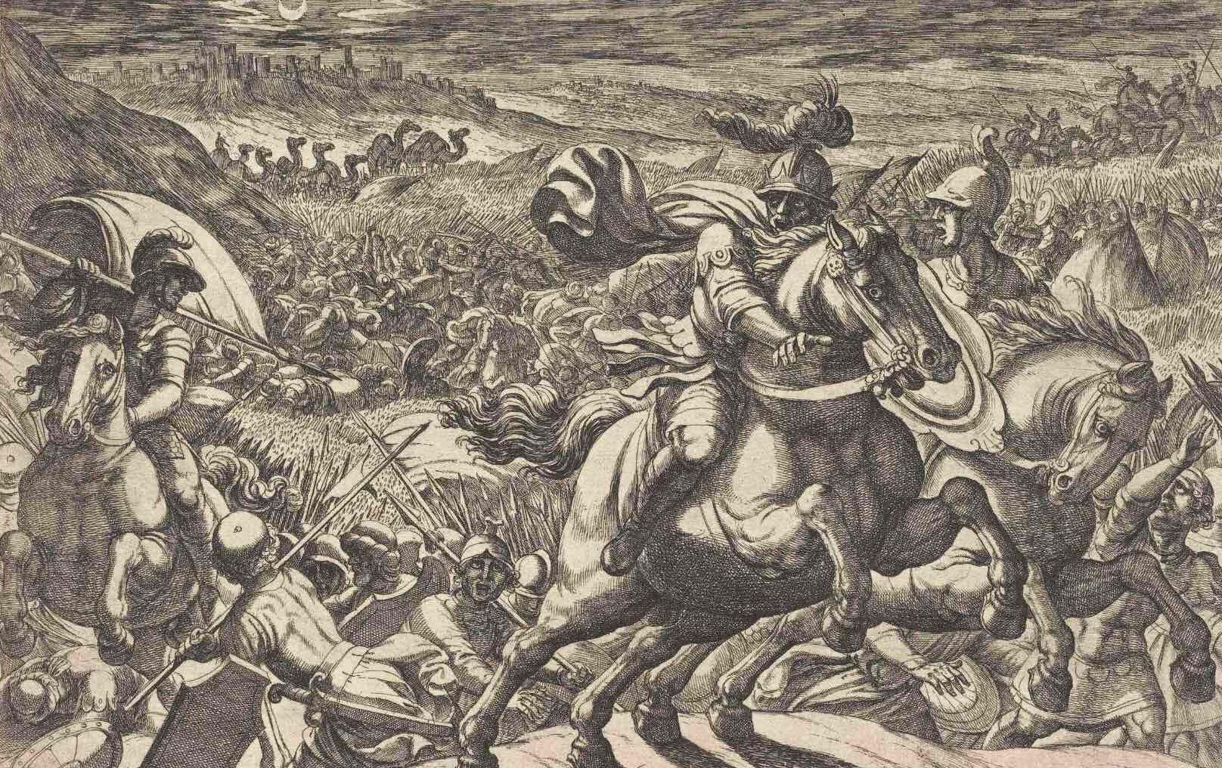
The Military Leader
Ancient armies were often very small by modern standards:
Abram’s 318, plus allies, = a credible fighting force.

Slide 30
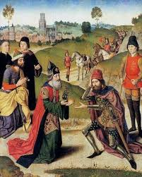
4. Who went out to meet Abraham on his return with the spoil?
Genesis 14:17
And the king of Sodom went out to meet him after his return from the slaughter of Chedorlaomer, and of the kings that were with him, at the valley of Shaveh, which is the king's dale.

Slide 31
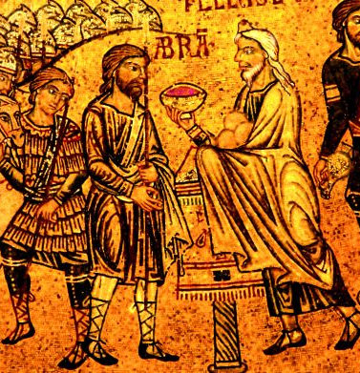
5. Who else met him and brought refreshments?
Genesis 14:18
And Melchizedek king of Salem brought forth bread and wine:

Slide 32
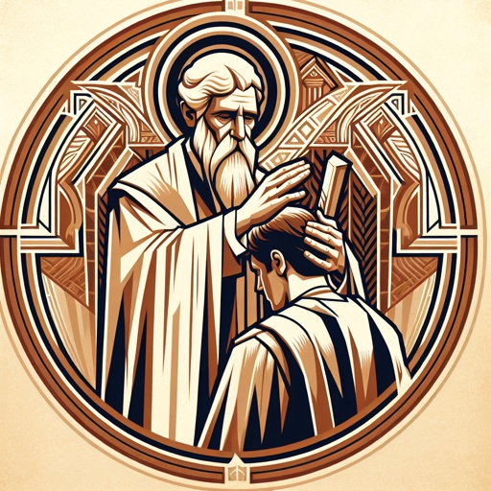
6. Who was Melchizedek?
Genesis 14:18; Hebrews 7:1-2
And he was the priest of the most high God.

Slide 33
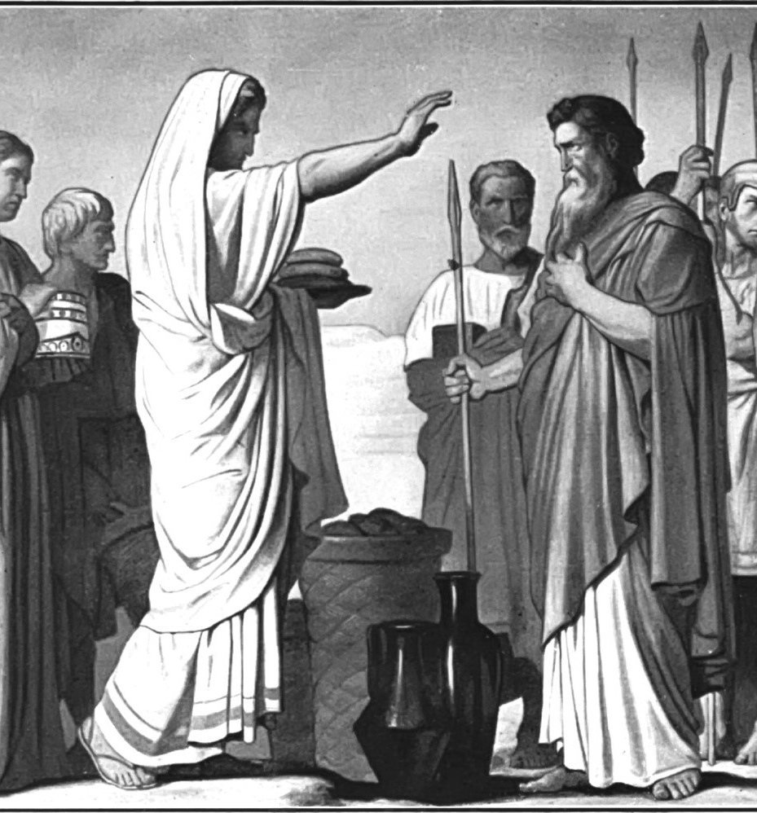
6. Who was Melchizedek?
Genesis 14:18; Hebrews 7:1-2
For this Melchisedec, king of Salem, priest of the most high God, who met Abraham returning from the slaughter of the kings, and blessed him;

Slide 34
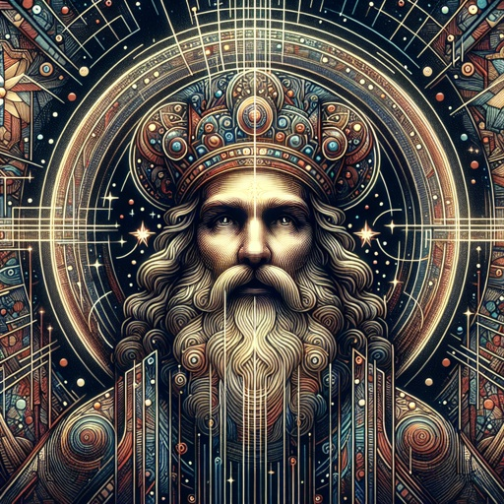
6. Who was Melchizedek?
Genesis 14:18; Hebrews 7:1-2
To whom also Abraham gave a tenth part of all; first being by interpretation King of righteousness, and after that also King of Salem, which is, King of peace;

Slide 35
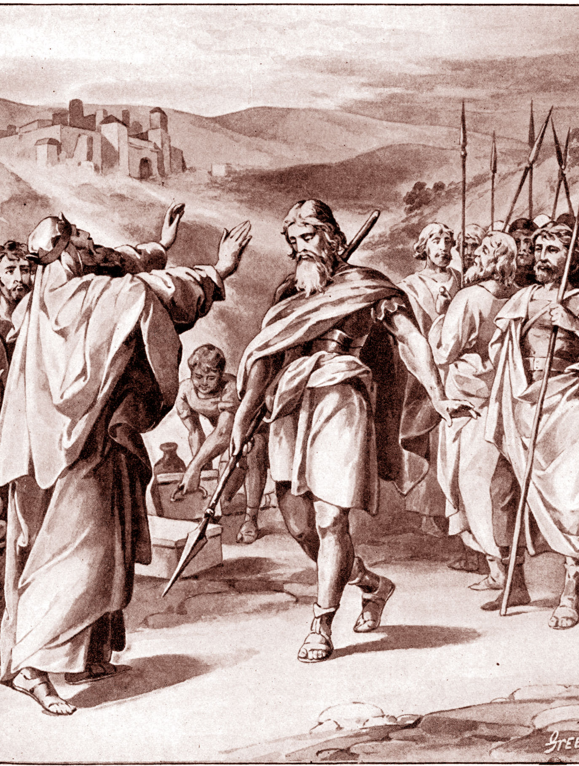
A Priest of the Most High God
Most High God: El Elyon = “Strong One, the Exalted, the Supreme God.”
Rarely used without a qualifier — here it emphasizes God’s universal sovereignty.
Remarkable: a Canaanite priest-king loyal to the true God!

Slide 36
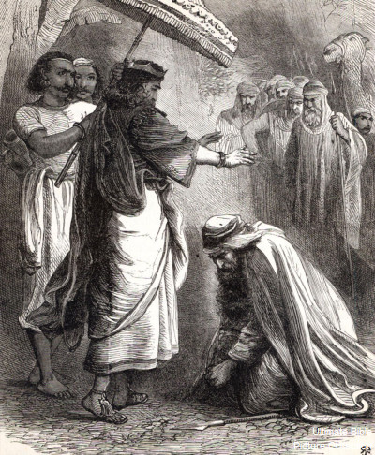
7. What besides giving him refreshments did Melchizedek do for Abraham?
Genesis 14:19
And he blessed him, and said, Blessed be Abram of the most high God, possessor of heaven and earth:

Slide 37
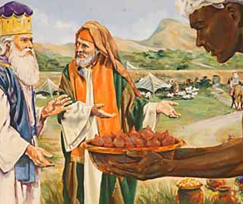
8. Which was the greater man, Abraham or Melchizedek?
Hebrews 7:4, 7
Now consider how great this man was, unto whom even the patriarch Abraham gave the tenth of the spoils.

Slide 38
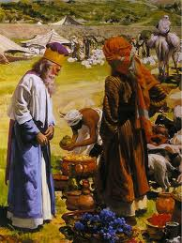
8. Which was the greater man, Abraham or Melchizedek?
Hebrews 7:4, 7
And without all contradiction the less is blessed of the better.

Slide 39
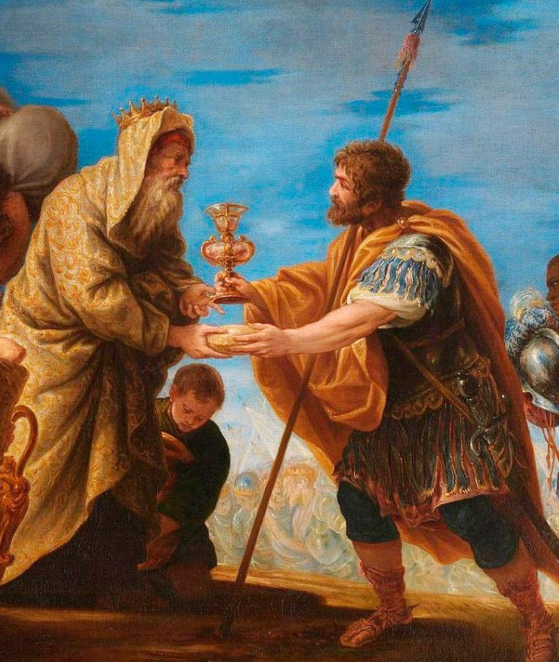
9. What did Abraham give to Melchizedek?
Genesis 14:20; Hebrews 7:4
And blessed be the most high God, which hath delivered thine enemies into thy hand. And he gave him tithes of all.

Slide 40
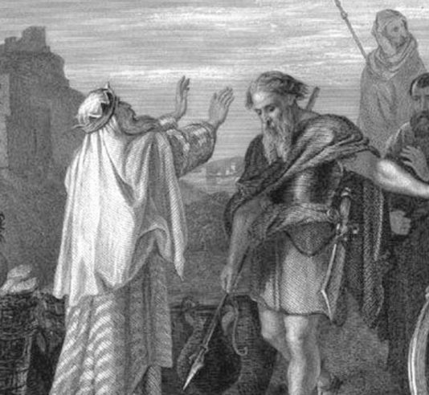
9. What did Abraham give to Melchizedek?
Genesis 14:20; Hebrews 7:4
Now consider how great this man was, unto whom even the patriarch Abraham gave the tenth of the spoils.

Slide 41
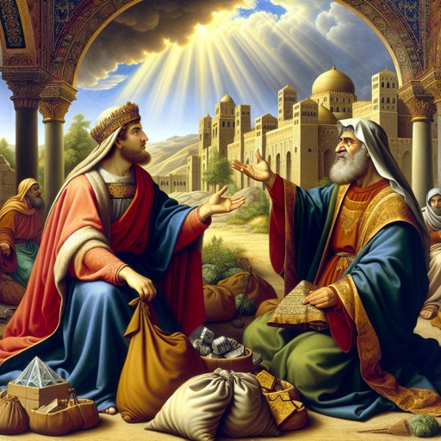
10. What did the king of Sodom say to Abraham?
Genesis 14:21
And the king of Sodom said unto Abram, Give me the persons, and take the goods to thyself.

Slide 42
Bera, King of Sodom
Name meaning: “victor” (ironic, since he had just fled defeat).
Bera had escaped from the battle in the vale of Siddim, and when he received word of Abram’s victorious return, went forth to meet him.

Slide 43
Two Kings
Bera, King of Sodom: Demanded “Give me the people; take the goods.”
Melchizedek, King of Salem: Blessed — brought bread and wine, pointed Abram to God.
One sought gain, the other gave blessing. Abram chose the way of Salem.

Slide 44
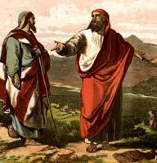
11. What reply did Abraham make?
Genesis 14:22-23
And Abram said to the king of Sodom, I have lift up mine hand unto the Lord, the most high God, the possessor of heaven and earth,

Slide 45
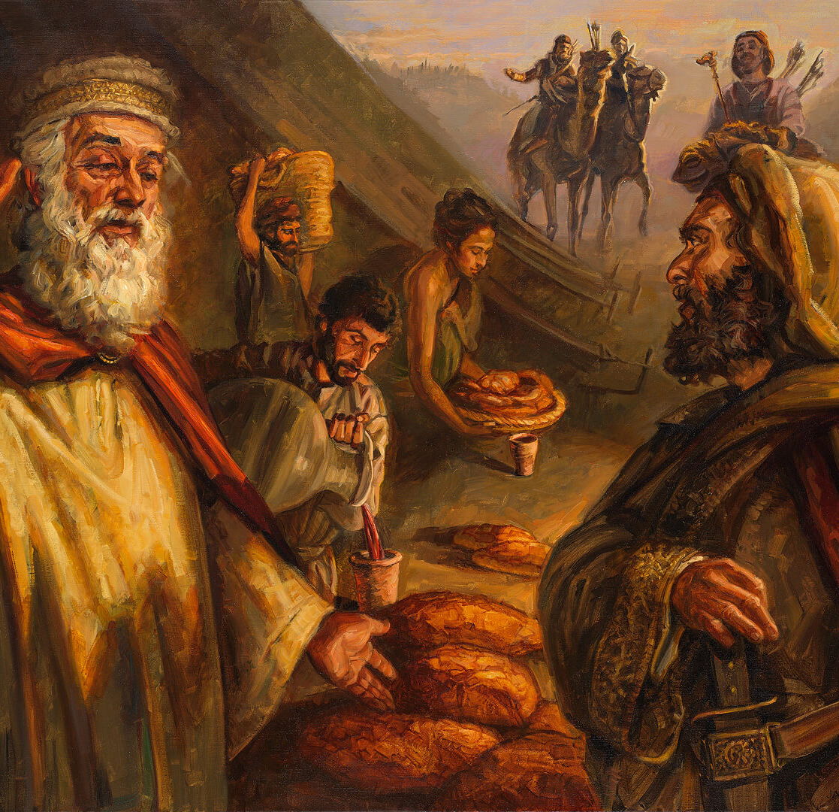
11. What reply did Abraham make?
Genesis 14:22-23
That I will not take from a thread even to a shoelatchet, and that I will not take any thing that is thine, lest thou shouldest say, I have made Abram rich:

Slide 46
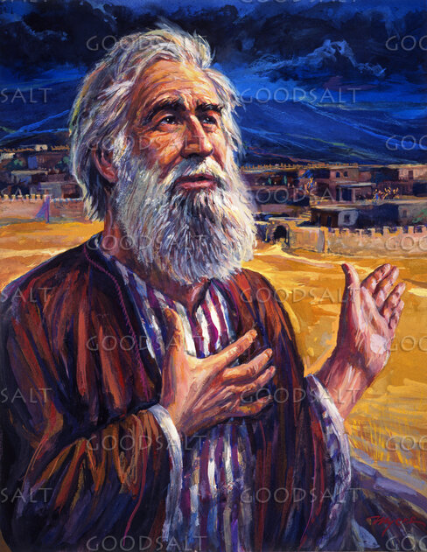
12. What only did Abraham reserve of the spoil?
Genesis 14:24
Save only that which the young men have eaten, and the portion of the men which went with me, Aner, Eshcol, and Mamre; let them take their portion.

Slide 47
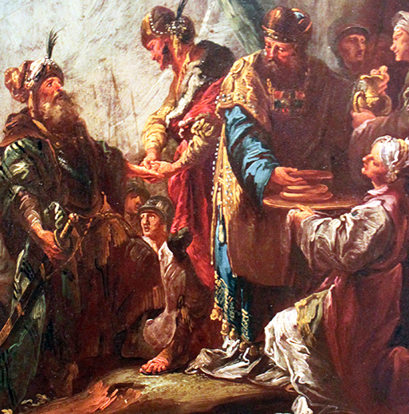
13. What had he taken out before he reserved the portion for the young men who went with him?
Genesis 14:20
And blessed be the most high God, which hath delivered thine enemies into thy hand. And he gave him tithes of all.

Slide 48
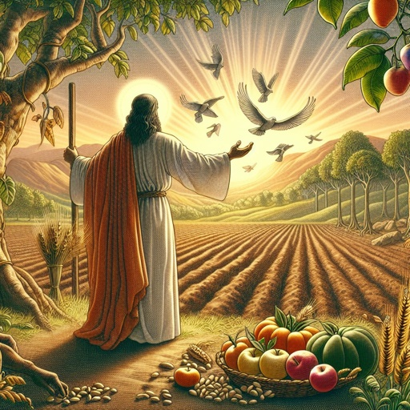
14. Since Abraham said that he would not take so much as a shoe latchet that belonged to the king of Sodom, whose property must he have regarded the tithe which he gave to the priest of the Lord?
Leviticus 27:30
And all the tithe of the land, whether of the seed of the land, or of the fruit of the tree, is the Lord's: it is holy unto the Lord.

Slide 49
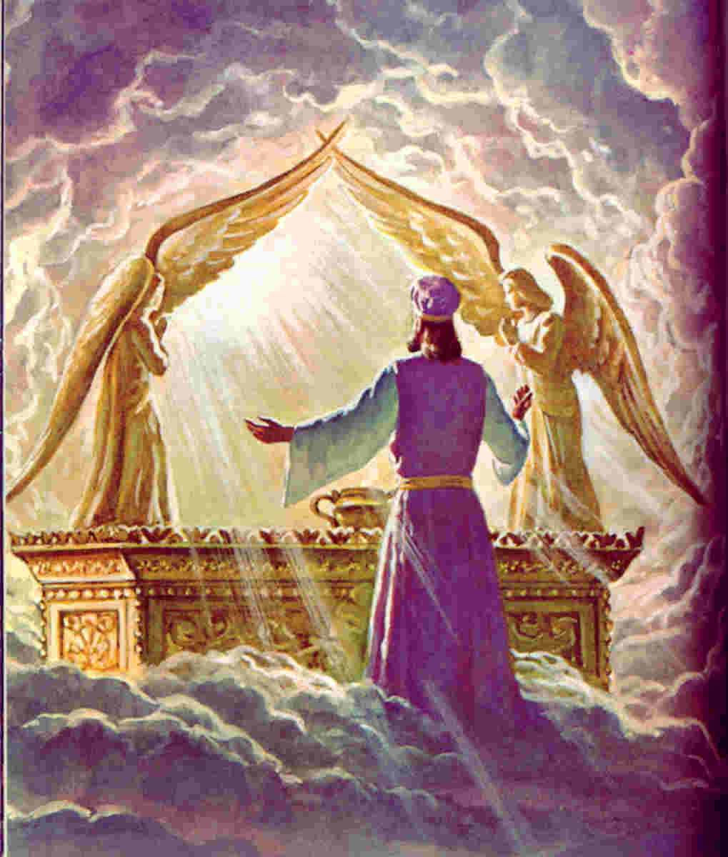
15. Who is our priest?
Hebrews 4:14
Seeing then that we have a great high priest, that is passed into the heavens, Jesus the Son of God, let us hold fast our profession.

Slide 50
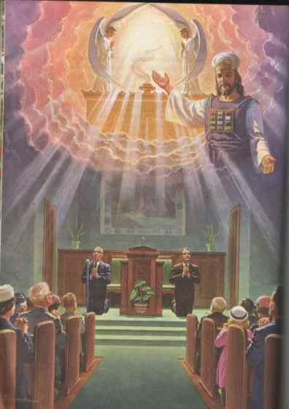
16. Of what order is He the priest?
Hebrews 6:20
Whither the forerunner is for us entered, even Jesus, made an high priest for ever after the order of Melchisedec.

Slide 51
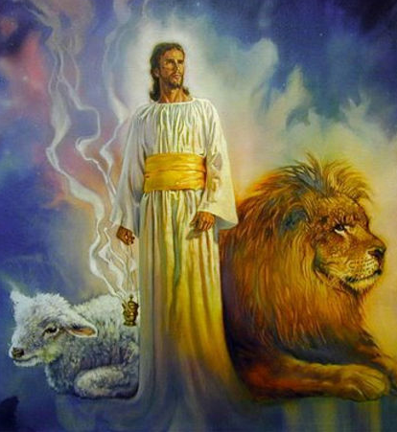
A Priest For Ever
Psalm 110:4
The Lord hath sworn, and will not repent, Thou art a priest for ever after the order of Melchizedek.

Slide 52
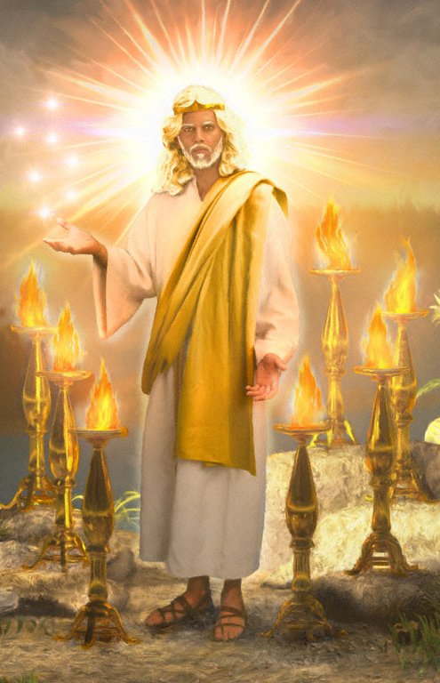
A Priest For Ever
Jesus fulfills this — eternal priest, not from Levi but by divine appointment.
Christ unites kingship and priesthood perfectly — reigning, interceding, and blessing His people forever.

Slide 53
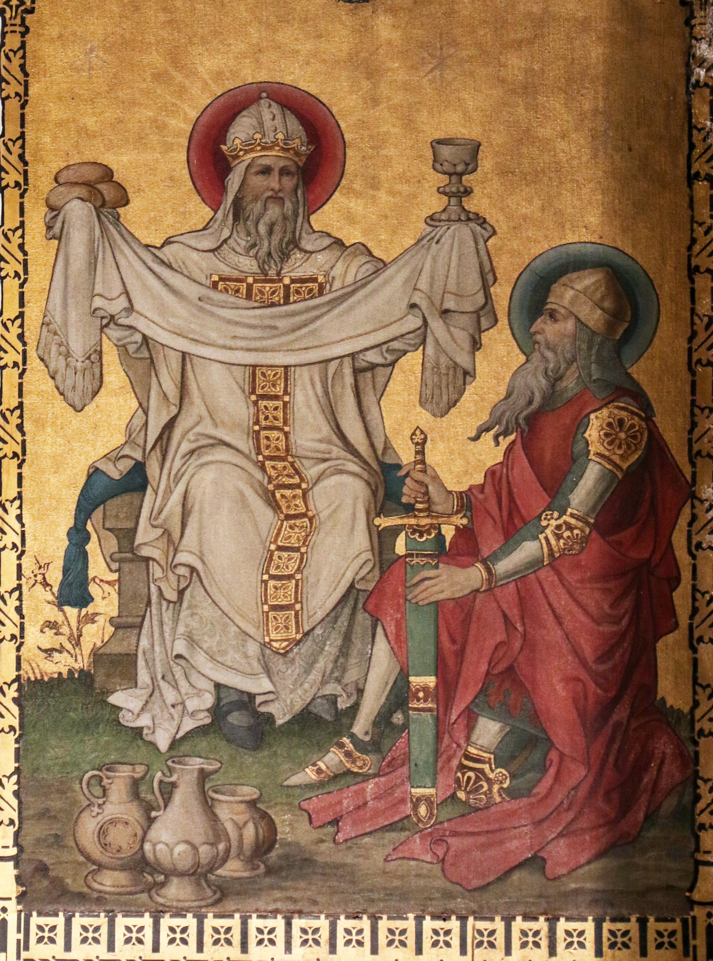
17. Then ought we not to pay tithes as well as Abraham?
Abraham’s example shows tithing is older than the Law — a principle of acknowledging God’s ownership.

Slide 54
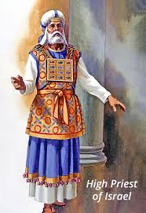
17. Then ought we not to pay tithes as well as Abraham?
Hebrews 7:8 — Christ, our eternal High Priest, still “receiveth them.”

Slide 55
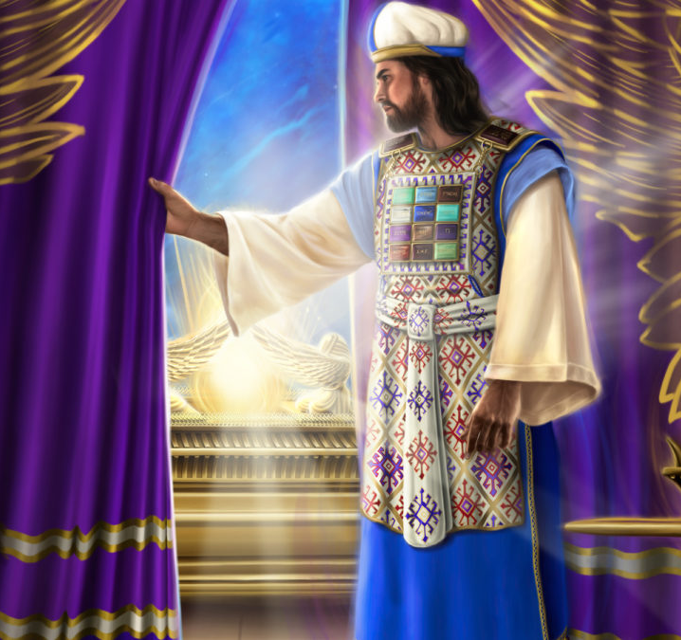
18. What words of the apostle Paul indicate that our great High Priest should receive tithes of us?
Hebrews 7:8
And here men that die receive tithes; but there he receiveth them, of whom it is witnessed that he liveth.

Slide 56
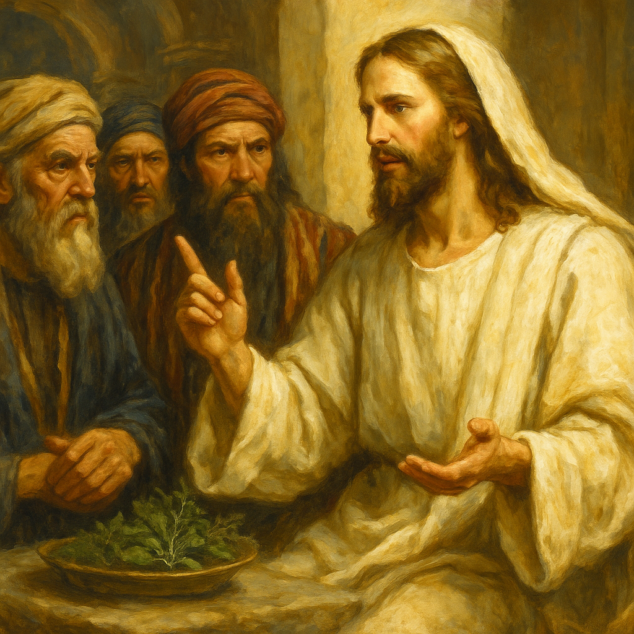
19. What did Jesus Himself say concerning men's duty to pay tithes?
Matthew 23:23
Woe unto you, scribes and Pharisees, hypocrites! for ye pay tithe of mint and anise and cummin, and have omitted the weightier matters of the law, judgment, mercy, and faith: these ought ye to have done, and not to leave the other undone.

Slide 57


Slide 58
Thank You &
HAPPY SABBATH!!

