Slide 1


Slide 2

Living the Light

Slide 3
Old Testament History:
Abraham’s Plea for Sodom
Lesson 11,1st Quarter, 1888

Slide 4
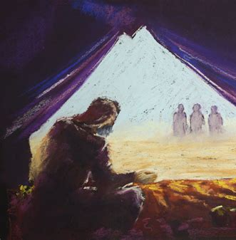
1. Who came to Abraham while he lived in Mamre?
Genesis 18:1-2
And the LORD appeared unto him in the plains of Mamre: and he sat in the tent door in the heat of the day;

Slide 5
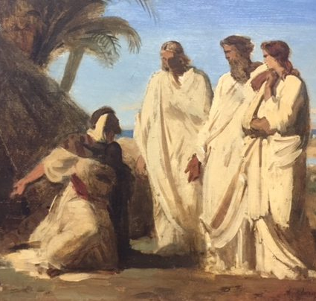
1. Who came to Abraham while he lived in Mamre?
Genesis 18:1-2
And he lift up his eyes and looked, and, lo, three men stood by him: and when he saw them, he ran to meet them from the tent door, and bowed himself toward the ground,

Slide 6
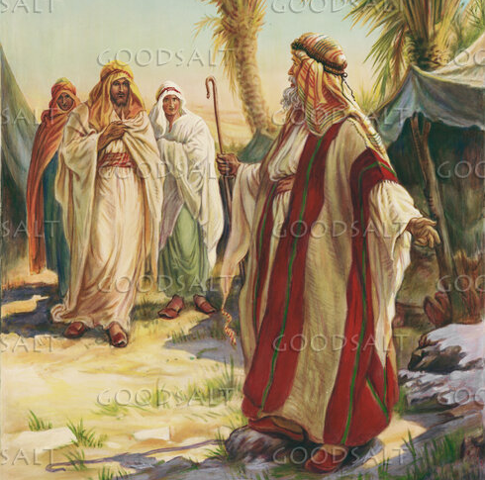
2. Who were these men?
Genesis 18:22
And the men turned their faces from thence, and went toward Sodom: but Abraham stood yet before the LORD.

Slide 7
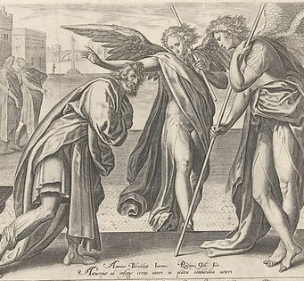
2. Who were these men?
Genesis 19:1
And there came two angels to Sodom at even; and Lot sat in the gate of Sodom: and Lot seeing them rose up to meet them; and he bowed himself with his face toward the ground;

Slide 8

3. Did Abraham recognize the Lord as one of the three men?

Slide 9
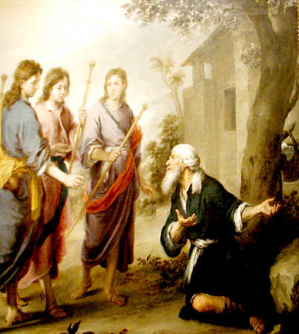
3. Did Abraham recognize the Lord as one of the three men?
Probably not! Abraham respectfully addressed one of the strangers as “my lord” (Heb. ’adonai, meaning sir).
This was a common formula of respect, not a recognition of deity. Examples: Laban to Jacob (Gen. 30:27), Jacob to Esau (Gen. 32:5; 33:8,10).

Slide 10
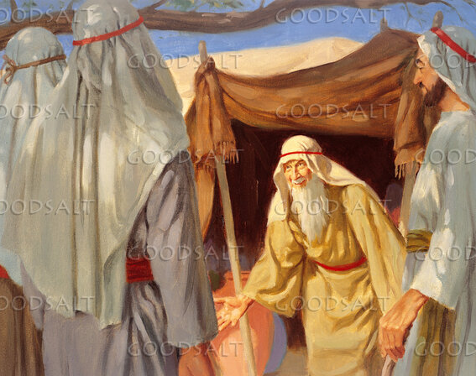
4. How did Abraham show his hospitality?
Genesis 18:3-8
And said, My Lord, if now I have found favour in thy sight, pass not away, I pray thee, from thy servant:

Slide 11
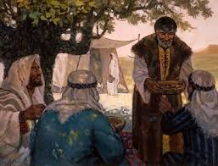
4. How did Abraham show his hospitality?
Genesis 18:3-8
Let a little water, I pray you, be fetched, and wash your feet, and rest yourselves under the tree:

Slide 12
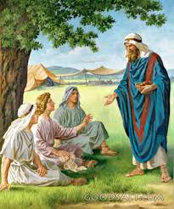
4. How did Abraham show his hospitality?
Genesis 18:3-8
And I will fetch a morsel of bread, and comfort ye your hearts; after that ye shall pass on: for therefore are ye come to your servant. And they said, So do, as thou hast said.

Slide 13
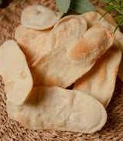
4. How did Abraham show his hospitality?
Genesis 18:3-8
And Abraham hastened into the tent unto Sarah, and said, Make ready quickly three measures of fine meal, knead it, and make cakes upon the hearth.

Slide 14

4. How did Abraham show his hospitality?
Abraham directed his wife to take three “measures,” se’im (or about 20 quarts) of fine meal and bake cakes. A quart of flour weighs about a pound, so we’re talking twenty pounds of flour. That’s a LOT of bread!

Slide 15
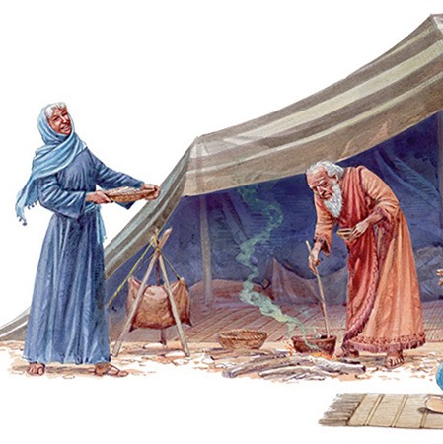
4. How did Abraham show his hospitality?
Genesis 18:3-8
And Abraham ran unto the herd, and fetcht a calf tender and good, and gave it unto a young man; and he hasted to dress it.

Slide 16
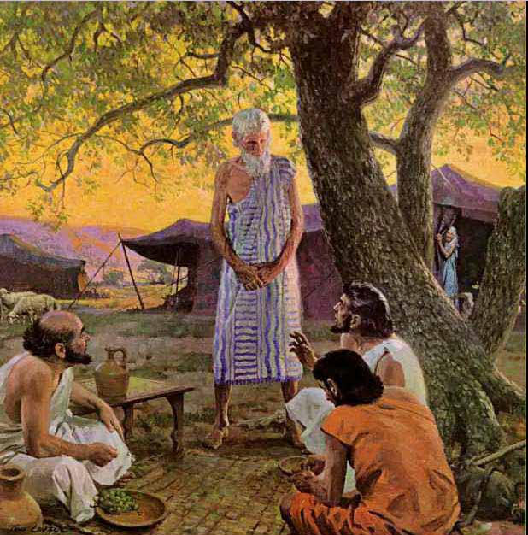
4. How did Abraham show his hospitality?
Extravagance! Abraham wasn’t just feeding guests; he was honoring them. In desert culture, hosting travelers was sacred, and abundance showed respect. Abraham runs, Sarah kneads, the servant dresses—the whole household is involved in the preparations.

Slide 17
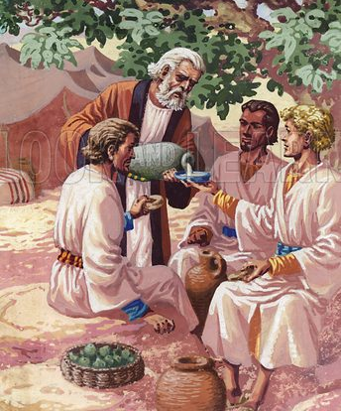
4. How did Abraham show his hospitality?
Genesis 18:3-8
And he took butter, and milk, and the calf which he had dressed, and set it before them; and he stood by them under the tree, and they did eat.

Slide 18
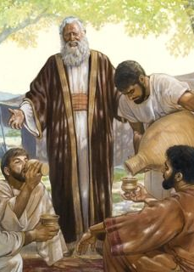
4. How did Abraham show his hospitality?
Abraham and Sarah weren’t just making lunch. In just bread, there were some 160-240 servings involved. They staged a banquet.
In desert culture, this wasn’t wasteful — the whole household, including servants, would join in.
Spiritually, it highlights Abraham’s lavish generosity — giving strangers the best, in abundance.

Slide 19
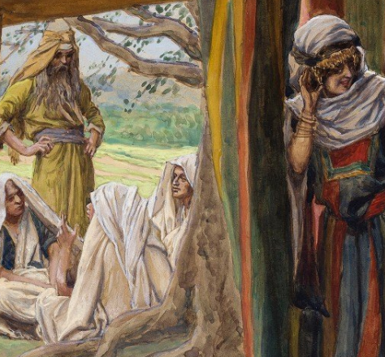
5. What exhortation based upon this occurrence is given to us?
Hebrews 13:2
Be not forgetful to entertain strangers: for thereby some have entertained angels unawares.

Slide 20
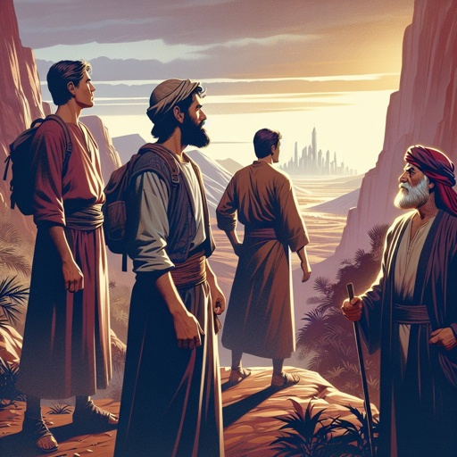
6. When the men rose to go, what did Abraham do?
Genesis 18:16
And the men rose up from thence, and looked toward Sodom: and Abraham went with them to bring them on the way.

Slide 21
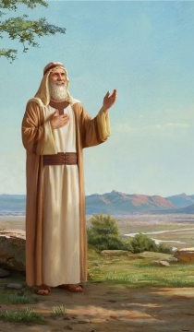
6. When the men rose to go, what did Abraham do?
In accordance with an old custom of friendship, Abraham accompanied his guests for a short distance. The distance traveled indicated the degree of respect and honor the host wishes to show them.

Slide 22
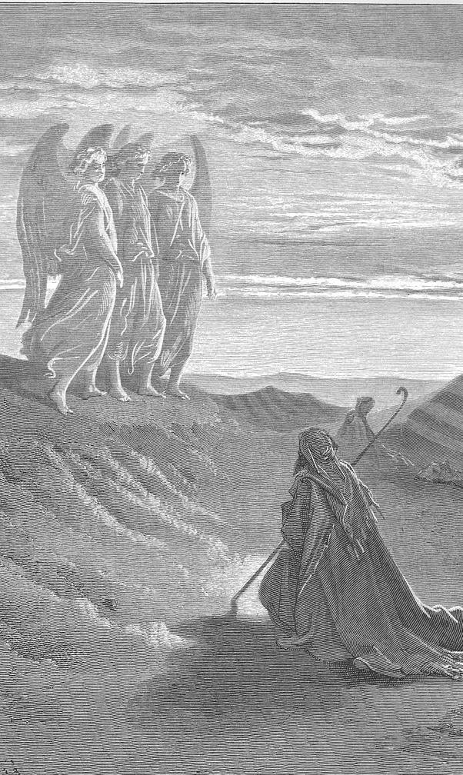
6. When the men rose to go, what did Abraham do?
An old tradition claims that Abraham went as far as Caphar-Barucha, a mountain spot approximately 4-5 mi. east-northeast of Hebron, whence one may see the Dead Sea. From this point, perhaps, Abraham and his guests beheld the prosperous cities of the plain.

Slide 23
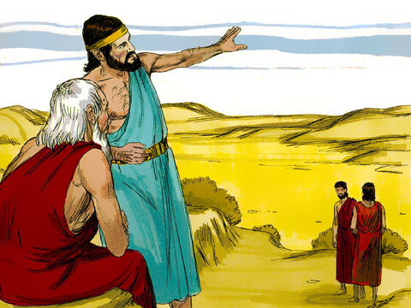
7. What did the Lord say?
Genesis 18:17-18
And the LORD said, Shall I hide from Abraham that thing which I do;

Slide 24
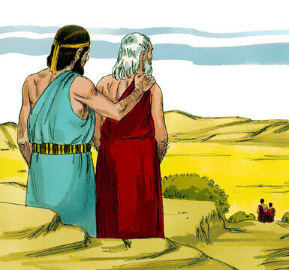
7. What did the Lord say?
Genesis 18:17-18
Seeing that Abraham shall surely become a great and mighty nation, and all the nations of the earth shall be blessed in him?

Slide 25
8. Why did the Lord honor Abraham in this manner?
Genesis 18:19
For I know him, that he will command his children and his household after him, and they shall keep the way of the LORD, to do justice and judgment; that the LORD may bring upon Abraham that which he hath spoken of him.

Slide 26
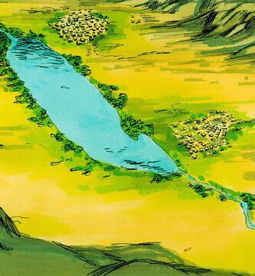
9. What did the Lord say of Sodom and Gomorrah?
Genesis 18:20
And the LORD said, Because the cry of Sodom and Gomorrah is great, and because their sin is very grievous;

Slide 27
9. What did the Lord say of Sodom and Gomorrah?
Genesis 18:21
I will go down now, and see whether they have done altogether according to the cry of it, which is come unto me; and if not, I will know.

Slide 28
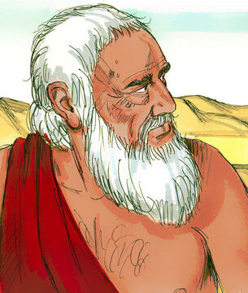
10. What did Abraham say to the Lord?
Genesis 18:23-25
And Abraham drew near, and said, Wilt thou also destroy the righteous with the wicked?

Slide 29
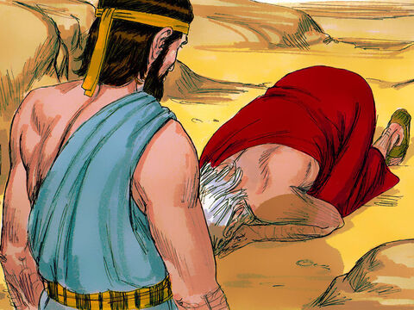
10. What did Abraham say to the Lord?
Genesis 18:23-25
Peradventure there be fifty righteous within the city: wilt thou also destroy and not spare the place for the fifty righteous that are therein?

Slide 30
10. What did Abraham say to the Lord?
Genesis 18:23-25
That be far from thee to do after this manner, to slay the righteous with the wicked: and that the righteous should be as the wicked, that be far from thee: Shall not the Judge of all the earth do right?

Slide 31
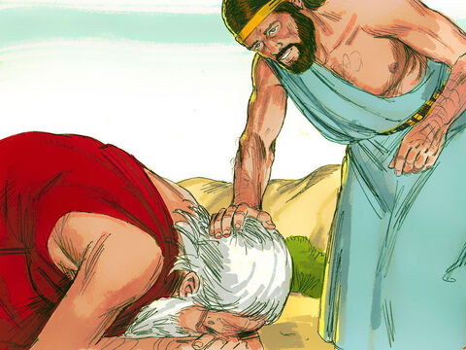
11. What reply did the Lord make?
Genesis 18:26
And the LORD said, If I find in Sodom fifty righteous within the city, then I will spare all the place for their sakes.

Slide 32
12. In what spirit did Abraham continue his plea?
Genesis 18:27
And Abraham answered and said, Behold now, I have taken upon me to speak unto the Lord, which am but dust and ashes:

Slide 33
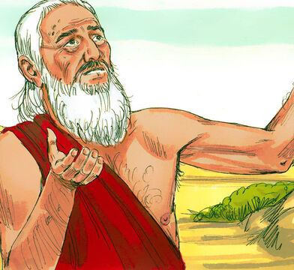
13. What was the second request, and the reply?
Genesis 18:28
Peradventure there shall lack five of the fifty righteous: wilt thou destroy all the city for lack of five? And he said, If I find there forty and five, I will not destroy it.

Slide 34
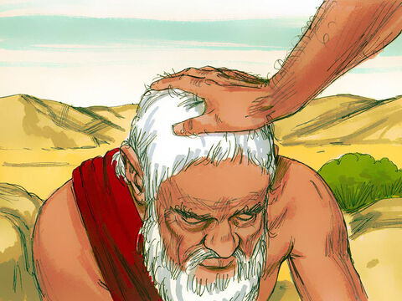
14. What concession did the Lord still further make in answer to Abraham's earnest prayer?
Genesis 18:29
And he spake unto him yet again, and said, Peradventure there shall be forty found there. And he said, I will not do it for forty's sake.

Slide 35
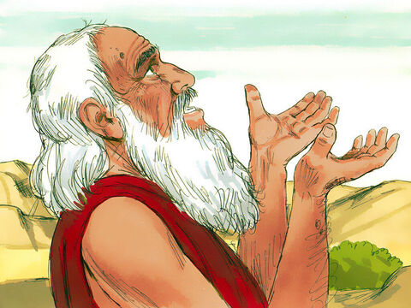
15. How did Abraham still further pray, and what was the result?
Genesis 18:30-31
And he said unto him, Oh let not the Lord be angry, and I will speak: Peradventure there shall thirty be found there. And he said, I will not do it, if I find thirty there.

Slide 36
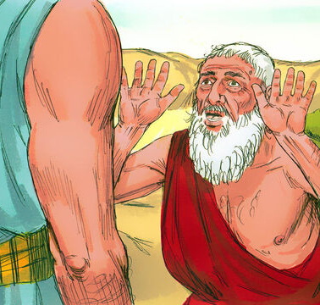
15. How did Abraham still further pray, and what was the result?
Genesis 18:30-31
And he said, Behold now, I have taken upon me to speak unto the Lord: Peradventure there shall be twenty found there. And he said, I will not destroy it for twenty's sake.

Slide 37
16. For what still smaller number did the Lord say He would spare Sodom?
Genesis 18:31
And he said, Behold now, I have taken upon me to speak unto the Lord: Peradventure there shall be twenty found there. And he said, I will not destroy it for twenty's sake.

Slide 38
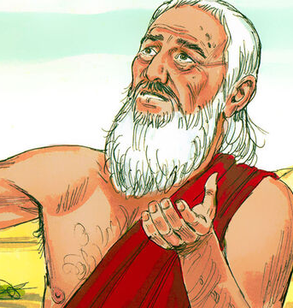
17. Finally, how many righteous persons did the Lord say would save Sodom?
Genesis 18:32
And he said, Oh let not the Lord be angry, and I will speak yet but this once: Peradventure ten shall be found there. And he said, I will not destroy it for ten's sake.

Slide 39
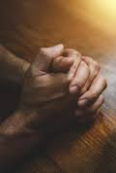
18. In this simple narrative, what scripture do we see fulfilled?
James 5:16
Confess your faults one to another, and pray one for another, that ye may be healed. The effectual fervent prayer of a righteous man availeth much.

Slide 40
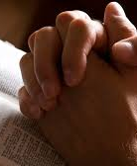
18. In this simple narrative, what scripture do we see fulfilled?
Prayer depends, not on talent, learning, rank, wealth, or office, but on the character of the man who prays. Abram is not perfect. But he is “righteous” in that he does not cling to known sin. He is righteous in that he is in active fellowship and communion with God.

Slide 41
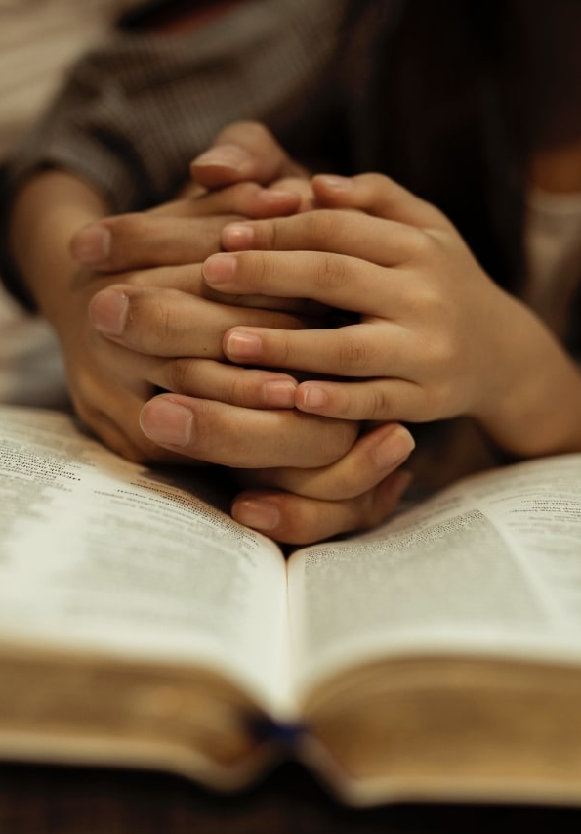
18. In this simple narrative, what scripture do we see fulfilled?
Availeth: “to be strong,” “to have power to accomplish.” Prayer as a means of cooperation with the will of God contributes most to Christian endurance and character development when it ascends from the pure and faithful in heart.

Slide 42
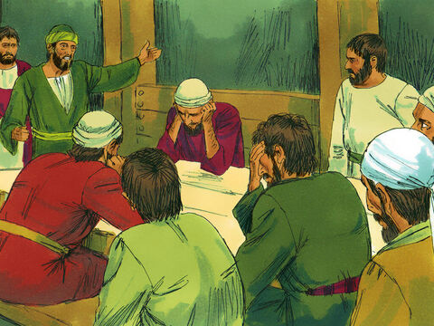
19. Cite some notable instances where wicked men's lives were spared on account of a righteous man:
Acts 27:21-25
But after long abstinence Paul stood forth in the midst of them, and said, Sirs, ye should have hearkened unto me, and not have loosed from Crete, and to have gained this harm and loss.

Slide 43
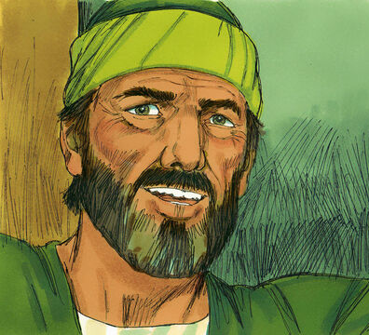
19. Cite some notable instances where wicked men's lives were spared on account of a righteous man:
Acts 27:21-25
And now I exhort you to be of good cheer: for there shall be no loss of any man's life among you, but of the ship.

Slide 44
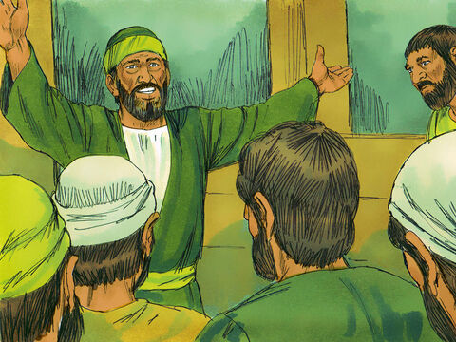
19. Cite some notable instances where wicked men's lives were spared on account of a righteous man:
Acts 27:21-25
For there stood by me this night the angel of God, whose I am, and whom I serve,

Slide 45
19. Cite some notable instances where wicked men's lives were spared on account of a righteous man:
Acts 27:21-25
Saying, Fear not, Paul; thou must be brought before Caesar: and, lo, God hath given thee all them that sail with thee.

Slide 46
19. Cite some notable instances where wicked men's lives were spared on account of a righteous man:
Acts 27:21-25
Wherefore, sirs, be of good cheer: for I believe God, that it shall be even as it was told me.

Slide 47
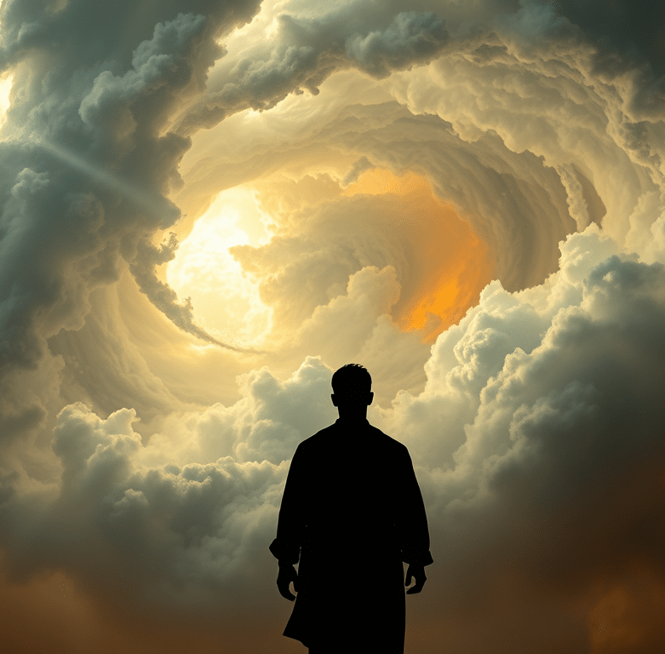
19. Cite some notable instances Where wicked men's lives were spared on account of a righteous man:
Job 42:7-9
And it was so, that after the LORD had spoken these words unto Job, the LORD said to Eliphaz the Temanite, My wrath is kindled against thee, and against thy two friends: for ye have not spoken of me the thing that is right, as my servant Job hath.

Slide 48
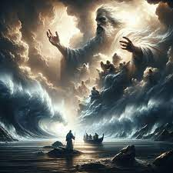
19. Cite some notable instances where wicked men's lives were spared on account of a righteous man:
Job 42:7-9
Therefore take unto you now seven bullocks and seven rams, and go to my servant Job, and offer up for yourselves a burnt offering; and my servant Job shall pray for you: for him will I accept: lest I deal with you after your folly, in that ye have not spoken of me the thing which is right, like my servant Job.

Slide 49
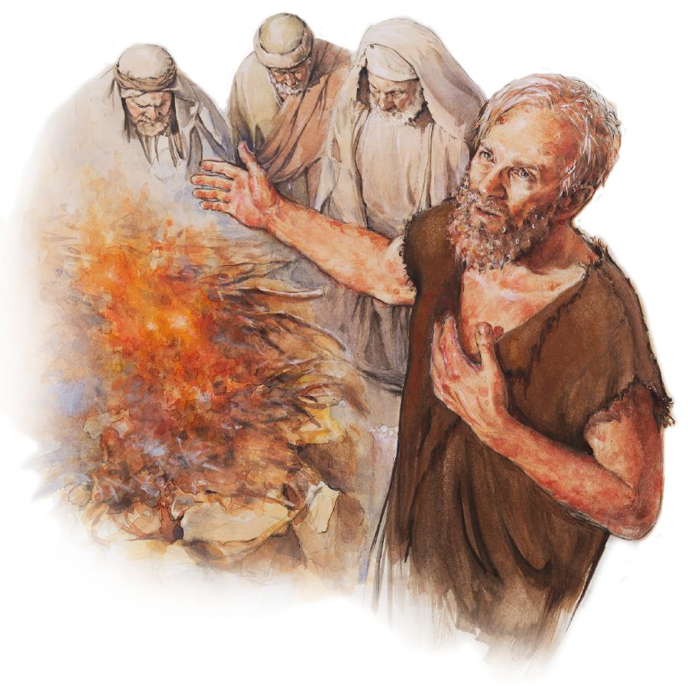
19. Cite some notable instances where wicked men's lives were spared on account of a righteous man:
Job 42:7-9
So Eliphaz the Temanite and Bildad the Shuhite and Zophar the Naamathite went, and did according as the LORD commanded them: the LORD also accepted Job.

Slide 50
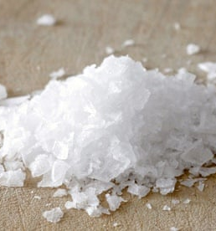
20. What relation do the righteous sustain to the people of the earth?
Matthew 5:13
Ye are the salt of the earth: but if the salt have lost his savour, wherewith shall it be salted? it is thenceforth good for nothing, but to be cast out, and to be trodden under foot of men.

Slide 51
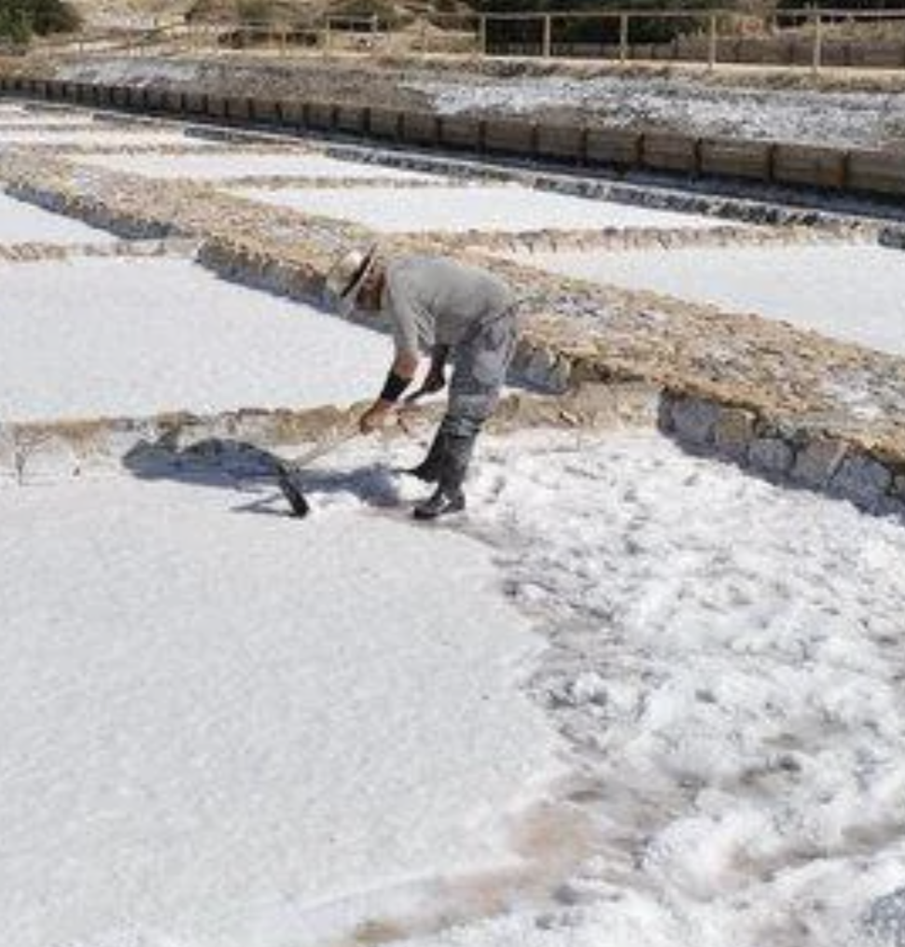
20. What relation do the righteous sustain to the people of the earth?
Salt Preserves:
In the ancient Near East, salt was the primary preservative — no refrigeration, so meat and fish were salted to keep them from rotting.

Slide 52
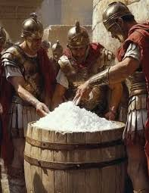
20. What relation do the righteous sustain to the people of the earth?
Salt Preserves:
Roman soldiers carried salted pork/fish on campaigns; survival depended on it. Salt was vital for replacing electrolytes lost in labor or battle.

Slide 53

20. What relation do the righteous sustain to the people of the earth?
Salt Preserves:
Christians hold back decay through a righteous example that influences society.

Slide 54

20. What relation do the righteous sustain to the people of the earth?
Salt Preserves:
Christians hold back destruction because God, in His mercy, blesses and protects others for the sake of His people.

Slide 55
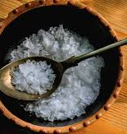
20. What relation do the righteous sustain to the people of the earth?
Salt Flavors:
Colossians 4:6 — “Let your speech be alway with grace, seasoned with salt…”

Slide 56
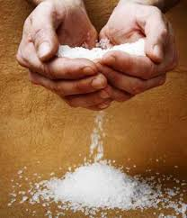
20. What relation do the righteous sustain to the people of the earth?
Historical note: Salt was valuable and precious — sometimes used as currency (salarium → salary).

Slide 57
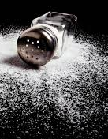
20. What relation do the righteous sustain to the people of the earth?
Salt Flavors:
Christians flavor life by bringing joy, hope, and meaning into the world through the message of Christ’s life-changing sacrifice.

Slide 58
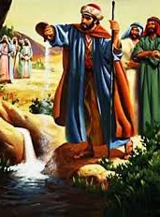
20. What relation do the righteous sustain to the people of the earth?
Salt Purifies & Heals:
2 Kings 2:20–21 — Elisha healed Jericho’s waters with salt.

Slide 59
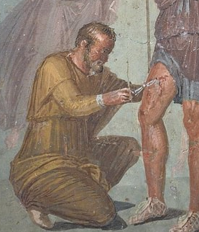
20. What relation do the righteous sustain to the people of the earth?
Historical note:
Salt was used in medicine and sanitation; rubbing wounds with salt disinfected, even if it stung.

Slide 60

20. What relation do the righteous sustain to the people of the earth?
Salt Purifies & Heals:
The gospel convicts and heals — it stings the conscience, but restores life (John 16:8).

Slide 61

20. What relation do the righteous sustain to the people of the earth?
Salt Purifies & Heals:
Christians purify by living holy lives that convict others of sin.

Slide 62

20. What relation do the righteous sustain to the people of the earth?
Salt Purifies & Heals:
Christians heal by pointing broken lives to the cleansing power of Christ.

Slide 63
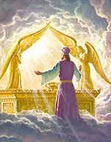
20. What relation do the righteous sustain to the people of the earth?
Salt is a COVENANT Symbol:
Leviticus 2:13 — “With all thine offerings thou shalt offer salt.”

Slide 64
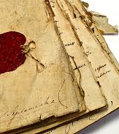
20. What relation do the righteous sustain to the people of the earth?
Historical note: Salt doesn’t rot; it symbolized permanence and loyalty. Ancient Near Eastern treaties sometimes included salt rituals to signify an unbreakable covenant.

Slide 65
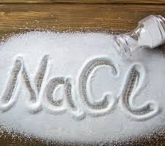
20. What relation do the righteous sustain to the people of the earth?
Biblical example: God’s covenant of salt with David’s line (2 Chron. 13:5).

Slide 66
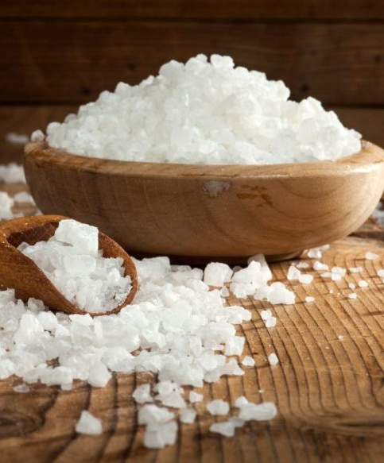
20. What relation do the righteous sustain to the people of the earth?
Salt is a COVENANT Symbol:
Christians are the evidence of the covenant’s unbreakableness — their existence proves God’s grace and demonstrates His character.

Slide 67
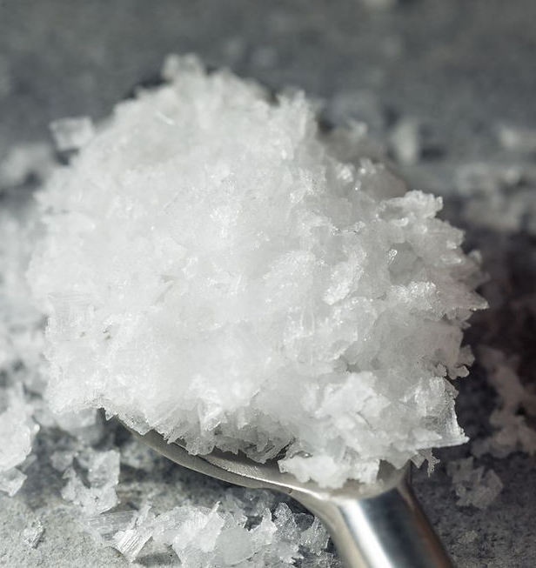
20. What relation do the righteous sustain to the people of the earth?
Salt is a COVENANT Symbol:
The endurance of the faithful at the end of time will stand as living proof that God keeps His Word forever. God is both merciful and just, and the fact of the faithful at the end proves it.

Slide 68

20. What relation do the righteous sustain to the people of the earth?
WARNING:
Salt can Poison
Matthew 5:13 — “If the salt have lost his savour, wherewith shall it be salted?”

Slide 69
20. What relation do the righteous sustain to the people of the earth?
Historical note: Dead Sea “salt” was often mixed with gypsum and other minerals; exposed to rain, it lost its flavor and became useless.

Slide 70

20. What relation do the righteous sustain to the people of the earth?
WARNING:
Salt can Poison
Too much salt sterilizes soil, preventing growth. Armies have been known to salt the ruins of enemy cities to prevent regrowth.

Slide 71

20. What relation do the righteous sustain to the people of the earth?
WARNING:
Salt can Poison
Biblical example: Lot’s wife (Gen. 19:26; Luke 17:32) — a pillar of salt, lifeless and sterile.

Slide 72

20. What relation do the righteous sustain to the people of the earth?
WARNING:
Salt can Poison
Christians must not cling to the world and lose their savor.

Slide 73
21. Will the presence of righteous men always be sufficient to save the wicked from merited punishment?
Ezekiel 14:19-20
Or if I send a pestilence into that land, and pour out my fury upon it in blood, to cut off from it man and beast:

Slide 74

21. Will the presence of righteous men always be sufficient to save the wicked from merited punishment?
Ezekiel 14:19-20
Though Noah, Daniel, and Job, were in it, as I live, saith the Lord GOD, they shall deliver neither son nor daughter; they shall but deliver their own souls by their righteousness.

Slide 75

22. What is the only safe place for people to occupy?
Psalm 91:1-4
He that dwelleth in the secret place of the most High shall abide under the shadow of the Almighty.

Slide 76

22. What is the only safe place for people to occupy?
Psalm 91:1-4
I will say of the LORD, He is my refuge and my fortress: my God; in him will I trust.

Slide 77

22. What is the only safe place for people to occupy?
Psalm 91:1-4
Surely he shall deliver thee from the snare of the fowler, and from the noisome pestilence.

Slide 78

22. What is the only safe place for people to occupy?
Psalm 91:1-4
He shall cover thee with his feathers, and under his wings shalt thou trust: his truth shall be thy shield and buckler.

Slide 79


Slide 80
Thank You &
HAPPY SABBATH!!

