Slide 1


Slide 2

Living the Light

Slide 3
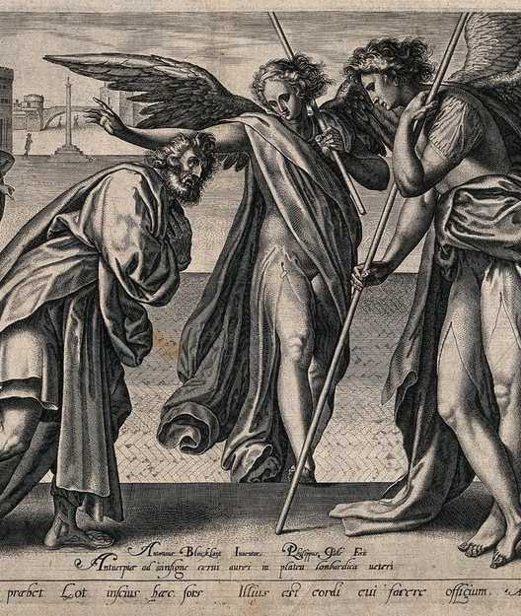
1. While Abraham was pleading with the Lord for Sodom, what were the two angels who accompanied him doing?
Genesis 18:22
And the men turned their faces from thence, and went toward Sodom: but Abraham stood yet before the LORD.

Slide 4
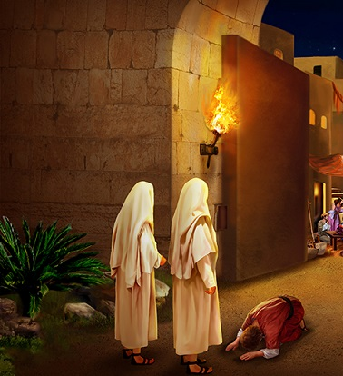
2. At what time did the angels reach Sodom?
Genesis 19:1
And there came two angels to Sodom at even; and Lot sat in the gate of Sodom: and Lot seeing them rose up to meet them; and he bowed himself with his face toward the ground;

Slide 5
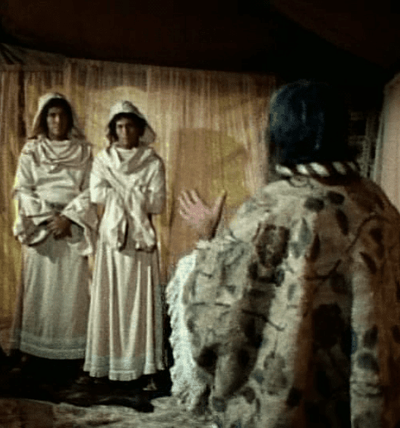
3. How did Lot greet them?
He bowed himself with his face toward the ground.
A gesture of deep respect and humility, showing reverence toward strangers — a striking contrast with the arrogance of Sodom’s inhabitants.

Slide 6
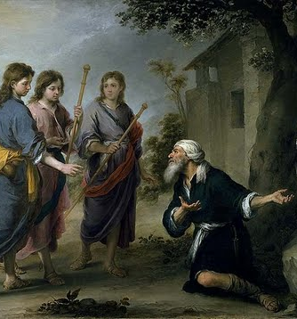
4. What trait had Lot in common with Abraham?
Answer: Hospitality

Slide 7
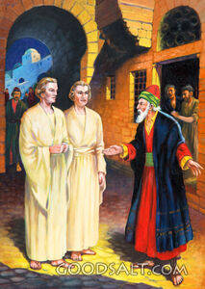
5. How did he exhibit it?
Genesis 19:2-3
And he said, Behold now, my lords, turn in, I pray you, into your servant’s house, and tarry all night, and wash your feet, and ye shall rise up early, and go on your ways. And they said, Nay; but we will abide in the street all night. And he pressed upon them greatly; and they turned in unto him, and entered into his house; and he made them a feast, and did bake unleavened bread, and they did eat.

Slide 8
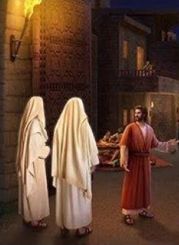
6. What place of honor did Lot occupy in the city of Sodom?
Genesis 19:1
And there came two angels to Sodom at even; and Lot sat in the gate of Sodom: and Lot seeing them rose up to meet them; and he bowed himself with his face toward the ground;

Slide 9
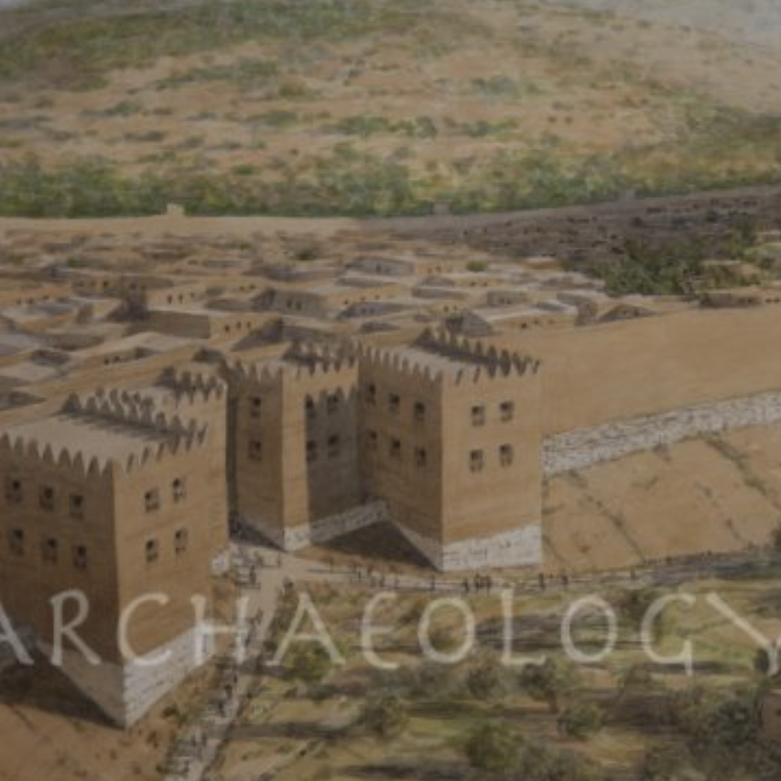
6. What place of honor did Lot occupy in the city of Sodom?
Archaeological excavations show that Bronze Age city gates, like those at Tall el-Hammam, were centers of civic and judicial life. This helps explain Lot’s role at the gate of Sodom as a position of public trust.

Slide 10
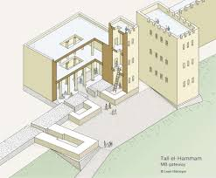

Slide 11
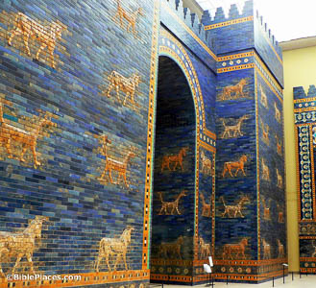
7. Cite other instances that indicate that those who sat in the gate occupied an office of public trust:
Daniel 2:49
Then Daniel requested of the king, and he set Shadrach, Meshach, and Abednego, over the affairs of the province of Babylon: but Daniel sat in the gate of the king.

Slide 12
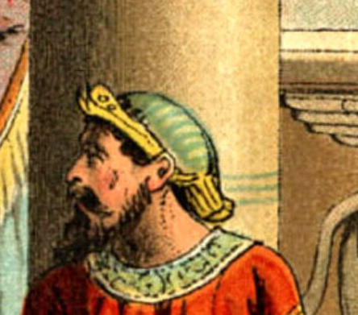
7. Cite other instances that indicate that those who sat in the gate occupied an office of public trust:
Esther 2:19, 21-22
And when the virgins were gathered together the second time, then Mordecai sat in the king's gate.

Slide 13
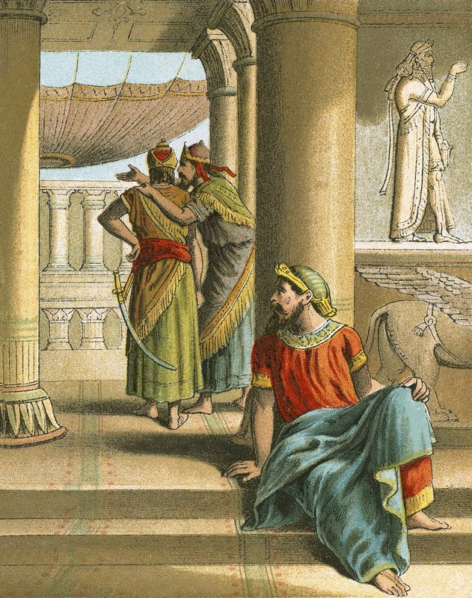
7. Cite other instances that indicate that those who sat in the gate occupied an office of public trust:
Esther 2:19, 21-22
In those days, while Mordecai sat in the king's gate, two of the king's chamberlains, Bigthan and Teresh, of those which kept the door, were wroth, and sought to lay hands on the king Ahasuerus.

Slide 14
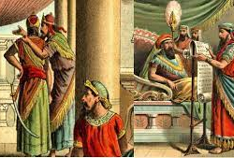
7. Cite other instances that indicate that those who sat in the gate occupied an office of public trust:
Esther 2:19, 21-22
And the thing was known to Mordecai, who told it unto Esther the queen; and Esther certified the king thereof in Mordecai's name.

Slide 15
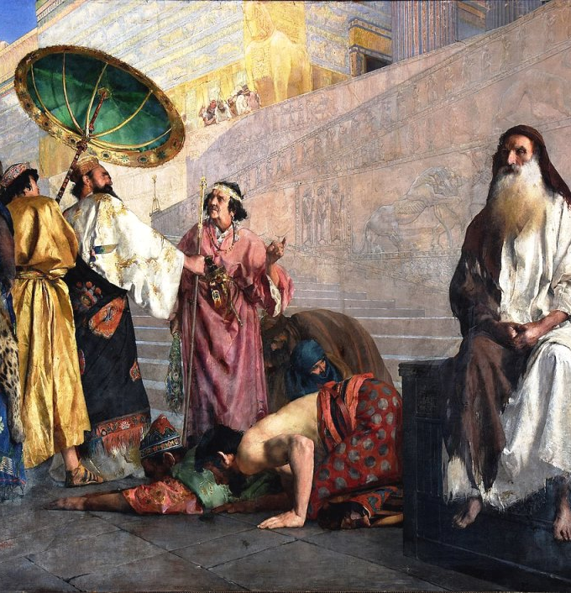
7. Cite other instances that indicate that those who sat in the gate occupied an office of public trust:
Esther 3:2-3
And all the king's servants, that were in the king's gate, bowed, and reverenced Haman: for the king had so commanded concerning him. But Mordecai bowed not, nor did him reverence.

Slide 16
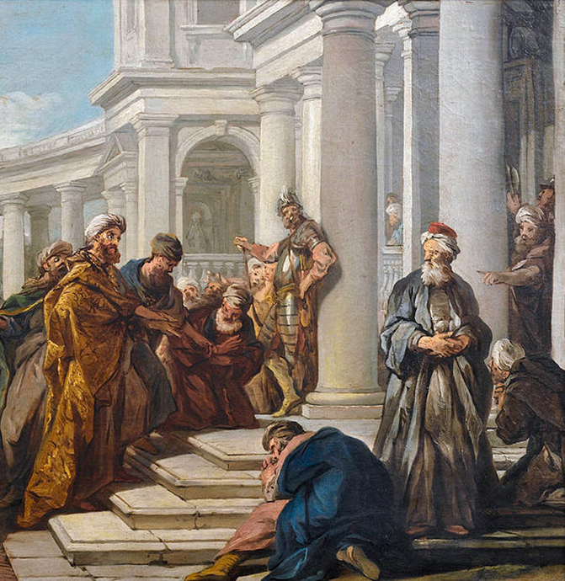
7. Cite other instances that indicate that those who sat in the gate occupied an office of public trust:
Esther 3:2-3
Then the king's servants, which were in the king's gate, said unto Mordecai, Why transgressest thou the king's commandment?

Slide 17
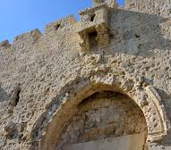
7. Cite other instances that indicate that those who sat in the gate occupied an office of public trust:
Proverbs 24:7
Wisdom is too high for a fool: he openeth not his mouth in the gate.

Slide 18
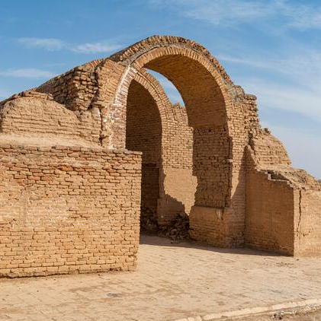
7. Cite other instances that indicate that those who sat in the gate occupied an office of public trust:
Proverbs 31:23
Her husband is known in the gates, when he sitteth among the elders of the land.

Slide 19
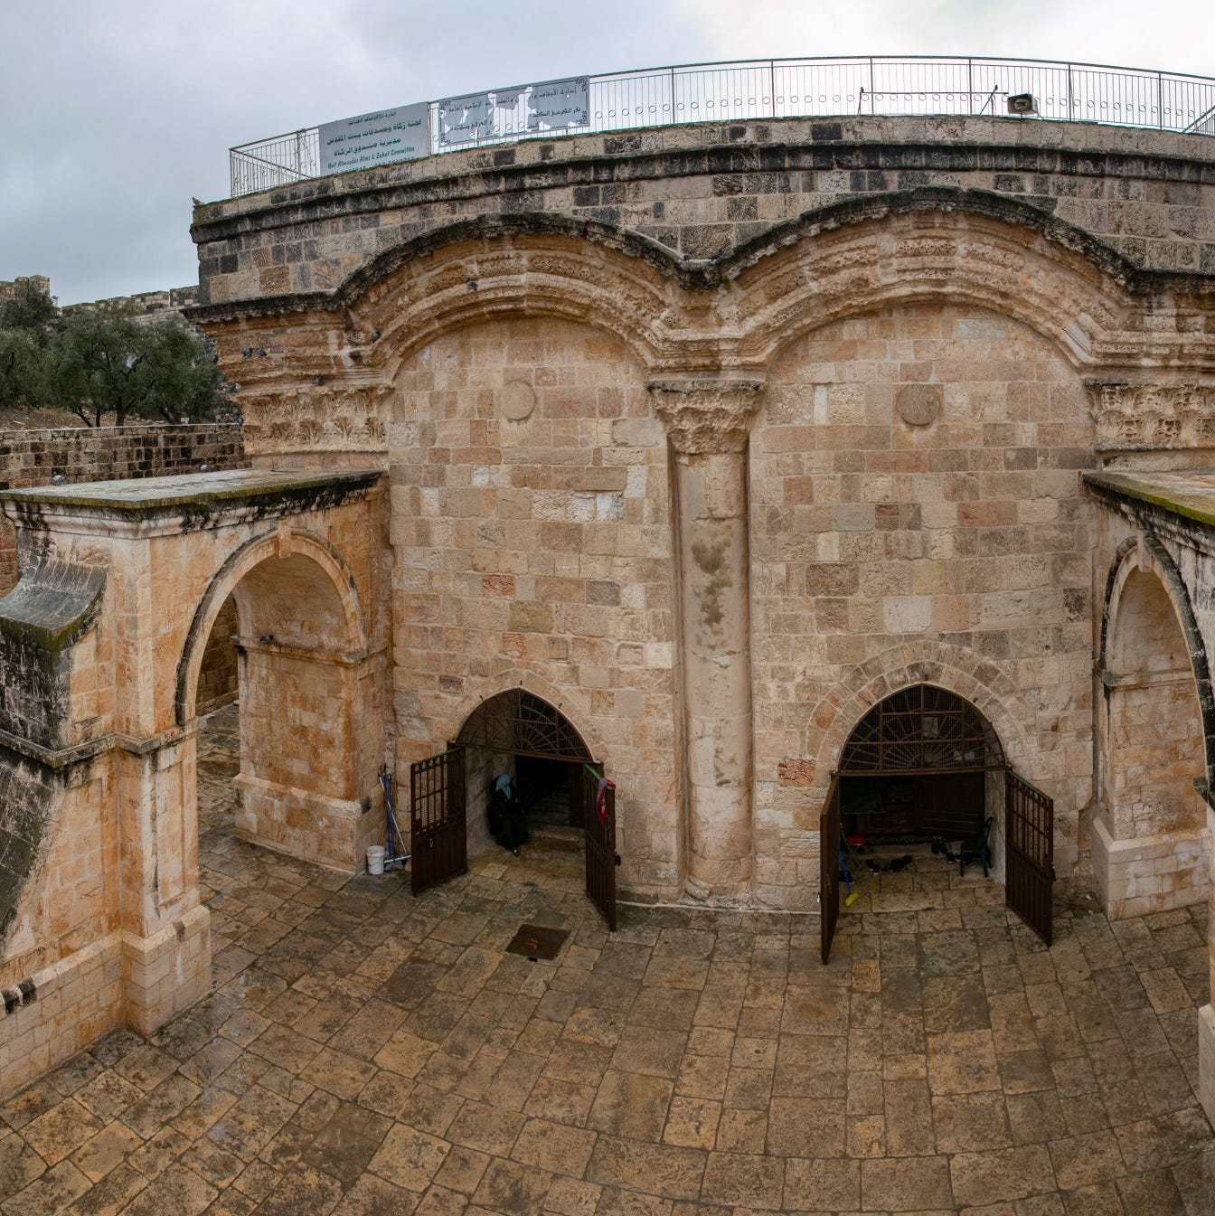
7. Cite other instances that indicate that those who sat in the gate occupied an office of public trust:
Lamentations 5:14
The elders have ceased from the gate, the young men from their musick.

Slide 20
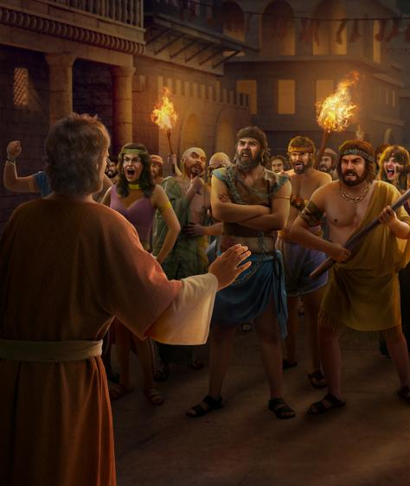
8. What words of the Sodomites corroborate this?
Genesis 19:9
And they said, Stand back. And they said again, This one fellow came in to sojourn, and he will needs be a judge: now will we deal worse with thee, than with them. And they pressed sore upon the man, even Lot, and came near to break the door.

Slide 21
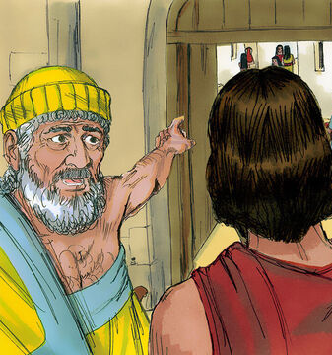
9. Did Lot participate in the wickedness of the Sodomites?
2 Peter 2:6-8
And turning the cities of Sodom and Gomorrha into ashes condemned them with an overthrow, making them an ensample unto those that after should live ungodly; And delivered just Lot, vexed with the filthy conversation of the wicked: (For that righteous man dwelling among them, in seeing and hearing, vexed his righteous soul from day to day with their unlawful deeds;)

Slide 22
10. What was the crying sin of Sodom and Gomorrah?

Slide 23
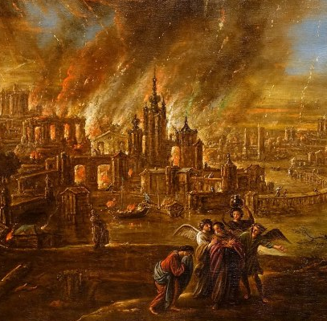
10. What was the crying sin of Sodom and Gomorrah?
Genesis 18:20
And the Lord said, Because the cry of Sodom and Gomorrah is great, and because their sin is very grievous;

Slide 24
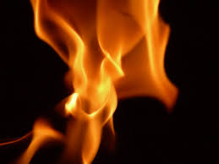
10. What was the crying sin of Sodom and Gomorrah?
Jude 7
Even as Sodom and Gomorrha, and the cities about them in like manner, giving themselves over to fornication, and going after strange flesh, are set forth for an example, suffering the vengeance of eternal fire.

Slide 25
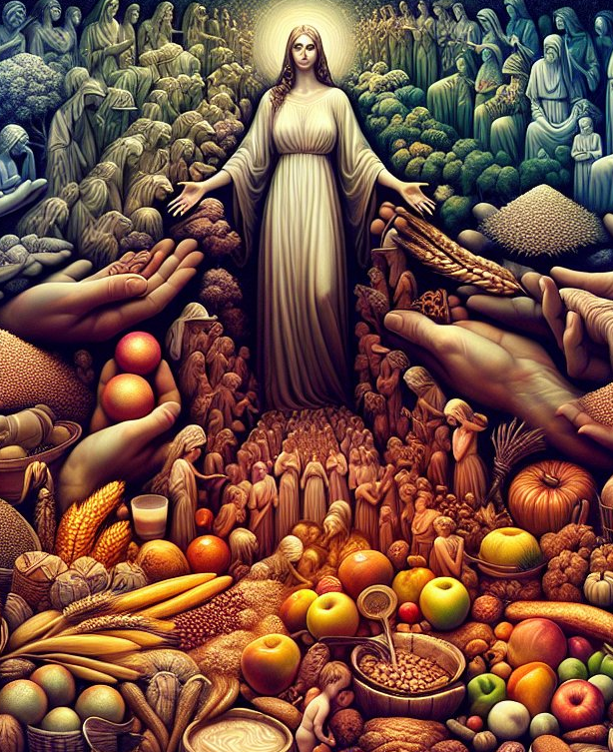
10. What was the crying sin of Sodom and Gomorrah?
Ezekiel 16:49-50
Behold, this was the iniquity of thy sister Sodom, pride, fulness of bread, and abundance of idleness was in her and in her daughters, neither did she strengthen the hand of the poor and needy.

Slide 26

10. What was the crying sin of Sodom and Gomorrah?
Ezekiel 16:49-50
And they were haughty, and committed abomination before me: therefore I took them away as I saw good.

Slide 27
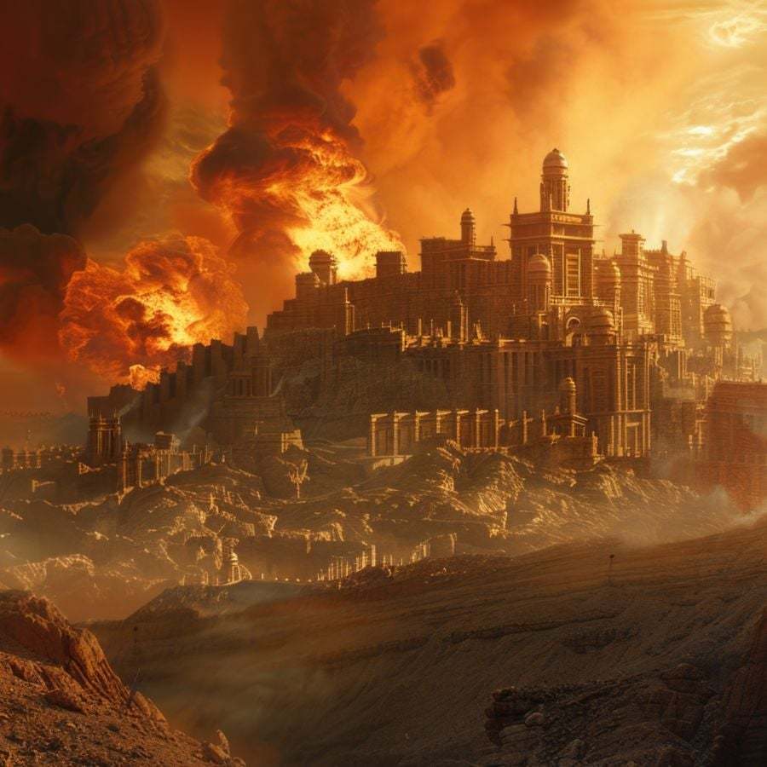
10. What was the crying sin of Sodom and Gomorrah?
Isaiah 3:9
The shew of their countenance doth witness against them; and they declare their sin as Sodom, they hide it not. Woe unto their soul! for they have rewarded evil unto themselves.

Slide 28
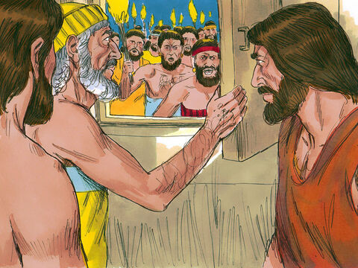
11. What marked contrast was there between the hospitality of Lot and the actions of the men of Sodom?
Genesis 19:4-7, 9
But before they lay down, the men of the city, even the men of Sodom, compassed the house round, both old and young, all the people from every quarter:

Slide 29
11. What marked contrast was there between the hospitality of Lot and the actions of the men of Sodom?
Genesis 19:4-7, 9
And they called unto Lot, and said unto him, Where are the men which came in to thee this night? bring them out unto us, that we may know them.

Slide 30
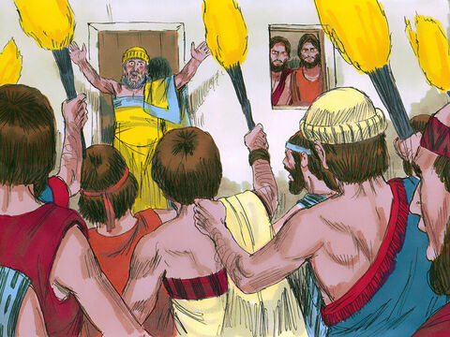
11. What marked contrast was there between the hospitality of Lot and the actions of the men of Sodom?
Genesis 19:4-7, 9
And Lot went out at the door unto them, and shut the door after him,

Slide 31
11. What marked contrast was there between the hospitality of Lot and the actions of the men of Sodom?
Genesis 19:4-7, 9
And said, I pray you, brethren, do not so wickedly.

Slide 32
11. What marked contrast was there between the hospitality of Lot and the actions of the men of Sodom?
Genesis 19:4-7, 9
And they said, Stand back. And they said again, This one fellow came in to sojourn, and he will needs be a judge: now will we deal worse with thee, than with them. And they pressed sore upon the man, even Lot, and came near to break the door.

Slide 33
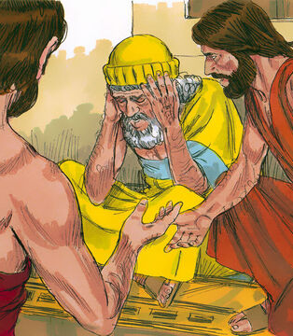
12. What did the angels say to Lot?
Genesis 19:12-13
And the men said unto Lot, Hast thou here any besides? son in law, and thy sons, and thy daughters, and whatsoever thou hast in the city, bring them out of this place:

Slide 34
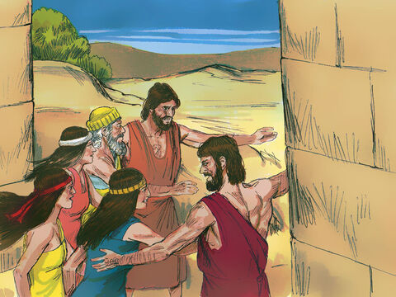
12. What did the angels say to Lot?
Genesis 19:12-13
For we will destroy this place, because the cry of them is waxen great before the face of the LORD; and the LORD hath sent us to destroy it.

Slide 35
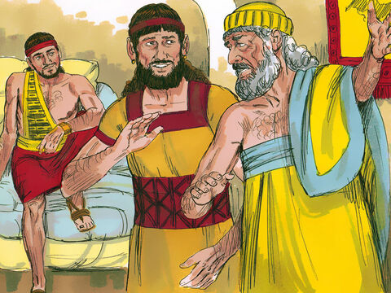
13. What did Lot do?
Genesis 19:14
And Lot went out, and spake unto his sons in law, which married his daughters, and said, Up, get you out of this place; for the LORD will destroy this city. But he seemed as one that mocked unto his sons in law.

Slide 36
14. How did his sons-in-law regard his appeal?
“But he seemed as one that mocked unto his sons in law.” (Genesis 19:14)
They dismissed his warning as a joke, showing unbelief and spiritual blindness.

Slide 37
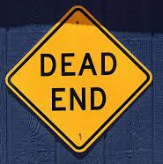
14. How did his sons-in-law regard his appeal?
Their reaction reveals the real sin of Sodom: indifference to God’s warning.
Not every man in Sodom was bent on rape or violence — but all were indifferent and spiritually blind.

Slide 38

14. How did his sons-in-law regard his appeal?
The sons-in-law are a perfect example: when faced with God’s urgent warning, they scoffed (Gen. 19:14).
That response is echoed in 2 Peter 3:3–4 — last-day scoffers who dismiss the reality of soon coming judgment.

Slide 39
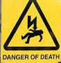
14. How did his sons-in-law regard his appeal?
2 Peter 3:3-4
Knowing this first, that there shall come in the last days scoffers, walking after their own lusts,

Slide 40
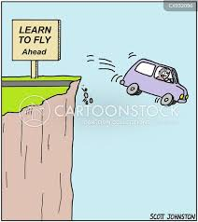
14. How did his sons-in-law regard his appeal?
2 Peter 3:3-4
And saying, Where is the promise of his coming? for since the fathers fell asleep, all things continue as they were from the beginning of the creation.

Slide 41
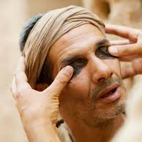
14. How did his sons-in-law regard his appeal?
This so closely aligns with the Laodicean spirit in Revelation 3:17: complacent, self-satisfied, and utterly blind. They’re blind to their own needs, the needs of those around them, and even to God’s warning.

Slide 42
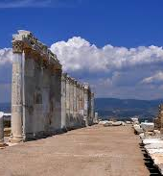
14. How did his sons-in-law regard his appeal?
Revelation 3:17-20
Because thou sayest, I am rich, and increased with goods, and have need of nothing; and knowest not that thou art wretched, and miserable, and poor, and blind, and naked:

Slide 43
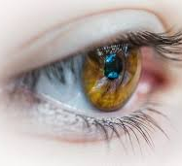
14. How did his sons-in-law regard his appeal?
Revelation 3:17-20
I counsel thee to buy of me gold tried in the fire, that thou mayest be rich; and white raiment, that thou mayest be clothed, and that the shame of thy nakedness do not appear; and anoint thine eyes with eyesalve, that thou mayest see.

Slide 44
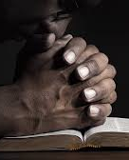
14. How did his sons-in-law regard his appeal?
Revelation 3:17-20
As many as I love, I rebuke and chasten: be zealous therefore, and repent.

Slide 45
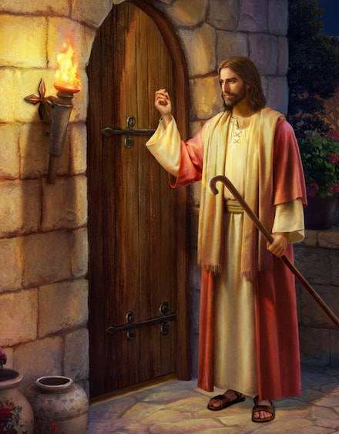
14. How did his sons-in-law regard his appeal?
Revelation 3:17-20
Behold, I stand at the door, and knock: if any man hear my voice, and open the door, I will come in to him, and will sup with him, and he with me.

Slide 46
15. What did the angels say as soon as it was morning?
Genesis 19:15
And when the morning arose, then the angels hastened Lot, saying, Arise, take thy wife, and thy two daughters, which are here; lest thou be consumed in the iniquity of the city.

Slide 47
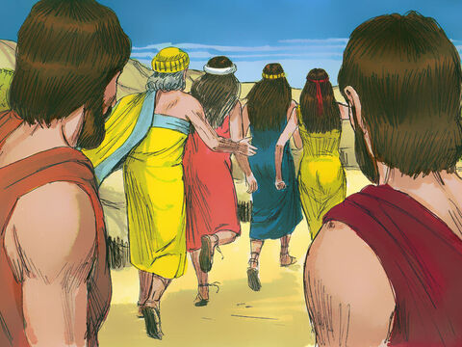
16. What steps did they take to hasten Lot and his family?
Genesis 19:16
And while he lingered, the men laid hold upon his hand, and upon the hand of his wife, and upon the hand of his two daughters; the LORD being merciful unto him: and they brought him forth, and set him without the city.

Slide 48
17. What earnest charge did the angels give them?
Genesis 19:17
And it came to pass, when they had brought them forth abroad, that he said, Escape for thy life; look not behind thee, neither stay thou in all the plain; escape to the mountain, lest thou be consumed.

Slide 49
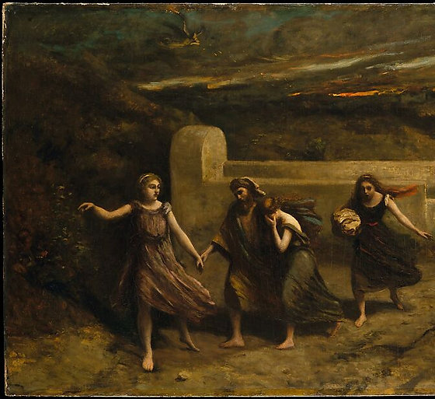
18. As soon as Lot had escaped, what did the Lord do?
Genesis 19:23-25
The sun was risen upon the earth when Lot entered into Zoar.

Slide 50
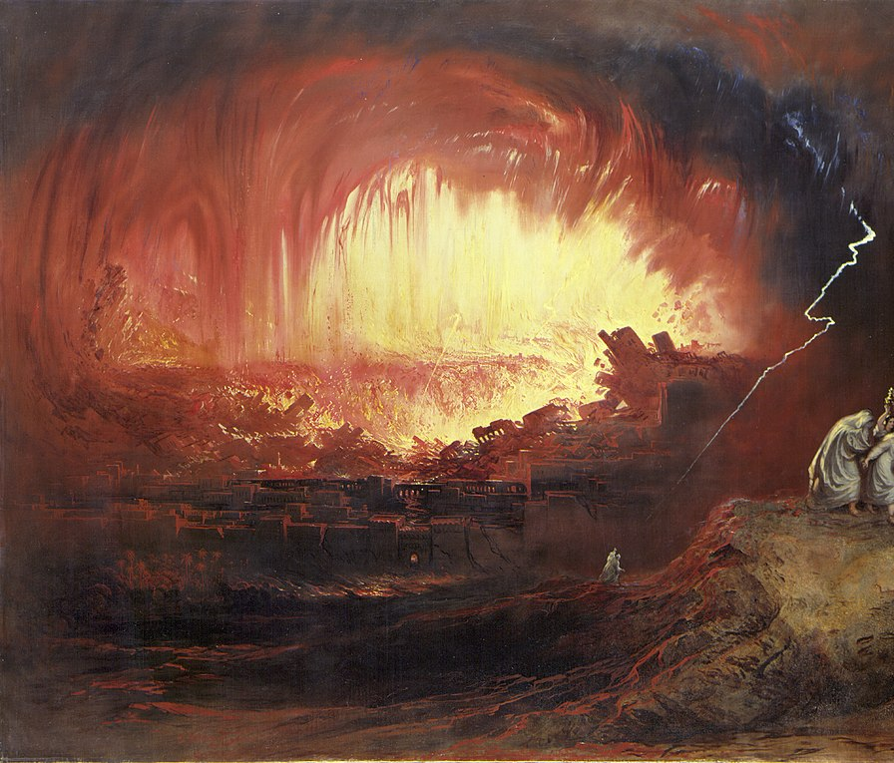
18. As soon as Lot had escaped, what did the Lord do?
Genesis 19:23-25
Then the LORD rained upon Sodom and upon Gomorrah brimstone and fire from the LORD out of heaven;

Slide 51
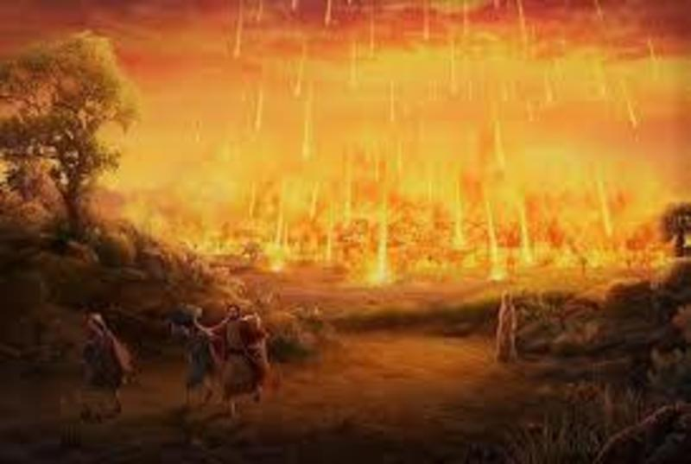
18. As soon as Lot had escaped, what did the Lord do?
Genesis 19:23-25
And he overthrew those cities, and all the plain, and all the inhabitants of the cities, and that which grew upon the ground.

Slide 52
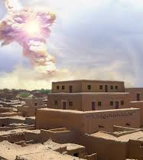
A “Meteor Airburst”
Archaeologists at Tall el-Hammam discovered jaw-dropping evidence of some sort of fiery holocaust event that wiped out the city instantaneously, killing all inhabitants within half a second.

Slide 53
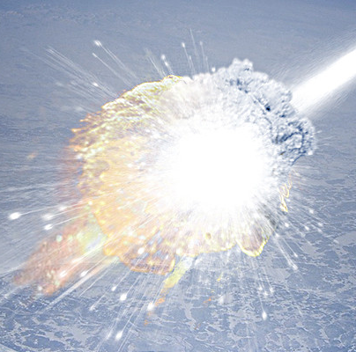
A “Meteor Airburst”
Chemical analyses of remains from the site revealed temperatures briefly spiking to levels approaching that of the surface of the sun.

Slide 54
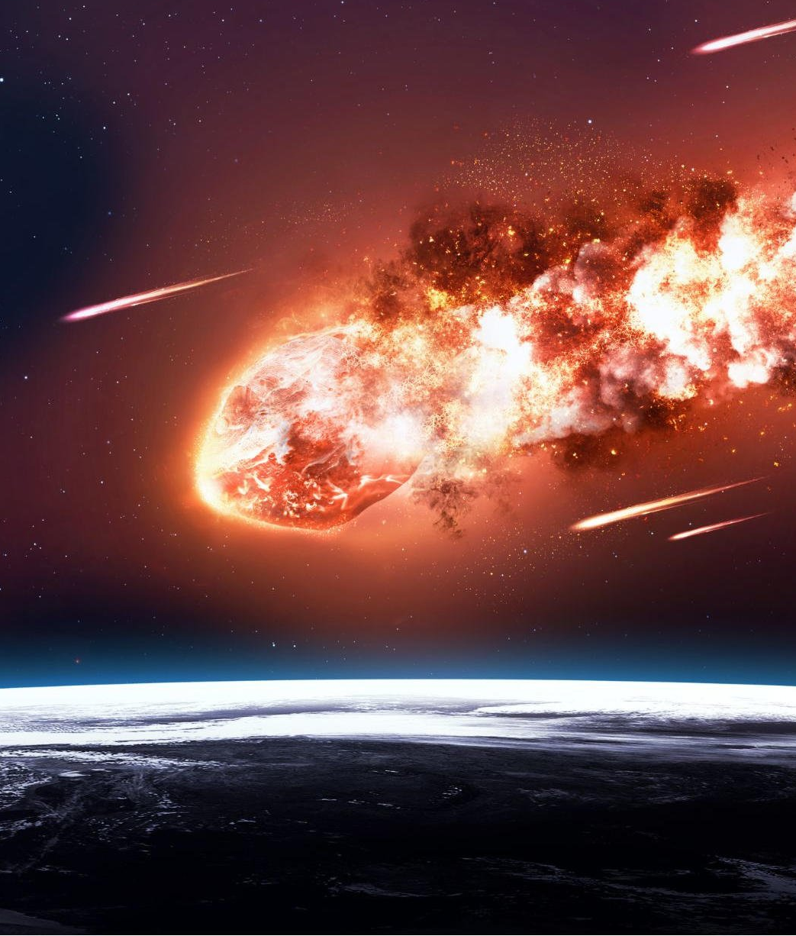
A “Meteor Airburst”
The researchers ascribed it to an “airburst event,” something like the mystery explosion in Tunguska, Russia, in 1908—when a meteor entering Earth’s atmosphere exploded above ground.

Slide 55
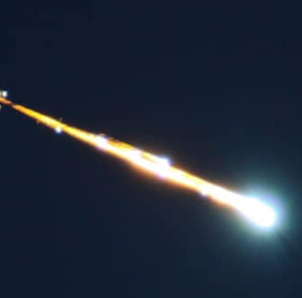
A “Meteor Airburst”
There was no crater, but everything below was flattened and incinerated by a yield equivalent to hundreds of atomic bombs.

Slide 56
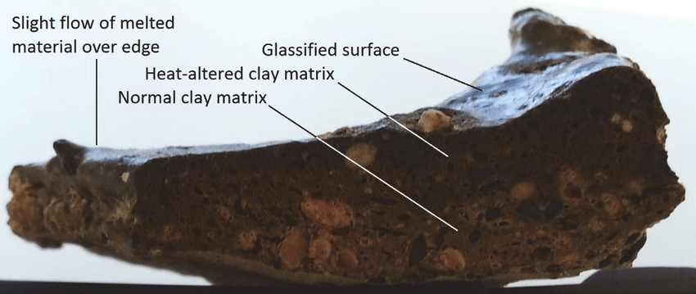
A “Meteor Airburst”

Slide 57
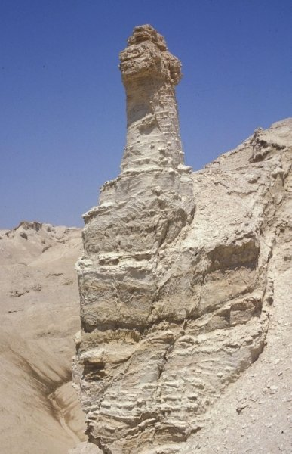
19. What happened to his wife because she disregarded the command of the angels?
Genesis 19:26
But his wife looked back from behind him, and she became a pillar of salt.

Slide 58
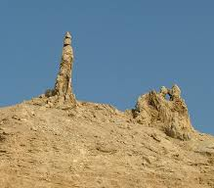
19. What happened to his wife because she disregarded the command of the angels?
South of the Dead Sea, natural salt formations rise like pillars. Travelers through the centuries have connected these striking shapes with the account of Lot’s wife.

Slide 59

20. What warning is given to us in view of such facts as this?
Hebrews 2:1-3
Therefore we ought to give the more earnest heed to the things which we have heard, lest at any time we should let them slip.

Slide 60

20. What warning is given to us in view of such facts as this?
Hebrews 2:1-3
For if the word spoken by angels was stedfast, and every transgression and disobedience received a just recompence of reward;

Slide 61

20. What warning is given to us in view of such facts as this?
Hebrews 2:1-3
How shall we escape, if we neglect so great salvation; which at the first began to be spoken by the Lord, and was confirmed unto us by them that heard him;

Slide 62
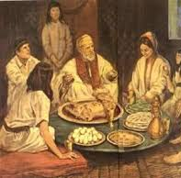
21. What did Jesus say of the condition of the world just before His second coming?
Luke 17:28-30
Likewise also as it was in the days of Lot; they did eat, they drank, they bought, they sold, they planted, they builded;

Slide 63
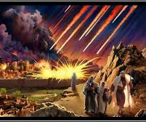
21. What did Jesus say of the condition of the world just before His second coming?
Luke 17:28-30
But the same day that Lot went out of Sodom it rained fire and brimstone from heaven, and destroyed them all.

Slide 64
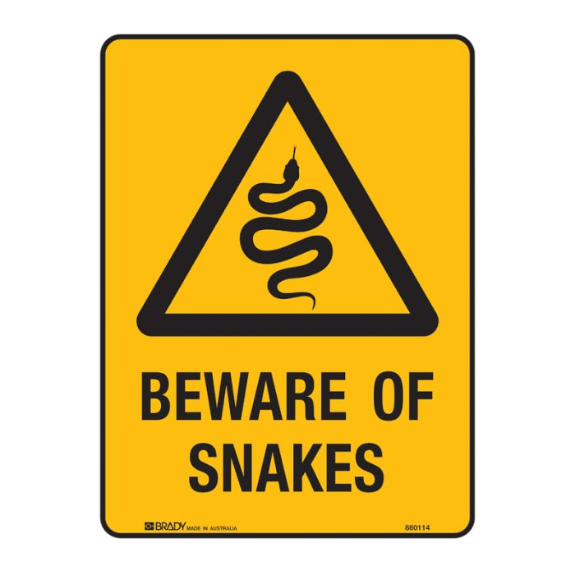
21. What did Jesus say of the condition of the world just before His second coming?
Luke 17:28-30
Even thus shall it be in the day when the Son of man is revealed.

Slide 65

22. What will He do when He is revealed?
2 Thessalonians 1:7-9
And to you who are troubled rest with us, when the Lord Jesus shall be revealed from heaven with his mighty angels,

Slide 66

22. What will He do when He is revealed?
2 Thessalonians 1:7-9
In flaming fire taking vengeance on them that know not God, and that obey not the gospel of our Lord Jesus Christ:

Slide 67

22. What will He do when He is revealed?
2 Thessalonians 1:7-9
Who shall be punished with everlasting destruction from the presence of the Lord, and from the glory of his power;

Slide 68

23. Of what was the destruction of Sodom and Gomorrah an example?
Jude 6-7
And the angels which kept not their first estate, but left their own habitation, he hath reserved in everlasting chains under darkness unto the judgment of the great day.

Slide 69

23. Of what was the destruction of Sodom and Gomorrah an example?
Jude 6-7
Even as Sodom and Gomorrha, and the cities about them in like manner, giving themselves over to fornication, and going after strange flesh, are set forth for an example, suffering the vengeance of eternal fire.

Slide 70

24. What charge is given to us who are living in these last days?
Luke 21:34-36
And take heed to yourselves, lest at any time your hearts be overcharged with surfeiting, and drunkenness, and cares of this life, and so that day come upon you unawares.

Slide 71

24. What charge is given to us who are living in these last days?
Luke 21:34-36
For as a snare shall it come on all them that dwell on the face of the whole earth.

Slide 72

24. What charge is given to us who are living in these last days?
Luke 21:34-36
Watch ye therefore, and pray always, that ye may be accounted worthy to escape all these things that shall come to pass, and to stand before the Son of man.

Slide 73

25. What warning is given us?
Luke 17:31-32
In that day, he which shall be upon the housetop, and his stuff in the house, let him not come down to take it away: and he that is in the field, let him likewise not return back.

Slide 74

25. What warning is given us?
Luke 17:31-32
Remember Lot's wife.

Slide 75


Slide 76
Thank You &
HAPPY SABBATH!!

