Slide 1


Slide 2

Living the Light

Slide 3
Old Testament History:
The Test of FAith
Lesson 14,2nd Quarter, 1888

Slide 4
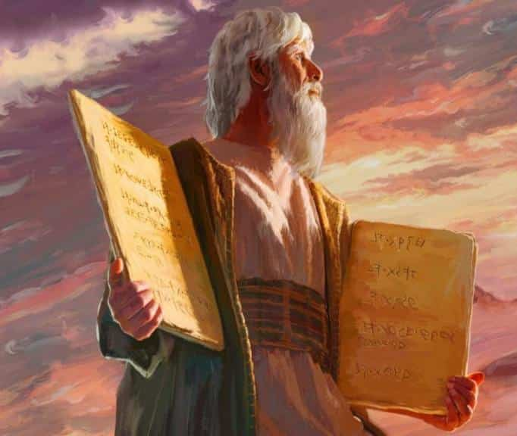
1. What was the character of Abraham?
Genesis 26:5
Because that Abraham obeyed my voice, and kept my charge, my commandments, my statutes, and my laws.

Slide 5
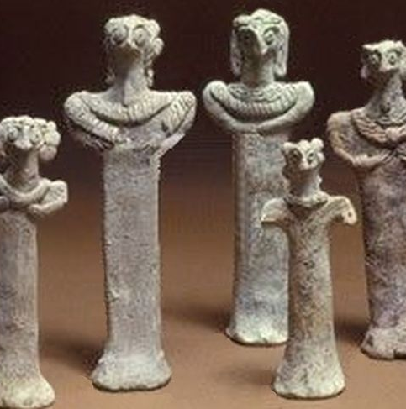
2. Were his early associations favorable to the formation of such a character?
Joshua 24:2
And Joshua said unto all the people, Thus saith the Lord God of Israel, Your fathers dwelt on the other side of the flood in old time, even Terah, the father of Abraham, and the father of Nachor: and they served other gods.

Slide 6
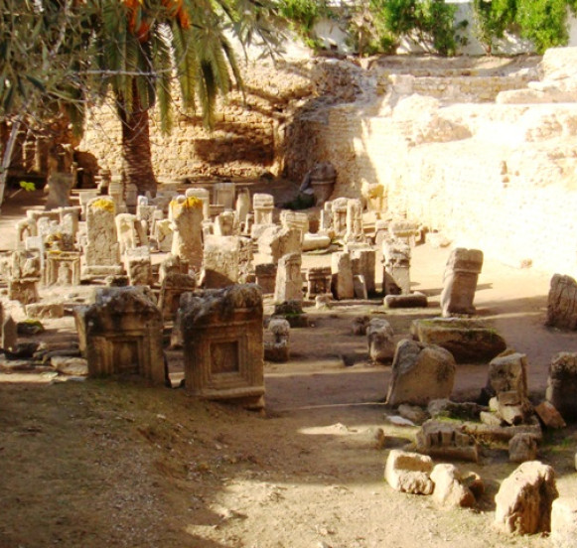
Cultural Context
The Carthage tophet (circa 1800 BC) is an ancient sacred area dedicated to the Phoenician deities Tanit and Baal. The tophet is a "hybrid of sanctuary and necropolis.”

Slide 7
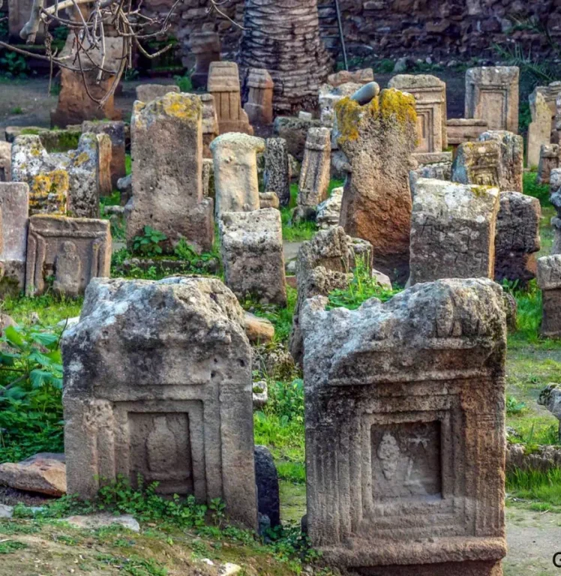
Cultural Context
It contains a large number of children's tombs. Children were sacrificed and buried here after their untimely death.

Slide 8
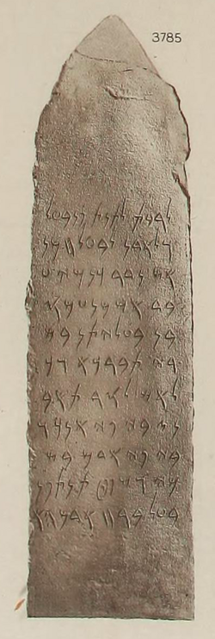
Cultural Context
This inscription is believed to record a so-called "molk" child sacrifice. The text is inscribed on a 55 cm high stela that was discovered in 1922.
In this inscription KNMY, a Carthaginian slave (or "servant"), says that he "vowed" (nador) "his flesh" (BŠRY, cf. Hebrew b^{e}śarō) to the two major gods of Carthage, which is understood to mean that he sacrificed a child of his.

Slide 9
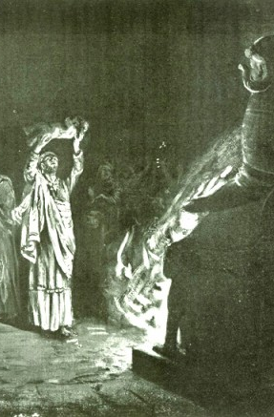
Cultural Context
“That human sacrifices, however, were known as far back as the Accadian era, is shown by a bilingual text (K5139) which enjoins the abgal, or “chief prophet,” to declare that the father must give the life of his child for the sin of his own soul, the child’s head for his head, the child’s neck for his neck, the child’s breast for his breast.”
A.H. Sayce, Lectures on the Origin and Growth of Religion as Illustrated by the Religion of the Ancient Babylonians, 5th ed., London, 1898, p. 78

Slide 10
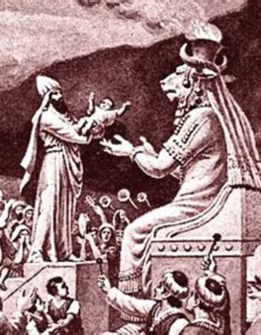
Cultural Context
“In the great work on astronomy called The Observations of Bel, we are told that “on the high-places the son is burnt.” The offering was consequently by fire, as in Phoenicia.”
A.H. Sayce, Lectures on the Origin and Growth of Religion as Illustrated by the Religion of the Ancient Babylonians, 5th ed., London, 1898, p. 78

Slide 11
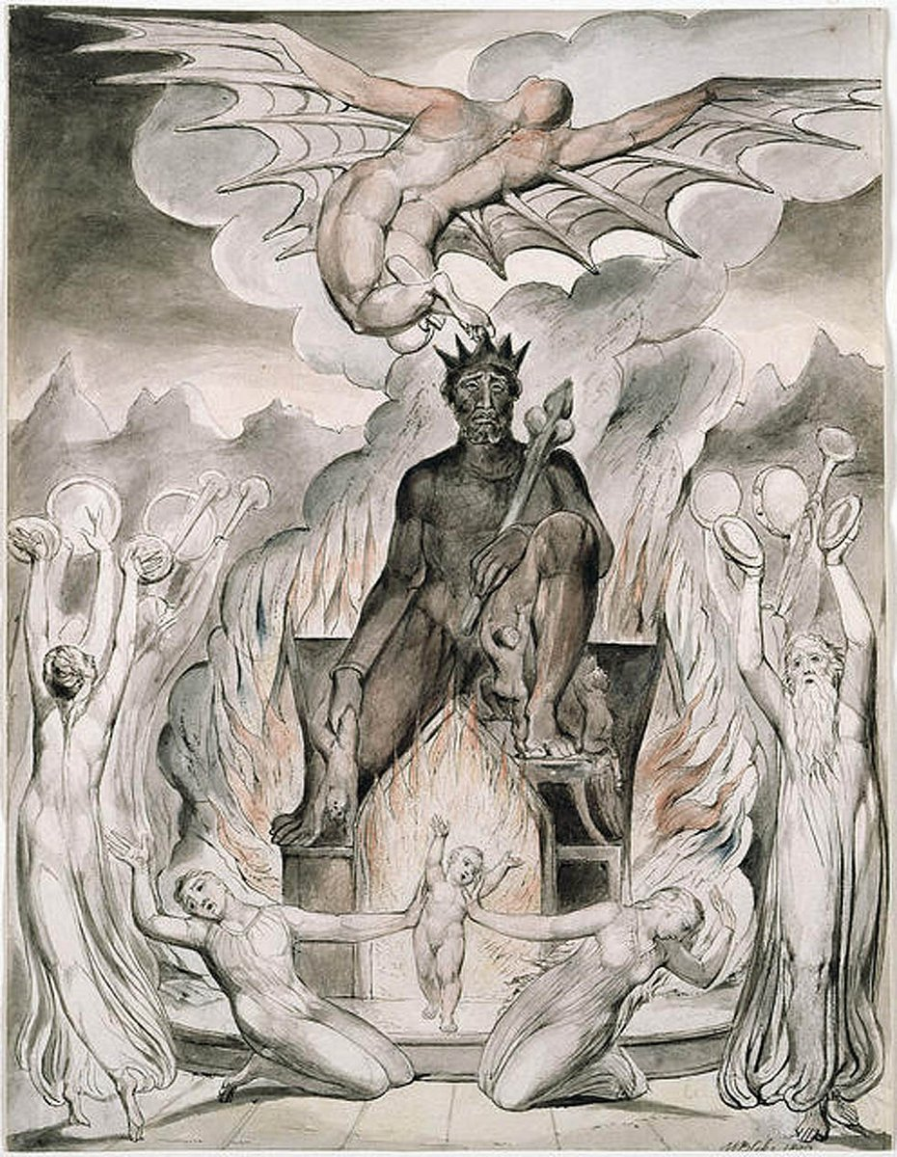
Cultural Context
Leviticus 18:21
²¹ And thou shalt not let any of thy seed pass through the fire to Molech, neither shalt thou profane the name of thy God: I am the Lord.

Slide 12
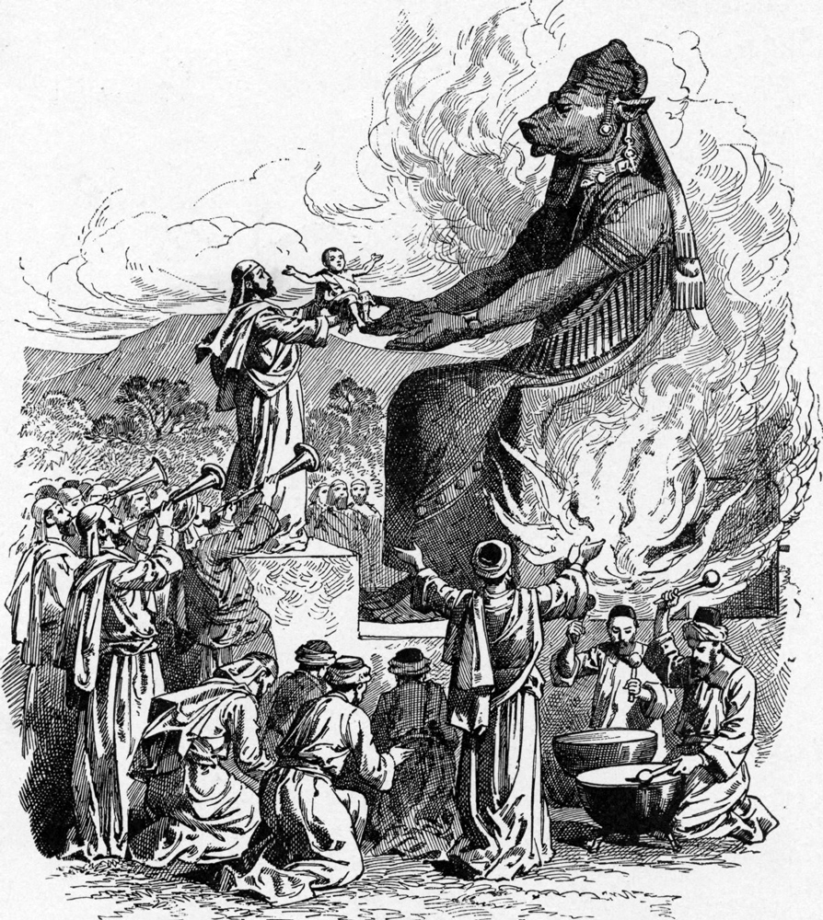
Cultural Context
Jeremiah 32:35
³⁵ And they built the high places of Baal, which are in the valley of the son of Hinnom, to cause their sons and their daughters to pass through the fire unto Molech; which I commanded them not, neither came it into my mind, that they should do this abomination, to cause Judah to sin.

Slide 13
Summary
Abraham lived in the Middle Bronze Age (c. 2000–1800 BC) — the same horizon as the Mari tablets, and not far removed from cultures where child sacrifice was known.
Archaeology (Mari → Canaanite Tophet → Carthage) shows a cultural throughline of costly ritual sacrifice across centuries of the Semitic world.
By Canaanite and later Phoenician standards, the request to sacrifice a child was not absurd; what was radical is that God reversed the expectation and provided the sacrifice Himself.

Slide 14
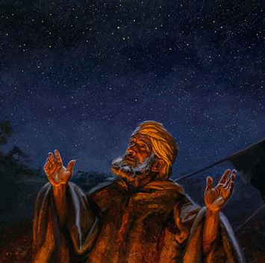
3. For what reason was Abraham counted righteous?
Romans 4:3
For what saith the scripture? Abraham believed God, and it was counted unto him for righteousness.

Slide 15
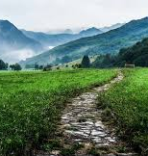
4. What will true faith do?
Galatians 5:6
For in Jesus Christ neither circumcision availeth any thing, nor uncircumcision; but faith which worketh by love.

Slide 16
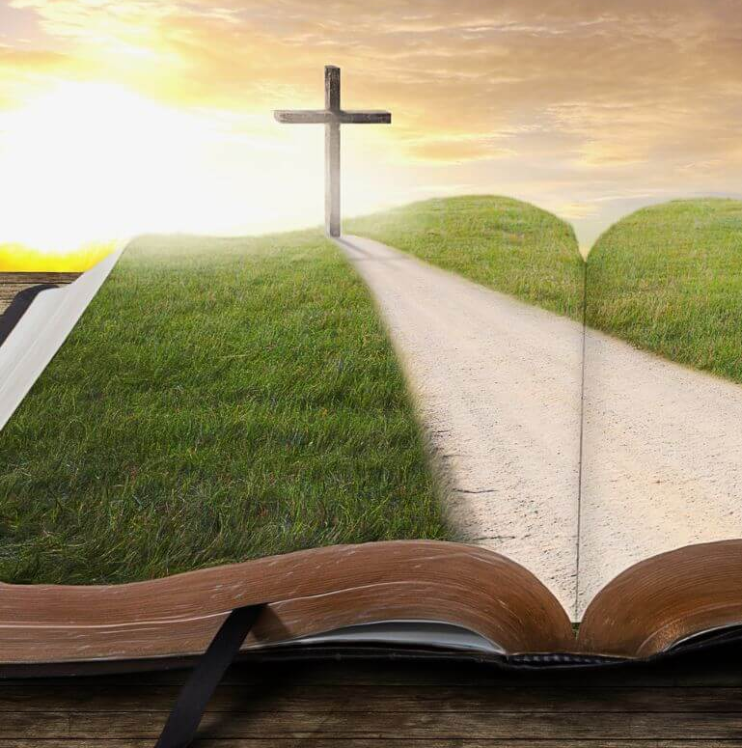
4. What will true faith do?
1 John 5:4
For whatsoever is born of God overcometh the world: and this is the victory that overcometh the world, even our faith.

Slide 17
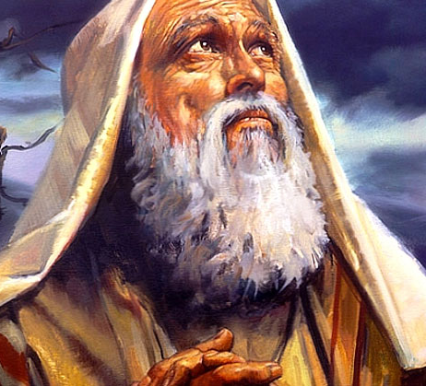
5. What did the Lord do to test Abraham’s faith?
Genesis 22:1-2
And it came to pass after these things, that God did tempt Abraham, and said unto him, Abraham: and he said, Behold, here I am.

Slide 18
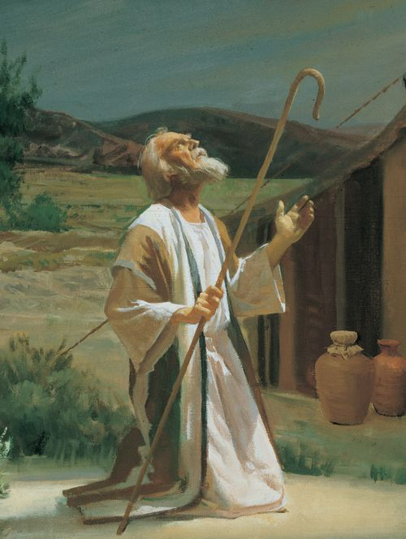
5. What did the Lord do to test Abraham’s faith?
Genesis 22:1-2
And he said, Take now thy son, thine only son Isaac, whom thou lovest, and get thee into the land of Moriah; and offer him there for a burnt offering upon one of the mountains which I will tell thee of.

Slide 19
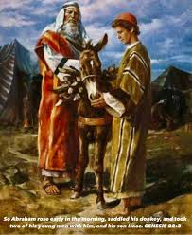
6. How did Abraham obey?
Genesis 22:3
And Abraham rose up early in the morning, and saddled his ass, and took two of his young men with him, and Isaac his son, and clave the wood for the burnt offering, and rose up, and went unto the place of which God had told him.

Slide 20
How Old was Isaac?
He couldn’t have been a young child, since he was able to carry a substantial amount of firewood up a mountain.
Sarah, Isaac’s mother, dies in the next chapter (Genesis 23) when Isaac was 37 years old.
So we may loosely conclude that Isaac had to have been between (at least) 15 years old and 37 years old, quite likely a strong young man, perhaps in his 20’s, and not a child (despite popular representations otherwise).
Josephus, in Antiquities of the Jews, Book 1, Chapter 13 Section 2, claims specifically that Isaac was 25 years old at this time.

Slide 21
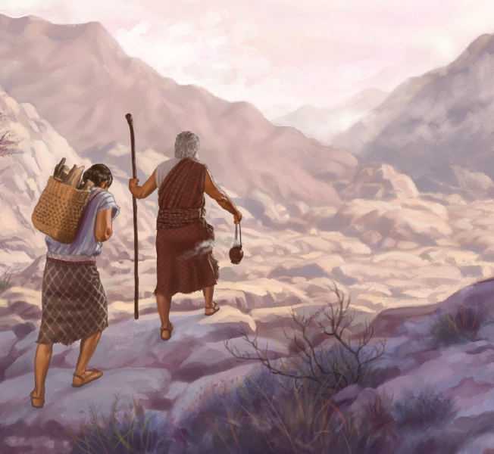
7. How long did they travel before they came to the place?
Genesis 22:4
Then on the third day Abraham lifted up his eyes, and saw the place afar off.

Slide 22
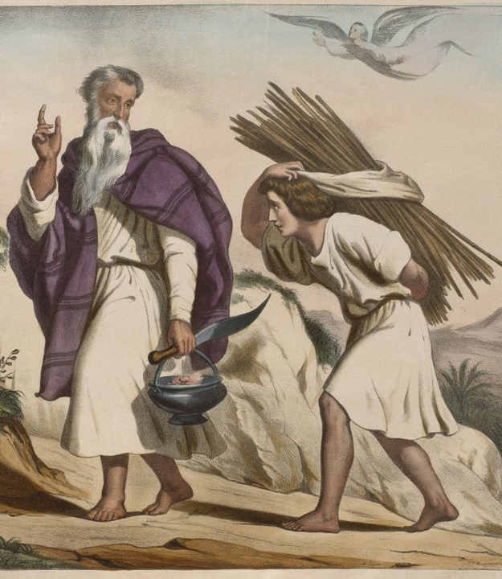
8. What did Isaac say to his father as they were going together to the place of sacrifice?
Genesis 22:7
And Isaac spake unto Abraham his father, and said, My father: and he said, Here am I, my son. And he said, Behold the fire and the wood: but where is the lamb for a burnt offering?

Slide 23
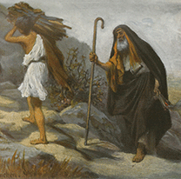
9. What was Abraham’s reply?
Genesis 22:8
And Abraham said, My son, God will provide himself a lamb for a burnt offering: so they went both of them together.

Slide 24
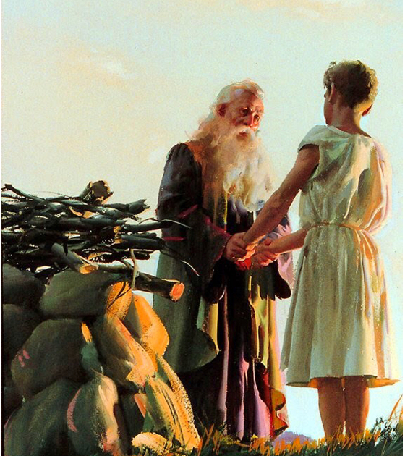
10. When they came to the place what did Abraham do?
Genesis 22:9
And they came to the place which God had told him of; and Abraham built an altar there, and laid the wood in order, and bound Isaac his son, and laid him on the altar upon the wood.

Slide 25
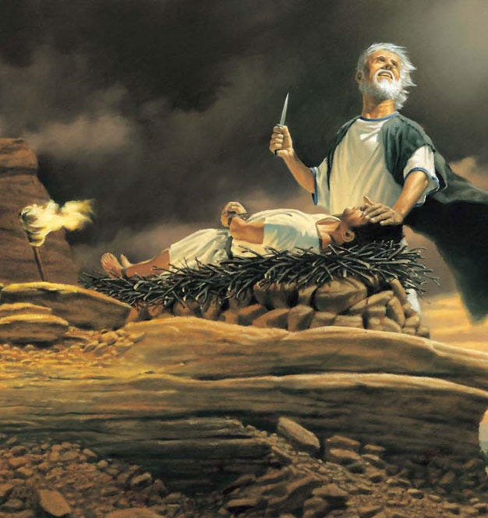
11. How far did he proceed toward slaying Isaac?
Genesis 22:10
And Abraham stretched forth his hand, and took the knife to slay his son.

Slide 26
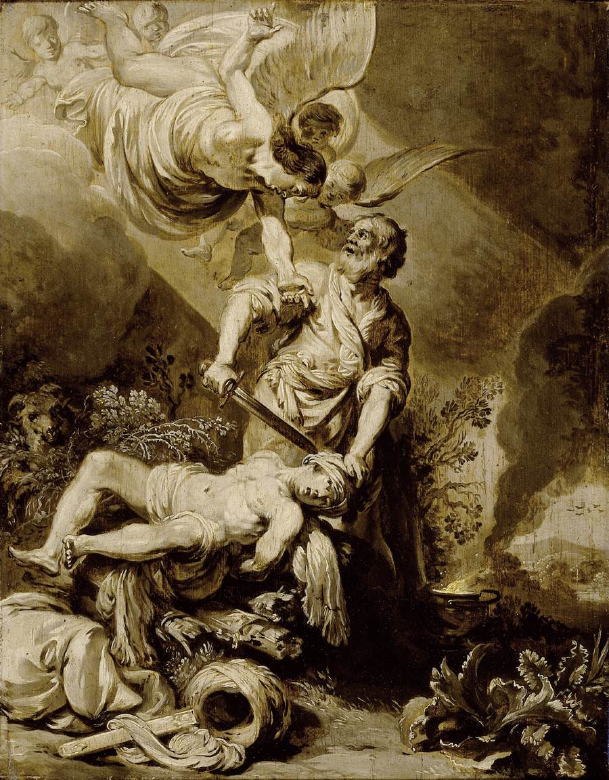
12. How was he prevented from completing the sacrifice?
Genesis 22:11-12
And the angel of the Lord called unto him out of heaven, and said, Abraham, Abraham: and he said, Here am I.

Slide 27
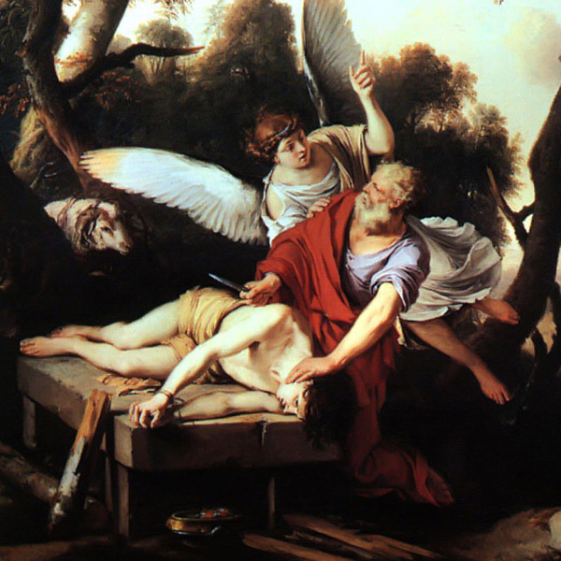
12. How was he prevented from completing the sacrifice?
Genesis 22:11-12
And he said, Lay not thine hand upon the lad, neither do thou any thing unto him: for now I know that thou fearest God, seeing thou hast not withheld thy son, thine only son from me.

Slide 28
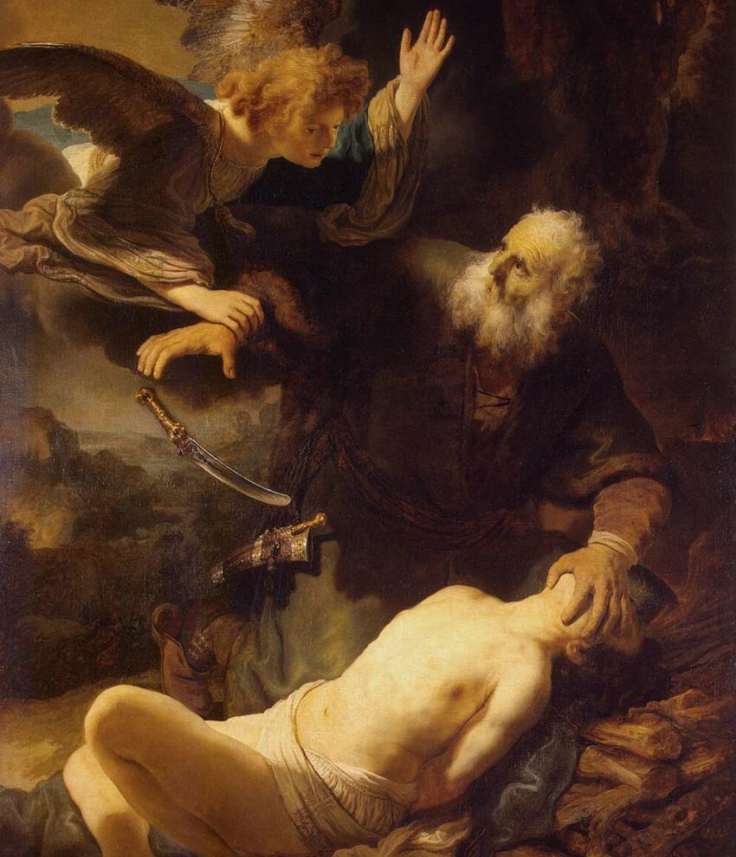
13. What did the angel of the Lord say was now proved?
Genesis 22:12
And he said, Lay not thine hand upon the lad, neither do thou any thing unto him: for now I know that thou fearest God, seeing thou hast not withheld thy son, thine only son from me.

Slide 29
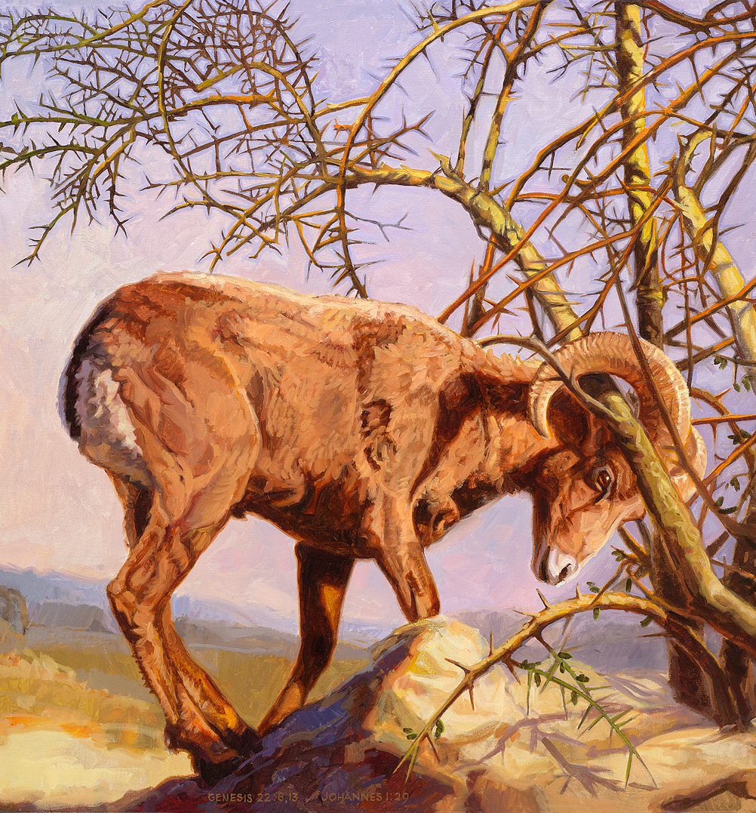
14. How were Abraham’s words, that God would provide Himself a lamb, fulfilled?
Genesis 22:13
And Abraham lifted up his eyes, and looked, and behold behind him a ram caught in a thicket by his horns: and Abraham went and took the ram, and offered him up for a burnt offering in the stead of his son.

Slide 30
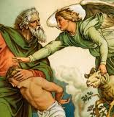
15. What promise did the Lord make because Abraham had done this?
Genesis 22:15-18
And the angel of the Lord called unto Abraham out of heaven the second time,

Slide 31
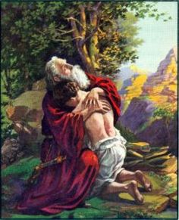
15. What promise did the Lord make because Abraham had done this?
Genesis 22:15-18
And said, By myself have I sworn, saith the Lord, for because thou hast done this thing, and hast not withheld thy son, thine only son:

Slide 32
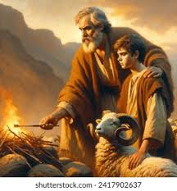
15. What promise did the Lord make because Abraham had done this?
Genesis 22:15-18
That in blessing I will bless thee, and in multiplying I will multiply thy seed as the stars of the heaven, and as the sand which is upon the sea shore; and thy seed shall possess the gate of his enemies;

Slide 33
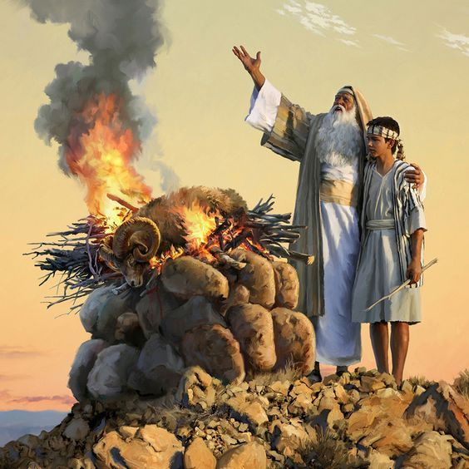
15. What promise did the Lord make because Abraham had done this?
Genesis 22:15-18
And in thy seed shall all the nations of the earth be blessed; because thou hast obeyed my voice.

Slide 34
God Reveals Himself
Abraham’s story makes a theological break: God does not require human sacrifice — He provides the sacrifice Himself.
👉 Radical contrast: pagan gods take children’s lives, but God provides the substitute.
This reveals the heart of God’s covenant: He is not the destroyer of humanity, but the One who saves.

Slide 35
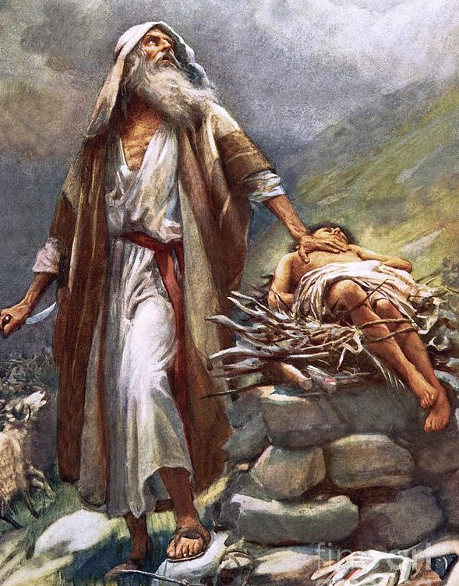
16. What made this a peculiarly strong test of Abraham’s faith?
Answer:
Isaac was Abraham’s only son (Genesis 22:2); there was no earthly hope he could ever have another; and more than all, God had promised that his numerous seed should come through Isaac. Hebrews 11:17-18.

Slide 36
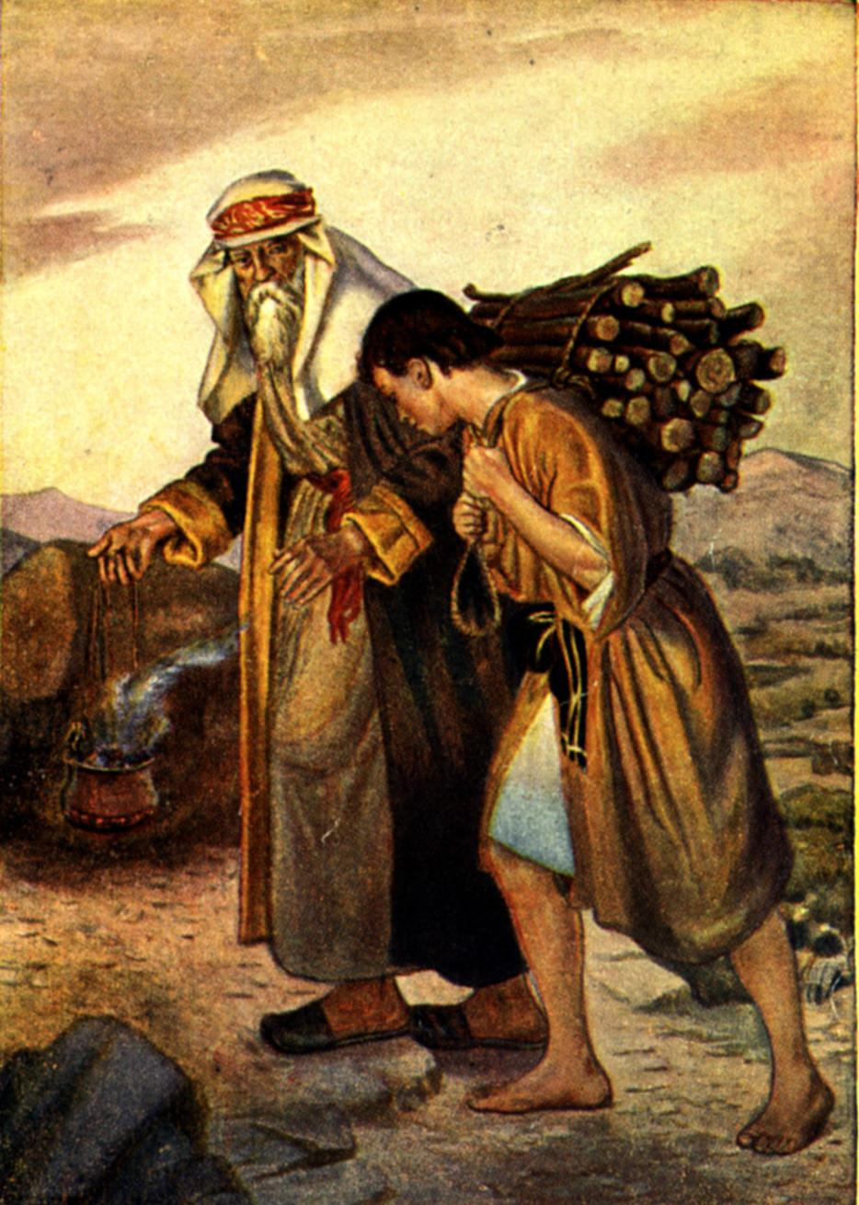
17. What did Abraham believe that God was able to do?
Hebrews 11:19
Accounting that God was able to raise him up, even from the dead; from whence also he received him in a figure.

Slide 37
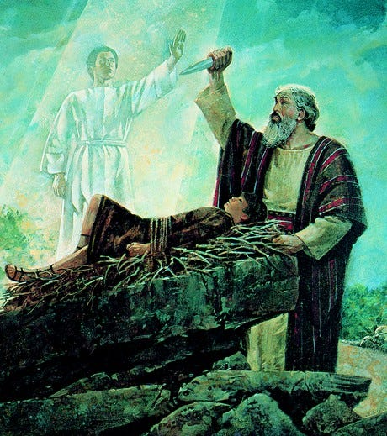
18. What did this act prove concerning Abraham’s faith?
James 2:21-22
Was not Abraham our father justified by works, when he had offered Isaac his son upon the altar?

Slide 38
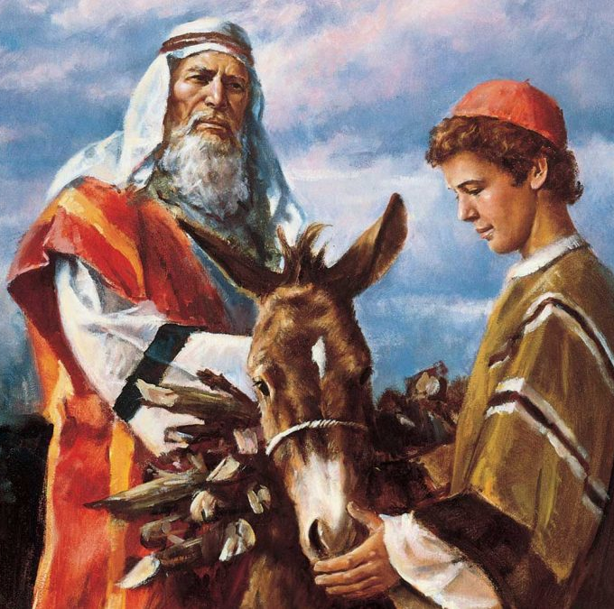
18. What did this act prove concerning Abraham’s faith?
James 2:21-22
Seest thou how faith wrought with his works, and by works was faith made perfect?

Slide 39

19. What wonderful title did Abraham thus gain?
James 2:23
And the scripture was fulfilled which saith, Abraham believed God, and it was imputed unto him for righteousness: and he was called the Friend of God.

Slide 40
In the supreme test of a long, eventful life Abraham obeyed without raising a single question, without offering a single objection, and without seeking human counsel. Where principle is involved, the mature Christian asks no more than a clear perception of duty.
SDABC V1 on Genesis 22:3

Slide 41
His cooperation springs from a heart overflowing with love and devotion. He lives as in the very presence of God, with no human considerations to dim his apprehension of truth and duty. Yet, upon this occasion, what a struggle must have taken place in the heart of the “friend of God,” not as to whether he would obey, but rather for divine assurance that his senses and reason were not deceiving him.
SDABC V1 on Genesis 22:3

Slide 42
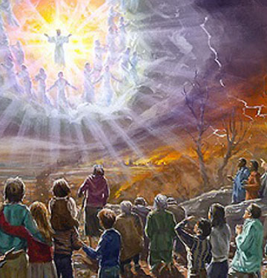
20. Who may share this blessing?
Galatians 3:9
So then they which be of faith are blessed with faithful Abraham.

Slide 43
Thank You &
HAPPY SABBATH!!

Slide 44


