Slide 1


Slide 2

Living the Light

Slide 3
Old Testament History:
Despising the Birthright
Lesson 15,2nd Quarter, 1888

Slide 4
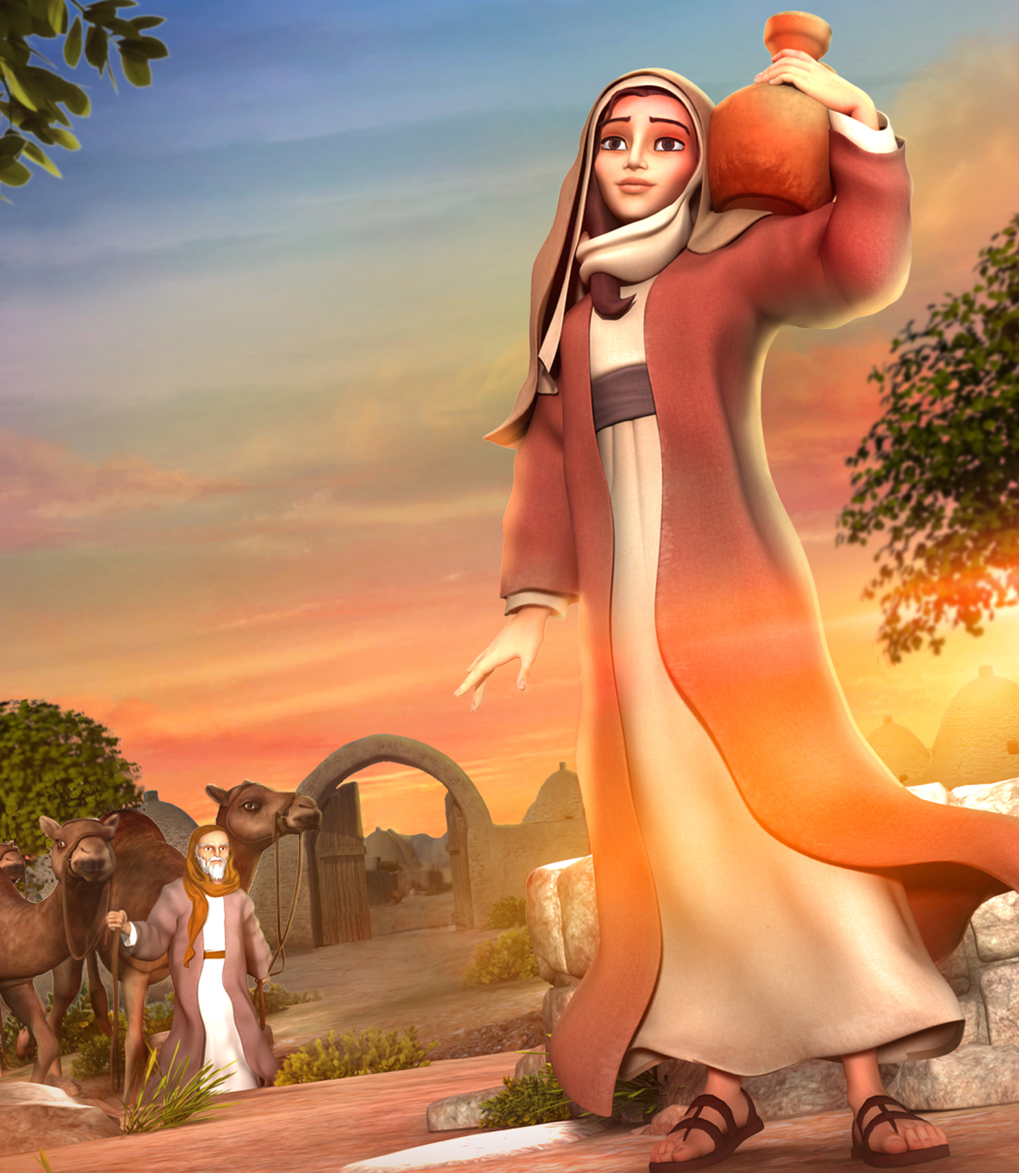
1. How old was Isaac when he was married?
Genesis 25:20
And Isaac was forty years old when he took Rebekah to wife, the daughter of Bethuel the Syrian of Padanaram, the sister to Laban the Syrian.

Slide 5
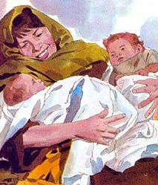
2. How old was he when his two sons were born?
Genesis 25:26
And after that came his brother out, and his hand took hold on Esau's heel; and his name was called Jacob: and Isaac was threescore years old when she bare them.

Slide 6
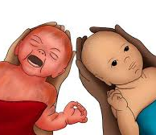
3. What were their names?
Jacob and Esau
The Hebrew word for “heel,” ‘aqeb, is related to the verb ‘aqab, “to take by the heel,” figuratively, “to deceive.” The personal name Jacob, meaning “he grasps the heel” or “he deceives,” was therefore most appropriate. The meaning of “Esau” is uncertain, but we know he was also called “Edom,” or “Red.”

Slide 7
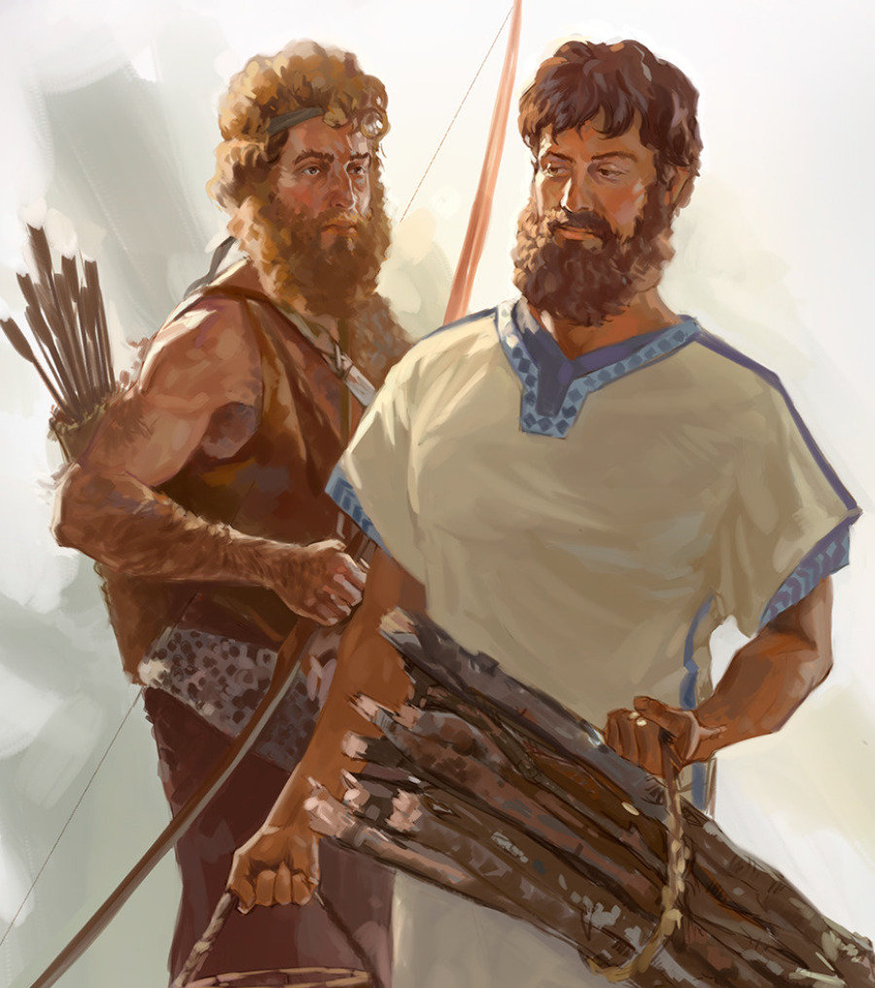
4. What difference was there between them?
Genesis 25:27
And the boys grew: and Esau was a cunning hunter, a man of the field; and Jacob was a plain man, dwelling in tents.

Slide 8
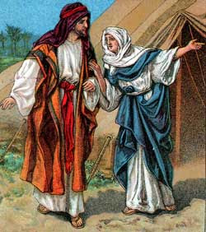
A “Plain” Man
The Hebrew word tam, here translated “plain,” suggests an amiable, pious, and cultured personality. The duties and responsibilities of settled family life, so monotonous and irritating to Esau, came naturally to Jacob, “a plain man, dwelling in tents.”

Slide 9
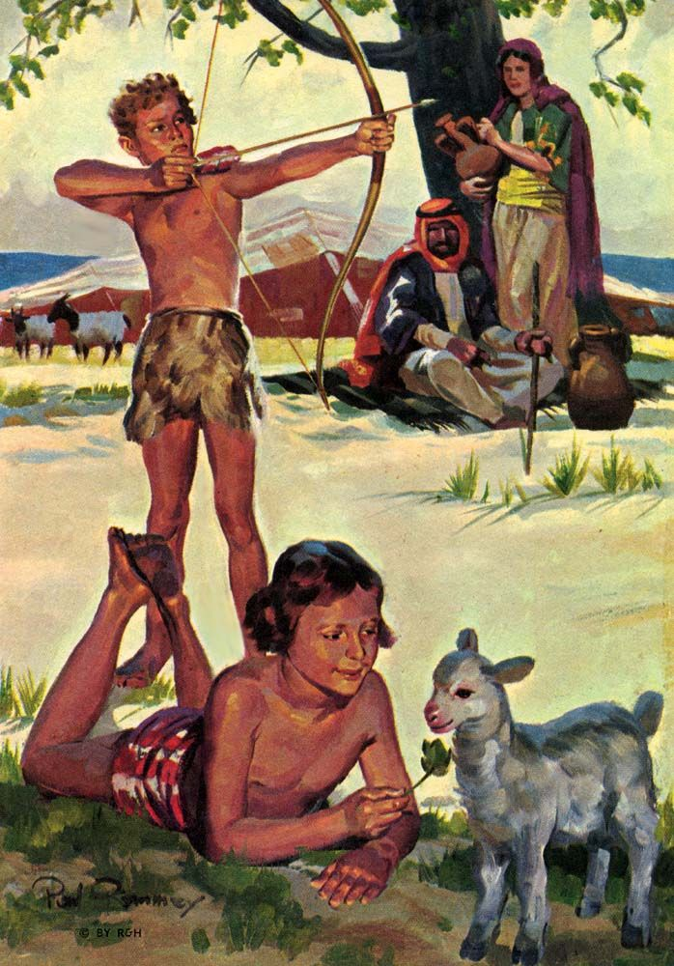
A “Plain” Man
Whereas Esau never outgrew the physical and emotional restlessness of adolescence, Jacob developed the stability of character and soundness of judgment that should come with maturity.

Slide 10
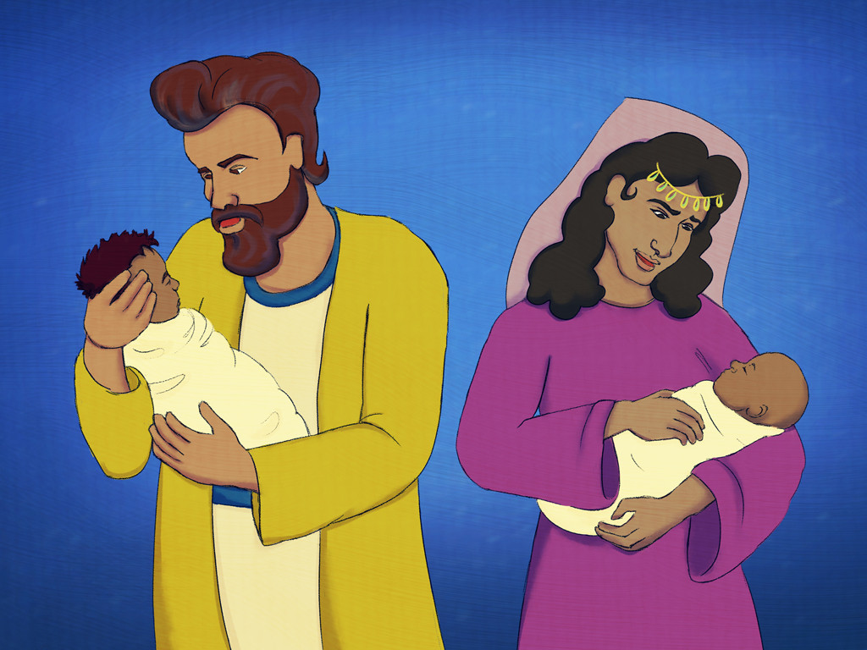
5. How did their parents regard them?
Genesis 25:28
And Isaac loved Esau, because he did eat of his venison: but Rebekah loved Jacob.

Slide 11
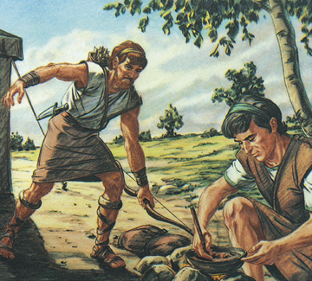
6. What did Jacob have as Esau came in one day from a hunting trip?
Genesis 25:29
And Jacob sod pottage: and Esau came from the field, and he was faint.

Slide 12
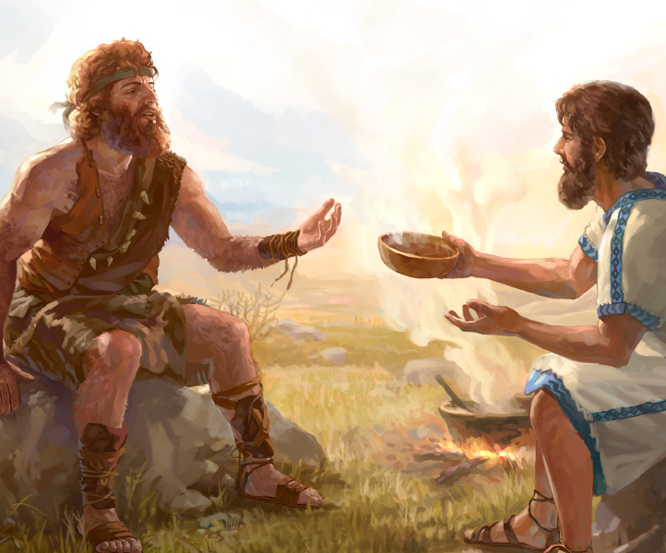
7. What did Esau say to Jacob?
Genesis 25:30
And Esau said to Jacob, Feed me, I pray thee, with that same red pottage; for I am faint: therefore was his name called Edom.

Slide 13
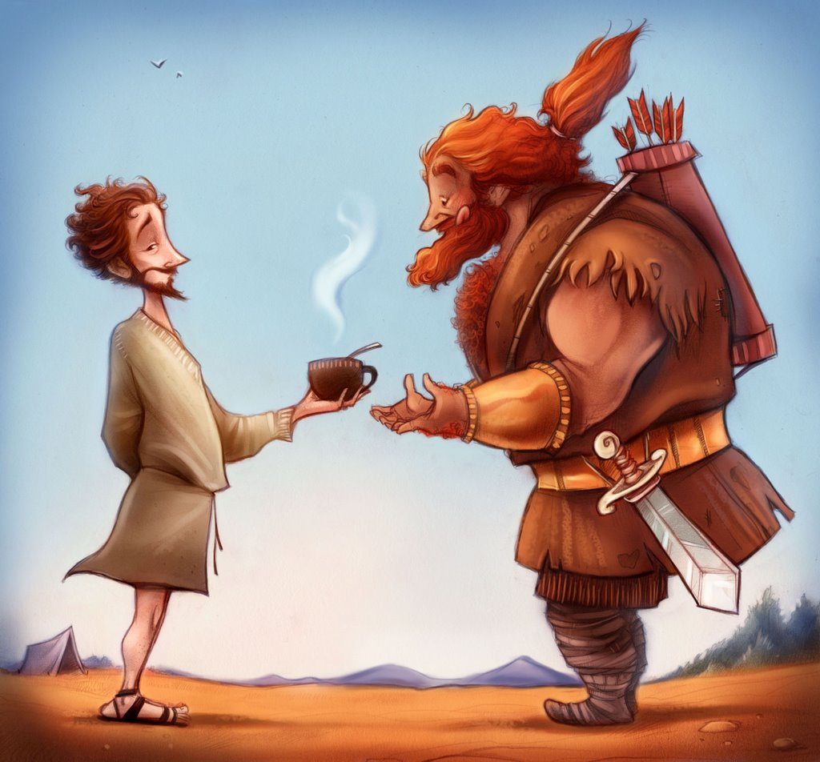
8. What did Jacob reply?
Genesis 25:31
And Jacob said, Sell me this day thy birthright.

Slide 14
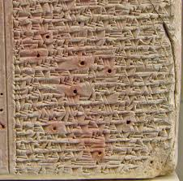
The Law of Primogeniture
Middle Assyrian Laws (Tablet B §1): Eldest son receives a double share; the rest divide what remains.
Circa 1450-1250 BC

Slide 15
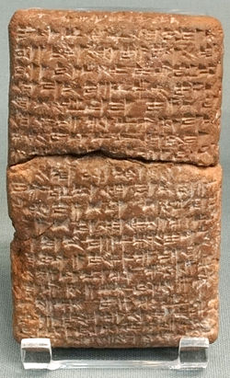
The Law of Primogeniture
Alalakh (modern Tell Atchana, c. 15th century BC) and other Near Eastern archives show that the firstborn son typically had priority in inheritance.
The exact rules vary by city and century, but the pattern is consistent: the eldest often received a larger share and leadership responsibilities.

Slide 16
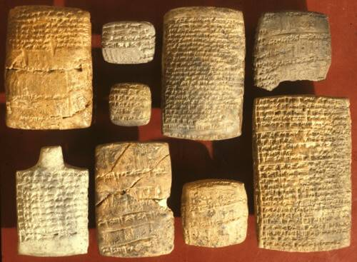
The Law of Primogeniture
Nuzi (Yorghan Tepe, near Kirkuk, Iraq) produced thousands of cuneiform tablets from the 15th–14th c. BC (Hurrian culture), excavated by the Joint Expedition to Nuzi (JEN) in the 1920s–30s and published in series like JEN and HSS.

Slide 17
The Law of Primogeniture
Nuzi private law shows inheritance rights were real, structured, and could be transferred by contract—sometimes even between brothers. This doesn’t retell Genesis 25, but it shows that transferring one’s share was legally thinkable.

Slide 18
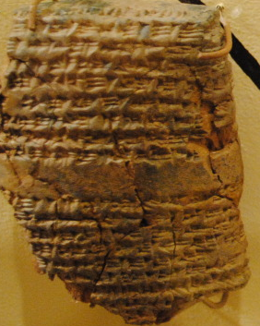
The Law of Primogeniture
In the famous “three sheep” tablet (JEN 204), Kurpazah receives his inheritance share from Tupkitilla; in exchange, Tupkitilla takes “three sheep.” Scholars note this as a plain example of trading inheritance rights for modest goods—legally transferrable, even if the price is strikingly small.

Slide 19
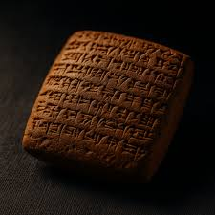
The Law of Primogeniture
Typical elements of a Nuzi transfer:
Parties identified (often kin, e.g., brothers).
Object defined (inheritance share, rights, or property).
Consideration stated (goods/money; sometimes modest).
Witnesses & seals; penalties for breach; date/place.

Slide 20
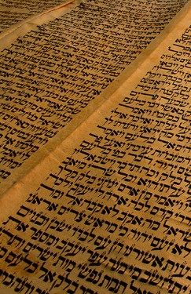
The Law of Primogeniture
Under the Mosaic legislation the privileges of the first-born were:
Succession to the official authority of the father,
The inheritance of a double portion of the father’s property,
The privilege of becoming the family priest.
See Ex. 22:29; Num. 8:14-17; Deut. 21:17

Slide 21
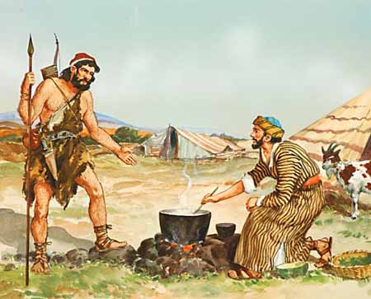
The Law of Primogeniture
Jacob took advantage of what appeared to him to be a fair, though unusual, opportunity.
But his conditions of sale were exacting, selfish, and base. The theory that the end justifies the means does not have the approval of Heaven . God could not approve the act, but He did overrule it to the eventual accomplishment of His purpose.

Slide 22
9. How did Esau reason concerning his birthright?
Genesis 25:32
And Esau said, Behold, I am at the point to die: and what profit shall this birthright do to me?

Slide 23
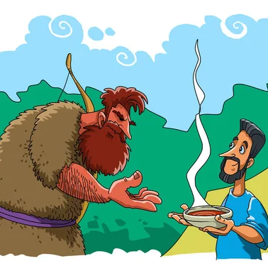
10. What transaction was thus made by the two brothers?
Genesis 25:33-34
And Jacob said, Swear to me this day; and he sware unto him: and he sold his birthright unto Jacob.

Slide 24
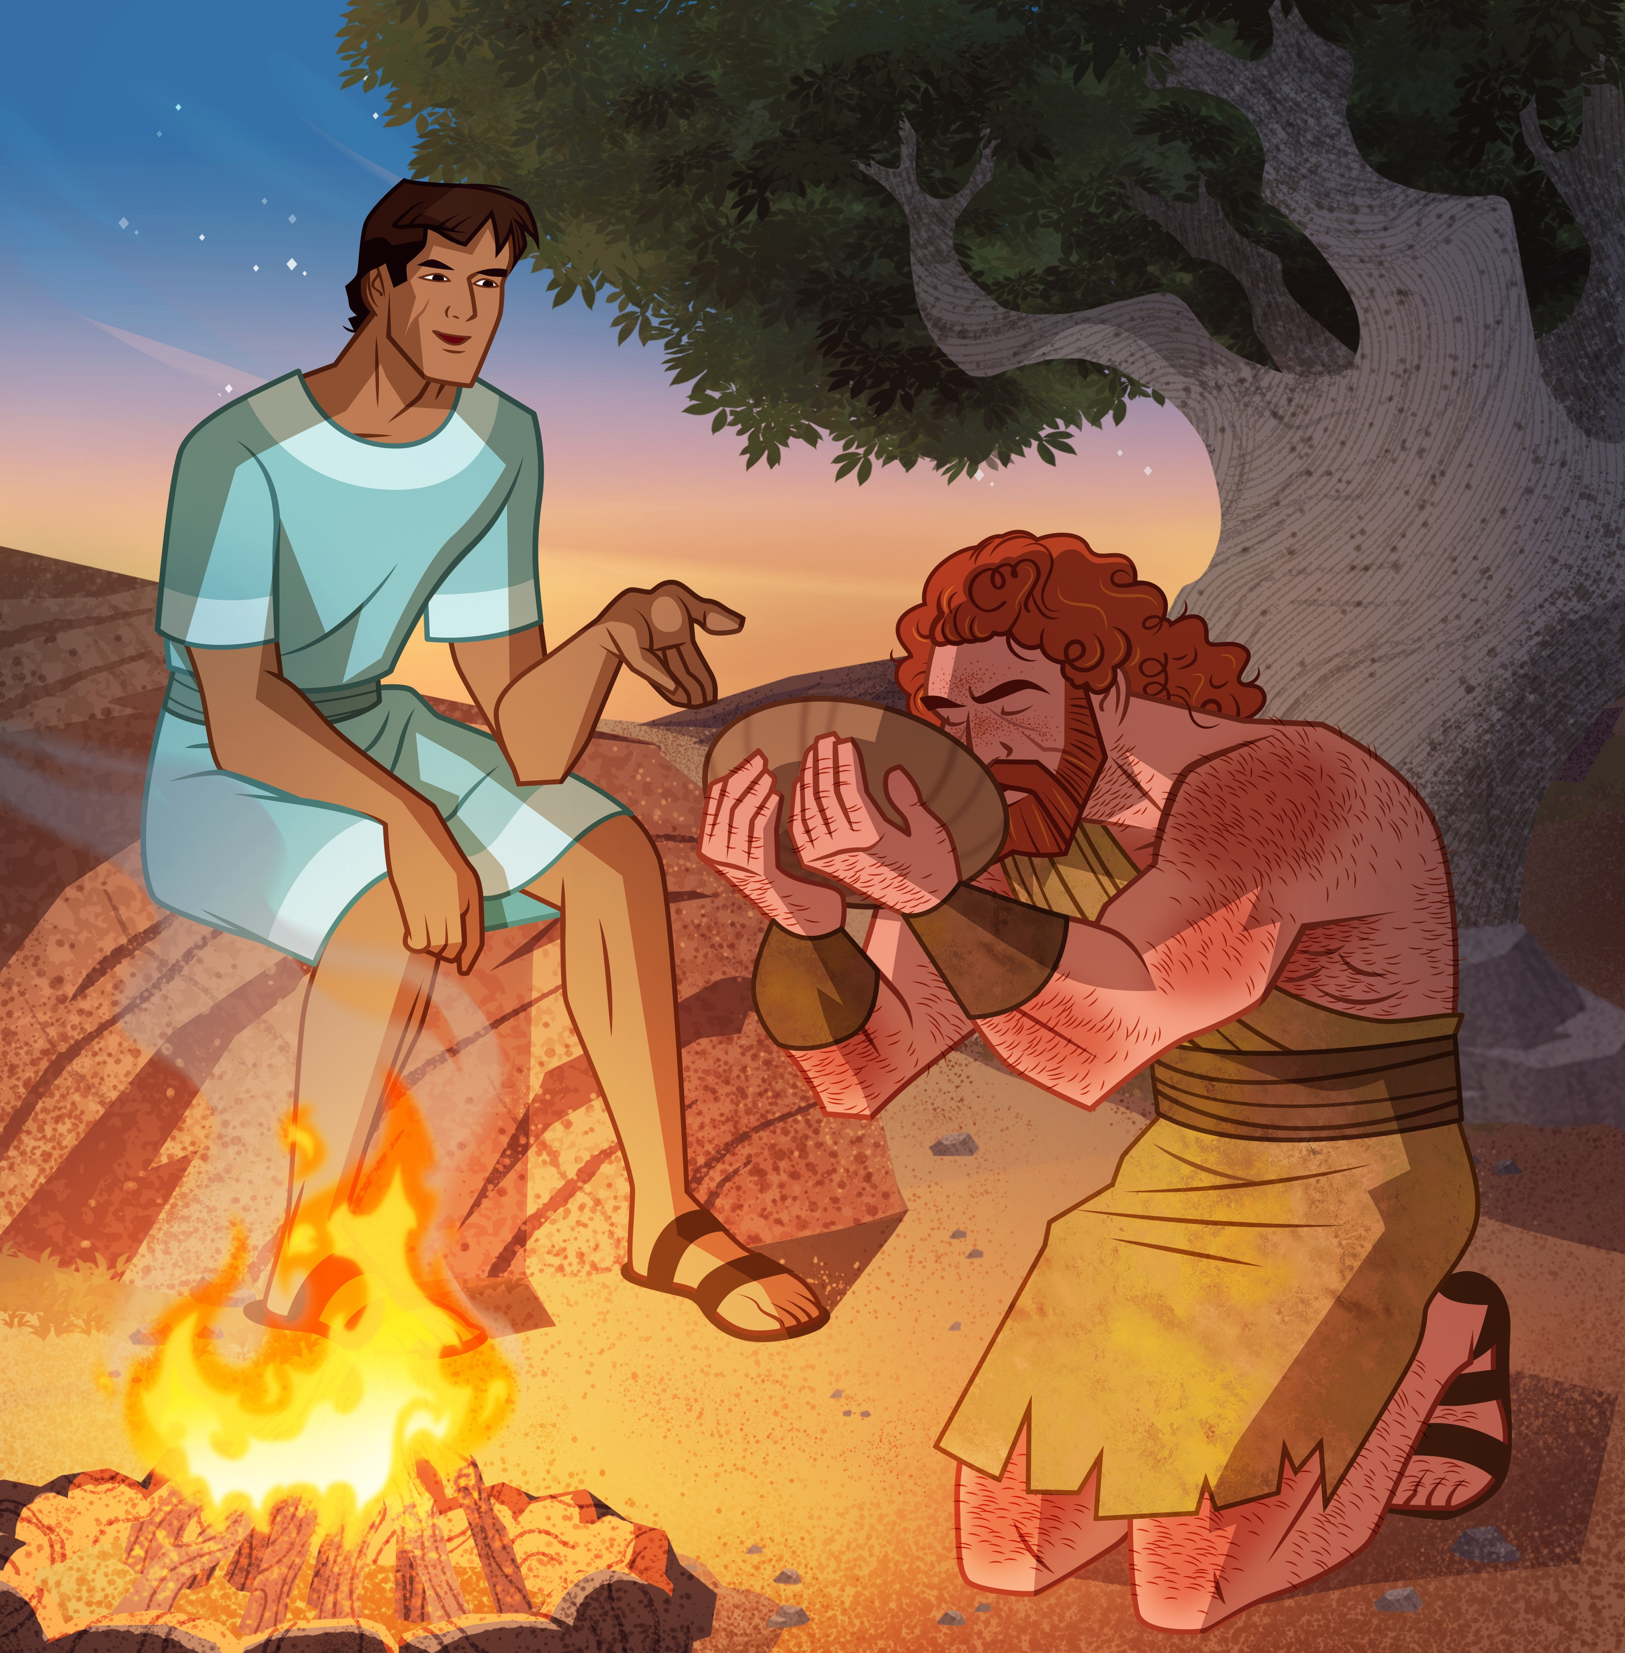
10. What transaction was thus made by the two brothers?
Genesis 25:33-34
Then Jacob gave Esau bread and pottage of lentiles; and he did eat and drink, and rose up, and went his way: thus Esau despised his birthright.

Slide 25
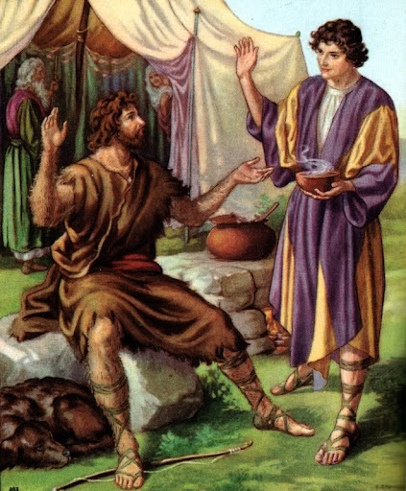
11. What was the birthright, and what was its importance to anyone?
The birthright was the firstborn’s special claim—a double share of the inheritance, succession to the father’s leadership of the family, and (in Israel) special spiritual privilege and responsibility as one devoted to God; therefore it carried both material and covenant significance.

Slide 26
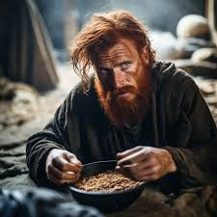
12. How did Esau regard his birthright?
Genesis 25:34
Then Jacob gave Esau bread and pottage of lentiles; and he did eat and drink, and rose up, and went his way: thus Esau despised his birthright.

Slide 27
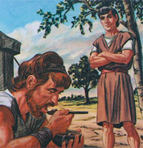
13. How highly did he value it?
Answer: He considered it worth no more than a meal of victuals, to satisfy present necessity.

Slide 28
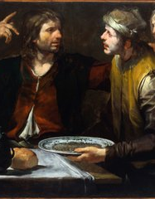
14. What language is used concerning Esau for this proceeding?
Hebrews 12:16
Lest there be any fornicator, or profane person, as Esau, who for one morsel of meat sold his birthright.

Slide 29
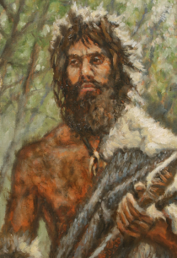
15. How did he afterward feel concerning the blessings of his birthright?
Hebrews 12:17
For ye know how that afterward, when he would have inherited the blessing, he was rejected: for he found no place of repentance, though he sought it carefully with tears.

Slide 30
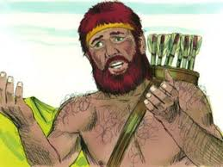
Esau’s Choices
Long years of living for earthly pursuits had deprived Esau of the capacity to bear the more serious responsibilities of life. By his own choice his mind and character had become fixed.

Slide 31
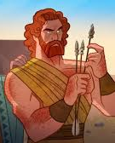
Esau’s Choices
The writer of Hebrews does not imply that Esau actually desired to repent of his worldly ways, but simply that he repented of having sold his birthright. He wished he had it back again, but realized that his decision was irrevocable. He had lost it forever.

Slide 32

Esau’s Choices
No arbitrary act of God kept Esau from receiving the inheritance that would normally have been his. His own character disqualified him for its privileges and responsibilities.

Slide 33
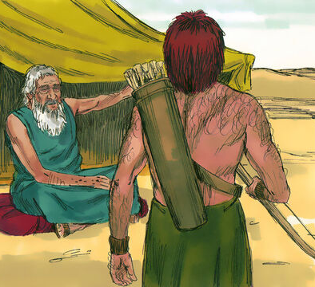
16. Relate, in brief, the circumstances of Genesis 27:1-40
Isaac, old and blind, asks Esau to hunt so he can bestow the blessing.

Slide 34
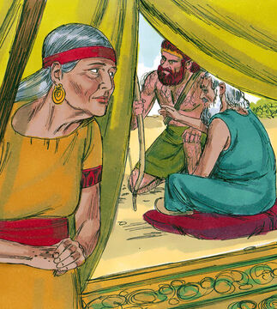
16. Relate, in brief, the circumstances of Genesis 27:1-40
Rebekah overhears; instructs Jacob to pose as Esau; prepares goat stew; disguises him.

Slide 35
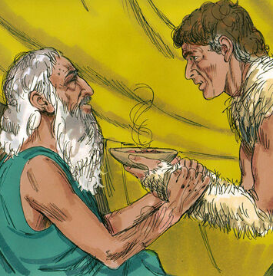
16. Relate, in brief, the circumstances of Genesis 27:1-40
Jacob brings the meal; Isaac, doubtful, tests voice and hands, then eats and blesses Jacob.

Slide 36
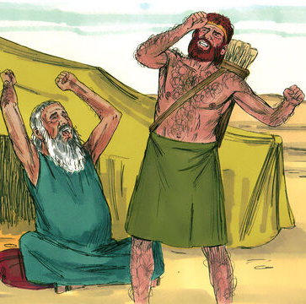
16. Relate, in brief, the circumstances of Genesis 27:1-40
Esau returns, discovers the deceit, weeps, and pleads for a blessing.

Slide 37
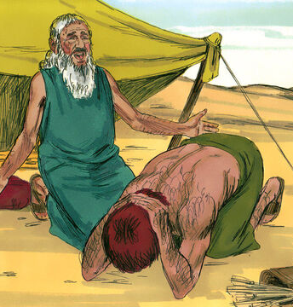
16. Relate, in brief, the circumstances of Genesis 27:1-40
Isaac affirms Jacob’s blessing; gives Esau a harder lot—by the sword, serving his brother, yet one day loosening the yoke.

Slide 38
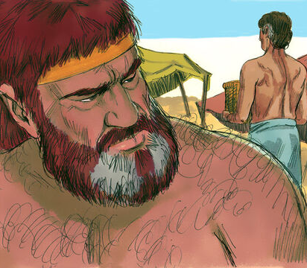
17. Was he able to get back the birthright?
Hebrews 12:17
For ye know how that afterward, when he would have inherited the blessing, he was rejected: for he found no place of repentance, though he sought it carefully with tears.

Slide 39
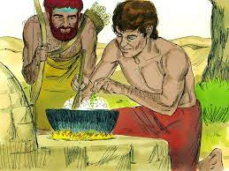
18. Why not?
Answer: Because he had deliberately sold it, and could not alter the trade.

Slide 40

19. What is the exhortation given to us in this connection?
Hebrews 12:14-17
Follow peace with all men, and holiness, without which no man shall see the Lord:

Slide 41
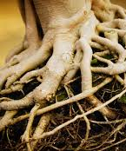
19. What is the exhortation given to us in this connection?
Hebrews 12:14-17
Looking diligently lest any man fail of the grace of God; lest any root of bitterness springing up trouble you, and thereby many be defiled;

Slide 42
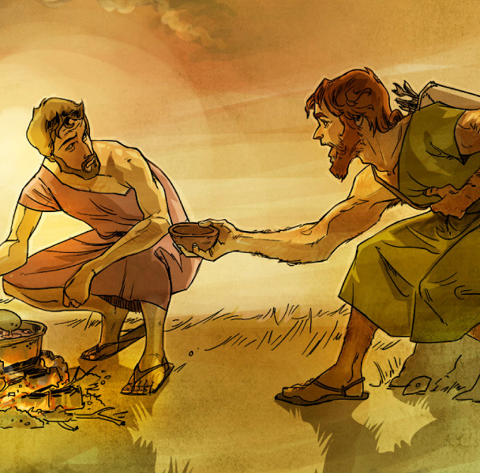
19. What is the exhortation given to us in this connection?
Hebrews 12:14-17
Lest there be any fornicator, or profane person, as Esau, who for one morsel of meat sold his birthright.

Slide 43
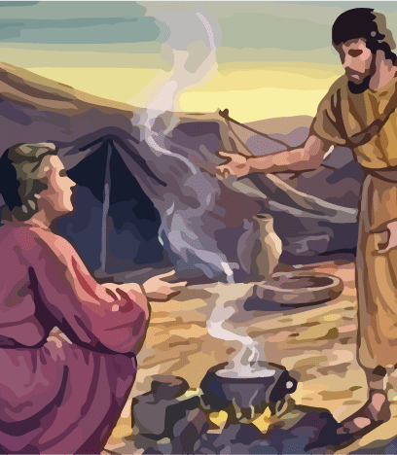
19. What is the exhortation given to us in this connection?
Hebrews 12:14-17
For ye know how that afterward, when he would have inherited the blessing, he was rejected: for he found no place of repentance, though he sought it carefully with tears.

Slide 44

20. If we are children of Abraham, what is our birthright?
Romans 4:13; Colossians 1:12; 1 John 3:1-2
For the promise, that he should be the heir of the world, was not to Abraham, or to his seed, through the law, but through the righteousness of faith.

Slide 45

20. If we are children of Abraham, what is our birthright?
Romans 4:13; Colossians 1:12; 1 John 3:1-2
Giving thanks unto the Father, which hath made us meet to be partakers of the inheritance of the saints in light:

Slide 46
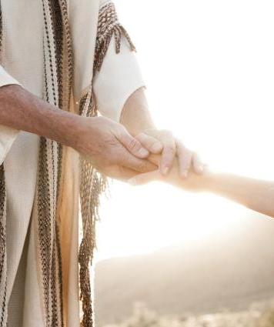
20. If we are children of Abraham, what is our birthright?
Romans 4:13; Colossians 1:12; 1 John 3:1-2
Behold, what manner of love the Father hath bestowed upon us, that we should be called the sons of God: therefore the world knoweth us not, because it knew him not.

Slide 47
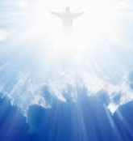
21. Through what are we made heirs of this inheritance?
Colossians 1:13-14
Who hath delivered us from the power of darkness, and hath translated us into the kingdom of his dear Son:

Slide 48
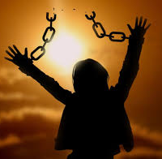
21. Through what are we made heirs of this inheritance?
Colossians 1:13-14
In whom we have redemption through his blood, even the forgiveness of sins:

Slide 49

22. What does the Spirit through Paul say of one who despises his heavenly birthright?
Hebrews 10:28-29
He that despised Moses' law died without mercy under two or three witnesses:

Slide 50
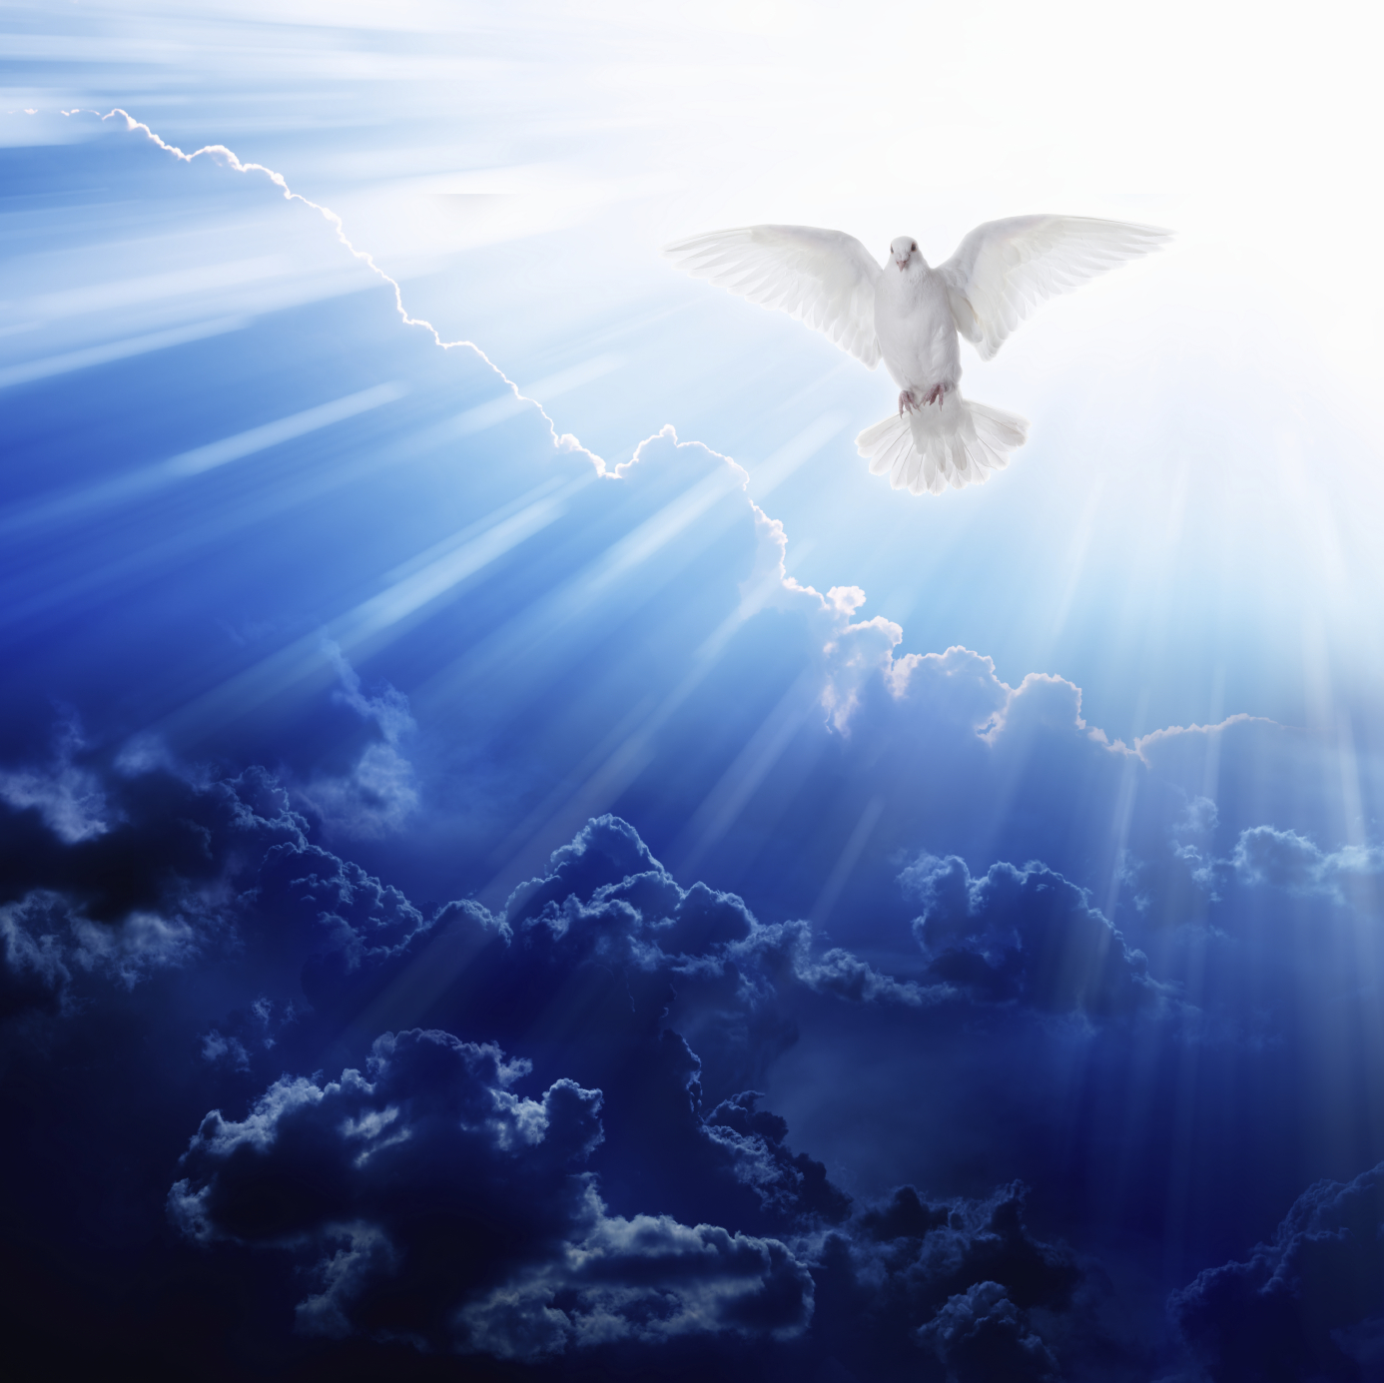
22. What does the Spirit through Paul say of one who despises his heavenly birthright?
Hebrews 10:28-29
Of how much sorer punishment, suppose ye, shall he be thought worthy, who hath trodden under foot the Son of God, and hath counted the blood of the covenant, wherewith he was sanctified, an unholy thing, and hath done despite unto the Spirit of grace?

Slide 51

23. How may we do this?
2 Timothy 4:10
For Demas hath forsaken me, having loved this present world, and is departed unto Thessalonica; Crescens to Galatia, Titus unto Dalmatia.

Slide 52
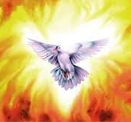
24. What can you say of the condition of one who deliberately barters his interest in the blood of Christ, and his hope of eternal life, for a little present enjoyment?
Hebrews 10:29-31
Of how much sorer punishment, suppose ye, shall he be thought worthy, who hath trodden under foot the Son of God, and hath counted the blood of the covenant, wherewith he was sanctified, an unholy thing, and hath done despite unto the Spirit of grace?

Slide 53
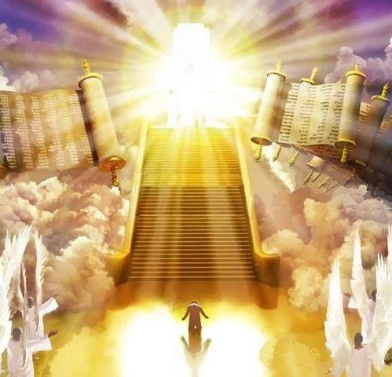
24. What can you say of the condition of one who deliberately barters his interest in the blood of Christ, and his hope of eternal life, for a little present enjoyment?
Hebrews 10:29-31
For we know him that hath said, Vengeance belongeth unto me, I will recompense, saith the Lord. And again, The Lord shall judge his people.

Slide 54
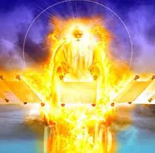
24. What can you say of the condition of one who deliberately barters his interest in the blood of Christ, and his hope of eternal life, for a little present enjoyment?
Hebrews 10:29-31
It is a fearful thing to fall into the hands of the living God.

Slide 55
Thank You &
HAPPY SABBATH!!

Slide 56


