Slide 1


Slide 2

Living the Light

Slide 3
Old Testament History:
Jacob’s Vow
Lesson 16,2nd Quarter, 1888

Slide 4
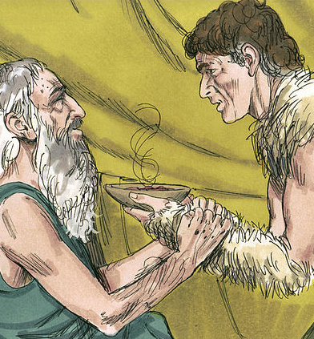
1. Relate the means by which Jacob secured the blessing.
At Rebekah’s urging, Jacob disguised himself as Esau to fool his blind father Isaac into thinking he was the elder son. Isaac, deceived by the measures Jacob had taken, blessed Jacob in Esau’s place.

Slide 5
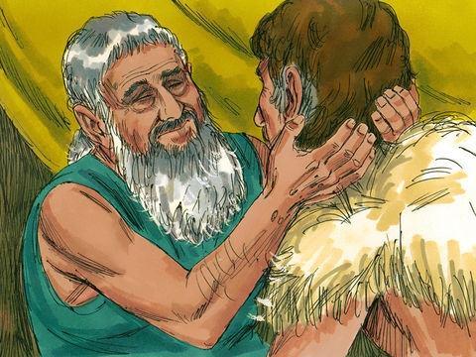
2. Was this honorable on the part of Jacob?
Genesis 27:35
And he said, Thy brother came with subtilty, and hath taken away thy blessing.

Slide 6
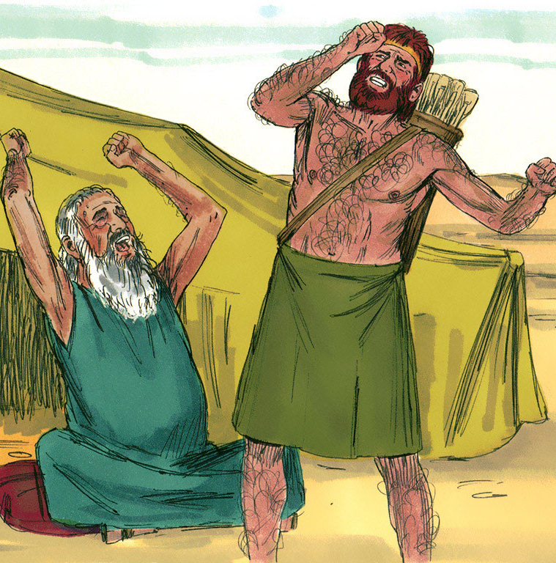
3. What is the meaning of the name “Jacob”?
Genesis 27:36
And he said, Is not he rightly named Jacob? for he hath supplanted me these two times: he took away my birthright; and, behold, now he hath taken away my blessing. And he said, Hast thou not reserved a blessing for me?

Slide 7
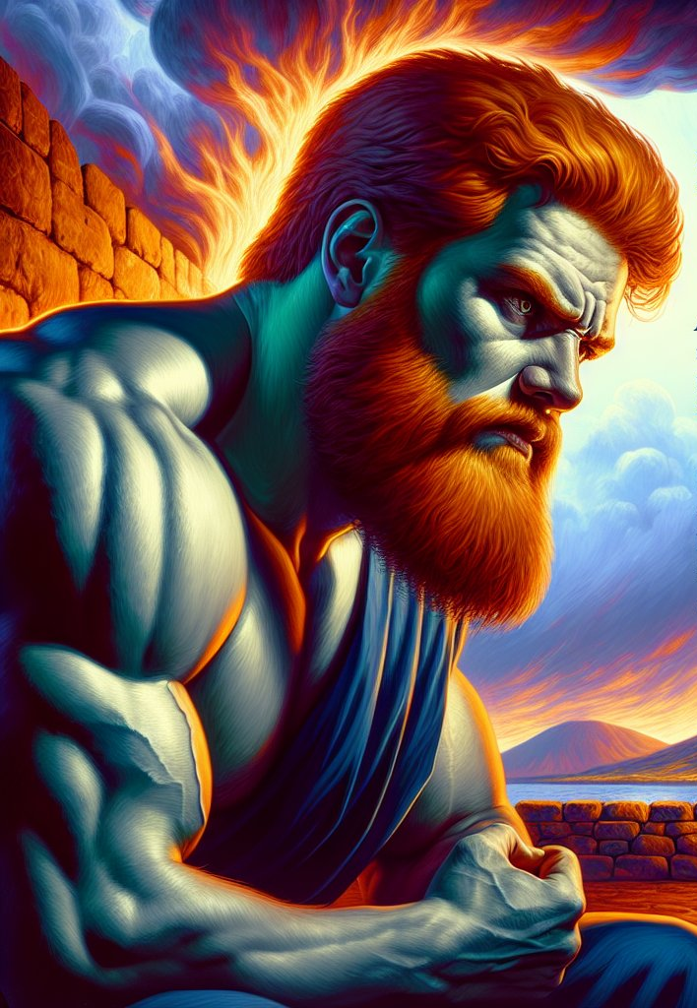
4. How did Esau regard Jacob for his course in securing the birthright?
Genesis 27:41 (first part)
And Esau hated Jacob because of the blessing wherewith his father blessed him:

Slide 8
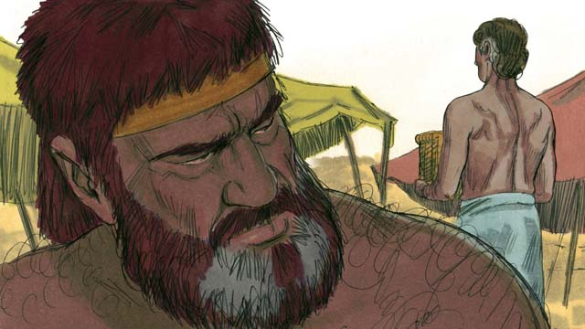
5. What did he purpose to do?
Genesis 27:41 (last part)
and Esau said in his heart, The days of mourning for my father are at hand; then will I slay my brother Jacob.

Slide 9
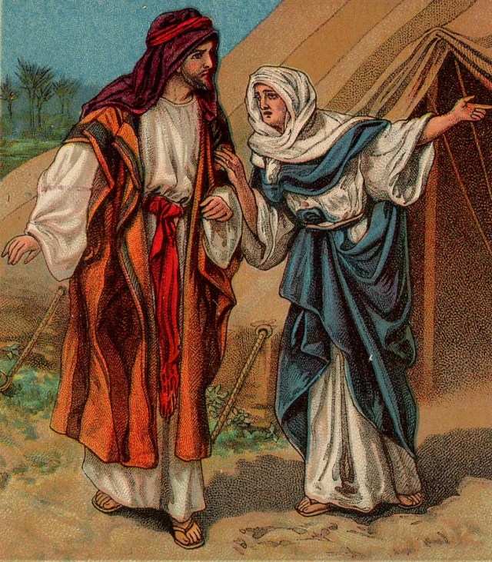
6. What did Jacob’s mother advise him to do?
Genesis 27:42-45
And these words of Esau her elder son were told to Rebekah: and she sent and called Jacob her younger son, and said unto him, Behold, thy brother Esau, as touching thee, doth comfort himself, purposing to kill thee.

Slide 10
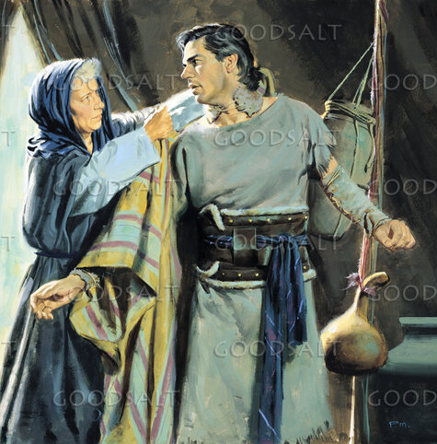
6. What did Jacob’s mother advise him to do?
Genesis 27:42-45
Now therefore, my son, obey my voice; arise, flee thou to Laban my brother to Haran;

Slide 11
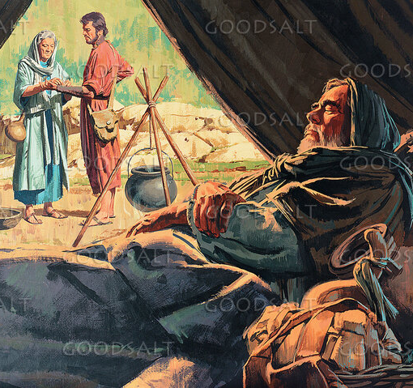
6. What did Jacob’s mother advise him to do?
Genesis 27:42-45
And tarry with him a few days, until thy brother’s fury turn away;

Slide 12
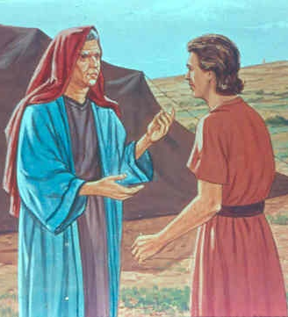
6. What did Jacob’s mother advise him to do?
Genesis 27:42-45
Until thy brother’s anger turn away from thee, and he forget that which thou hast done to him: then I will send, and fetch thee from thence: why should I be deprived also of you both in one day?

Slide 13

7. Into how many years did the “few days” expand?
Answer: More than twenty.

Slide 14
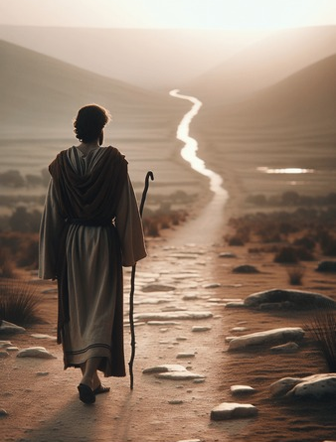
8. What sort of a sleeping-place did Jacob have one night on his journey?
Genesis 28:10-11
And Jacob went out from Beersheba, and went toward Haran.

Slide 15
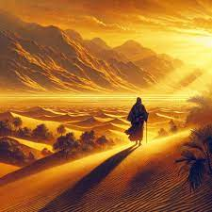
8. What sort of a sleeping-place did Jacob have one night on his journey?
Genesis 28:10-11
And he lighted upon a certain place, and tarried there all night, because the sun was set; and he took of the stones of that place, and put them for his pillows, and lay down in that place to sleep.

Slide 16
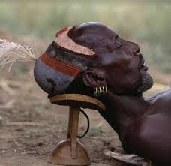
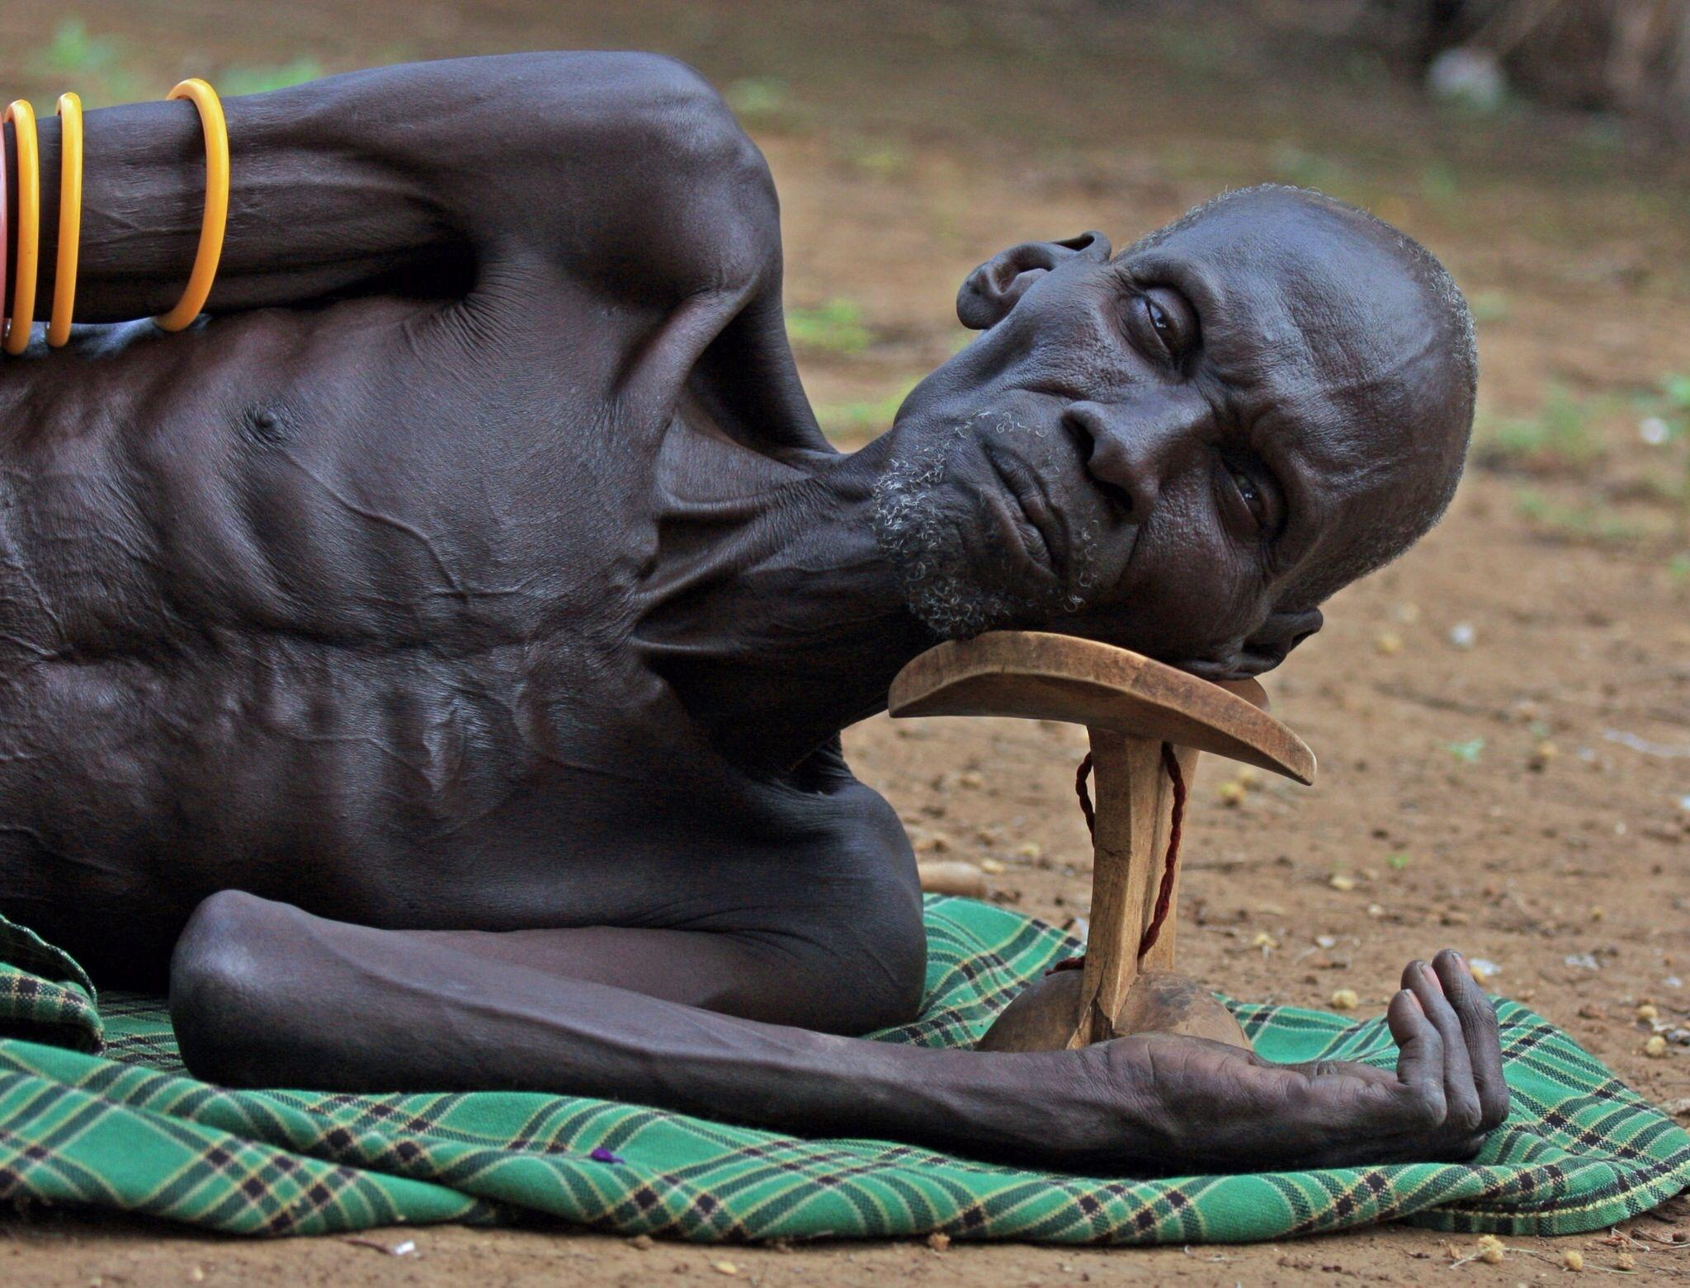
8. What sort of a sleeping-place did Jacob have one night on his journey?
In ancient times, people used hard headrests of wood, stone, or clay instead of soft pillows. Jacob’s “stone pillow” was typical, not a hardship—later it became the memorial pillar at Bethel.

Slide 17
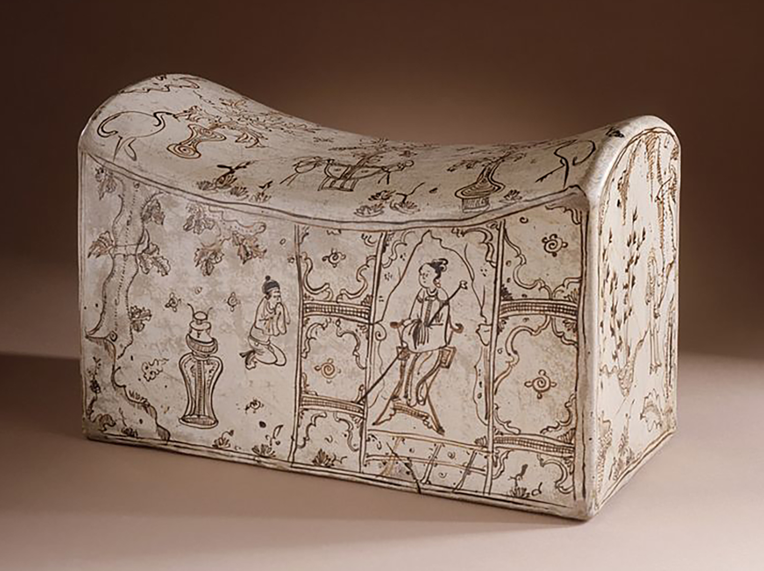
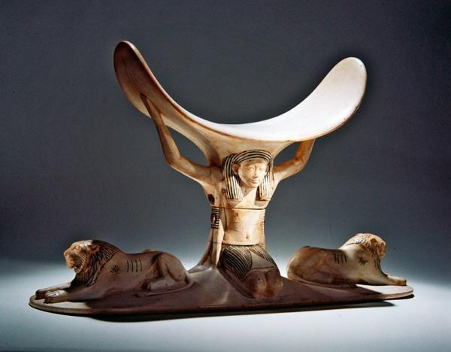
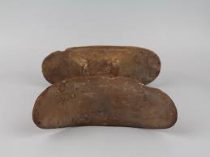
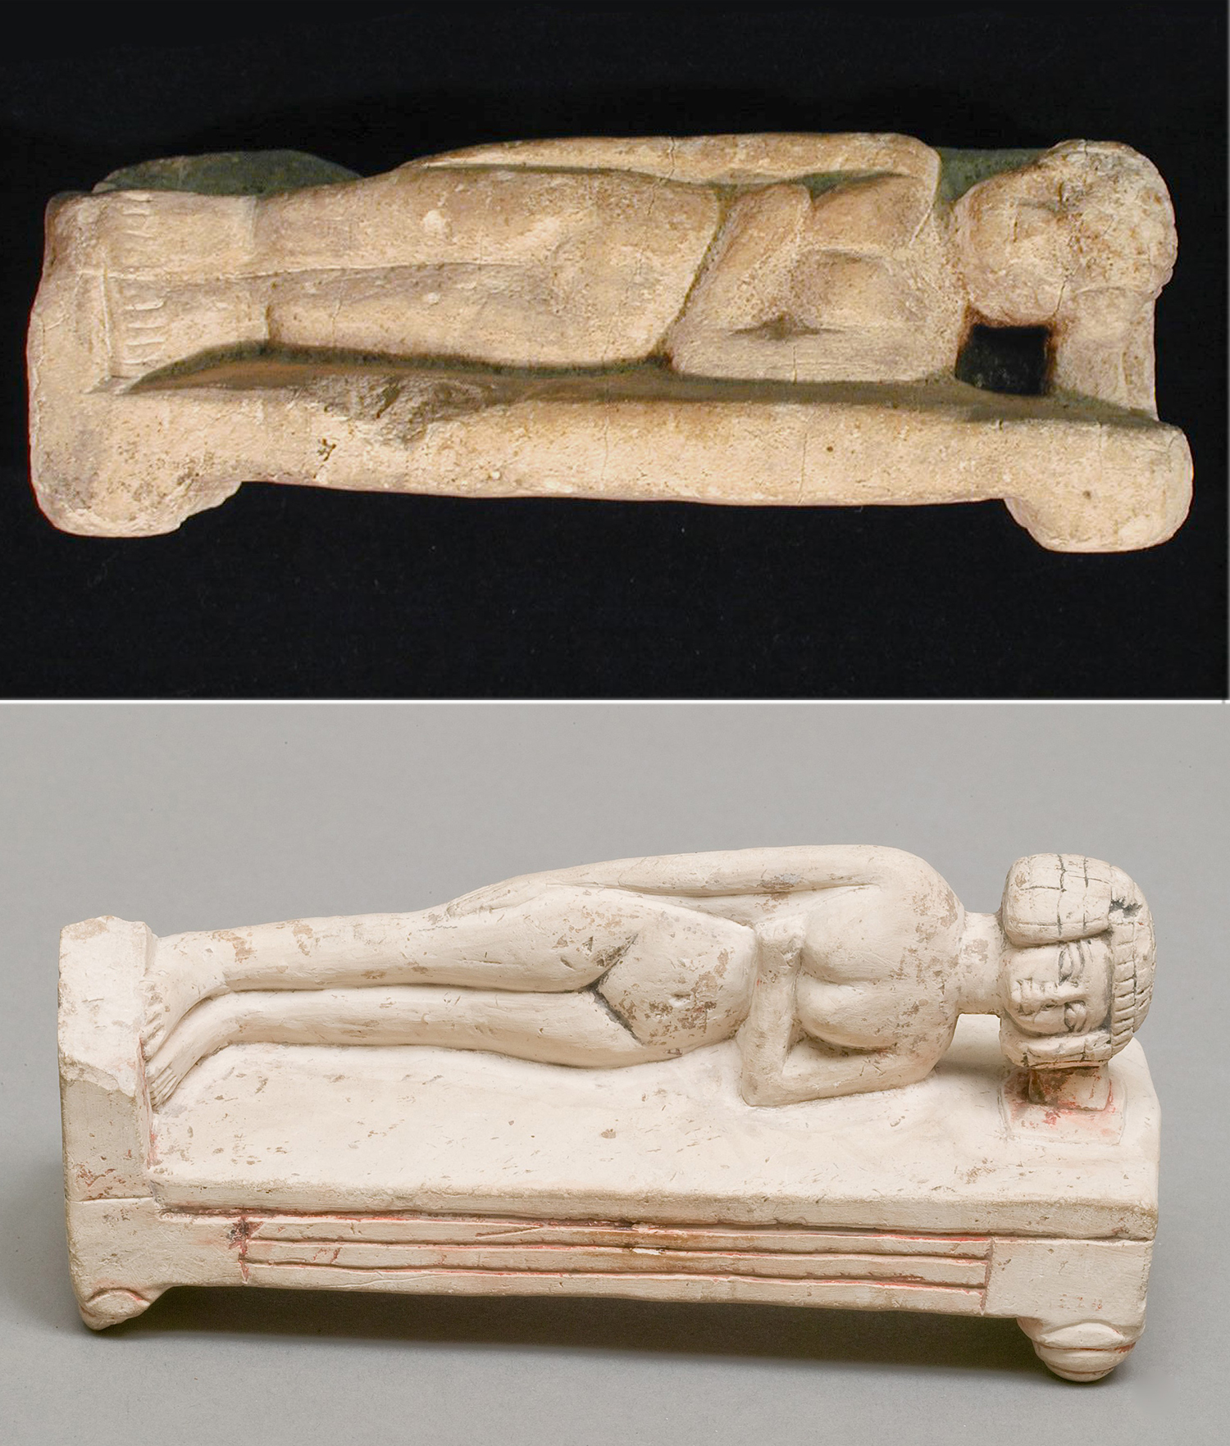
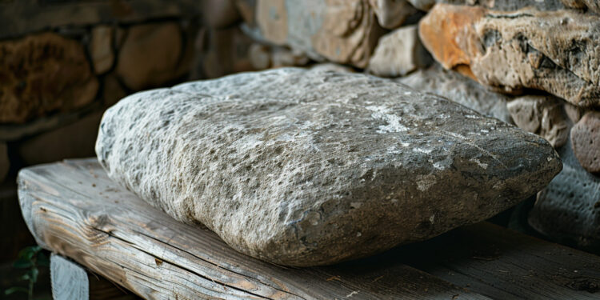
8. What sort of a sleeping-place did Jacob have one night on his journey?

Slide 18
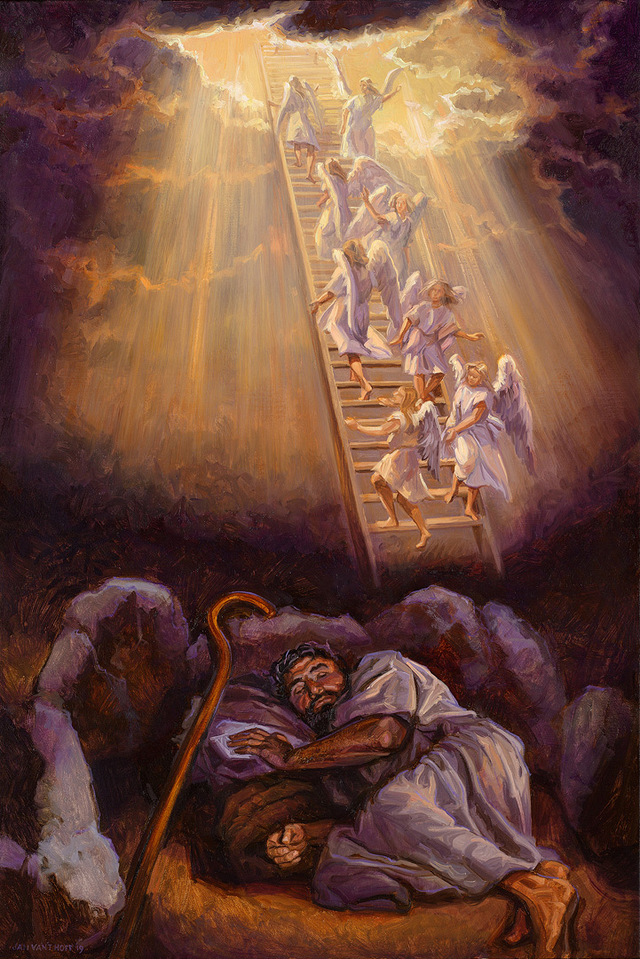
9. What dream did he have there?
Genesis 28:12
And he dreamed, and behold a ladder set up on the earth, and the top of it reached to heaven: and behold the angels of God ascending and descending on it.

Slide 19
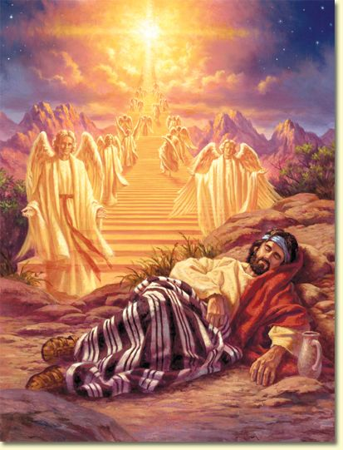
10. Who stood at the head of the ladder?
Genesis 28:13
And, behold, the LORD stood above it, and said, I am the LORD God of Abraham thy father, and the God of Isaac: the land whereon thou liest, to thee will I give it, and to thy seed;

Slide 20
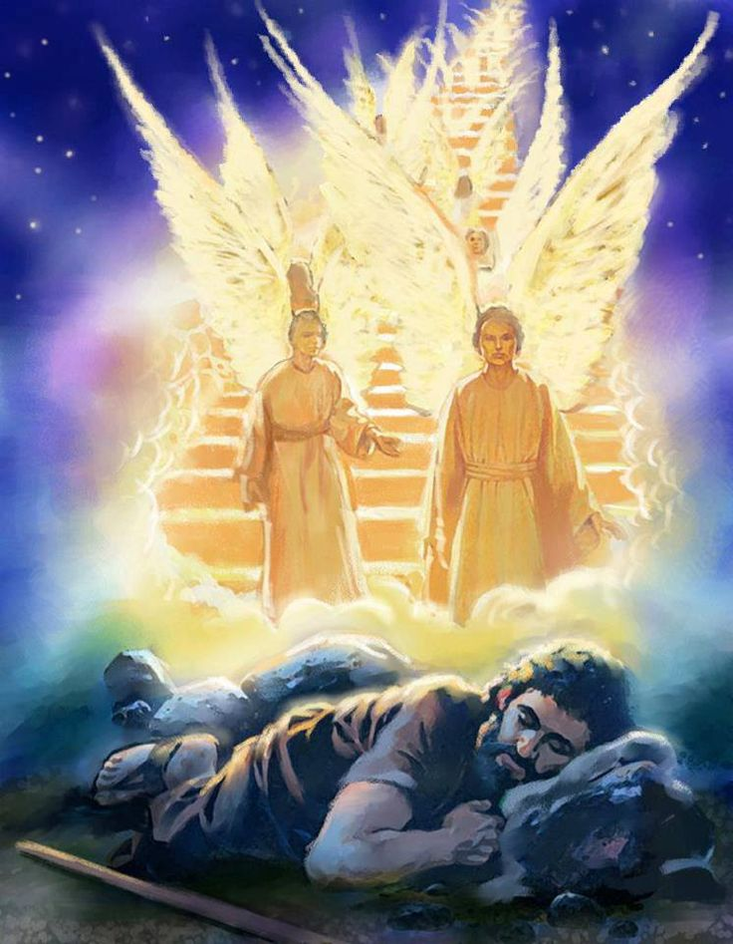
11. What promise did the Lord make to him?
Genesis 28:13-15
And, behold, the LORD stood above it, and said, I am the LORD God of Abraham thy father, and the God of Isaac: the land whereon thou liest, to thee will I give it, and to thy seed;

Slide 21
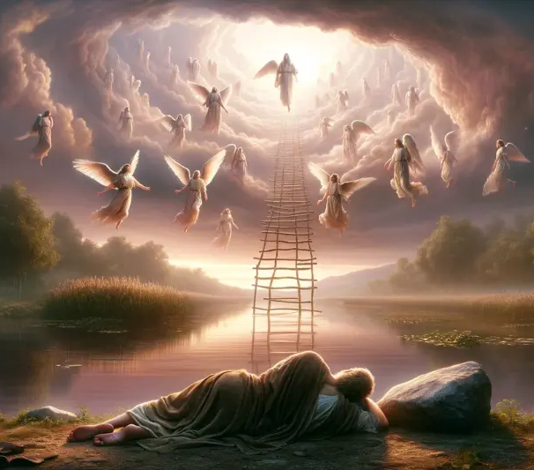
11. What promise did the Lord make to him?
Genesis 28:13-15
And thy seed shall be as the dust of the earth, and thou shalt spread abroad to the west, and to the east, and to the north, and to the south: and in thee and in thy seed shall all the families of the earth be blessed.

Slide 22
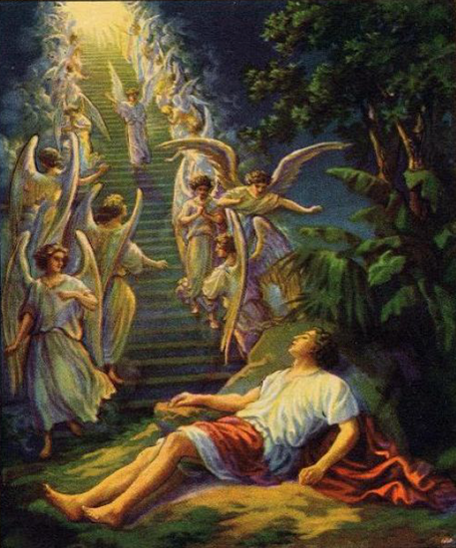
11. What promise did the Lord make to him?
Genesis 28:13-15
And, behold, I am with thee, and will keep thee in all places whither thou goest, and will bring thee again into this land; for I will not leave thee, until I have done that which I have spoken to thee of.

Slide 23

Christ, the True Ladder (John 1:51)
“Hereafter ye shall see heaven open, and the angels of God ascending and descending upon the Son of man.” — John 1:51 (KJV)
“For there is one God, and one mediator between God and men, the man Christ Jesus.” — 1 Timothy 2:5
Jesus revealed Himself as the true Ladder—the connection between God and man. He bridges the separation caused by sin, and every ray of light and mercy comes through Him.

Slide 24
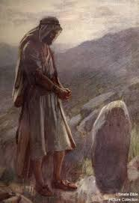
12. What did Jacob say when he awoke?
Genesis 28:16
And Jacob awaked out of his sleep, and he said, Surely the LORD is in this place; and I knew it not.

Slide 25
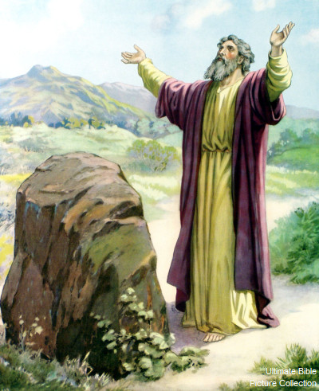
13. What did he say of that place?
Genesis 28:17
And he was afraid, and said, How dreadful is this place! this is none other but the house of God, and this is the gate of heaven.

Slide 26
While the sinner is yet afar off, the ladder is let down that he may ascend to heaven.
Patriarchs and Prophets, 184

Slide 27
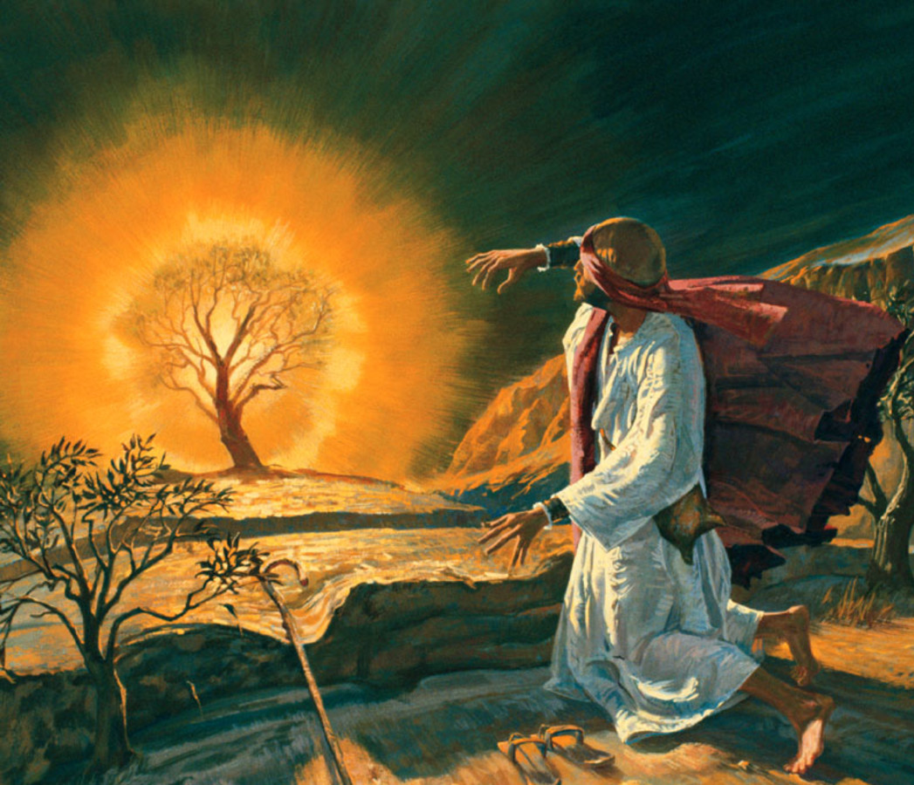
14. When the Lord appeared to certain of His servants what did He say to them?
Exodus 3:7; Joshua 5:15
And the LORD said, I have surely seen the affliction of my people which are in Egypt, and have heard their cry by reason of their taskmasters; for I know their sorrows;

Slide 28
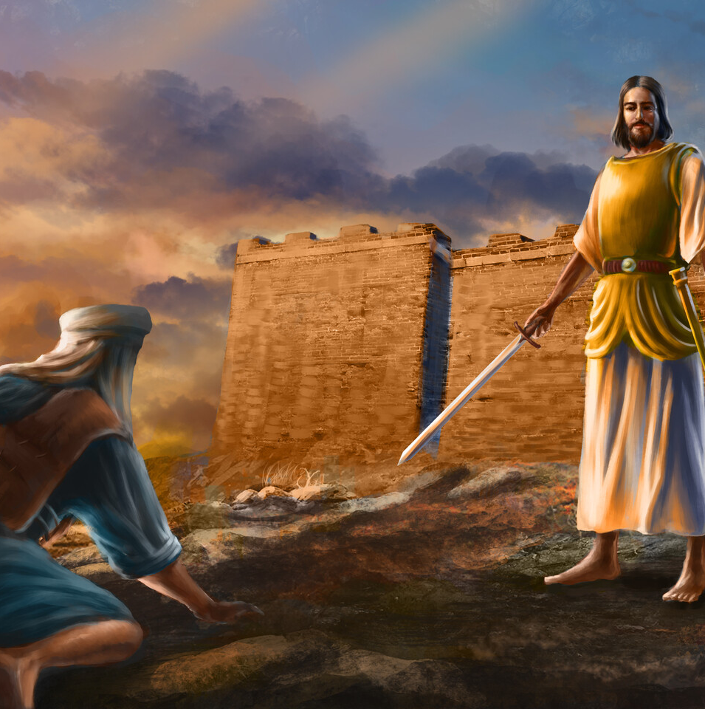
14. When the Lord appeared to certain of His servants what did He say to them?
Exodus 3:7; Joshua 5:15
And the captain of the LORD'S host said unto Joshua, Loose thy shoe from off thy foot; for the place whereon thou standest is holy. And Joshua did so.

Slide 29
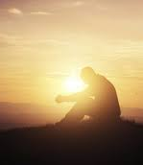
15. What may we learn from this?
Answer: That the presence of God in any place makes that place holy.

Slide 30
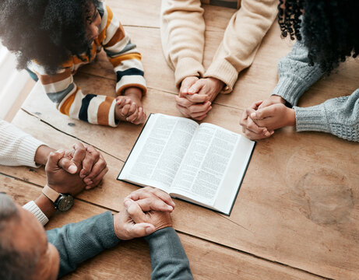
16. Where has the Lord promised always to be?
Matthew 18:20
For where two or three are gathered together in my name, there am I in the midst of them.

Slide 31
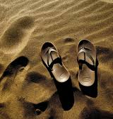
17. What lesson should this teach us?
Answer: That places dedicated to the worship of God are sacred, and should always be entered with reverence.

Slide 32
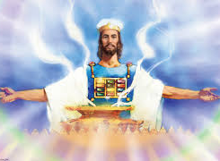
🌿 Christ is not far off—He is the Ladder, the Mediator, and the Way.
“Seeing then that we have a great High Priest, that is passed into the heavens, Jesus the Son of God, let us hold fast our profession.” — Hebrews 4:14

Slide 33
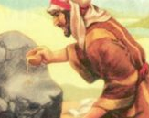
18. What did Jacob do in the morning?
Genesis 28:18-19
And Jacob rose up early in the morning, and took the stone that he had put for his pillows, and set it up for a pillar, and poured oil upon the top of it.

Slide 34
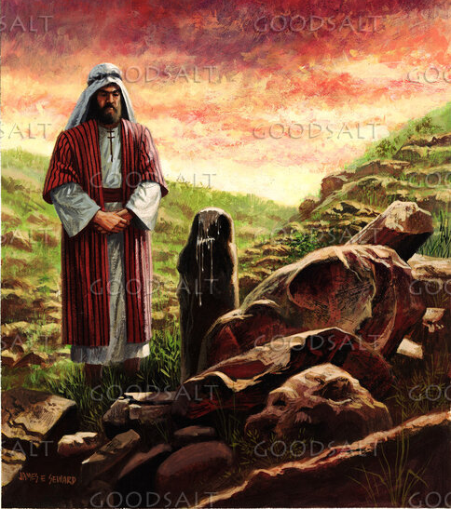
18. What did Jacob do in the morning?
Genesis 28:18-19
And he called the name of that place Bethel: but the name of that city was called Luz at the first.

Slide 35
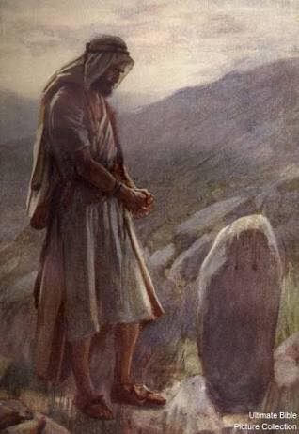
19. What vow did he make?
Genesis 28:20-22
And Jacob vowed a vow, saying, If God will be with me, and will keep me in this way that I go, and will give me bread to eat, and raiment to put on,

Slide 36
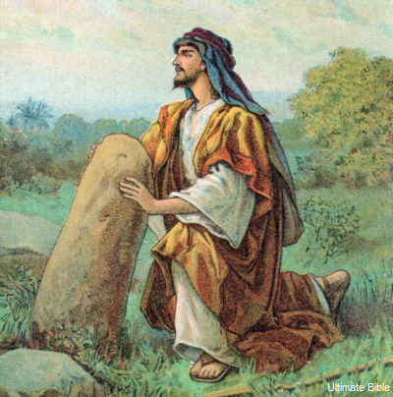
19. What vow did he make?
Genesis 28:20-22
So that I come again to my father's house in peace; then shall the LORD be my God:

Slide 37
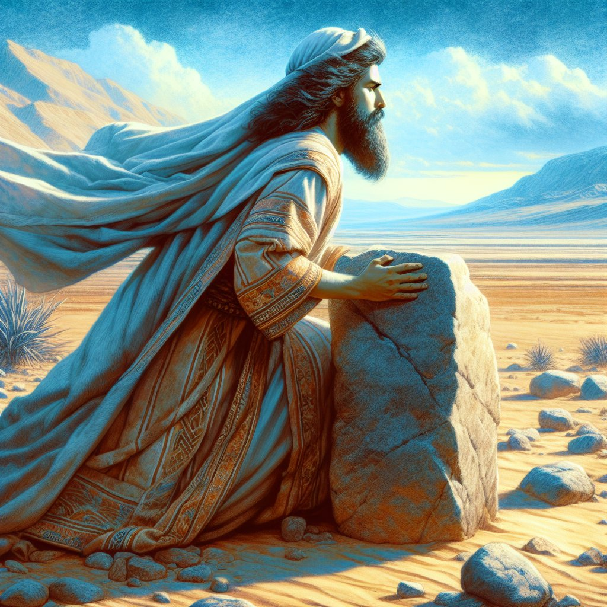
19. What vow did he make?
Genesis 28:20-22
And this stone, which I have set for a pillar, shall be God's house: and of all that thou shalt give me I will surely give the tenth unto thee.

Slide 38
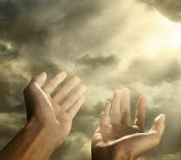
20. What was the extent of Jacob’s desire from the Lord?
Genesis 28:20
And Jacob vowed a vow, saying, If God will be with me, and will keep me in this way that I go, and will give me bread to eat, and raiment to put on,

Slide 39
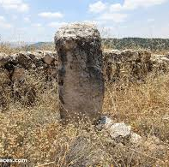
21. Could he have asked for less?
Answer: Jacob asked for food, clothing, and a safe return home. He could hardly have asked for less, which shows his humility and trust in God’s care.

Slide 40
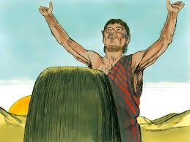
22. Yet what did he purpose to do?
Genesis 28:22
And this stone, which I have set for a pillar, shall be God's house: and of all that thou shalt give me I will surely give the tenth unto thee.

Slide 41
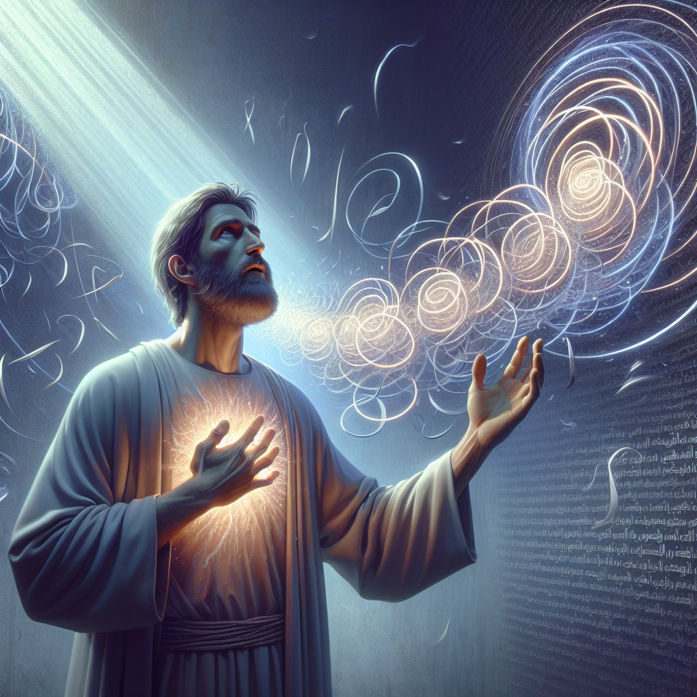
23. Is it right to make vows or pledges to the Lord?
Psalm 76:11
Vow, and pay unto the LORD your God: let all that be round about him bring presents unto him that ought to be feared.

Slide 42
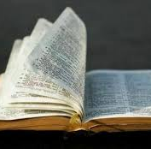
24. When a person makes a vow, what should he be careful to do?
Ecclesiastes 5:4-5
When thou vowest a vow unto God, defer not to pay it; for he hath no pleasure in fools: pay that which thou hast vowed.

Slide 43

24. When a person makes a vow, what should he be careful to do?
Ecclesiastes 5:4-5
Better is it that thou shouldest not vow, than that thou shouldest vow and not pay.

Slide 44
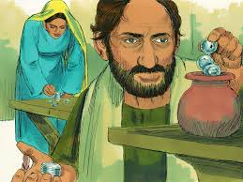
25. Why should we be so careful to pay our vows?
Deuteronomy 23:21
When thou shalt vow a vow unto the LORD thy God, thou shalt not slack to pay it: for the LORD thy God will surely require it of thee; and it would be sin in thee.

Slide 45
Thank You &
HAPPY SABBATH!!

Slide 46


