Slide 1


Slide 2

Living the Light

Slide 3
Old Testament History:
Jacob and the Angel
Lesson 17,2nd Quarter, 1888

Slide 4
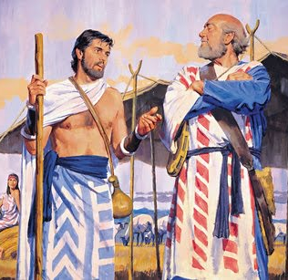
1. How long was Jacob with his Uncle Laban?
Genesis 31:38
This twenty years have I been with thee; thy ewes and thy she goats have not cast their young, and the rams of thy flock have I not eaten.

Slide 5
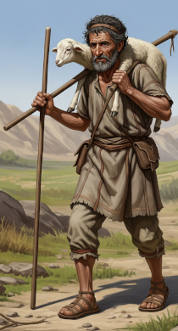
2. Was his service an easy one?
Genesis 31:39-41
That which was torn of beasts I brought not unto thee; I bare the loss of it; of my hand didst thou require it, whether stolen by day, or stolen by night.

Slide 6
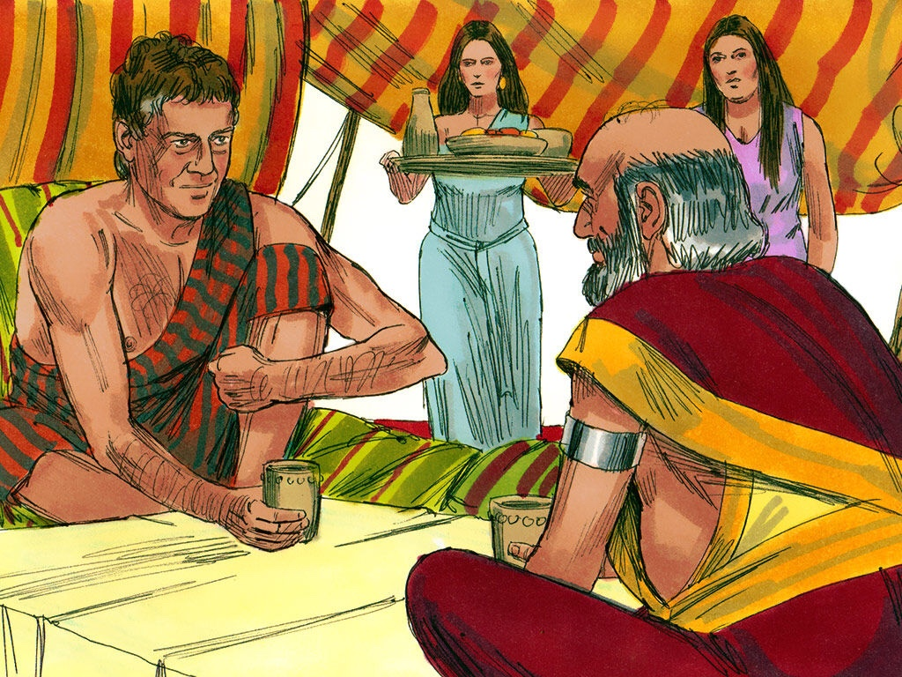
2. Was his service an easy one?
Genesis 31:39-41
Thus I was; in the day the drought consumed me, and the frost by night; and my sleep departed from mine eyes.

Slide 7
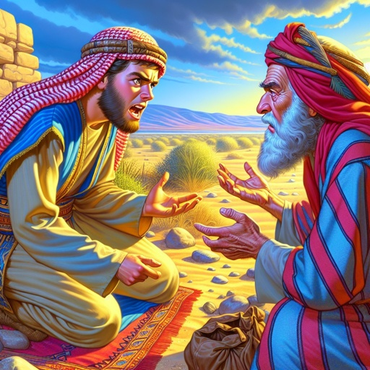
2. Was his service an easy one?
Genesis 31:39-41
Thus have I been twenty years in thy house; I served thee fourteen years for thy two daughters, and six years for thy cattle: and thou hast changed my wages ten times.

Slide 8
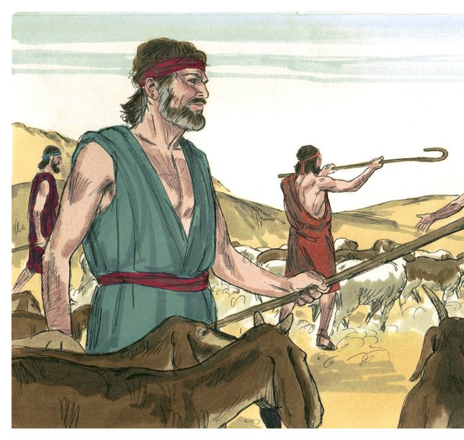
3. How did God prosper him?
Genesis 31:7-9, 42
And your father hath deceived me, and changed my wages ten times; but God suffered him not to hurt me.

Slide 9
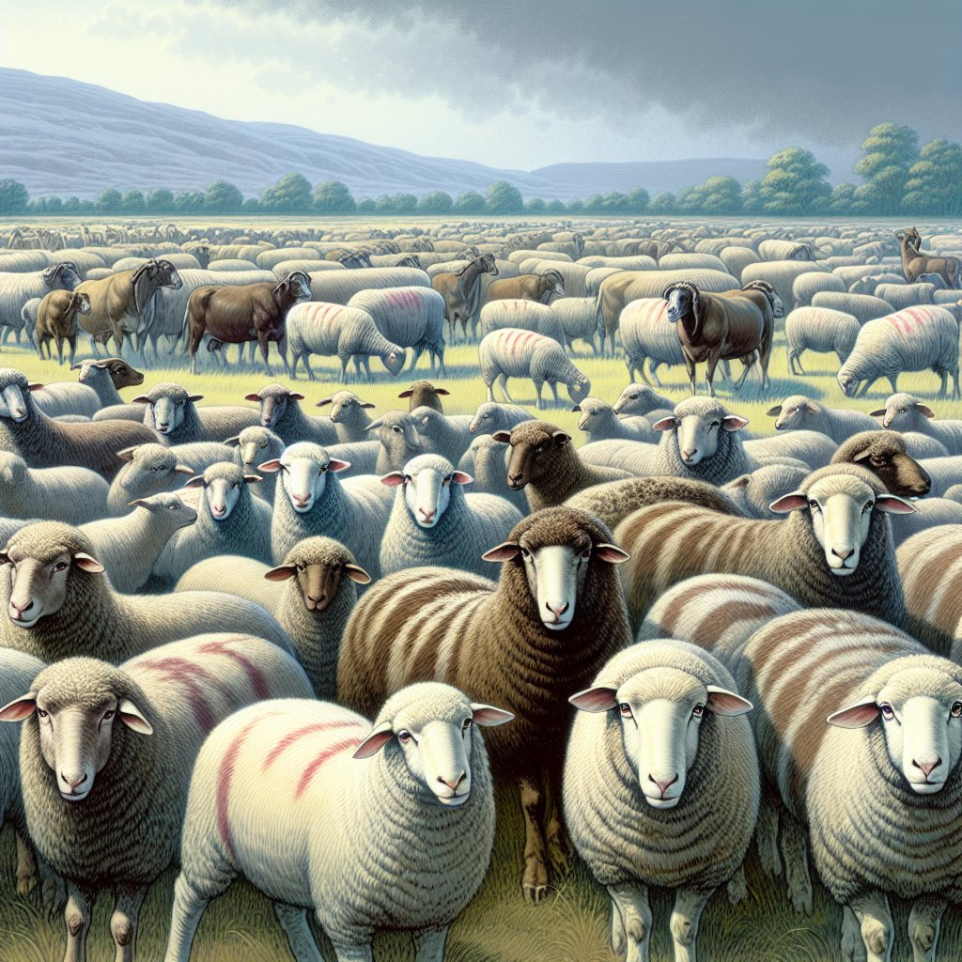
3. How did God prosper him?
Genesis 31:7-9, 42
If he said thus, The speckled shall be thy wages; then all the cattle bare speckled: and if he said thus, The ringstraked shall be thy hire; then bare all the cattle ringstraked.

Slide 10
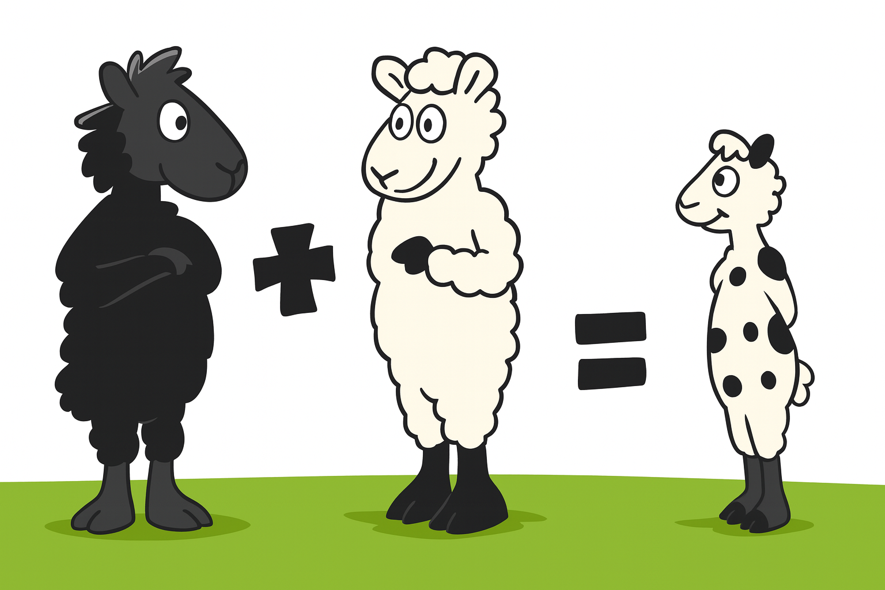
3. How did God prosper him?
Genesis 31:7-9, 42
Thus God hath taken away the cattle of your father, and given them to me.

Slide 11
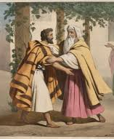
3. How did God prosper him?
Genesis 31:7-9, 42
Except the God of my father, the God of Abraham, and the fear of Isaac, had been with me, surely thou hadst sent me away now empty. God hath seen mine affliction and the labour of my hands, and rebuked thee yesternight.

Slide 12
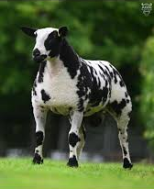
Science Catching Up to Scripture
Genesis 31:10–12
“All the rams which leap upon the cattle are ringstraked, speckled, and grisled…”
Though Laban removed every spotted animal, God manipulated which animals were actually bred
Many solid-colored animals still carried the hidden allele.

Slide 13
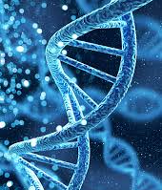
Science Catching Up to Scripture
Genesis 30:37-38
“Jacob took him rods of green poplar, and of the hazel and chesnut tree…And he set the rods which he had pilled before the flocks in the gutters in the watering troughs…”

Slide 14
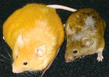
Science Catching Up to Scripture
There is a gene – the agouti gene – that determines the color an animal’s fur (mostly explored in mice). If all the agouti genes in the cells are turned either on or off, the animal will be solid-colored. But if this gene is turned on in some cells and off in others, the animal will be speckled, streaked, or spotted.

Slide 15
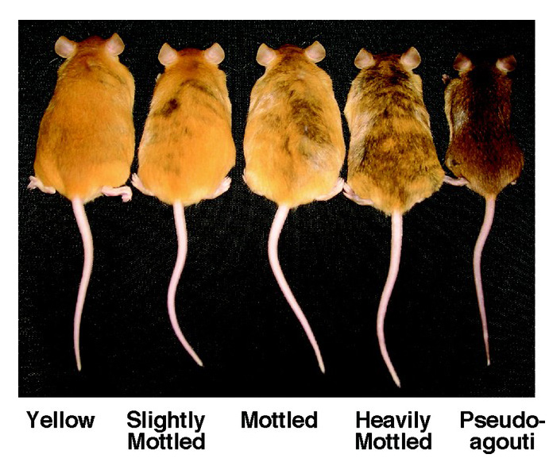
Science Catching Up to Scripture

Slide 16
Science Catching Up to Scripture
In this image there are five cloned mice (genetically identical), yet their fur looks different. The mouse on the far left has all of its agouti genes turned on and, thus, is solid yellow. The mouse on the far right has all its agouti genes turned off and is solid brown. But the three mice in the middle have some of the agouti genes turned on and some turned off.

Slide 17
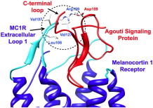
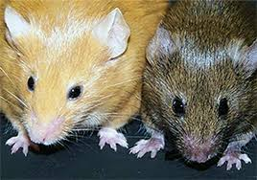
Science Catching Up to Scripture
But what turns the agouti gene on or off? The diet of the mother when she is pregnant! Depending on the mother’s diet, the gene is turned either on or off, thus changing the expression of the gene and the fur of the animal. And this change will pass down up to four generations. It’s epigenetics!

Slide 18
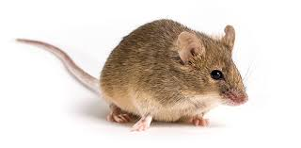
Science Catching Up to Scripture
Although not fully explored, the agouti gene is thought to impact color in species other than mice, quite likely including domestic animals like sheep and goats.
Please be aware that it’s far from proven that the tree branches Jacob added to the water had the potential to affect the agouti gene…

Slide 19
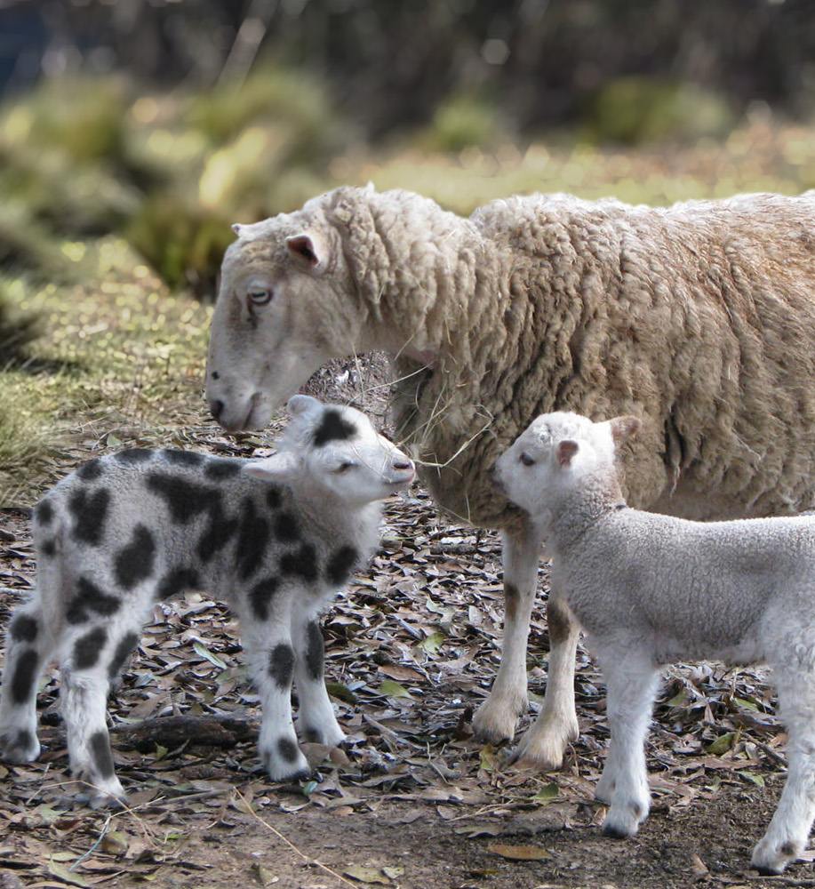
Science Catching Up to Scripture
And yet it’s worth noting that in the recent past science said that DNA alone fixed every trait. Now we know life is more dynamic than this: genes and environment interact. Maybe Jacob’s actions affected the breeding outcomes after all!

Slide 20
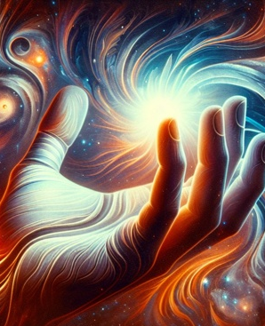
4. When Jacob fled from Laban, how did the Lord interpose to protect him from Laban’s wrath?
Genesis 31:29
It is in the power of my hand to do you hurt: but the God of your father spake unto me yesternight, saying, Take thou heed that thou speak not to Jacob either good or bad.

Slide 21
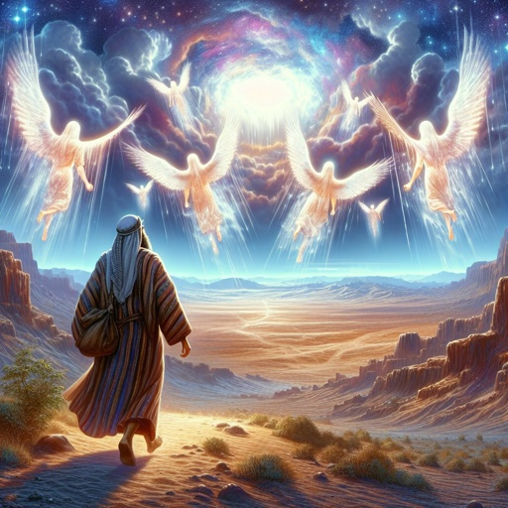
5. As Jacob went on his way, who met him?
Genesis 32:1
And Jacob went on his way, and the angels of God met him.

Slide 22
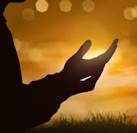
6. What did Jacob say, and what did he call the place?
Genesis 32:2
And when Jacob saw them, he said, This is God's host: and he called the name of that place Mahanaim.

Slide 23

7. For what purpose are angels sent to earth?
Hebrews 1:14
Are they not all ministering spirits, sent forth to minister for them who shall be heirs of salvation?

Slide 24
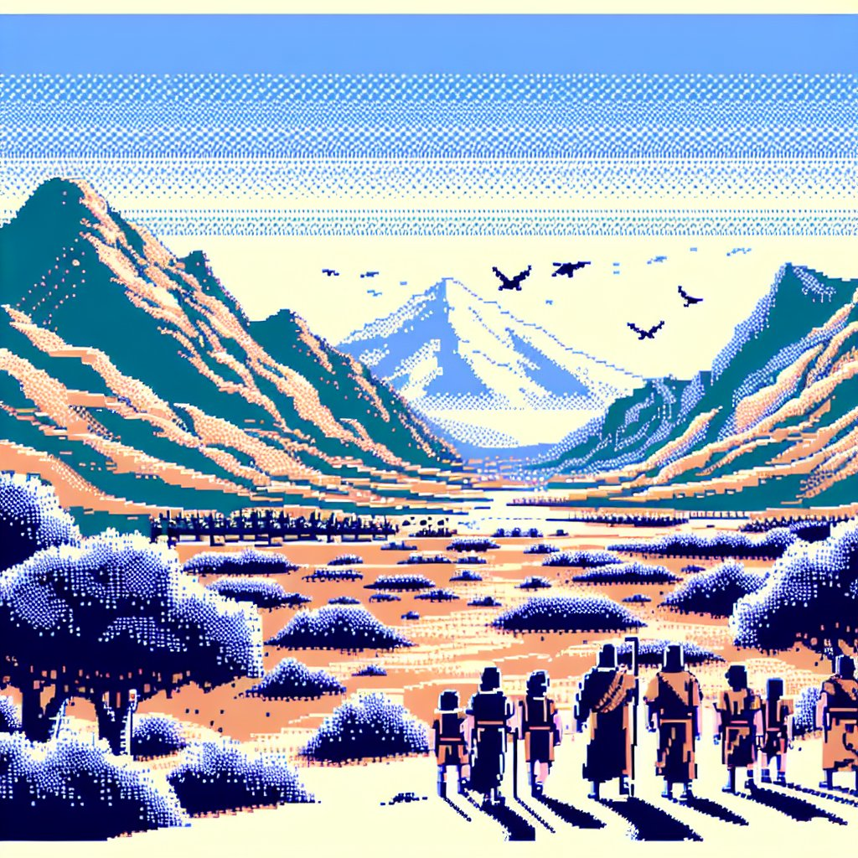
8. What message did Jacob send to Esau?
Genesis 32:3-5
And Jacob sent messengers before him to Esau his brother unto the land of Seir, the country of Edom.

Slide 25
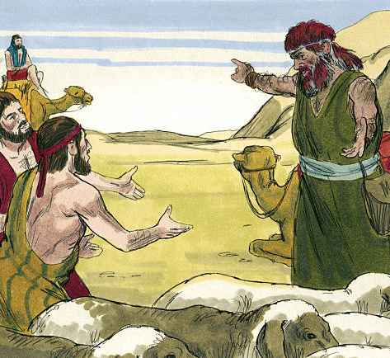
8. What message did Jacob send to Esau?
Genesis 32:3-5
And he commanded them, saying, Thus shall ye speak unto my lord Esau; Thy servant Jacob saith thus, I have sojourned with Laban, and stayed there until now:

Slide 26
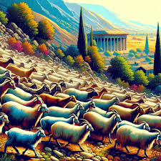
8. What message did Jacob send to Esau?
Genesis 32:3-5
And I have oxen, and asses, flocks, and menservants, and womenservants: and I have sent to tell my lord, that I may find grace in thy sight.

Slide 27
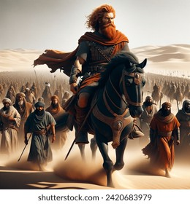
9. What news did the messengers bring back?
Genesis 32:6
And the messengers returned to Jacob, saying, We came to thy brother Esau, and also he cometh to meet thee, and four hundred men with him.

Slide 28
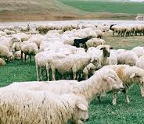
10.How was Jacob affected by this news?
Genesis 32:7
Then Jacob was greatly afraid and distressed: and he divided the people that was with him, and the flocks, and herds, and the camels, into two bands;

Slide 29
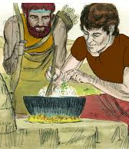
11.What good reason had Jacob for fearing Esau?
Jacob feared Esau because years earlier Esau had vowed to kill him for taking the birthright and blessing (Gen. 27:41). Now Esau was approaching with four hundred men (Gen. 32:6-7).

Slide 30
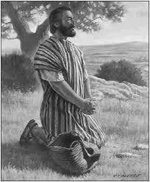
12.What prayer for deliverance did he make?
Genesis 32:9-12
And Jacob said, O God of my father Abraham, and God of my father Isaac, the Lord which saidst unto me, Return unto thy country, and to thy kindred, and I will deal well with thee:

Slide 31
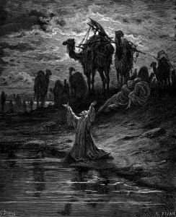
12.What prayer for deliverance did he make?
Genesis 32:9-12
I am not worthy of the least of all the mercies, and of all the truth, which thou hast shewed unto thy servant; for with my staff I passed over this Jordan; and now I am become two bands.

Slide 32
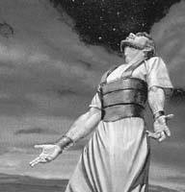
12.What prayer for deliverance did he make?
Genesis 32:9-12
Deliver me, I pray thee, from the hand of my brother, from the hand of Esau: for I fear him, lest he will come and smite me, and the mother with the children.

Slide 33
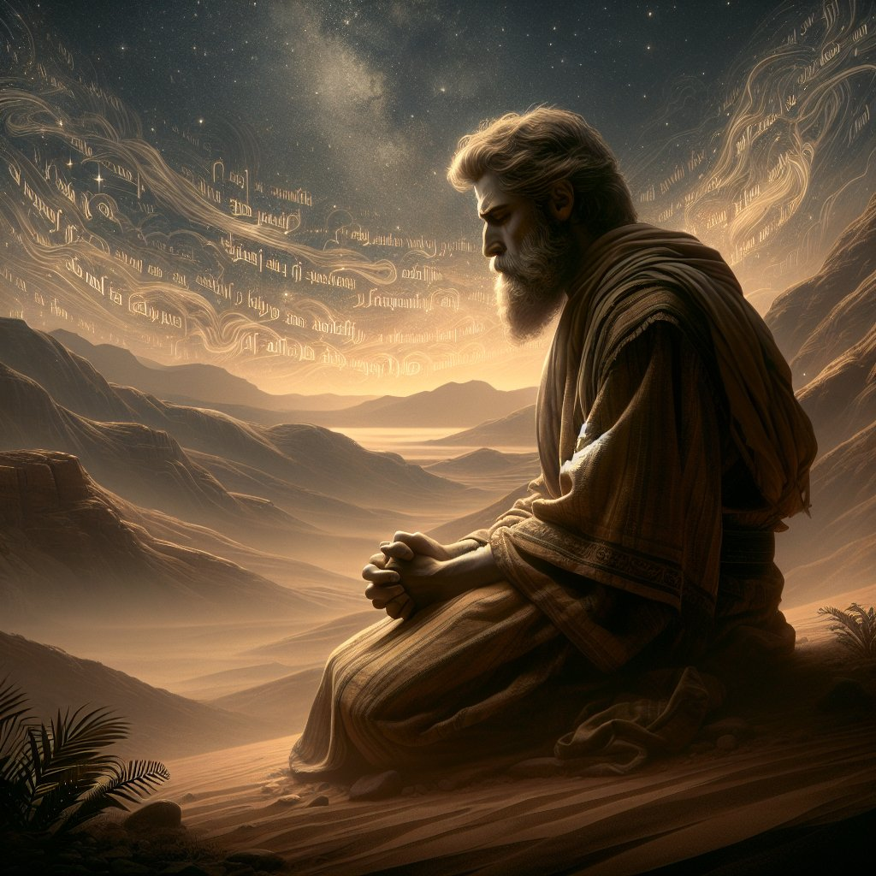
12.What prayer for deliverance did he make?
Genesis 32:9-12
And thou saidst, I will surely do thee good, and make thy seed as the sand of the sea, which cannot be numbered for multitude.

Slide 34
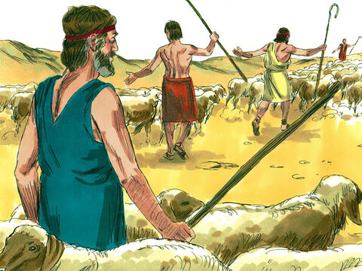
13. What precautions did he take for safety?
Genesis 32:7-8, 13-21
Then Jacob was greatly afraid and distressed: and he divided the people that was with him, and the flocks, and herds, and the camels, into two bands;

Slide 35
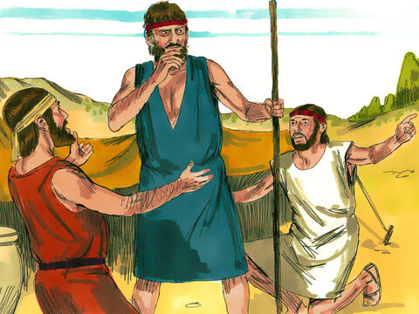
13. What precautions did he take for safety?
Genesis 32:7-8, 13-21
And said, If Esau come to the one company, and smite it, then the other company which is left shall escape.

Slide 36
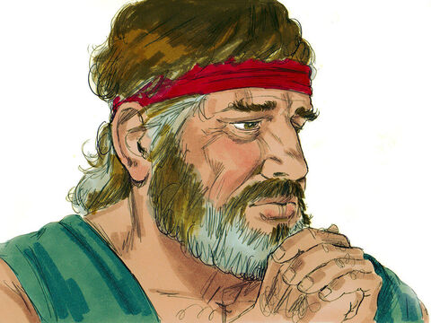
13. What precautions did he take for safety?
Genesis 32:7-8, 13-21
And he lodged there that same night; and took of that which came to his hand a present for Esau his brother;

Slide 37
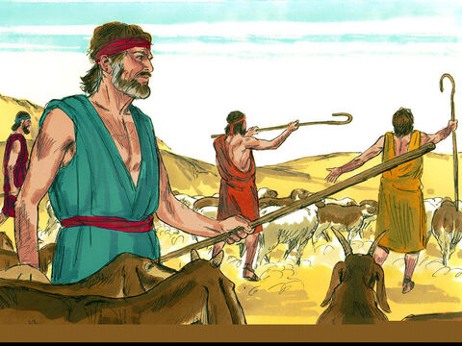
13. What precautions did he take for safety?
Genesis 32:7-8, 13-21
Two hundred she goats, and twenty he goats, two hundred ewes, and twenty rams,

Slide 38
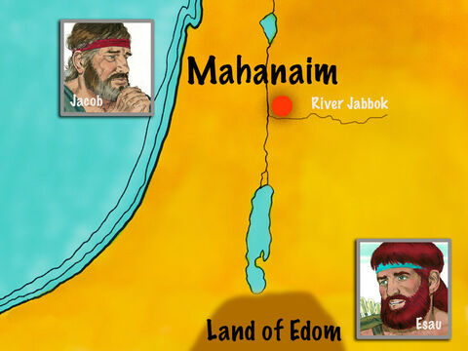
13. What precautions did he take for safety?
Genesis 32:7-8, 13-21
Thirty milch camels with their colts, forty kine, and ten bulls, twenty she asses, and ten foals.

Slide 39
13. What precautions did he take for safety?
Genesis 32:7-8, 13-21
And he delivered them into the hand of his servants, every drove by themselves; and said unto his servants, Pass over before me, and put a space betwixt drove and drove.

Slide 40
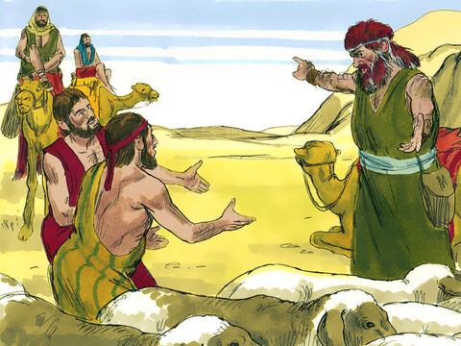
13. What precautions did he take for safety?
Genesis 32:7-8, 13-21
And he commanded the foremost, saying, When Esau my brother meeteth thee, and asketh thee, saying, Whose art thou? and whither goest thou? and whose are these before thee?

Slide 41
13. What precautions did he take for safety?
Genesis 32:7-8, 13-21
Then thou shalt say, They be thy servant Jacob's; it is a present sent unto my lord Esau: and, behold, also he is behind us.

Slide 42
13. What precautions did he take for safety?
Genesis 32:7-8, 13-21
And so commanded he the second, and the third, and all that followed the droves, saying, On this manner shall ye speak unto Esau, when ye find him.

Slide 43
13. What precautions did he take for safety?
Genesis 32:7-8, 13-21
And say ye moreover, Behold, thy servant Jacob is behind us. For he said, I will appease him with the present that goeth before me, and afterward I will see his face; peradventure he will accept of me.

Slide 44
13. What precautions did he take for safety?
Genesis 32:7-8, 13-21
So went the present over before him: and himself lodged that night in the company.

Slide 45
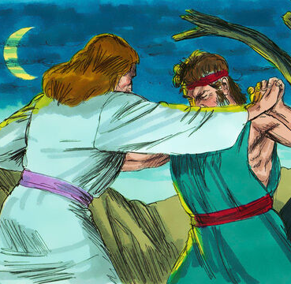
14.When Jacob was left alone who encountered him?
Genesis 32:24
And Jacob was left alone; and there wrestled a man with him until the breaking of the day.

Slide 46
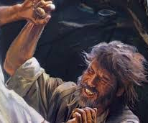
16.Who was it that was wrestling with him?
Hosea 12:4-5
Yea, he had power over the angel, and prevailed: he wept, and made supplication unto him: he found him in Bethel, and there he spake with us;

Slide 47
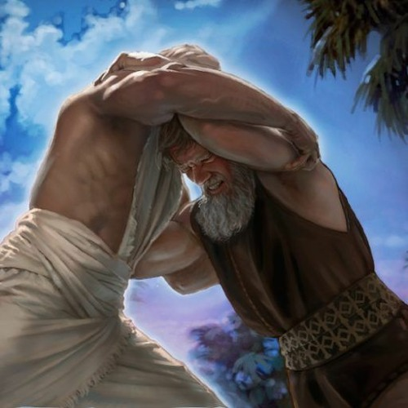
16.Who was it that was wrestling with him?
Hosea 12:4-5
Even the Lord God of hosts; the Lord is his memorial.

Slide 48
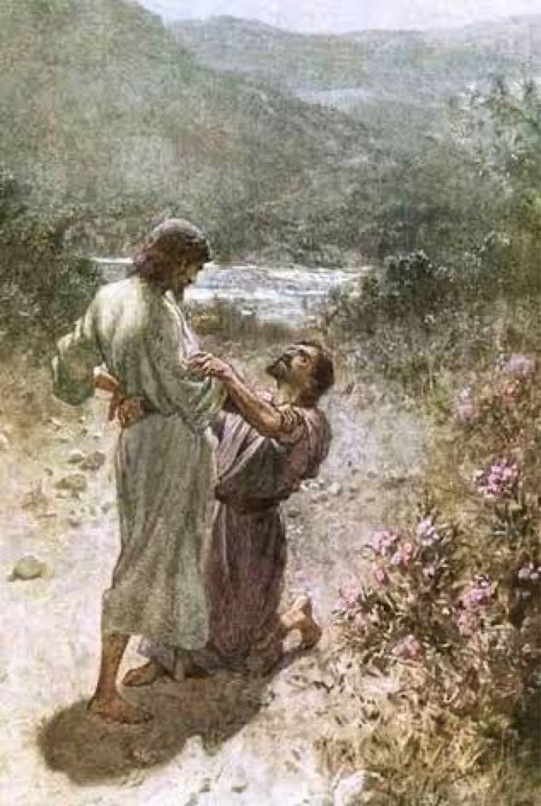
17.What act opened Jacob’s eyes as to the real nature of his antagonist?
Genesis 32:25
And when he saw that he prevailed not against him, he touched the hollow of his thigh; and the hollow of Jacob's thigh was out of joint, as he wrestled with him.

Slide 49
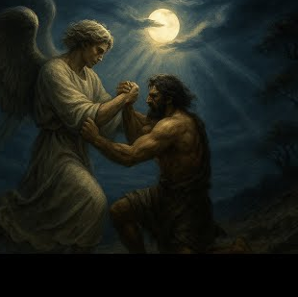
18.What did the Lord then say?
Genesis 32:26
And he said, Let me go, for the day breaketh. And he said, I will not let thee go, except thou bless me.

Slide 50
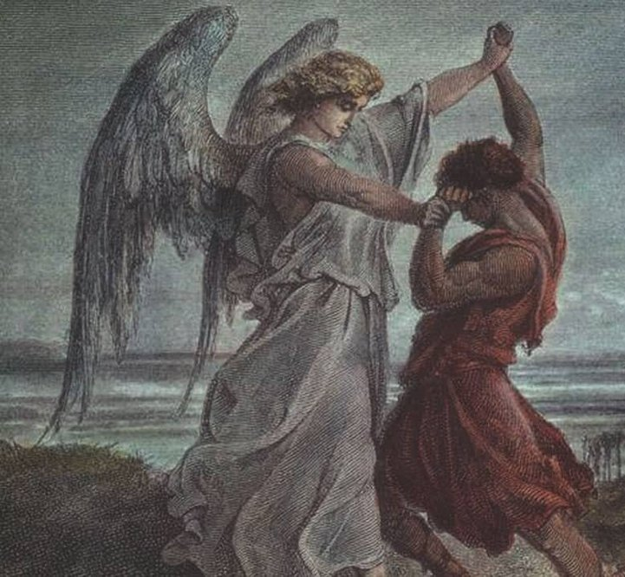
19.What may we conclude from this?
Answer: That as soon as Jacob found out who it was that he was wrestling with, he ceased wrestling, and threw his arms about the Lord.

Slide 51
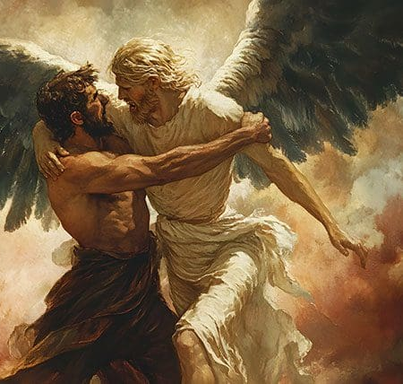
20.What reply did Jacob make to the Lord’s request?
Genesis 32:26
And he said, Let me go, for the day breaketh. And he said, I will not let thee go, except thou bless me.

Slide 52
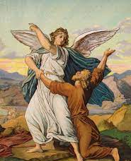
21.How urgent was Jacob’s plea?
Hosea 12:4
Yea, he had power over the angel, and prevailed: he wept, and made supplication unto him: he found him in Bethel, and there he spake with us;

Slide 53
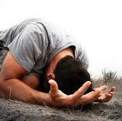
22.Why was Jacob so urgent at this time?
Because Jacob knew his life and family were in danger. Esau was coming, and only God’s mercy could save them. His urgency sprang from fear, guilt, and a desperate need for divine help (Gen. 32:6–11).

Slide 54
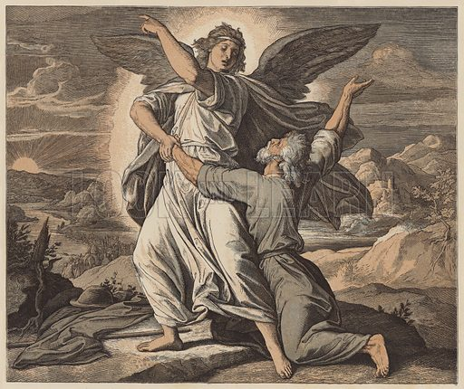
23.What evidence did he finally receive that his prayer was successful?
Genesis 32:27-28
And he said unto him, What is thy name? And he said, Jacob.

Slide 55
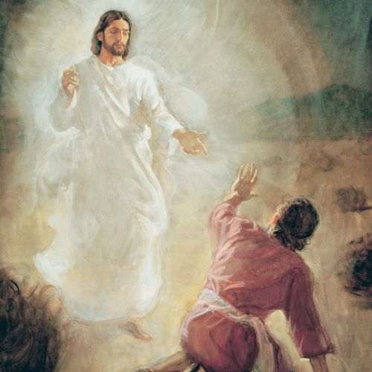
23.What evidence did he finally receive that his prayer was successful?
Genesis 32:27-28
And he said, Thy name shall be called no more Jacob, but Israel: for as a prince hast thou power with God and with men, and hast prevailed.

Slide 56
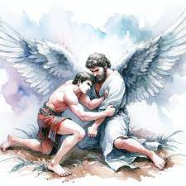
24.What was involved in this blessing?
Answer: The pardon of all the sins of his past life.

Slide 57
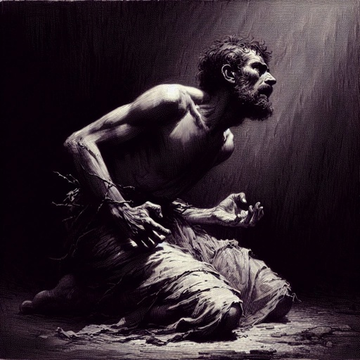
25.Into what condition do sinners usually come before obtaining pardon?
Romans 7:24-25
O wretched man that I am! who shall deliver me from the body of this death?

Slide 58
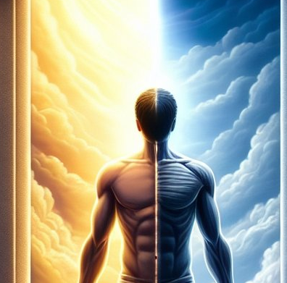
25.Into what condition do sinners usually come before obtaining pardon?
Romans 7:24-25
I thank God through Jesus Christ our Lord. So then with the mind I myself serve the law of God; but with the flesh the law of sin.

Slide 59
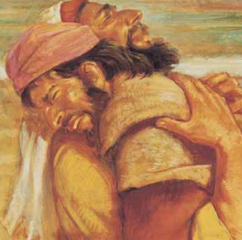
26.What further evidence did he have that he had prevailed with God and with men?
Genesis 33:1-16
When Jacob met Esau, his brother ran to meet him, embraced him, and forgave him. The two were reconciled, and Esau returned home while Jacob continued on to Canaan.

Slide 60

27.What exhortation is given us from this case?
Hosea 12:6
Therefore turn thou to thy God: keep mercy and judgment and wait on thy God continually.

Slide 61
28.Of what time in the history of the people of God was this experience of Jacob a figure?
Daniel 12:1; Jeremiah 30:7
And at that time shall Michael stand up, the great prince which standeth for the children of thy people: and there shall be a time of trouble, such as never was since there was a nation even to that same time: and at that time thy people shall be delivered, every one that shall be found written in the book.

Slide 62

28.Of what time in the history of the people of God was this experience of Jacob a figure?
Daniel 12:1; Jeremiah 30:7
Alas! for that day is great, so that none is like it: it is even the time of Jacob's trouble, but he shall be saved out of it.

Slide 63

29.What will be granted to all those who finally prevail?
Revelation 3:21
To him that overcometh will I grant to sit with me in my throne, even as I also overcame, and am set down with my Father in his throne.

Slide 64
Thank You &
HAPPY SABBATH!!

Slide 65


