Slide 1


Slide 2

Living the Light

Slide 3
Old Testament History:
Plotting against the Just
Lesson 18,2nd Quarter, 1888

Slide 4
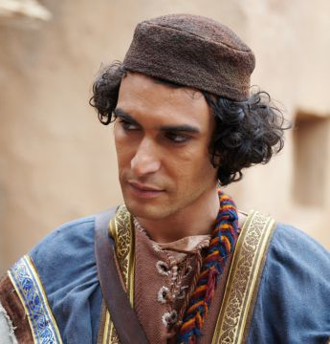
1. Where did Jacob dwell?
Genesis 37:1
And Jacob dwelt in the land wherein his father was a stranger, in the land of Canaan.

Slide 5
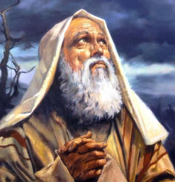
2. In what light did the patriarchs consider their residence in the land of Canaan?
Hebrews 11:13
These all died in faith, not having received the promises, but having seen them afar off, and were persuaded of them, and embraced them, and confessed that they were strangers and pilgrims on the earth.

Slide 6

3. To what did they look forward as a permanent residence?
Hebrews 11:16
But now they desire a better country, that is, an heavenly: wherefore God is not ashamed to be called their God: for he hath prepared for them a city.

Slide 7
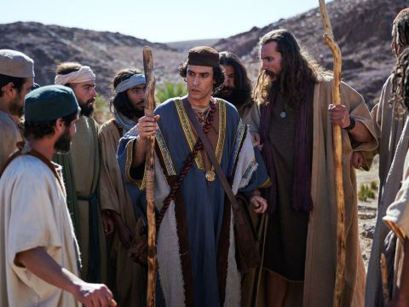
4. How many sons had Jacob?
Genesis 35:22
Now the sons of Jacob were twelve:

Slide 8
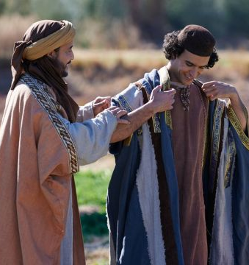
5. Which one did Jacob love the most?
Genesis 37:3
Now Israel loved Joseph more than all his children, because he was the son of his old age: and he made him a coat of many colours.

Slide 9
6. How did Joseph’s brethren regard him?
Genesis 37:4
And when his brethren saw that their father loved him more than all his brethren, they hated him, and could not speak peaceably unto him.

Slide 10
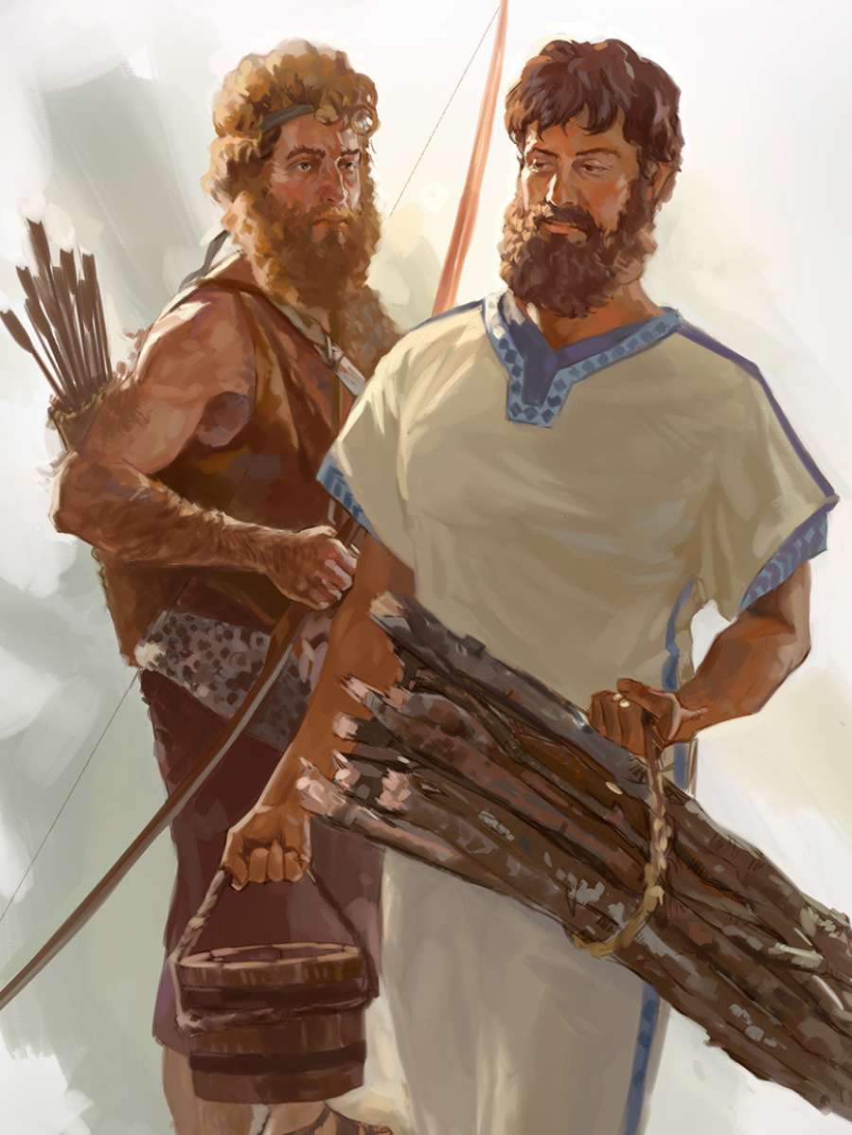
A Family Pattern Repeated
The tension between Joseph and his brothers didn’t begin in the fields of Dothan — it began a generation earlier. Isaac favored Esau; Rebekah favored Jacob (Gen 25:28).

Slide 11
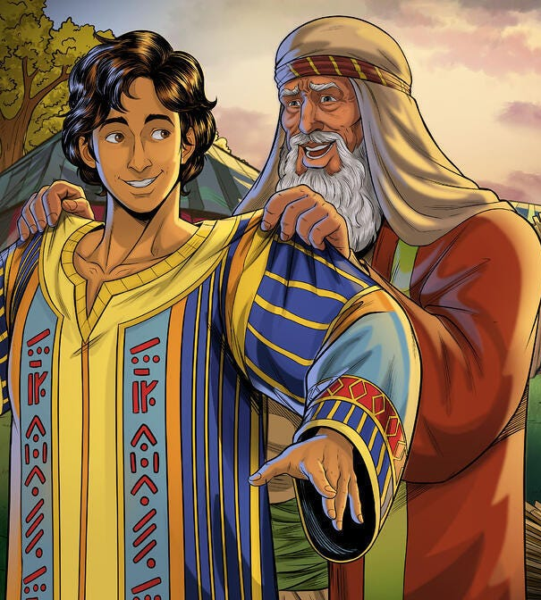
A Family Pattern Repeated
Jacob repeats the pattern: “Israel loved Joseph more than all his children” (Gen 37:3)
Sin’s patterns often echo through generations until surrendered to God.

Slide 12
Patterns NOT Repeated
Joseph is repeatedly noted for fairness:
“There was none so discreet and wise as thou art.” — Genesis 41:39
“And Joseph nourished his father, and his brethren, and all his father’s household, with bread, according to their families.” — Genesis 47:12
“Come near to me, I pray you… Be not grieved, nor angry with yourselves… God did send me before you to preserve life.” — Genesis 45:4–5

Slide 13
Patterns NOT Repeated
“And Joseph took them both, Ephraim in his right hand toward Israel’s left hand, and Manasseh in his left hand toward Israel’s right hand, and brought them near unto him.” — Genesis 48:13
Joseph expects the elder (Manasseh) to receive the greater blessing.
But Jacob crosses his hands, giving the greater blessing to Ephraim. Joseph objects:
“Not so, my father: for this is the firstborn; put thy right hand upon his head.” — Genesis 48:18

Slide 14
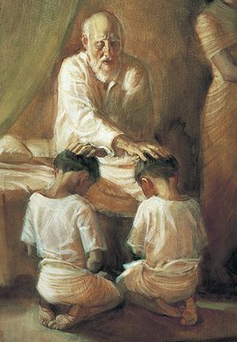
Grace Breaks the Cycle
The younger is blessed above the elder again, yet without deceit or hatred.
The story comes full circle: what began in envy ends in grace.
God’s mercy can redeem even inherited dysfunction.

Slide 15
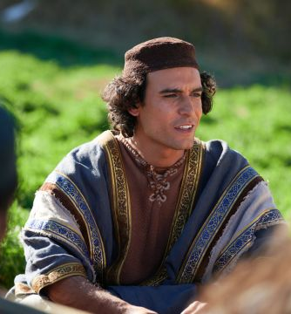
7. What made them hate him still more?
Genesis 37:5-11
And Joseph dreamed a dream, and he told it his brethren: and they hated him yet the more.

Slide 16
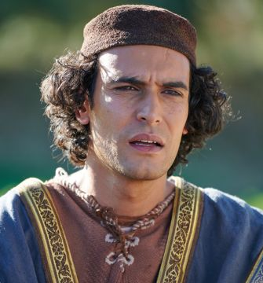
7. What made them hate him still more?
Genesis 37:5
And he said unto them, Hear, I pray you, this dream which I have dreamed:

Slide 17
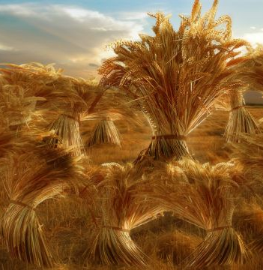
7. What made them hate him still more?
Genesis 37:7
For, behold, we were binding sheaves in the field, and, lo, my sheaf arose, and also stood upright; and, behold, your sheaves stood round about, and made obeisance to my sheaf.

Slide 18
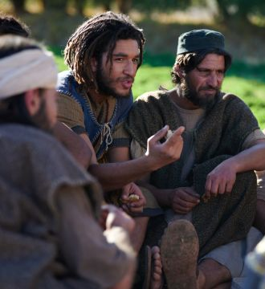
7. What made them hate him still more?
Genesis 37:8
And his brethren said to him, Shalt thou indeed reign over us? or shalt thou indeed have dominion over us? And they hated him yet the more for his dreams, and for his words.

Slide 19
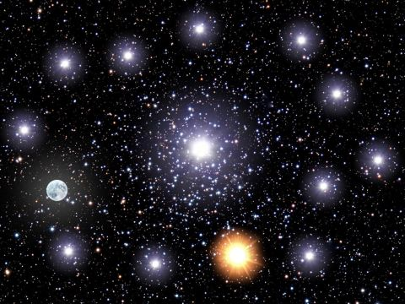
7. What made them hate him still more?
Genesis 37:9
And he dreamed yet another dream, and told it his brethren, and said, Behold, I have dreamed a dream more; and, behold, the sun and the moon and the eleven stars made obeisance to me.

Slide 20
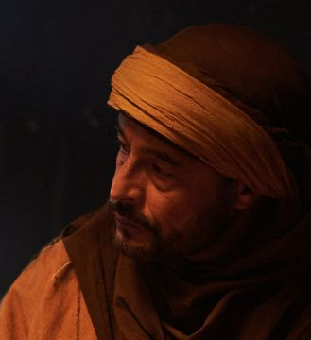
7. What made them hate him still more?
Genesis 37:10
And he told it to his father, and to his brethren: and his father rebuked him, and said unto him, What is this dream that thou hast dreamed? Shall I and thy mother and thy brethren indeed come to bow down ourselves to thee to the earth?

Slide 21
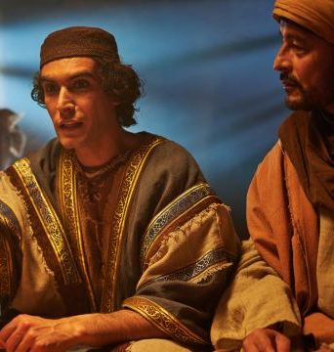
7. What made them hate him still more?
Genesis 37:11
And his brethren envied him; but his father observed the saying.

Slide 22
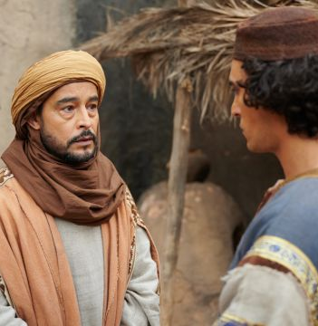
8. Upon what errand did Jacob send Joseph?
Genesis 37:13-14
And Israel said unto Joseph, Do not thy brethren feed the flock in Shechem? come, and I will send thee unto them. And he said to him, Here am I.

Slide 23
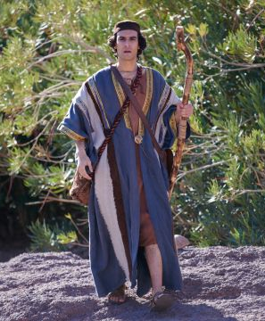
8. Upon what errand did Jacob send Joseph?
Genesis 37:13-14
And he said to him, Go, I pray thee, see whether it be well with thy brethren, and well with the flocks; and bring me word again. So he sent him out of the vale of Hebron, and he came to Shechem.

Slide 24
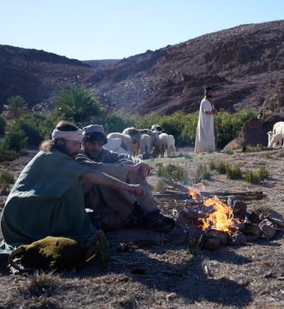
9. When his brethren saw him coming, what did they propose to do?
Genesis 37:18, 20
And when they saw him afar off, even before he came near unto them, they conspired against him to slay him.

Slide 25
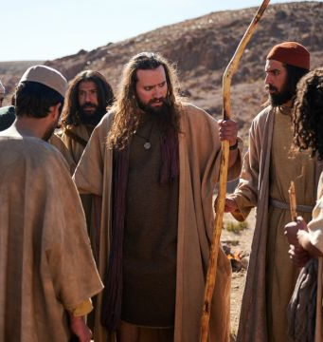
9. When his brethren saw him coming, what did they propose to do?
Genesis 37:18, 20
Come now therefore, and let us slay him, and cast him into some pit, and we will say, Some evil beast hath devoured him: and we shall see what will become of his dreams.

Slide 26
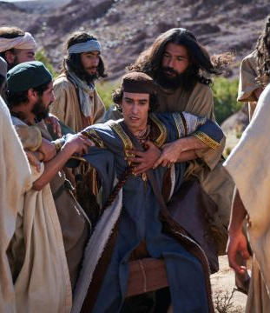
10. What did they do with him when he came?
Genesis 37:23-24
And it came to pass, when Joseph was come unto his brethren, that they stript Joseph out of his coat, his coat of many colours that was on him;

Slide 27
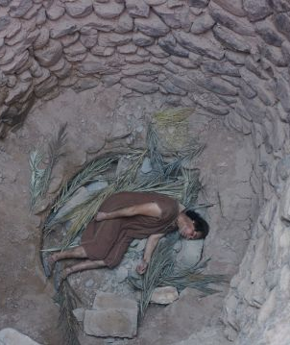
10. What did they do with him when he came?
Genesis 37:23-24
And they took him, and cast him into a pit: and the pit was empty, there was no water in it.

Slide 28
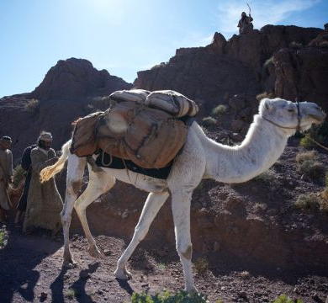
11. How did they afterwards dispose of him?
Genesis 37:25-27
And they sat down to eat bread: and they lifted up their eyes and looked, and, behold, a company of Ishmeelites came from Gilead with their camels bearing spicery and balm and myrrh, going to carry it down to Egypt.

Slide 29
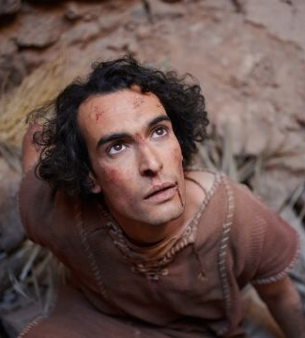
11. How did they afterwards dispose of him?
Genesis 37:25-27
And Judah said unto his brethren, What profit is it if we slay our brother, and conceal his blood?

Slide 30
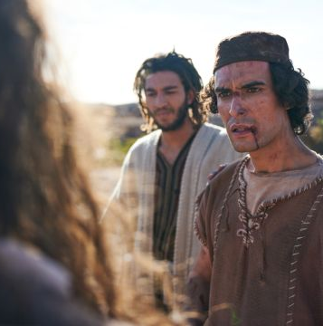
11. How did they afterwards dispose of him?
Genesis 37:25-27
Come, and let us sell him to the Ishmeelites, and let not our hand be upon him; for he is our brother and our flesh. And his brethren were content.

Slide 31
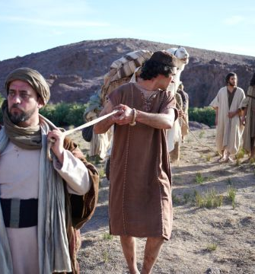
12. For how much did they sell him?
Genesis 37:28
Then there passed by Midianites merchantmen; and they drew and lifted up Joseph out of the pit, and sold Joseph to the Ishmeelites for twenty pieces of silver: and they brought Joseph into Egypt.

Slide 32
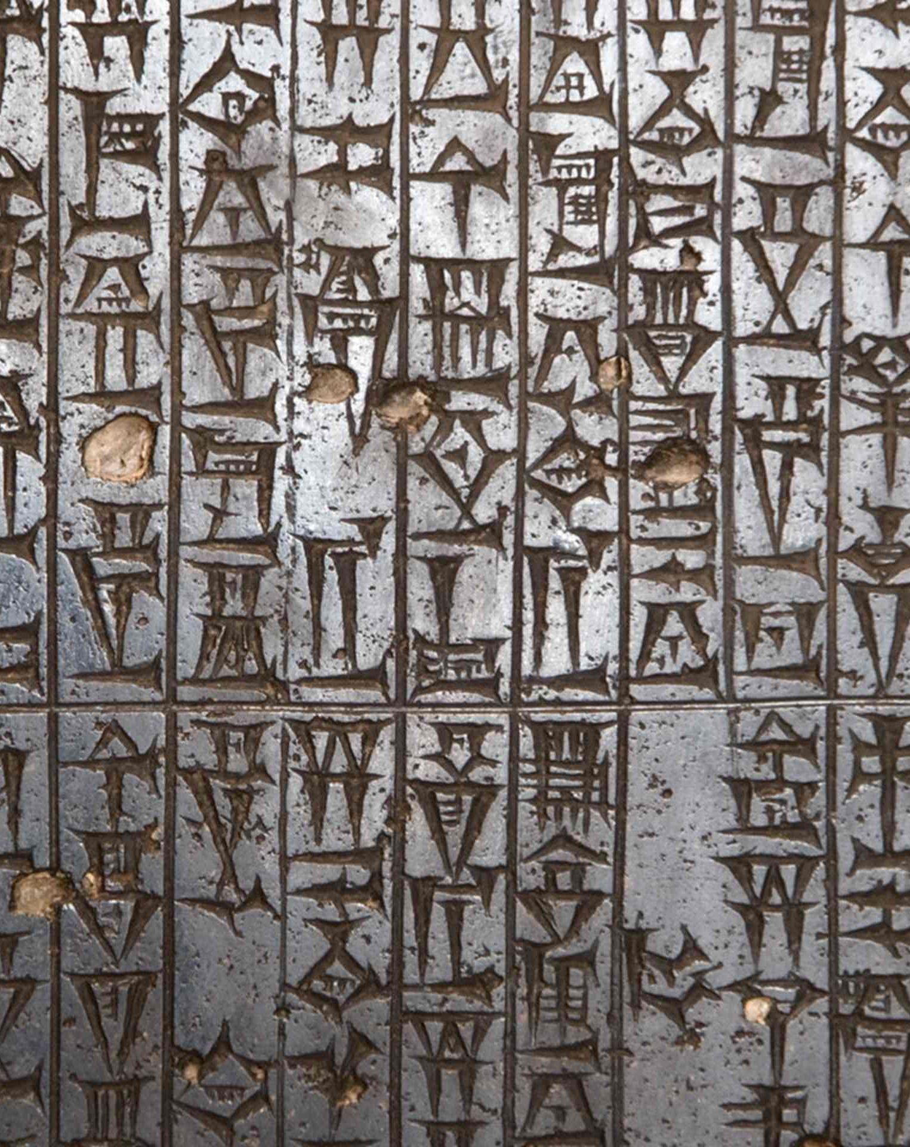
Twenty Pieces of Silver
In the Middle Bronze Age (specifically the Old Babylonian period, circa 1800-1500 BC), the average price of a slave in cities like Mari and in other Mesopotamian regions was 20 pieces (shekels) of silver.

Slide 33
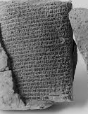
Twenty Pieces of Silver
Historical documents, including the Code of Hammurabi and administrative texts from Mari, confirm that 20 shekels was the standard or common price for a slave during this era.

Slide 34
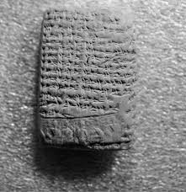
Twenty Pieces of Silver
Later, in the Late Bronze Age (around 1500-1300 BCE), documents from Nuzi and Ugarit show that the price of a male slave had risen to about 30 shekels of silver.

Slide 35
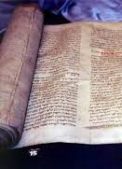
Twenty Pieces of Silver
This aligns with the price mentioned in the Mosaic Law (Exodus 21:32).
“If the ox shall push a manservant or a maidservant; he shall give unto their master thirty shekels of silver, and the ox shall be stoned.”

Slide 36
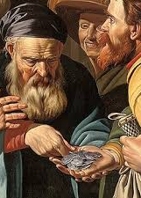
Twenty Pieces of Silver
Matthew 26:14-15
Then one of the twelve, called Judas Iscariot, went unto the chief priests,
And said unto them, What will ye give me, and I will deliver him unto you? And they covenanted with him for thirty pieces of silver.

Slide 37

13. How do the wicked ever regard the just?
Psalm 37:12
The wicked plotteth against the just, and gnasheth upon him with his teeth.

Slide 38

14. What trait was it that moved Joseph’s brethren to sell him into Egypt?
Acts 7:9
And the patriarchs, moved with envy, sold Joseph into Egypt: but God was with him,

Slide 39

15. What scripture was verified in their case?
James 3:16
For where envying and strife is, there is confusion and every evil work.

Slide 40
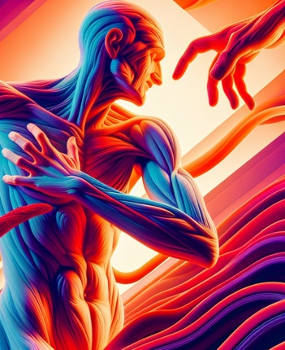
16. In what class is envy placed?
Galatians 5:19-21
Now the works of the flesh are manifest, which are these; Adultery, fornication, uncleanness, lasciviousness,

Slide 41
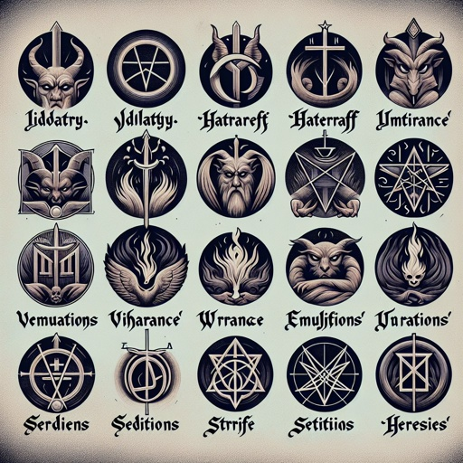
16. In what class is envy placed?
Galatians 5:19-21
Idolatry, witchcraft, hatred, variance, emulations, wrath, strife, seditions, heresies,

Slide 42
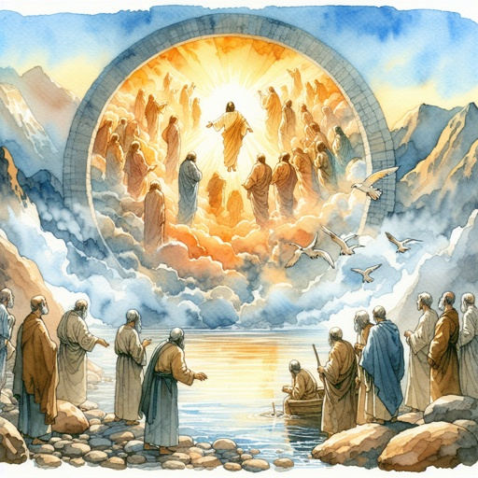
16. In what class is envy placed?
Galatians 5:19-21
Envyings, murders, drunkenness, revellings, and such like: of the which I tell you before, as I have also told you in time past, that they which do such things shall not inherit the kingdom of God.

Slide 43
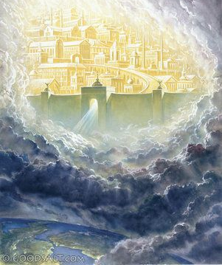
17. What is said of those who do such things?
Answer: They shall not inherit the kingdom of God.

Slide 44
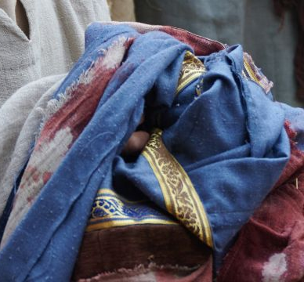
18. What course did they take to deceive their father?
Genesis 37:31-32
And they took Joseph's coat, and killed a kid of the goats, and dipped the coat in the blood;

Slide 45
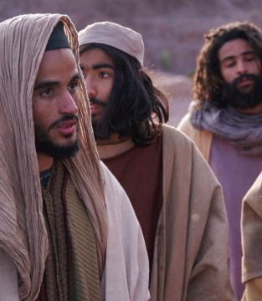
18. What course did they take to deceive their father?
Genesis 37:31-32
And they sent the coat of many colours, and they brought it to their father; and said, This have we found: know now whether it be thy son's coat or no.

Slide 46
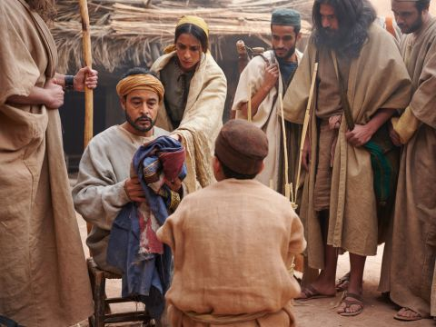
19. When Jacob saw the coat, what did he at once conclude?
Genesis 37:33
And he knew it, and said, It is my son's coat; an evil beast hath devoured him; Joseph is without doubt rent in pieces.

Slide 47
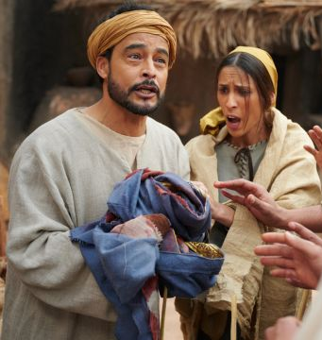
20. How did this affect Jacob?
Genesis 37:34-35
And Jacob rent his clothes, and put sackcloth upon his loins, and mourned for his son many days.

Slide 48
20. How did this affect Jacob?
Genesis 37:34-35
And all his sons and all his daughters rose up to comfort him; but he refused to be comforted; and he said, For I will go down into the grave unto my son mourning. Thus his father wept for him.

Slide 49
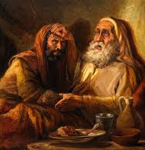
21. Can you recall any actions of Jacob that were of a similar character to this wicked deception? Relate them.
Answer: He once deceived his father with a goat and a garment, as his sons later deceived him.

Slide 50
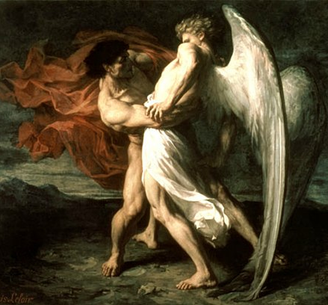
22. When had Jacob been forgiven for his wicked deeds?
When he wrestled with the Angel and was pardoned at Peniel.

Slide 51

23. What important lesson may we draw from this?
Answer: That although a sin may be forgiven, the results of it may remain, and the one who committed it will often have it brought before him, and will suffer in consequence.

Slide 52

24. What scripture is fulfilled even in this life?
Matthew 7:2
For with what judgment ye judge, ye shall be judged: and with what measure ye mete, it shall be measured to you again.

Slide 53


Slide 54
Thank You &
HAPPY SABBATH!!

