Slide 1


Slide 2

Living the Light

Slide 3
Old Testament History:
The Consequence of Pleasing God
Lesson 19, 2nd Quarter, 1888

Slide 4
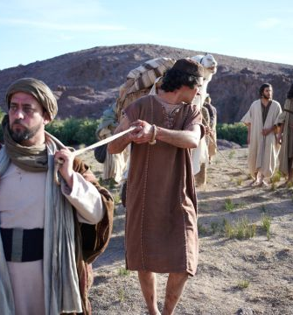
1. To whom did Joseph’s brethren sell him?
Genesis 37:28
Then there passed by Midianites merchantmen; and they drew and lifted up Joseph out of the pit, and sold Joseph to the Ishmeelites for twenty pieces of silver: and they brought Joseph into Egypt.

Slide 5
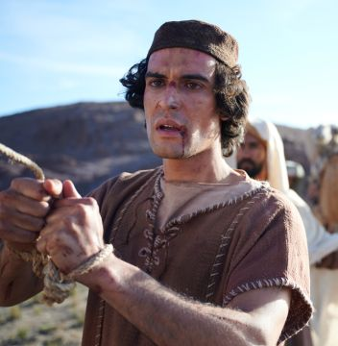
2. What did the Midianites do with him?
Genesis 37:36
And the Midianites sold him into Egypt unto Potiphar, an officer of Pharaoh’s, and captain of the guard.

Slide 6
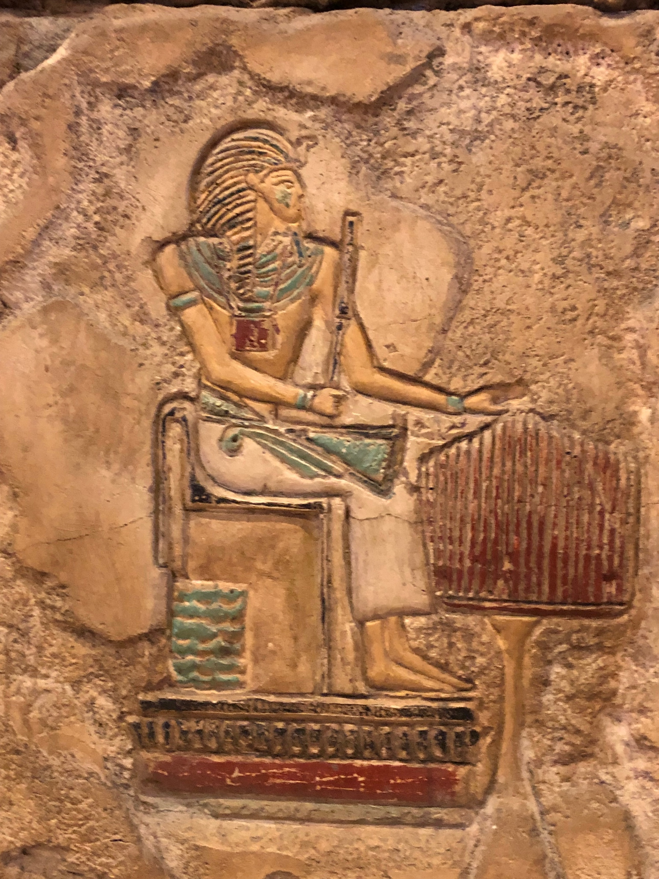
A Note on Potiphar
(SDABC on Gen. 37:36)
The Hebrew word translated “officer” is saris, meaning, first of all, “eunuch.”
Oriental rulers made use of eunuchs in various important positions, especially as officers in charge of the royal harem.

Slide 7
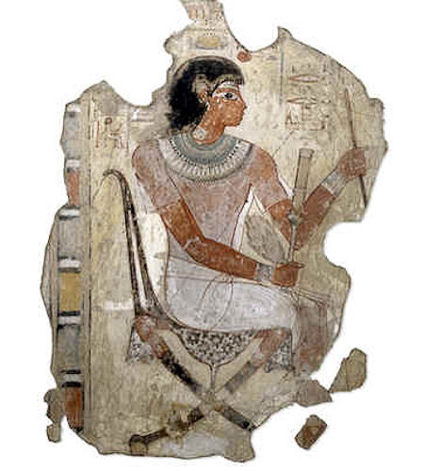
A Note on Potiphar
(SDABC on Gen. 37:36)
The fact that Potiphar was married has been taken as evidence that the term saris has other meanings, which may be true, but stands without proof, since even eunuchs may have been married.

Slide 8
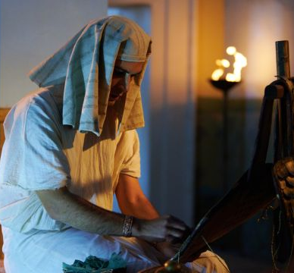
3. Who was with Joseph in this strange land?
Genesis 39:2;
Acts 7:9
And the LORD was with Joseph, and he was a prosperous man; and he was in the house of his master the Egyptian.

Slide 9
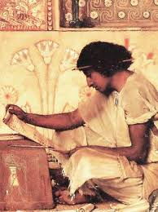
3. Who was with Joseph in this strange land?
Genesis 39:2; Acts 7:9
And the patriarchs, moved with envy, sold Joseph into Egypt: but God was with him,

Slide 10
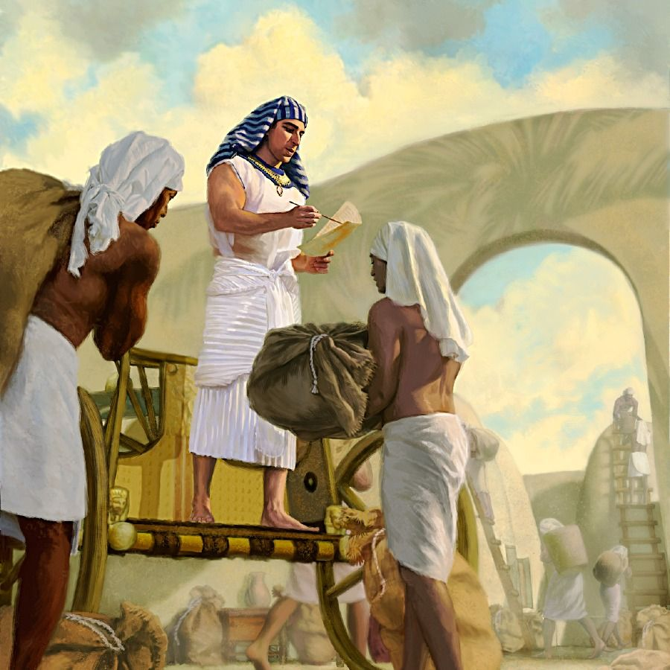
4. What was the consequence to Joseph of the Lord’s being with him?
Genesis 39:3-4; Acts 7:9-10
And his master saw that the LORD was with him, and that the LORD made all that he did to prosper in his hand.

Slide 11
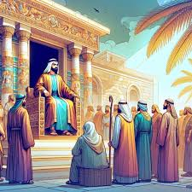
4. What was the consequence to Joseph of the Lord’s being with him?
Genesis 39:3-4; Acts 7:9-10
And Joseph found grace in his sight, and he served him: and he made him overseer over his house, and all that he had he put into his hand.

Slide 12
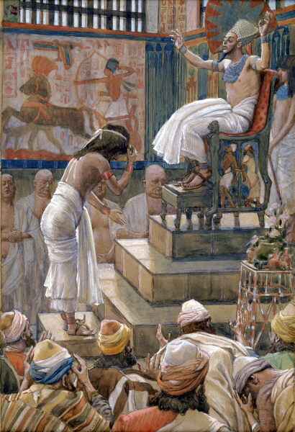
4. What was the consequence to Joseph of the Lord’s being with him?
Genesis 39:3-4; Acts 7:9-10
And the patriarchs, moved with envy, sold Joseph into Egypt: but God was with him,

Slide 13
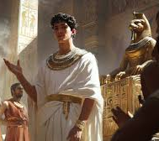
4. What was the consequence to Joseph of the Lord’s being with him?
Genesis 39:3-4; Acts 7:9-10
And delivered him out of all his afflictions, and gave him favour and wisdom in the sight of Pharaoh king of Egypt; and he made him governor over Egypt and all his house.

Slide 14
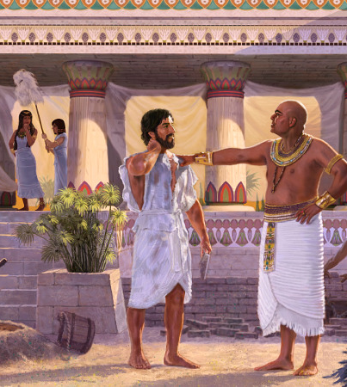
5. What was the result to Potiphar, from having a godly man in his house?
Genesis 39:5
And it came to pass from the time that he had made him overseer in his house, and over all that he had, that the LORD blessed the Egyptian’s house for Joseph’s sake; and the blessing of the LORD was upon all that he had in the house, and in the field.

Slide 15
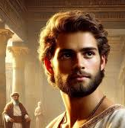
6. How much responsibility was placed upon Joseph?
Genesis 39:6
And he left all that he had in Joseph’s hand; and he knew not ought he had, save the bread which he did eat. And Joseph was a goodly person, and well favoured.

Slide 16
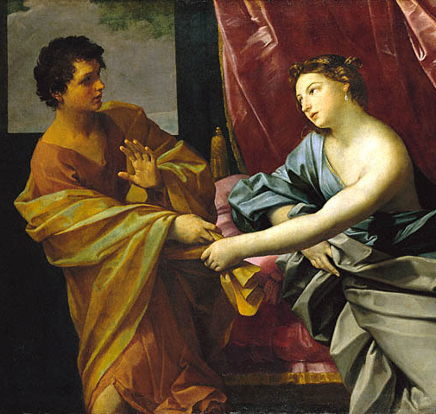
7. How old was Joseph when he was sold into Egypt?
Genesis 37:2
These are the generations of Jacob. Joseph, being seventeen years old, was feeding the flock with his brethren; and the lad was with the sons of Bilhah, and with the sons of Zilpah, his father’s wives: and Joseph brought unto his father their evil report.

Slide 17
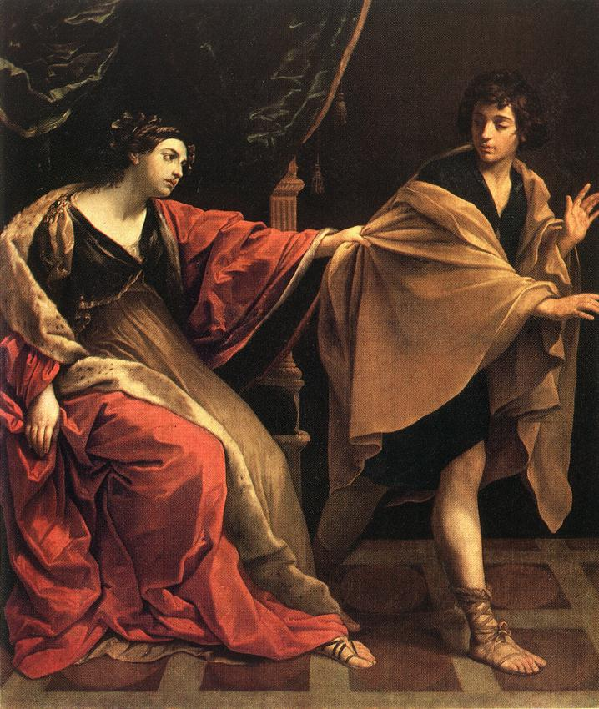
8. When he was strongly tempted in Potiphar’s house, what noble stand did he take?
Genesis 39:8-9
But he refused, and said unto his master’s wife, Behold, my master wotteth not what is with me in the house, and he hath committed all that he hath to my hand;

Slide 18
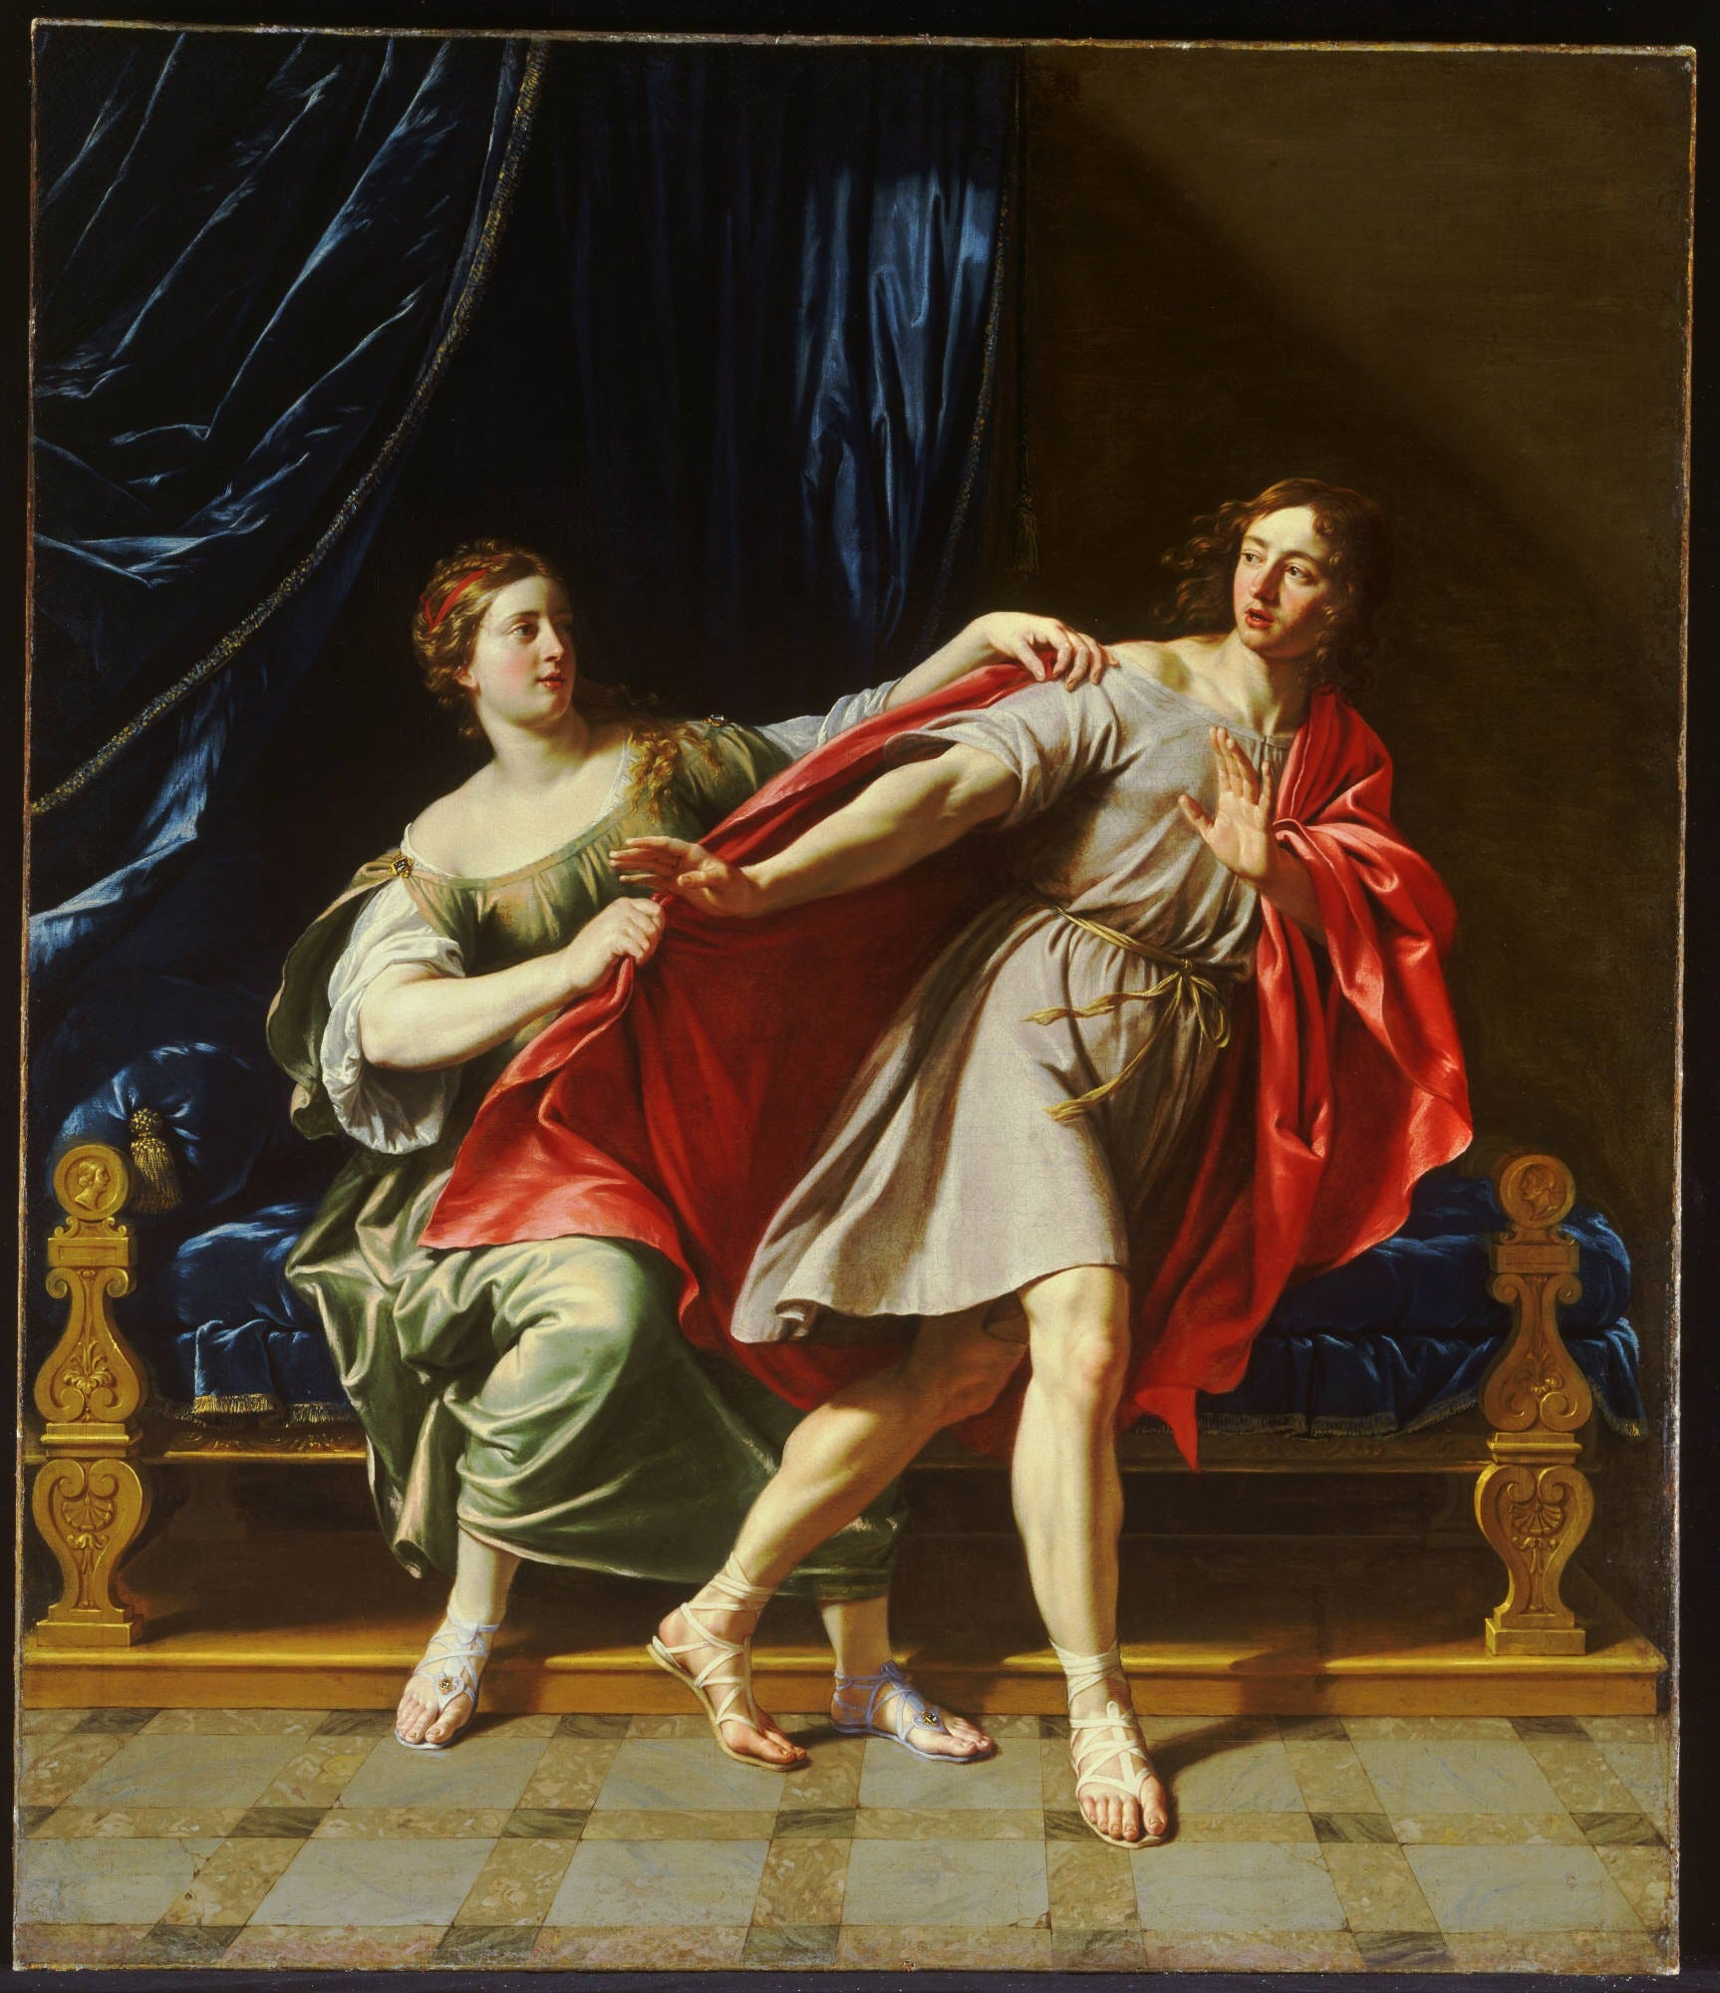
8. When he was strongly tempted in Potiphar’s house, what noble stand did he take?
Genesis 39:8-9
There is none greater in this house than I; neither hath he kept back any thing from me but thee, because thou art his wife: how then can I do this great wickedness, and sin against God?

Slide 19
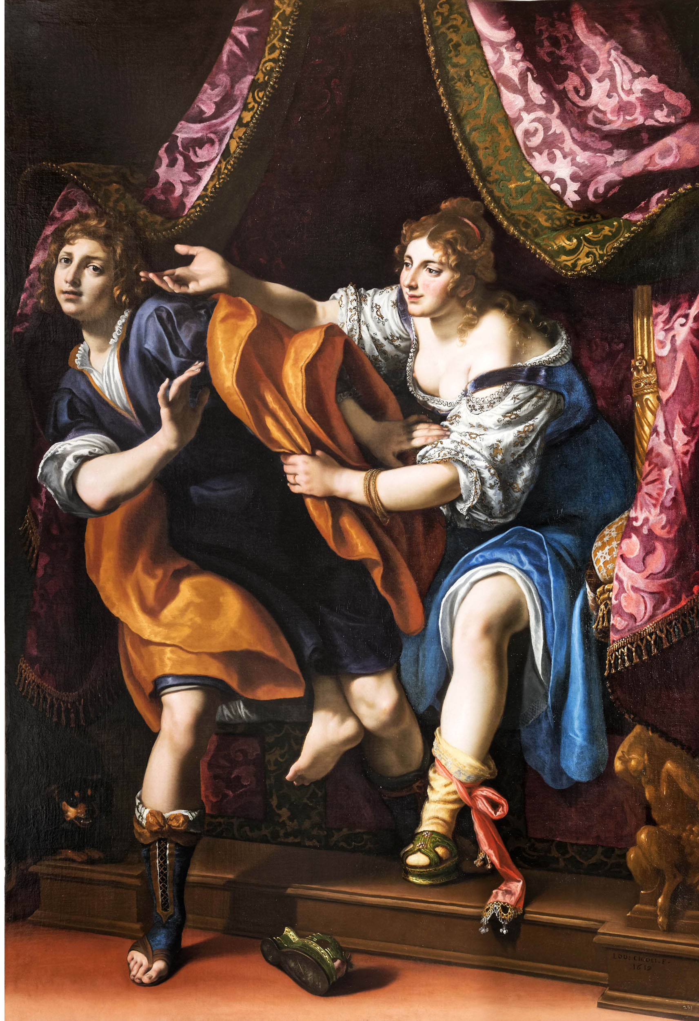
9. Did he stand firm to this resolution?
Genesis 39:10
And it came to pass, as she spake to Joseph day by day, that he hearkened not unto her, to lie by her, or to be with her.

Slide 20
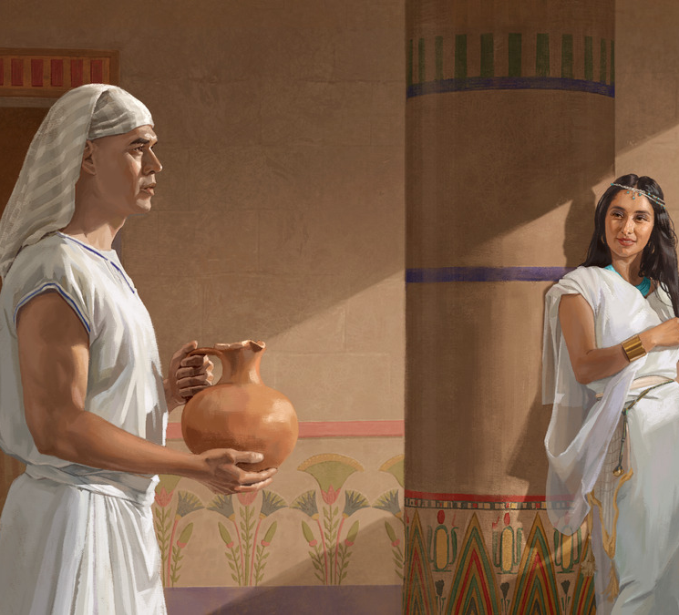
10. What was the immediate result of his upright conduct?
Genesis 39:11-20
And it came to pass about this time, that Joseph went into the house to do his business; and there was none of the men of the house there within.

Slide 21
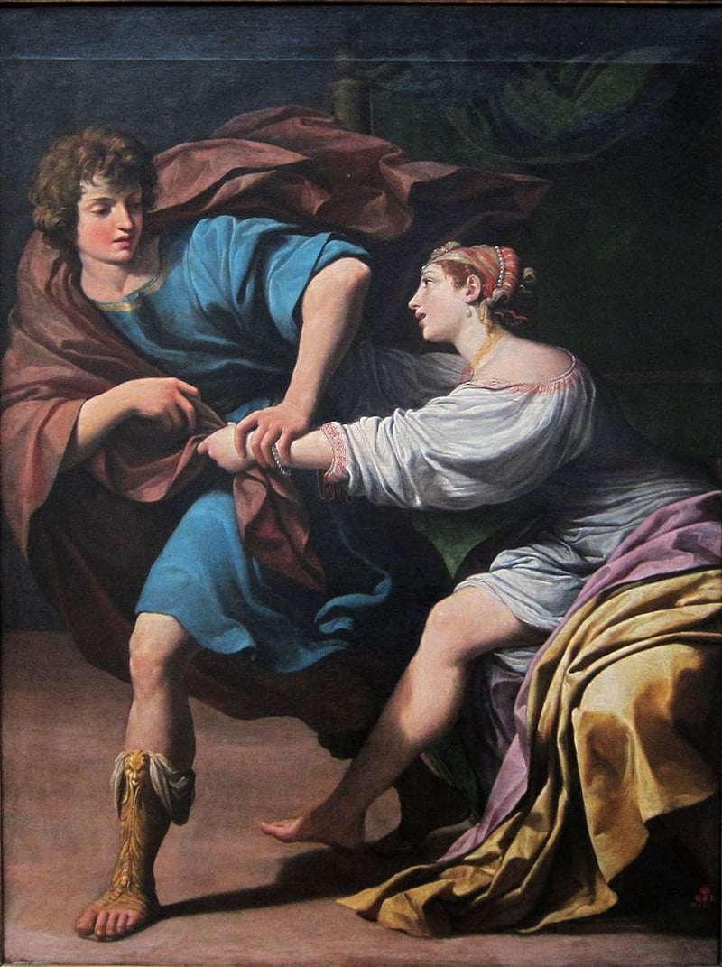
10. What was the immediate result of his upright conduct?
Genesis 39:11-20
And she caught him by his garment, saying, Lie with me: and he left his garment in her hand, and fled, and got him out.

Slide 22
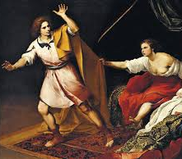
10. What was the immediate result of his upright conduct?
Genesis 39:11-20
And it came to pass, when she saw that he had left his garment in her hand, and was fled forth,

Slide 23
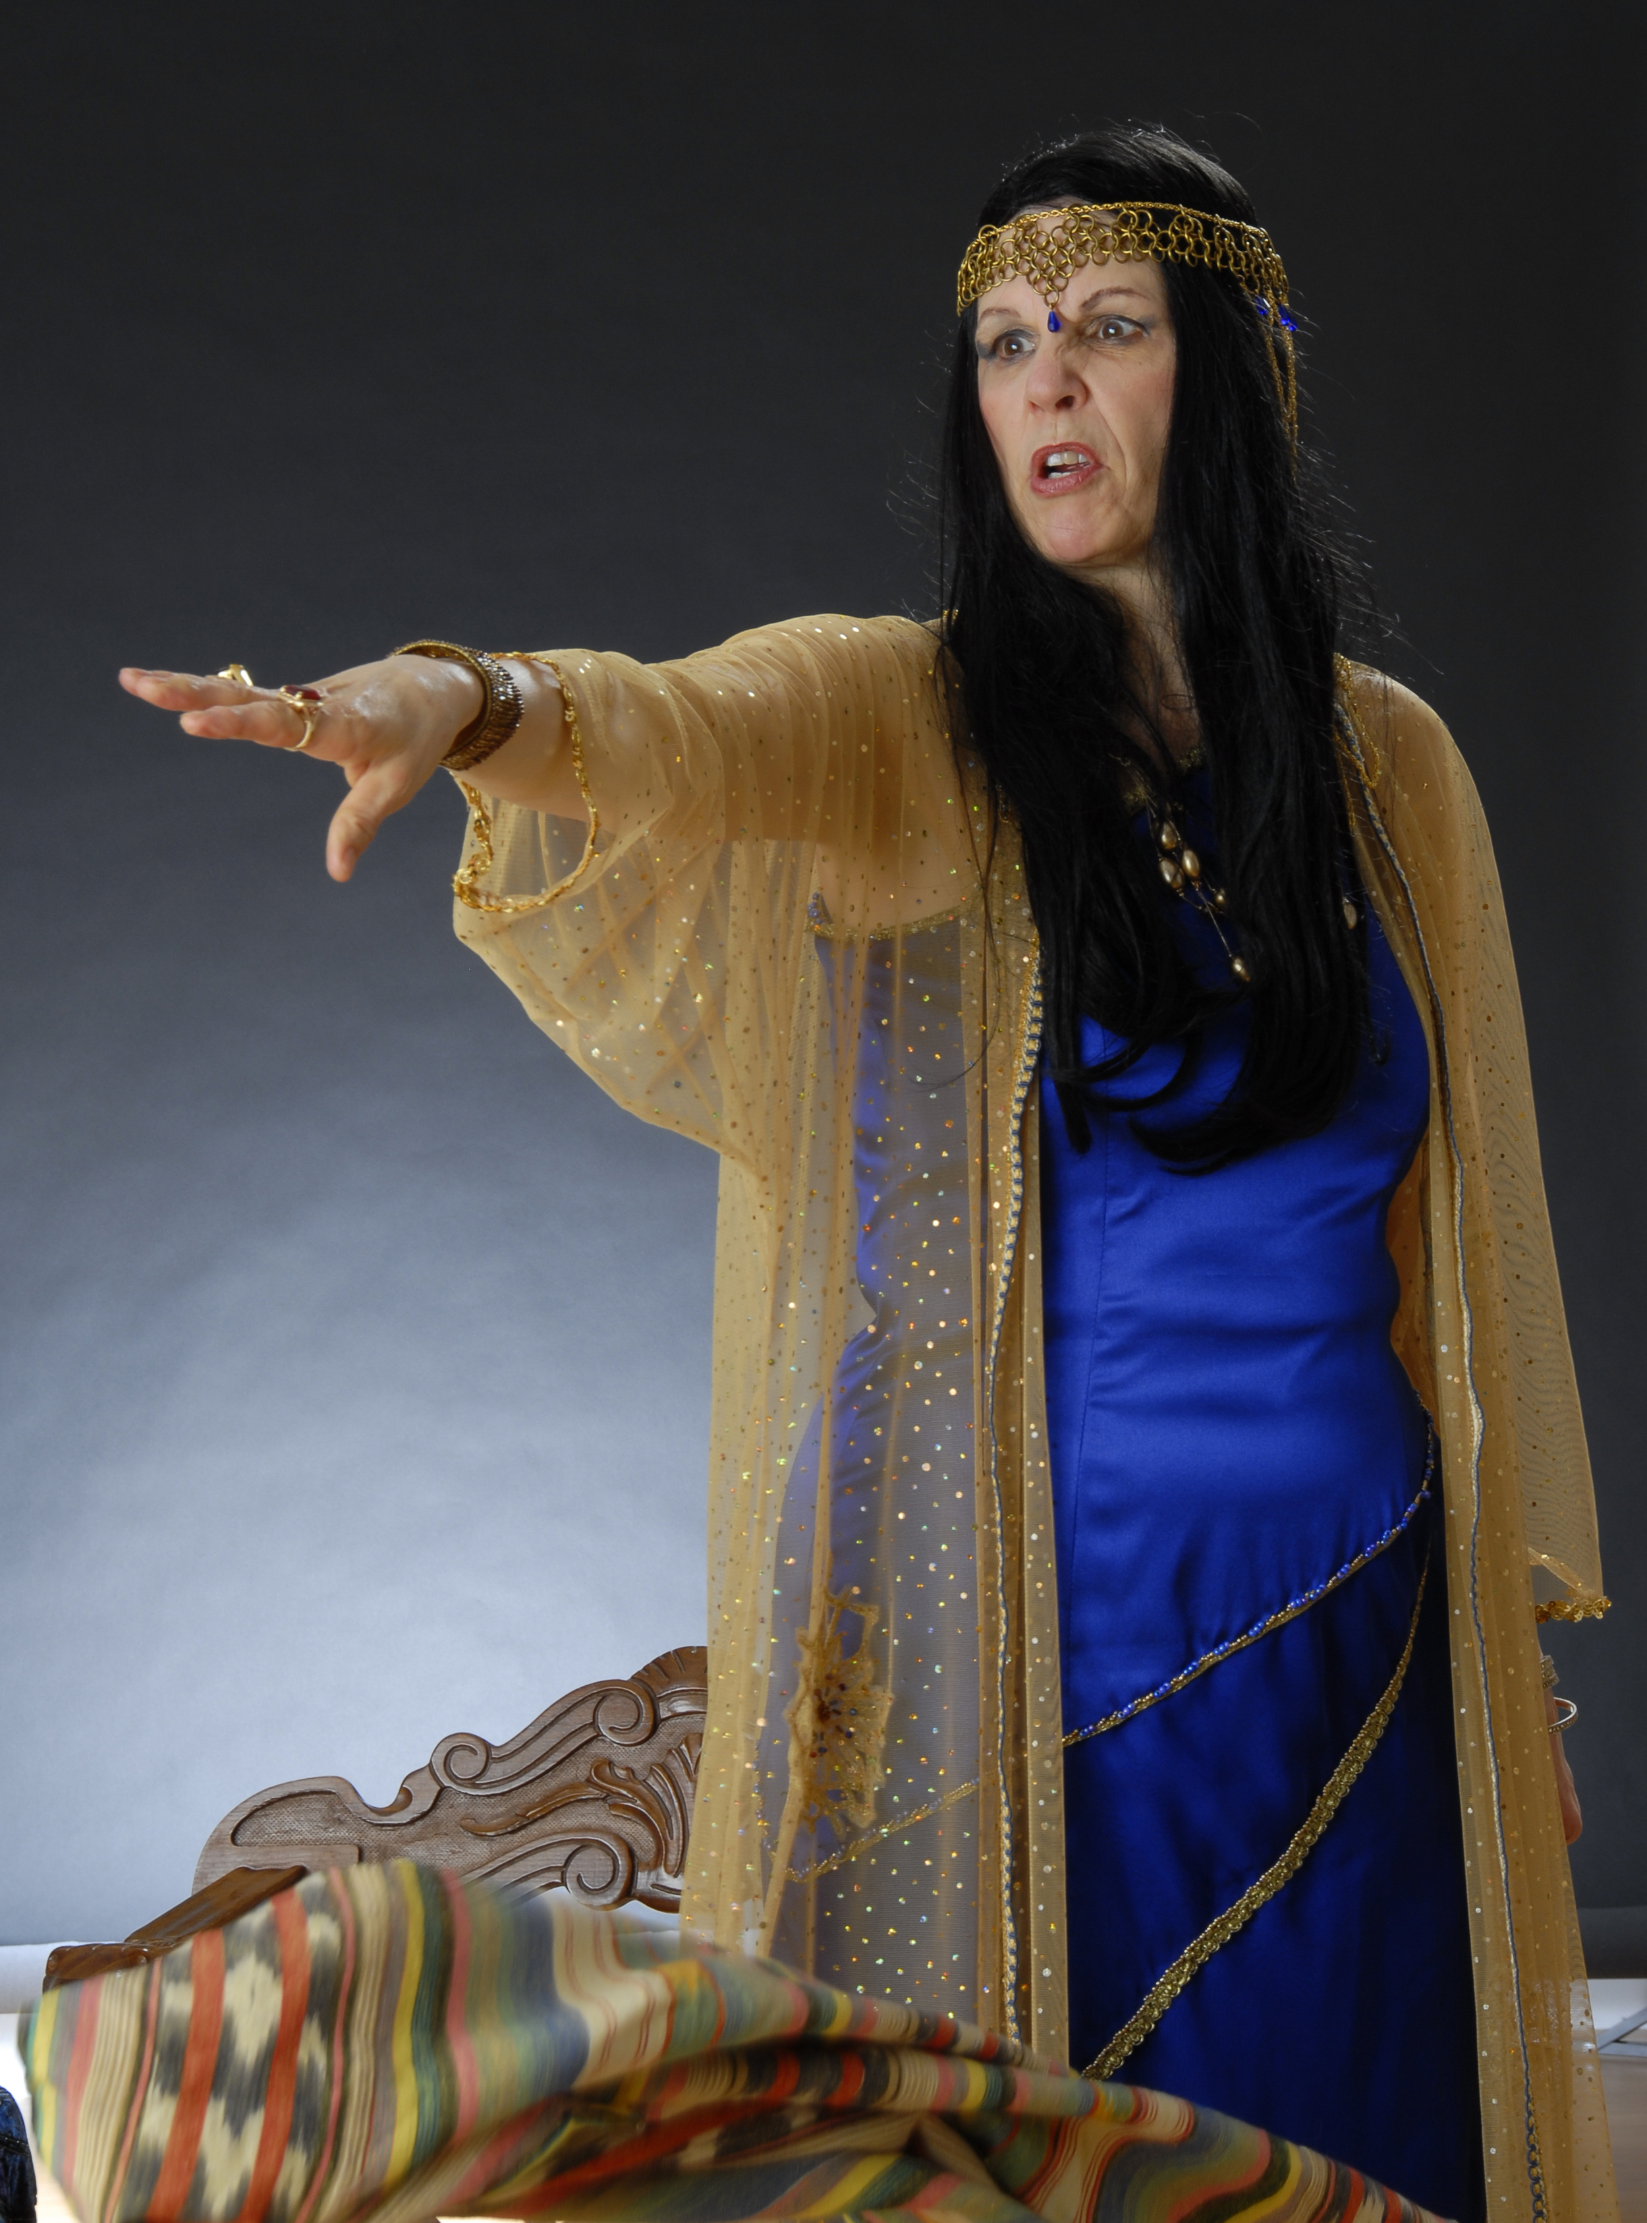
10. What was the immediate result of his upright conduct?
Genesis 39:11-20
That she called unto the men of her house, and spake unto them, saying, See, he hath brought in an Hebrew unto us to mock us; he came in unto me to lie with me, and I cried with a loud voice:

Slide 24
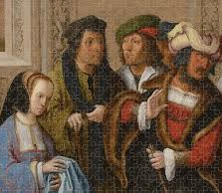
10. What was the immediate result of his upright conduct?
Genesis 39:11-20
And it came to pass, when he heard that I lifted up my voice and cried, that he left his garment with me, and fled, and got him out.

Slide 25
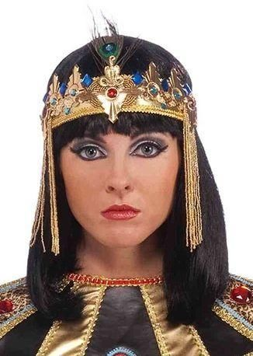
10. What was the immediate result of his upright conduct?
Genesis 39:11-20
And she laid up his garment by her, until his lord came home.

Slide 26
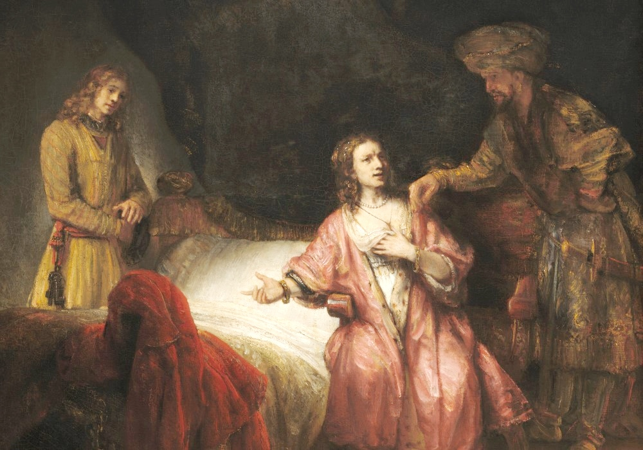
10. What was the immediate result of his upright conduct?
Genesis 39:11-20
And she spake unto him according to these words, saying, The Hebrew servant, which thou hast brought unto us, came in unto me to mock me:

Slide 27
10. What was the immediate result of his upright conduct?
Genesis 39:11-20
And it came to pass, as I lifted up my voice and cried, that he left his garment with me, and fled out.

Slide 28
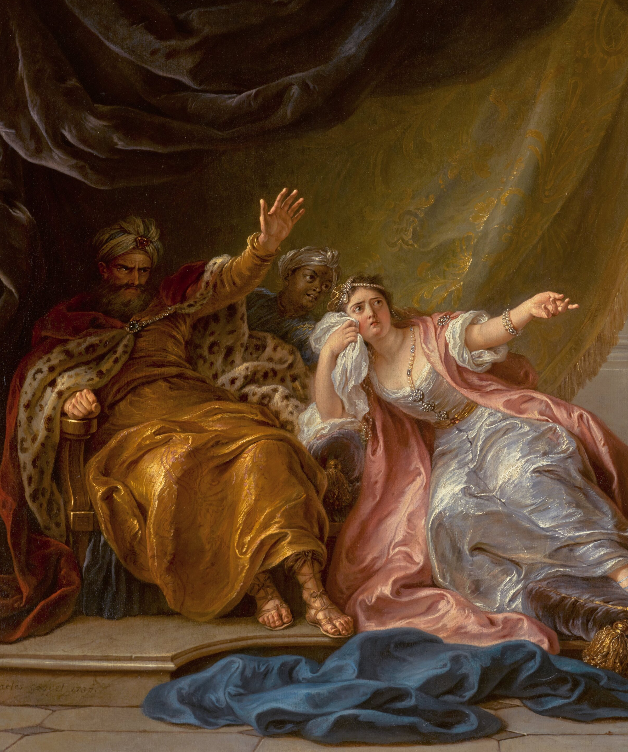
10. What was the immediate result of his upright conduct?
Genesis 39:11-20
And it came to pass, when his master heard the words of his wife, which she spake unto him, saying, After this manner did thy servant to me; that his wrath was kindled.

Slide 29
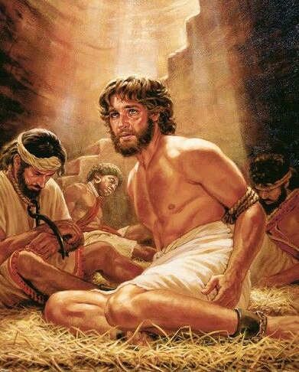
10. What was the immediate result of his upright conduct?
Genesis 39:11-20
And Joseph’s master took him, and put him into the prison, a place where the king’s prisoners were bound: and he was there in the prison.

Slide 30
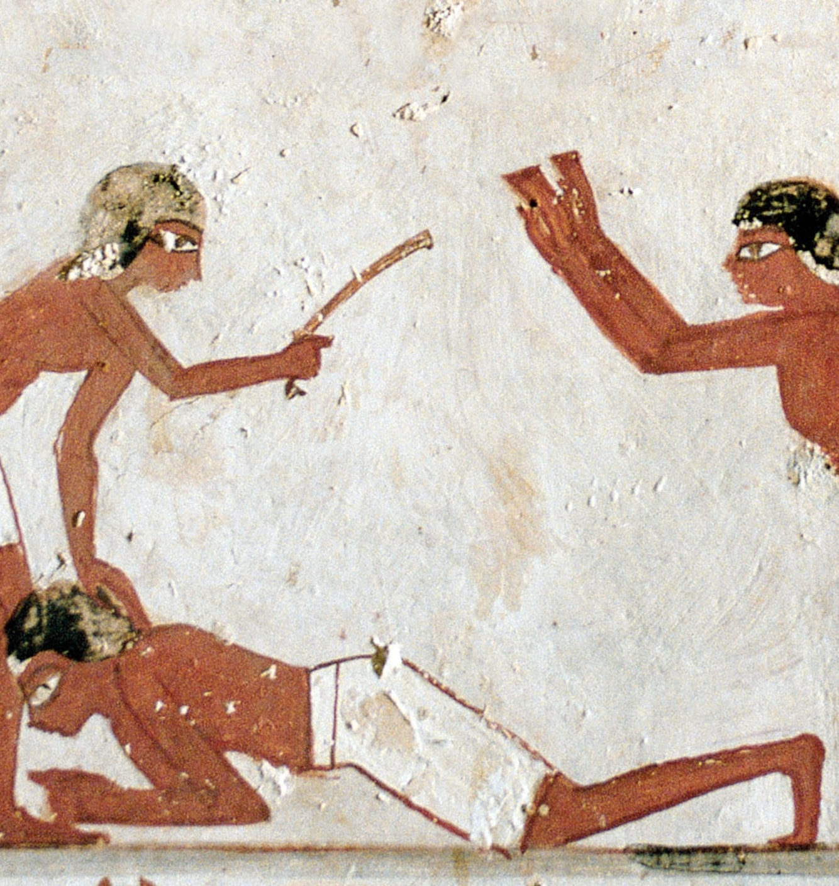
Ancient Egyptian Law
Diodorus Siculus (Bibliotheca Historica 1.78)
In ancient Egypt, punishment by beating the soles of the feet (bastinado) was among the harshest penalties short of execution. Greek historian Diodorus Siculus records that an attempt at adultery could bring “a thousand blows upon the feet.”

Slide 31
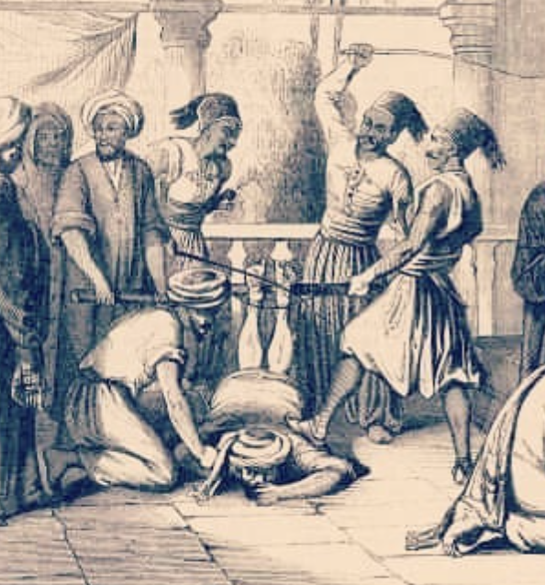
Ancient Egyptian Law
Diodorus Siculus (Bibliotheca Historica 1.78)
Even a fraction of that number could cripple a man for life; the full punishment was often fatal. Potiphar’s decision to confine Joseph rather than have him beaten or killed shows remarkable leniency and likely reflects his doubt of his wife’s story and respect for Joseph’s integrity.

Slide 32
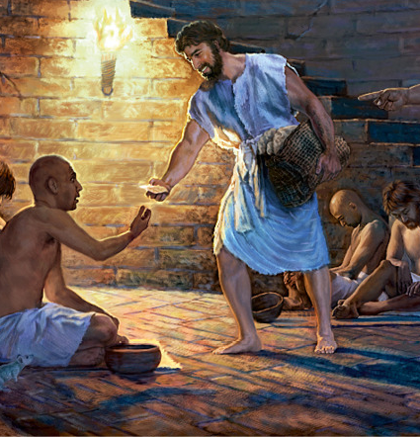
11. Who was with Joseph still?
Genesis 39:21
But the LORD was with Joseph, and shewed him mercy, and gave him favour in the sight of the keeper of the prison.

Slide 33
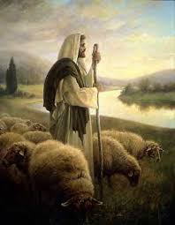
12. What can always be said by one who has the Lord for a companion?
Psalm 23
The LORD is my shepherd; I shall not want.

Slide 34
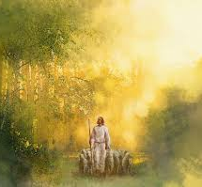
12. What can always be said by one who has the Lord for a companion?
Psalm 23
He maketh me to lie down in green pastures: he leadeth me beside the still waters.

Slide 35
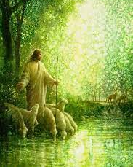
12. What can always be said by one who has the Lord for a companion?
Psalm 23
He restoreth my soul: he leadeth me in the paths of righteousness for his name’s sake.

Slide 36

12. What can always be said by one who has the Lord for a companion?
Psalm 23
Yea, though I walk through the valley of the shadow of death, I will fear no evil: for thou art with me; thy rod and thy staff they comfort me.

Slide 37

12. What can always be said by one who has the Lord for a companion?
Psalm 23
Thou preparest a table before me in the presence of mine enemies: thou anointest my head with oil; my cup runneth over.

Slide 38
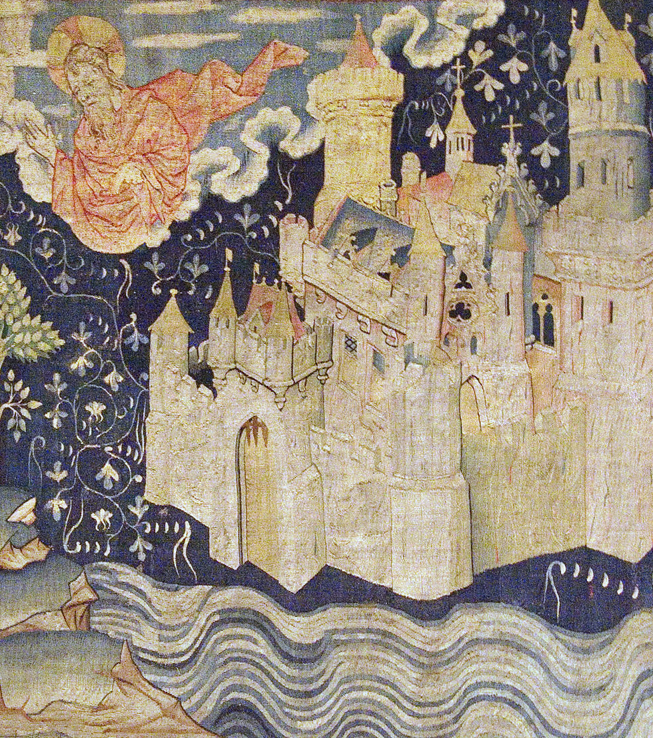
12. What can always be said by one who has the Lord for a companion?
Psalm 23
Surely goodness and mercy shall follow me all the days of my life: and I will dwell in the house of the LORD for ever.

Slide 39

Joseph’s Path: Psalm 105:17-22
¹⁷ He sent a man before them, even Joseph, who was sold for a servant:
¹⁸ Whose feet they hurt with fetters: he was laid in iron:

Slide 40
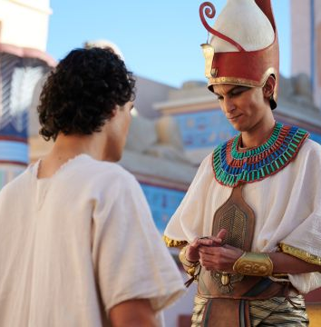
Joseph’s Path: Psalm 105:17-22
¹⁹ Until the time that his word came: the word of the Lord tried him.
²⁰ The king sent and loosed him; even the ruler of the people, and let him go free.

Slide 41
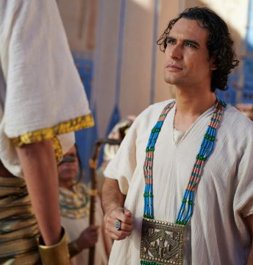
Joseph’s Path: Psalm 105:17-22
²¹ He made him lord of his house, and ruler of all his substance:
²² To bind his princes at his pleasure; and teach his senators wisdom.

Slide 42
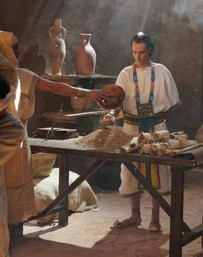
Joseph’s Path: Psalm 105:17-22
Psalm 105 interprets Joseph’s suffering as part of divine providence: his fetters and iron chains were God’s forge, shaping a deliverer. Even in confinement, “the Lord was with him.” (Genesis 39:21)

Slide 43
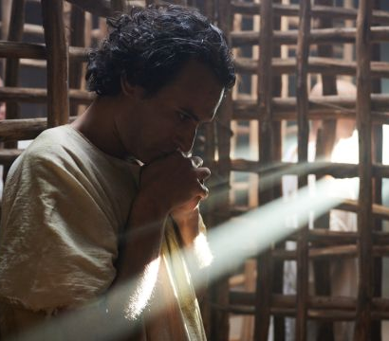
13. How was this verified in Joseph’s case?
Genesis 39:21
But the LORD was with Joseph, and shewed him mercy, and gave him favour in the sight of the keeper of the prison.

Slide 44
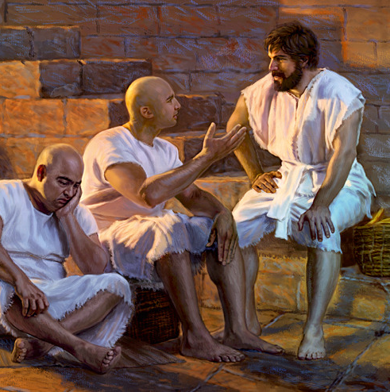
14. What trust was committed to Joseph in the prison?
Genesis 39:22
And the keeper of the prison committed to Joseph’s hand all the prisoners that were in the prison; and whatsoever they did there, he was the doer of it.

Slide 45

15. Why was this?
Genesis 39:23
The keeper of the prison looked not to any thing that was under his hand; because the LORD was with him, and that which he did, the LORD made it to prosper.

Slide 46
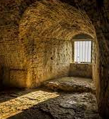
16. What scripture was fulfilled in Joseph’s case?
Proverbs 16:7
When a man’s ways please the LORD, he maketh even his enemies to be at peace with him.

Slide 47


Slide 48
Thank you and
HAPPY SABBATH!

