Slide 1


Slide 2

Living the Light

Slide 3
Old Testament History:
Joseph Before Pharaoh
Lesson 20, 2nd Quarter, 1888

Slide 4

1. What is wisdom?
Proverbs 9:10
The fear of the LORD is the beginning of wisdom: and the knowledge of the holy is understanding.

Slide 5
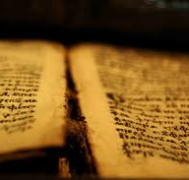
2. When a man receives wisdom from God what else does he receive with it?
Proverbs 2:6-7
For the LORD giveth wisdom: out of his mouth cometh knowledge and understanding.

Slide 6

2. When a man receives wisdom from God what else does he receive with it?
Proverbs 2:6-7
He layeth up sound wisdom for the righteous: he is a buckler to them that walk uprightly.

Slide 7

3. If any one lacks wisdom, what should he do?
James 1:5
If any of you lack wisdom, let him ask of God, that giveth to all men liberally, and upbraideth not; and it shall be given him.

Slide 8
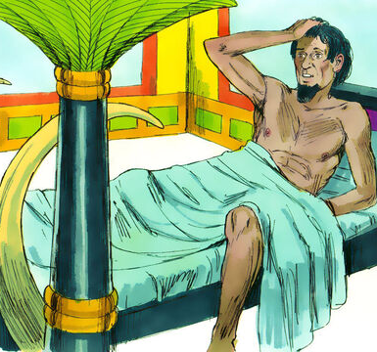
4. What dream did Pharaoh have?
Genesis 41:1-7
And it came to pass at the end of two full years, that Pharaoh dreamed: and, behold, he stood by the river.

Slide 9
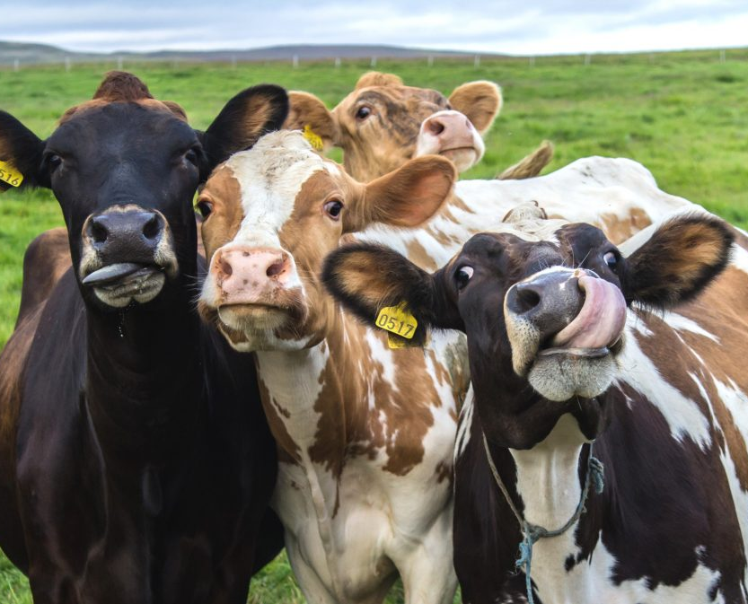
4. What dream did Pharaoh have?
Genesis 41:1-7
And, behold, there came up out of the river seven well favored kine and fatfleshed; and they fed in a meadow.

Slide 10
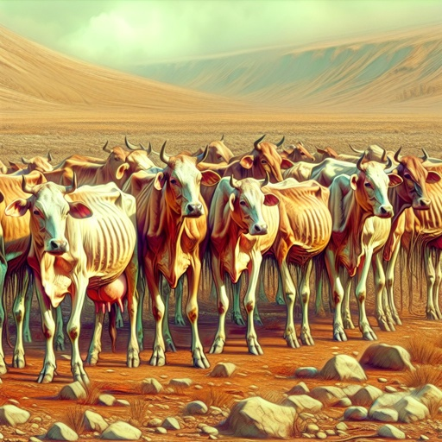
4. What dream did Pharaoh have?
Genesis 41:1-7
And, behold, seven other kine came up after them out of the river, ill favored and leanfleshed; and stood by the other kine upon the brink of the river.

Slide 11
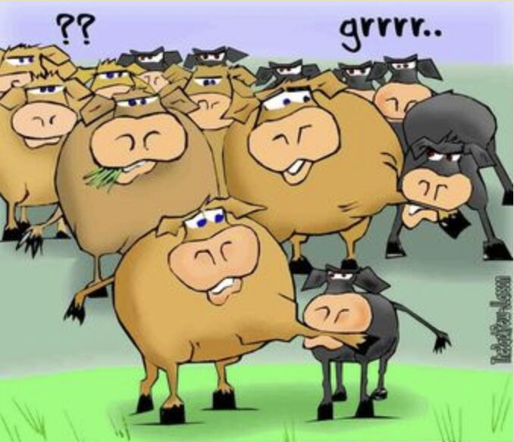
4. What dream did Pharaoh have?
Genesis 41:1-7
And the ill favored and leanfleshed kine did eat up the seven well favored and fat kine. So Pharaoh awoke.

Slide 12

4. What dream did Pharaoh have?
Genesis 41:1-7
And he slept and dreamed the second time: and, behold, seven ears of corn came up upon one stalk, rank and good.

Slide 13
4. What dream did Pharaoh have?
Genesis 41:1-7
And, behold, seven thin ears and blasted with the east wind sprung up after them.

Slide 14
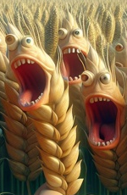
4. What dream did Pharaoh have?
Genesis 41:1-7
And the seven thin ears devoured the seven rank and full ears. And Pharaoh awoke, and, behold, it was a dream.

Slide 15
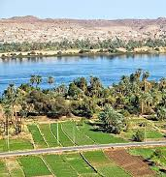
Egyptian Nightmares
The Nile was Egypt’s lifeline — “the father of life,” according to the Pyramid Texts.
Cows symbolized fertility and life (linked to the goddess Hathor), and Grain was Egypt’s wealth.

Slide 16
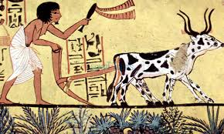
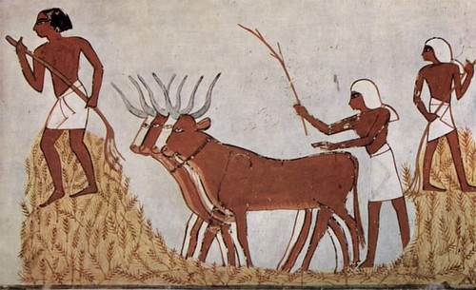
Egyptian Nightmares
So Pharaoh’s dream directly touches the three pillars of Egypt’s survival: water, agriculture, and divine favor.
This would make the dream more terrifying than it sounds to a modern reader.

Slide 17
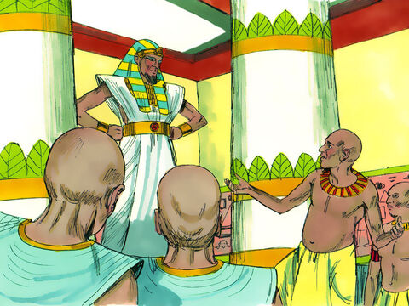
5. Could Pharaoh find anyone to interpret his dreams?
Genesis 41:8
And it came to pass in the morning that his spirit was troubled; and he sent and called for all the magicians of Egypt, and all the wise men thereof: and Pharaoh told them his dream; but there was none that could interpret them unto Pharaoh.

Slide 18
5. Could Pharaoh find anyone to interpret his dreams?
Genesis 41:8
And it came to pass in the morning that his spirit was troubled; and he sent and called for all the magicians of Egypt, and all the wise men thereof: and Pharaoh told them his dream; but there was none that could interpret them unto Pharaoh.

Slide 19
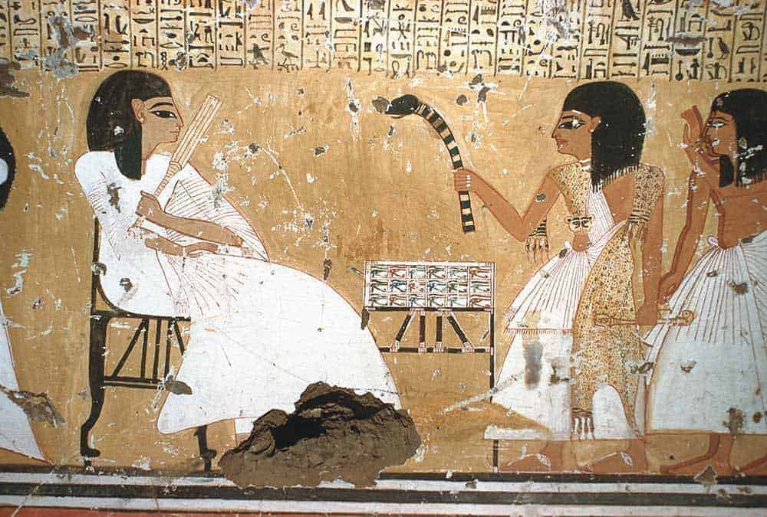
The Failure of Egyptian Wisdom
Pharaoh first calls:
ḥarṭummîm — priestly-magicians trained in temple ritual
ḥăkāmîm — “wise men,” scholars of sacred lore

Slide 20
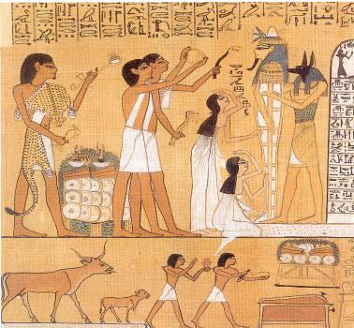
The Failure of Egyptian Wisdom
In Egyptian culture, these would include:
The Reader-Priests (ḥery-heb)
Experts in sacred texts, incantations, and ritual purity.

Slide 21
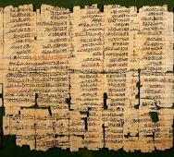
The Failure of Egyptian Wisdom
The Chief Scribe (sab or seš-per-ankh)
Trained in hieroglyphic interpretation, “masters of secret knowledge.”
The Dream Interpreters
Egyptian dream books (like the Ramesside Dream Manual) listed hundreds of common dreams.

Slide 22
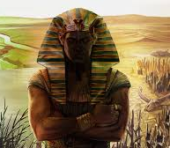
The Failure of Egyptian Wisdom
Inasmuch as the Nile, whence the lean as well as the fat cows ascended, was regarded by the Egyptians as the source of all life and fertility, these wise men were puzzled as to the meaning of the dreams and could think of no interpretation that would be likely to satisfy the king.

Slide 23
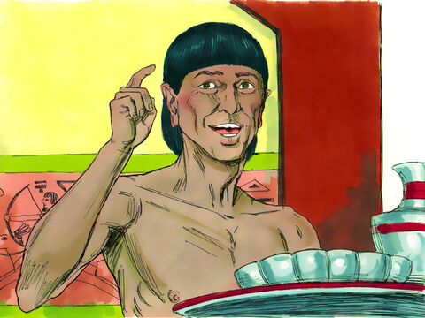
6. Who then remembered Joseph?
Genesis 41:9-13
Then spake the chief butler unto Pharaoh, saying, I do remember my faults this day:

Slide 24
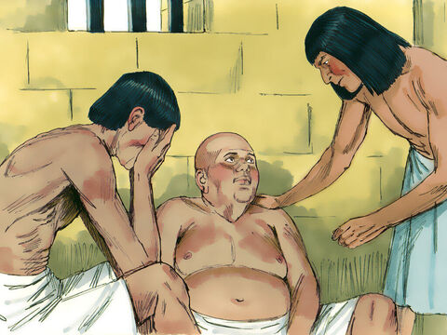
6. Who then remembered Joseph?
Genesis 41:9-13
Pharaoh was wroth with his servants, and put me in ward in the captain of the guard's house, both me and the chief baker:

Slide 25
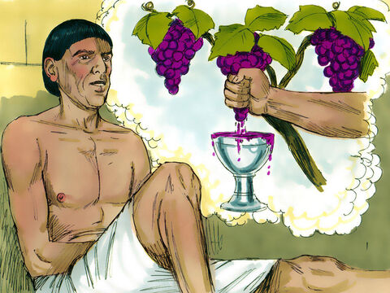
6. Who then remembered Joseph?
Genesis 41:9-13
And we dreamed a dream in one night, I and he; we dreamed each man according to the interpretation of his dream.

Slide 26
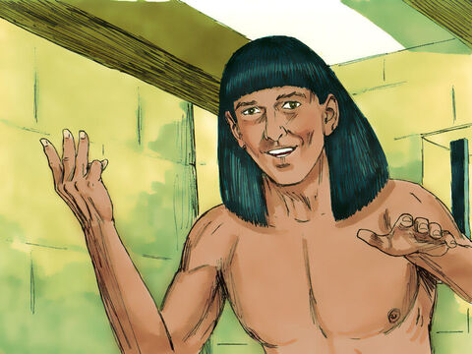
6. Who then remembered Joseph?
Genesis 41:9-13
And there was there with us a young man, an Hebrew, servant to the captain of the guard; and we told him, and he interpreted to us our dreams; to each man according to his dream he did interpret.

Slide 27
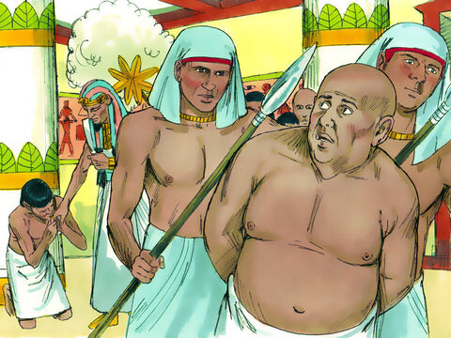
6. Who then remembered Joseph?
Genesis 41:9-13
And it came to pass, as he interpreted to us, so it was; me he restored unto mine office, and him he hanged.

Slide 28
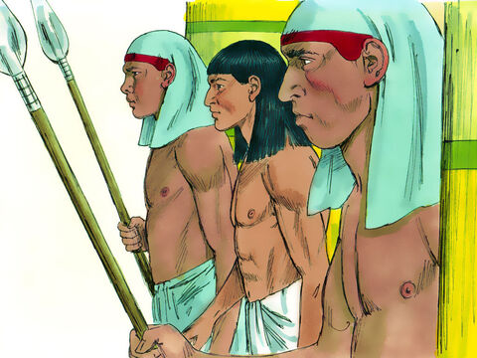
7. When Joseph had been brought before Pharaoh, what did he say?
Genesis 41:15-16
And Pharaoh said unto Joseph, I have dreamed a dream, and there is none that can interpret it: and I have heard say of thee, that thou canst understand a dream to interpret it.

Slide 29
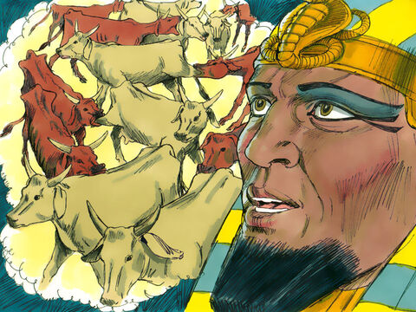
7. When Joseph had been brought before Pharaoh, what did he say?
Genesis 41:15-16
And Joseph answered Pharaoh, saying, It is not in me: God shall give Pharaoh an answer of peace.

Slide 30
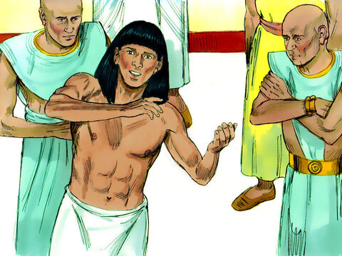
8. What was Joseph’s interpretation of the two dreams?
Genesis 41:25-32
And Joseph said unto Pharaoh, The dream of Pharaoh is one: God hath showed Pharaoh what he is about to do.

Slide 31
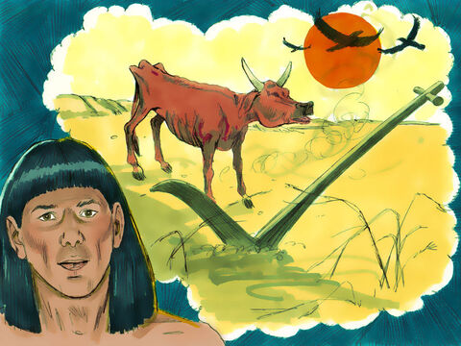
8. What was Joseph’s interpretation of the two dreams?
Genesis 41:25-32
The seven good kine are seven years; and the seven good ears are seven years: the dream is one.

Slide 32
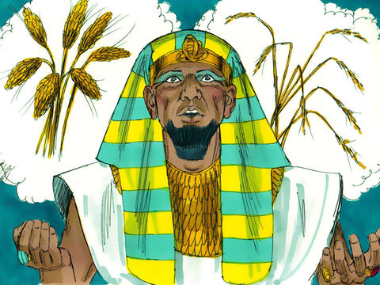
8. What was Joseph’s interpretation of the two dreams?
Genesis 41:25-32
And the seven thin and ill favored kine that came up after them are seven years; and the seven empty ears blasted with the east wind shall be seven years of famine.

Slide 33
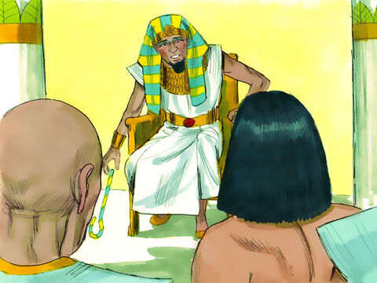
8. What was Joseph’s interpretation of the two dreams?
Genesis 41:25-32
This is the thing which I have spoken unto Pharaoh: What God is about to do he showeth unto Pharaoh.

Slide 34
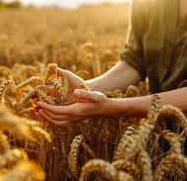
8. What was Joseph’s interpretation of the two dreams?
Genesis 41:25-32
Behold, there come seven years of great plenty throughout all the land of Egypt:

Slide 35

8. What was Joseph’s interpretation of the two dreams?
Genesis 41:25-32
And there shall arise after them seven years of famine; and all the plenty shall be forgotten in the land of Egypt; and the famine shall consume the land;

Slide 36
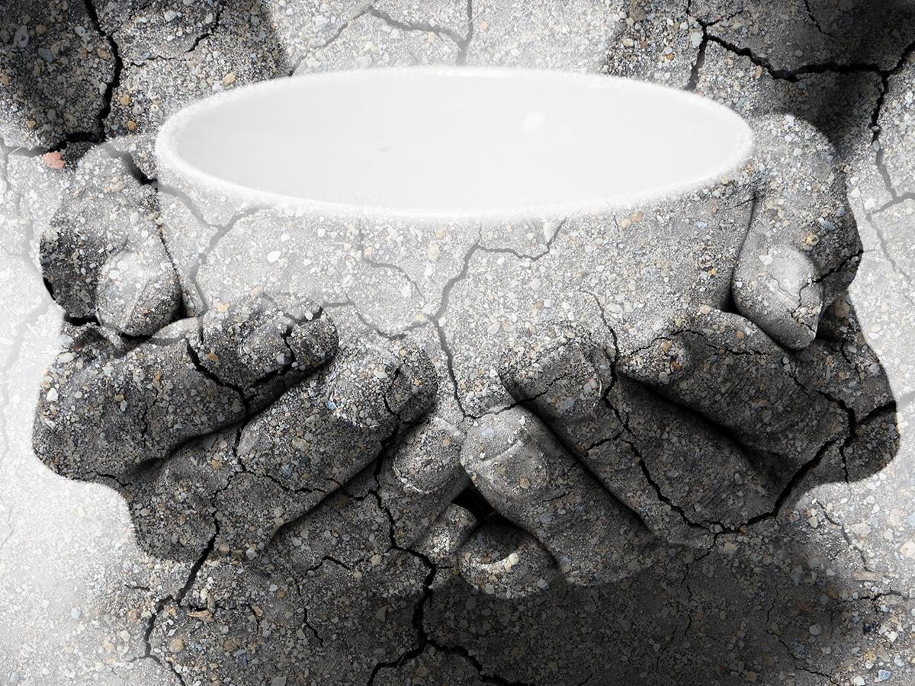
8. What was Joseph’s interpretation of the two dreams?
Genesis 41:25-32
And the plenty shall not be known in the land by reason of that famine following; for it shall be very grievous.

Slide 37
8. What was Joseph’s interpretation of the two dreams?
Genesis 41:25-32
And for that the dream was doubled unto Pharaoh twice; it is because the thing is established by God, and God will shortly bring it to pass.

Slide 38
9. What did Joseph say that Pharaoh should do?
Genesis 41:33-36
Now therefore let Pharaoh look out a man discreet and wise, and set him over the land of Egypt.

Slide 39
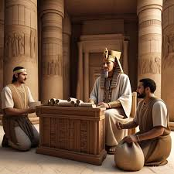
9. What did Joseph say that Pharaoh should do?
Genesis 41:33-36
Let Pharaoh do this, and let him appoint officers over the land, and take up the fifth part of the land of Egypt in the seven plenteous years.

Slide 40
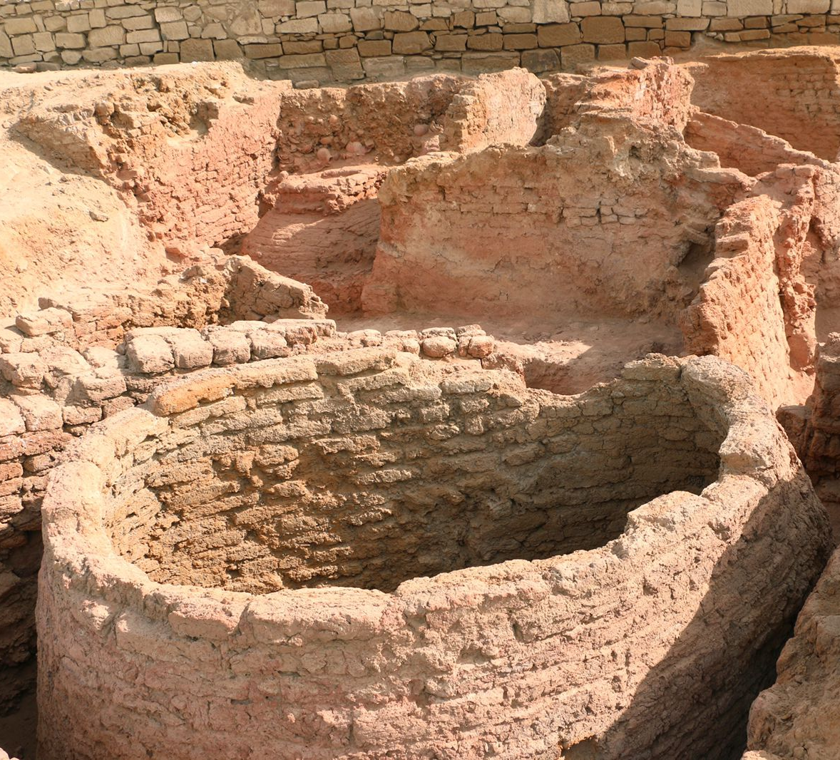
9. What did Joseph say that Pharaoh should do?
Genesis 41:33-36
And let them gather all the food of those good years that come, and lay up corn under the hand of Pharaoh, and let them keep food in the cities.

Slide 41
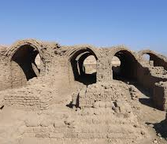
9. What did Joseph say that Pharaoh should do?
Genesis 41:33-36
And that food shall be for store to the land against the seven years of famine, which shall be in the land of Egypt; that the land perish not through the famine.

Slide 42
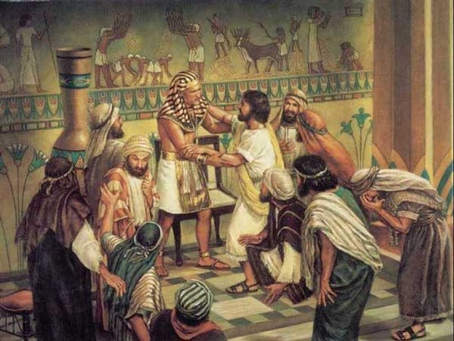
10. How did Pharaoh regard Joseph’s counsel?
Genesis 41:37-39
And the thing was good in the eyes of Pharaoh, and in the eyes of all his servants.

Slide 43
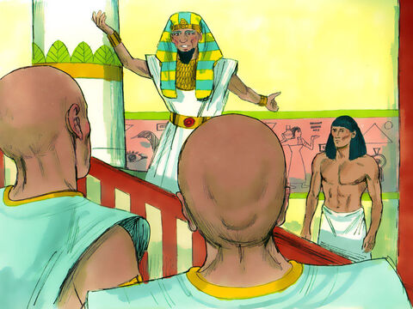
10. How did Pharaoh regard Joseph’s counsel?
Genesis 41:37-39
And Pharaoh said unto his servants, Can we find such a one as this is, a man in whom the Spirit of God is?

Slide 44
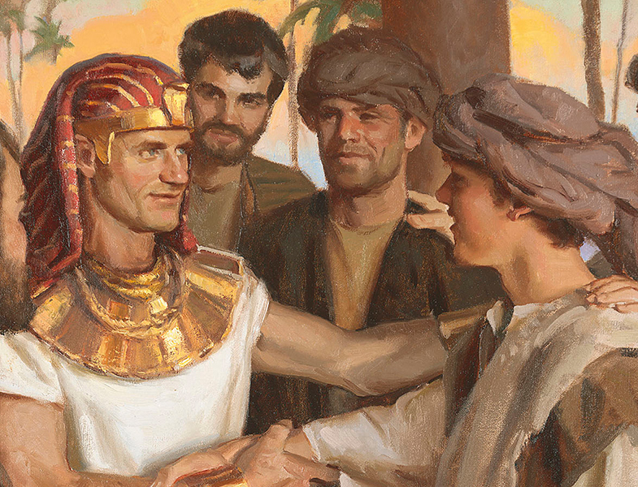
10. How did Pharaoh regard Joseph’s counsel?
Genesis 41:37-39
And Pharaoh said unto Joseph, Forasmuch as God hath showed thee all this, there is none so discreet and wise as thou art:

Slide 45
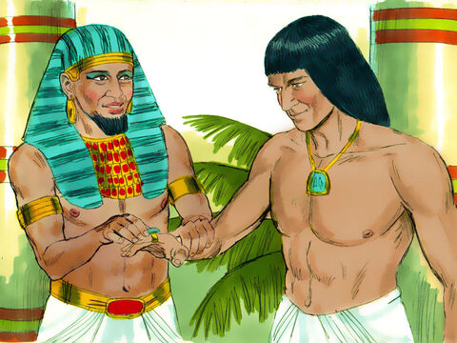
11. To what office was Joseph appointed?
Genesis 41:40-41
Thou shalt be over my house, and according unto thy word shall all my people be ruled: only in the throne will I be greater than thou.

Slide 46
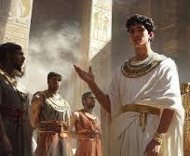
11. To what office was Joseph appointed?
Genesis 41:40-41
And Pharaoh said unto Joseph, See, I have set thee over all the land of Egypt.

Slide 47
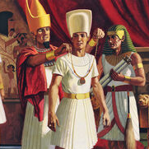
12. What mark of distinction was put upon Joseph?
Genesis 41:42-43
And Pharaoh took off his ring from his hand, and put it upon Joseph's hand, and arrayed him in vestures of fine linen, and put a gold chain about his neck;

Slide 48
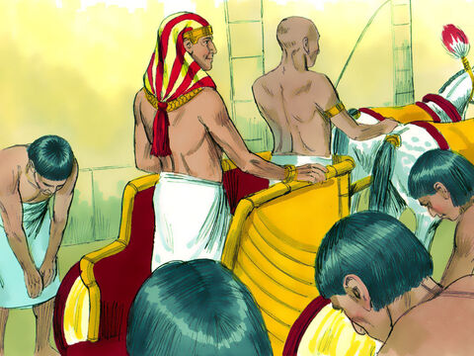
12. What mark of distinction was put upon Joseph?
Genesis 41:42-43
And he made him to ride in the second chariot which he had; and they cried before him, Bow the knee: and he made him ruler over all the land of Egypt.

Slide 49
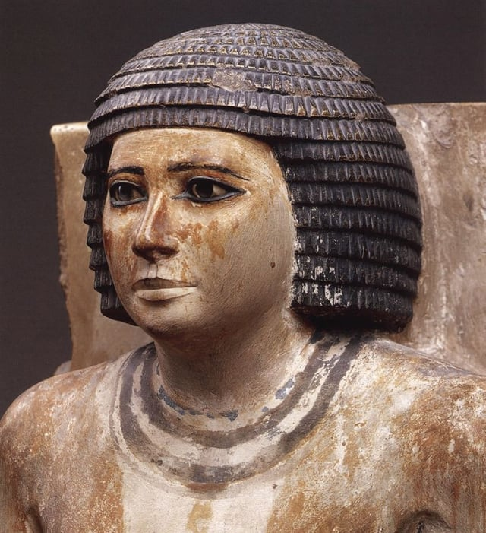
The Highest Official
Egyptian records describe the tjaty (vizier), the highest official under Pharaoh.
Several of these viziers, including Kai (5th Dynasty, circa 2465-2323 BC), pictured here, are well attested by archeological evidence.

Slide 50
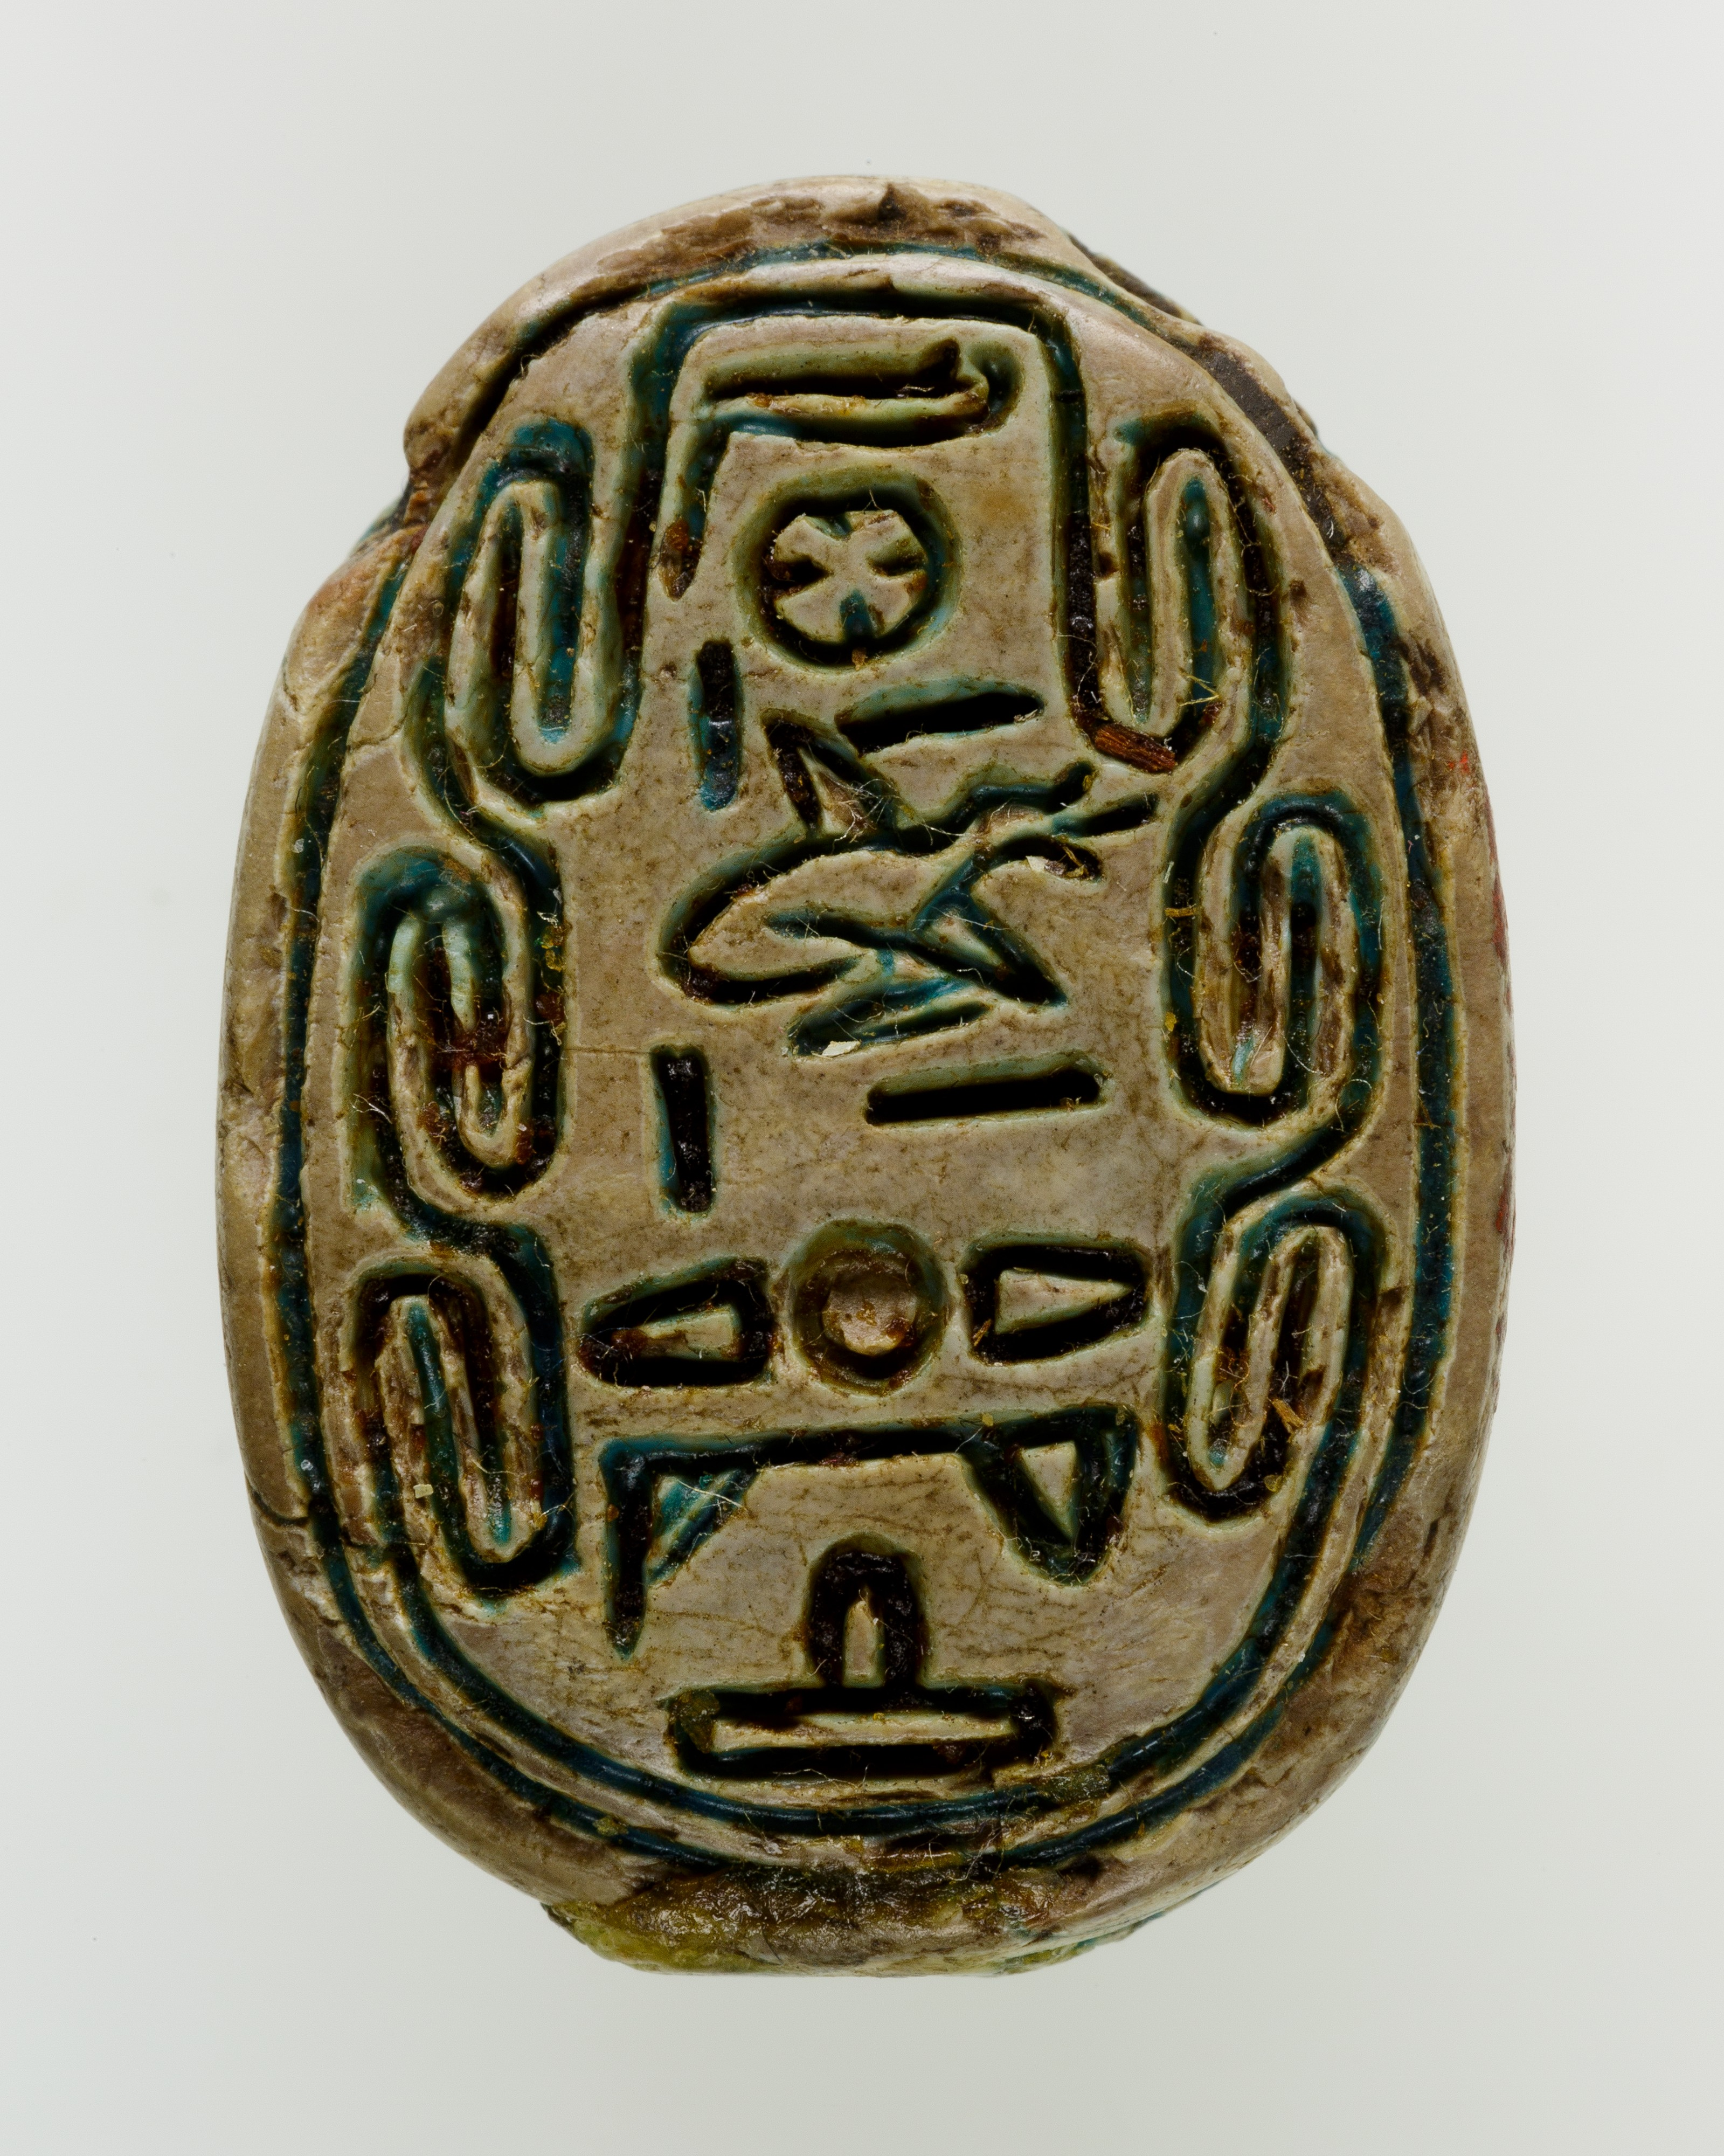
The Highest Official
Vizier duties included:
Managing grain and agriculture
Taxation
Hearing legal cases
Oversight of national projects
Supervision of storage cities and food distribution
Scarab of Vizier Minhotep (12th or 13th dynasty, circa 1760-1670 BC)

Slide 51
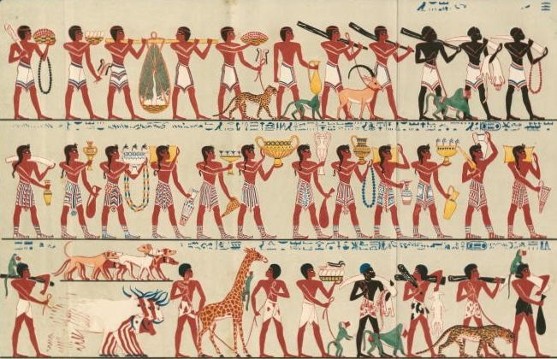
The Highest Official
Well-known viziers like:
Rekhmire (tomb shows tribute-gathering scenes)
Vizier Rekhmire’s Tomb Paintings (18th dynasty, circa 1400 BC)

Slide 52
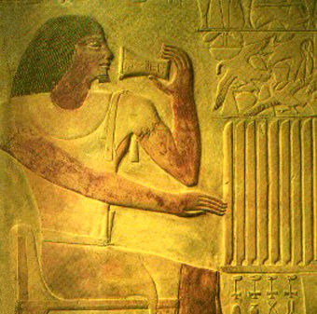
The Highest Official
And Ptah-hotep (author of The Instruction of Ptah-hotep)
…held nearly identical positions to Joseph’s
Vizier Ptah-hotep (5th dynasty, circa 2400 BC)

Slide 53
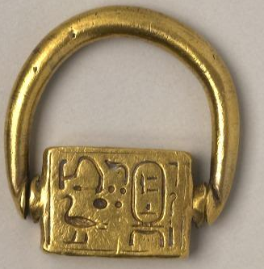
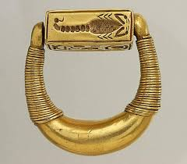
The Highest Official
Signet ring of Amenhotep II (18th dynasty, circa 1400 BC)
These other viziers held symbols of authority like those given to Joseph, especially the signet ring, carved with the royal cartouche, signifying executive authority.
Signet ring of Horemheb (18th dynasty, circa 1300 BC)

Slide 54
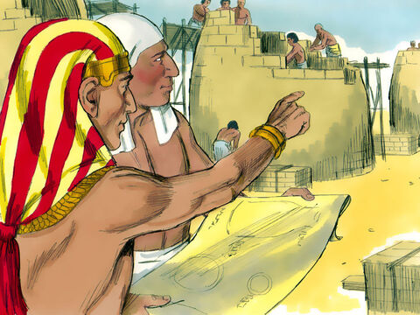
13. How old was Joseph when he stood before Pharaoh?
Genesis 41:46
And Joseph was thirty years old when he stood before Pharaoh king of Egypt. And Joseph went out from the presence of Pharaoh, and went throughout all the land of Egypt.

Slide 55
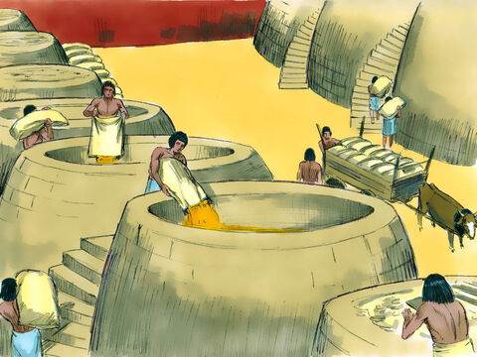
14. How faithfully did Joseph perform his trust?
Genesis 41:47-49
And in the seven plenteous years the earth brought forth by handfuls.

Slide 56
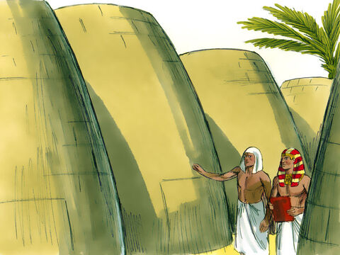
14. How faithfully did Joseph perform his trust?
Genesis 41:47-49
And he gathered up all the food of the seven years, which were in the land of Egypt, and laid up the food in the cities: the food of the field, which was round about every city, laid he up in the same.

Slide 57
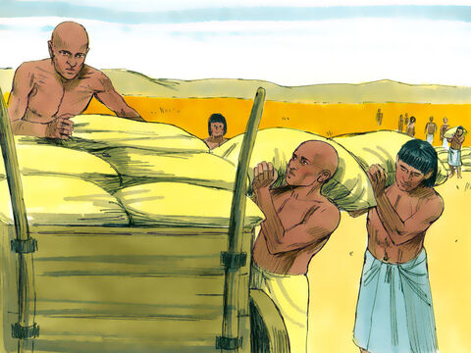
14. How faithfully did Joseph perform his trust?
Genesis 41:47-49
And Joseph gathered corn as the sand of the sea, very much, until he left numbering; for it was without number.

Slide 58
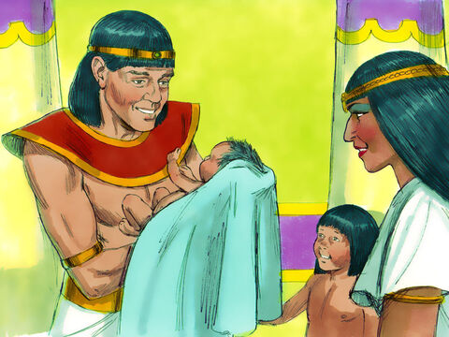
15. What did he name his two sons?
Genesis 41:50-52
And unto Joseph were born two sons before the years of famine came, which Asenath the daughter of Potipherah priest of On bare unto him.

Slide 59
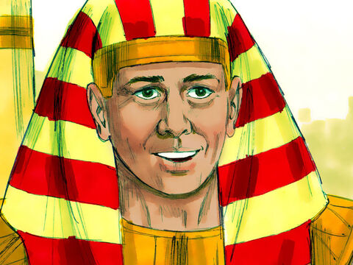
15. What did he name his two sons?
Genesis 41:50-52
And Joseph called the name of the firstborn Manasseh: For God, said he, hath made me forget all my toil, and all my father's house.

Slide 60
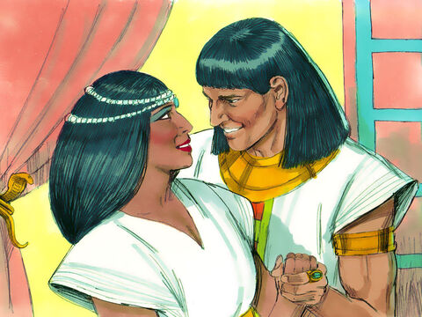
15. What did he name his two sons?
Genesis 41:50-52
And the name of the second called he Ephraim: For God hath caused me to be fruitful in the land of my affliction.

Slide 61

16. What came upon the land at the end of the seven plenteous years?
Genesis 41:53-54
And the seven years of plenteousness, that was in the land of Egypt, were ended.

Slide 62

16. What came upon the land at the end of the seven plenteous years?
Genesis 41:53-54
And the seven years of dearth began to come, according as Joseph had said: and the dearth was in all lands; but in all the land of Egypt there was bread.

Slide 63

Seven Years of Famine
The Famine Stela is an inscription written in Egyptian hieroglyphs located on Sehel Island in the Nile near Aswan in Egypt, which tells of a seven-year period of drought and famine during the reign of pharaoh Djoser (reigned ca. 2686–2648 BC) of the Third Dynasty.

Slide 64

Seven Years of Famine
It is thought that the stele was inscribed during the Ptolemaic Kingdom, which ruled from 332 to 31 BC. The inscription has been tentatively dated to the reign of king Ptolemy V (205 – 180 BC).

Slide 65

Seven Years of Famine
The story told on the stela is set in the 18th year of the reign of Djoser.
The text describes how the king is upset and worried as the land has been in the grip of a drought and famine for seven years, during which time the Nile has not flooded the farmlands.

Slide 66

Seven Years of Famine
Djoser asks the priest staff under the supervision of high lector priest Imhotep for help. Much fantastic fiction follows. It’s interesting, though, that this sort of cultural reminiscence of a seven-year drought is recorded here.

Slide 67

17. Who were fed by Joseph?
Genesis 41:55-57
And when all the land of Egypt was famished, the people cried to Pharaoh for bread: and Pharaoh said unto all the Egyptians, Go unto Joseph; what he saith to you, do.

Slide 68

17. Who were fed by Joseph?
Genesis 41:55-57
And the famine was over all the face of the earth: and Joseph opened all the storehouses, and sold unto the Egyptians; and the famine waxed sore in the land of Egypt.

Slide 69

17. Who were fed by Joseph?
Genesis 41:55-57
And all countries came into Egypt to Joseph for to buy corn; because that the famine was so sore in all lands.

Slide 70


Slide 71
Thank you and
HAPPY SABBATH!

