Slide 1


Slide 2

Living the Light

Slide 3
Old Testament History:
God’s Care for the Righteous
Lesson 21, 2nd Quarter, 1888

Slide 4
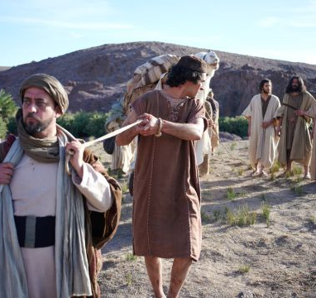
1. Relate the main points of what happened to Joseph in Egypt.
Joseph was sold into slavery in Egypt, but the Lord was with him and caused all he did to prosper.
He served faithfully in Potiphar’s house until he was falsely accused and cast into prison.

Slide 5
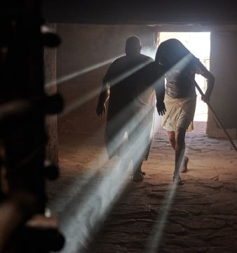
1. Relate the main points of what happened to Joseph in Egypt.
Even in prison God blessed him, giving him favor with the keeper and enabling him to interpret the dreams of Pharaoh’s servants.
After interpreting Pharaoh’s own dreams and giving wise counsel, Joseph was exalted to be ruler over all Egypt.

Slide 6
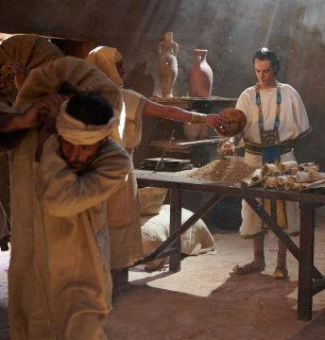
1. Relate the main points of what happened to Joseph in Egypt.
Under God’s guidance, he prepared the nation for the coming famine, ultimately saving Egypt and many surrounding nations—including his own family.

Slide 7
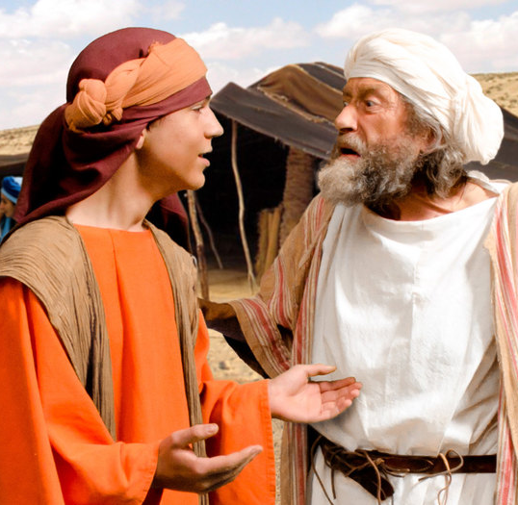
2. How long had he been in bondage when he was made prime minister?
Genesis 37:2; Genesis 41:46
These are the generations of Jacob. Joseph, being seventeen years old, was feeding the flock with his brethren; and the lad was with the sons of Bilhah, and with the sons of Zilpah, his father's wives: and Joseph brought unto his father their evil report.

Slide 8
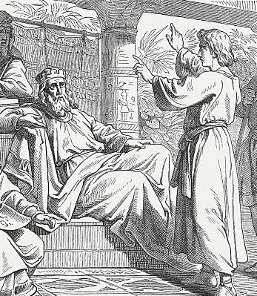
2. How long had he been in bondage when he was made prime minister?
Genesis 37:2; Genesis 41:46
And Joseph was thirty years old when he stood before Pharaoh king of Egypt. And Joseph went out from the presence of Pharaoh, and went throughout all the land of Egypt.

Slide 9
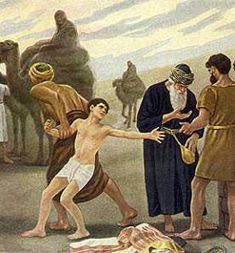
3. Why did the Lord allow Joseph to experience so much bitter suffering?
Psalm 105:17–19
He sent a man before them, even Joseph, who was sold for a servant:

Slide 10
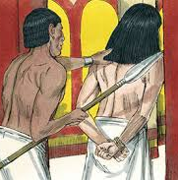
3. Why did the Lord allow Joseph to experience so much bitter suffering?
Psalm 105:17–19
Whose feet they hurt with fetters: he was laid in iron:

Slide 11
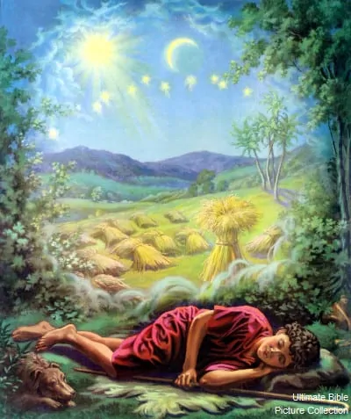
3. Why did the Lord allow Joseph to experience so much bitter suffering?
Psalm 105:17–19
Until the time that his word came: the word of the LORD tried him.

Slide 12
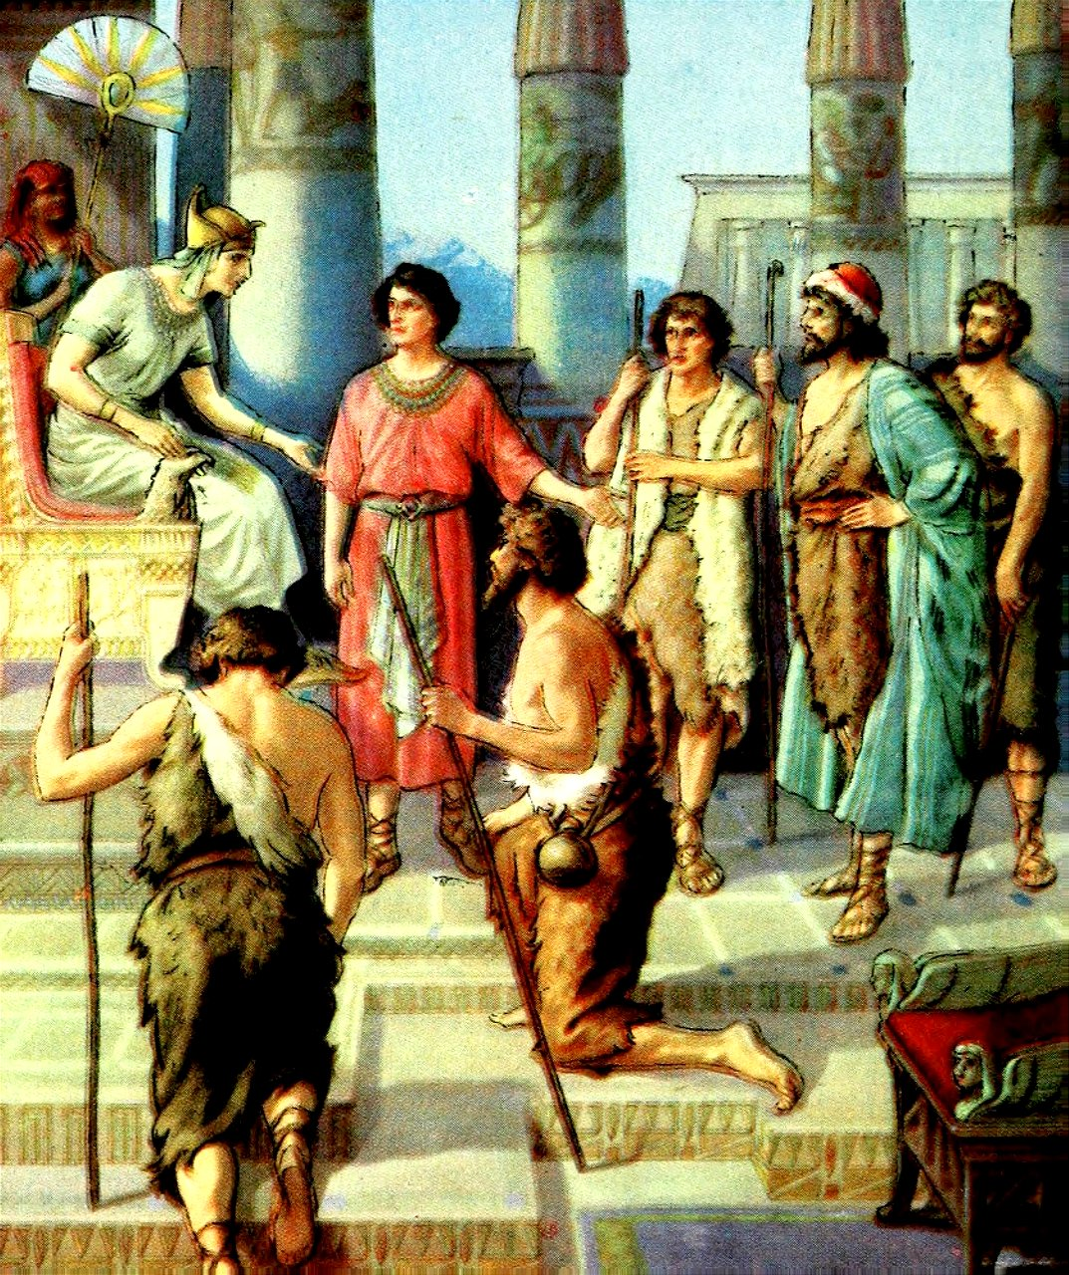
4. After having been the lowest of all, over whom was he exalted?
Psalm 105:20–22
The king sent and loosed him; even the ruler of the people, and let him go free.

Slide 13
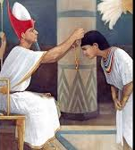
4. After having been the lowest of all, over whom was he exalted?
Psalm 105:20–22
He made him lord of his house, and ruler of all his substance:

Slide 14
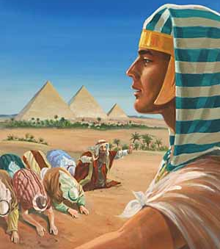
4. After having been the lowest of all, over whom was he exalted?
Psalm 105:20–22
To bind his princes at his pleasure; and teach his senators wisdom.

Slide 15
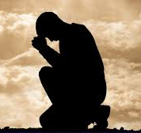
5. Of what general statement is the case of Joseph an example?
Proverbs 15:33
The fear of the LORD is the instruction of wisdom; and before honour is humility.

Slide 16
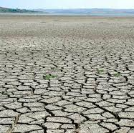
6. How extensive was the famine which Joseph had predicted?
Genesis 41:56–57
And the famine was over all the face of the earth: and Joseph opened all the storehouses, and sold unto the Egyptians; and the famine waxed sore in the land of Egypt.

Slide 17
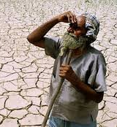
6. How extensive was the famine which Joseph had predicted?
Genesis 41:56–57
And all countries came into Egypt to Joseph for to buy corn; because that the famine was so sore in all lands.

Slide 18
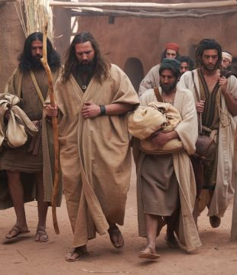
7. Who, among others, went to Egypt to buy corn?
Genesis 42:3
And Joseph's ten brethren went down to buy corn in Egypt.

Slide 19
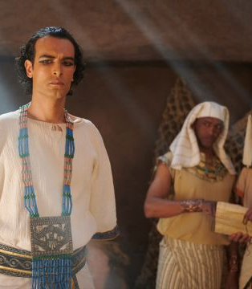
8. What did Joseph’s brethren do when they came into his presence?
Genesis 42:6
And Joseph was the governor over the land, and he it was that sold to all the people of the land: and Joseph's brethren came, and bowed down themselves before him with their faces to the earth.

Slide 20
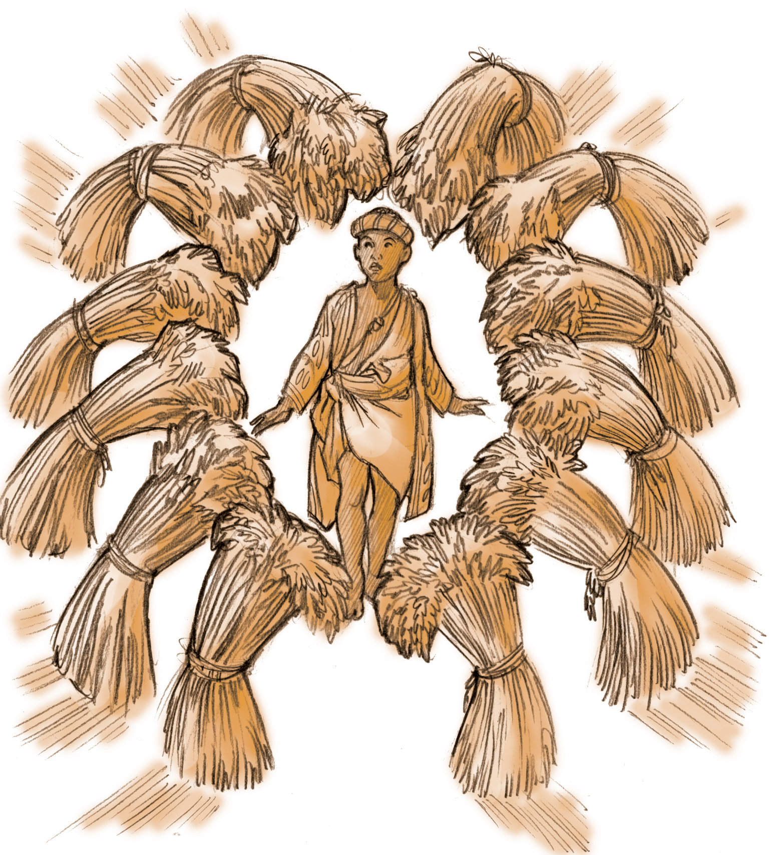
9. In so doing what did they fulfill?
They fulfilled Joseph’s own prophetic dreams—specifically the dreams in which his brothers bowed down before him. Their act of bowing in his presence brought to pass the very things they once hated him for.

Slide 21
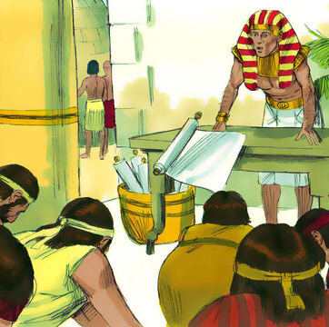
10. Did they recognize one another?
Genesis 42:8
And Joseph knew his brethren, but they knew not him.

Slide 22
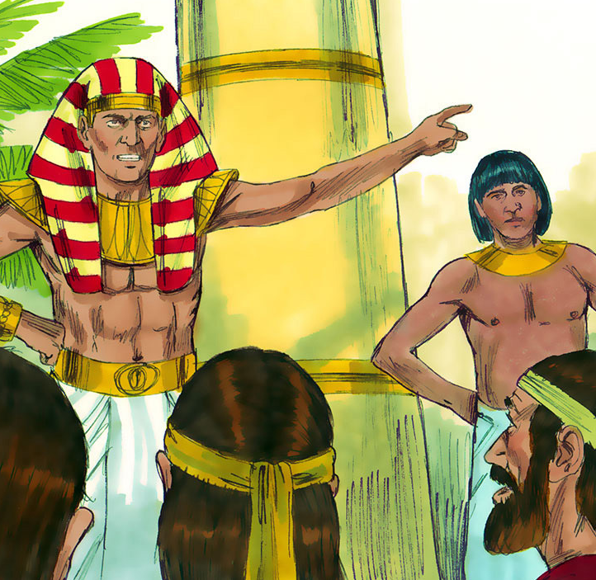
11. How did Joseph accost his brethren?
Genesis 42:7–9
And Joseph saw his brethren, and he knew them, but made himself strange unto them, and spake roughly unto them; and he said unto them, Whence come ye? And they said, From the land of Canaan to buy food.

Slide 23
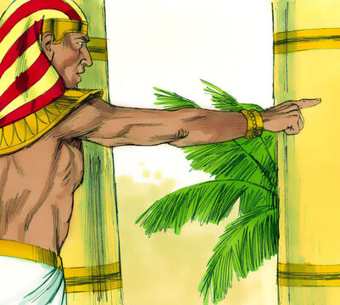
11. How did Joseph accost his brethren?
Genesis 42:7–9
And Joseph knew his brethren, but they knew not him.

Slide 24
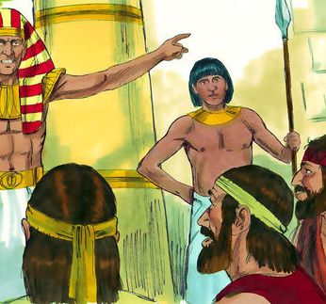
11. How did Joseph accost his brethren?
Genesis 42:7–9
And Joseph remembered the dreams which he dreamed of them, and said unto them, Ye are spies; to see the nakedness of the land ye are come.

Slide 25
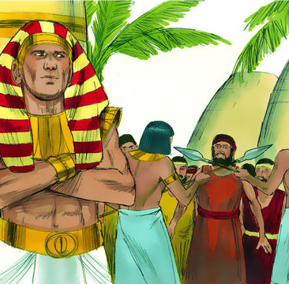
12. What did he do to them?
Genesis 42:17
And he put them all together into ward three days.

Slide 26
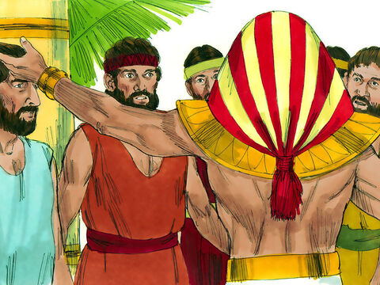
13. Afterward what did he say and do to them?
Genesis 42:18–20
And Joseph said unto them the third day, This do, and live; for I fear God:

Slide 27
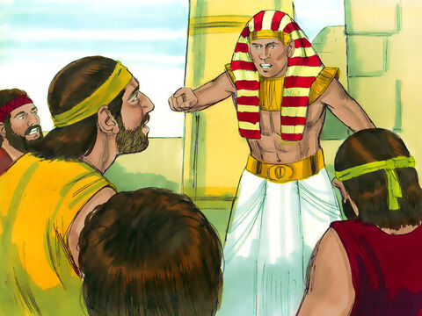
13. Afterward what did he say and do to them?
Genesis 42:18–20
If ye be true men, let one of your brethren be bound in the house of your prison: go ye, carry corn for the famine of your houses:

Slide 28
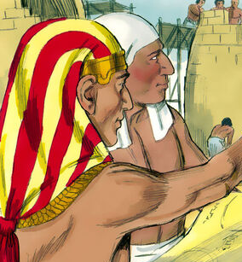
13. Afterward what did he say and do to them?
Genesis 42:18–20
But bring your youngest brother unto me; so shall your words be verified, and ye shall not die. And they did so.

Slide 29
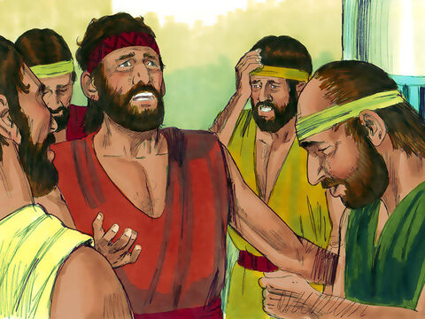
14. What did this treatment cause them to remember?
Genesis 42:21
And they said one to another, We are verily guilty concerning our brother, in that we saw the anguish of his soul, when he besought us, and we would not hear; therefore is this distress come upon us.

Slide 30
15. What did they rightly judge had now come upon them?
Genesis 42:22
And Reuben answered them, saying, Spake I not unto you, saying, Do not sin against the child; and ye would not hear? therefore, behold, also his blood is required.

Slide 31
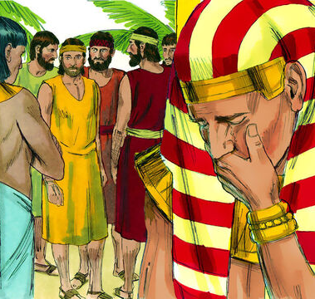
16. How was Joseph affected by this evidence of their remorse for their evil course?
Genesis 42:24
And he turned himself about from them, and wept; and returned to them again, and communed with them, and took from them Simeon, and bound him before their eyes.

Slide 32
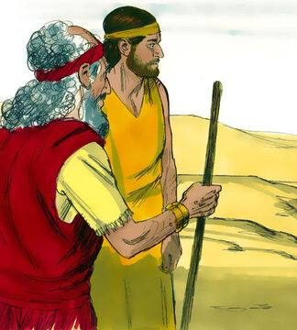
17. When the corn which they took home was eaten up, what conversation took place between Jacob and his sons?
Genesis 43:2–7
And it came to pass, when they had eaten up the corn which they had brought out of Egypt, their father said unto them, Go again, buy us a little food.

Slide 33
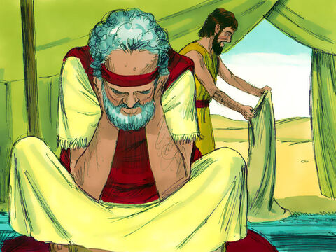
17. When the corn which they took home was eaten up, what conversation took place between Jacob and his sons?
Genesis 43:2–7
And Judah spake unto him, saying, The man did solemnly protest unto us, saying, Ye shall not see my face, except your brother be with you.

Slide 34
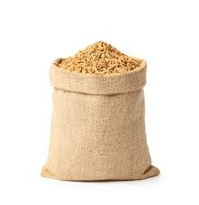
17. When the corn which they took home was eaten up, what conversation took place between Jacob and his sons?
Genesis 43:2–7
If thou wilt send our brother with us, we will go down and buy thee food:

Slide 35
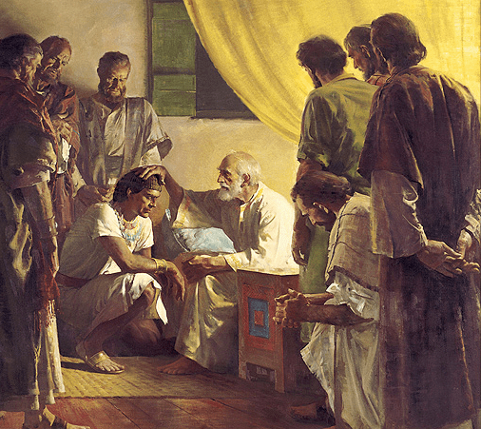
17. When the corn which they took home was eaten up, what conversation took place between Jacob and his sons?
Genesis 43:2–7
But if thou wilt not send him, we will not go down: for the man said unto us, Ye shall not see my face, except your brother be with you.

Slide 36
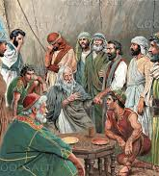
17. When the corn which they took home was eaten up, what conversation took place between Jacob and his sons?
Genesis 43:2–7
And Israel said, Wherefore dealt ye so ill with me, as to tell the man whether ye had yet a brother?

Slide 37
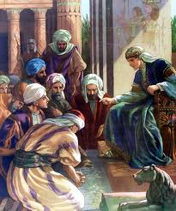
17. When the corn which they took home was eaten up, what conversation took place between Jacob and his sons?
Genesis 43:2–7
And they said, The man asked us straitly of our state, and of our kindred, saying, Is your father yet alive? have ye another brother? and we told him according to the tenor of these words: could we certainly know that he would say, Bring your brother down?

Slide 38
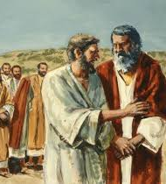
18. What responsibility did Judah take concerning Benjamin?
Genesis 43:8–9
And Judah said unto Israel his father, Send the lad with me, and we will arise and go; that we may live, and not die, both we, and thou, and also our little ones.

Slide 39
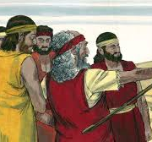
18. What responsibility did Judah take concerning Benjamin?
Genesis 43:8–9
I will be surety for him; of my hand shalt thou require him: if I bring him not unto thee, and set him before thee, then let me bear the blame for ever:

Slide 40
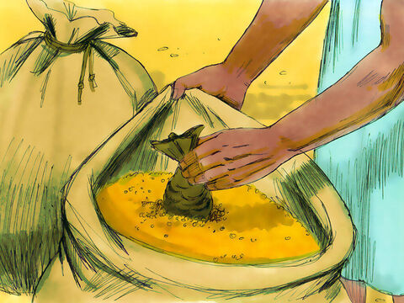
19. When they were about to return home the second time with their corn, what did Joseph do to try them?
Genesis 44:1–5
And he commanded the steward of his house, saying, Fill the men's sacks with food, as much as they can carry, and put every man's money in his sack's mouth.

Slide 41
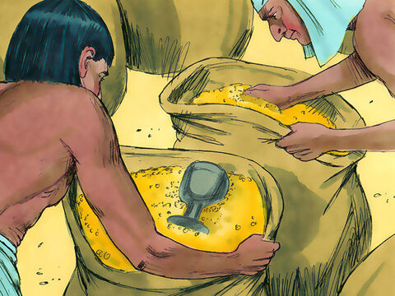
19. When they were about to return home the second time with their corn, what did Joseph do to try them?
Genesis 44:1–5
And put my cup, the silver cup, in the sack's mouth of the youngest, and his corn money. And he did according to the word that Joseph had spoken.

Slide 42
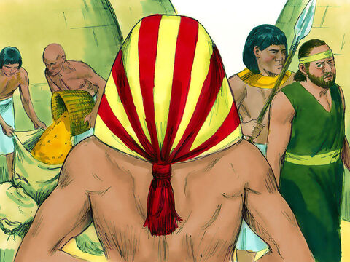
19. When they were about to return home the second time with their corn, what did Joseph do to try them?
Genesis 44:1–5
As soon as the morning was light, the men were sent away, they and their asses.

Slide 43
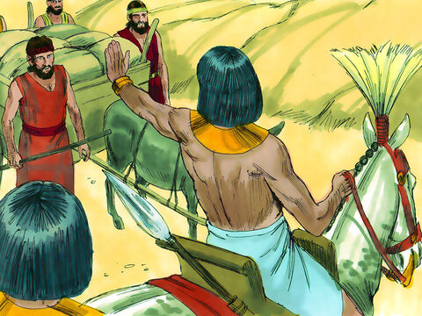
19. When they were about to return home the second time with their corn, what did Joseph do to try them?
Genesis 44:1–5
And when they were gone out of the city, and not yet far off, Joseph said unto his steward, Up, follow after the men; and when thou dost overtake them, say unto them, Wherefore have ye rewarded evil for good?

Slide 44
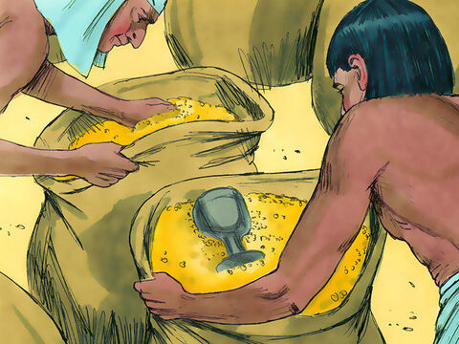
19. When they were about to return home the second time with their corn, what did Joseph do to try them?
Genesis 44:1–5
Is not this it in which my lord drinketh, and whereby indeed he divineth? ye have done evil in so doing.

Slide 45
20. To what did they attribute all these calamities?
Genesis 44:16
And Judah said, What shall we say unto my lord? what shall we speak? or how shall we clear ourselves? God hath found out the iniquity of thy servants: behold, we are my lord's servants, both we, and he also with whom the cup is found.

Slide 46
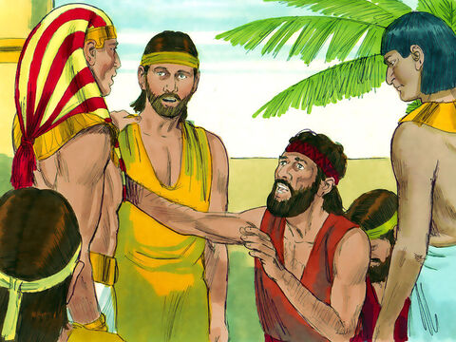
21. When they thought that Benjamin was about to be enslaved, what pathetic plea did Judah make?
Genesis 44:18–34
Then Judah came near unto him, and said, Oh my lord, let thy servant, I pray thee, speak a word in my lord's ears, and let not thine anger burn against thy servant: for thou art even as Pharaoh.

Slide 47
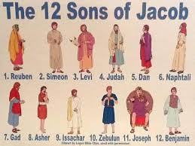
21. When they thought that Benjamin was about to be enslaved, what pathetic plea did Judah make?
Genesis 44:18–34
My lord asked his servants, saying, Have ye a father, or a brother?

Slide 48
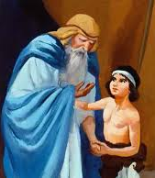
21. When they thought that Benjamin was about to be enslaved, what pathetic plea did Judah make?
Genesis 44:18–34
And we said unto my lord, We have a father, an old man, and a child of his old age, a little one; and his brother is dead, and he alone is left of his mother, and his father loveth him.

Slide 49
21. When they thought that Benjamin was about to be enslaved, what pathetic plea did Judah make?
Genesis 44:18–34
And thou saidst unto thy servants, Bring him down unto me, that I may set mine eyes upon him.

Slide 50
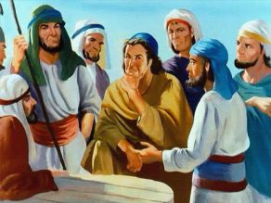
21. When they thought that Benjamin was about to be enslaved, what pathetic plea did Judah make?
Genesis 44:18–34
And we said unto my lord, The lad cannot leave his father: for if he should leave his father, his father would die.

Slide 51
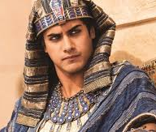
21. When they thought that Benjamin was about to be enslaved, what pathetic plea did Judah make?
Genesis 44:18–34
And thou saidst unto thy servants, Except your youngest brother come down with you, ye shall see my face no more.

Slide 52
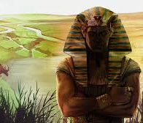
21. When they thought that Benjamin was about to be enslaved, what pathetic plea did Judah make?
Genesis 44:18–34
And it came to pass when we came up unto thy servant my father, we told him the words of my lord.

Slide 53
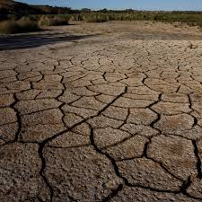
21. When they thought that Benjamin was about to be enslaved, what pathetic plea did Judah make?
Genesis 44:18–34
And our father said, Go again, and buy us a little food.

Slide 54
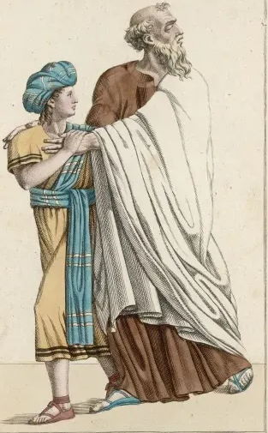
21. When they thought that Benjamin was about to be enslaved, what pathetic plea did Judah make?
Genesis 44:18–34
And we said, We cannot go down: if our youngest brother be with us, then will we go down: for we may not see the man's face, except our youngest brother be with us.

Slide 55
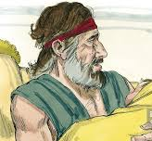
21. When they thought that Benjamin was about to be enslaved, what pathetic plea did Judah make?
Genesis 44:18–34
And thy servant my father said unto us, Ye know that my wife bare me two sons:

Slide 56
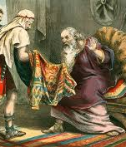
21. When they thought that Benjamin was about to be enslaved, what pathetic plea did Judah make?
Genesis 44:18–34
And the one went out from me, and I said, Surely he is torn in pieces; and I saw him not since:

Slide 57

21. When they thought that Benjamin was about to be enslaved, what pathetic plea did Judah make?
Genesis 44:18–34
And if ye take this also from me, and mischief befall him, ye shall bring down my gray hairs with sorrow to the grave.

Slide 58

21. When they thought that Benjamin was about to be enslaved, what pathetic plea did Judah make?
Genesis 44:18–34
Now therefore when I come to thy servant my father, and the lad be not with us; seeing that his life is bound up in the lad's life;

Slide 59

21. When they thought that Benjamin was about to be enslaved, what pathetic plea did Judah make?
Genesis 44:18–34
It shall come to pass, when he seeth that the lad is not with us, that he will die: and thy servants shall bring down the gray hairs of thy servant our father with sorrow to the grave.

Slide 60

21. When they thought that Benjamin was about to be enslaved, what pathetic plea did Judah make?
Genesis 44:18–34
For thy servant became surety for the lad unto my father, saying, If I bring him not unto thee, then I shall bear the blame to my father for ever.

Slide 61
21. When they thought that Benjamin was about to be enslaved, what pathetic plea did Judah make?
Genesis 44:18–34
Now therefore, I pray thee, let thy servant abide instead of the lad a bondman to my lord; and let the lad go up with his brethren.

Slide 62

21. When they thought that Benjamin was about to be enslaved, what pathetic plea did Judah make?
Genesis 44:18–34
For how shall I go up to my father, and the lad be not with me? lest peradventure I see the evil that shall come on my father.

Slide 63

22. What did Joseph now know?
Answer: He knew that his brethren had thoroughly repented of their past wicked course.

Slide 64

23. What did he say to comfort them?
Genesis 45:4–6
And Joseph said unto his brethren, Come near to me, I pray you. And they came near. And he said, I am Joseph your brother, whom ye sold into Egypt.

Slide 65

23. What did he say to comfort them?
Genesis 45:4–6
Now therefore be not grieved, nor angry with yourselves, that ye sold me hither: for God did send me before you to preserve life.

Slide 66

23. What did he say to comfort them?
Genesis 45:4–6
For these two years hath the famine been in the land: and yet there are five years, in the which there shall neither be earing nor harvest.

Slide 67

24. Who did he say had ordered his being sold into Egypt?
Genesis 45:7–8
And God sent me before you to preserve you a posterity in the earth, and to save your lives by a great deliverance.

Slide 68

24. Who did he say had ordered his being sold into Egypt?
Genesis 45:7–8
So now it was not you that sent me hither, but God: and he hath made me a father to Pharaoh, and lord of all his house, and a ruler throughout all the land of Egypt.

Slide 69

25. What will God always accomplish with the wrath of men?
Psalm 76:10
Surely the wrath of man shall praise thee: the remainder of wrath shalt thou restrain.

Slide 70


Slide 71
Thank you and
HAPPY SABBATH!

