Slide 1


Slide 2

Living the Light

Slide 3
Old Testament History:
The Bondage in Egypt
Lesson 22, 2nd Quarter, 1888

Slide 4
Genesis 15:13-16
¹³ And he said unto Abram, Know of a surety that thy seed shall be a stranger in a land that is not theirs, and shall serve them; and they shall afflict them four hundred years;
¹⁴ And also that nation, whom they shall serve, will I judge: and afterward shall they come out with great substance.
¹⁵ And thou shalt go to thy fathers in peace; thou shalt be buried in a good old age.
¹⁶ But in the fourth generation they shall come hither again: for the iniquity of the Amorites is not yet full.

Slide 5
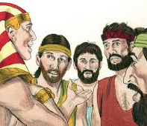
1. When Joseph had made himself known to his brethren, what did he tell them to do?
Genesis 45:9-11
Haste ye, and go up to my father, and say unto him, Thus saith thy son Joseph, God hath made me lord of all Egypt: come down unto me, tarry not:

Slide 6
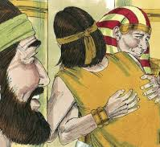
1. When Joseph had made himself known to his brethren, what did he tell them to do?
Genesis 45:9-11
And thou shalt dwell in the land of Goshen, and thou shalt be near unto me, thou, and thy children, and thy children's children, and thy flocks, and thy herds, and all that thou hast:

Slide 7
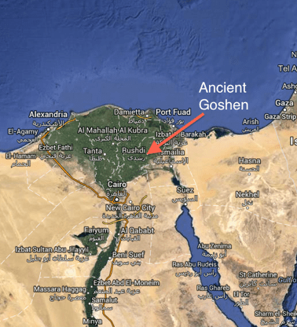
1. When Joseph had made himself known to his brethren, what did he tell them to do?
Genesis 45:9-11
And there will I nourish thee; for yet there are five years of famine; lest thou, and thy household, and all that thou hast, come to poverty.

Slide 8
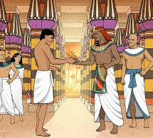
2. What liberal offer did Pharaoh make?
Genesis 45:17-20
And Pharaoh said unto Joseph, Say unto thy brethren, This do ye; lade your beasts, and go, get you unto the land of Canaan;

Slide 9
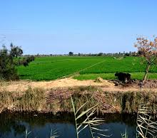
2. What liberal offer did Pharaoh make?
Genesis 45:17-20
And take your father and your households, and come unto me: and I will give you the good of the land of Egypt, and ye shall eat the fat of the land.

Slide 10
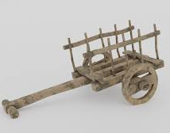
2. What liberal offer did Pharaoh make?
Genesis 45:17-20
Now thou art commanded, this do ye; take you wagons out of the land of Egypt for your little ones, and for your wives, and bring your father, and come.

Slide 11
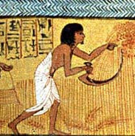
2. What liberal offer did Pharaoh make?
Genesis 45:17-20
Also regard not your stuff; for the good of all the land of Egypt is yours.

Slide 12
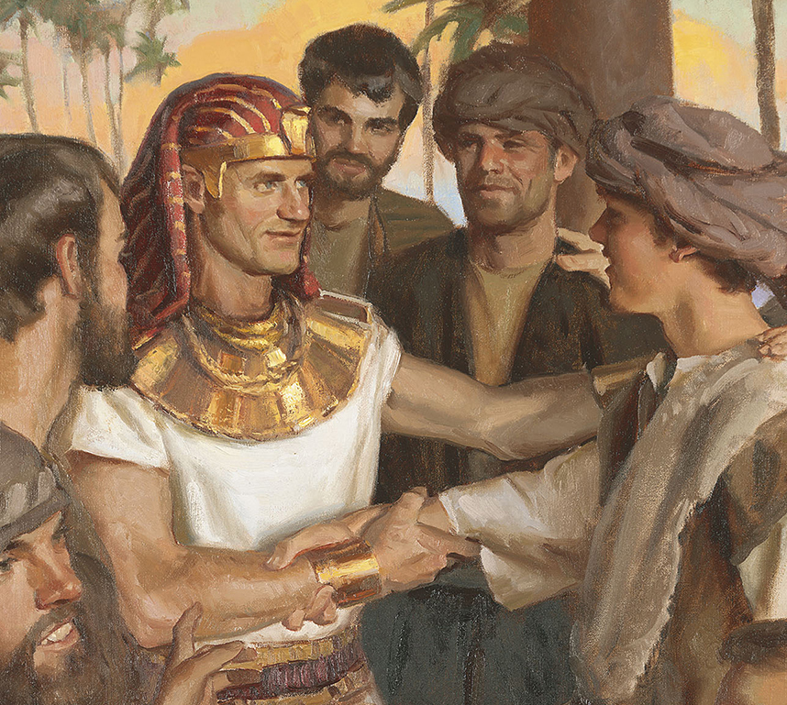
3. What timely caution did Joseph give his brethren?
Genesis 45:24
So he sent his brethren away, and they departed: and he said unto them, See that ye fall not out by the way.

Slide 13
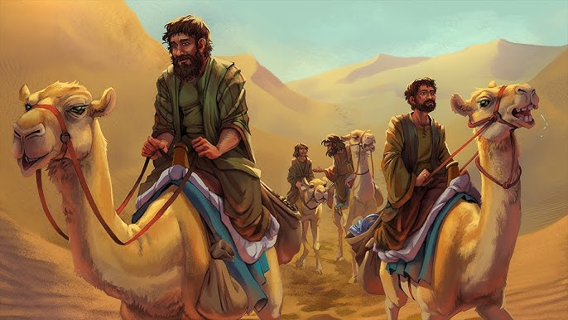
4. How did Jacob feel when his sons returned with this story?
Genesis 45:25-26
And they went up out of Egypt, and came into the land of Canaan unto Jacob their father,

Slide 14
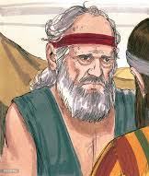
4. How did Jacob feel when his sons returned with this story?
Genesis 45:25-26
And told him, saying, Joseph is yet alive, and he is governor over all the land of Egypt. And Jacob's heart fainted, for he believed them not.

Slide 15
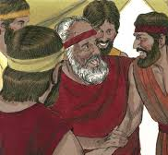
5. What finally induced him to consent to go?
Genesis 45:27-28
And they told him all the words of Joseph, which he had said unto them: and when he saw the wagons which Joseph had sent to carry him, the spirit of Jacob their father revived:

Slide 16
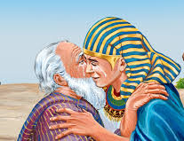
5. What finally induced him to consent to go?
Genesis 45:27-28
And Israel said, It is enough; Joseph my son is yet alive: I will go and see him before I die.

Slide 17
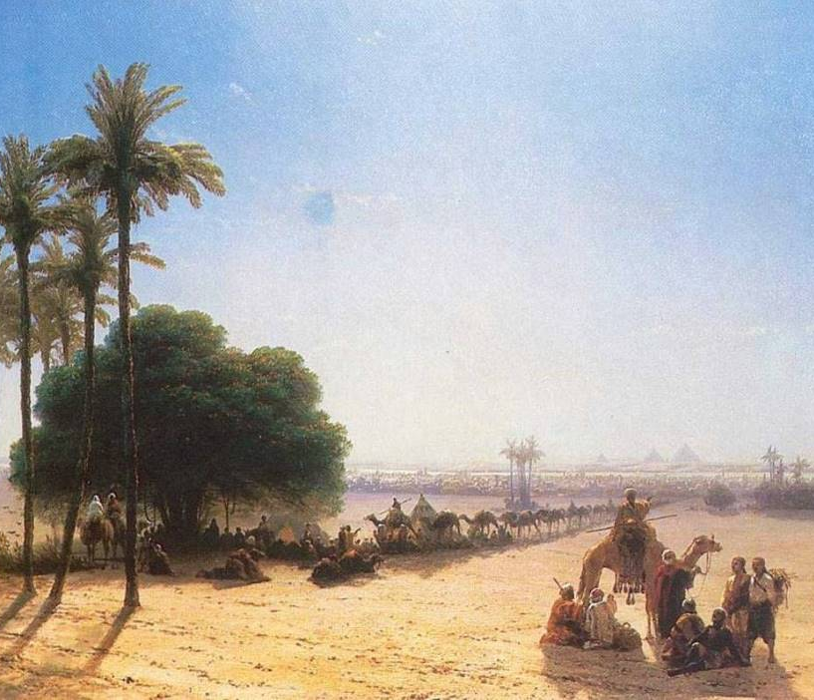
6. When he started, what encouragement did the Lord give him?
Genesis 46:1-4
And Israel took his journey with all that he had, and came to Beersheba, and offered sacrifices unto the God of his father Isaac.

Slide 18
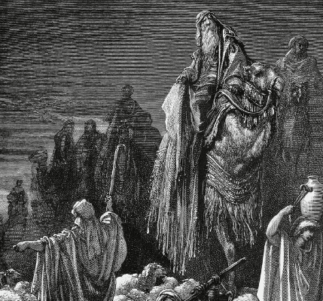
6. When he started, what encouragement did the Lord give him?
Genesis 46:1-4
And God spake unto Israel in the visions of the night, and said, Jacob, Jacob. And he said, Here am I.

Slide 19
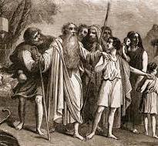
6. When he started, what encouragement did the Lord give him?
Genesis 46:1-4
And he said, I am God, the God of thy father: fear not to go down into Egypt; for I will there make of thee a great nation:

Slide 20
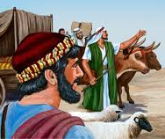
6. When he started, what encouragement did the Lord give him?
Genesis 46:1-4
I will go down with thee into Egypt; and I will also surely bring thee up again: and Joseph shall put his hand upon thine eyes.

Slide 21
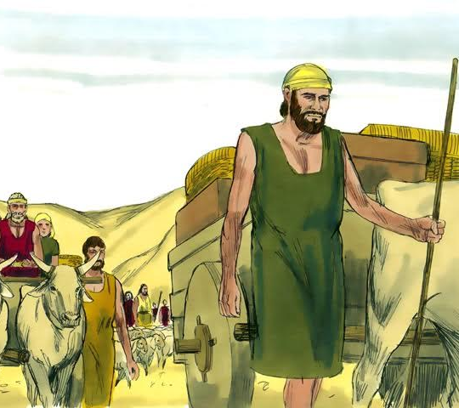
7. How many were there who went down into Egypt?
Acts 7:14
Then sent Joseph, and called his father Jacob to him, and all his kindred, threescore and fifteen souls.

Slide 22
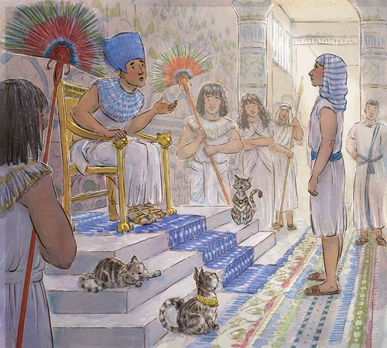
8. How long did they live there in peace?
Genesis 41:46
And Joseph was thirty years old when he stood before Pharaoh king of Egypt. And Joseph went out from the presence of Pharaoh, and went throughout all the land of Egypt.

Slide 23
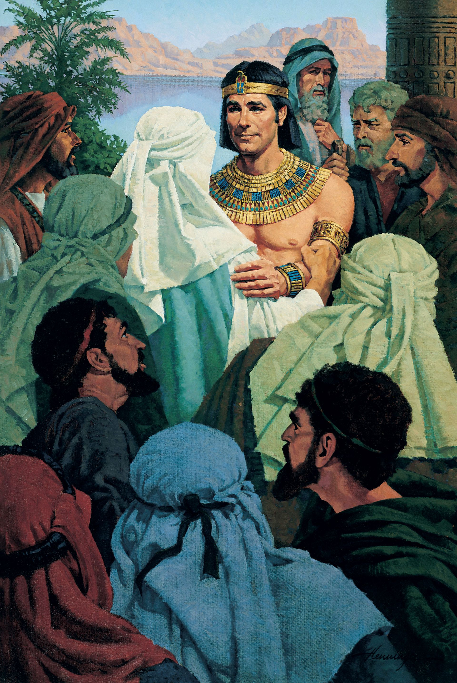
8. How long did they live there in peace?
Genesis 45:11
And there will I nourish thee; for yet there are five years of famine; lest thou, and thy household, and all that thou hast, come to poverty.

Slide 24
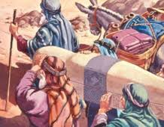
8. How long did they live there in peace?
Genesis 50:26
So Joseph died, being an hundred and ten years old: and they embalmed him, and he was put in a coffin in Egypt.

Slide 25
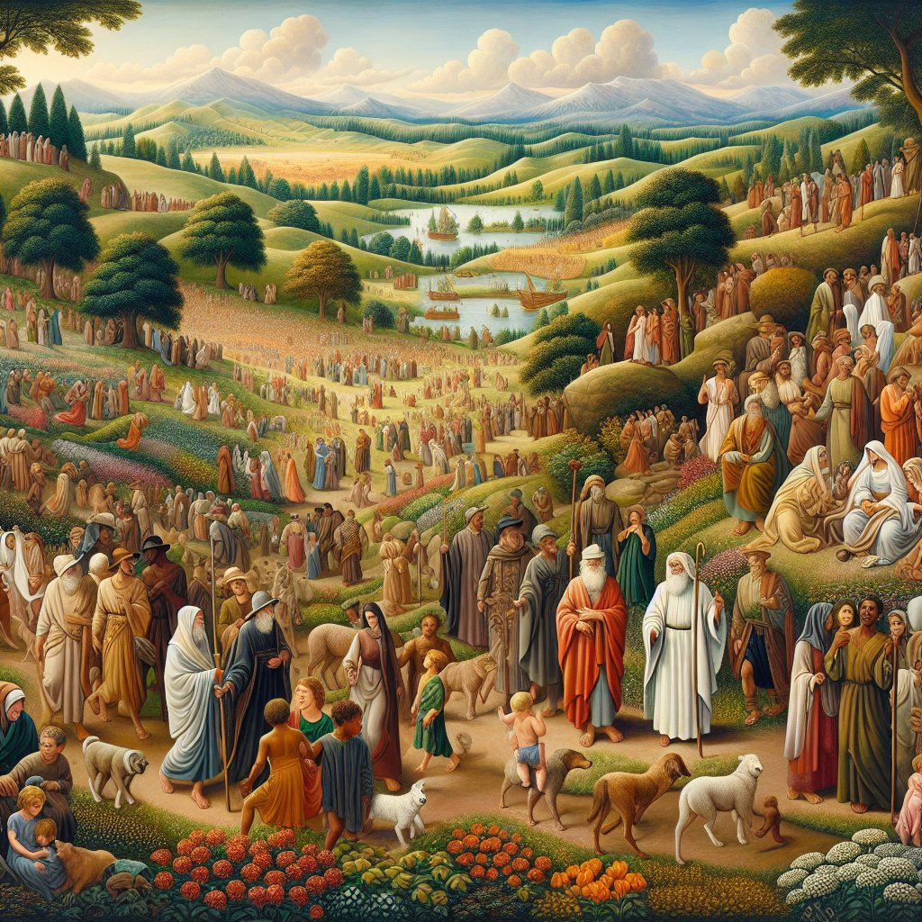
9. How did the children of Israel prosper in Egypt?
Exodus 1:7
And the children of Israel were fruitful, and increased abundantly, and multiplied, and waxed exceeding mighty; and the land was filled with them.

Slide 26
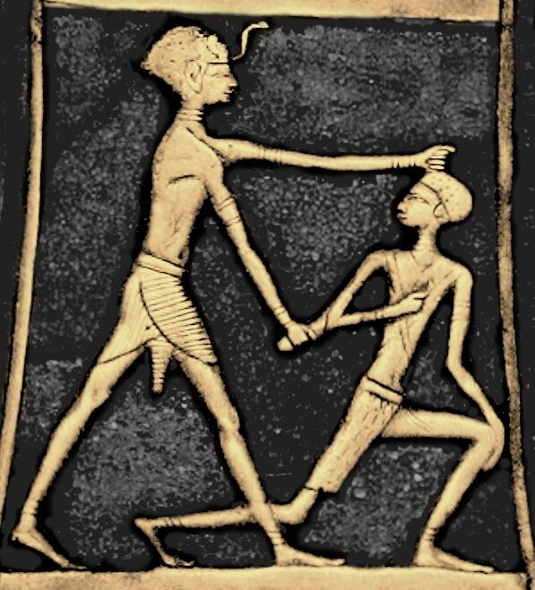
10. What took place some time after Joseph’s death?
Exodus 1:8
Now there arose up a new king over Egypt, which knew not Joseph.

Slide 27
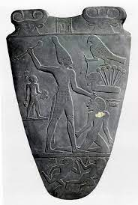
11. What did this king say to his people?
Exodus 1:9-10
And he said unto his people, Behold, the people of the children of Israel are more and mightier than we:

Slide 28
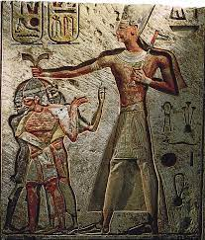
11. What did this king say to his people?
Exodus 1:9-10
Come on, let us deal wisely with them; lest they multiply, and it come to pass, that, when there falleth out any war, they join also unto our enemies, and fight against us, and so get them up out of the land.

Slide 29
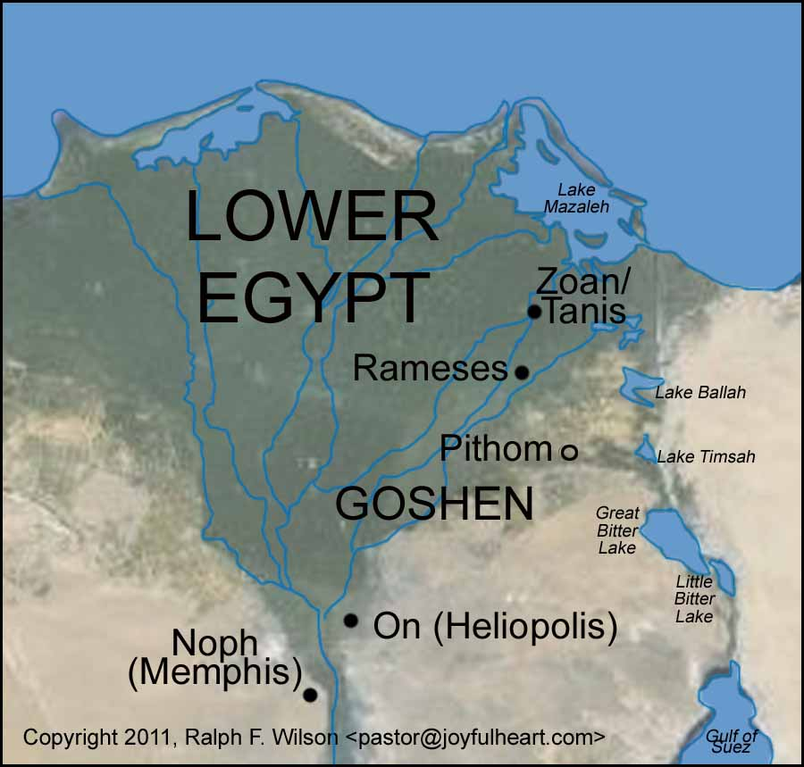
12. What did they do to the Israelites?
Exodus 1:11
Therefore they did set over them taskmasters to afflict them with their burdens. And they built for Pharaoh treasure cities, Pithom and Raamses.

Slide 30
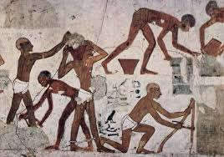
13. How did this affect them?
Exodus 1:12
But the more they afflicted them, the more they multiplied and grew. And they were grieved because of the children of Israel.

Slide 31
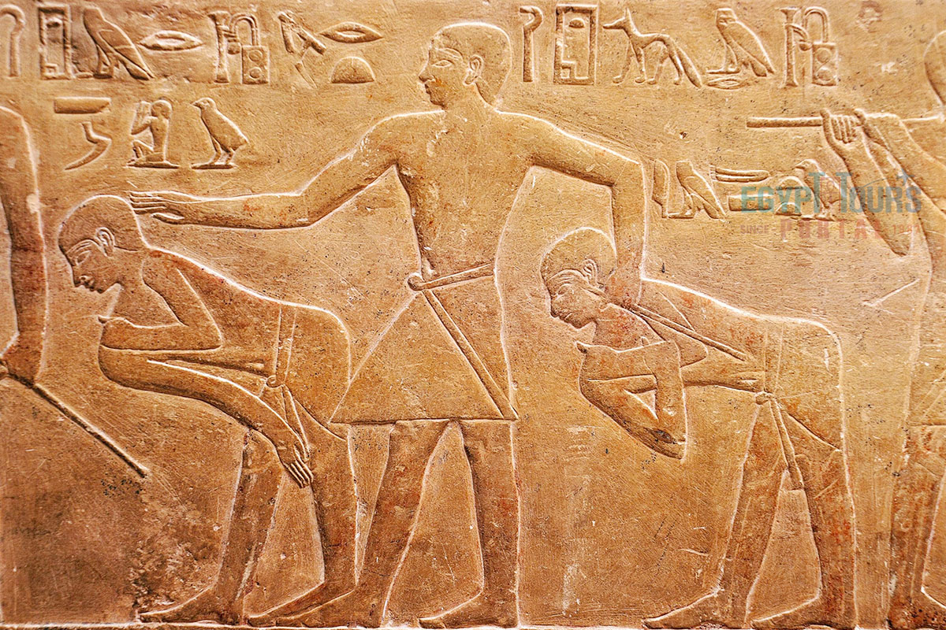
14. What did the children of Israel have to suffer at the hands of the Egyptians?
Exodus 1:13-14
And the Egyptians made the children of Israel to serve with rigor:

Slide 32
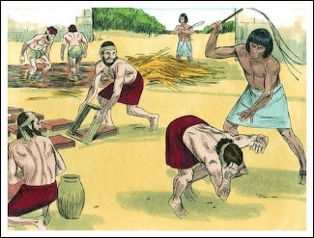
14. What did the children of Israel have to suffer at the hands of the Egyptians?
Exodus 1:13-14
And they made their lives bitter with hard bondage, in mortar, and in brick, and in all manner of service in the field: all their service, wherein they made them serve, was with rigor.

Slide 33
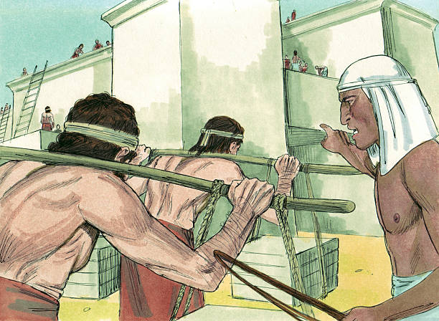
15. Of what prophecy was this a fulfillment?
Genesis 15:13
And he said unto Abram, Know of a surety that thy seed shall be a stranger in a land that is not theirs, and shall serve them; and they shall afflict them four hundred years;

Slide 34
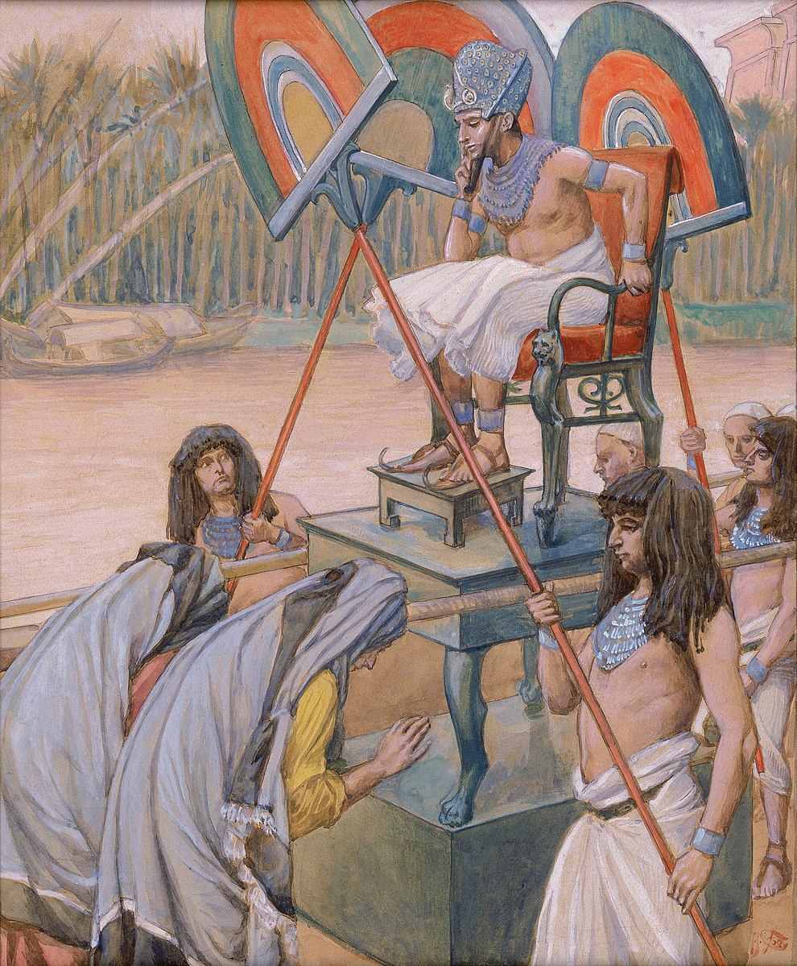
16. What cruel order did the king of Egypt make?
Exodus 1:22
And Pharaoh charged all his people, saying, Every son that is born ye shall cast into the river, and every daughter ye shall save alive.

Slide 35
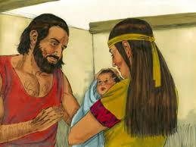
17. Relate the story of one child who was saved from the king’s decree.
Exodus 2:1-10
And there went a man of the house of Levi, and took to wife a daughter of Levi.

Slide 36
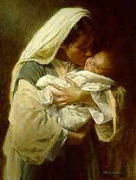
17. Relate the story of one child who was saved from the king’s decree.
Exodus 2:1-10
And the woman conceived, and bare a son: and when she saw him that he was a goodly child, she hid him three months.

Slide 37
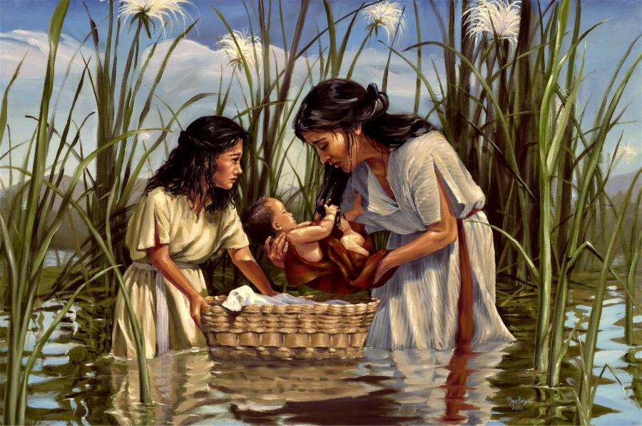
17. Relate the story of one child who was saved from the king’s decree.
Exodus 2:1-10
And when she could not longer hide him, she took for him an ark of bulrushes, and daubed it with slime and with pitch, and put the child therein; and she laid it in the flags by the river's brink.

Slide 38
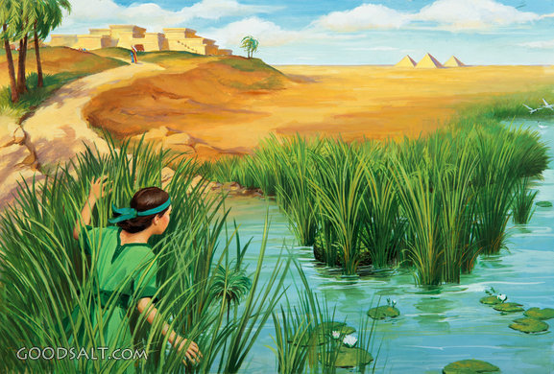
17. Relate the story of one child who was saved from the king’s decree.
Exodus 2:1-10
And his sister stood afar off, to wit what would be done to him.

Slide 39
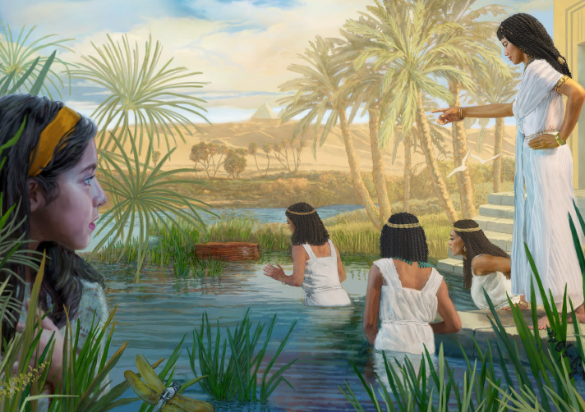
17. Relate the story of one child who was saved from the king’s decree.
Exodus 2:1-10
And the daughter of Pharaoh came down to wash herself at the river; and her maidens walked along by the river's side; and when she saw the ark among the flags, she sent her maid to fetch it.

Slide 40
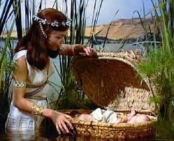
17. Relate the story of one child who was saved from the king’s decree.
Exodus 2:1-10
And when she had opened it, she saw the child: and, behold, the babe wept. And she had compassion on him, and said, This is one of the Hebrews' children.

Slide 41
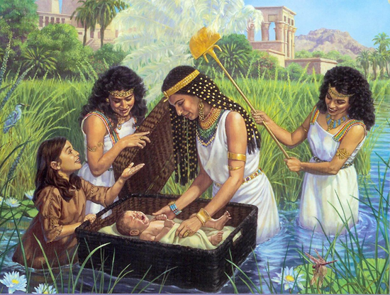
17. Relate the story of one child who was saved from the king’s decree.
Exodus 2:1-10
Then said his sister to Pharaoh's daughter, Shall I go and call to thee a nurse of the Hebrew women, that she may nurse the child for thee?

Slide 42
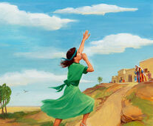
17. Relate the story of one child who was saved from the king’s decree.
Exodus 2:1-10
And Pharaoh's daughter said to her, Go. And the maid went and called the child's mother.

Slide 43
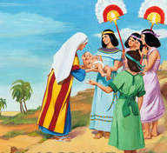
17. Relate the story of one child who was saved from the king’s decree.
Exodus 2:1-10
And Pharaoh's daughter said unto her, Take this child away, and nurse it for me, and I will give thee thy wages. And the women took the child, and nursed it.

Slide 44
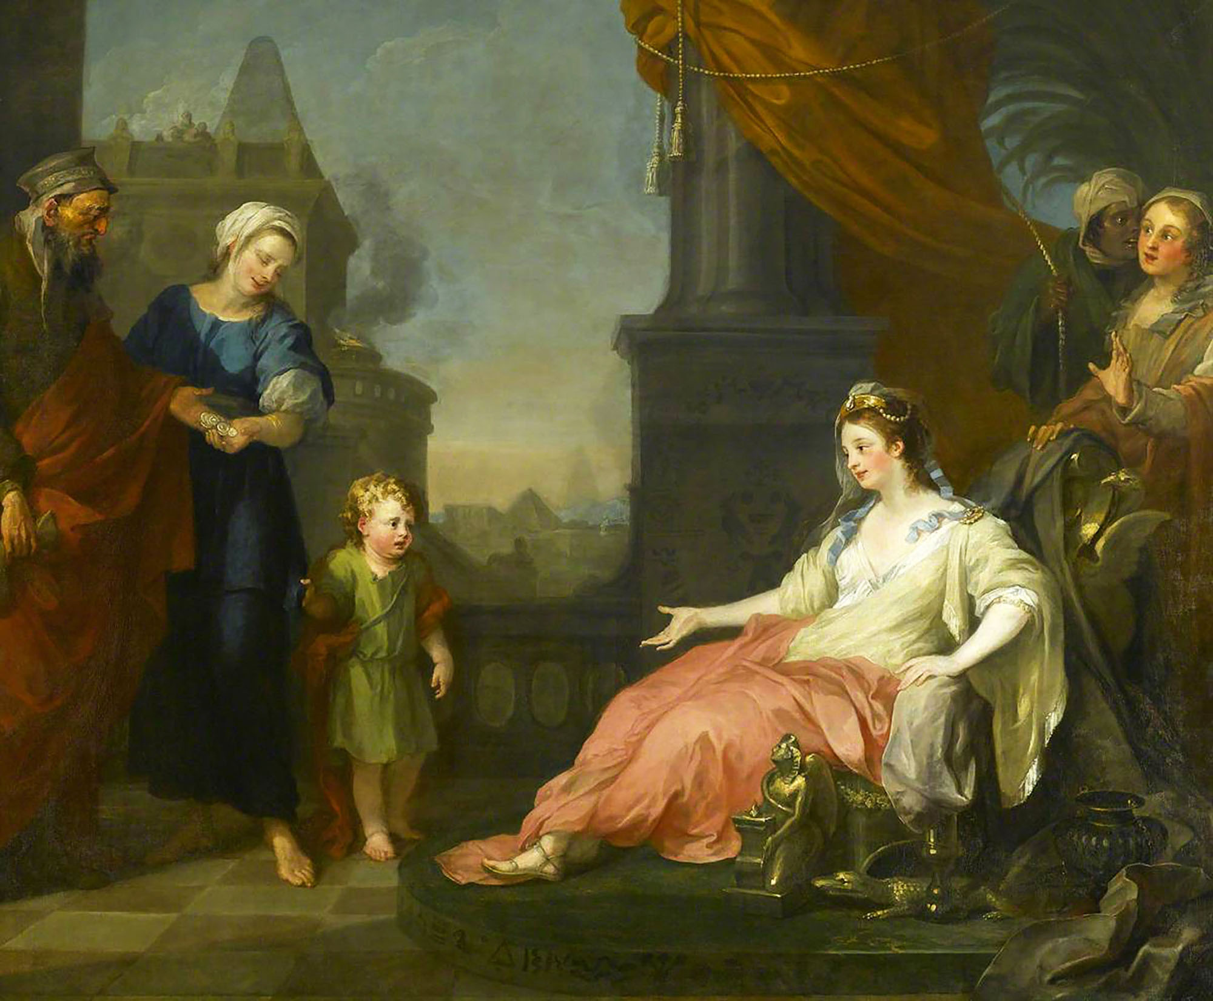
17. Relate the story of one child who was saved from the king’s decree.
Exodus 2:1-10
And the child grew, and she brought him unto Pharaoh's daughter, and he became her son. And she called his name Moses: and she said, Because I drew him out of the water.

Slide 45
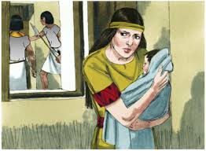
18. What led the parents of Moses to do as they did?
Hebrews 11:23
By faith Moses, when he was born, was hid three months of his parents, because they saw he was a proper child; and they were not afraid of the king's commandment.

Slide 46


Slide 47
Thank you and
HAPPY SABBATH!

