Slide 1


Slide 2

Living the Light

Slide 3
Old Testament History:
Moses and His Work
Lesson 23, 2nd Quarter, 1888

Slide 4
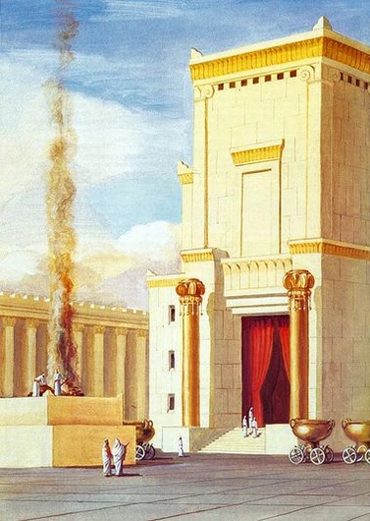
A Note on Bible Chronology
1 Kings 6:1
And it came to pass in the four hundred and eightieth year after the children of Israel were come out of the land of Egypt, in the fourth year of Solomon's reign over Israel, in the month Zif, which is the second month, that he began to build the house of the Lord.

Slide 5
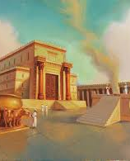
A Note on Bible Chronology
Solomon’s reign is widely recognized to date to the middle part of the 10th century b.c. More specifically, many scholars identify the construction of Solomon’s temple as beginning in 967 b.c.

Slide 6
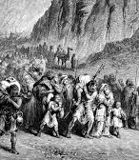
A Note on Bible Chronology
So calculating the date of the Exodus is simple arithmetic: 480 years prior to the early-to-mid-10th century b.c. puts the Exodus somewhere in the mid-15th century b.c. Using the date of 967, the Exodus is dated to 1446 b.c.

Slide 7
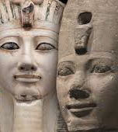
Moses: Born into a Hyksos-Haunted Egypt?
The Thutmosid Dynasty, the 18th, is thought to have ruled Egypt during the first part of the New Kingdom, after the Hyksos dominance ended in the mid-16th century, until about 1300 BC.

Slide 8
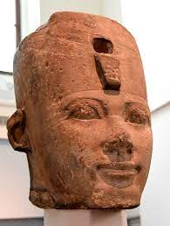
Moses: Born into a Hyksos-Haunted Egypt?
Thutmose I (1525–1508 B.C.): a powerful builder whose projects match the rising oppression of Exodus 1.

Slide 9
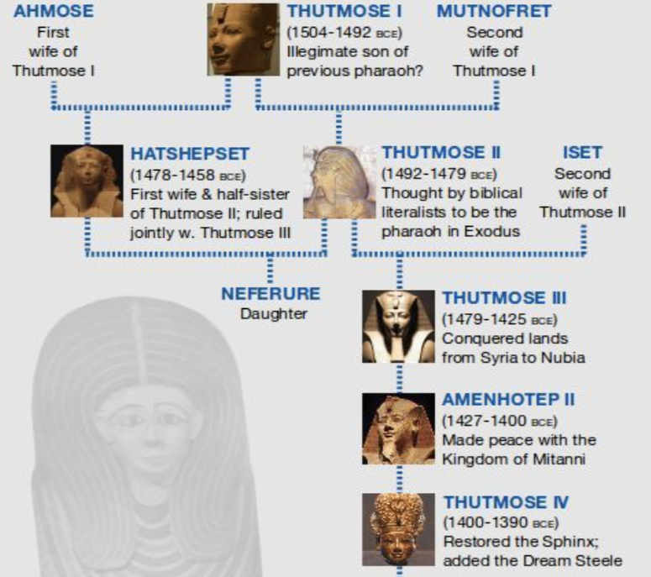

Slide 10
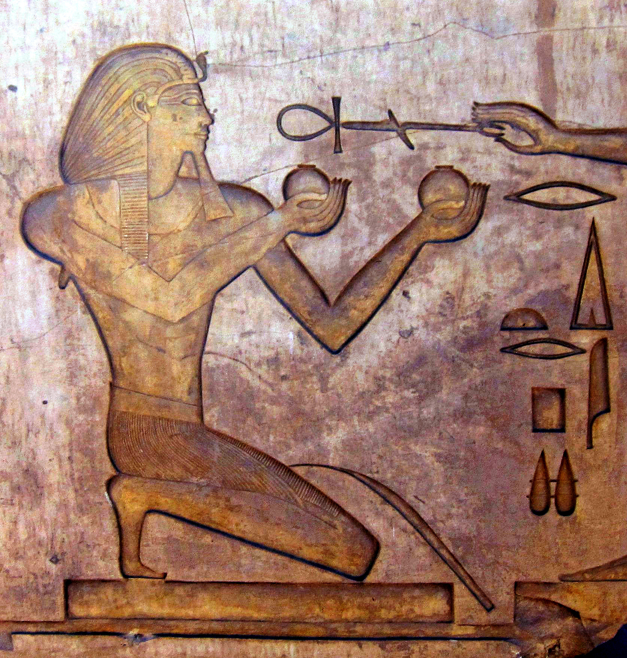
Egypt is hyper-defensive and genocidal toward Semitic males
Thutmose II (1508–1504 B.C.): a brief reign marked by androcidal decrees, aligning with Exodus 1:22.
Aswan inscription: “I will not leave a male alive.”

Slide 11
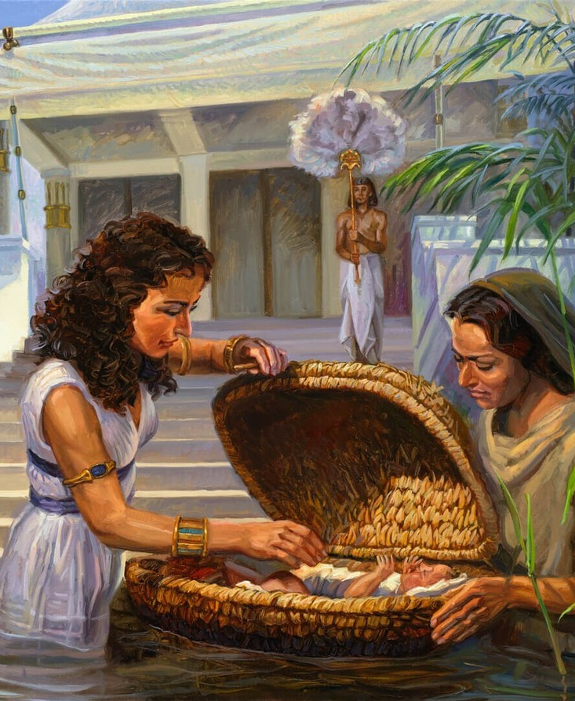
1. Who claimed Moses as her son?
Exodus 2:10
And the child grew, and she brought him unto Pharaoh's daughter, and he became her son. And she called his name Moses: and she said, Because I drew him out of the water.

Slide 12
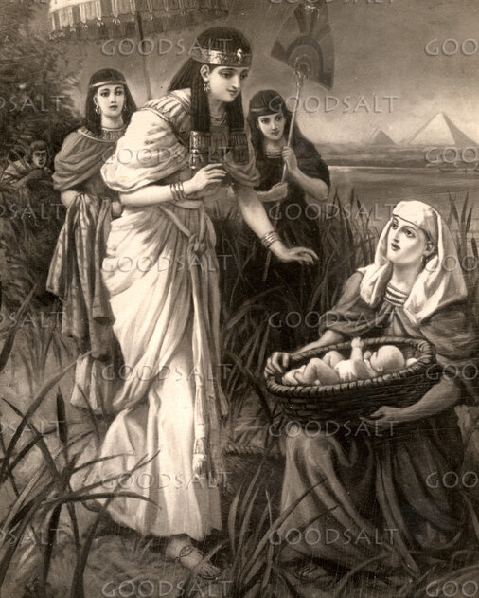
2. What advantages did this give him?
Acts 7:21-22
And when he was cast out, Pharaoh's daughter took him up, and nourished him for her own son.

Slide 13
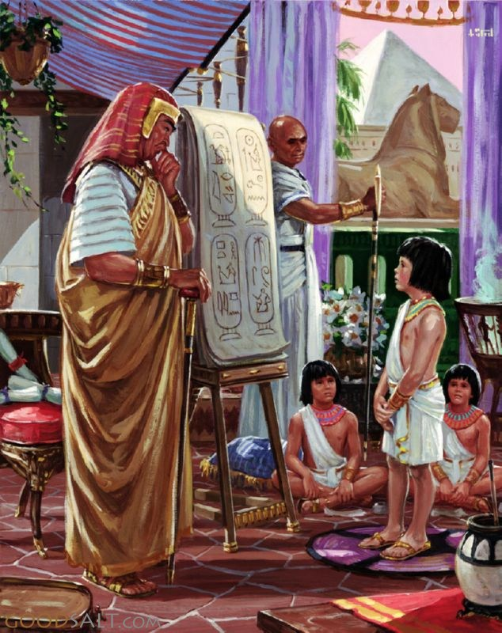
2. What advantages did this give him?
Acts 7:21-22
And Moses was learned in all the wisdom of the Egyptians, and was mighty in words and in deeds.

Slide 14
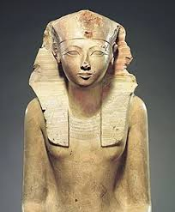
Moses grows up within the Thutmosid royal house… Hatshepsut’s son?
Hatshepsut was
Uniquely powerful—one of Egypt’s strongest female rulers.
Continued calling herself “daughter of the Pharaoh” long after his death.

Slide 15
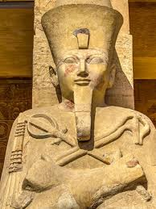
Moses grows up within the Thutmosid royal house… Hatshepsut’s son?
Hatshepsut was
Known for compassionate governance, unusual among pharaohs.
Recognized for expressing affection for “foreign peoples.”

Slide 16
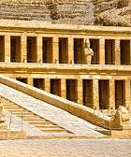
Moses grows up within the Thutmosid royal house… Hatshepsut’s son?
Hatshepsut was
Later erased from Egyptian history—many details of her reign and history removed. Evidence of wrath at her show of favor for Moses?

Slide 17
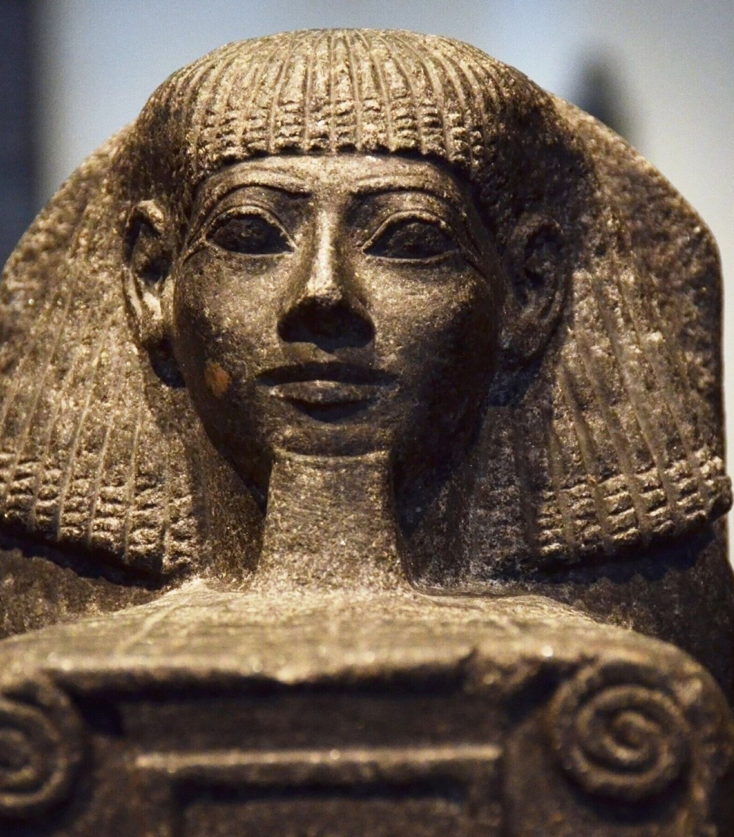
Moses grows up within the Thutmosid royal house… Hatshepsut’s son?
Hatshepsut never had sons. But one Egyptian inscription describes a ‘commoner’ who rose mysteriously to princely rank under Hatshepsut, then vanished from the record. Some see this as archaeological ‘silhouette’ of Moses.

Slide 18
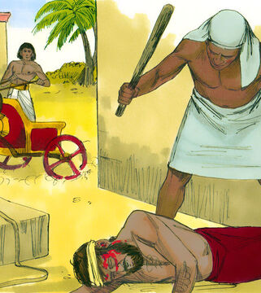
3. What happened one day when he was grown?
Exodus 2:11-12
And it came to pass in those days, when Moses was grown, that he went out unto his brethren, and looked on their burdens: and he spied an Egyptian smiting an Hebrew, one of his brethren.

Slide 19
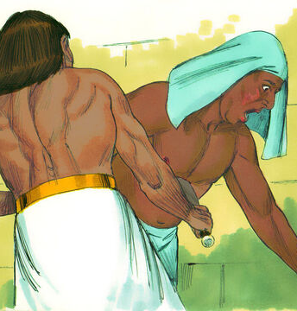
3. What happened one day when he was grown?
Exodus 2:11-12
And he looked this way and that way, and when he saw that there was no man, he slew the Egyptian, and hid him in the sand.

Slide 20
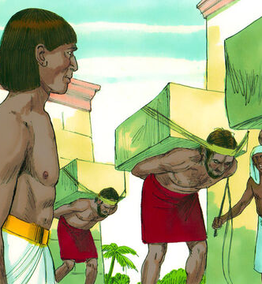
4. How old was he when this happened?
Acts 7:23-24
And when he was full forty years old, it came into his heart to visit his brethren the children of Israel.

Slide 21
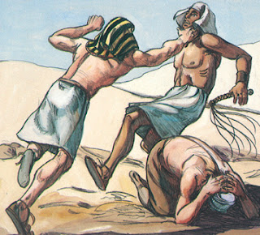
4. How old was he when this happened?
Acts 7:23-24
And seeing one of them suffer wrong, he defended him, and avenged him that was oppressed, and smote the Egyptian:

Slide 22
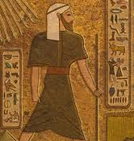
5. Why did he do this?
Acts 7:25
For he supposed his brethren would have understood how that God by his hand would deliver them: but they understood not.

Slide 23
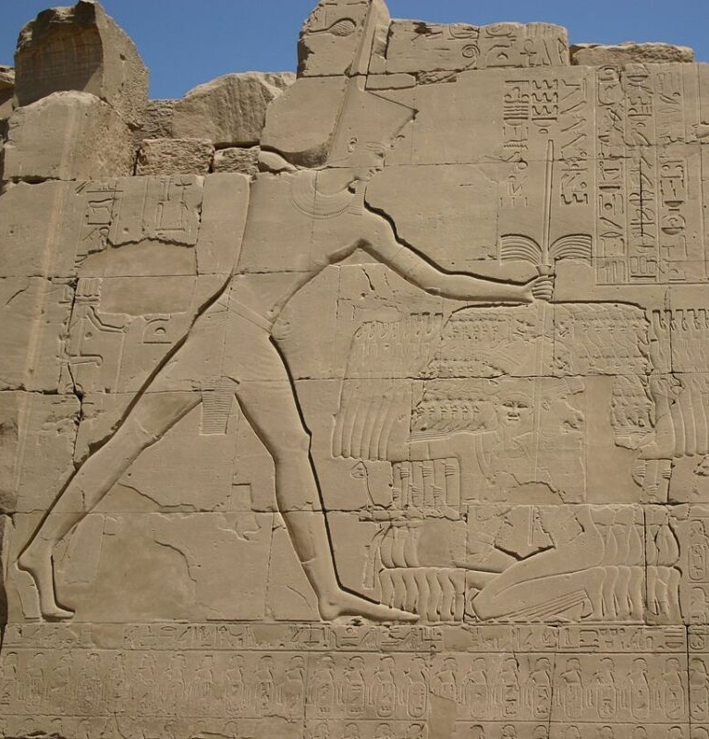
6. What is indicated by this verse?
Answer: That Moses had in some way learned that God would make use of him to deliver the children of Israel; and he supposed that they would understand it also.

Slide 24
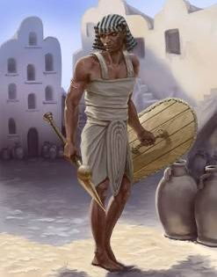
7. Did they understand it?
No.
Not at all.

Slide 25
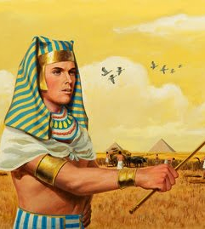
8. What shows that they did not?
Acts 7:25-28
For he supposed his brethren would have understood how that God by his hand would deliver them: but they understood not.

Slide 26
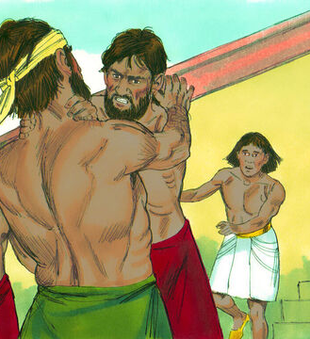
8. What shows that they did not?
Acts 7:25-28
And the next day he shewed himself unto them as they strove, and would have set them at one again, saying, Sirs, ye are brethren; why do ye wrong one to another?

Slide 27
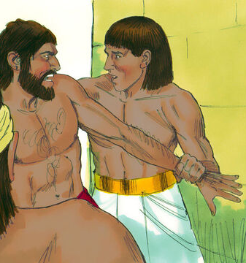
8. What shows that they did not?
Acts 7:25-28
But he that did his neighbour wrong thrust him away, saying, Who made thee a ruler and a judge over us?

Slide 28
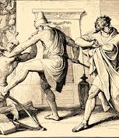
8. What shows that they did not?
Acts 7:25-28
Wilt thou kill me, as thou diddest the Egyptian yesterday?

Slide 29
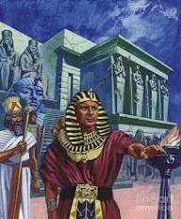
9. By this attempted deliverance of Israel, what stand did Moses take?
Answer: He identified himself with Israel.
Hebrews 11:24
By faith Moses, when he was come to years, refused to be called the son of Pharaoh's daughter;

Slide 30
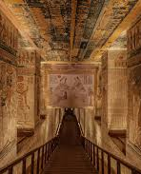
A Political Statement
Under the Thutmosid pharaohs—whose power rested on massive building projects and forced labor—Moses’ defense of a Hebrew was a direct challenge to the state that relied on Israelite oppression.

Slide 31

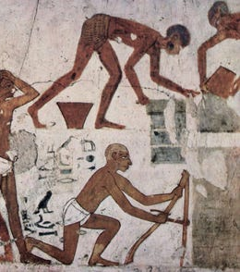
10. What choice did he make?
Hebrews 11:25
Choosing rather to suffer affliction with the people of God, than to enjoy the pleasures of sin for a season;

Slide 32
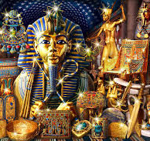
11. What did he value more highly than the wealth of Egypt?
Hebrews 11:26
Esteeming the reproach of Christ greater riches than the treasures in Egypt: for he had respect unto the recompence of the reward.

Slide 33
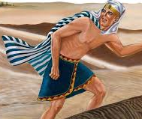
12. When Moses found that even his own people would not acknowledge him as a deliverer, what did he do?
Exodus 2:15
Now when Pharaoh heard this thing, he sought to slay Moses. But Moses fled from the face of Pharaoh, and dwelt in the land of Midian: and he sat down by a well.

Slide 34
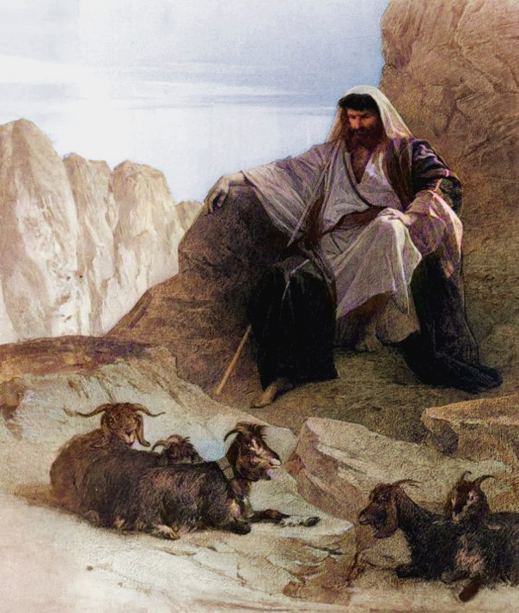
12. When Moses found that even his own people would not acknowledge him as a deliverer, what did he do?
Acts 7:29
Then fled Moses at this saying, and was a stranger in the land of Midian, where he begat two sons.

Slide 35
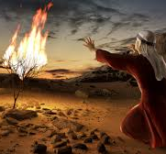
13. How long did he remain there?
Acts 7:30
And when forty years were expired, there appeared to him in the wilderness of mount Sina an angel of the Lord in a flame of fire in a bush.

Slide 37
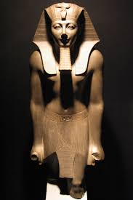
Moses’ 40-Year Exile Does Fit Under Thutmose III
Thutmose III
Had one of the longest in Egyptian history (almost 54 years).
Would have outlived those who sought Moses’ life (Ex. 4:19).
Egypt’s greatest military pharaoh—worth avoiding!

Slide 38
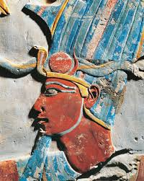
Moses’ 40-Year Exile Does Fit Under Thutmose III
The phrase ‘after many days the king of Egypt died’ (Ex. 2:23) aligns very well with the monumental 54-year reign of Thutmose III — the only pharaoh long-lived enough to match Moses’ exile.

Slide 39
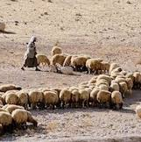
14. What did he do all these years?
Exodus 3:1
Now Moses kept the flock of Jethro his father in law, the priest of Midian:

Slide 40
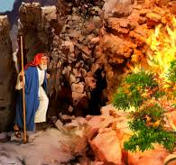
15. At the expiration of forty years, what took place?
Acts 7:30
And when forty years were expired, there appeared to him in the wilderness of mount Sina an angel of the Lord in a flame of fire in a bush.

Slide 41
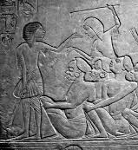
16. What did the Lord then propose to do with Moses?
Acts 7:34
I have seen, I have seen the affliction of my people which is in Egypt, and I have heard their groaning, and am come down to deliver them. And now come, I will send thee into Egypt.

Slide 43
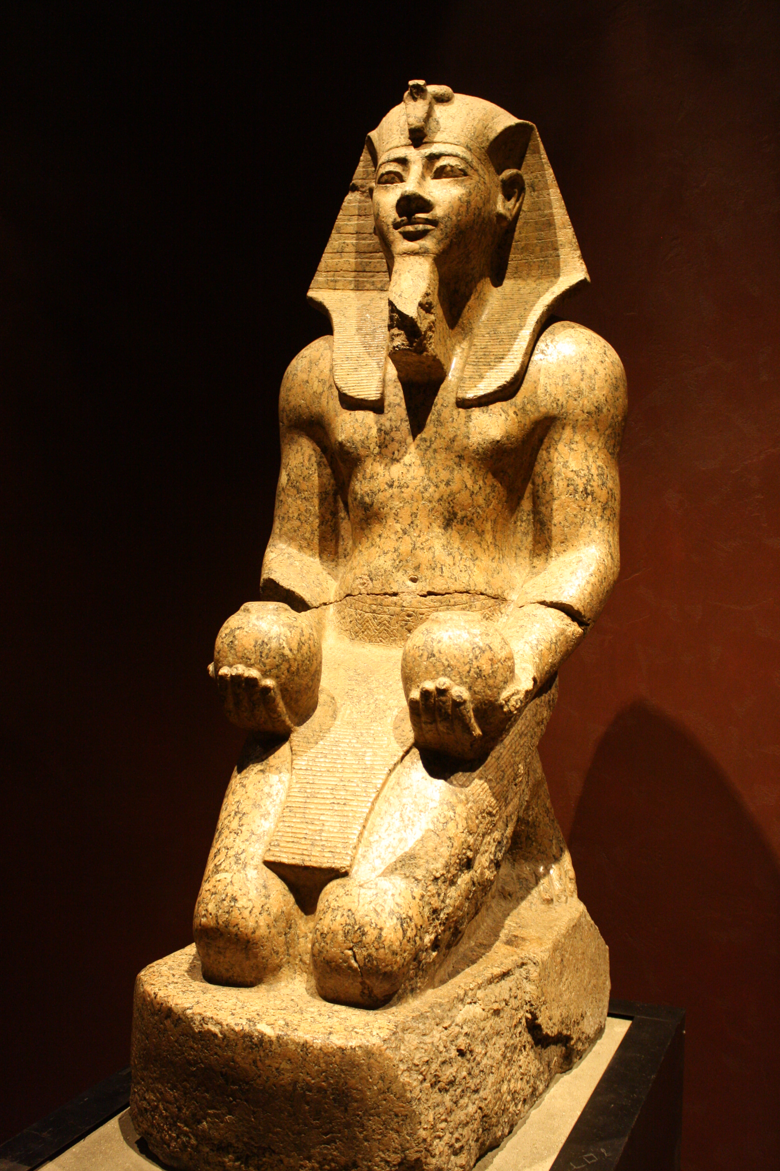
Evidence for Amenhotep II as Pharaoh of the Exodus
His firstborn son died early → matches plague of the firstborn
Amenhotep II was NOT himself a firstborn → His elder brother Amenemhat died before their father, Thutmose III
Ruled with exceptional cruelty → fits “hardened heart” pattern

Slide 44
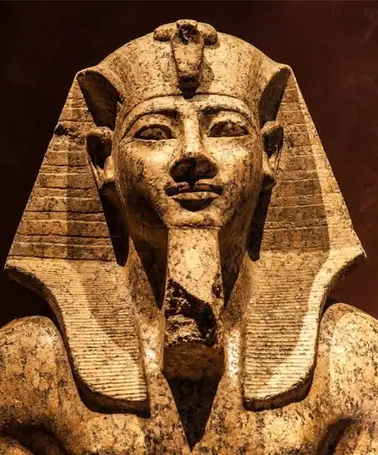
Evidence for Amenhotep II as Pharaoh of the Exodus
Amenhotep II was obsessed with magicians and foreigners. Amenhotep II left an inscription at Semna, recorded by his viceroy Usersatet, where he warned about the influence of foreigners and even their magicians — a revealing detail in light of the Exodus story.

Slide 45
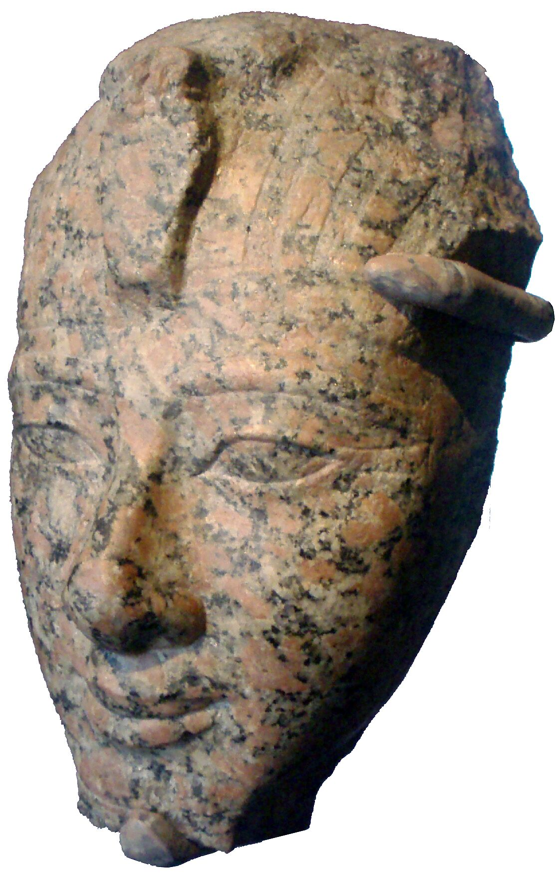
Evidence for Amenhotep II as Pharaoh of the Exodus
Monument-building halts mid-life → consistent with national catastrophe
Dies younger than expected, possibly after plague-related illness (his mummy marked by “unusual tubercles”)
Years 10–26 of his reign go strangely “silent” → consistent with a devastated Egypt
City of Avaris abandoned during his reign → matches Exodus departure

Slide 46
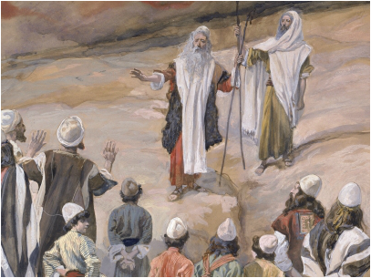
17. Did the Israelites believe in the mission of Moses this time?
Exodus 4:29-31
And Moses and Aaron went and gathered together all the elders of the children of Israel:

Slide 47
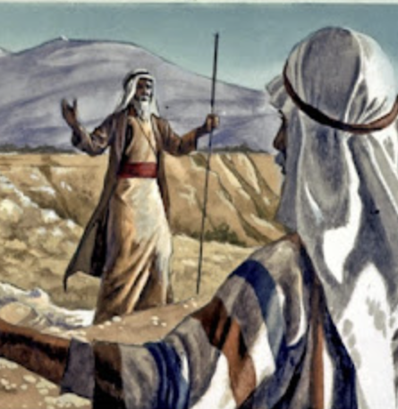
17. Did the Israelites believe in the mission of Moses this time?
Exodus 4:29-31
And Aaron spake all the words which the Lord had spoken unto Moses, and did the signs in the sight of the people.

Slide 48
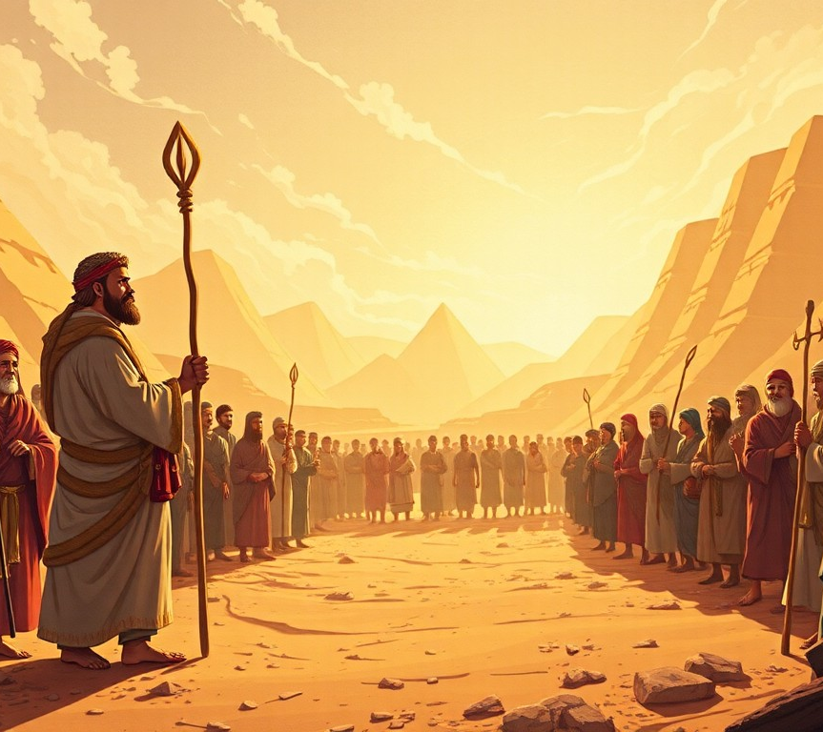
17. Did the Israelites believe in the mission of Moses this time?
Exodus 4:29-31
And the people believed: and when they heard that the Lord had visited the children of Israel, and that he had looked upon their affliction, then they bowed their heads and worshipped.

Slide 49

18. What must have been the reason that they did not accept him before?
Answer: Because although he had been appointed to do the work, he did not go in the Lord’s way nor the Lord’s time; he had only his own credentials.

Slide 50


Slide 51
Thank you and
HAPPY SABBATH!

