Slide 1


Slide 2

Living the Light

Slide 3
Old Testament History:
Moses Sent to Egypt
Lesson 24, 2nd Quarter, 1888

Slide 4
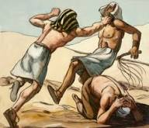
1. When Moses went out the first time to deliver Israel, by slaying the Egyptian, what did he manifest?
Answer: Pride and self-sufficiency.

Slide 5
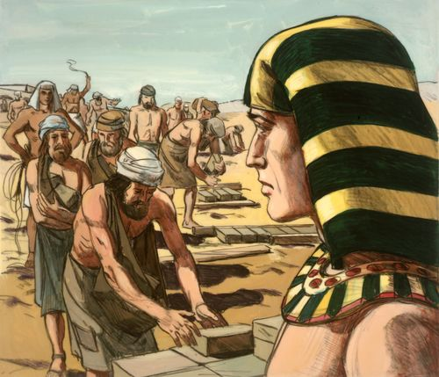
2. What must we conclude was his idea of the way deliverance would come?
Answer: That the people would rally around him, and that under his military guidance they would fight their way out of bondage.

Slide 6
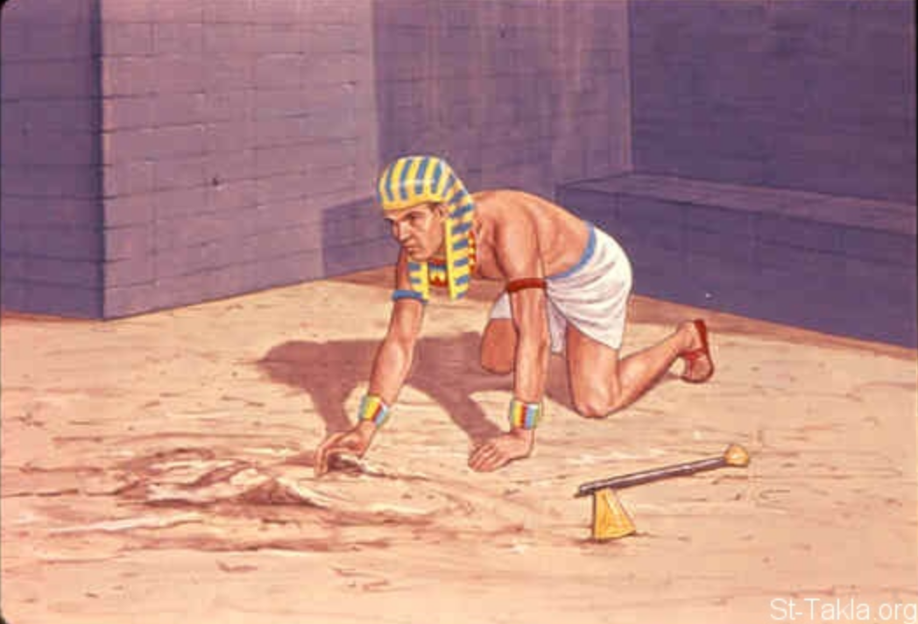
3. In that case who alone would have received the glory?
Moses

Slide 7
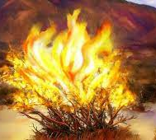
4. What was God’s design?
Exodus 14:17-18
And I, behold, I will harden the hearts of the Egyptians, and they shall follow them: and I will get me honour upon Pharaoh, and upon all his host, upon his chariots, and upon his horsemen.

Slide 8
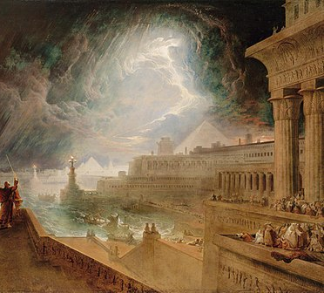
4. What was God’s design?
Exodus 14:17-18
And the Egyptians shall know that I am the Lord, when I have gotten me honour upon Pharaoh, upon his chariots, and upon his horsemen.

Slide 9
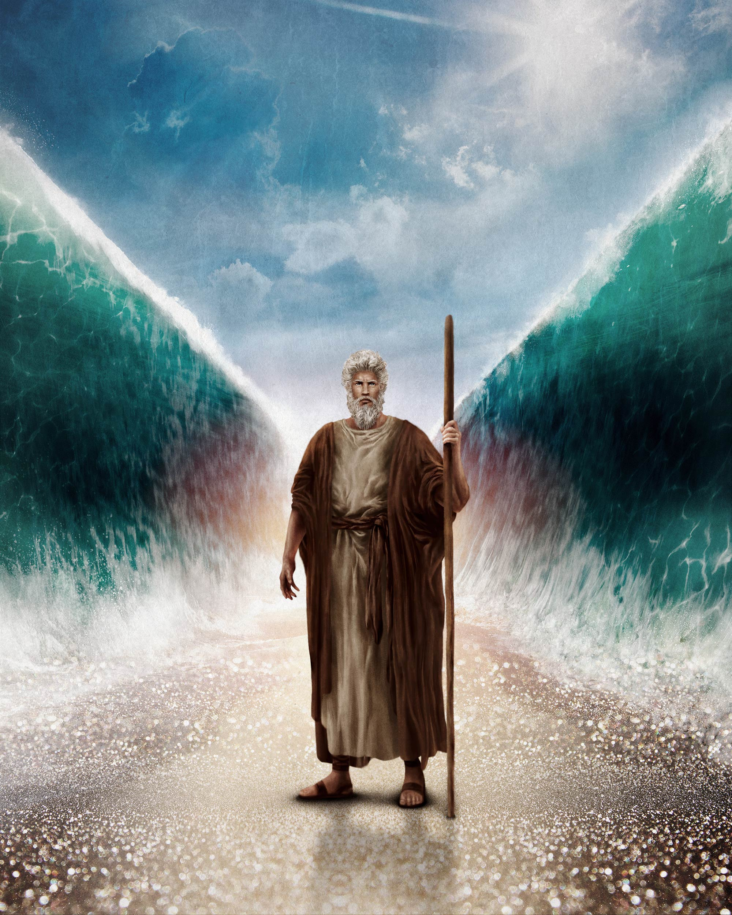
5. While Moses was keeping sheep in the wilderness, what did he learn?
Numbers 12:3
Now the man Moses was very meek, above all the men which were upon the face of the earth.

Slide 10
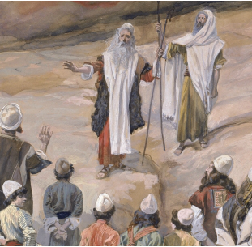
6. When he went with the Lord’s commission, how was he regarded?
Exodus 11:3
And the Lord gave the people favour in the sight of the Egyptians. Moreover the man Moses was very great in the land of Egypt, in the sight of Pharaoh's servants, and in the sight of the people.

Slide 11

7. How did the Lord appear to Moses, when he would send him to Egypt?
Exodus 3:2-4
And the angel of the Lord appeared unto him in a flame of fire out of the midst of a bush: and he looked, and, behold, the bush burned with fire, and the bush was not consumed.

Slide 12

7. How did the Lord appear to Moses, when he would send him to Egypt?
Exodus 3:2-4
And Moses said, I will now turn aside, and see this great sight, why the bush is not burnt.

Slide 13
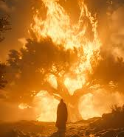
7. How did the Lord appear to Moses, when he would send him to Egypt?
Exodus 3:2-4
And when the Lord saw that he turned aside to see, God called unto him out of the midst of the bush, and said, Moses, Moses. And he said, Here am I.

Slide 14
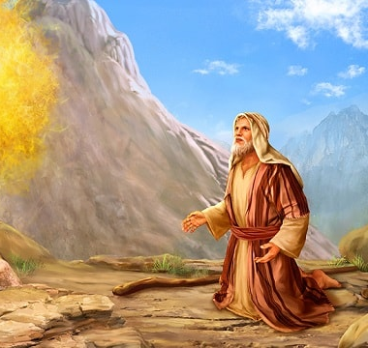
8. When Moses went to see the burning bush, what was said to him?
Exodus 3:4-5
And when the Lord saw that he turned aside to see, God called unto him out of the midst of the bush, and said, Moses, Moses. And he said, Here am I.

Slide 15

8. When Moses went to see the burning bush, what was said to him?
Exodus 3:4-5
And he said, Draw not nigh hither: put off thy shoes from off thy feet, for the place whereon thou standest is holy ground.

Slide 16
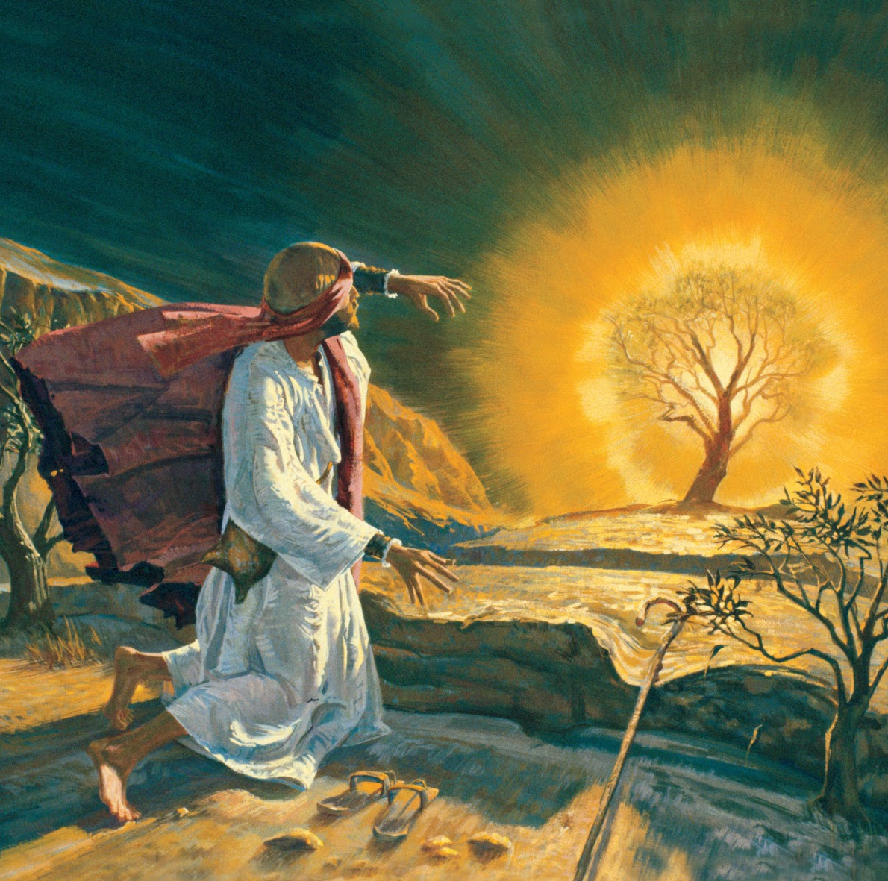
9. Who was it speaking from the bush?
Exodus 3:6
Moreover he said, I am the God of thy father, the God of Abraham, the God of Isaac, and the God of Jacob. And Moses hid his face; for he was afraid to look upon God.

Slide 17
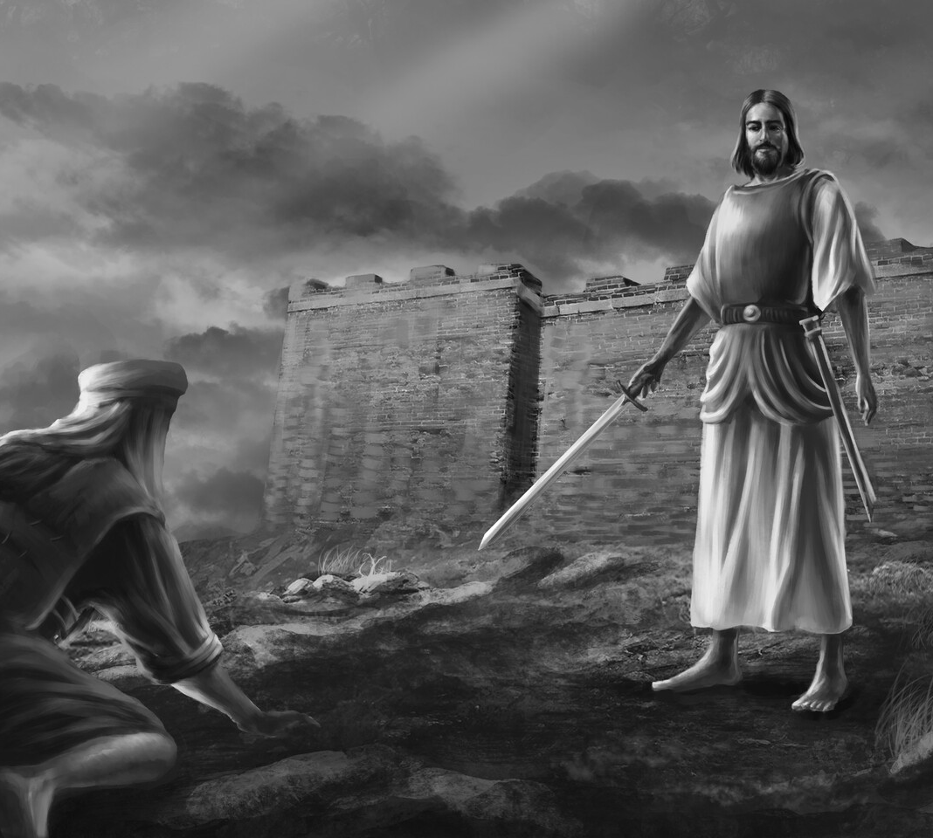
10. What other instances can you name where people were required to put off their shoes on account of the presence of God?
Joshua before the Captain of the Lord’s Host
(Joshua 5:13–15)
“Loose thy shoe from off thy foot; for the place whereon thou standest is holy.”

Slide 18
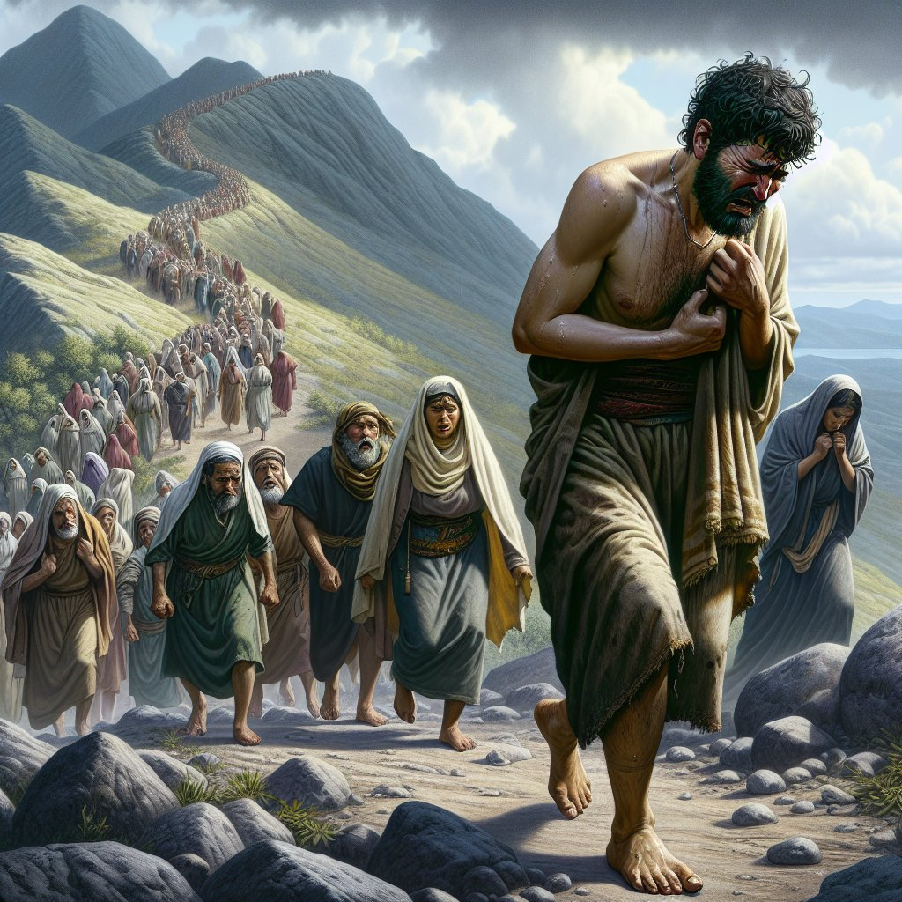
10. What other instances can you name where people were required to put off their shoes on account of the presence of God?
David climbed Mt. Olivet, where he worshipped God, without shoes (2 Samuel 15:30-32)
David went barefoot as a sign of submission, repentance, and humility before God

Slide 19

10. What other instances can you name where people were required to put off their shoes on account of the presence of God?
Priests (probably) ministering barefoot
Priestly clothing is specified (Ezekiel 44:18), but shoes/sandals are not on the list.
Probably a symbol of humility, purity

Slide 20
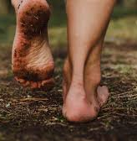
10. What other instances can you name where people were required to put off their shoes on account of the presence of God?
In the ancient Near East:
Removing sandals signified relinquishing authority
Bare feet acknowledged another’s ownership of the ground

Slide 21
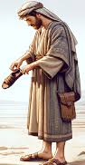
10. What other instances can you name where people were required to put off their shoes on account of the presence of God?
In Ruth 4:7–8, a near kinsman removes his shoe to publicly renounce his right to redeem the land and marry Ruth:
“Now this was the manner in former time in Israel concerning redeeming and concerning changing, for to confirm all things; a man plucked off his shoe, and gave it to his neighbour: and this was a testimony in Israel.”
— Ruth 4:7

Slide 22
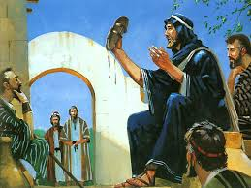
10. What other instances can you name where people were required to put off their shoes on account of the presence of God?
Removing the shoe = relinquishing a claim
• He gives up his legal right to the inheritance
• He steps back from acting as redeemer
• He yields the ground to another

Slide 23

10. What other instances can you name where people were required to put off their shoes on account of the presence of God?
Thus, removing shoes before God symbolized:
“This place is not mine.”
“I stand here only by Your permission.”

Slide 24
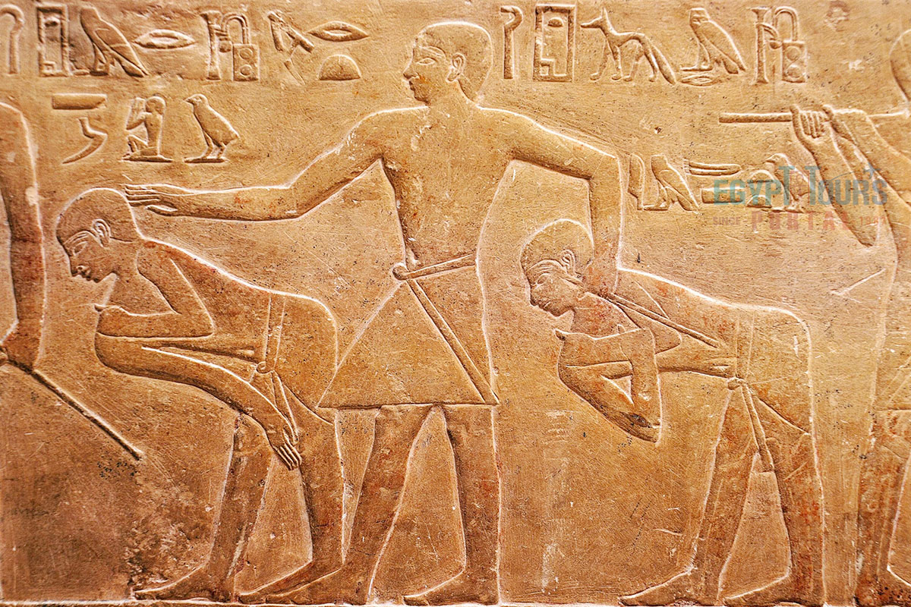
11. What did the Lord say he had seen and heard?
Exodus 3:7; Acts 7:34
And the Lord said, I have surely seen the affliction of my people which are in Egypt, and have heard their cry by reason of their taskmasters; for I know their sorrows.

Slide 25
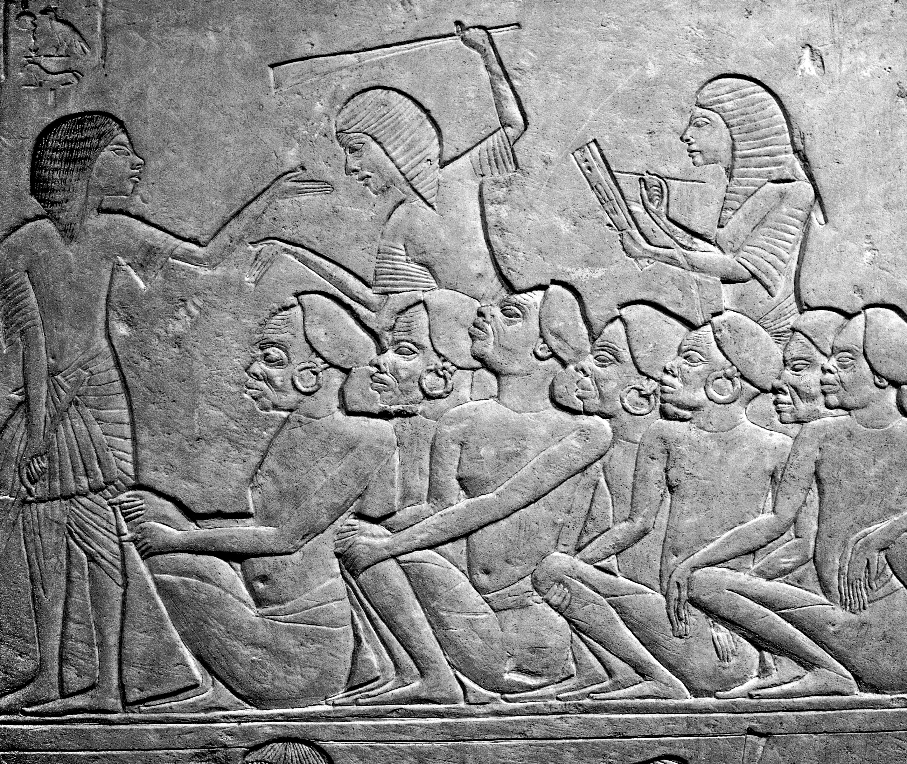
11. What did the Lord say he had seen and heard?
Exodus 3:7; Acts 7:34
I have seen, I have seen the affliction of my people which is in Egypt, and I have heard their groaning, and am come down to deliver them.

Slide 26
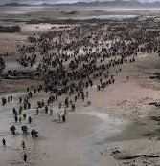
12. What did he say he now proposed to do?
Exodus 3:8-10
And I am come down to deliver them out of the hand of the Egyptians, and to bring them up out of that land unto a good land and a large, unto a land flowing with milk and honey; unto the place of the Canaanites, and the Hittites, and the Amorites, and the Perizzites, and the Hivites, and the Jebusites.

Slide 27
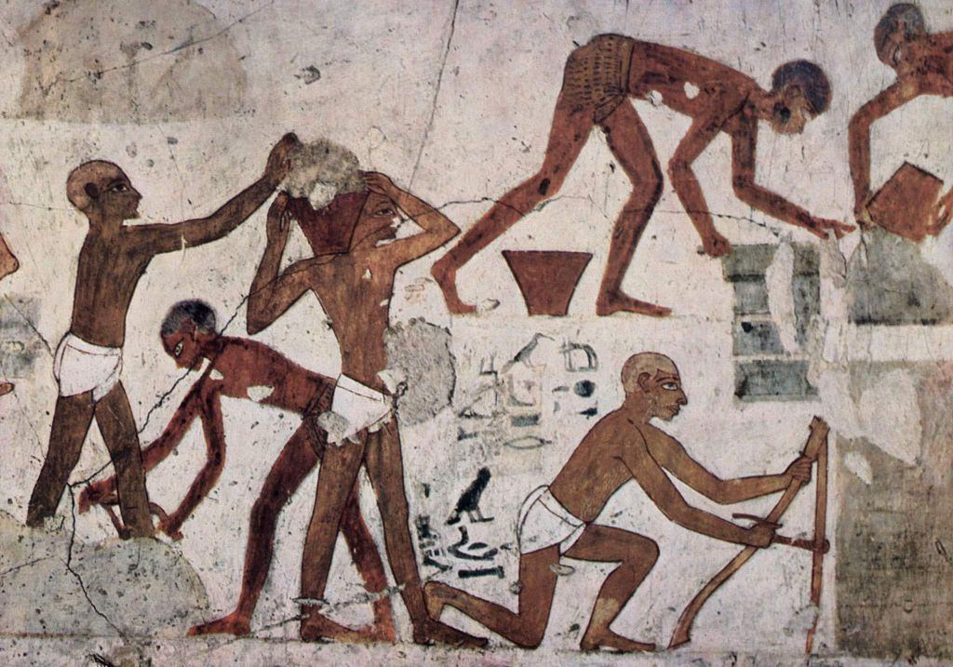
12. What did he say he now proposed to do?
Exodus 3:8-10
Now therefore, behold, the cry of the children of Israel is come unto me, and I have also seen the oppression wherewith the Egyptians oppress them.

Slide 28
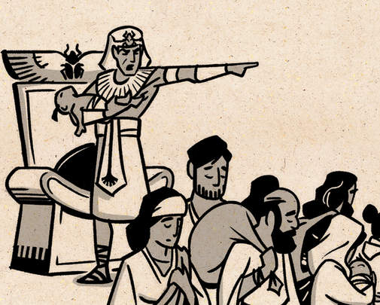
12. What did he say he now proposed to do?
Exodus 3:8-10
Come now therefore, and I will send thee unto Pharaoh, that thou mayest bring forth my people the children of Israel out of Egypt.

Slide 29
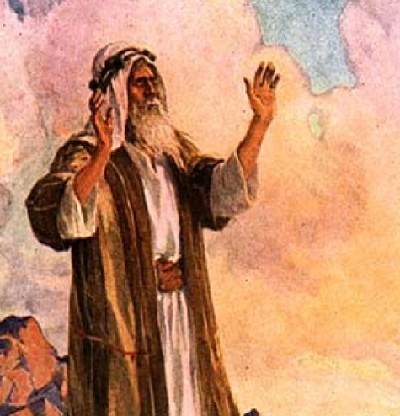
13. How eager was Moses now to go?
Exodus 3:11
And Moses said unto God, Who am I, that I should go unto Pharaoh, and that I should bring forth the children of Israel out of Egypt?

Slide 30
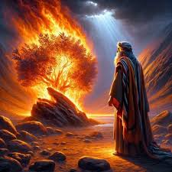
14. What did the Lord say?
Exodus 3:12
And he said, Certainly I will be with thee; and this shall be a token unto thee, that I have sent thee: When thou hast brought forth the people out of Egypt, ye shall serve God upon this mountain.

Slide 31
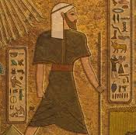
“Who Am I?”
Forty years earlier:
Moses assumed leadership
He acted without commission
He expected recognition (Acts 7:25)

Slide 32
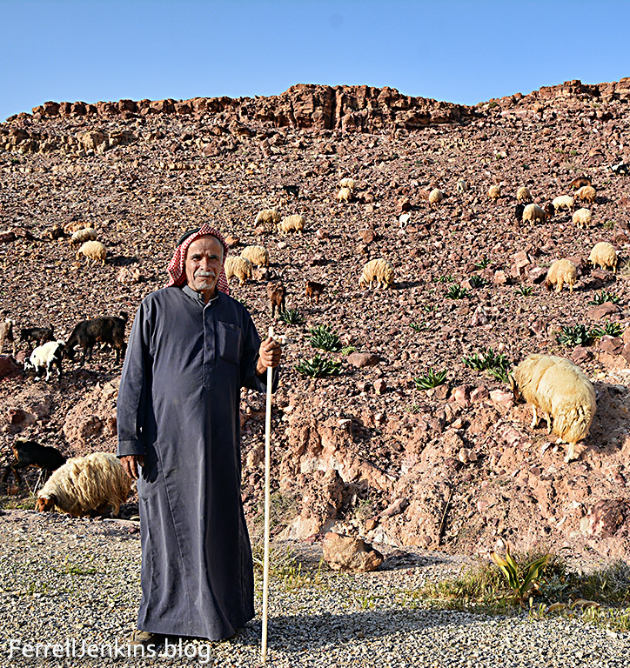
“Who Am I?”
He no longer trusts position, strength, or intellect
He has learned humility through obscurity
The same man who once volunteered to deliver Israel now fears the task entirely.

Slide 33
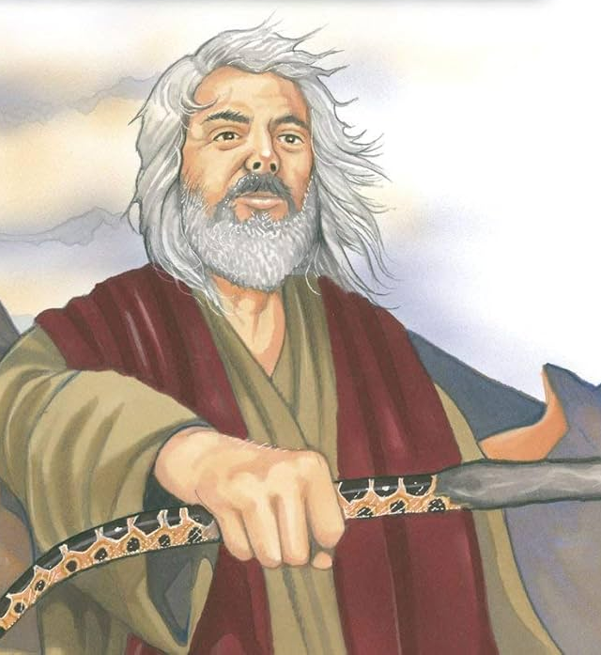
God’s Answer Is Presence, Not Argument
God does not refute Moses’ objections. He does not say:
“You are capable”
“You are persuasive”
“You are strong enough”
He says:
“I will be with thee.”

Slide 34
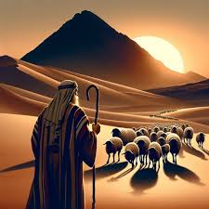
God’s Answer Is Presence, Not Argument
This establishes a principle that will govern all biblical leadership:
What cannot be done by human skill becomes possible in cooperation with God.

Slide 35
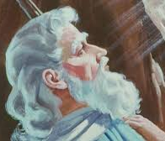
15. What question did Moses ask?
Exodus 3:13
And Moses said unto God, Behold, when I come unto the children of Israel, and shall say unto them, The God of your fathers hath sent me unto you; and they shall say to me, What is his name? what shall I say unto them?

Slide 36
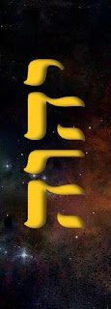
“Who are You?”
The supposition that the people might ask this question is not to be attributed to ignorance of the name of their God. The name by which God had revealed Himself to their fathers could not have vanished entirely from memory, and the mere mention of God’s name could not have been of much help to Moses.

Slide 37
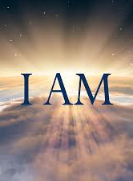
“Who are You?”
However, the nature and power of the One who sent Moses would be expressed in that name, and since names meant so much to the Semite mind, it was important for Moses to reveal to his people the true nature of their God, who was now ready to deliver them from bondage.

Slide 38
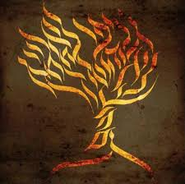
16. What did the Lord reply?
Exodus 3:14
And God said unto Moses, I AM THAT I AM: and he said, Thus shalt thou say unto the children of Israel, I AM hath sent me unto you.

Slide 39
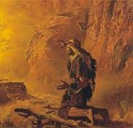
17. What did God say of this name?
Exodus 3:15
And God said moreover unto Moses, Thus shalt thou say unto the children of Israel, The Lord God of your fathers, the God of Abraham, the God of Isaac, and the God of Jacob, hath sent me unto you: this is my name for ever, and this is my memorial unto all generations.

Slide 40

18. What is its meaning?
Answer: It means “the One who is,” that is, the self-existent One, thus expressing the distinguishing characteristic of God.

Slide 41

“I Am That I Am”
God does not say “I exist” — He says “I AM.”
His existence is not caused, sustained, or defined by anything else.
He does not become; He simply is.

Slide 42
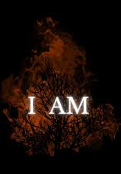
“I Am That I Am”
All existence depends on the one I AM, not merely our own created world, but all things. Creation is not self-existent — it is dependent.
This name anchors God as Creator, not merely a powerful being within the universe, but the actual source of being.

Slide 43
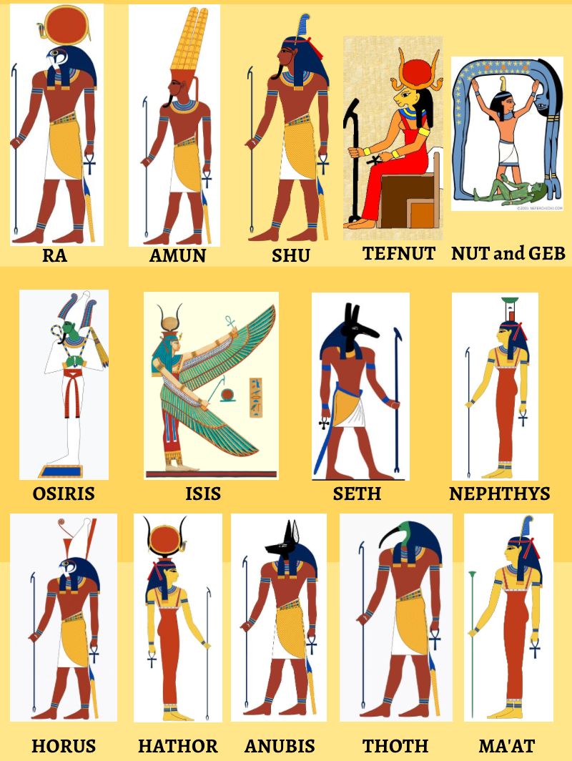
“I Am That I Am”
This name is a direct rebuke to all competing claims.
In Egypt,
Gods were localized (Nile, sun, fertility, death)
Gods required maintenance through ritual
Gods were part of the created order

Slide 44
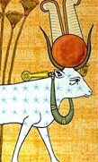
“I Am That I Am”
“I AM” quietly but decisively declares:
God is not one being among many
God is not dependent on nature
God is not sustained by human action
The name denies the independent existence of all other ‘gods,’ (really creatures, concepts, or counterfeits.)

Slide 45
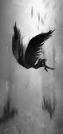
“I Am That I Am”
From the beginning, Satan’s aim has been to:
Displace God as Creator
Blur the distinction between Creator and creation
Replace dependence with self-sufficiency

Slide 46
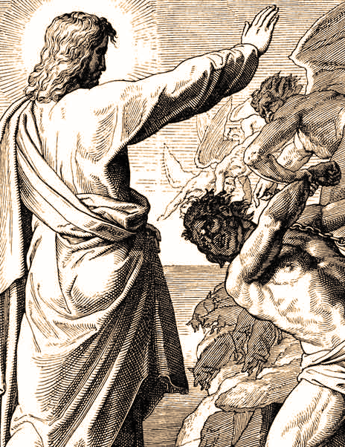
“I Am That I Am”
“I AM” stands against:
Evolutionary self-creation (“we came to be on our own”)
Spiritualism (created beings masquerading as divine)
Pantheism (“everything is god”)
Human exaltation (“ye shall be as gods”)

Slide 47

“I Am That I Am”
If God simply IS, then:
Creation is not self-originating
Truth is not fluid
Morality is not negotiable
Authority does not arise from consensus

Slide 48
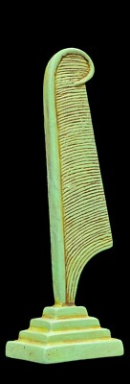
“I Am That I Am”
Yahweh is derived from I AM
  Rendered LORD (small capitals) in the KJV
  Emphasizes permanence, faithfulness, covenant continuity
  “This is my name for ever, and this is my memorial unto all generations.” — Exodus 3:15
The self-existent God binds Himself by promise
The Eternal One enters history without losing transcendence

Slide 49
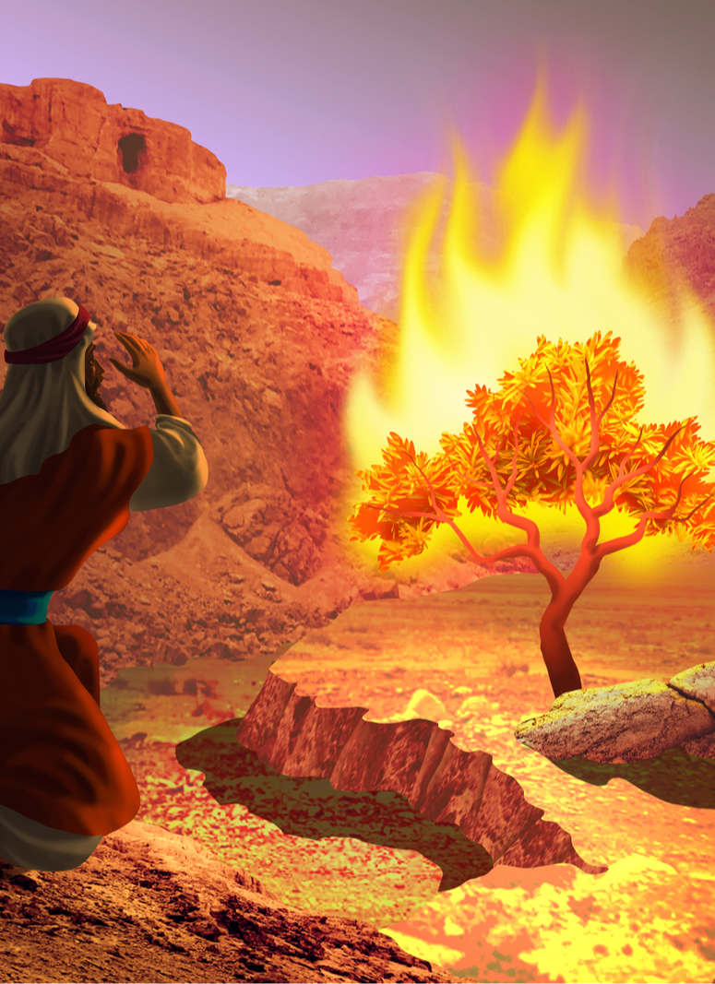
“I Am That I Am”
Israel was enslaved, disheartened, surrounded by visible power and false gods
God gives:
No battle plan
No strategy
No miracles yet
He gives a name.

Slide 50
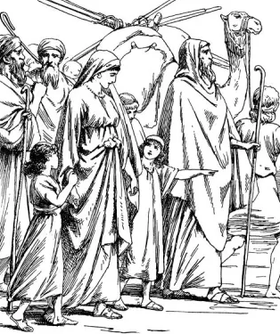
“I Am That I Am”
Because before Israel needed freedom, they needed a foundation:
• A reorientation of identity
• A growing trust in God
• A clearer revelation of who God is
Their deliverance would rest on who God is — not on circumstances.

Slide 51
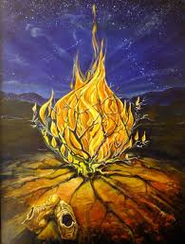
“I Am That I Am”
“I AM” means God does not merely act in history —
history exists because He does.

Slide 52
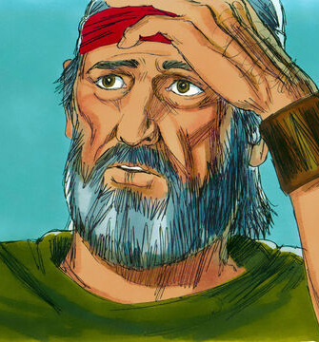
19. What objection did Moses still interpose?
Exodus 4:1
And Moses answered and said, But, behold, they will not believe me, nor hearken unto my voice: for they will say, The Lord hath not appeared unto thee.

Slide 53
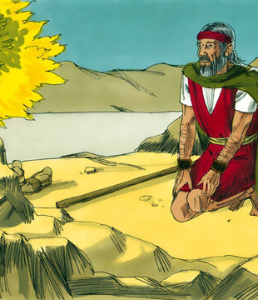
20. What three signs did the Lord give him by which he might prove that he had a divine commission?
Exodus 4:2-9
And the Lord said unto him, What is that in thine hand? And he said, A rod.

Slide 54
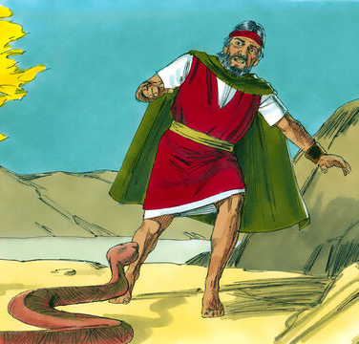
20. What three signs did the Lord give him by which he might prove that he had a divine commission?
Exodus 4:2-9
And he said, Cast it on the ground. And he cast it on the ground, and it became a serpent; and Moses fled from before it.

Slide 55
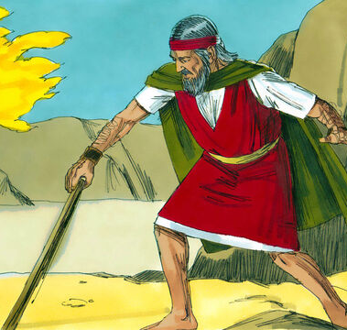
20. What three signs did the Lord give him by which he might prove that he had a divine commission?
Exodus 4:2-9
And the Lord said unto Moses, Put forth thine hand, and take it by the tail. And he put forth his hand, and caught it, and it became a rod in his hand:

Slide 56
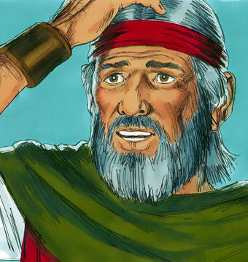
20. What three signs did the Lord give him by which he might prove that he had a divine commission?
Exodus 4:2-9
That they may believe that the Lord God of their fathers, the God of Abraham, the God of Isaac, and the God of Jacob, hath appeared unto thee.

Slide 57
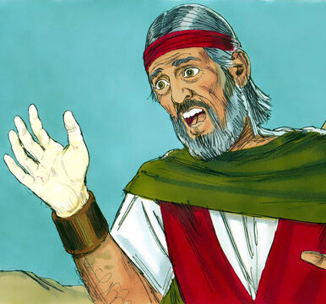
20. What three signs did the Lord give him by which he might prove that he had a divine commission?
Exodus 4:2-9
And the Lord said furthermore unto him, Put now thine hand into thy bosom. And he put his hand into his bosom: and when he took it out, behold, his hand was leprous as snow.

Slide 58
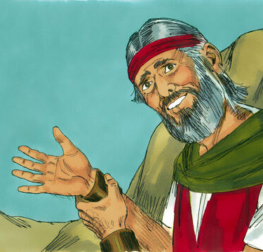
20. What three signs did the Lord give him by which he might prove that he had a divine commission?
Exodus 4:2-9
And he said, Put thine hand into thy bosom again. And he put his hand into his bosom again; and plucked it out of his bosom, and, behold, it was turned again as his other flesh.

Slide 59
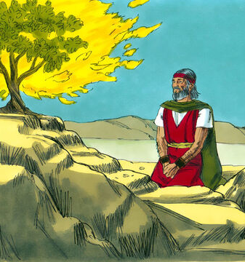
20. What three signs did the Lord give him by which he might prove that he had a divine commission?
Exodus 4:2-9
And it shall come to pass, if they will not believe thee, neither hearken to the voice of the first sign, that they will believe the voice of the latter sign.

Slide 60
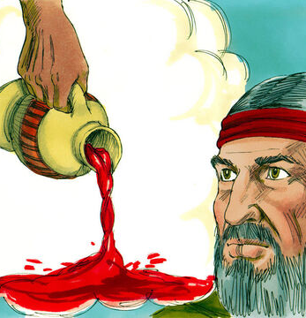
20. What three signs did the Lord give him by which he might prove that he had a divine commission?
Exodus 4:2-9
And it shall come to pass, if they will not believe also these two signs, neither hearken unto thy voice, that thou shalt take of the water of the river, and pour it upon the dry land: and the water which thou takest out of the river shall become blood upon the dry land.

Slide 61
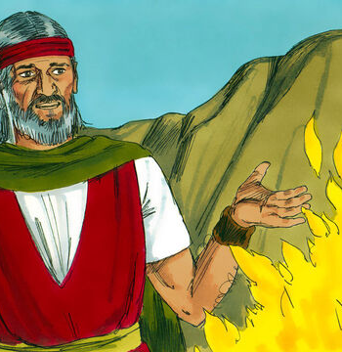
21. Was Moses ready to go then?
Exodus 4:10
And Moses said unto the Lord, O my Lord, I am not eloquent, neither heretofore, nor since thou hast spoken unto thy servant: but I am slow of speech, and of a slow tongue.

Slide 62

22. What reply did the Lord make?
Exodus 4:11-12
And the Lord said unto him, Who hath made man's mouth? or who maketh the dumb, or deaf, or the seeing, or the blind? have not I the Lord?

Slide 63

22. What reply did the Lord make?
Exodus 4:11-12
Now therefore go, and I will be with thy mouth, and teach thee what thou shalt say.

Slide 64

23. What did Moses still say?
Exodus 4:13
And he said, O my Lord, send, I pray thee, by the hand of him whom thou wilt send.

Slide 65

24. How did the Lord regard this continued refusal?
Exodus 4:14, first clause
And the anger of the Lord was kindled against Moses…

Slide 66

25. What help did he provide for Moses?
Exodus 4:14
And the anger of the Lord was kindled against Moses, and he said, Is not Aaron the Levite thy brother? I know that he can speak well.

Slide 67

26. Who did he say should instruct them both?
Exodus 4:15-16
And thou shalt speak unto him, and put words in his mouth: and I will be with thy mouth, and with his mouth, and will teach you what ye shall do.

Slide 68

26. Who did he say should instruct them both?
Exodus 4:15-16
And he shall be thy spokesman unto the people: and he shall be, even he shall be to thee instead of a mouth, and thou shalt be to him instead of God.

Slide 69

27. What confidence may the Lord’s servants have in this age as they go to preach the gospel?
Matthew 28:18-20
And Jesus came and spake unto them, saying, All power is given unto me in heaven and in earth.

Slide 70

27. What confidence may the Lord’s servants have in this age as they go to preach the gospel?
Matthew 28:18-20
Go ye therefore, and teach all nations, baptizing them in the name of the Father, and of the Son, and of the Holy Ghost:

Slide 71

27. What confidence may the Lord’s servants have in this age as they go to preach the gospel?
Matthew 28:18-20
Teaching them to observe all things whatsoever I have commanded you: and, lo, I am with you alway, even unto the end of the world. Amen.

Slide 72


Slide 73
Thank you and
HAPPY SABBATH!

