Slide 1


Slide 2

Living the Light

Slide 3
Old Testament History:
God’s Requirement for Israel
Lesson 25, 2nd Quarter, 1888

Slide 4
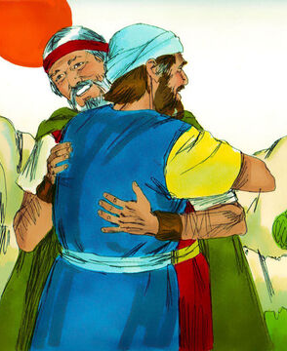
1. Who met Moses as he was on his way to Egypt?
Exodus 4:27
And the Lord said to Aaron, Go into the wilderness to meet Moses. And he went, and met him in the mount of God, and kissed him.

Slide 5
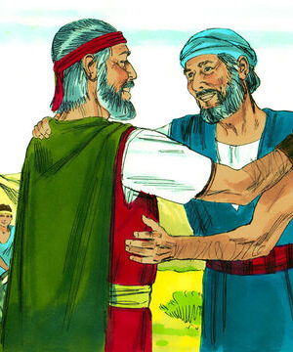
2. What did Moses tell Aaron?
Exodus 4:28
And Moses told Aaron all the words of the Lord who had sent him, and all the signs which he had commanded him.

Slide 6
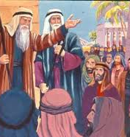
3. When they reached Egypt, what did they do?
Exodus 4:29-30
And Moses and Aaron went and gathered together all the elders of the children of Israel:

Slide 7
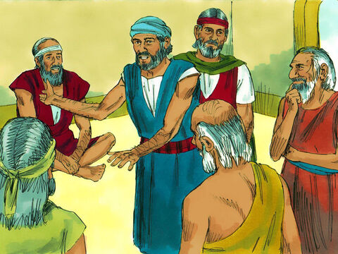
3. When they reached Egypt, what did they do?
Exodus 4:29-30
And Aaron spake all the words which the Lord had spoken unto Moses, and did the signs in the sight of the people.

Slide 8
4. How did the people receive the message, and what did they do?
Exodus 4:31
And the people believed: and when they heard that the Lord had visited the children of Israel, and that he had looked upon their affliction, then they bowed their heads and worshipped.

Slide 9
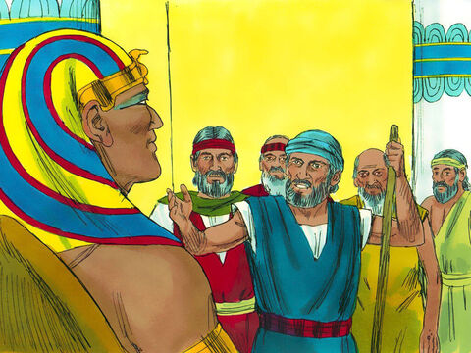
5. With what words did Moses and Aaron greet Pharaoh?
Exodus 5:1
And afterward Moses and Aaron went in, and told Pharaoh, Thus saith the Lord God of Israel, Let my people go, that they may hold a feast unto me in the wilderness.

Slide 10
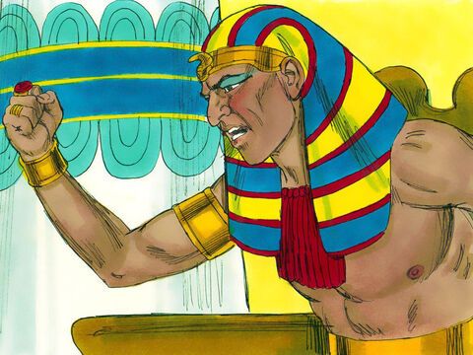
6. What reply did Pharaoh make?
Exodus 5:2
And Pharaoh said, Who is the Lord, that I should obey his voice to let Israel go? I know not the Lord, neither will I let Israel go.

Slide 11
7. What further statement did Moses and Aaron make, showing the urgency of the case?
Exodus 5:3
And they said, The God of the Hebrews hath met with us: let us go, we pray thee, three days' journey into the desert, and sacrifice unto the Lord our God; lest he fall upon us with pestilence, or with the sword.

Slide 12
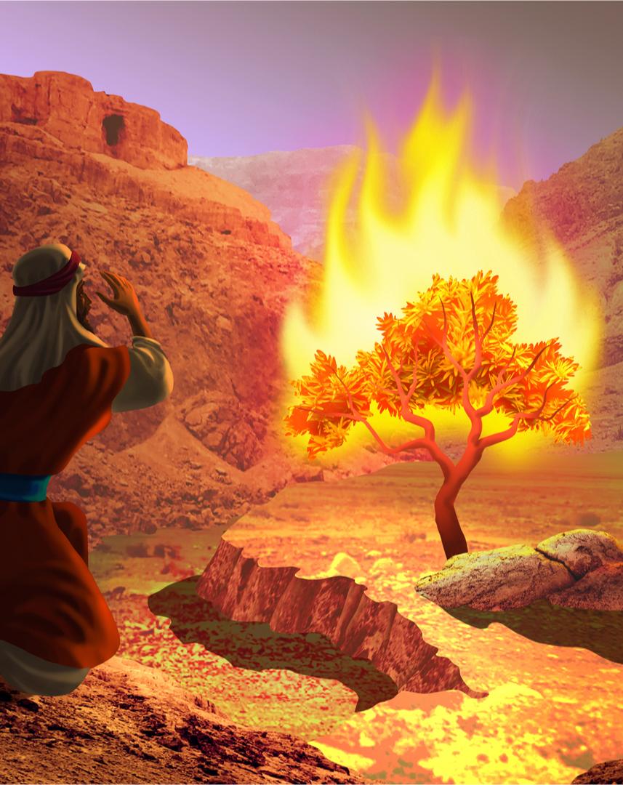
8. Had God told Moses to make this request?
Exodus 3:18
And they shall hearken to thy voice: and thou shalt come, thou and the elders of Israel, unto the king of Egypt, and ye shall say unto him, The Lord God of the Hebrews hath met with us: and now let us go, we beseech thee, three days' journey into the wilderness, that we may sacrifice to the Lord our God.

Slide 13
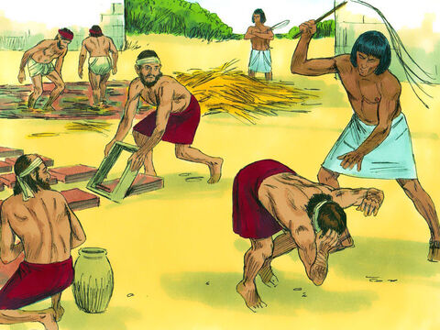
9. Do you think that Moses expected Pharaoh to grant this request?
Exodus 5:19
And the officers of the children of Israel did see that they were in evil case, after it was said, Ye shall not minish ought from your bricks of your daily task.

Slide 14
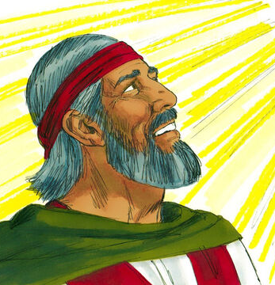
10. Then why was he directed to make it, and why did he ask that the people might be allowed to go and sacrifice, when they wanted complete deliverance?
God directed Moses to make a simple request in order to test Pharaoh’s willingness to recognize His authority, and to show that Israel could not even render basic service to God while in bondage.

Slide 15
11. What did Pharaoh charge Moses and Aaron with doing?
Exodus 5:4-5
And the king of Egypt said unto them, Wherefore do ye, Moses and Aaron, let the people from their works? get you unto your burdens.

Slide 16
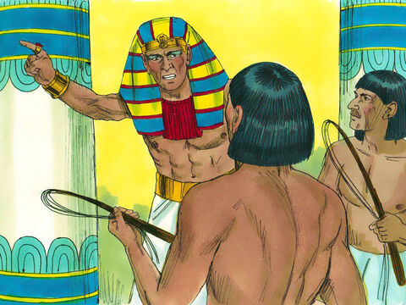
11. What did Pharaoh charge Moses and Aaron with doing?
Exodus 5:4-5
And Pharaoh said, Behold, the people of the land now are many, and ye make them rest from their burdens.

Slide 17
12. What did he say was the reason that the people wanted to go and sacrifice?
Exodus 5:8, 17
And the tale of the bricks, which they did make heretofore, ye shall lay upon them; ye shall not diminish ought thereof: for they be idle; therefore they cry, saying, Let us go and sacrifice to our God.

Slide 18
12. What did he say was the reason that the people wanted to go and sacrifice?
Exodus 5:8, 17
But he said, Ye are idle, ye are idle: therefore ye say, Let us go and do sacrifice to the Lord.

Slide 19
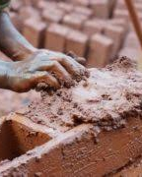
13. How were their burdens increased in consequence?
Exodus 5:6-7, 17-19
And Pharaoh commanded the same day the taskmasters of the people, and their officers, saying,

Slide 20
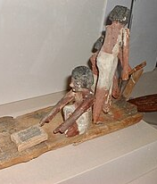
13. How were their burdens increased in consequence?
Exodus 5:6-7, 17-19
Ye shall no more give the people straw to make brick, as heretofore: let them go and gather straw for themselves.

Slide 21
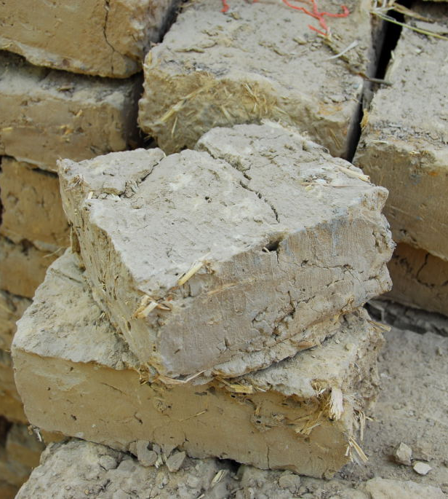
13. How were their burdens increased in consequence?
Exodus 5:6-7, 17-19
But he said, Ye are idle, ye are idle: therefore ye say, Let us go and do sacrifice to the Lord.

Slide 22
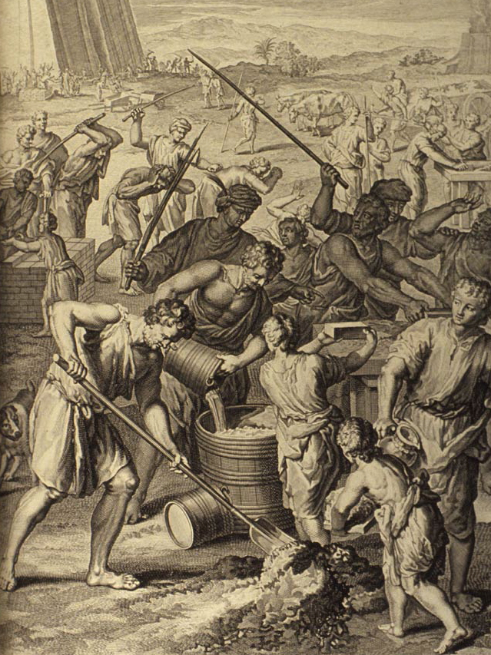
13. How were their burdens increased in consequence?
Exodus 5:6-7, 17-19
Go therefore now, and work; for there shall no straw be given you, yet shall ye deliver the tale of bricks.

Slide 23
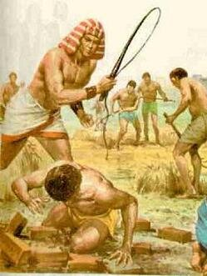
13. How were their burdens increased in consequence?
Exodus 5:6-7, 17-19
And the officers of the children of Israel did see that they were in evil case, after it was said, Ye shall not minish ought from your bricks of your daily task.

Slide 24
Obedience Under Constraint
Why couldn’t Israel simply “worship God” while enslaved?

Slide 25
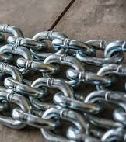
Obedience Under Constraint
Ephesians 6:5-9
Servants, be obedient to them that are your masters according to the flesh, with fear and trembling, in singleness of your heart, as unto Christ;

Slide 26
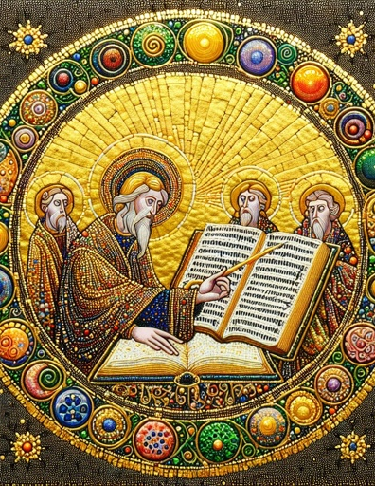
Obedience Under Constraint
Ephesians 6:5-9
Not with eyeservice, as menpleasers; but as the servants of Christ, doing the will of God from the heart;

Slide 27

Obedience Under Constraint
Ephesians 6:5-9
With good will doing service, as to the Lord, and not to men:

Slide 28
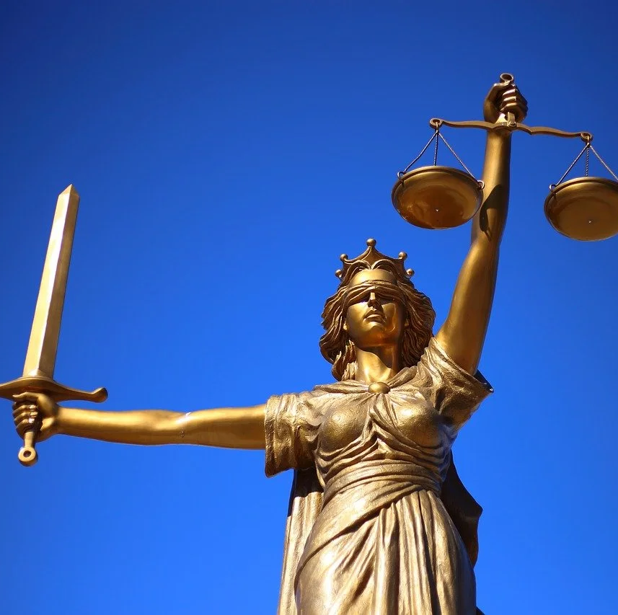

Obedience Under Constraint
Ephesians 6:5-9
Knowing that whatsoever good thing any man doeth, the same shall he receive of the Lord, whether he be bond or free.

Slide 29
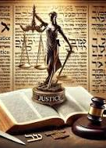
Obedience Under Constraint
Ephesians 6:5-9
And, ye masters, do the same things unto them, forbearing threatening: knowing that your Master also is in heaven; neither is there respect of persons with him.

Slide 30
Obedience Under Constraint
God does expect faithfulness within unjust systems.
Obedience to earthly masters can coexist with obedience to God.
Christian duty is not suspended by hardship.
God does not require ideal circumstances in order to be obeyed.

Slide 31
Obedience Under Constraint
Egypt was not merely:
an unjust employer, or
a harsh social system.
It was a totalizing religious state
where labor, religion, and loyalty were inseparable
and where Pharaoh was a divine authority

Slide 32
Obedience Under Constraint
Israel was not just working under Egyptians; they were living inside a theological system that claimed:
ownership of time,
ownership of bodies,
ownership of allegiance.
Worship is assumed to be an act of rebellion.
All this pushes us beyond Ephesians 6, which assumes a degree of moral freedom in the service of even a harsh master.

Slide 33
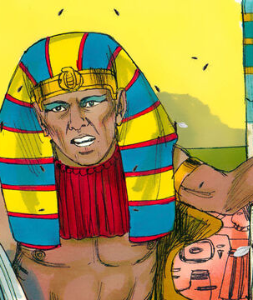
Obedience Under Constraint
Exodus 8:25-26
And Pharaoh called for Moses and for Aaron, and said, Go ye, sacrifice to your God in the land.

Slide 34
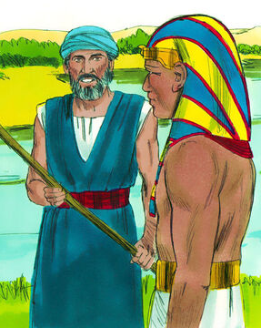
Obedience Under Constraint
Exodus 8:25-26
And Moses said, It is not meet so to do; for we shall sacrifice the abomination of the Egyptians to the Lord our God: lo, shall we sacrifice the abomination of the Egyptians before their eyes, and will they not stone us?

Slide 35
Obedience Under Constraint
God does not say:
“Worship Me here anyway.”
“Offer sacrifices in Egypt and accept the consequences.”
Instead, He says: “Let My people go, that they may serve Me.”
The commanded obedience is departure
Not symbolic defiance within Egypt
Not martyrdom-by-provocation
The obedience God requires is not the sacrifice itself, but the leaving.

Slide 36
Obedience Under Constraint
Notice from what Israel is delivered!
Israel is not freed from service
Israel is freed for service
The question is not whether they will serve, but whom. This has not changed! Service is unavoidable — but deliverance restores the right allegiance.

Slide 37
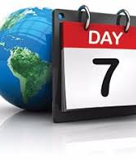
14. After the Israelites had been delivered, what exhortation was given to them, based on their hard usage in Egypt?
Deuteronomy 5:14-15
But the seventh day is the sabbath of the Lord thy God: in it thou shalt not do any work, thou, nor thy son, nor thy daughter, nor thy manservant, nor thy maidservant, nor thine ox, nor thine ass, nor any of thy cattle, nor thy stranger that is within thy gates; that thy manservant and thy maidservant may rest as well as thou.

Slide 38
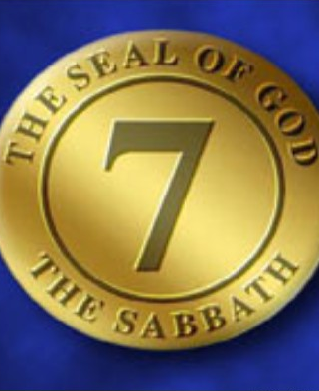
14. After the Israelites had been delivered, what exhortation was given to them, based on their hard usage in Egypt?
Deuteronomy 5:14-15
And remember that thou wast a servant in the land of Egypt, and that the Lord thy God brought thee out thence through a mighty hand and by a stretched out arm: therefore the Lord thy God commanded thee to keep the sabbath day.

Slide 39
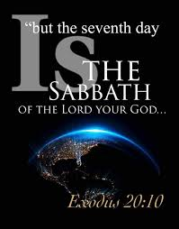
15. What were they told to remember, in order that they might not be led to require their servants to work on the Sabbath?
Deuteronomy 5:15
And remember that thou wast a servant in the land of Egypt, and that the Lord thy God brought thee out thence through a mighty hand and by a stretched out arm: therefore the Lord thy God commanded thee to keep the sabbath day.

Slide 40
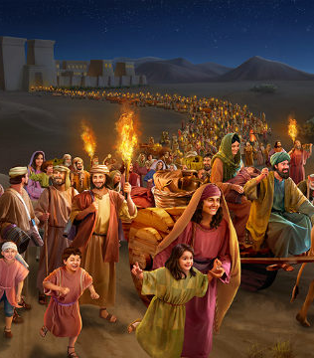
16. For what purpose did God deliver them from bondage?
Exodus 4:23; Psalm 105:43-45
And he brought forth his people with joy, and his chosen with gladness:

Slide 41
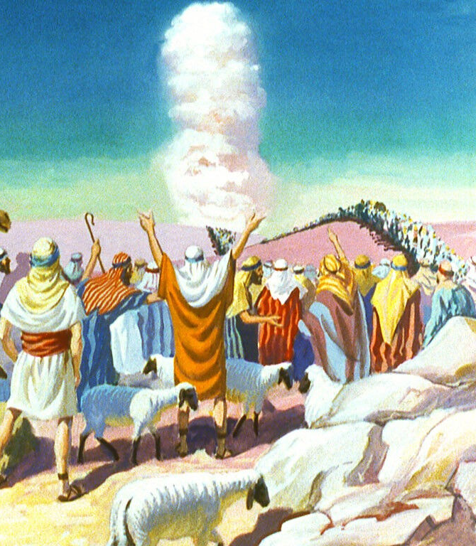
16. For what purpose did God deliver them from bondage?
Exodus 4:23; Psalm 105:43-45
And I say unto thee, Let my son go, that he may serve me: and if thou refuse to let him go, behold, I will slay thy son, even thy firstborn.

Slide 42
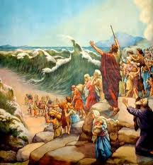
16. For what purpose did God deliver them from bondage?
Exodus 4:23; Psalm 105:43-45
And gave them the lands of the heathen: and they inherited the labour of the people;

Slide 43
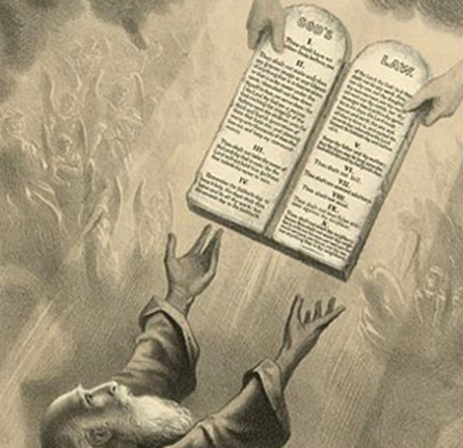
16. For what purpose did God deliver them from bondage?
Exodus 4:23; Psalm 105:43-45
That they might observe his statutes, and keep his laws. Praise ye the Lord.

Slide 44
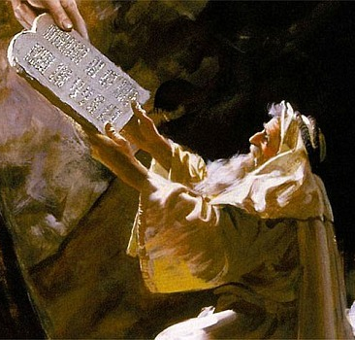
17. What does this indicate?
Answer: That they could not properly serve him in Egypt.

Slide 45
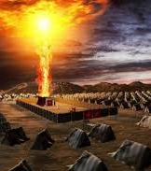
18. What may we conclude from this fact, and Pharaoh’s statement to Moses and Aaron that they made the people “rest from their burdens,” and the exhortation in Deuteronomy 5:14-15?
That Israel could not keep the Sabbath while in bondage, and that true obedience to God—including rest—required deliverance from oppressive servitude.

Slide 46
The Sabbath and Service
The Sabbath is:
not merely rest,
not merely mercy,
but the weekly declaration of changed ownership. It makes it clear whom, precisely we choose to serve.

Slide 47
The Sabbath and Service
On Sabbath:
Pharaoh has no claim
Productivity does not define worth
Time belongs to God
That’s why Pharaoh hated rest.
That’s why God commanded it.

Slide 48


Slide 49
Thank you and
HAPPY SABBATH!

