Slide 1


Slide 2

Living the Light

Slide 3
Quarterly Review
Old Testament History
Lesson 26, 2nd Quarter, 1888

Slide 4
1. Give a brief Bible description of the character of Abraham.

Slide 5
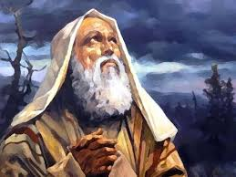
1. Give a brief Bible description of the character of Abraham. (Lesson 14)
Genesis 26:5
Because that Abraham obeyed my voice, and kept my charge, my commandments, my statutes, and my laws.

Slide 6
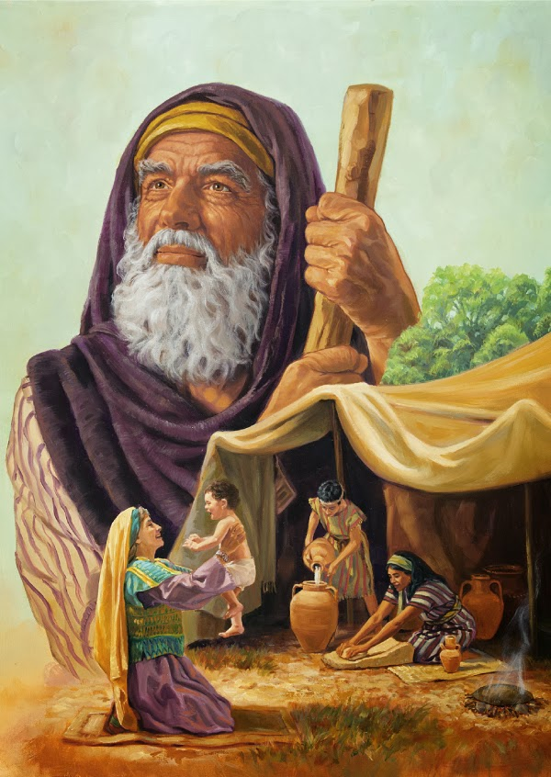
1. Give a brief Bible description of the character of Abraham. (Lesson 14)
Hebrews 11:8
By faith Abraham, when he was called to go out into a place which he should after receive for an inheritance, obeyed; and he went out, not knowing whither he went.

Slide 7
2. What was the foundation of Abraham’s righteousness?

Slide 8
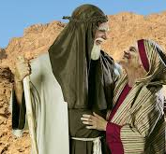
2. What was the foundation of Abraham’s righteousness? (Lesson 14)
Romans 4:3
For what saith the scripture? Abraham believed God, and it was counted unto him for righteousness.

Slide 9
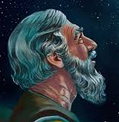
2. What was the foundation of Abraham’s righteousness? (Lesson 14)
Genesis 15:6
And he believed in the Lord; and he counted it to him for righteousness.

Slide 10
3. Tell how Abraham’s faith was tested.

Slide 11
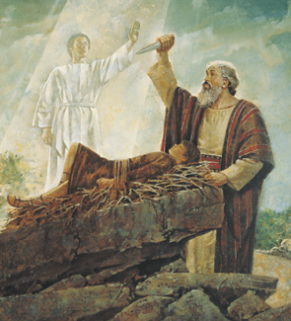
3. Tell how Abraham’s faith was tested. (Lesson 14)
Genesis 22:1
And it came to pass after these things, that God did tempt Abraham, and said unto him, Abraham: and he said, Behold, here I am.

Slide 12
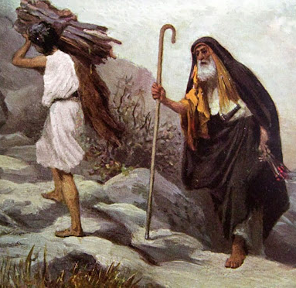
3. Tell how Abraham’s faith was tested. (Lesson 14)
Genesis 22:2
And he said, Take now thy son, thine only son Isaac, whom thou lovest, and get thee into the land of Moriah; and offer him there for a burnt offering upon one of the mountains which I will tell thee of.

Slide 13
4. What made this such a test of his faith?

Slide 14
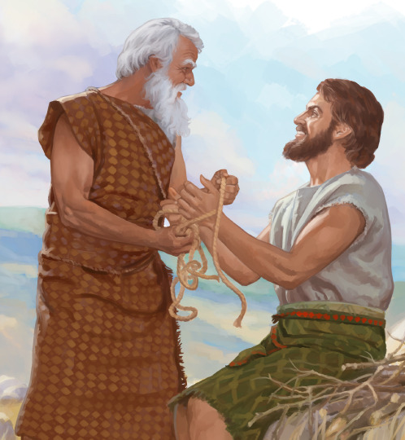
4. What made this such a test of his faith? (Lesson 14)
Hebrews 11:17
By faith Abraham, when he was tried, offered up Isaac: and he that had received the promises offered up his only begotten son.

Slide 15
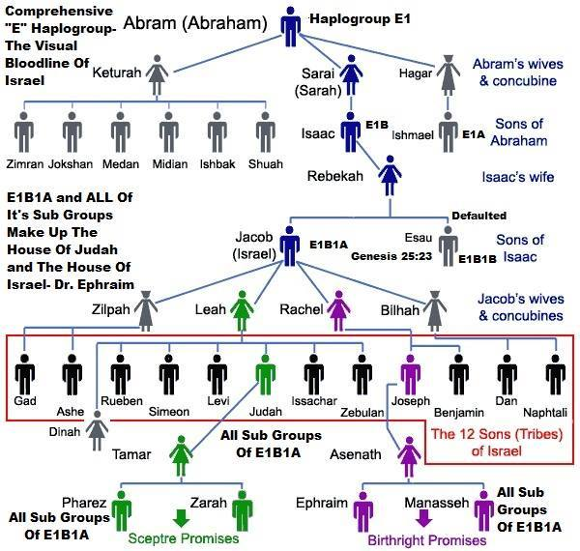
4. What made this such a test of his faith? (Lesson 14)
Hebrews 11:18
Of whom it was said, That in Isaac shall thy seed be called:

Slide 16
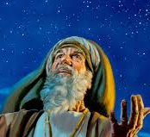
4. What made this such a test of his faith? (Lesson 14)
Hebrews 11:19
Accounting that God was able to raise him up, even from the dead; from whence also he received him in a figure.

Slide 17
5. How did Jacob come to leave his father’s house?

Slide 18
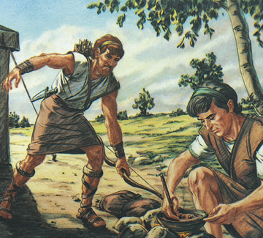
5. How did Jacob come to leave his father’s house? (Lesson 16)
Genesis 27:41
And Esau hated Jacob because of the blessing wherewith his father blessed him: and Esau said in his heart, The days of mourning for my father are at hand; then will I slay my brother Jacob.

Slide 19
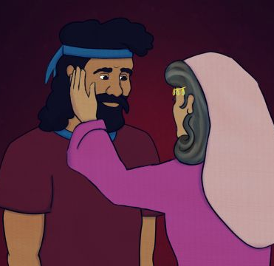
5. How did Jacob come to leave his father’s house? (Lesson 16)
Genesis 27:42
And these words of Esau her elder son were told to Rebekah: and she sent and called Jacob her younger son, and said unto him, Behold, thy brother Esau, as touching thee, doth comfort himself, purposing to kill thee.

Slide 20
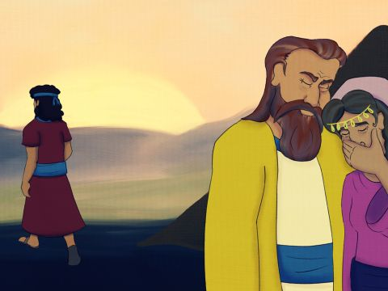
5. How did Jacob come to leave his father’s house? (Lesson 16)
Genesis 27:43
Now therefore, my son, obey my voice; and arise, flee thou to Laban my brother to Haran;

Slide 21
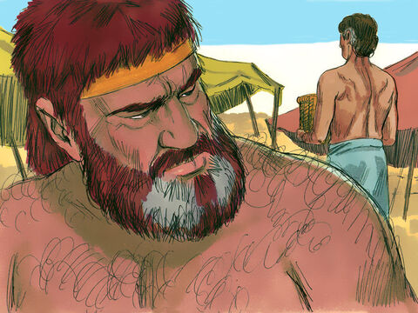
5. How did Jacob come to leave his father’s house? (Lesson 16)
Genesis 27:44
And tarry with him a few days, until thy brother’s fury turn away;

Slide 22
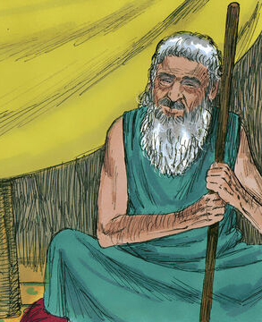
5. How did Jacob come to leave his father’s house? (Lesson 16)
Genesis 27:45
Until thy brother’s anger turn away from thee, and he forget that which thou hast done to him: then I will send, and fetch thee from thence: why should I be deprived also of you both in one day?

Slide 23
6. Relate the dream which he had while on his journey.

Slide 24
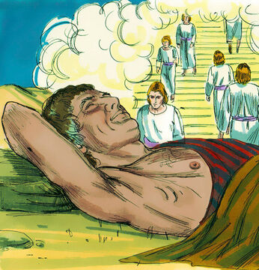
6. Relate the dream which he had while on his journey. (Lesson 16)
Genesis 28:12
And he dreamed, and behold a ladder set up on the earth, and the top of it reached to heaven: and behold the angels of God ascending and descending on it.

Slide 25
7. What vow did he make?

Slide 26
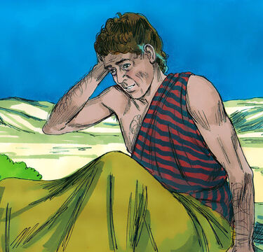
7. What vow did he make? (Lesson 16)
Genesis 28:20
And Jacob vowed a vow, saying, If God will be with me, and will keep me in this way that I go, and will give me bread to eat, and raiment to put on,

Slide 27
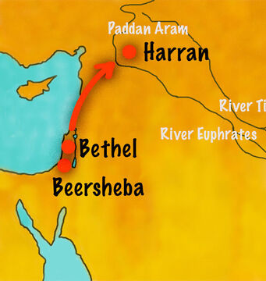
7. What vow did he make? (Lesson 16)
Genesis 28:21
So that I come again to my father’s house in peace; then shall the Lord be my God:

Slide 28
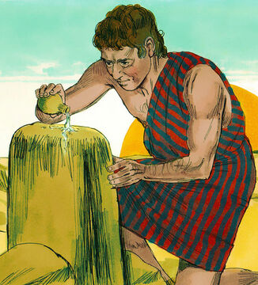
7. What vow did he make? (Lesson 16)
Genesis 28:22
And this stone, which I have set for a pillar, shall be God’s house: and of all that thou shalt give me I will surely give the tenth unto thee.

Slide 29
8. Give proof that it is right for us to make such vows.

Slide 30
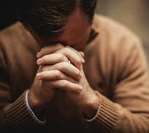
8. Give proof that it is right for us to make such vows.
(Lesson 16)
Psalm 76:11
Vow, and pay unto the Lord your God: let all that be round about him bring presents unto him that ought to be feared.

Slide 31

8. Give proof that it is right for us to make such vows.
(Lesson 16)
Ecclesiastes 5:4
When thou vowest a vow unto God, defer not to pay it; for he hath no pleasure in fools: pay that which thou hast vowed.

Slide 32

8. Give proof that it is right for us to make such vows.
(Lesson 16)
Ecclesiastes 5:5
Better is it that thou shouldest not vow, than that thou shouldest vow and not pay.

Slide 33
9. Where is this narrative recorded?

Slide 34
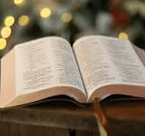
9. Where is this narrative recorded? (Lesson 16)
Genesis 27:1
And it came to pass, that when Isaac was old, and his eyes were dim, so that he could not see, he called Esau his eldest son, and said unto him, My son: and he said unto him, Behold, here am I.

Slide 35
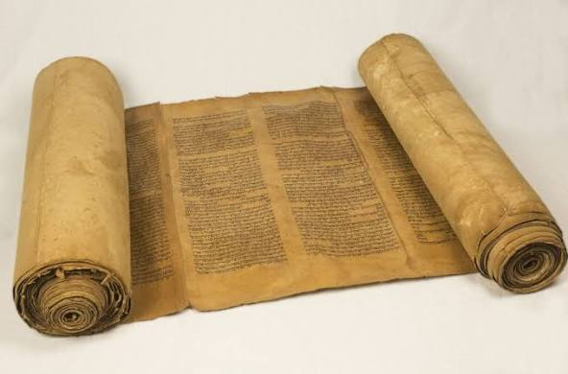
9. Where is this narrative recorded? (Lesson 16)
Genesis 28:1
And Isaac called Jacob, and blessed him, and charged him, and said unto him, Thou shalt not take a wife of the daughters of Canaan.

Slide 36
10. Relate the circumstances of Jacob’s wrestling with the angel.

Slide 37
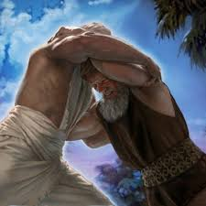
10. Relate the circumstances of Jacob’s wrestling with the angel. (Lesson 17)
Genesis 32:24
And Jacob was left alone; and there wrestled a man with him until the breaking of the day.

Slide 38
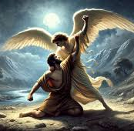
10. Relate the circumstances of Jacob’s wrestling with the angel. (Lesson 17)
Genesis 32:25
And when he saw that he prevailed not against him, he touched the hollow of his thigh; and the hollow of Jacob’s thigh was out of joint, as he wrestled with him.

Slide 39
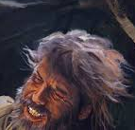
10. Relate the circumstances of Jacob’s wrestling with the angel. (Lesson 17)
Genesis 32:26
And he said, Let me go, for the day breaketh. And he said, I will not let thee go, except thou bless me.

Slide 40
11. Who was the angel?

Slide 41
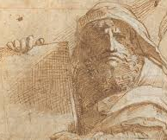
11. Who was the angel? (Lesson 17)
Hosea 12:2
The Lord hath also a controversy with Judah, and will punish Jacob according to his ways; according to his doings will he recompense him.

Slide 42
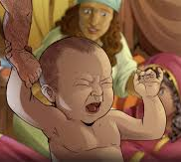
11. Who was the angel? (Lesson 17)
Hosea 12:3
He took his brother by the heel in the womb, and by his strength he had power with God:

Slide 43
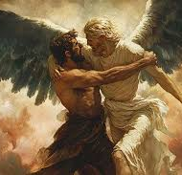
11. Who was the angel? (Lesson 17)
Hosea 12:4
Yea, he had power over the angel, and prevailed: he wept, and made supplication unto him: he found him in Bethel, and there he spake with us;

Slide 44
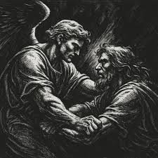
11. Who was the angel? (Lesson 17)
Hosea 12:5
Even the Lord God of hosts; the Lord is his memorial.

Slide 45
12. What was the cause of Jacob’s importunity, and what did he receive?

Slide 46
12. What was the cause of Jacob’s importunity, and what did he receive? (Lesson 17)
Genesis 32:26
And he said, Let me go, for the day breaketh. And he said, I will not let thee go, except thou bless me.

Slide 47
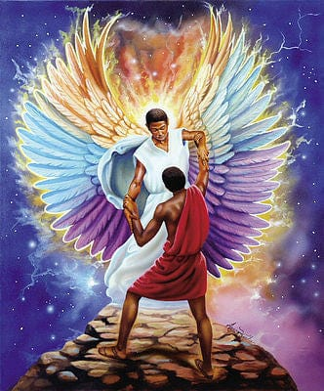
12. What was the cause of Jacob’s importunity, and what did he receive? (Lesson 17)
Genesis 32:27
And he said unto him, What is thy name? And he said, Jacob.

Slide 48
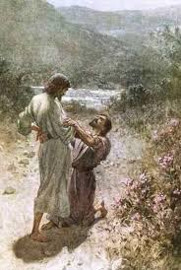
12. What was the cause of Jacob’s importunity, and what did he receive? (Lesson 17)
Genesis 32:28
And he said, Thy name shall be called no more Jacob, but Israel: for as a prince hast thou power with God and with men, and hast prevailed.

Slide 49
13. For what purpose was this narrative recorded?

Slide 50

13. For what purpose was this narrative recorded? (Lesson 17)
Hosea 12:6
Therefore turn thou to thy God: keep mercy and judgment, and wait on thy God continually.

Slide 51
14. What led to Joseph’s being sold into Egypt?

Slide 52
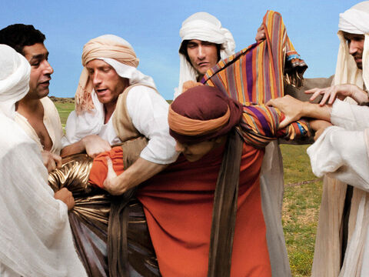
14. What led to Joseph’s being sold into Egypt? (Lesson 18)
Acts 7:9
And the patriarchs, moved with envy, sold Joseph into Egypt: but God was with him,

Slide 53
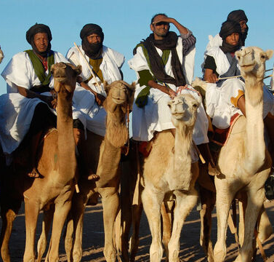
14. What led to Joseph’s being sold into Egypt? (Lesson 18)
Genesis 37:28
Then there passed by Midianites merchantmen; and they drew and lifted up Joseph out of the pit, and sold Joseph to the Ishmeelites for twenty pieces of silver: and they brought Joseph into Egypt.

Slide 54
15. How did he suffer there, and what for?

Slide 55
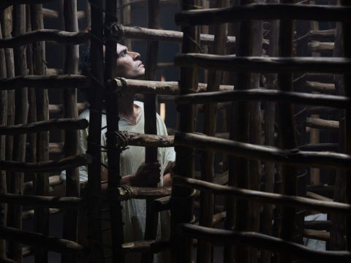
15. How did he suffer there, and what for? (Lesson 19)
Genesis 39:20
And Joseph’s master took him, and put him into the prison, a place where the king’s prisoners were bound: and he was there in the prison.

Slide 56
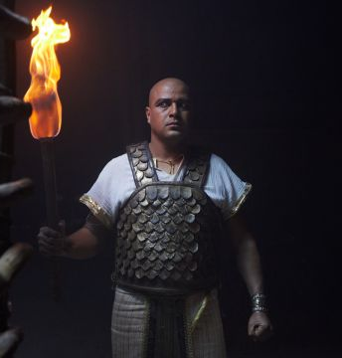
15. How did he suffer there, and what for? (Lesson 19)
Genesis 39:21
But the Lord was with Joseph, and shewed him mercy, and gave him favour in the sight of the keeper of the prison.

Slide 57
16. What subsequent position did he occupy?

Slide 58
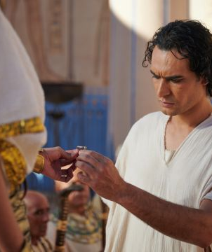
16. What subsequent position did he occupy? (Lesson 20)
Genesis 41:40
Thou shalt be over my house, and according unto thy word shall all my people be ruled: only in the throne will I be greater than thou.

Slide 59
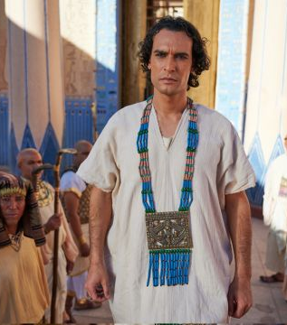
16. What subsequent position did he occupy? (Lesson 20)
Genesis 41:41
And Pharaoh said unto Joseph, See, I have set thee over all the land of Egypt.

Slide 60
17. What was the real cause of Joseph’s prosperity?

Slide 61
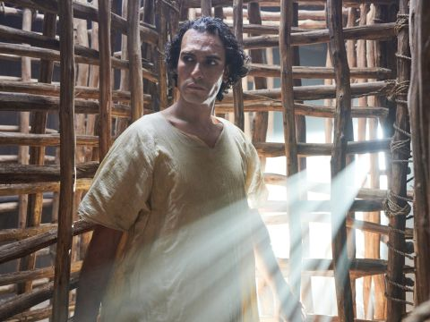
17. What was the real cause of Joseph’s prosperity? (Lesson 19)
Genesis 39:2
And the Lord was with Joseph, and he was a prosperous man; and he was in the house of his master the Egyptian.

Slide 62
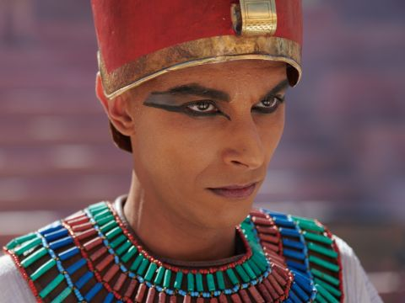
17. What was the real cause of Joseph’s prosperity? (Lesson 19)
Proverbs 16:7
When a man’s ways please the Lord, he maketh even his enemies to be at peace with him.

Slide 63
18. Show how God overruled the purposes of wicked men for good.

Slide 64
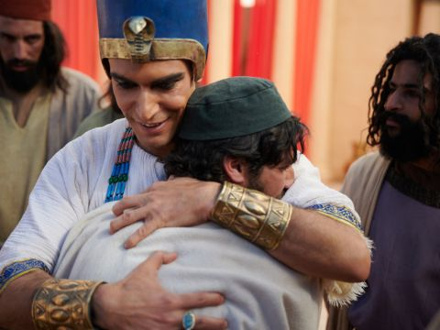
18. Show how God overruled the purposes of wicked men for good. (Lesson 21)
Genesis 50:20
But as for you, ye thought evil against me; but God meant it unto good, to bring to pass, as it is this day, to save much people alive.

Slide 65
19. How did the Israelites come to settle in the land of Egypt?

Slide 66
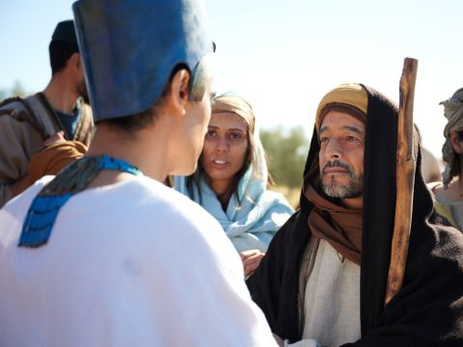
19. How did the Israelites come to settle in the land of Egypt? (Lesson 22)
Genesis 45:9
Haste ye, and go up to my father, and say unto him, Thus saith thy son Joseph, God hath made me lord of all Egypt: come down unto me, tarry not:

Slide 67
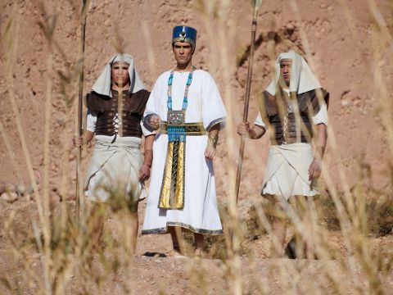
19. How did the Israelites come to settle in the land of Egypt? (Lesson 22)
Genesis 45:10
And thou shalt dwell in the land of Goshen, and thou shalt be near unto me, thou, and thy children, and thy children’s children, and thy flocks, and thy herds, and all that thou hast:

Slide 68
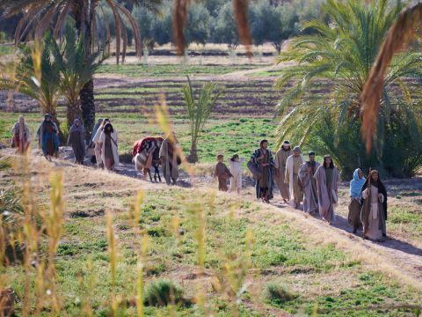
19. How did the Israelites come to settle in the land of Egypt? (Lesson 22)
Genesis 45:11
And there will I nourish thee; for yet there are five years of famine; lest thou, and thy household, and all that thou hast, come to poverty.

Slide 69
20. After they became very numerous, what was done to them?

Slide 70
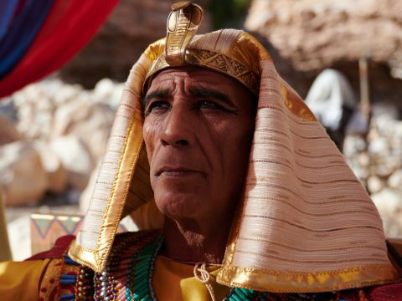
20. After they became very numerous, what was done to them? (Lesson 22)
Exodus 1:8
Now there arose up a new king over Egypt, which knew not Joseph.

Slide 71
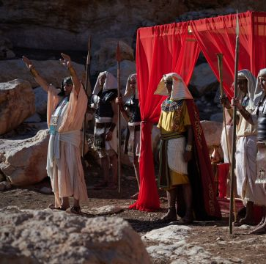
20. After they became very numerous, what was done to them? (Lesson 22)
Exodus 1:9
And he said unto his people, Behold, the people of the children of Israel are more and mightier than we:

Slide 72
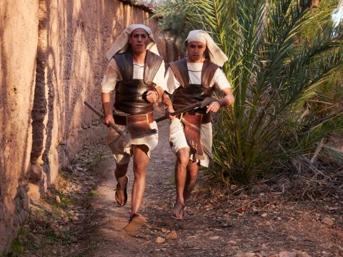
20. After they became very numerous, what was done to them? (Lesson 22)
Exodus 1:10
Come on, let us deal wisely with them; lest they multiply, and it come to pass, that, when there falleth out any war, they join also unto our enemies, and fight against us, and so get them up out of the land.

Slide 73
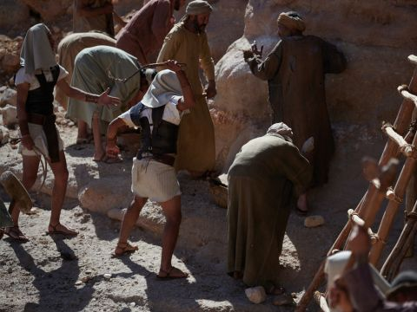
20. After they became very numerous, what was done to them? (Lesson 22)
Exodus 1:11
Therefore they did set over them taskmasters to afflict them with their burdens. And they built for Pharaoh treasure cities, Pithom and Raamses.

Slide 74
20. After they became very numerous, what was done to them? (Lesson 22)
Exodus 1:12
But the more they afflicted them, the more they multiplied and grew. And they were grieved because of the children of Israel.

Slide 75
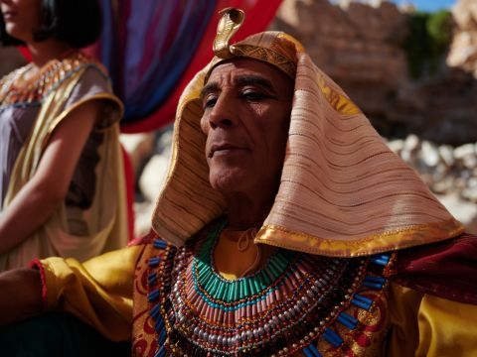
20. After they became very numerous, what was done to them? (Lesson 22)
Exodus 1:13
And the Egyptians made the children of Israel to serve with rigour:

Slide 76
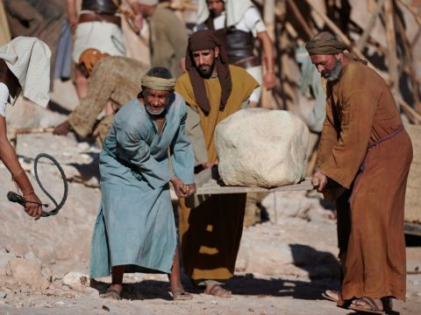
20. After they became very numerous, what was done to them? (Lesson 22)
Exodus 1:14
And they made their lives bitter with hard bondage, in morter, and in brick, and in all manner of service in the field: all their service, wherein they made them serve, was with rigour.

Slide 77
21. Tell how Moses was fitted for the work of delivering the people.

Slide 78
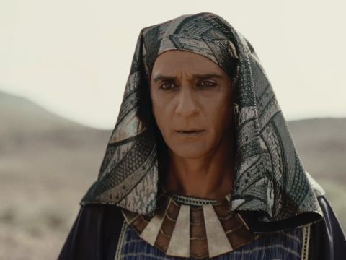
21. Tell how Moses was fitted for the work of delivering the people. (Lessons 23–24)
Acts 7:22
And Moses was learned in all the wisdom of the Egyptians, and was mighty in words and in deeds.

Slide 79
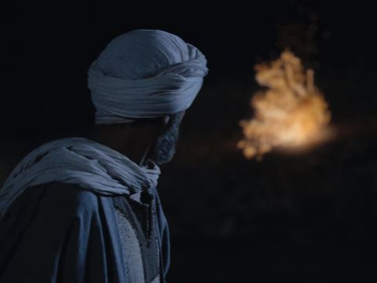
21. Tell how Moses was fitted for the work of delivering the people. (Lessons 23–24)
Acts 7:30
And when forty years were expired, there appeared to him in the wilderness of mount Sina an angel of the Lord in a flame of fire in a bush.

Slide 80
22. Relate the circumstances of his call to return to Egypt to deliver Israel.

Slide 81

22. Relate the circumstances of his call to return to Egypt to deliver Israel. (Lesson 24)
Exodus 3:2
And the angel of the Lord appeared unto him in a flame of fire out of the midst of a bush: and he looked, and, behold, the bush burned with fire, and the bush was not consumed.

Slide 82

22. Relate the circumstances of his call to return to Egypt to deliver Israel. (Lesson 24)
Exodus 3:7
And the Lord said, I have surely seen the affliction of my people which are in Egypt, and have heard their cry by reason of their taskmasters; for I know their sorrows;

Slide 83

22. Relate the circumstances of his call to return to Egypt to deliver Israel. (Lesson 24)
Exodus 3:8
And I am come down to deliver them out of the hand of the Egyptians, and to bring them up out of that land unto a good land and a large, unto a land flowing with milk and honey; unto the place of the Canaanites, and the Hittites, and the Amorites, and the Perizzites, and the Hivites, and the Jebusites.

Slide 84

22. Relate the circumstances of his call to return to Egypt to deliver Israel. (Lesson 24)
Exodus 3:10
Come now therefore, and I will send thee unto Pharaoh, that thou mayest bring forth my people the children of Israel out of Egypt.

Slide 85
23. What was God’s special object in delivering his people?

Slide 86

23. What was God’s special object in delivering his people? (Lesson 25)
Exodus 4:23
And I say unto thee, Let my son go, that he may serve me: and if thou refuse to let him go, behold, I will slay thy son, even thy firstborn.

Slide 87

23. What was God’s special object in delivering his people? (Lesson 25)
Psalm 105:43
And he brought forth his people with joy, and his chosen with gladness:

Slide 88

23. What was God’s special object in delivering his people? (Lesson 25)
Psalm 105:44
And gave them the lands of the heathen: and they inherited the labour of the people;

Slide 89

23. What was God’s special object in delivering his people? (Lesson 25)
Psalm 105:45
That they might observe his statutes, and keep his laws. Praise ye the Lord.

Slide 90


Slide 91
Quarterly Review Complete!!
Thank you and
HAPPY SABBATH!

