Slide 1


Slide 2


Slide 3
Old Testament History
Lesson 1: January 5, 1889

Slide 4
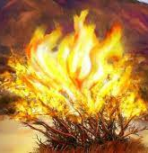
1. Under what circumstances did the Lord appear to Moses at Horeb?
Exodus 3:1-6

Slide 5
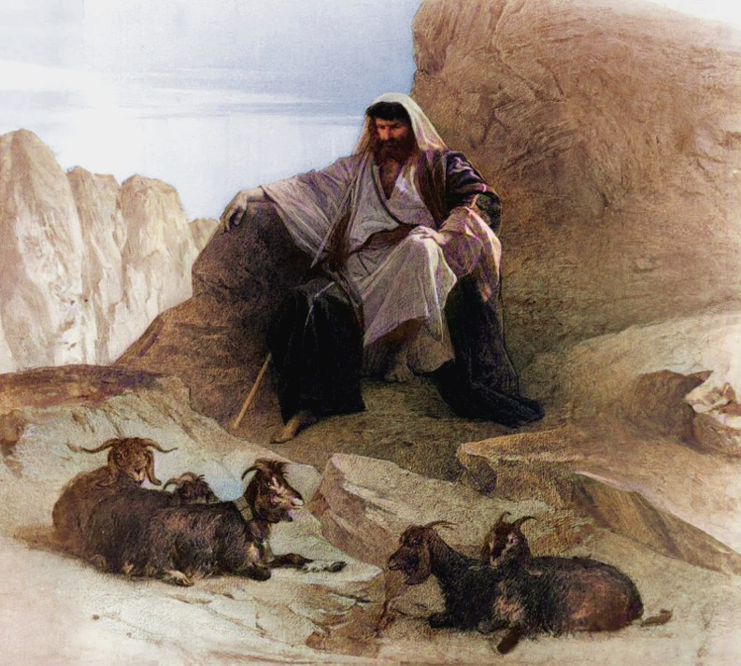
Exodus 3:1-6
3 Now Moses kept the flock of Jethro his father in law, the priest of Midian: and he led the flock to the backside of the desert, and came to the mountain of God, even to Horeb.

Slide 6
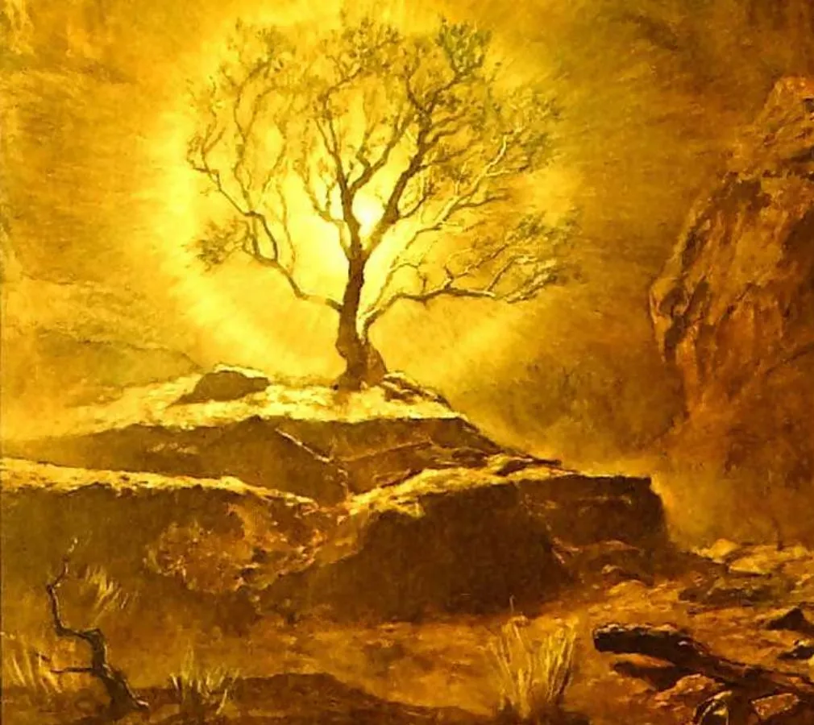
Exodus 3:1-6
² And the angel of the Lord appeared unto him in a flame of fire out of the midst of a bush: and he looked, and, behold, the bush burned with fire, and the bush was not consumed.

Slide 7
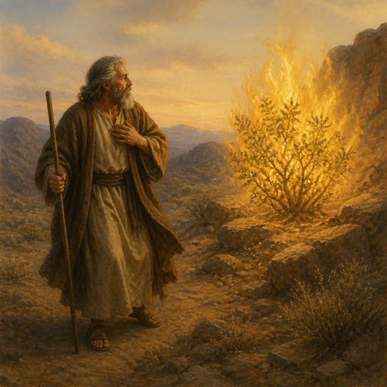
Exodus 3:1-6
³ And Moses said, I will now turn aside, and see this great sight, why the bush is not burnt.

Slide 8
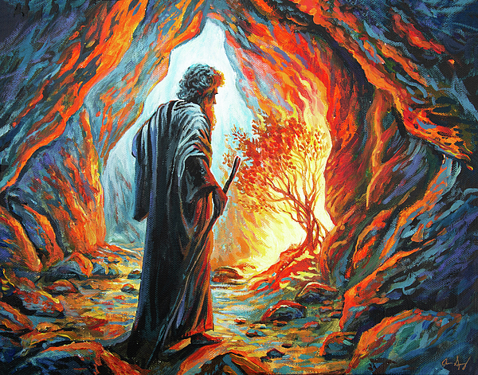
Exodus 3:1-6
⁴ And when the Lord saw that he turned aside to see, God called unto him out of the midst of the bush, and said, Moses, Moses. And he said, Here am I.

Slide 9
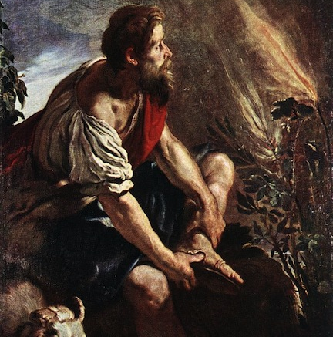
Exodus 3:1-6
⁵ And he said, Draw not nigh hither: put off thy shoes from off thy feet, for the place whereon thou standest is holy ground.

Slide 10
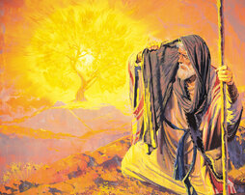
Exodus 3:1-6
⁶ Moreover he said, I am the God of thy father, the God of Abraham, the God of Isaac, and the God of Jacob. And Moses hid his face; for he was afraid to look upon God.

Slide 11
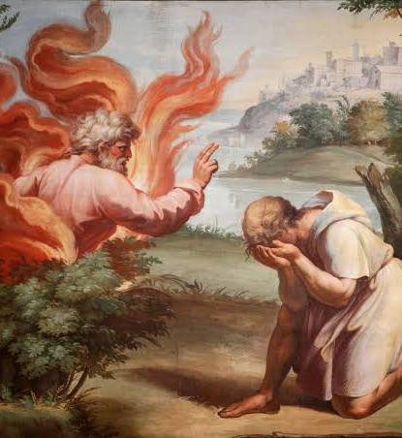
The Angel of the Lord
The context (vs. 4-6, 14) makes it clear that this “angel of the Lord” was the Lord Himself, the second person of the Godhead (see PP 252, 311, 366). Already in Abraham’s time the Lord had revealed Himself under this form and name.

Slide 12
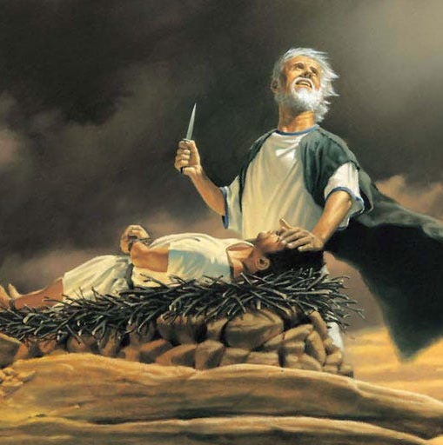
The Angel of the Lord
¹⁰ And Abraham stretched forth his hand, and took the knife to slay his son.
¹¹ And the angel of the Lord called unto him out of heaven, and said, Abraham, Abraham: and he said, Here am I.

Slide 13
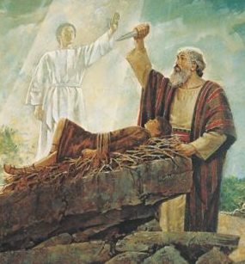
The Angel of the Lord
¹² And he said, Lay not thine hand upon the lad, neither do thou any thing unto him: for now I know that thou fearest God, seeing thou hast not withheld thy son, thine only son from me.

Slide 14
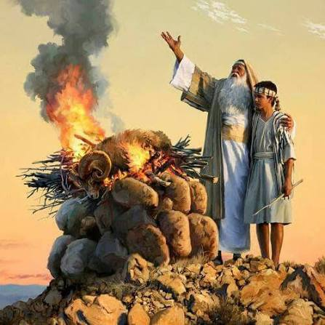
The Angel of the Lord
¹³ And Abraham lifted up his eyes, and looked, and behold behind him a ram caught in a thicket by his horns: and Abraham went and took the ram, and offered him up for a burnt offering in the stead of his son.

Slide 15
The Angel of the Lord
¹⁴ And Abraham called the name of that place Jehovahjireh [The Lord will provide]: as it is said to this day, In the mount of the Lord it shall be seen.

Slide 16
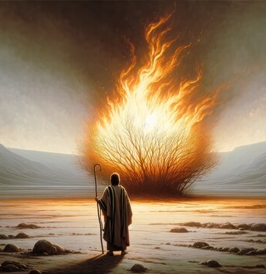
2. For what purpose did the Lord appear to him?
Exodus 3:7-10

Slide 17
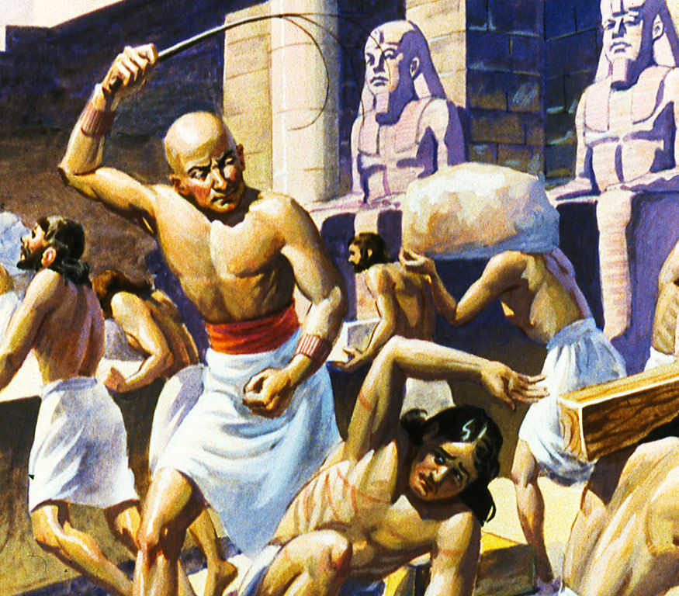
Exodus 3:7-10
⁷ And the Lord said, I have surely seen the affliction of my people which are in Egypt, and have heard their cry by reason of their taskmasters; for I know their sorrows;

Slide 18
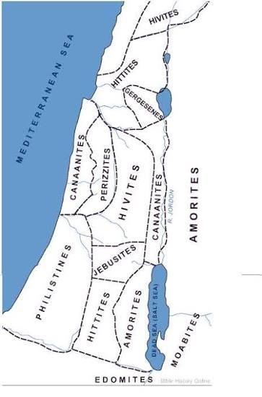
Exodus 3:7-10
⁸ And I am come down to deliver them out of the hand of the Egyptians, and to bring them up out of that land unto a good land and a large, unto a land flowing with milk and honey; unto the place of the Canaanites, and the Hittites, and the Amorites, and the Perizzites, and the Hivites, and the Jebusites.

Slide 19
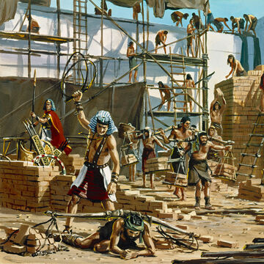
Exodus 3:7-10
⁹ Now therefore, behold, the cry of the children of Israel is come unto me: and I have also seen the oppression wherewith the Egyptians oppress them.

Slide 20
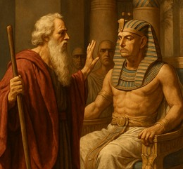
Exodus 3:7-10
¹⁰ Come now therefore, and I will send thee unto Pharaoh, that thou mayest bring forth my people the children of Israel out of Egypt.

Slide 21
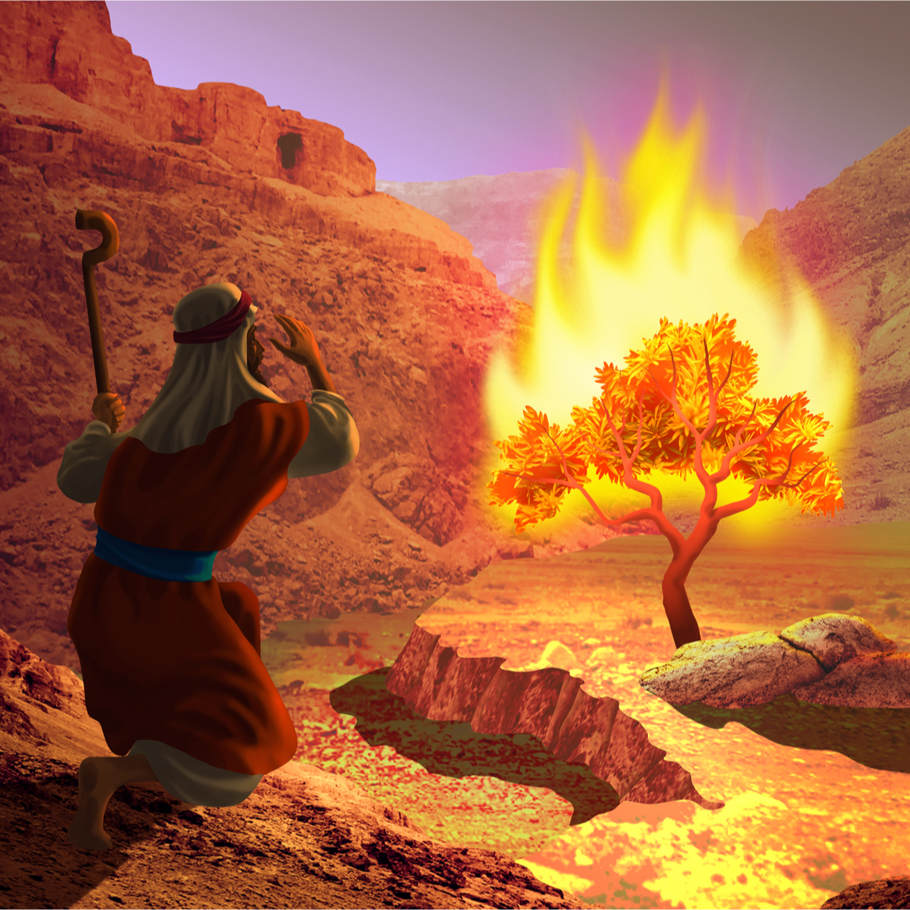
3. By what name did the Lord say He would be known?
Exodus 3:13-15

Slide 22
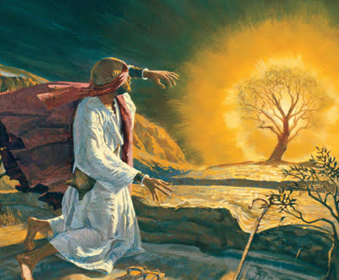
Exodus 3:13-15
¹³ And Moses said unto God, Behold, when I come unto the children of Israel, and shall say unto them, The God of your fathers hath sent me unto you; and they shall say to me, What is his name? what shall I say unto them?

Slide 23
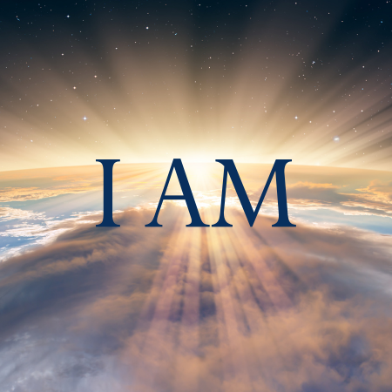
Exodus 3:13-15
¹⁴ And God said unto Moses, I Am That I Am: and he said, Thus shalt thou say unto the children of Israel, I Am hath sent me unto you.

Slide 24
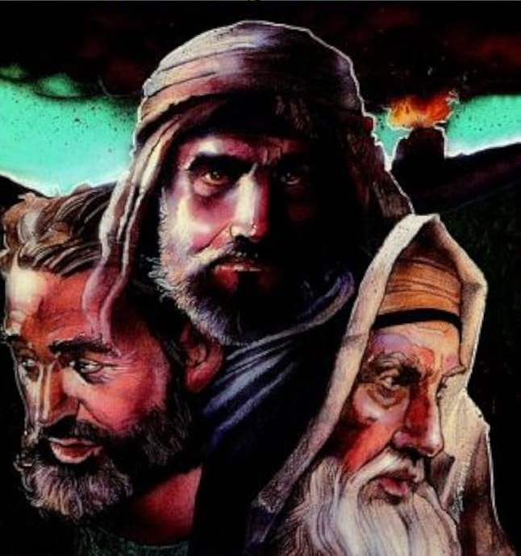
Exodus 3:13-15
¹⁵ And God said moreover unto Moses, Thus shalt thou say unto the children of Israel, the Lord God of your fathers, the God of Abraham, the God of Isaac, and the God of Jacob, hath sent me unto you: this is my name for ever, and this is my memorial unto all generations.

Slide 25
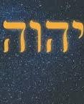
From the Hebrew word translated as “I am” comes the derived form Yahweh. Yahweh is rather consistently rendered “Lord,” by the KJV, with the whole word in capital and small capital letters as it appears here. The ASV of 1901 transliterates Yahweh as “Jehovah.”

Slide 26
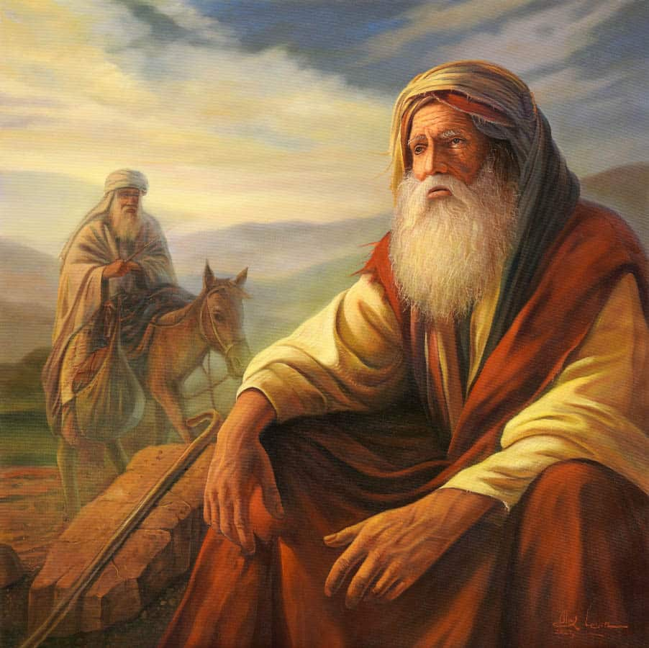
The name by which God had revealed Himself to their fathers could not have vanished entirely from memory (Gen. 4:26; 12:8; 22:14), and the mere mention of God’s name could not have been of much help to Moses.

Slide 27
Moses' mother was Jochebed (Yokheved)
Usually understood as containing a shortened form of YHWH (Yo/Yah) + "glory."
“YHWH is glory” or “the LORD is glory.”
If this understanding of Jochebed’s name is correct, Moses’ own mother’s name testified to Jehovah!

Slide 28
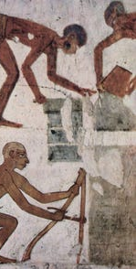
Has the God of Abraham lost? Has He forgotten us? Is He still our God?
Ancient nations generally connected the fortunes of a people with the power of their god(s). Victory in battle was often interpreted as a victory of one nation's deity over another. Defeat, exile, or enslavement raised the question: Where is your god now?

Slide 29
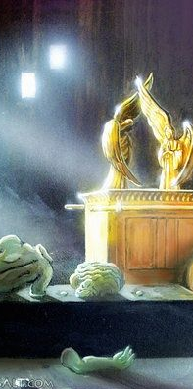
When the Philistines captured the ark:
“And when the Philistines took the ark of God, they brought it into the house of Dagon...” (1 Samuel 5:2)
The symbolism is obvious: Israel's God has been captured and placed before Dagon. But the next morning Dagon is fallen before the ark. God reverses the assumption.

Slide 30
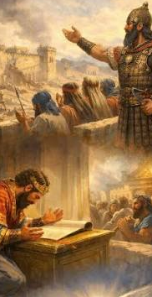
The same idea appears with Assyria:
“Who are they among all the gods of the countries, that have delivered their country out of mine hand, that the LORD should deliver Jerusalem out of mine hand?”
(2 Kings 18:35)
The Assyrian logic is:
“I defeated those nations. Their gods couldn't save them. Why would yours?”

Slide 31
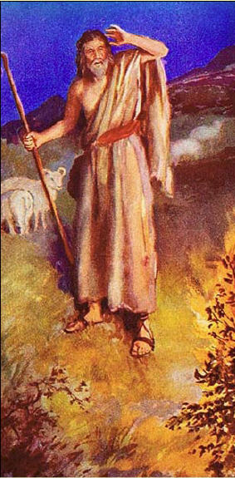
So Moses is not asking merely:
“What sounds should I use to identify You?”
It is more like:
“When they ask, ‘Who is this God of our fathers who has allowed us to remain in bondage for generations? What does His name mean now?’ — what shall I tell them?”

Slide 32
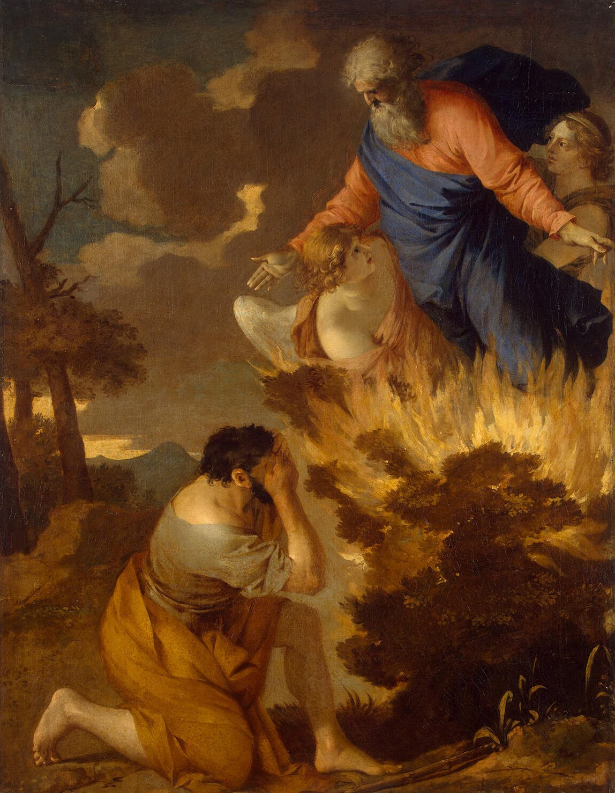
And God answers:
“I AM THAT I AM.”
The passing of centuries has not diminished Him. Egypt's power has not threatened Him. Israel's slavery has not changed His covenant.

Slide 33
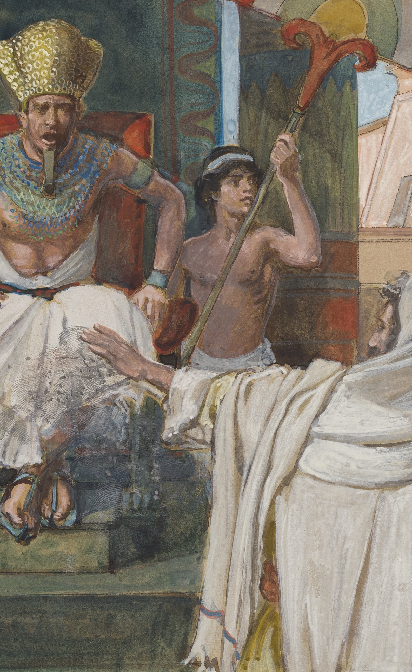
This also sets up the plagues. They are not simply punishments; they are a revelation.
“Against all the gods of Egypt I will execute judgment: I am the LORD.” (Exodus 12:12)

Slide 34
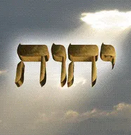
4. What is the significance of this name?

Slide 35
Answer: The One who is; the self-existent and eternal One.

Slide 36
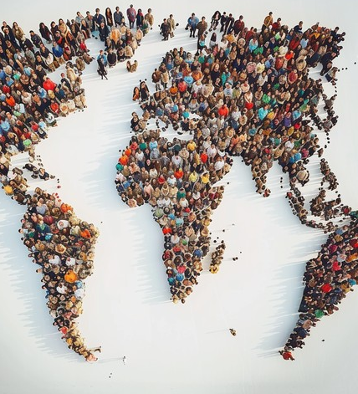
Colossians 1:16-17
¹⁶ For by him were all things created, that are in heaven, and that are in earth, visible and invisible, whether they be thrones, or dominions, or principalities, or powers: all things were created by him, and for him:
¹⁷ And he is before all things, and by him all things consist.

Slide 37
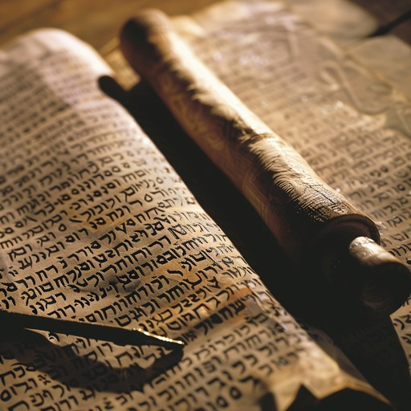
5. What similar terms do we find in the New Testament?
Revelation 1:4; Hebrews 13:8

Slide 38
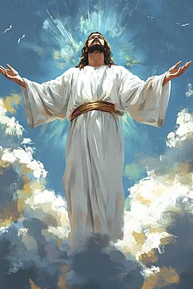
Revelation 1:4
⁴ John to the seven churches which are in Asia: Grace be unto you, and peace, from him which is, and which was, and which is to come; and from the seven Spirits which are before his throne;

Slide 39
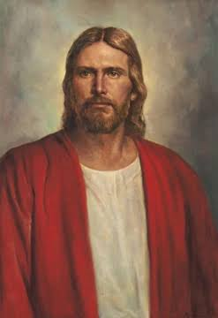
Hebrews 13:8
⁸ Jesus Christ the same yesterday, and to day, and for ever.

Slide 40

6. What sign was given to Moses, by which the Israelites might know that the Lord had appeared to him?
Exodus 4:1-5

Slide 41
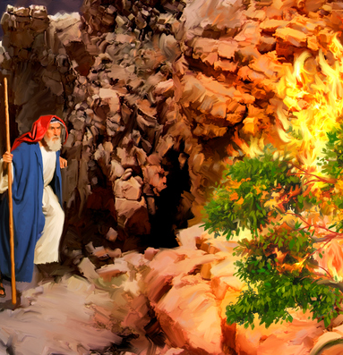
Exodus 4:1-5
4 And Moses answered and said, But, behold, they will not believe me, nor hearken unto my voice: for they will say, The Lord hath not appeared unto thee.

Slide 42
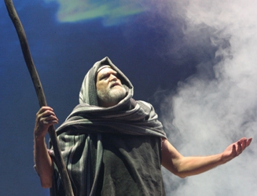
Exodus 4:1-5
² And the Lord said unto him, What is that in thine hand? And he said, A rod.

Slide 43
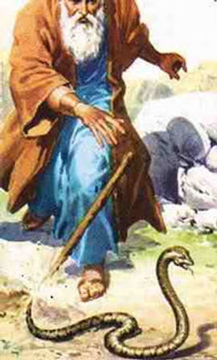
Exodus 4:1-5
³ And he said, Cast it on the ground. And he cast it on the ground, and it became a serpent; and Moses fled from before it.

Slide 44
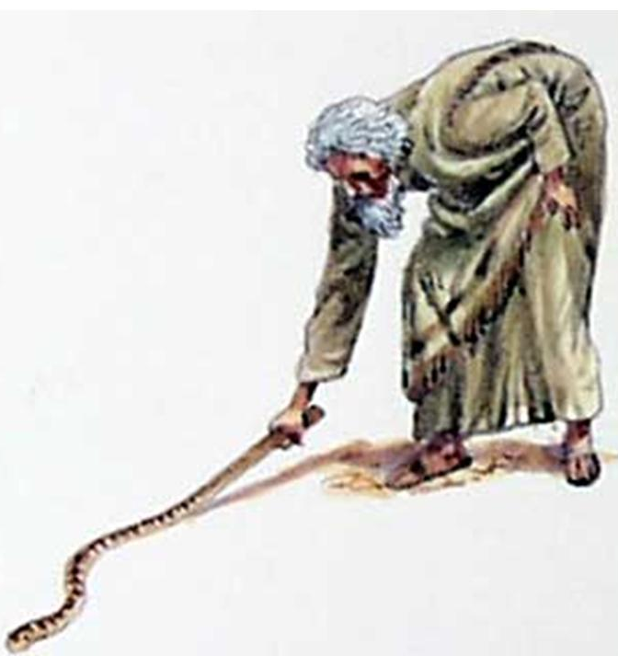
Exodus 4:1-5
⁴ And the Lord said unto Moses, Put forth thine hand, and take it by the tail. And he put forth his hand, and caught it, and it became a rod in his hand:

Slide 45
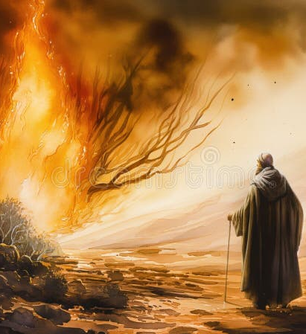
Exodus 4:1-5
⁵ That they may believe that the Lord God of their fathers, the God of Abraham, the God of Isaac, and the God of Jacob, hath appeared unto thee.

Slide 46

7. What additional sign was given?
Exodus 4:6, 7

Slide 47
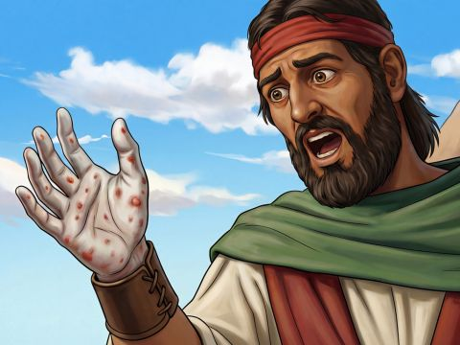
Exodus 4:6, 7
⁶ And the Lord said furthermore unto him, Put now thine hand into thy bosom. And he put his hand into his bosom: and when he took it out, behold, his hand was leprous as snow.

Slide 48
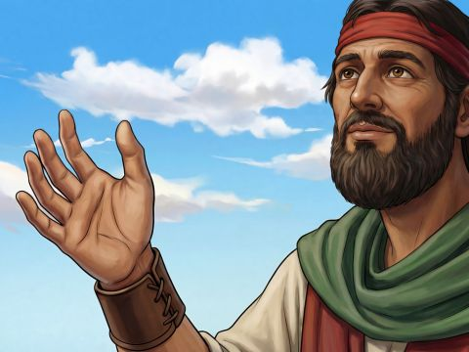
Exodus 4:6, 7
⁷ And he said, Put thine hand into thy bosom again. And he put his hand into his bosom again; and plucked it out of his bosom, and, behold, it was turned again as his other flesh.

Slide 49

Witnesses: Exodus 4:8
⁸ And it shall come to pass, if they will not believe thee, neither hearken to the voice of the first sign, that they will believe the voice of the latter sign.

Slide 50

8. What further sign was Moses to give in case the Israelites should not believe the first two?
Exodus 4:9.

Slide 51
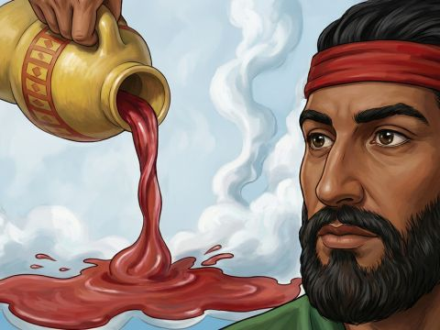
Exodus 4:9
⁹ And it shall come to pass, if they will not believe also these two signs, neither hearken unto thy voice, that thou shalt take of the water of the river, and pour it upon the dry land: and the water which thou takest out of the river shall become blood upon the dry land.

Slide 52
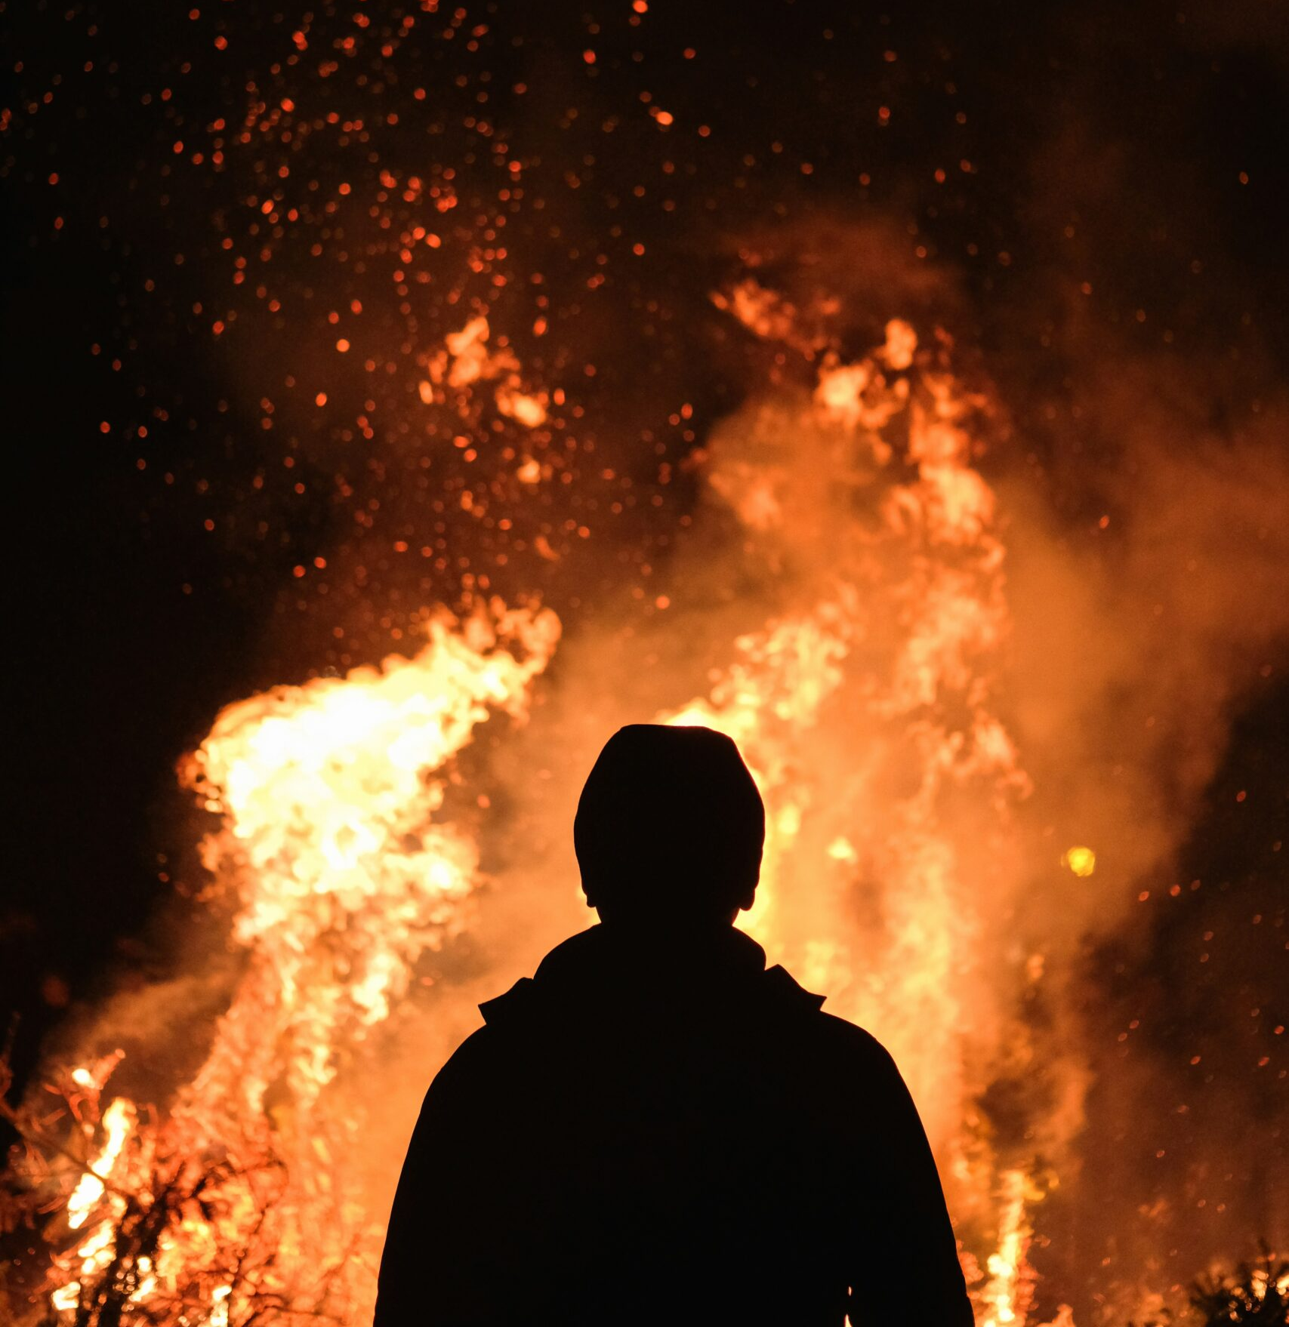
9. What excuse did Moses then make?
Exodus 4:10.

Slide 53
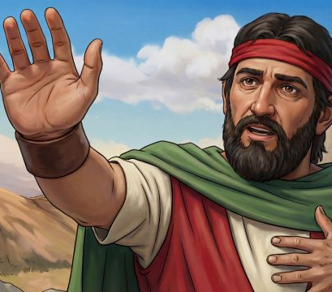
Exodus 4:10
¹⁰ And Moses said unto the Lord, O my Lord, I am not eloquent, neither heretofore, nor since thou hast spoken unto thy servant: but I am slow of speech, and of a slow tongue.

Slide 54
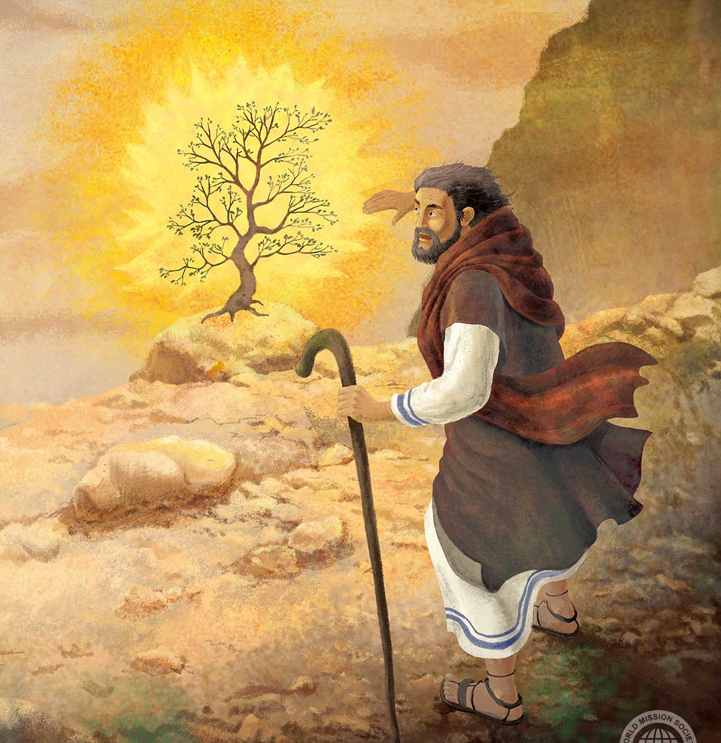
10. What rebuke and encouragement did the Lord give him?
Exodus 4:11, 12.

Slide 55
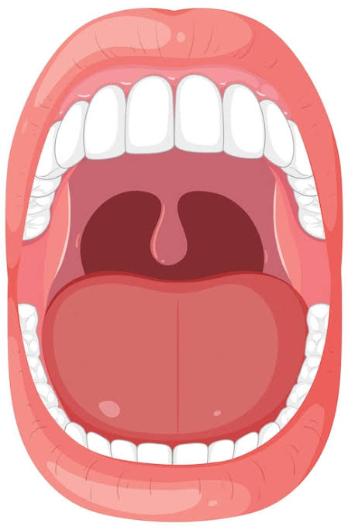
Exodus 4:11, 12
¹¹ And the Lord said unto him, Who hath made man's mouth? or who maketh the dumb, or deaf, or the seeing, or the blind? have not I the Lord?

Slide 56
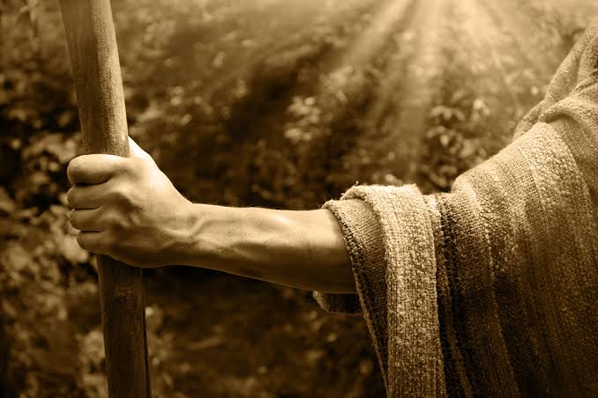
Exodus 4:11, 12
¹² Now therefore go, and I will be with thy mouth, and teach thee what thou shalt say.

Slide 57

11. What reply did Moses make?
Exodus 4:13, see marginal reading

Slide 58
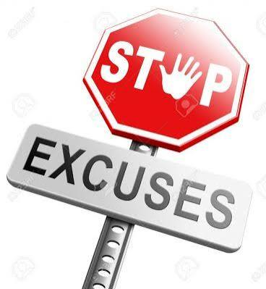
Exodus 4:13
¹³ And he said, O my Lord, send, I pray thee, by the hand of him whom thou wilt send.

Slide 59
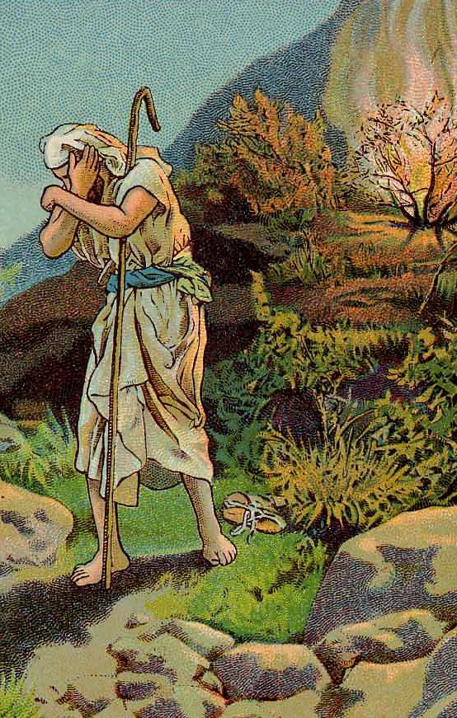
¹³ And he said, O my Lord, send, I pray thee, by the hand of him whom thou Shouldest send.
By saying "send by whomever you will," Moses is awkwardly dodging the call and effectively telling God, “Send somebody else—anyone but me.”

Slide 60
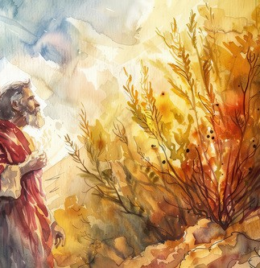
12. With what did Moses thus indirectly charge God?
See note.

Slide 61

When Moses said to the Lord, "Send, I pray thee, by the hand of him whom thou shouldst send," he indirectly charged God with not knowing whom he ought to send. If the Lord had not seen that Moses was the best man for the place, he would not have selected him.

Slide 62
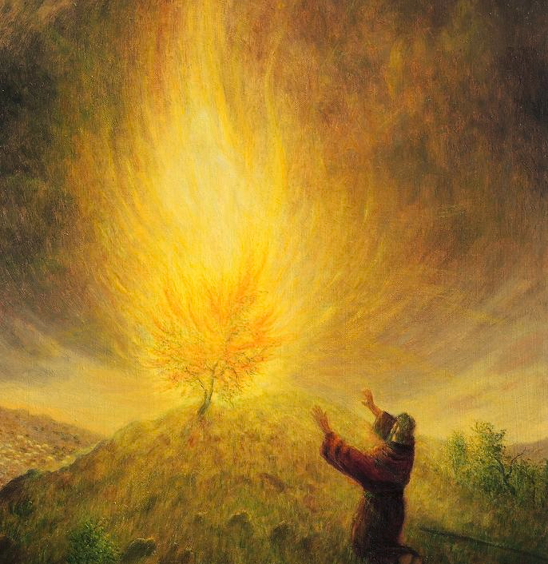
13. How did the Lord regard this?
Exodus 4:14, first clause

Slide 63

Exodus 4:14
¹⁴ And the anger of the Lord was kindled against Moses, and he said, Is not Aaron the Levite thy brother? I know that he can speak well. And also, behold, he cometh forth to meet thee: and when he seeth thee, he will be glad in his heart.

Slide 64

14. What further encouragement did He give Moses?
Exodus 4:14-16

Slide 65

Exodus 4:14-16
¹⁴ And the anger of the Lord was kindled against Moses, and he said, Is not Aaron the Levite thy brother? I know that he can speak well. And also, behold, he cometh forth to meet thee: and when he seeth thee, he will be glad in his heart.

Slide 66

Exodus 4:14-16
¹⁵ And thou shalt speak unto him, and put words in his mouth: and I will be with thy mouth, and with his mouth, and will teach you what ye shall do.

Slide 67

Exodus 4:14-16
¹⁶ And he shall be thy spokesman unto the people: and he shall be, even he shall be to thee instead of a mouth, and thou shalt be to him instead of God.

Slide 68

15. What practical lesson may we learn from this occurrence?
See note.

Slide 69

Moses said, essentially:
I am not important enough.
I do not know enough.
I am not convincing enough.
I am not eloquent enough.
And... those things were true!

Slide 70
God never says:
"Nonsense, Moses, you're amazing!"
"Believe in yourself!"
"You have everything you need inside you!"

Slide 71
Those modern motivational answers are almost the opposite of God’s response. He says:
"Certainly I will be with thee." and
“Who hath made man's mouth?... have not I the LORD?”

Slide 72

God does not call people because they are sufficient in themselves; He calls them so they may learn to depend on His sufficiency. True humility recognizes our weakness but trusts God's strength. False humility looks only at our weakness and refuses to believe what God can do through us.

Slide 73


Slide 74


Slide 75


