Slide 1


Slide 2


Slide 3
Resisting the Truth
Lesson 2: January 12, 1889

Slide 4
1. When Moses and Aaron delivered their message to Pharaoh, what answer did they get?
Exodus 5:1-2

Slide 5
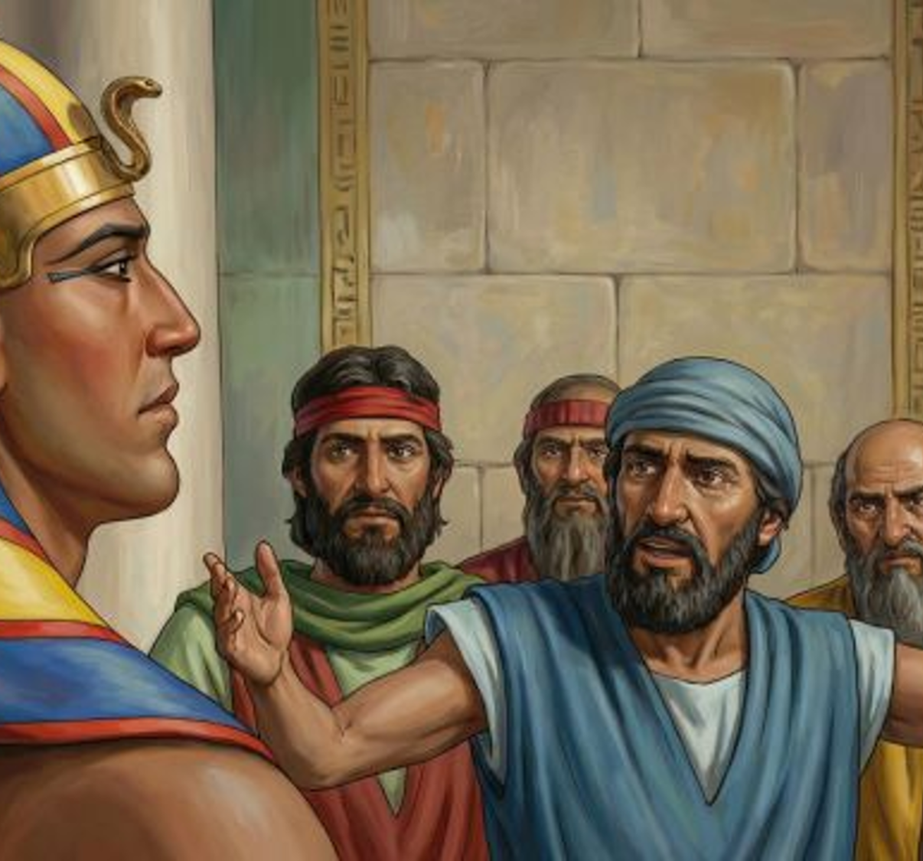
Exodus 5:1-2
5 And afterward Moses and Aaron went in, and told Pharaoh, Thus saith the Lord God of Israel, Let my people go, that they may hold a feast unto me in the wilderness.

Slide 6
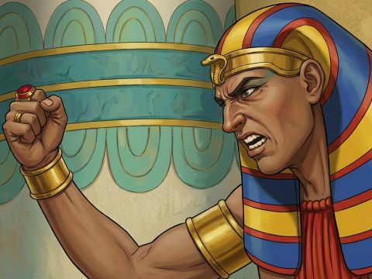
Exodus 5:1-2
² And Pharaoh said, Who is the Lord, that I should obey his voice to let Israel go? I know not the Lord, neither will I let Israel go.

Slide 7
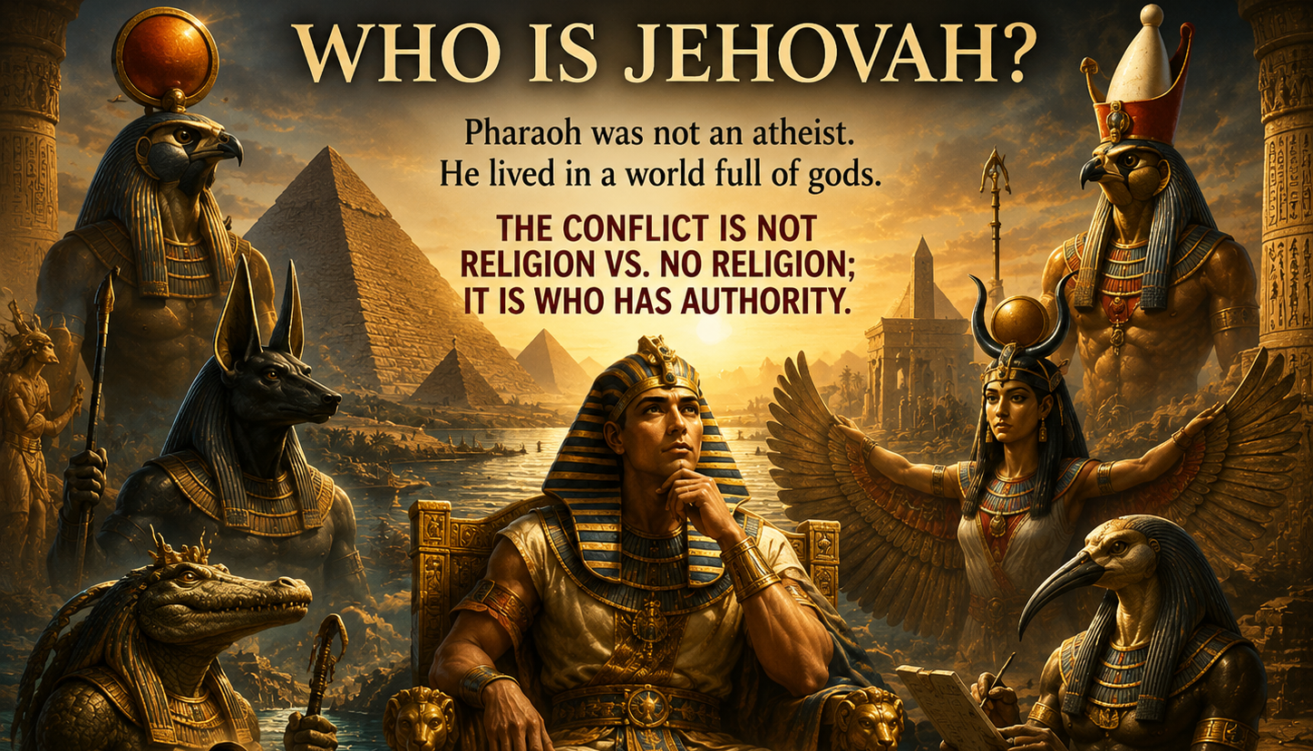

Slide 8
2. Of what did Pharaoh accuse them?
Exodus 5:4-5

Slide 9
Exodus 5:4-5
⁴ And the king of Egypt said unto them, Wherefore do ye, Moses and Aaron, let the people from their works? get you unto your burdens.

Slide 10
Exodus 5:4-5
⁵ And Pharaoh said, Behold, the people of the land now are many, and ye make them rest from their burdens.

Slide 11
3. What additional burden was placed on the Israelites in consequence?
Exodus 5:6-9

Slide 12
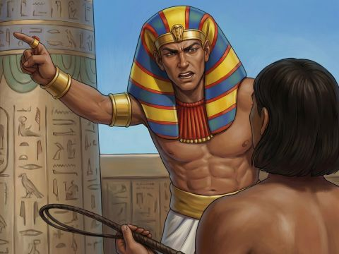
Exodus 5:6-9
⁶ And Pharaoh commanded the same day the taskmasters of the people, and their officers, saying,

Slide 13
Exodus 5:6-9
⁷ Ye shall no more give the people straw to make brick, as heretofore: let them go and gather straw for themselves.

Slide 14
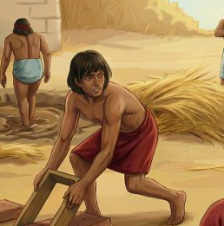
Exodus 5:6-9
⁸ And the tale of the bricks, which they did make heretofore, ye shall lay upon them; ye shall not diminish ought thereof: for they be idle; therefore they cry, saying, Let us go and sacrifice to our God.

Slide 15
Exodus 5:6-9
⁹ Let there more work be laid upon the men, that they may labour therein; and let them not regard vain words.

Slide 16
4. When Moses the second time repeated God's promise to the Israelites, how did they receive his words?
Exodus 6:9

Slide 17
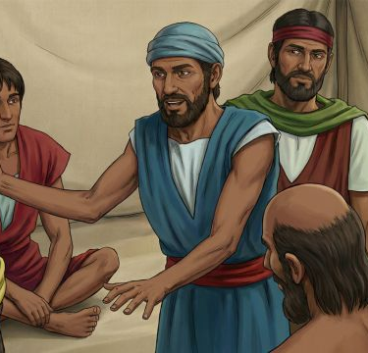
Exodus 6:9
⁹ And Moses spake so unto the children of Israel: but they hearkened not unto Moses for anguish of spirit, and for cruel bondage.

Slide 18
5. How did this make Moses feel about going again before Pharaoh?
Exodus 6:12

Slide 19
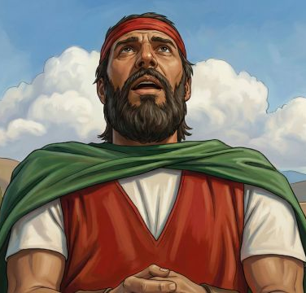
Exodus 6:12
¹² And Moses spake before the Lord, saying, Behold, the children of Israel have not hearkened unto me; how then shall Pharaoh hear me, who am of uncircumcised lips?

Slide 20
6. What assurance did the Lord give him?
Exodus 7:1

Slide 21
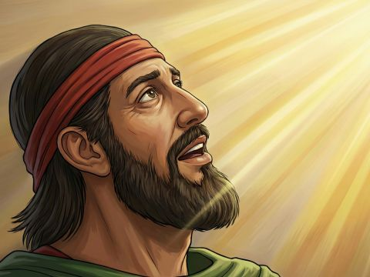
Exodus 7:1
7 And the Lord said unto Moses, See, I have made thee a god to Pharaoh: and Aaron thy brother shall be thy prophet.

Slide 22
7. What was meant by this?
Exodus 7:2, 4:16

Slide 23
Exodus 7:2
² Thou shalt speak all that I command thee: and Aaron thy brother shall speak unto Pharaoh, that he send the children of Israel out of his land.

Slide 24
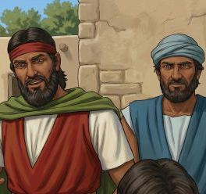
Exodus 4:16
¹⁶ And he shall be thy spokesman unto the people: and he shall be, even he shall be to thee instead of a mouth, and thou shalt be to him instead of God.

Slide 25
8. What was Moses told to do when Pharaoh should ask for a miracle?
Exodus 7:9

Slide 26
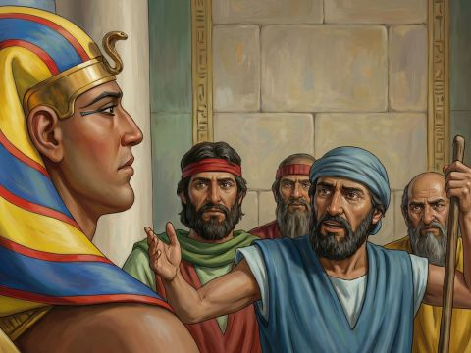
Exodus 7:9
⁹ When Pharaoh shall speak unto you, saying, Shew a miracle for you: then thou shalt say unto Aaron, Take thy rod, and cast it before Pharaoh, and it shall become a serpent.

Slide 27
9. When this miracle was performed, what did Pharaoh’s sorcerers do?
Exodus 7:10-12

Slide 28
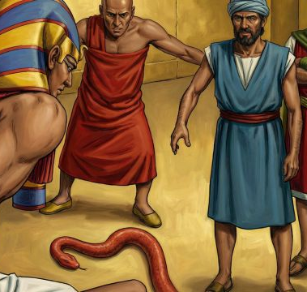
Exodus 7:10-12
¹⁰ And Moses and Aaron went in unto Pharaoh, and they did so as the Lord had commanded: and Aaron cast down his rod before Pharaoh, and before his servants, and it became a serpent.

Slide 29
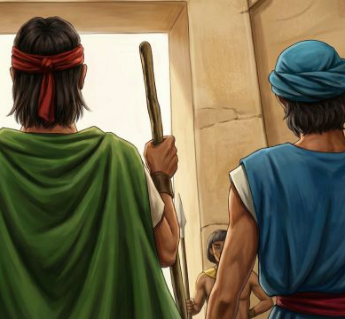
Exodus 7:10-12
¹¹ Then Pharaoh also called the wise men and the sorcerers: now the magicians of Egypt, they also did in like manner with their enchantments.

Slide 30
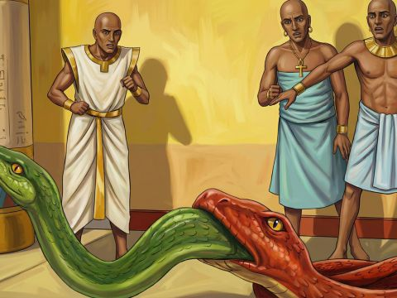
Exodus 7:10-12
¹² For they cast down every man his rod, and they became serpents: but Aaron's rod swallowed up their rods.

Slide 31
10. What manifestation of God’s power followed this act of the magicians?
Exodus 7:12, last clause

Slide 32
Exodus 7:12
¹² For they cast down every man his rod, and they became serpents: but Aaron's rod swallowed up their rods.

Slide 33
11. What effect did the rejection of this evidence have upon Pharaoh?
Exodus 7:13

Slide 34
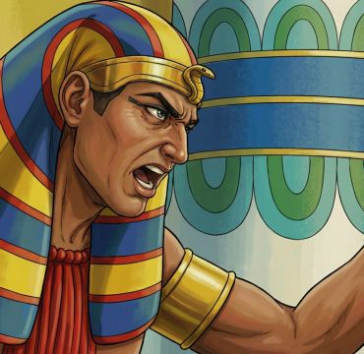
Exodus 7:13
¹³ And he hardened Pharaoh's heart, that he hearkened not unto them; as the Lord had said.

Slide 35
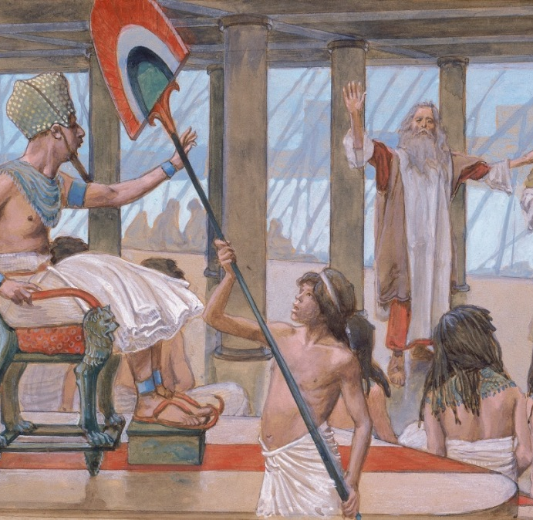
Exodus 7:13
Douay-Rheims 1899 American
¹³ And Pharao's heart was hardened, and he did not hearken to them, as the Lord had commanded.

Slide 36
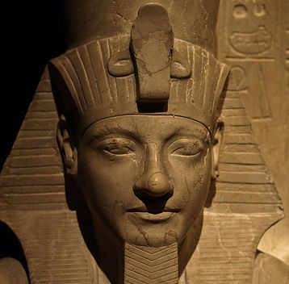
Exodus 7:13
1599 Geneva Bible
¹³ So Pharaoh’s heart was hardened, and he hearkened not to them, as the Lord had said.

Slide 37
12. What were Moses and Aaron told to do next?
Exodus 7:19

Slide 38
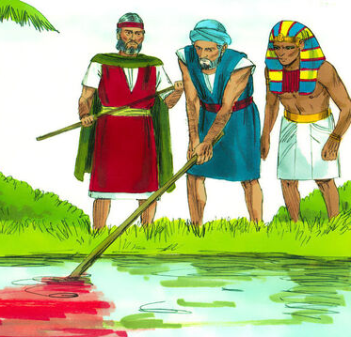
Exodus 7:19
¹⁹ And the Lord spake unto Moses, Say unto Aaron, Take thy rod, and stretch out thine hand upon the waters of Egypt, upon their streams, upon their rivers, and upon their ponds, and upon all their pools of water, that they may become blood; and that there may be blood throughout all the land of Egypt, both in vessels of wood, and in vessels of stone.

Slide 39
13. What was the result?
Exodus 7:20, 21

Slide 40
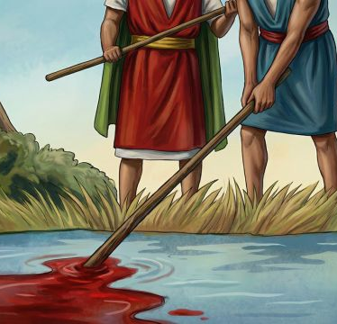
Exodus 7:20, 21
²⁰ And Moses and Aaron did so, as the Lord commanded; and he lifted up the rod, and smote the waters that were in the river, in the sight of Pharaoh, and in the sight of his servants; and all the waters that were in the river were turned to blood.

Slide 41
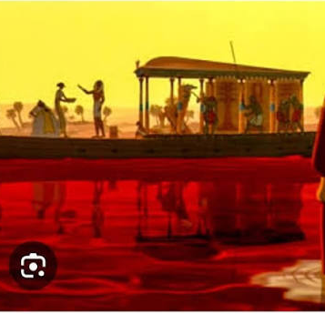
Exodus 7:20, 21
²¹ And the fish that was in the river died; and the river stank, and the Egyptians could not drink of the water of the river; and there was blood throughout all the land of Egypt.

Slide 42
14. What destroyed the effect of this miracle upon Pharaoh?
Exodus 7:22

Slide 43
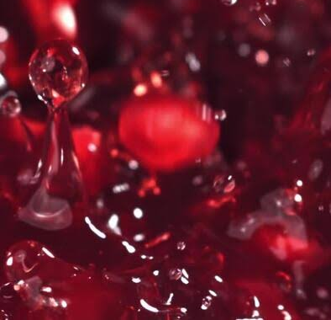
Exodus 7:22
²² And the magicians of Egypt did so with their enchantments: and Pharaoh's heart was hardened, neither did he hearken unto them; as the Lord had said.

Slide 44
15. What plague was next threatened, if the king should refuse to let the people go?
Exodus 8:1, 2

Slide 45
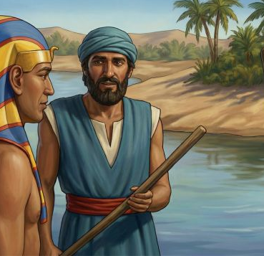
Exodus 8:1-2
8 And the Lord spake unto Moses, Go unto Pharaoh, and say unto him, Thus saith the Lord, Let my people go, that they may serve me.

Slide 46
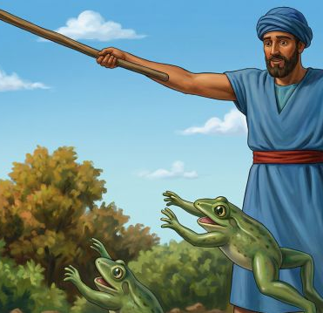
Exodus 8:1-2
² And if thou refuse to let them go, behold, I will smite all thy borders with frogs:

Slide 47
16. Was this done?
Exodus 8:5, 6

Slide 48
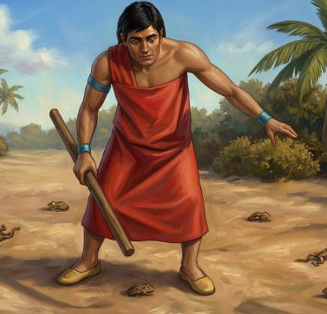
Exodus 8:5-6
⁵ And the Lord spake unto Moses, Say unto Aaron, Stretch forth thine hand with thy rod over the streams, over the rivers, and over the ponds, and cause frogs to come up upon the land of Egypt.

Slide 49
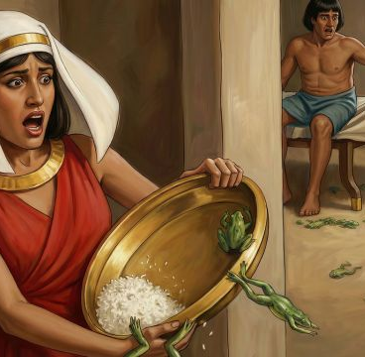
Exodus 8:5-6
⁶ And Aaron stretched out his hand over the waters of Egypt; and the frogs came up, and covered the land of Egypt.

Slide 50
17. How severe was this plague?
Exodus 8:3, 4, 6

Slide 51
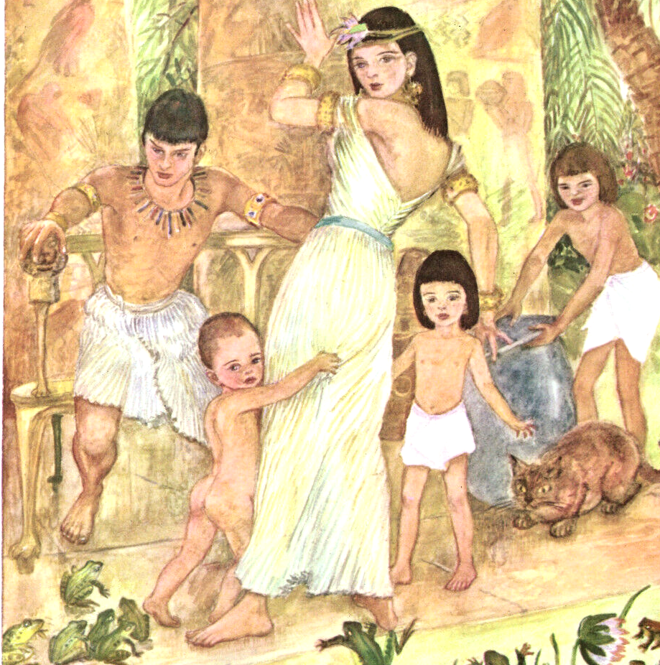
Exodus 8:3, 4, 6
³ And the river shall bring forth frogs abundantly, which shall go up and come into thine house, and into thy bedchamber, and upon thy bed, and into the house of thy servants, and upon thy people, and into thine ovens, and into thy kneadingtroughs:

Slide 52
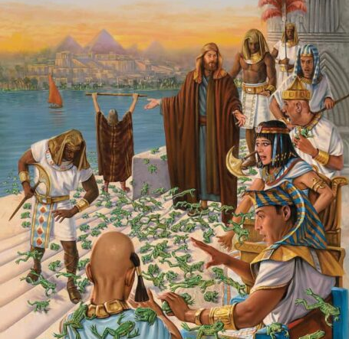
Exodus 8:3, 4, 6
⁴ And the frogs shall come up both on thee, and upon thy people, and upon all thy servants.

Slide 53
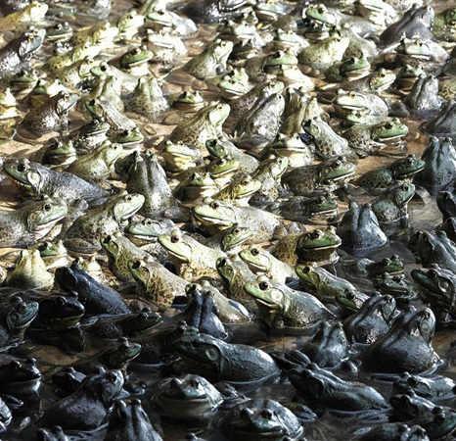
Exodus 8:3, 4, 6
⁶ And Aaron stretched out his hand over the waters of Egypt; and the frogs came up, and covered the land of Egypt.

Slide 54
18. What did the magicians do?
Exodus 8:7

Slide 55
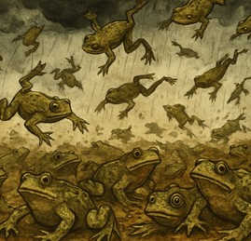
Exodus 8:7
⁷ And the magicians did so with their enchantments, and brought up frogs upon the land of Egypt.

Slide 56
19. What request and promise did Pharaoh then make?
Exodus 8:8

Slide 57
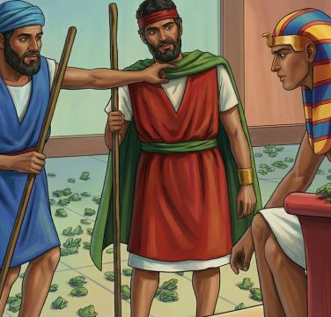
Exodus 8:8
⁸ Then Pharaoh called for Moses and Aaron, and said, Intreat the Lord, that he may take away the frogs from me, and from my people; and I will let the people go, that they may do sacrifice unto the Lord.

Slide 58
20. Why did not his magicians and sorcerers remove the plague?
See Note

Slide 59
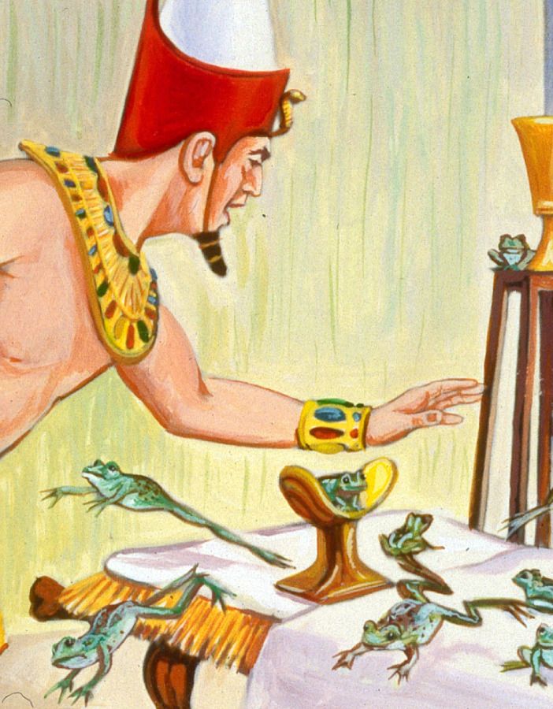
The only reason that can be given why the magicians did not remove the plague of frogs, is that they could not… The fact that Pharaoh was obliged to call upon Moses and Aaron to remove the plague was an additional humiliation, and emphasized the fact that the power that was with them was greater than that power that was with the magicians.

Slide 60
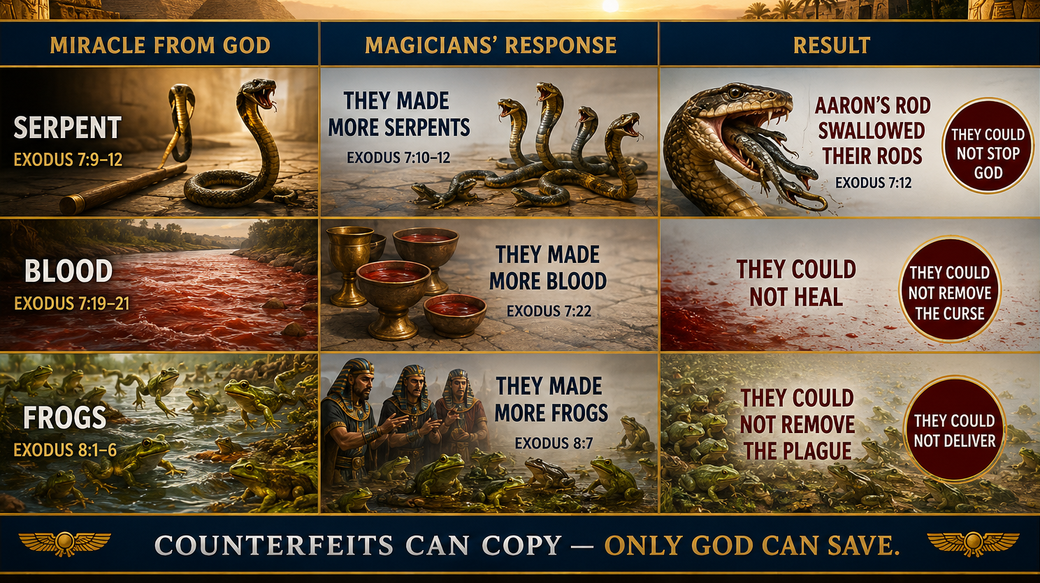

Slide 61
21. What is a magician?

Slide 62
Webster’s Defines “Magician”
1828
2026
One skilled in magic; one who practices the black art; an enchanter, a necromancer; a sorcerer or sorceress.
One skilled in magic; esp. a sorcerer; one who performs tricks of illusion and sleight of hand.

Slide 63
Webster’s Defines “Magic”
1828
2026
The art or science of putting into action the power of spirits; or the science of producing wonderful effects by the aid of superhuman beings, or of departed spirits; sorcery; enchantment. [This art or science is now discarded.]
The use of means (such as charms or spells) believed to have supernatural power over natural forces; an extraordinary power or influence seemingly from a supernatural source; the art of producing illusions by sleight of hand.

Slide 64
22. What is sorcery?

Slide 65
Webster’s Defines “Sorcery”
1828
2026
Divination by the assistance or supposed assistance of evil spirits; or the power of commanding evil spirits; magic; enchantment; witchcraft.
The use of power gained from the assistance or control of evil spirits especially for divining. See also necromancy; magic.

Slide 66
23. Whom did the heathen worship?
1 Corinthians 10:20

Slide 67
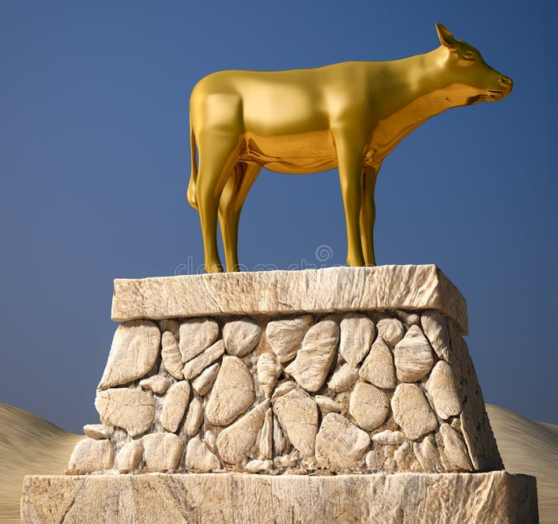
1 Corinthians 10:20
²⁰ But I say, that the things which the Gentiles sacrifice, they sacrifice to devils, and not to God: and I would not that ye should have fellowship with devils.

Slide 68
24. Then on whose side were Pharaoh and his magicians?

Slide 69
25. What does the Bible say is Satan's sole work?
1 Peter 5:8

Slide 70
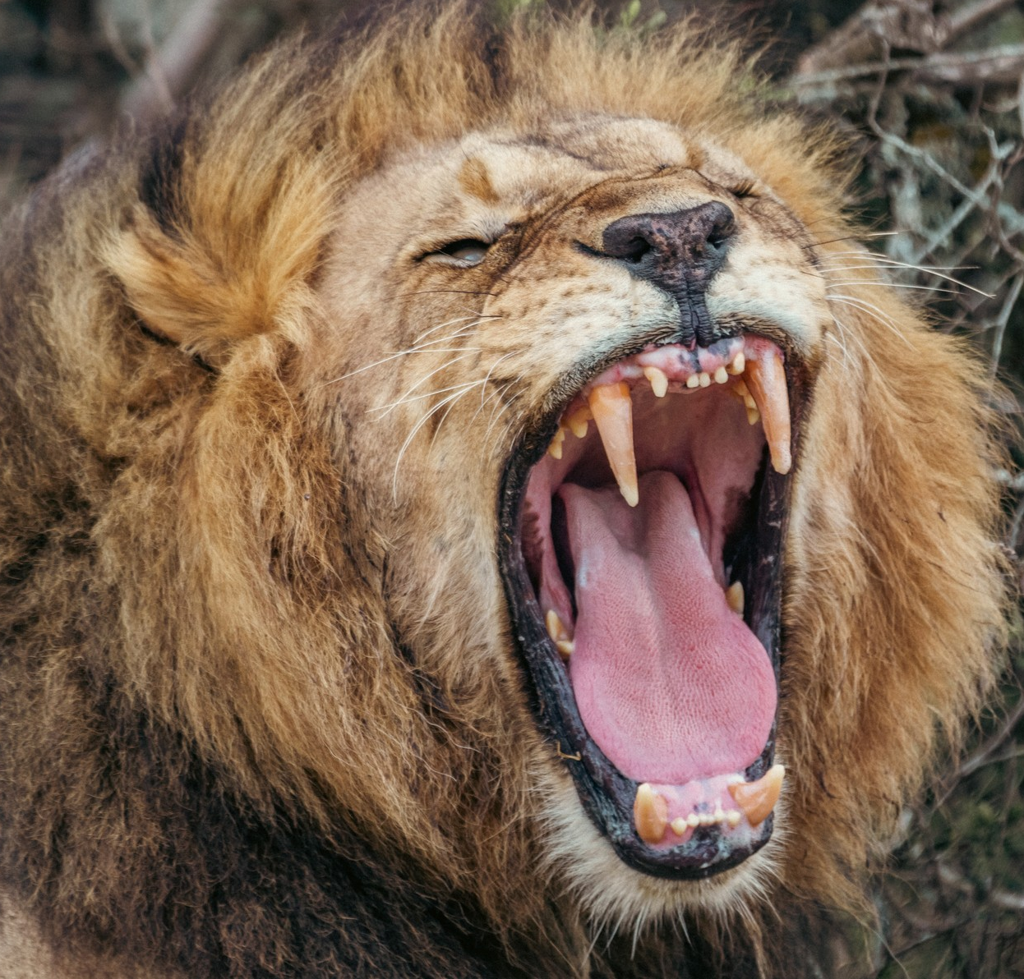
1 Peter 5:8
⁸ Be sober, be vigilant; because your adversary the devil, as a roaring lion, walketh about, seeking whom he may devour:

Slide 71
Concluding Next week

Slide 72


Slide 73


