Slide 1


Slide 2


Slide 3
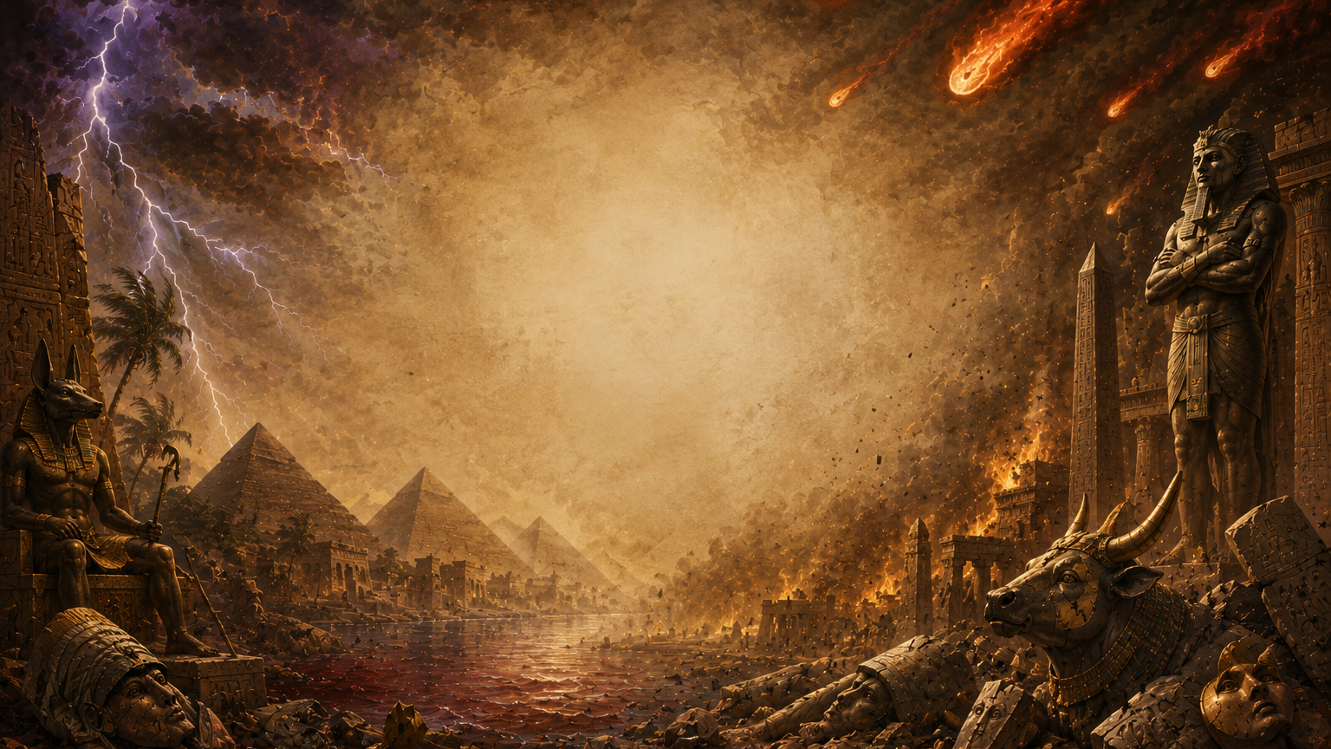
Resisting the Truth: Concluded
Lesson 3
January 19, 1889

Slide 4
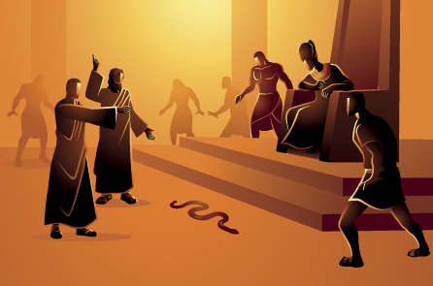
1. Relate what we have already learned of the work of Pharaoh’s magicians.

Slide 5
They counterfeited the first miracles by Satan's power, turning rods into serpents, water into blood, and bringing up frogs. But they were not permitted to do anything to counteract God.

Slide 6
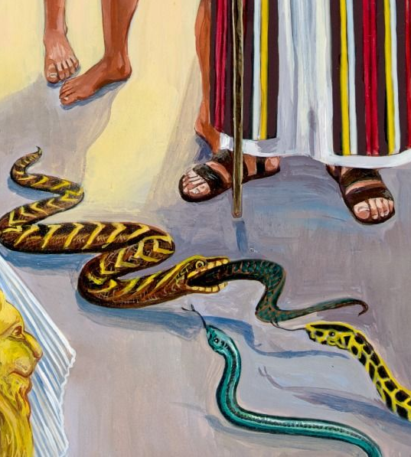
2. What have we learned that they could not do?

Slide 7
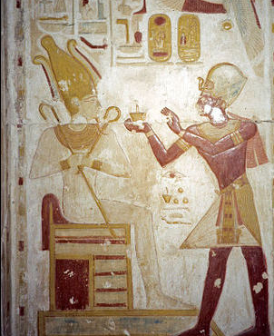
They could not remove the plagues, and they could not counterfeit every miracle that God performed.

Slide 8
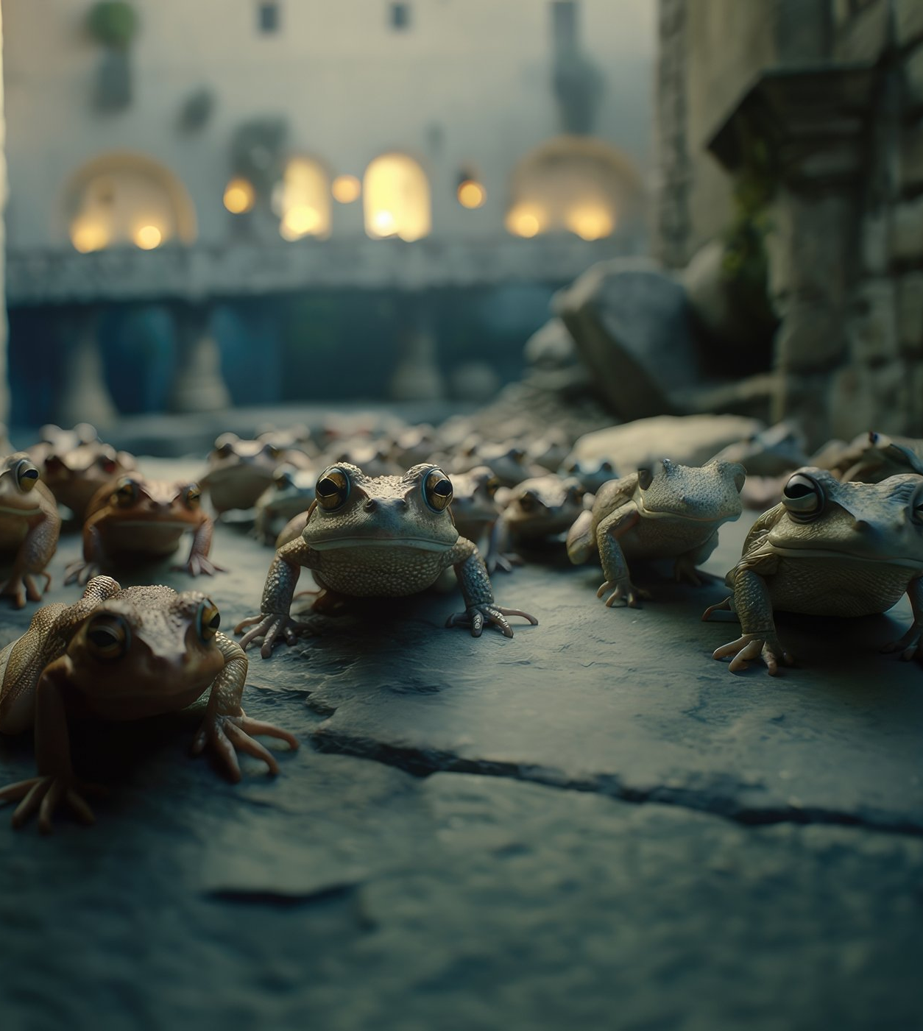
3. What was the second plague that was brought on the land of Egypt?

Slide 9
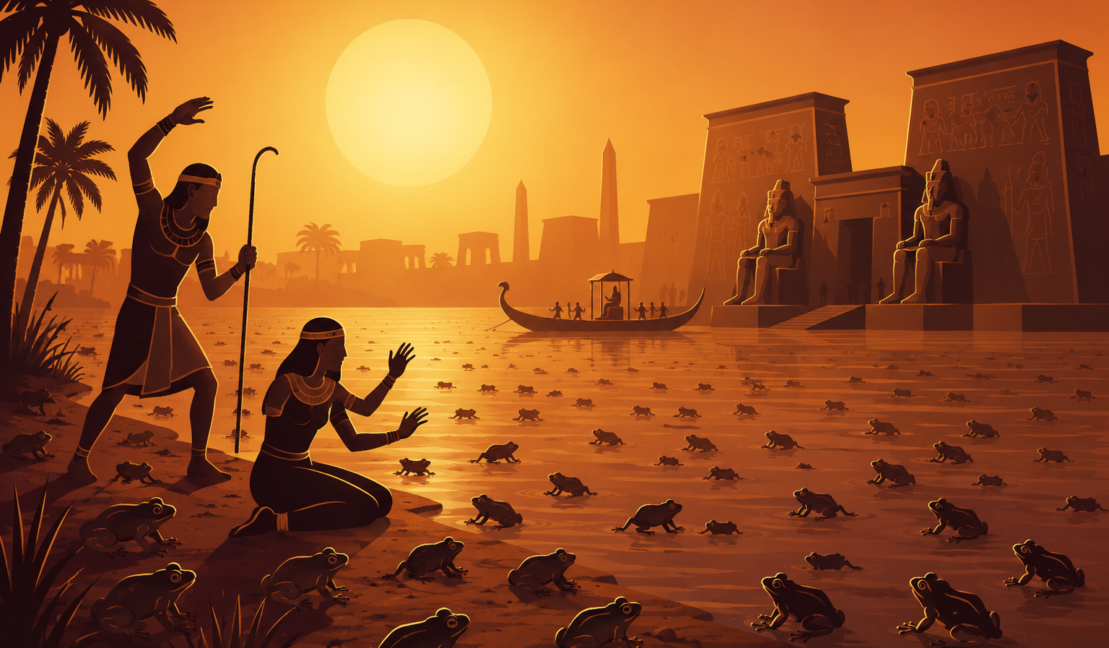
FROGS

Slide 10
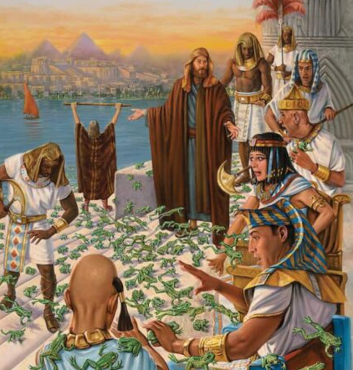
4. When this plague was stayed, did Pharaoh keep his promise?
Exodus 8:12-15.

Slide 11
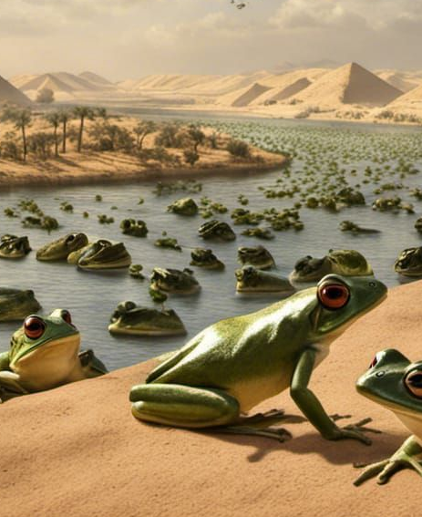
¹² And Moses and Aaron went out from Pharaoh: and Moses cried unto the Lord because of the frogs which he had brought against Pharaoh.
Exodus 8:12-15.

Slide 12
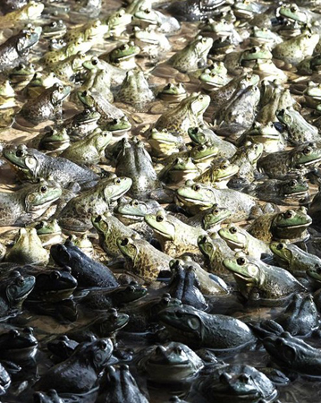
¹³ And the Lord did according to the word of Moses; and the frogs died out of the houses, out of the villages, and out of the fields.
Exodus 8:12-15.

Slide 13
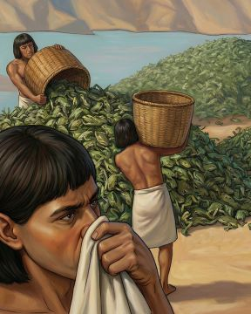
¹⁴ And they gathered them together upon heaps: and the land stank.
Exodus 8:12-15.

Slide 14
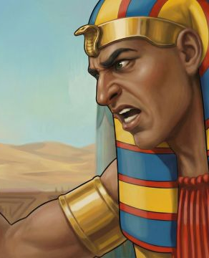
¹⁵ But when Pharaoh saw that there was respite, he hardened his heart, and hearkened not unto them; as the Lord had said.
Exodus 8:12-15.

Slide 15
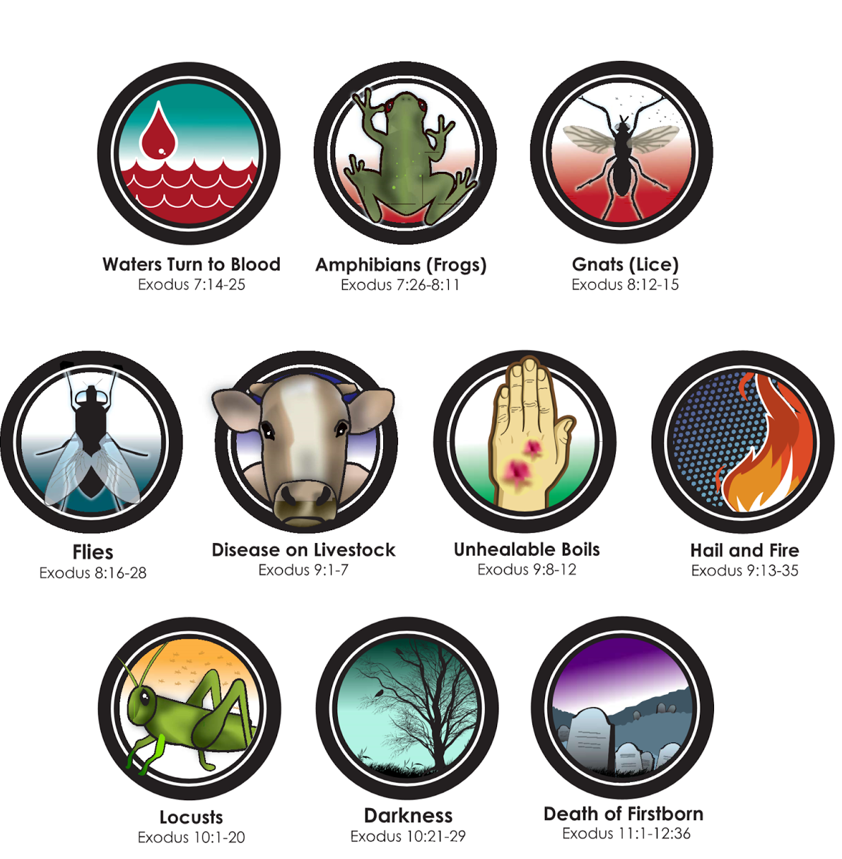
5. What was the next plague?
Exodus 8:16, 17.

Slide 16
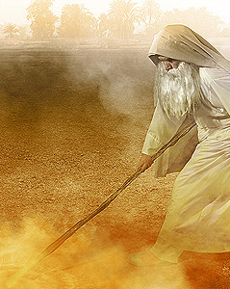
¹⁶ And the Lord said unto Moses, Say unto Aaron, Stretch out thy rod, and smite the dust of the land, that it may become lice throughout all the land of Egypt.
Exodus 8:16, 17.

Slide 17
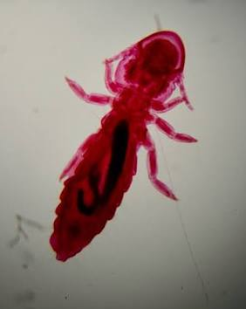
¹⁷ And they did so; for Aaron stretched out his hand with his rod, and smote the dust of the earth, and it became lice in man, and in beast; all the dust of the land became lice throughout all the land of Egypt.
Exodus 8:16, 17.

Slide 18
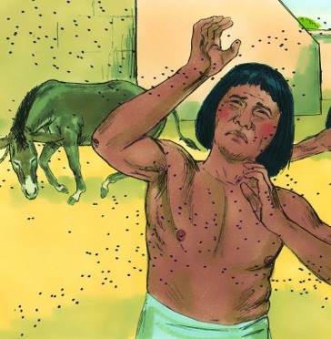
6. Could the magicians repeat this miracle?
Exodus 8:18.

Slide 19
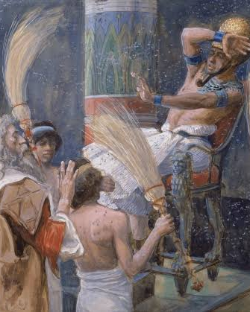
¹⁸ And the magicians did so with their enchantments to bring forth lice, but they could not: so there were lice upon man, and upon beast.
Exodus 8:18.

Slide 20
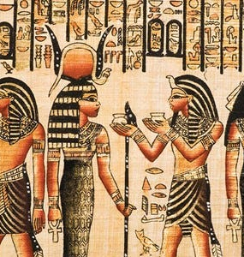
7. What were they forced to acknowledge to Pharaoh?
Exodus 8:19, first part.

Slide 21
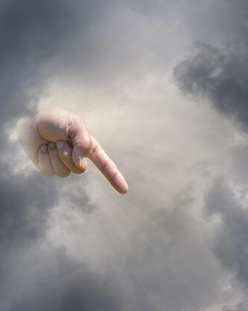
¹⁹ Then the magicians said unto Pharaoh, This is the finger of God: and Pharaoh's heart was hardened, and he hearkened not unto them; as the Lord had said.
Exodus 8:19.

Slide 22
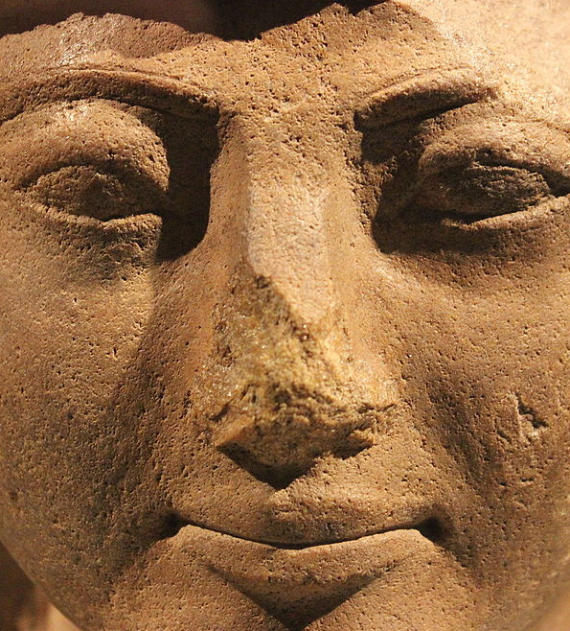
8. In so saying, what did they virtually admit concerning their own work?

Slide 23
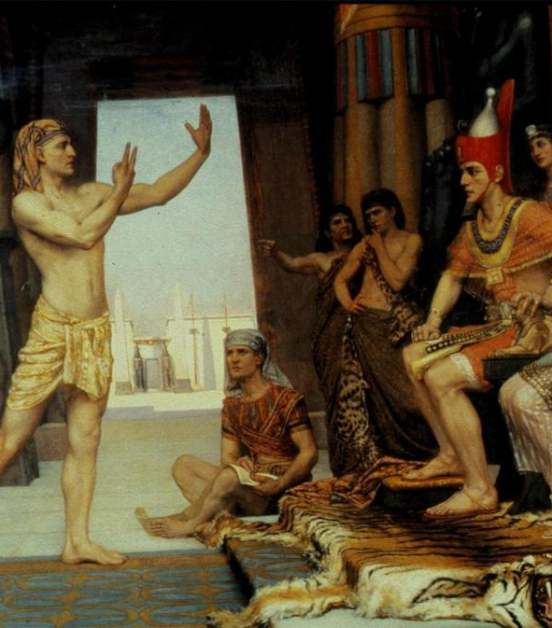
They admitted that their own miracles were only counterfeits and could not equal the genuine power of God.

Slide 24
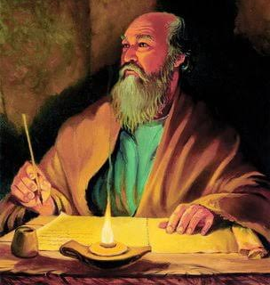
9. What does Paul say will be the character of men in the last days?
2 Timothy 3:1-4

Slide 25
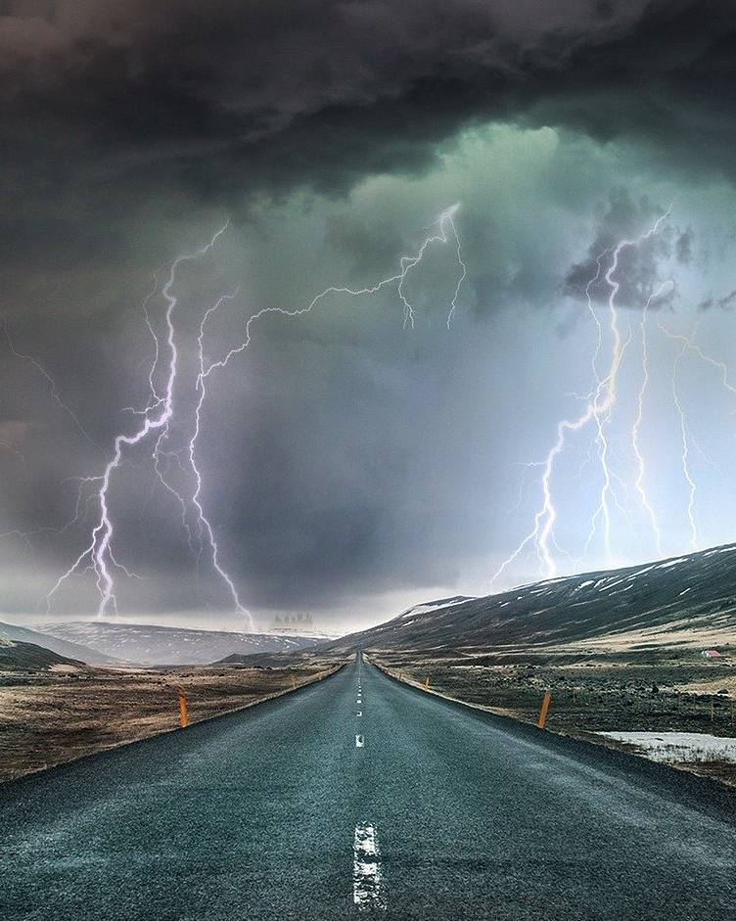
3 This know also, that in the last days perilous times shall come.
2 Timothy 3:1-4

Slide 26
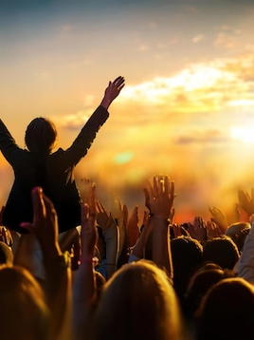
² For men shall be lovers of their own selves, covetous, boasters, proud, blasphemers, disobedient to parents, unthankful, unholy,
2 Timothy 3:1-4

Slide 27
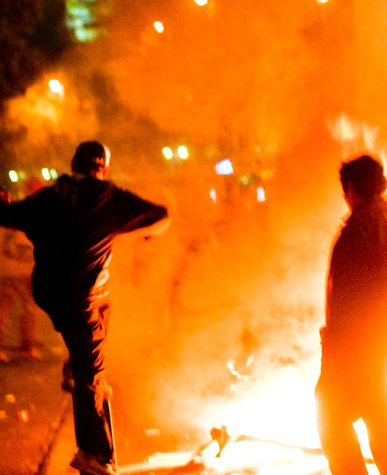
³ Without natural affection, trucebreakers, false accusers, incontinent, fierce, despisers of those that are good,
2 Timothy 3:1-4

Slide 28
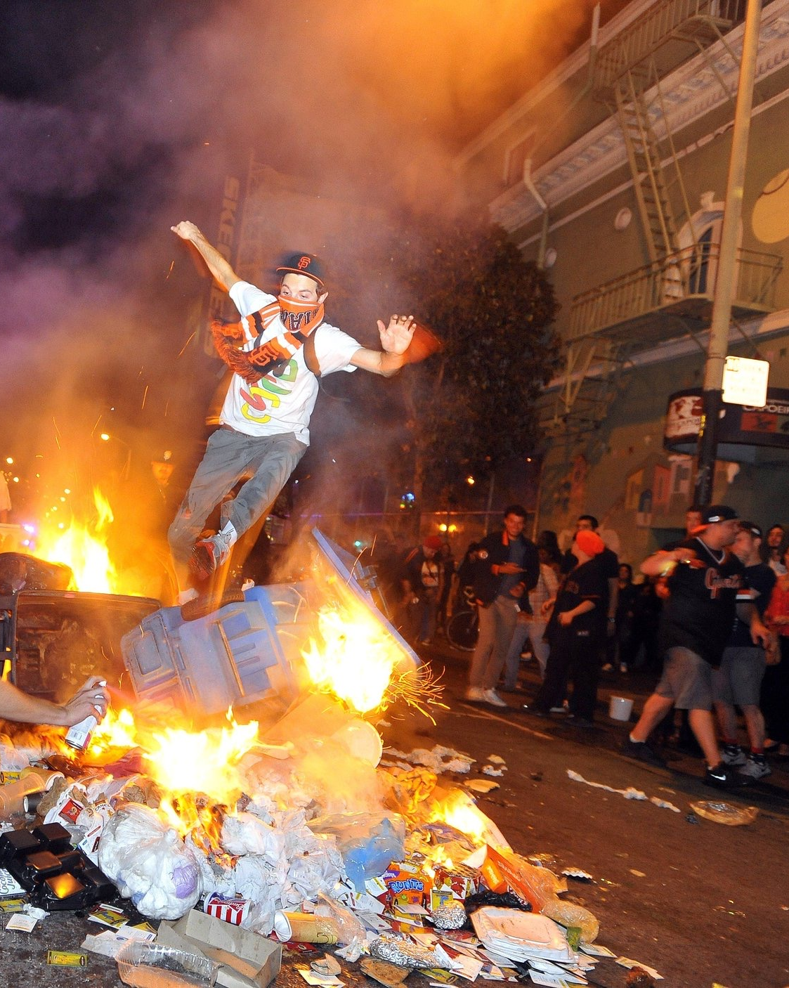
⁴ Traitors, heady, highminded, lovers of pleasures more than lovers of God;
2 Timothy 3:1-4

Slide 29
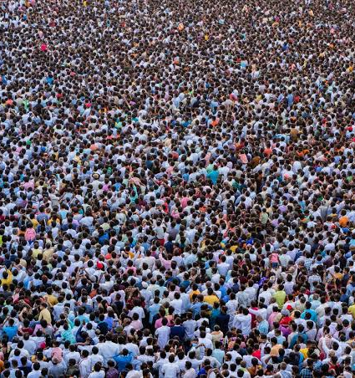
10. Among what people will this wickedness exist?
2 Timothy 3:5.

Slide 30
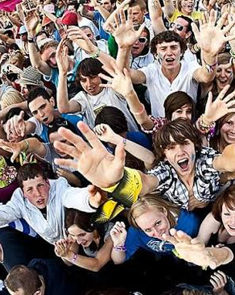
⁵ Having a form of godliness, but denying the power thereof: from such turn away.
2 Timothy 3:5.

Slide 31
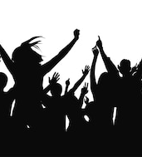
11. What will this sort of people do?
2 Timothy 3:6, 7.

Slide 32
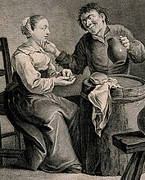
⁶ For of this sort are they which creep into houses, and lead captive silly women laden with sins, led away with divers lusts,
2 Timothy 3:6, 7.

Slide 33
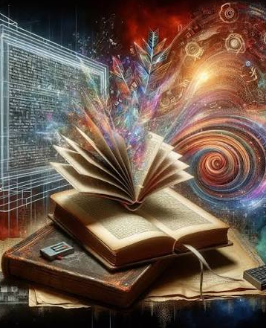
⁷ Ever learning, and never able to come to the knowledge of the truth.
2 Timothy 3:6, 7.

Slide 34
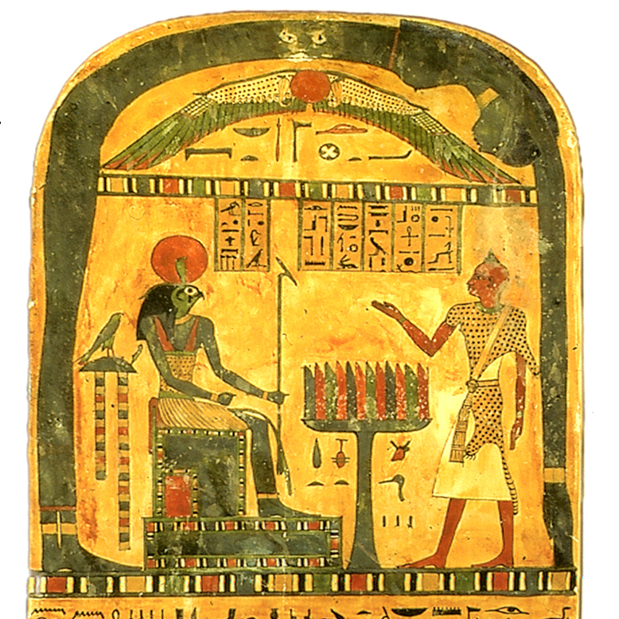
12. How will they resist the truth?
2 Timothy 3:8

Slide 35
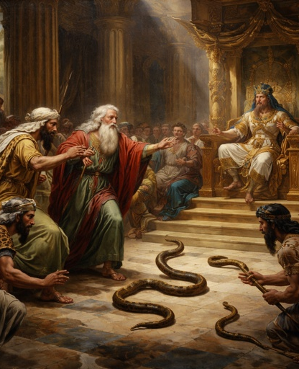
⁸ Now as Jannes and Jambres withstood Moses, so do these also resist the truth: men of corrupt minds, reprobate concerning the faith.
2 Timothy 3:8.

Slide 36
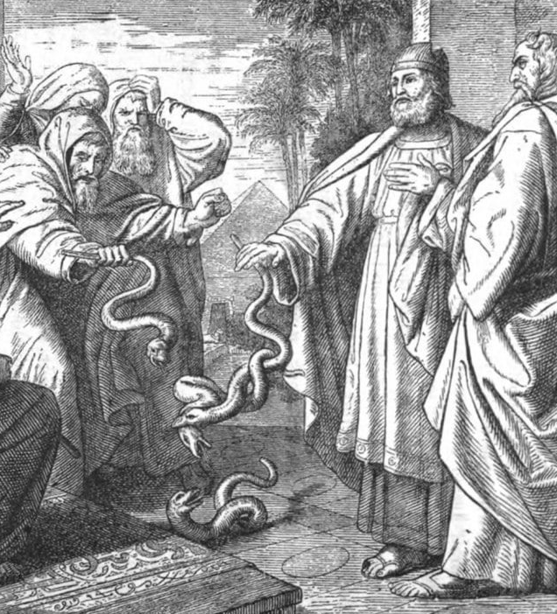
Although not found in the Old Testament, the names Jannes and Jambres are preserved in a Jewish Targum that comments on Ex. 7:11. Purportedly, these men were two of the magicians who imitated the miracles of Moses when he first appeared before Pharaoh.

Slide 37
A Targum is a very old translation and explanation of the Old Testament.
After the Babylonian exile, many Jews spoke Aramaic more fluently than Hebrew.
In the synagogue, the Hebrew Scriptures were read aloud. But Aramaic was the common language of the day.
So after the Hebrew reading, an Aramaic "Targum" was given so everyone could better understand.
What Is a Targum?

Slide 38
A Targum is an expanded translation that may also include commentary—something like a cross between a translation and a study Bible. It was never intended to replace Scripture.
Some Targums stayed pretty close to the original Hebrew.
Others included traditional explanations, comments, and stories passed down in Jewish tradition.

Slide 39
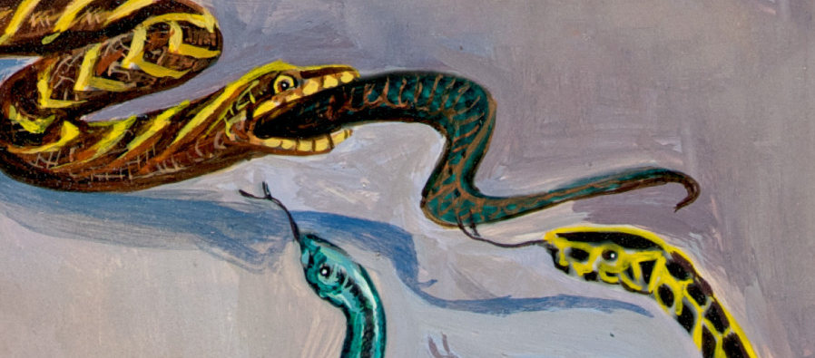
Targum Pseudo-Jonathan
(Etheridge’s 1862 English Translation, on Exodus 7:11)
But Pharaoh called the wise men and the magicians; and they also, Janis and Jamberes, magicians of Mizraim, did the same by their burnings of divination.

Slide 40
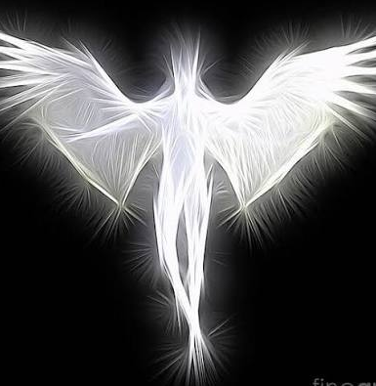
13. What other prophecy have we of miracles to be wrought for the purpose of deceiving?
Revelation 14:13, 14

Slide 41
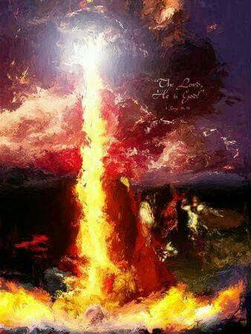
¹³ And he doeth great wonders, so that he maketh fire come down from heaven on the earth in the sight of men,
Revelation 13:13-14

Slide 42
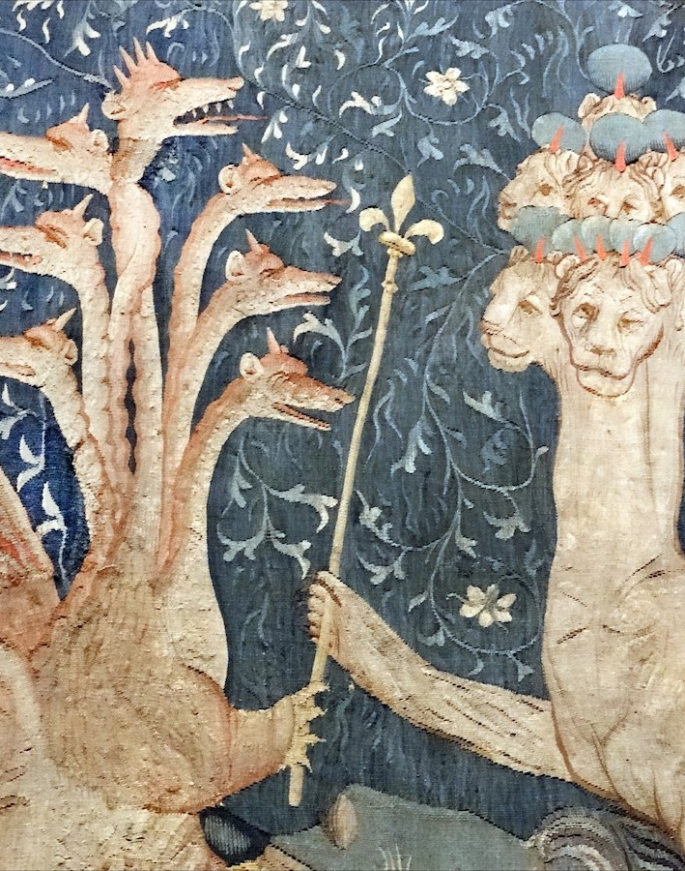
¹⁴ And deceiveth them that dwell on the earth by the means of those miracles which he had power to do in the sight of the beast; saying to them that dwell on the earth, that they should make an image to the beast, which had the wound by a sword, and did live.
Revelation 13:13-14

Slide 43
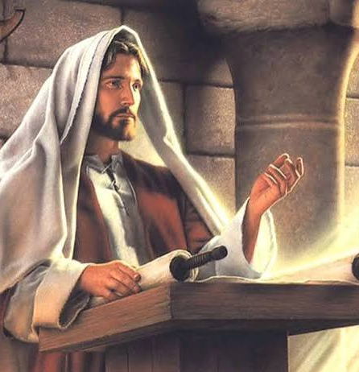
14. What did the Saviour say on this point?
Matthew 24:24

Slide 44
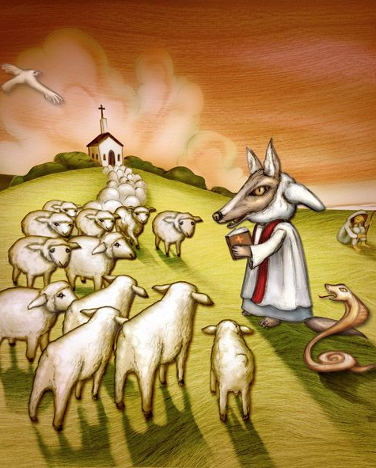
²⁴ For there shall arise false Christs, and false prophets, and shall shew great signs and wonders; insomuch that, if it were possible, they shall deceive the very elect.
Matthew 24:24

Slide 45
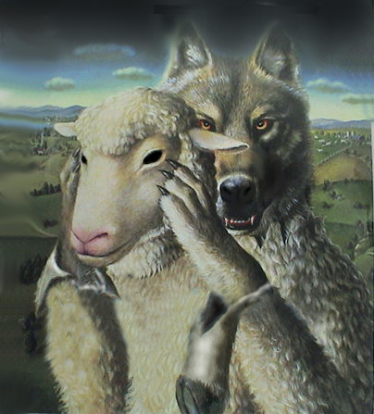
15. By what agency are these lying miracles wrought?
Revelation 16:14

Slide 46
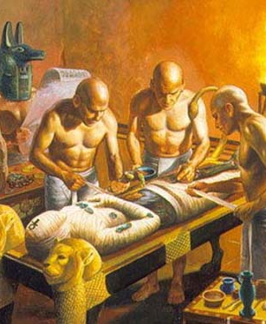
¹⁴ For they are the spirits of devils, working miracles, which go forth unto the kings of the earth and of the whole world, to gather them to the battle of that great day of God Almighty.
Revelation 16:14

Slide 47
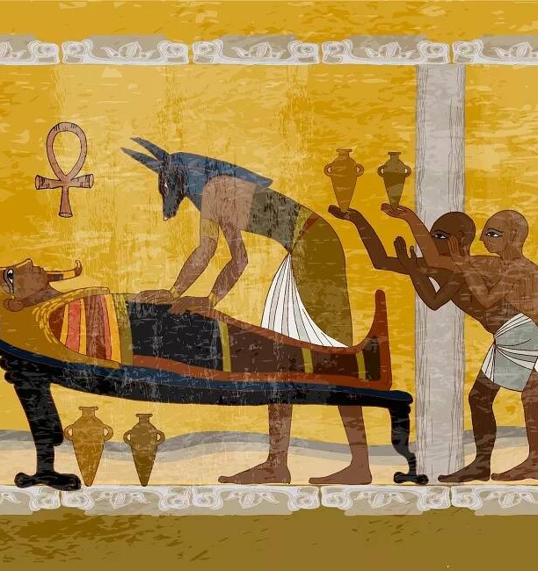
16. What name is given to those who in this age do the work which the ancient magicians and sorcerers did?

Slide 48
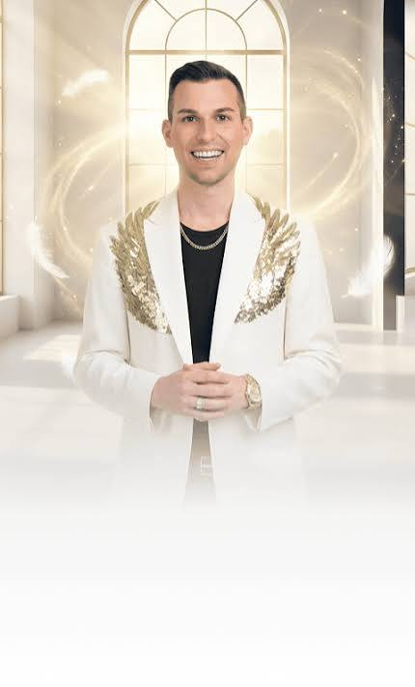
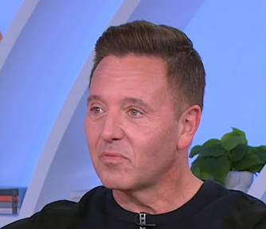
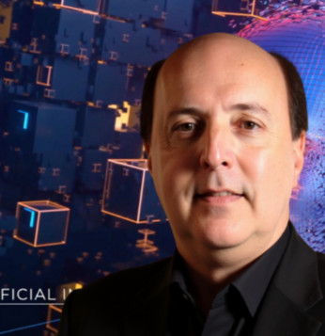
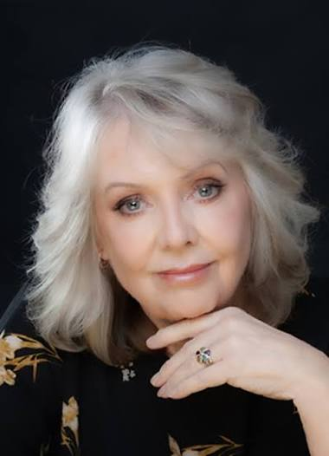
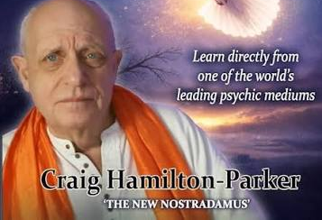

Answer: Spiritualist mediums.
Today we have slightly different terminology for those who claim supernatural knowledge or communication through occult or spiritualistic means (psychics, mediums, spirit speakers, channelers, and similar practitioners).

Slide 49
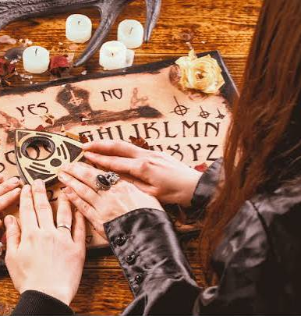
17. Is there now any indication that the deceptions of Spiritualism will find a place among those who profess godliness?

Slide 50
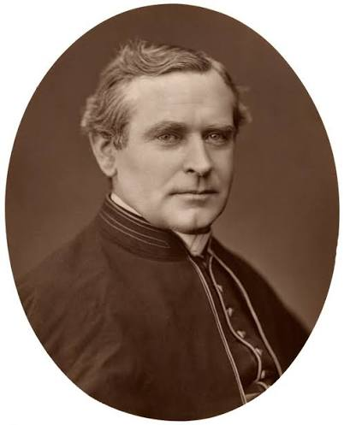
…Spiritualism was but a misrepresentation of Catholic teaching, and it had been in the world from the beginning. He said, further, that to Catholics the spirit world was as clear as the light of a gas jet;
In 1885, Monsignor Capel, a celebrated Roman Catholic propagandist, said in a lecture that…

Slide 51
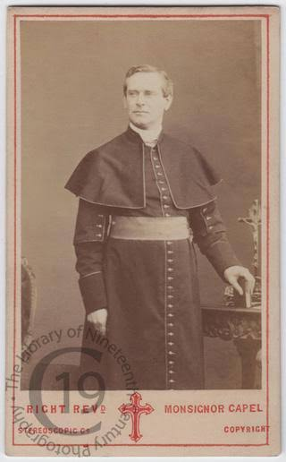
that the dead were but disembodied spirits, with whom they were in daily communication, and to whom they prayed. Thus the great Roman Catholic Church is essentially at one with Spiritualism.
In 1885, Monsignor Capel, a celebrated Roman Catholic propagandist, said in a lecture that…

Slide 52

"Much of the best work of the world is done through the present, personal influence of the dead. . . . As a practical fact, and as a great spiritual truth, our dead do for us as constantly and as variously as they could do for us if they were still here in the flesh;”
The Sunday School Times, a widely read evangelical Protestant periodical, dated August 29, 1885, suggests that…

Slide 53

“…and they do for us very much that they could not do unless they were dead…
Our living friends do much for us, but perhaps our dead friends do yet more."
The Sunday School Times, a widely read evangelical Protestant periodical, dated August 29, 1885, suggests that…

Slide 54

"Oh, may the dead ever be with us, walking by our side, taking us by the hand, smoothing the cares from the troubled brow, and pointing us upward to the regions of everlasting light and peace."
The Christian Union, a protestant paper of Nov. 3, 1887, contained a sermon by Dr. Henry M. Field (Presbyterian) which said…

Slide 55

18. What does Paul say of those who shall resist the truth by their lying wonders?
2 Timothy 3:9

Slide 56

⁹ But they shall proceed no further: for their folly shall be manifest unto all men, as their's also was.
2 Timothy 3:9

Slide 57

19. How was the folly of Pharaoh's magicians made manifest?
Exodus 8:18-19; 9:10-11

Slide 58

¹⁸ And the magicians did so with their enchantments to bring forth lice, but they could not: so there were lice upon man, and upon beast.
Exodus 8:18-19

Slide 59

¹⁹ Then the magicians said unto Pharaoh, This is the finger of God: and Pharaoh's heart was hardened, and he hearkened not unto them; as the Lord had said.
Exodus 8:18-19

Slide 60

¹⁰ And they took ashes of the furnace, and stood before Pharaoh; and Moses sprinkled it up toward heaven; and it became a boil breaking forth with blains upon man, and upon beast.
Exodus 9:10-11

Slide 61

¹¹ And the magicians could not stand before Moses because of the boils; for the boil was upon the magicians, and upon all the Egyptians.
Exodus 9:10-11

Slide 62
The folly of Pharaoh's magicians was made manifest by their inability to counterfeit all the miracles which Moses performed. So, says Paul, it will be with the last-day wonder-workers.

Slide 63




Slide 64


Slide 65


