Slide 1


Slide 2


Slide 3
God’s Care for His People
Lesson 4: January 26, 1889

Slide 4
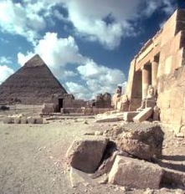
Exodus 8:20, 21, 24
1. What was the fourth plague that came upon the land of Egypt?

Slide 5
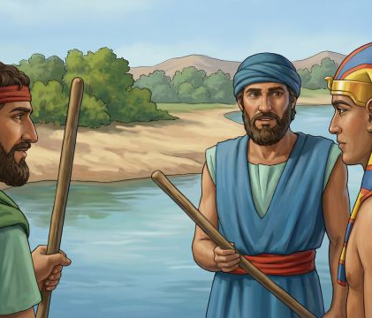
Exodus 8:20, 21, 24
²⁰ And the Lord said unto Moses, Rise up early in the morning, and stand before Pharaoh; lo, he cometh forth to the water; and say unto him, Thus saith the Lord, Let my people go, that they may serve me.

Slide 6
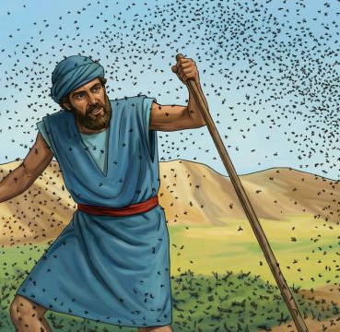
Exodus 8:20, 21, 24
²¹ Else, if thou wilt not let my people go, behold, I will send swarms of flies upon thee, and upon thy servants, and upon thy people, and into thy houses: and the houses of the Egyptians shall be full of swarms of flies, and also the ground whereon they are.

Slide 7
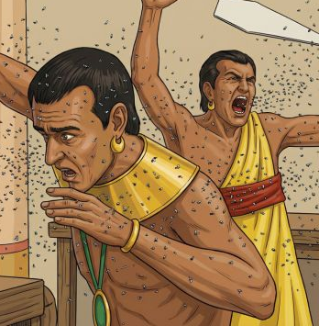
Exodus 8:20, 21, 24
²⁴ And the Lord did so; and there came a grievous swarm of flies into the house of Pharaoh, and into his servants' houses, and into all the land of Egypt: the land was corrupted by reason of the swarm of flies.

Slide 8
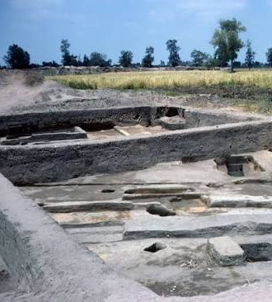
Exodus 8:22, 23
2. What remarkable proof of his power did the Lord give?

Slide 9
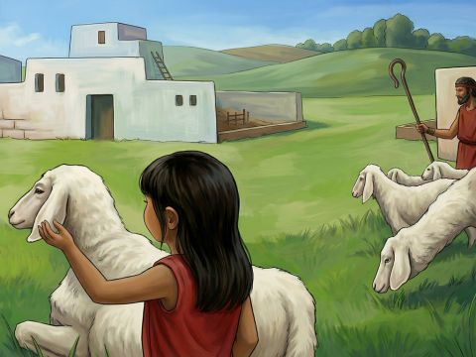
Exodus 8:22, 23
²² And I will sever in that day the land of Goshen, in which my people dwell, that no swarms of flies shall be there; to the end thou mayest know that I am the Lord in the midst of the earth.

Slide 10
Exodus 8:22, 23
²³ And I will put a division between my people and thy people: to morrow shall this sign be.

Slide 11
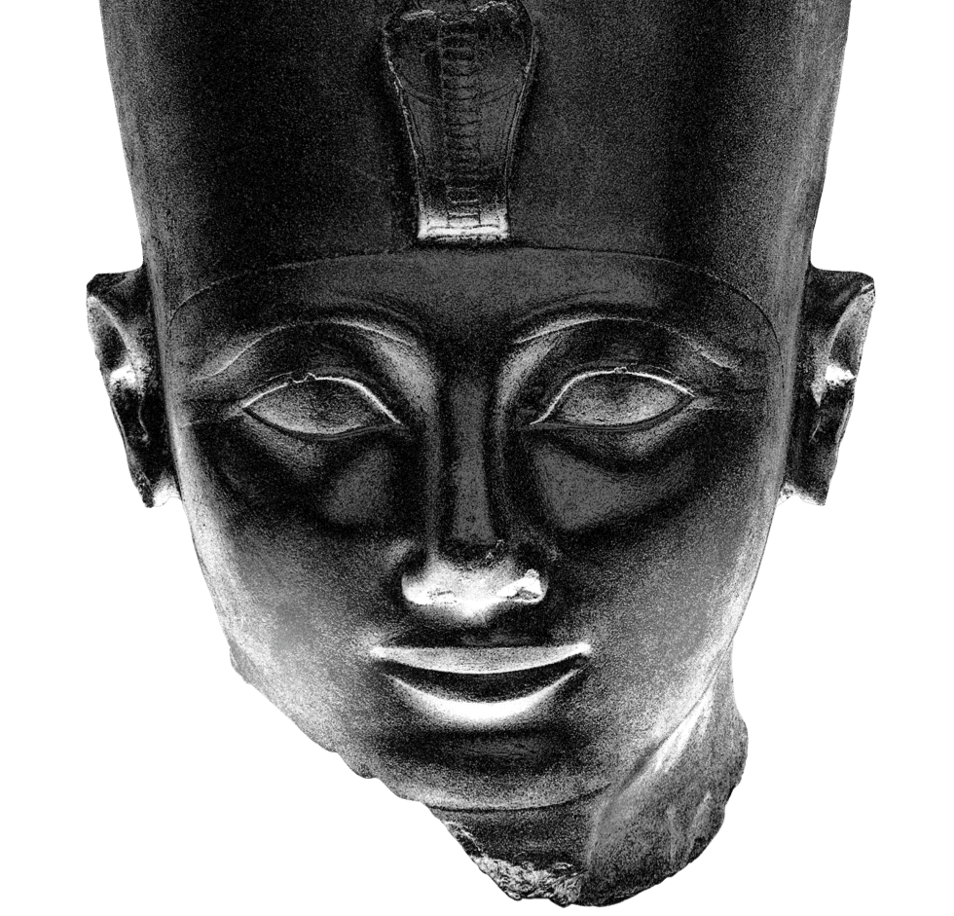
Exodus 9:1-3
3. When Pharaoh still refused to let the people go, what plague was threatened?

Slide 12
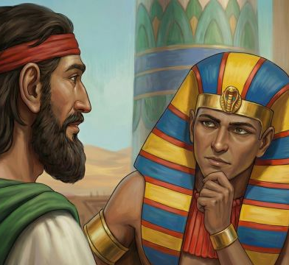
Exodus 9:1-3
9 Then the Lord said unto Moses, Go in unto Pharaoh, and tell him, Thus saith the Lord God of the Hebrews, Let my people go, that they may serve me.
² For if thou refuse to let them go, and wilt hold them still,

Slide 13
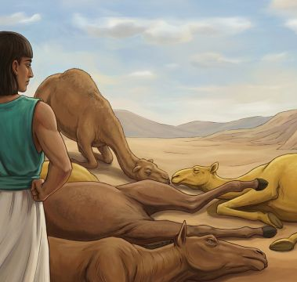
Exodus 9:1-3
³ Behold, the hand of the Lord is upon thy cattle which is in the field, upon the horses, upon the asses, upon the camels, upon the oxen, and upon the sheep: there shall be a very grievous murrain.

Slide 14
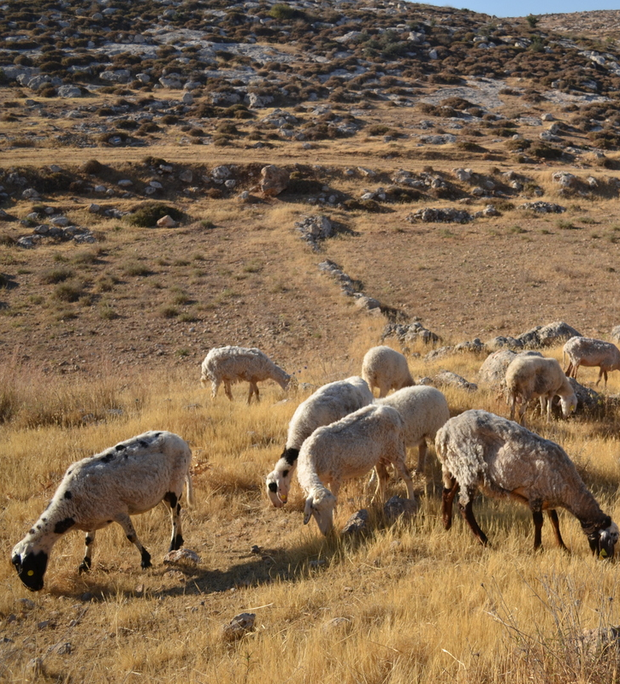
Exodus 9:4-7
4. Did the cattle of the children of Israel suffer?

Slide 15
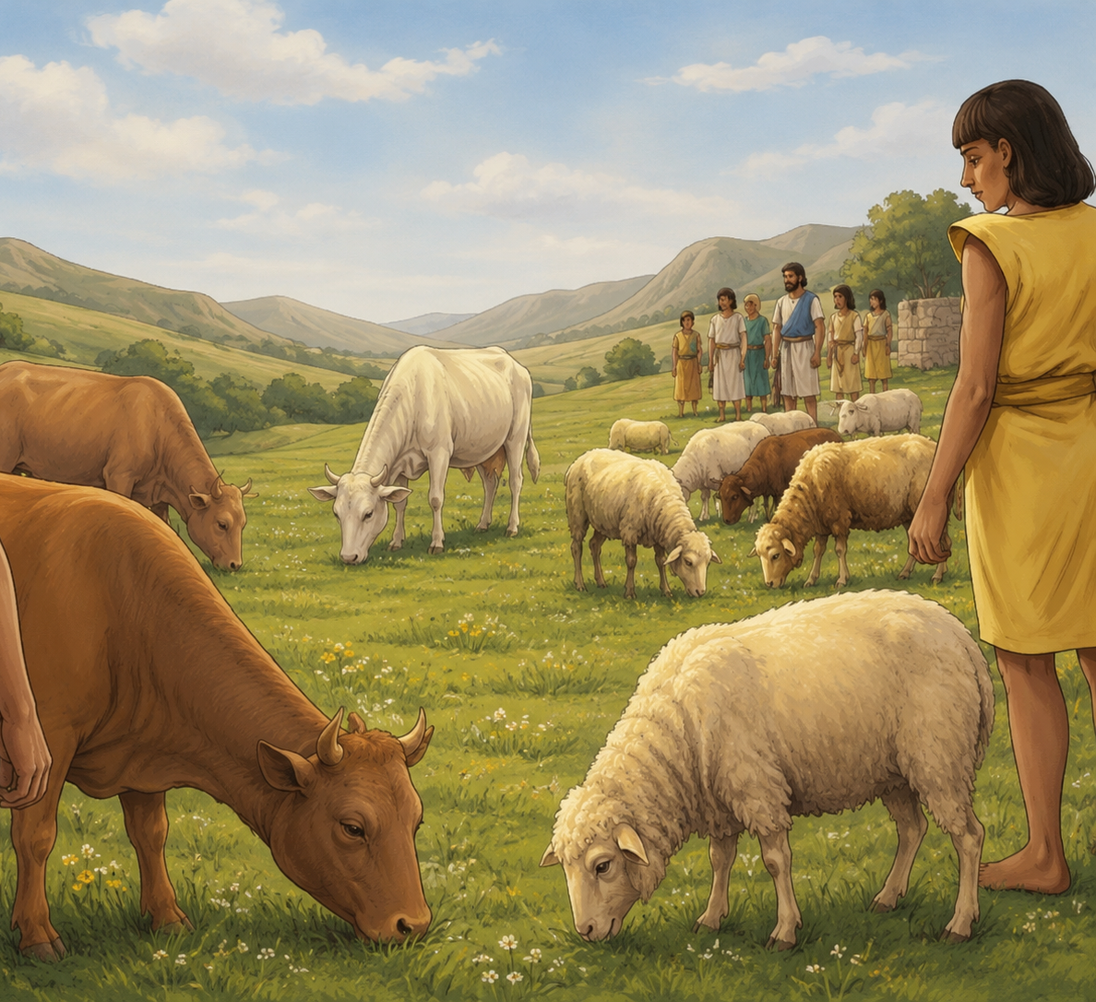
Exodus 9:4-7
⁴ And the Lord shall sever between the cattle of Israel and the cattle of Egypt: and there shall nothing die of all that is the children's of Israel.

Slide 16
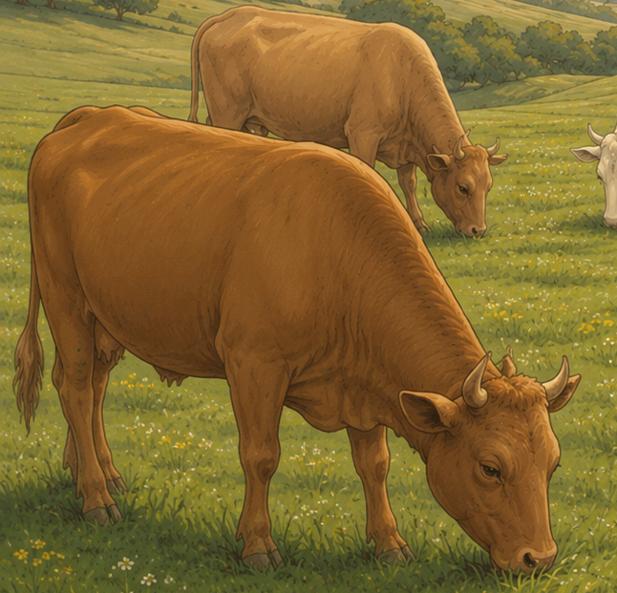
Exodus 9:4-7
⁵ And the Lord appointed a set time, saying, To morrow the Lord shall do this thing in the land.
⁶ And the Lord did that thing on the morrow, and all the cattle of Egypt died: but of the cattle of the children of Israel died not one.

Slide 17
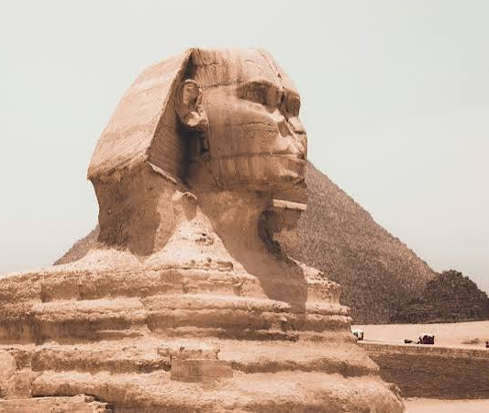
Exodus 9:8-10
5. What was the sixth plague?

Slide 18
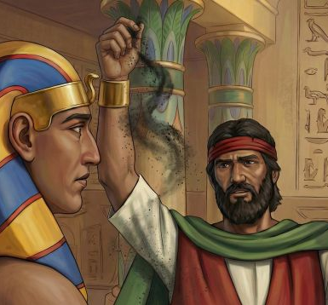
Exodus 9:8-10
⁸ And the Lord said unto Moses and unto Aaron, Take to you handfuls of ashes of the furnace, and let Moses sprinkle it toward the heaven in the sight of Pharaoh.

Slide 19
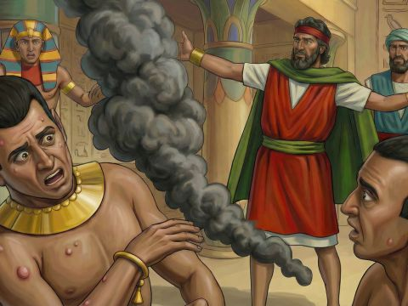
Exodus 9:8-10
⁹ And it shall become small dust in all the land of Egypt, and shall be a boil breaking forth with blains upon man, and upon beast, throughout all the land of Egypt.

Slide 20
Exodus 9:8-10
¹⁰ And they took ashes of the furnace, and stood before Pharaoh; and Moses sprinkled it up toward heaven; and it became a boil breaking forth with blains upon man, and upon beast.

Slide 21
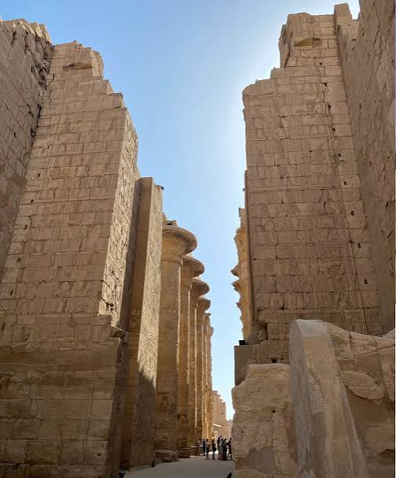
Exodus 9:22
6. What was threatened as the seventh plague?

Slide 22
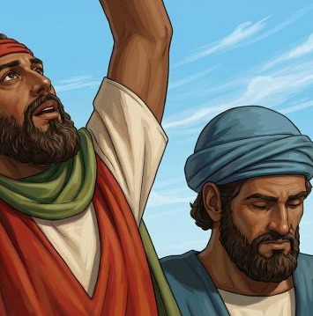
Exodus 9:22
²² And the Lord said unto Moses, Stretch forth thine hand toward heaven, that there may be hail in all the land of Egypt, upon man, and upon beast, and upon every herb of the field, throughout the land of Egypt.

Slide 23
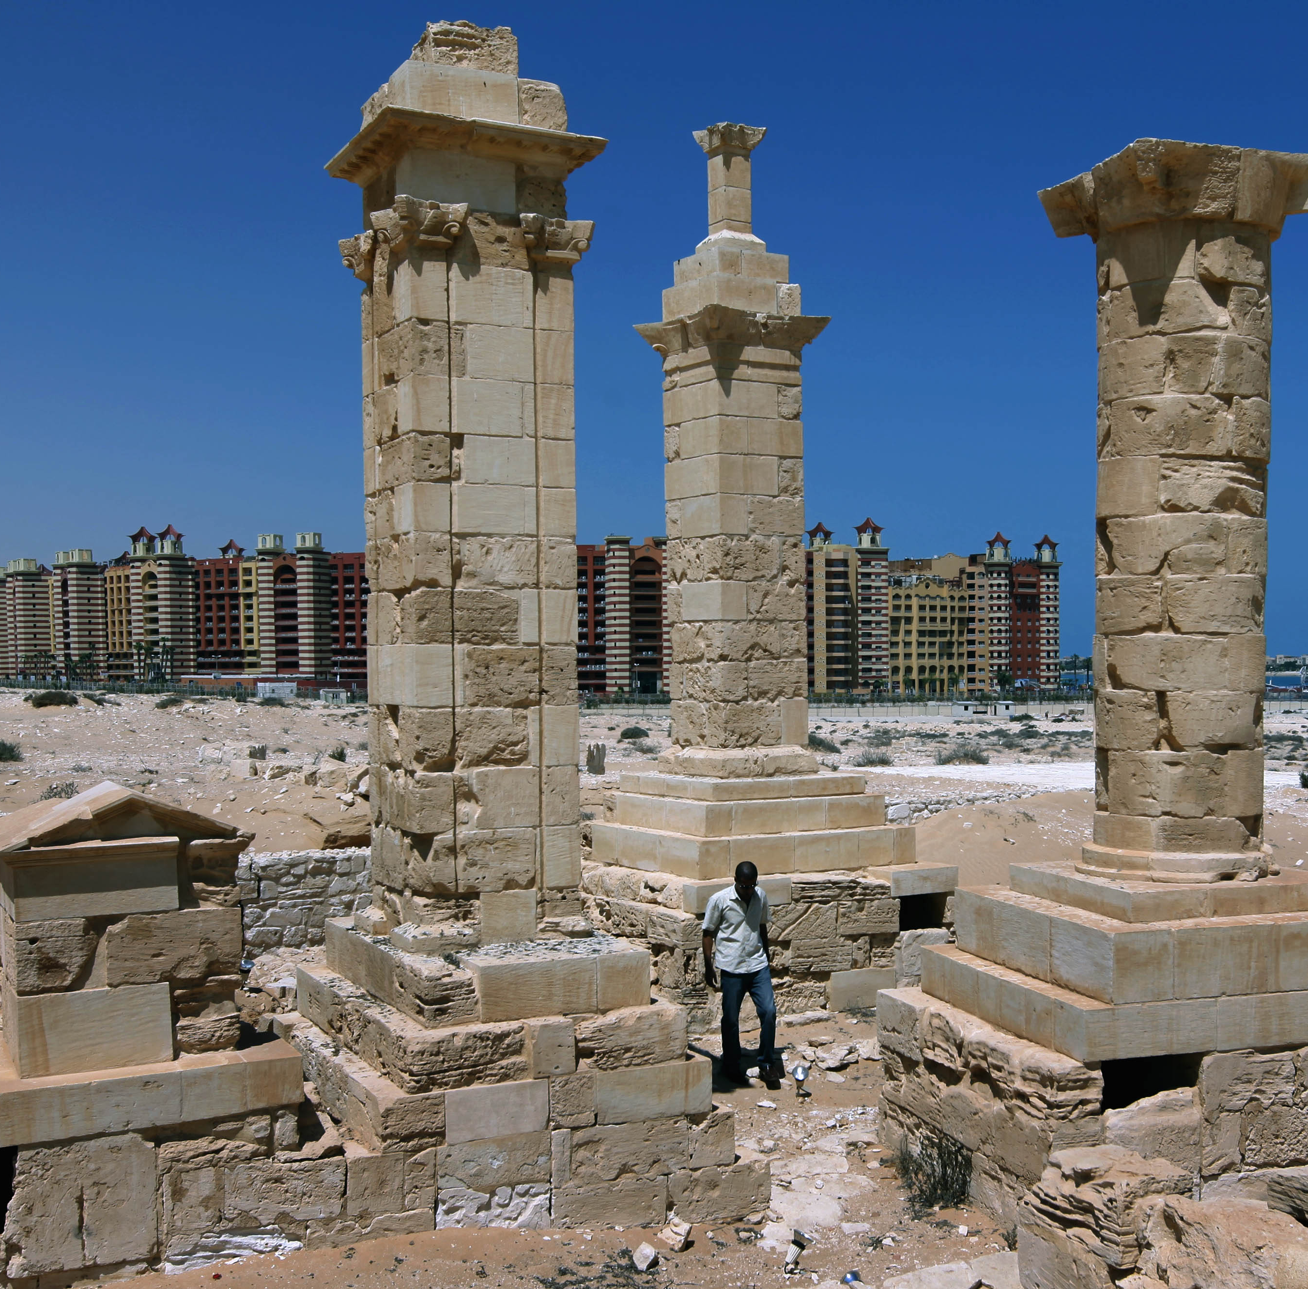
Exodus 9:23-25
7. How terrible was this plague?

Slide 24
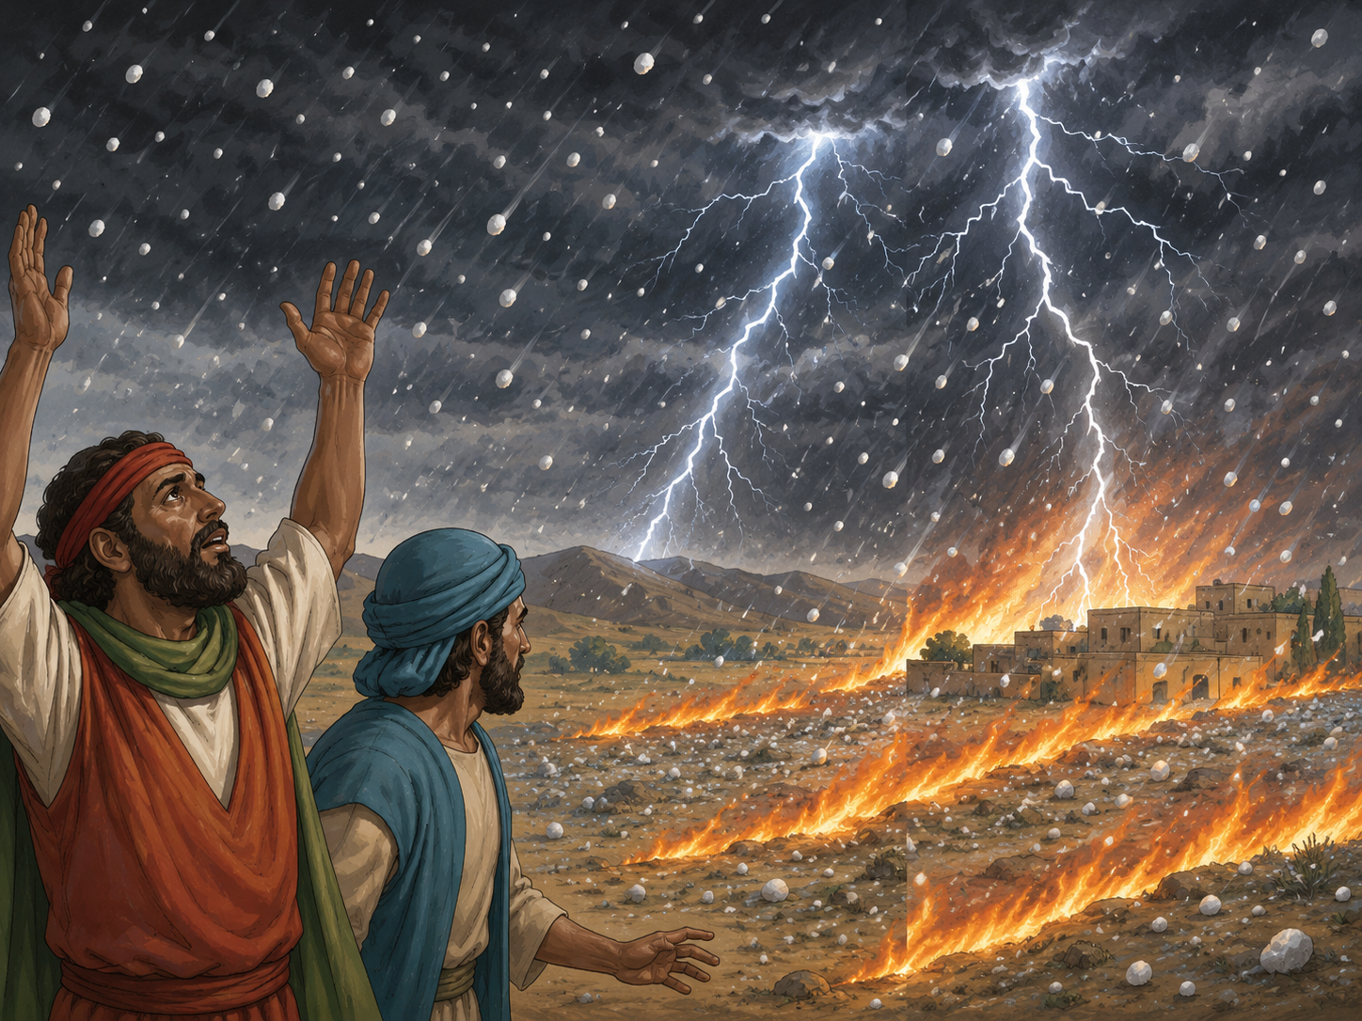
Exodus 9:23-25
²³ And Moses stretched forth his rod toward heaven: and the Lord sent thunder and hail, and the fire ran along upon the ground; and the Lord rained hail upon the land of Egypt.

Slide 25
Exodus 9:23-25
²⁴ So there was hail, and fire mingled with the hail, very grievous, such as there was none like it in all the land of Egypt since it became a nation.

Slide 26
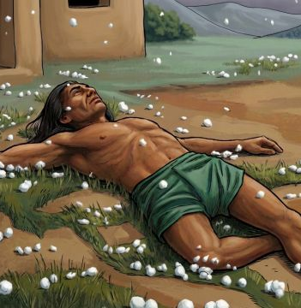
Exodus 9:23-25
²⁵ And the hail smote throughout all the land of Egypt all that was in the field, both man and beast; and the hail smote every herb of the field, and brake every tree of the field.

Slide 27
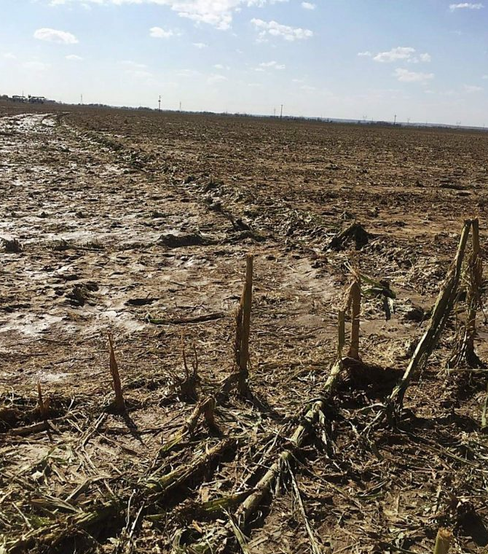
Exodus 9:32
8. Was there anything that was not destroyed by the hail?

Slide 28
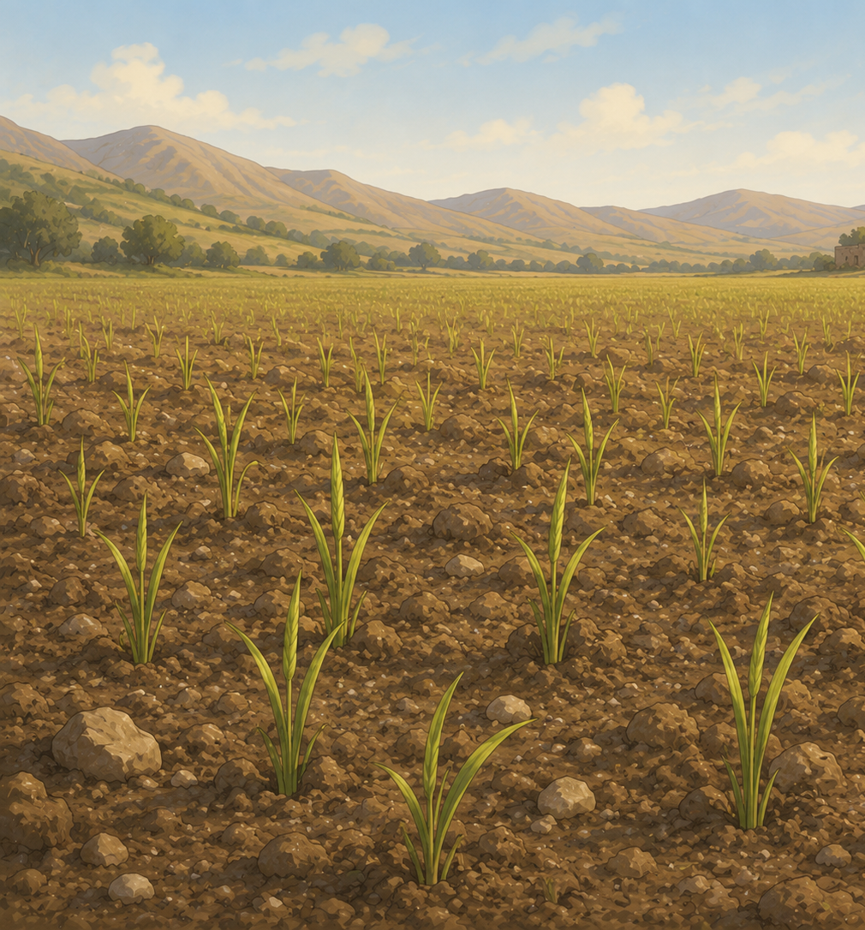
Exodus 9:32
³² But the wheat and the rie were not smitten: for they were not grown up.

Slide 29
Exodus 9:26
9. How did God again show his power, and his care for his people?

Slide 30
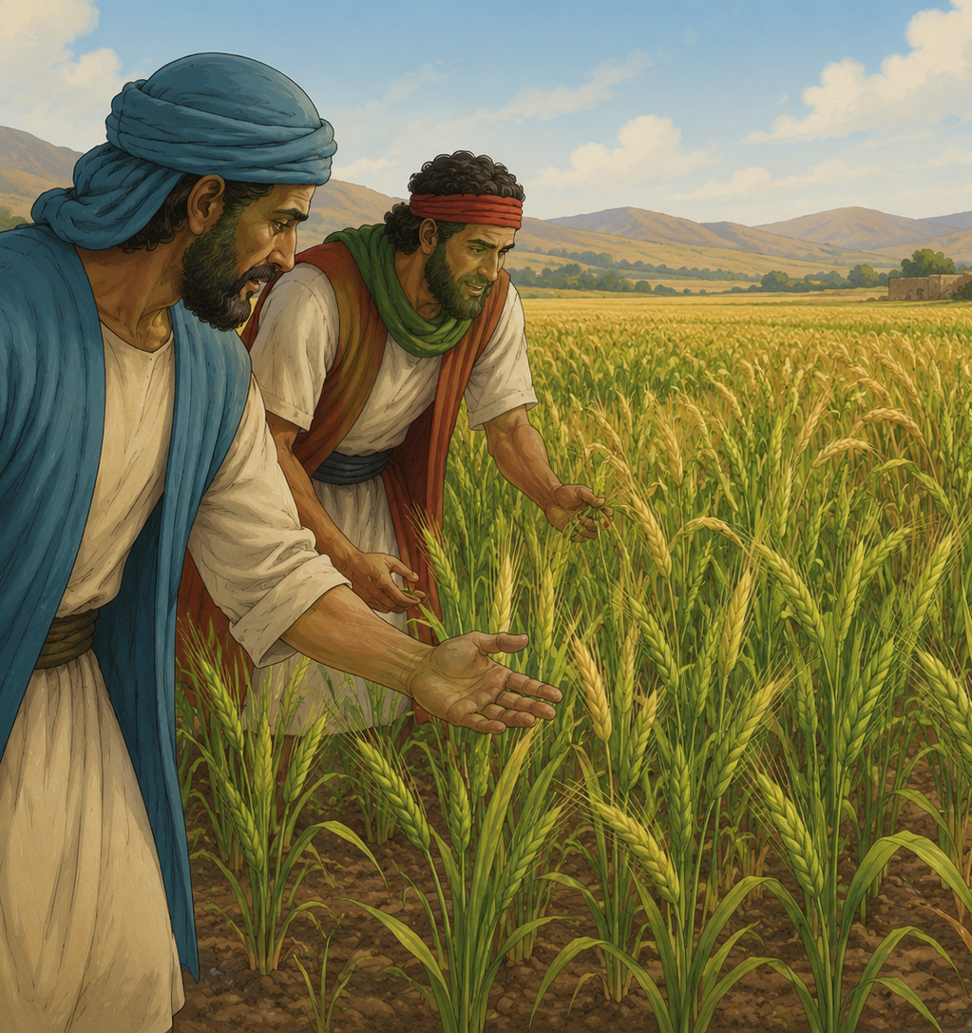
Exodus 9:26
²⁶ Only in the land of Goshen, where the children of Israel were, was there no hail.

Slide 31
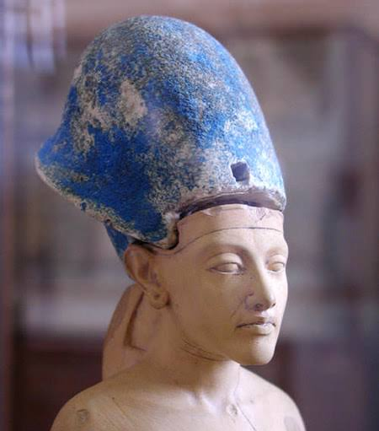
Exodus 10:4, 5
10. When Pharaoh again broke his promise to let the people go, what did the Lord threaten?

Slide 32
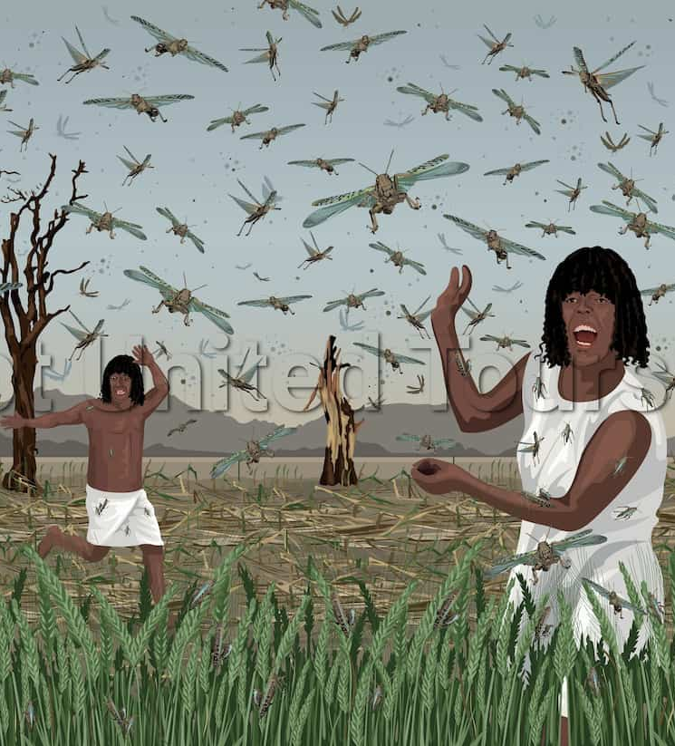
Exodus 10:4, 5
⁴ Else, if thou refuse to let my people go, behold, to morrow will I bring the locusts into thy coast:

Slide 33
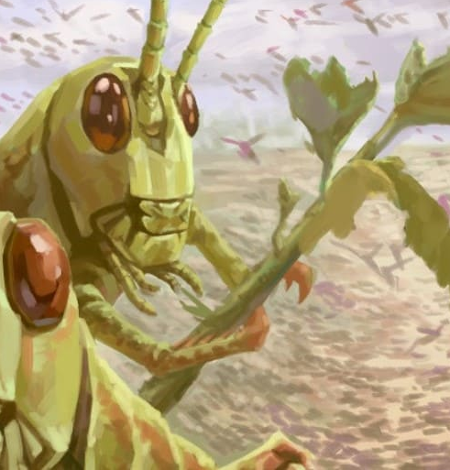
Exodus 10:4, 5
⁵ And they shall cover the face of the earth, that one cannot be able to see the earth: and they shall eat the residue of that which is escaped, which remaineth unto you from the hail, and shall eat every tree which groweth for you out of the field:

Slide 34
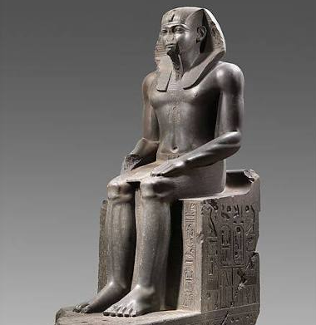
Exodus 10:13-15
11. How severe was this plague?

Slide 35
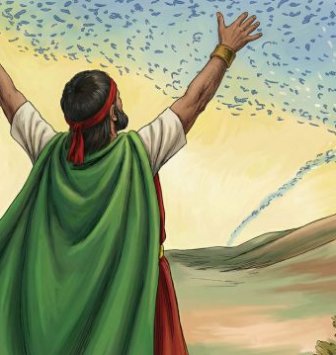
Exodus 10:13-15
¹³ And Moses stretched forth his rod over the land of Egypt, and the Lord brought an east wind upon the land all that day, and all that night; and when it was morning, the east wind brought the locusts.

Slide 36
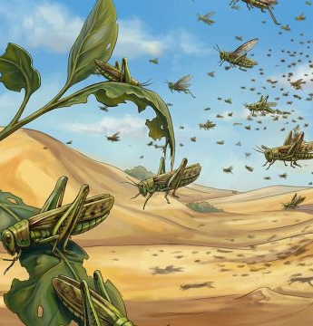
Exodus 10:13-15
¹⁴ And the locust went up over all the land of Egypt, and rested in all the coasts of Egypt: very grievous were they; before them there were no such locusts as they, neither after them shall be such.

Slide 37
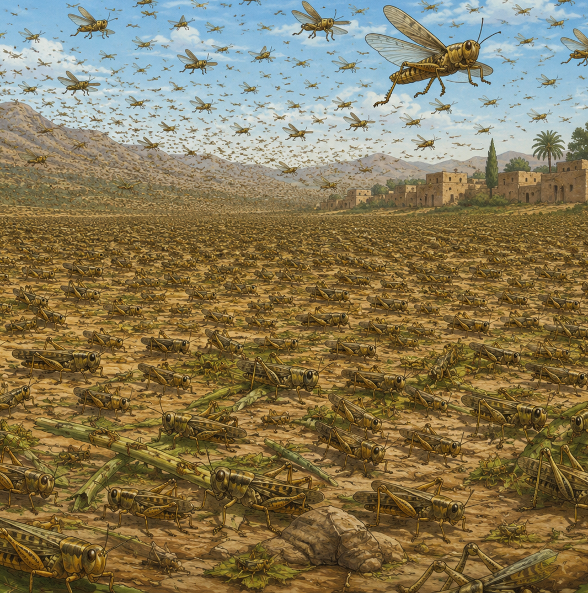
Exodus 10:13-15
¹⁵ For they covered the face of the whole earth, so that the land was darkened; and they did eat every herb of the land, and all the fruit of the trees which the hail had left: and there remained not any green thing in the trees, or in the herbs of the field, through all the land of Egypt.

Slide 38
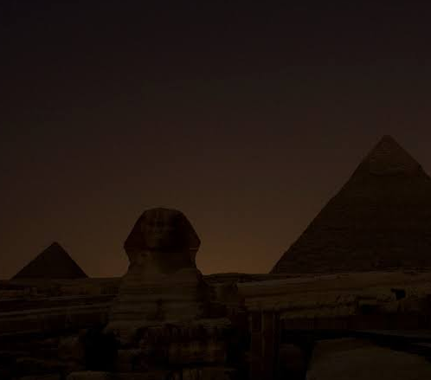
Exodus 10:21-23
12. What was the ninth plague?

Slide 39
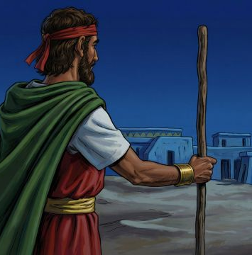
Exodus 10:21-23
²¹ And the Lord said unto Moses, Stretch out thine hand toward heaven, that there may be darkness over the land of Egypt, even darkness which may be felt.

Slide 40
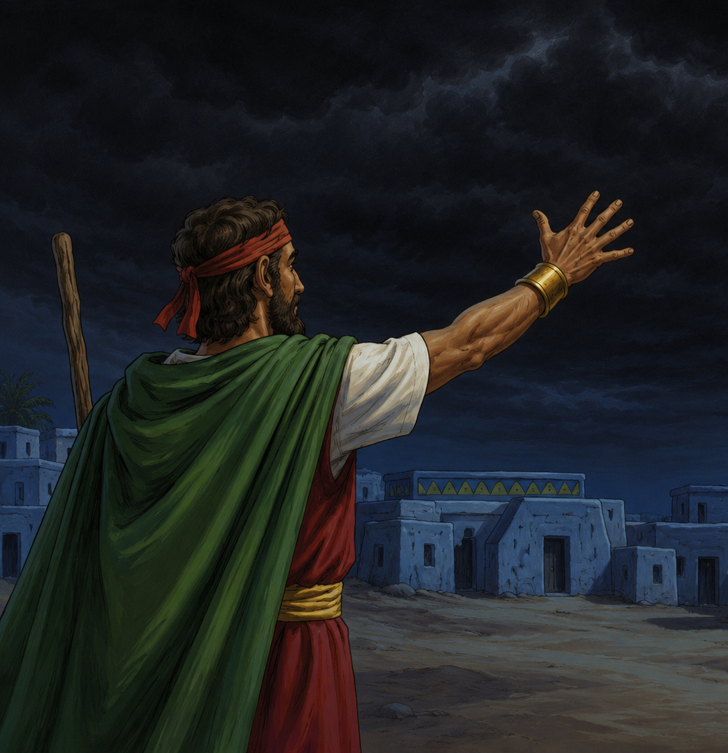
Exodus 10:21-23
²² And Moses stretched forth his hand toward heaven; and there was a thick darkness in all the land of Egypt three days:

Slide 41
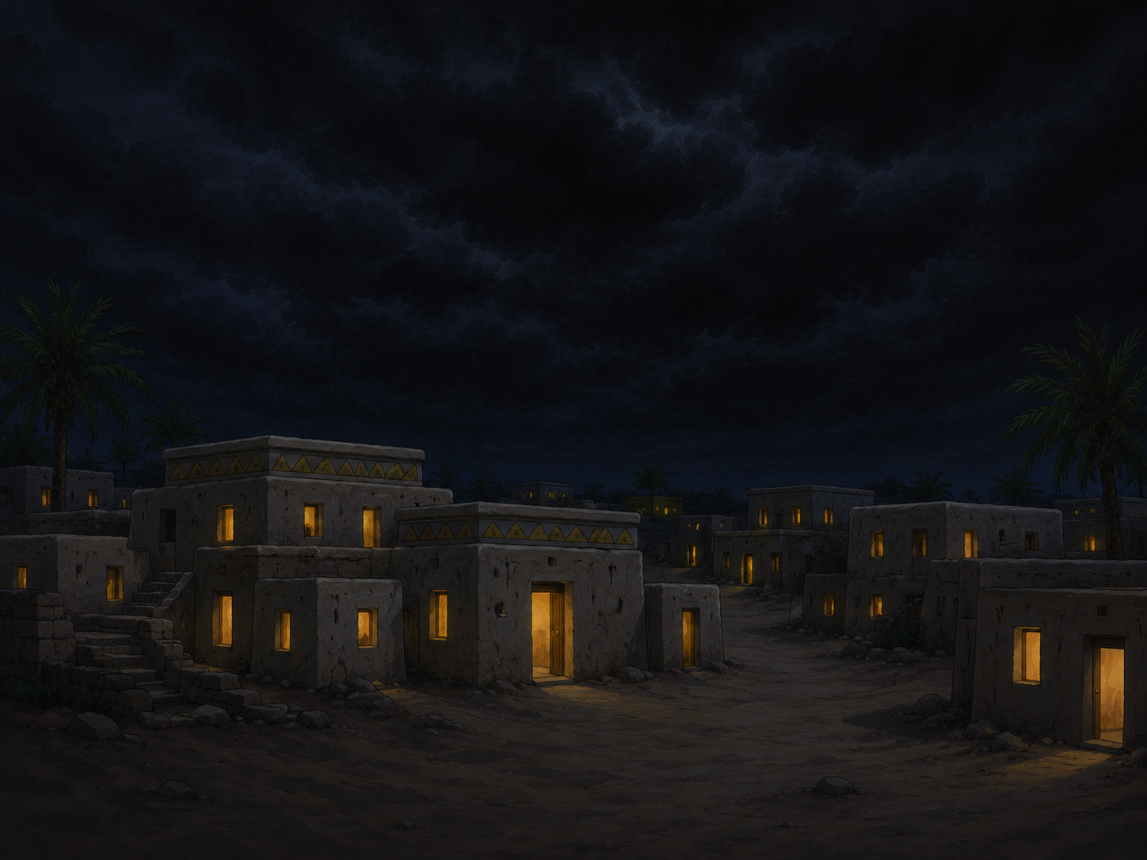
Exodus 10:21-23
²³ They saw not one another, neither rose any from his place for three days: but all the children of Israel had light in their dwellings.

Slide 42
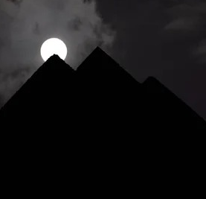
Exodus 10:23
13. What showed in a special manner that this darkness was not from ordinary causes?

Slide 43
Exodus 10:21-23
²³ They saw not one another, neither rose any from his place for three days: but all the children of Israel had light in their dwellings.

Slide 44
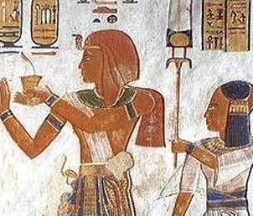
Exodus 11:4-6
14. What was the tenth and last plague threatened?

Slide 45
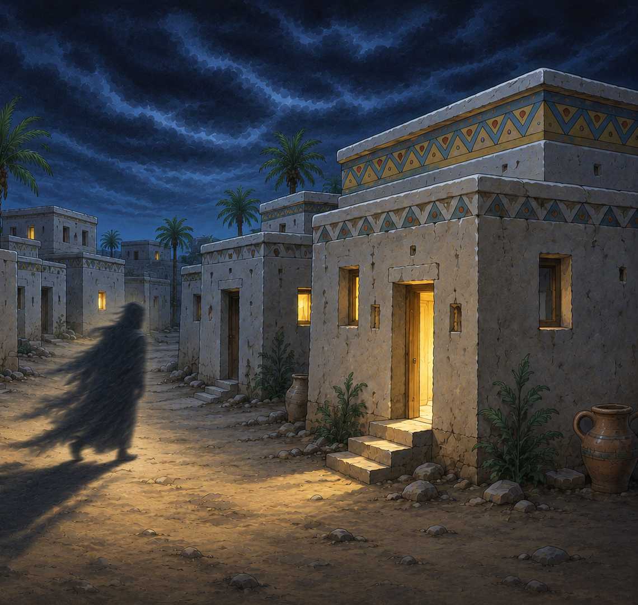
Exodus 11:4-6
⁴ And Moses said, Thus saith the Lord, About midnight will I go out into the midst of Egypt:

Slide 46
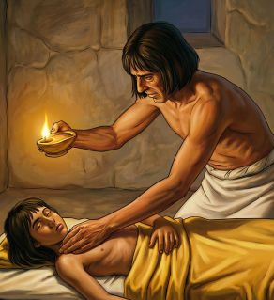
Exodus 11:4-6
⁵ And all the firstborn in the land of Egypt shall die, from the first born of Pharaoh that sitteth upon his throne, even unto the firstborn of the maidservant that is behind the mill; and all the firstborn of beasts.

Slide 47
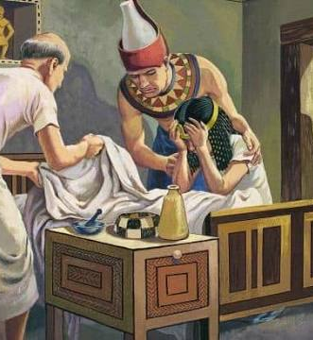
Exodus 11:4-6
⁶ And there shall be a great cry throughout all the land of Egypt, such as there was none like it, nor shall be like it any more.

Slide 48
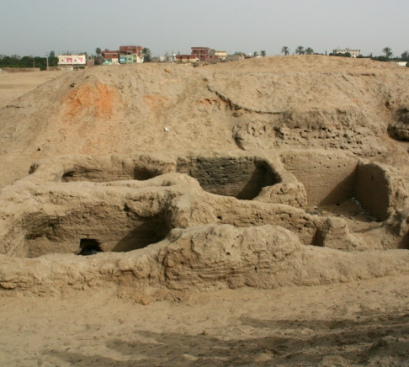
Exodus 11:7
15. How did the Lord propose to show that he put a difference between the Egyptians and the Israelites?

Slide 49
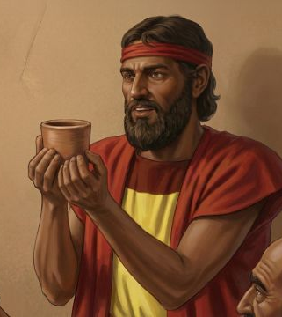
Exodus 11:7
⁷ But against any of the children of Israel shall not a dog move his tongue, against man or beast: that ye may know how that the Lord doth put a difference between the Egyptians and Israel.

Slide 50
The Note:
James B. Walker’s
The Philosophy of the Plan of Salvation.

Slide 51
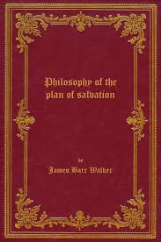
The Philosophy of the Plan of Salvation was enormously influential in its day though much less known now. It first appeared anonymously in 1846 ("By an American Citizen"), though Walker's authorship soon became known. Walker was a Congregational minister, educator, and later president of Grand Traverse College.

Slide 52
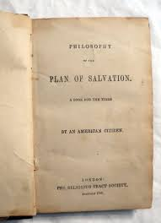
Walker's argument is that God designed the human mind, so God's plan of salvation is perfectly adapted to how the human heart actually works.
He builds the case almost like a lawyer or philosopher.

Slide 53
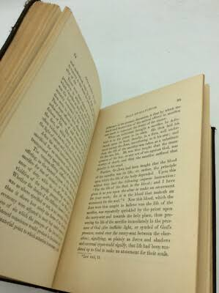
Human beings inevitably worship something.
We gradually become like whatever we worship.
Therefore God must reveal Himself in a way that transforms character.
God's plan of salvation uniquely accomplishes this.
That psychological emphasis made the book unusual for its day.

Slide 54
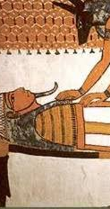
The note comes from a chapter in which Walker argues that God did not perform miracles arbitrarily.
Instead, he says the miracles were carefully selected demonstrations aimed at destroying Egypt's confidence in its false religion. He views the plagues as a systematic demolition of Egypt's religious worldview rather than merely punishments.

Slide 55
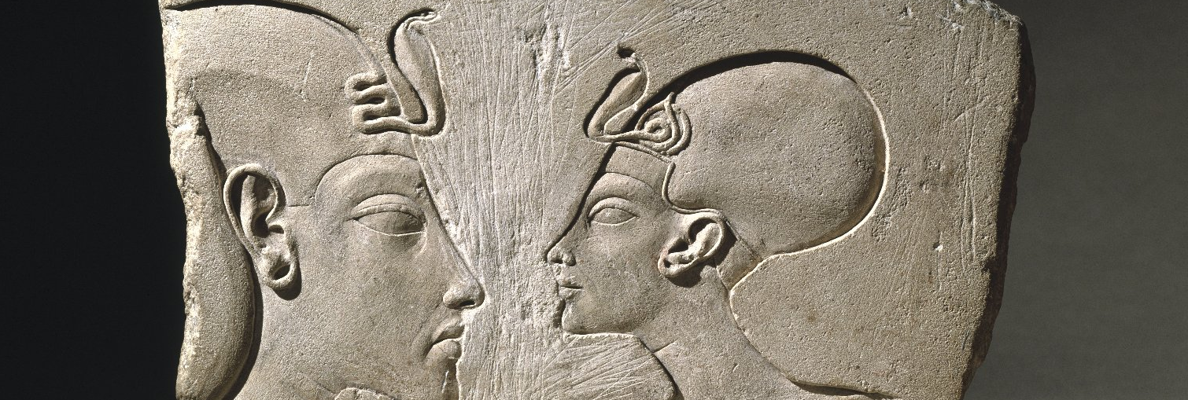
The first miracle, while it authenticated the mission of Moses, destroyed the serpents, which among the Egyptians were objects of worship, thus evincing, in the outset, that their gods could neither help the people nor save themselves.

Slide 56
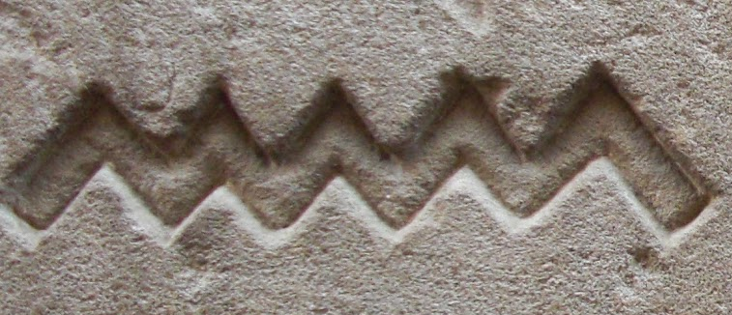
The second miracle was directed against the river Nile, another object which they regarded with religious reverence. This river they held sacred, as the Hindoos do the Ganges; and even the fish in its waters they revered as objects of worship.

Slide 57
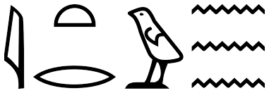
They drank the water with reverence and delight, and supposed that a divine efficacy dwelt in its waves to heal diseases of the body. The water of this, their cherished object of idolatrous homage, was transmuted to blood; and its finny idols became a mass of putridity.

Slide 58
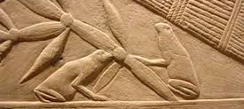
The third miracle was directed to the accomplishment of the same end—the destruction of faith in the river as an object of worship.
By the fourth miracle of a series constantly increasing in power and severity, lice came upon man and beast throughout the land.

Slide 59
"Now if it be remembered," says Glieg, "that no one could approach the altars of Egypt upon whom so impure an insect harbored; and that the priests, to guard against the slightest risk of contamination, wore only linen garments, and shaved their heads and bodies every day [every third day according to Herodotus], the severity of this miracle as a judgment upon Egyptian idolatry may be imagined….”

Slide 60
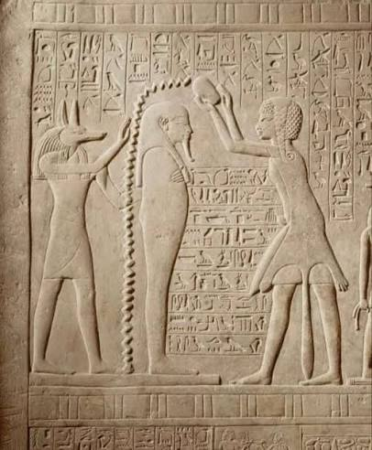
“Whilst it lasted, no act of worship could be performed, and so keenly was this felt that the very magicians exclaimed, ‘This is the finger of God.’”

Slide 61
The fifth miracle was designed to destroy the trust of the people in Beelzebub or the Fly-god, who was reverenced as their protector from visitations of swarms of ravenous flies which infested the land, generally about the time of the dog-days, and removed only, as they supposed, at the will of this idol.

Slide 62

2 Kings 1:2 - The Fly-god
² And Ahaziah fell down through a lattice in his upper chamber that was in Samaria, and was sick: and he sent messengers, and said unto them, Go, enquire of Baalzebub the god of Ekron whether I shall recover of this disease.

Slide 63


The sixth miracle, which destroyed the cattle excepting those of the Israelites, was aimed at the destruction of the entire system of brute worship. This system, degrading and bestial as it was, had become a monster of many heads in Egypt.

Slide 64



They had their sacred bull, and ram, and heifer, and goat, and many others, all of which were destroyed by the agency of the God of Moses. Thus by one act of power Jehovah manifested his own supremacy, and destroyed the very existence of their brute idols.

Slide 65

Of the peculiar fitness of the sixth plague (the seventh miracle) says the writer before quoted, the reader will receive a better impression when he is reminded that in Egypt there were several altars upon which human sacrifices were occasionally offered, when they desired to propitiate Typhon, or the Evil Principle.
GREEK

Slide 66

Set was a complex deity associated with storms, deserts, violence, and chaos, but he was not always viewed as purely evil. Over time, however, especially in later Egyptian religion and Greek interpretations, Set became increasingly associated with disorder and opposition to the forces of good.

Slide 67

These victims being burned alive, their ashes were gathered together by the officiating priests, and thrown up into the air, in order that evil might be averted from every place to which an atom of the ashes was wafted.

Slide 68

Some ancient writers, especially Plutarch, describe occasional human sacrifices associated with Typhon (Set), in which victims were burned and their ashes scattered. Walker accepted these ancient reports as historical, but today they are generally regarded as possible rather than certain.

Slide 69

Some commentators connect the furnace not with pagan ritual but with the brick kilns where the Israelites had been enslaved. The soot from the furnaces of oppression becomes the instrument of God's judgment upon the oppressors.

Slide 70

By the direction of Jehovah, Moses took a handful of ashes from the furnace (which, very probably, the Egyptians at this time had frequently used to turn aside the plagues with which they were smitten) and he cast it into the air, as they were accustomed to do; and instead of averting evil, boils and blains fell upon all the people of the land.

Slide 71

Neither king, nor priest, nor people, escaped. Thus the bloody rites of Typhon became a curse to the idolaters— the supremacy of Jehovah was affirmed, and the deliverance of the Israelites insisted upon.

Slide 72

The ninth miracle was directed against the worship of Serapis, whose peculiar office was supposed to be to protect the country from locusts.

Slide 73

Serapis was a Graeco-Egyptian deity promoted during the Ptolemaic period, long after the Exodus. The older Egyptian religious ideas behind Serapis—especially the worship of Osiris and the sacred Apis bull—were already present in ancient Egypt, but the deity Serapis itself belongs to a much later period.

Slide 74

The eighth and tenth miracles were directed against the worship of Isis and Osiris, to whom, and the river Nile, they awarded the first place in the long catalogue of their idolatry.

Slide 75

In a country where rain seldom falls—where the atmosphere is always calm, and the light of the heavenly bodies always continued, what was the horror pervading ail minds during the elemental war described in the Hebrew record!—during the long period of three days and three nights, while the gloom of thick darkness settled, like the outspread pall of death, over the whole land!

Slide 76
The Almighty having thus revealed himself as the true God, by miraculous agency, and pursued those measures, in the exercise of his power, which were directly adapted to destroy the various forms of idolatry which existed in Egypt, the eleventh and last miracle was a judgment, in order to manifest to all minds that Jehovah was the God who executed judgment in the earth.

Slide 77

The plagues revealed Jehovah as the only true God and Judge, but the Passover revealed something more. The same God who judged rebellion also provided a substitute, gave clear instructions, and promised safety to every home sheltered by the blood. Justice and mercy met together in the deliverance of Israel—a foreshadowing of the greater redemption to come through Christ.

Slide 78


Slide 79


