Slide 1


Slide 2


Slide 3
God’s Care for His People
-Concluded-
Lesson 5: February 2, 1889

Slide 4
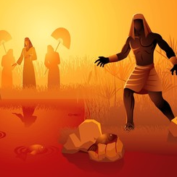
1. Tell, in their order, what plagues were brought upon the land of Egypt because Pharaoh would not let Israel go?

Slide 5
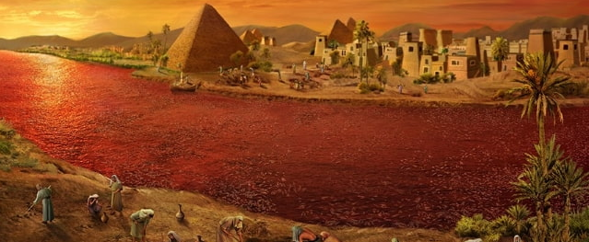
1: Water Turns To Blood

Slide 6
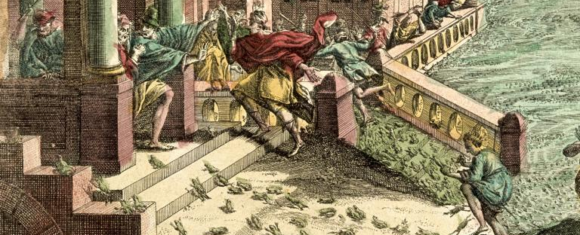
2: Frogs

Slide 7
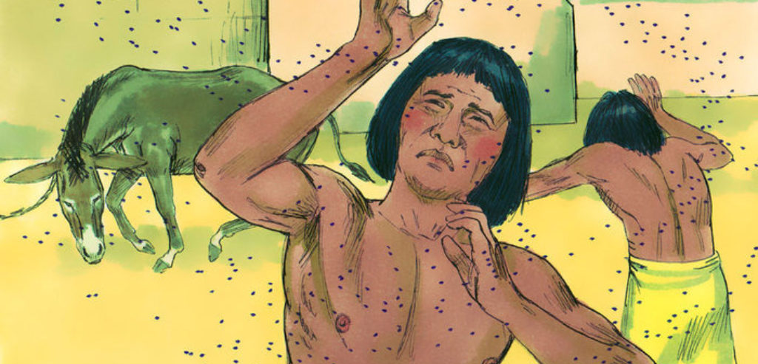
3: Gnats or Lice

Slide 8
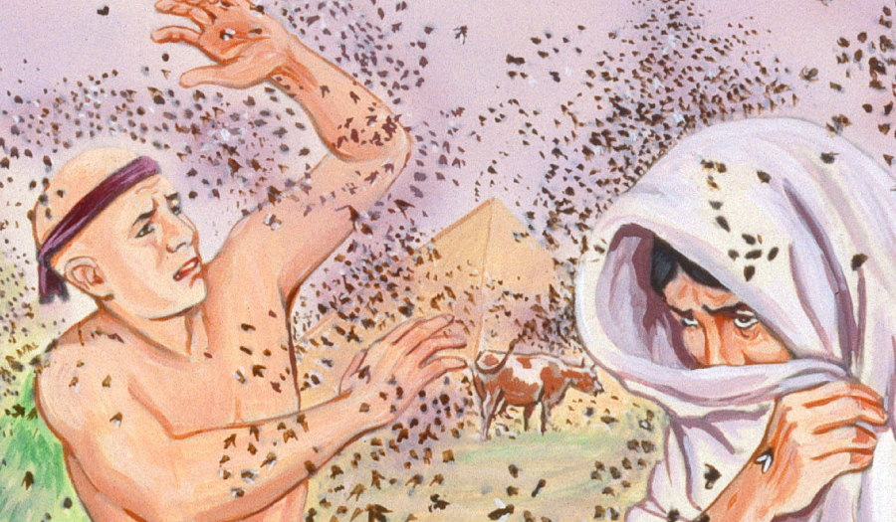
4: Flies

Slide 9
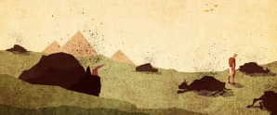
5: Murrain (Disease of Livestock)

Slide 10
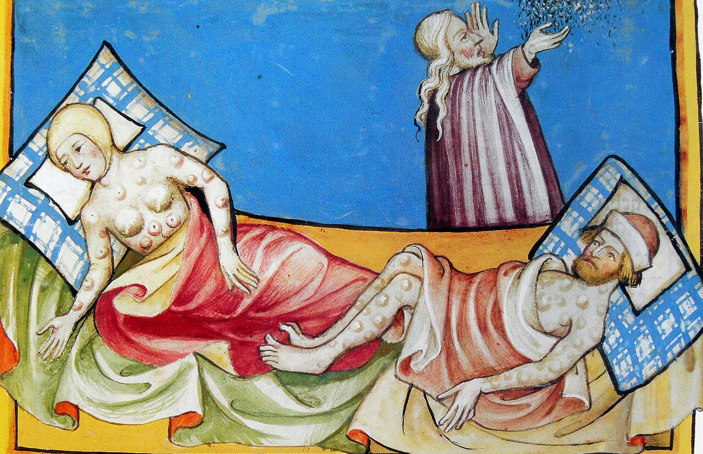
6: Boils

Slide 11
7: Hail

Slide 12
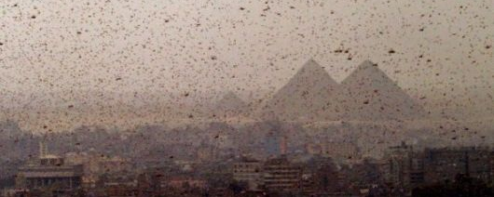
8: Locusts

Slide 13
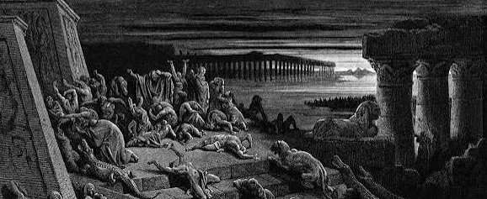
9: Darkness

Slide 14
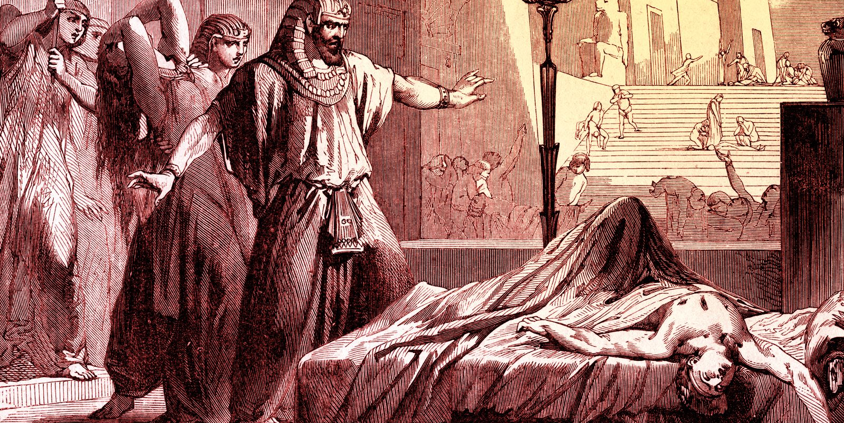
10: Death of the Firstborn

Slide 15
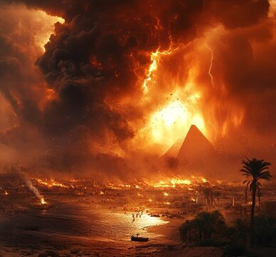
2. State the particulars of how God discriminated between his people and the Egyptians.

Slide 16

The plagues did not come upon Goshen, the cattle of Israel did not die, no hail fell where they lived, they had light while Egypt was in darkness, and in the final plague every home protected by the blood of the Passover lamb was spared.

Slide 17
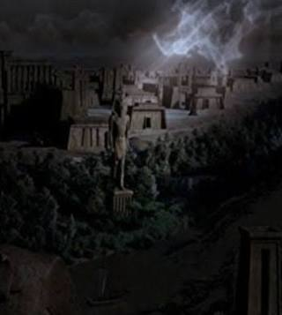
Exodus 11:4-6
3. What was the last plague?

Slide 18
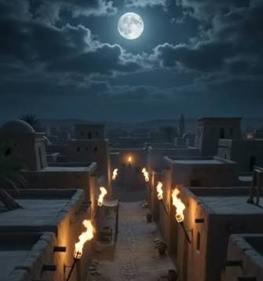
Exodus 11:4-6
⁴ And Moses said, Thus saith the Lord, About midnight will I go out into the midst of Egypt:

Slide 19
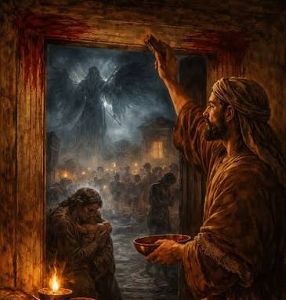
Exodus 11:4-6
⁵ And all the firstborn in the land of Egypt shall die, from the first born of Pharaoh that sitteth upon his throne, even unto the firstborn of the maidservant that is behind the mill; and all the firstborn of beasts.

Slide 20
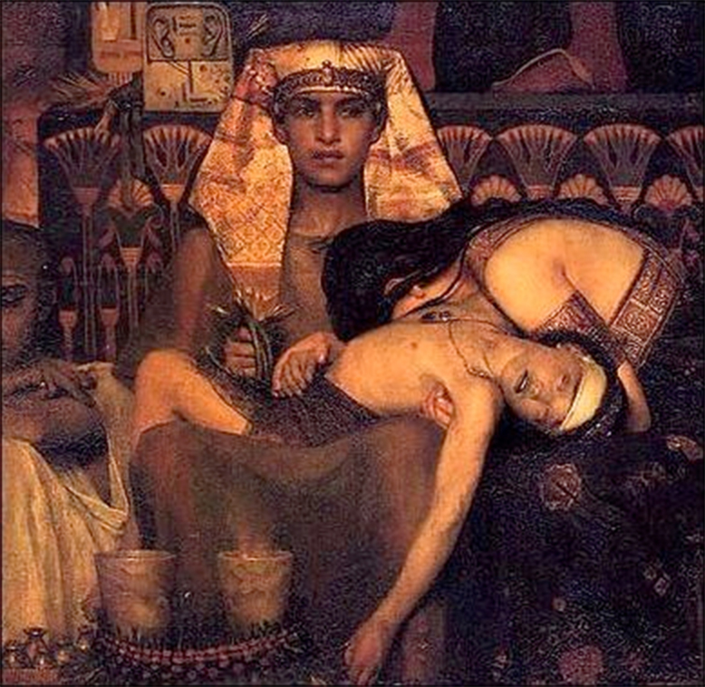
Exodus 11:4-6
⁶ And there shall be a great cry throughout all the land of Egypt, such as there was none like it, nor shall be like it any more.

Slide 21
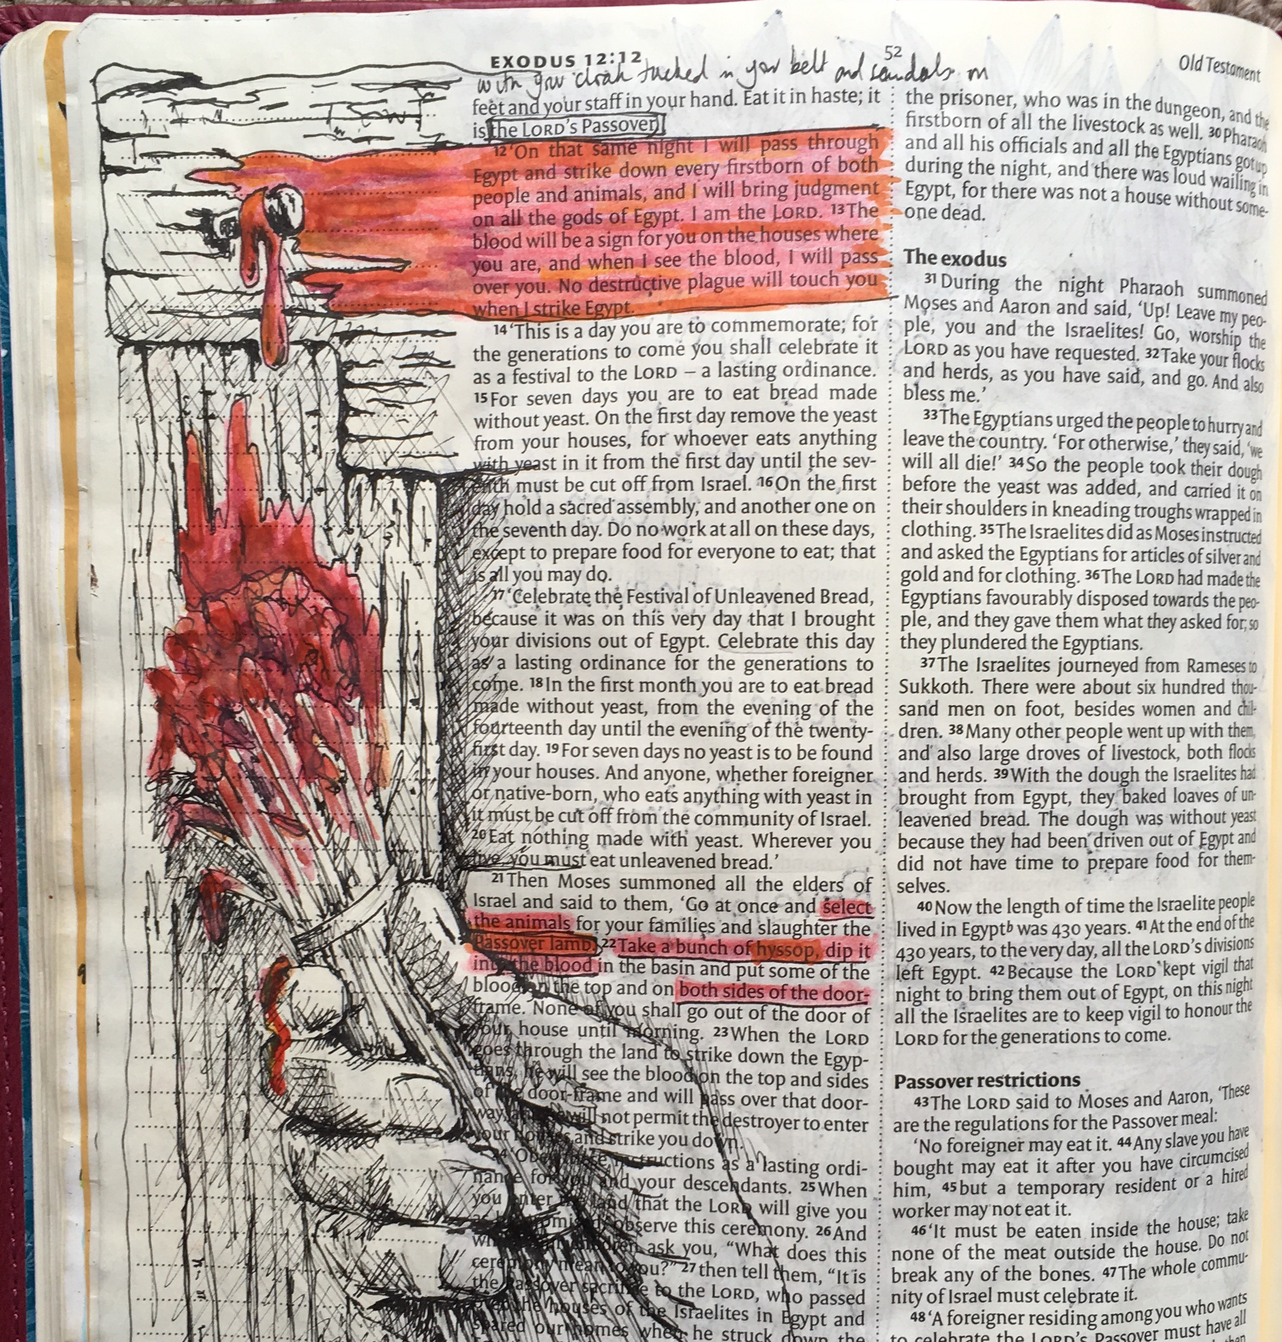
Exodus 11:7
4. How safe were the Israelites to be?

Slide 22
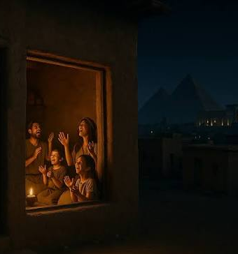
Exodus 11:7
⁷ But against any of the children of Israel shall not a dog move his tongue, against man or beast: that ye may know how that the Lord doth put a difference between the Egyptians and Israel.

Slide 23
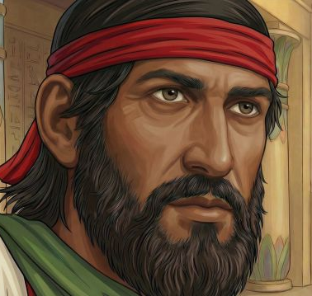
Exodus 12:1-10
5. Before this plague was inflicted, what instruction did the Lord give his people?

Slide 24
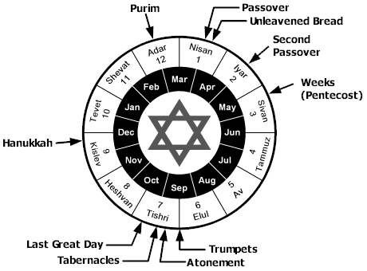
Exodus 12:1-10
12 And the Lord spake unto Moses and Aaron in the land of Egypt saying,
² This month shall be unto you the beginning of months: it shall be the first month of the year to you.

Slide 25
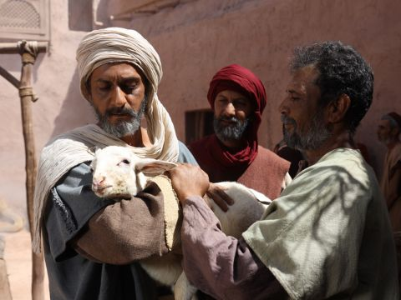
Exodus 12:1-10
³ Speak ye unto all the congregation of Israel, saying, In the tenth day of this month they shall take to them every man a lamb, according to the house of their fathers, a lamb for an house:

Slide 26
Exodus 12:1-10
⁴ And if the household be too little for the lamb, let him and his neighbour next unto his house take it according to the number of the souls; every man according to his eating shall make your count for the lamb.

Slide 27
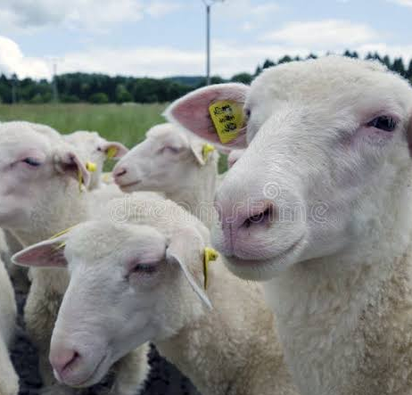
Exodus 12:1-10
⁵ Your lamb shall be without blemish, a male of the first year: ye shall take it out from the sheep, or from the goats:

Slide 28
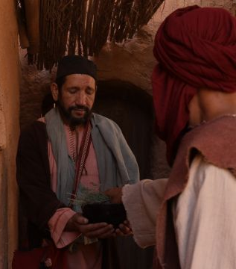
Exodus 12:1-10
⁶ And ye shall keep it up until the fourteenth day of the same month: and the whole assembly of the congregation of Israel shall kill it in the evening.

Slide 29
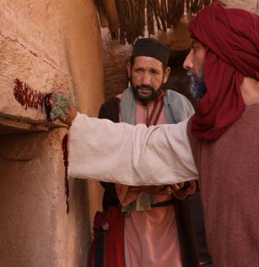
Exodus 12:1-10
⁷ And they shall take of the blood, and strike it on the two side posts and on the upper door post of the houses, wherein they shall eat it.

Slide 30
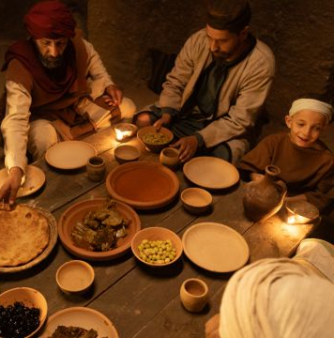
Exodus 12:1-10
⁸ And they shall eat the flesh in that night, roast with fire, and unleavened bread; and with bitter herbs they shall eat it.

Slide 31
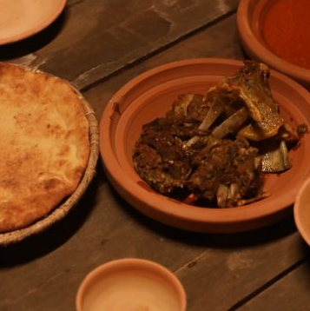
Exodus 12:1-10
⁹ Eat not of it raw, nor sodden at all with water, but roast with fire; his head with his legs, and with the purtenance thereof.

Slide 32
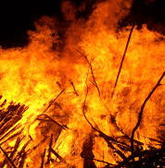
Exodus 12:1-10
¹⁰ And ye shall let nothing of it remain until the morning; and that which remaineth of it until the morning ye shall burn with fire.

Slide 33
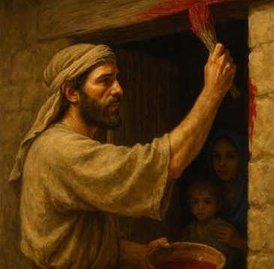
Exodus 12:11
6. What was this feast declared to be?

Slide 34
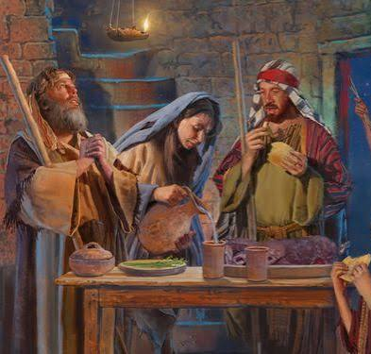
Exodus 12:11
¹¹ And thus shall ye eat it; with your loins girded, your shoes on your feet, and your staff in your hand; and ye shall eat it in haste: it is the Lord's passover.

Slide 35
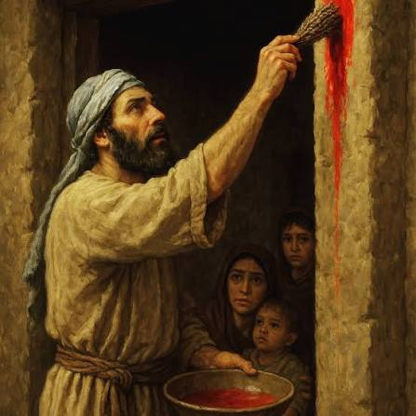
Exodus 12:21-22
7. What were they to do with the blood of the lamb?

Slide 36
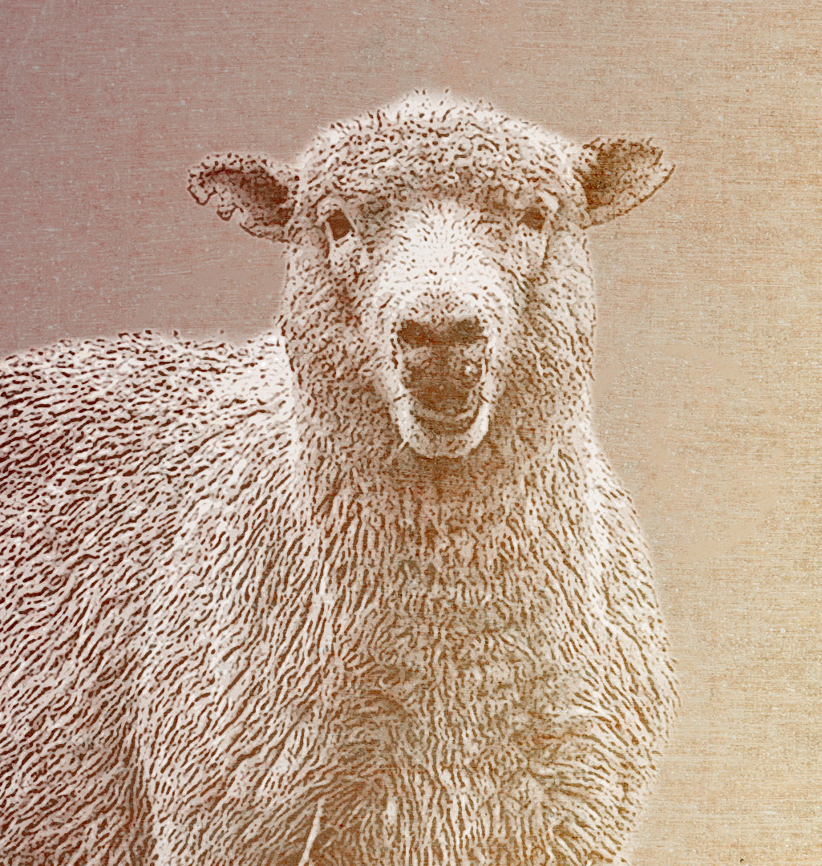
Exodus 12:21-22
²¹ Then Moses called for all the elders of Israel, and said unto them, Draw out and take you a lamb according to your families, and kill the passover.

Slide 37
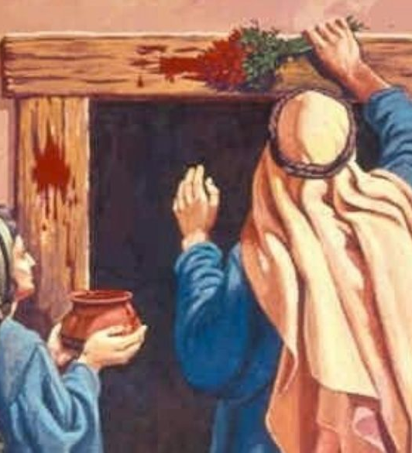
Exodus 12:21-22
²² And ye shall take a bunch of hyssop, and dip it in the blood that is in the bason, and strike the lintel and the two side posts with the blood that is in the bason; and none of you shall go out at the door of his house until the morning.

Slide 38
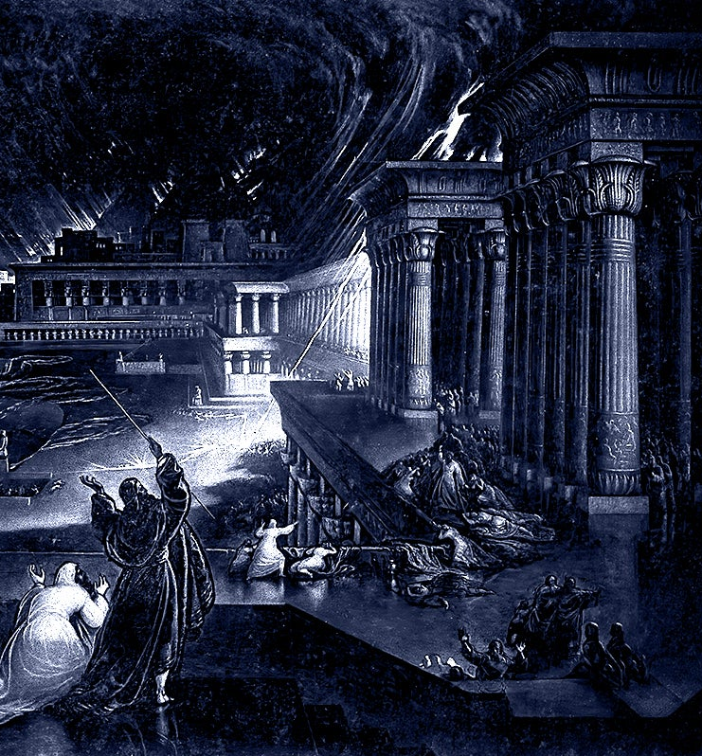
Exodus 12:13, 23
8. Why were they to do this?

Slide 39
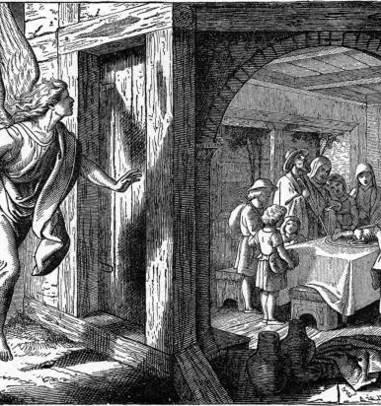
Exodus 12:13, 23
¹³ And the blood shall be to you for a token upon the houses where ye are: and when I see the blood, I will pass over you, and the plague shall not be upon you to destroy you, when I smite the land of Egypt.

Slide 40
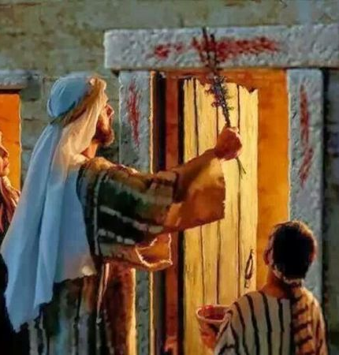
Exodus 12:13, 23
²³ For the Lord will pass through to smite the Egyptians; and when he seeth the blood upon the lintel, and on the two side posts, the Lord will pass over the door, and will not suffer the destroyer to come in unto your houses to smite you.

Slide 41
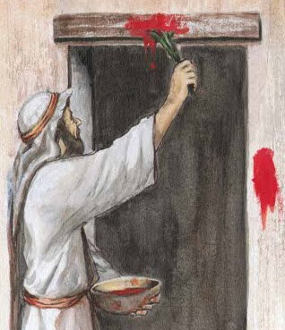
Answer:
Faith in God.
9. What did this simple act indicate?

Slide 42
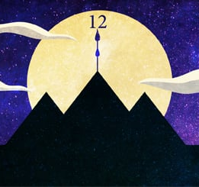
Exodus 12:29, 30
10. What took place at midnight?

Slide 43
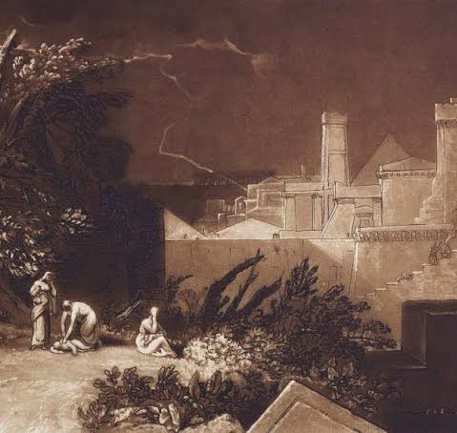
Exodus 12:29, 30
²⁹ And it came to pass, that at midnight the Lord smote all the firstborn in the land of Egypt, from the firstborn of Pharaoh that sat on his throne unto the firstborn of the captive that was in the dungeon; and all the firstborn of cattle.

Slide 44
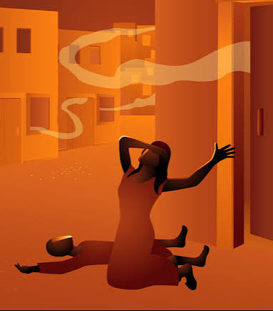
Exodus 12:29, 30
³⁰ And Pharaoh rose up in the night, he, and all his servants, and all the Egyptians; and there was a great cry in Egypt; for there was not a house where there was not one dead.

Slide 45
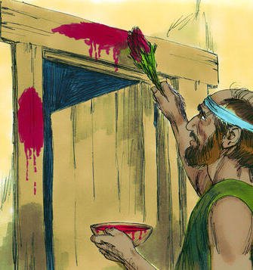
Exodus 9:20, 21
11. What part of the previous record warrants us in believing that the Egyptians might have availed themselves of the protection afforded the Israelites?

Slide 46
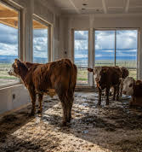
Exodus 9:20, 21
²⁰ He that feared the word of the Lord among the servants of Pharaoh made his servants and his cattle flee into the houses:

Slide 47
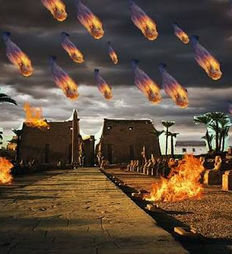
Exodus 9:20, 21
²¹ And he that regarded not the word of the Lord left his servants and his cattle in the field.

Slide 48
1 Corinthians 5:7
12. Of what was the lamb whose sprinkled blood saved the Israelites from death, a type? [That is, whom did the Passover lamb represent?]

Slide 49
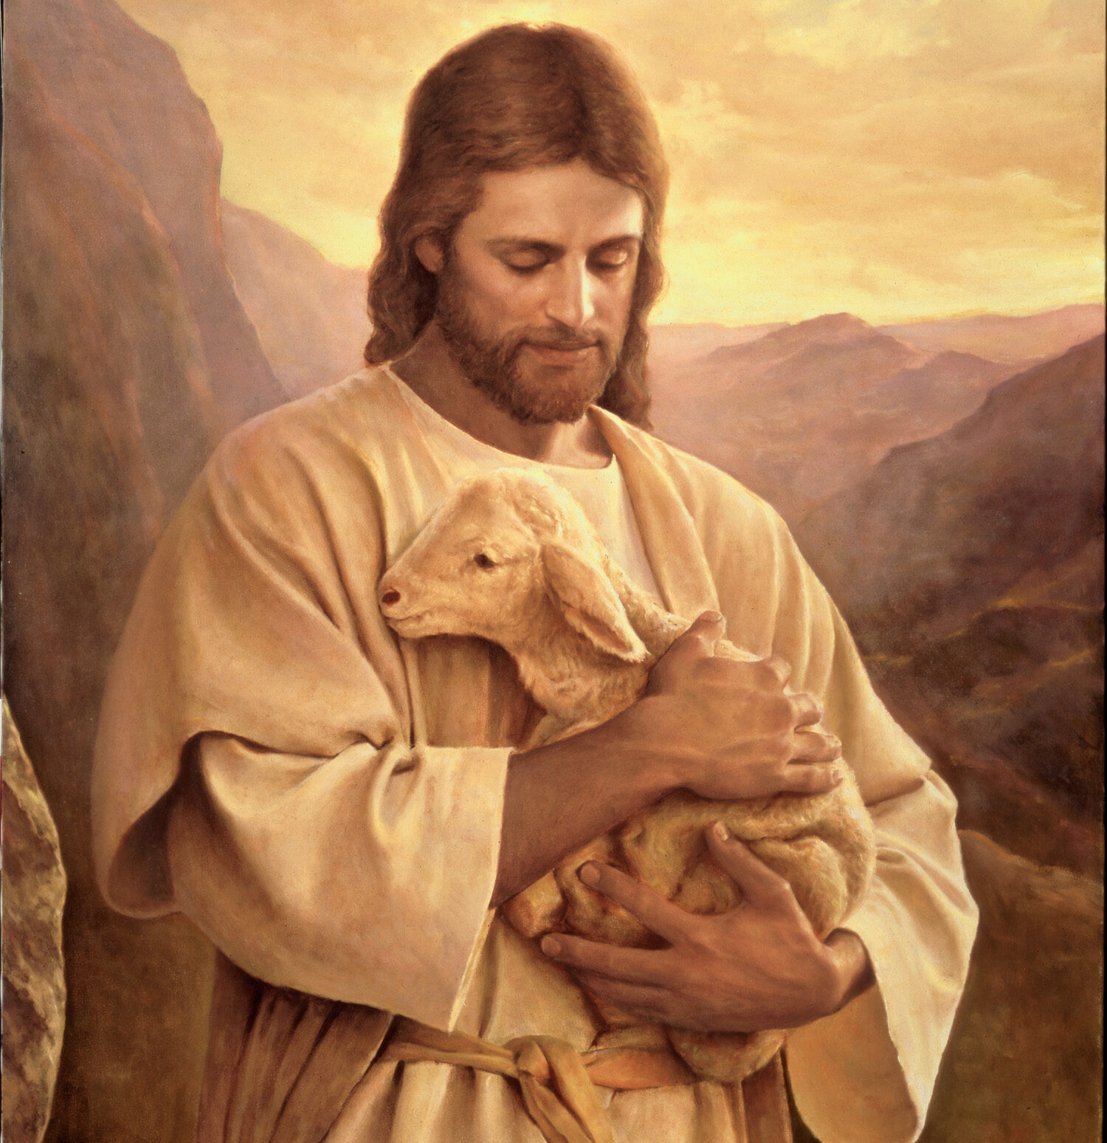
1 Corinthians 5:7
⁷ Purge out therefore the old leaven, that ye may be a new lump, as ye are unleavened. For even Christ our passover is sacrificed for us:

Slide 50
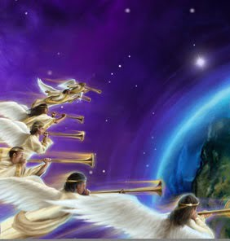
Revelation 15:1; 16:1
14. Just before God's people are finally delivered from this evil world, what will come upon the earth?

Slide 51
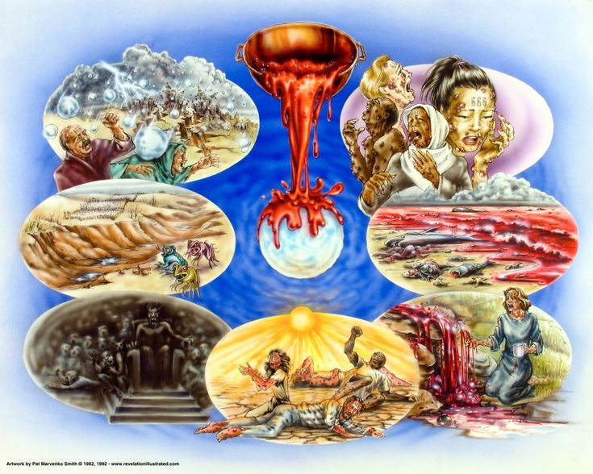
Revelation 15:1
15 And I saw another sign in heaven, great and marvellous, seven angels having the seven last plagues; for in them is filled up the wrath of God.

Slide 52
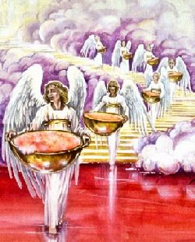
Revelation 16:1
16 And I heard a great voice out of the temple saying to the seven angels, Go your ways, and pour out the vials of the wrath of God upon the earth.

Slide 53
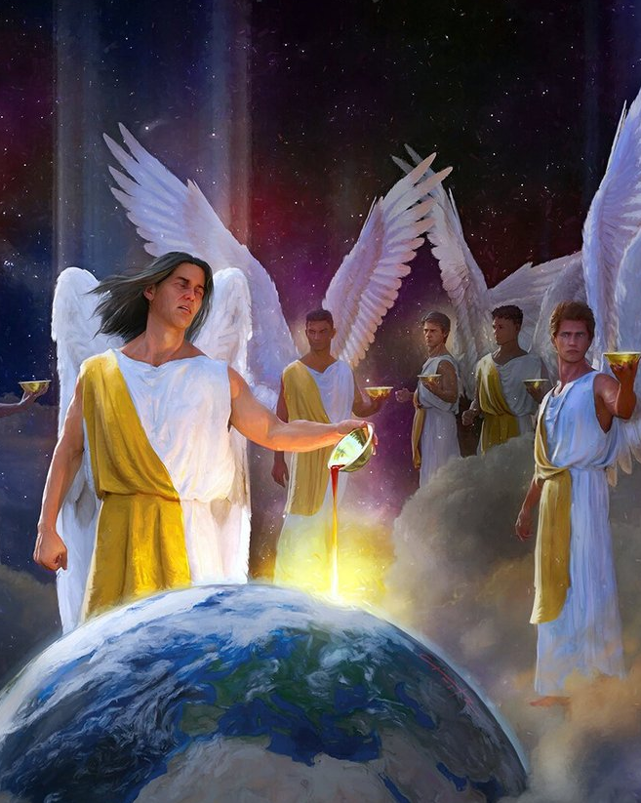
Revelation 16
15. Which of the seven last plagues will be similar to the plagues upon Egypt?

Slide 54
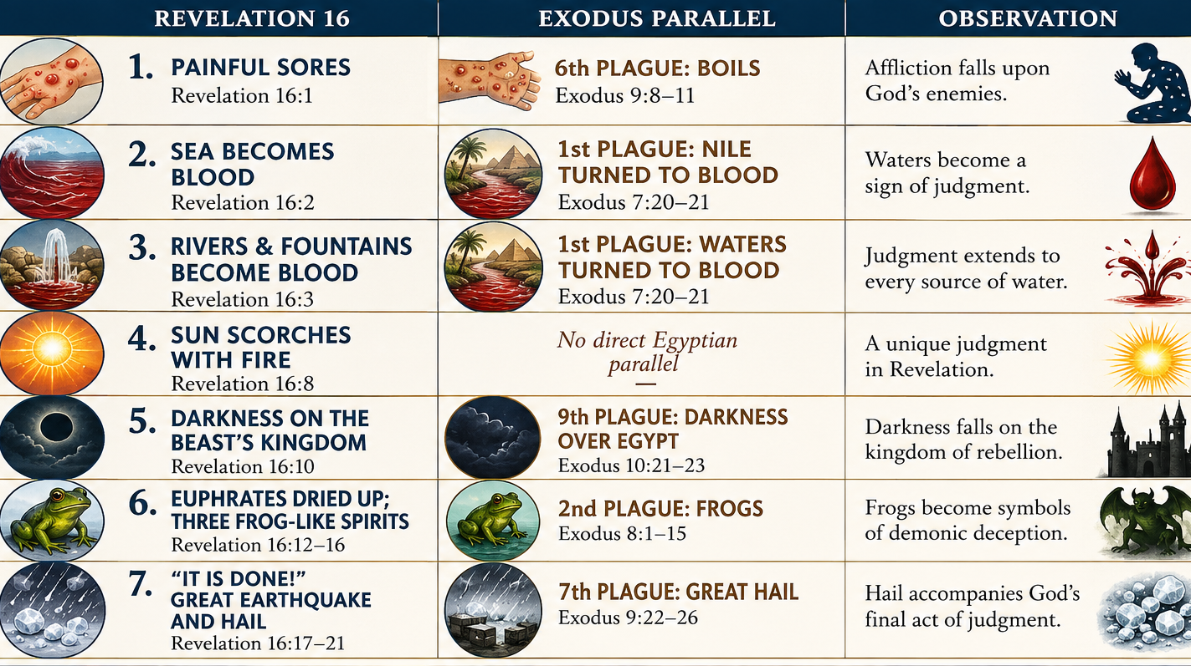

Slide 55
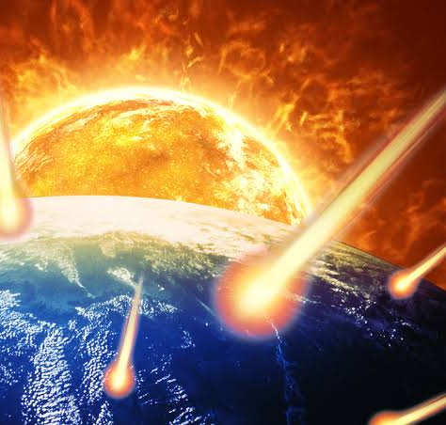
Daniel 12:1;
Isaiah 2:20-21; 13:6, 7, 9;
24:1, 3-6, 17-21.
16. Mention some of the things that are said as to the trouble of that day.

Slide 56
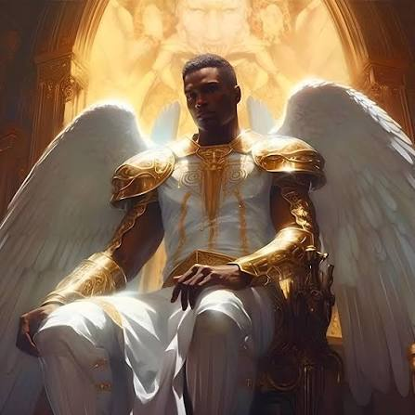
Daniel 12:1
12 And at that time shall Michael stand up, the great prince which standeth for the children of thy people: and there shall be a time of trouble, such as never was since there was a nation even to that same time: and at that time thy people shall be delivered, every one that shall be found written in the book.

Slide 57
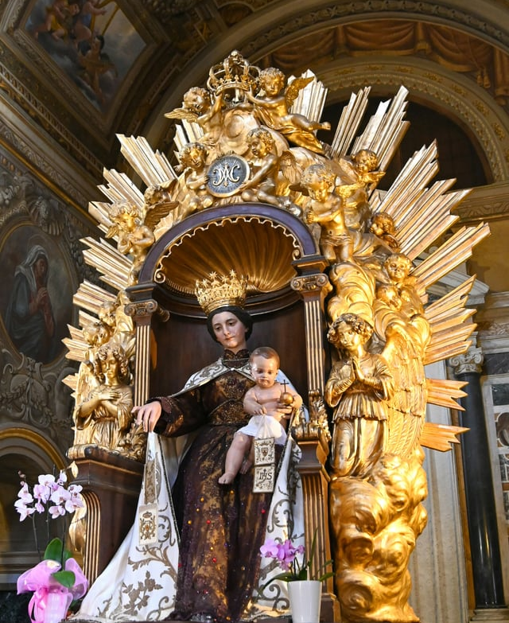
Isaiah 2:20-21
²⁰ In that day a man shall cast his idols of silver, and his idols of gold, which they made each one for himself to worship, to the moles and to the bats;

Slide 58

Isaiah 2:20-21
²¹ To go into the clefts of the rocks, and into the tops of the ragged rocks, for fear of the Lord, and for the glory of his majesty, when he ariseth to shake terribly the earth.

Slide 59

Isaiah 13:6, 7, 9
⁶ Howl ye; for the day of the Lord is at hand; it shall come as a destruction from the Almighty.
⁷ Therefore shall all hands be faint, and every man's heart shall melt:

Slide 60

Isaiah 13:6, 7, 9
⁹ Behold, the day of the Lord cometh, cruel both with wrath and fierce anger, to lay the land desolate: and he shall destroy the sinners thereof out of it.

Slide 61

Isaiah 24:1, 3-6
24 Behold, the Lord maketh the earth empty, and maketh it waste, and turneth it upside down, and scattereth abroad the inhabitants thereof.

Slide 62

Isaiah 24:1, 3-6
³ The land shall be utterly emptied, and utterly spoiled: for the Lord hath spoken this word.
⁴ The earth mourneth and fadeth away, the world languisheth and fadeth away, the haughty people of the earth do languish.

Slide 63

Isaiah 24:1, 3-6
⁵ The earth also is defiled under the inhabitants thereof; because they have transgressed the laws, changed the ordinance, broken the everlasting covenant.

Slide 64

Isaiah 24:1, 3-6
⁶ Therefore hath the curse devoured the earth, and they that dwell therein are desolate: therefore the inhabitants of the earth are burned, and few men left.

Slide 65

Isaiah 24:17-21
¹⁷ Fear, and the pit, and the snare, are upon thee, O inhabitant of the earth.

Slide 66

Isaiah 24:17-21
¹⁸ And it shall come to pass, that he who fleeth from the noise of the fear shall fall into the pit; and he that cometh up out of the midst of the pit shall be taken in the snare: for the windows from on high are open, and the foundations of the earth do shake.

Slide 67

Isaiah 24:17-21
¹⁹ The earth is utterly broken down, the earth is clean dissolved, the earth is moved exceedingly.

Slide 68

Isaiah 24:17-21
²⁰ The earth shall reel to and fro like a drunkard, and shall be removed like a cottage; and the transgression thereof shall be heavy upon it; and it shall fall, and not rise again.

Slide 69

Isaiah 24:17-21
²¹ And it shall come to pass in that day, that the Lord shall punish the host of the high ones that are on high, and the kings of the earth upon the earth.

Slide 70

Psalm 91:1-10
17. What distinction will God then put between his servants and the wicked?

Slide 71

Psalm 91:1-10
91 He that dwelleth in the secret place of the most High shall abide under the shadow of the Almighty.

Slide 72

Psalm 91:1-10
² I will say of the Lord, He is my refuge and my fortress: my God; in him will I trust.

Slide 73

Psalm 91:1-10
³ Surely he shall deliver thee from the snare of the fowler, and from the noisome pestilence.

Slide 74

Psalm 91:1-10
⁴ He shall cover thee with his feathers, and under his wings shalt thou trust: his truth shall be thy shield and buckler.

Slide 75

Psalm 91:1-10
⁵ Thou shalt not be afraid for the terror by night; nor for the arrow that flieth by day;

Slide 76

Psalm 91:1-10
⁶ Nor for the pestilence that walketh in darkness; nor for the destruction that wasteth at noonday.

Slide 77

Psalm 91:1-10
⁷ A thousand shall fall at thy side, and ten thousand at thy right hand; but it shall not come nigh thee.

Slide 78

Psalm 91:1-10
⁸ Only with thine eyes shalt thou behold and see the reward of the wicked.

Slide 79

Psalm 91:1-10
⁹ Because thou hast made the Lord, which is my refuge, even the most High, thy habitation;

Slide 80

Psalm 91:1-10
¹⁰ There shall no evil befall thee, neither shall any plague come nigh thy dwelling.

Slide 81


Slide 82


