Slide 1


Slide 2


Slide 3
Hardening Pharaoh’s Heart
Lesson 6: February 9, 1889

Slide 4



1. When the Lord sent Moses to Egypt, what did he say that he knew of Pharaoh?
Exodus 3:19, margin.

Slide 5
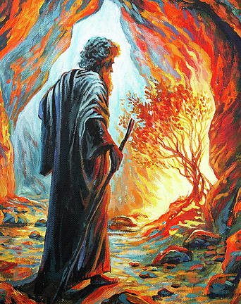
¹⁹ And I am sure that the king of Egypt will not let you go, no, not by a mighty hand.
Exodus 3:19
Marginal Reading: no not by a mighty hand: Or, but by strong hand

Slide 6
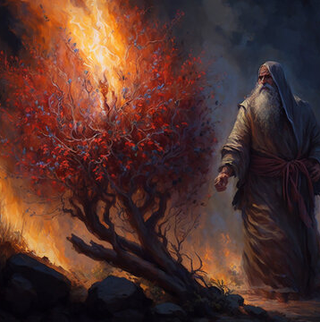
2. What did he say he would have to do before Pharaoh would relent?
Exodus 3:20.

Slide 7
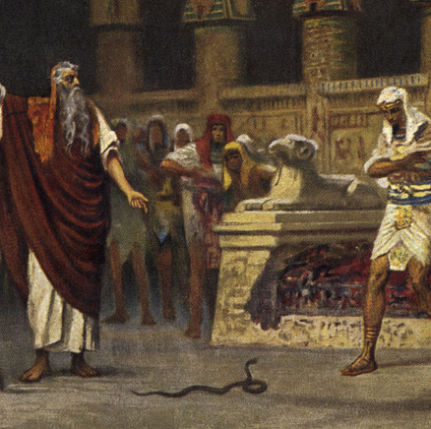
²⁰ And I will stretch out my hand, and smite Egypt with all my wonders which I will do in the midst thereof: and after that he will let you go.
Exodus 3:20

Slide 8
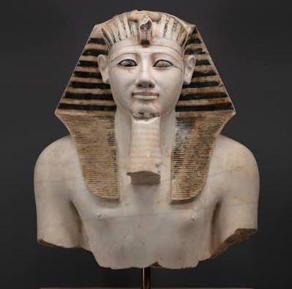
3. Then what was Pharaoh's natural disposition?

Slide 9
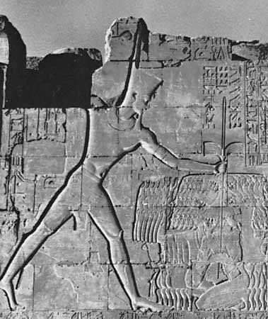
Answer: Stubborn and self-willed; hard and unyielding.

Slide 10
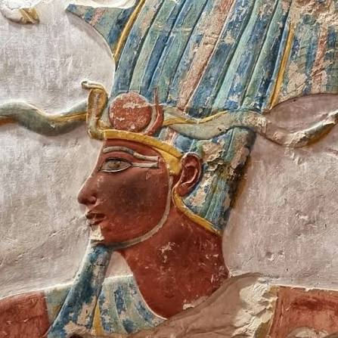
4. Afterward, what did the Lord tell Moses he would do to Pharaoh?
Exodus 7:3.

Slide 11
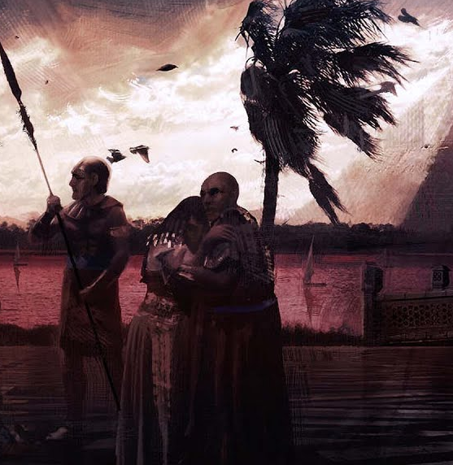
³ And I will harden Pharaoh's heart, and multiply my signs and my wonders in the land of Egypt.
Exodus 7:3

Slide 12
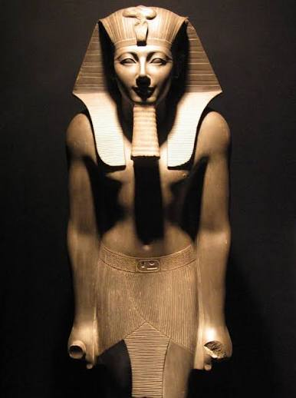
5. What did he say that Pharaoh's stubbornness would give him an opportunity to do?
Exodus 7:4-5.

Slide 13
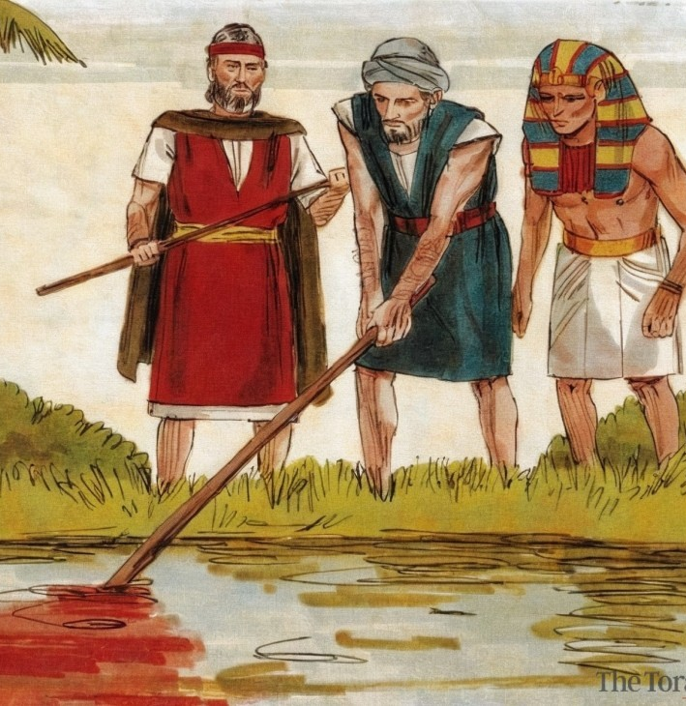
⁴ But Pharaoh shall not hearken unto you, that I may lay my hand upon Egypt, and bring forth mine armies, and my people the children of Israel, out of the land of Egypt by great judgments.
Exodus 7:4-5

Slide 14
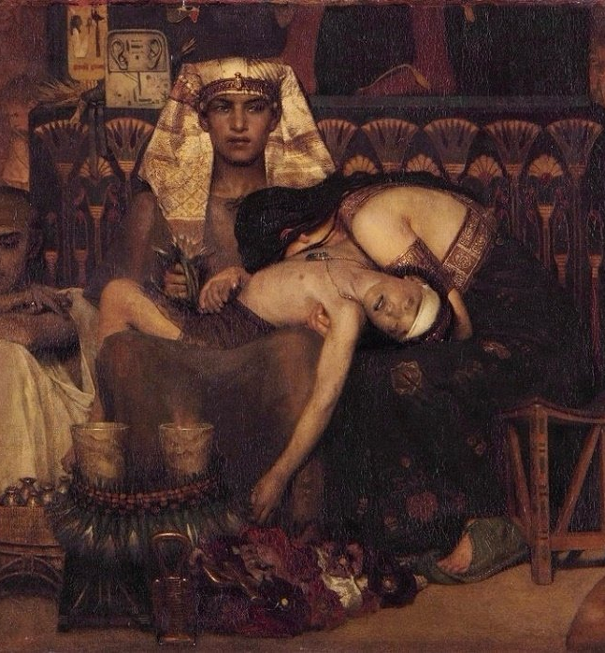
⁵ And the Egyptians shall know that I am the Lord, when I stretch forth mine hand upon Egypt, and bring out the children of Israel from among them.
Exodus 7:4-5

Slide 15
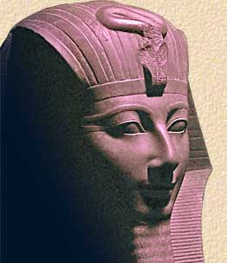
6. What first tended to harden Pharaoh's heart?
Exodus 7:10-13.

Slide 16
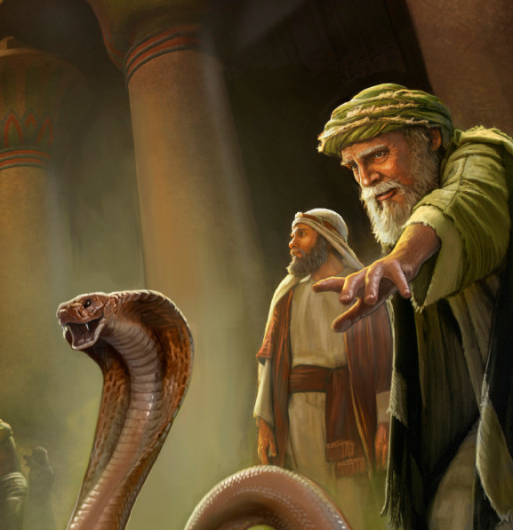
¹⁰ And Moses and Aaron went in unto Pharaoh, and they did so as the Lord had commanded: and Aaron cast down his rod before Pharaoh, and before his servants, and it became a serpent.
Exodus 7:10-13

Slide 17
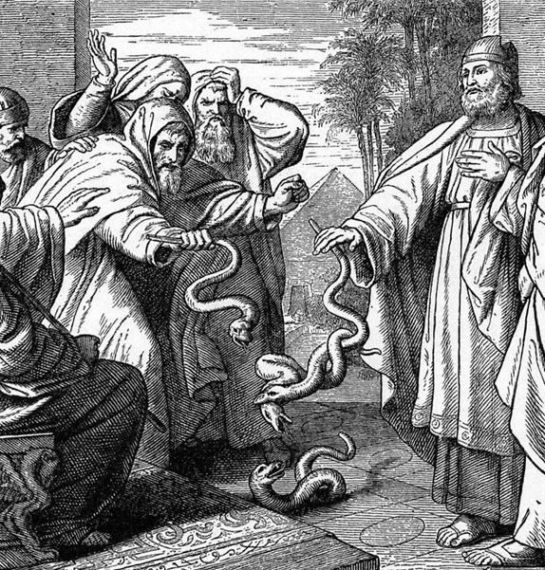
¹¹ Then Pharaoh also called the wise men and the sorcerers: now the magicians of Egypt, they also did in like manner with their enchantments.
Exodus 7:10-13

Slide 18
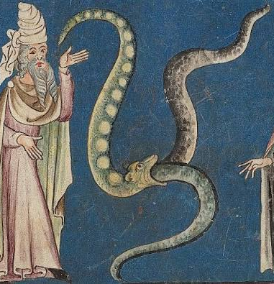
¹² For they cast down every man his rod, and they became serpents: but Aaron's rod swallowed up their rods.
Exodus 7:10-13

Slide 19
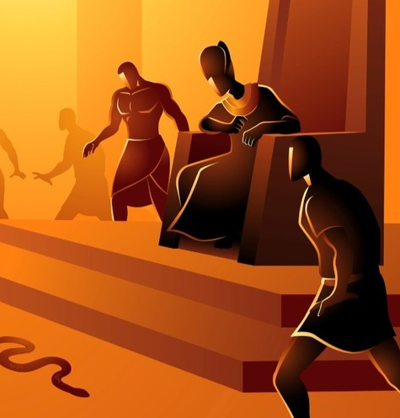
¹³ And he hardened Pharaoh's heart, that he hearkened not unto them; as the Lord had said.
Exodus 7:10-13

Slide 20
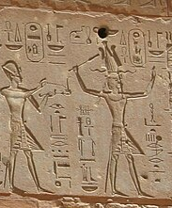
7. What again confirmed him in his stubbornness?
Exodus 7:20-22.

Slide 21
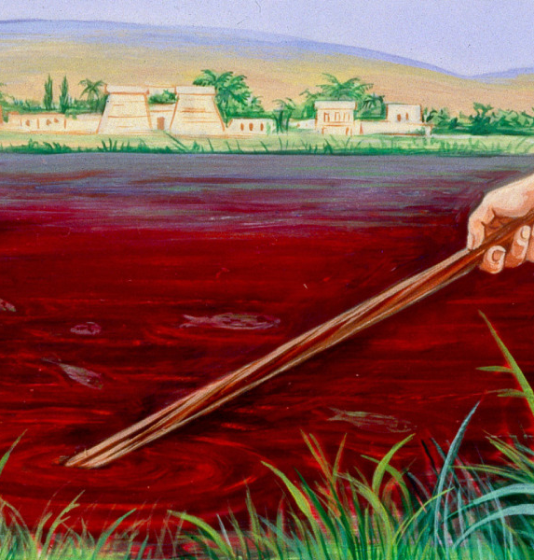
²⁰ And Moses and Aaron did so, as the Lord commanded; and he lifted up the rod, and smote the waters that were in the river, in the sight of Pharaoh, and in the sight of his servants; and all the waters that were in the river were turned to blood.
Exodus 7:20-22

Slide 22
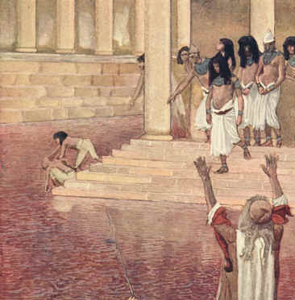
²¹ And the fish that was in the river died; and the river stank, and the Egyptians could not drink of the water of the river; and there was blood throughout all the land of Egypt.
Exodus 7:20-22

Slide 23
²² And the magicians of Egypt did so with their enchantments: and Pharaoh's heart was hardened, neither did he hearken unto them; as the Lord had said.
Exodus 7:20-22

Slide 24
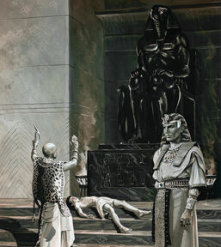
8. Through whose power did the magicians resist the truth, and strengthen the king's evil purpose?

Slide 25
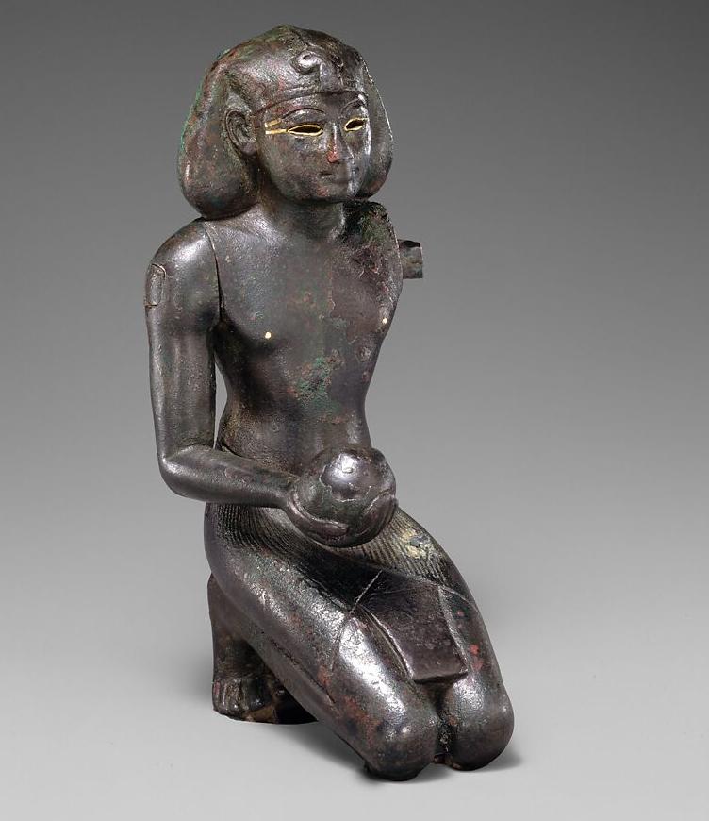
9. What first caused Pharaoh's determination to weaken?
Exodus 8:8.

Slide 26
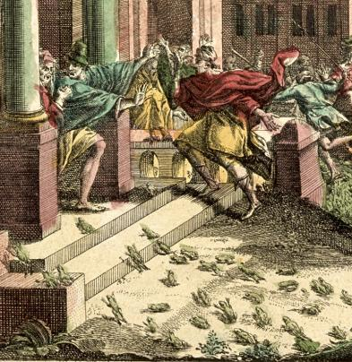
⁸ Then Pharaoh called for Moses and Aaron, and said, Intreat the Lord, that he may take away the frogs from me, and from my people; and I will let the people go, that they may do sacrifice unto the Lord.
Exodus 8:8

Slide 27
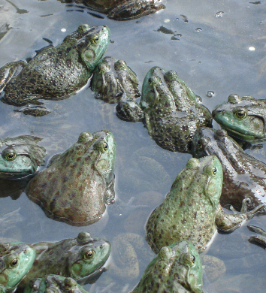
10. When the Lord granted him this favor, what was the result?
Exodus 8:12-15.

Slide 28
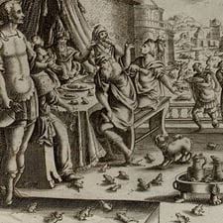
¹² And Moses and Aaron went out from Pharaoh: and Moses cried unto the Lord because of the frogs which he had brought against Pharaoh.
Exodus 8:12-15

Slide 29
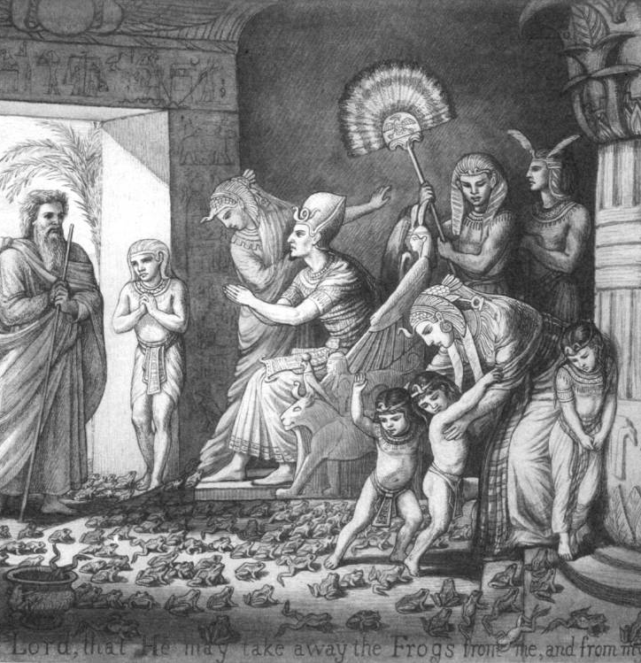
¹³ And the Lord did according to the word of Moses; and the frogs died out of the houses, out of the villages, and out of the fields.
Exodus 8:12-15

Slide 30
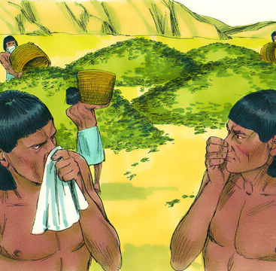
¹⁴ And they gathered them together upon heaps: and the land stank.
¹⁵ But when Pharaoh saw that there was respite, he hardened his heart, and hearkened not unto them; as the Lord had said.
Exodus 8:12-15

Slide 31
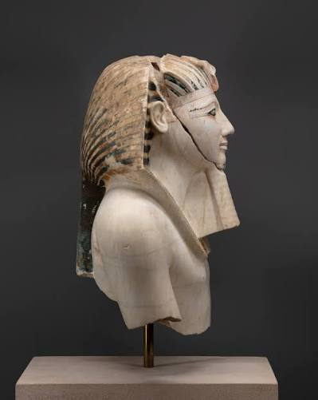
11. Did the next plague have any effect on the king?
Exodus 8:17-19.

Slide 32
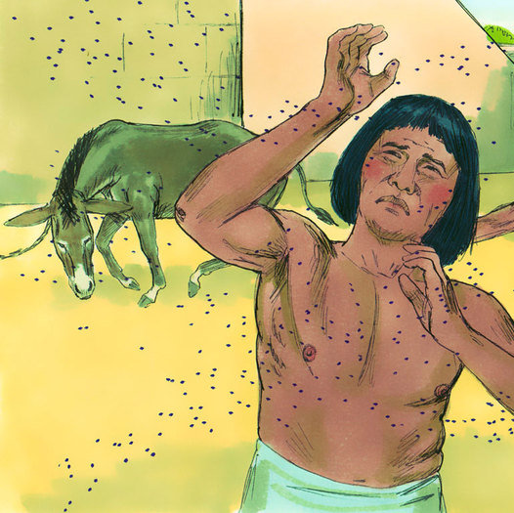
¹⁷ And they did so; for Aaron stretched out his hand with his rod, and smote the dust of the earth, and it became lice in man, and in beast; all the dust of the land became lice throughout all the land of Egypt.
Exodus 8:17-19

Slide 33
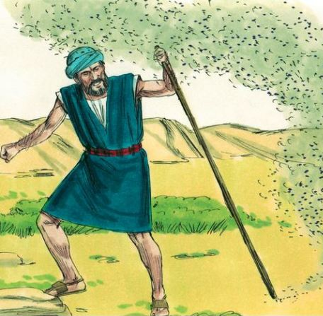
¹⁸ And the magicians did so with their enchantments to bring forth lice, but they could not: so there were lice upon man, and upon beast.
Exodus 8:17-19

Slide 34
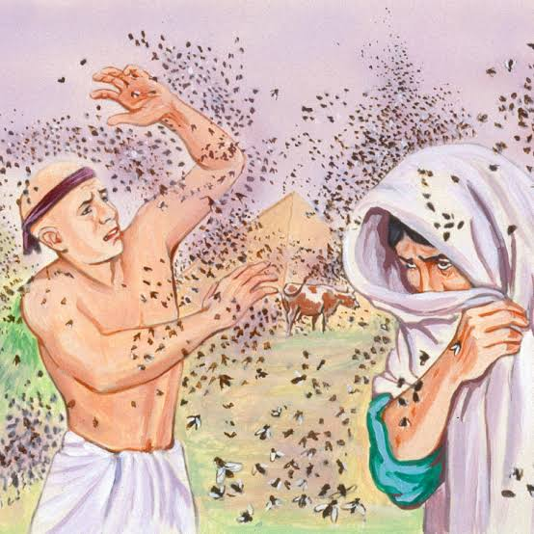
¹⁹ Then the magicians said unto Pharaoh, This is the finger of God: and Pharaoh's heart was hardened, and he hearkened not unto them; as the Lord had said.
Exodus 8:17-19

Slide 35
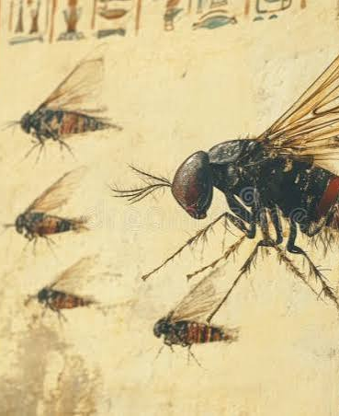
12. When the plague of flies came, how was he affected?
Exodus 8:24-28.

Slide 36

²⁴ And the Lord did so; and there came a grievous swarm of flies into the house of Pharaoh, and into his servants' houses, and into all the land of Egypt: the land was corrupted by reason of the swarm of flies.
Exodus 8:24-28

Slide 37
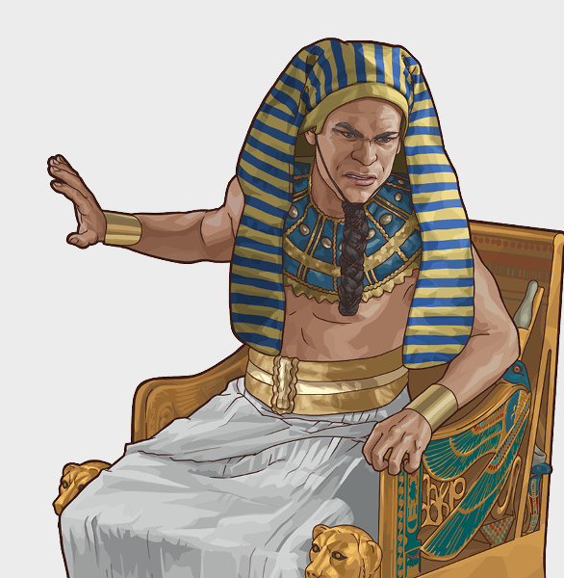
²⁵ And Pharaoh called for Moses and for Aaron, and said, Go ye, sacrifice to your God in the land.
Exodus 8:24-28

Slide 38
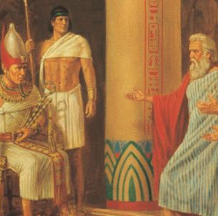
²⁶ And Moses said, It is not meet so to do; for we shall sacrifice the abomination of the Egyptians to the Lord our God: lo, shall we sacrifice the abomination of the Egyptians before their eyes, and will they not stone us?
Exodus 8:24-28

Slide 39
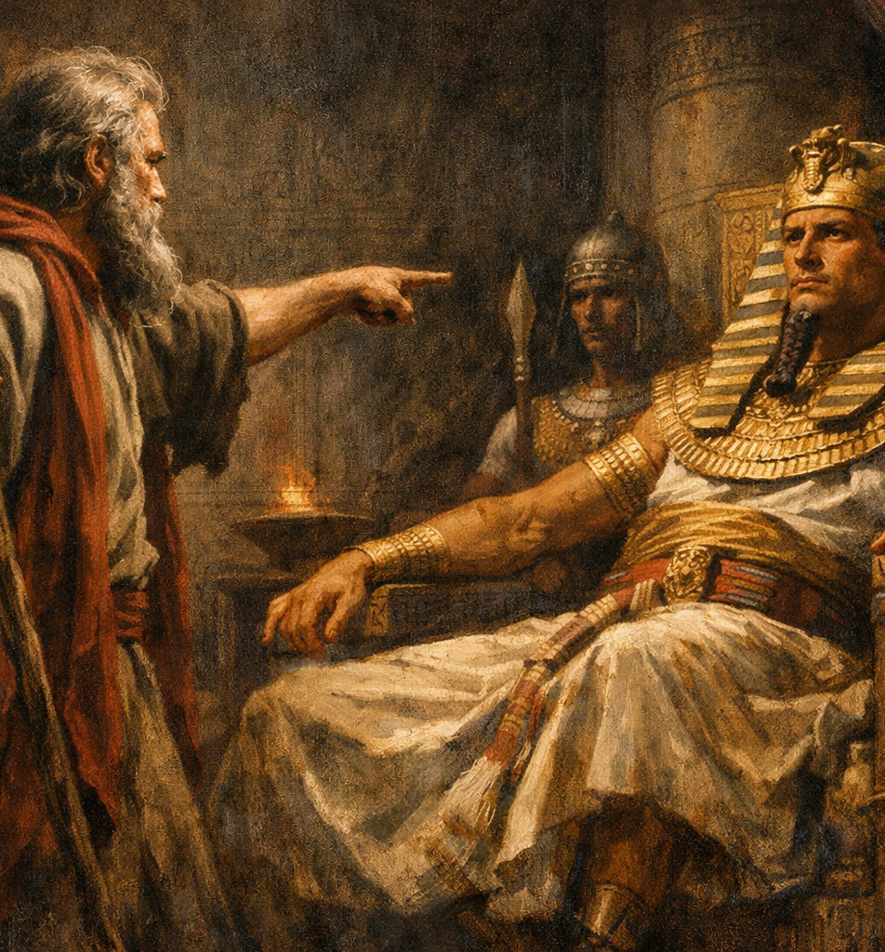
²⁷ We will go three days' journey into the wilderness, and sacrifice to the Lord our God, as he shall command us.
Exodus 8:24-28

Slide 40
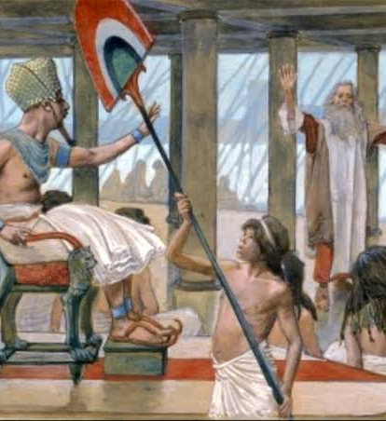
²⁸ And Pharaoh said, I will let you go, that ye may sacrifice to the Lord your God in the wilderness; only ye shall not go very far away: intreat for me.
Exodus 8:24-28

Slide 41
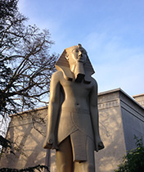
13. When favor was again shown him, what was the result?
Exodus 8:30-32.

Slide 42
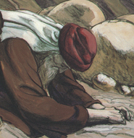
³⁰ And Moses went out from Pharaoh, and intreated the Lord.
³¹ And the Lord did according to the word of Moses; and he removed the swarms of flies from Pharaoh, from his servants, and from his people; there remained not one.
Exodus 8:30-32

Slide 43
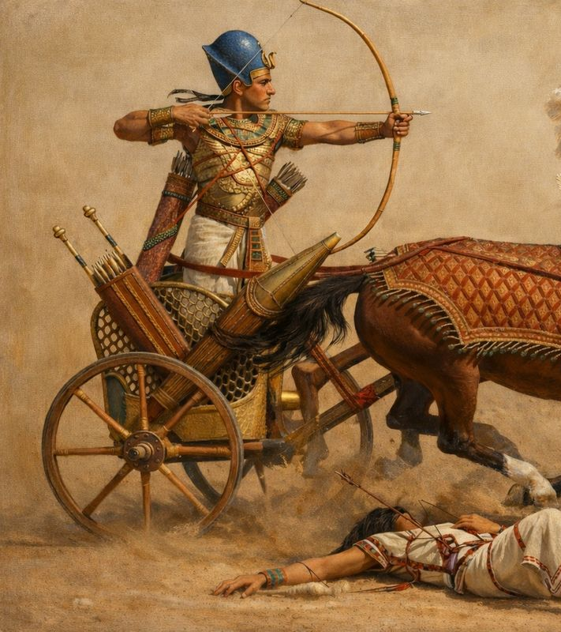
³² And Pharaoh hardened his heart at this time also, neither would he let the people go.
Exodus 8:30-32

Slide 44
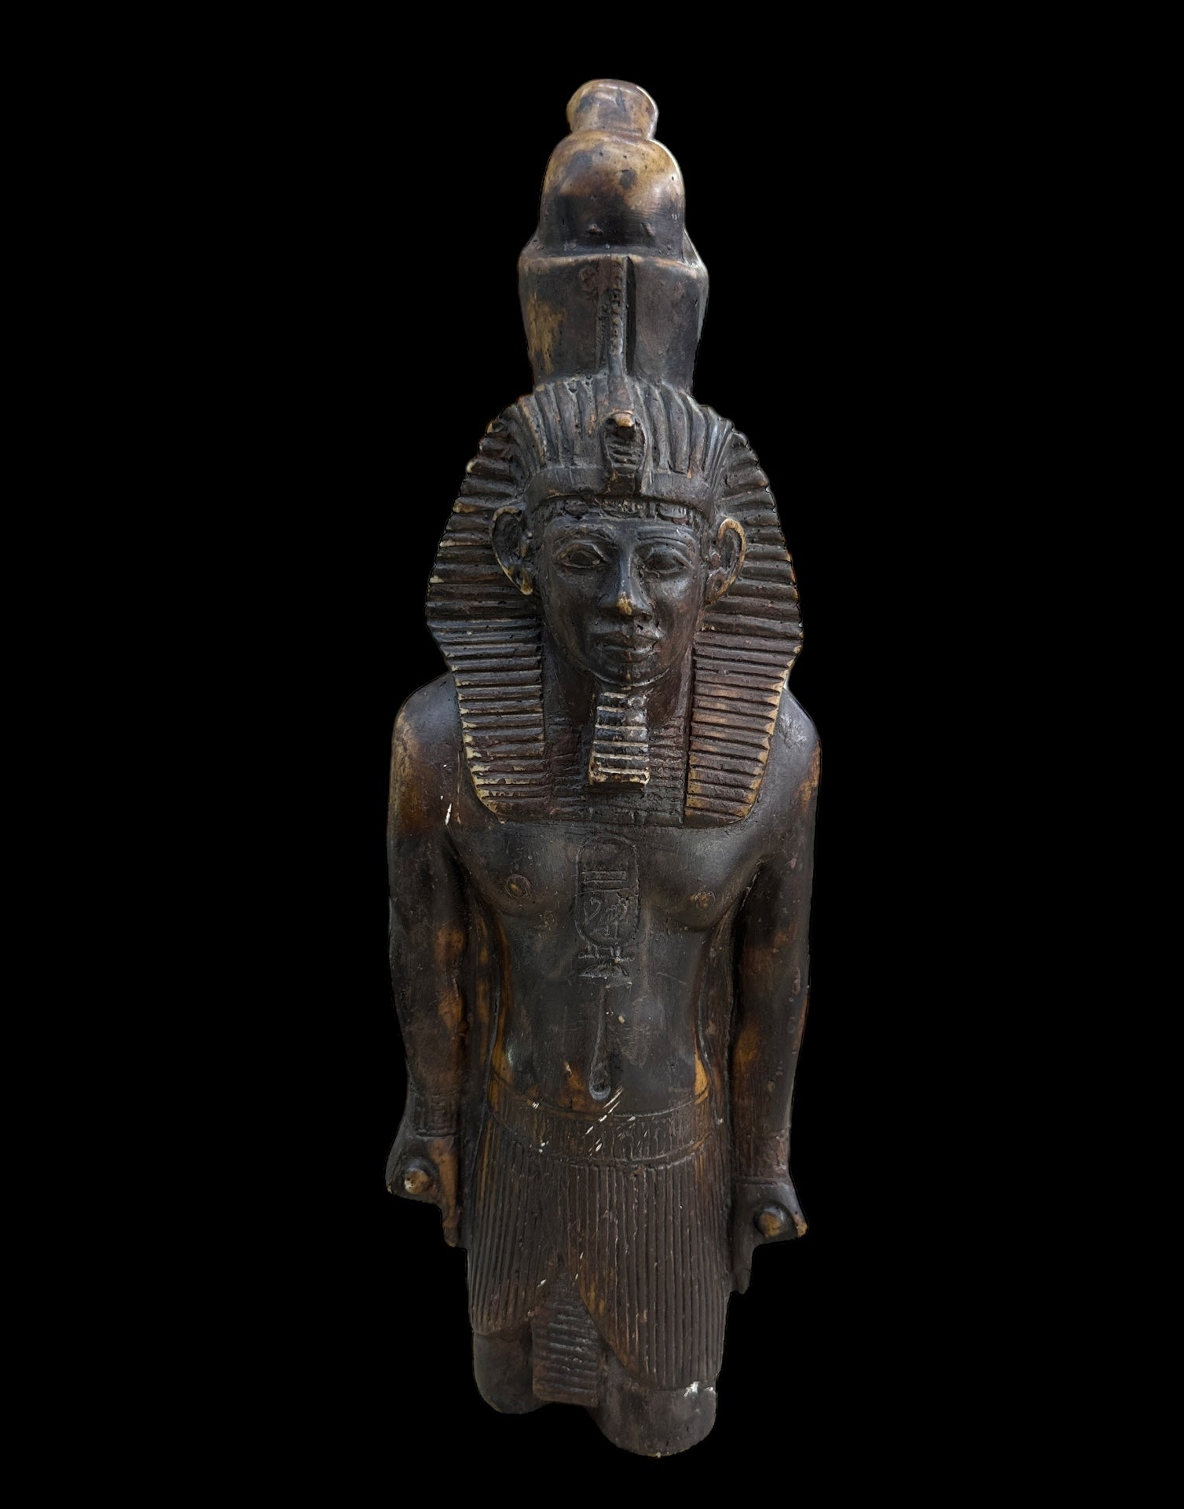
14. How was Pharaoh affected by the next two plagues?
Exodus 9:6-7, 10-12

Slide 45
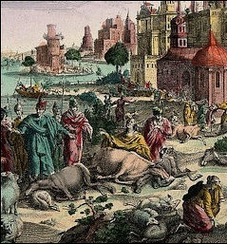
⁶ And the Lord did that thing on the morrow, and all the cattle of Egypt died: but of the cattle of the children of Israel died not one.
Exodus 9:6-7

Slide 46
⁷ And Pharaoh sent, and, behold, there was not one of the cattle of the Israelites dead. And the heart of Pharaoh was hardened, and he did not let the people go.
Exodus 9:6-7

Slide 47
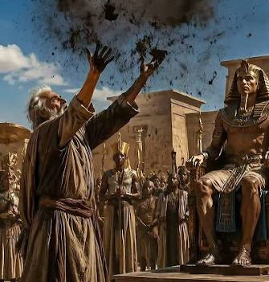
¹⁰ And they took ashes of the furnace, and stood before Pharaoh; and Moses sprinkled it up toward heaven; and it became a boil breaking forth with blains upon man, and upon beast.
Exodus 9:10-12

Slide 48
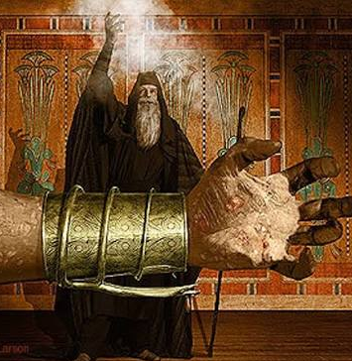
¹¹ And the magicians could not stand before Moses because of the boils; for the boil was upon the magicians, and upon all the Egyptians.
Exodus 9:10-12

Slide 49
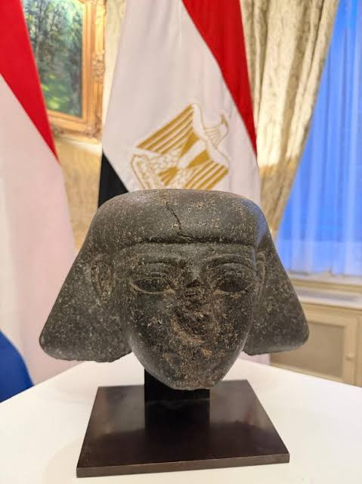
¹² And the Lord hardened the heart of Pharaoh, and he hearkened not unto them; as the Lord had spoken unto Moses.
Exodus 9:10-12

Slide 50
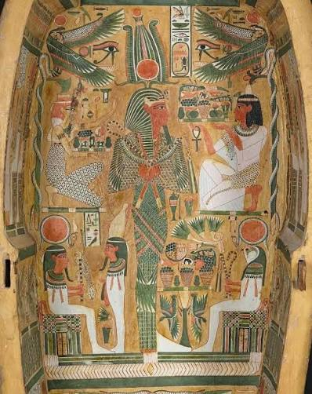
15. After Pharaoh had so often hardened his heart, what did the Lord do?
Exodus 9:12

Slide 51
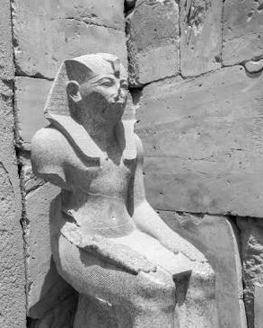
¹² And the Lord hardened the heart of Pharaoh, and he hearkened not unto them; as the Lord had spoken unto Moses.
Exodus 9:10-12

Slide 52
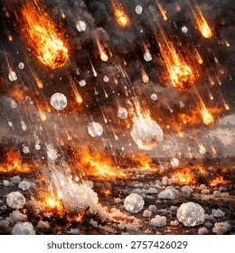
16. What was the seventh plague?
Exodus 9:23-25

Slide 53
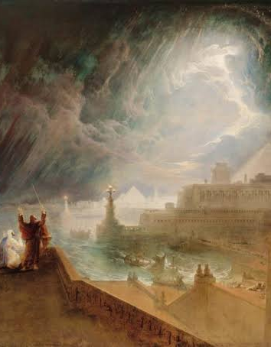
²³ And Moses stretched forth his rod toward heaven: and the Lord sent thunder and hail, and the fire ran along upon the ground; and the Lord rained hail upon the land of Egypt.
Exodus 9:23-25

Slide 54
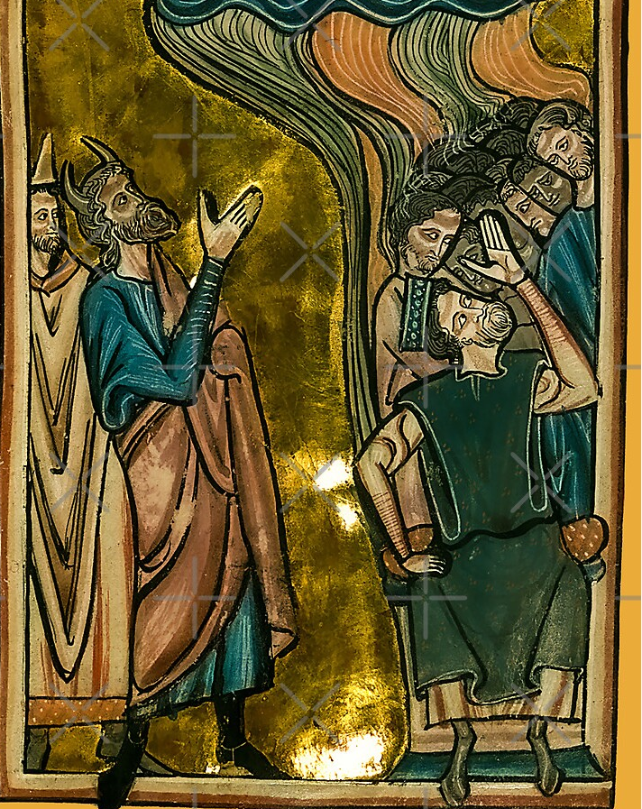
²⁴ So there was hail, and fire mingled with the hail, very grievous, such as there was none like it in all the land of Egypt since it became a nation.
Exodus 9:23-25

Slide 55
²⁵ And the hail smote throughout all the land of Egypt all that was in the field, both man and beast; and the hail smote every herb of the field, and brake every tree of the field.
Exodus 9:23-25

Slide 56
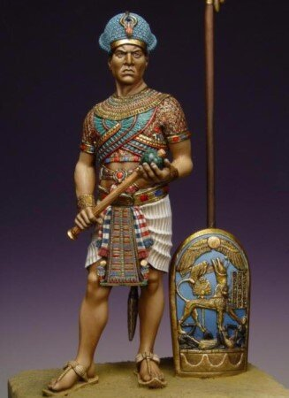
17. How did this terrible plague affect the king?
Exodus 9:27-28

Slide 57
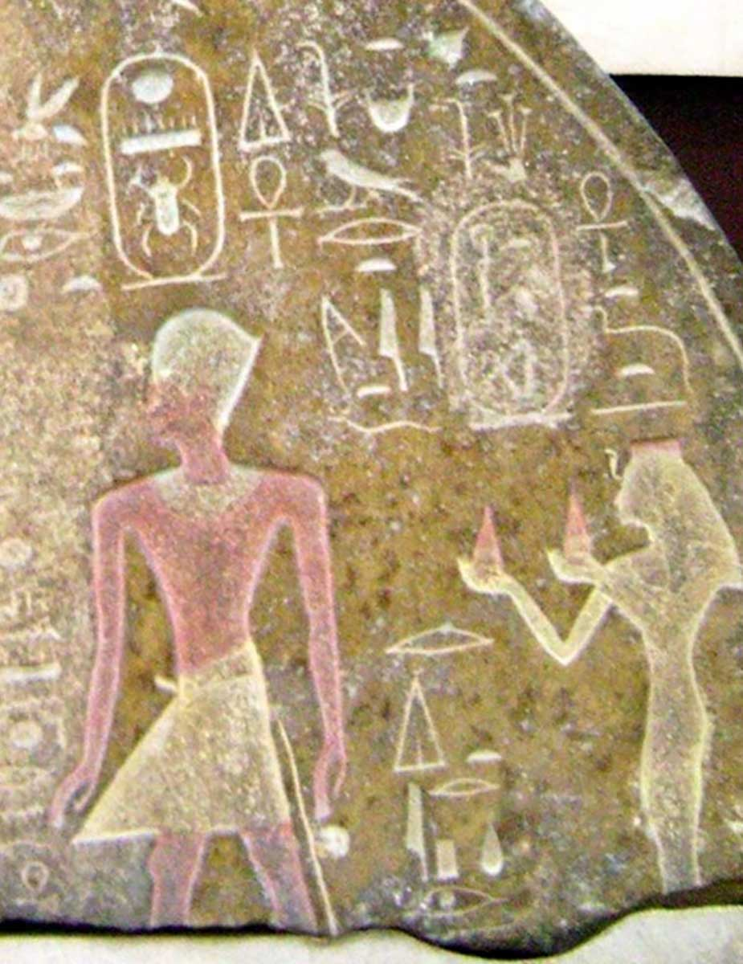
²⁷ And Pharaoh sent, and called for Moses and Aaron, and said unto them, I have sinned this time: the Lord is righteous, and I and my people are wicked.
Exodus 9:27-28

Slide 58
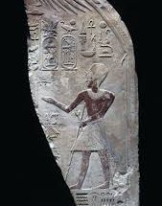
²⁸ Intreat the Lord (for it is enough) that there be no more mighty thunderings and hail; and I will let you go, and ye shall stay no longer.
Exodus 9:27-28

Slide 59
18. Was his request granted?
Exodus 9:33

Slide 60

³³ And Moses went out of the city from Pharaoh, and spread abroad his hands unto the Lord: and the thunders and hail ceased, and the rain was not poured upon the earth.
Exodus 9:33

Slide 61

19. What did this favor lead Pharaoh to manifest still more?
Exodus 9:34, 35

Slide 62

³⁴ And when Pharaoh saw that the rain and the hail and the thunders were ceased, he sinned yet more, and hardened his heart, he and his servants.
Exodus 9:34-35

Slide 63

³⁵ And the heart of Pharaoh was hardened, neither would he let the children of Israel go; as the Lord had spoken by Moses.
Exodus 9:34-35

Slide 64
20. When the terrible plague of locusts was sent, what request, confession, and promise did the king make?
Exodus 10:16, 17

Slide 65

¹⁶ Then Pharaoh called for Moses and Aaron in haste; and he said, I have sinned against the Lord your God, and against you.
Exodus 10:16-17

Slide 66

¹⁷ Now therefore forgive, I pray thee, my sin only this once, and intreat the Lord your God, that he may take away from me this death only.
Exodus 10:16-17

Slide 67

21. Did the Lord grant his request?
Exodus 10:19

Slide 68

¹⁹ And the Lord turned a mighty strong west wind, which took away the locusts, and cast them into the Red sea; there remained not one locust in all the coasts of Egypt.
Exodus 10:19

Slide 69

22. What did the Lord again do to Pharaoh, even by this act of kindness?
Exodus 10:22

Slide 70

²⁰ But the Lord hardened Pharaoh's heart, so that he would not let the children of Israel go.
Exodus 10:20

Slide 71

23. In all this record, what special thing is it that had the effect of hardening Pharaoh's heart?

Slide 72

Answer: The rejection of light from God.
See notes.

Slide 73

24. With what scripture is this in harmony?
Isaiah 26:10

Slide 74

¹⁰ Let favour be shewed to the wicked, yet will he not learn righteousness: in the land of uprightness will he deal unjustly, and will not behold the majesty of the Lord.
Isaiah 26:10

Slide 75

25. What is it that makes wicked persons more settled in their determination to sin?
Ecclesiastes 8:11

Slide 76
¹¹ Because sentence against an evil work is not executed speedily, therefore the heart of the sons of men is fully set in them to do evil.
Ecclesiastes 8:11

Slide 77

26. After the sixth plague, what did the Lord say was the reason he had preserved Pharaoh for so long a time?
Exodus 9:15, 16

Slide 78

¹⁵ For now I will stretch out my hand, that I may smite thee and thy people with pestilence; and thou shalt be cut off from the earth.
Exodus 9:15, 16

Slide 79

¹⁶ And in very deed for this cause have I raised thee up, for to shew in thee my power; and that my name may be declared throughout all the earth.
Exodus 9:15, 16

Slide 80

27. When God's judgments are in the land, for what purpose is it?
Isaiah 26:9

Slide 81

⁹ With my soul have I desired thee in the night; yea, with my spirit within me will I seek thee early: for when thy judgments are in the earth, the inhabitants of the world will learn righteousness.
Isaiah 26:9

Slide 82


Slide 83


