Slide 1


Slide 2


Slide 3

The Departure from Egypt
Lesson 7: February 16, 1889

Slide 4
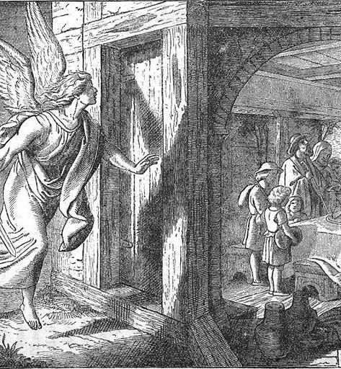
1. What was the last plague upon Egypt?

Slide 5
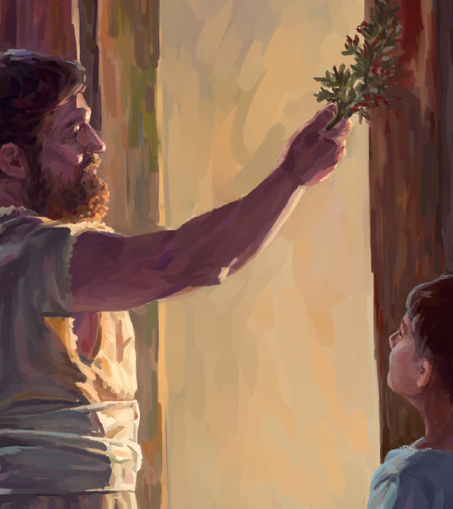
2. What were the Israelites required to do in order to escape it?

Slide 6
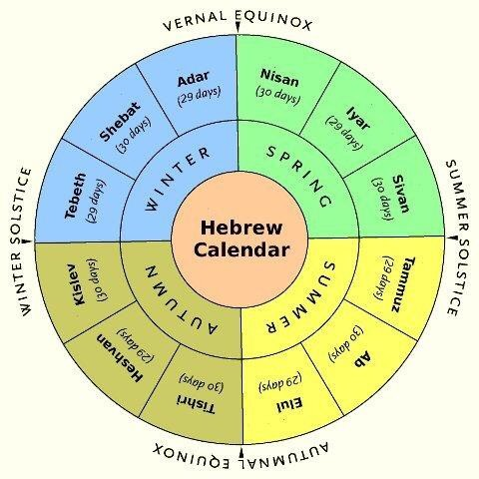
3. On what day of the month was the Passover?
Exodus 12:6.

Slide 7
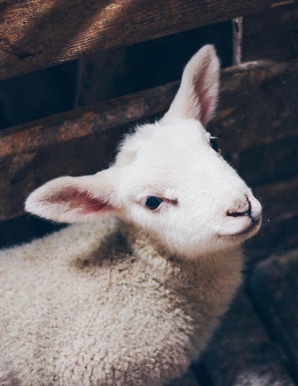
⁶ And ye shall keep it up until the fourteenth day of the same month: and the whole assembly of the congregation of Israel shall kill it in the evening.
Exodus 12:6

Slide 8
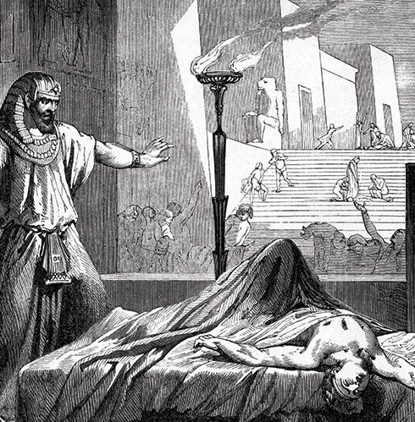
4. At what time in the night were the first-born slain?
Exodus 12:29

Slide 9
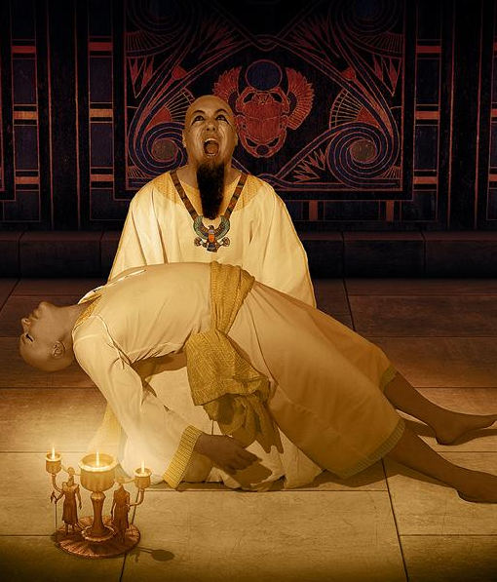
²⁹ And it came to pass, that at midnight the Lord smote all the firstborn in the land of Egypt, from the firstborn of Pharaoh that sat on his throne unto the firstborn of the captive that was in the dungeon; and all the firstborn of cattle.
Exodus 12:29

Slide 10
5. When this great calamity came, what did Pharaoh do?
Exodus 12:30-32

Slide 11
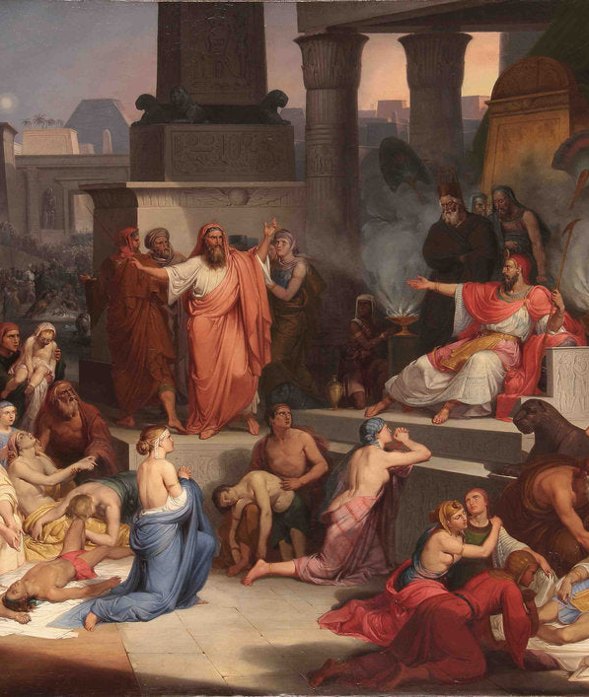
³⁰ And Pharaoh rose up in the night, he, and all his servants, and all the Egyptians; and there was a great cry in Egypt; for there was not a house where there was not one dead.
Exodus 12:30-32

Slide 12
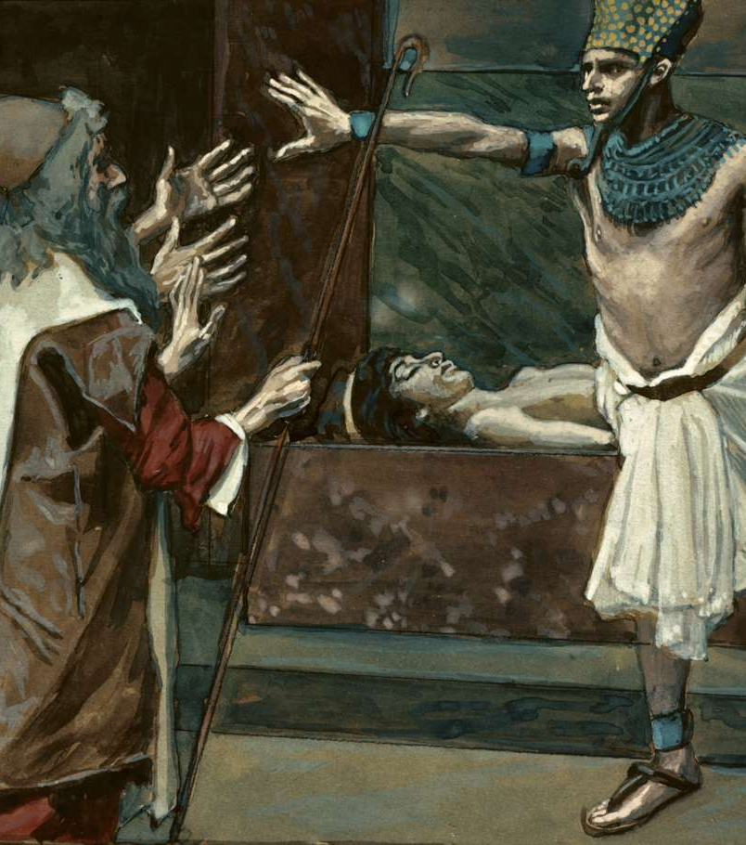
³¹ And he called for Moses and Aaron by night, and said, Rise up, and get you forth from among my people, both ye and the children of Israel; and go, serve the Lord, as ye have said.
Exodus 12:30-32

Slide 13
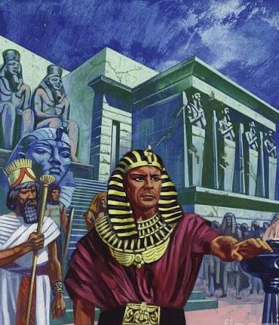
³² Also take your flocks and your herds, as ye have said, and be gone; and bless me also.
Exodus 12:30-32

Slide 14
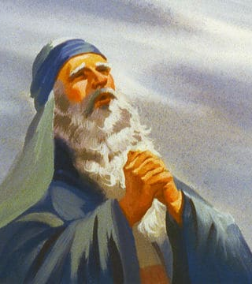
6. Of what word of the Lord was this a fulfillment?
Exodus 11:1

Slide 15
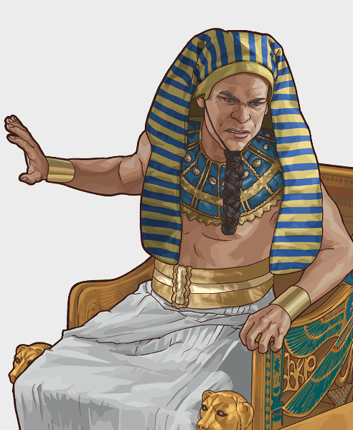
11 And the Lord said unto Moses, Yet will I bring one plague more upon Pharaoh, and upon Egypt; afterwards he will let you go hence: when he shall let you go, he shall surely thrust you out hence altogether.
Exodus 11:1

Slide 16
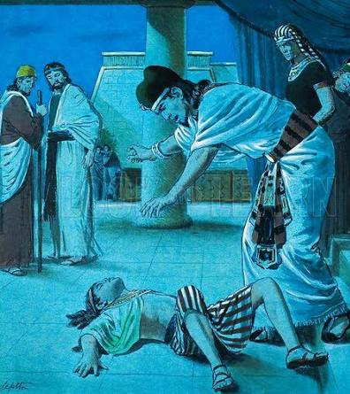
7. How did the people of Egypt feel?
Exodus 12:33

Slide 17
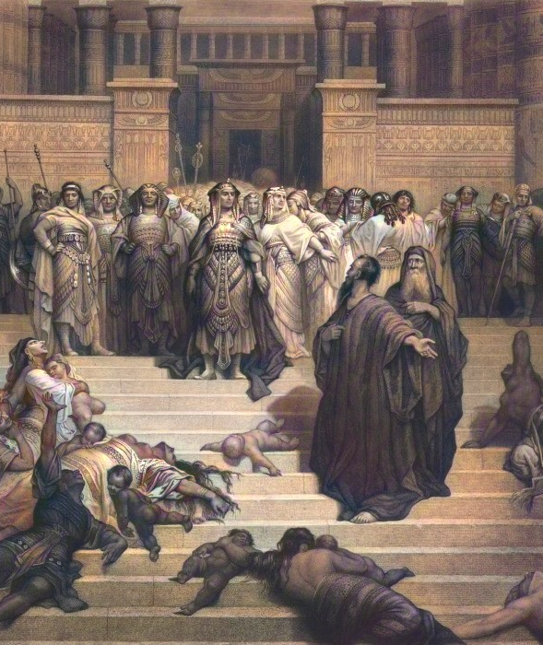
³³ And the Egyptians were urgent upon the people, that they might send them out of the land in haste; for they said, We be all dead men.
Exodus 12:33

Slide 18
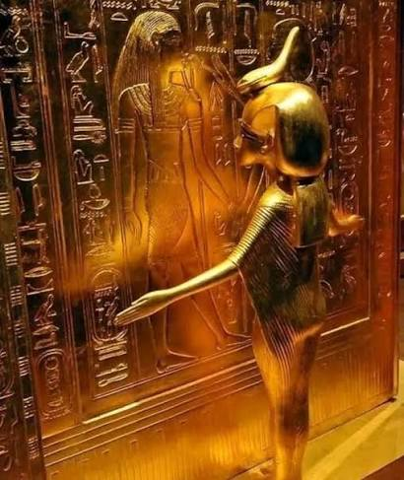
8. What did the Israelites receive from the Egyptians?
Exodus 12:35, 36

Slide 19
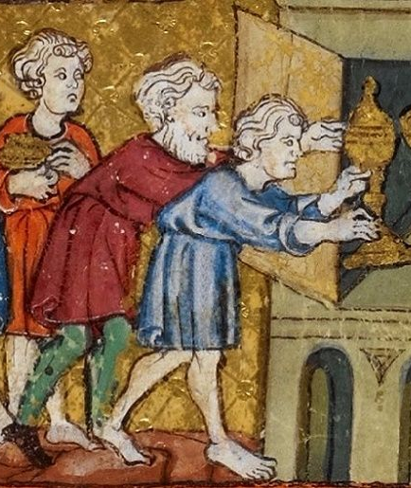
³⁵ And the children of Israel did according to the word of Moses; and they borrowed of the Egyptians jewels of silver, and jewels of gold, and raiment:
Exodus 12:35, 36

Slide 20
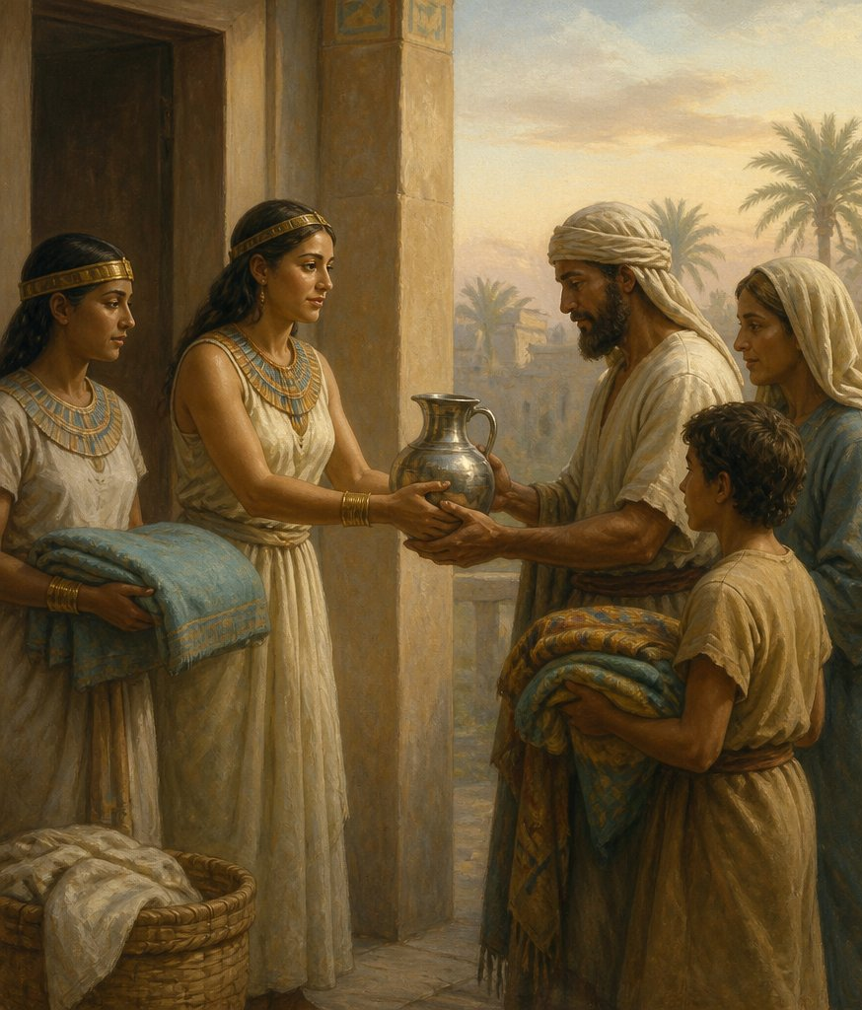
³⁶ And the Lord gave the people favour in the sight of the Egyptians, so that they lent unto them such things as they required. And they spoiled the Egyptians.
Exodus 12:35, 36

Slide 21
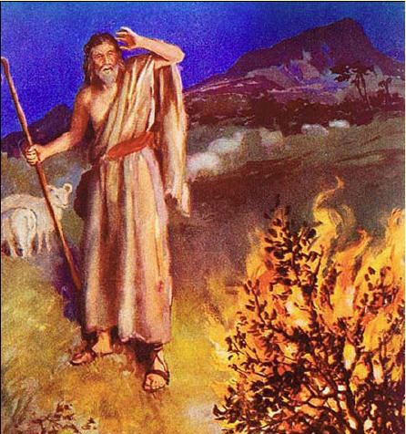
9. With what word of the Lord was this in harmony?
Exodus 3:21-22;
Genesis 15:13-14

Slide 22
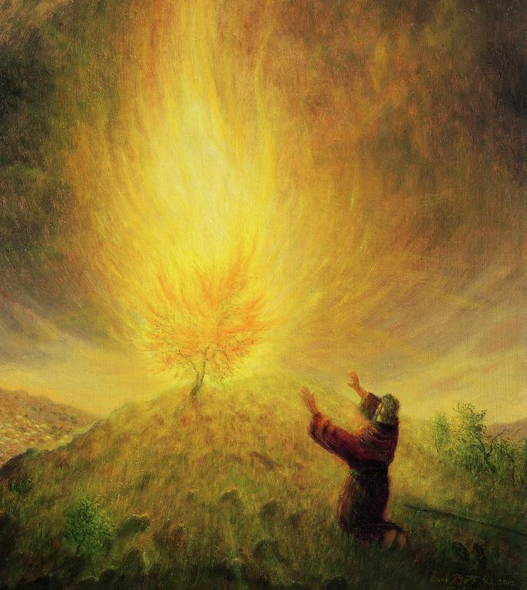
²¹ And I will give this people favour in the sight of the Egyptians: and it shall come to pass, that, when ye go, ye shall not go empty.
Exodus 3:21-22

Slide 23
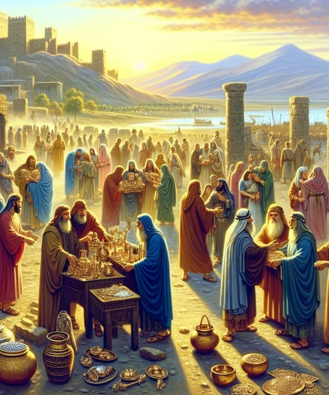
²² But every woman shall borrow of her neighbour, and of her that sojourneth in her house, jewels of silver, and jewels of gold, and raiment: and ye shall put them upon your sons, and upon your daughters; and ye shall spoil the Egyptians.
Exodus 3:21-22

Slide 24
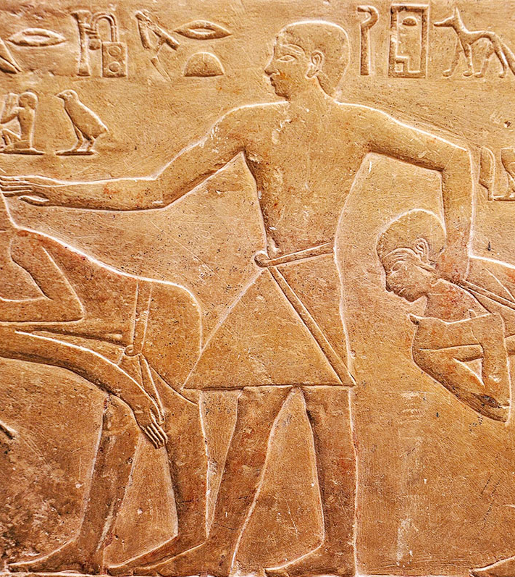
¹³ And he said unto Abram, Know of a surety that thy seed shall be a stranger in a land that is not theirs, and shall serve them; and they shall afflict them four hundred years;
Genesis 15:13-14

Slide 25
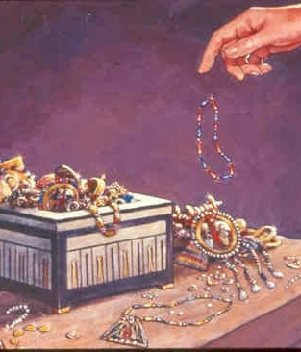
¹⁴ And also that nation, whom they shall serve, will I judge: and afterward shall they come out with great substance.
Genesis 15:13-14

Slide 26
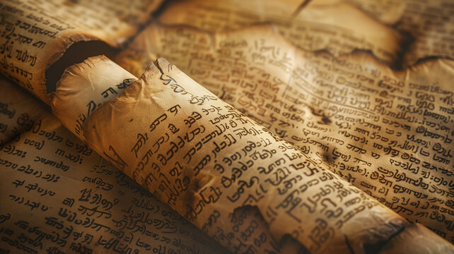
10. Explain the seeming discrepancy between Genesis 15:13 and
Exodus 12:40.

Slide 27
Genesis 15:13 Exodus 12:40
¹³ And he said unto Abram, Know of a surety that thy seed shall be a stranger in a land that is not theirs, and shall serve them; and they shall afflict them four hundred years;
⁴⁰ Now the sojourning of the children of Israel, who dwelt in Egypt, was four hundred and thirty years.

Slide 28
Genesis 15:13 Exodus 12:40
¹³ And he said unto Abram, Know of a surety that thy seed shall be a stranger in a land that is not theirs, and shall serve them; and they shall afflict them four hundred years;
⁴⁰ Now the sojourning of the children of Israel, who dwelt in Egypt, was four hundred and thirty years.

Slide 29
Genesis 15:13 Exodus 12:40
¹³ And he said unto Abram, Know of a surety that thy seed shall be a stranger in a land that is not theirs, and shall serve them; and they shall afflict them four hundred years;
⁴⁰ Now the sojourning of the children of Israel, who dwelt in Egypt, was four hundred and thirty years.
Notes:
Mark that this latter text does not say that the children of Israel dwelt in Egypt four hundred and thirty years; but that the sojourning of the children of Israel, "who dwelt in Egypt," was so long. Their sojourning was not alone in Egypt, but in Canaan, as Paul says of Abraham: " By faith he sojourned in the land of promise, as in a strange country, dwelling in tabernacles with Isaac and Jacob, the heirs with him of the same promise." Hebrews 11:9.

Slide 30
Genesis 15:13 Exodus 12:40
¹³ And he said unto Abram, Know of a surety that thy seed shall be a stranger in a land that is not theirs, and shall serve them; and they shall afflict them four hundred years;
⁴⁰ Now the sojourning of the children of Israel, who dwelt in Egypt, was four hundred and thirty years.
Notes:
This four hundred and thirty years of sojourning dates from the promise to Abraham; for Paul speaks of the giving of the law, which was immediately after the deliverance from Egypt, as four hundred and thirty years after the promise. Galatians 3: 17, 18. But while the sojourning was four hundred and thirty years, the affliction was only four hundred years. Genesis 15:13; Acts 7:6.

Slide 31
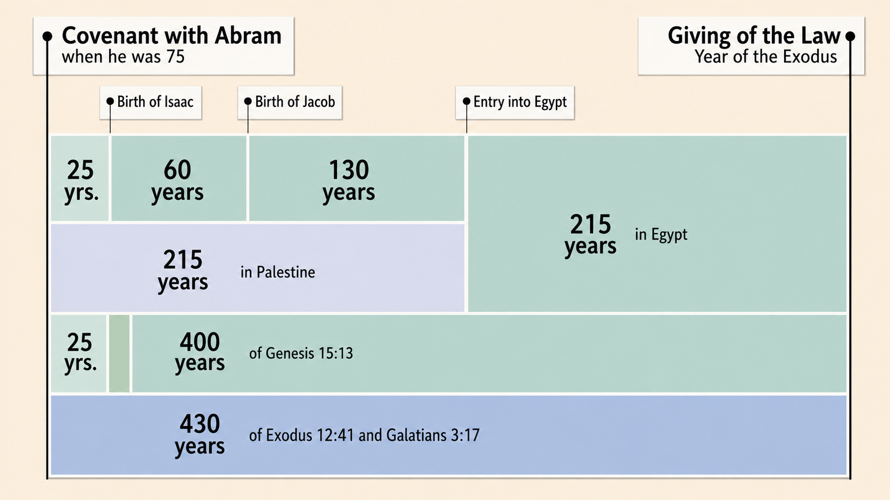
Notes:
Therefore, since the four hundred and thirty years of sojourn began with the giving of the promise, the affliction must have begun thirty years after the promise; and this was when Isaac was about five years old, for he was not born until twenty-five years after the promise. Compare Genesis 12:1-4 and 21:5. So the affliction dates from the time when Ishmael mocked Isaac (Genesis 21:9, 10), for Paul refers to this as the persecution of him that was born after the Spirit, by him that was born after the flesh.

Slide 32
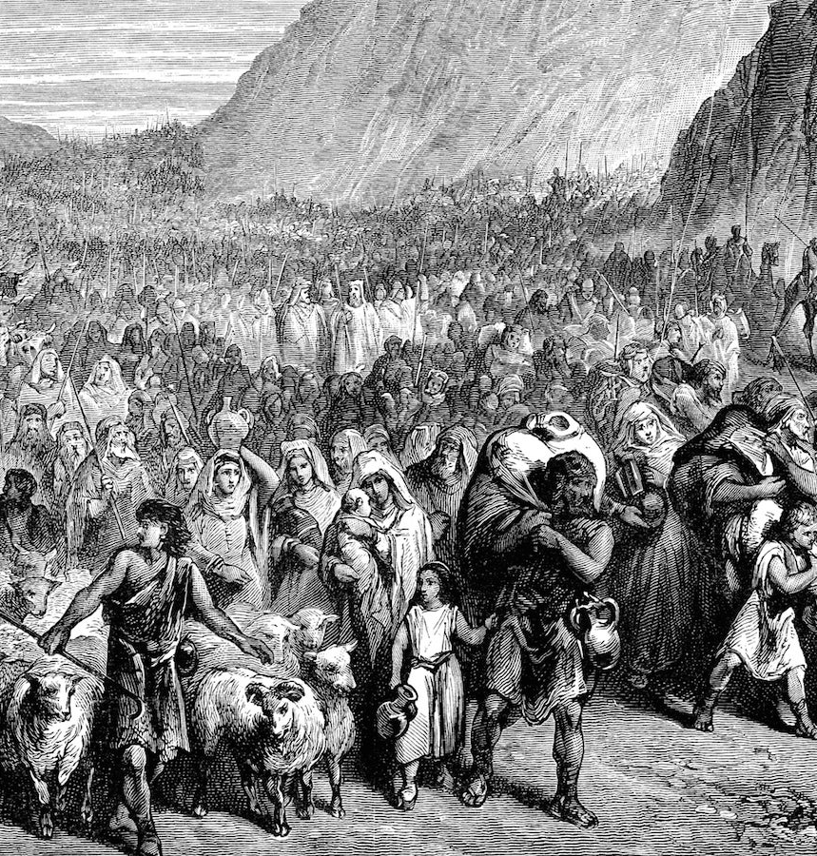
11. How large a company went out from Egypt?
Exodus 12:37.

Slide 33
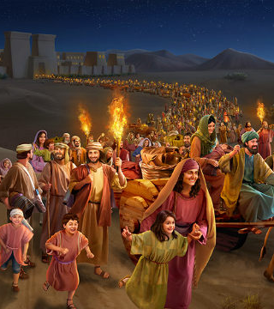
³⁷ And the children of Israel journeyed from Rameses to Succoth, about six hundred thousand on foot that were men, beside children.
Exodus 12:37

Slide 34
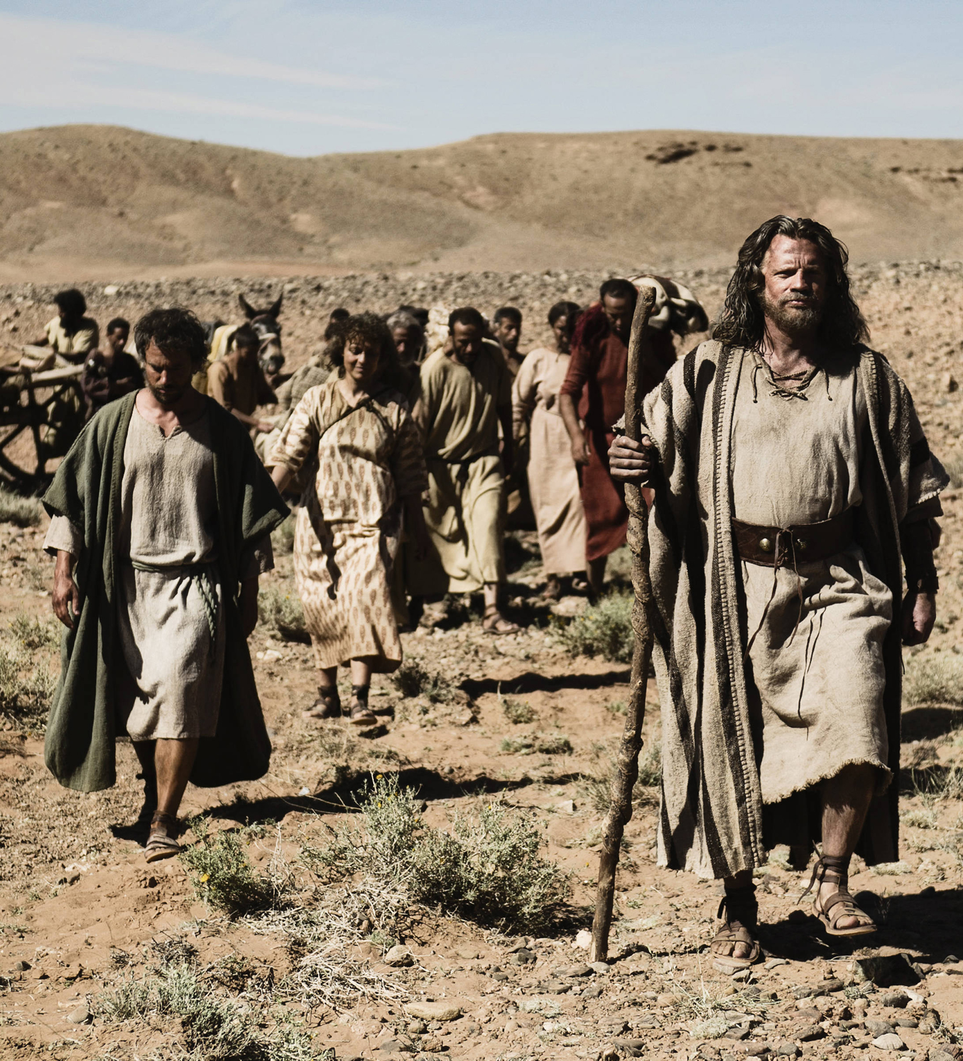
12. What did Moses take with him?
Exodus 13:19.
Genesis 50:24, 25.

Slide 35
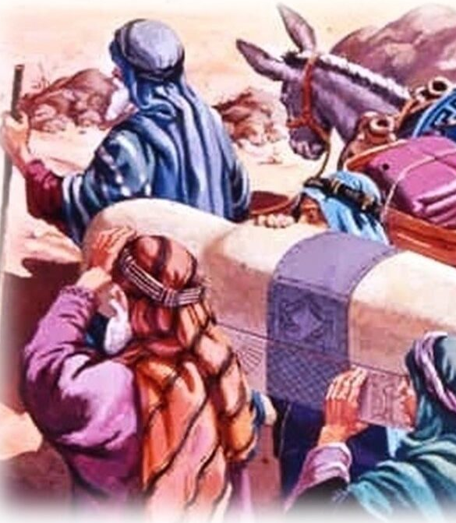
¹⁹ And Moses took the bones of Joseph with him: for he had straitly sworn the children of Israel, saying, God will surely visit you; and ye shall carry up my bones away hence with you.
Exodus 13:19

Slide 36
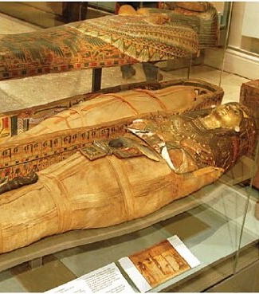
²⁴ And Joseph said unto his brethren, I die: and God will surely visit you, and bring you out of this land unto the land which he sware to Abraham, to Isaac, and to Jacob.
Genesis 50:24, 25

Slide 37
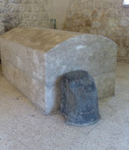
²⁵ And Joseph took an oath of the children of Israel, saying, God will surely visit you, and ye shall carry up my bones from hence.
Genesis 50:24, 25

Slide 38
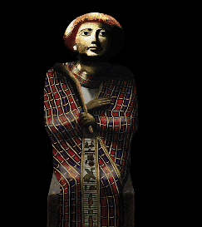
13. In exacting this promise, by what was Joseph actuated?
Hebrews 11:22.

Slide 39
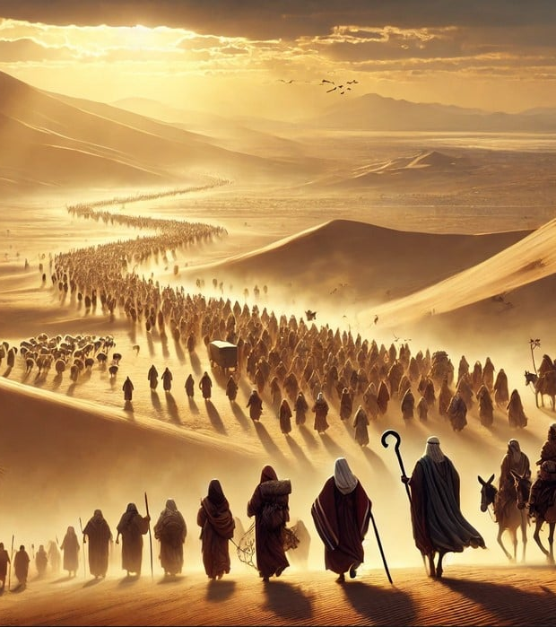
²² By faith Joseph, when he died, made mention of the departing of the children of Israel; and gave commandment concerning his bones.
Hebrews 11:22

Slide 40
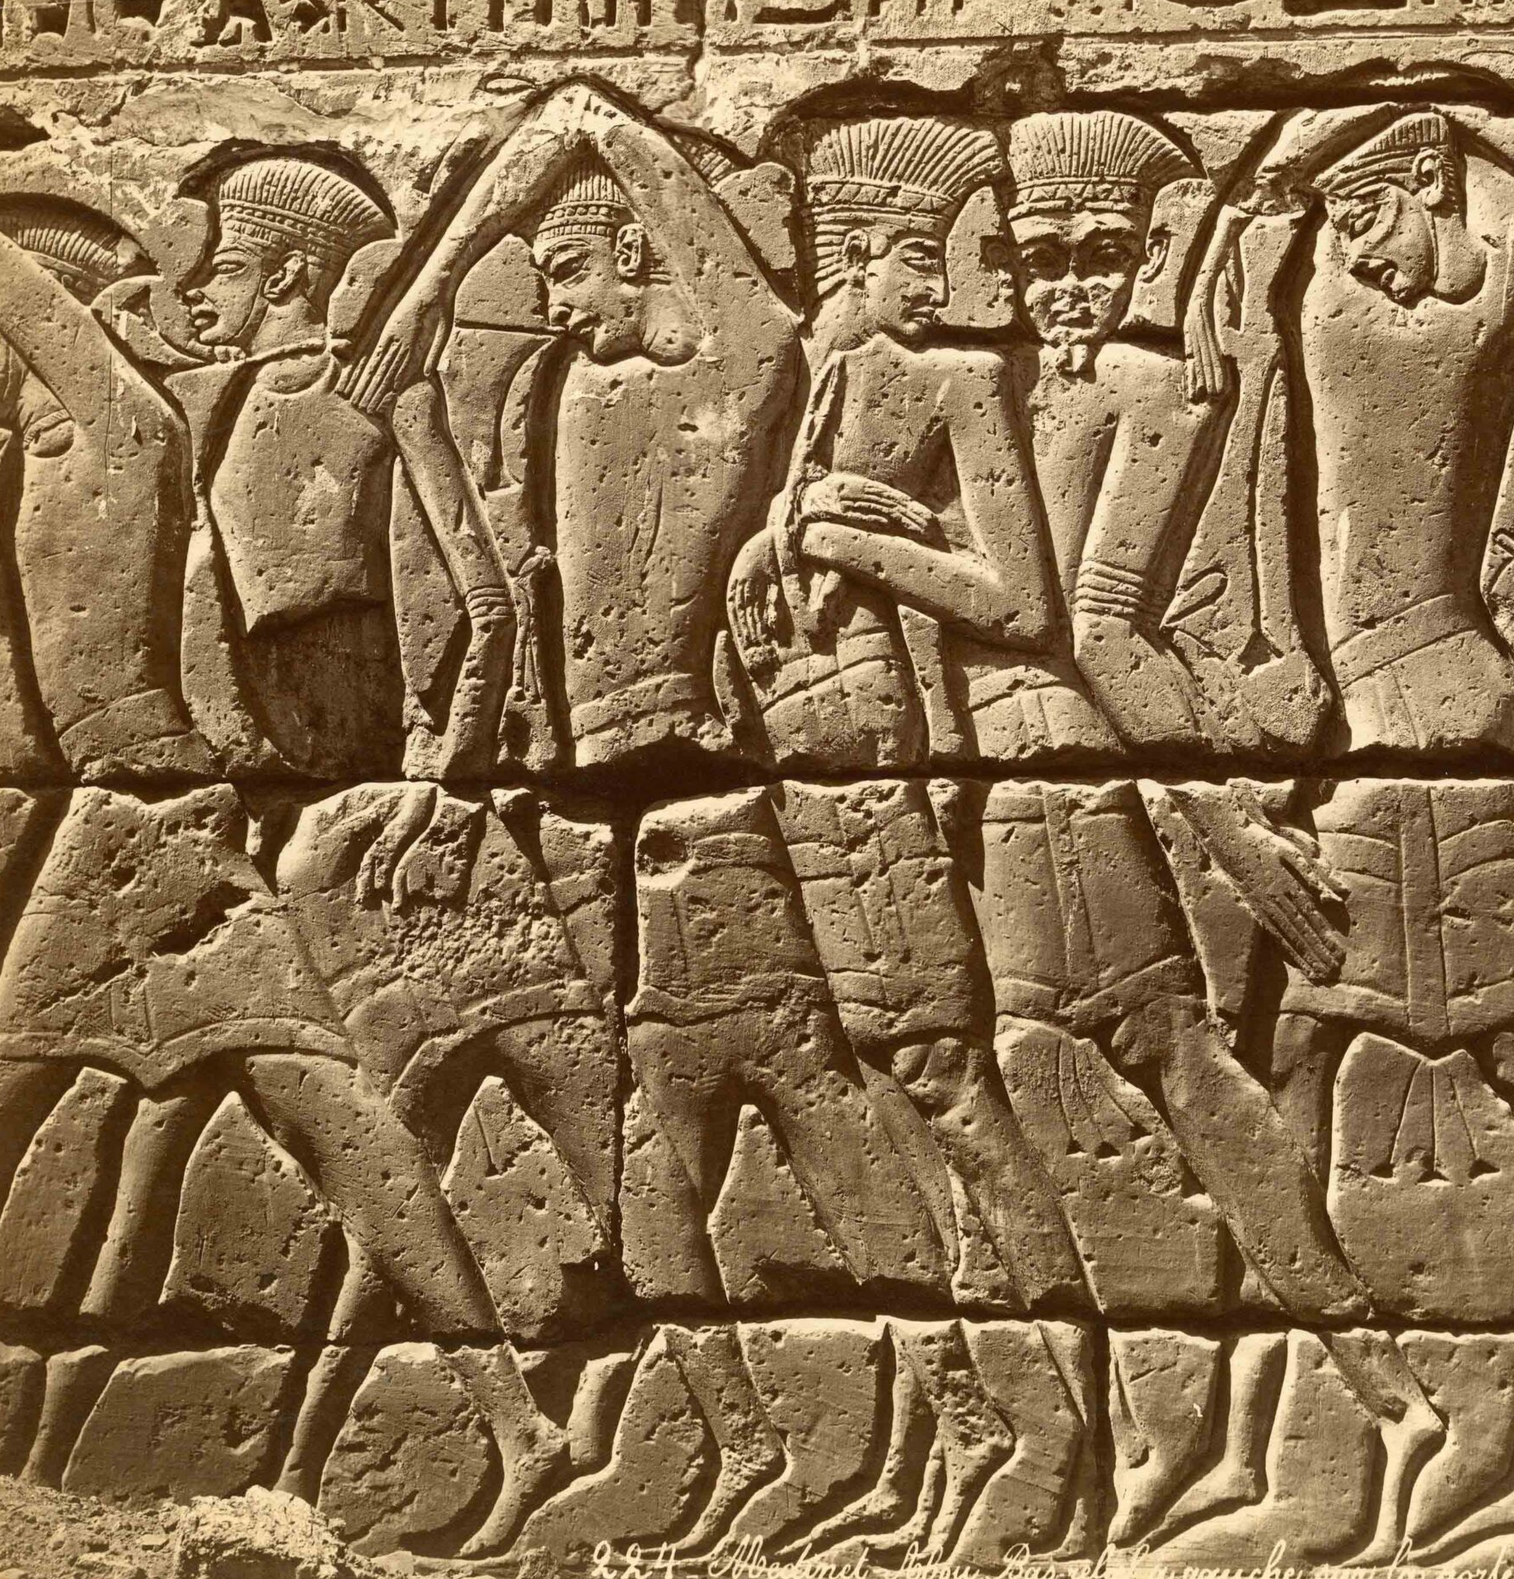
14. What precaution did the Lord take against causing the Israelites to become discouraged?
Exodus 13:17, 18

Slide 41
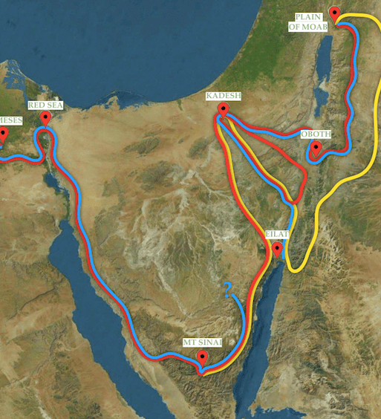
¹⁷ And it came to pass, when Pharaoh had let the people go, that God led them not through the way of the land of the Philistines, although that was near; for God said, Lest peradventure the people repent when they see war, and they return to Egypt:
Exodus 13:17, 18

Slide 42
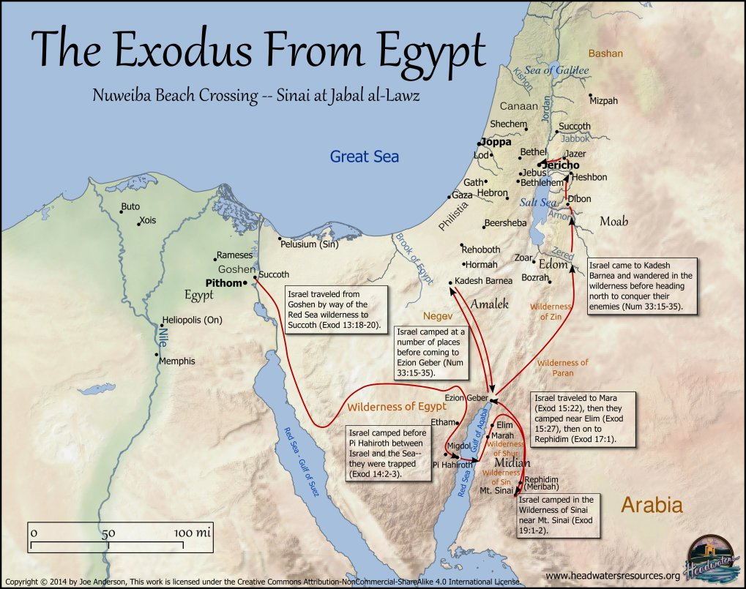
¹⁸ But God led the people about, through the way of the wilderness of the Red sea: and the children of Israel went up harnessed out of the land of Egypt.
Exodus 13:17, 18

Slide 44
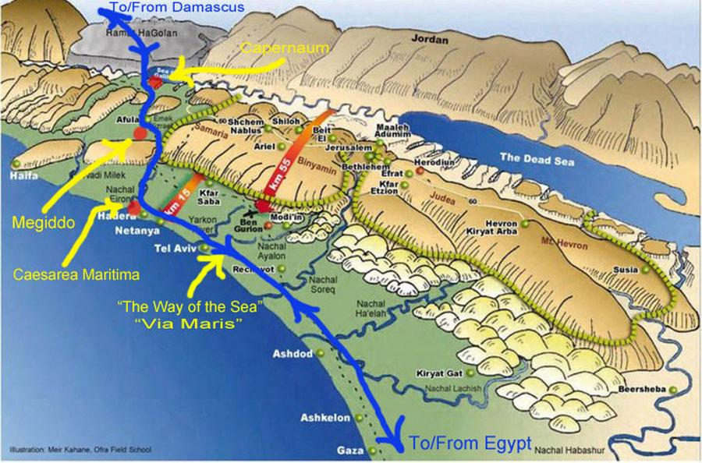

Slide 45
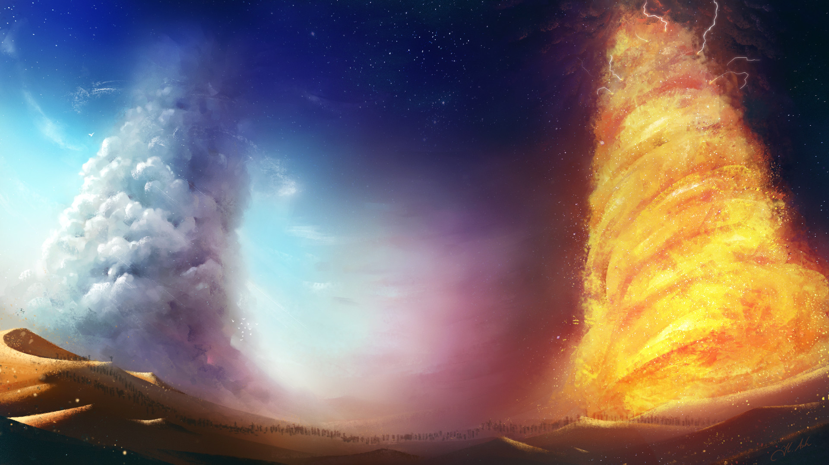
15. What protection and guidance did he give them?
Exodus 13:21, 22

Slide 46
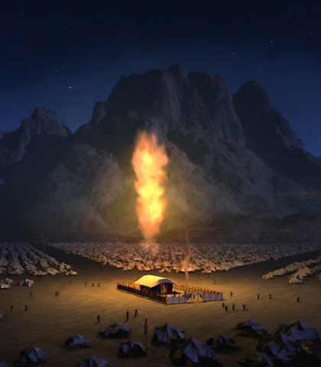
²¹ And the Lord went before them by day in a pillar of a cloud, to lead them the way; and by night in a pillar of fire, to give them light; to go by day and night:
Exodus 13:21, 22

Slide 47
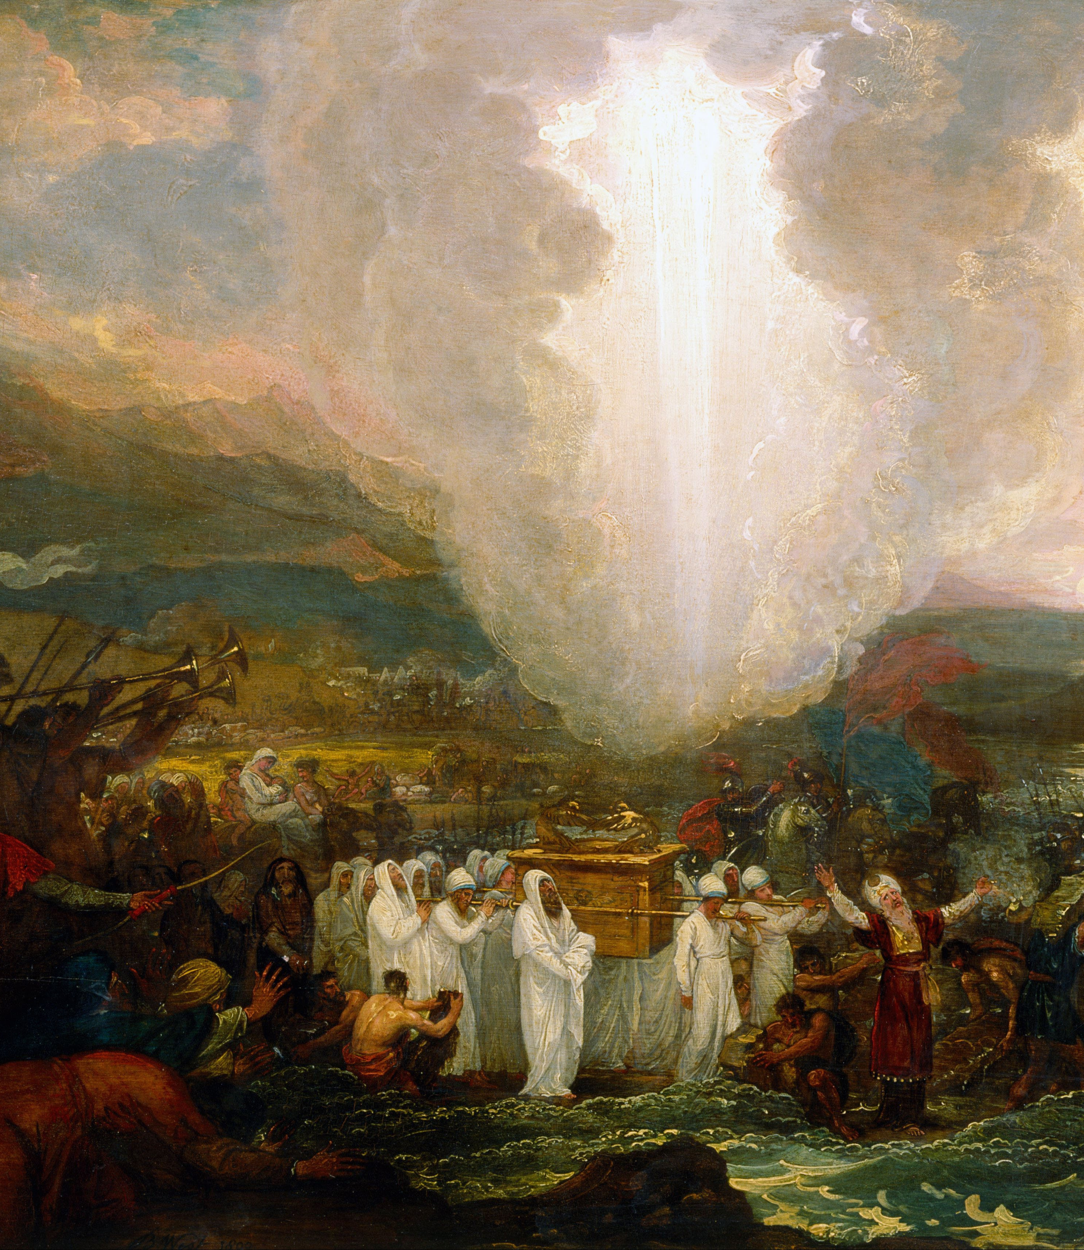
²² He took not away the pillar of the cloud by day, nor the pillar of fire by night, from before the people.
Exodus 13:21, 22

Slide 48
16. What confidence may God's people ever have?
Psalm 34:7;
125:1-2

Slide 49
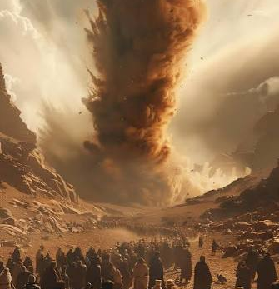
⁷ The angel of the lord encampeth round about them that fear him, and delivereth them
Psalm 34:7

Slide 50
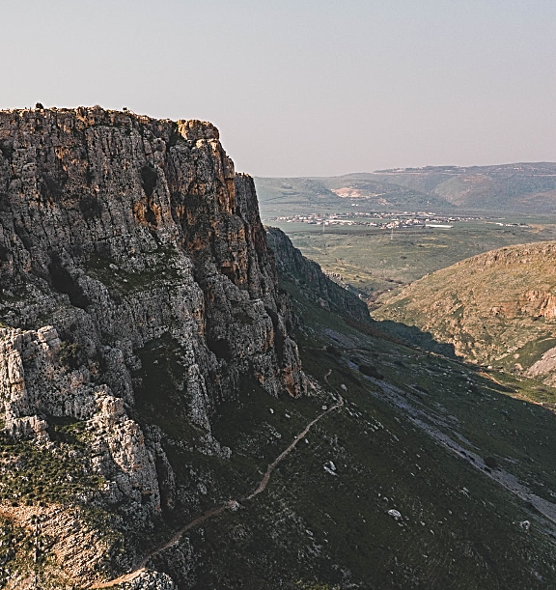
125 They that trust in the Lord shall be as mount Zion, which cannot be removed, but abideth for ever.
Psalm 125:1-2

Slide 51
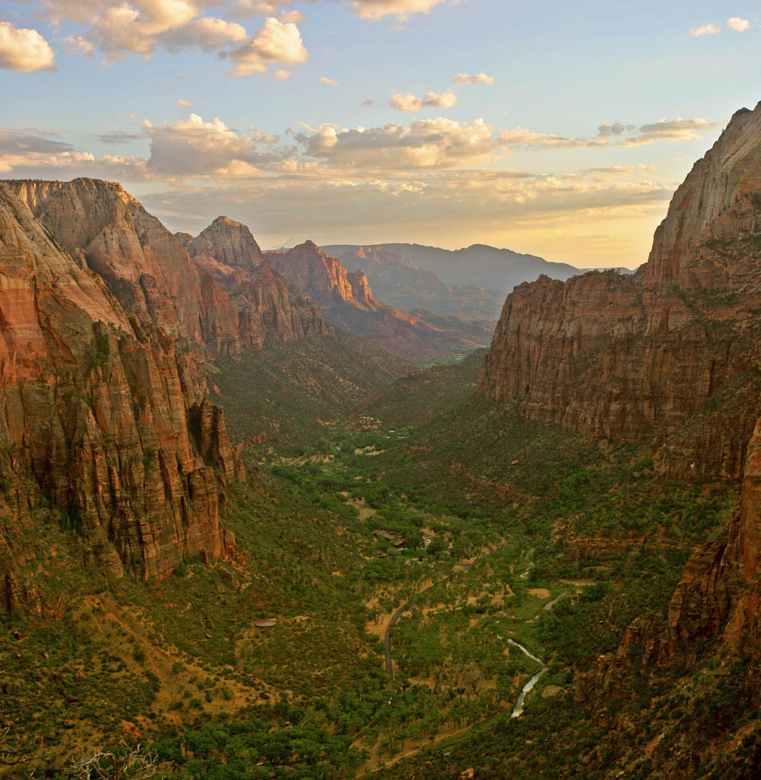
² As the mountains are round about Jerusalem, so the Lord is round about his people from henceforth even for ever.
Psalm 125:1-2

Slide 52
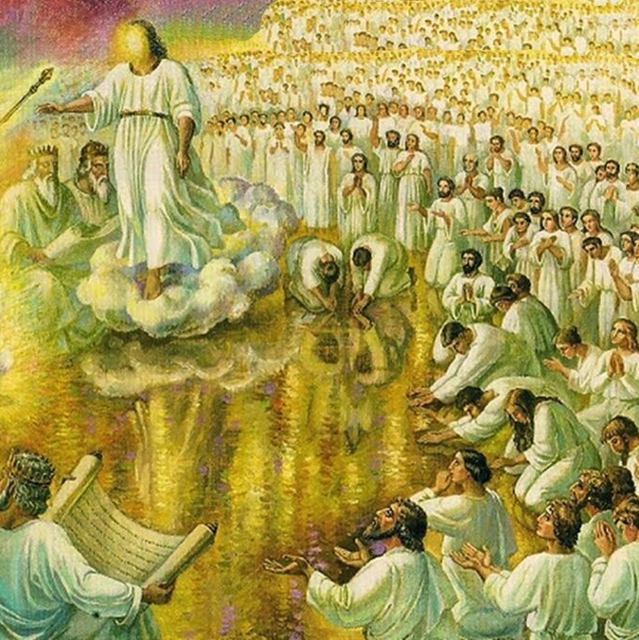
17. Then what should ever be their song?
Isaiah 12:2

Slide 53

² Behold, God is my salvation; I will trust, and not be afraid: for the Lord Jehovah is my strength and my song; he also is become my salvation.
Isaiah 12:2

Slide 54
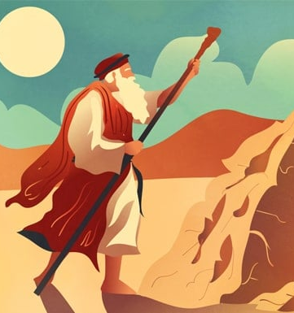
18. What sustained Moses all through the contest with Pharaoh, and the departure from Egypt?
Hebrews 11:27, 28

Slide 55
²⁷ By faith he forsook Egypt, not fearing the wrath of the king: for he endured, as seeing him who is invisible.
Hebrews 11:27, 28

Slide 56
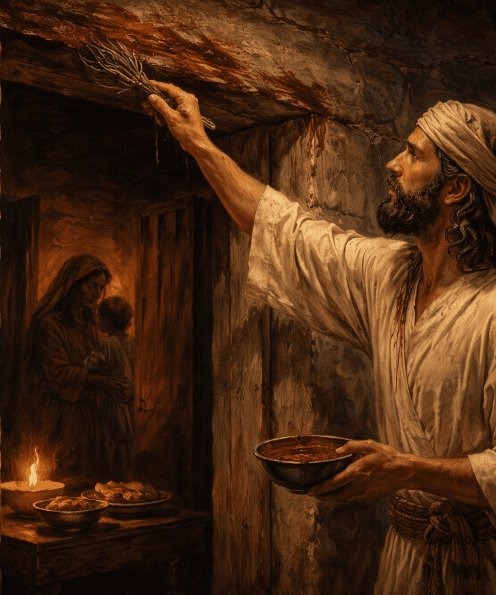
²⁸ Through faith he kept the passover, and the sprinkling of blood, lest he that destroyed the firstborn should touch them.
Hebrews 11:27, 28

Slide 57


Slide 58
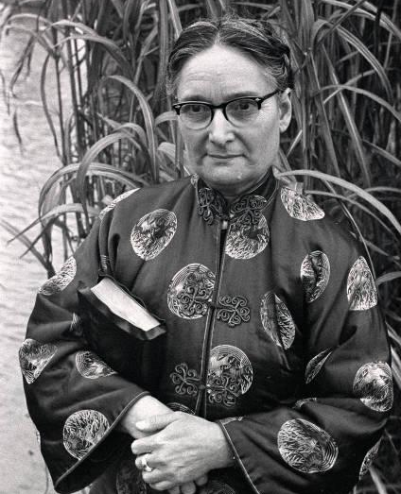
Gladys Aylward

Slide 59
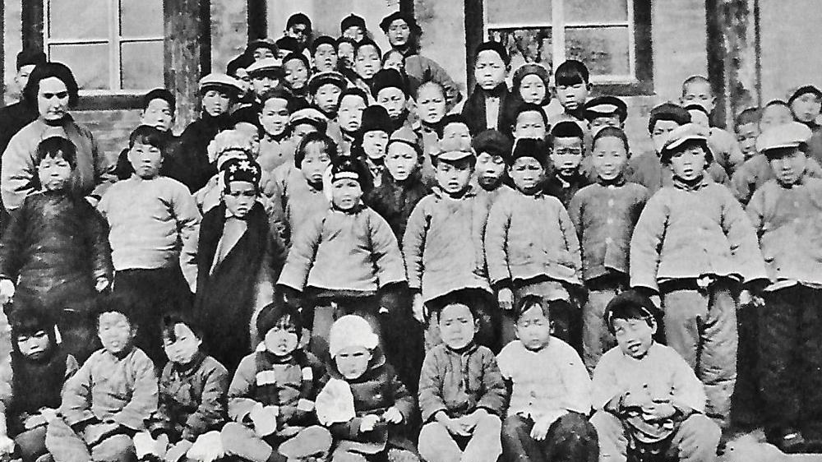

Slide 60
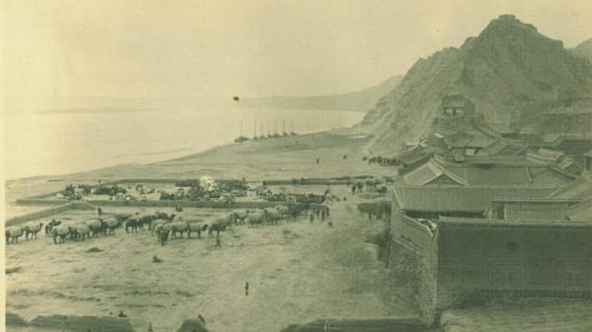

Slide 61
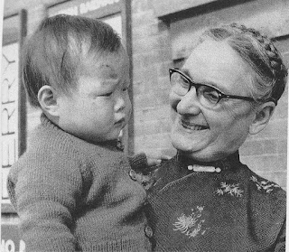
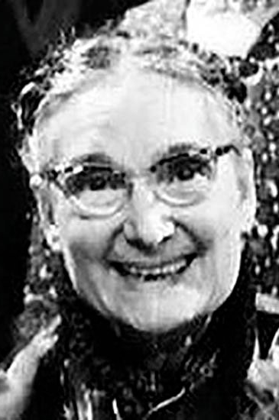

Slide 62
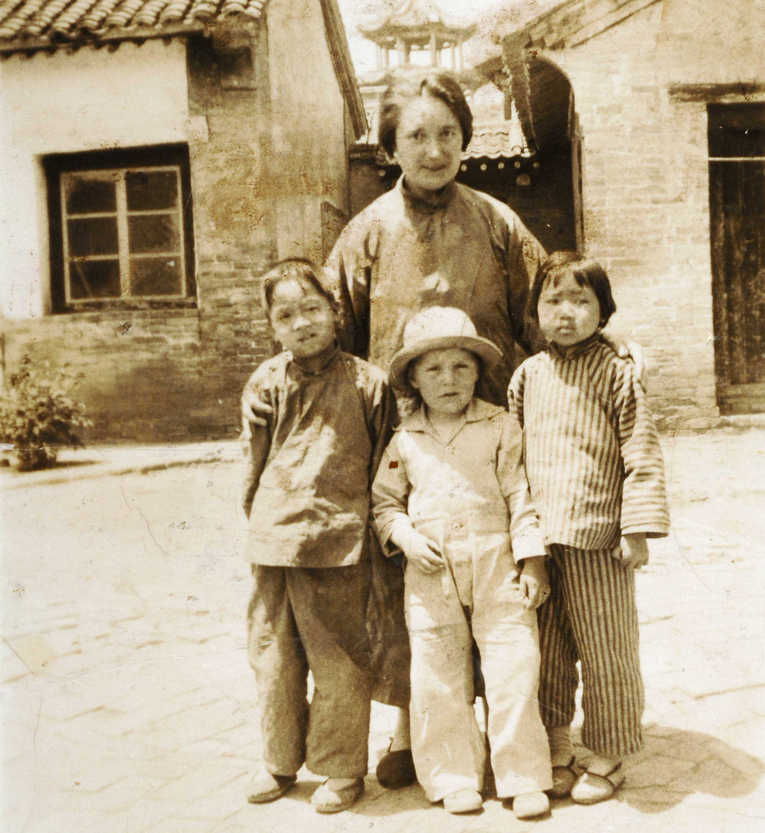
Gladys Aylward

Slide 63


