Slide 1


Slide 2


Slide 3
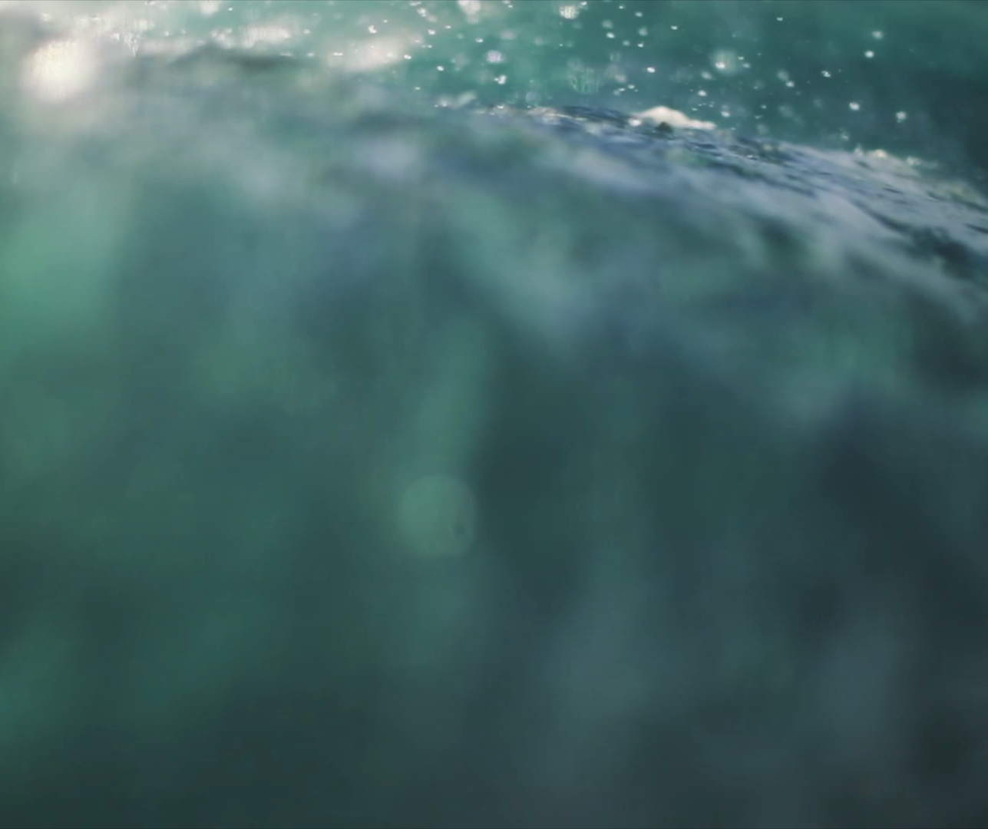
Crossing the Red Sea
Lesson 8:
February 23, 1889

Slide 4
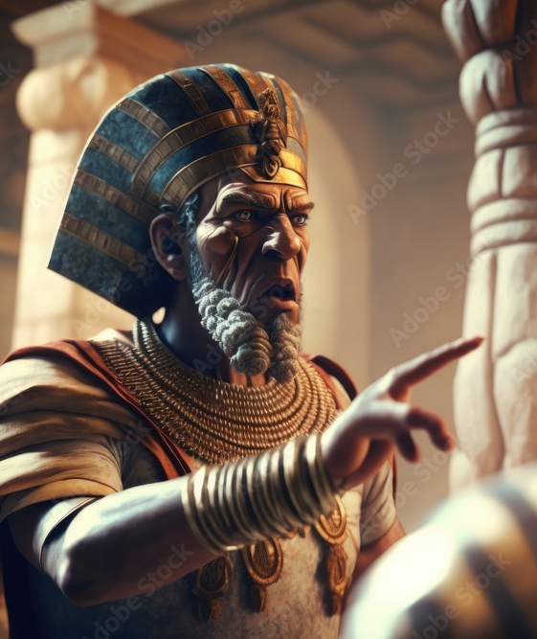
1. When the king of Egypt found that the Israelites had actually gone, how did he feel?
Exodus 14:5

Slide 5
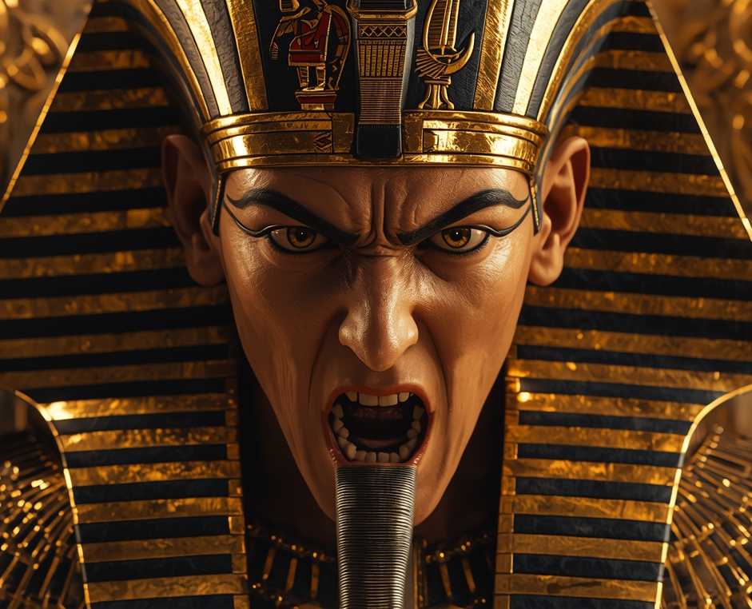
Exodus 14:5
⁵ And it was told the king of Egypt that the people fled: and the heart of Pharaoh and of his servants was turned against the people, and they said, Why have we done this, that we have let Israel go from serving us?

Slide 6
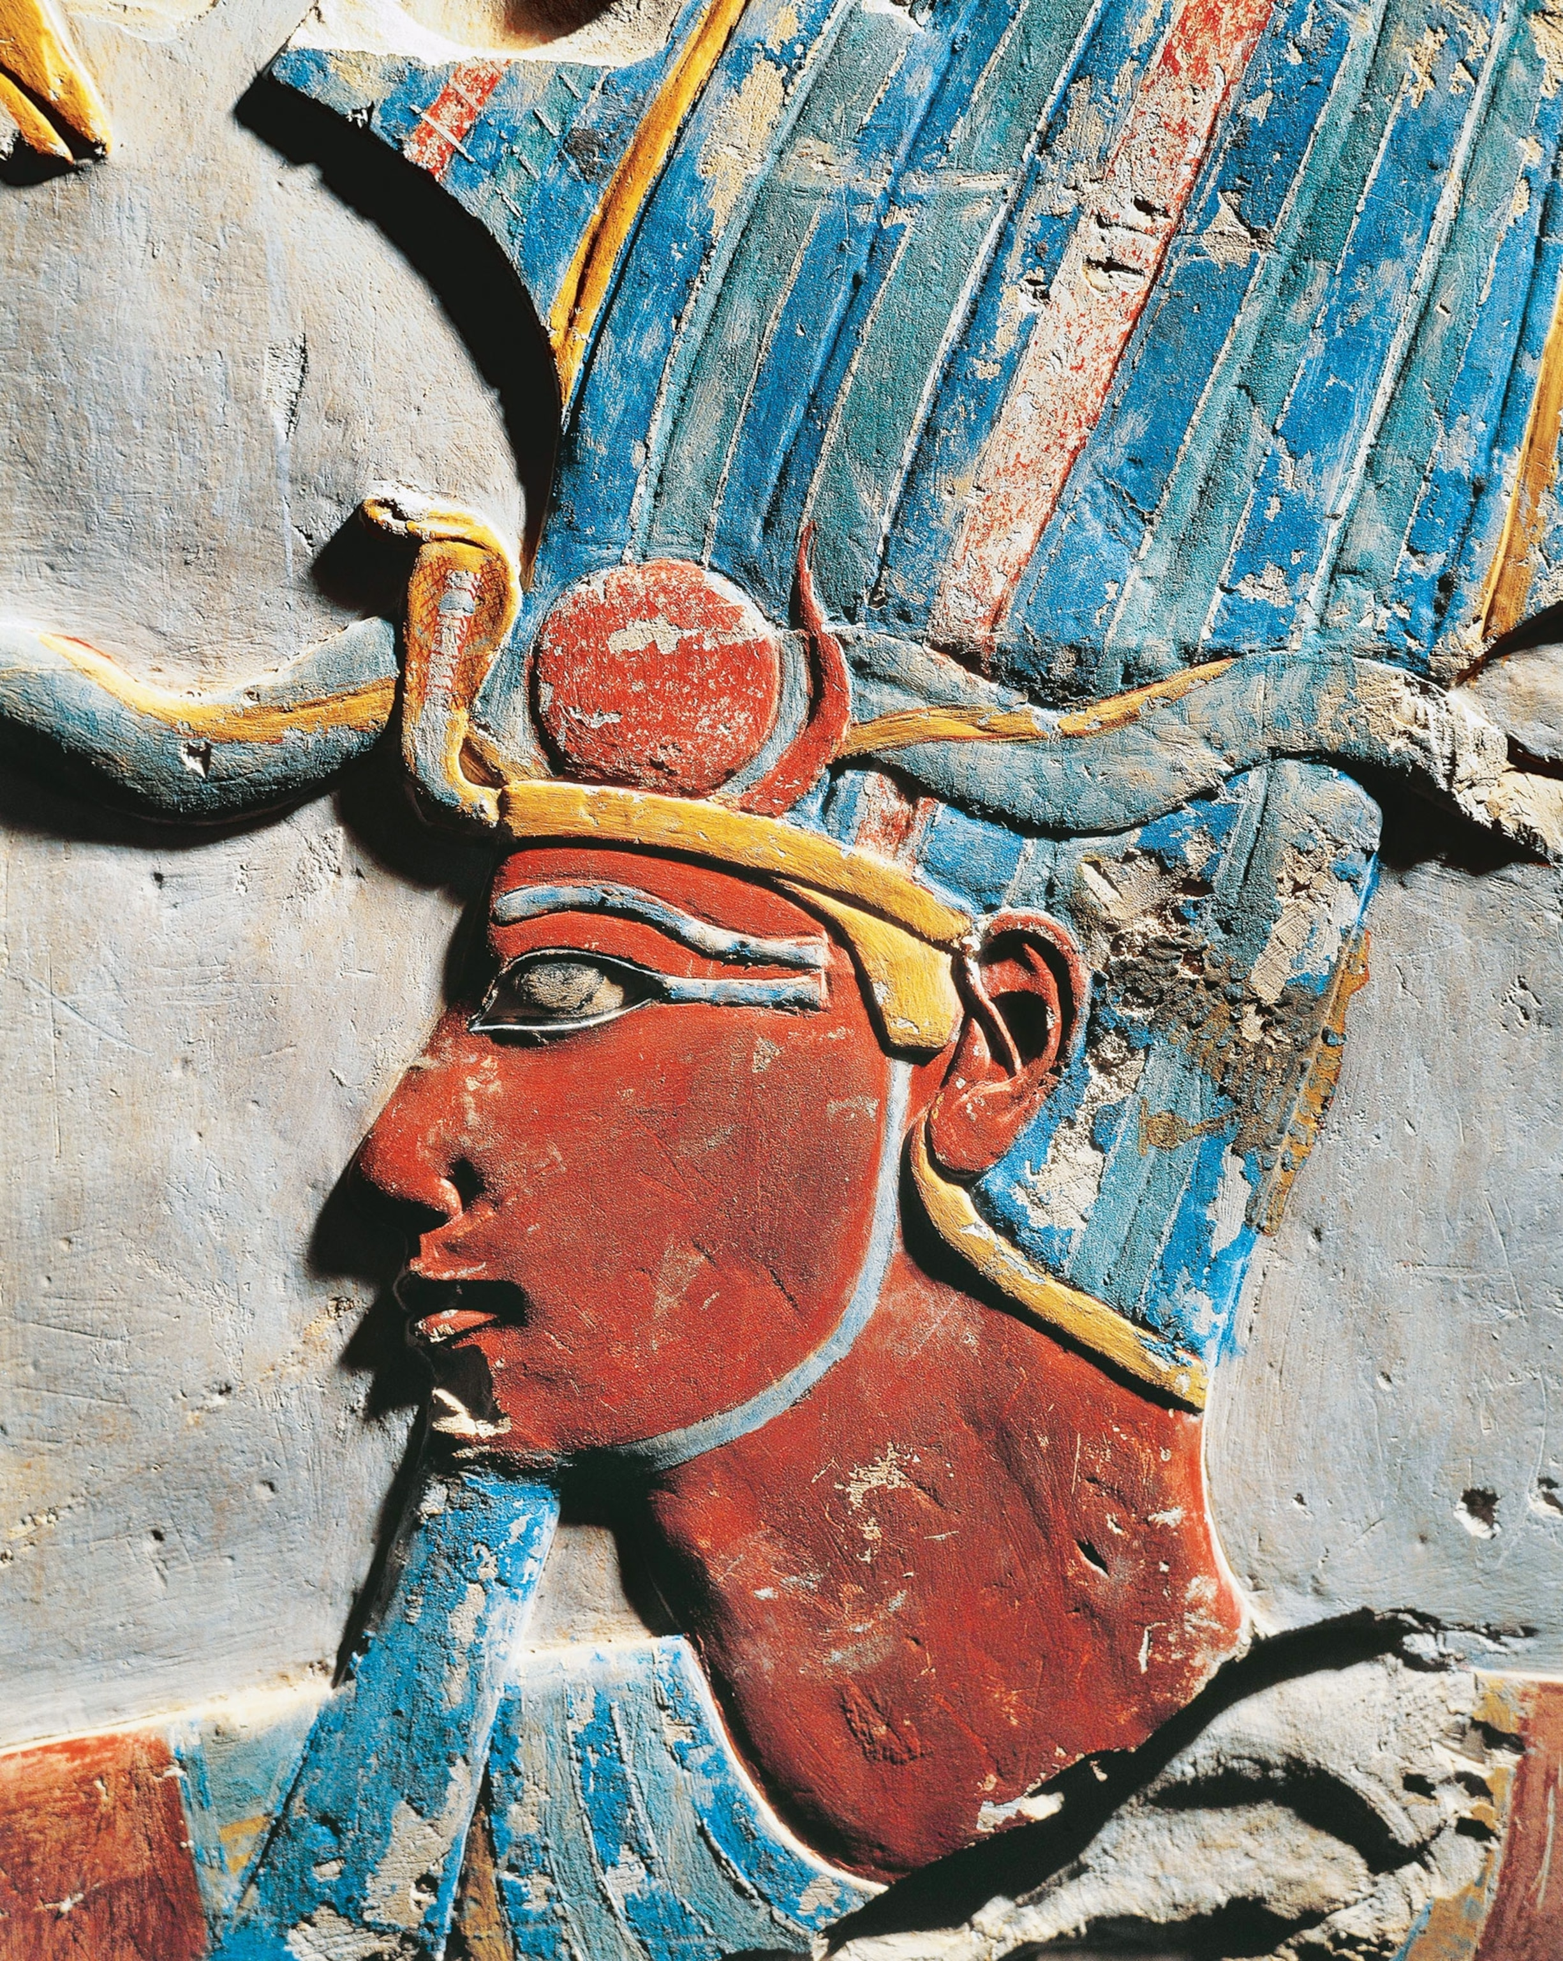
2. What did he do?
Exodus 14:6, 7

Slide 7
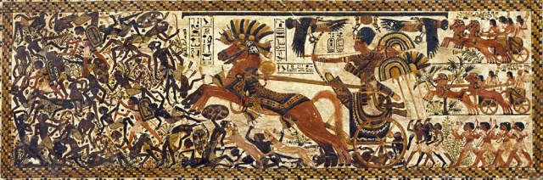
⁶ And he made ready his chariot, and took his people with him:
Exodus 14:6

Slide 8
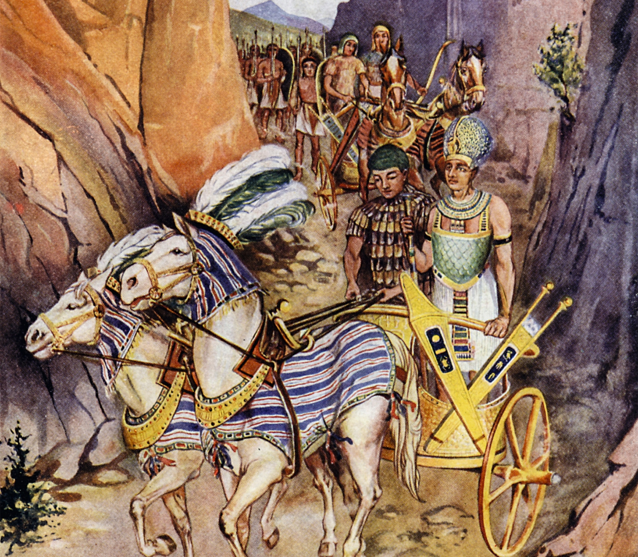
Exodus 14:7
⁷ And he took six hundred chosen chariots, and all the chariots of Egypt, and captains over every one of them.

Slide 9
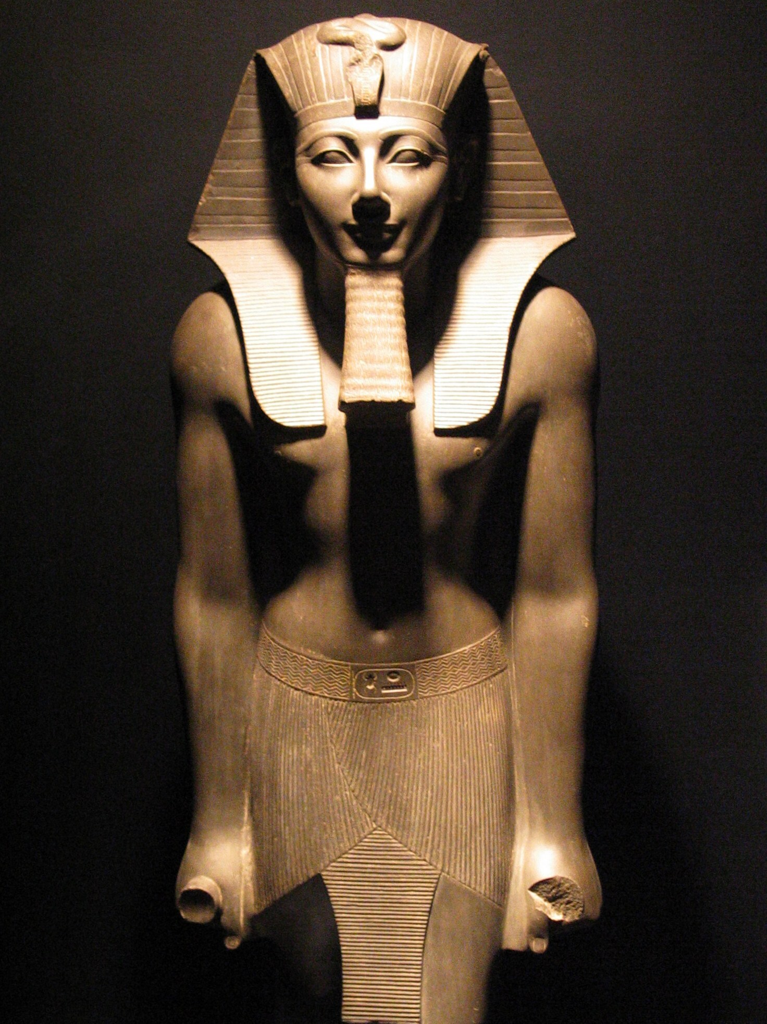
3. Had the Lord foretold this action on the part of Pharaoh?
Exodus 14:1-4

Slide 10
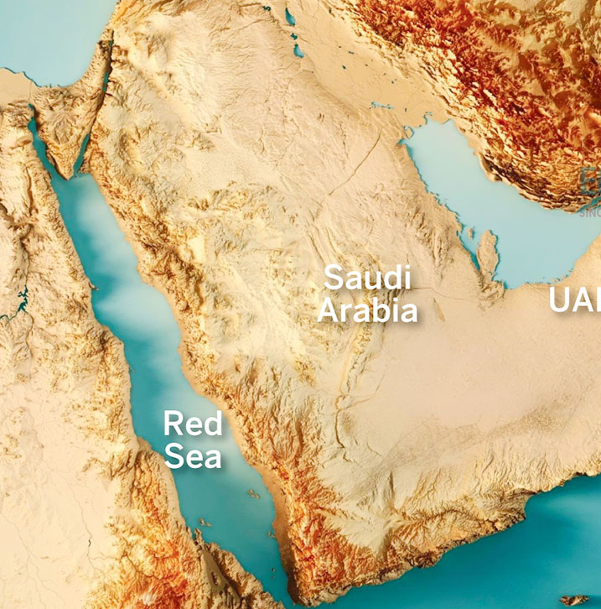
Exodus 14:1-4
14 And the Lord spake unto Moses, saying,
² Speak unto the children of Israel, that they turn and encamp before Pihahiroth, between Migdol and the sea, over against Baalzephon: before it shall ye encamp by the sea.

Slide 11
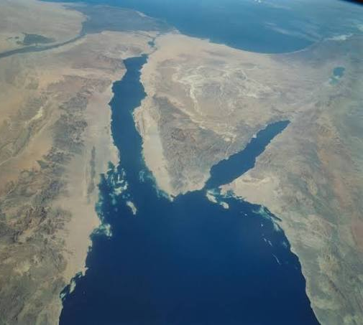
Exodus 14:1-4
³ For Pharaoh will say of the children of Israel, They are entangled in the land, the wilderness hath shut them in.

Slide 12
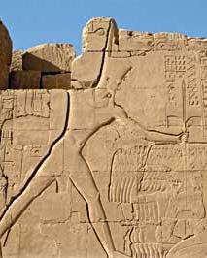
Exodus 14:1-4
⁴ And I will harden Pharaoh's heart, that he shall follow after them; and I will be honoured upon Pharaoh, and upon all his host; that the Egyptians may know that I am the Lord. And they did so.

Slide 13
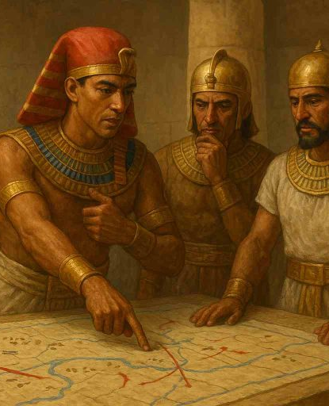
4. Where did Pharaoh and his army overtake the Israelites?
Exodus 14:9

Slide 14
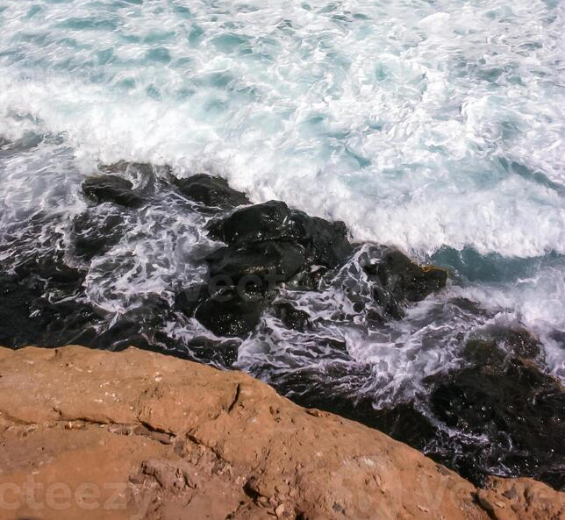
Exodus 14:9
⁹ But the Egyptians pursued after them, all the horses and chariots of Pharaoh, and his horsemen, and his army, and overtook them encamping by the sea, beside Pihahiroth, before Baalzephon.

Slide 15
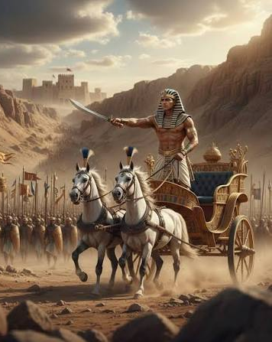
5. When the Israelites saw the Egyptians, how did they feel?
Exodus 14:10

Slide 16
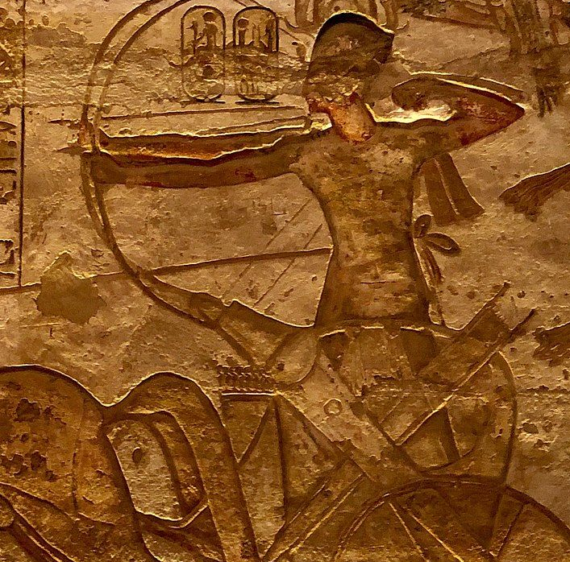
Exodus 14:10
¹⁰ And when Pharaoh drew nigh, the children of Israel lifted up their eyes, and, behold, the Egyptians marched after them; and they were sore afraid: and the children of Israel cried out unto the Lord.

Slide 17
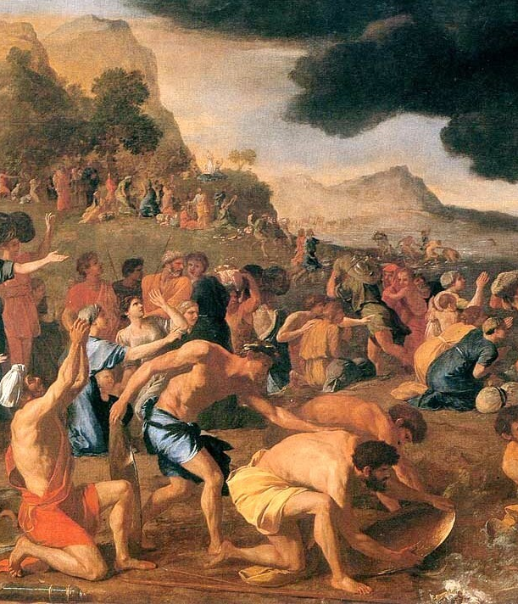
6. How did they show their lack of faith in God?
Exodus 14:11-12

Slide 18
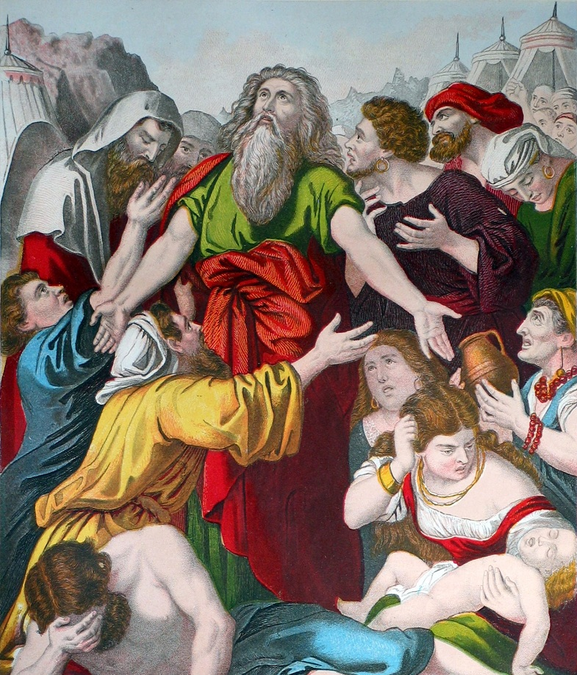
Exodus 14:11-12
¹¹ And they said unto Moses, Because there were no graves in Egypt, hast thou taken us away to die in the wilderness? wherefore hast thou dealt thus with us, to carry us forth out of Egypt?

Slide 19
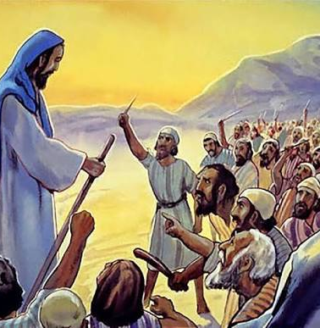
Exodus 14:11-12
¹² Is not this the word that we did tell thee in Egypt, saying, Let us alone, that we may serve the Egyptians? For it had been better for us to serve the Egyptians, than that we should die in the wilderness.

Slide 20
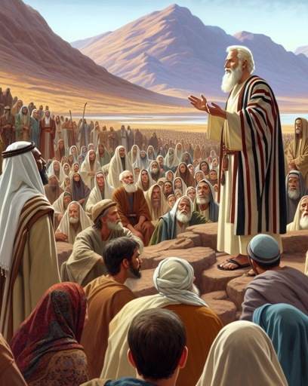
7. What words of courage did Moses speak?
Exodus 14:13-14

Slide 21
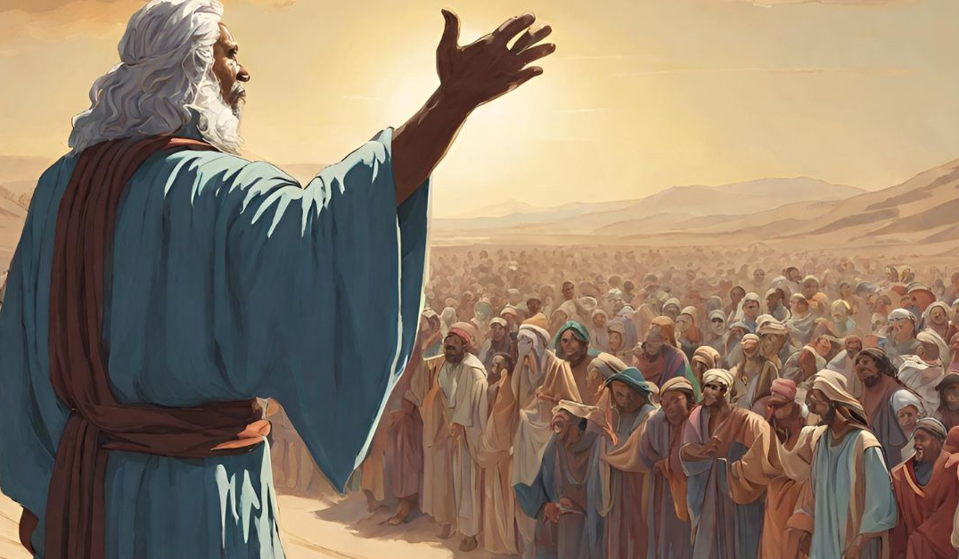
Exodus 14:13-14
¹³ And Moses said unto the people, Fear ye not, stand still, and see the salvation of the Lord, which he will shew to you to day: for the Egyptians whom ye have seen to day, ye shall see them again no more for ever.

Slide 22
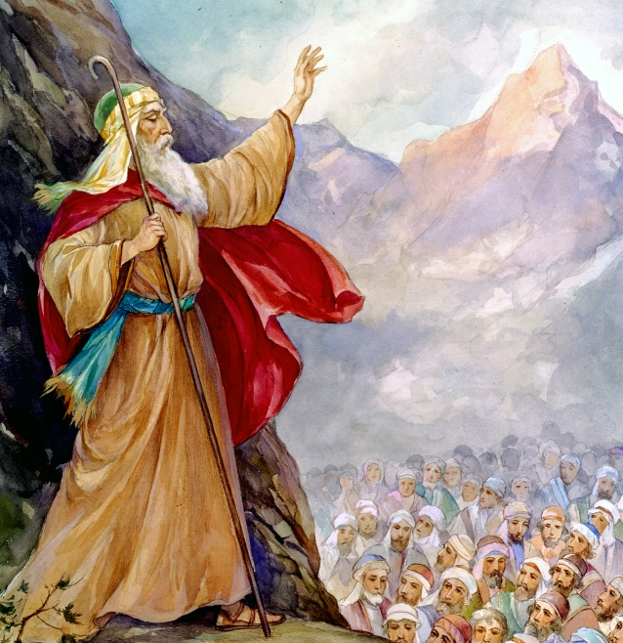
Exodus 14:13-14
¹⁴ The Lord shall fight for you, and ye shall hold your peace.

Slide 23
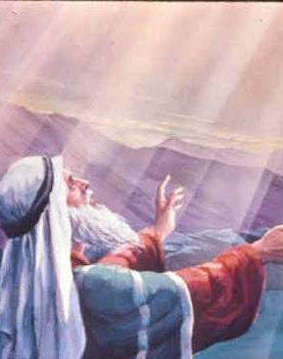
8. What did the Lord say to him?
Exodus 14:15, 16

Slide 24
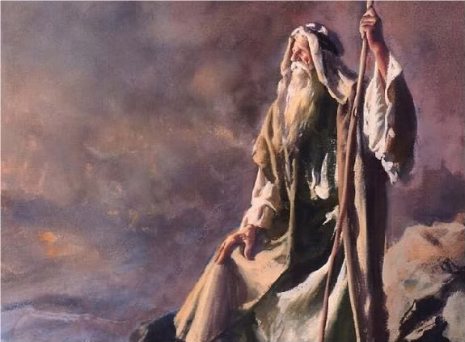
Exodus 14:15-16
15 And the Lord said unto Moses, Wherefore criest thou unto me? speak unto the children of Israel, that they go forward:

Slide 25
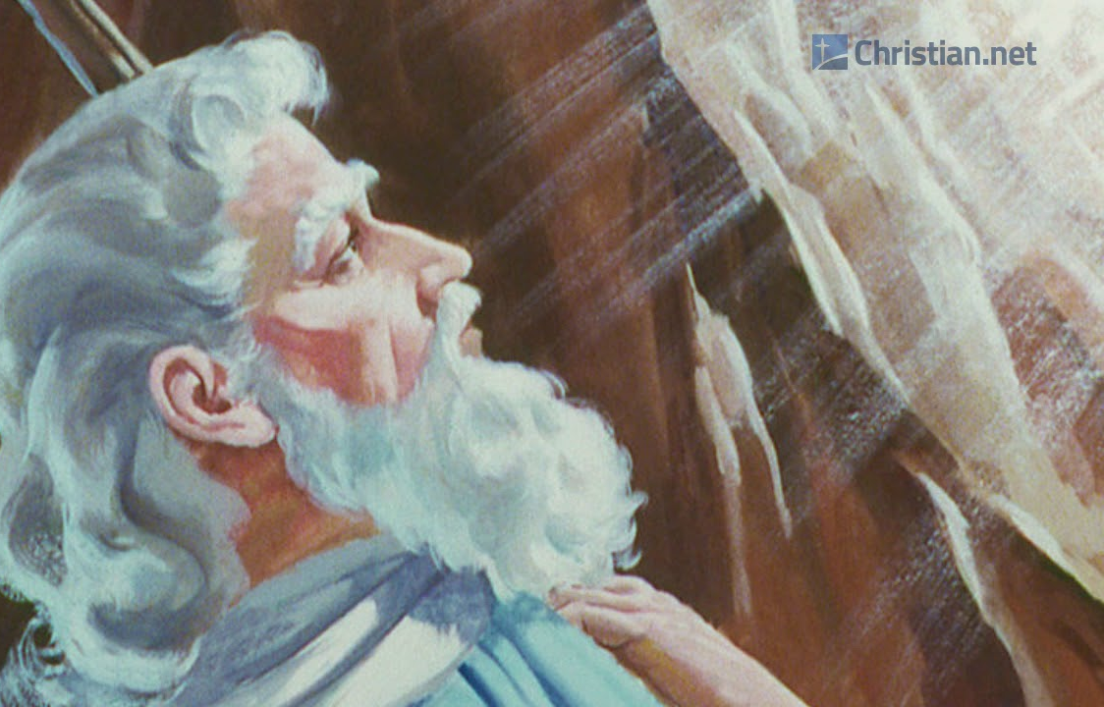
Exodus 14:15-16
¹⁶ But lift thou up thy rod, and stretch out thine hand over the sea, and divide it: and the children of Israel shall go on dry ground through the midst of the sea.

Slide 26
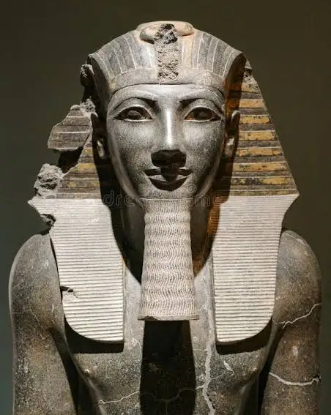
9. What did he say that the Egyptians would do?
Exodus 14:17

Slide 27
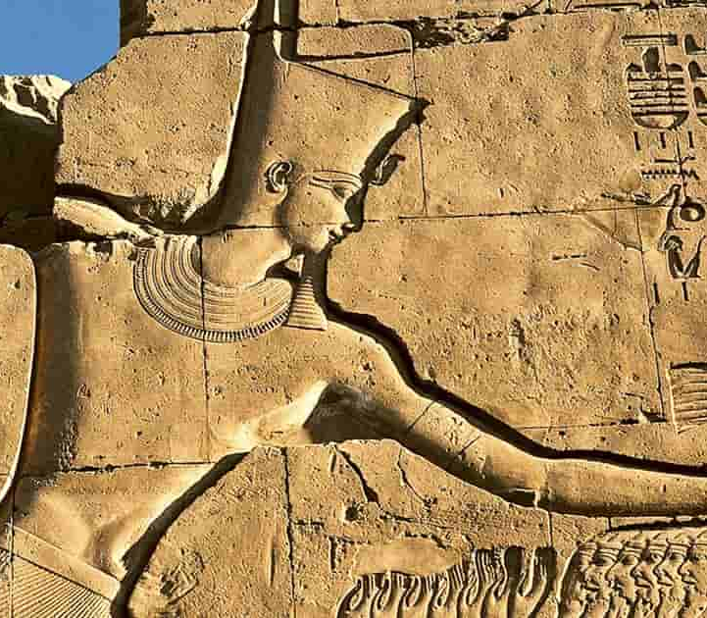
Exodus 14:17
¹⁷ And I, behold, I will harden the hearts of the Egyptians, and they shall follow them: and I will get me honour upon Pharaoh, and upon all his host, upon his chariots, and upon his horsemen.

Slide 28
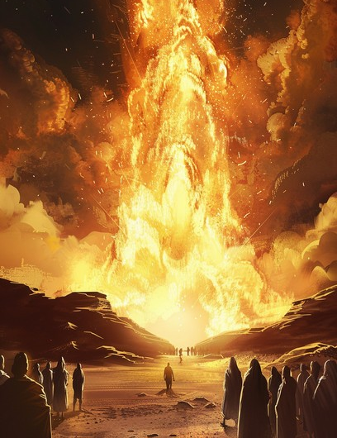
10. How did the Lord protect the Israelites through the night?
Exodus 14:19, 20

Slide 29
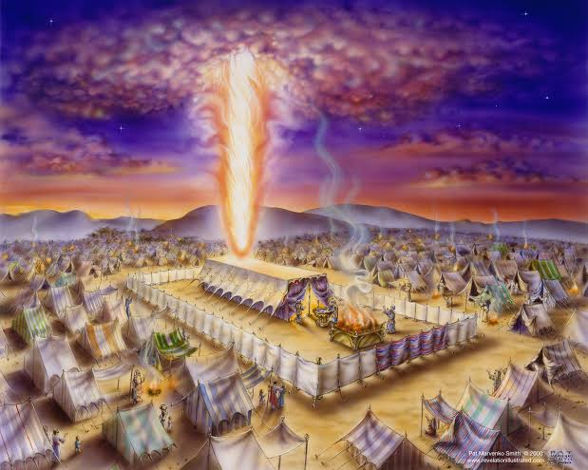
Exodus 14:19
¹⁹ And the angel of God, which went before the camp of Israel, removed and went behind them; and the pillar of the cloud went from before their face, and stood behind them:

Slide 30
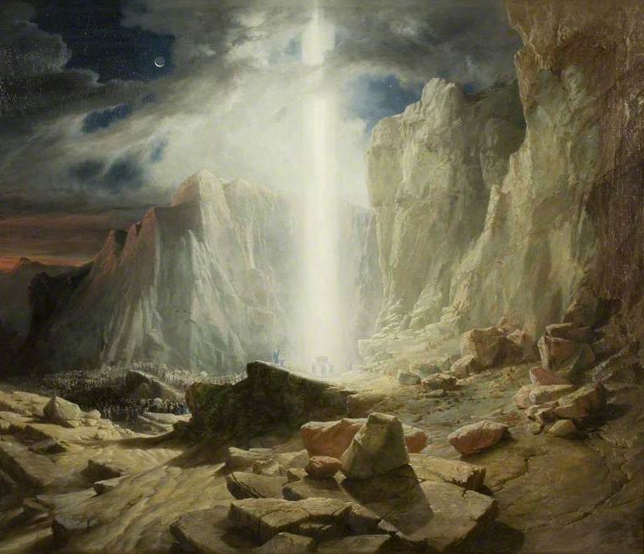
Exodus 14:20
²⁰ And it came between the camp of the Egyptians and the camp of Israel; and it was a cloud and darkness to them, but it gave light by night to these: so that the one came not near the other all the night.

Slide 31
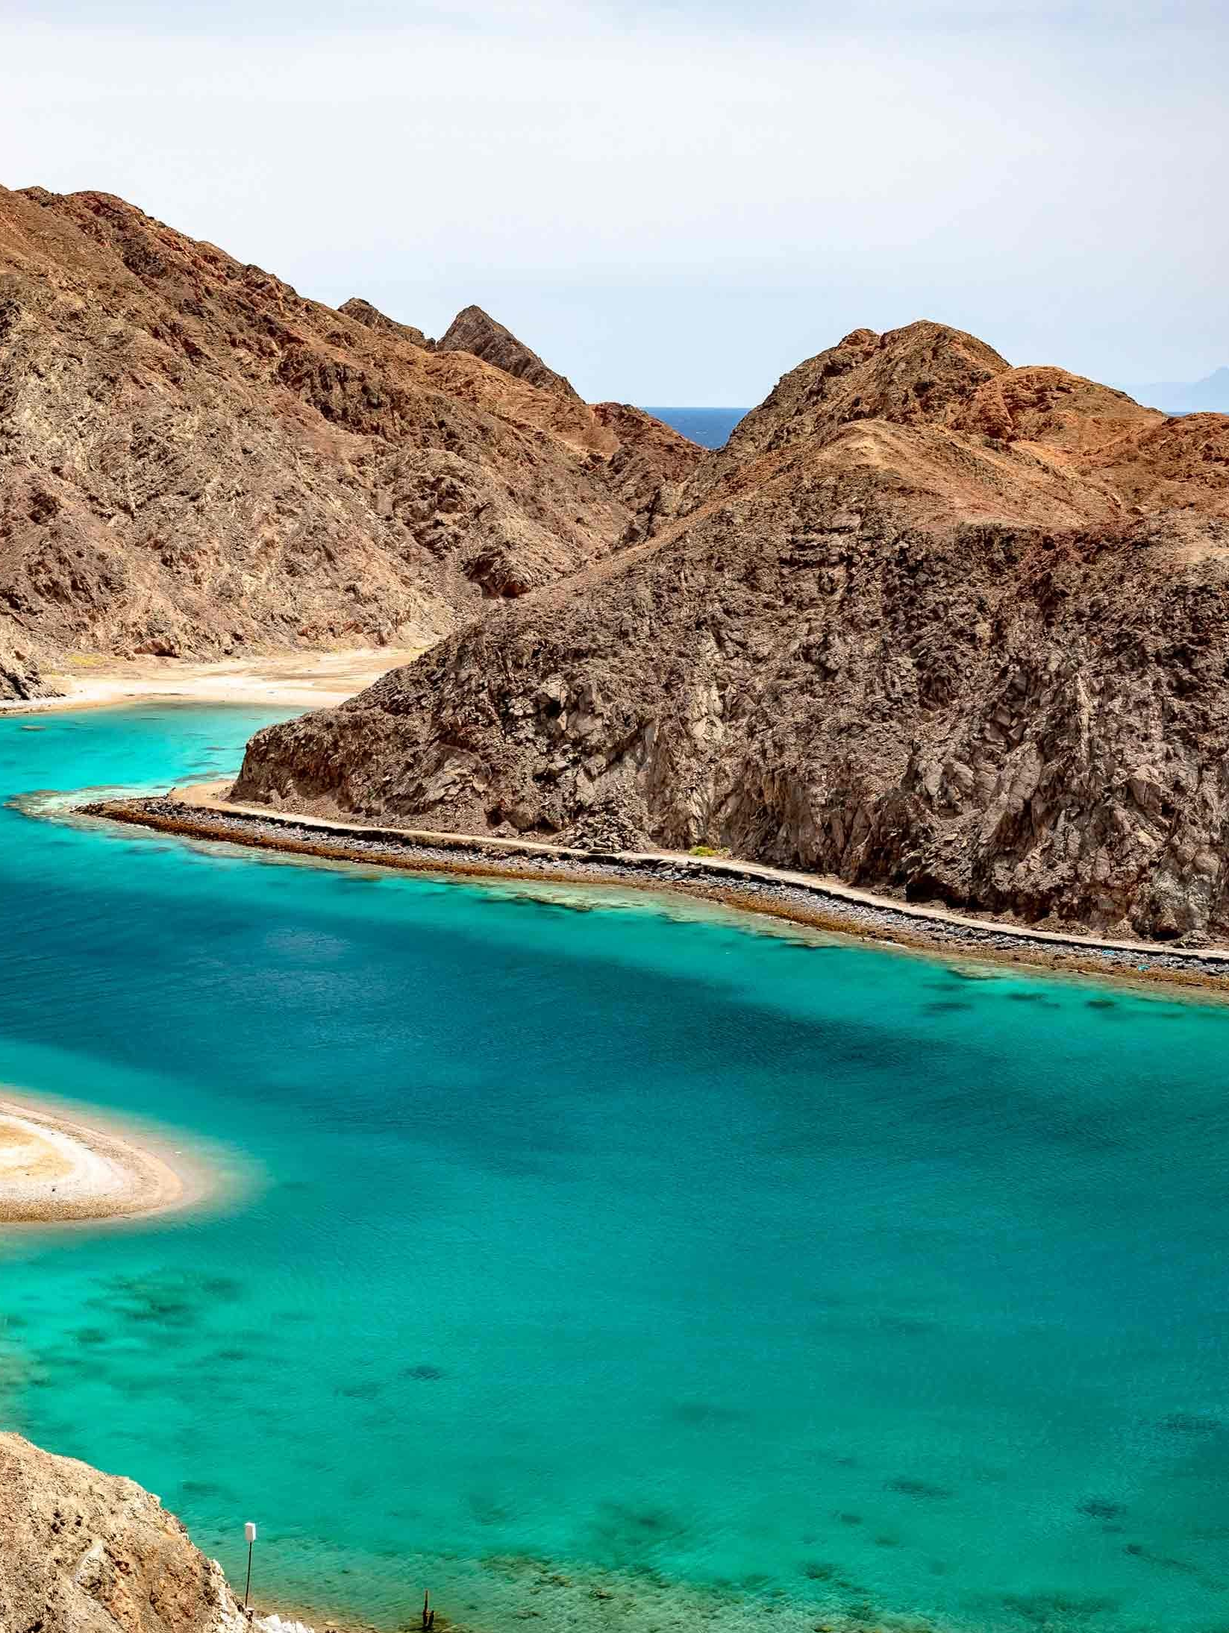
11. What way of escape did he prepare for them?
Exodus 14:21, 22, 29; 15:8

Slide 32
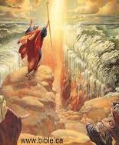
Exodus 14:21, 22, 29
²¹ And Moses stretched out his hand over the sea; and the Lord caused the sea to go back by a strong east wind all that night, and made the sea dry land, and the waters were divided.

Slide 33
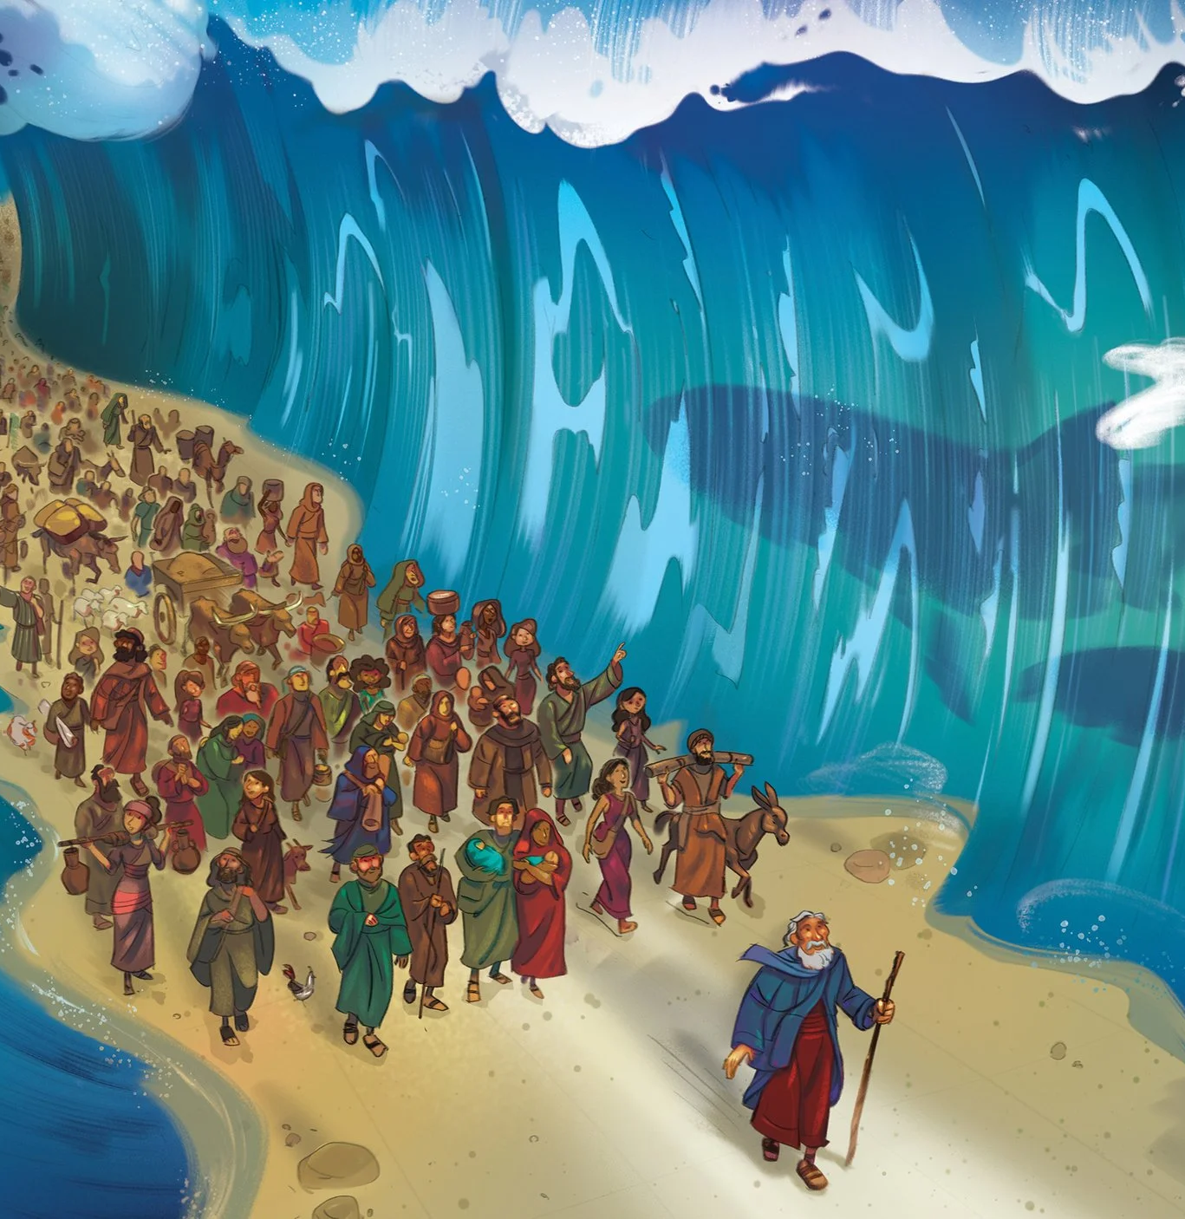
Exodus 14:21, 22, 29
²² And the children of Israel went into the midst of the sea upon the dry ground: and the waters were a wall unto them on their right hand, and on their left.

Slide 34
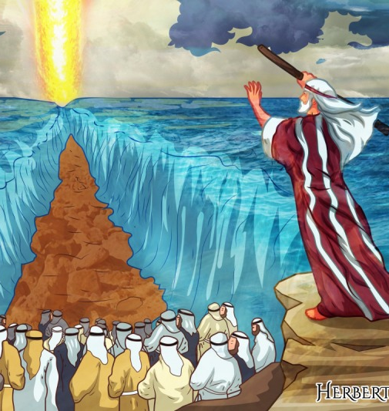
Exodus 14:21, 22, 29
²⁹ But the children of Israel walked upon dry land in the midst of the sea; and the waters were a wall unto them on their right hand, and on their left.

Slide 35
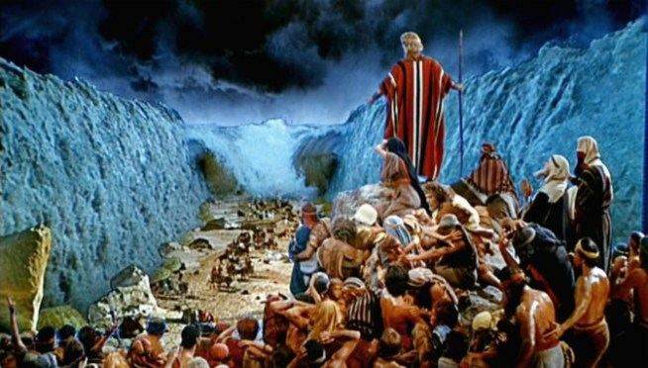
Exodus 15:8
⁸ And with the blast of thy nostrils the waters were gathered together, the floods stood upright as an heap, and the depths were congealed in the heart of the sea.

Slide 36
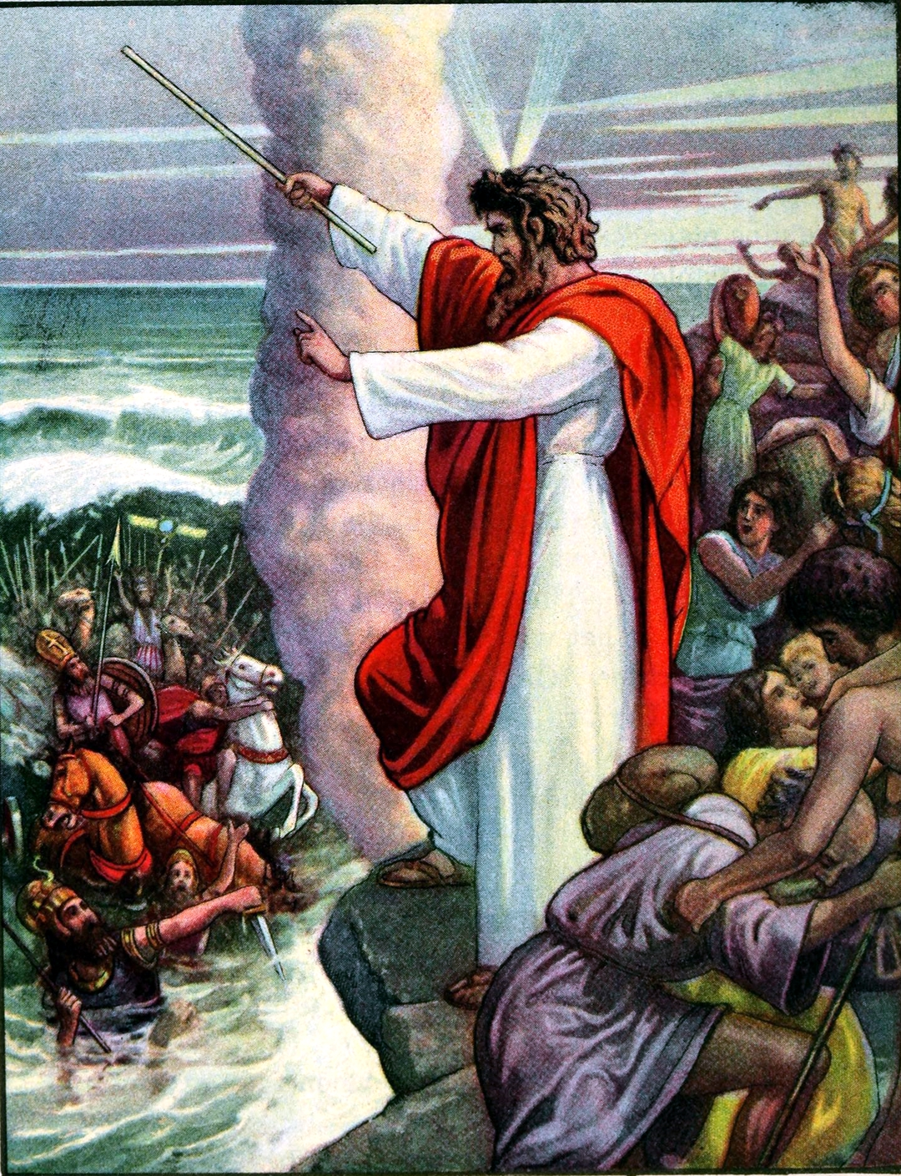
12. When the Egyptians followed them into the sea, what did the Lord do?
Exodus 14:23-28; 15:9-10

Slide 37
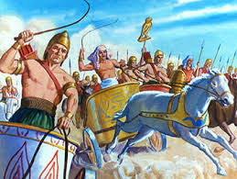
Exodus 14:23-28
²³ And the Egyptians pursued, and went in after them to the midst of the sea, even all Pharaoh's horses, his chariots, and his horsemen.

Slide 38
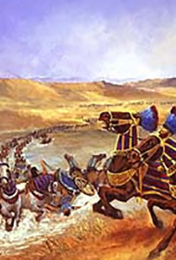
Exodus 14:23-28
²⁴ And it came to pass, that in the morning watch the Lord looked unto the host of the Egyptians through the pillar of fire and of the cloud, and troubled the host of the Egyptians,

Slide 39
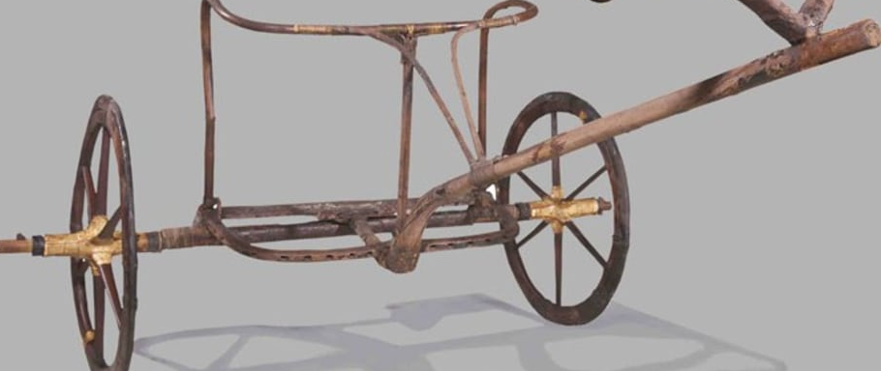
Exodus 14:23-28
²⁵ And took off their chariot wheels, that they drave them heavily: so that the Egyptians said, Let us flee from the face of Israel; for the Lord fighteth for them against the Egyptians.

Slide 40
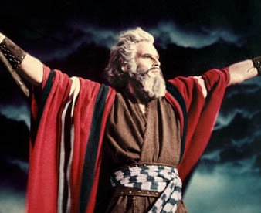
Exodus 14:23-28
26 And the Lord said unto Moses, Stretch out thine hand over the sea, that the waters may come again upon the Egyptians, upon their chariots, and upon their horsemen.

Slide 41
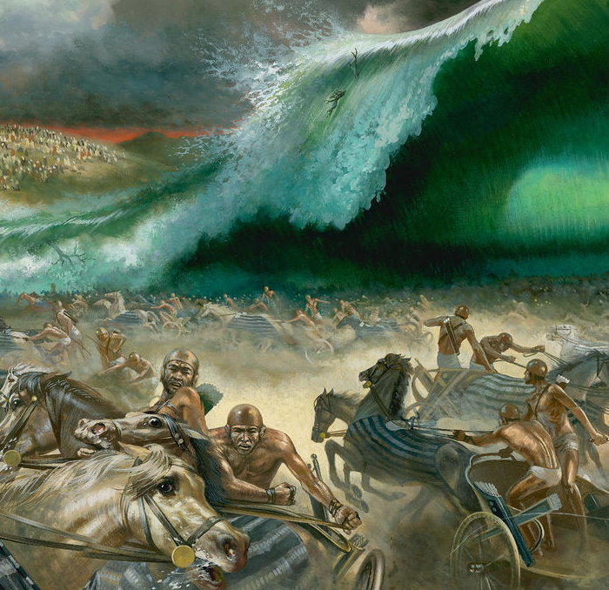
Exodus 14:23-28
27 And Moses stretched forth his hand over the sea, and the sea returned to his strength when the morning appeared; and the Egyptians fled against it; and the Lord overthrew the Egyptians in the midst of the sea.

Slide 42
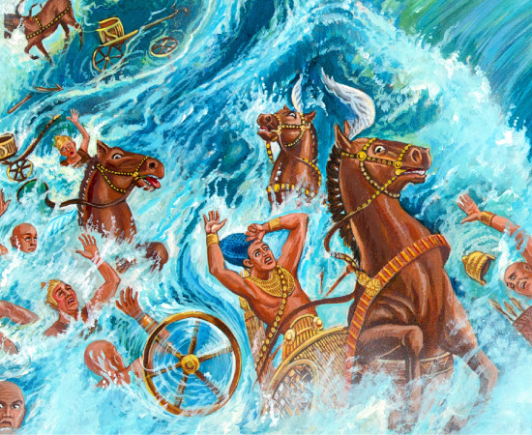
Exodus 14:23-28
28 And the waters returned, and covered the chariots, and the horsemen, and all the host of Pharaoh that came into the sea after them; there remained not so much as one of them.

Slide 43
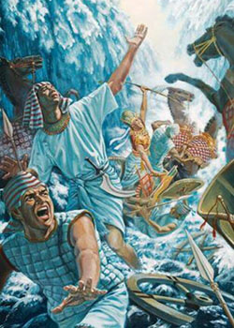
Exodus 15:9-10
⁹ The enemy said, I will pursue, I will overtake, I will divide the spoil; my lust shall be satisfied upon them; I will draw my sword, my hand shall destroy them.
¹⁰ Thou didst blow with thy wind, the sea covered them: they sank as lead in the mighty waters.

Slide 44
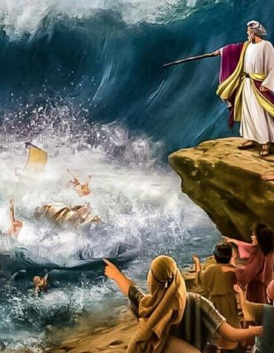
13. What was it that enabled the Israelites to cross the sea?
Hebrews 11:29

Slide 45
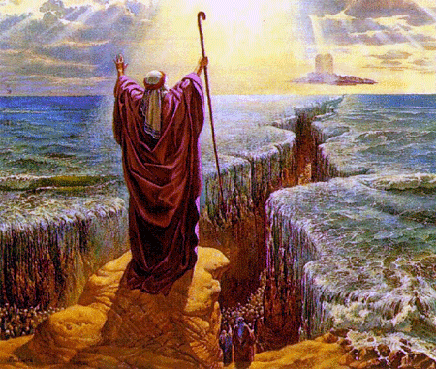
Hebrews 11:29
²⁹ By faith they passed through the Red sea as by dry land: which the Egyptians assaying to do were drowned.

Slide 46
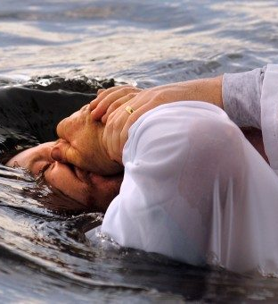
1 Corinthians 10:1-2
10 Moreover, brethren, I would not that ye should be ignorant, how that all our fathers were under the cloud, and all passed through the sea;
² And were all baptized unto Moses in the cloud and in the sea;

Slide 47
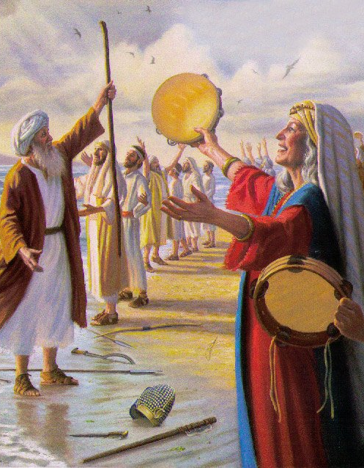
14. What effect did this deliverance have upon the people of Israel?
Exodus 14:30, 31

Slide 48
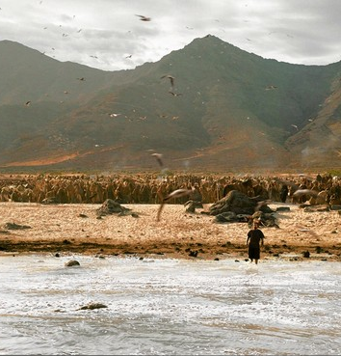
Exodus 14:30-31
³⁰ Thus the Lord saved Israel that day out of the hand of the Egyptians; and Israel saw the Egyptians dead upon the sea shore.

Slide 49
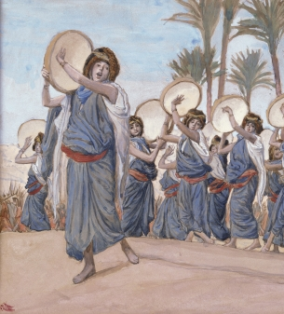
Exodus 14:30-31
³¹ And Israel saw that great work which the Lord did upon the Egyptians: and the people feared the Lord, and believed the Lord, and his servant Moses.

Slide 50
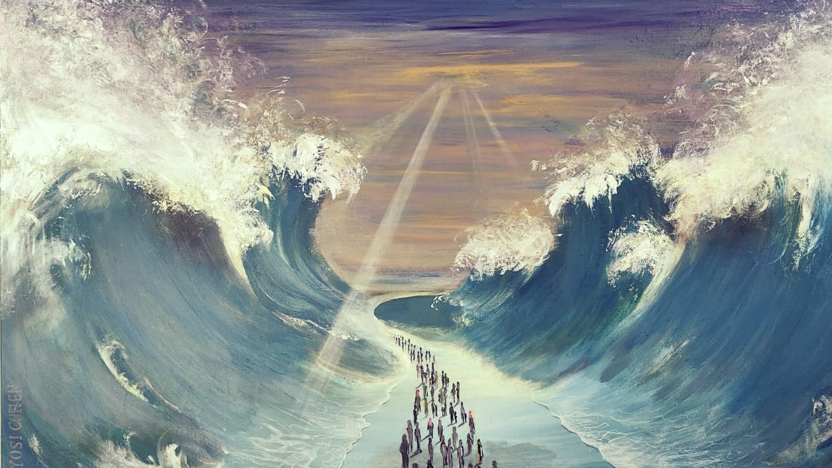
15. After such exhibitions of God's power and His care for them, ought they ever to have feared again?

Slide 51
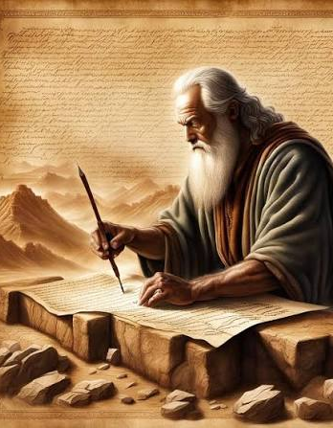
16. Why were all these things written?
Romans 15:4

Slide 52
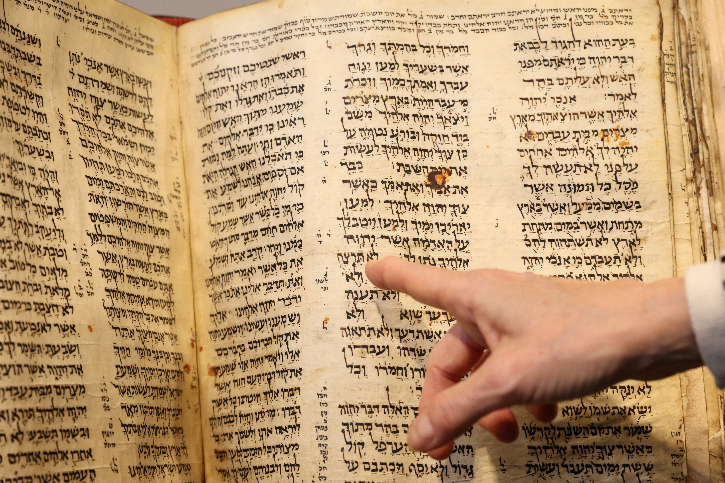
Romans 15:4
⁴ For whatsoever things were written aforetime were written for our learning, that we through patience and comfort of the scriptures might have hope.

Slide 53

17. What song did Moses and the children of Israel sing after their deliverance?
Read Exodus 15:1-21

Slide 54


Slide 55

18. After the seven last plagues are poured upon the wicked, what song will the delivered sing?
Exodus 15:2-3

Slide 56

Revelation 15:2-3
² And I saw as it were a sea of glass mingled with fire: and them that had gotten the victory over the beast, and over his image, and over his mark, and over the number of his name, stand on the sea of glass, having the harps of God.

Slide 57

Revelation 15:2-3
³ And they sing the song of Moses the servant of God, and the song of the Lamb, saying, Great and marvellous are thy works, Lord God Almighty; just and true are thy ways, thou King of saints.

Slide 58

19. Repeat the substance of this song.
Exodus 15:3-4

Slide 59

Revelation 15:3-4
³ And they sing the song of Moses the servant of God, and the song of the Lamb, saying, Great and marvellous are thy works, Lord God Almighty; just and true are thy ways, thou King of saints.

Slide 60

Revelation 15:3-4
⁴ Who shall not fear thee, O Lord, and glorify thy name? for thou only art holy: for all nations shall come and worship before thee; for thy judgments are made manifest.

Slide 61


Slide 62


Slide 63


Slide 64


Slide 65

1 Corinthians 12:12-13
¹² For as the body is one, and hath many members, and all the members of that one body, being many, are one body: so also is Christ.

Slide 66

1 Corinthians 12:12-13
¹³ For by one Spirit are we all baptized into one body, whether we be Jews or Gentiles, whether we be bond or free; and have been all made to drink into one Spirit.

Slide 67


