Slide 1


Slide 2


Slide 3
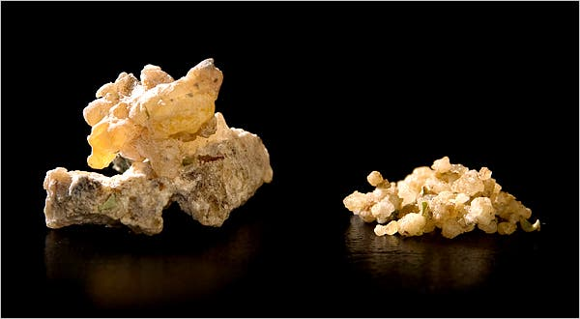
The Giving of Manna
Lesson 9: March 2, 1889

Slide 4
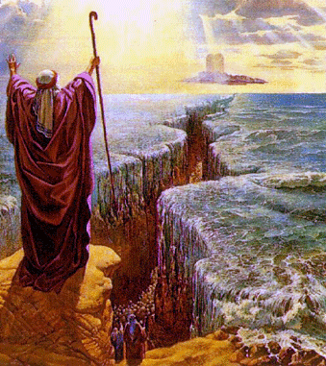
Exodus 15:23
1. What inconvenience did the children of Israel suffer soon after they crossed the Red Sea?

Slide 5

Exodus 15:23
²³ And when they came to Marah, they could not drink of the waters of Marah, for they were bitter: therefore the name of it was called Marah.

Slide 6
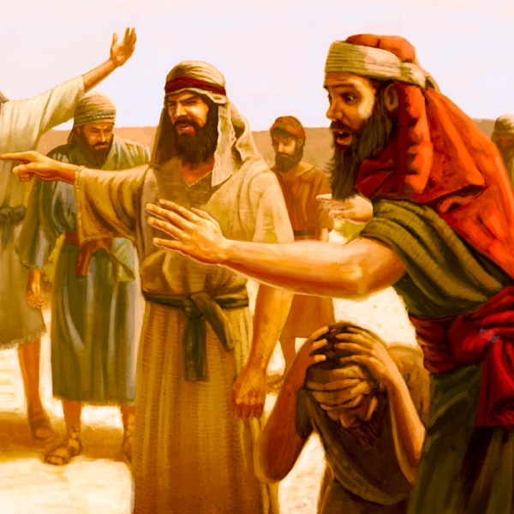
Exodus 15:24
2. How did they act?

Slide 7
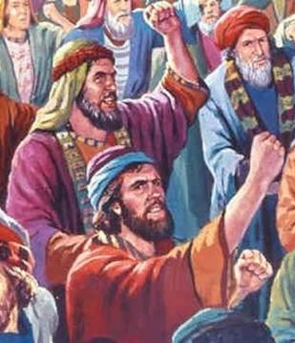
Exodus 15:24
²⁴ And the people murmured against Moses, saying, What shall we drink?

Slide 8
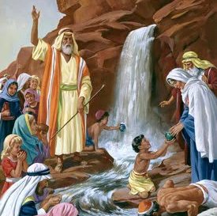
Exodus 15:25
3. How did the Lord give them relief?

Slide 9
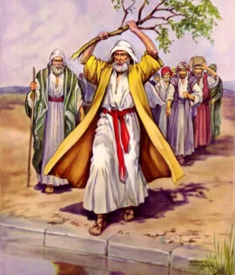
Exodus 15:25
²⁵ And he cried unto the Lord; and the Lord shewed him a tree, which when he had cast into the waters, the waters were made sweet: there he made for them a statute and an ordinance, and there he proved them,

Slide 10
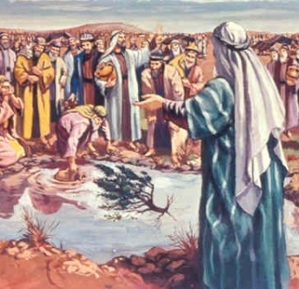
Exodus 15:26
4. What promise did the Lord then give the people?

Slide 11
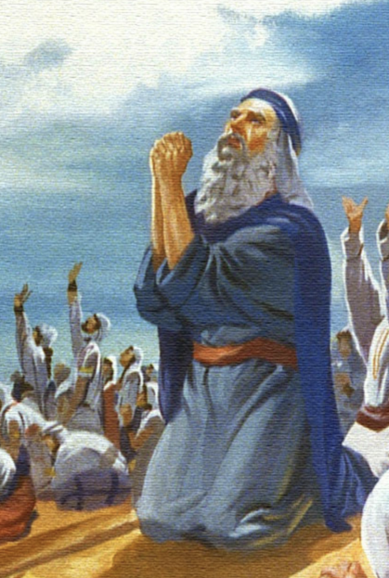
Exodus 15:26
²⁶ And said, If thou wilt diligently hearken to the voice of the Lord thy God, and wilt do that which is right in his sight, and wilt give ear to his commandments, and keep all his statutes, I will put none of these diseases upon thee, which I have brought upon the Egyptians: for I am the Lord that healeth thee.

Slide 12
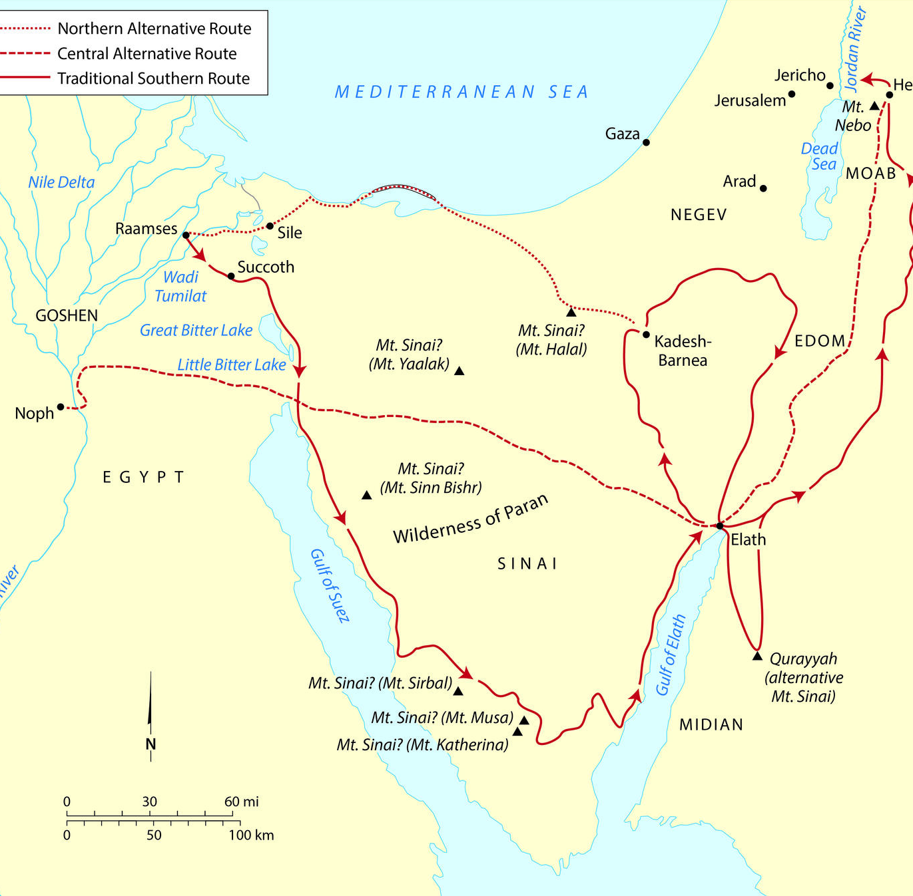
Exodus 16:1-3
5. When they came to the Wilderness of Sin, what wicked charge did they bring against Moses and Aaron?

Slide 13
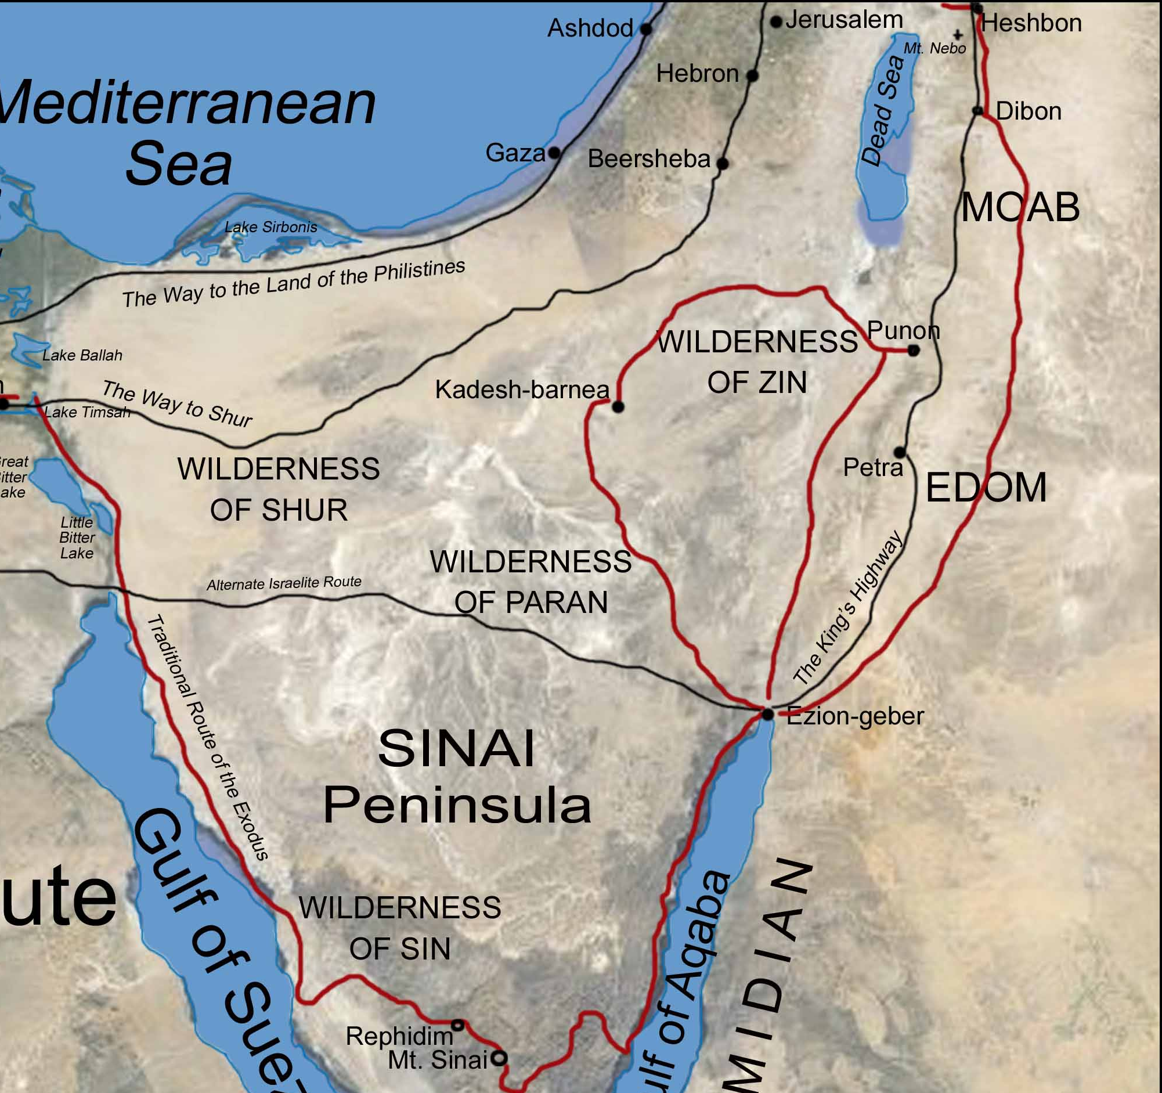
Exodus 16:1-3
16 And they took their journey from Elim, and all the congregation of the children of Israel came unto the wilderness of Sin, which is between Elim and Sinai, on the fifteenth day of the second month after their departing out of the land of Egypt.

Slide 14
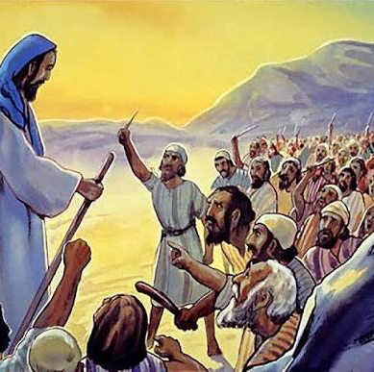
Exodus 16:1-3
² And the whole congregation of the children of Israel murmured against Moses and Aaron in the wilderness:

Slide 15
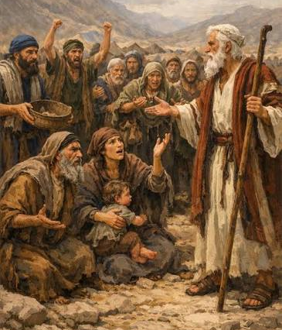
Exodus 16:1-3
³ And the children of Israel said unto them, Would to God we had died by the hand of the Lord in the land of Egypt, when we sat by the flesh pots, and when we did eat bread to the full; for ye have brought us forth into this wilderness, to kill this whole assembly with hunger.

Slide 16
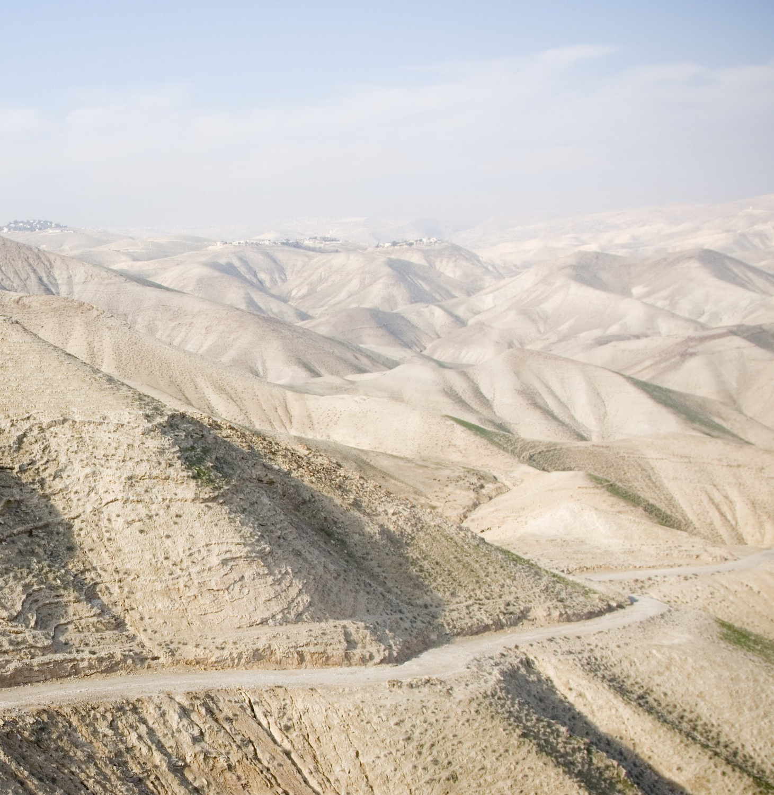
Exodus 16:4
6. What did the Lord say he would do to satisfy their hunger?

Slide 17
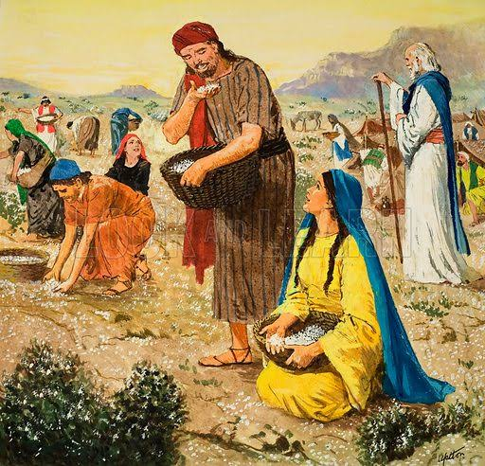
Exodus 16:4
⁴ Then said the Lord unto Moses, Behold, I will rain bread from heaven for you; and the people shall go out and gather a certain rate every day, that I may prove them, whether they will walk in my law, or no.

Slide 18
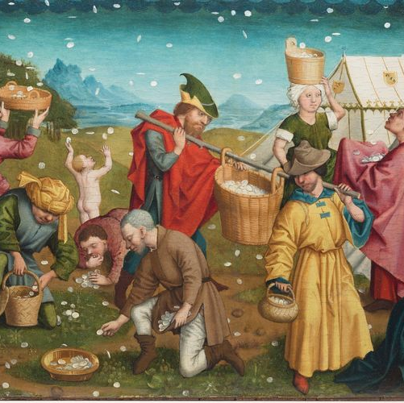
Exodus 16:4
7. What test did he say this would be for them?

Slide 19
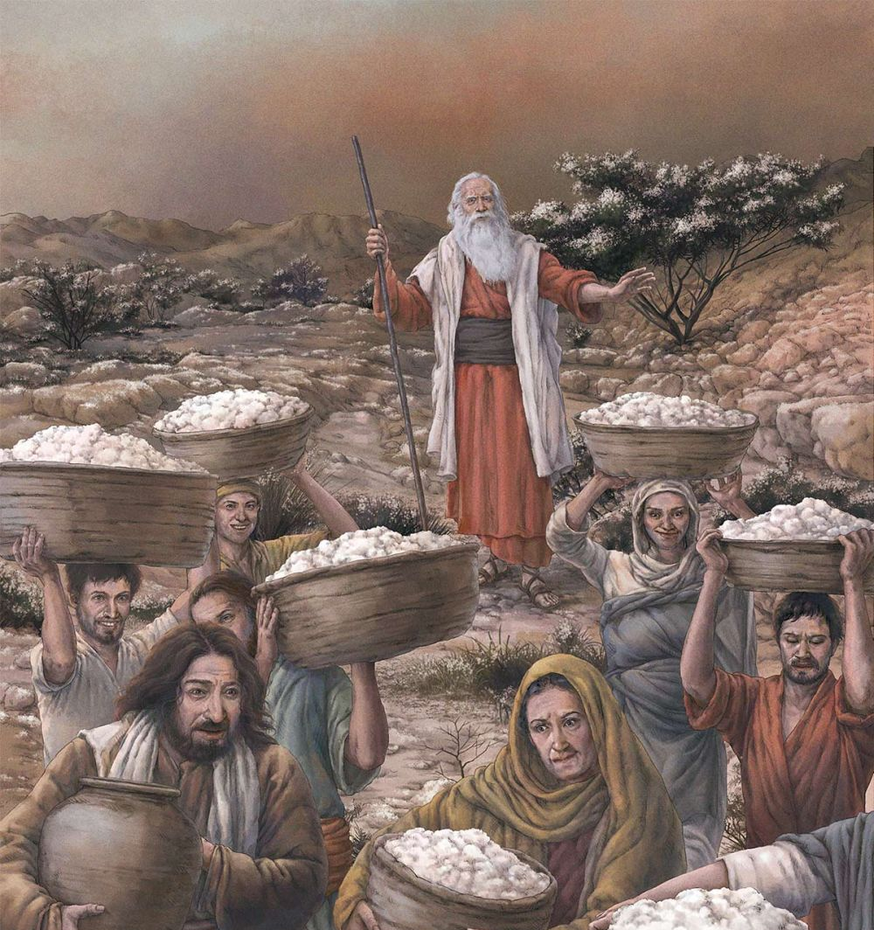
Exodus 16:4
⁴ Then said the Lord unto Moses, Behold, I will rain bread from heaven for you; and the people shall go out and gather a certain rate every day, that I may prove them, whether they will walk in my law, or no.

Slide 20
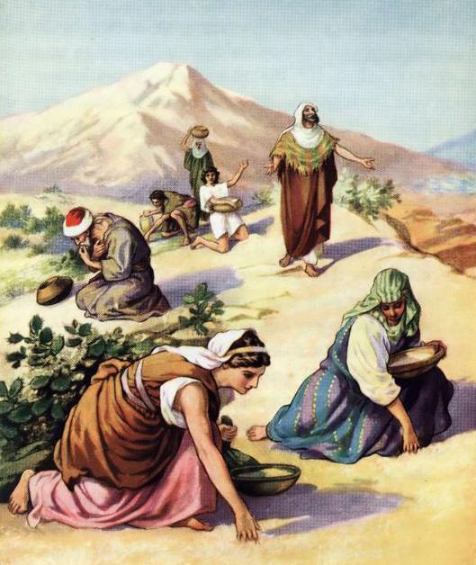
Exodus 16:6-8, 12
8. When were they told that they should receive food?

Slide 21
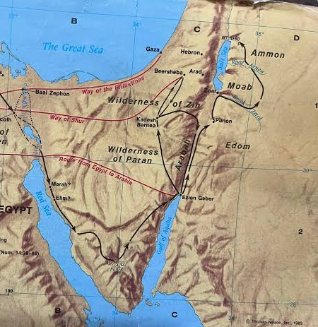
Exodus 16:6-9, 12
⁶ And Moses and Aaron said unto all the children of Israel, At even, then ye shall know that the Lord hath brought you out from the land of Egypt:

Slide 22

Exodus 16:6-9, 12
⁷ And in the morning, then ye shall see the glory of the Lord; for that he heareth your murmurings against the Lord: and what are we, that ye murmur against us?

Slide 23
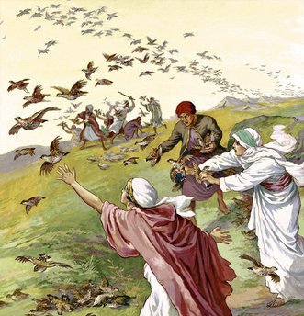
Exodus 16:6-9, 12
⁸ And Moses said, This shall be, when the Lord shall give you in the evening flesh to eat, and in the morning bread to the full; for that the Lord heareth your murmurings which ye murmur against him: and what are we? your murmurings are not against us, but against the Lord.

Slide 24
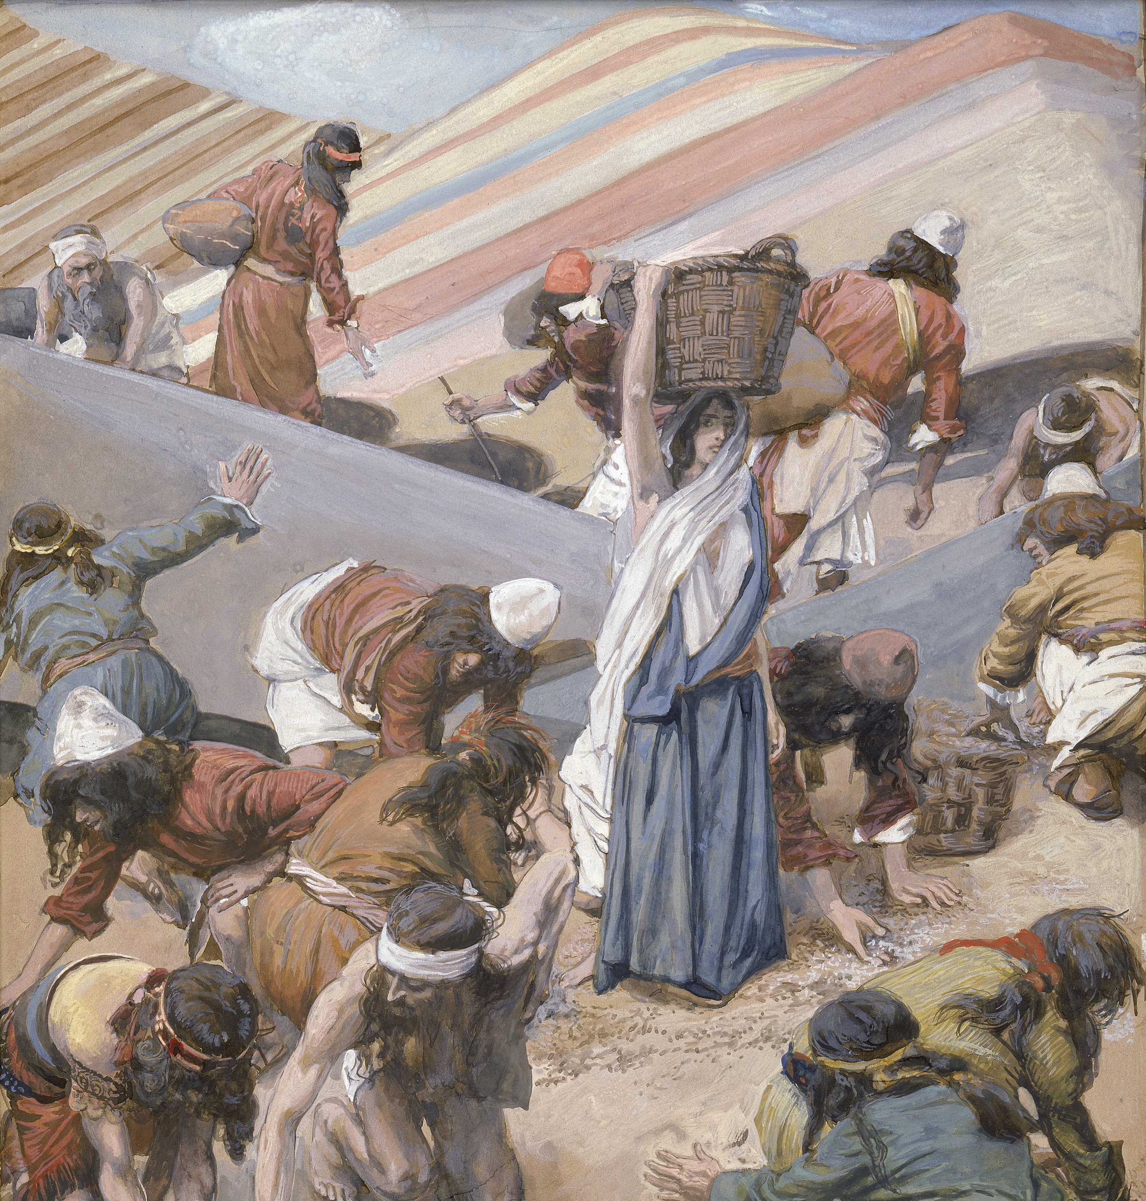
Exodus 16:6-9, 12
⁹ And Moses spake unto Aaron, Say unto all the congregation of the children of Israel, Come near before the Lord: for he hath heard your murmurings.

Slide 25
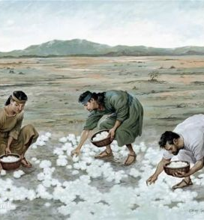
Exodus 16:6-9, 12
¹² I have heard the murmurings of the children of Israel: speak unto them, saying, At even ye shall eat flesh, and in the morning ye shall be filled with bread; and ye shall know that I am the Lord your God.

Slide 26
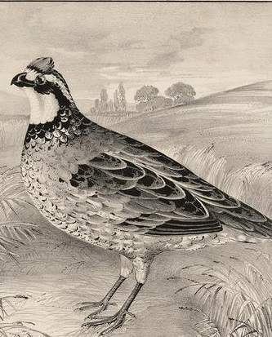
Exodus 16:13
9. What kind of flesh did they have at even?

Slide 27
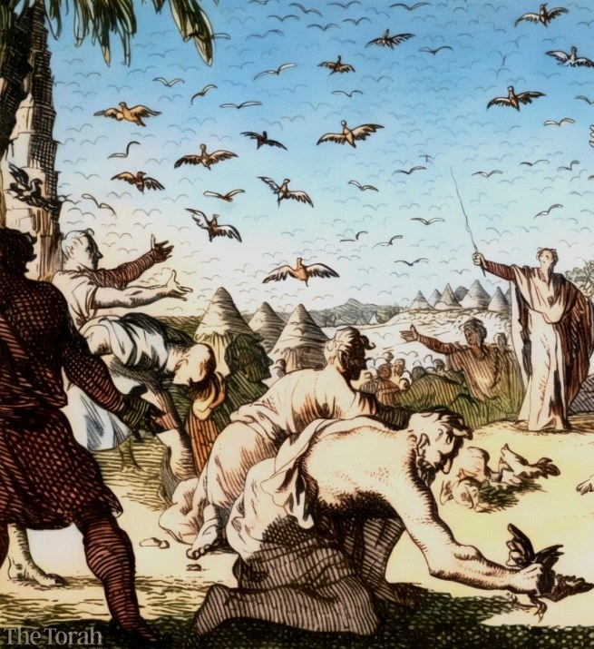
Exodus 16:13
¹³ And it came to pass, that at even the quails came up, and covered the camp: and in the morning the dew lay round about the host.

Slide 28
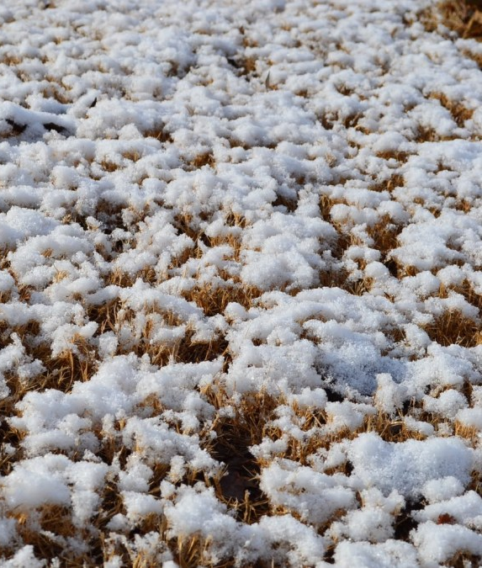
Exodus 16:14, 15
10. In the morning when the dew was gone what did they find?

Slide 29
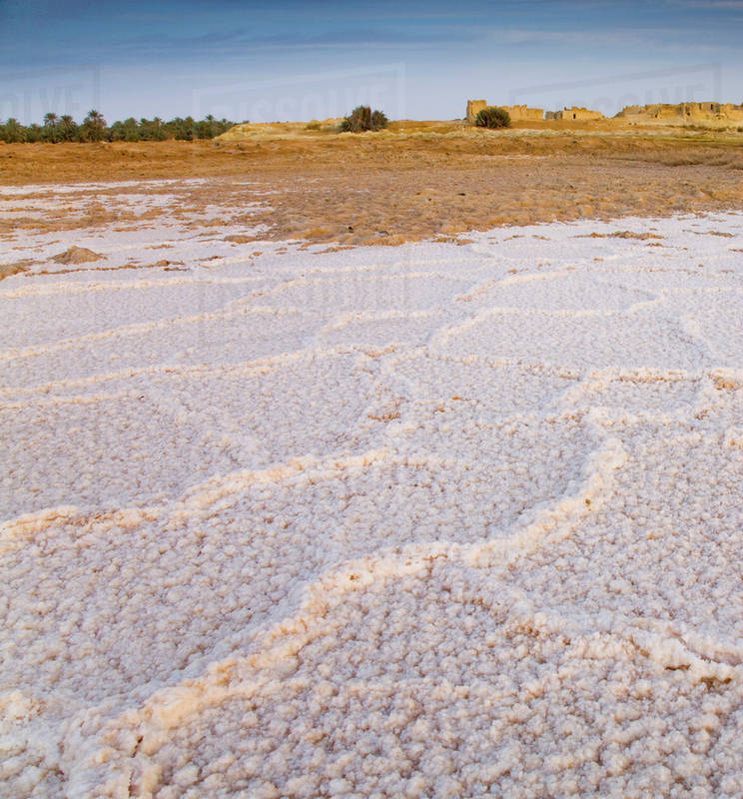
Exodus 16:14-15
¹⁴ And when the dew that lay was gone up, behold, upon the face of the wilderness there lay a small round thing, as small as the hoar frost on the ground.

Slide 30
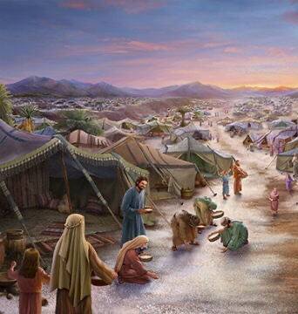
Exodus 16:14-15
¹⁵ And when the children of Israel saw it, they said one to another, It is manna: for they wist not what it was. And Moses said unto them, This is the bread which the Lord hath given you to eat.

Slide 31
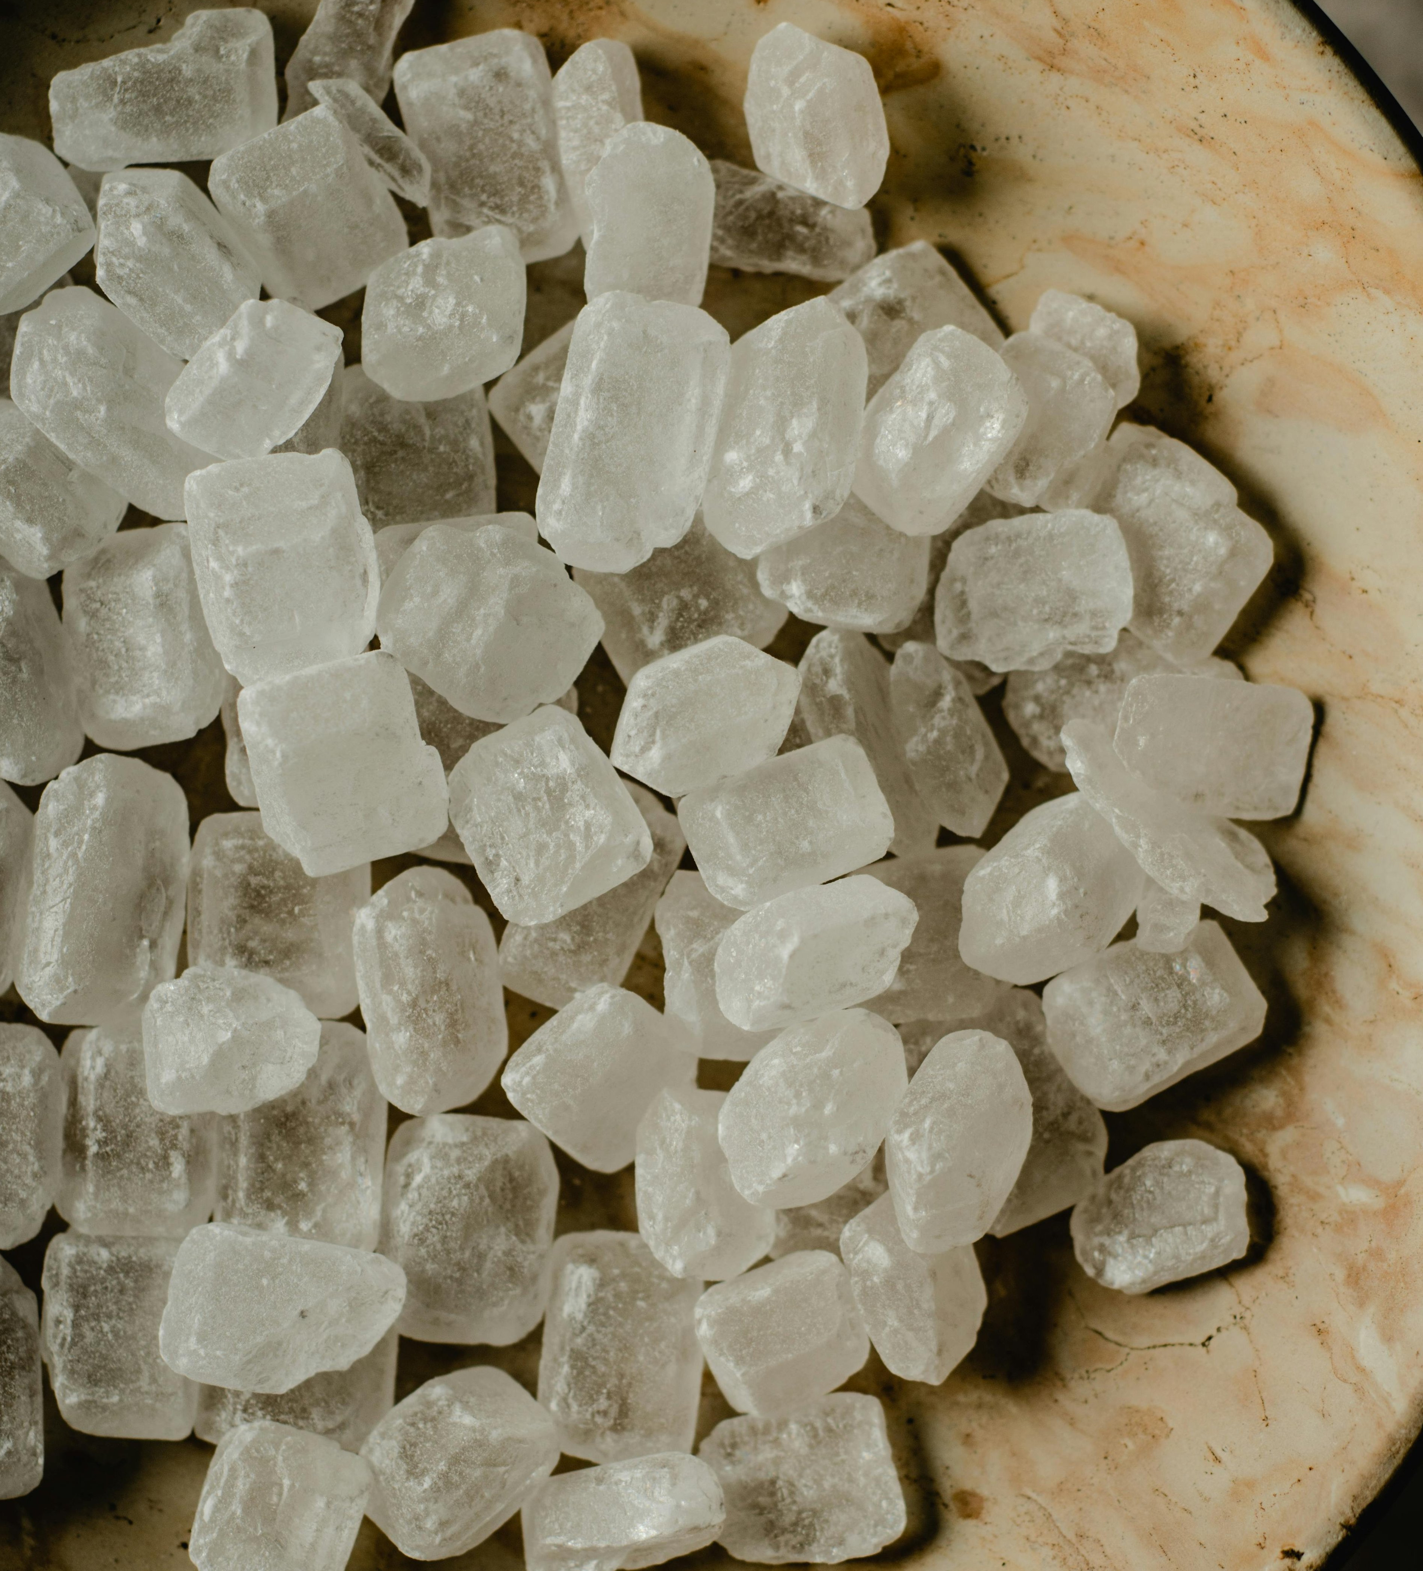
Numbers 11:7
11. Describe the manna.

Slide 32
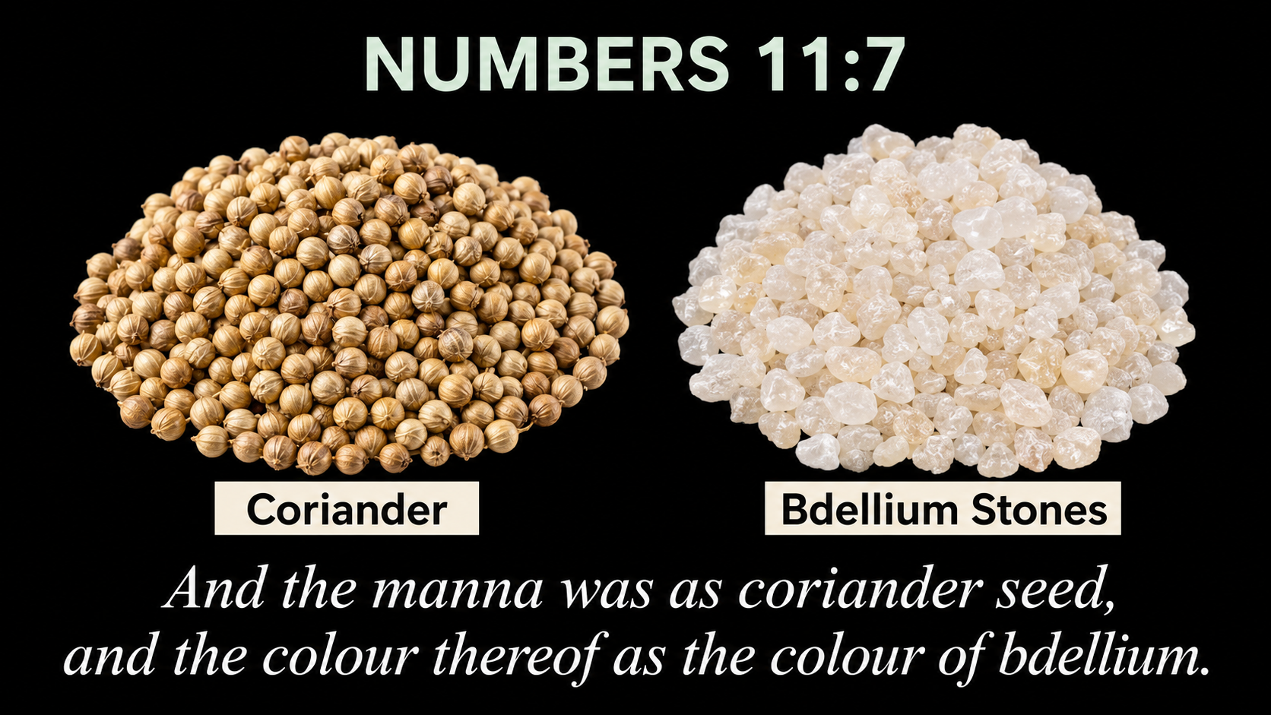

Slide 33


Slide 34

Description and Sanitary Delivery
The manna was the size of a coriander seed and the color of a white bedolach, which commentaries explain is a fine crystal.⁵
In order that the manna remain clean, a north wind would blow, sweeping the ground, and then rain would wash it. The ground would then be covered with a layer of dew, and the manna would fall upon it, after which the manna was covered with another layer of dew, as if it were packaged in a box.⁶

Slide 35
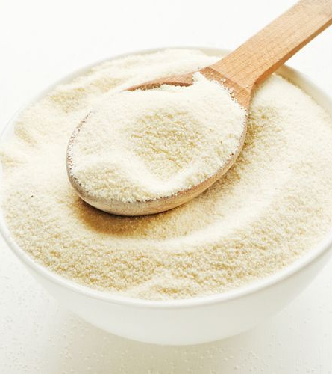
Numbers 11:8
12. How did they prepare it, and how did it taste?

Slide 36
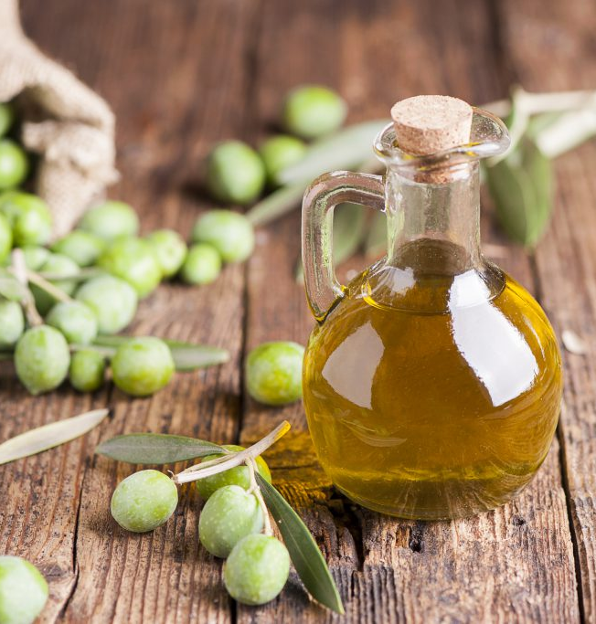
Numbers 11:8
⁸ And the people went about, and gathered it, and ground it in mills, or beat it in a mortar, and baked it in pans, and made cakes of it: and the taste of it was as the taste of fresh oil.

Slide 37
The Torah describes the taste as being similar to that of something fried in oil and honey. The manna was adapted to the taste of each individual; to the adult it tasted like the food of the adult, while it tasted like breastmilk for a baby. By wishing, one could taste in the manna anything desired, whether beef, fruit or grain.¹⁷
Interestingly, the Israelites later complained to Moses that they missed zucchini, watermelon, leeks, onions and garlic. If the manna could taste like anything in the world, why did they miss those vegetables?

Slide 38
The Talmud explains that since these vegetables could be harmful to lactating women, the manna didn’t taste like them. Another explanation is that while it could taste like those foods, it wouldn’t take on their texture, as it did with other foods.¹⁸
Being a heavenly food, the manna contained nutritious matter only and was fully absorbed by the body, so after consuming it the Israelites didn’t needed to expel any waste products.¹⁹

Slide 39
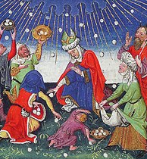
Exodus 16:16
13. How much were they to gather for each person?

Slide 40
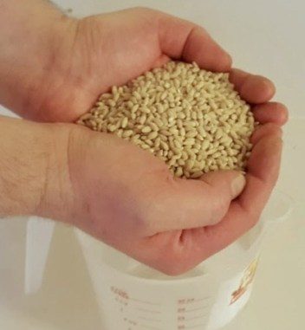
Exodus 16:16
¹⁶ This is the thing which the Lord hath commanded, Gather of it every man according to his eating, an omer for every man, according to the number of your persons; take ye every man for them which are in his tents.

Slide 41
Lessons in Faith—Limited Portion Sizes
The manna served as a great lesson in faith. Every day, enough manna would fall for each person to have an omer (approximately 43 oz.), which was enough to feel satiated for one day. One was not allowed to save the manna from one day to the next⁷—leftovers had to be discarded outside the tent,⁸ otherwise they would become wormy and inedible.⁹ This taught a great lesson in faith. Not having any reserves, the Israelites had to have full faith in G‑d that He would provide their needs each day.¹⁰

Slide 42
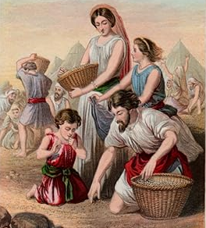
Exodus 16:17-18
14. How was it if some gathered too much or not enough?

Slide 43
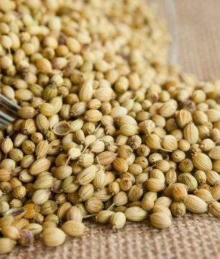
Exodus 16:17-18
¹⁷ And the children of Israel did so, and gathered, some more, some less.

Slide 44
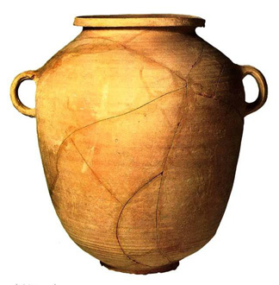
Exodus 16:17-18
¹⁸ And when they did mete it with an omer, he that gathered much had nothing over, and he that gathered little had no lack; they gathered every man according to his eating.

Slide 45
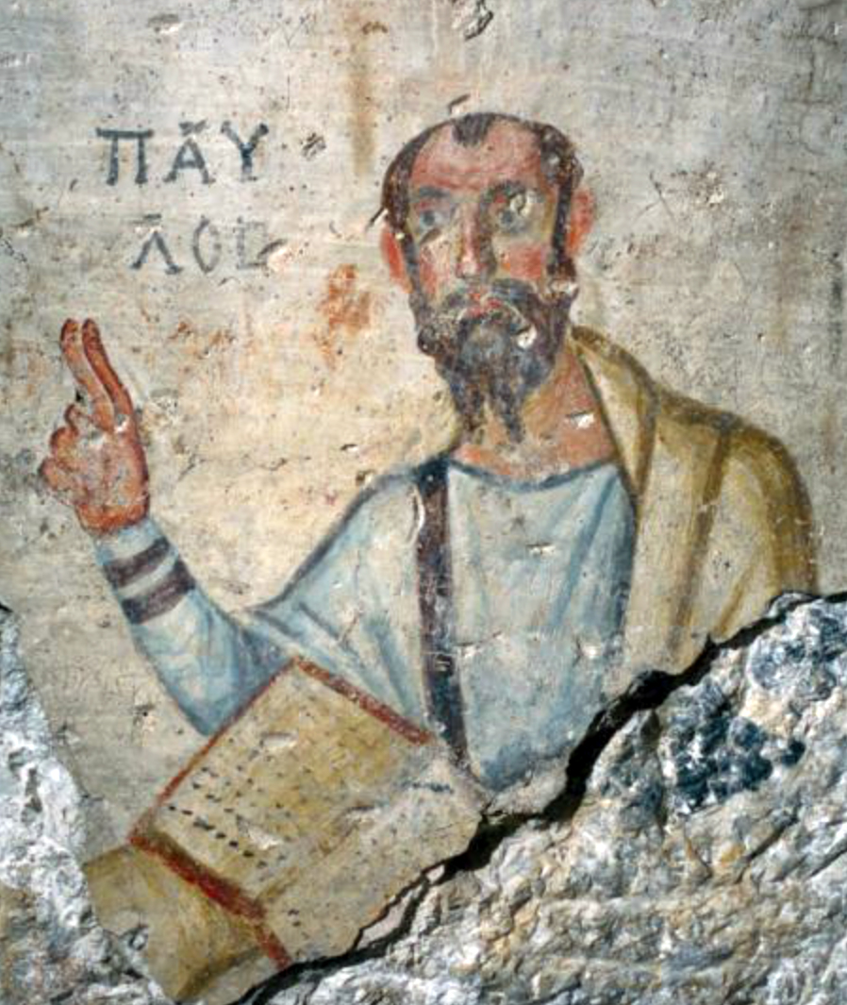
2 Corinthians 8:13-15
15. What practical lesson does the apostle Paul draw from this?

Slide 46
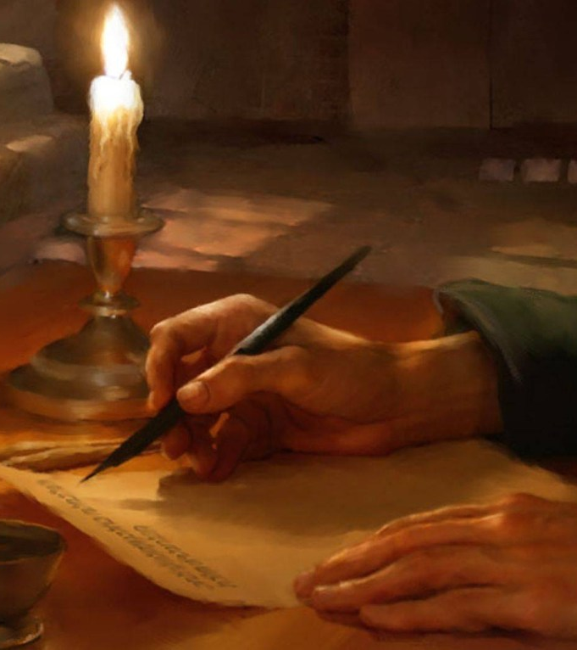
2 Corinthians
8:13-15
¹³ For I mean not that other men be eased, and ye burdened:

Slide 47
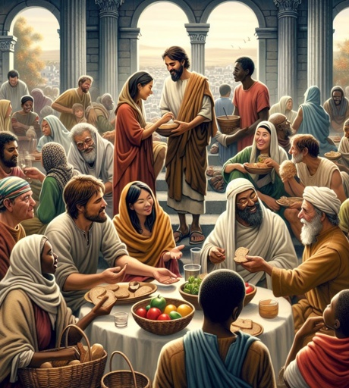
2 Corinthians 8:13-15
¹⁴ But by an equality, that now at this time your abundance may be a supply for their want, that their abundance also may be a supply for your want: that there may be equality:

Slide 48
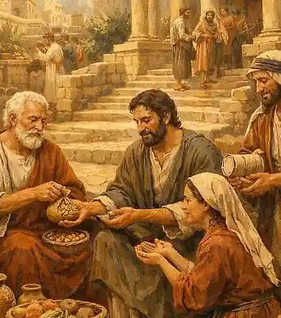
2 Corinthians 8:13-15
¹⁵ As it is written, He that had gathered much had nothing over; and he that had gathered little had no lack.

Slide 49

Exodus 16:19, 20
16. What took place if they tried to keep the manna till the next day?

Slide 50
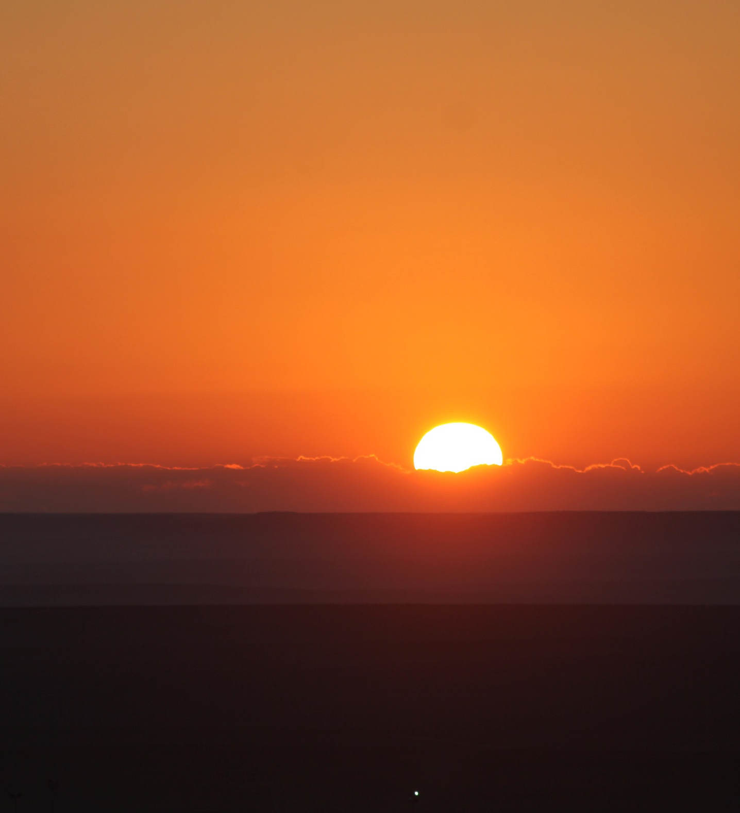
Exodus 16:19, 20
¹⁹ And Moses said, Let no man leave of it till the morning.

Slide 51
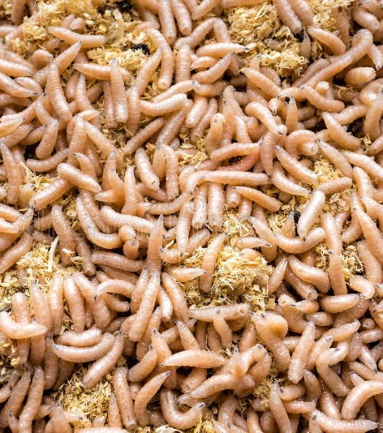
Exodus 16:19, 20
²⁰ Notwithstanding they hearkened not unto Moses; but some of them left of it until the morning, and it bred worms, and stank: and Moses was wroth with them.

Slide 52

Exodus 16:22
17. On the sixth day what did they do?

Slide 53
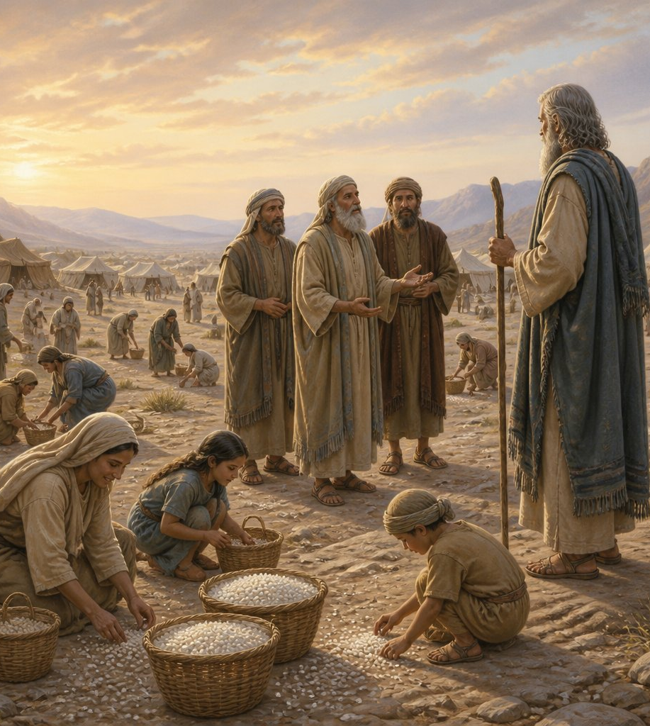
Exodus 16:22
²² And it came to pass, that on the sixth day they gathered twice as much bread, two omers for one man: and all the rulers of the congregation came and told Moses.

Slide 54
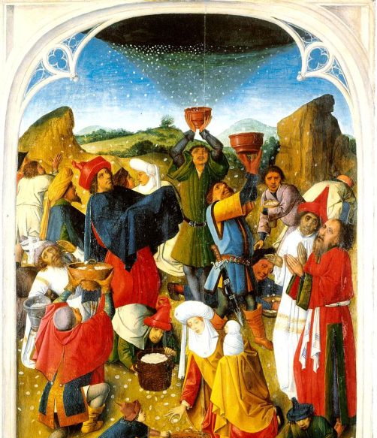
Exodus 16:5
18. What instruction had they received on this point?

Slide 55

Exodus 16:5
⁵ And it shall come to pass, that on the sixth day they shall prepare that which they bring in; and it shall be twice as much as they gather daily.

Slide 56
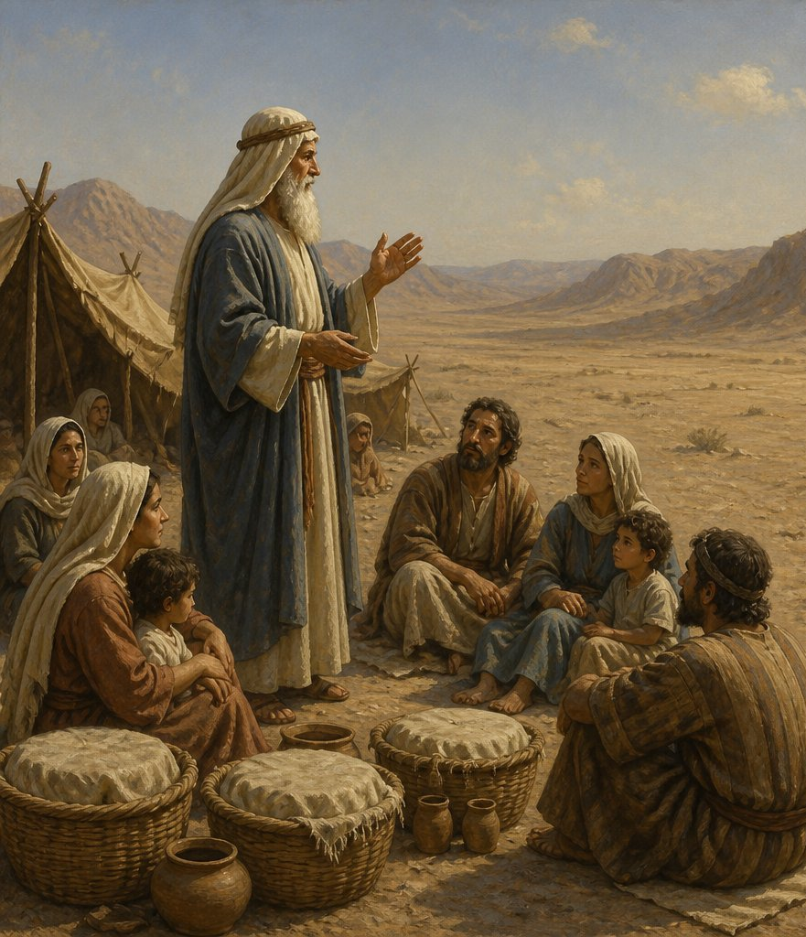
Exodus 16:23
19. What did Moses say to them on that day?

Slide 57
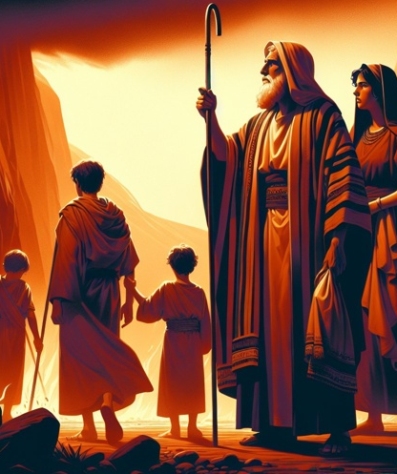
Exodus 16:23
²³ And he said unto them, This is that which the Lord hath said, To morrow is the rest of the holy sabbath unto the Lord: bake that which ye will bake to day, and seethe that ye will seethe; and that which remaineth over lay up for you to be kept until the morning.

Slide 58
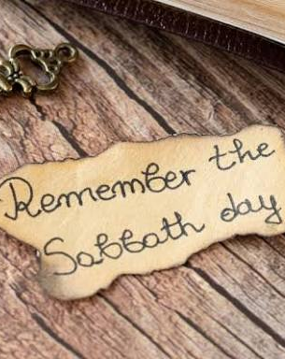
Exodus 16:26
20. Did any manna fall on the Sabbath?

Slide 59

Exodus 16:26
²⁶ Six days ye shall gather it; but on the seventh day, which is the sabbath, in it there shall be none.

Slide 60
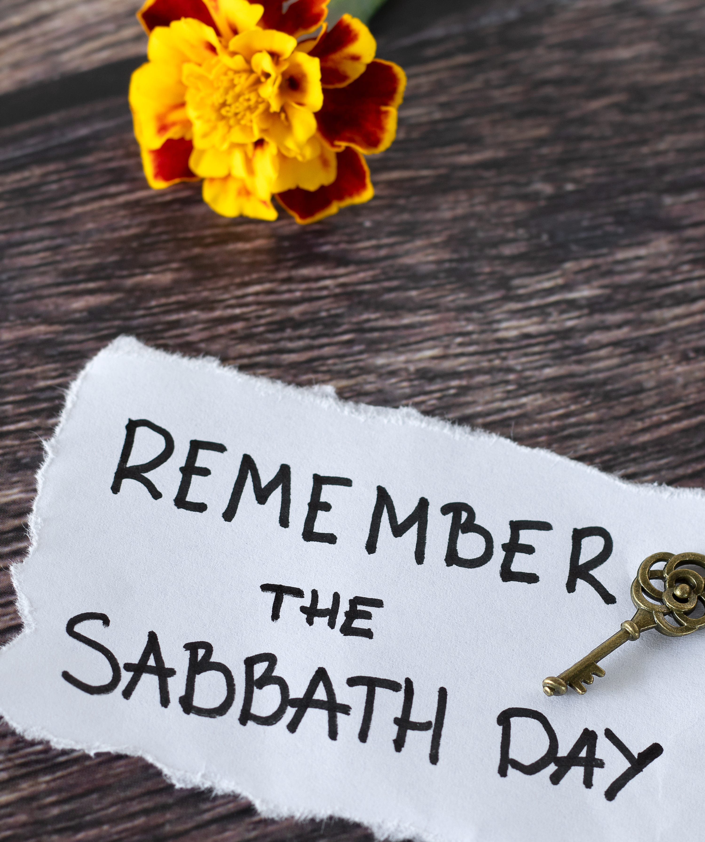
Exodus 16:23, 24, 29
21. How were they provided with food on that day?

Slide 61

Exodus 16:23, 24, 29
²³ And he said unto them, This is that which the Lord hath said, To morrow is the rest of the holy sabbath unto the Lord: bake that which ye will bake to day, and seethe that ye will seethe; and that which remaineth over lay up for you to be kept until the morning.

Slide 62

Exodus 16:23, 24, 29
²⁴ And they laid it up till the morning, as Moses bade: and it did not stink, neither was there any worm therein.

Slide 63

Exodus 16:23, 24, 29
²⁹ See, for that the Lord hath given you the sabbath, therefore he giveth you on the sixth day the bread of two days; abide ye every man in his place, let no man go out of his place on the seventh day.

Slide 64

Exodus 16:27
22. What did some of the people do on the seventh day?

Slide 65
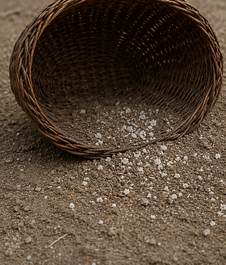
Exodus 16:27
²⁷ And it came to pass, that there went out some of the people on the seventh day for to gather, and they found none.

Slide 66

Exodus 16:28
23. What reproof did the Lord give them?

Slide 67
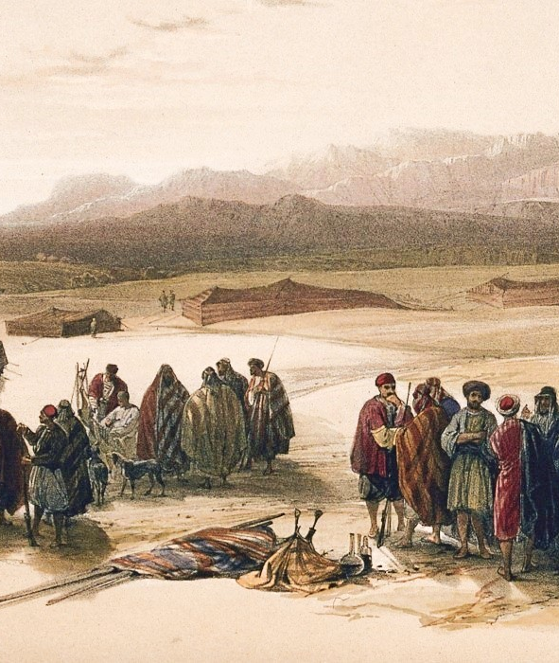
Exodus 16:28
²⁸ And the Lord said unto Moses, How long refuse ye to keep my commandments and my laws?

Slide 68
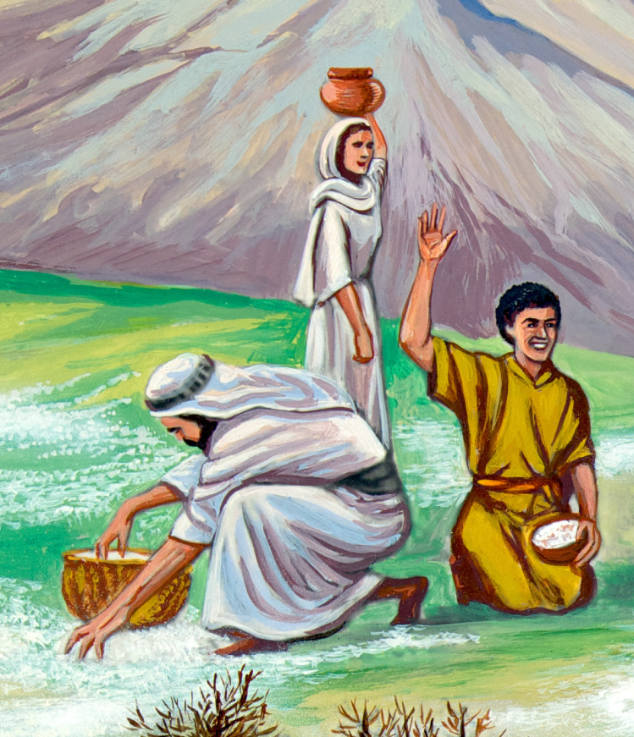
Exodus 16:35
24. How long did the children of Israel eat the manna?

Slide 69

Exodus 16:35
³⁵ And the children of Israel did eat manna forty years, until they came to a land inhabited; they did eat manna, until they came unto the borders of the land of Canaan.

Slide 70

25. Show how they could not by any possibility have made a mistake in regard to the Sabbath in that time.

Slide 71
Double Portion for Shabbat
On the first Friday after the manna started falling, the Israelites went out and discovered that there was a double portion for each person. Moses explained that the extra portion was for Shabbat, the day of rest, on which no manna would fall.¹¹ To commemorate this double portion, on Shabbat we make the Hamotzi blessing on two loaves of bread.¹² This also serves as a reminder that just as the manna came from heaven, so, too, our livelihood is ultimately dependent upon G‑d.

Slide 72

26. In giving the manna, what purpose did God effect besides supplying the children of Israel with food?

Slide 73
Three Tiers of Delivery and Readiness
The manna would fall in such a way that the righteous would find it at the doors of their tents; the average people had to go out of the camp to gather what fell there; and the wicked had to go far out to find their portions.¹³
Additionally, for the righteous it fell ready-to-eat, similar to baked bread; for the average person, it fell as unbaked cakes, requiring minimal preparation; and for the wicked it came in an unprocessed form, and consequently they had to grind it in a mill.¹⁴

Slide 74
A person had until the fourth hour of the day to collect the manna, after which it would melt in the heat of the sun.¹⁵ The Midrash relates that the melting manna would create streams that provided drinking water for many of the animals in the wilderness. If a member of a nearby nation would then eat one of those animals that had drunk from the manna-infused streams, he would be able to get a taste of the manna.¹⁶

Slide 75
The Manna Used as a Means of Adjudication
The Talmud relates that the manna was used to adjudicate many quarrels. For example, if two people came before Moses for a judgment, one saying, “You stole my servant,” and the other one saying, “I did not steal him, rather you sold him to me,” Moses would say to them, “In the morning, there will be a judgment.” How was the matter resolved? If on the following day the servant found his omer of manna in his first master’s house, it would be clear that he was stolen, because the manna still came to the first owner. And if on the following day he found his omer of manna in his second master’s house, it would be clear that he had been sold.²²

Slide 76
Jewelry and Other Bonuses
According to tradition, together with the manna, all sorts of precious gems and pearls would fall.²⁰ Additionally, it gave off a fragrant odor, and during the 40 years that the Israelites wandered in the wilderness, it served as perfume for the women.²¹

Slide 77
A Jug of Manna Is Hidden Away
G‑d commanded Moses that a portion of manna be kept throughout the generations so that the Jews would see how G‑d sustained us in the desert. Aaron collected some manna and put it in a jar inside the Holy of Holies.²⁴ The Midrash relates that it remained there for many years, and in the days of the prophet Jeremiah, when Jeremiah rebuked the Jews, saying, “Why do you not engage in the Torah?”

Slide 78
They answered, “Should we leave our work and engage in the Torah? From what will we support ourselves?” He brought out the jar of manna and said to them, “You see the word of the L‑rd.”²⁵
It does not say “hear” but “see.” In other words, Jeremiah was saying, “With this, your ancestors supported themselves. G‑d has many agents to prepare food for those who revere Him.”²⁶
[A reference to Jeremiah 2:31, which does say, “see ye the word of the LORD,” although the biblical context is quite different from the exchange described here.]

Slide 79
Our sages tell us that “when King Solomon built the Holy Temple, knowing that it was destined to be destroyed, he built a place in which to hide the Ark, at the end of hidden, deep, winding passageways.”
Ultimately, 22 years before the destruction of the First Temple, King Josiah hid the jug of manna together with the Ark in that special hidden passage.²⁷
According to tradition, it is still hidden there, waiting to be rediscovered with the advent of Moshiach [Messiah].

Slide 80

Psalm 78:24, 25
27. What does the psalmist say this manna was?

Slide 81

Psalm 78:24, 25
²⁴ And had rained down manna upon them to eat, and had given them of the corn of heaven.
²⁵ Man did eat angels' food: he sent them meat to the full.

Slide 82

John 6:48-51, 58
28. Of what was it a type?

Slide 83

John 6:48-51, 58
⁴⁸ I am that bread of life.
⁴⁹ Your fathers did eat manna in the wilderness, and are dead.

Slide 84

John 6:48-51, 58
⁵⁰ This is the bread which cometh down from heaven, that a man may eat thereof, and not die.

Slide 85

John 6:48-51, 58
⁵¹ I am the living bread which came down from heaven: if any man eat of this bread, he shall live for ever: and the bread that I will give is my flesh, which I will give for the life of the world.

Slide 86

John 6:48-51, 58
⁵⁸ This is that bread which came down from heaven: not as your fathers did eat manna, and are dead: he that eateth of this bread shall live for ever.

Slide 87


Slide 88



Slide 89


