Slide 1


Slide 2


Slide 3

Water from the rock
Lesson 10: March 9, 1889

Slide 4
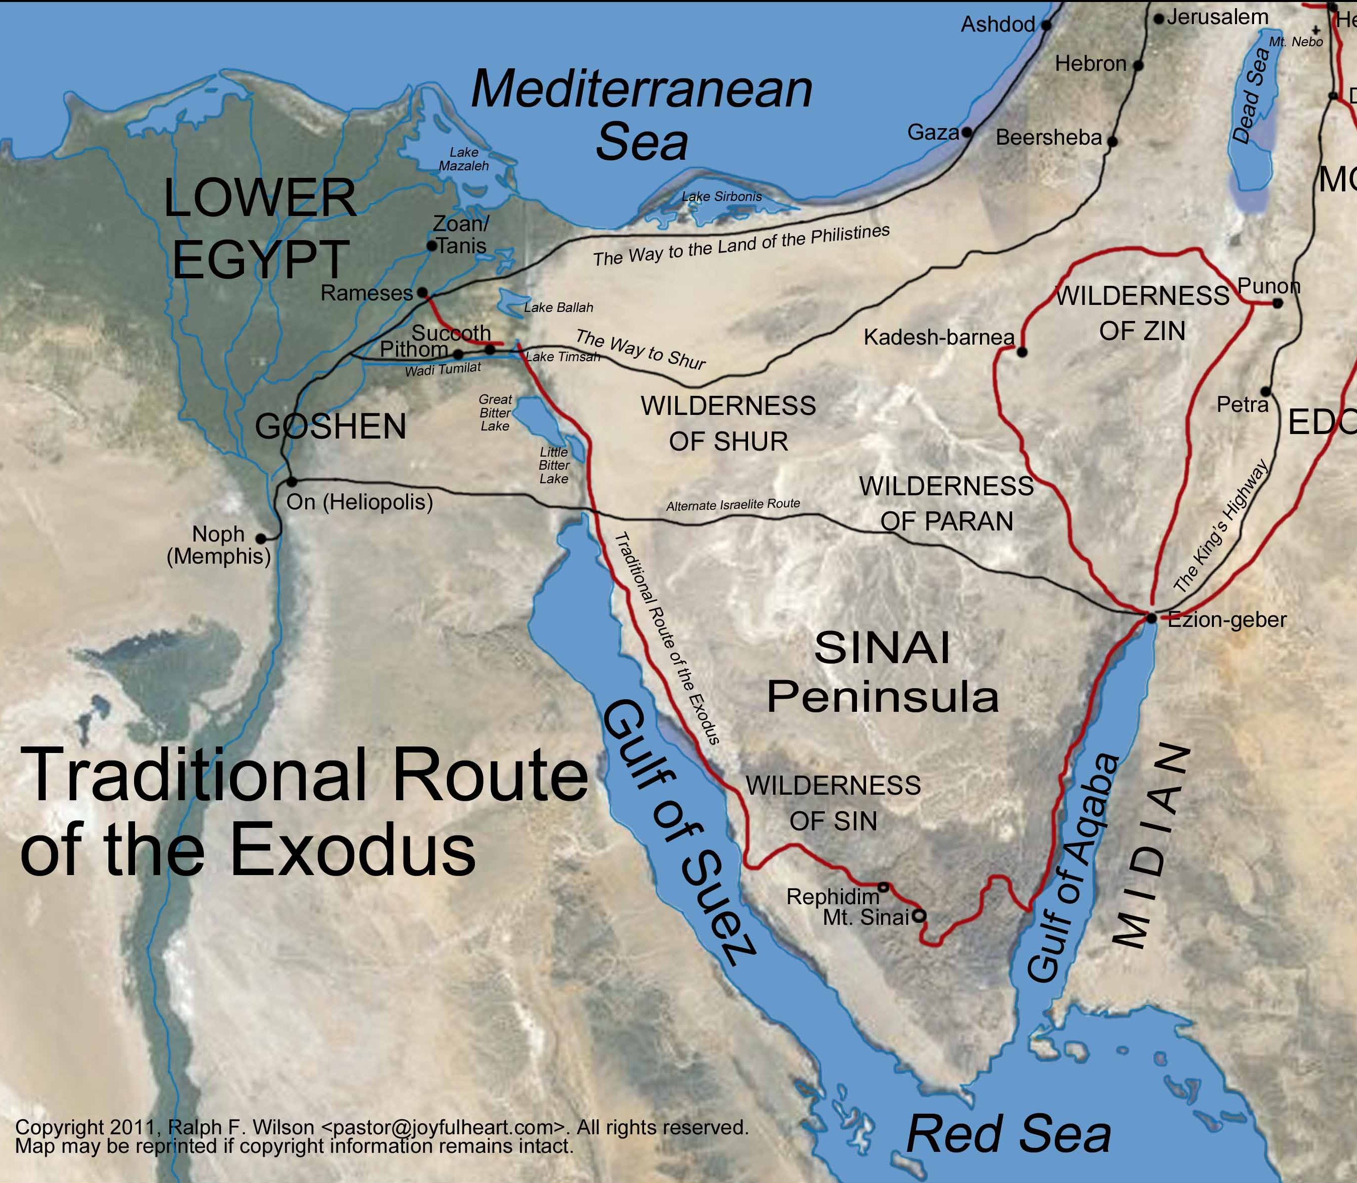
1. Relate the instances already learned, in which God miraculously interposed to deliver his people.

Slide 5
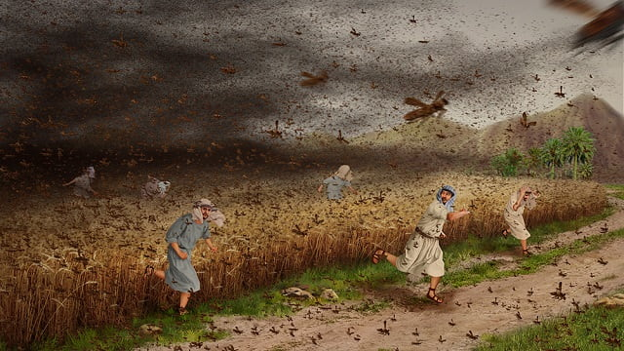
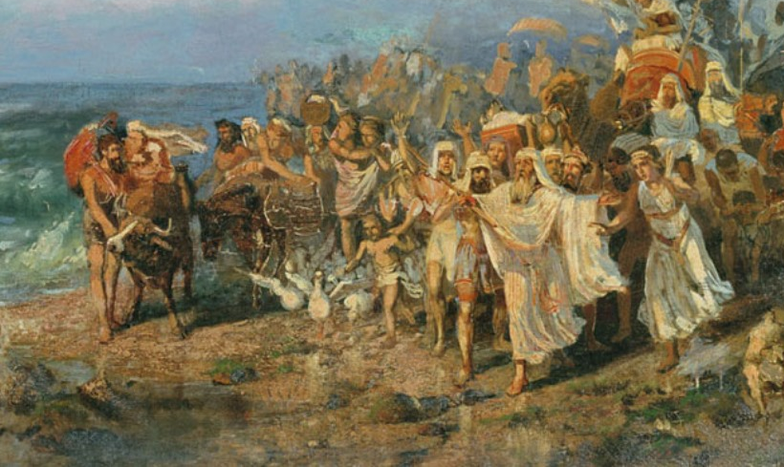
Protected in the plagues
Freed from slavery

Slide 6
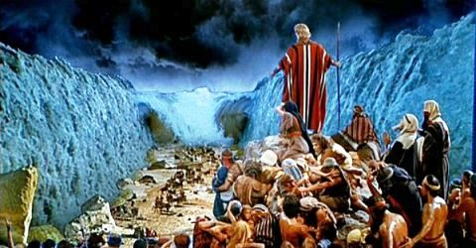
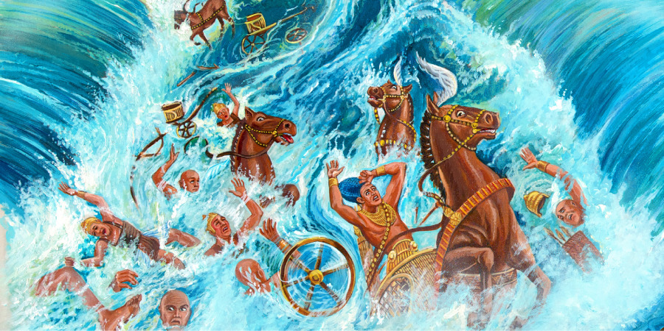
Brought through the Red Sea
Saved from Pharaoh

Slide 7
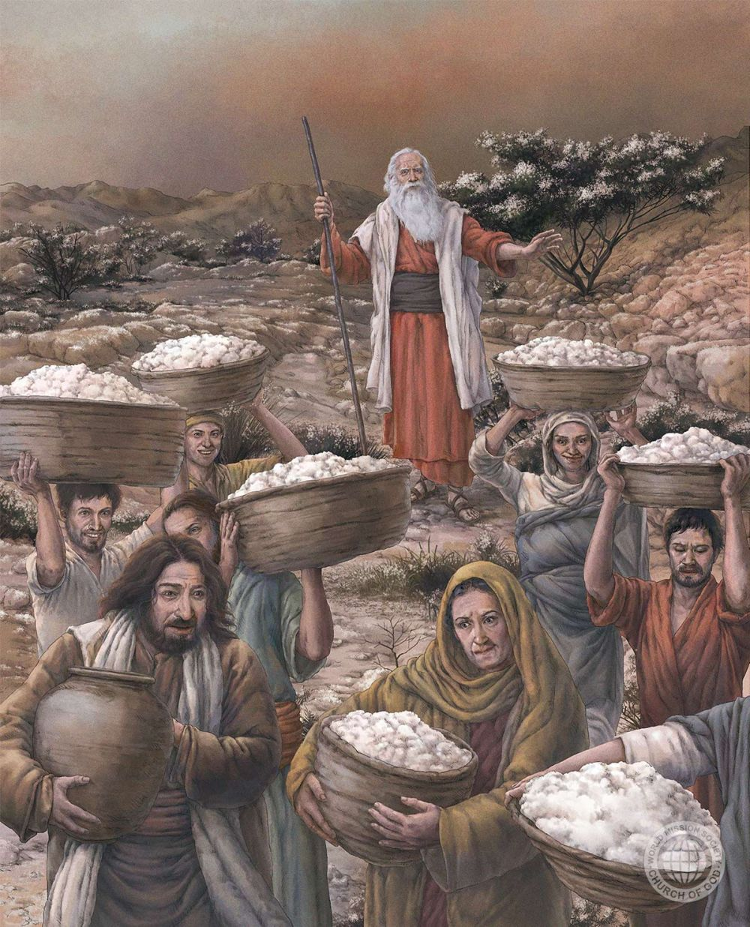
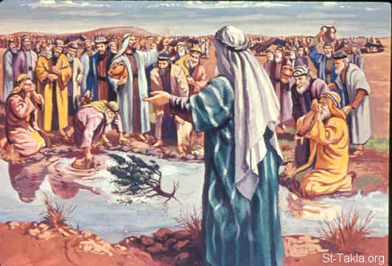
Provided with sweet water
Given quail and manna

Slide 8
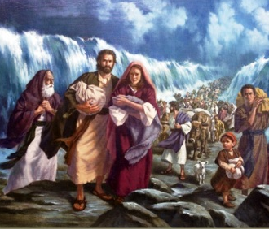
2. After all these deliverances, how should they have felt?

Slide 9
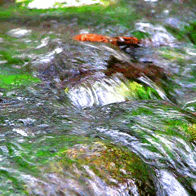
Exodus 17:1
3. Into what straits were they brought in their next encampment, after the giving of the manna?

Slide 10
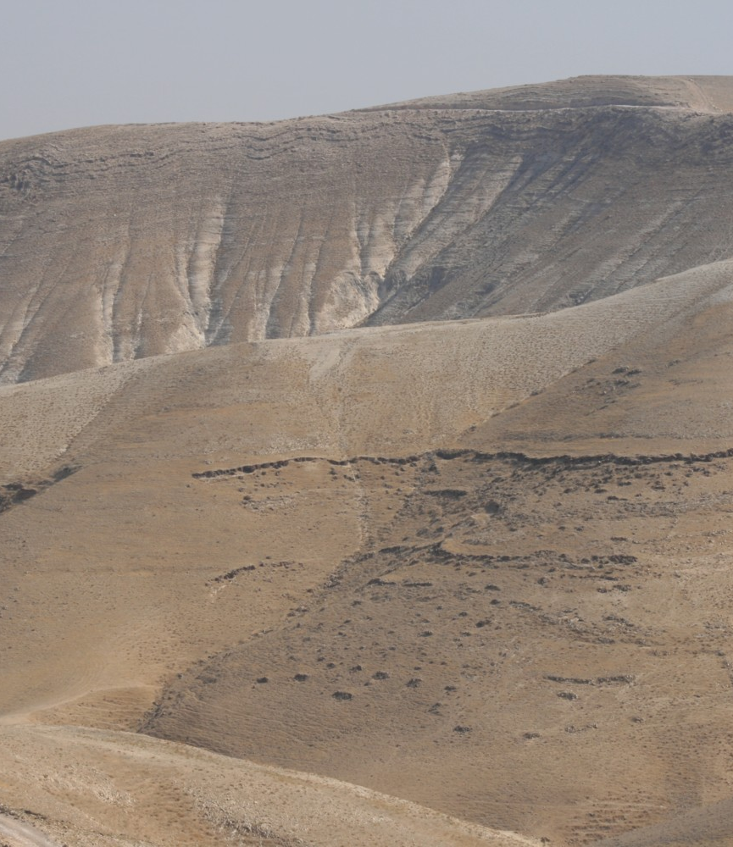
Exodus 17:1
17 And all the congregation of the children of Israel journeyed from the wilderness of Sin, after their journeys, according to the commandment of the Lord, and pitched in Rephidim: and there was no water for the people to drink.

Slide 11
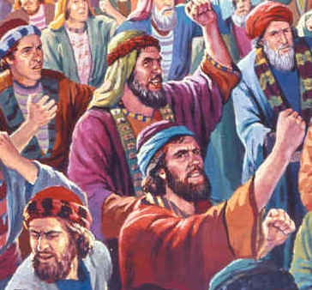
Exodus 17:2
4. What did they do?

Slide 12
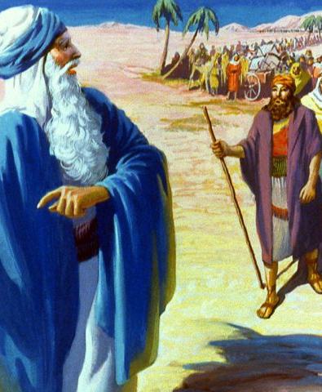
Exodus 17:2
² Wherefore the people did chide with Moses, and said, Give us water that we may drink. And Moses said unto them, Why chide ye with me? wherefore do ye tempt the Lord?

Slide 13
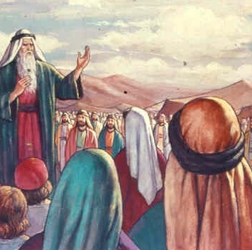
Exodus 17:3
5. With what did they again charge Moses?

Slide 14
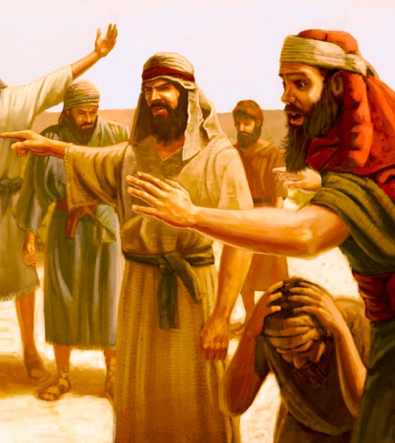
Exodus 17:3
³ And the people thirsted there for water; and the people murmured against Moses, and said, Wherefore is this that thou hast brought us up out of Egypt, to kill us and our children and our cattle with thirst?

Slide 15
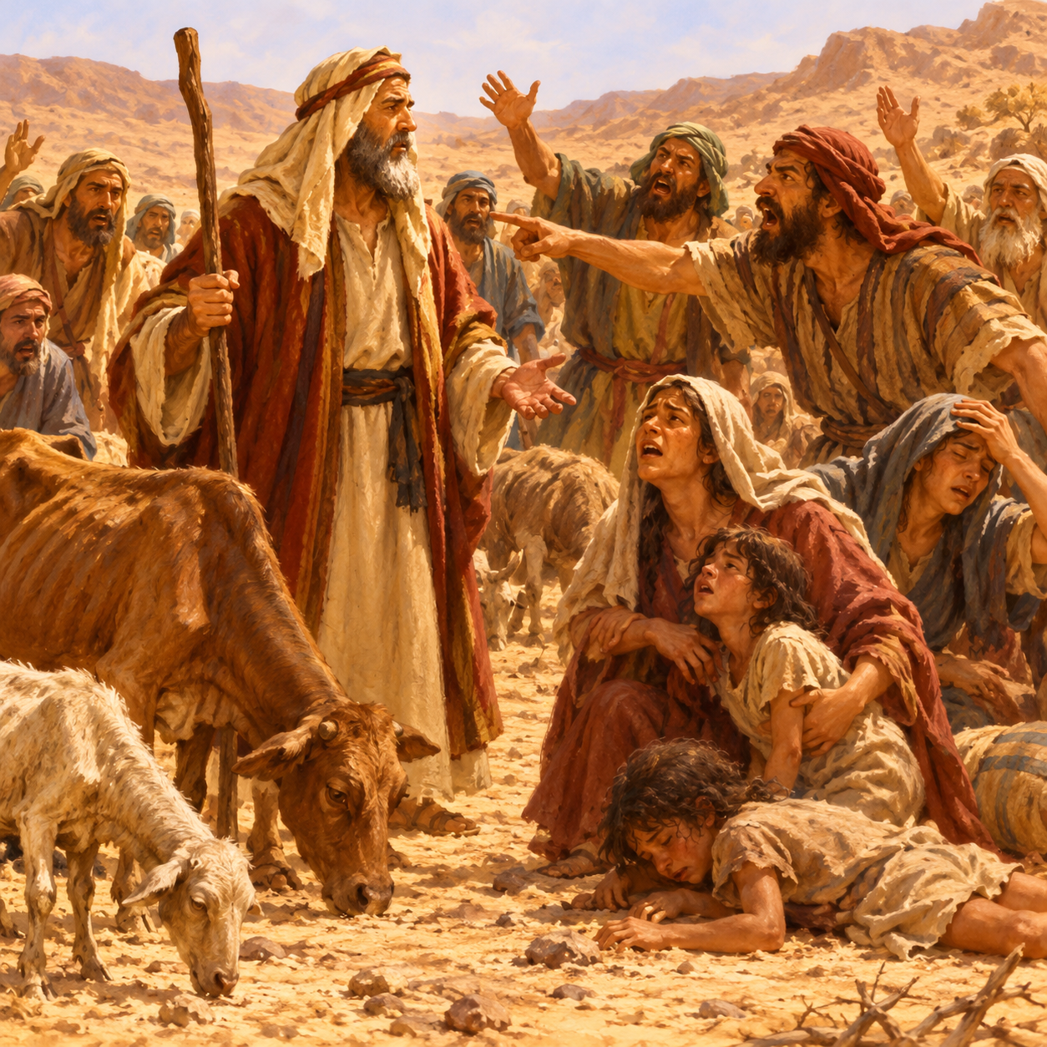
Exodus 17:4
6. What were they about to do to him?

Slide 16
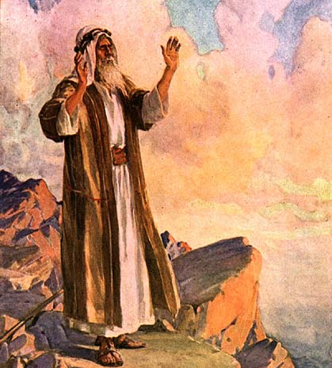
Exodus 17:4
⁴ And Moses cried unto the Lord, saying, What shall I do unto this people? they be almost ready to stone me.

Slide 17
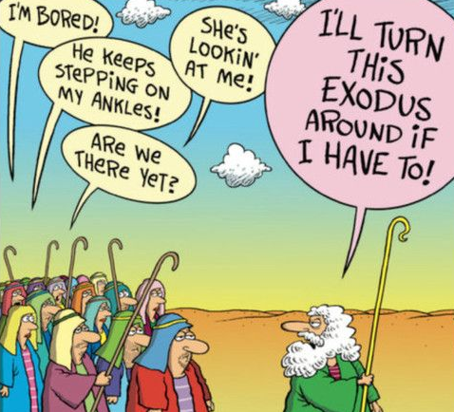
Exodus 17:2
7. Against whom were they really murmuring?

Slide 18
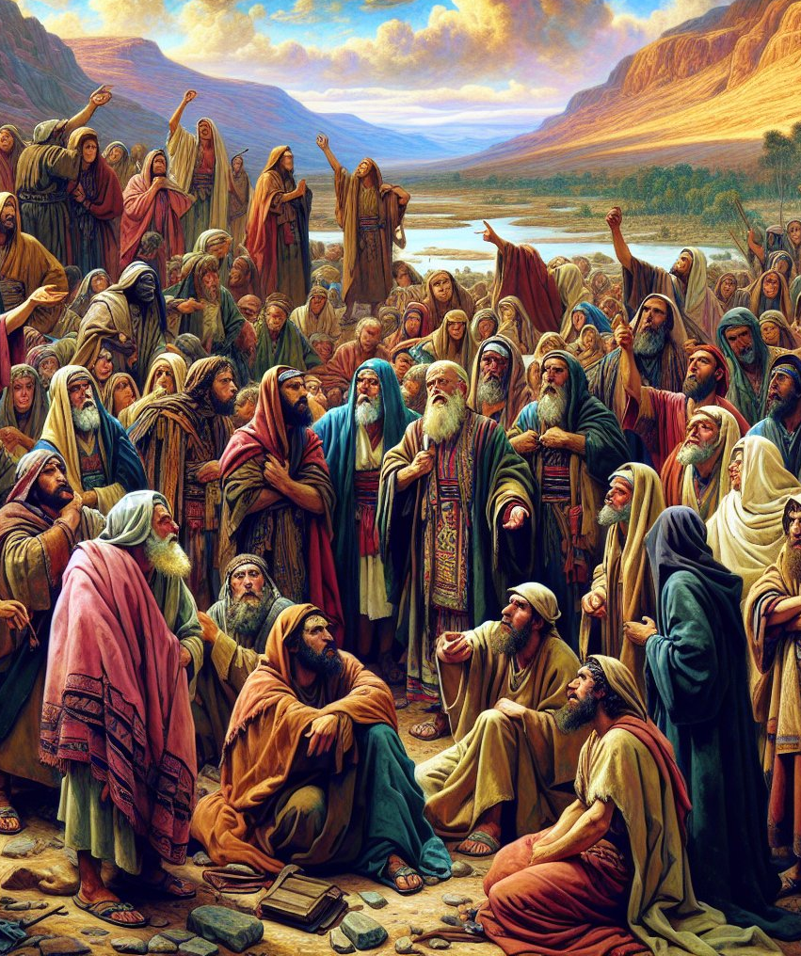
Exodus 17:2
² Wherefore the people did chide with Moses, and said, Give us water that we may drink. And Moses said unto them, Why chide ye with me? wherefore do ye tempt the Lord?

Slide 19
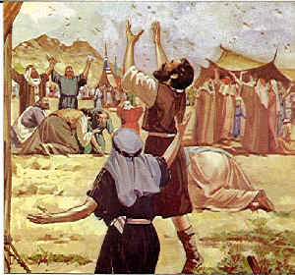
Exodus 17:7
8. What doubt was indicated by their murmuring?

Slide 20
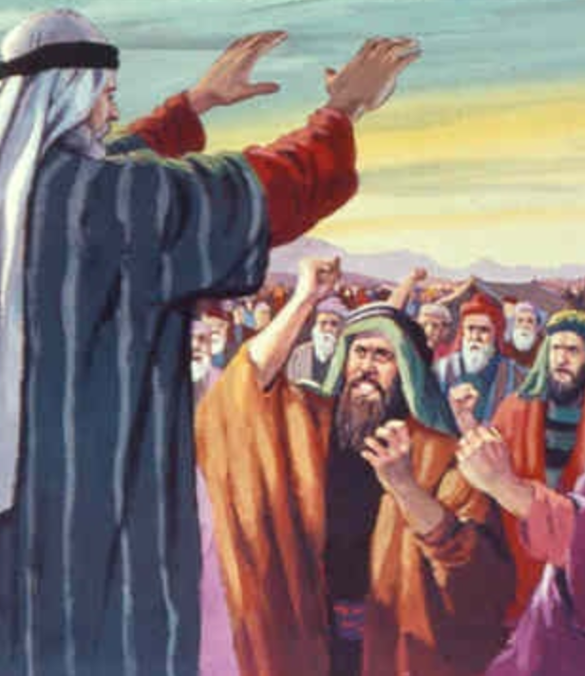
Exodus 17:7
⁷ And he called the name of the place Massah, and Meribah, because of the chiding of the children of Israel, and because they tempted the Lord, saying, Is the Lord among us, or not?

Slide 21
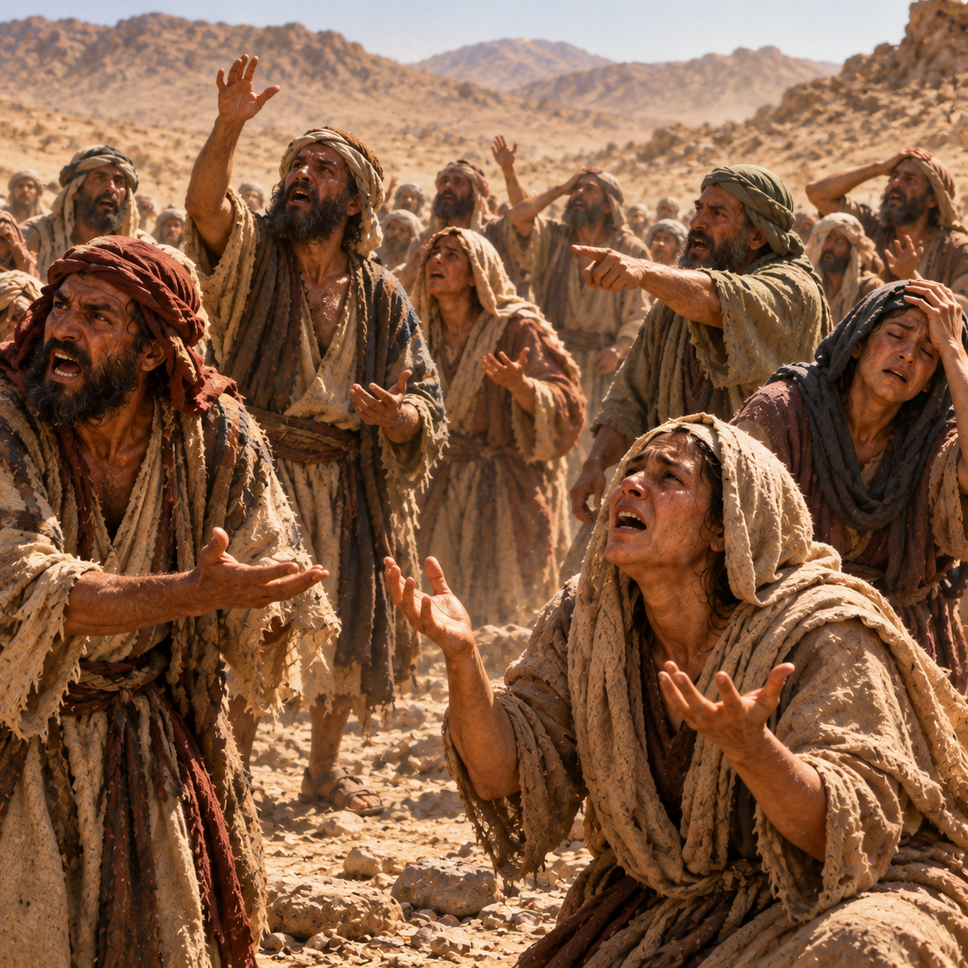
9. What did they thereby virtually say about the wonderful miracles that they had witnessed?

Slide 22
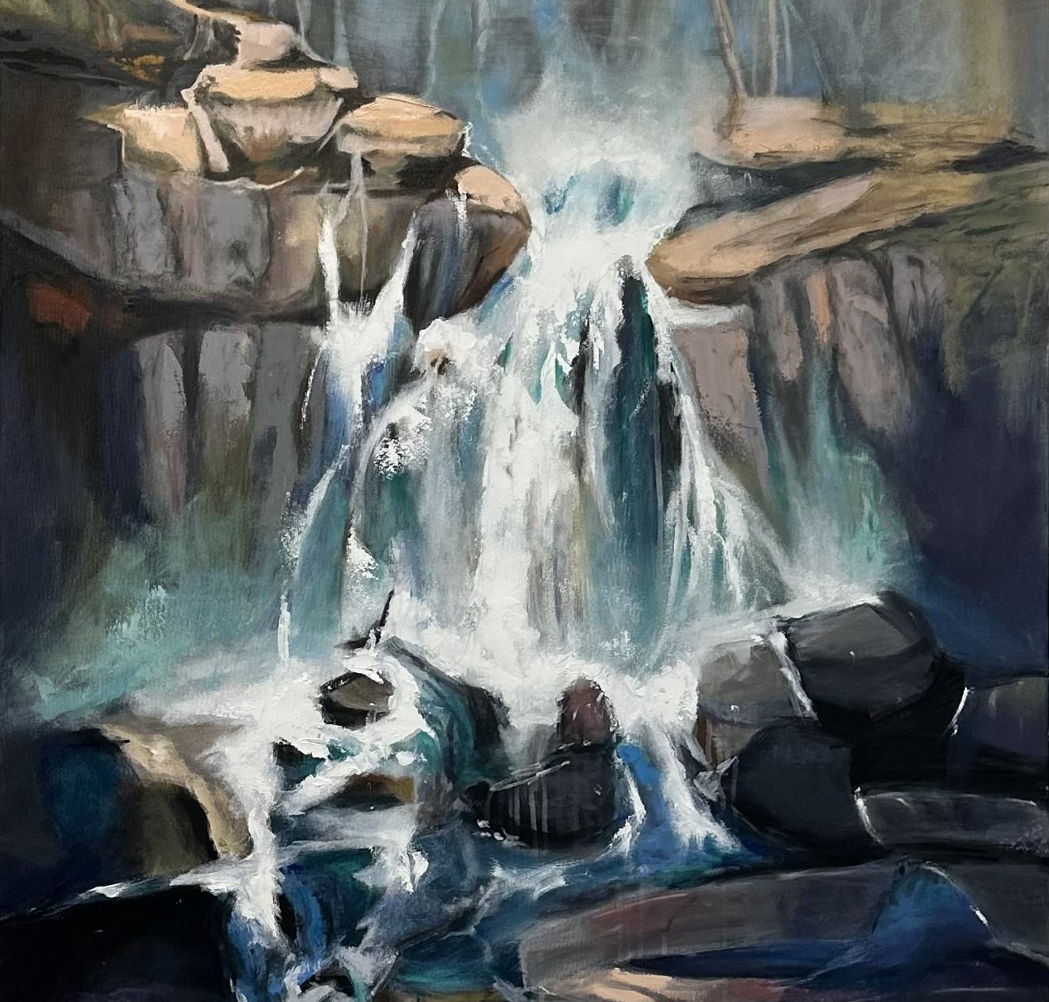
Exodus 17:5, 6
10. How did the Lord provide for them on this occasion?

Slide 23
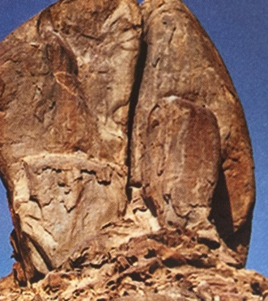
Exodus 17:5-6
⁵ And the Lord said unto Moses, Go on before the people, and take with thee of the elders of Israel; and thy rod, wherewith thou smotest the river, take in thine hand, and go.

Slide 24
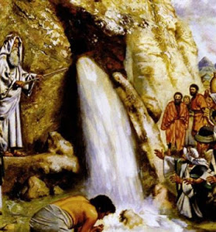
Exodus 17:5-6
⁶ Behold, I will stand before thee there upon the rock in Horeb; and thou shalt smite the rock, and there shall come water out of it, that the people may drink. And Moses did so in the sight of the elders of Israel.

Slide 25
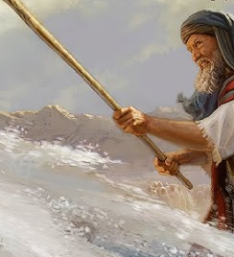
Psalm 78:15, 16
11. What graphic description does the psalmist give of this?

Slide 26
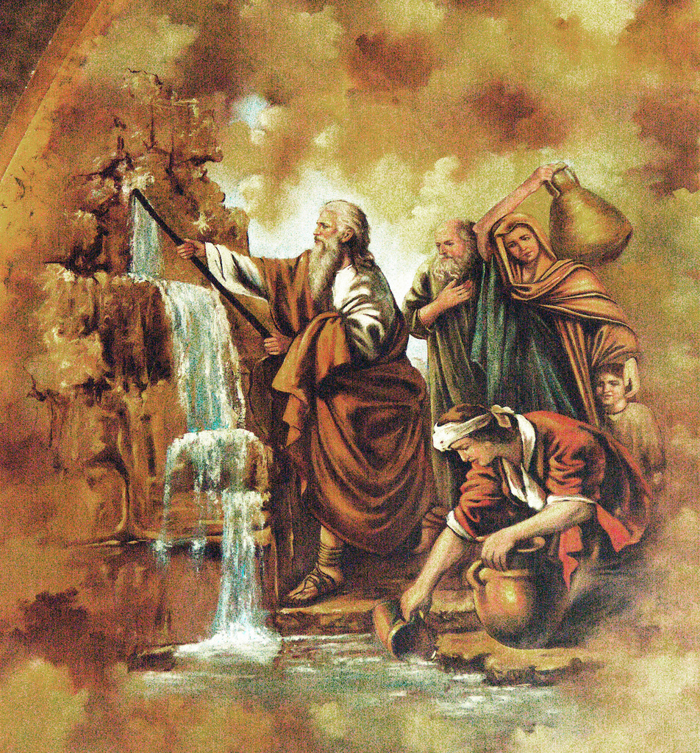
Psalm 78:15, 16
¹⁵ He clave the rocks in the wilderness, and gave them drink as out of the great depths.

Slide 27
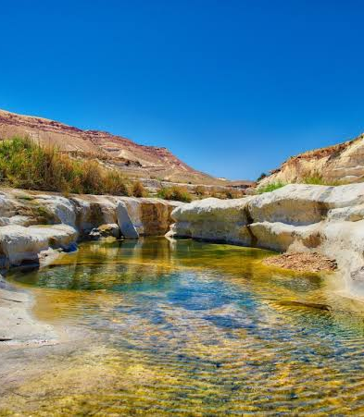
Psalm 78:15, 16
¹⁶ He brought streams also out of the rock, and caused waters to run down like rivers.

Slide 28
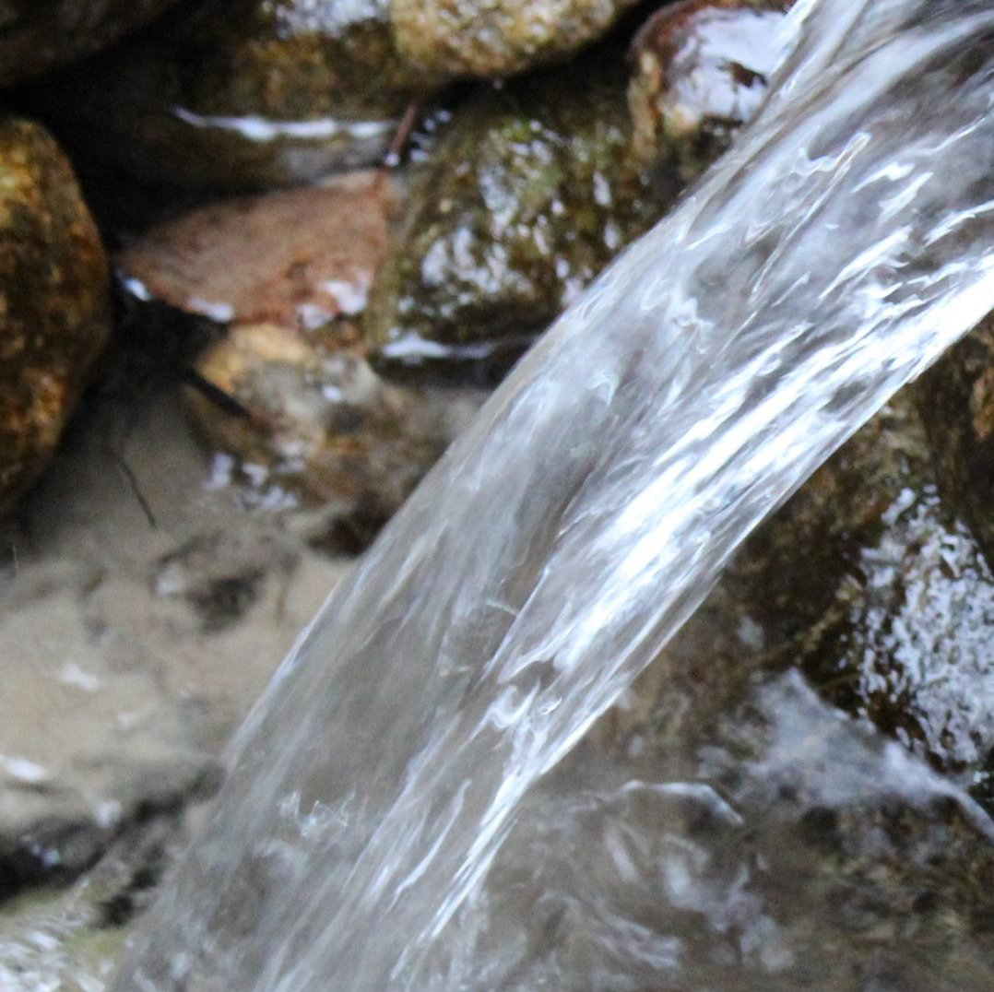
1 Corinthians 10:4
12. Of what was their drinking water from the rock an emblem?

Slide 29
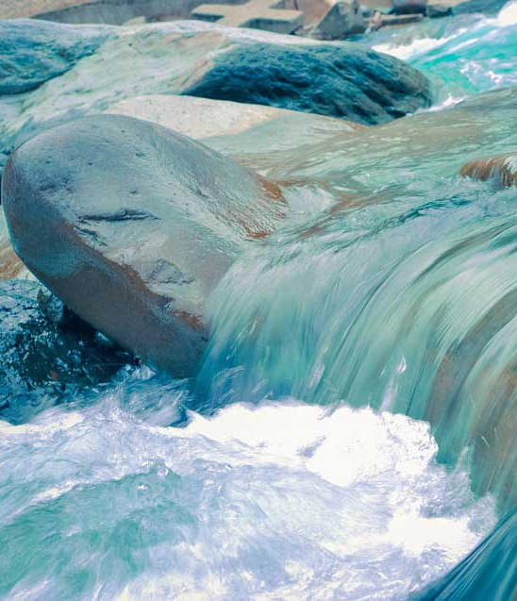
1 Corinthians 10:4
⁴ And did all drink the same spiritual drink: for they drank of that spiritual Rock that followed them: and that Rock was Christ.

Slide 30
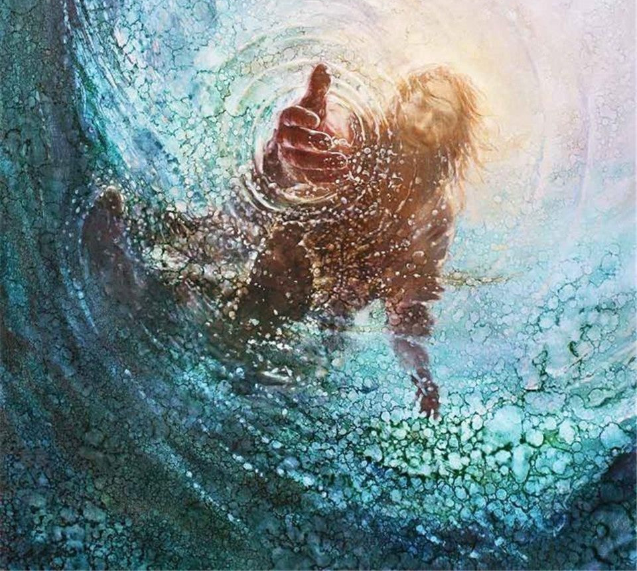
John 4:10
13. What kind of water does Christ give?

Slide 31
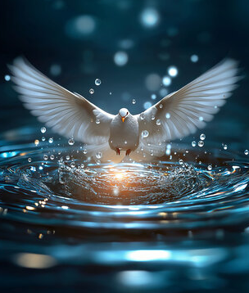
John 4:10
¹⁰ Jesus answered and said unto her, If thou knewest the gift of God, and who it is that saith to thee, Give me to drink; thou wouldest have asked of him, and he would have given thee living water.

Slide 32
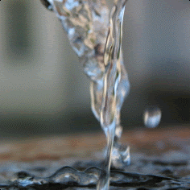
John 4:14
14. What will it do for the one who drinks it?

Slide 33
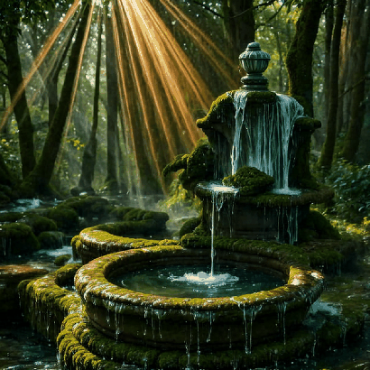
John 4:14
¹⁴ But whosoever drinketh of the water that I shall give him shall never thirst; but the water that I shall give him shall be in him a well of water springing up into everlasting life.

Slide 34
Exodus 17:8
15. While the Jews were at Rephidim, what other trouble did they have?

Slide 35
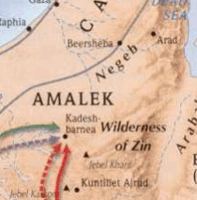
Exodus 17:8
⁸ Then came Amalek, and fought with Israel in Rephidim.

Slide 36
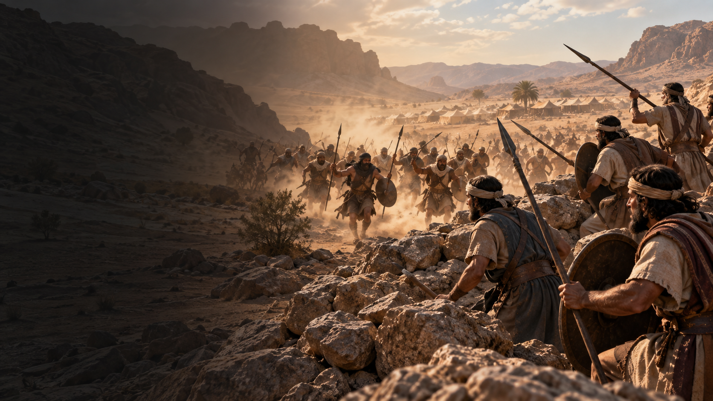
The Amalekites were the first group to launch a surprise attack on the exhausted Israelites after the Exodus from Egypt, specifically targeting the vulnerable stragglers

Slide 37
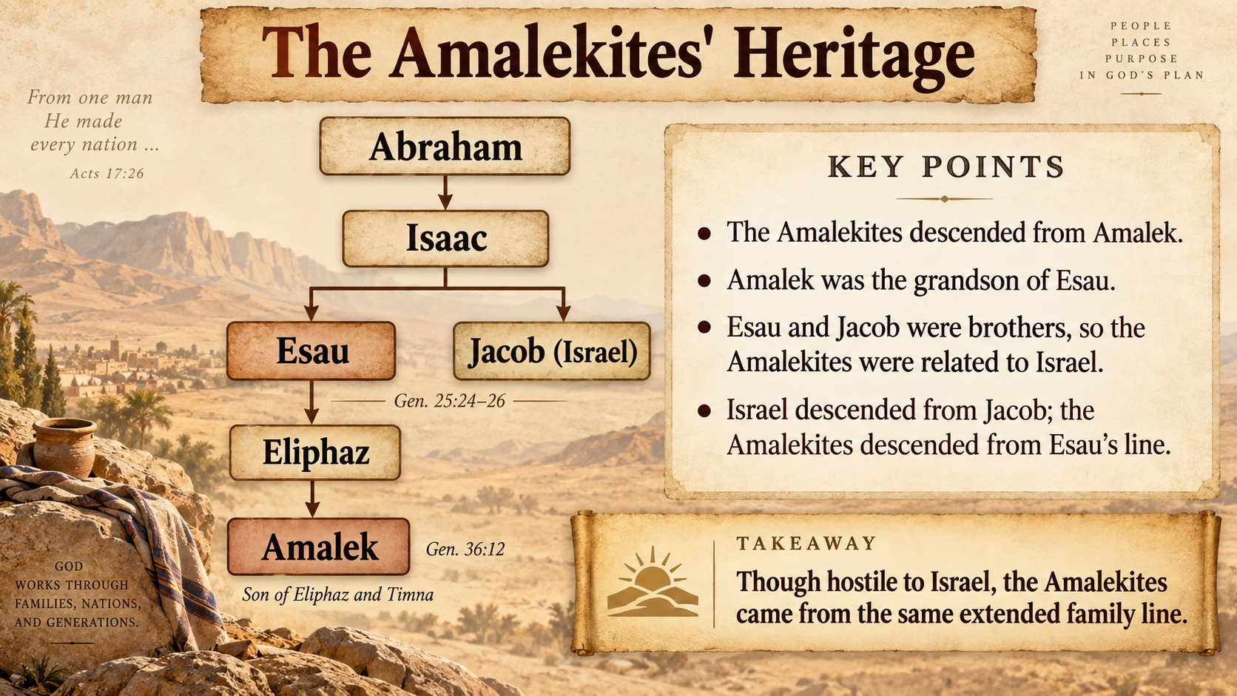

Slide 38
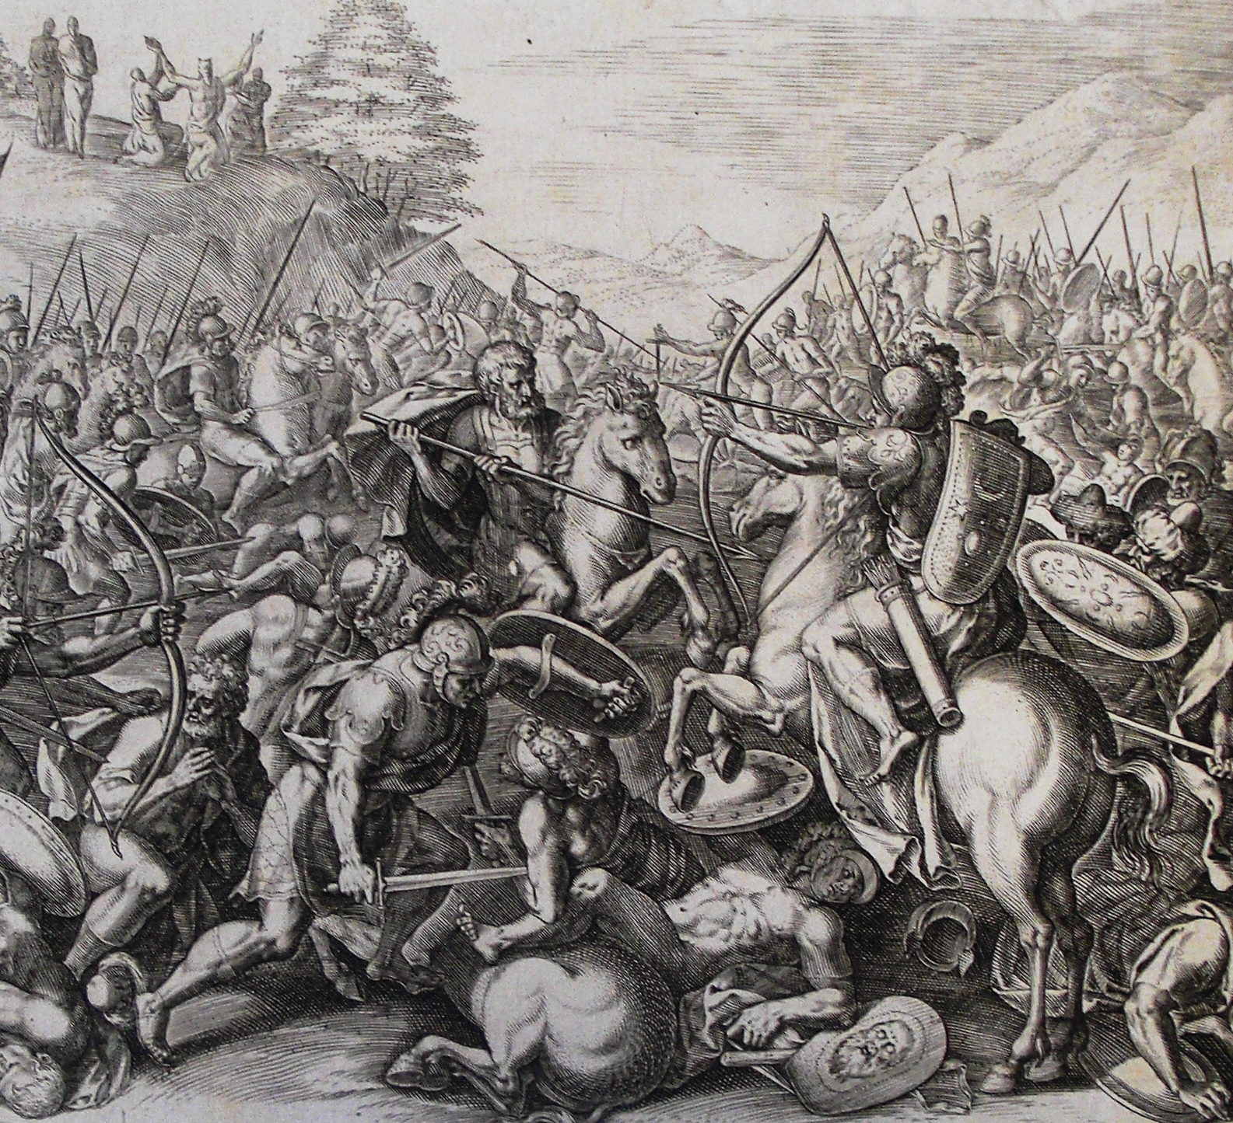
Exodus 17:9-13
16. Relate what followed.

Slide 39
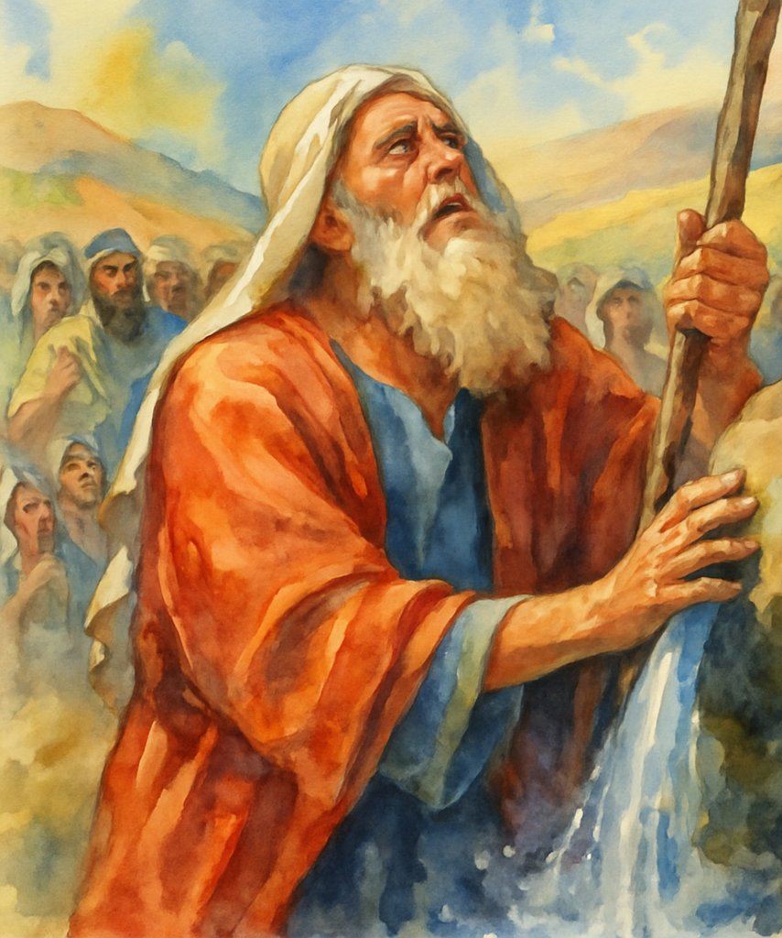
Exodus 17:9-13
⁹ And Moses said unto Joshua, Choose us out men, and go out, fight with Amalek: to morrow I will stand on the top of the hill with the rod of God in mine hand.

Slide 40
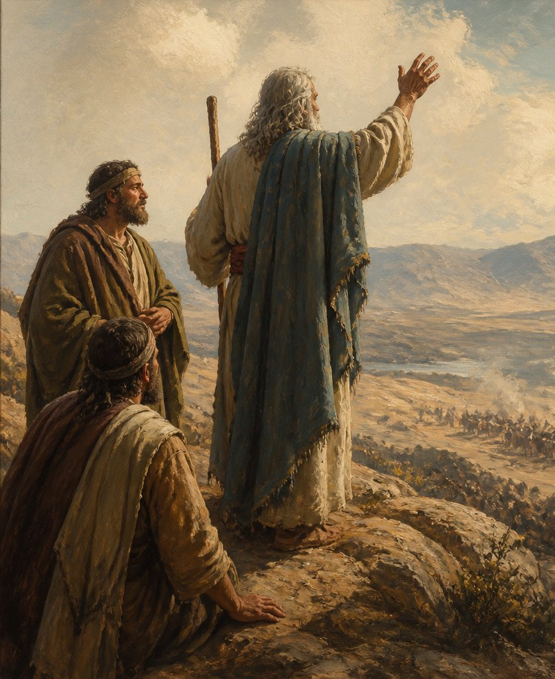
Exodus 17:9-13
¹⁰ So Joshua did as Moses had said to him, and fought with Amalek: and Moses, Aaron, and Hur went up to the top of the hill.
¹¹ And it came to pass, when Moses held up his hand, that Israel prevailed: and when he let down his hand, Amalek prevailed.

Slide 41
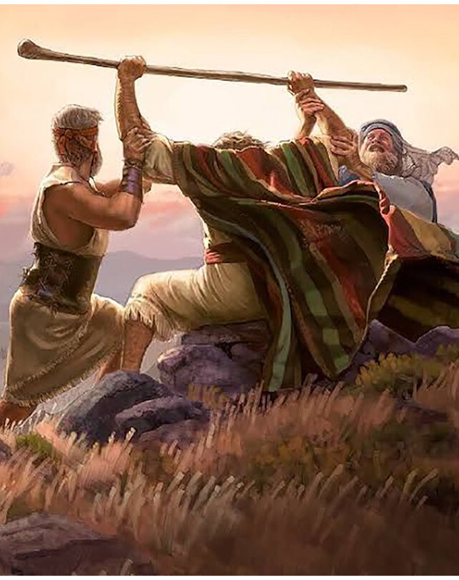
Exodus 17:9-13
¹² But Moses hands were heavy; and they took a stone, and put it under him, and he sat thereon; and Aaron and Hur stayed up his hands, the one on the one side, and the other on the other side; and his hands were steady until the going down of the sun.

Slide 42
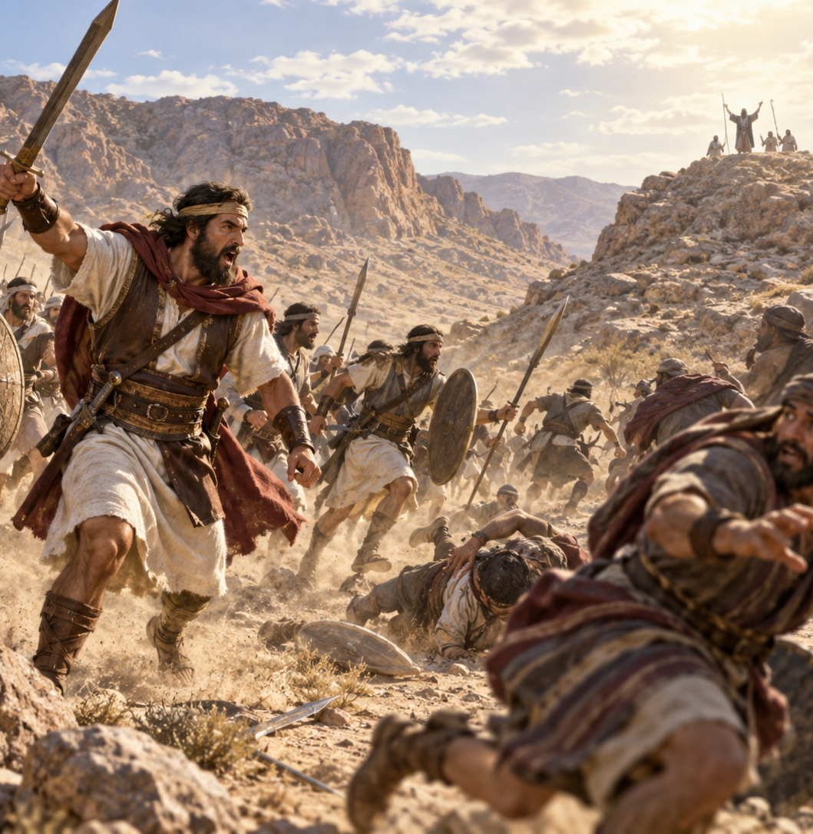
Exodus 17:9-13
¹³ And Joshua discomfited Amalek and his people with the edge of the sword.

Slide 43
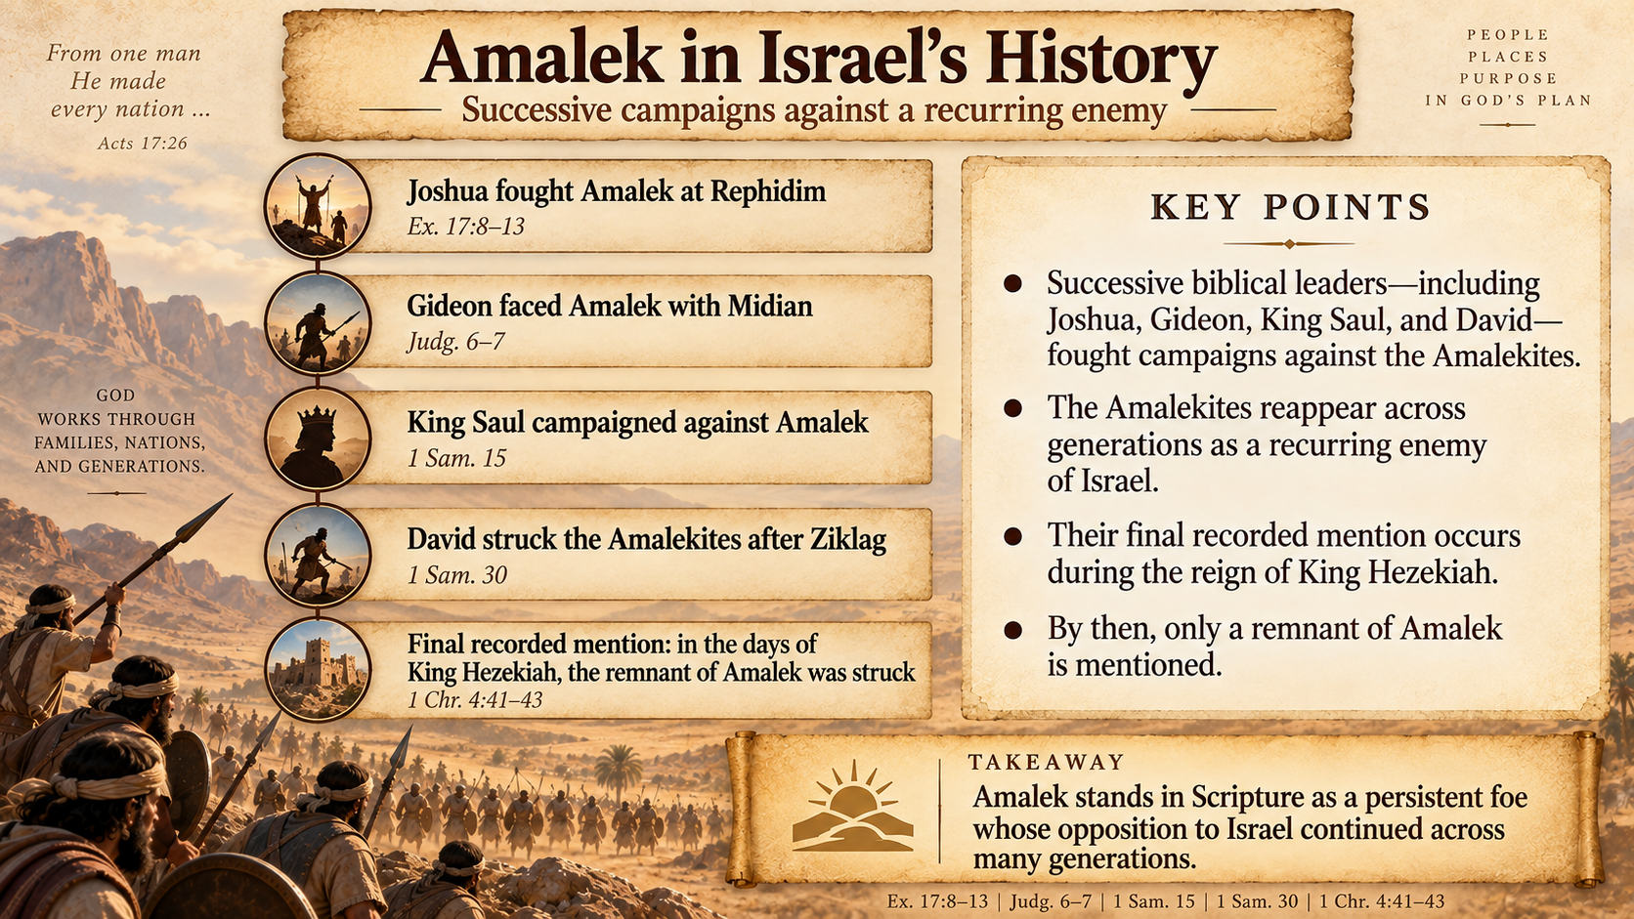

Slide 44
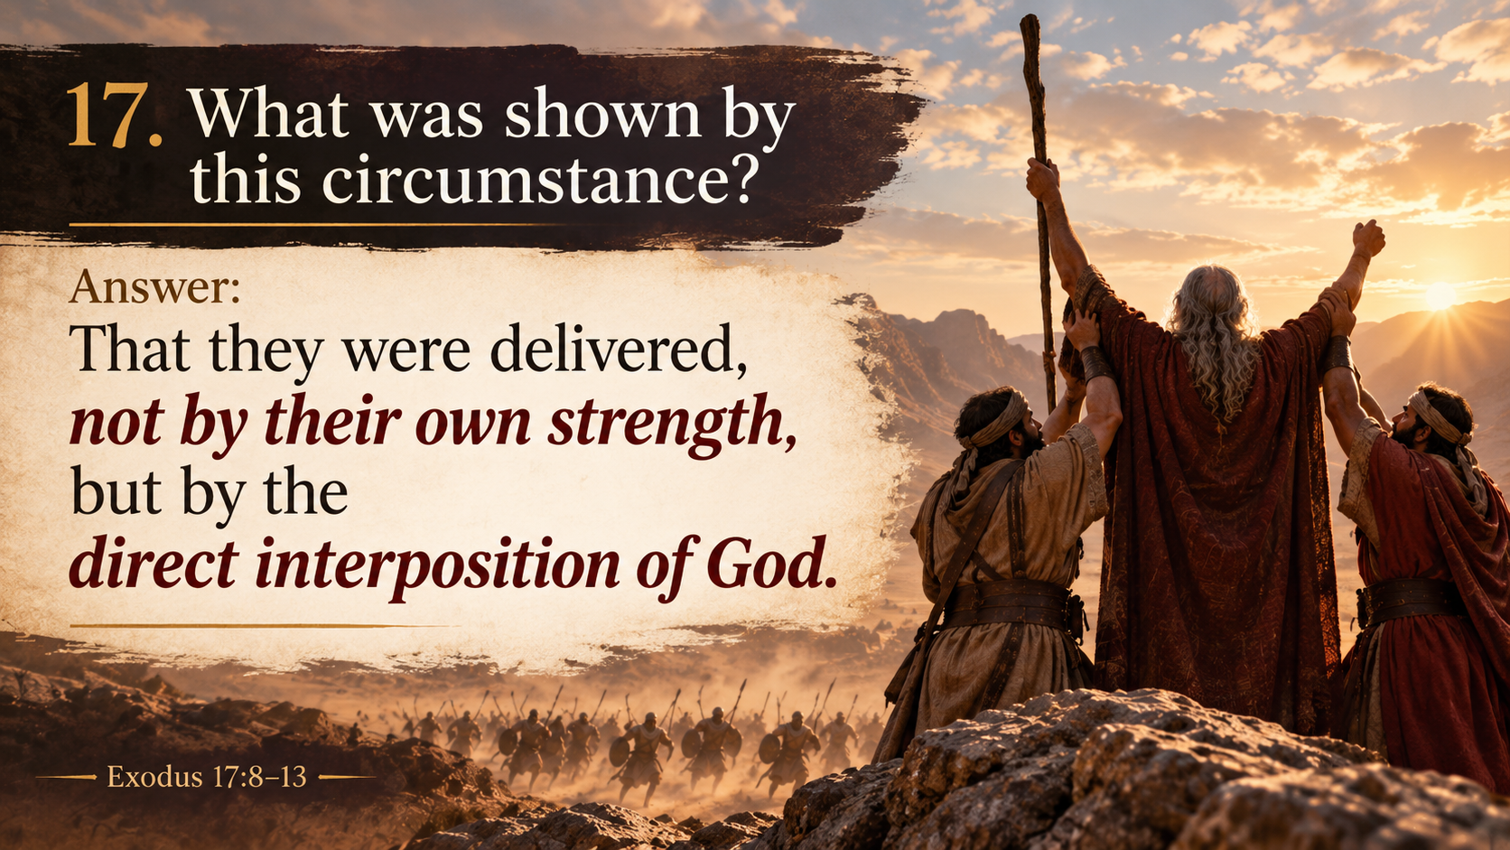

Slide 45
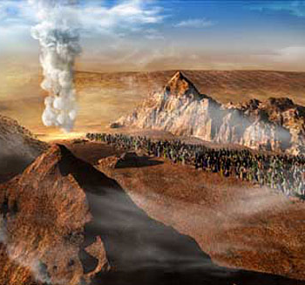
Isaiah 63:8-9
18. What does the prophet Isaiah say of God's tender care for them?

Slide 46
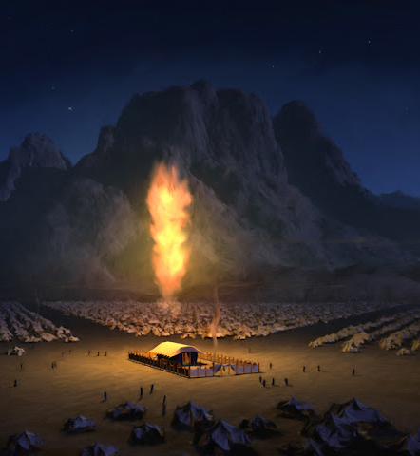
Isaiah 63:8-9
⁸ For he said, Surely they are my people, children that will not lie: so he was their Saviour.

Slide 47
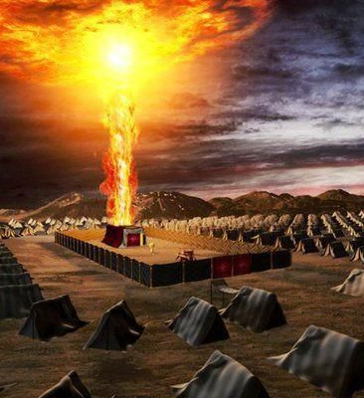
Isaiah 63:9
⁹ In all their affliction he was afflicted, and the angel of his presence saved them: in his love and in his pity he redeemed them; and he bare them, and carried them all the days of old.

Slide 48
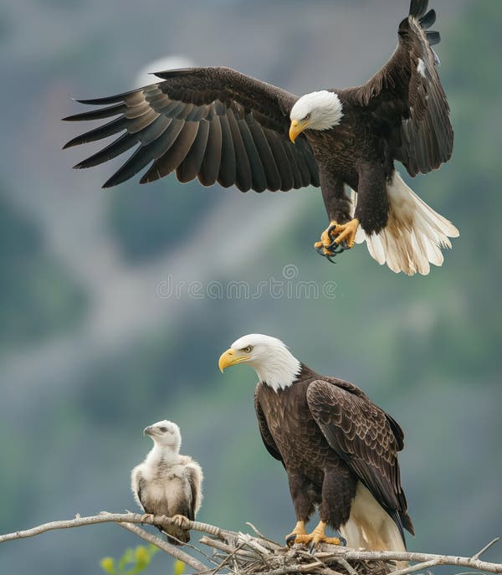
Deuteronomy 32:11-12
19. What beautiful illustration is given to show how the Lord carried them?

Slide 49
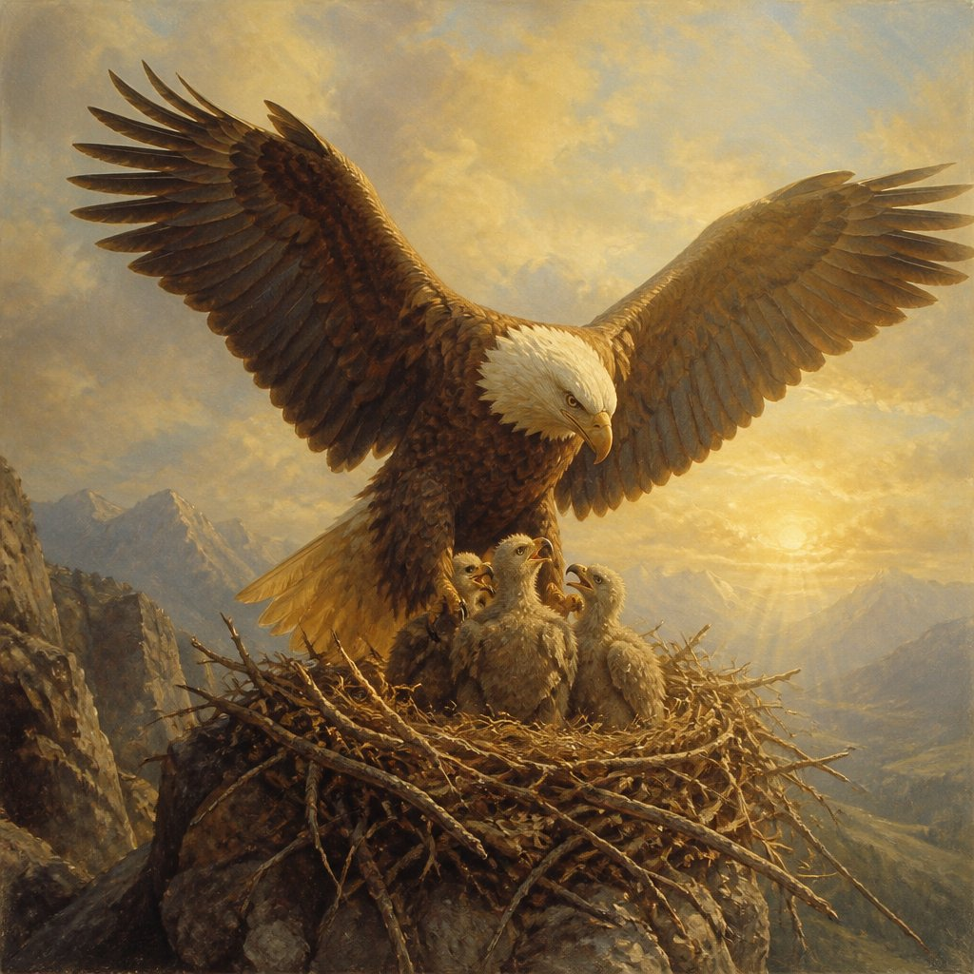
Deuteronomy 32:11-12
¹¹ As an eagle stirreth up her nest, fluttereth over her young, spreadeth abroad her wings, taketh them, beareth them on her wings:
¹² So the Lord alone did lead him, and there was no strange god with him.

Slide 50
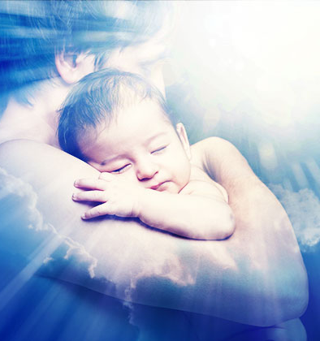
Deuteronomy 33:25-27
20. Of what may the people of God always be assured?

Slide 51
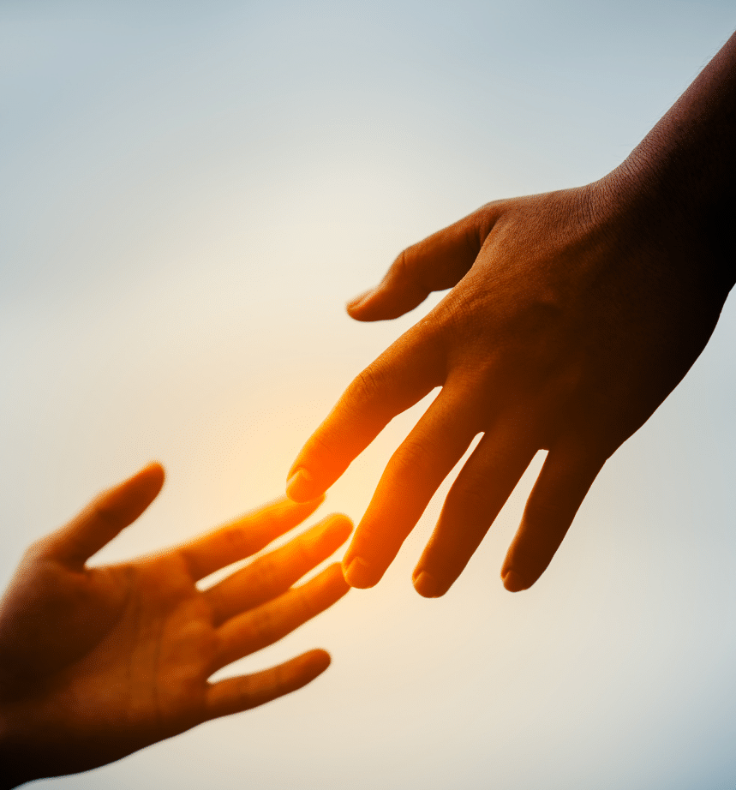
Deuteronomy 33:25-27
²⁵ Thy shoes shall be iron and brass; and as thy days, so shall thy strength be.
²⁶ There is none like unto the God of Jeshurun, who rideth upon the heaven in thy help, and in his excellency on the sky.

Slide 52

Deuteronomy 33:25-27
²⁷ The eternal God is thy refuge, and underneath are the everlasting arms: and he shall thrust out the enemy from before thee; and shall say, Destroy them.

Slide 53


Slide 54


Slide 55


