Slide 1


Slide 2


Slide 3
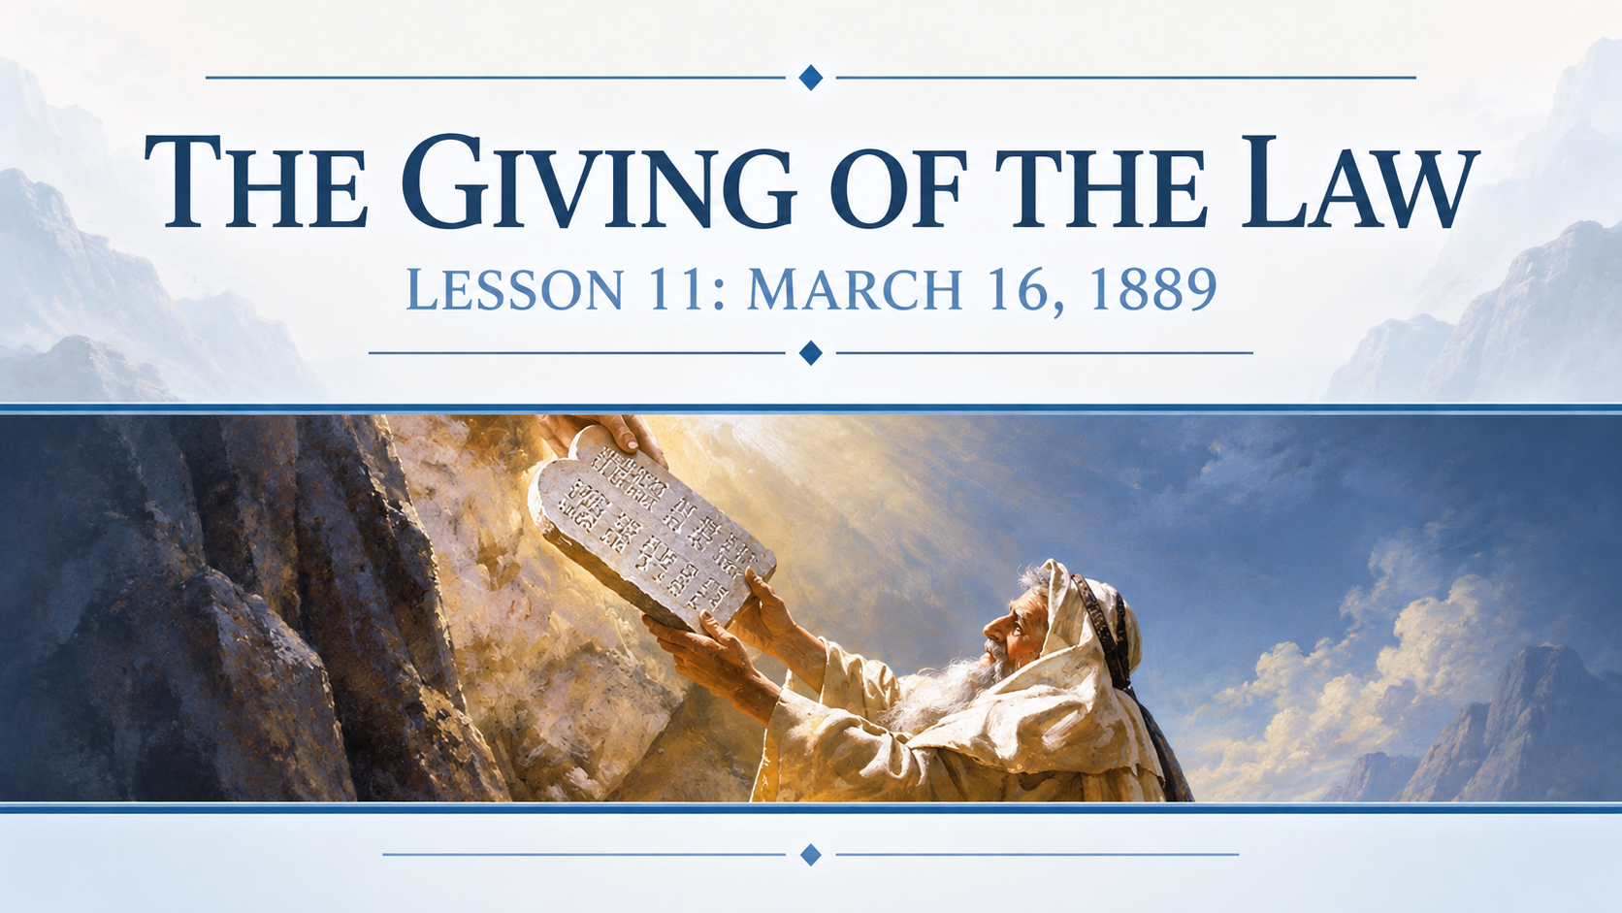

Slide 4
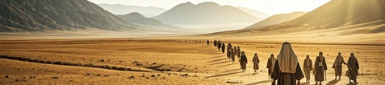
1. How long was it after the children of Israel left Egypt until they came to Sinai?
Exodus 19:1-2

Slide 5
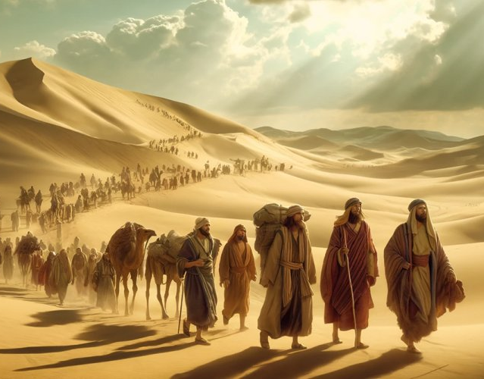
Exodus 19:1-2
19 In the third month, when the children of Israel were gone forth out of the land of Egypt, the same day came they into the wilderness of Sinai.

Slide 6
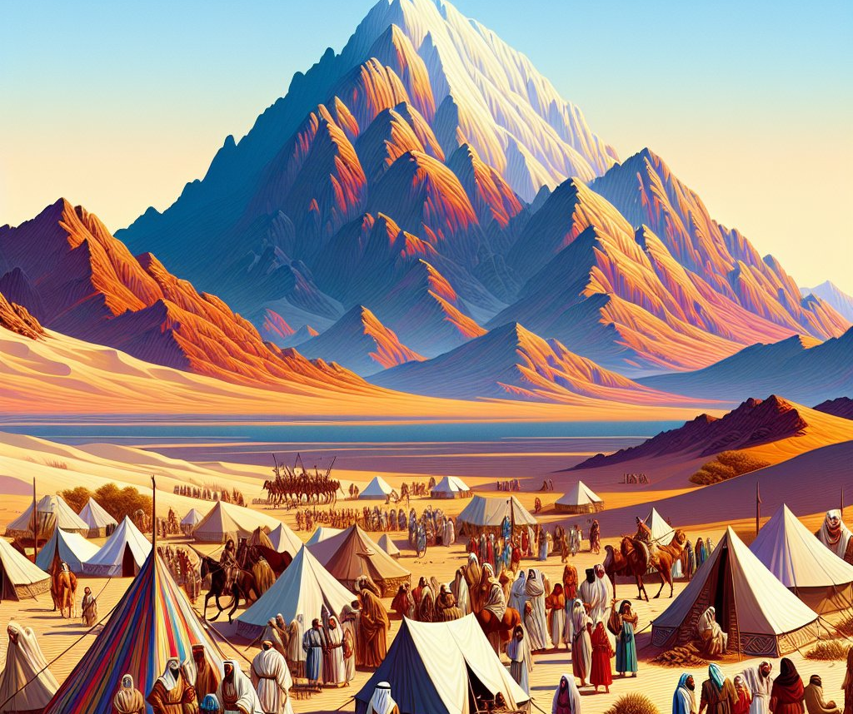
Exodus 19:1-2
² For they were departed from Rephidim, and were come to the desert of Sinai, and had pitched in the wilderness; and there Israel camped before the mount.

Slide 7
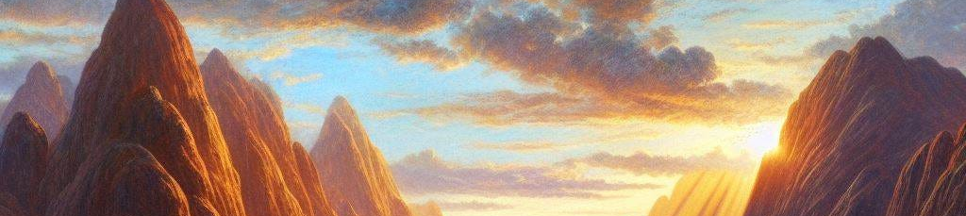
2. What did the Lord say he would do the third day afterward?
Exodus 19:10-11

Slide 8
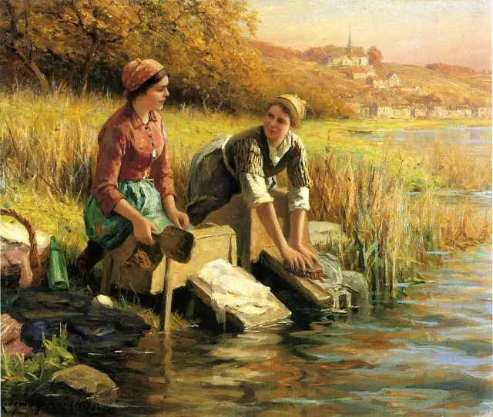
Exodus 19:10-11
¹⁰ And the Lord said unto Moses, Go unto the people, and sanctify them to day and to morrow, and let them wash their clothes,

Slide 9
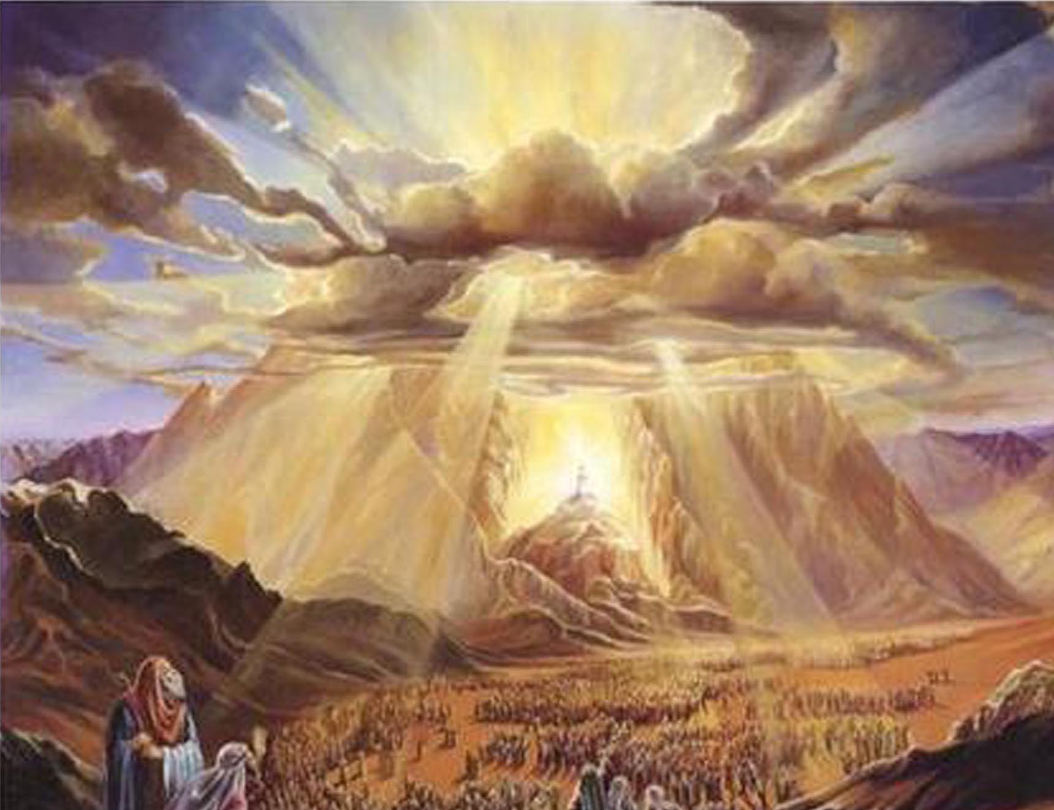
Exodus 19:10-11
¹¹ And be ready against the third day: for the third day the Lord will come down in the sight of all the people upon mount Sinai.

Slide 10
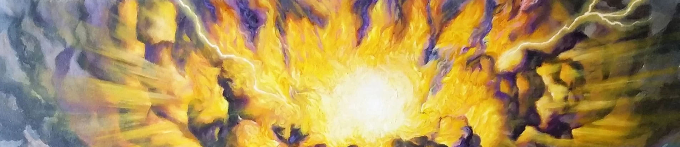
3. What precaution was taken to keep the people from touching the mount?
Exodus 19:12

Slide 11
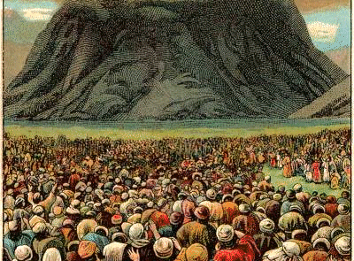
Exodus 19:12
¹² And thou shalt set bounds unto the people round about, saying, Take heed to yourselves, that ye go not up into the mount, or touch the border of it: whosoever toucheth the mount shall be surely put to death:

Slide 12
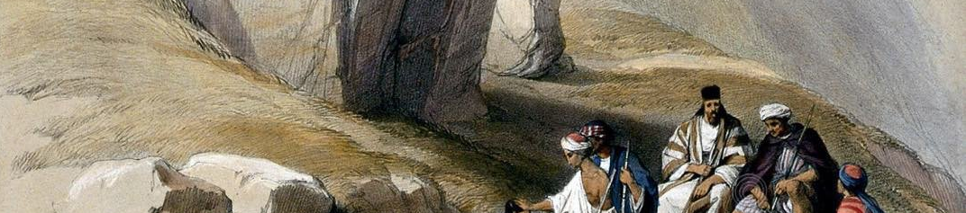
4. What severe penalty was to follow any violation of this order?
Exodus 19:12, 13, 21

Slide 13
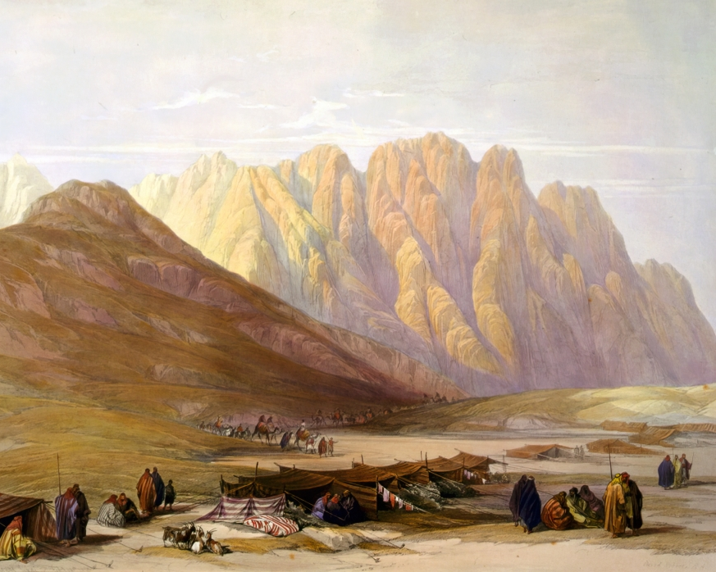
Exodus 19:12, 13, 21
¹² And thou shalt set bounds unto the people round about, saying, Take heed to yourselves, that ye go not up into the mount, or touch the border of it: whosoever toucheth the mount shall be surely put to death:

Slide 14
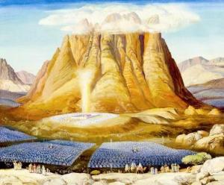
Exodus 19:12, 13, 21
¹³ There shall not an hand touch it, but he shall surely be stoned, or shot through; whether it be beast or man, it shall not live: when the trumpet soundeth long, they shall come up to the mount.

Slide 15
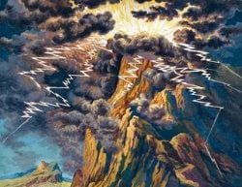
Exodus 19:12, 13, 21
²¹ And the Lord said unto Moses, Go down, charge the people, lest they break through unto the Lord to gaze, and many of them perish.

Slide 16
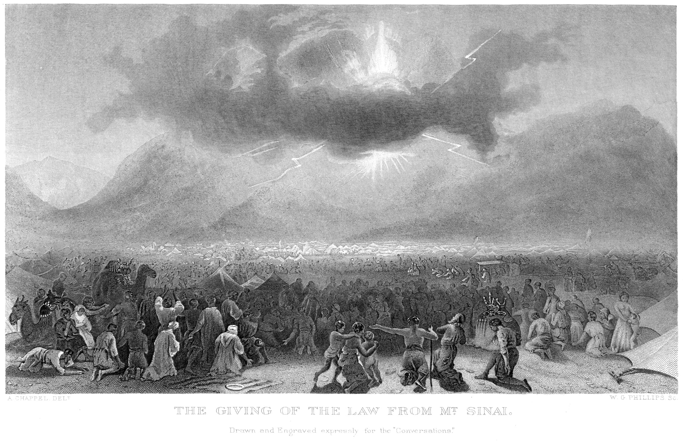
5. With what words did Moses describe this setting off of the mount?
Exodus 19:23

Slide 17
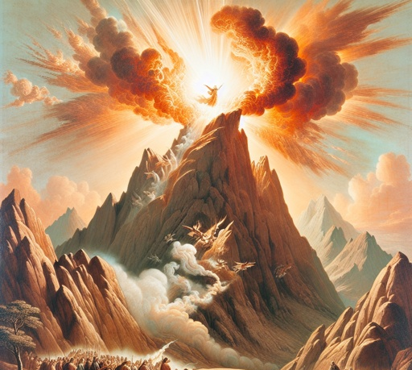
Exodus 19:23
²³ And Moses said unto the Lord, The people cannot come up to mount Sinai: for thou chargedst us, saying, Set bounds about the mount, and sanctify it.

Slide 18

6. What other order indicated the solemnity of what was about to be done?
Exodus 19:10, 14, 22

Slide 19
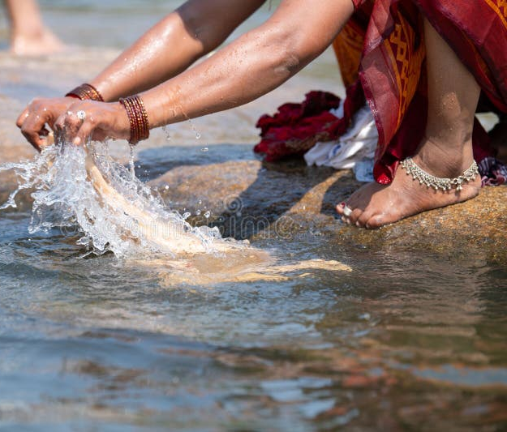
Exodus 19:10, 14, 22
¹⁰ And the Lord said unto Moses, Go unto the people, and sanctify them to day and to morrow, and let them wash their clothes,

Slide 20
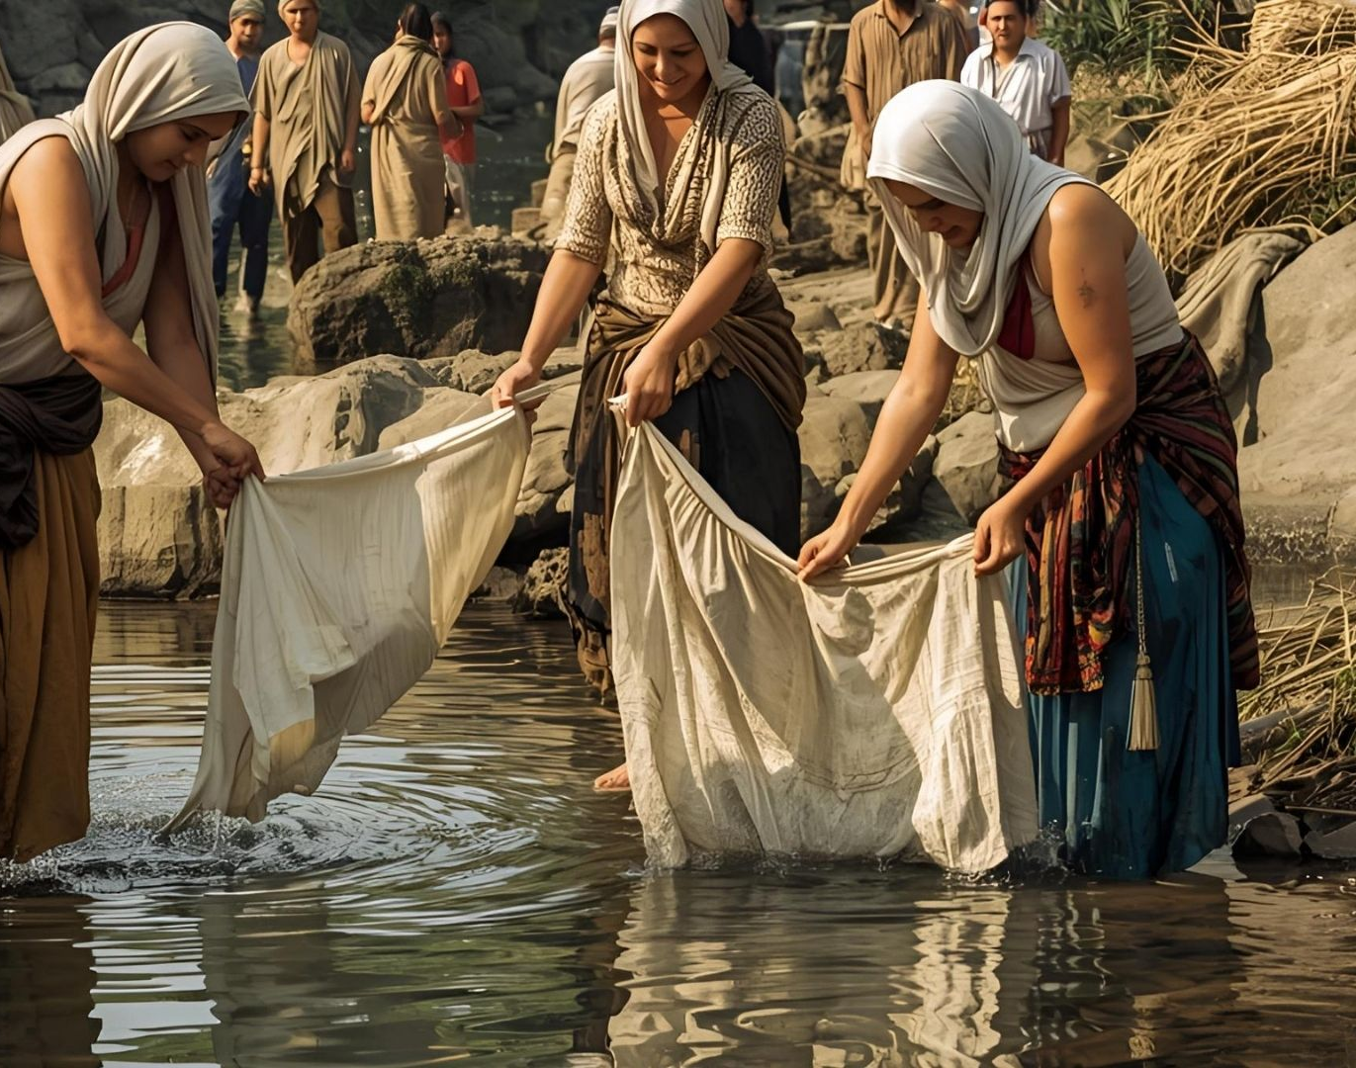
Exodus 19:10, 14, 22
¹⁴ And Moses went down from the mount unto the people, and sanctified the people; and they washed their clothes.

Slide 21
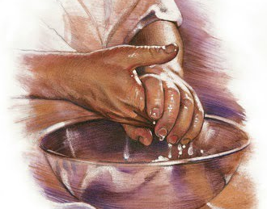
Exodus 19:10, 14, 22
²² And let the priests also, which come near to the Lord, sanctify themselves, lest the Lord break forth upon them.

Slide 22
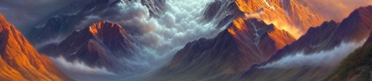
7. What terrible things did the people hear on the third day?
Exodus 19:16

Slide 23
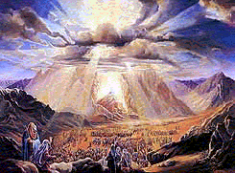
Exodus 19:16
¹⁶ And it came to pass on the third day in the morning, that there were thunders and lightnings, and a thick cloud upon the mount, and the voice of the trumpet exceeding loud; so that all the people that was in the camp trembled.

Slide 24
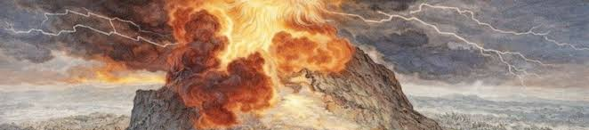
8. What caused this?
Exodus 19:18, 20

Slide 25
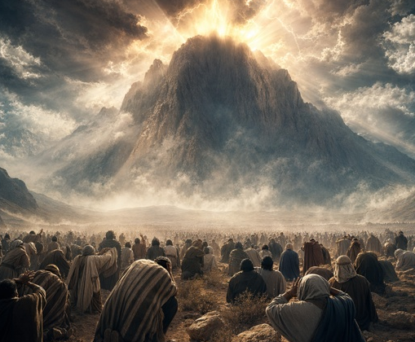
Exodus 19:18, 20
¹⁸ And mount Sinai was altogether on a smoke, because the Lord descended upon it in fire: and the smoke thereof ascended as the smoke of a furnace, and the whole mount quaked greatly.

Slide 26
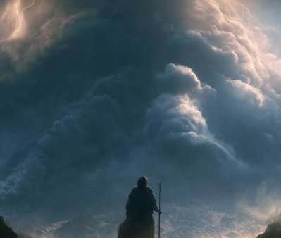
Exodus 19:18, 20
²⁰ And the Lord came down upon mount Sinai, on the top of the mount: and the Lord called Moses up to the top of the mount; and Moses went up.

Slide 27
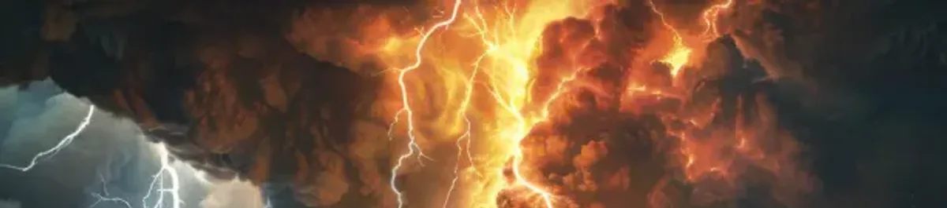
9. For what purpose did the Lord come down upon Sinai in his terrible glory?
Nehemiah 9:13, 14

Slide 28
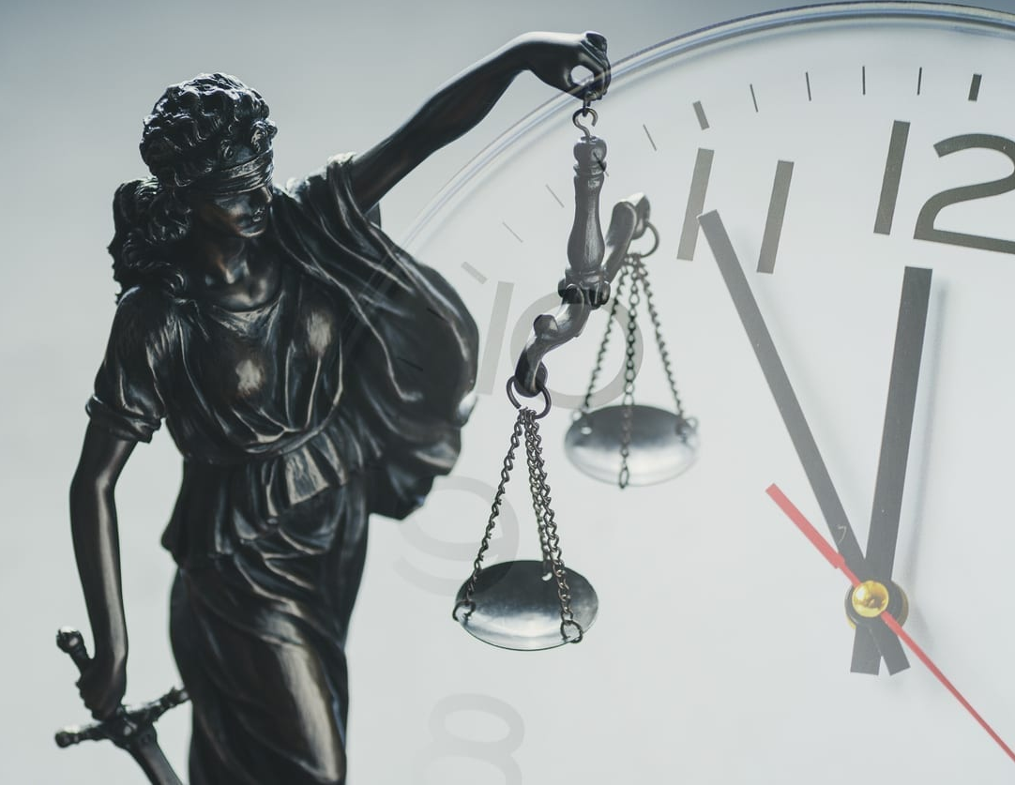
Nehemiah 9:13, 14
¹³ Thou camest down also upon mount Sinai, and spakest with them from heaven, and gavest them right judgments, and true laws, good statutes and commandments:

Slide 29
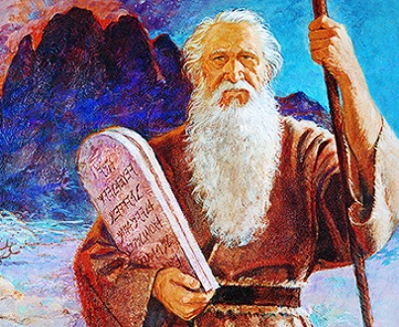
Nehemiah 9:13, 14
¹⁴ And madest known unto them thy holy sabbath, and commandedst them precepts, statutes, and laws, by the hand of Moses thy servant:

Slide 30
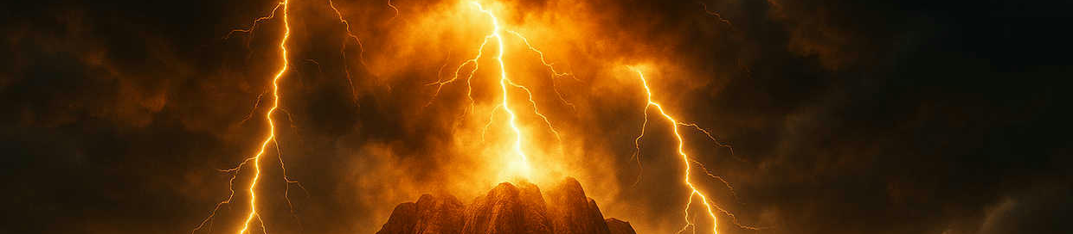
10. Who accompanied him?
Deuteronomy 33:2; Psalm 68:17

Slide 31
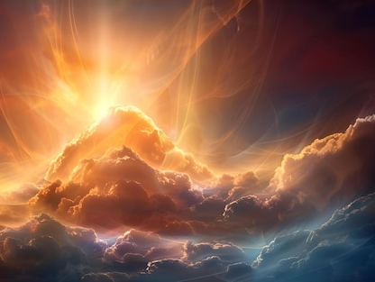
Deuteronomy 33:2
² And he said, The Lord came from Sinai, and rose up from Seir unto them; he shined forth from mount Paran, and he came with ten thousands of saints: from his right hand went a fiery law for them.

Slide 32
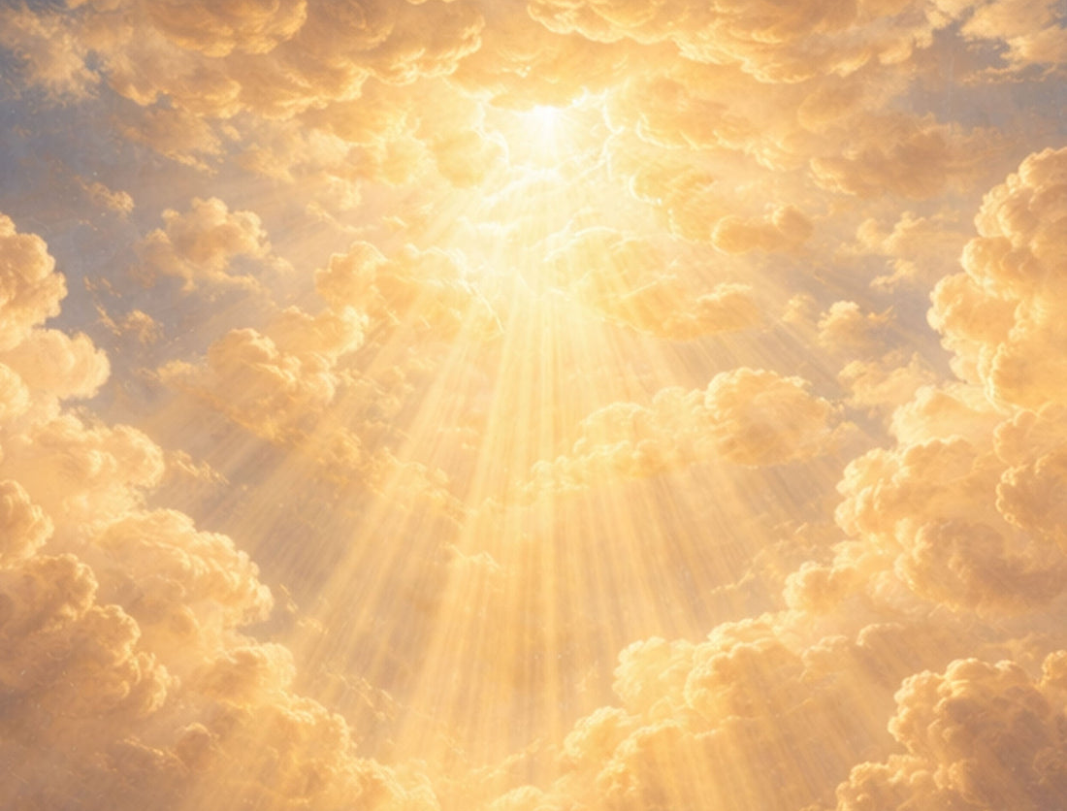
Psalm 68:17
¹⁷ The chariots of God are twenty thousand, even thousands of angels: the Lord is among them, as in Sinai, in the holy place.

Slide 33
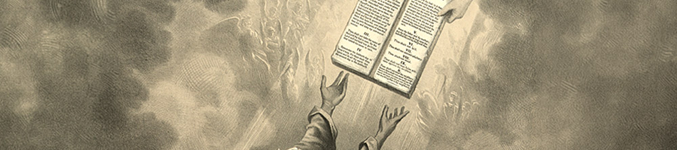
11. Of what was this giving of the law a manifestation?
Deuteronomy 33:2, 3

Slide 34
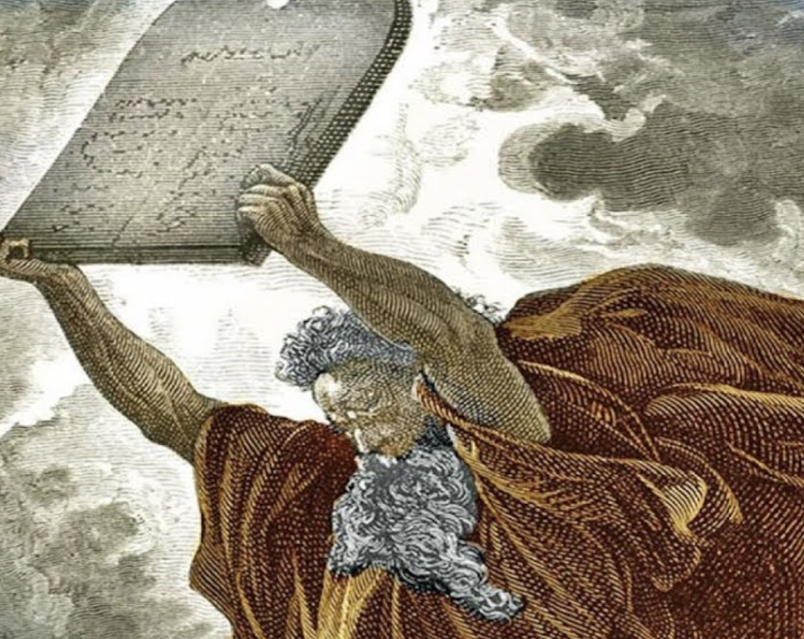
Deuteronomy 33:2, 3
² And he said, The Lord came from Sinai, and rose up from Seir unto them; he shined forth from mount Paran, and he came with ten thousands of saints: from his right hand went a fiery law for them.

Slide 35
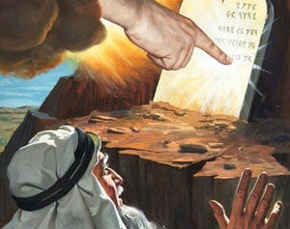
Deuteronomy 33:2, 3
³ Yea, he loved the people; all his saints are in thy hand: and they sat down at thy feet; every one shall receive of thy words.

Slide 36
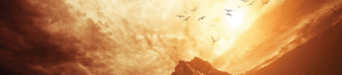
12. Where do we find the law which the Lord spoke from Sinai?
Exodus 20:3-17

Slide 37
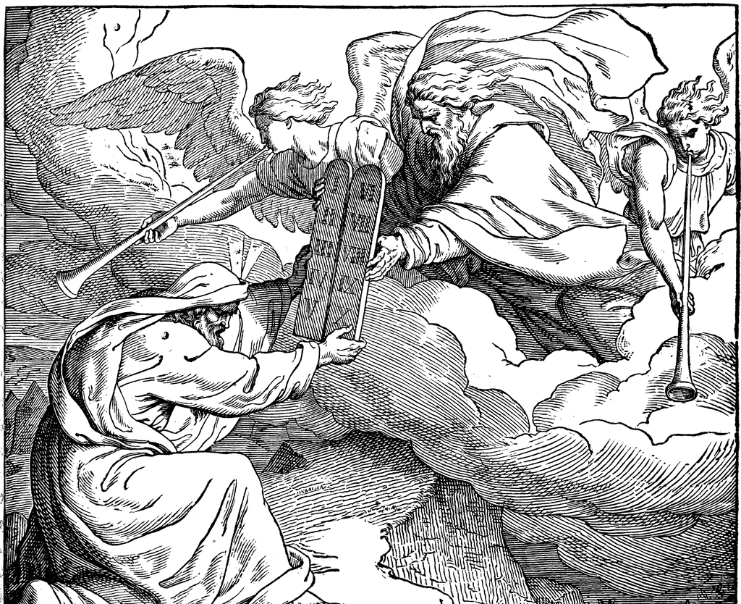
Exodus 20:3-17
³ Thou shalt have no other gods before me.
⁴ Thou shalt not make unto thee any graven image, or any likeness of any thing that is in heaven above, or that is in the earth beneath, or that is in the water under the earth.

Slide 38
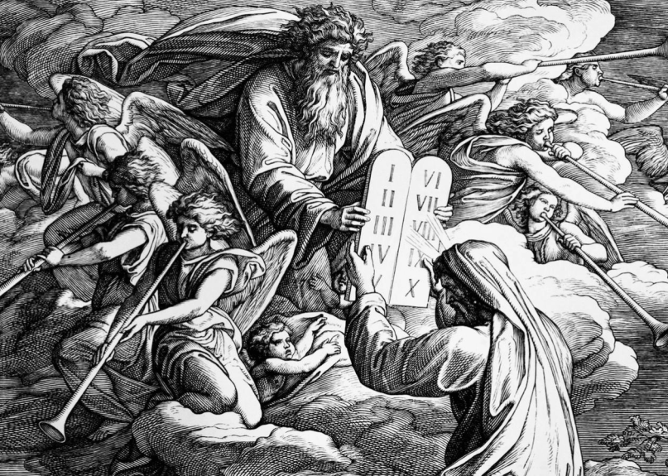
Exodus 20:3-17
⁵ Thou shalt not bow down thyself to them, nor serve them: for I the Lord thy God am a jealous God, visiting the iniquity of the fathers upon the children unto the third and fourth generation of them that hate me;

Slide 39
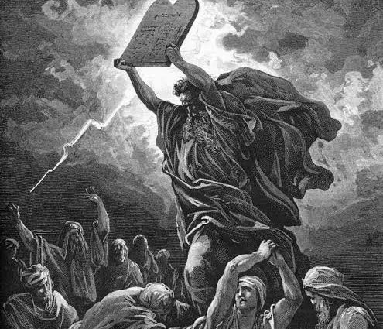
Exodus 20:3-17
⁶ And shewing mercy unto thousands of them that love me, and keep my commandments.
⁷ Thou shalt not take the name of the Lord thy God in vain; for the Lord will not hold him guiltless that taketh his name in vain.

Slide 40
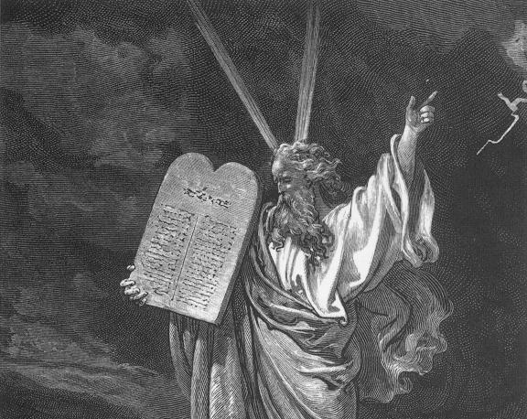
Exodus 20:3-17
⁸ Remember the sabbath day, to keep it holy.
⁹ Six days shalt thou labour, and do all thy work:

Slide 41
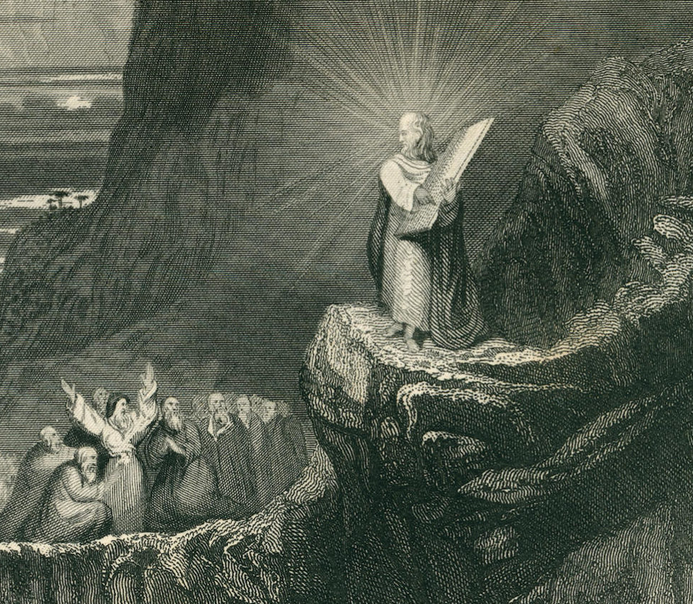
Exodus 20:3-17
¹⁰ But the seventh day is the sabbath of the Lord thy God: in it thou shalt not do any work, thou, nor thy son, nor thy daughter, thy manservant, nor thy maidservant, nor thy cattle, nor thy stranger that is within thy gates:

Slide 42
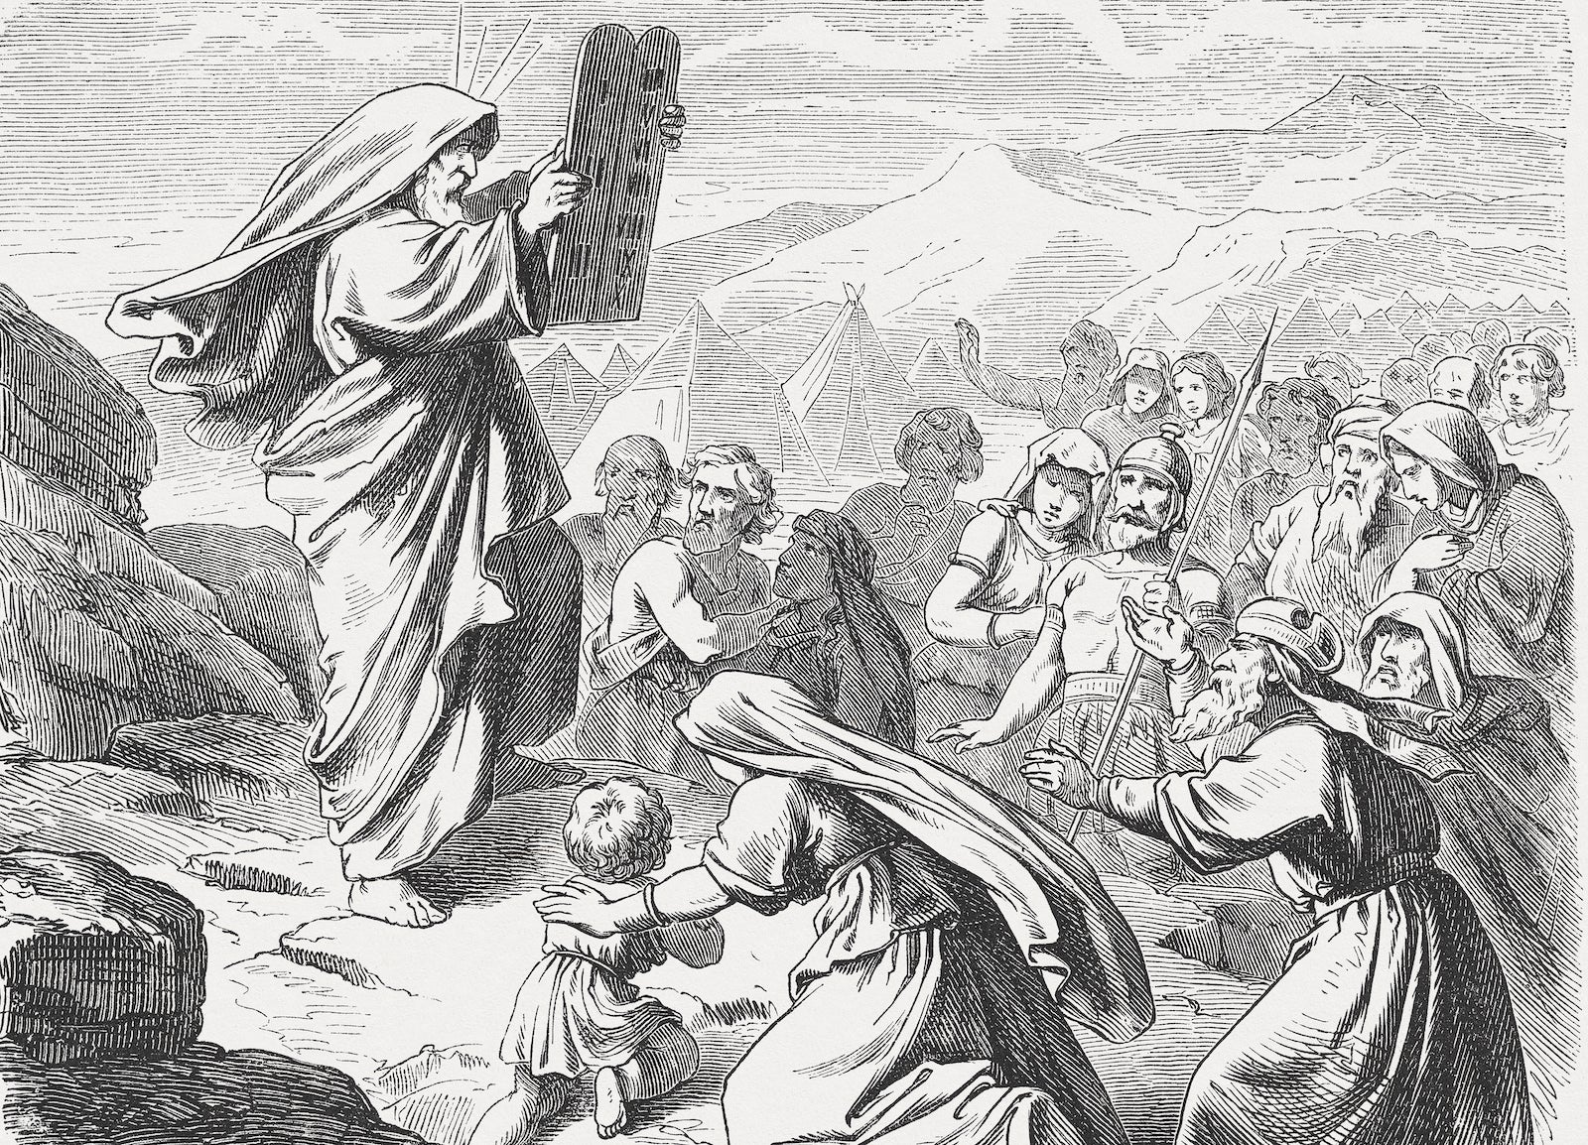
Exodus 20:3-17
¹¹ For in six days the Lord made heaven and earth, the sea, and all that in them is, and rested the seventh day: wherefore the Lord blessed the sabbath day, and hallowed it.

Slide 43
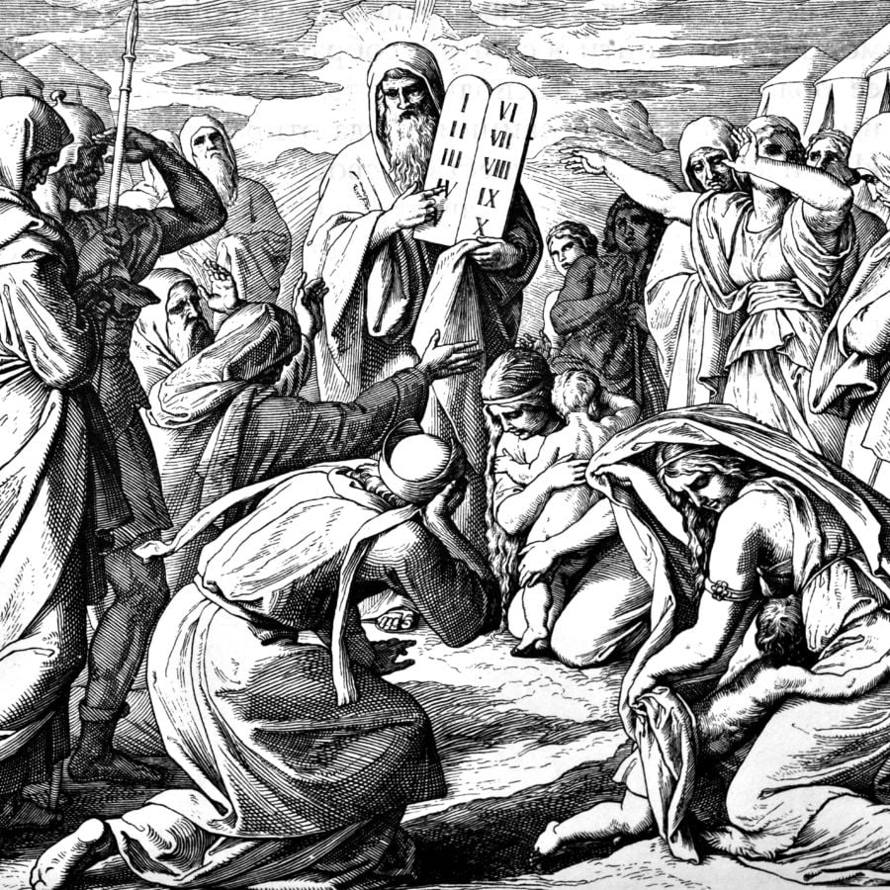
Exodus 20:3-17
¹² Honour thy father and thy mother: that thy days may be long upon the land which the Lord thy God giveth thee.
¹³ Thou shalt not kill.
¹⁴ Thou shalt not commit adultery.

Slide 44
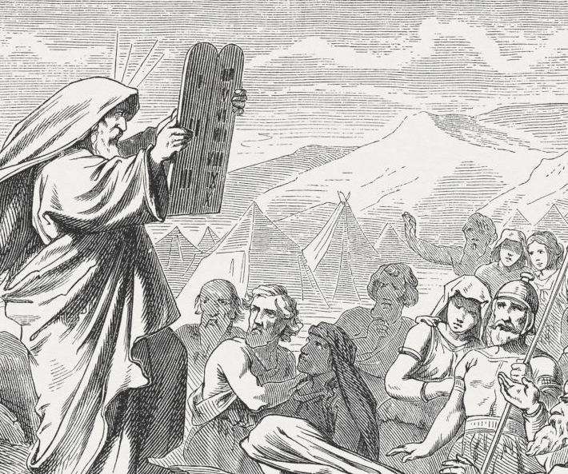
Exodus 20:3-17
¹⁵ Thou shalt not steal.
¹⁶ Thou shalt not bear false witness against thy neighbour.

Slide 45
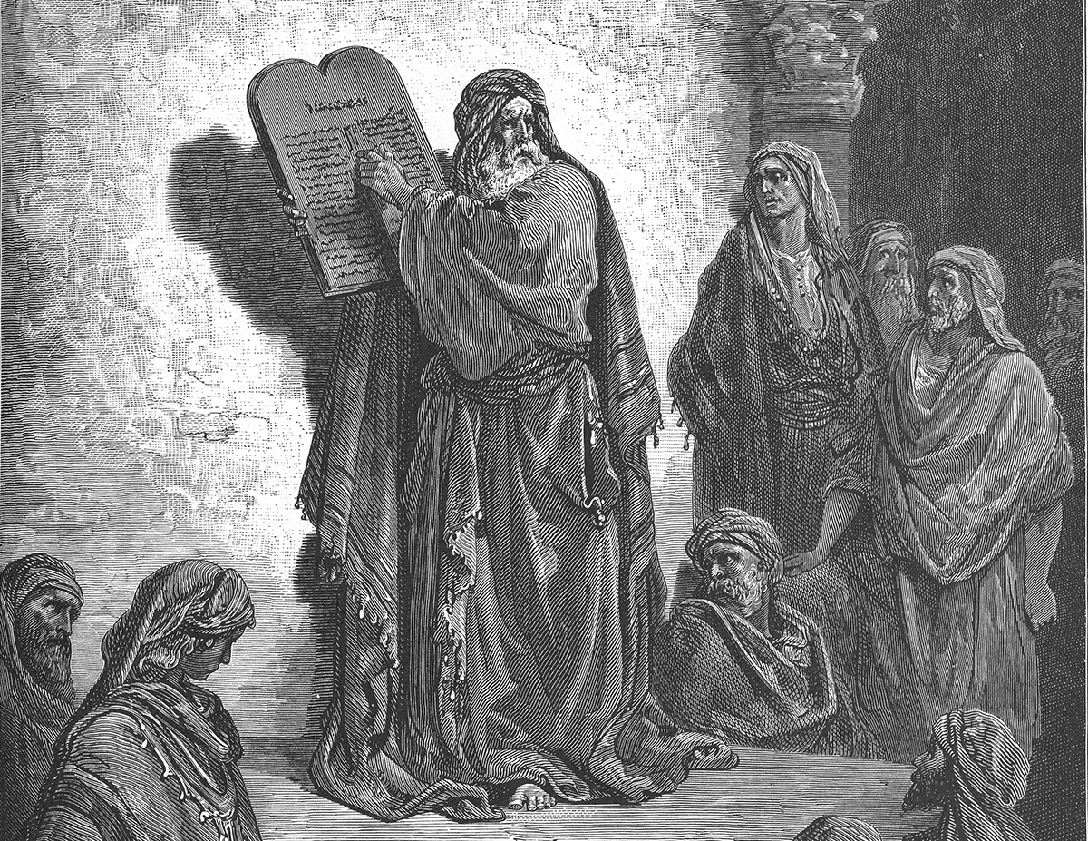
Exodus 20:3-17
¹⁷ Thou shalt not covet thy neighbour's house, thou shalt not covet thy neighbour's wife, nor his manservant, nor his maidservant, nor his ox, nor his ass, nor any thing that is thy neighbour's.

Slide 46
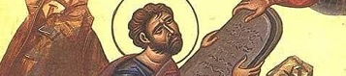
13. What is the law called, which the Lord spoke?
Deuteronomy 4:12, 13

Slide 47
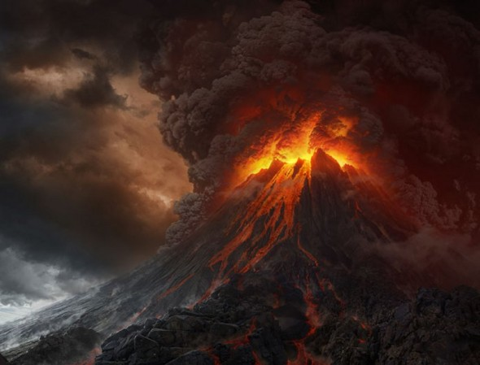
Deuteronomy 4:12, 13
¹² And the Lord spake unto you out of the midst of the fire: ye heard the voice of the words, but saw no similitude; only ye heard a voice.

Slide 48
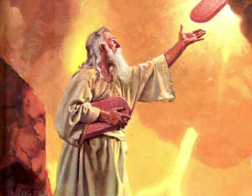
Deuteronomy 4:12, 13
¹³ And he declared unto you his covenant, which he commanded you to perform, even ten commandments; and he wrote them upon two tables of stone.

Slide 49
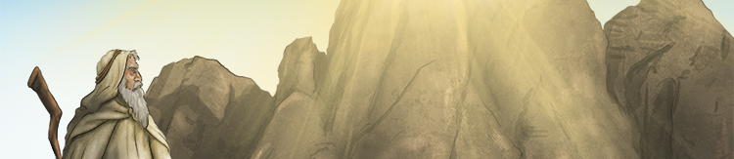
14. Did he speak anything beside the ten commandments?
Deuteronomy 5:22

Slide 50
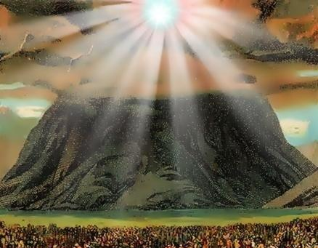
Deuteronomy 5:22
²² These words the Lord spake unto all your assembly in the mount out of the midst of the fire, of the cloud, and of the thick darkness, with a great voice: and he added no more. And he wrote them in two tables of stone, and delivered them unto me.

Slide 51
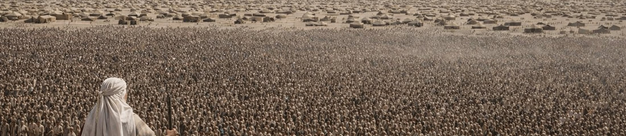
15. As soon as he had spoken them, what did the people say?
Exodus 20:18, 19; Hebrews 12:19

Slide 52
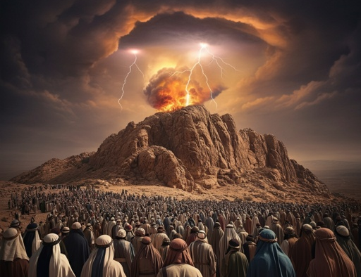
Exodus 20:18, 19
¹⁸ And all the people saw the thunderings, and the lightnings, and the noise of the trumpet, and the mountain smoking: and when the people saw it, they removed, and stood afar off.

Slide 53
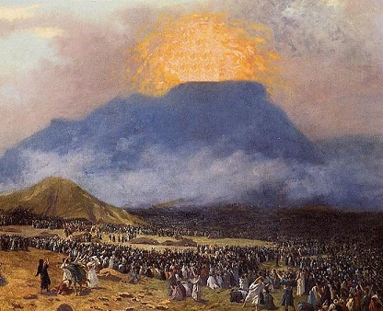
Exodus 20:18, 19
¹⁹ And they said unto Moses, Speak thou with us, and we will hear: but let not God speak with us, lest we die.

Slide 54

Hebrews 12:19
¹⁹ And the sound of a trumpet, and the voice of words; which voice they that heard intreated that the word should not be spoken to them any more:

Slide 55

16. What does Paul say of the awfulness of that occasion?
Hebrews 12:20, 21

Slide 56
Hebrews 12:20, 21
²⁰ (For they could not endure that which was commanded, And if so much as a beast touch the mountain, it shall be stoned, or thrust through with a dart:

Slide 57
Hebrews 12:20, 21
²¹ And so terrible was the sight, that Moses said, I exceedingly fear and quake:)

Slide 58

17. Upon what did God write the ten commandments?
Deuteronomy 4:13; 5:22

Slide 59

Deuteronomy 4:13; 5:22
¹³ And he declared unto you his covenant, which he commanded you to perform, even ten commandments; and he wrote them upon two tables of stone.

Slide 60

Deuteronomy 4:13; 5:22
²² These words the Lord spake unto all your assembly in the mount out of the midst of the fire, of the cloud, and of the thick darkness, with a great voice: and he added no more. And he wrote them in two tables of stone, and delivered them unto me.

Slide 61

18. When will the trump of God be heard again?
1 Thessalonians 4:16; 1 Corinthians 15:51-52

Slide 62

1 Thessalonians 4:16
¹⁶ For the Lord himself shall descend from heaven with a shout, with the voice of the archangel, and with the trump of God: and the dead in Christ shall rise first:

Slide 63

1 Corinthians 15:51-52
⁵¹ Behold, I shew you a mystery; We shall not all sleep, but we shall all be changed,

Slide 64

1 Corinthians 15:51-52
⁵² In a moment, in the twinkling of an eye, at the last trump: for the trumpet shall sound, and the dead shall be raised incorruptible, and we shall be changed.

Slide 65

19. When the voice of the Lord was heard at Sinai, what took place?
Exodus 19:18, 19; Psalm 68:8

Slide 66

Exodus 19:18, 19
¹⁸ And mount Sinai was altogether on a smoke, because the Lord descended upon it in fire: and the smoke thereof ascended as the smoke of a furnace, and the whole mount quaked greatly.

Slide 67

Exodus 19:18, 19
¹⁹ And when the voice of the trumpet sounded long, and waxed louder and louder, Moses spake, and God answered him by a voice.

Slide 68

Psalm 68:8
⁸ The earth shook, the heavens also dropped at the presence of God: even Sinai itself was moved at the presence of God, the God of Israel.

Slide 69

20. What will take place when it is heard at the last day?
Hebrews 12:26; Joel 3:16

Slide 70

Hebrews 12:26
²⁶ Whose voice then shook the earth: but now he hath promised, saying, Yet once more I shake not the earth only, but also heaven.

Slide 71

Joel 3:16
¹⁶ The Lord also shall roar out of Zion, and utter his voice from Jerusalem; and the heavens and the earth shall shake: but the Lord will be the hope of his people, and the strength of the children of Israel.

Slide 72


Slide 73


