Slide 1


Slide 2


Slide 3
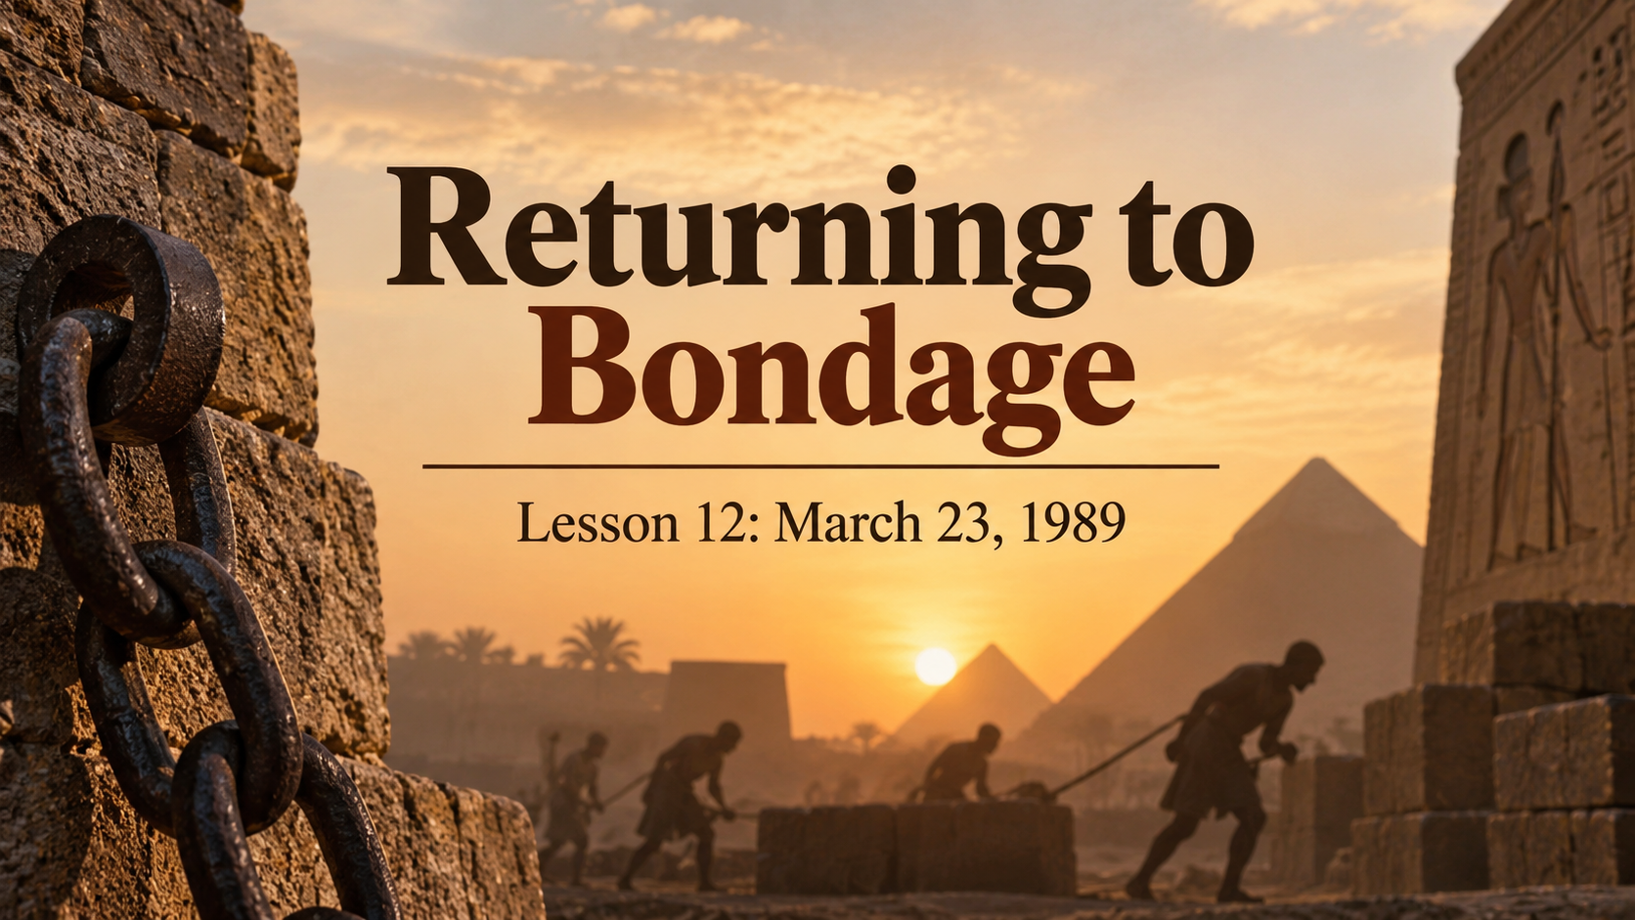

Slide 4
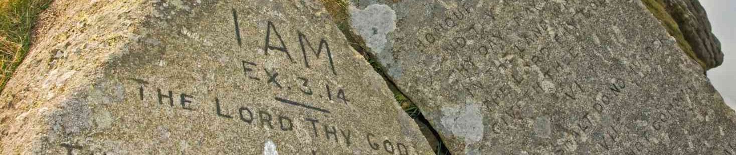
1. After the covenant between God and Israel had been ratified, what did the Lord say to Moses?
Exodus 24:12

Slide 5
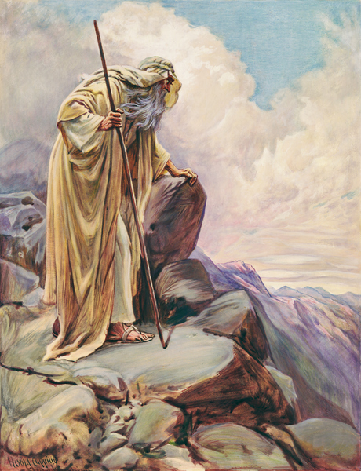
Exodus 24:12
¹² And the Lord said unto Moses, Come up to me into the mount, and be there: and I will give thee tables of stone, and a law, and commandments which I have written; that thou mayest teach them.

Slide 6
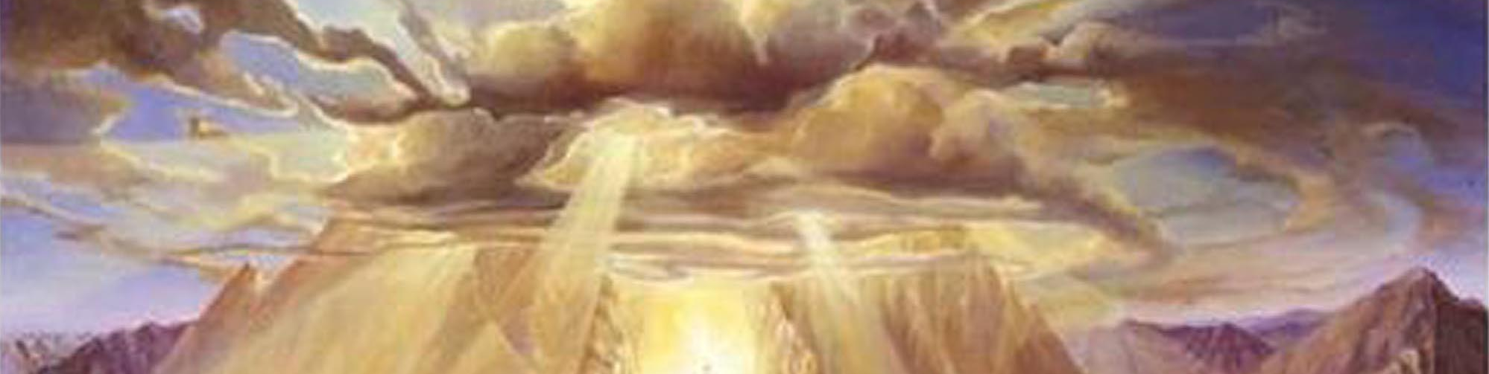
2. What covered the mount, and what was its appearance?
Exodus 24:15-17

Slide 7
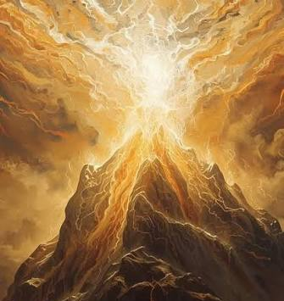
Exodus 24:15-17
¹⁵ And Moses went up into the mount, and a cloud covered the mount.

Slide 8
Exodus 24:15-17
¹⁶ And the glory of the Lord abode upon mount Sinai, and the cloud covered it six days: and the seventh day he called unto Moses out of the midst of the cloud.

Slide 9
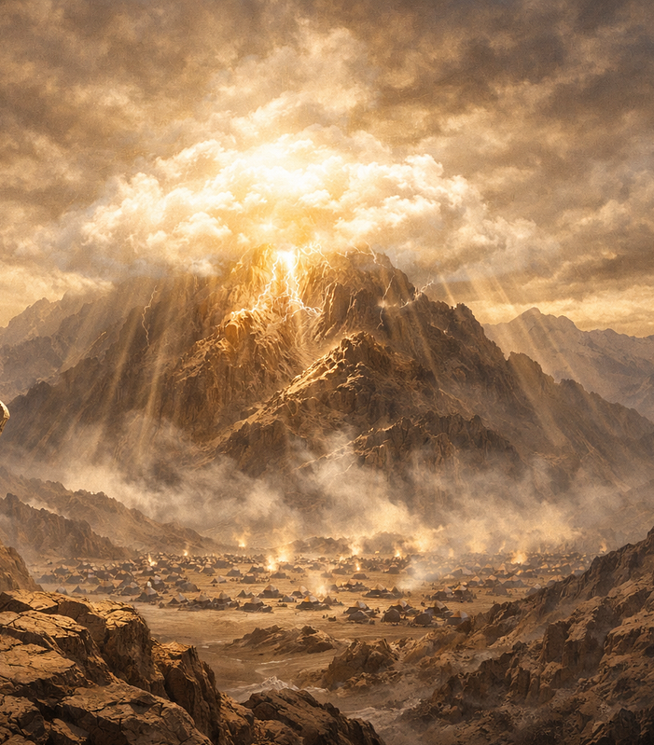
Exodus 24:15-17
¹⁷ And the sight of the glory of the Lord was like devouring fire on the top of the mount in the eyes of the children of Israel.

Slide 10
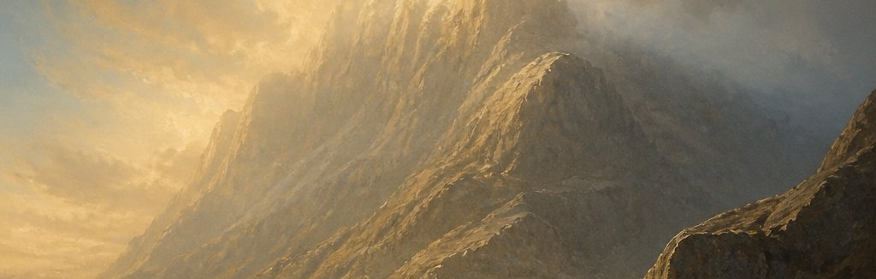
3. How long was Moses in the mount?
Exodus 24:18

Slide 11
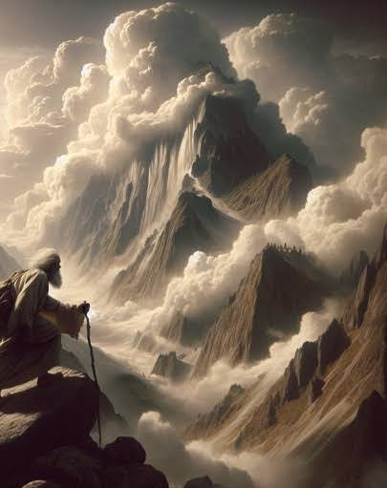
Exodus 24:18
¹⁸ And Moses went into the midst of the cloud, and gat him up into the mount: and Moses was in the mount forty days and forty nights.

Slide 12
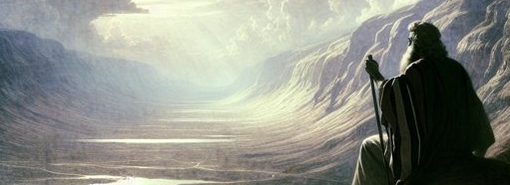
4. Did he eat or drink during that time?
Deuteronomy 9:9

Slide 13
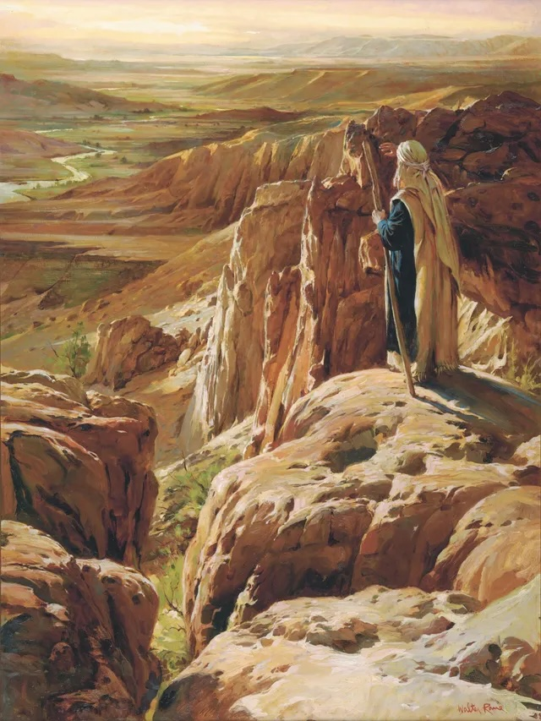
Deuteronomy 9:9
⁹ When I was gone up into the mount to receive the tables of stone, even the tables of the covenant which the Lord made with you, then I abode in the mount forty days and forty nights, I neither did eat bread nor drink water:

Slide 14
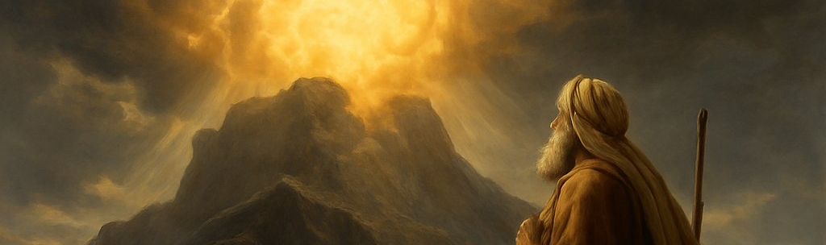
5. When the Lord had finished talking with Moses, what did he give him?
Exodus 31:18

Slide 15
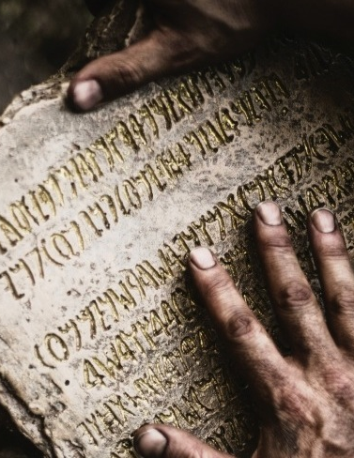
Exodus 31:18
¹⁸ And he gave unto Moses, when he had made an end of communing with him upon mount Sinai, two tables of testimony, tables of stone, written with the finger of God.

Slide 16
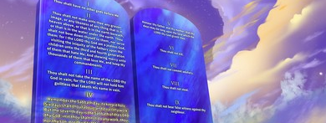
6. What was on these tables of stone?
Deuteronomy 9:10

Slide 17
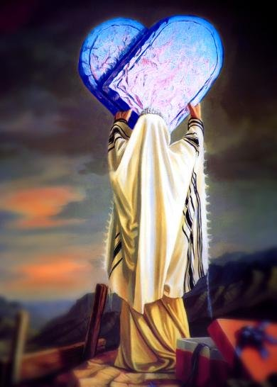
Deuteronomy 9:10
¹⁰ And the Lord delivered unto me two tables of stone written with the finger of God; and on them was written according to all the words, which the Lord spake with you in the mount out of the midst of the fire in the day of the assembly.

Slide 18
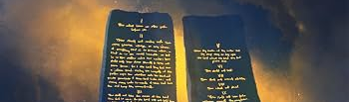
7. Whose workmanship were the tables, and how were they filled?
Exodus 32:15, 16

Slide 19
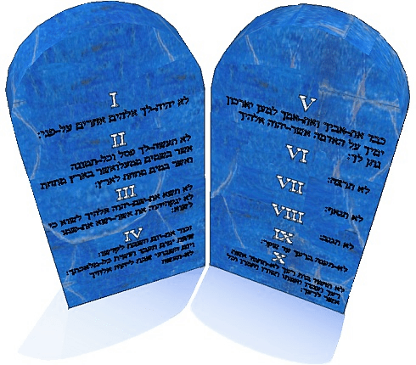
Exodus 32:15, 16
¹⁵ And Moses turned, and went down from the mount, and the two tables of the testimony were in his hand: the tables were written on both their sides; on the one side and on the other were they written.

Slide 20
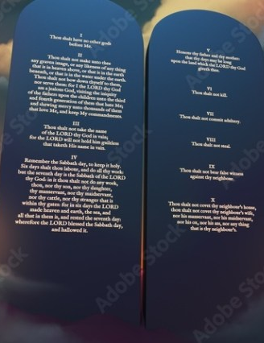
Exodus 32:15, 16
¹⁶ And the tables were the work of God, and the writing was the writing of God, graven upon the tables.

Slide 21
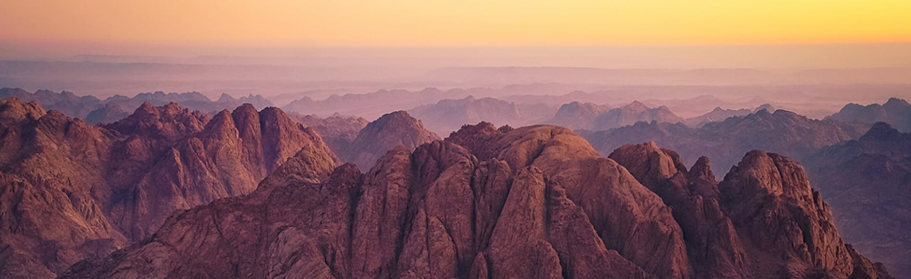
8. What did the people say and do when they saw how long Moses was gone?
Exodus 32:1-3

Slide 22
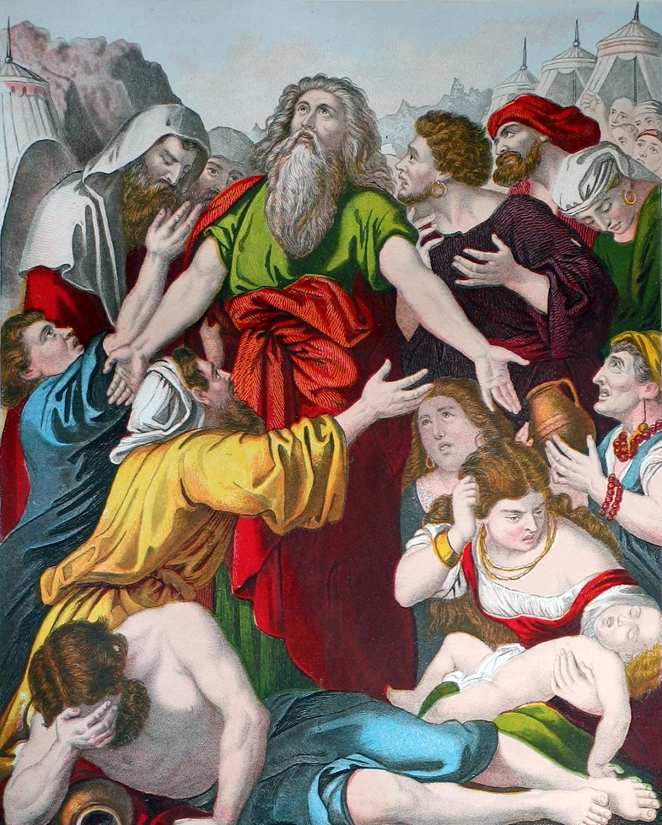
Exodus 32:1-3
32 And when the people saw that Moses delayed to come down out of the mount, the people gathered themselves together unto Aaron, and said unto him, Up, make us gods, which shall go before us; for as for this Moses, the man that brought us up out of the land of Egypt, we wot not what is become of him.

Slide 23
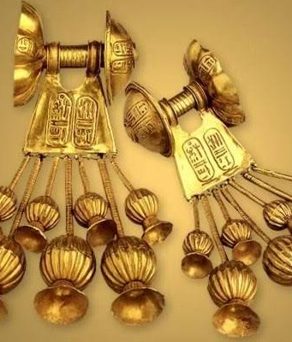
Exodus 32:1-3
² And Aaron said unto them, Break off the golden earrings, which are in the ears of your wives, of your sons, and of your daughters, and bring them unto me.

Slide 24
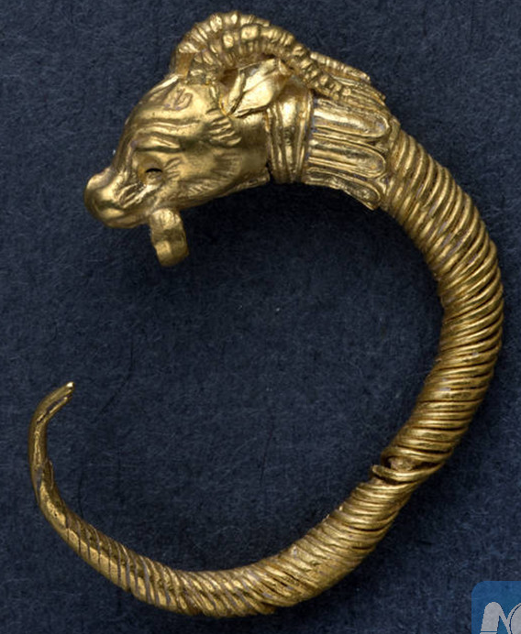
Exodus 32:1-3
³ And all the people brake off the golden earrings which were in their ears, and brought them unto Aaron.

Slide 25
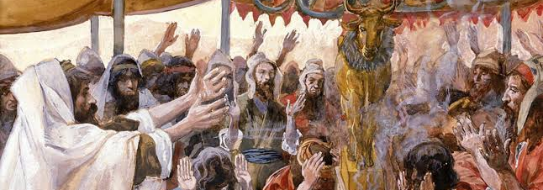
9. What did Aaron do with the gold?
Exodus 32:4

Slide 26
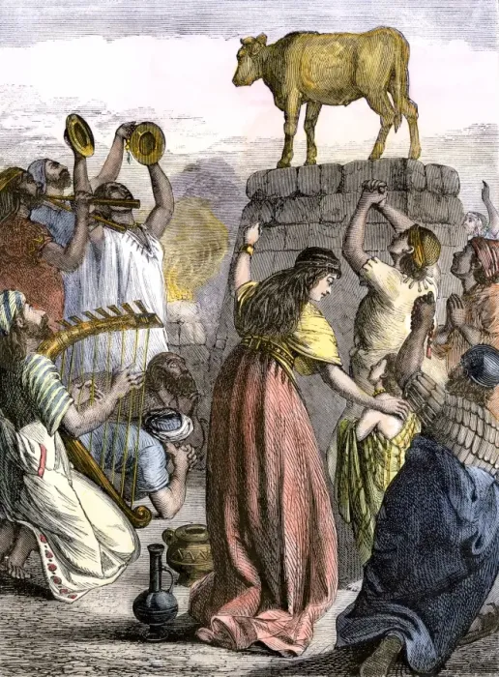
Exodus 32:4
⁴ And he received them at their hand, and fashioned it with a graving tool, after he had made it a molten calf: and they said, These be thy gods, O Israel, which brought thee up out of the land of Egypt.

Slide 27
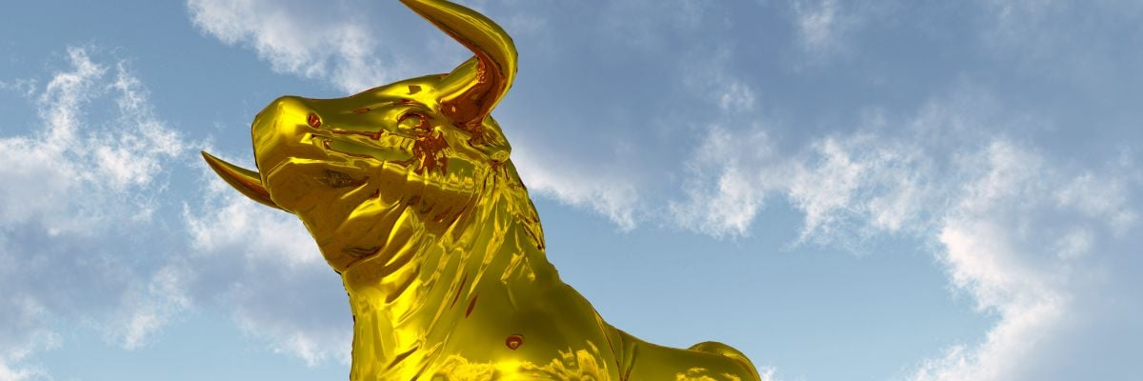
10. What did they call this golden calf?
Exodus 32:4

Slide 28
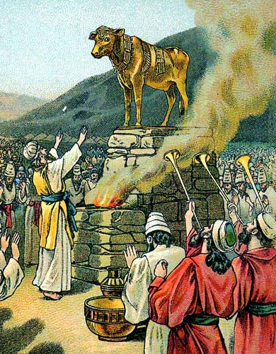
Exodus 32:4
⁴ And he received them at their hand, and fashioned it with a graving tool, after he had made it a molten calf: and they said, These be thy gods, O Israel, which brought thee up out of the land of Egypt.

Slide 29
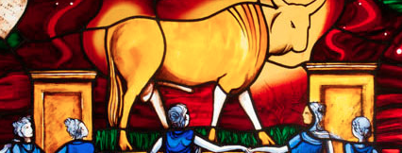
11. What does the psalmist say of this?
Psalm 106:19, 20

Slide 30
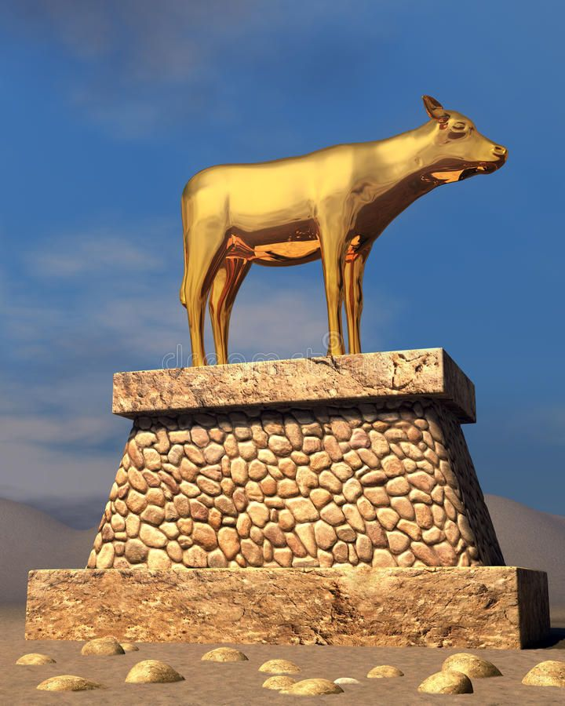
Psalm 106:19-20
¹⁹ They made a calf in Horeb, and worshipped the molten image.
²⁰ Thus they changed their glory into the similitude of an ox that eateth grass.

Slide 31
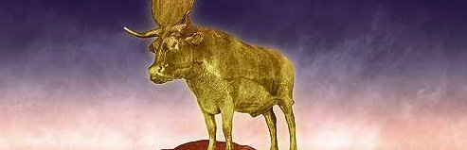
12. Before they could do this, what did they forget?
Psalm 106:21, 22

Slide 32
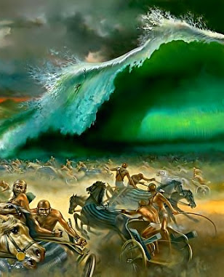
Psalm 106:21-22
²¹ They forgat God their saviour, which had done great things in Egypt;
²² Wondrous works in the land of Ham, and terrible things by the Red sea.

Slide 33
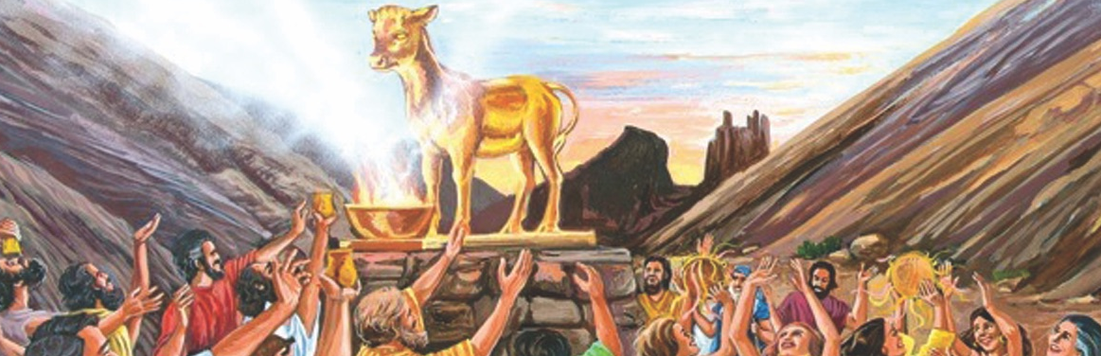
13. How did they worship this image?
Exodus 32:6

Slide 34
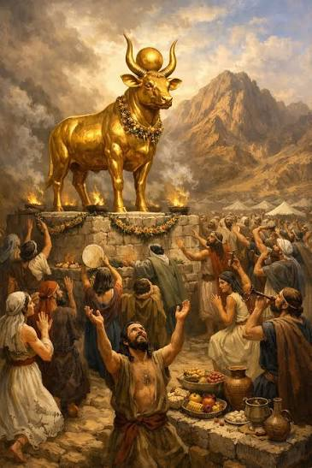
Exodus 32:6
⁶ And they rose up early on the morrow, and offered burnt offerings, and brought peace offerings; and the people sat down to eat and to drink, and rose up to play.

Slide 35
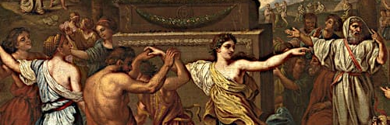
14. What must we conclude as to the nature of this "play"?

Slide 36
…when we read of the Israelites that “the people sat down to eat and to drink, and rose up to play” (Exodus 32:6), and learn that the word rendered “play” is the same as that rendered “mock” in Genesis 39:14, 17, we get a better idea of the heinousness of the sin of the Israelites.

Slide 37
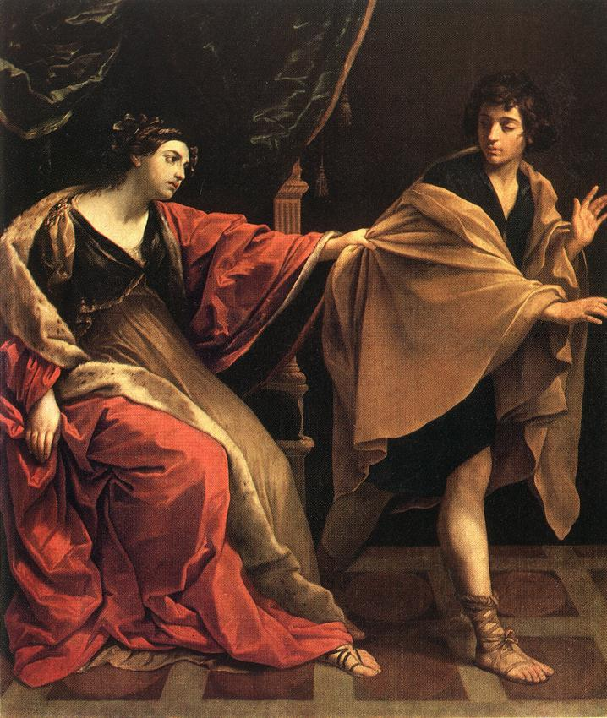
¹¹ And it came to pass about this time, that Joseph went into the house to do his business; and there was none of the men of the house there within.
¹² And she caught him by his garment, saying, Lie with me: and he left his garment in her hand, and fled, and got him out.

Slide 38
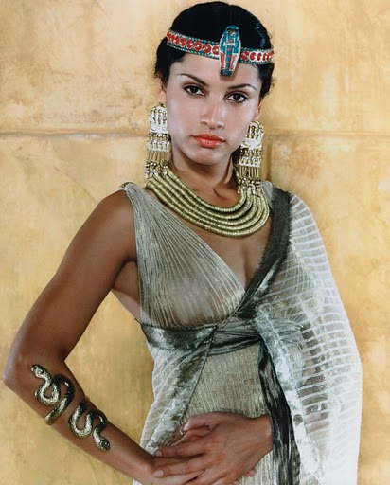
¹³ And it came to pass, when she saw that he had left his garment in her hand, and was fled forth,
¹⁴ That she called unto the men of her house, and spake unto them, saying, See, he hath brought in an Hebrew unto us to mock us; he came in unto me to lie with me, and I cried with a loud voice:

Slide 39
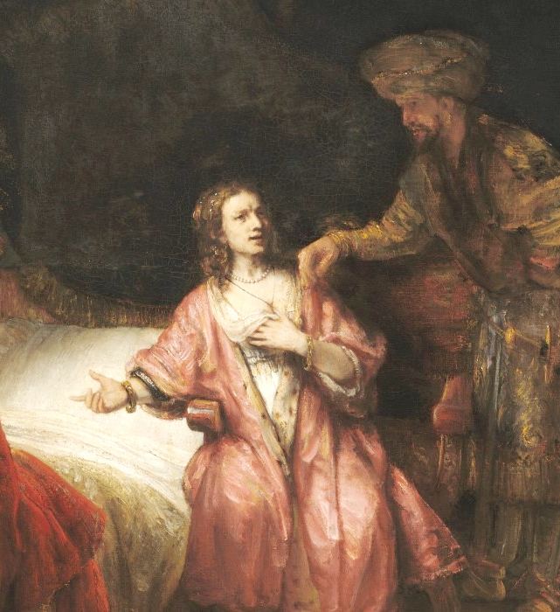
¹⁶ And she laid up his garment by her, until his lord came home.
¹⁷ And she spake unto him according to these words, saying, The Hebrew servant, which thou hast brought unto us, came in unto me to mock me:

Slide 40
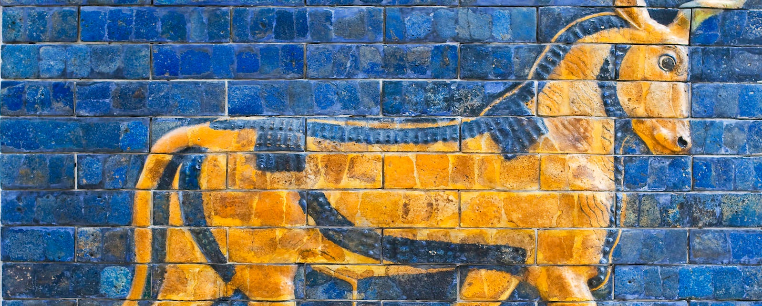
15. How did the people happen to make a calf to worship, instead of the image of a man?

Slide 41
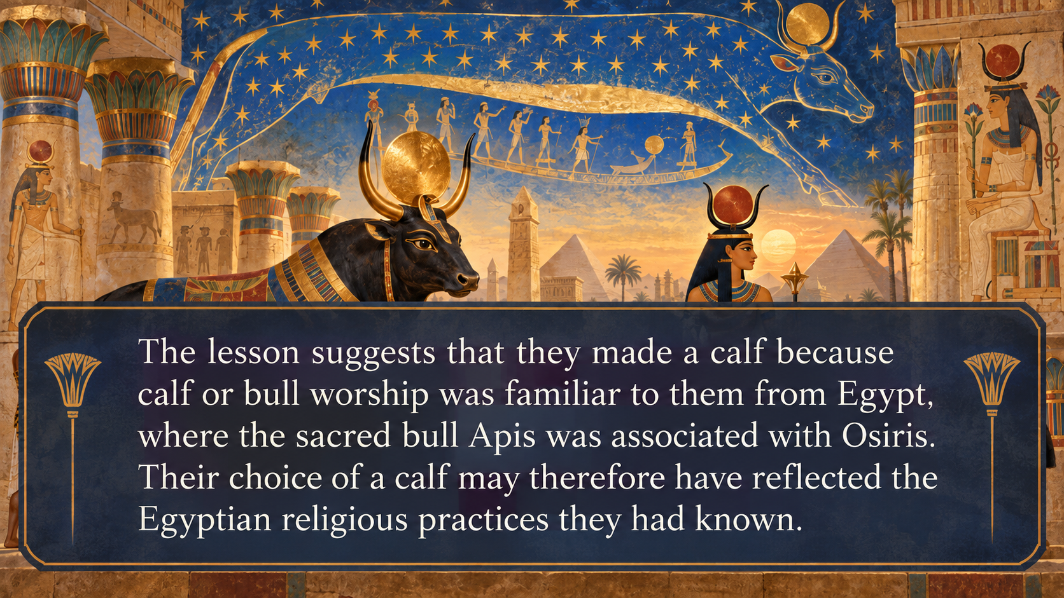

Slide 42
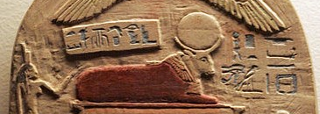
16. What was the Egyptian calf-worship?

Slide 43
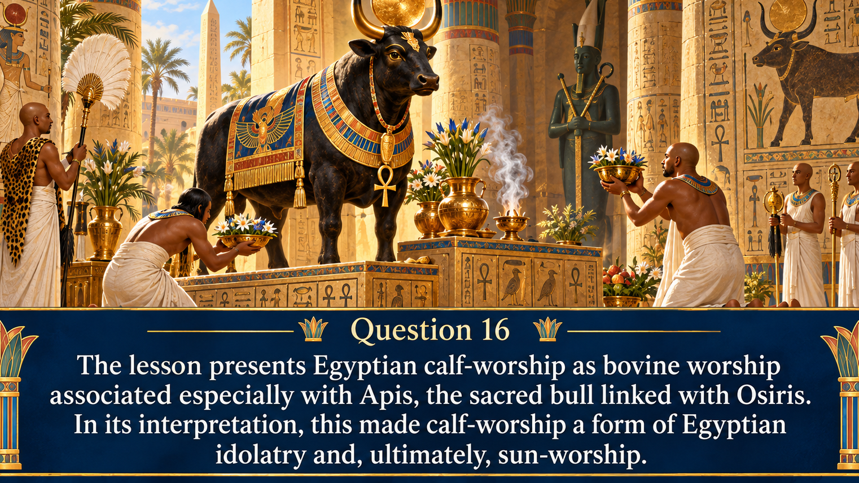

Slide 44
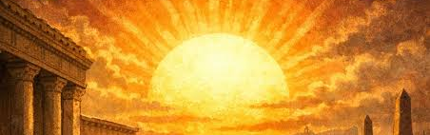
17. How extensive was sun-worship anciently? and what was the nature of it?

Slide 45

Sun-worship as one of the most widespread forms of ancient idolatry, appearing in many nations under different names and deities. Because the sun was regarded as a life-giving power, its worship was often connected with fertility and reproduction and, in some forms, with sexually immoral rites.

Slide 46
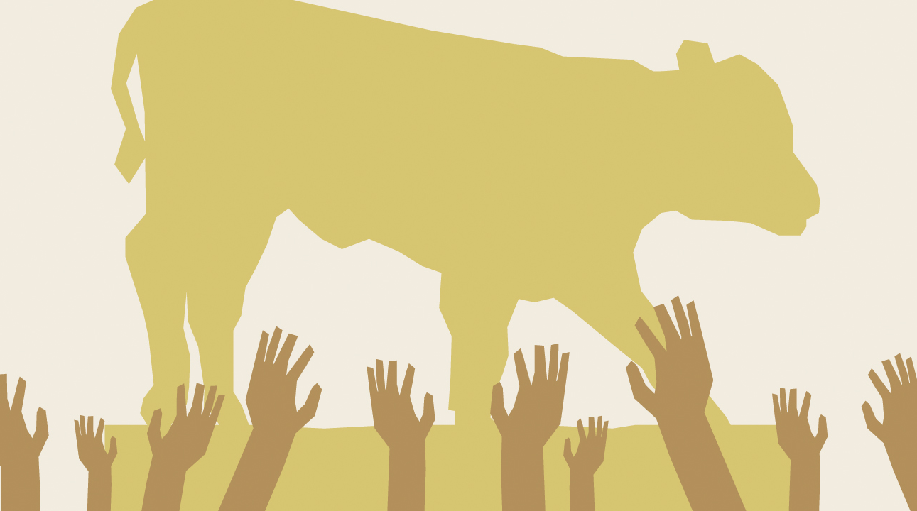
18. What did God think to do to the Israelites for their abominable idolatry?
Exodus 32:9, 10; Deuteronomy 9:20

Slide 47
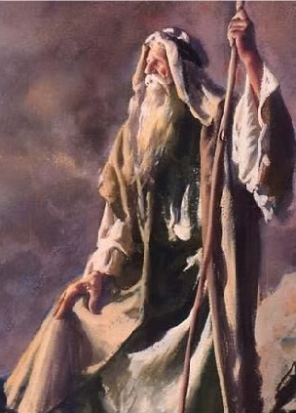
Exodus 32:9, 10
⁹ And the Lord said unto Moses, I have seen this people, and, behold, it is a stiffnecked people:
¹⁰ Now therefore let me alone, that my wrath may wax hot against them, and that I may consume them: and I will make of thee a great nation.

Slide 48
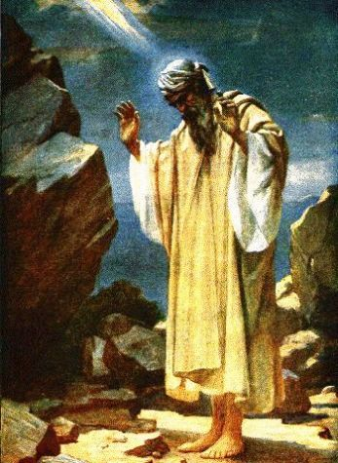
Deuteronomy 9:20
²⁰ And the Lord was very angry with Aaron to have destroyed him: and I prayed for Aaron also the same time.

Slide 49
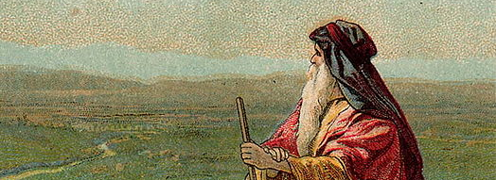
19. With what words did Moses plead for them?
Exodus 32:11-13, 31-32

Slide 50
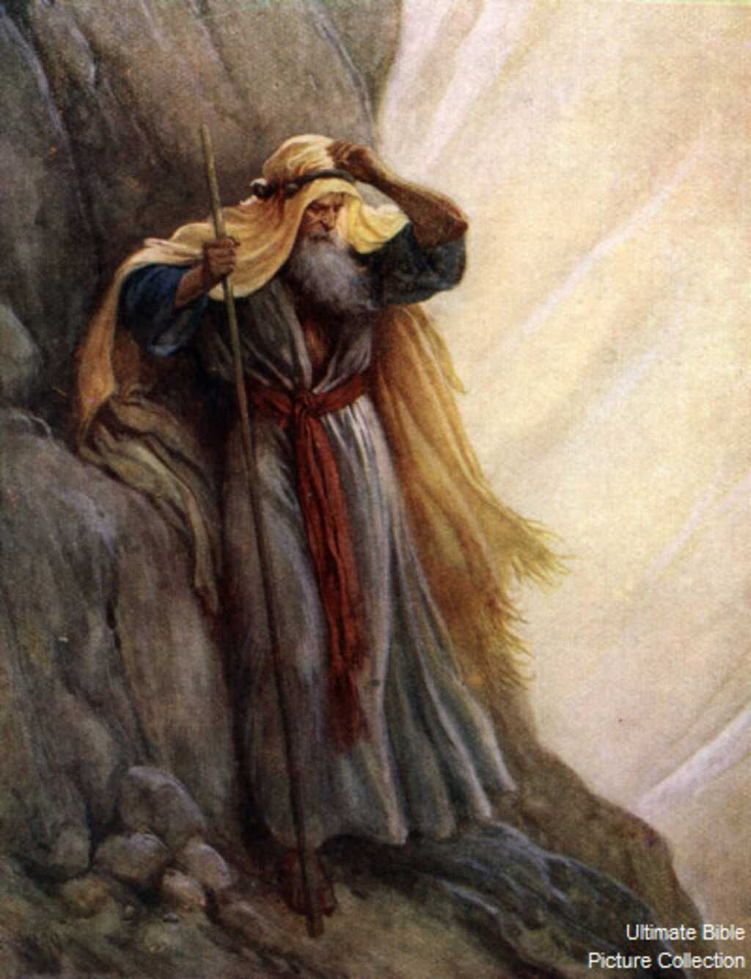
Exodus 32:11-13
¹¹ And Moses besought the Lord his God, and said, Lord, why doth thy wrath wax hot against thy people, which thou hast brought forth out of the land of Egypt with great power, and with a mighty hand?

Slide 51
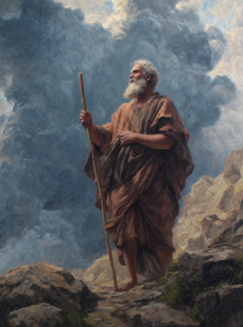
Exodus 32:11-13
¹² Wherefore should the Egyptians speak, and say, For mischief did he bring them out, to slay them in the mountains, and to consume them from the face of the earth? Turn from thy fierce wrath, and repent of this evil against thy people.

Slide 52
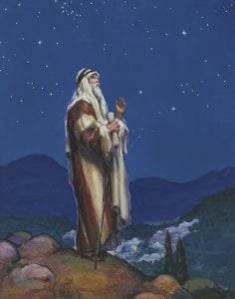
Exodus 32:11-13
¹³ Remember Abraham, Isaac, and Israel, thy servants, to whom thou swarest by thine own self, and saidst unto them, I will multiply your seed as the stars of heaven, and all this land that I have spoken of will I give unto your seed, and they shall inherit it for ever.

Slide 53
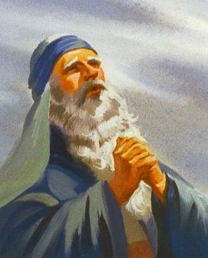
Exodus 32:31-32
³¹ And Moses returned unto the Lord, and said, Oh, this people have sinned a great sin, and have made them gods of gold.
³² Yet now, if thou wilt forgive their sin--; and if not, blot me, I pray thee, out of thy book which thou hast written.

Slide 54
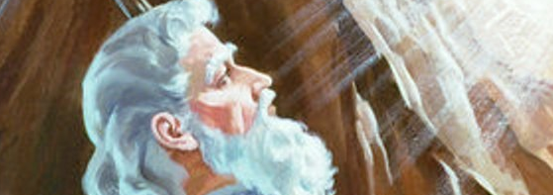
20. Did the Lord grant his request?
Exodus 32:14, 33, 34

Slide 55
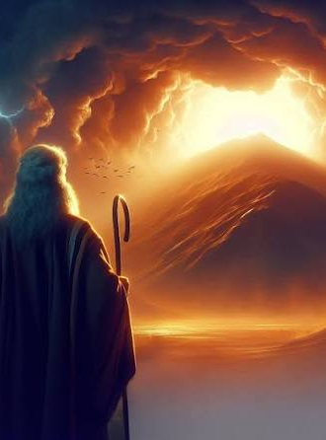
Exodus 32:14, 33, 34
¹⁴ And the Lord repented of the evil which he thought to do unto his people.

Slide 56

Exodus 32:14, 33, 34
³³ And the Lord said unto Moses, Whosoever hath sinned against me, him will I blot out of my book.
³⁴ Therefore now go, lead the people unto the place of which I have spoken unto thee: behold, mine Angel shall go before thee: nevertheless in the day when I visit I will visit their sin upon them.

Slide 57

21. What immediate punishment did the people receive?
Exodus 32:19, 20, 26-28, 35

Slide 58

Exodus 32:19, 20
¹⁹ And it came to pass, as soon as he came nigh unto the camp, that he saw the calf, and the dancing: and Moses' anger waxed hot, and he cast the tables out of his hands, and brake them beneath the mount.

Slide 59

Exodus 32:19, 20
²⁰ And he took the calf which they had made, and burnt it in the fire, and ground it to powder, and strawed it upon the water, and made the children of Israel drink of it.

Slide 60

Exodus 32:26-28
²⁶ Then Moses stood in the gate of the camp, and said, Who is on the Lord's side? let him come unto me. And all the sons of Levi gathered themselves together unto him.

Slide 61

Exodus 32:26-28
²⁷ And he said unto them, Thus saith the Lord God of Israel, Put every man his sword by his side, and go in and out from gate to gate throughout the camp, and slay every man his brother, and every man his companion, and every man his neighbour.

Slide 62

Exodus 32:26-28
²⁸ And the children of Levi did according to the word of Moses: and there fell of the people that day about three thousand men.

Slide 63

Exodus 32:35
³⁵ And the Lord plagued the people, because they made the calf, which Aaron made.

Slide 64


Slide 65


Slide 66


Slide 67


Slide 68


Slide 69


Slide 70

2 Chronicles 33:11
Wherefore the Lord brought upon them the captains of the host of the king of Assyria, which took Manasseh among the thorns, and bound him with fetters, and carried him to Babylon.

Slide 71

2 Kings 19 describes the failed campaign of Assyrian King Sennacherib against Jerusalem at the end of the eighth century b.c.e., at the time ruled by Manasseh’s father, Hezekiah. Here was God’s message to Sennacherib:
“Because of thy raging against Me, And for that they tumult is come up into Mine ears, Therefore will I put My hook in thy nose, And My bridle in thy lips, And I will turn thee back by the way By which thou camest” (2 Kings 19:28)

Slide 73

2 Chronicles 33:12-13
¹² And when he was in affliction, he besought the Lord his God, and humbled himself greatly before the God of his fathers,
¹³ And prayed unto him: and he was intreated of him, and heard his supplication, and brought him again to Jerusalem into his kingdom. Then Manasseh knew that the Lord he was God.

Slide 74


