Slide 1


Slide 2


Slide 3
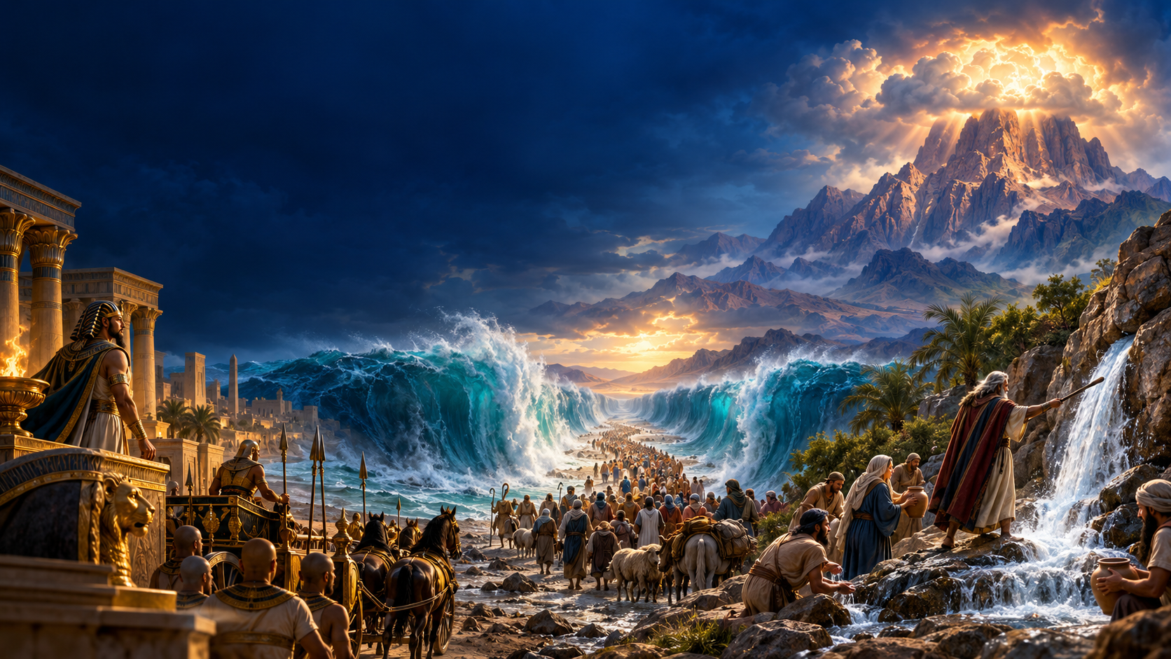
QUARTERLY REVIEW
OLD TESTAMENT HISTORY
Lesson 13 · March 30, 1889

Slide 4
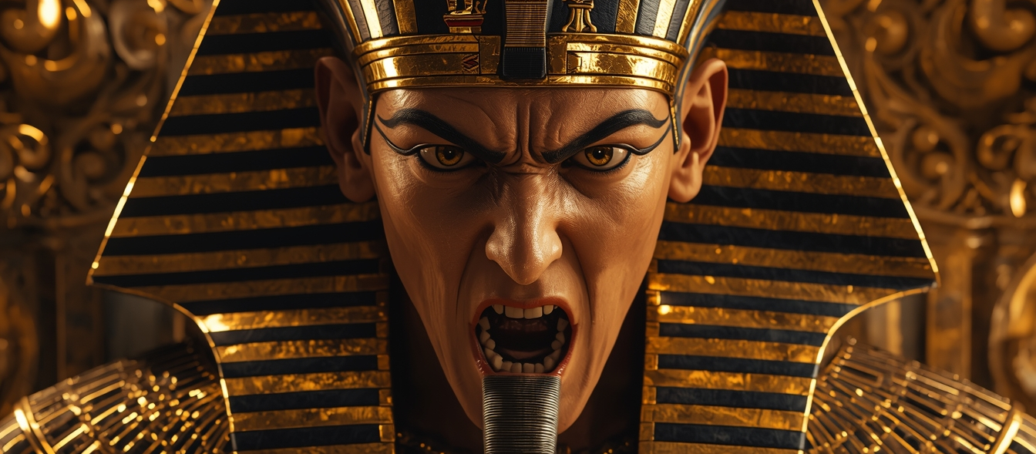
1. How many plagues came upon Egypt because of Pharaoh’s refusal to let the Israelites go?

Slide 5
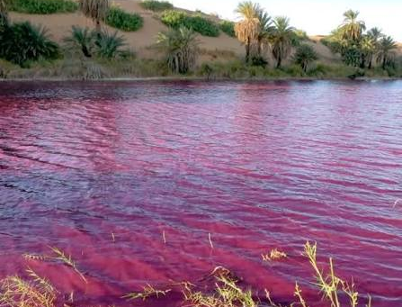
1. How many plagues came upon Egypt because of Pharaoh’s refusal to let the Israelites go?
Ten Plagues
Exodus 12:12
For I will pass through the land of Egypt this night, and will smite all the firstborn in the land of Egypt, both man and beast; and against all the gods of Egypt I will execute judgment: I am the LORD .

Slide 6
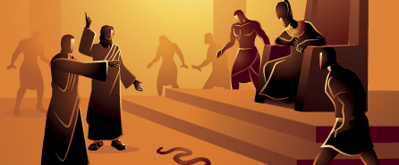
2. How many of these were imitated by the magicians?

Slide 7

2. How many of these were imitated by the magicians?
Exodus 7:21
And the fish that was in the river died; and the river stank, and the Egyptians could not drink of the water of the river; and there was blood throughout all the land of Egypt.

Slide 8
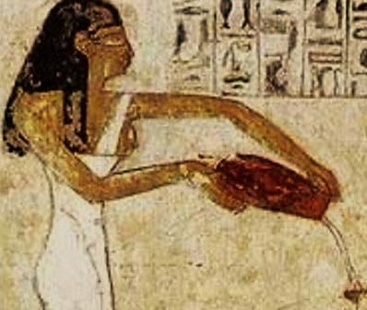
2. How many of these were imitated by the magicians?
Exodus 7:22
And the magicians of Egypt did so with their enchantments: and Pharaoh's heart was hardened, neither did he hearken unto them; as the LORD had said.

Slide 9

2. How many of these were imitated by the magicians?
Exodus 8:7
And the magicians did so with their enchantments, and brought up frogs upon the land of Egypt.

Slide 10
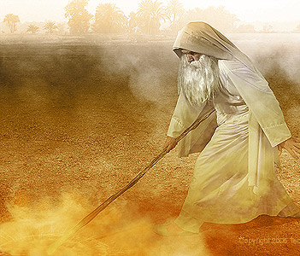
2. How many of these were imitated by the magicians?
Exodus 8:18
And the magicians did so with their enchantments to bring forth lice, but they could not: so there were lice upon man, and upon beast.

Slide 11
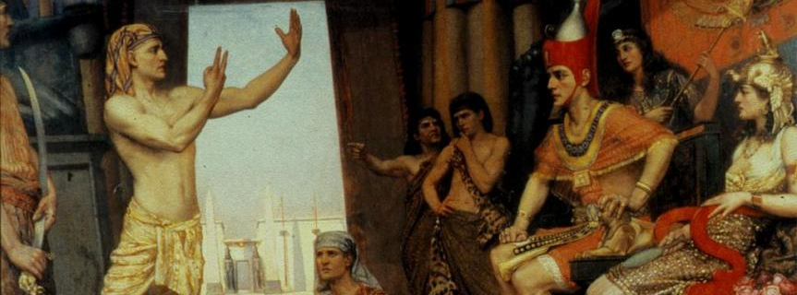
3. What effect did the work of the magicians have upon Pharaoh?

Slide 12
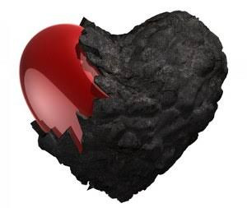
3. What effect did the work of the magicians have upon Pharaoh?
Exodus 7:22
And the magicians of Egypt did so with their enchantments: and Pharaoh's heart was hardened, neither did he hearken unto them; as the LORD had said.

Slide 13
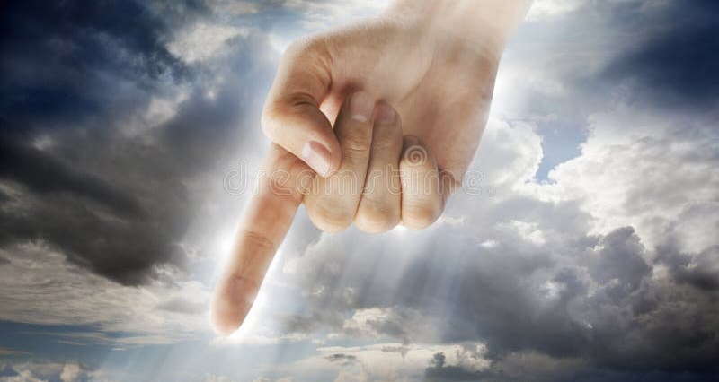
3. What effect did the work of the magicians have upon Pharaoh?
Their imitation gave Pharaoh another reason to resist. When they could no longer imitate the plagues, he still refused to listen.
Exodus 8:19
Then the magicians said unto Pharaoh, This is the finger of God: and Pharaoh's heart was hardened, and he hearkened not unto them; as the LORD had said.

Slide 14
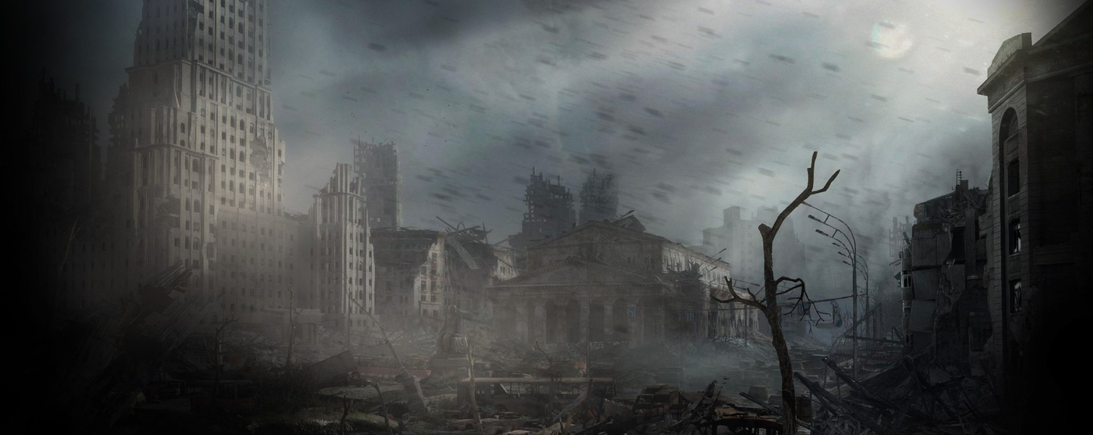
4. What similar thing will take place in the last days?

Slide 15

4. What similar thing will take place in the last days?
Deceptive signs will again be used to draw people away from the truth.
2 Thessalonians 2:9
Even him , whose coming is after the working of Satan with all power and signs and lying wonders,

Slide 16
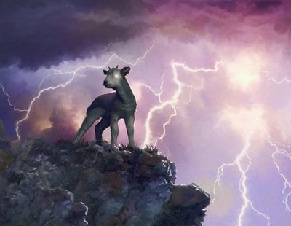
4. What similar thing will take place in the last days?
Revelation 13:13
And he doeth great wonders, so that he maketh fire come down from heaven on the earth in the sight of men,

Slide 17
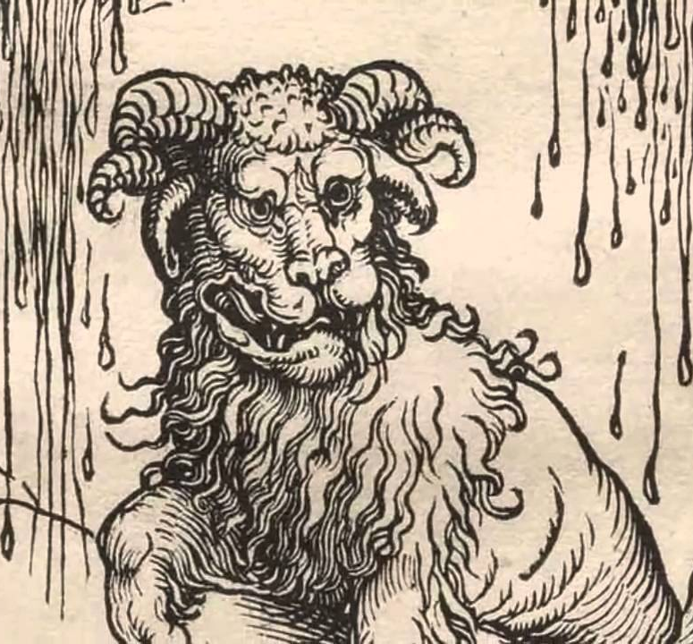
4. What similar thing will take place in the last days?
Revelation 13:14
And deceiveth them that dwell on the earth by the means of those miracles which he had power to do in the sight of the beast; saying to them that dwell on the earth, that they should make an image to the beast, which had the wound by a sword, and did live.

Slide 18
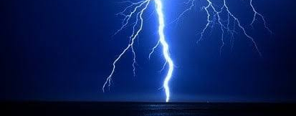
5. What power is behind all opposition to the truth?

Slide 19
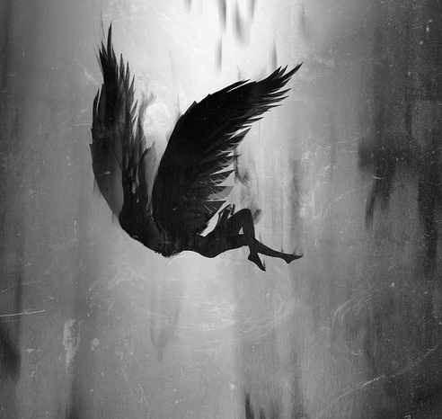
5. What power is behind all opposition to the truth?
John 8:44
Ye are of your father the devil, and the lusts of your father ye will do. He was a murderer from the beginning, and abode not in the truth, because there is no truth in him. When he speaketh a lie, he speaketh of his own: for he is a liar, and the father of it.

Slide 20
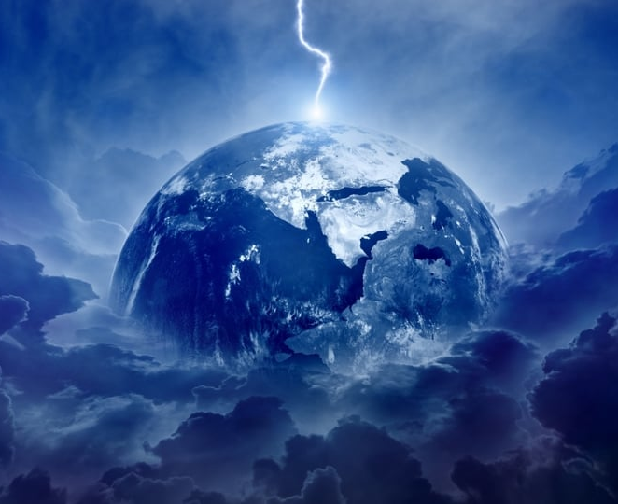
5. What power is behind all opposition to the truth?
Ephesians 6:12
For we wrestle not against flesh and blood, but against principalities, against powers, against the rulers of the darkness of this world, against spiritual wickedness in high places .

Slide 21
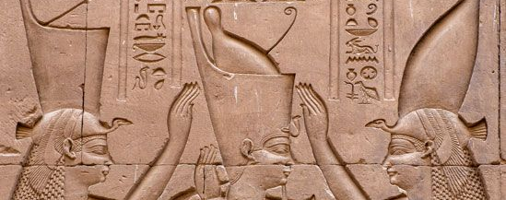
6. What was the character and disposition of Pharaoh?

Slide 22
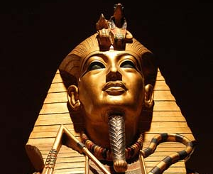
6. What was the character and disposition of Pharaoh?
Exodus 5:2
And Pharaoh said, Who is the LORD , that I should obey his voice to let Israel go? I know not the LORD , neither will I let Israel go.

Slide 23
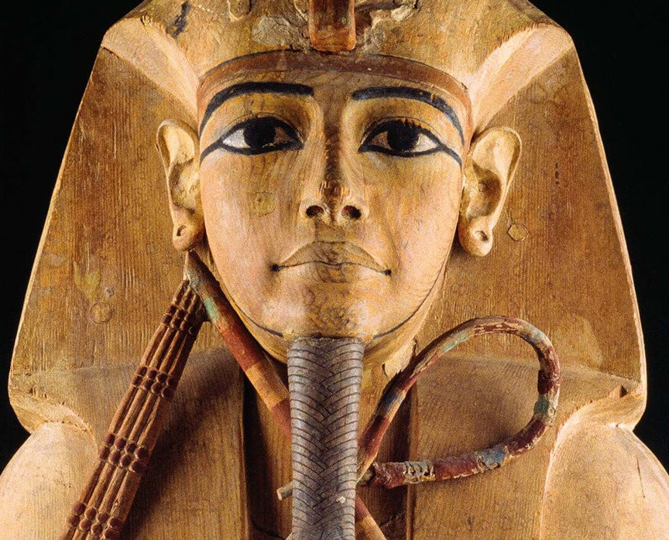
6. What was the character and disposition of Pharaoh?
Exodus 10:3
And Moses and Aaron came in unto Pharaoh, and said unto him, Thus saith the LORD God of the Hebrews, How long wilt thou refuse to humble thyself before me? let my people go, that they may serve me.

Slide 24
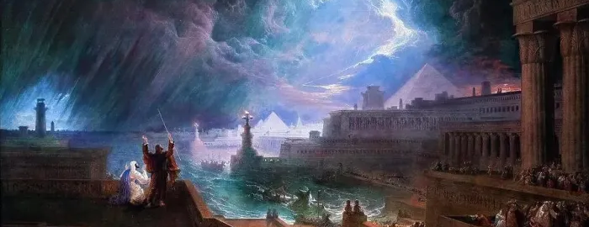
7. What effect did the plagues have upon him?

Slide 25
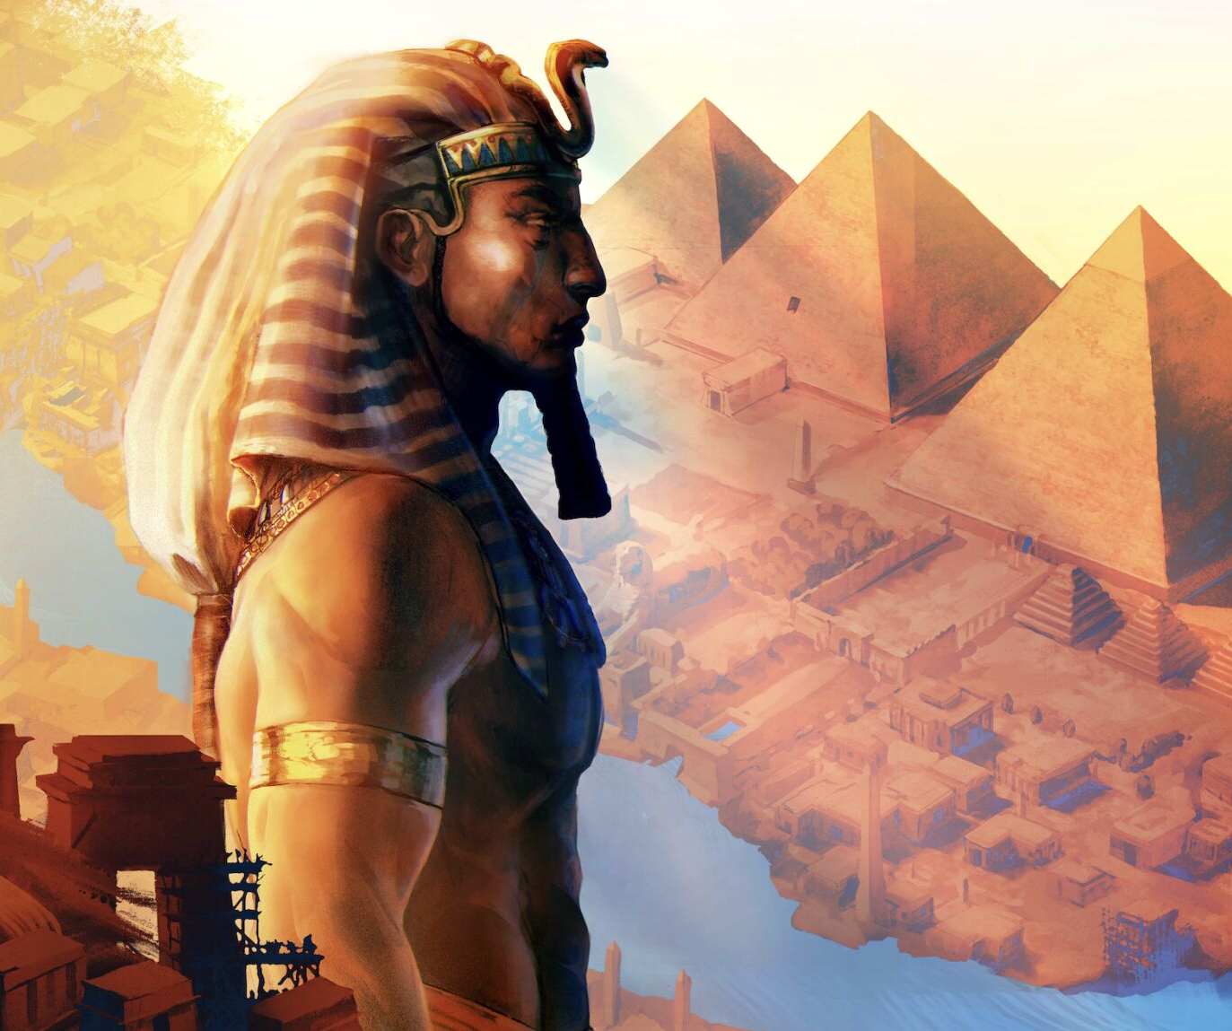
7. What effect did the plagues have upon him?
Exodus 9:27
And Pharaoh sent, and called for Moses and Aaron, and said unto them, I have sinned this time: the LORD is righteous, and I and my people are wicked.

Slide 26
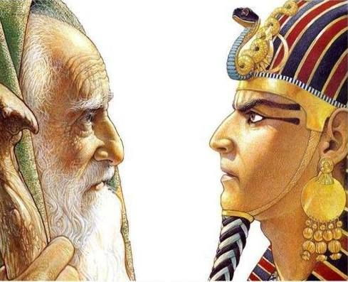
7. What effect did the plagues have upon him?
Exodus 8:15
But when Pharaoh saw that there was respite, he hardened his heart, and hearkened not unto them; as the LORD had said.

Slide 27
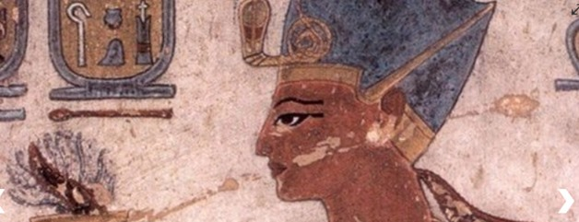
8. How was he confirmed in his obstinacy?

Slide 28
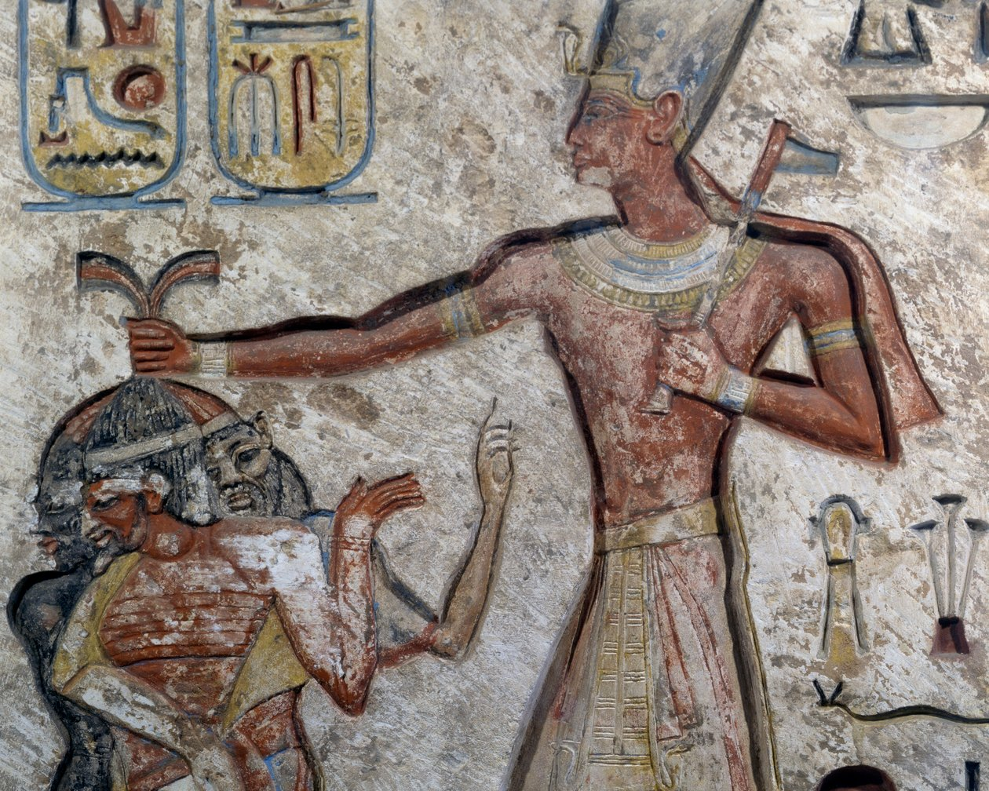
8. How was he confirmed in his obstinacy?
Exodus 8:15
But when Pharaoh saw that there was respite, he hardened his heart, and hearkened not unto them; as the LORD had said.

Slide 29
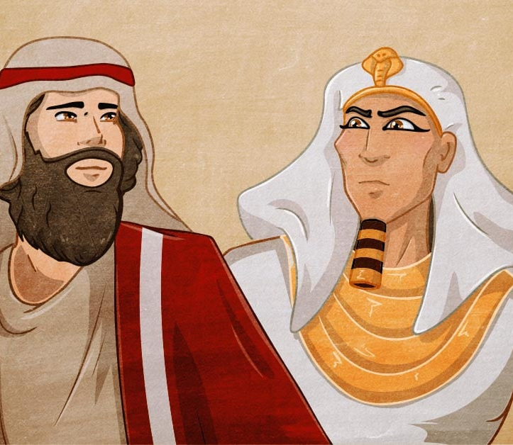
8. How was he confirmed in his obstinacy?
Exodus 9:34
And when Pharaoh saw that the rain and the hail and the thunders were ceased, he sinned yet more, and hardened his heart, he and his servants.

Slide 30
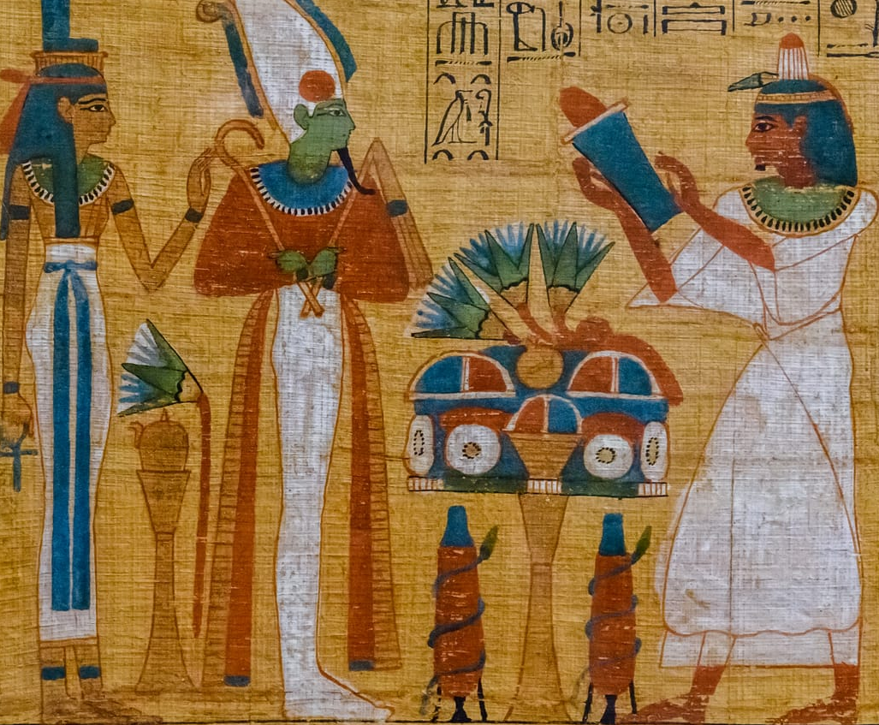
8. How was he confirmed in his obstinacy?
Exodus 7:22
And the magicians of Egypt did so with their enchantments: and Pharaoh's heart was hardened, neither did he hearken unto them; as the LORD had said.

Slide 31
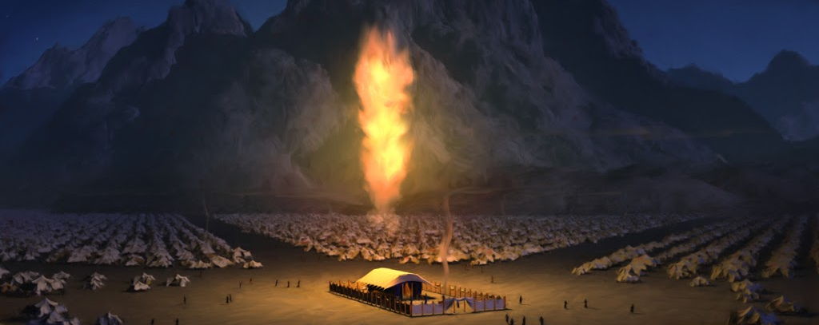
9. State the instances in which God showed his special care for his people.

Slide 32
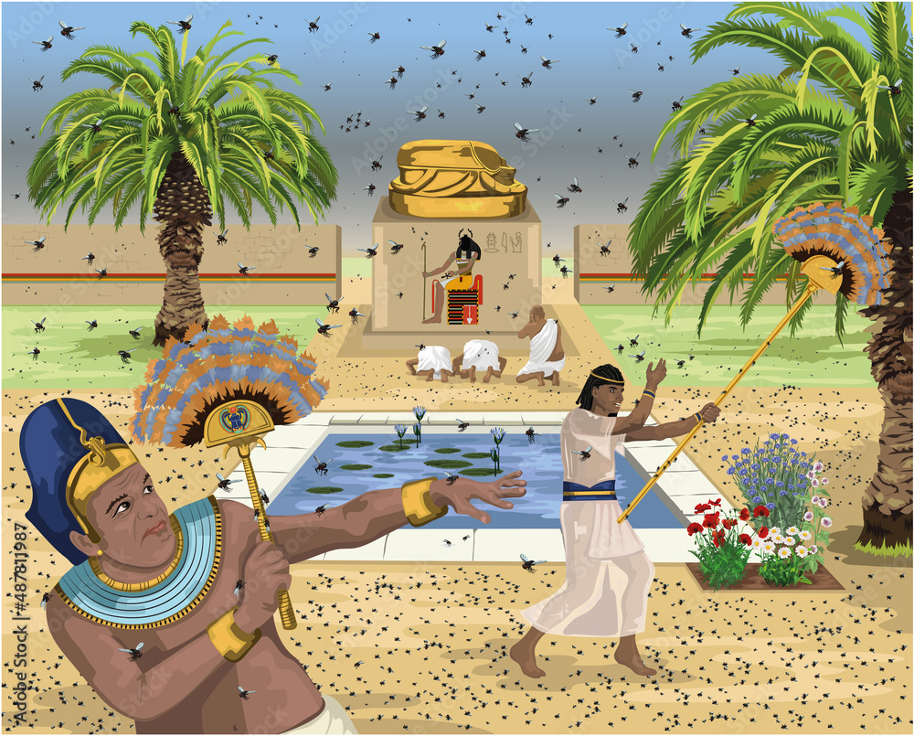
9. State the instances in which God showed his special care for his people.
Exodus 8:22
And I will sever in that day the land of Goshen, in which my people dwell, that no swarms of flies shall be there; to the end thou mayest know that I am the LORD in the midst of the earth.

Slide 33
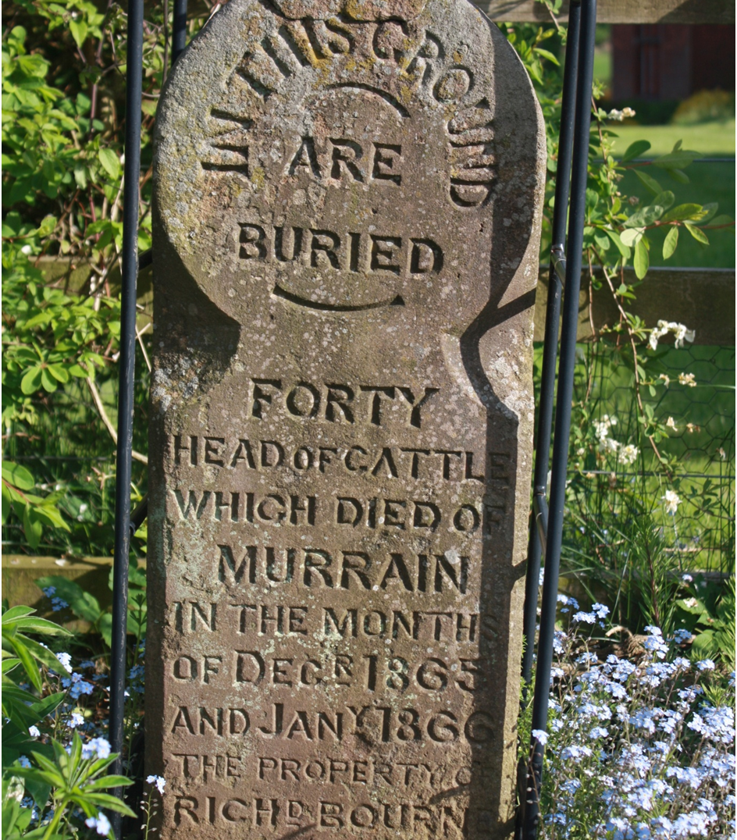
9. State the instances in which God showed his special care for his people.
Exodus 9:4
And the LORD shall sever between the cattle of Israel and the cattle of Egypt: and there shall nothing die of all that is the children's of Israel.

Slide 34
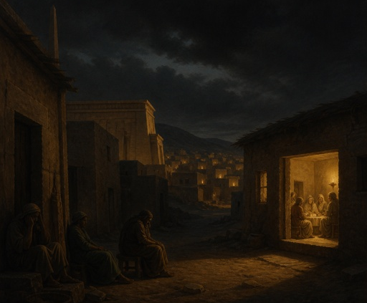
9. State the instances in which God showed his special care for his people.
Exodus 10:23
They saw not one another, neither rose any from his place for three days: but all the children of Israel had light in their dwellings.

Slide 35
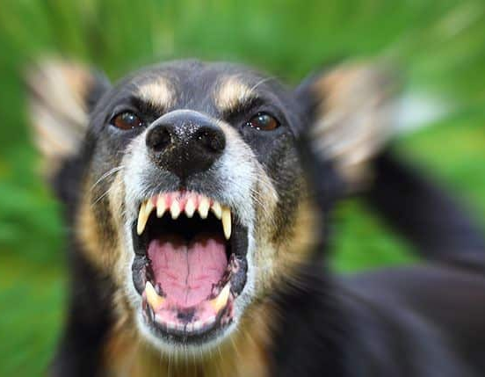
9. State the instances in which God showed his special care for his people.
Exodus 11:7
But against any of the children of Israel shall not a dog move his tongue, against man or beast: that ye may know how that the LORD doth put a difference between the Egyptians and Israel.

Slide 36

9. State the instances in which God showed his special care for his people.
Exodus 13:21
And the LORD went before them by day in a pillar of a cloud, to lead them the way; and by night in a pillar of fire, to give them light; to go by day and night:

Slide 37
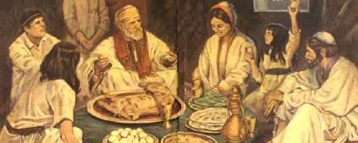
10. When, how, and why was the Passover instituted?

Slide 38

10. When, how, and why was the Passover instituted?
Exodus 12:3
Speak ye unto all the congregation of Israel, saying, In the tenth day of this month they shall take to them every man a lamb, according to the house of their fathers, a lamb for an house:

Slide 39
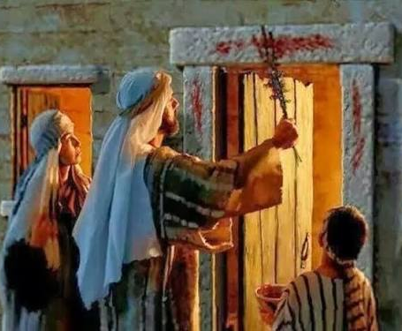
10. When, how, and why was the Passover instituted?
Exodus 12:7
And they shall take of the blood, and strike it on the two side posts and on the upper door post of the houses, wherein they shall eat it.

Slide 40
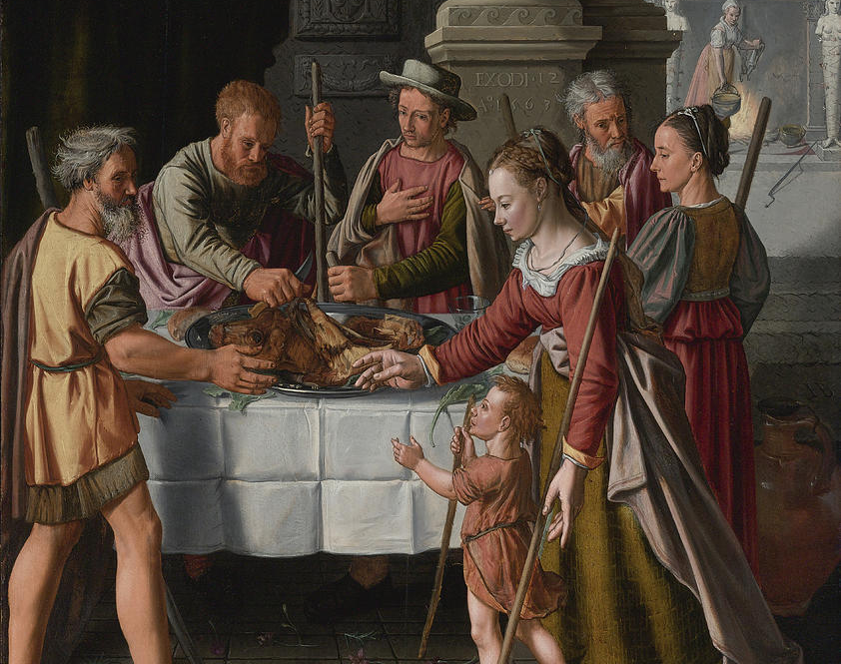
10. When, how, and why was the Passover instituted?
Exodus 12:11
And thus shall ye eat it; with your loins girded, your shoes on your feet, and your staff in your hand; and ye shall eat it in haste: it is the LORD's passover.

Slide 41
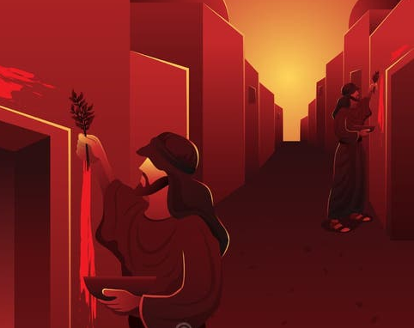
10. When, how, and why was the Passover instituted?
Exodus 12:13
And the blood shall be to you for a token upon the houses where ye are: and when I see the blood, I will pass over you, and the plague shall not be upon you to destroy you , when I smite the land of Egypt.

Slide 42
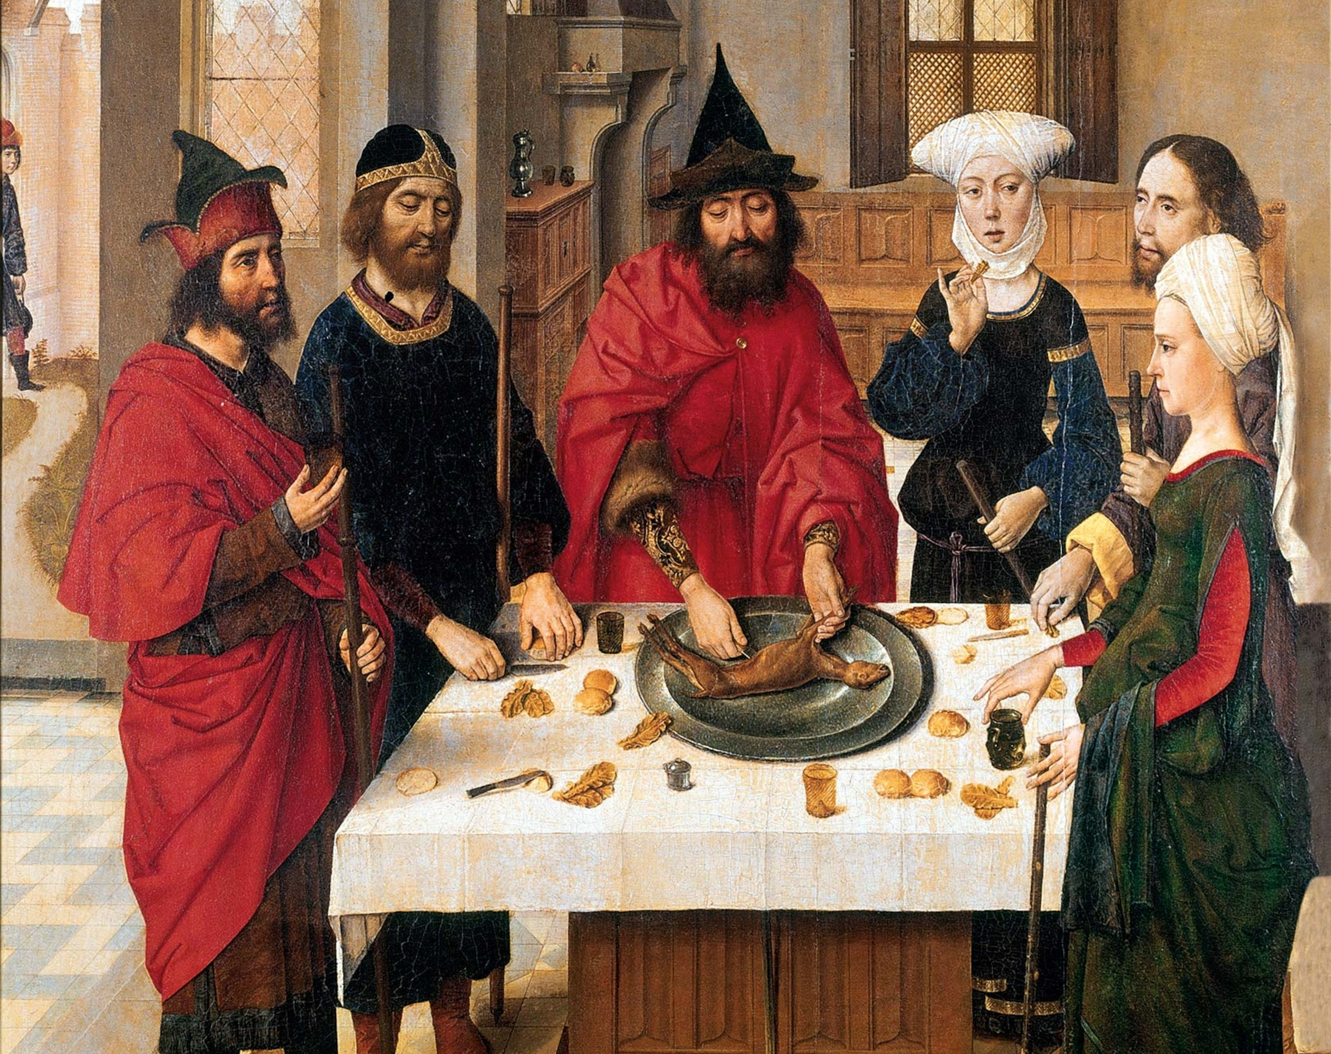
10. When, how, and why was the Passover instituted?
Exodus 12:14
And this day shall be unto you for a memorial; and ye shall keep it a feast to the LORD throughout your generations; ye shall keep it a feast by an ordinance for ever.

Slide 43
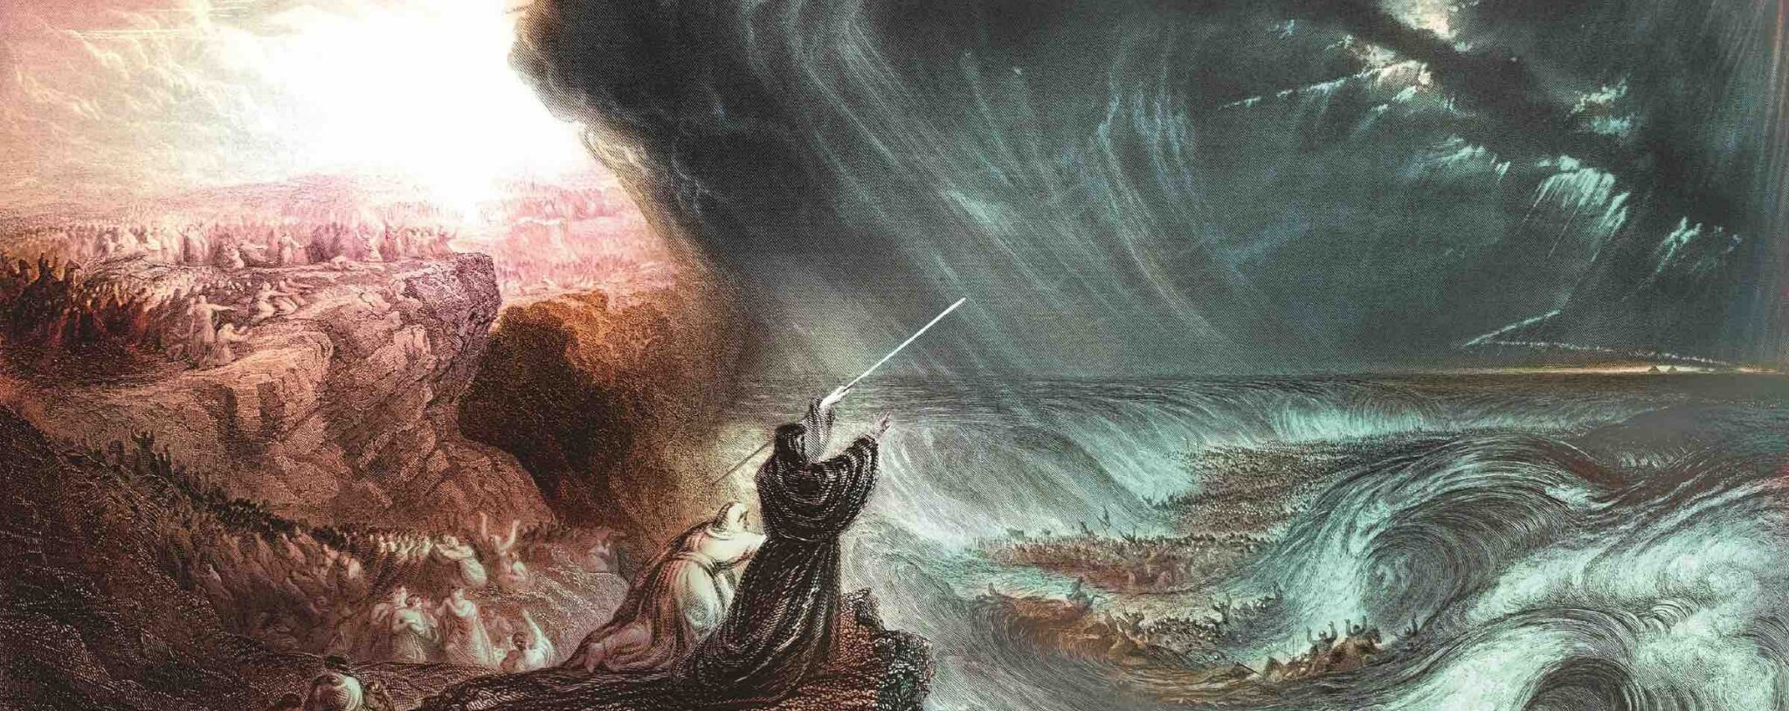
11. Of what was the deliverance from Egypt a type?

Slide 44
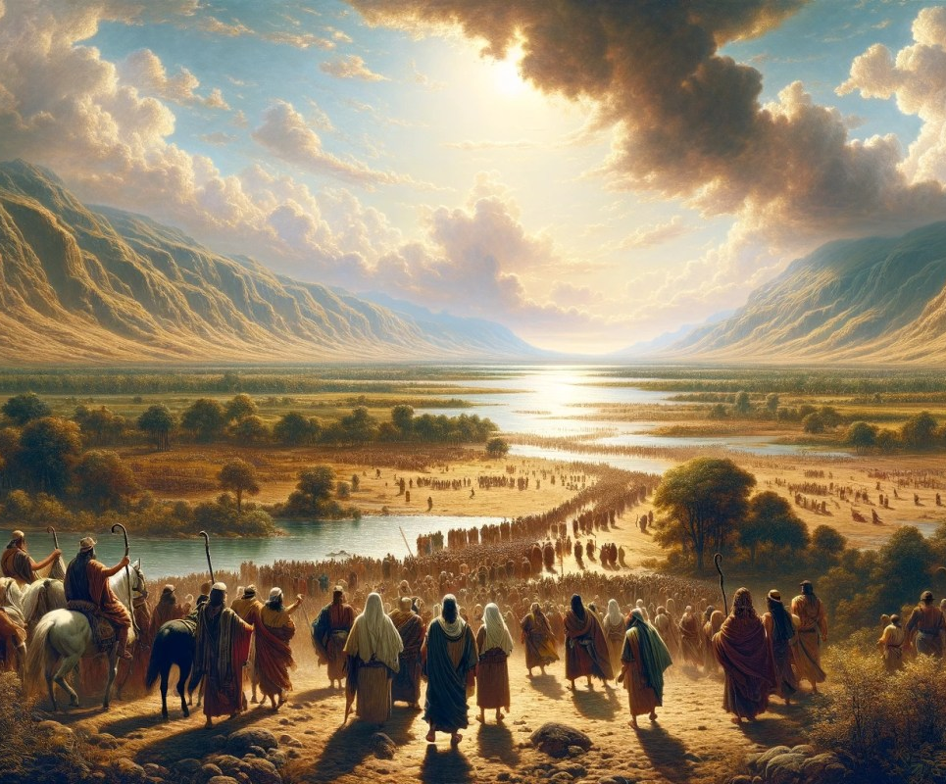
11. Of what was the deliverance from Egypt a type?
It foreshadowed deliverance from sin and the world through Christ, and the journey toward our ultimate promised inheritance.

Slide 45
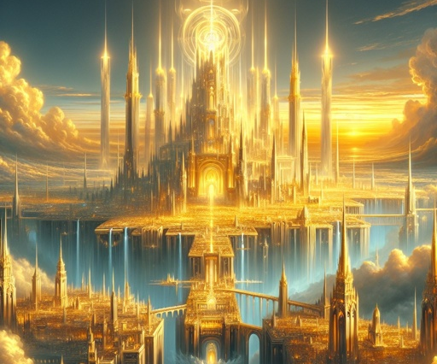
11. Of what was the deliverance from Egypt a type?
Hebrews 11:16
But now they desire a better country , that is, an heavenly: wherefore God is not ashamed to be called their God: for he hath prepared for them a city.

Slide 46
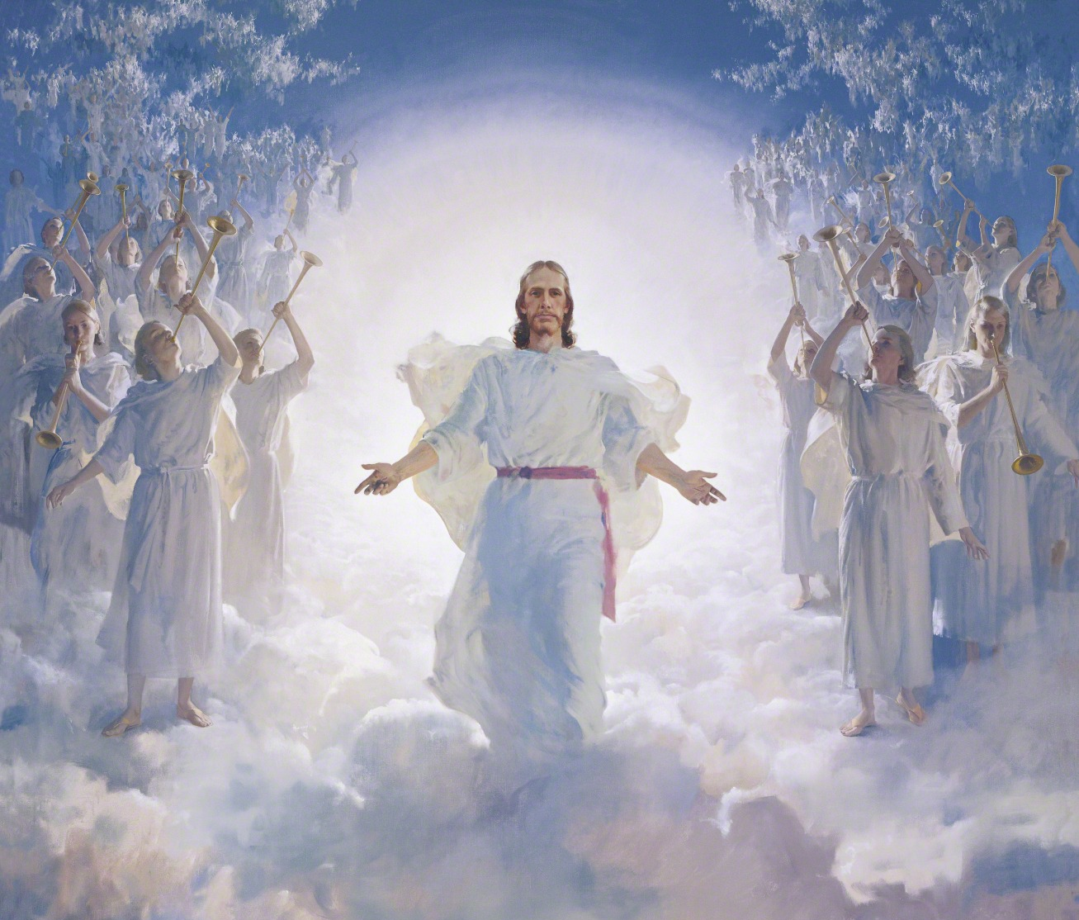
11. Of what was the deliverance from Egypt a type?
Galatians 1:4
Who gave himself for our sins, that he might deliver us from this present evil world, according to the will of God and our Father:

Slide 47

11. Of what was the deliverance from Egypt a type?
1 Corinthians 5:7
Purge out therefore the old leaven, that ye may be a new lump, as ye are unleavened. For even Christ our passover is sacrificed for us:

Slide 48
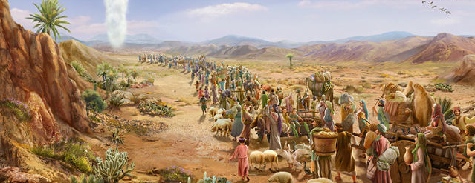
12. Show that Christ was the real leader of the Israelites.

Slide 49
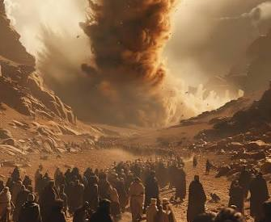
12. Show that Christ was the real leader of the Israelites.
Exodus 13:21
And the LORD went before them by day in a pillar of a cloud, to lead them the way; and by night in a pillar of fire, to give them light; to go by day and night:

Slide 50
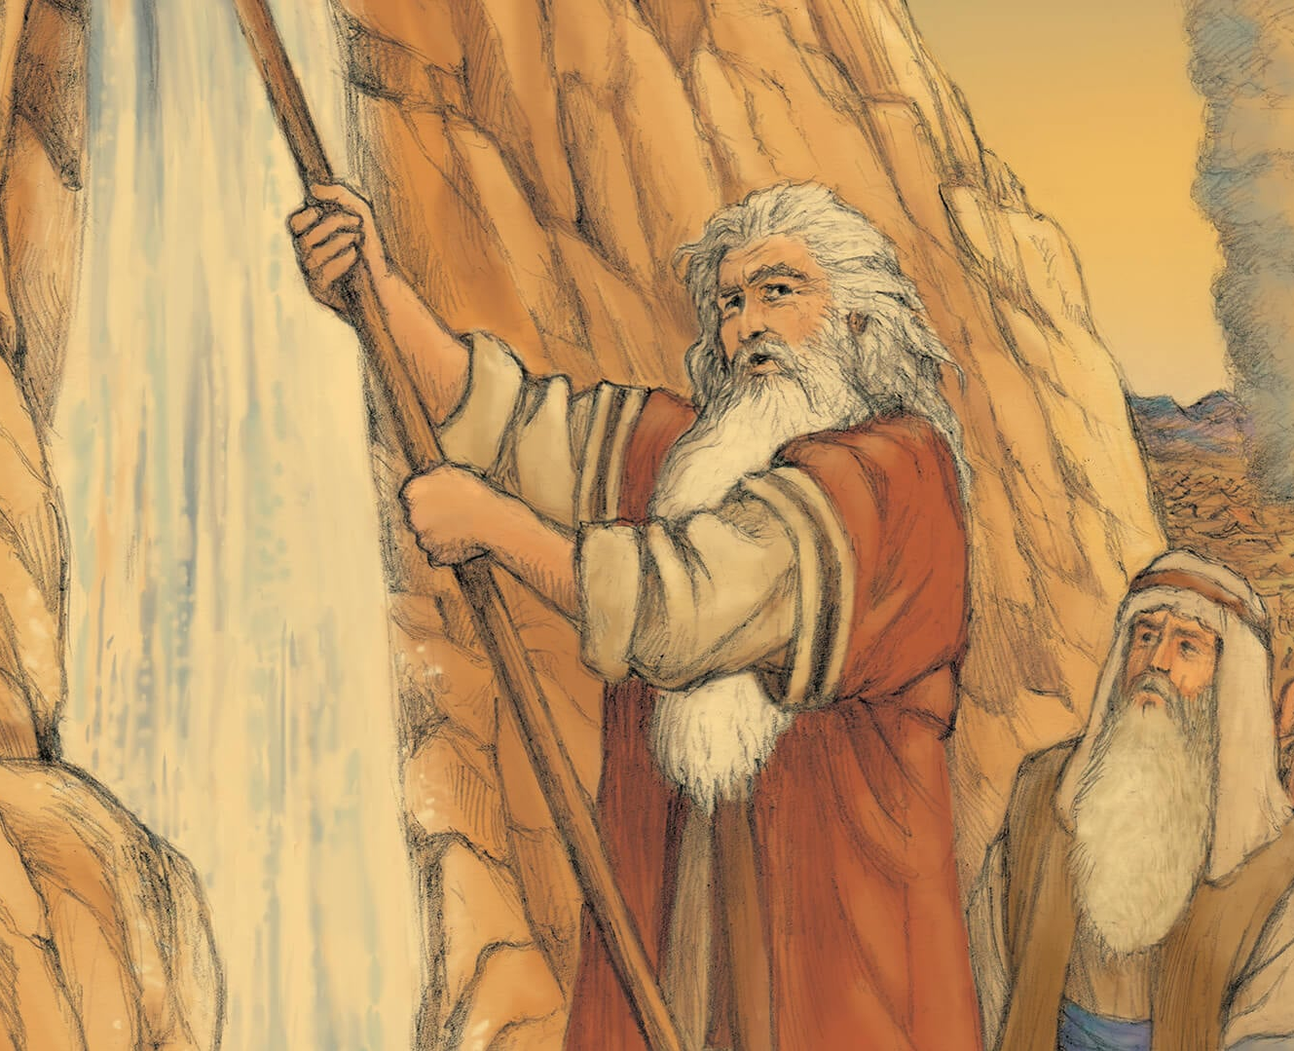
12. Show that Christ was the real leader of the Israelites.
1 Corinthians 10:4
And did all drink the same spiritual drink: for they drank of that spiritual Rock that followed them: and that Rock was Christ.

Slide 51
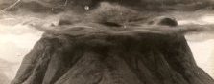
13. Relate the circumstances of the giving of the law.

Slide 52
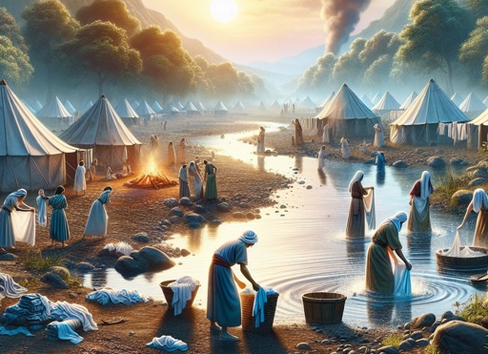
13. Relate the circumstances of the giving of the law.
Exodus 19:10
And the LORD said unto Moses, Go unto the people, and sanctify them to day and to morrow, and let them wash their clothes,

Slide 53
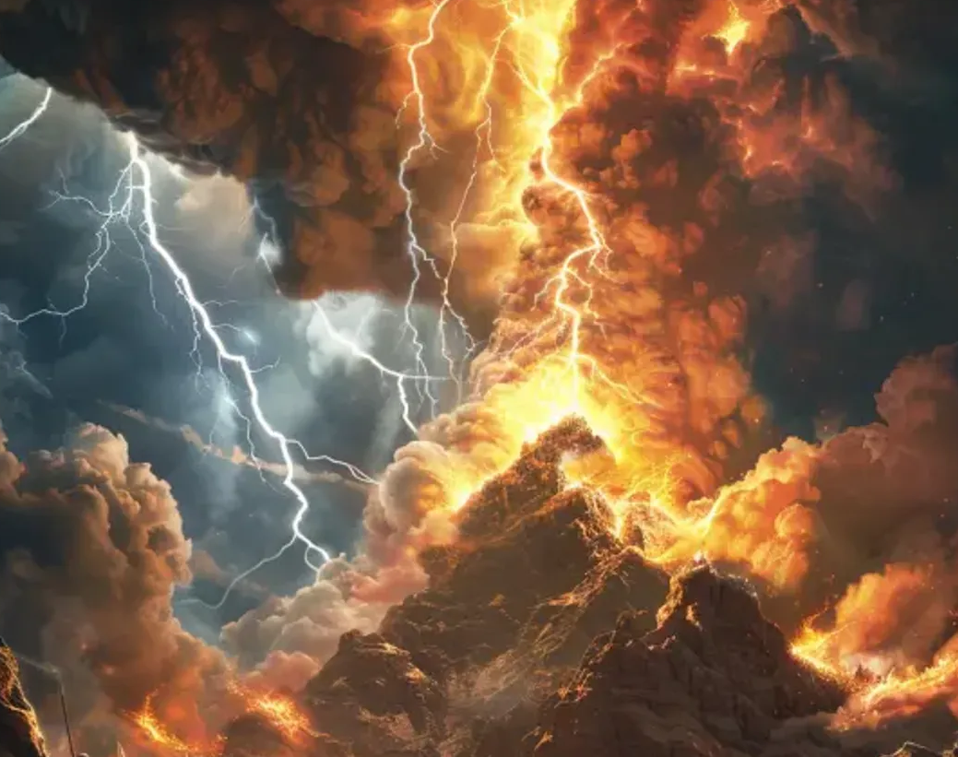
13. Relate the circumstances of the giving of the law.
Exodus 19:16
And it came to pass on the third day in the morning, that there were thunders and lightnings, and a thick cloud upon the mount, and the voice of the trumpet exceeding loud; so that all the people that was in the camp trembled.

Slide 54
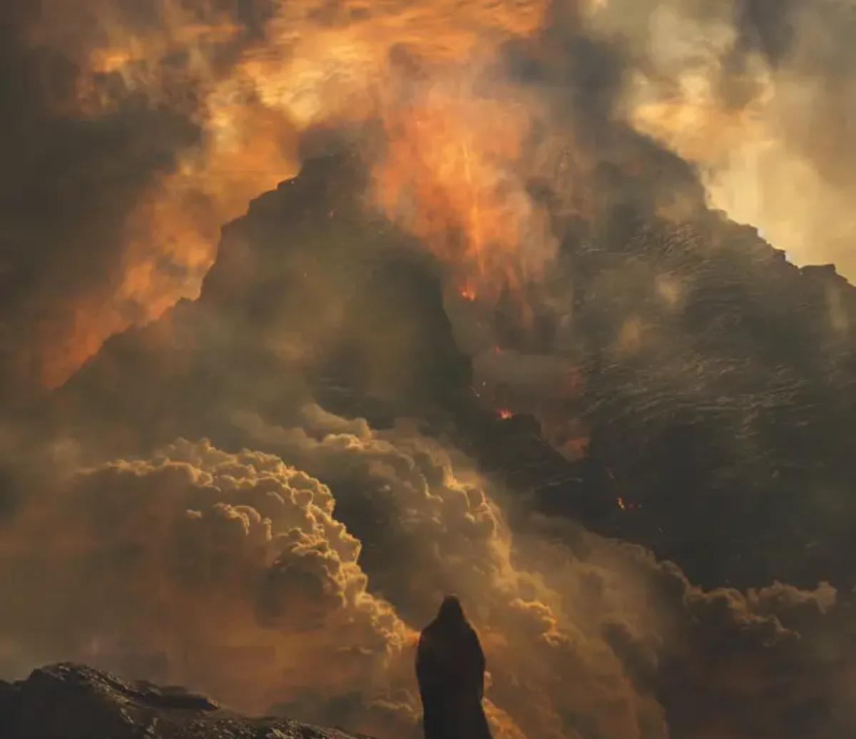
13. Relate the circumstances of the giving of the law.
Exodus 19:18
And mount Sinai was altogether on a smoke, because the LORD descended upon it in fire: and the smoke thereof ascended as the smoke of a furnace, and the whole mount quaked greatly.

Slide 55
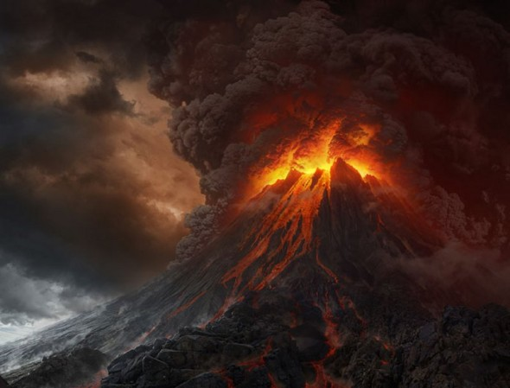
13. Relate the circumstances of the giving of the law.
Exodus 20:1-2
And God spake all these words, saying,
I am the Lord thy God, which have brought thee out of the land of Egypt, out of the house of bondage…

Slide 56
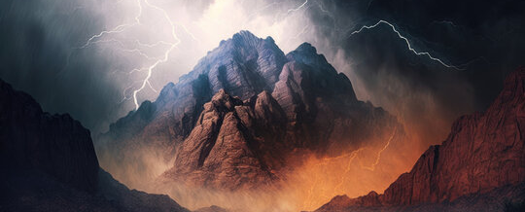
14. Why was the law given amid such terrible majesty?

Slide 57
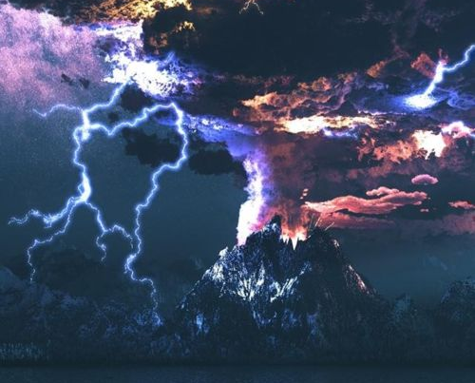
14. Why was the law given amid such terrible majesty?
Exodus 20:18
And all the people saw the thunderings, and the lightnings, and the noise of the trumpet, and the mountain smoking: and when the people saw it , they removed, and stood afar off.

Slide 58
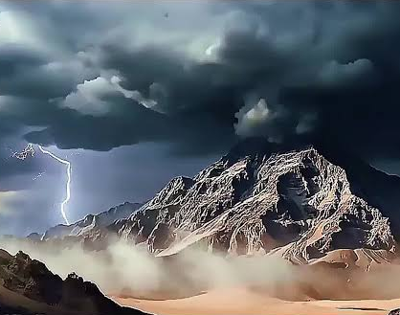
14. Why was the law given amid such terrible majesty?
Exodus 20:20
And Moses said unto the people, Fear not: for God is come to prove you, and that his fear may be before your faces, that ye sin not.

Slide 59

14. Why was the law given amid such terrible majesty?
Deuteronomy 4:10
Specially the day that thou stoodest before the LORD thy God in Horeb, when the LORD said unto me, Gather me the people together, and I will make them hear my words, that they may learn to fear me all the days that they shall live upon the earth, and that they may teach their children.

Slide 60

15. What is the only other event that can compare with the giving of the ten commandments?

Slide 61

15. What is the only other event that can compare with the giving of the ten commandments?
Matthew 24:30
And then shall appear the sign of the Son of man in heaven: and then shall all the tribes of the earth mourn, and they shall see the Son of man coming in the clouds of heaven with power and great glory.

Slide 62

15. What is the only other event that can compare with the giving of the ten commandments?
Matthew 24:31
And he shall send his angels with a great sound of a trumpet, and they shall gather together his elect from the four winds, from one end of heaven to the other.

Slide 63

15. What is the only other event that can compare with the giving of the ten commandments?
1 Thessalonians 4:16
For the Lord himself shall descend from heaven with a shout, with the voice of the archangel, and with the trump of God: and the dead in Christ shall rise first:

Slide 64

16. What great wickedness did the Israelites do while Moses was in the mount with God?

Slide 65

16. What great wickedness did the Israelites do while Moses was in the mount with God?
Exodus 32:4
And he received them at their hand, and fashioned it with a graving tool, after he had made it a molten calf: and they said, These be thy gods, O Israel, which brought thee up out of the land of Egypt.

Slide 66

16. What great wickedness did the Israelites do while Moses was in the mount with God?
Exodus 32:8
They have turned aside quickly out of the way which I commanded them: they have made them a molten calf, and have worshipped it, and have sacrificed thereunto, and said, These be thy gods, O Israel, which have brought thee up out of the land of Egypt.

Slide 67

17. What was the nature of their idolatry?

Slide 68

17. What was the nature of their idolatry?
Exodus 32:5
And when Aaron saw it , he built an altar before it; and Aaron made proclamation, and said, To morrow is a feast to the LORD .

Slide 69

17. What was the nature of their idolatry?
Exodus 32:6
And they rose up early on the morrow, and offered burnt offerings, and brought peace offerings; and the people sat down to eat and to drink, and rose up to play.

Slide 70

17. What was the nature of their idolatry?
Acts 7:41
And they made a calf in those days, and offered sacrifice unto the idol, and rejoiced in the works of their own hands.

Slide 71

18. What form of idolatry has from the earliest ages drawn men from the worship of God?

Slide 72

18. What form of idolatry has from the earliest ages drawn men from the worship of God?
Deuteronomy 4:19
And lest thou lift up thine eyes unto heaven, and when thou seest the sun, and the moon, and the stars, even all the host of heaven, shouldest be driven to worship them, and serve them, which the LORD thy God hath divided unto all nations under the whole heaven.

Slide 73

18. What form of idolatry has from the earliest ages drawn men from the worship of God?
Ezekiel 8:16
And he brought me into the inner court of the LORD's house, and, behold, at the door of the temple of the LORD , between the porch and the altar, were about five and twenty men, with their backs toward the temple of the LORD , and their faces toward the east; and they worshipped the sun toward the east.

Slide 74

Worship is always a choice!
Joshua 24:15-17
And if it seem evil unto you to serve the Lord, choose you this day whom ye will serve; whether the gods which your fathers served that were on the other side of the flood, or the gods of the Amorites, in whose land ye dwell: but as for me and my house, we will serve the Lord.

Slide 75

Worship is always a choice!
Joshua 24:15-17
And the people answered and said, God forbid that we should forsake the Lord, to serve other gods;

Slide 76

Worship is always a choice!
Joshua 24:15-17
For the Lord our God, he it is that brought us up and our fathers out of the land of Egypt, from the house of bondage, and which did those great signs in our sight, and preserved us in all the way wherein we went, and among all the people through whom we passed:

Slide 77


Slide 78


