Slide 1


Slide 2


Slide 3
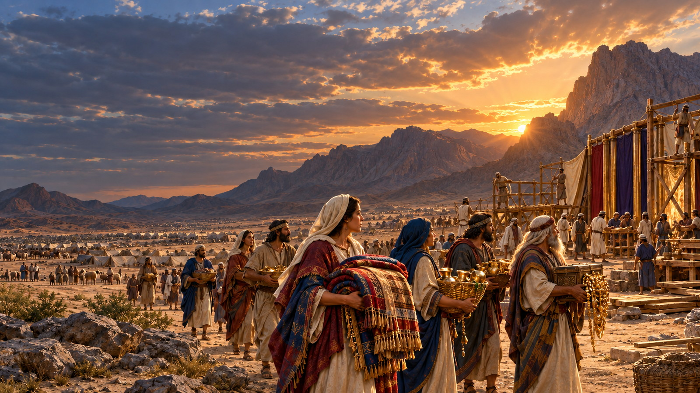
OLD TESTAMENT HISTORY:
FREE-WILL OFFERINGS
Lesson 14 • April 6, 1889

Slide 4
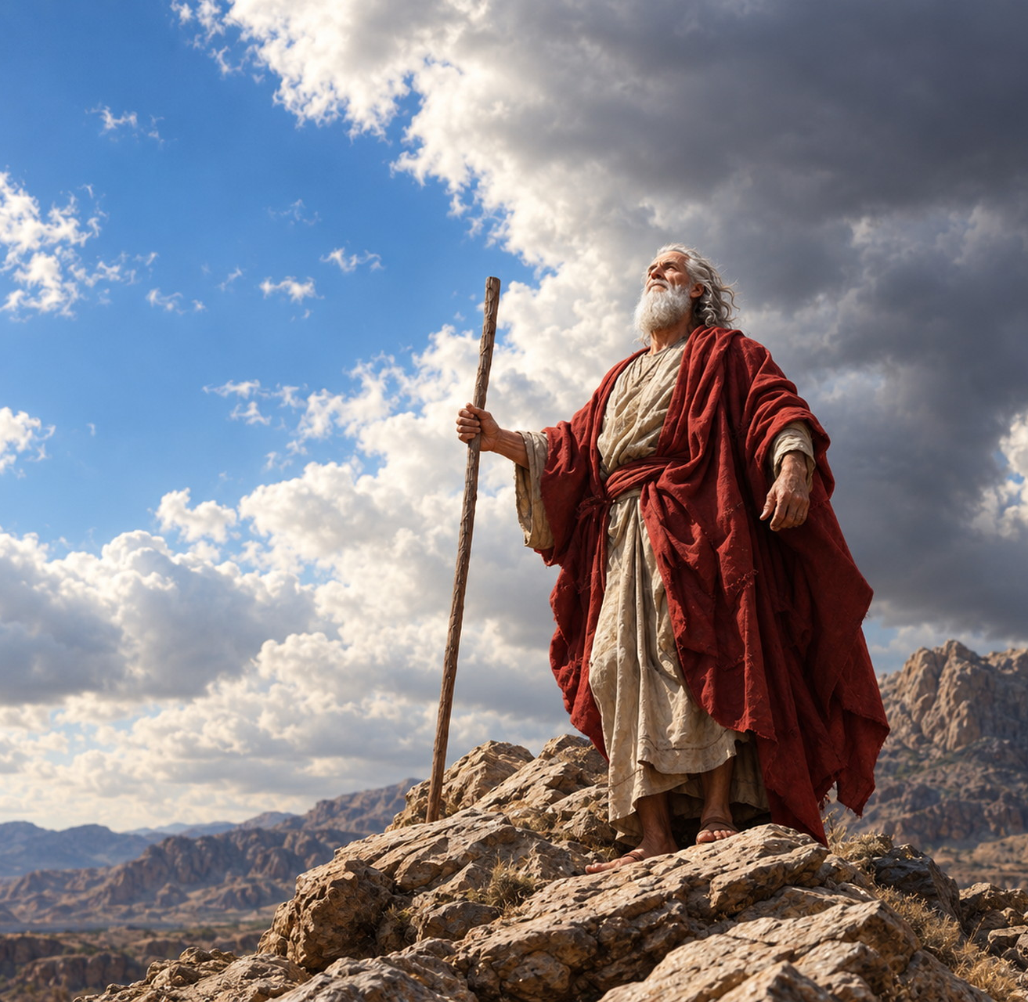
QUESTION 1
While Moses was in the mount, what did God tell him to say to the children of Israel?
Exodus 25:1, 2

Slide 5
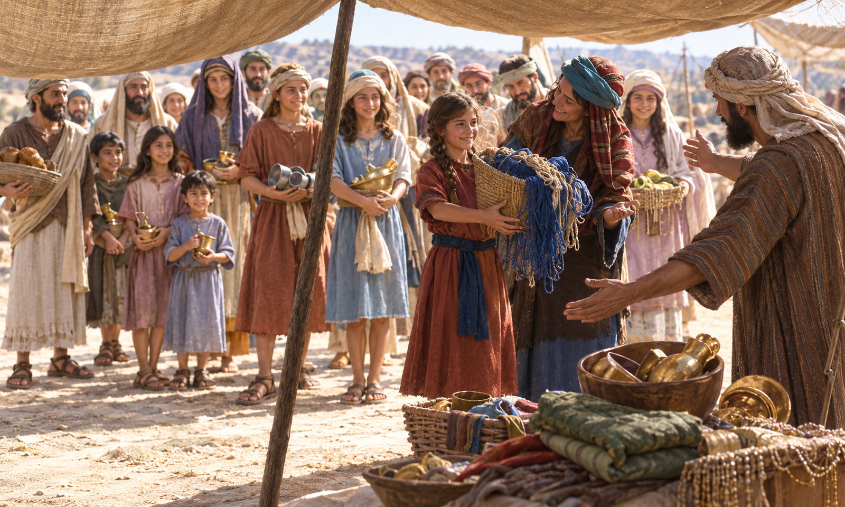
Exodus 25:1–2
1 And the LORD spake unto Moses, saying,
2 Speak unto the children of Israel, that they bring me an offering: of every man that giveth it willingly with his heart ye shall take my offering.

Slide 6
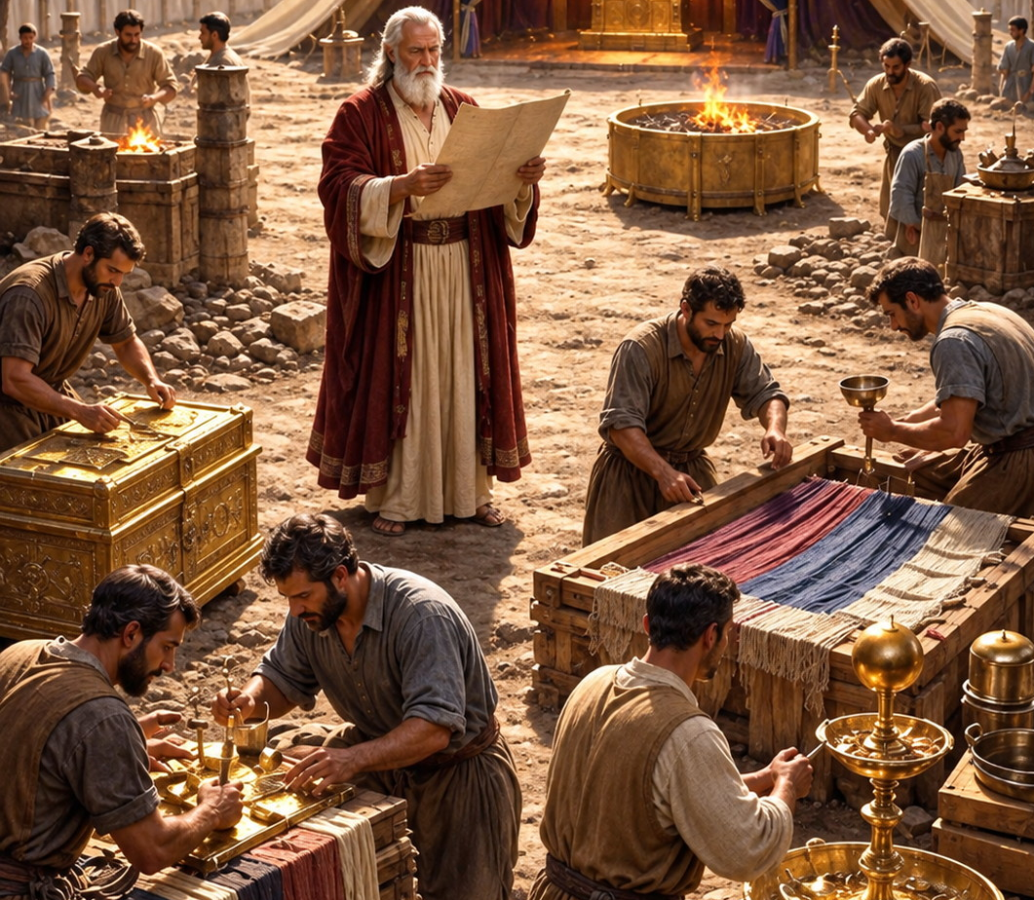
QUESTION 2
Of what was their offering to consist?
Exodus 25:3–7

Slide 7
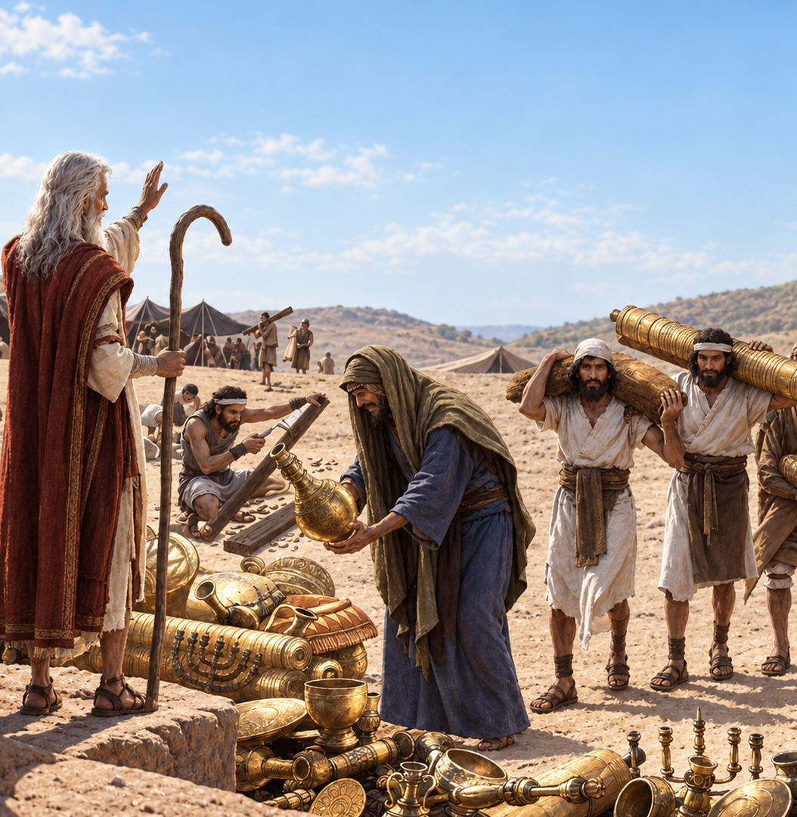
Exodus 25:3–7
3 And this is the offering which ye shall take of them; gold, and silver, and brass,
4 And blue, and purple, and scarlet, and fine linen, and goats’ hair,

Slide 8
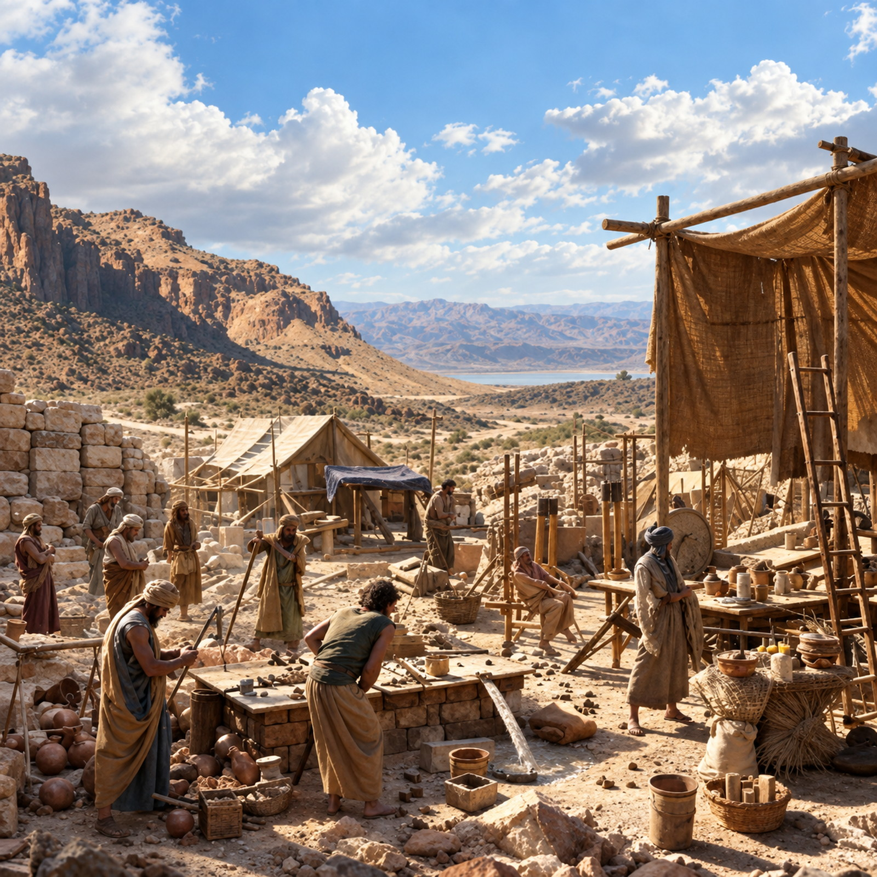
Exodus 25:5–7
5 And rams’ skins dyed red, and badgers’ skins, and shittim wood,
6 Oil for the light, spices for anointing oil, and for sweet incense,

Slide 9
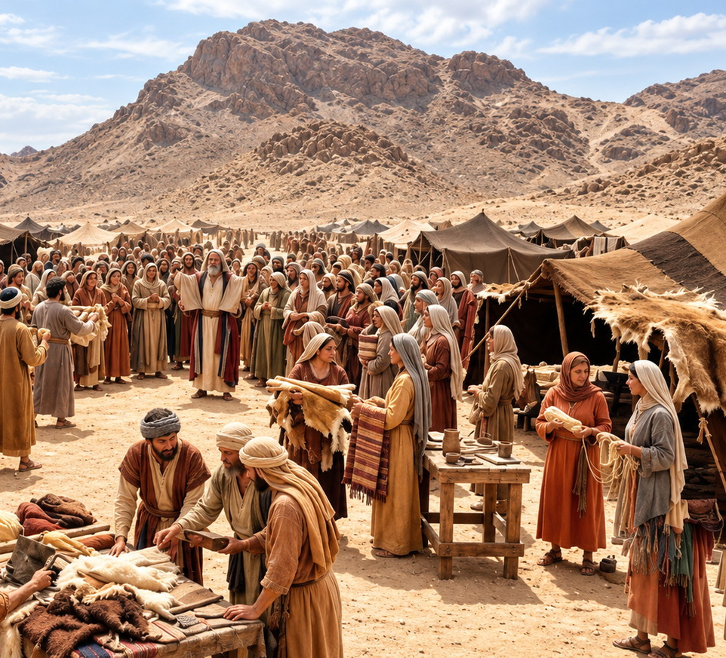
Exodus 25:3-7
7 Onyx stones, and stones to be set in the ephod, and in the breastplate.

Slide 10
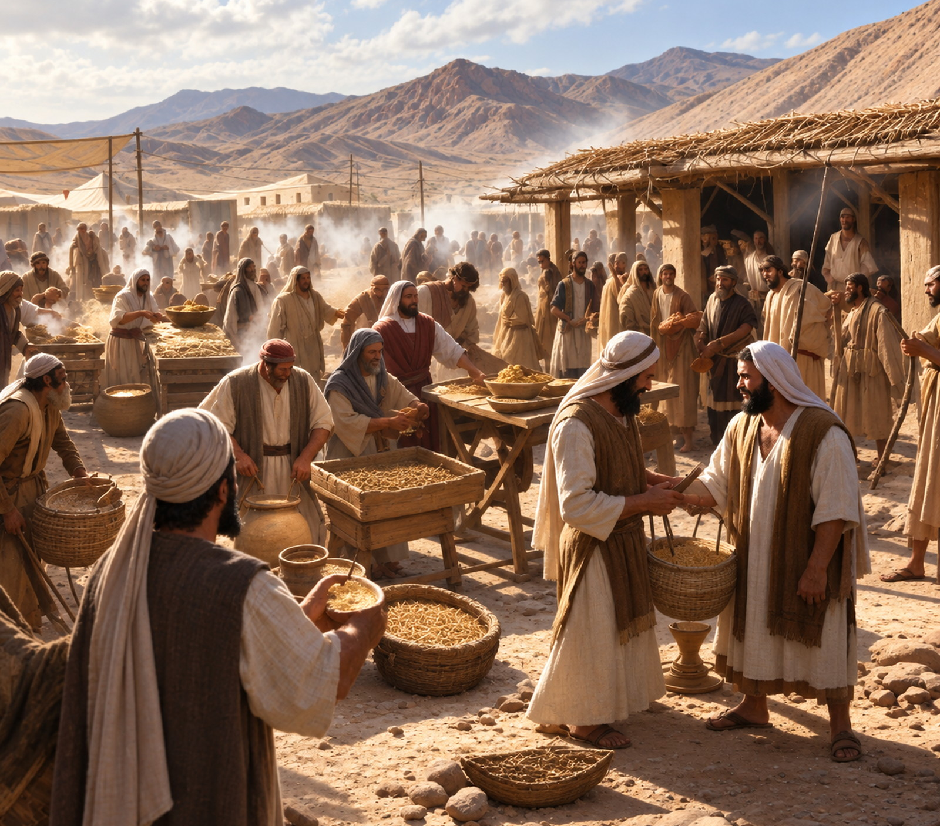
QUESTION 3
What were these offerings for?
Exodus 25:8

Slide 11
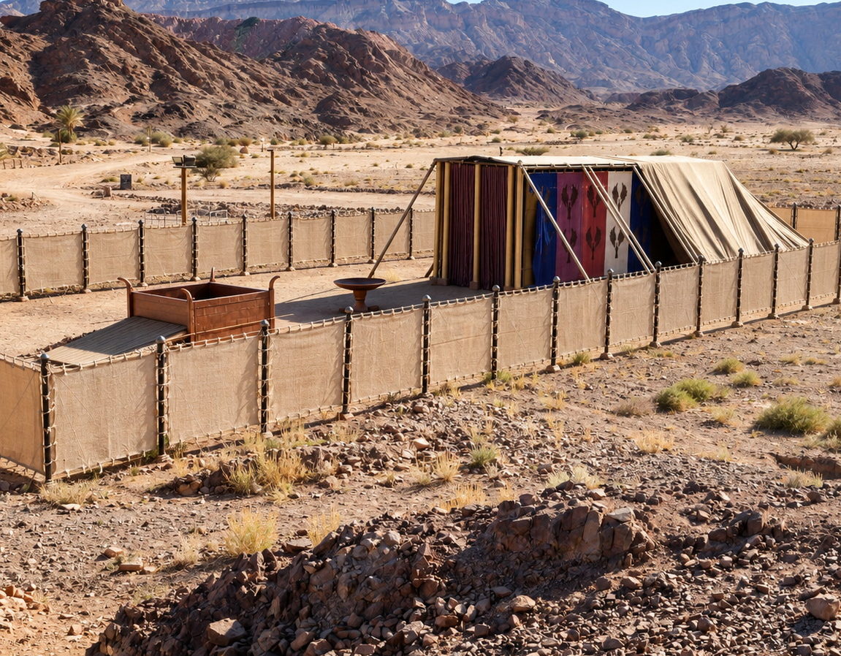
Exodus 25:8
8 And let them make me a sanctuary; that I may dwell among them.

Slide 12
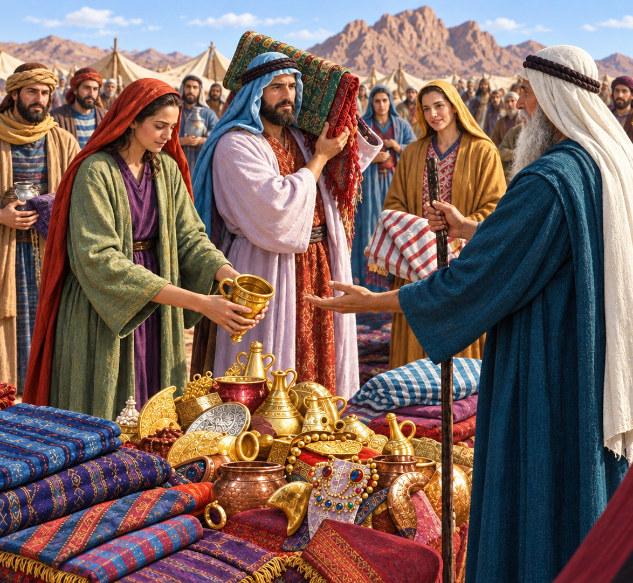
QUESTION 4
Who only were to bring an offering?
Exodus 25:2;
35:5, 21

Slide 13
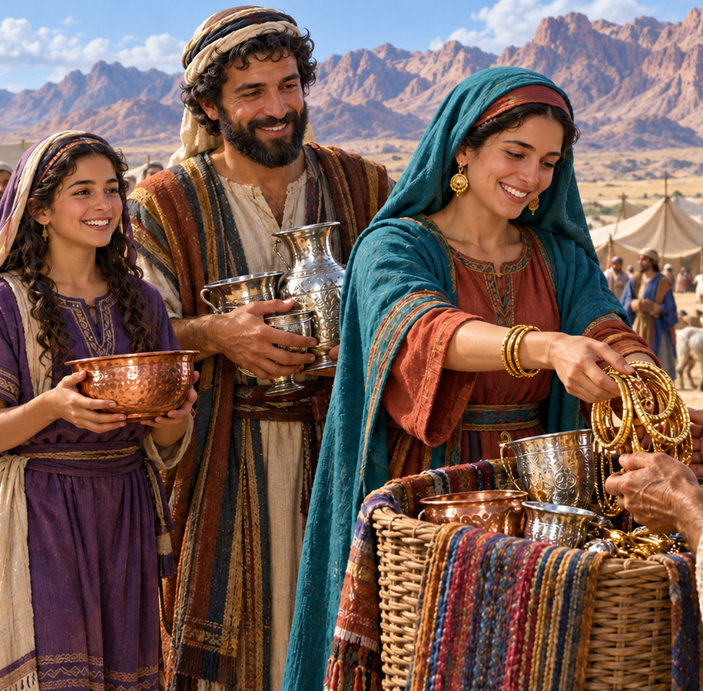
Exodus 25:2
2 Speak unto the children of Israel, that they bring me an offering: of every man that giveth it willingly with his heart ye shall take my offering.

Slide 14
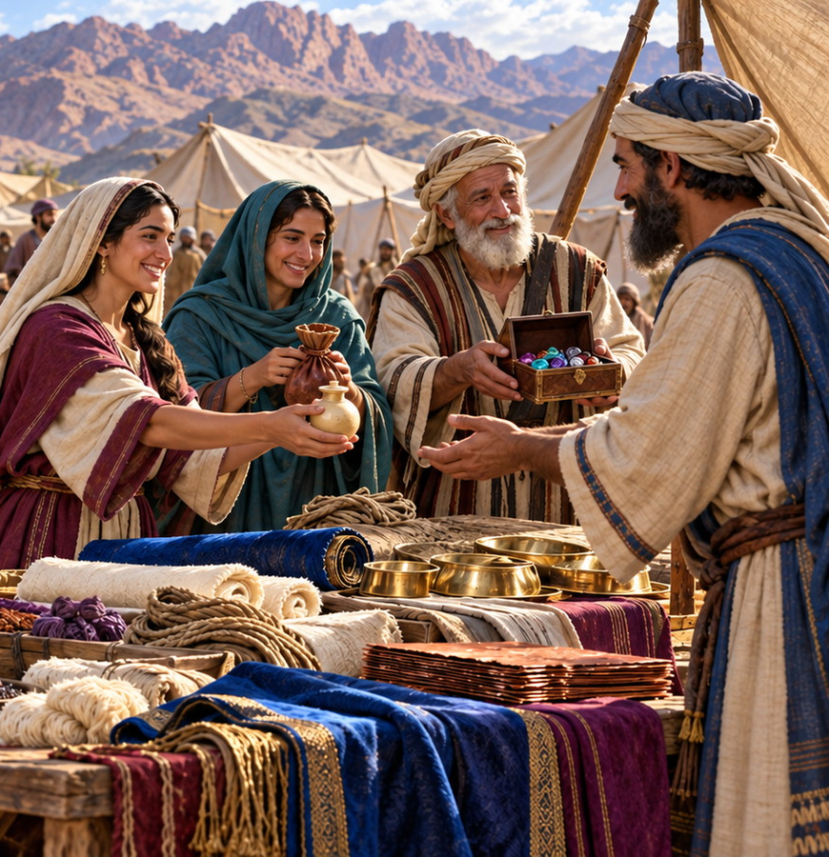
Exodus 35:5
5 Take ye from among you an offering unto the LORD: whosoever is of a willing heart, let him bring it, an offering of the LORD; gold, and silver, and brass,

Slide 15
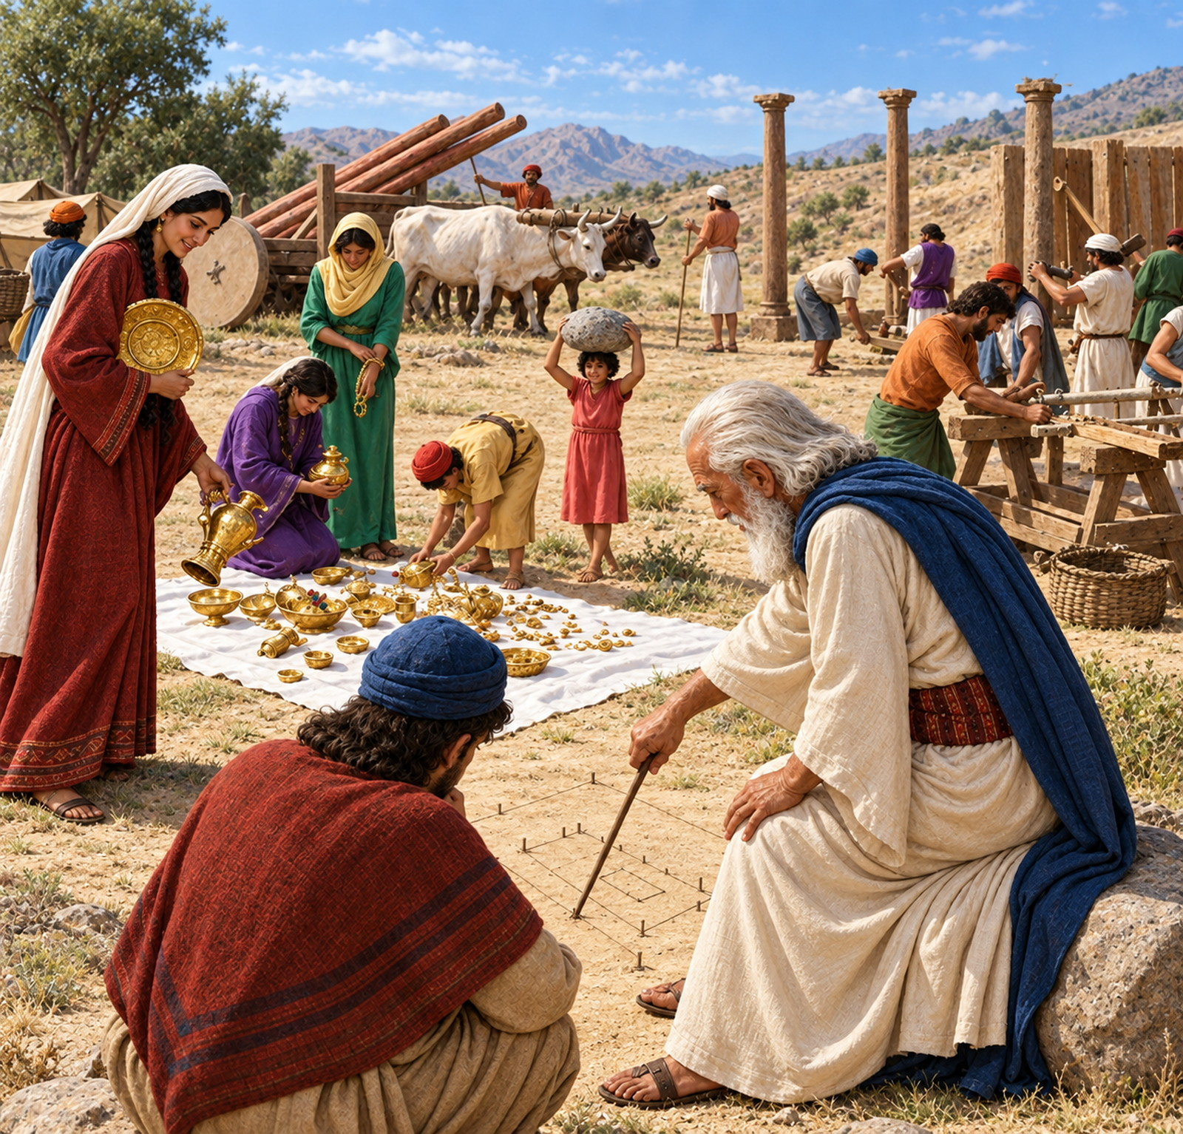
Exodus 35:21
21 And they came, every one whose heart stirred him up, and every one whom his spirit made willing, and they brought the LORD’s offering to the work of the tabernacle of the congregation, and for all his service, and for the holy garments.

Slide 16
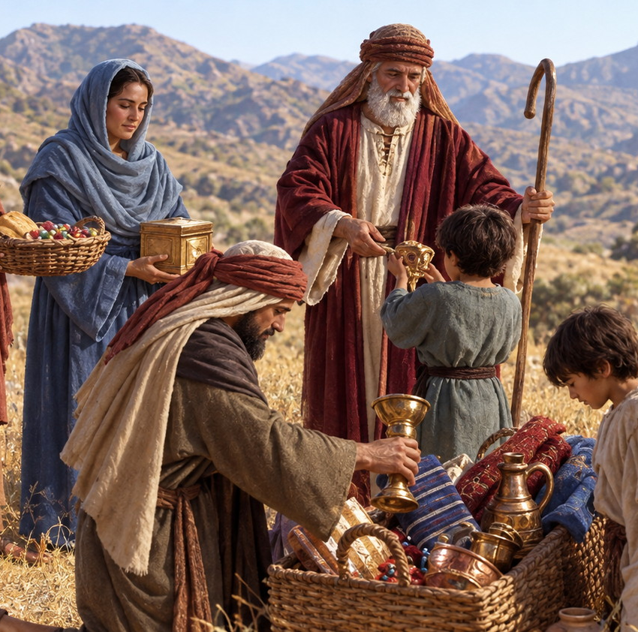
QUESTION 5
What sort of things did they bring?
Exodus 35:22–24

Slide 17
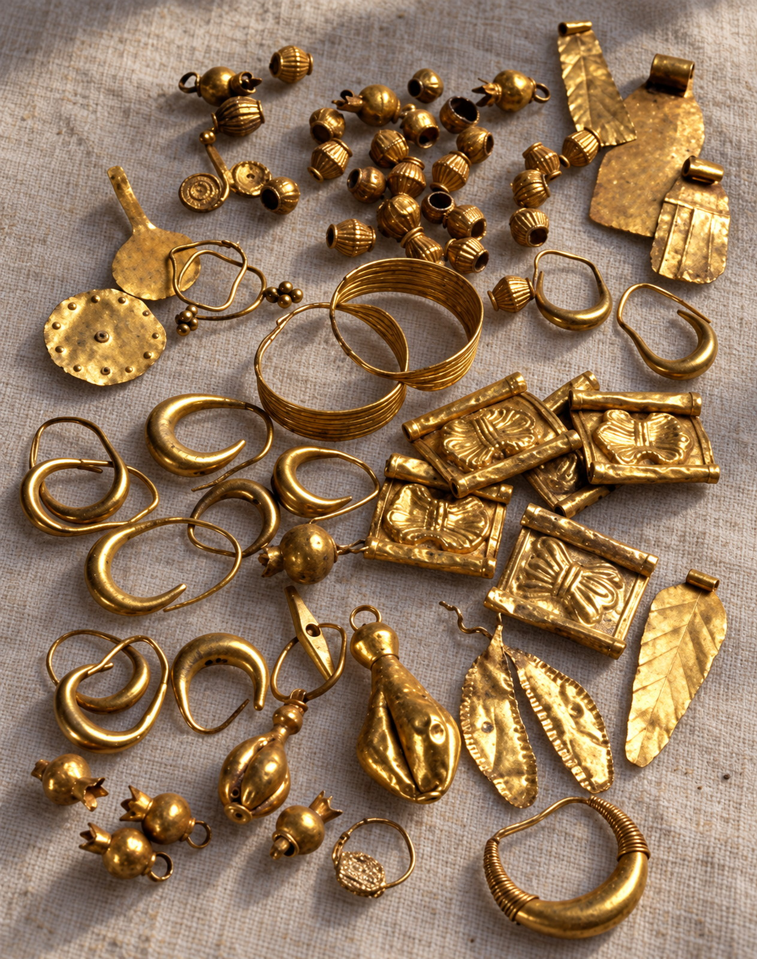
Exodus 35:22-24
22 And they came, both men and women, as many as were willing hearted, and brought bracelets, and earrings, and rings, and tablets, all jewels of gold: and every man that offered offered an offering of gold unto the LORD.

Slide 18
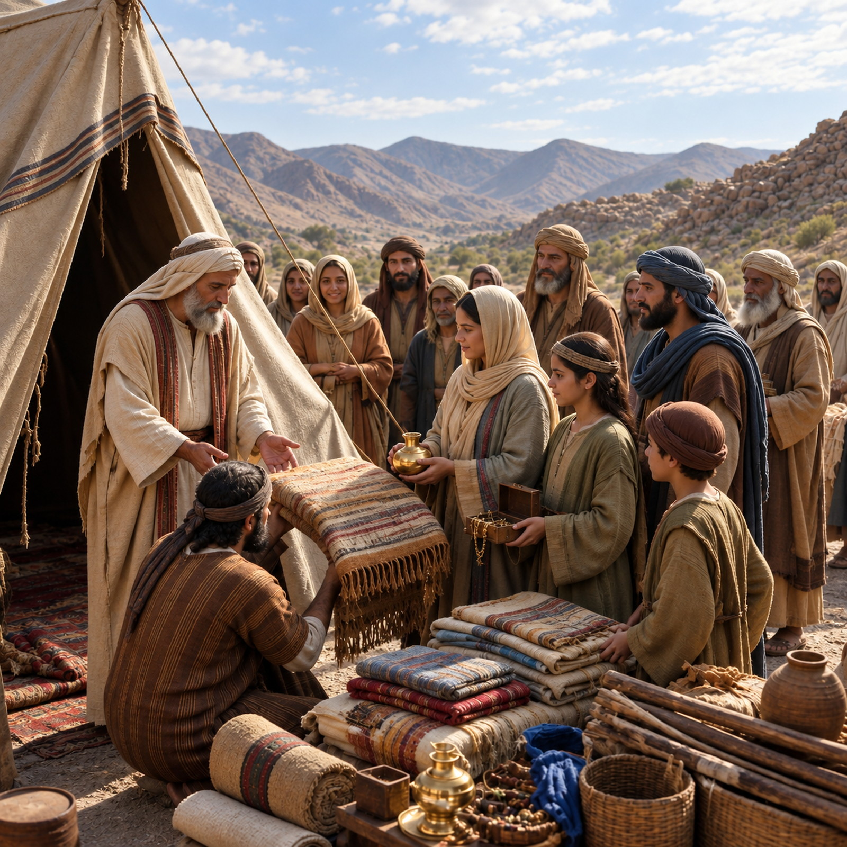
Exodus 35:22-24
23 And every man, with whom was found blue, and purple, and scarlet, and fine linen, and goats’ hair, and red skins of rams, and badgers’ skins, brought them.

Slide 19
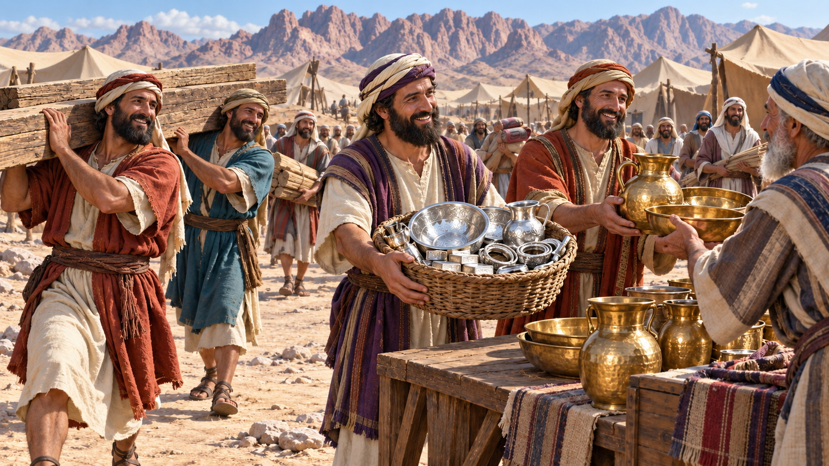
Exodus 35:22-24
24 Every one that did offer an offering of silver and brass brought the LORD’s offering: and every man, with whom was found shittim wood for any work of the service, brought it.

Slide 20
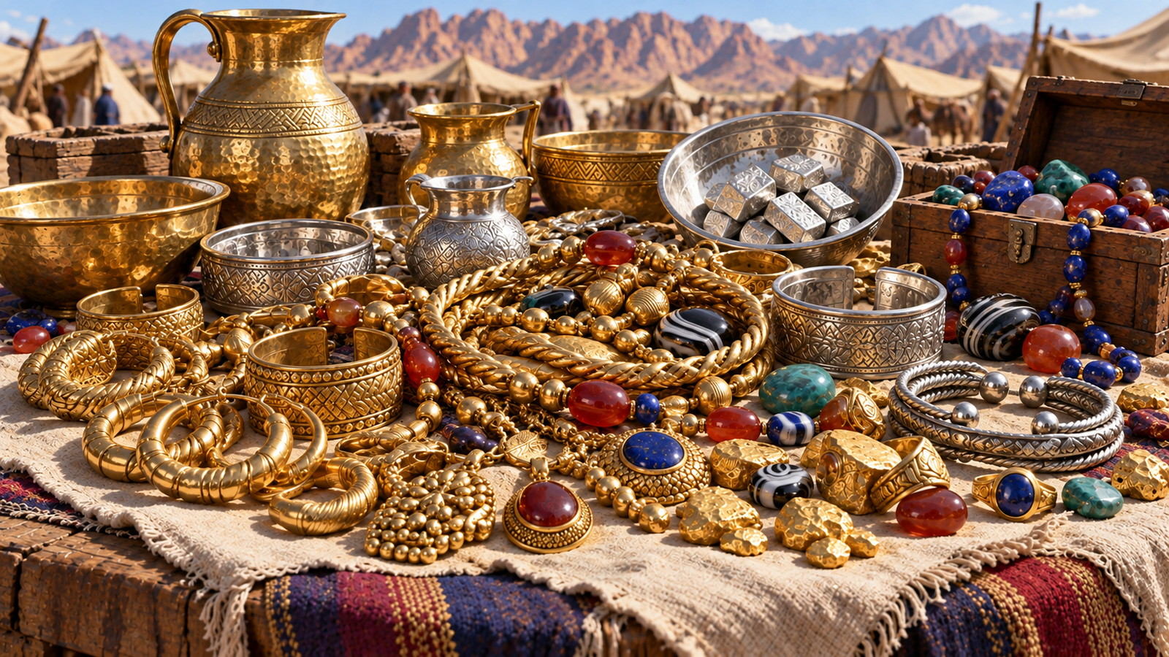
QUESTION 6
How did they come to have so many valuable things?
Exodus 12:35, 36

Slide 21
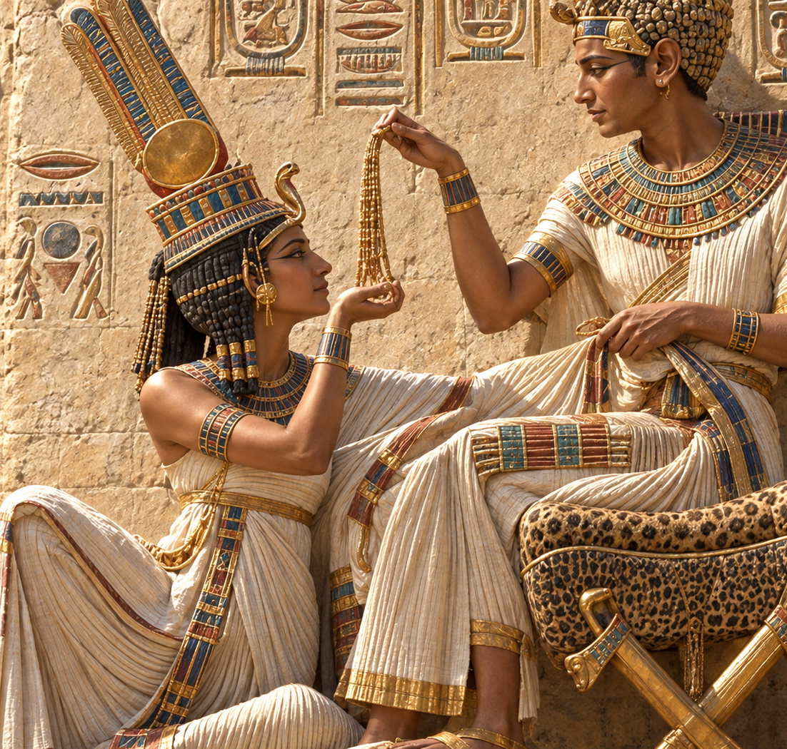
Exodus 12:35-36
35 And the children of Israel did according to the word of Moses; and they borrowed of the Egyptians jewels of silver, and jewels of gold, and raiment:

Slide 22
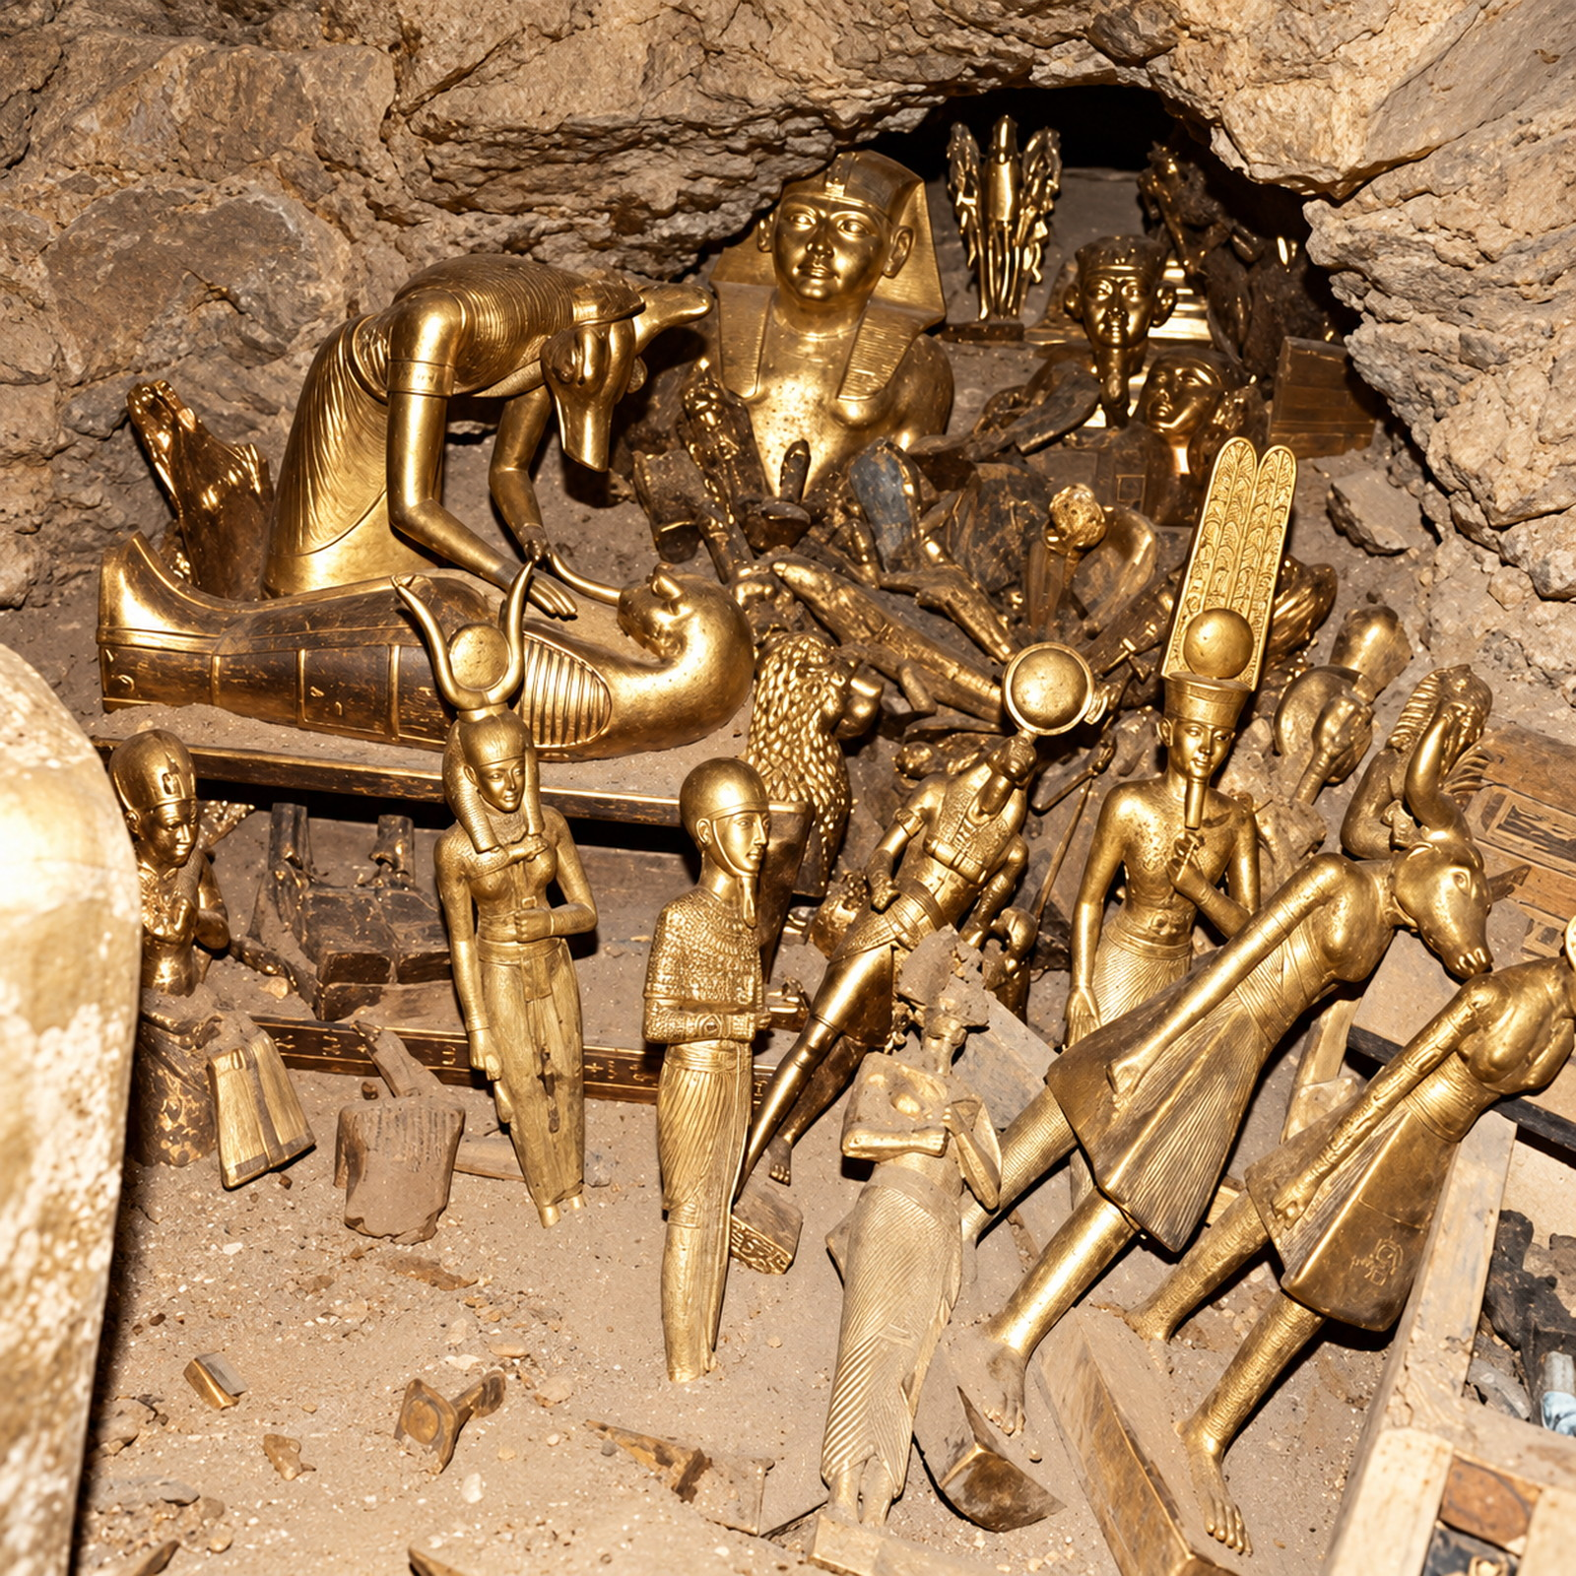
Exodus 12:35-36
36 And the LORD gave the people favour in the sight of the Egyptians, so that they lent unto them such things as they required. And they spoiled the Egyptians.

Slide 23
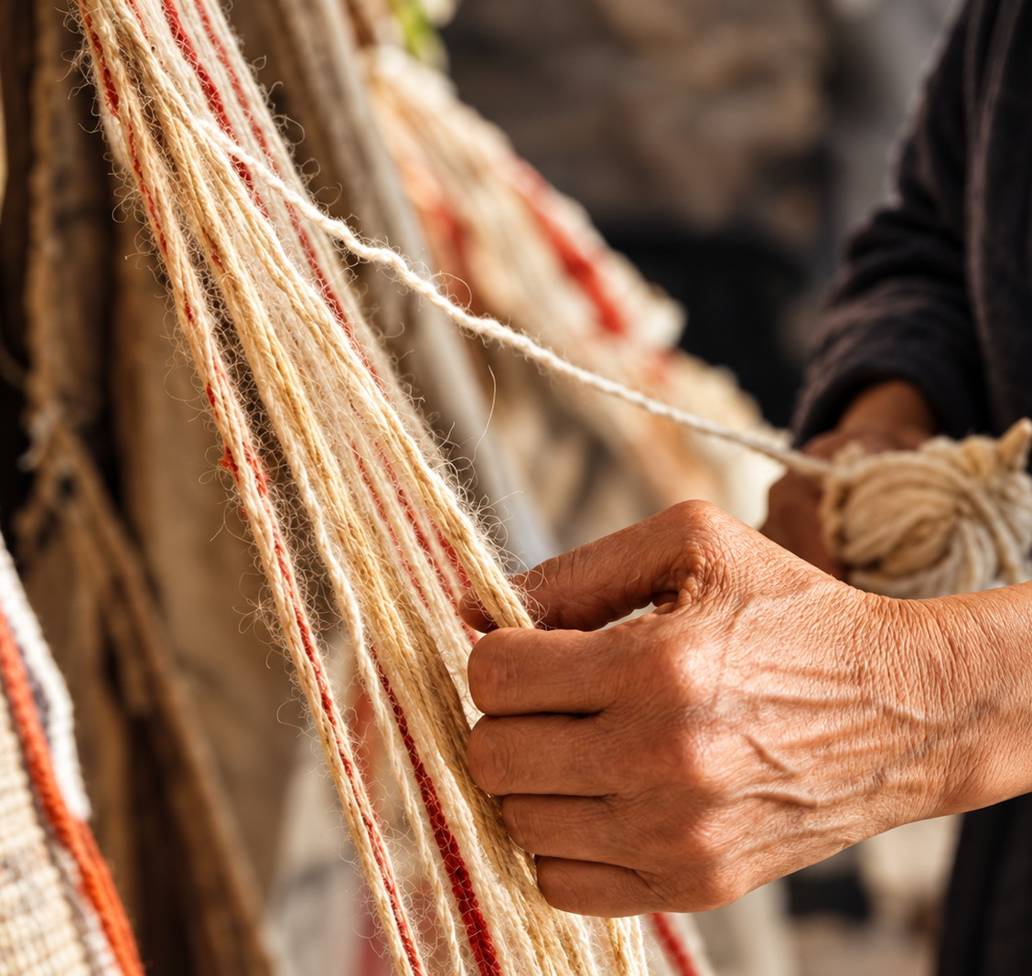
QUESTION 7
What did the women do?
Exodus 35:25, 26

Slide 24
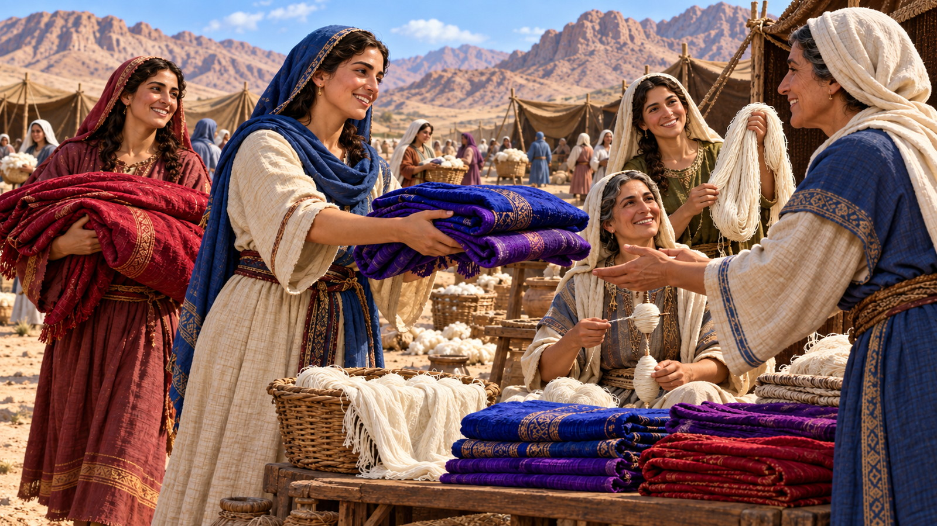
Exodus 35:25–26
25 And all the women that were wise hearted did spin with their hands, and brought that which they had spun, both of blue, and of purple, and of scarlet, and of fine linen.

Slide 25
Exodus 35:25–26
26 And all the women whose heart stirred them up in wisdom spun goats’ hair.

Slide 26
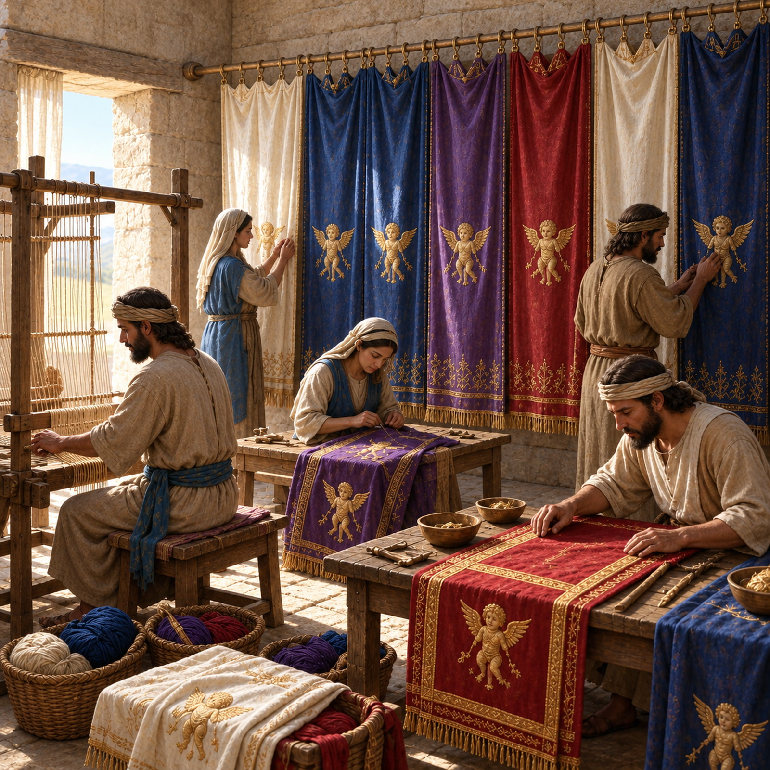
QUESTION 8
What kind of service was all this?
Exodus 35:29

Slide 27
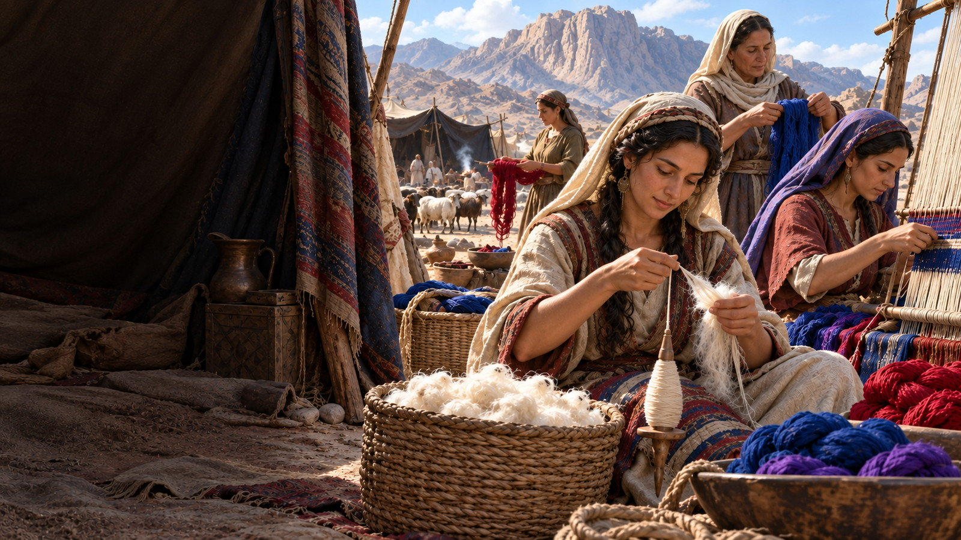
Exodus 35:29
29 The children of Israel brought a willing offering unto the LORD, every man and woman, whose heart made them willing to bring for all manner of work, which the LORD had commanded to be made by the hand of Moses.

Slide 28
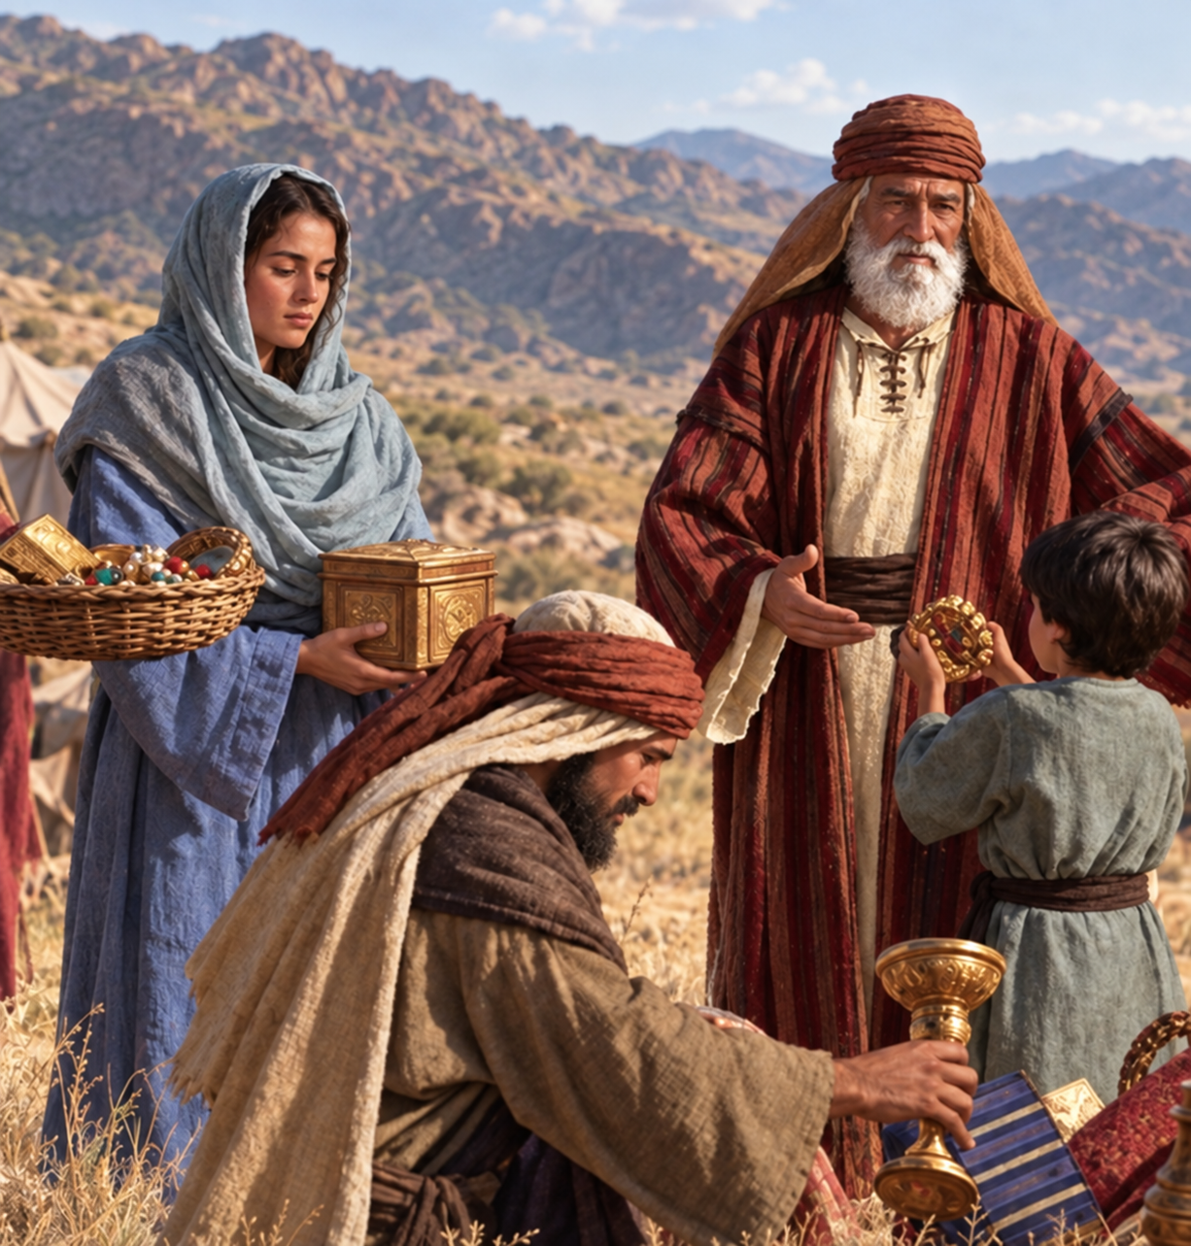
QUESTION 9
How are we exhorted to give?
2 Corinthians 9:7

Slide 29
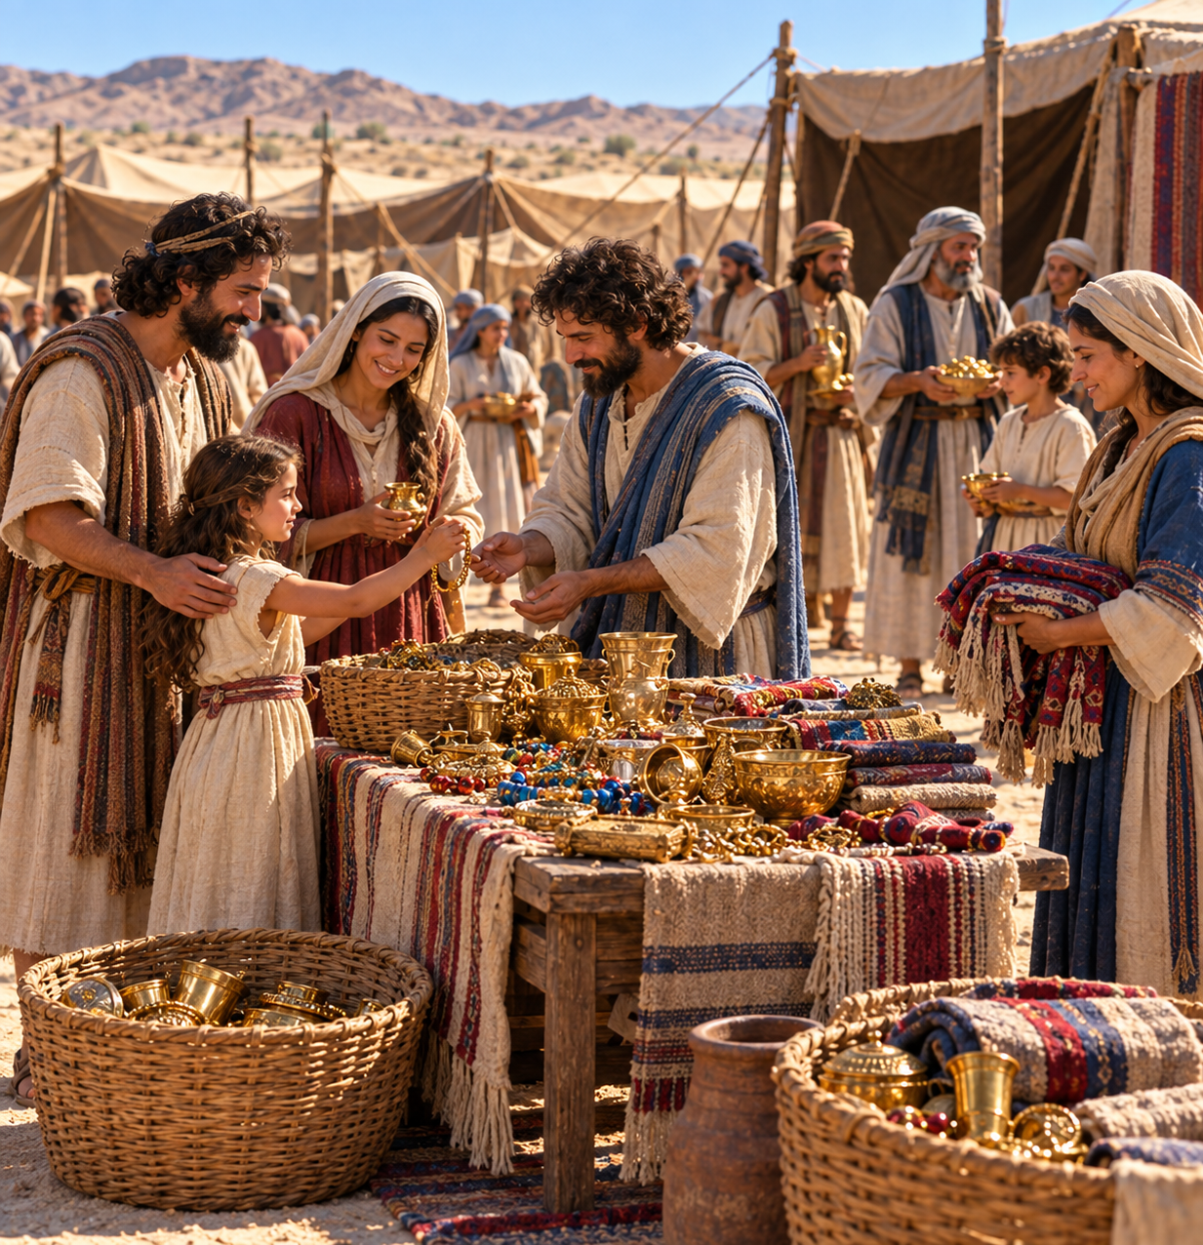
2 Corinthians 9:7
7 Every man according as he purposeth in his heart, so let him give; not grudgingly, or of necessity: for God loveth a cheerful giver.

Slide 30
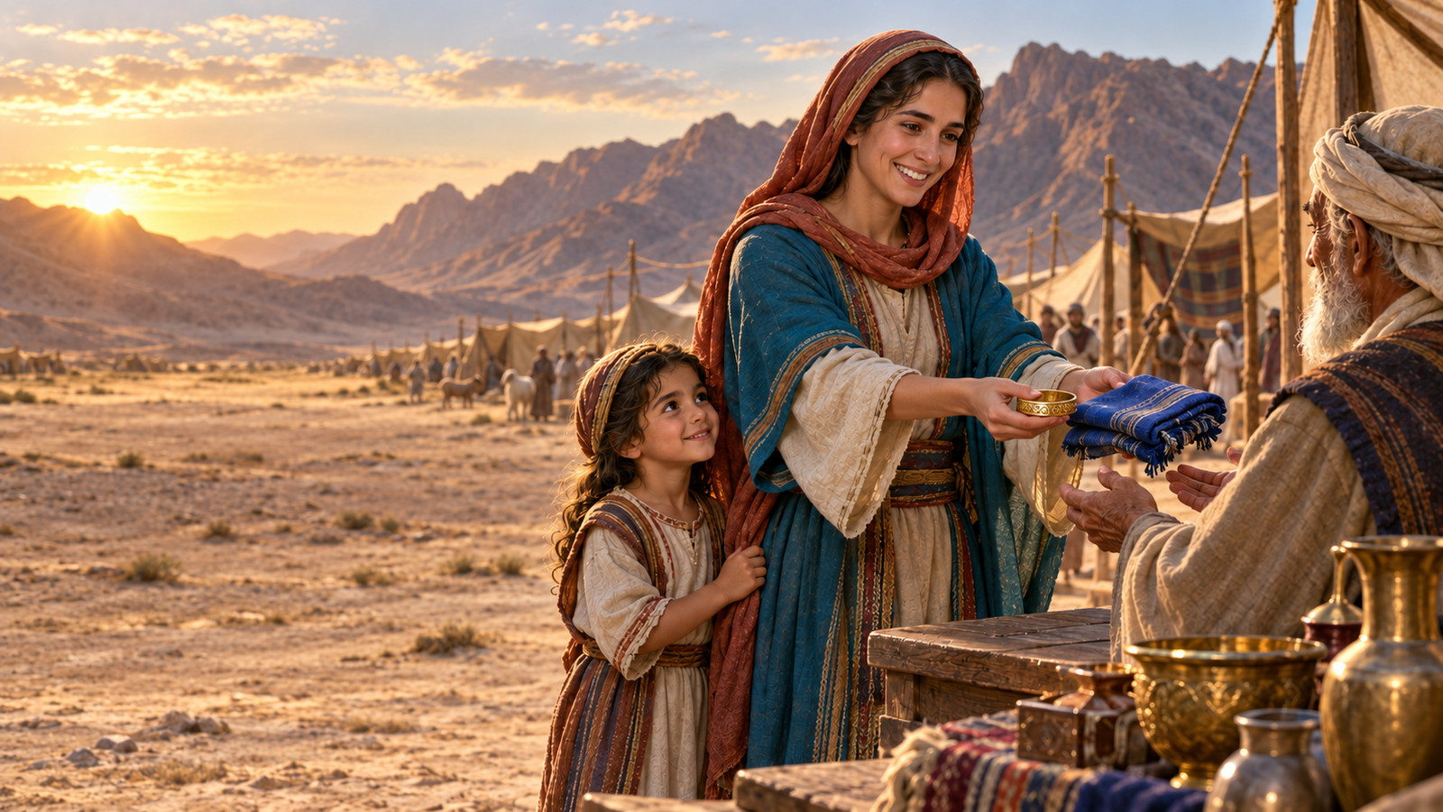
QUESTION 10
What kind of a giver does God love?
2 Corinthians 9:7

Slide 31
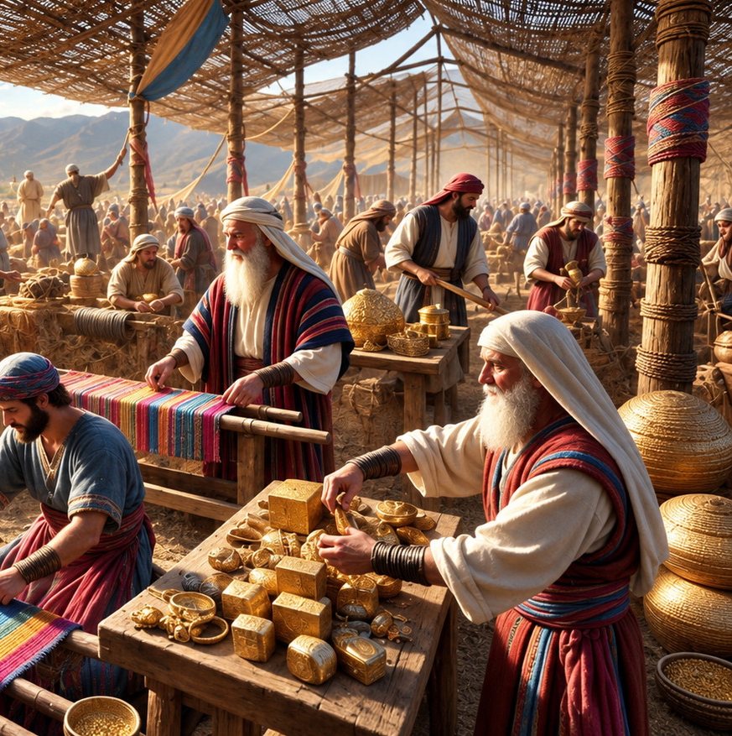
2 Corinthians 9:7
7 Every man according as he purposeth in his heart, so let him give; not grudgingly, or of necessity: for God loveth a cheerful giver.

Slide 32
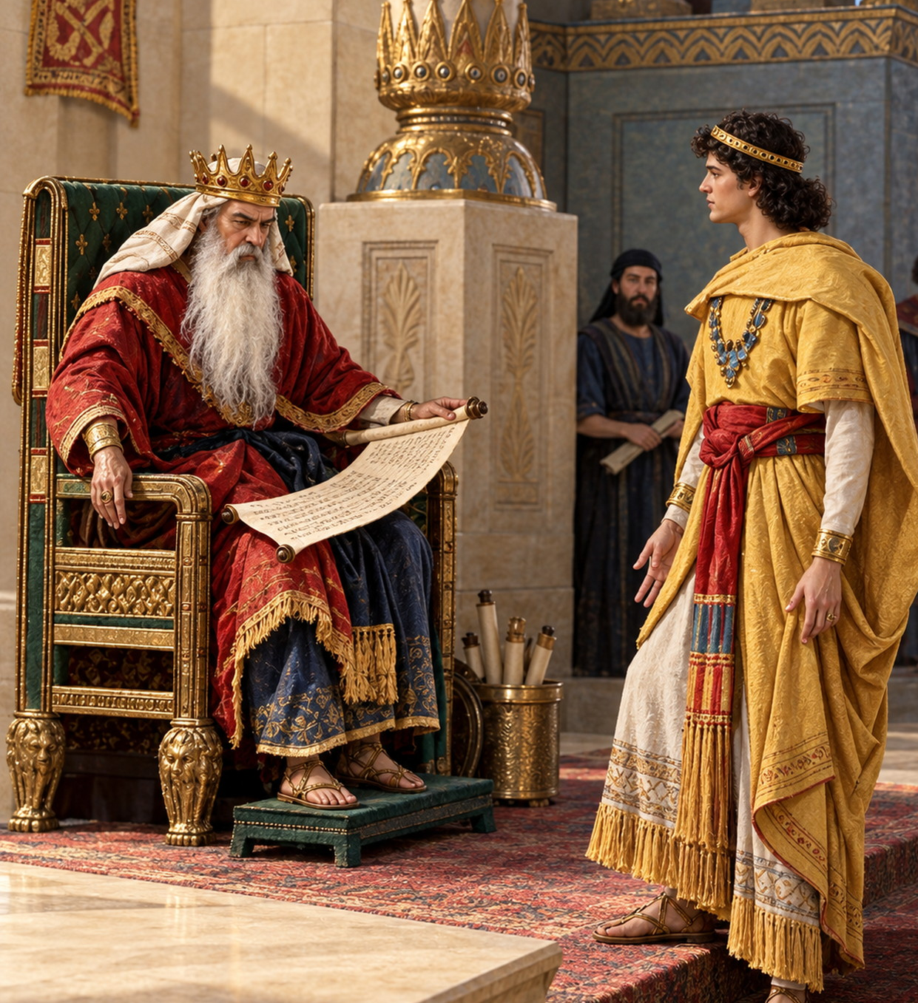
QUESTION 11
Cite another instance where the people offered willingly to the cause of God.
1 Chronicles 29:6–8

Slide 33
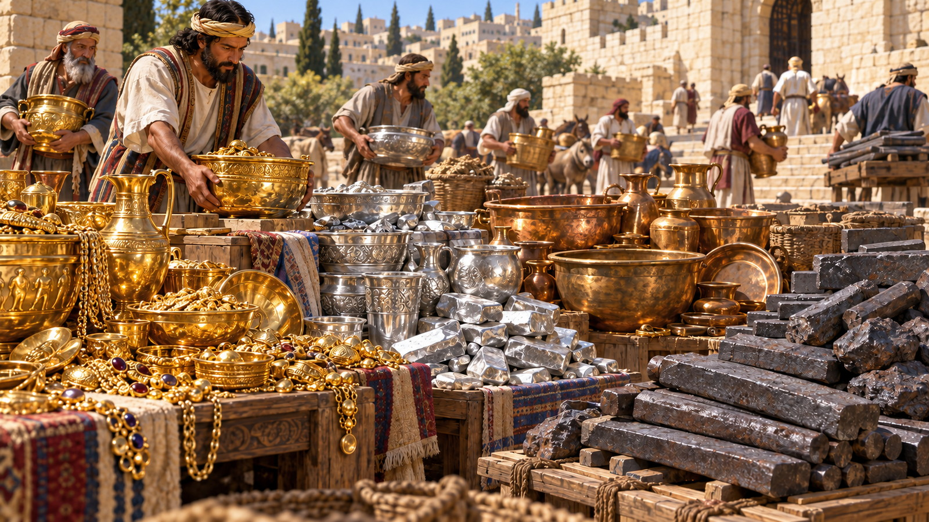
1 Chronicles 29:6-8
6 Then the chief of the fathers and princes of the tribes of Israel, and the captains of thousands and of hundreds, with the rulers of the king’s work, offered willingly,

Slide 34
1 Chronicles 29:6-8
7 And gave for the service of the house of God of gold five thousand talents and ten thousand drams, and of silver ten thousand talents, and of brass eighteen thousand talents, and one hundred thousand talents of iron.

Slide 35
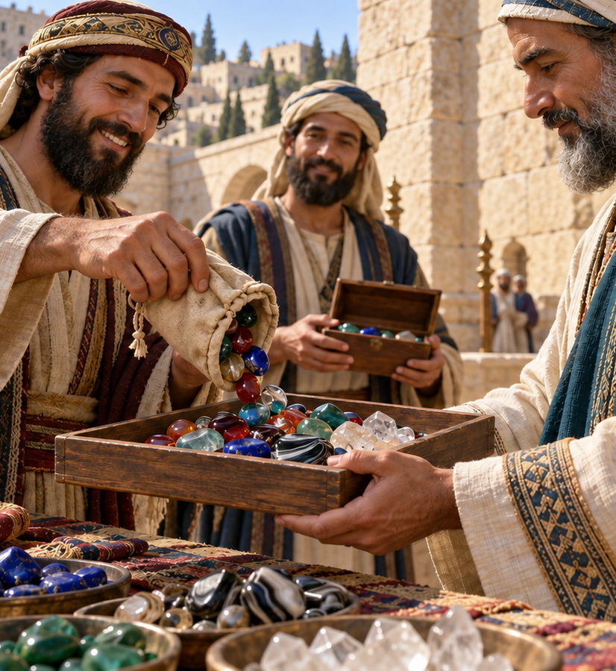
1 Chronicles 29:6-8
8 And they with whom precious stones were found gave them to the treasure of the house of the LORD, by the hand of Jehiel the Gershonite.

Slide 36
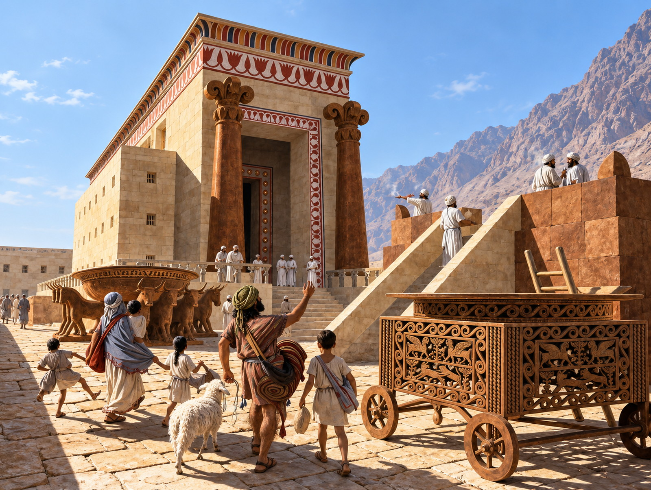
QUESTION 12
How was it that the people were enabled to give so willingly?
1 Chronicles 29:9

Slide 37
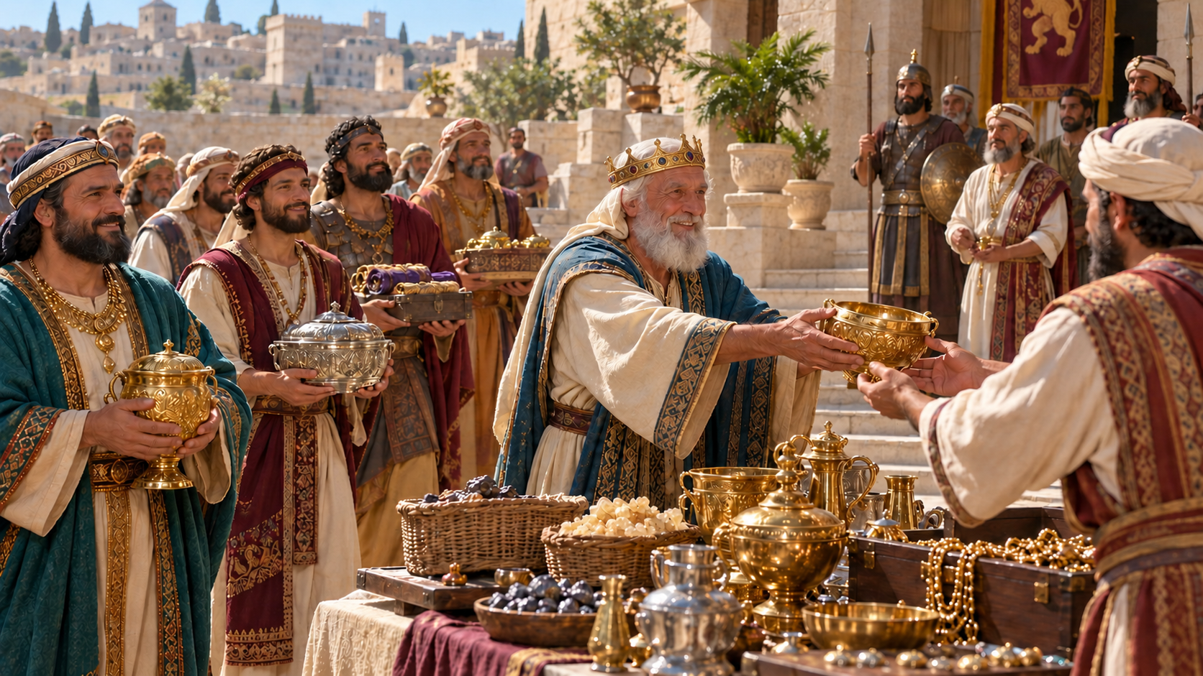
1 Chronicles 29:9
9 Then the people rejoiced, for that they offered willingly, because with perfect heart they offered willingly to the LORD: and David the king also rejoiced with great joy.

Slide 38
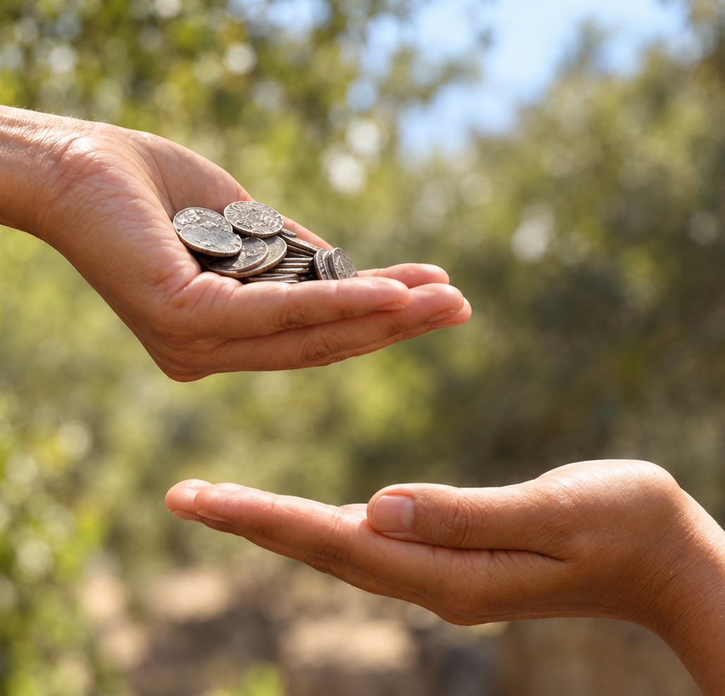
QUESTION 13
Is there danger of coming to poverty through generous giving to the cause of God?
Proverbs 11:24, 25

Slide 39
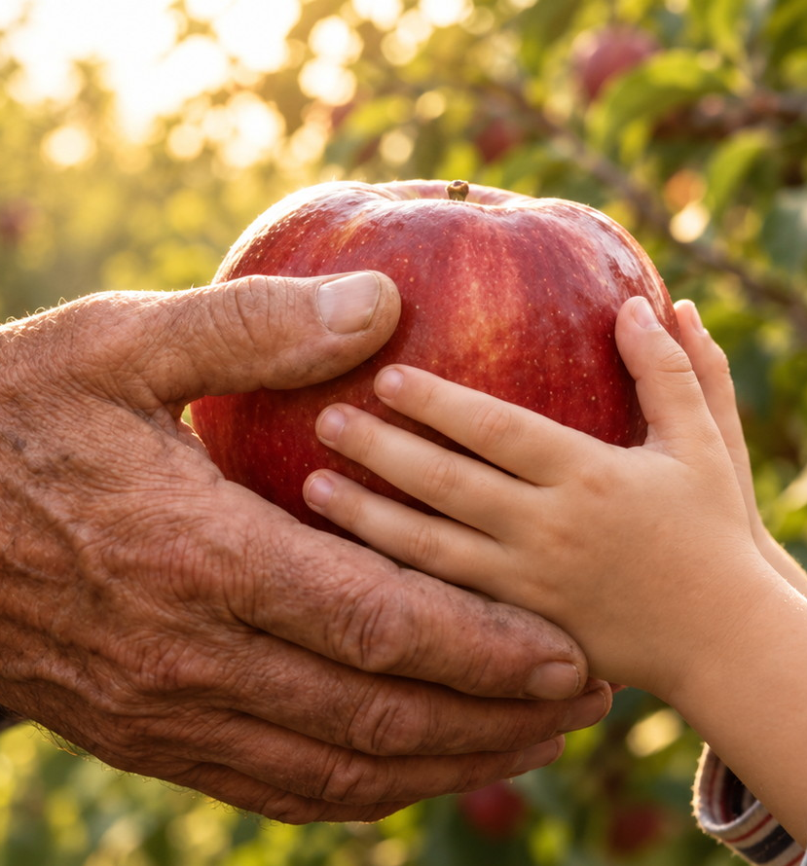
Proverbs 11:24–25
24 There is that scattereth, and yet increaseth; and there is that withholdeth more than is meet, but it tendeth to poverty.
25 The liberal soul shall be made fat: and he that watereth shall be watered also himself.

Slide 40
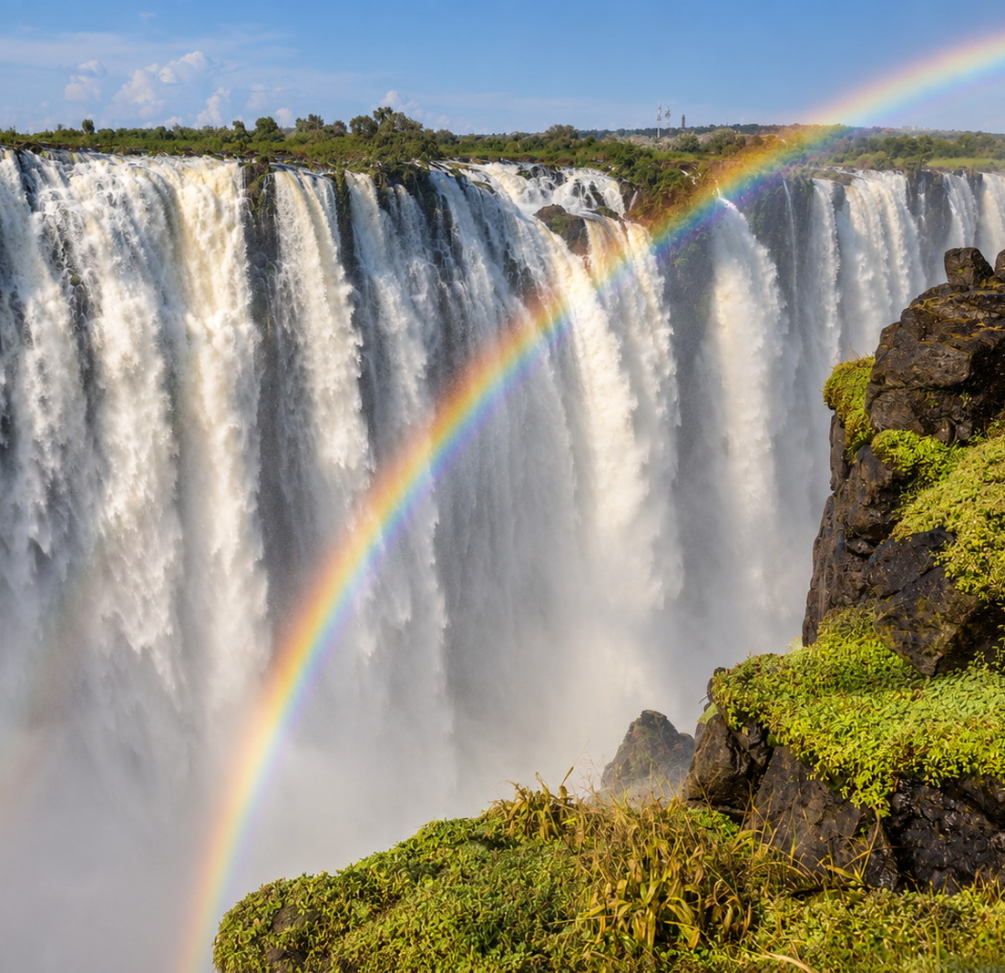
QUESTION 14
What is God able to do?
2 Corinthians 9:8, 11

Slide 41
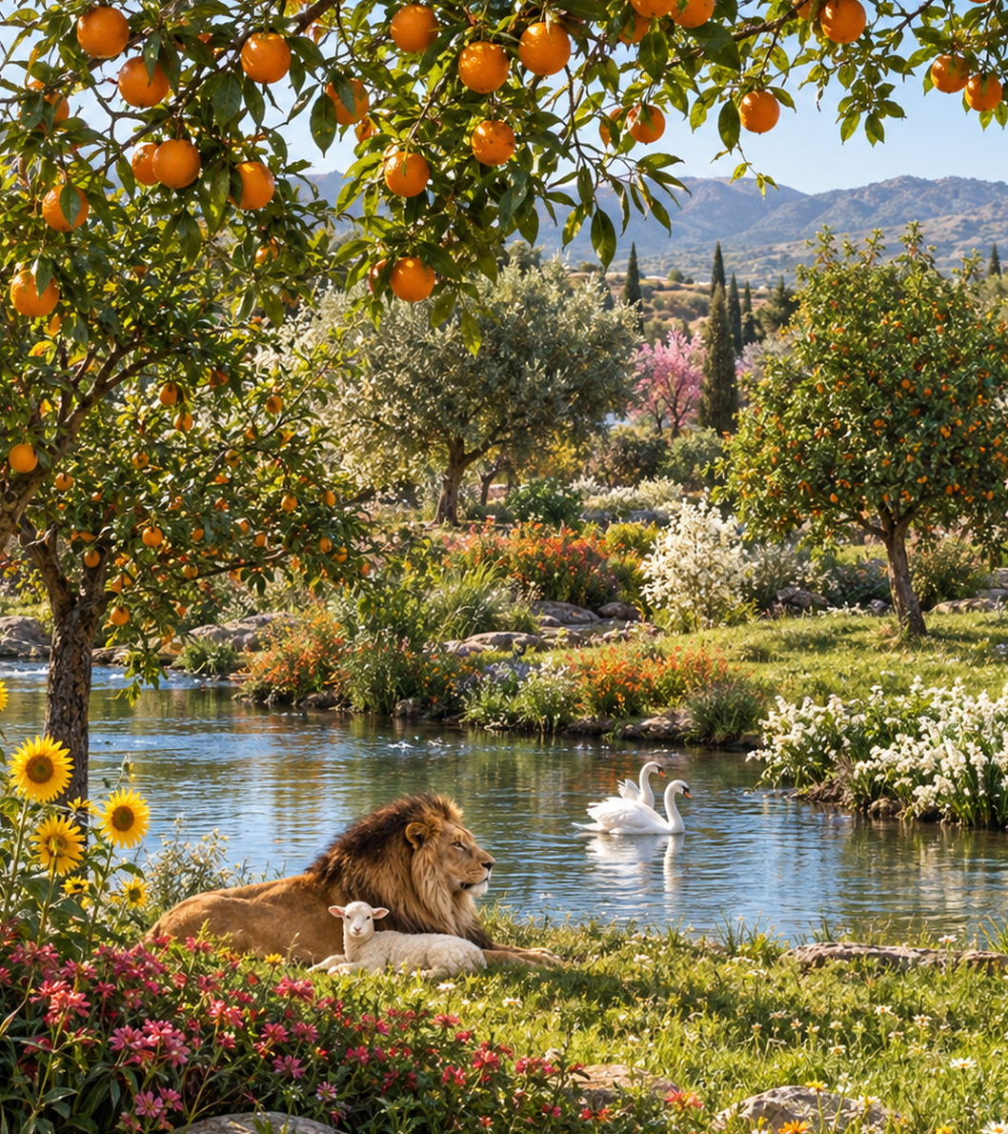
2 Corinthians 9:8, 11
8 And God is able to make all grace abound toward you; that ye, always having all sufficiency in all things, may abound to every good work:
11 Being enriched in every thing to all bountifulness, which causeth through us thanksgiving to God.

Slide 42

QUESTION 15
How is this?
Psalm 24:1;
50:10–12;
Haggai 2:8

Slide 43

Psalm 24:1
1 The earth is the LORD’s, and the fulness thereof; the world, and they that dwell therein.

Slide 44
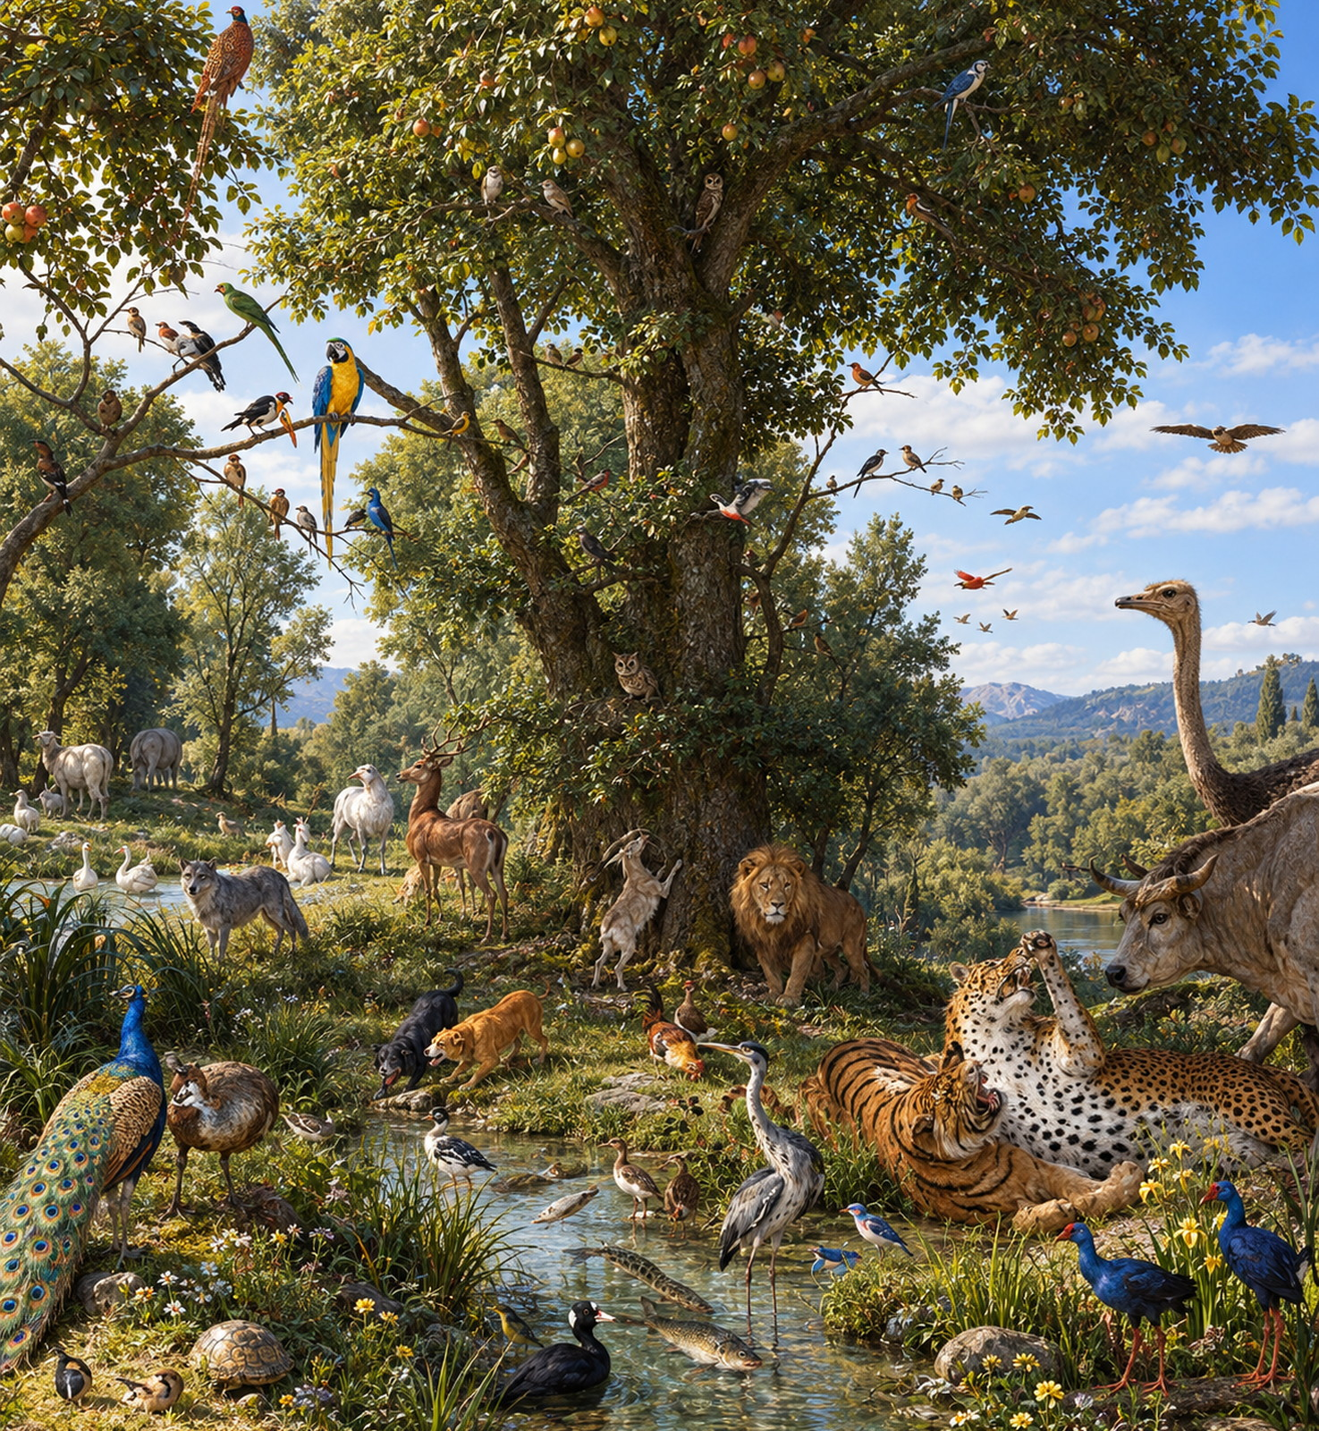
Psalm 50:10–12
10 For every beast of the forest is mine, and the cattle upon a thousand hills.
11 I know all the fowls of the mountains: and the wild beasts of the field are mine.

Slide 45
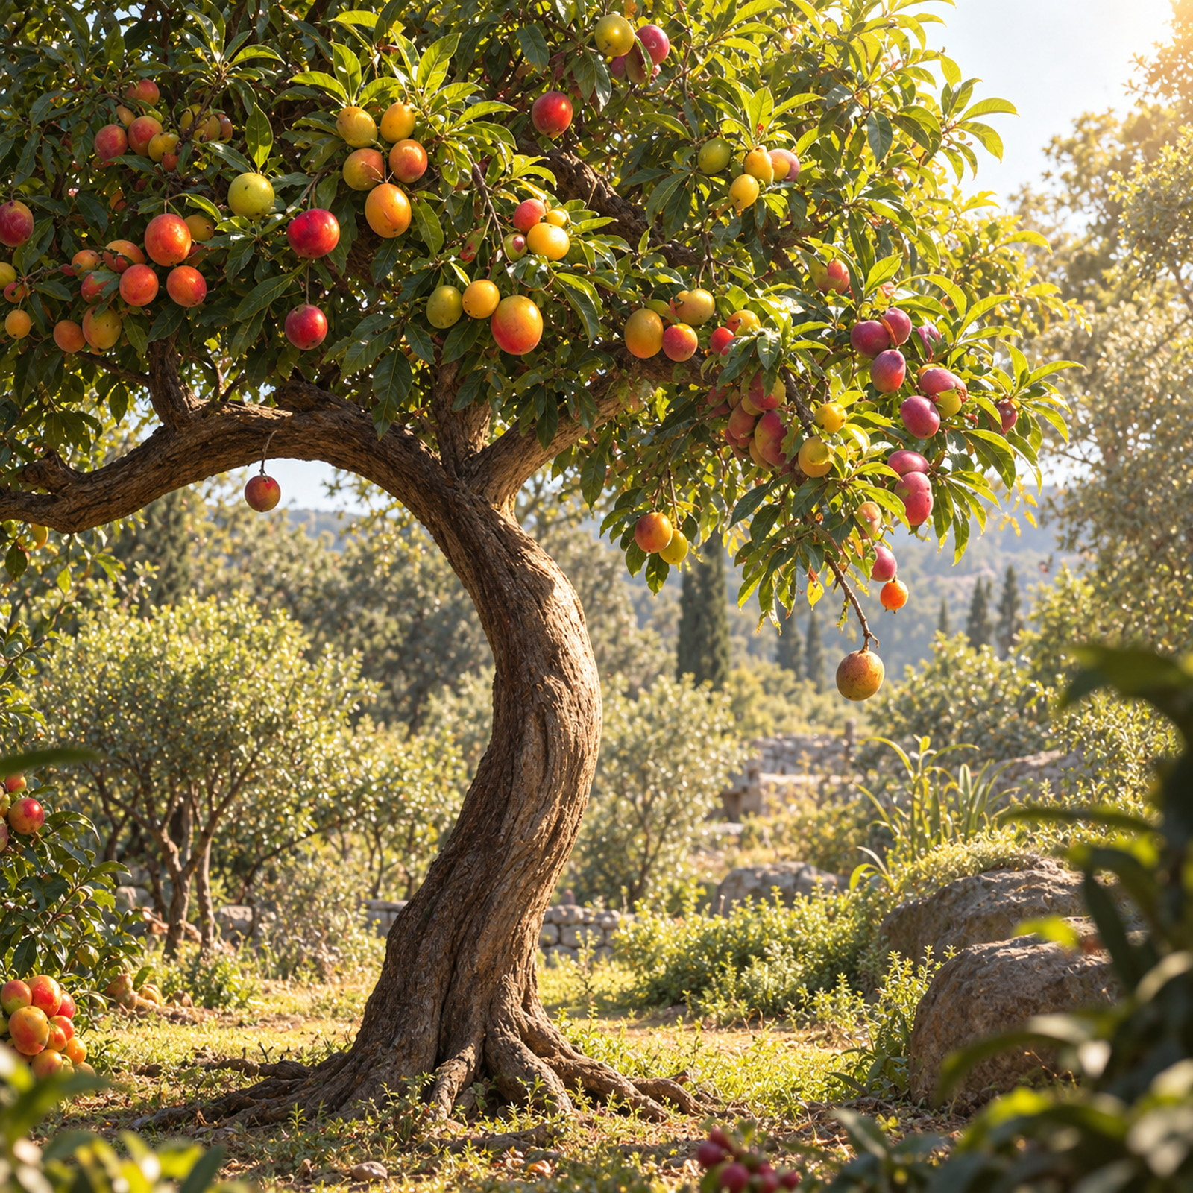
Psalm 50:10-12
12 If I were hungry, I would not tell thee: for the world is mine, and the fulness thereof.

Slide 46
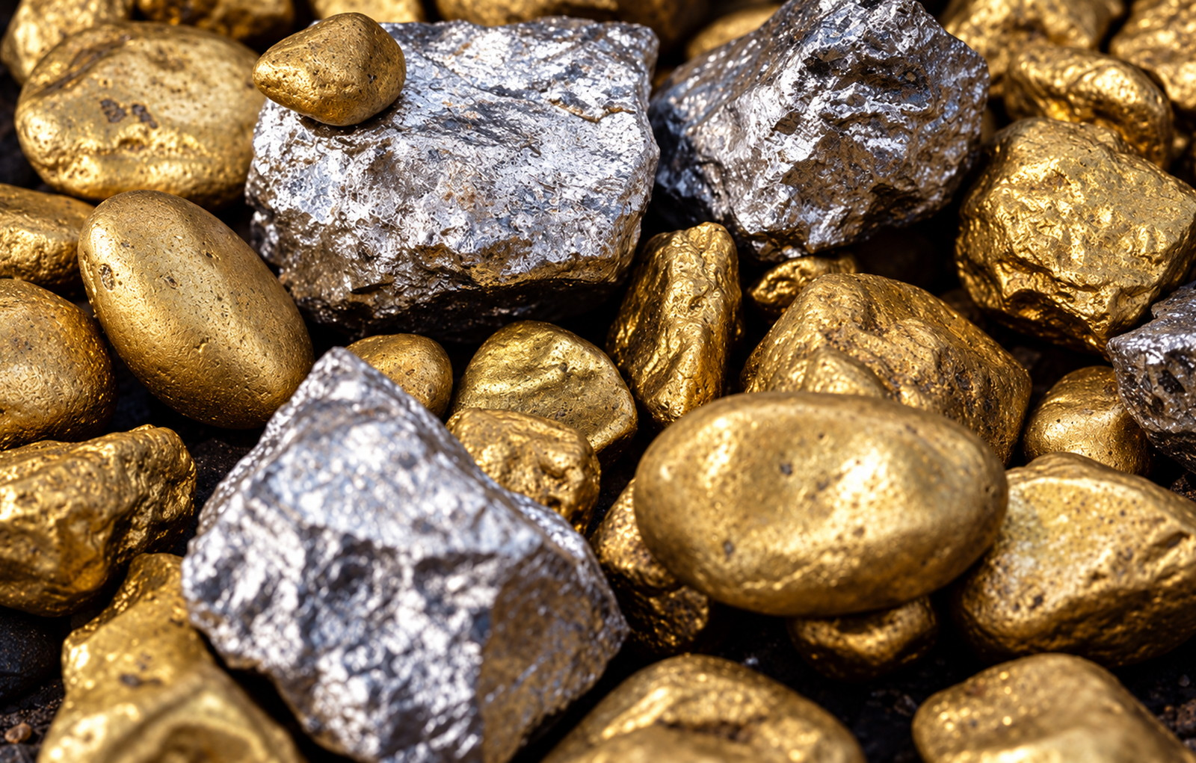
Haggai 2:8
8 The silver is mine, and the gold is mine, saith the LORD of hosts.

Slide 47
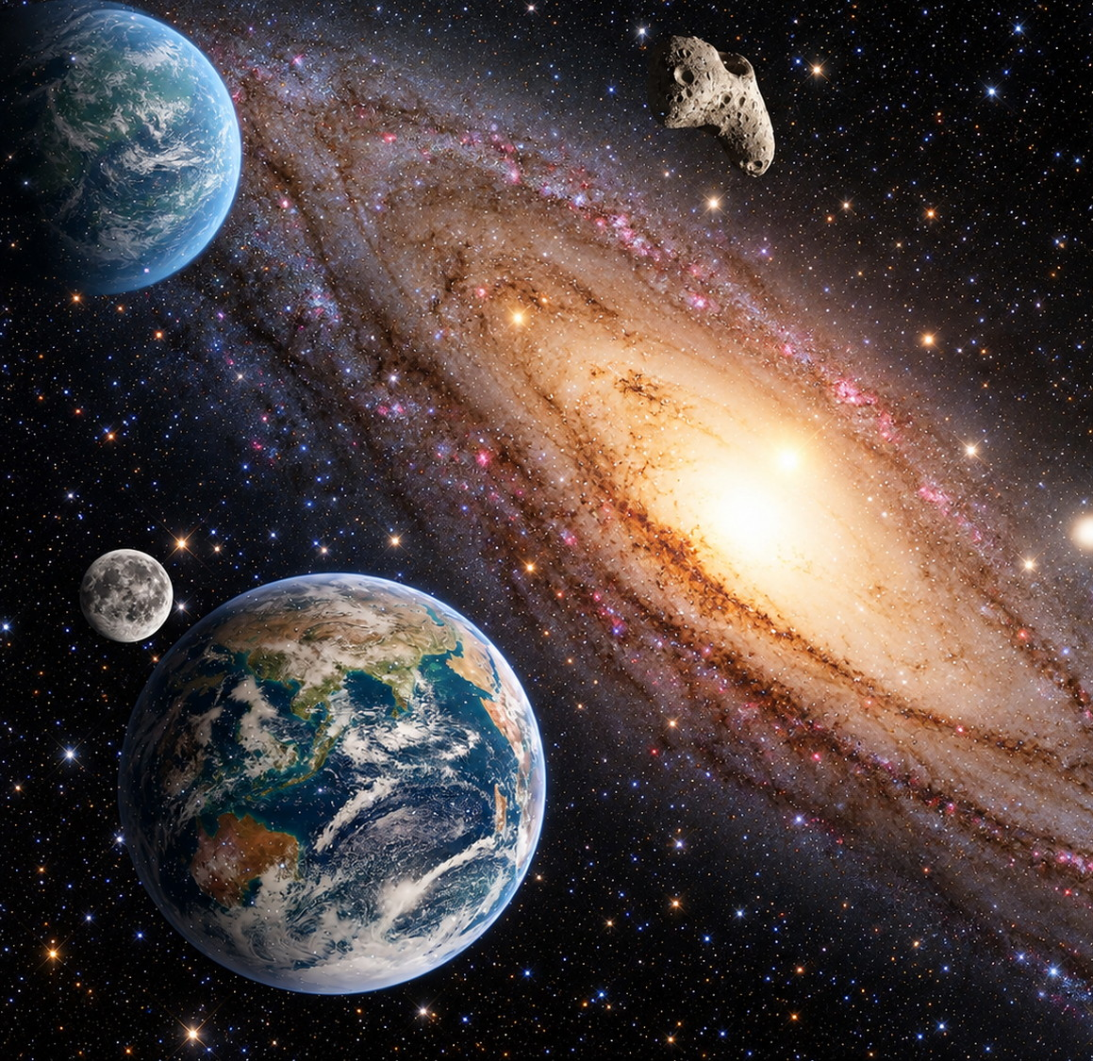
QUESTION 16
Then when people make offerings to God, whose property do they give?
1 Chronicles 29:14–16

Slide 48
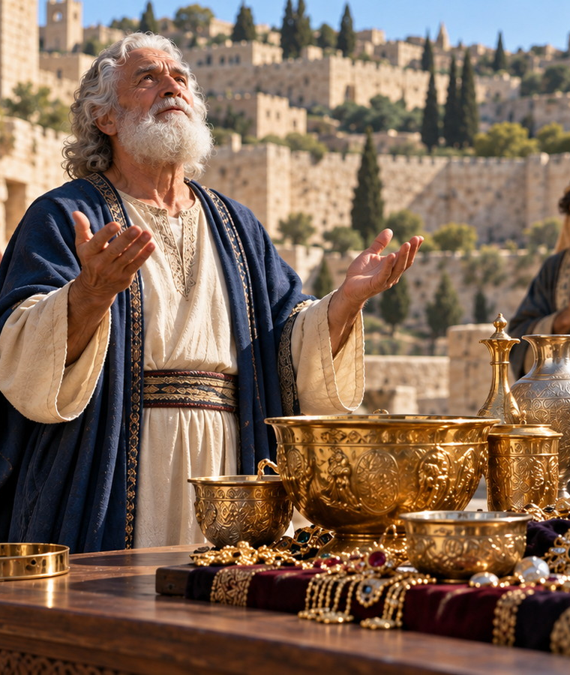
1 Chronicles 29:14-16
14 But who am I, and what is my people, that we should be able to offer so willingly after this sort? for all things come of thee, and of thine own have we given thee.

Slide 49
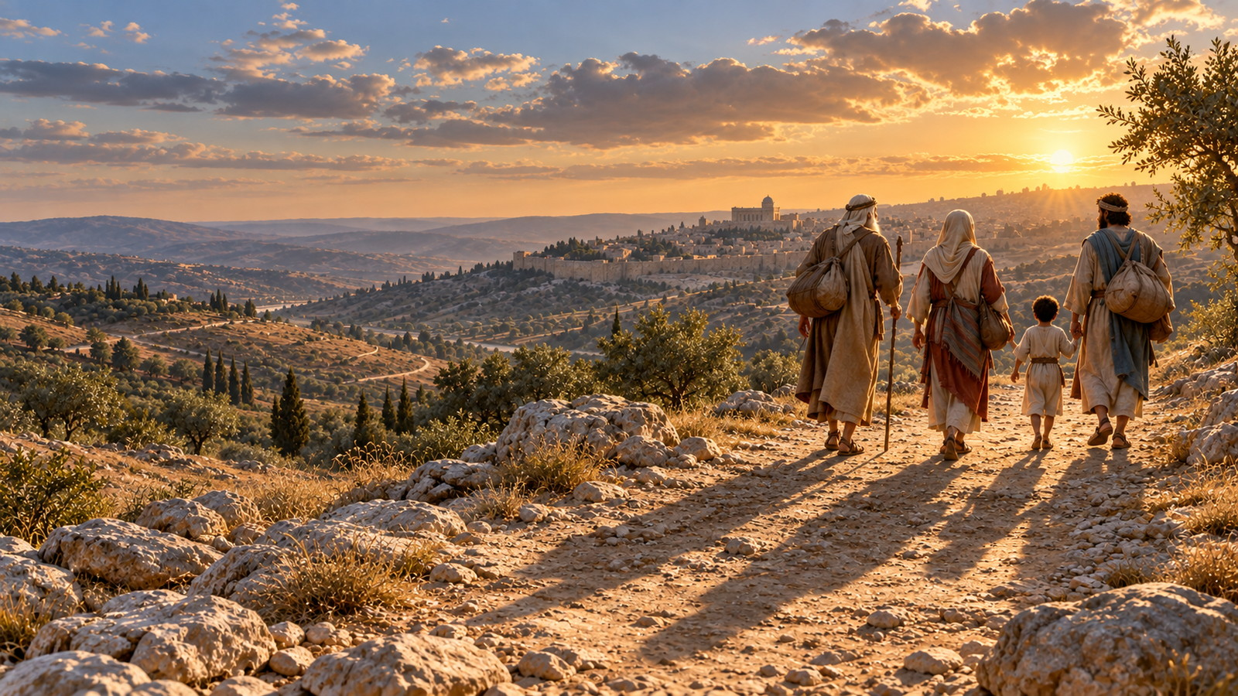
1 Chronicles 29:14-16
15 For we are strangers before thee, and sojourners, as were all our fathers: our days on the earth are as a shadow, and there is none abiding.

Slide 50
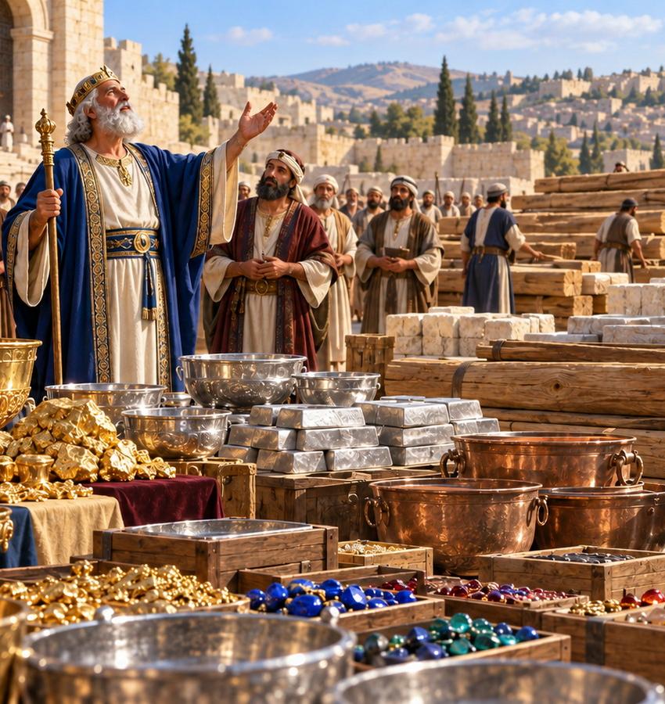
1 Chronicles 29:16
16 O LORD our God, all this store that we have prepared to build thee an house for thine holy name cometh of thine hand, and is all thine own.

Slide 51

QUESTION 17
What was the result when the people gave with a willing heart?
Exodus 36:4, 5

Slide 52
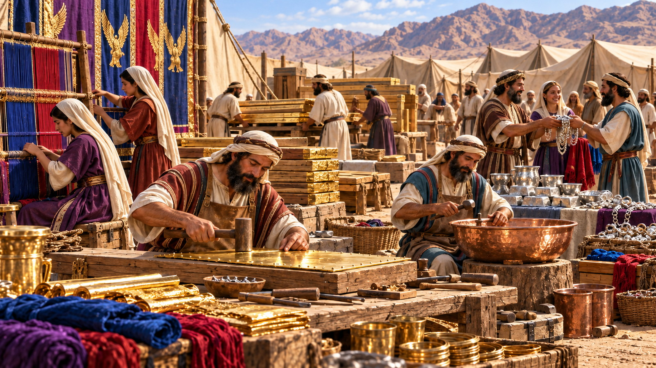
Exodus 36:4–5
4 And all the wise men, that wrought all the work of the sanctuary, came every man from his work which they made;

Slide 53
Exodus 36:4–5
5 And they spake unto Moses, saying, The people bring much more than enough for the service of the work, which the LORD commanded to make.

Slide 54
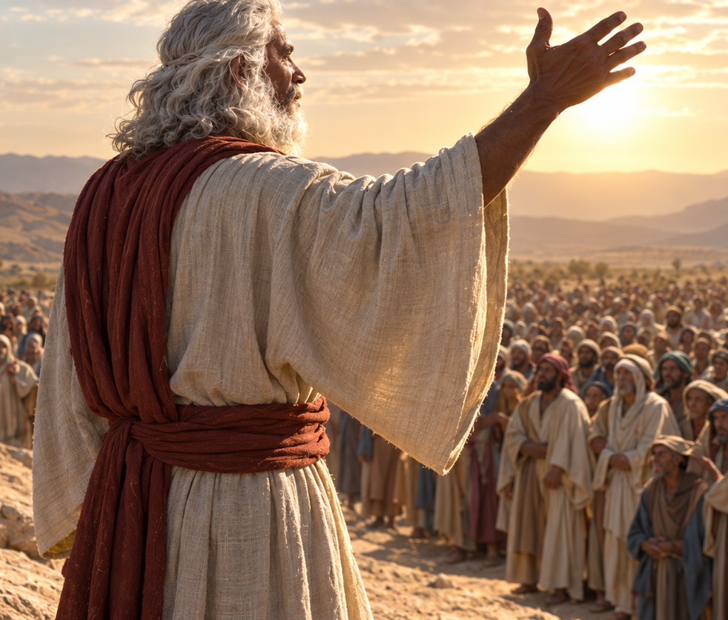
QUESTION 18
What proclamation had to be made?
Exodus 36:6, 7

Slide 55
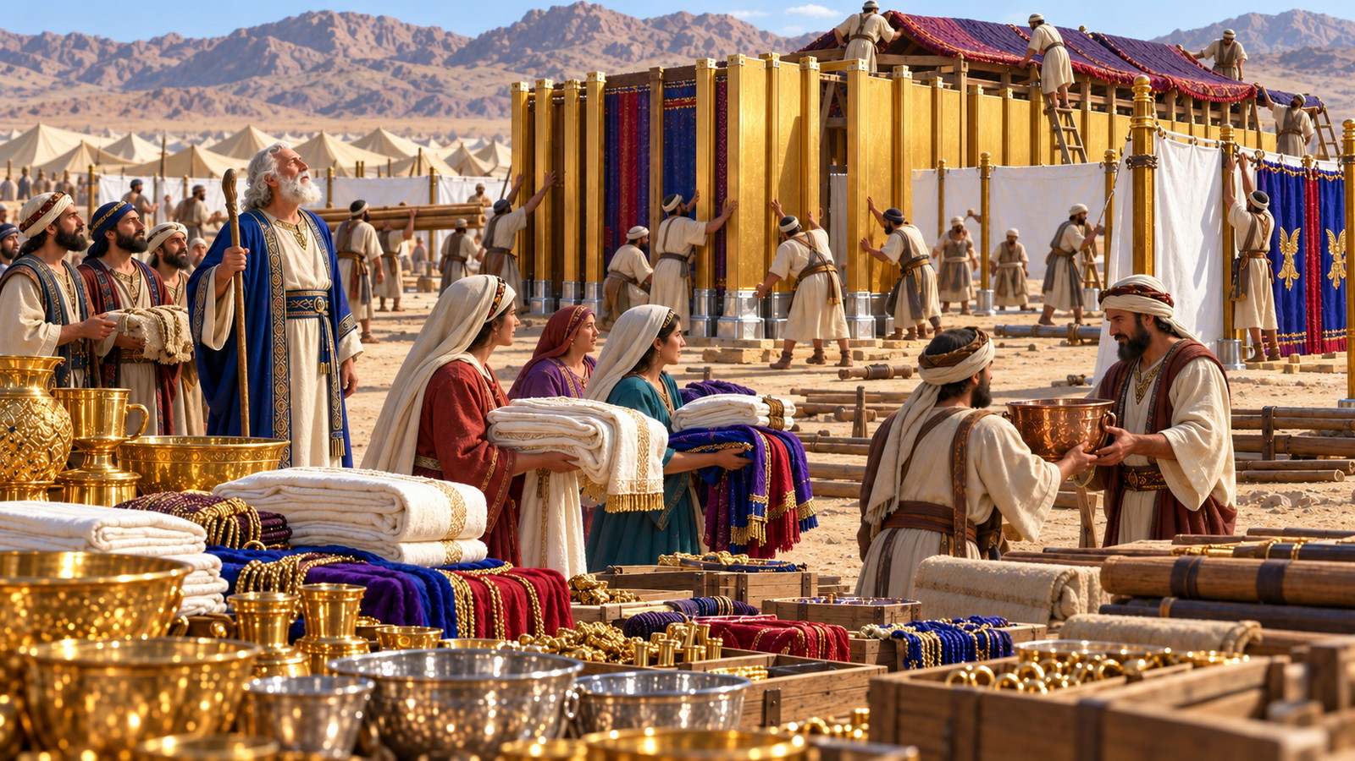
Exodus 36:6-7
6 And Moses gave commandment, and they caused it to be proclaimed throughout the camp, saying, Let neither man nor woman make any more work for the offering of the sanctuary. So the people were restrained from bringing.

Slide 56
Exodus 36:6-7
7 For the stuff they had was sufficient for all the work to make it, and too much.

Slide 57
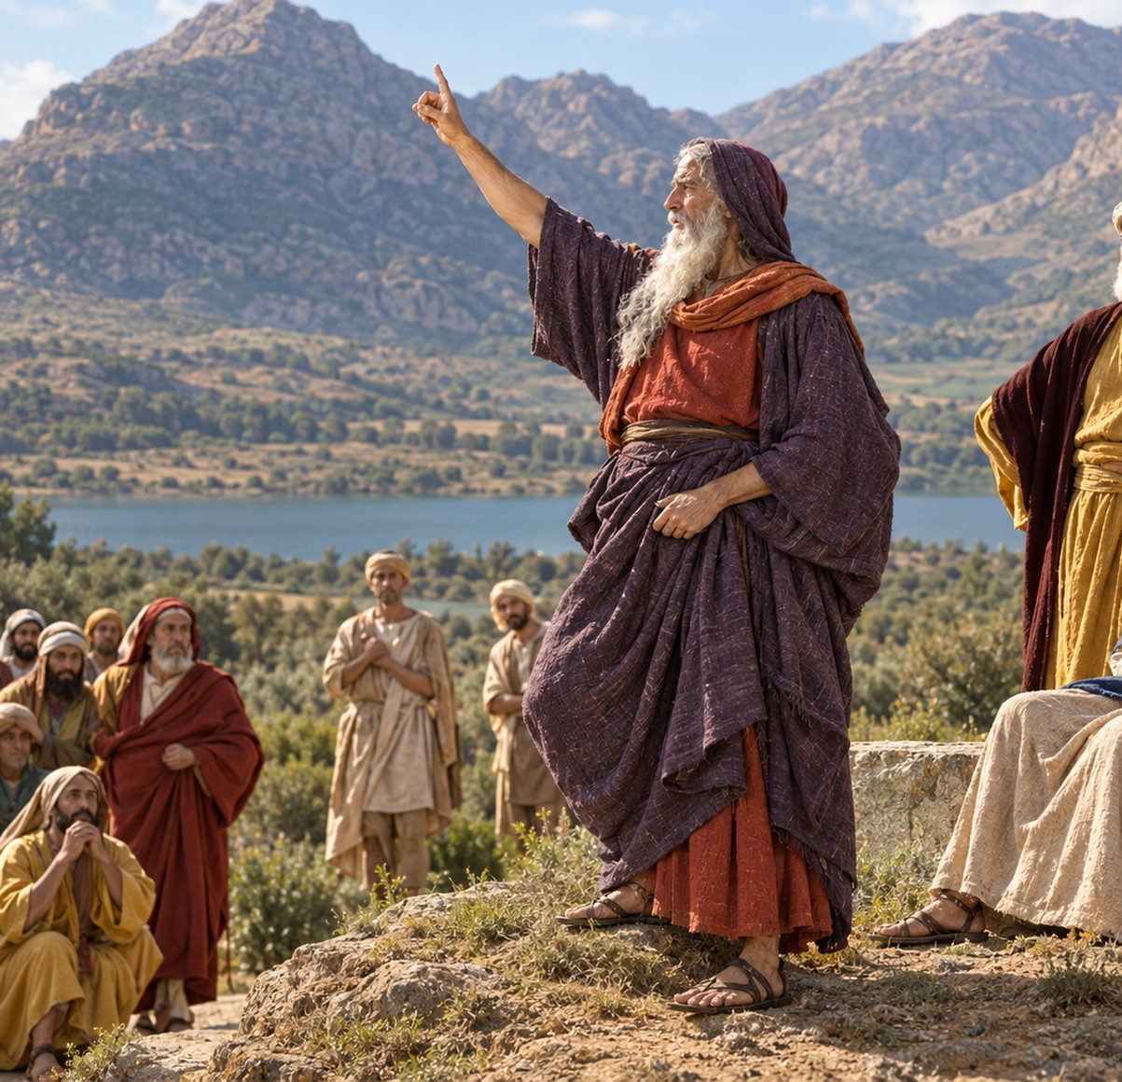
QUESTION 19
How many have known of such an instance in the history of the cause?

Slide 58
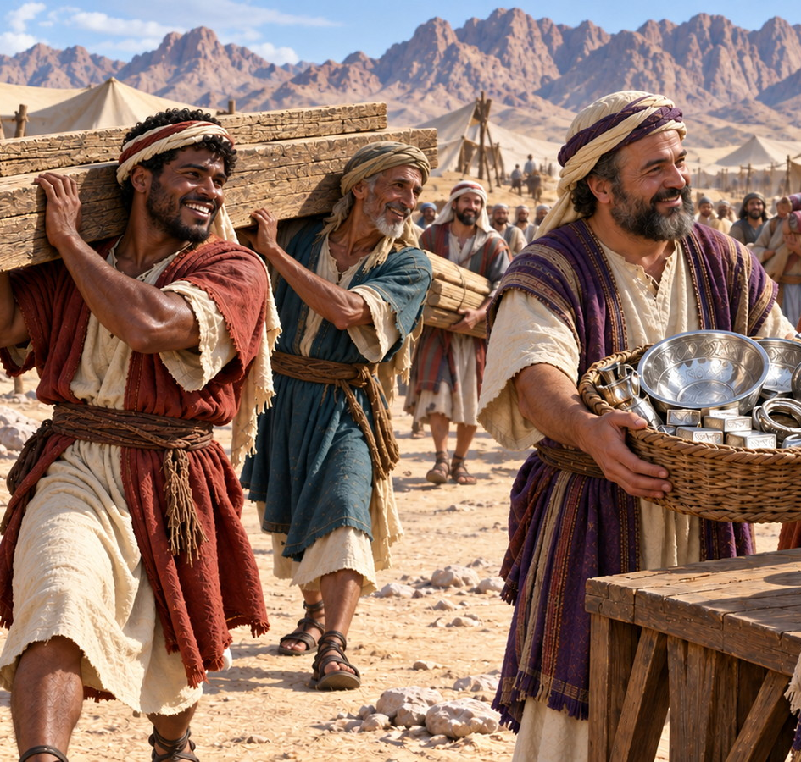
QUESTION 20
Is there in this record any lesson for us?

Slide 59


Slide 60


