Slide 1


Slide 2


Slide 3
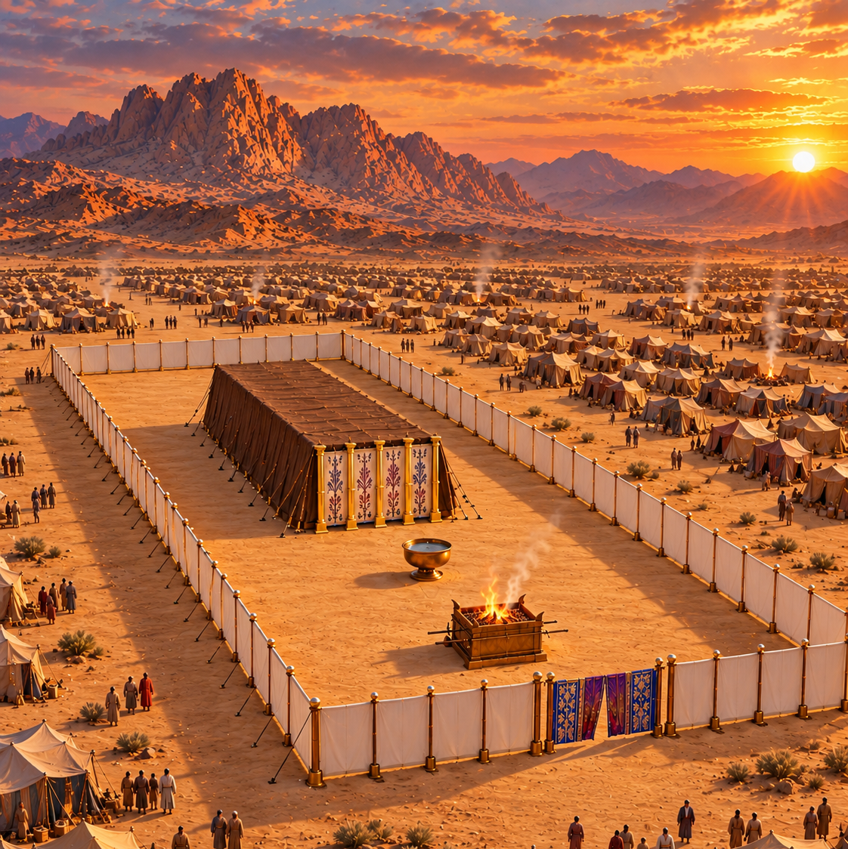
Lesson 15
THE
TABERNACLE
April 13, 1889
Notes:
THE TABERNACLE
KJV texts are quoted in full. Illustration is a reconstruction, not a surviving photograph.

Slide 4
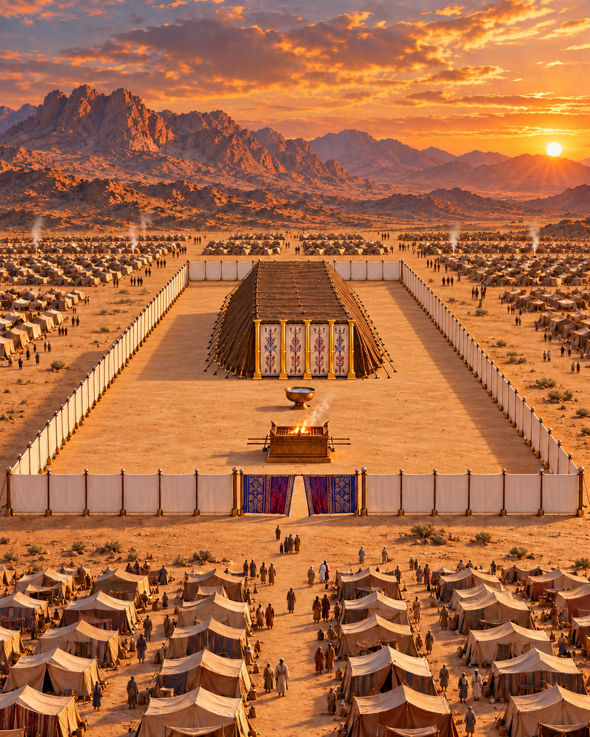
1. What was the object of the sanctuary which the Lord told the children of Israel to build?
Exodus 25:8
Notes:
1. What was the object of the sanctuary which the Lord told the children of Israel to build?
Exodus 25:8
KJV texts are quoted in full. Illustration is a reconstruction, not a surviving photograph.

Slide 5
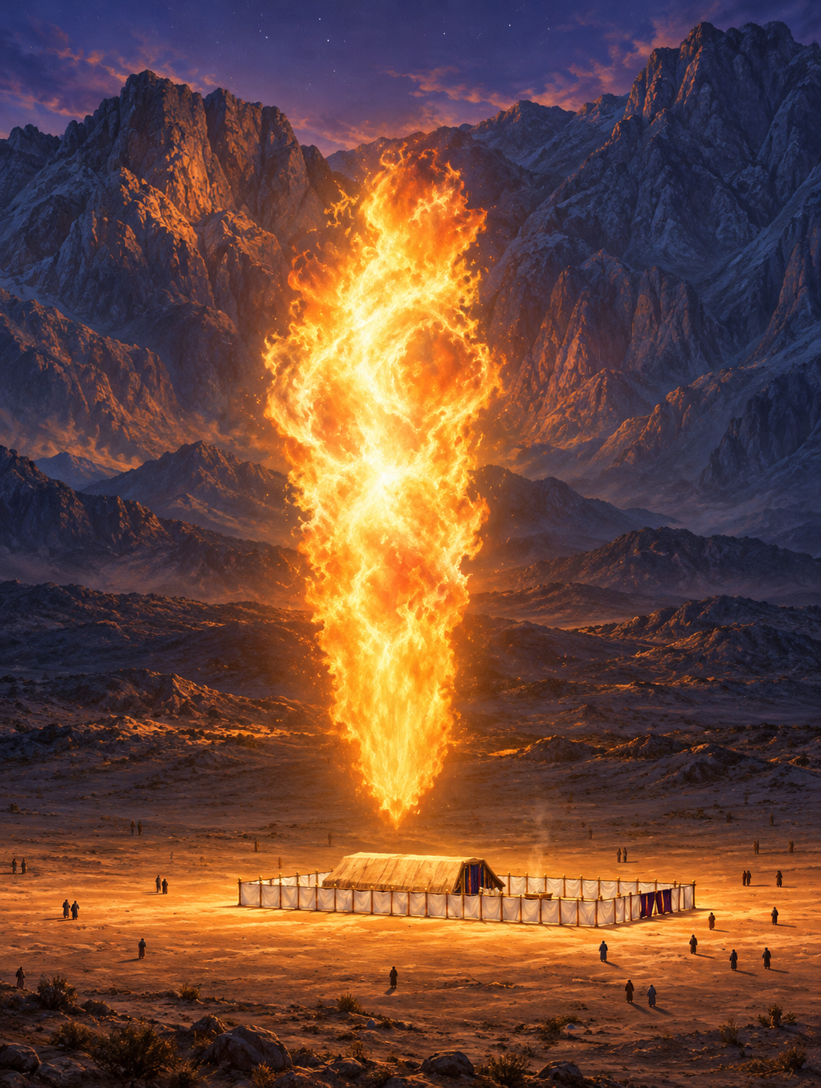
Exodus 25:8
To provide a sanctuary, that the Lord might dwell among His people.
8 And let them make me a sanctuary; that I may dwell among them.
Notes:
Exodus 25:8
To provide a sanctuary, that the Lord might dwell among His people.
https://biblehub.com/kjv/exodus/25.htm
KJV texts are quoted in full. Illustration is a reconstruction, not a surviving photograph.

Slide 6
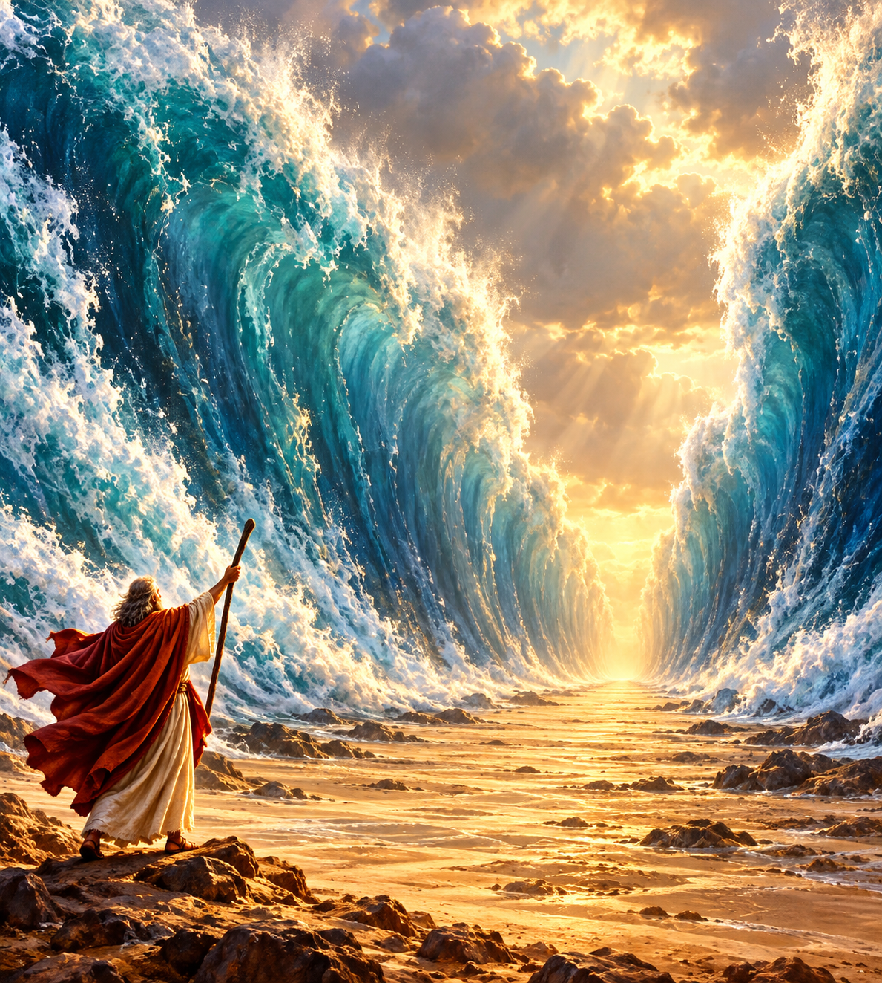
2. Was this an entirely new thought to them?
Exodus 15:1–2
Notes:
2. Was this an entirely new thought to them?
Exodus 15:1–2
KJV texts are quoted in full. Illustration is a reconstruction, not a surviving photograph.

Slide 7
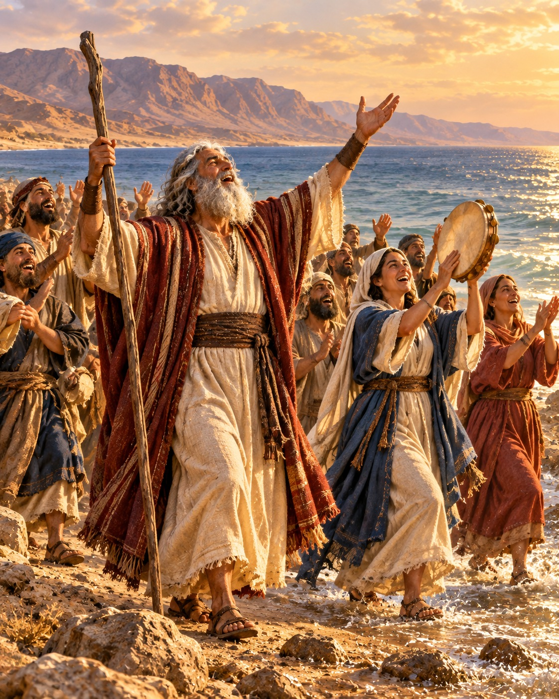
Exodus 15:1–2
1 Then sang Moses and the children of Israel this song unto the LORD, and spake, saying, I will sing unto the LORD, for he hath triumphed gloriously: the horse and his rider hath he thrown into the sea.
2 The LORD is my strength and song, and he is become my salvation: he is my God, and I will prepare him an habitation; my father's God, and I will exalt him.
Notes:
Exodus 15:1–2
No. In their song after the deliverance at the Red Sea, they had spoken of preparing Him an habitation.
https://biblehub.com/kjv/exodus/15.htm
KJV texts are quoted in full. Illustration is a reconstruction, not a surviving photograph.

Slide 8
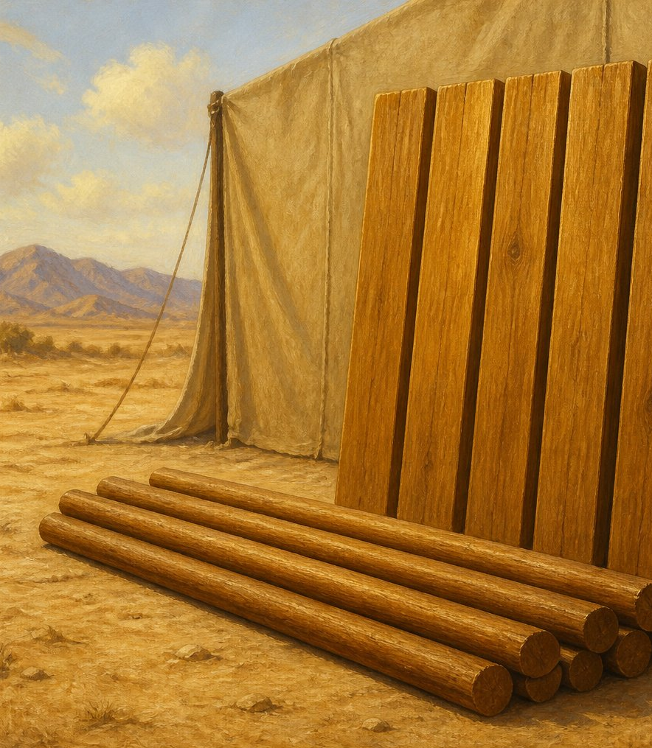
3. Of what was the frame-work of the tabernacle made?
Exodus 26:15
Notes:
3. Of what was the frame-work of the tabernacle made?
Exodus 26:15
KJV texts are quoted in full. Illustration is a reconstruction, not a surviving photograph.
Construction source: Exodus 25–26, https://biblehub.com/kjv/exodus/26.htm. The text specifies boards, sockets, bars, curtains, pillars and materials. Flat roof profile, exact corner joinery, board thickness and textile motifs are reconstruction choices. The familiar 10-cubit width and 20/10-cubit room division are conventional reconstruction dimensions. The KJV calls the outer covering badgers’ skins; the animal identification is uncertain.

Slide 9
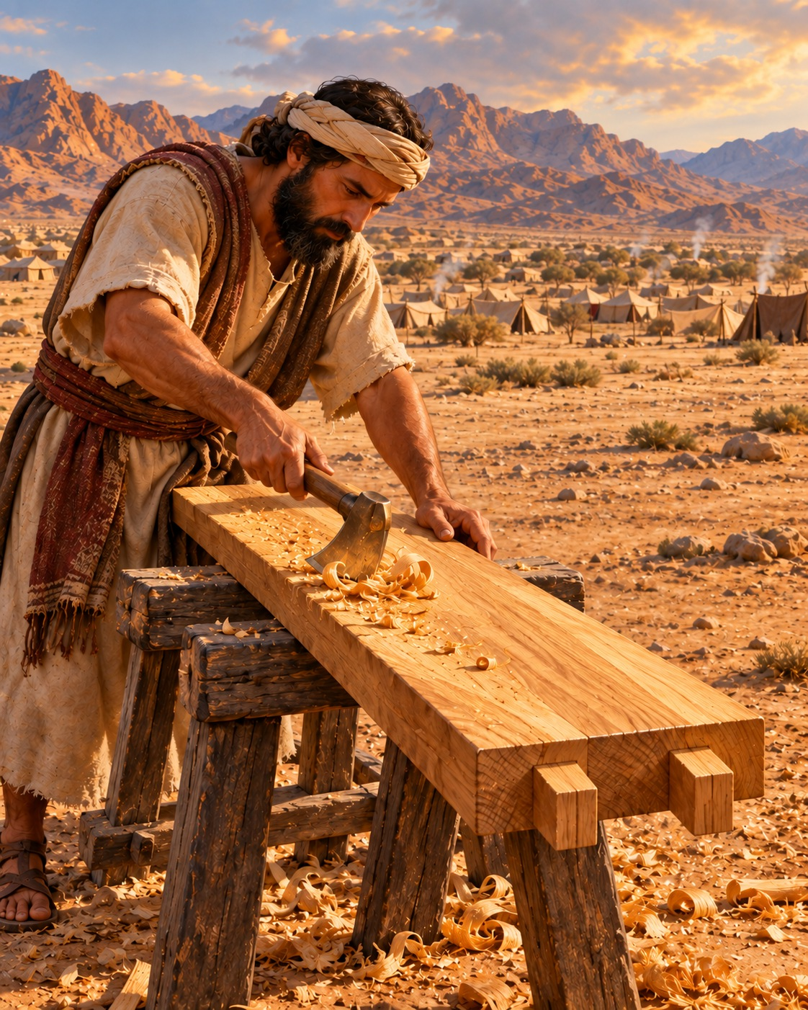
Exodus 26:15
Upright boards of shittim wood.
15 And thou shalt make boards for the tabernacle of shittim wood standing up.
Notes:
Exodus 26:15
Upright boards of shittim wood.
https://biblehub.com/kjv/exodus/26.htm
KJV texts are quoted in full. Illustration is a reconstruction, not a surviving photograph.
Construction source: Exodus 25–26, https://biblehub.com/kjv/exodus/26.htm. The text specifies boards, sockets, bars, curtains, pillars and materials. Flat roof profile, exact corner joinery, board thickness and textile motifs are reconstruction choices. The familiar 10-cubit width and 20/10-cubit room division are conventional reconstruction dimensions. The KJV calls the outer covering badgers’ skins; the animal identification is uncertain.

Slide 10
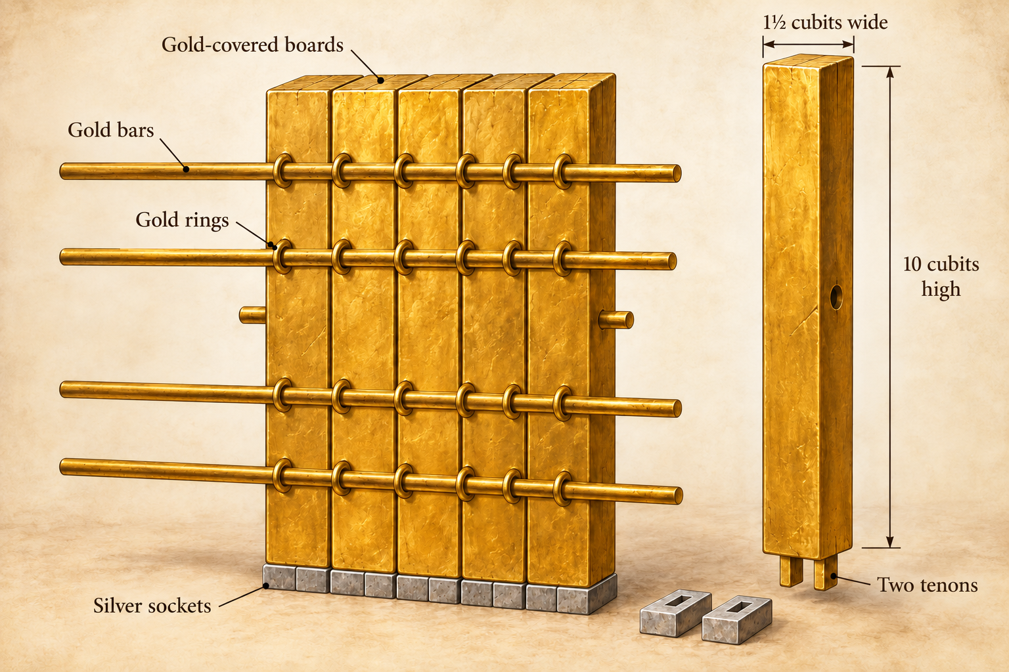
4. How many boards were there on each side?
Exodus 26:18–20
Notes:
4. How many boards were there on each side?
Exodus 26:18–20
KJV texts are quoted in full. Illustration is a reconstruction, not a surviving photograph.
Construction source: Exodus 25–26, https://biblehub.com/kjv/exodus/26.htm. The text specifies boards, sockets, bars, curtains, pillars and materials. Flat roof profile, exact corner joinery, board thickness and textile motifs are reconstruction choices. The familiar 10-cubit width and 20/10-cubit room division are conventional reconstruction dimensions. The KJV calls the outer covering badgers’ skins; the animal identification is uncertain.

Slide 11
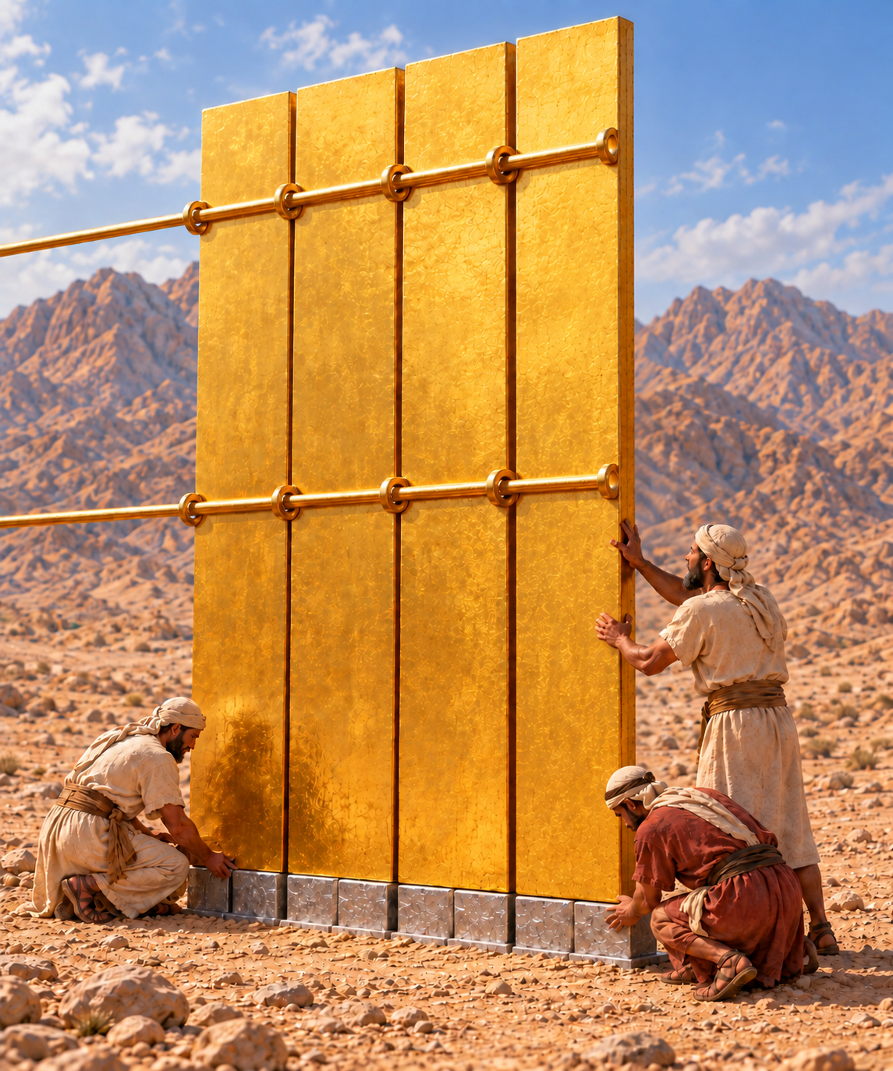
Exodus 26:18–20
18 And thou shalt make the boards for the tabernacle, twenty boards on the south side southward.
19 And thou shalt make forty sockets of silver under the twenty boards; two sockets under one board for his two tenons, and two sockets under another board for his two tenons.
20 And for the second side of the tabernacle on the north side there shall be twenty boards:
Notes:
Exodus 26:18–20
Twenty boards on the south side, and twenty on the north.
https://biblehub.com/kjv/exodus/26.htm
KJV texts are quoted in full. Illustration is a reconstruction, not a surviving photograph.
Construction source: Exodus 25–26, https://biblehub.com/kjv/exodus/26.htm. The text specifies boards, sockets, bars, curtains, pillars and materials. Flat roof profile, exact corner joinery, board thickness and textile motifs are reconstruction choices. The familiar 10-cubit width and 20/10-cubit room division are conventional reconstruction dimensions. The KJV calls the outer covering badgers’ skins; the animal identification is uncertain.

Slide 12
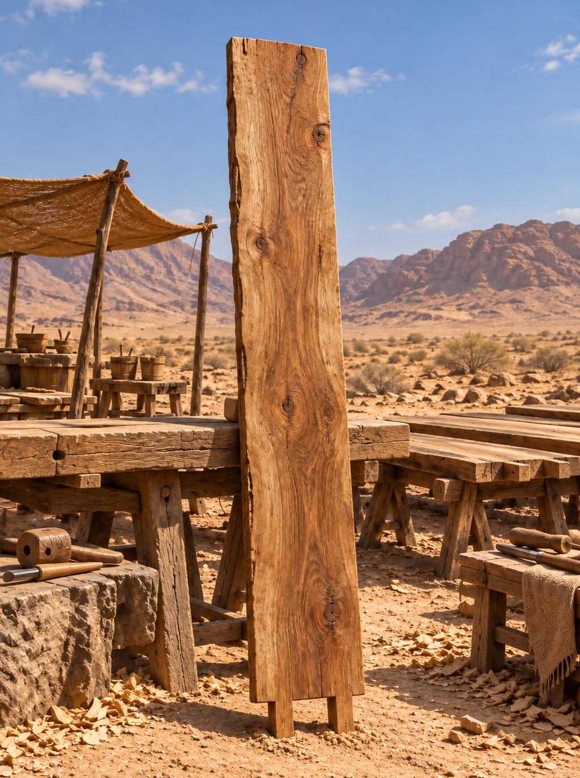
5. What were the dimensions of each board?
Exodus 26:16
Notes:
5. What were the dimensions of each board?
Exodus 26:16
KJV texts are quoted in full. Illustration is a reconstruction, not a surviving photograph.
Construction source: Exodus 25–26, https://biblehub.com/kjv/exodus/26.htm. The text specifies boards, sockets, bars, curtains, pillars and materials. Flat roof profile, exact corner joinery, board thickness and textile motifs are reconstruction choices. The familiar 10-cubit width and 20/10-cubit room division are conventional reconstruction dimensions. The KJV calls the outer covering badgers’ skins; the animal identification is uncertain.

Slide 13
Exodus 26:16
Ten cubits long and one and a half cubits broad.
16 Ten cubits shall be the length of a board, and a cubit and a half shall be the breadth of one board.
Notes:
Exodus 26:16
Ten cubits long and one and a half cubits broad.
https://biblehub.com/kjv/exodus/26.htm
KJV texts are quoted in full. Illustration is a reconstruction, not a surviving photograph.
Construction source: Exodus 25–26, https://biblehub.com/kjv/exodus/26.htm. The text specifies boards, sockets, bars, curtains, pillars and materials. Flat roof profile, exact corner joinery, board thickness and textile motifs are reconstruction choices. The familiar 10-cubit width and 20/10-cubit room division are conventional reconstruction dimensions. The KJV calls the outer covering badgers’ skins; the animal identification is uncertain.

Slide 14
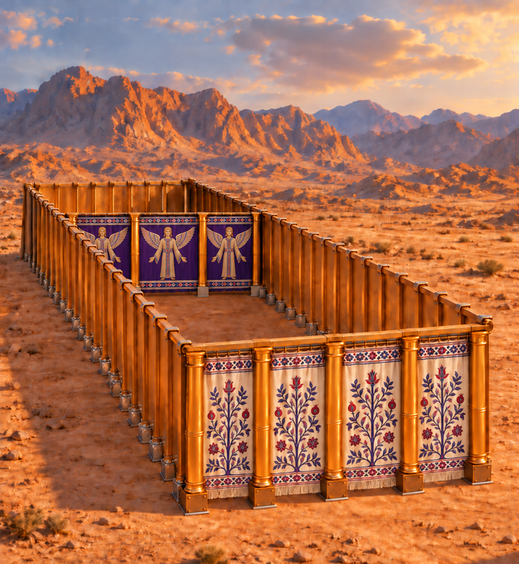
6. Then what was the length and the height of the tabernacle?
Notes:
6. Then what was the length and the height of the tabernacle?
KJV texts are quoted in full. Illustration is a reconstruction, not a surviving photograph.
Construction source: Exodus 25–26, https://biblehub.com/kjv/exodus/26.htm. The text specifies boards, sockets, bars, curtains, pillars and materials. Flat roof profile, exact corner joinery, board thickness and textile motifs are reconstruction choices. The familiar 10-cubit width and 20/10-cubit room division are conventional reconstruction dimensions. The KJV calls the outer covering badgers’ skins; the animal identification is uncertain.

Slide 15
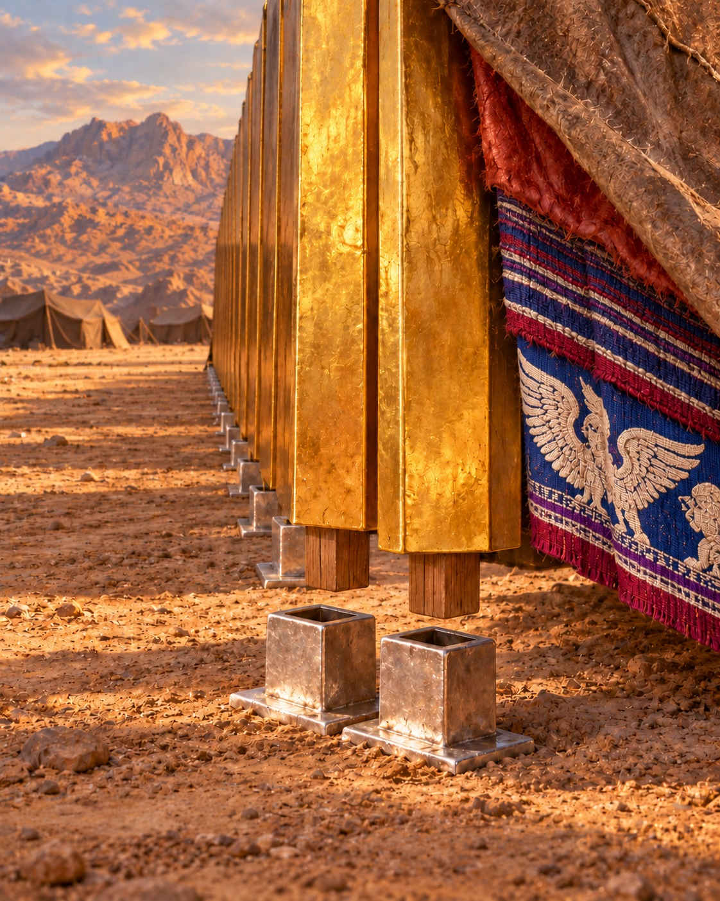
Exodus 26:16, 18
Length: 30 cubits. Height: 10 cubits.
20 boards × 1½ cubits = 30 cubits.
16 Ten cubits shall be the length of a board, and a cubit and a half shall be the breadth of one board.
18 And thou shalt make the boards for the tabernacle, twenty boards on the south side southward.
Notes:
Exodus 26:16, 18
Length: 30 cubits. Height: 10 cubits.
20 boards × 1½ cubits = 30 cubits.
https://biblehub.com/kjv/exodus/26.htm
KJV texts are quoted in full. Illustration is a reconstruction, not a surviving photograph.
Construction source: Exodus 25–26, https://biblehub.com/kjv/exodus/26.htm. The text specifies boards, sockets, bars, curtains, pillars and materials. Flat roof profile, exact corner joinery, board thickness and textile motifs are reconstruction choices. The familiar 10-cubit width and 20/10-cubit room division are conventional reconstruction dimensions. The KJV calls the outer covering badgers’ skins; the animal identification is uncertain.

Slide 16
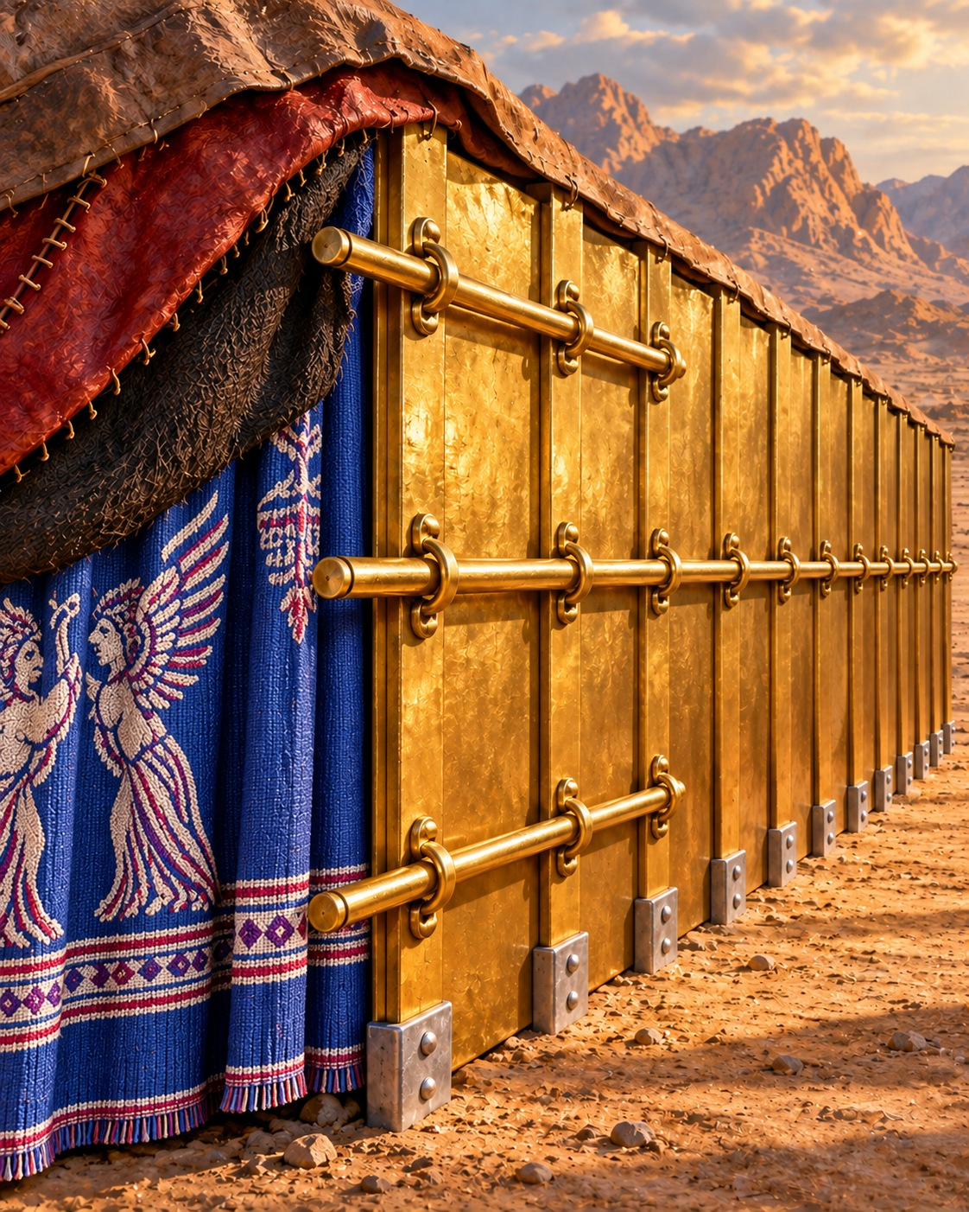
7. How were these boards kept in an upright position?
Exodus 26:17, 19, 26, 27, 28
Notes:
7. How were these boards kept in an upright position?
Exodus 26:17, 19, 26, 27, 28
KJV texts are quoted in full. Illustration is a reconstruction, not a surviving photograph.
Construction source: Exodus 25–26, https://biblehub.com/kjv/exodus/26.htm. The text specifies boards, sockets, bars, curtains, pillars and materials. Flat roof profile, exact corner joinery, board thickness and textile motifs are reconstruction choices. The familiar 10-cubit width and 20/10-cubit room division are conventional reconstruction dimensions. The KJV calls the outer covering badgers’ skins; the animal identification is uncertain.

Slide 17
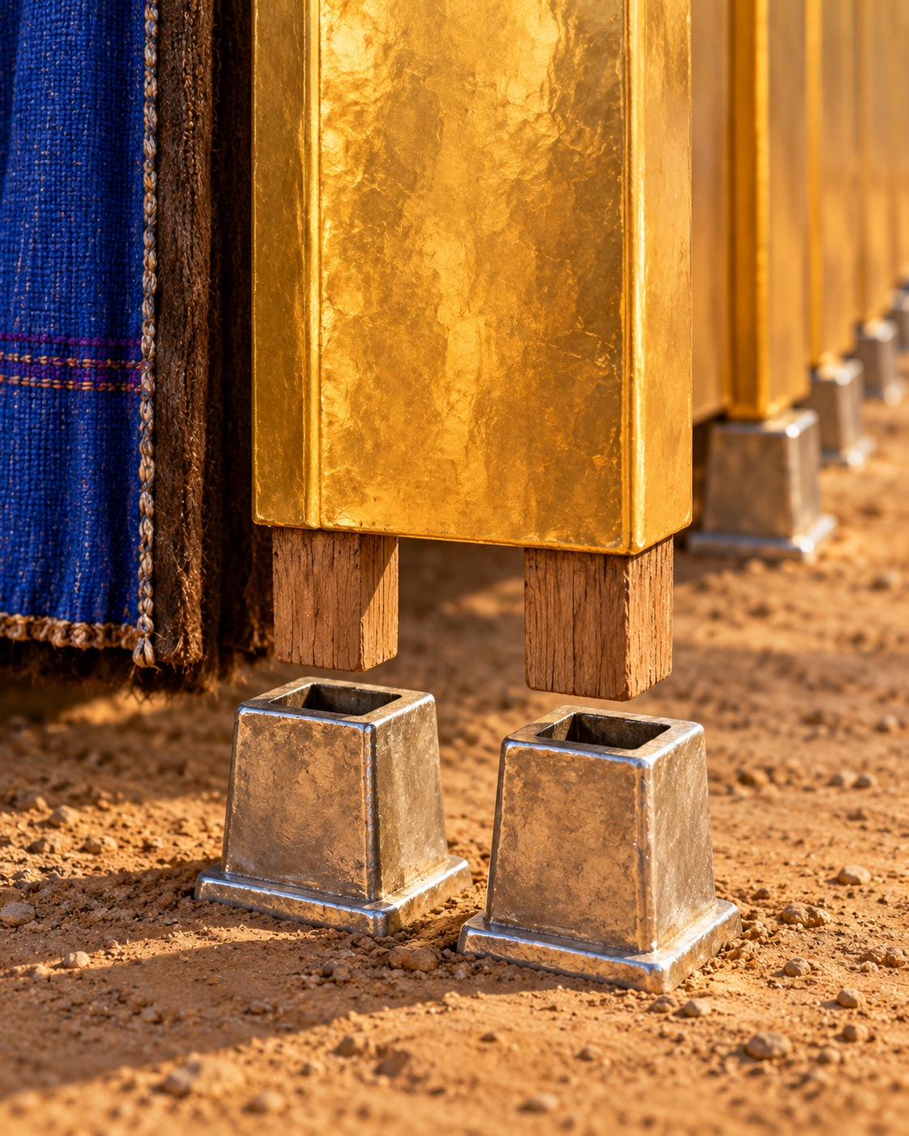
Exodus 26:17, 19
17 Two tenons shall there be in one board, set in order one against another: thus shalt thou make for all the boards of the tabernacle.
19 And thou shalt make forty sockets of silver under the twenty boards; two sockets under one board for his two tenons, and two sockets under another board for his two tenons.
Notes:
Exodus 26:17, 19
Two tenons on each board fitted into silver sockets. Bars held the boards together.
https://biblehub.com/kjv/exodus/26.htm
KJV texts are quoted in full. Illustration is a reconstruction, not a surviving photograph.
Construction source: Exodus 25–26, https://biblehub.com/kjv/exodus/26.htm. The text specifies boards, sockets, bars, curtains, pillars and materials. Flat roof profile, exact corner joinery, board thickness and textile motifs are reconstruction choices. The familiar 10-cubit width and 20/10-cubit room division are conventional reconstruction dimensions. The KJV calls the outer covering badgers’ skins; the animal identification is uncertain.

Slide 18
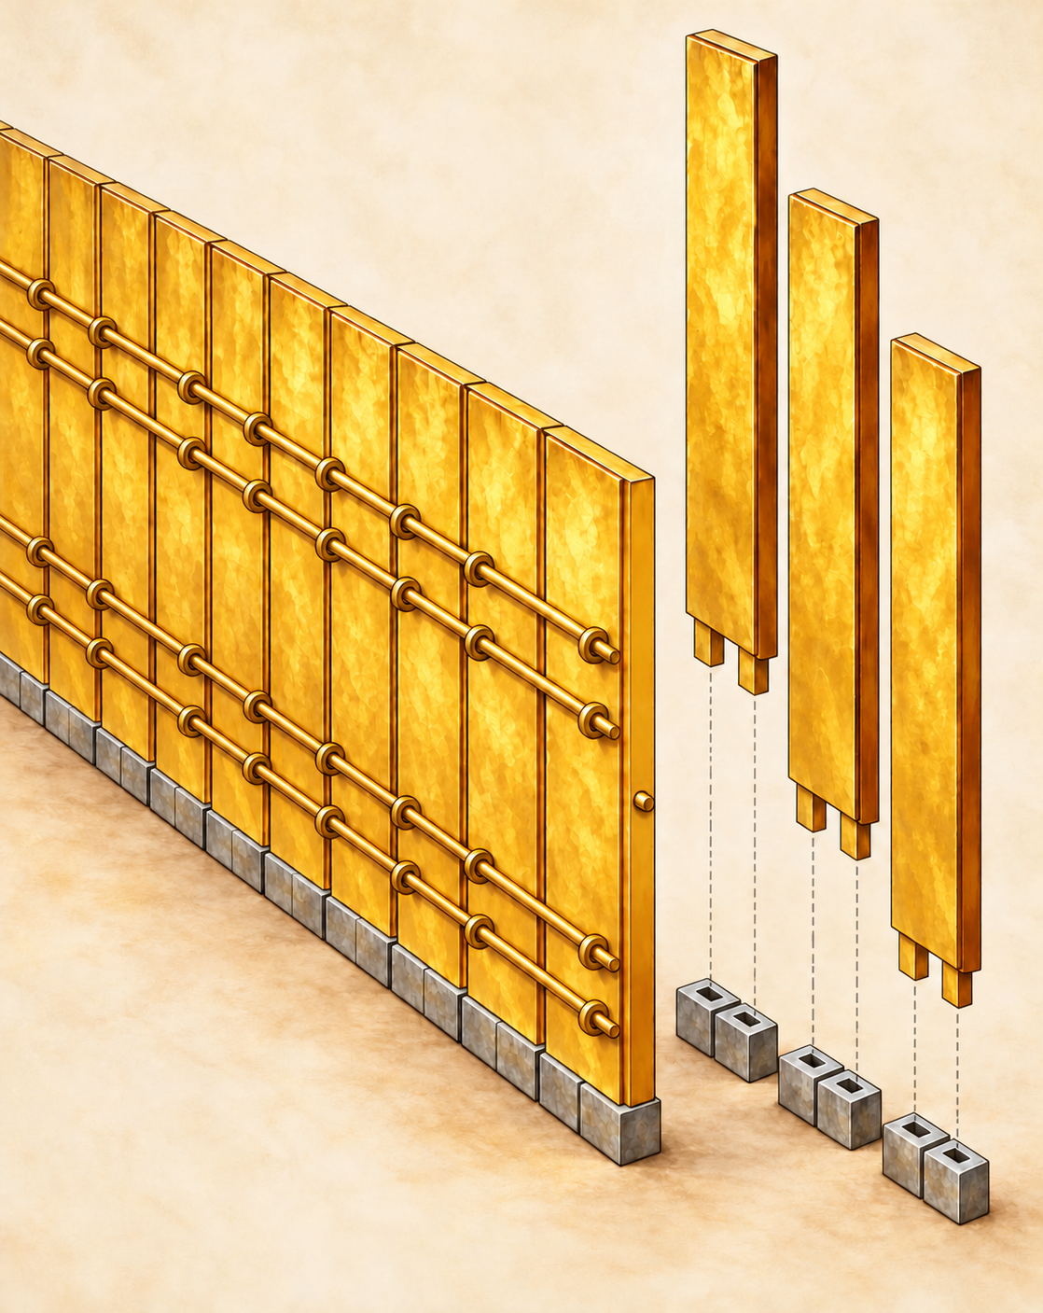
Exodus 26:26–28
26 And thou shalt make bars of shittim wood; five for the boards of the one side of the tabernacle,
27 And five bars for the boards of the other side of the tabernacle, and five bars for the boards of the side of the tabernacle, for the two sides westward.
28 And the middle bar in the midst of the boards shall reach from end to end.
Notes:
Exodus 26:26–28
https://biblehub.com/kjv/exodus/26.htm
KJV texts are quoted in full. Illustration is a reconstruction, not a surviving photograph.
Construction source: Exodus 25–26, https://biblehub.com/kjv/exodus/26.htm. The text specifies boards, sockets, bars, curtains, pillars and materials. Flat roof profile, exact corner joinery, board thickness and textile motifs are reconstruction choices. The familiar 10-cubit width and 20/10-cubit room division are conventional reconstruction dimensions. The KJV calls the outer covering badgers’ skins; the animal identification is uncertain.

Slide 19
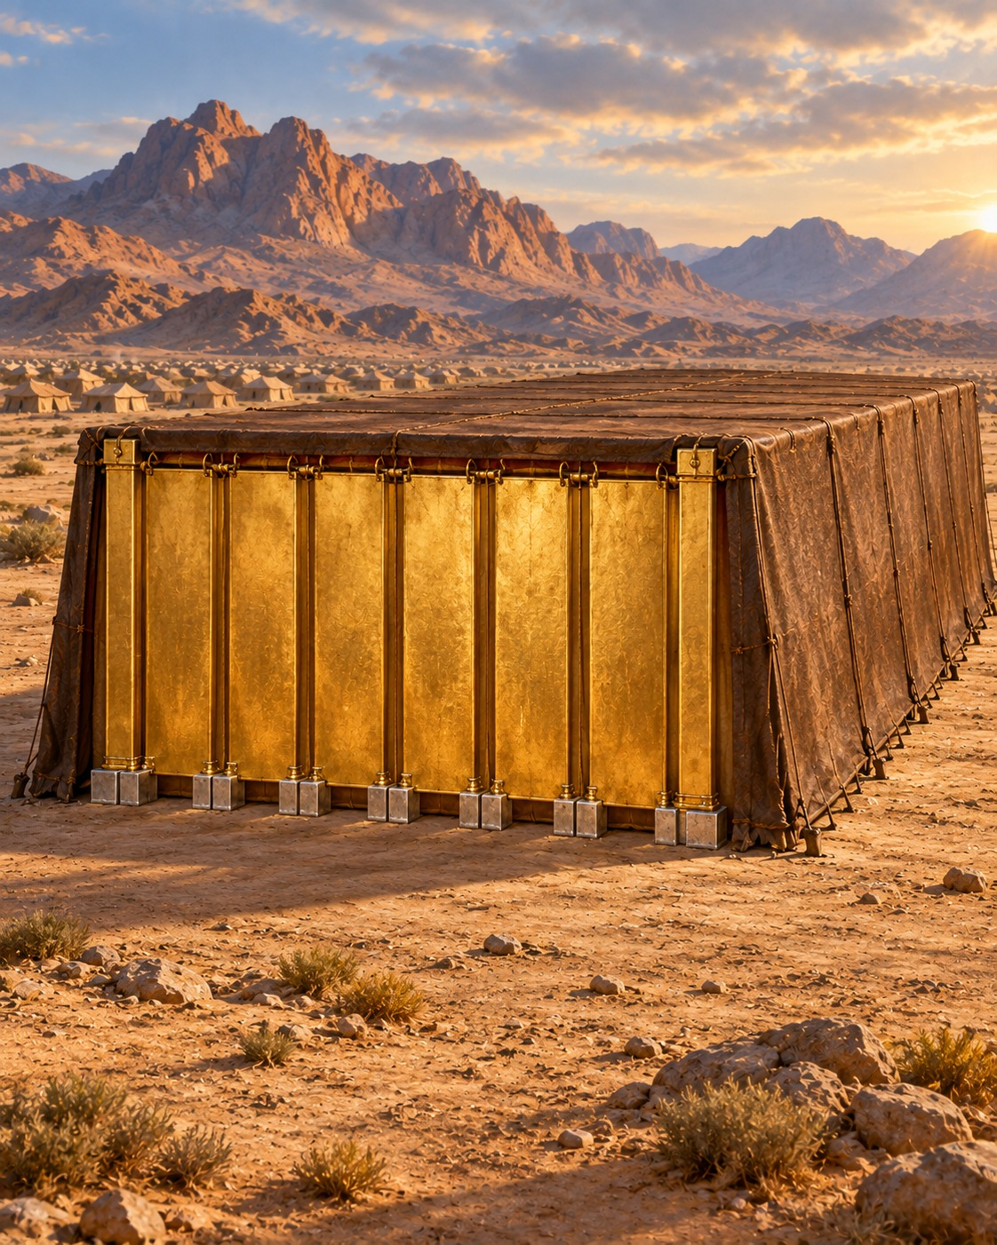
8. Describe the west end of the tabernacle.
Exodus 26:22–25
Notes:
8. Describe the west end of the tabernacle.
Exodus 26:22–25
KJV texts are quoted in full. Illustration is a reconstruction, not a surviving photograph.
Construction source: Exodus 25–26, https://biblehub.com/kjv/exodus/26.htm. The text specifies boards, sockets, bars, curtains, pillars and materials. Flat roof profile, exact corner joinery, board thickness and textile motifs are reconstruction choices. The familiar 10-cubit width and 20/10-cubit room division are conventional reconstruction dimensions. The KJV calls the outer covering badgers’ skins; the animal identification is uncertain.

Slide 20
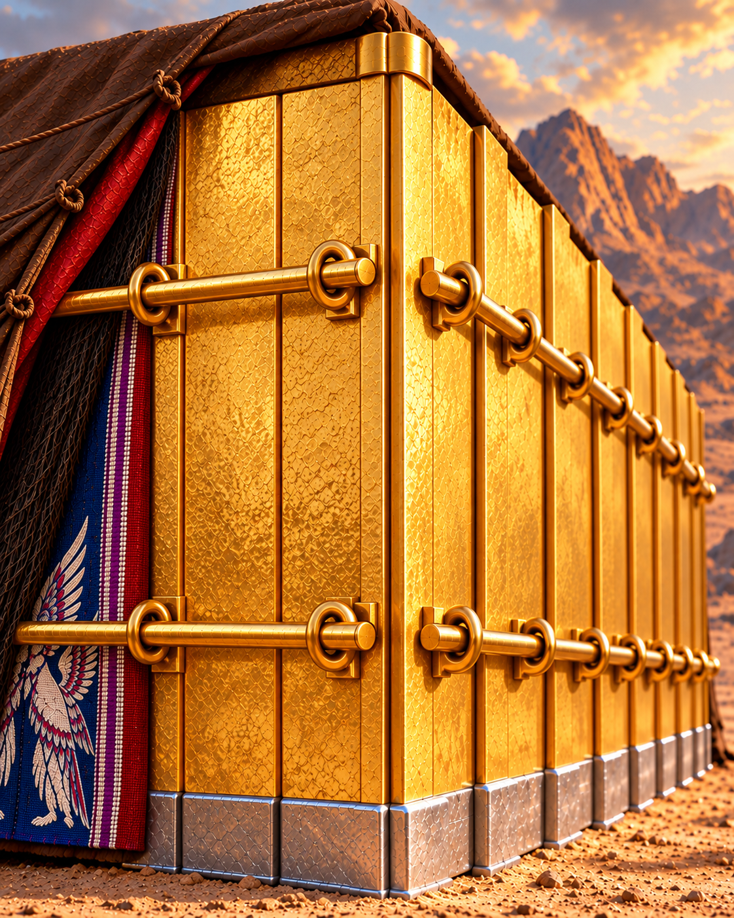
Exodus 26:22–24
22 And for the sides of the tabernacle westward thou shalt make six boards.
23 And two boards shalt thou make for the corners of the tabernacle in the two sides.
24 And they shall be coupled together beneath, and they shall be coupled together above the head of it unto one ring: thus shall it be for them both; they shall be for the two corners.
Notes:
Exodus 26:22–24
Six boards, with two additional corner boards: eight boards in all, resting in sixteen silver sockets.
https://biblehub.com/kjv/exodus/26.htm
KJV texts are quoted in full. Illustration is a reconstruction, not a surviving photograph.
Construction source: Exodus 25–26, https://biblehub.com/kjv/exodus/26.htm. The text specifies boards, sockets, bars, curtains, pillars and materials. Flat roof profile, exact corner joinery, board thickness and textile motifs are reconstruction choices. The familiar 10-cubit width and 20/10-cubit room division are conventional reconstruction dimensions. The KJV calls the outer covering badgers’ skins; the animal identification is uncertain.

Slide 21
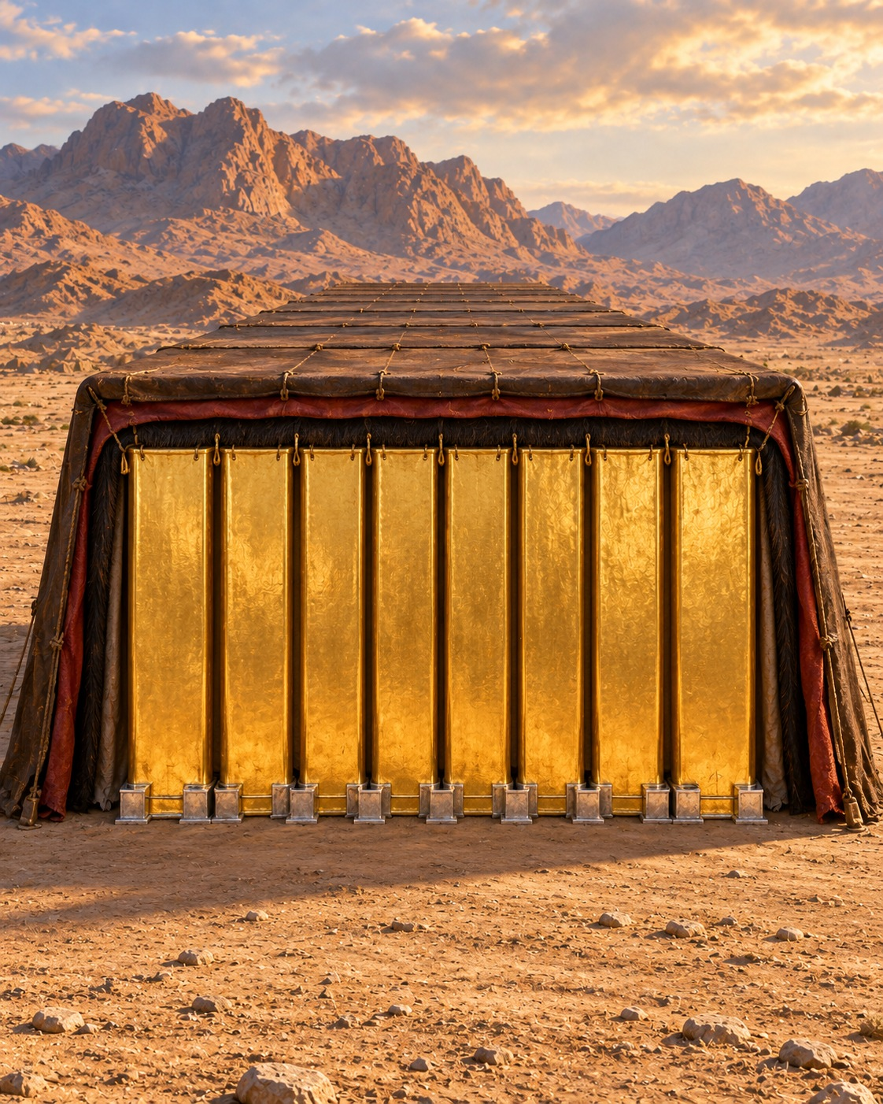
Exodus 26:25
25 And they shall be eight boards, and their sockets of silver, sixteen sockets; two sockets under one board, and two sockets under another board.
Notes:
Exodus 26:25
https://biblehub.com/kjv/exodus/26.htm
KJV texts are quoted in full. Illustration is a reconstruction, not a surviving photograph.
Construction source: Exodus 25–26, https://biblehub.com/kjv/exodus/26.htm. The text specifies boards, sockets, bars, curtains, pillars and materials. Flat roof profile, exact corner joinery, board thickness and textile motifs are reconstruction choices. The familiar 10-cubit width and 20/10-cubit room division are conventional reconstruction dimensions. The KJV calls the outer covering badgers’ skins; the animal identification is uncertain.

Slide 22
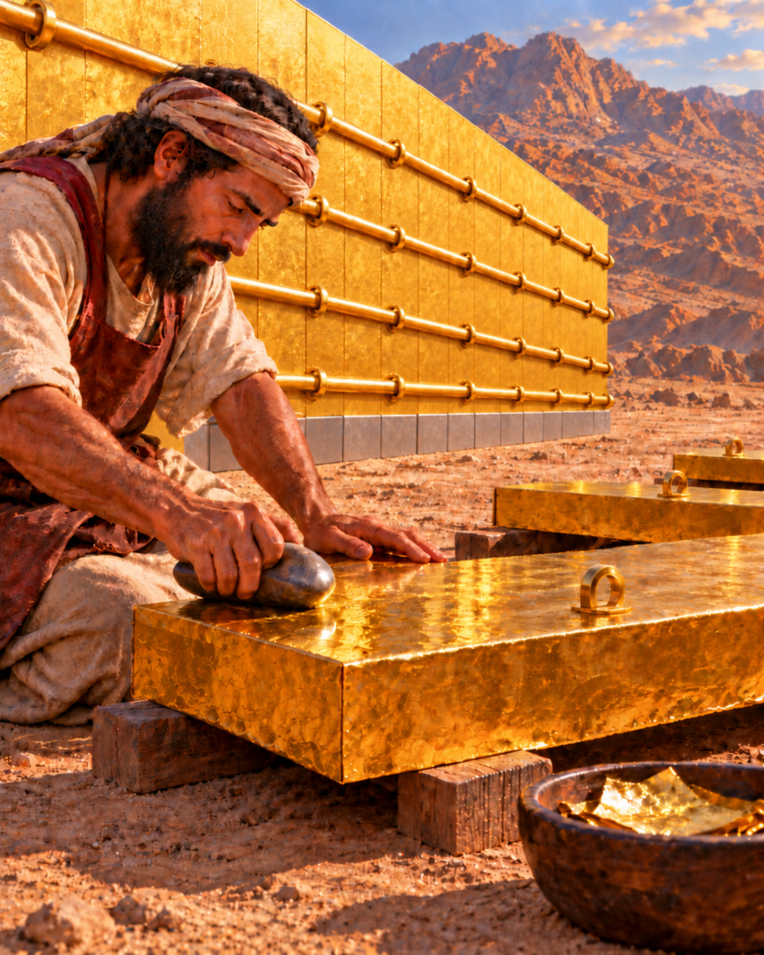
9. With what was all the wood-work covered?
Exodus 26:29
Notes:
9. With what was all the wood-work covered?
Exodus 26:29
KJV texts are quoted in full. Illustration is a reconstruction, not a surviving photograph.
Construction source: Exodus 25–26, https://biblehub.com/kjv/exodus/26.htm. The text specifies boards, sockets, bars, curtains, pillars and materials. Flat roof profile, exact corner joinery, board thickness and textile motifs are reconstruction choices. The familiar 10-cubit width and 20/10-cubit room division are conventional reconstruction dimensions. The KJV calls the outer covering badgers’ skins; the animal identification is uncertain.

Slide 23
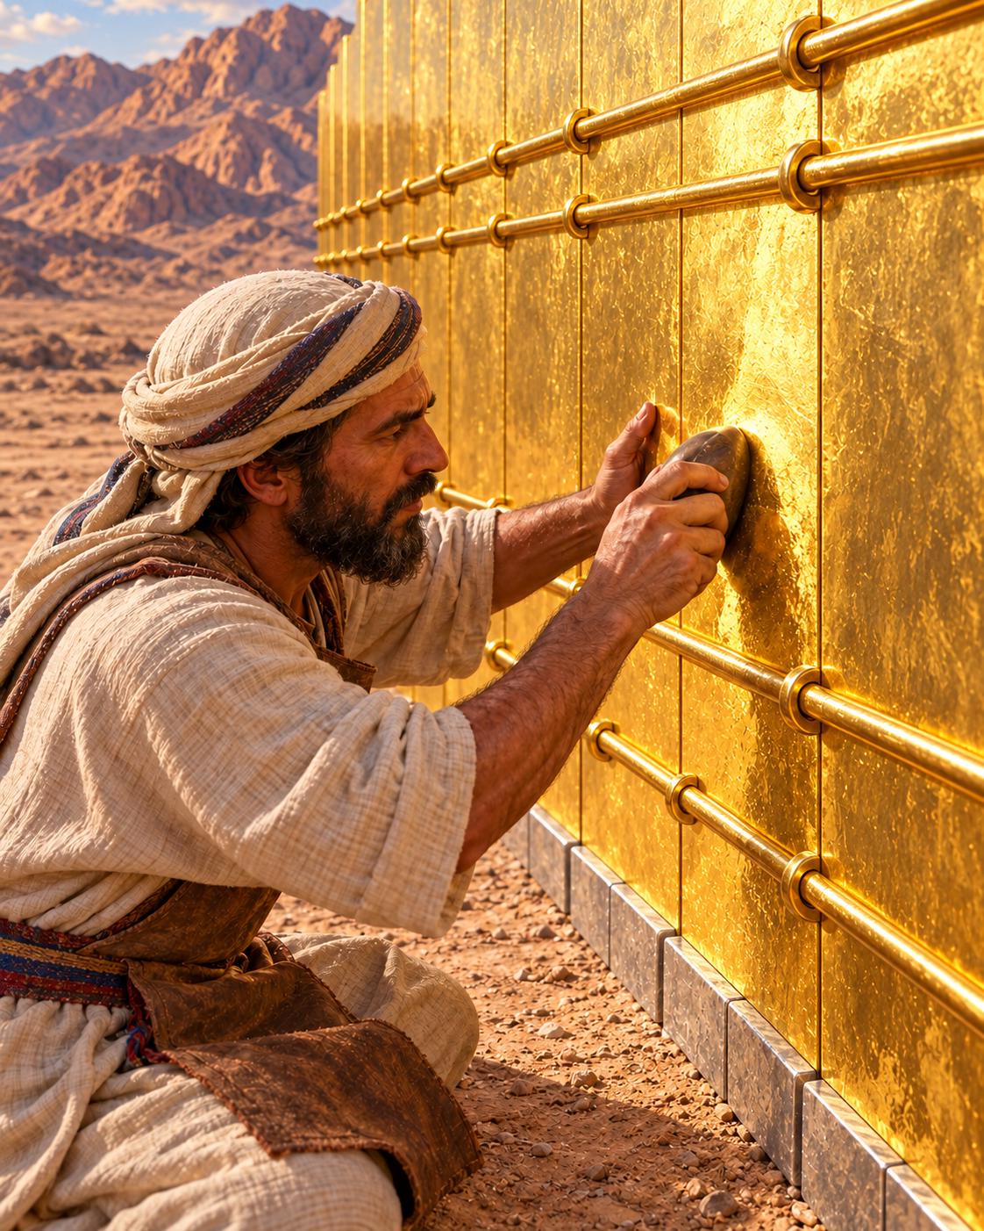
Exodus 26:29
The boards and bars were overlaid with gold. The rings for the bars were also gold.
29 And thou shalt overlay the boards with gold, and make their rings of gold for places for the bars: and thou shalt overlay the bars with gold.
Notes:
Exodus 26:29
The boards and bars were overlaid with gold. The rings for the bars were also gold.
https://biblehub.com/kjv/exodus/26.htm
KJV texts are quoted in full. Illustration is a reconstruction, not a surviving photograph.
Construction source: Exodus 25–26, https://biblehub.com/kjv/exodus/26.htm. The text specifies boards, sockets, bars, curtains, pillars and materials. Flat roof profile, exact corner joinery, board thickness and textile motifs are reconstruction choices. The familiar 10-cubit width and 20/10-cubit room division are conventional reconstruction dimensions. The KJV calls the outer covering badgers’ skins; the animal identification is uncertain.

Slide 24
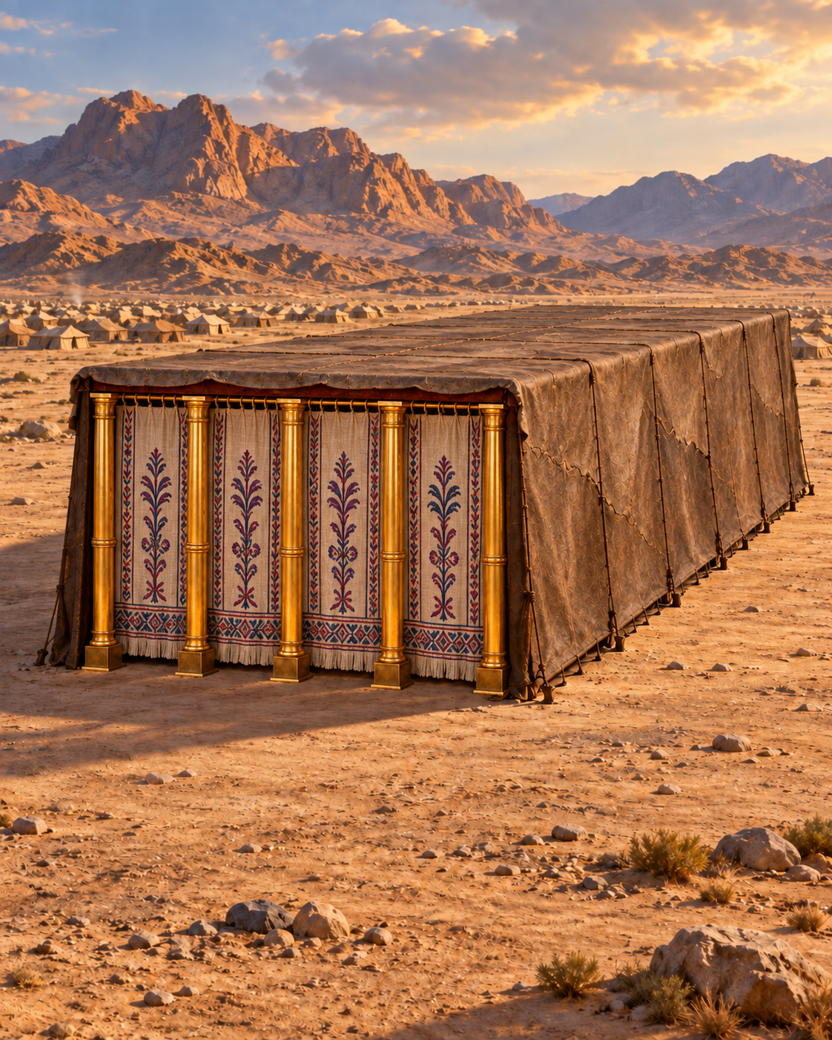
10. How was the east end inclosed?
Exodus 26:36–37
Notes:
10. How was the east end inclosed?
Exodus 26:36–37
KJV texts are quoted in full. Illustration is a reconstruction, not a surviving photograph.
Construction source: Exodus 25–26, https://biblehub.com/kjv/exodus/26.htm. The text specifies boards, sockets, bars, curtains, pillars and materials. Flat roof profile, exact corner joinery, board thickness and textile motifs are reconstruction choices. The familiar 10-cubit width and 20/10-cubit room division are conventional reconstruction dimensions. The KJV calls the outer covering badgers’ skins; the animal identification is uncertain.

Slide 25
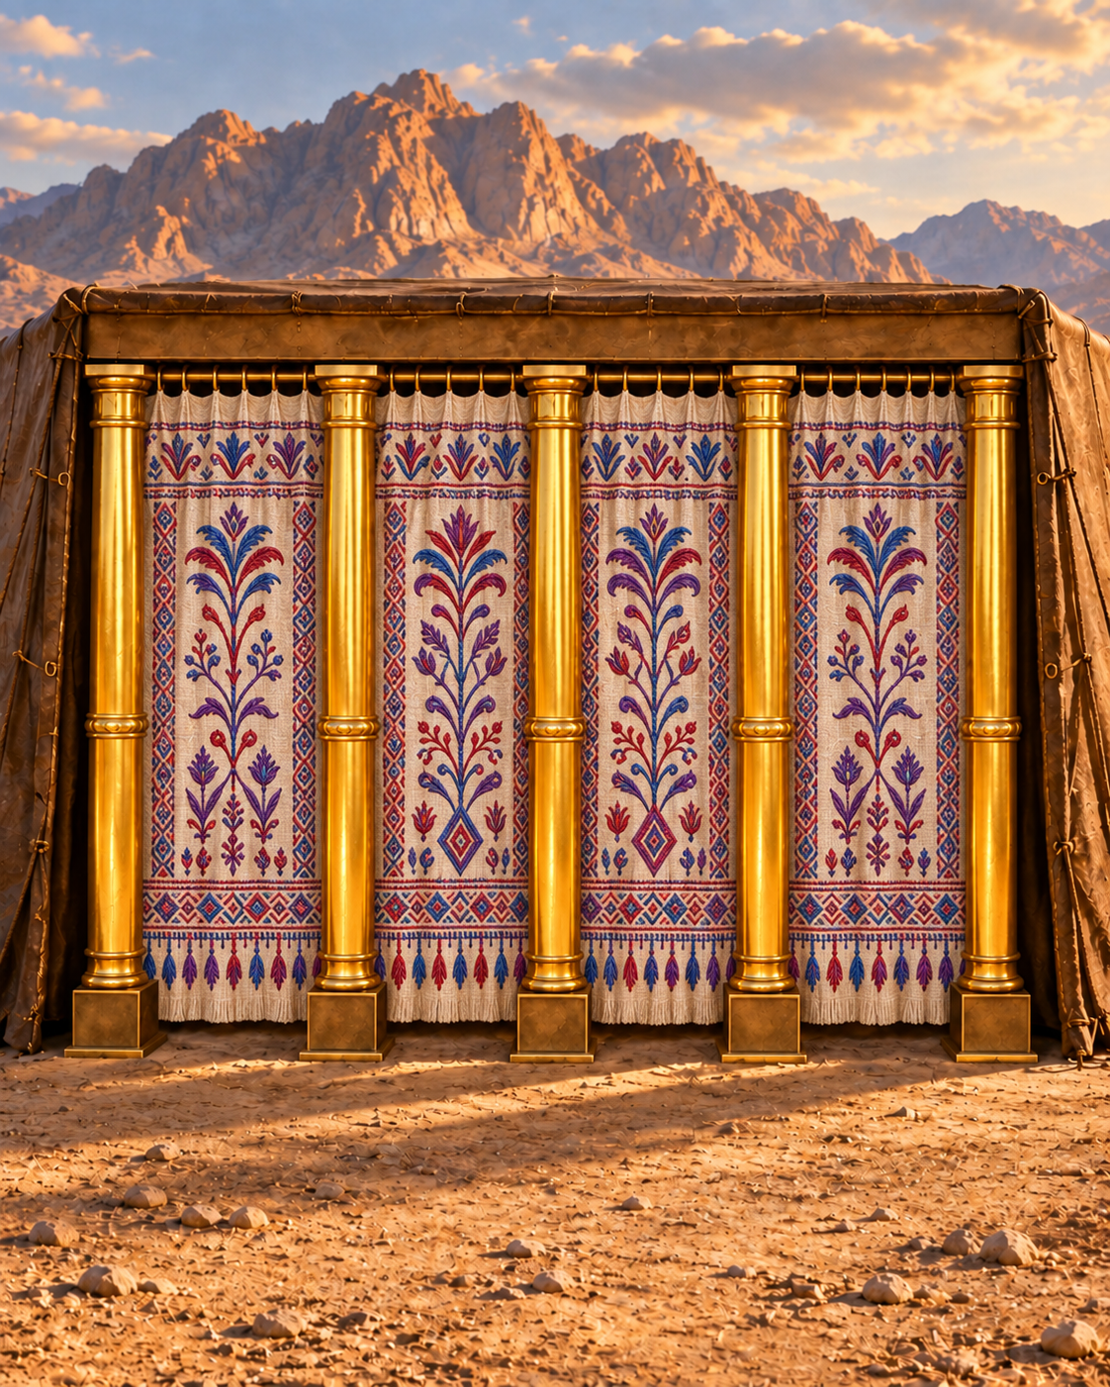
Exodus 26:36–37
36 And thou shalt make an hanging for the door of the tent, of blue, and purple, and scarlet, and fine twined linen, wrought with needlework.
37 And thou shalt make for the hanging five pillars of shittim wood, and overlay them with gold, and their hooks shall be of gold: and thou shalt cast five sockets of brass for them.
Notes:
Exodus 26:36–37
A hanging of blue, purple, scarlet, and fine twined linen, on five gold-covered pillars with brass sockets.
https://biblehub.com/kjv/exodus/26.htm
KJV texts are quoted in full. Illustration is a reconstruction, not a surviving photograph.
Construction source: Exodus 25–26, https://biblehub.com/kjv/exodus/26.htm. The text specifies boards, sockets, bars, curtains, pillars and materials. Flat roof profile, exact corner joinery, board thickness and textile motifs are reconstruction choices. The familiar 10-cubit width and 20/10-cubit room division are conventional reconstruction dimensions. The KJV calls the outer covering badgers’ skins; the animal identification is uncertain.

Slide 26
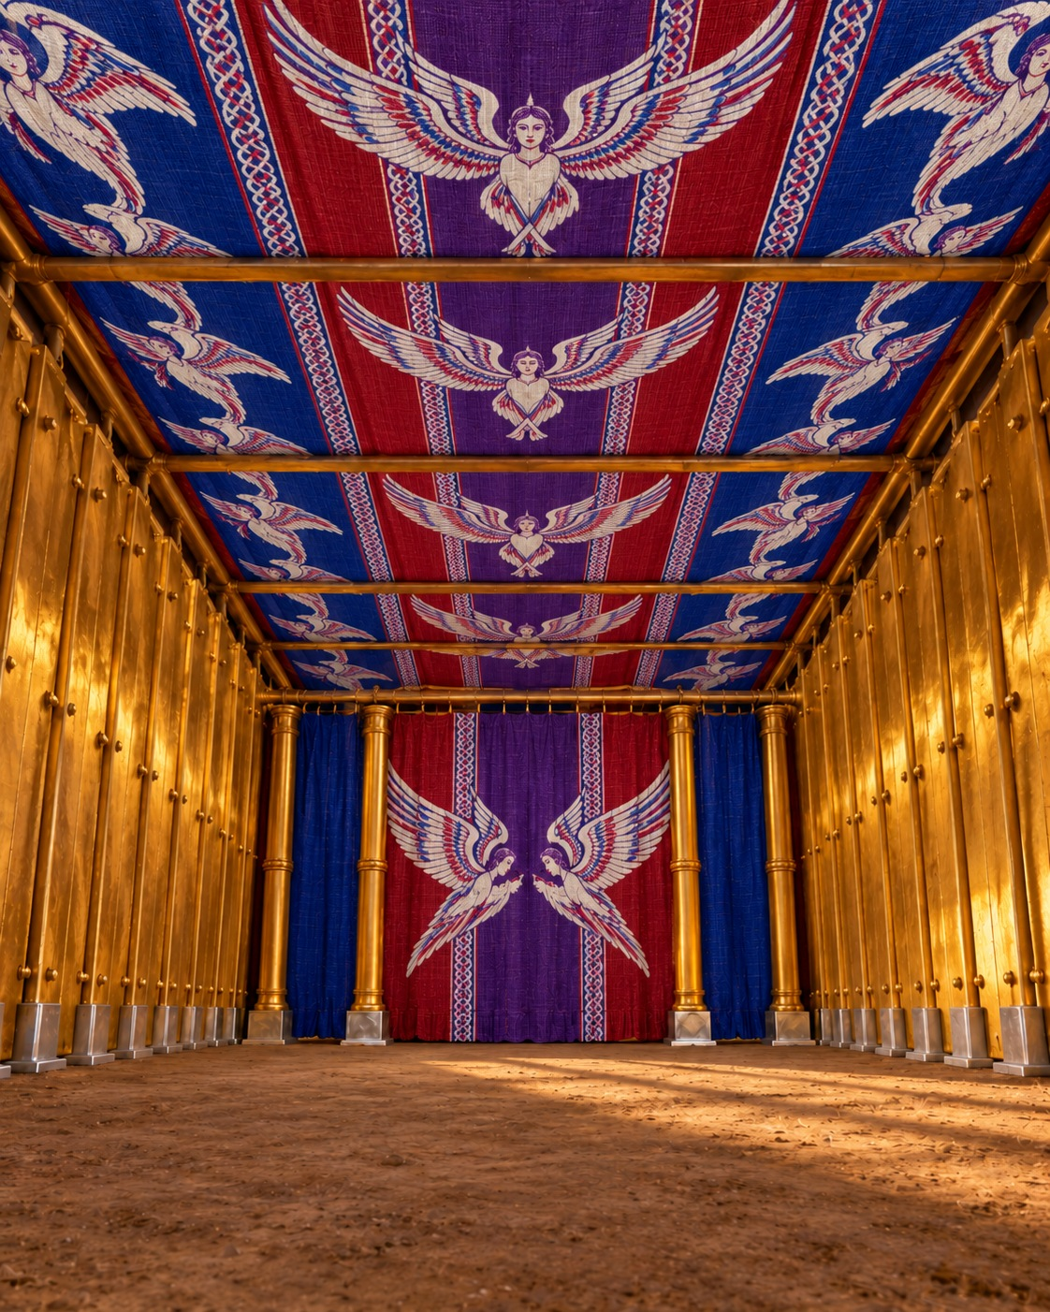
11. What formed the ceiling of the tabernacle?
Exodus 26:1–6
Notes:
11. What formed the ceiling of the tabernacle?
Exodus 26:1–6
KJV texts are quoted in full. Illustration is a reconstruction, not a surviving photograph.
Construction source: Exodus 25–26, https://biblehub.com/kjv/exodus/26.htm. The text specifies boards, sockets, bars, curtains, pillars and materials. Flat roof profile, exact corner joinery, board thickness and textile motifs are reconstruction choices. The familiar 10-cubit width and 20/10-cubit room division are conventional reconstruction dimensions. The KJV calls the outer covering badgers’ skins; the animal identification is uncertain.

Slide 27
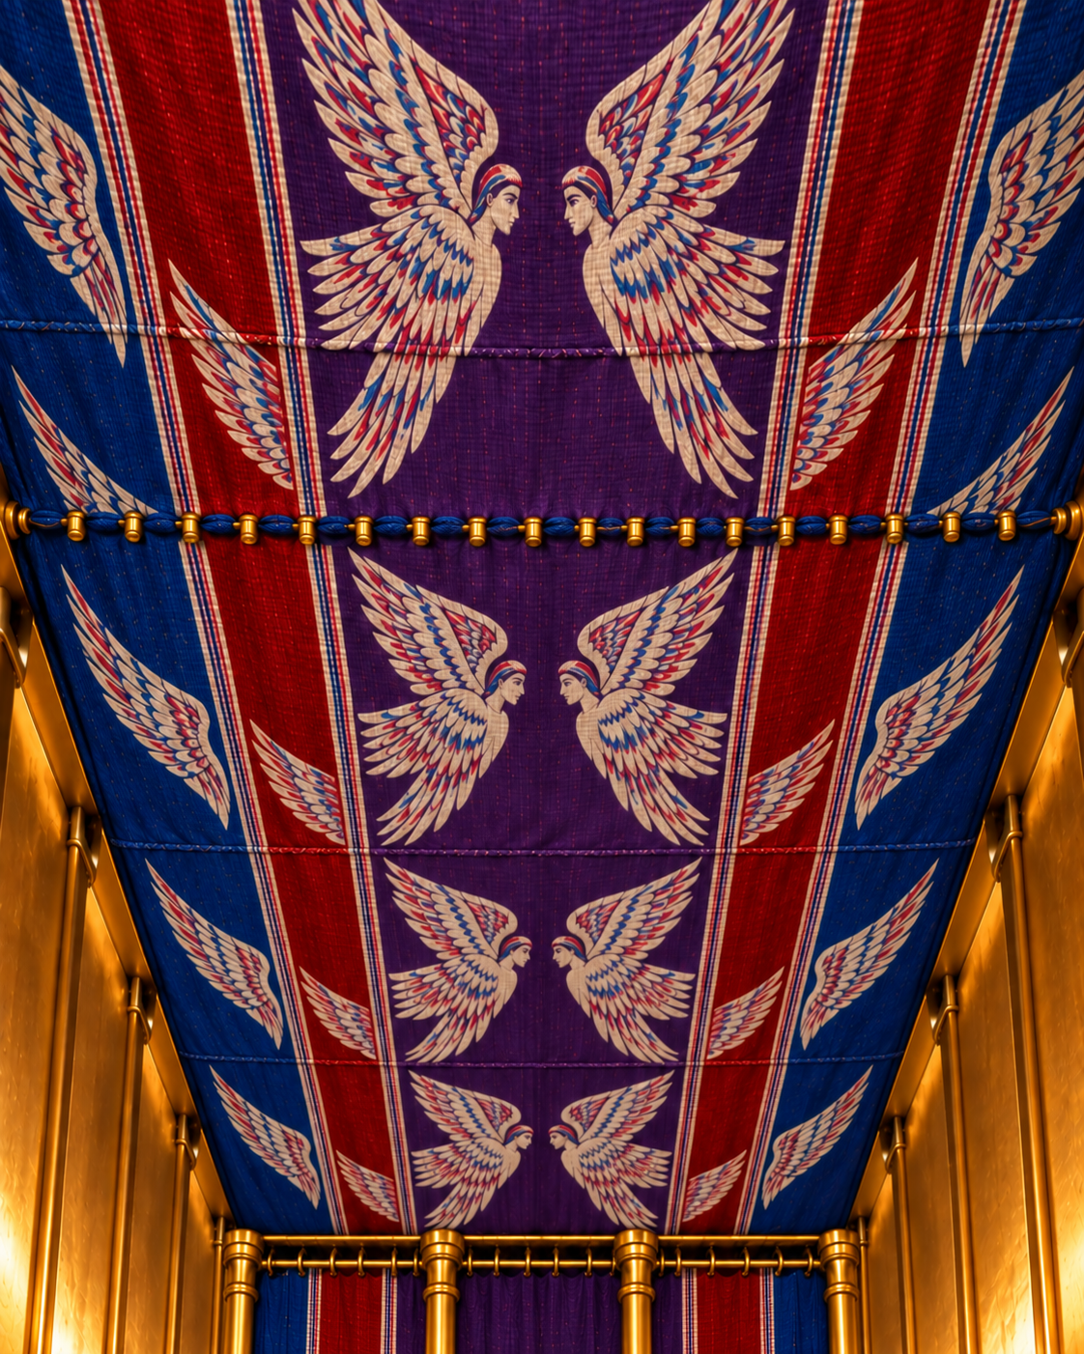
Exodus 26:1–2
1 Moreover thou shalt make the tabernacle with ten curtains of fine twined linen, and blue, and purple, and scarlet: with cherubims of cunning work shalt thou make them.
2 The length of one curtain shall be eight and twenty cubits, and the breadth of one curtain four cubits: and every one of the curtains shall have one measure.
Notes:
Exodus 26:1–2
Ten curtains of fine twined linen, with blue, purple, and scarlet, and woven cherubim.
https://biblehub.com/kjv/exodus/26.htm
KJV texts are quoted in full. Illustration is a reconstruction, not a surviving photograph.
Construction source: Exodus 25–26, https://biblehub.com/kjv/exodus/26.htm. The text specifies boards, sockets, bars, curtains, pillars and materials. Flat roof profile, exact corner joinery, board thickness and textile motifs are reconstruction choices. The familiar 10-cubit width and 20/10-cubit room division are conventional reconstruction dimensions. The KJV calls the outer covering badgers’ skins; the animal identification is uncertain.

Slide 28
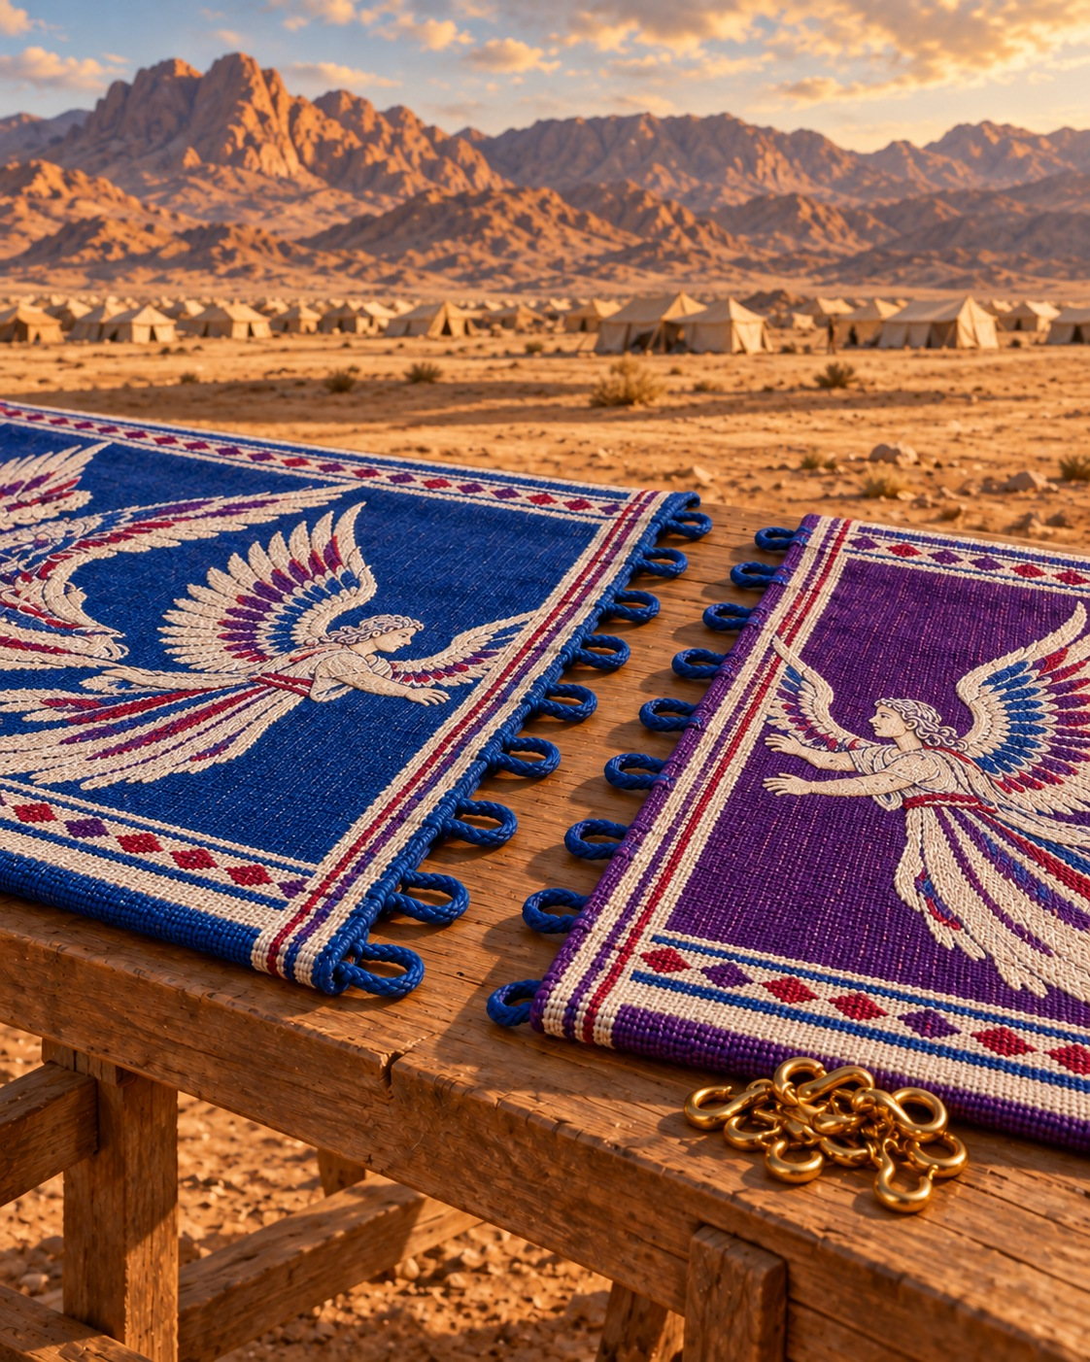
Exodus 26:3–4
3 The five curtains shall be coupled together one to another; and other five curtains shall be coupled one to another.
4 And thou shalt make loops of blue upon the edge of the one curtain from the selvedge in the coupling; and likewise shalt thou make in the uttermost edge of another curtain, in the coupling of the second.
Notes:
Exodus 26:3–4
https://biblehub.com/kjv/exodus/26.htm
KJV texts are quoted in full. Illustration is a reconstruction, not a surviving photograph.
Construction source: Exodus 25–26, https://biblehub.com/kjv/exodus/26.htm. The text specifies boards, sockets, bars, curtains, pillars and materials. Flat roof profile, exact corner joinery, board thickness and textile motifs are reconstruction choices. The familiar 10-cubit width and 20/10-cubit room division are conventional reconstruction dimensions. The KJV calls the outer covering badgers’ skins; the animal identification is uncertain.

Slide 29
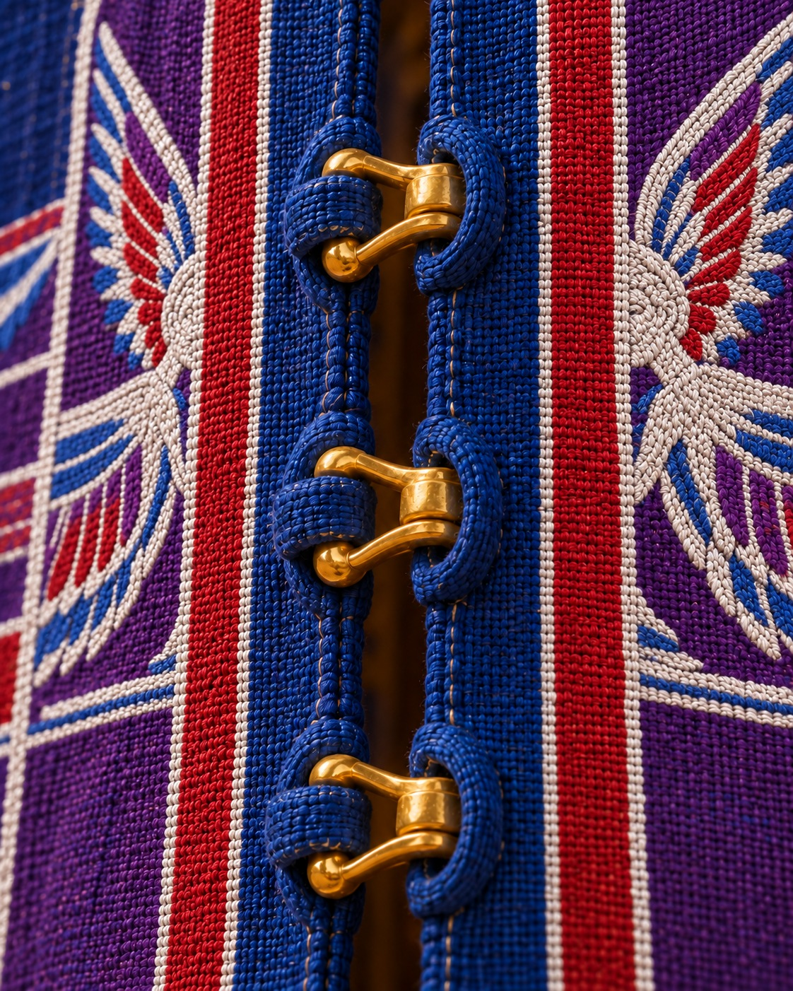
Exodus 26:5–6
5 Fifty loops shalt thou make in the one curtain, and fifty loops shalt thou make in the edge of the curtain that is in the coupling of the second; that the loops may take hold one of another.
6 And thou shalt make fifty taches of gold, and couple the curtains together with the taches: and it shall be one tabernacle.
Notes:
Exodus 26:5–6
https://biblehub.com/kjv/exodus/26.htm
KJV texts are quoted in full. Illustration is a reconstruction, not a surviving photograph.
Construction source: Exodus 25–26, https://biblehub.com/kjv/exodus/26.htm. The text specifies boards, sockets, bars, curtains, pillars and materials. Flat roof profile, exact corner joinery, board thickness and textile motifs are reconstruction choices. The familiar 10-cubit width and 20/10-cubit room division are conventional reconstruction dimensions. The KJV calls the outer covering badgers’ skins; the animal identification is uncertain.

Slide 30
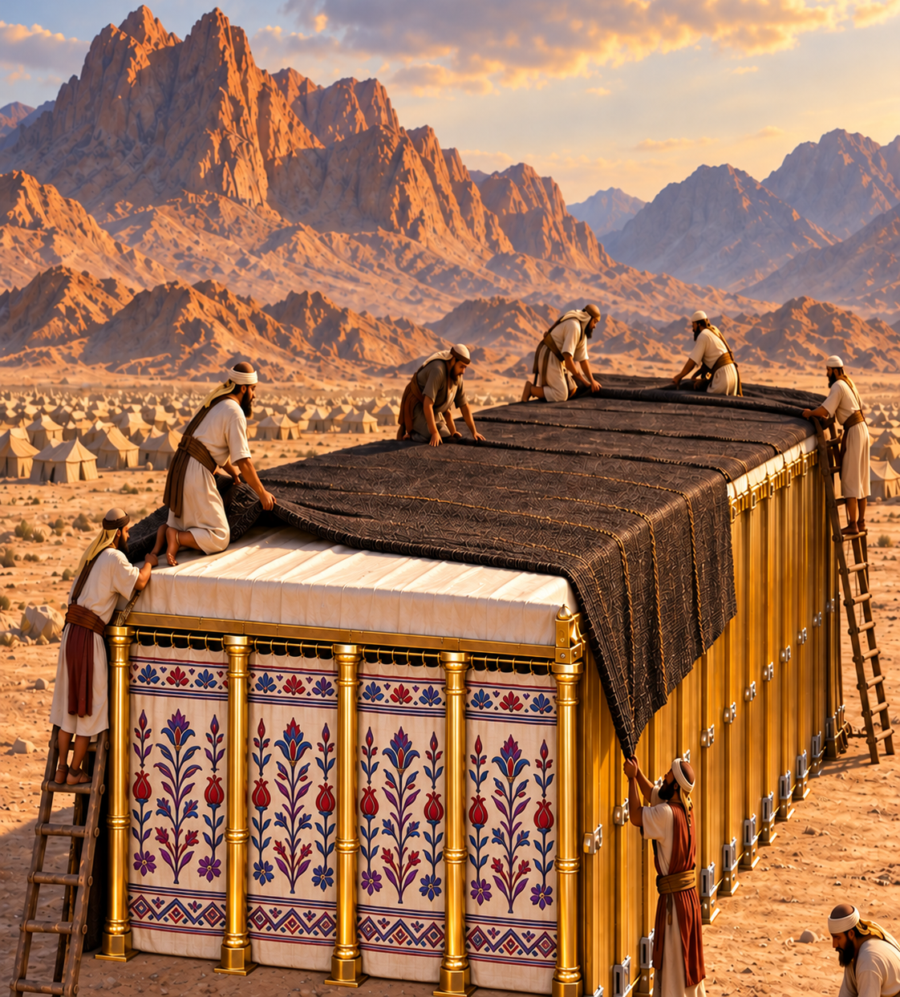
12. What covering was above this?
Exodus 26:7–13
Notes:
12. What covering was above this?
Exodus 26:7–13
KJV texts are quoted in full. Illustration is a reconstruction, not a surviving photograph.
Construction source: Exodus 25–26, https://biblehub.com/kjv/exodus/26.htm. The text specifies boards, sockets, bars, curtains, pillars and materials. Flat roof profile, exact corner joinery, board thickness and textile motifs are reconstruction choices. The familiar 10-cubit width and 20/10-cubit room division are conventional reconstruction dimensions. The KJV calls the outer covering badgers’ skins; the animal identification is uncertain.

Slide 31
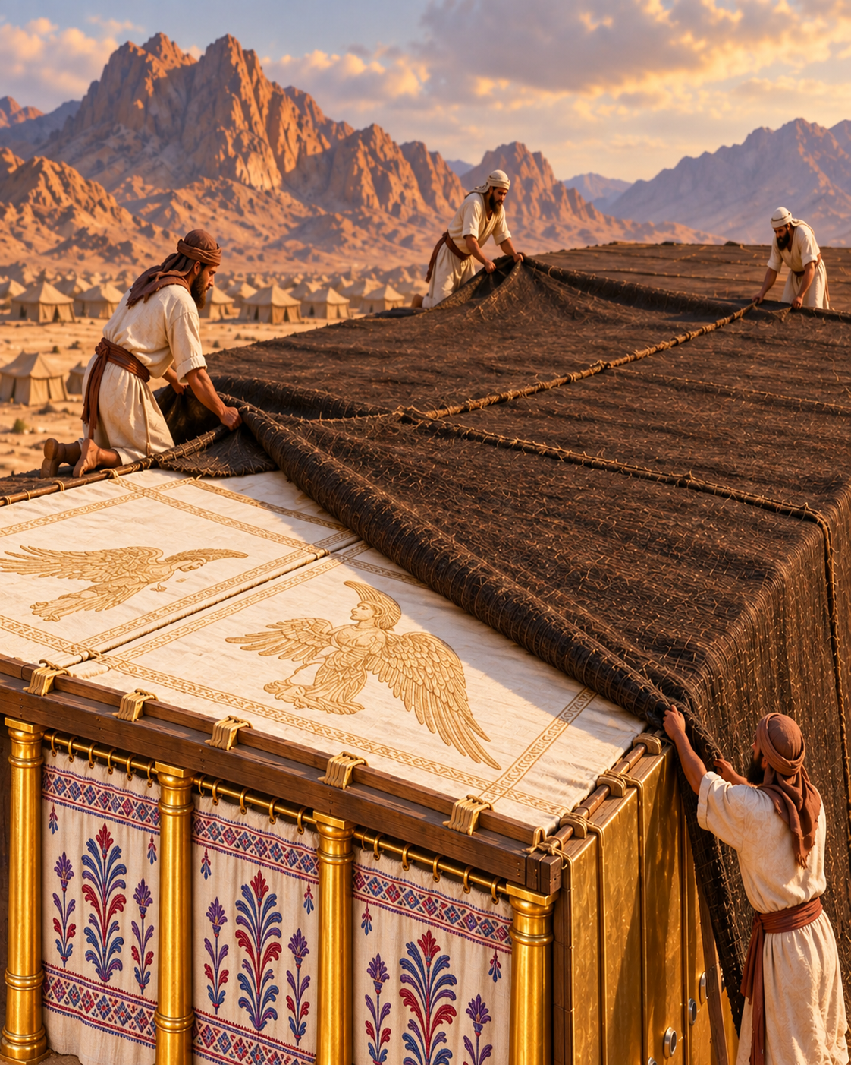
Exodus 26:7–9
7 And thou shalt make curtains of goats' hair to be a covering upon the tabernacle: eleven curtains shalt thou make.
8 The length of one curtain shall be thirty cubits, and the breadth of one curtain four cubits: and the eleven curtains shall be all of one measure.
9 And thou shalt couple five curtains by themselves, and six curtains by themselves, and shalt double the sixth curtain in the forefront of the tabernacle.
Notes:
Exodus 26:7–9
Eleven curtains of goats’ hair, joined with brass taches.
https://biblehub.com/kjv/exodus/26.htm
KJV texts are quoted in full. Illustration is a reconstruction, not a surviving photograph.
Construction source: Exodus 25–26, https://biblehub.com/kjv/exodus/26.htm. The text specifies boards, sockets, bars, curtains, pillars and materials. Flat roof profile, exact corner joinery, board thickness and textile motifs are reconstruction choices. The familiar 10-cubit width and 20/10-cubit room division are conventional reconstruction dimensions. The KJV calls the outer covering badgers’ skins; the animal identification is uncertain.

Slide 32
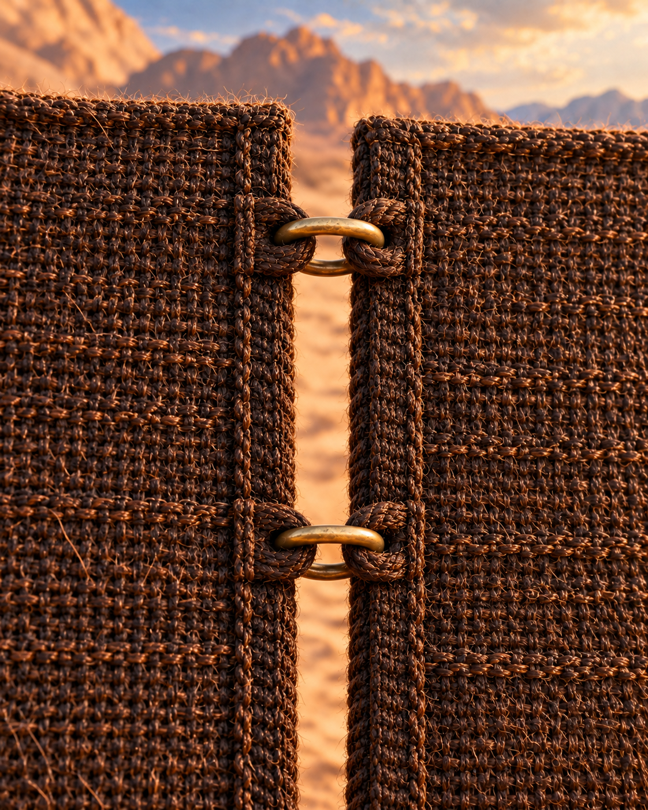
Exodus 26:10–11
10 And thou shalt make fifty loops on the edge of the one curtain that is outmost in the coupling, and fifty loops in the edge of the curtain which coupleth the second.
11 And thou shalt make fifty taches of brass, and put the taches into the loops, and couple the tent together, that it may be one.
Notes:
Exodus 26:10–11
https://biblehub.com/kjv/exodus/26.htm
KJV texts are quoted in full. Illustration is a reconstruction, not a surviving photograph.
Construction source: Exodus 25–26, https://biblehub.com/kjv/exodus/26.htm. The text specifies boards, sockets, bars, curtains, pillars and materials. Flat roof profile, exact corner joinery, board thickness and textile motifs are reconstruction choices. The familiar 10-cubit width and 20/10-cubit room division are conventional reconstruction dimensions. The KJV calls the outer covering badgers’ skins; the animal identification is uncertain.

Slide 33
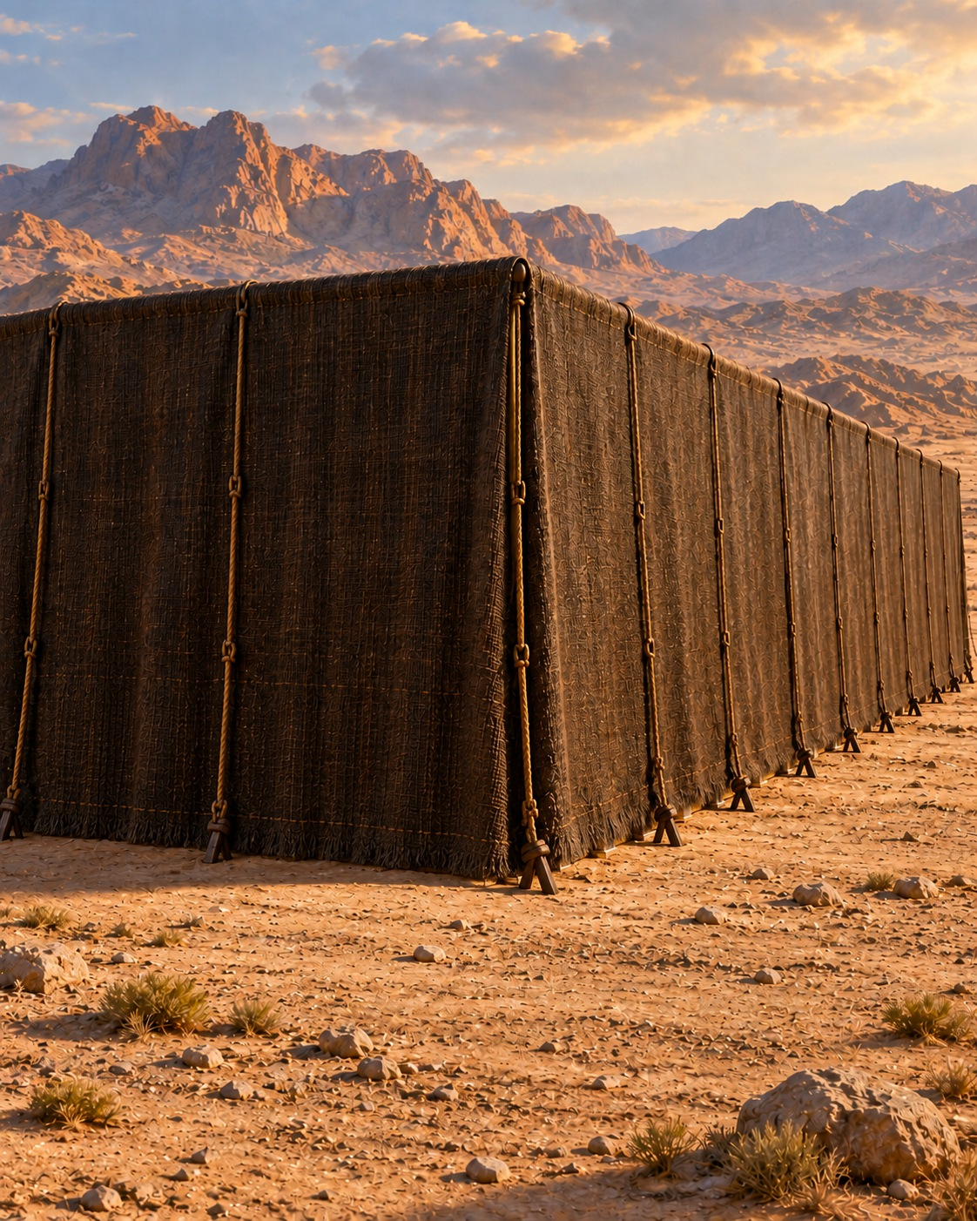
Exodus 26:12–13
12 And the remnant that remaineth of the curtains of the tent, the half curtain that remaineth, shall hang over the backside of the tabernacle.
13 And a cubit on the one side, and a cubit on the other side of that which remaineth in the length of the curtains of the tent, it shall hang over the sides of the tabernacle on this side and on that side, to cover it.
Notes:
Exodus 26:12–13
https://biblehub.com/kjv/exodus/26.htm
KJV texts are quoted in full. Illustration is a reconstruction, not a surviving photograph.
Construction source: Exodus 25–26, https://biblehub.com/kjv/exodus/26.htm. The text specifies boards, sockets, bars, curtains, pillars and materials. Flat roof profile, exact corner joinery, board thickness and textile motifs are reconstruction choices. The familiar 10-cubit width and 20/10-cubit room division are conventional reconstruction dimensions. The KJV calls the outer covering badgers’ skins; the animal identification is uncertain.

Slide 34
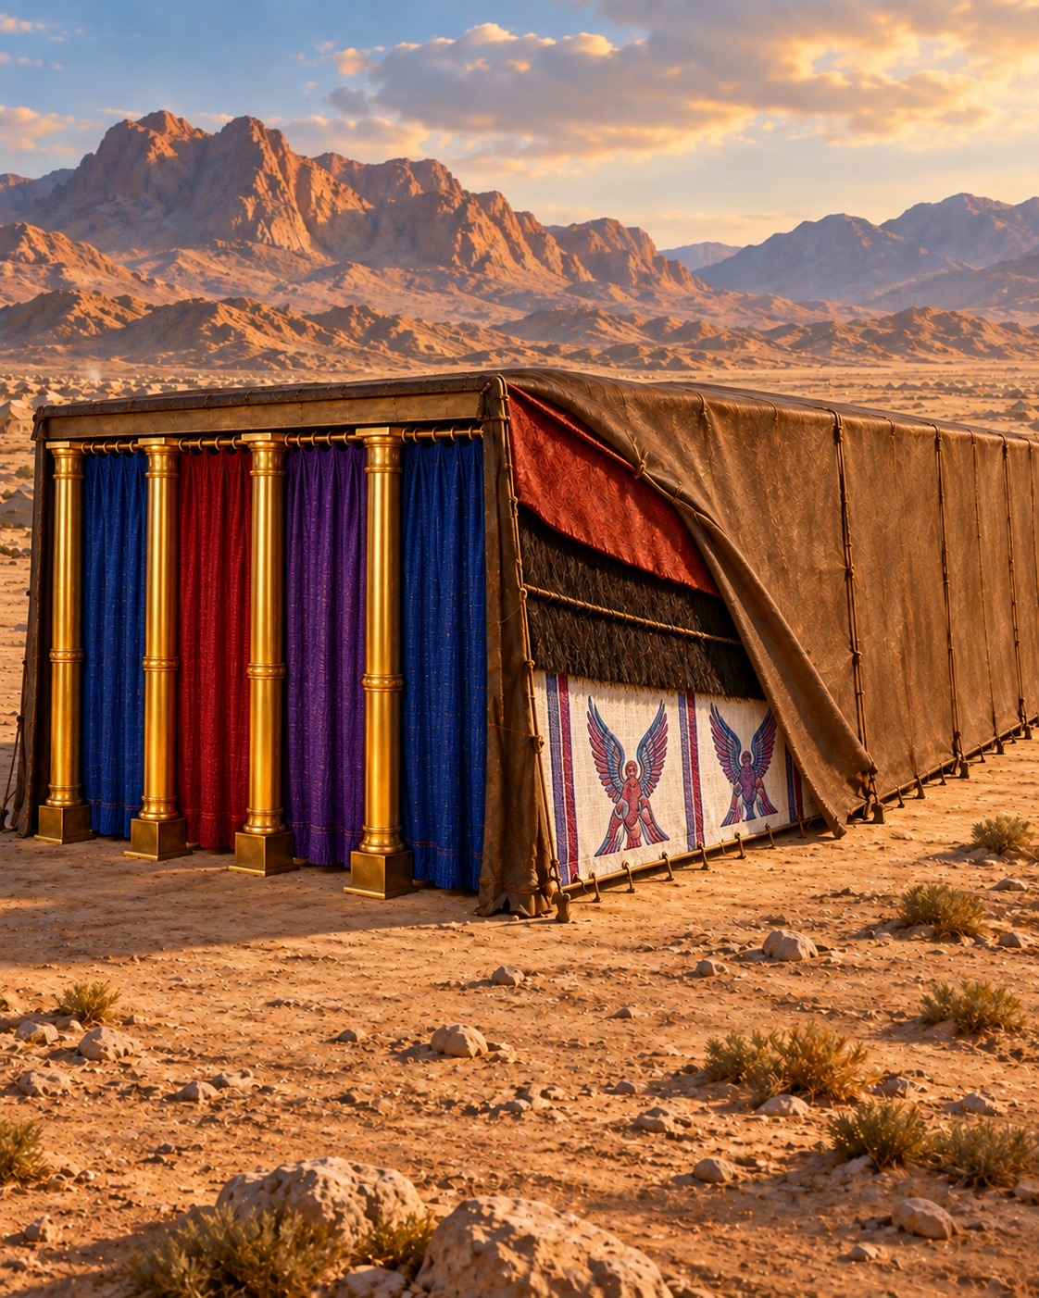
13. What further protection did the tabernacle have above?
Exodus 26:14
Notes:
13. What further protection did the tabernacle have above?
Exodus 26:14
KJV texts are quoted in full. Illustration is a reconstruction, not a surviving photograph.
Construction source: Exodus 25–26, https://biblehub.com/kjv/exodus/26.htm. The text specifies boards, sockets, bars, curtains, pillars and materials. Flat roof profile, exact corner joinery, board thickness and textile motifs are reconstruction choices. The familiar 10-cubit width and 20/10-cubit room division are conventional reconstruction dimensions. The KJV calls the outer covering badgers’ skins; the animal identification is uncertain.

Slide 35
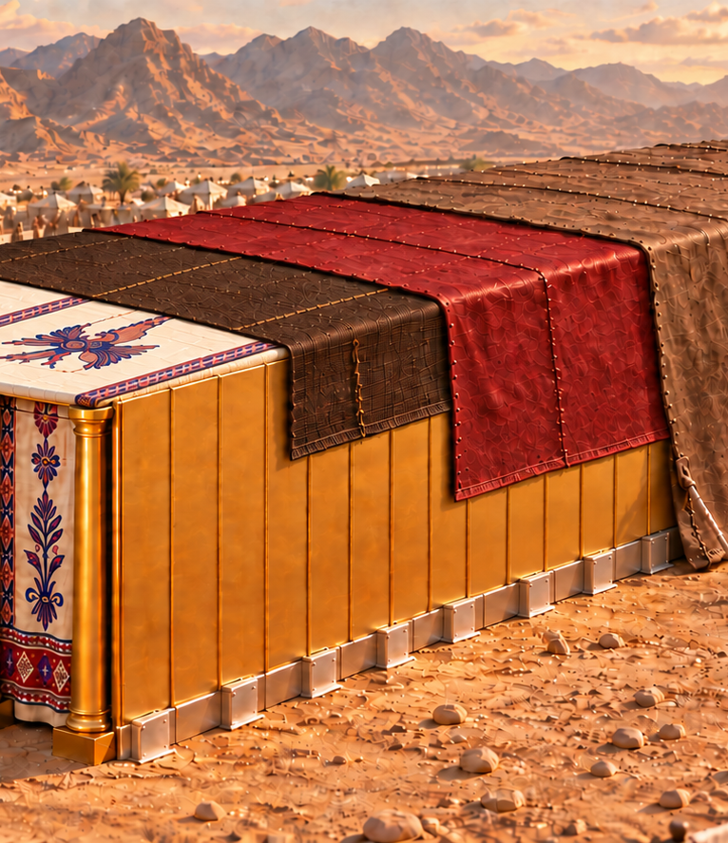
Exodus 26:14
Rams’ skins dyed red, and above them a covering of badgers’ skins.
14 And thou shalt make a covering for the tent of rams' skins dyed red, and a covering above of badgers' skins.
Notes:
Exodus 26:14
Rams’ skins dyed red, and above them a covering of badgers’ skins.
https://biblehub.com/kjv/exodus/26.htm
KJV texts are quoted in full. Illustration is a reconstruction, not a surviving photograph.
Construction source: Exodus 25–26, https://biblehub.com/kjv/exodus/26.htm. The text specifies boards, sockets, bars, curtains, pillars and materials. Flat roof profile, exact corner joinery, board thickness and textile motifs are reconstruction choices. The familiar 10-cubit width and 20/10-cubit room division are conventional reconstruction dimensions. The KJV calls the outer covering badgers’ skins; the animal identification is uncertain.

Slide 36
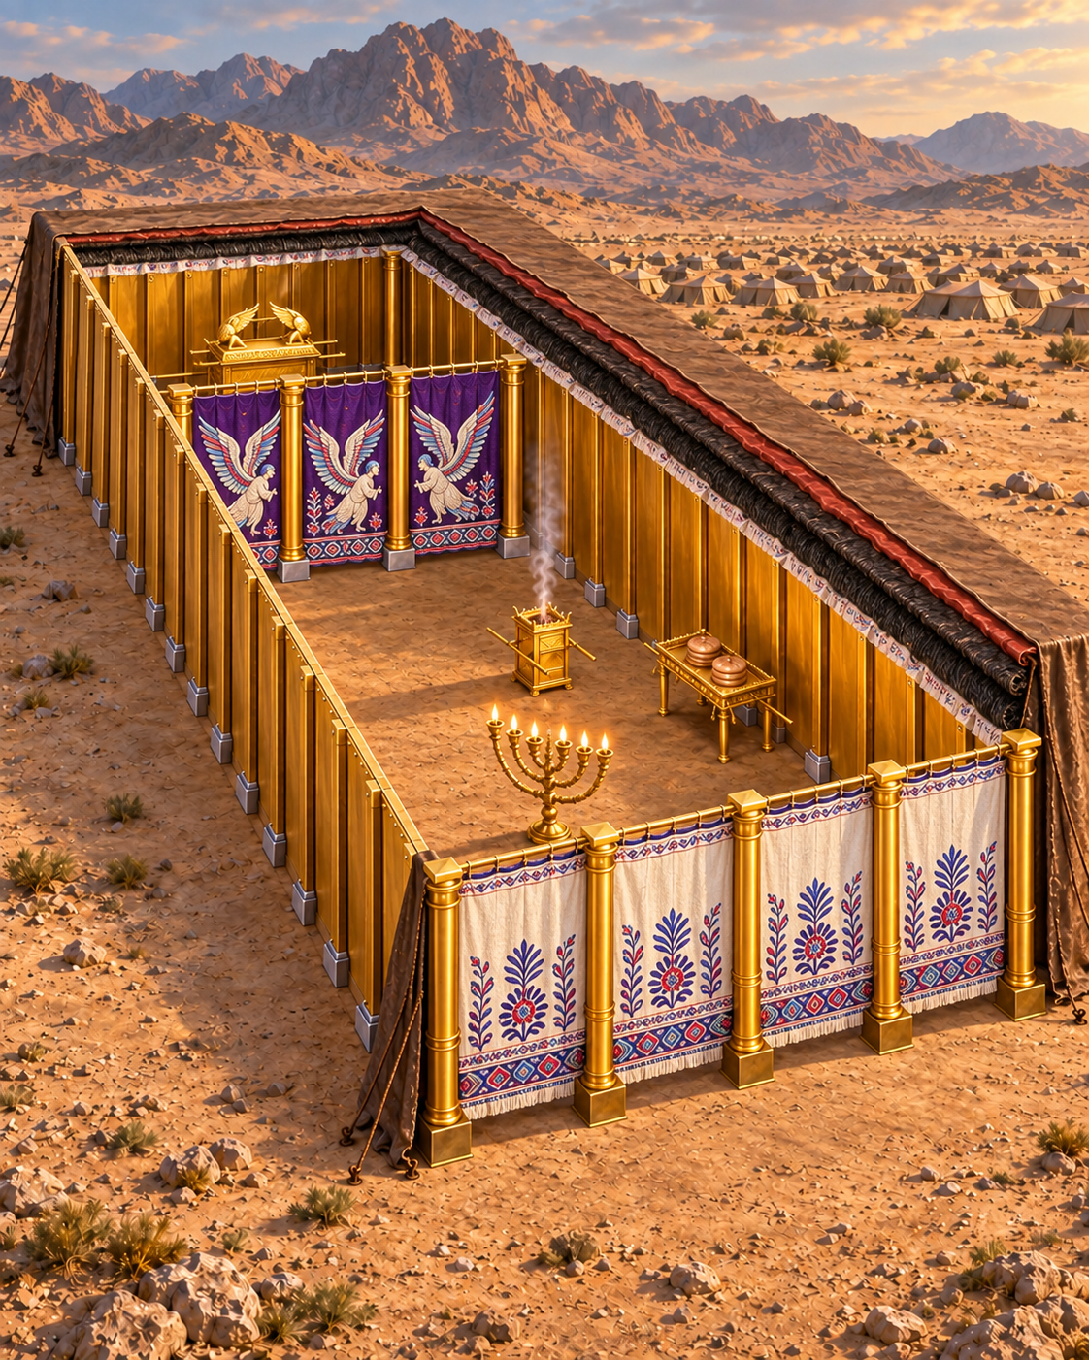
14. How many apartments were there in the tabernacle? What were they called? And how were they separated?
Exodus 26:31–33
Notes:
14. How many apartments were there in the tabernacle? What were they called? And how were they separated?
Exodus 26:31–33
KJV texts are quoted in full. Illustration is a reconstruction, not a surviving photograph.
Construction source: Exodus 25–26, https://biblehub.com/kjv/exodus/26.htm. The text specifies boards, sockets, bars, curtains, pillars and materials. Flat roof profile, exact corner joinery, board thickness and textile motifs are reconstruction choices. The familiar 10-cubit width and 20/10-cubit room division are conventional reconstruction dimensions. The KJV calls the outer covering badgers’ skins; the animal identification is uncertain.

Slide 37
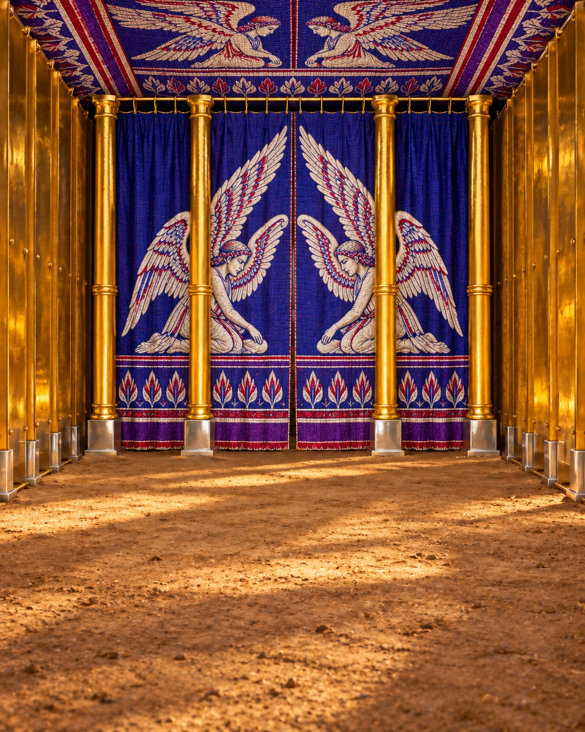
Exodus 26:31–32
31 And thou shalt make a vail of blue, and purple, and scarlet, and fine twined linen of cunning work: with cherubims shall it be made:
32 And thou shalt hang it upon four pillars of shittim wood overlaid with gold: their hooks shall be of gold, upon the four sockets of silver.
Notes:
Exodus 26:31–32
Two: the holy place and the most holy. A veil divided them.
https://biblehub.com/kjv/exodus/26.htm
KJV texts are quoted in full. Illustration is a reconstruction, not a surviving photograph.
Construction source: Exodus 25–26, https://biblehub.com/kjv/exodus/26.htm. The text specifies boards, sockets, bars, curtains, pillars and materials. Flat roof profile, exact corner joinery, board thickness and textile motifs are reconstruction choices. The familiar 10-cubit width and 20/10-cubit room division are conventional reconstruction dimensions. The KJV calls the outer covering badgers’ skins; the animal identification is uncertain.

Slide 38
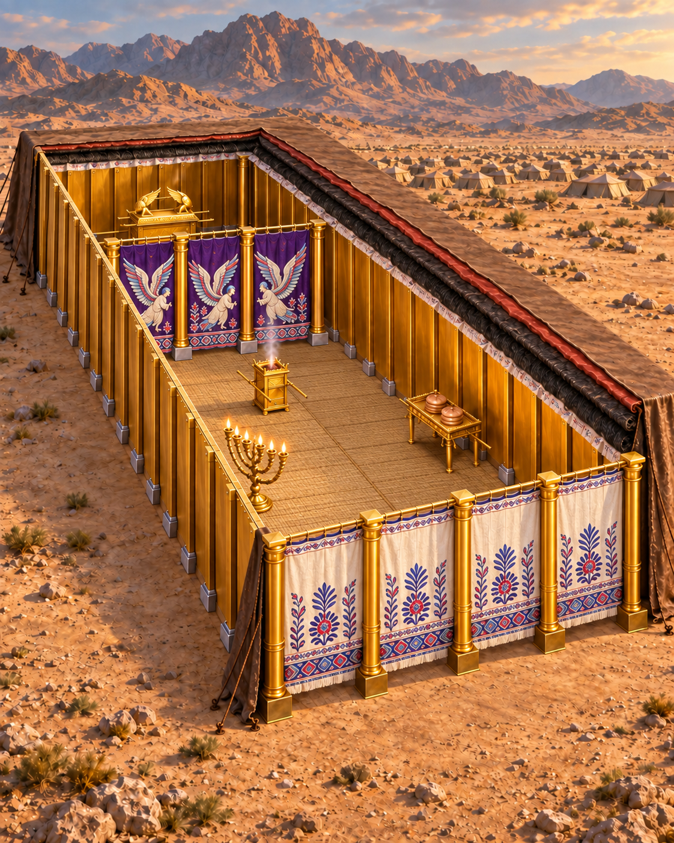
Exodus 26:33
33 And thou shalt hang up the vail under the taches, that thou mayest bring in thither within the vail the ark of the testimony: and the vail shall divide unto you between the holy place and the most holy.
Notes:
Exodus 26:33
https://biblehub.com/kjv/exodus/26.htm
KJV texts are quoted in full. Illustration is a reconstruction, not a surviving photograph.
Construction source: Exodus 25–26, https://biblehub.com/kjv/exodus/26.htm. The text specifies boards, sockets, bars, curtains, pillars and materials. Flat roof profile, exact corner joinery, board thickness and textile motifs are reconstruction choices. The familiar 10-cubit width and 20/10-cubit room division are conventional reconstruction dimensions. The KJV calls the outer covering badgers’ skins; the animal identification is uncertain.

Slide 39
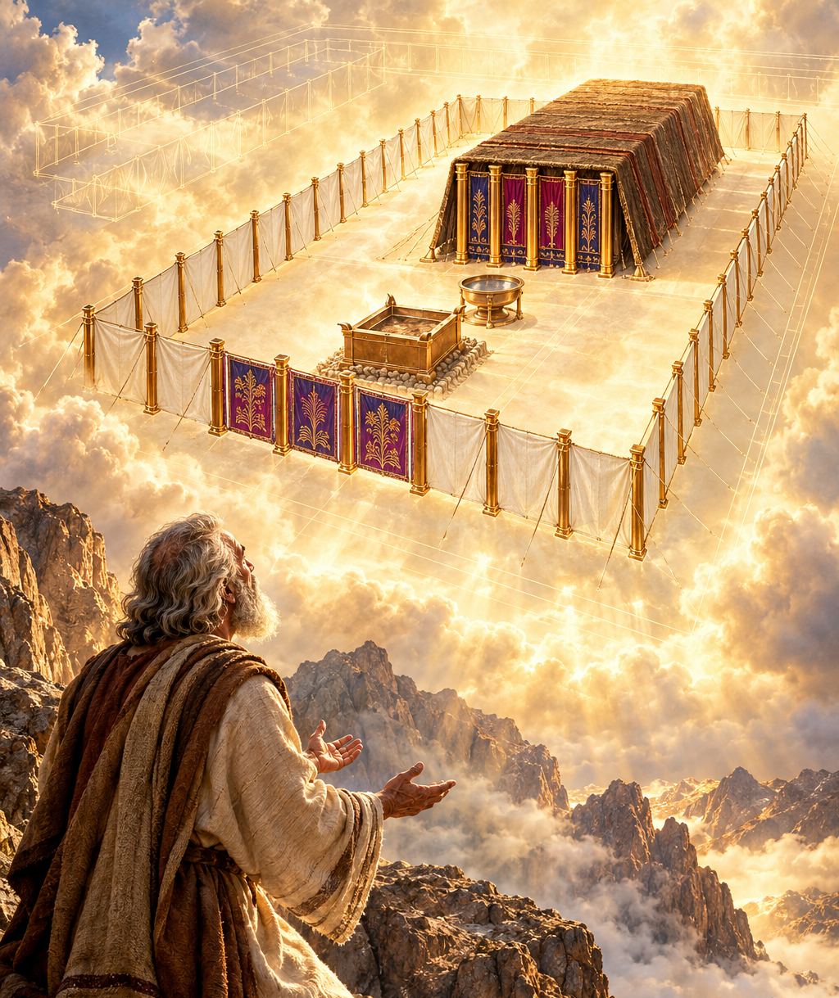
15. How was Moses guided in building this tabernacle?
Exodus 25:8–9
Notes:
15. How was Moses guided in building this tabernacle?
Exodus 25:8–9
KJV texts are quoted in full. Illustration is a reconstruction, not a surviving photograph.
Construction source: Exodus 25–26, https://biblehub.com/kjv/exodus/26.htm. The text specifies boards, sockets, bars, curtains, pillars and materials. Flat roof profile, exact corner joinery, board thickness and textile motifs are reconstruction choices. The familiar 10-cubit width and 20/10-cubit room division are conventional reconstruction dimensions. The KJV calls the outer covering badgers’ skins; the animal identification is uncertain.

Slide 40
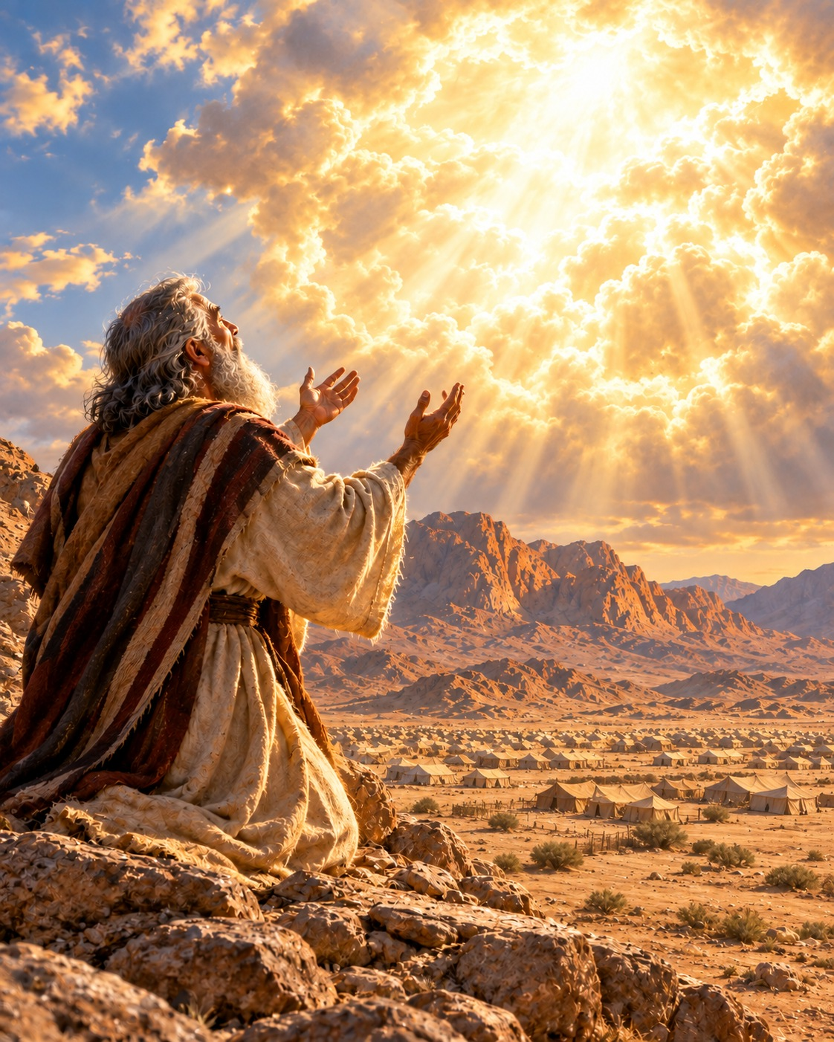
Exodus 25:8–9
The Lord showed Moses the pattern of the tabernacle and its instruments.
8 And let them make me a sanctuary; that I may dwell among them.
9 According to all that I shew thee, after the pattern of the tabernacle, and the pattern of all the instruments thereof, even so shall ye make it.
Notes:
Exodus 25:8–9
The Lord showed Moses the pattern of the tabernacle and its instruments.
https://biblehub.com/kjv/exodus/25.htm
KJV texts are quoted in full. Illustration is a reconstruction, not a surviving photograph.
Construction source: Exodus 25–26, https://biblehub.com/kjv/exodus/26.htm. The text specifies boards, sockets, bars, curtains, pillars and materials. Flat roof profile, exact corner joinery, board thickness and textile motifs are reconstruction choices. The familiar 10-cubit width and 20/10-cubit room division are conventional reconstruction dimensions. The KJV calls the outer covering badgers’ skins; the animal identification is uncertain.

Slide 41
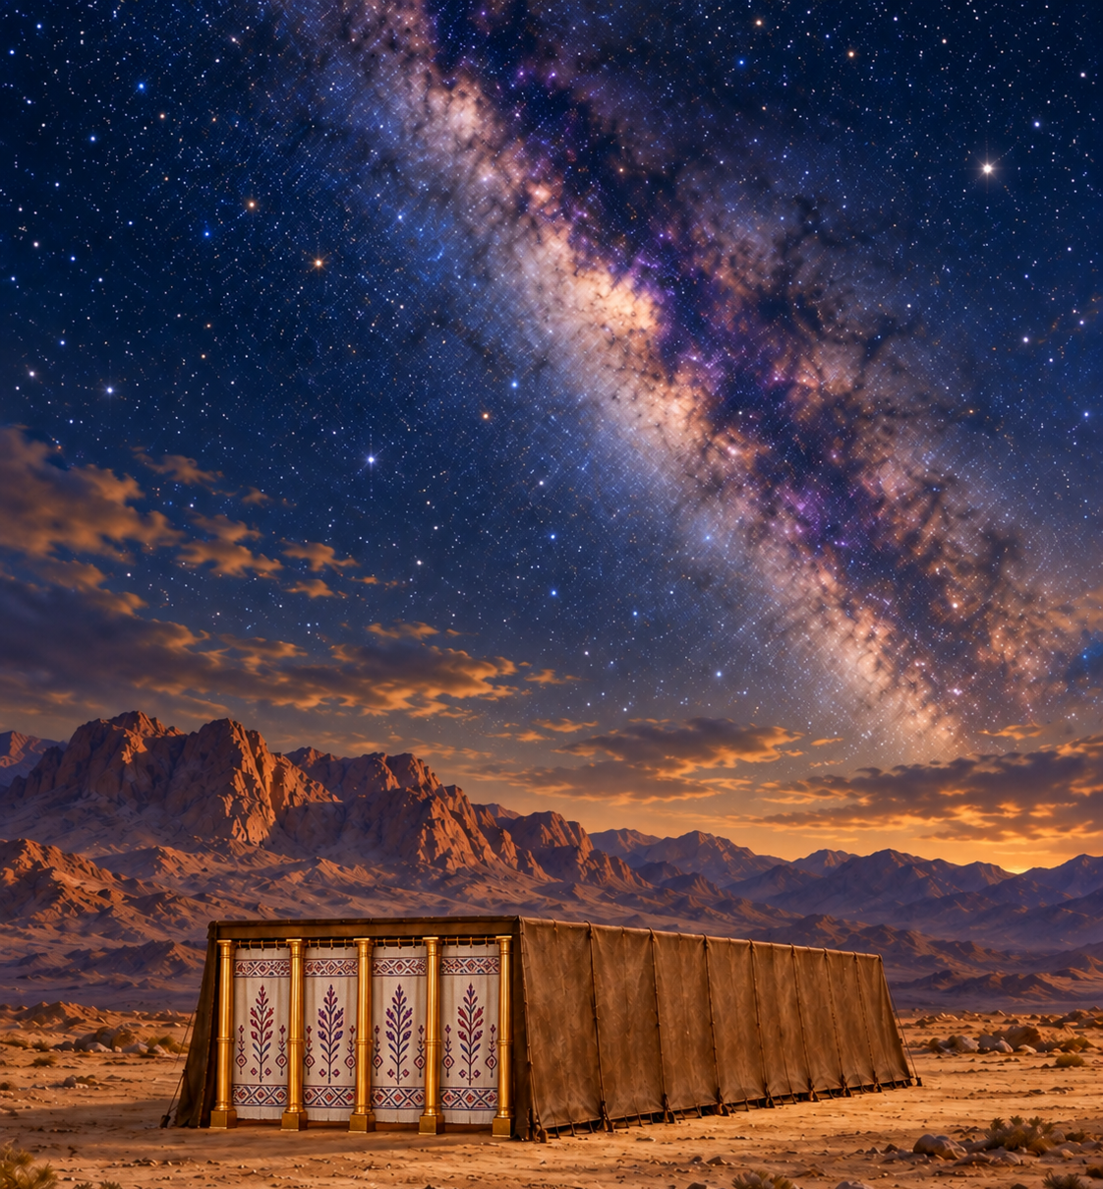
16. Was this tabernacle the real dwelling-place of God?
1 Kings 8:27;
Acts 7:48–49;
Isaiah 66:1–2
Notes:
16. Was this tabernacle the real dwelling-place of God?
1 Kings 8:27; Acts 7:48–49; Isaiah 66:1–2
KJV texts are quoted in full. Illustration is a reconstruction, not a surviving photograph.
Heavenly imagery is symbolic illustration of the cited biblical passages, not an architectural reconstruction of heaven.

Slide 42
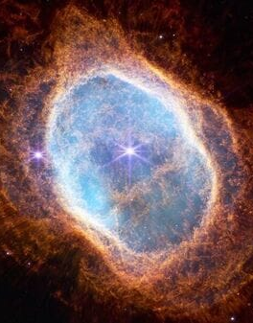
1 Kings 8:27
God cannot be contained in an earthly building. Heaven is His throne.
27 But will God indeed dwell on the earth? behold, the heaven and heaven of heavens cannot contain thee; how much less this house that I have builded?
Notes:
1 Kings 8:27
God cannot be contained in an earthly building. Heaven is His throne, and He regards the humble and contrite.
https://biblehub.com/kjv/1_kings/8.htm
KJV texts are quoted in full. Illustration is a reconstruction, not a surviving photograph.
Heavenly imagery is symbolic illustration of the cited biblical passages, not an architectural reconstruction of heaven.

Slide 43
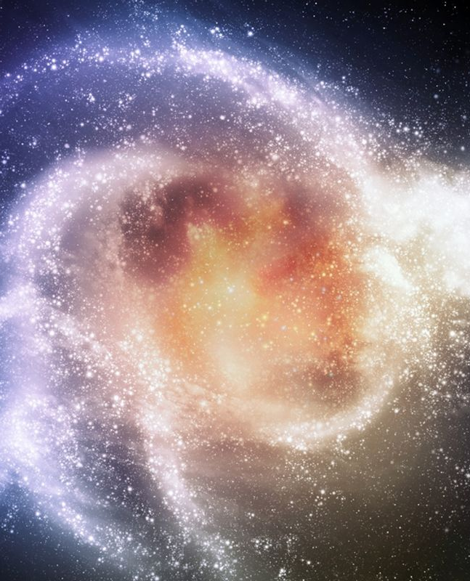
Acts 7:48–49
48 Howbeit the most High dwelleth not in temples made with hands; as saith the prophet,
49 Heaven is my throne, and earth is my footstool: what house will ye build me? saith the Lord: or what is the place of my rest?
Notes:
Acts 7:48–49
https://biblehub.com/kjv/acts/7.htm
KJV texts are quoted in full. Illustration is a reconstruction, not a surviving photograph.
Heavenly imagery is symbolic illustration of the cited biblical passages, not an architectural reconstruction of heaven.

Slide 44
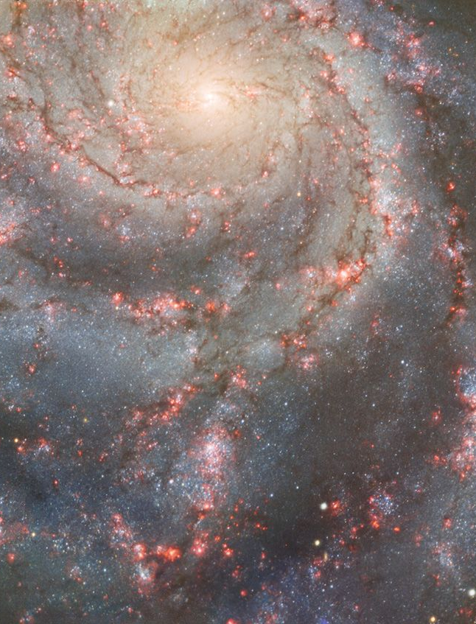
Isaiah 66:1–2
1 Thus saith the LORD, The heaven is my throne, and the earth is my footstool: where is the house that ye build unto me? and where is the place of my rest?
2 For all those things hath mine hand made, and all those things have been, saith the LORD: but to this man will I look, even to him that is poor and of a contrite spirit, and trembleth at my word.
Notes:
Isaiah 66:1–2
https://biblehub.com/kjv/isaiah/66.htm
KJV texts are quoted in full. Illustration is a reconstruction, not a surviving photograph.
Heavenly imagery is symbolic illustration of the cited biblical passages, not an architectural reconstruction of heaven.

Slide 45
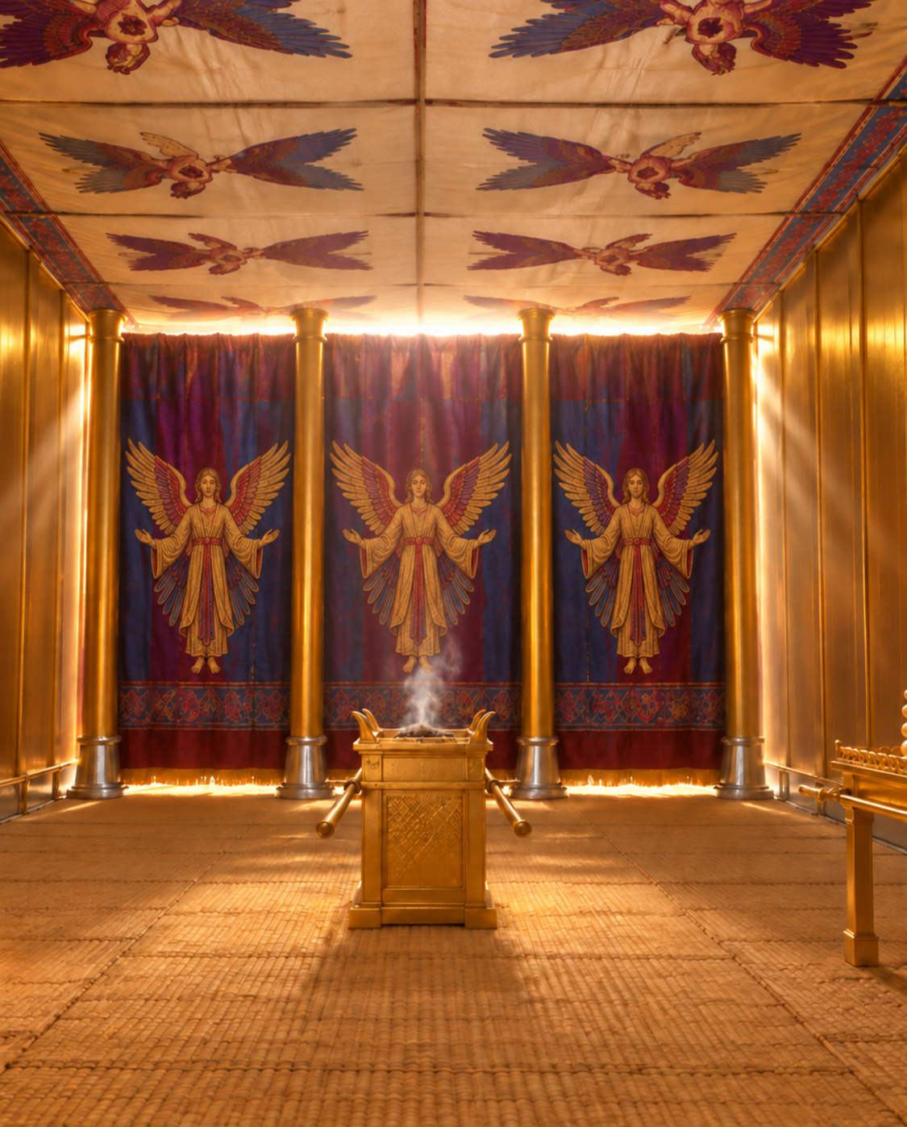
17. What were these “holy places” which Moses made?
Hebrews 9:23–24
Notes:
17. What were these “holy places” which Moses made?
Hebrews 9:23–24
KJV texts are quoted in full. Illustration is a reconstruction, not a surviving photograph.
Heavenly imagery is symbolic illustration of the cited biblical passages, not an architectural reconstruction of heaven.

Slide 46
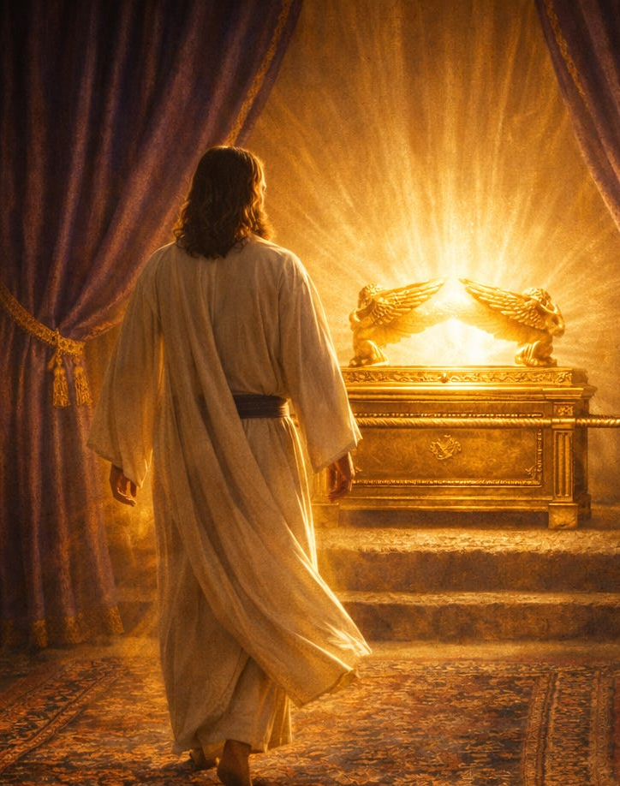
Hebrews 9:23–24
23 It was therefore necessary that the patterns of things in the heavens should be purified with these; but the heavenly things themselves with better sacrifices than these.
24 For Christ is not entered into the holy places made with hands, which are the figures of the true; but into heaven itself, now to appear in the presence of God for us:
Notes:
Hebrews 9:23–24
Patterns of things in the heavens, and figures of the true holy places.
https://biblehub.com/kjv/hebrews/9.htm
KJV texts are quoted in full. Illustration is a reconstruction, not a surviving photograph.
Heavenly imagery is symbolic illustration of the cited biblical passages, not an architectural reconstruction of heaven.

Slide 47
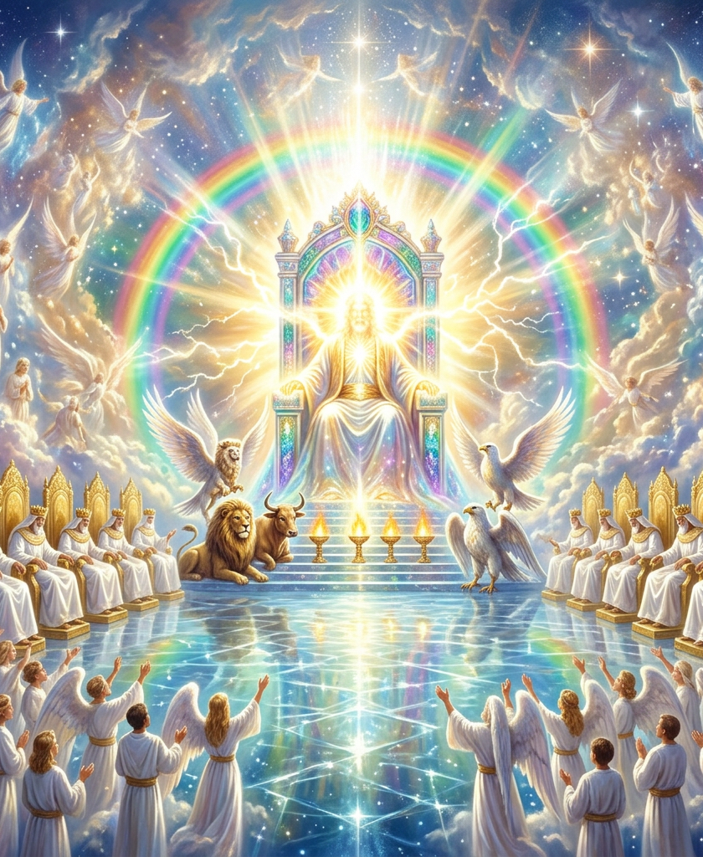
18. Then where are the true holy places?
Notes:
18. Then where are the true holy places?
KJV texts are quoted in full. Illustration is a reconstruction, not a surviving photograph.
Heavenly imagery is symbolic illustration of the cited biblical passages, not an architectural reconstruction of heaven.

Slide 48
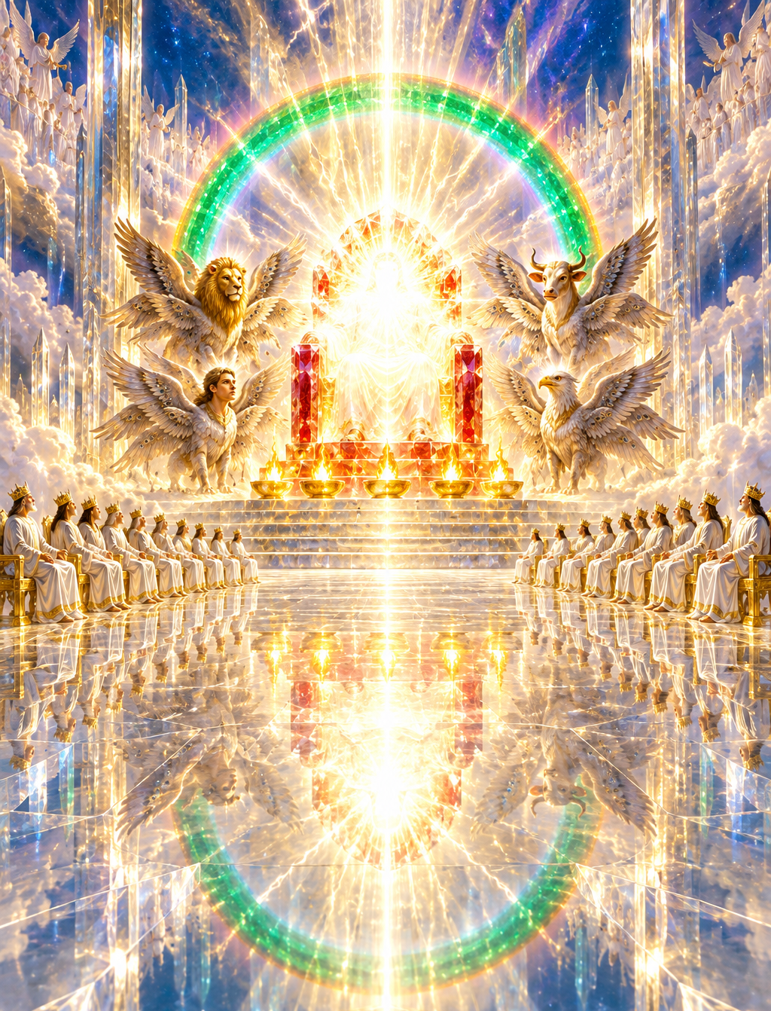
Hebrews 9:24
In heaven itself, in the presence of God.
Hebrews 9:24
24 For Christ is not entered into the holy places made with hands, which are the figures of the true; but into heaven itself, now to appear in the presence of God for us:
Notes:
Hebrews 9:24
In heaven itself, in the presence of God.
Hebrews 9:24
https://biblehub.com/kjv/hebrews/9.htm
KJV texts are quoted in full. Illustration is a reconstruction, not a surviving photograph.
Heavenly imagery is symbolic illustration of the cited biblical passages, not an architectural reconstruction of heaven.

Slide 49
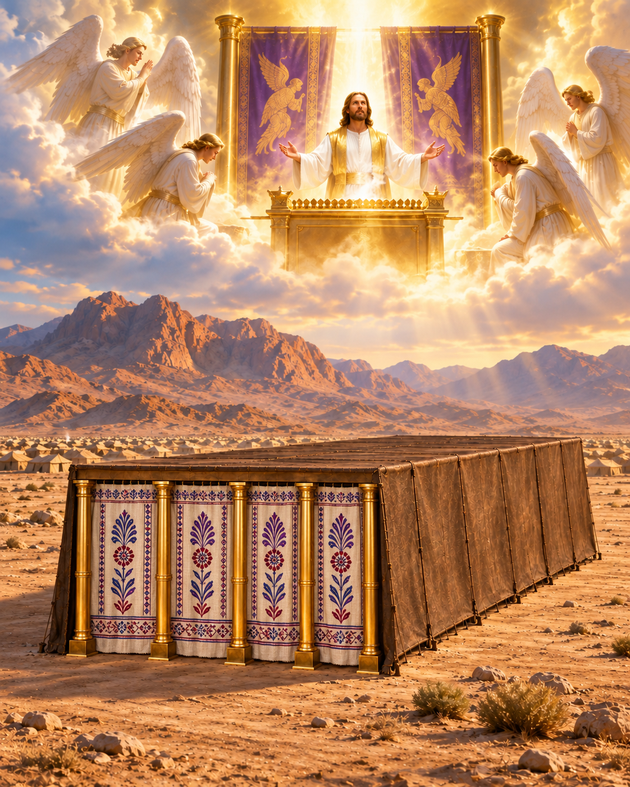
19. Is there a real sanctuary, a special dwelling place, for God in Heaven?
Hebrews 8:1–2;
Psalm 11:4; 1 Kings 8:30
Notes:
19. Is there a real sanctuary, a special dwelling place, for God in Heaven?
Hebrews 8:1–2; Psalm 11:4; 1 Kings 8:30
KJV texts are quoted in full. Illustration is a reconstruction, not a surviving photograph.
Heavenly imagery is symbolic illustration of the cited biblical passages, not an architectural reconstruction of heaven.

Slide 50
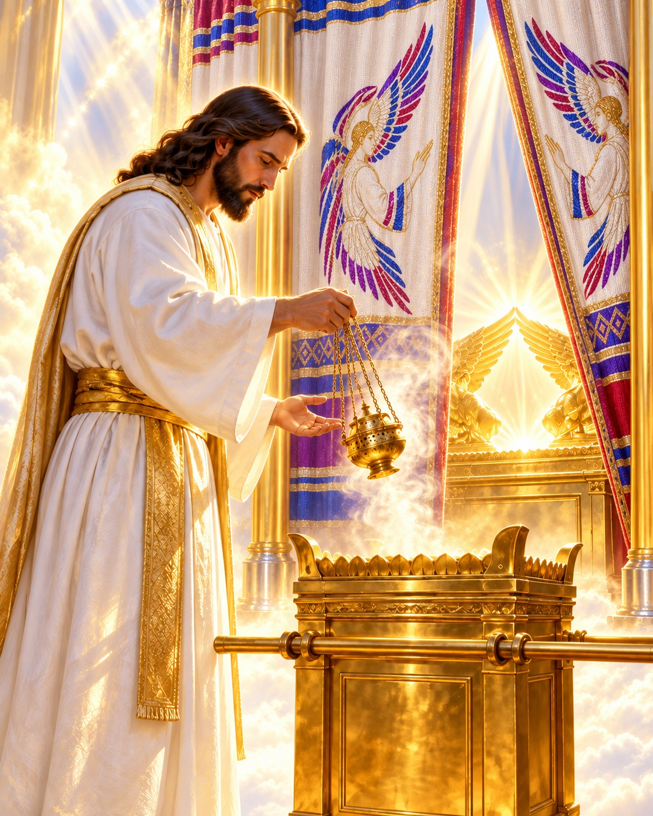
Hebrews 8:1–2
1 Now of the things which we have spoken this is the sum: We have such an high priest, who is set on the right hand of the throne of the Majesty in the heavens;
2 A minister of the sanctuary, and of the true tabernacle, which the Lord pitched, and not man.
Notes:
Hebrews 8:1–2
Yes. The true tabernacle is in heaven, where Christ ministers as our High Priest.
https://biblehub.com/kjv/hebrews/8.htm
KJV texts are quoted in full. Illustration is a reconstruction, not a surviving photograph.
Heavenly imagery is symbolic illustration of the cited biblical passages, not an architectural reconstruction of heaven.

Slide 51
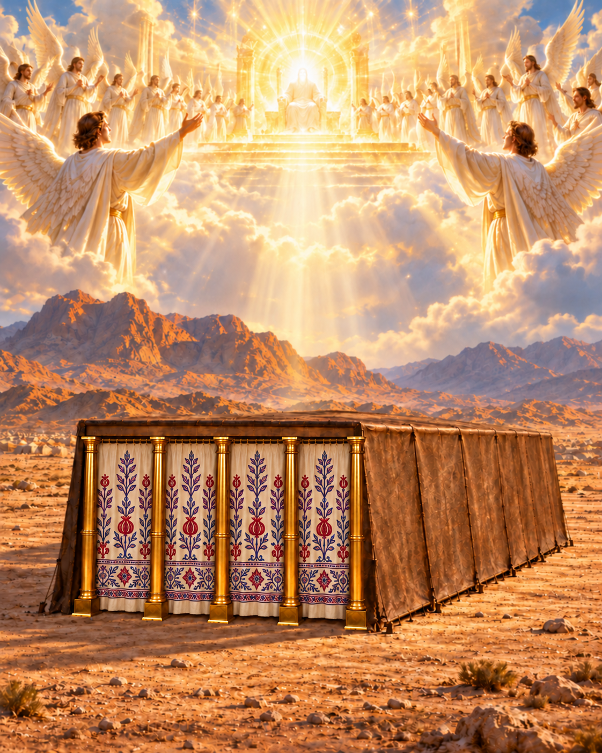
Psalm 11:4
4 The LORD is in his holy temple, the LORD'S throne is in heaven: his eyes behold, his eyelids try, the children of men.
Notes:
Psalm 11:4
https://biblehub.com/kjv/psalms/11.htm
KJV texts are quoted in full. Illustration is a reconstruction, not a surviving photograph.
Heavenly imagery is symbolic illustration of the cited biblical passages, not an architectural reconstruction of heaven.

Slide 52
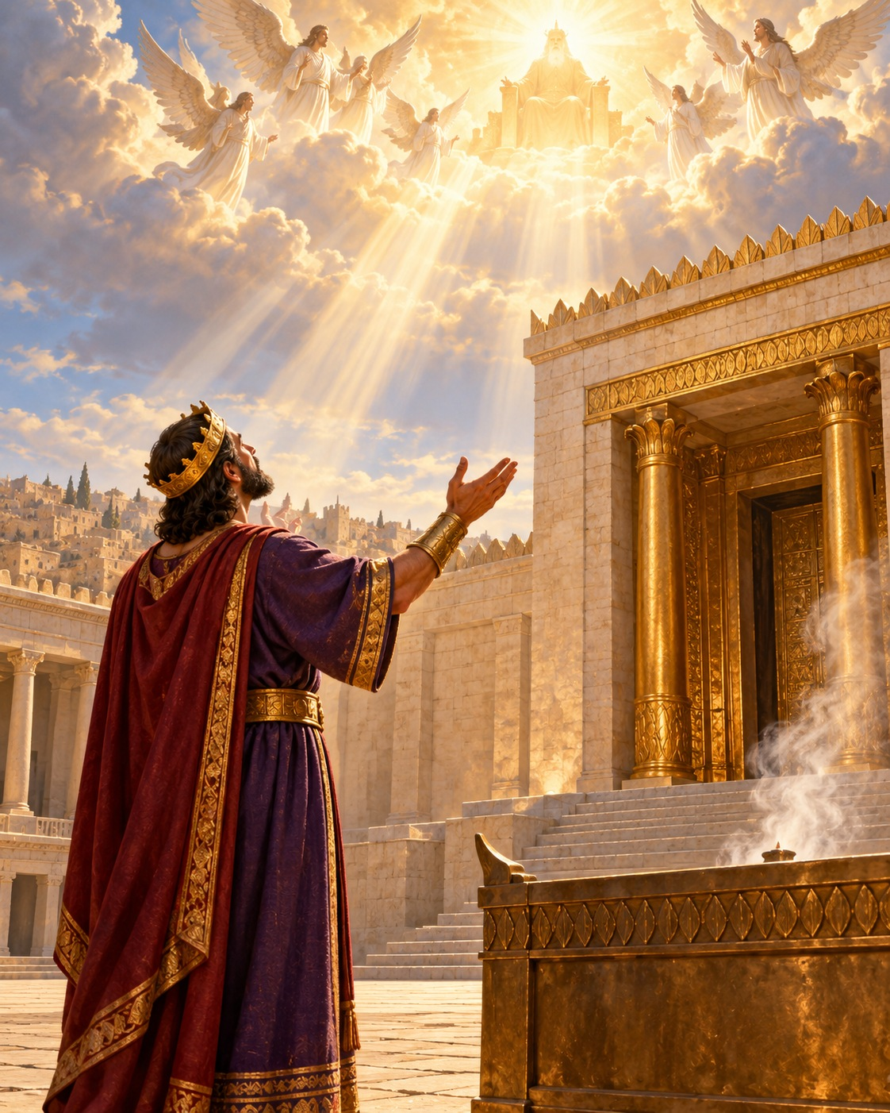
1 Kings 8:30
30 And hearken thou to the supplication of thy servant, and of thy people Israel, when they shall pray toward this place: and hear thou in heaven thy dwelling place: and when thou hearest, forgive.
Notes:
1 Kings 8:30
https://biblehub.com/kjv/1_kings/8.htm
KJV texts are quoted in full. Illustration is a reconstruction, not a surviving photograph.
Heavenly imagery is symbolic illustration of the cited biblical passages, not an architectural reconstruction of heaven.

Slide 53
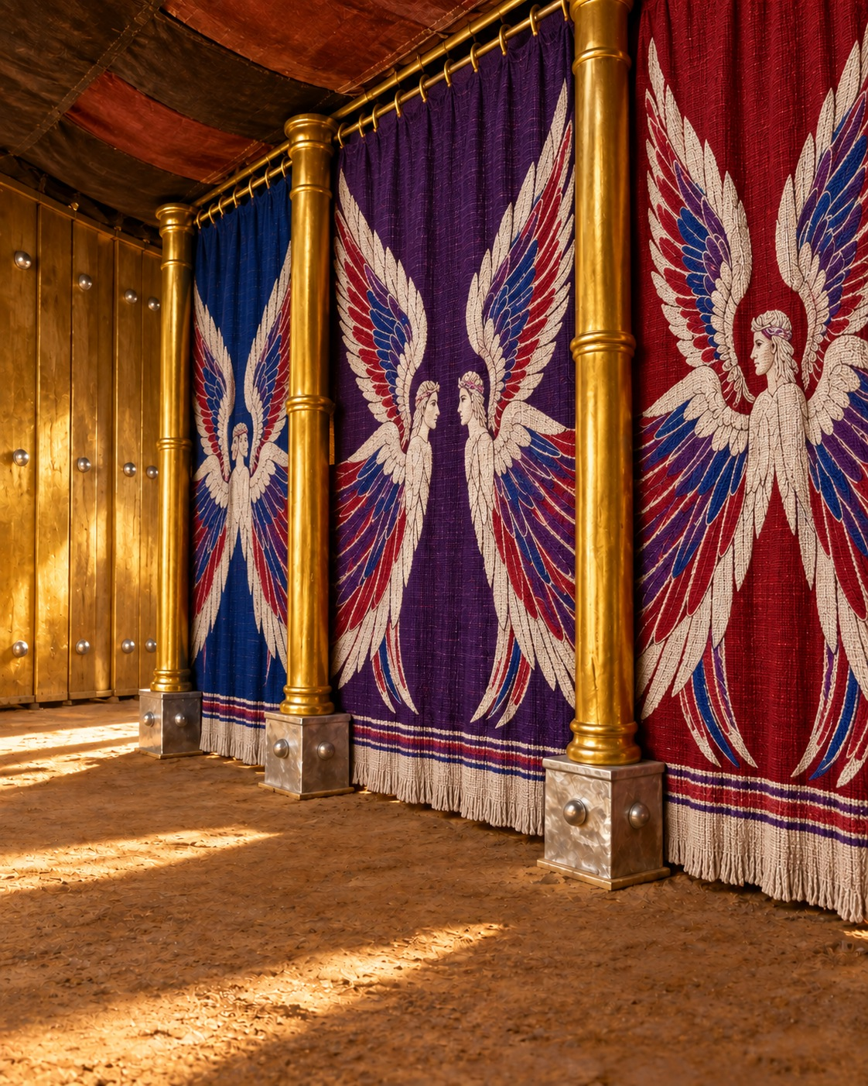
20. In the type, what were pictured on all the curtains within?
Exodus 26:1, 31
Notes:
20. In the type, what were pictured on all the curtains within?
Exodus 26:1, 31
KJV texts are quoted in full. Illustration is a reconstruction, not a surviving photograph.
Heavenly imagery is symbolic illustration of the cited biblical passages, not an architectural reconstruction of heaven.

Slide 54

Exodus 26:1, 31
1 Moreover thou shalt make the tabernacle with ten curtains of fine twined linen, and blue, and purple, and scarlet: with cherubims of cunning work shalt thou make them.
31 And thou shalt make a vail of blue, and purple, and scarlet, and fine twined linen of cunning work: with cherubims shall it be made:
Notes:
Exodus 26:1, 31
Cherubim appeared in the work of the inner curtains and the dividing veil.
https://biblehub.com/kjv/exodus/26.htm
KJV texts are quoted in full. Illustration is a reconstruction, not a surviving photograph.
Heavenly imagery is symbolic illustration of the cited biblical passages, not an architectural reconstruction of heaven.

Slide 55

21. What were these to represent in the reality?
Revelation 5:11
Notes:
21. What were these to represent in the reality?
Revelation 5:11
KJV texts are quoted in full. Illustration is a reconstruction, not a surviving photograph.
Heavenly imagery is symbolic illustration of the cited biblical passages, not an architectural reconstruction of heaven.

Slide 56

Revelation 5:11
The multitude of angels around the throne of God.
11 And I beheld, and I heard the voice of many angels round about the throne and the beasts and the elders: and the number of them was ten thousand times ten thousand, and thousands of thousands;
Notes:
Revelation 5:11
The multitude of angels around the throne of God.
https://biblehub.com/kjv/revelation/5.htm
KJV texts are quoted in full. Illustration is a reconstruction, not a surviving photograph.
Heavenly imagery is symbolic illustration of the cited biblical passages, not an architectural reconstruction of heaven.

Slide 57

22. For what purpose are these angels round about the throne of God in the heavenly sanctuary?
Psalm 103:19–20;
Hebrews 1:14;
Daniel 7:9–10
Notes:
22. For what purpose are these angels round about the throne of God in the heavenly sanctuary?
Psalm 103:19–20; Hebrews 1:14; Daniel 7:9–10
KJV texts are quoted in full. Illustration is a reconstruction, not a surviving photograph.
Heavenly imagery is symbolic illustration of the cited biblical passages, not an architectural reconstruction of heaven.

Slide 58

Psalm 103:19–20
They obey His word, minister before Him, and serve those who shall inherit salvation.
19 The LORD hath prepared his throne in the heavens; and his kingdom ruleth over all.
20 Bless the LORD, ye his angels, that excel in strength, that do his commandments, hearkening unto the voice of his word.
Notes:
Psalm 103:19–20
They obey His word, minister before Him, and serve those who shall inherit salvation.
https://biblehub.com/kjv/psalms/103.htm
KJV texts are quoted in full. Illustration is a reconstruction, not a surviving photograph.
Heavenly imagery is symbolic illustration of the cited biblical passages, not an architectural reconstruction of heaven.

Slide 59

Hebrews 1:14
14 Are they not all ministering spirits, sent forth to minister for them who shall be heirs of salvation?
Notes:
Hebrews 1:14
https://biblehub.com/kjv/hebrews/1.htm
KJV texts are quoted in full. Illustration is a reconstruction, not a surviving photograph.
Heavenly imagery is symbolic illustration of the cited biblical passages, not an architectural reconstruction of heaven.

Slide 60

Daniel 7:9
9 I beheld till the thrones were cast down, and the Ancient of days did sit, whose garment was white as snow, and the hair of his head like the pure wool: his throne was like the fiery flame, and his wheels as burning fire.
Notes:
Daniel 7:9
https://biblehub.com/kjv/daniel/7.htm
KJV texts are quoted in full. Illustration is a reconstruction, not a surviving photograph.
Heavenly imagery is symbolic illustration of the cited biblical passages, not an architectural reconstruction of heaven.

Slide 61

Daniel 7:10
10 A fiery stream issued and came forth from before him: thousand thousands ministered unto him, and ten thousand times ten thousand stood before him: the judgment was set, and the books were opened.
Notes:
Daniel 7:10
https://biblehub.com/kjv/daniel/7.htm
KJV texts are quoted in full. Illustration is a reconstruction, not a surviving photograph.
Heavenly imagery is symbolic illustration of the cited biblical passages, not an architectural reconstruction of heaven.

Slide 62


Slide 63


Slide 64


