Slide 1


Slide 2


Slide 3
Lesson 1:
2 Peter 1:1-4
October 27, 1888

Slide 4
1. To whom did Peter address his second epistle?
2 Peter 1:1

Slide 5
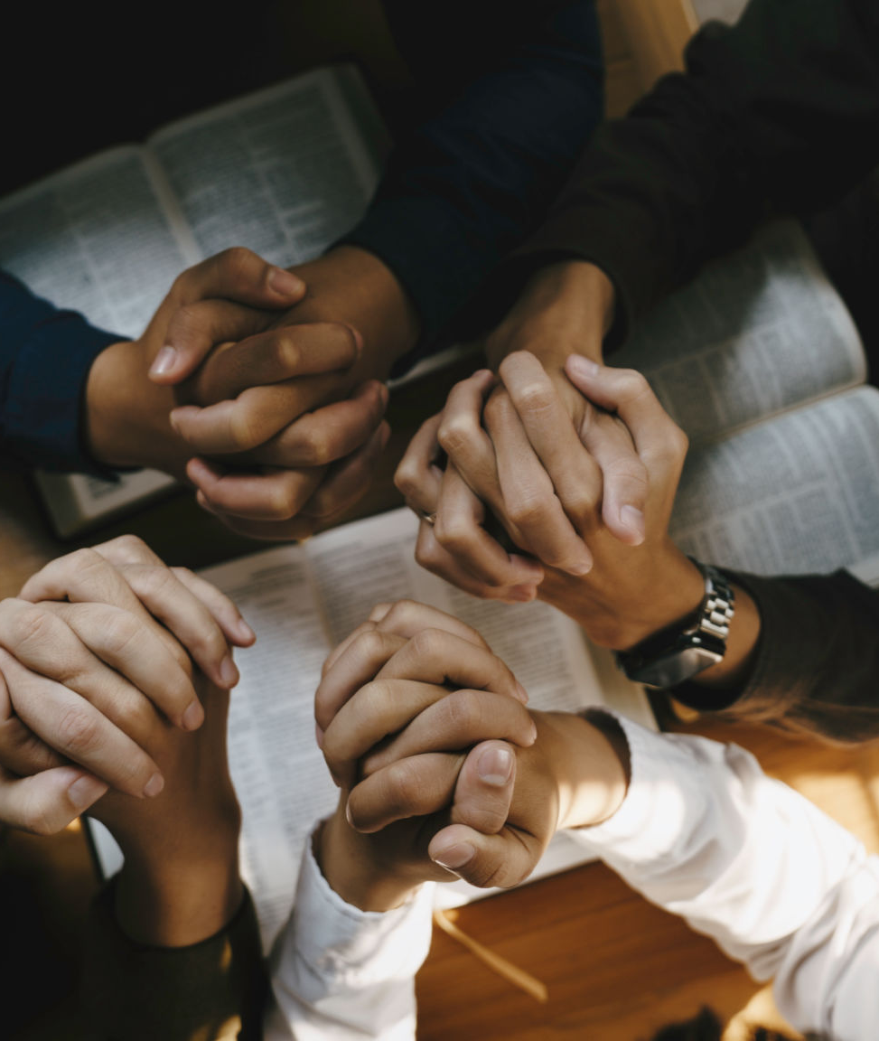
2 Peter 1:1
1 Simon Peter, a servant and an apostle of Jesus Christ, to them that have obtained like precious faith with us through the righteousness of God and our Saviour Jesus Christ:

Slide 6
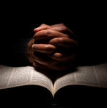
This lesson is not about trying harder to be good.
It’s about what happens when you actually come to know God.

Slide 7
2. How is this “precious faith” obtained?
2 Peter 1:1 (last part)

Slide 8
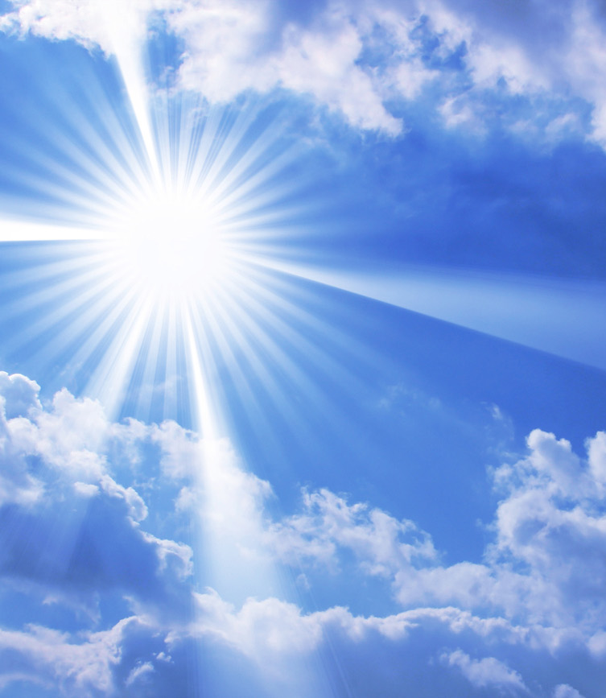
2 Peter 1:1
1 Simon Peter, a servant and an apostle of Jesus Christ, to them that have obtained like precious faith with us through the righteousness of God and our Saviour Jesus Christ:

Slide 9
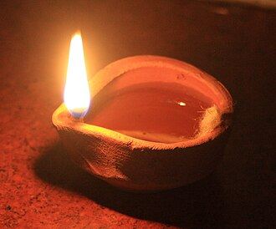
We don’t produce faith
—God gives it.
Faith Comes Through
His righteousness, not ours

Slide 10
3. What invocation did the apostle make in behalf of those whom he addressed?
2 Peter 1:2

Slide 11
A prayer or appeal, generally directed to a higher power.
Invocation

Slide 12

2 Peter 1:2
² Grace and peace be multiplied unto you through the knowledge of God, and of Jesus our Lord,

Slide 13
4. What does grace do for those who accept it?
Hebrews 4:16;
2 Corinthians 12:9;
Titus 2:11

Slide 14
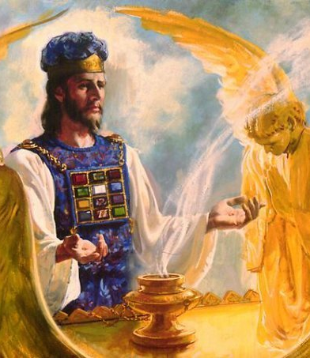
Hebrews 4:16
¹⁶ Let us therefore come boldly unto the throne of grace, that we may obtain mercy, and find grace to help in time of need.

Slide 15
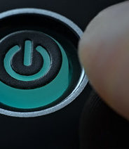
2 Corinthians 12:9
⁹ And he said unto me, My grace is sufficient for thee: for my strength is made perfect in weakness. Most gladly therefore will I rather glory in my infirmities, that the power of Christ may rest upon me.

Slide 16
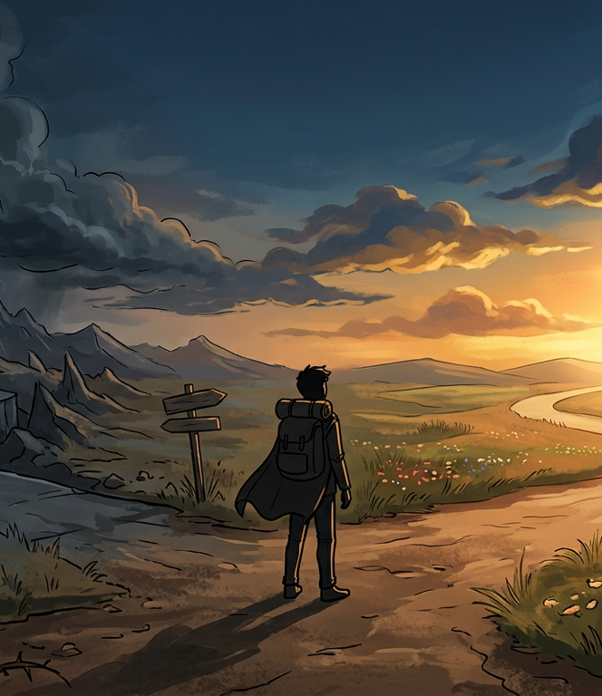
Titus 2:11
¹¹ For the grace of God that bringeth salvation hath appeared to all men,

Slide 17
5. Who alone have peace?
Romans 5:1;
Isaiah 48:18;
Isaiah 57:20, 21

Slide 18
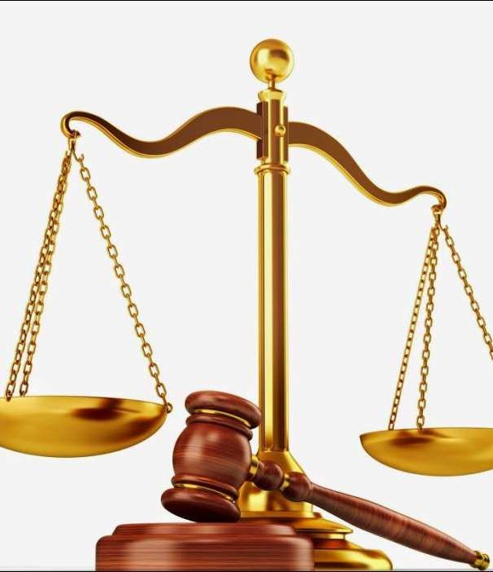
Romans 5:1
5 Therefore being justified by faith, we have peace with God through our Lord Jesus Christ:

Slide 19
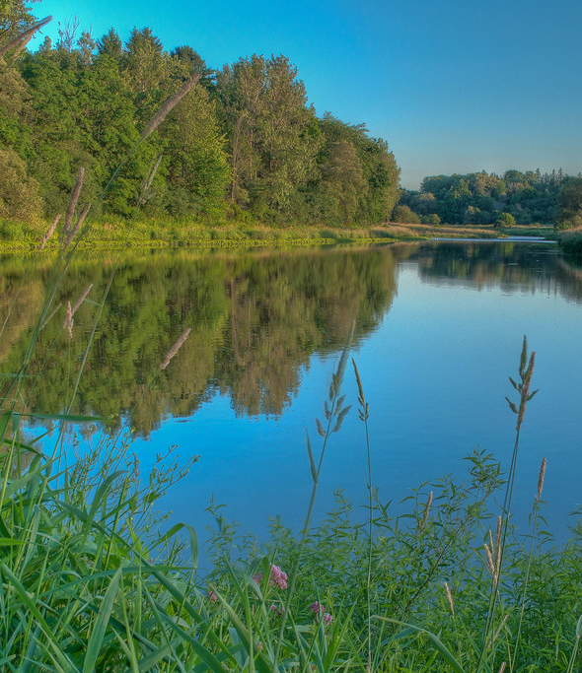
Isaiah 48:18
¹⁸ O that thou hadst hearkened to my commandments! then had thy peace been as a river, and thy righteousness as the waves of the sea:

Slide 20
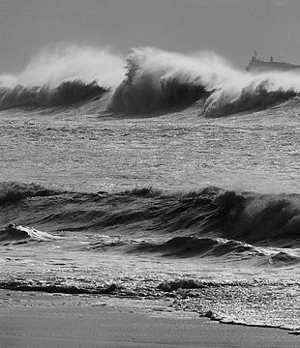
Isaiah 57:20, 21
²⁰ But the wicked are like the troubled sea, when it cannot rest, whose waters cast up mire and dirt.
²¹ There is no peace, saith my God, to the wicked.

Slide 21
6. Then to what, in effect, is Peter’s invocation in verse 2 equivalent?
Philippians 1:9-11

Slide 22
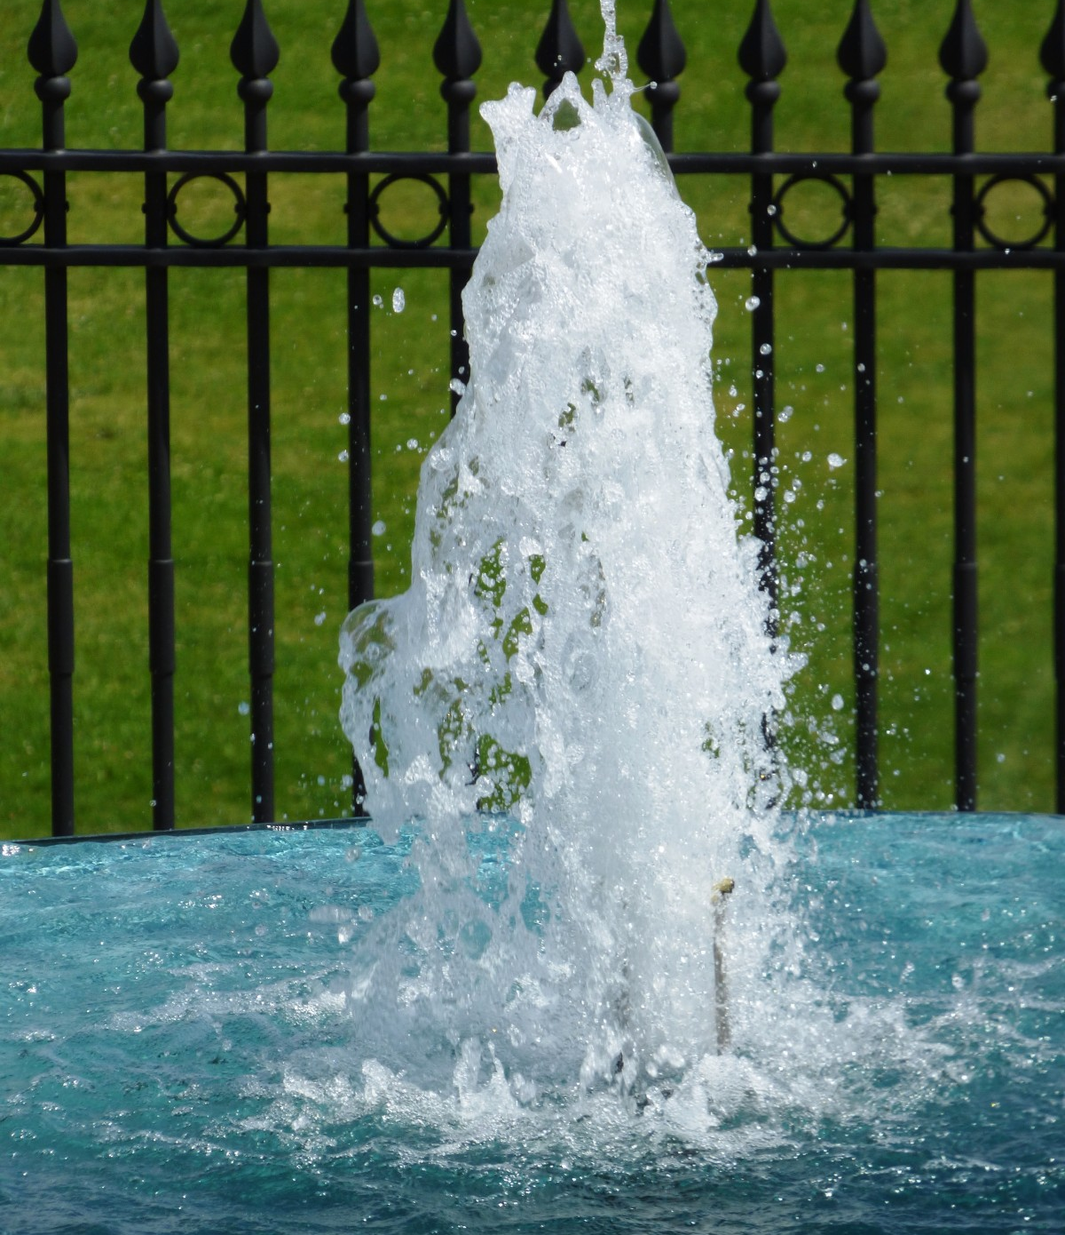
Philippians 1:9-11
⁹ And this I pray, that your love may abound yet more and more in knowledge and in all judgment;

Slide 23

Philippians 1:9-11
¹⁰ That ye may approve things that are excellent; that ye may be sincere and without offence till the day of Christ.

Slide 24
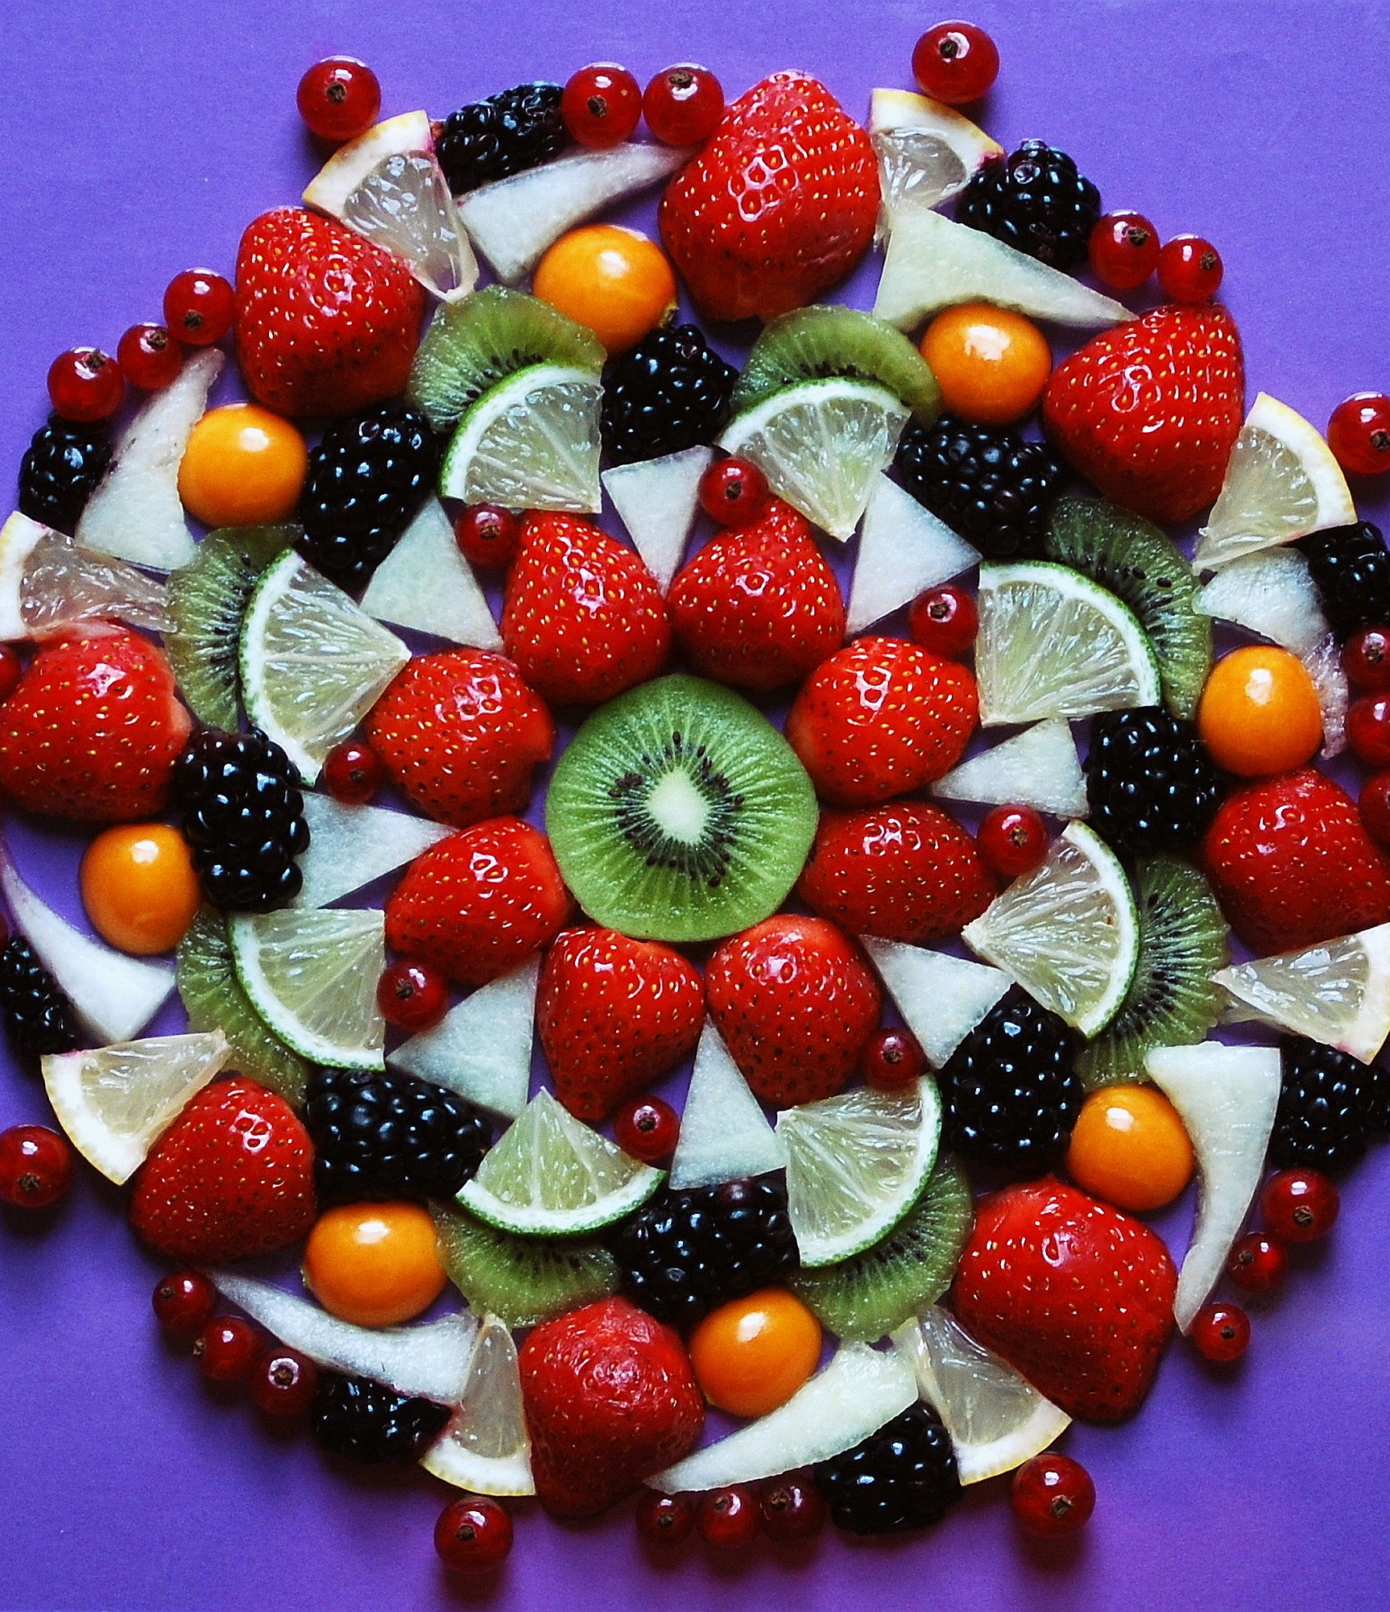
Philippians 1:9-11
¹¹ Being filled with the fruits of righteousness, which are by Jesus Christ, unto the glory and praise of God.

Slide 25
7. How are this grace and peace to be obtained?
2 Peter 1:2

Slide 26

2 Peter 1:2
² Grace and peace be multiplied unto you through the knowledge of God, and of Jesus our Lord,

Slide 27

Grace and peace aren’t random—they grow as we come to know God.

Slide 28
8. How much of that which is needful to the acquirement of life and godliness has God given to us?
2 Peter 1:3

Slide 29
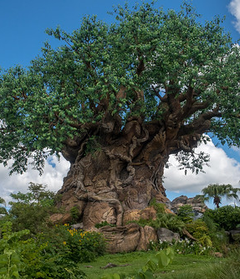
2 Peter 1:3
³ According as his divine power hath given unto us all things that pertain unto life and godliness, through the knowledge of him that hath called us to glory and virtue:

Slide 30
9. How much does the apostle Paul say that God will do for us?
Ephesians 3:20

Slide 31
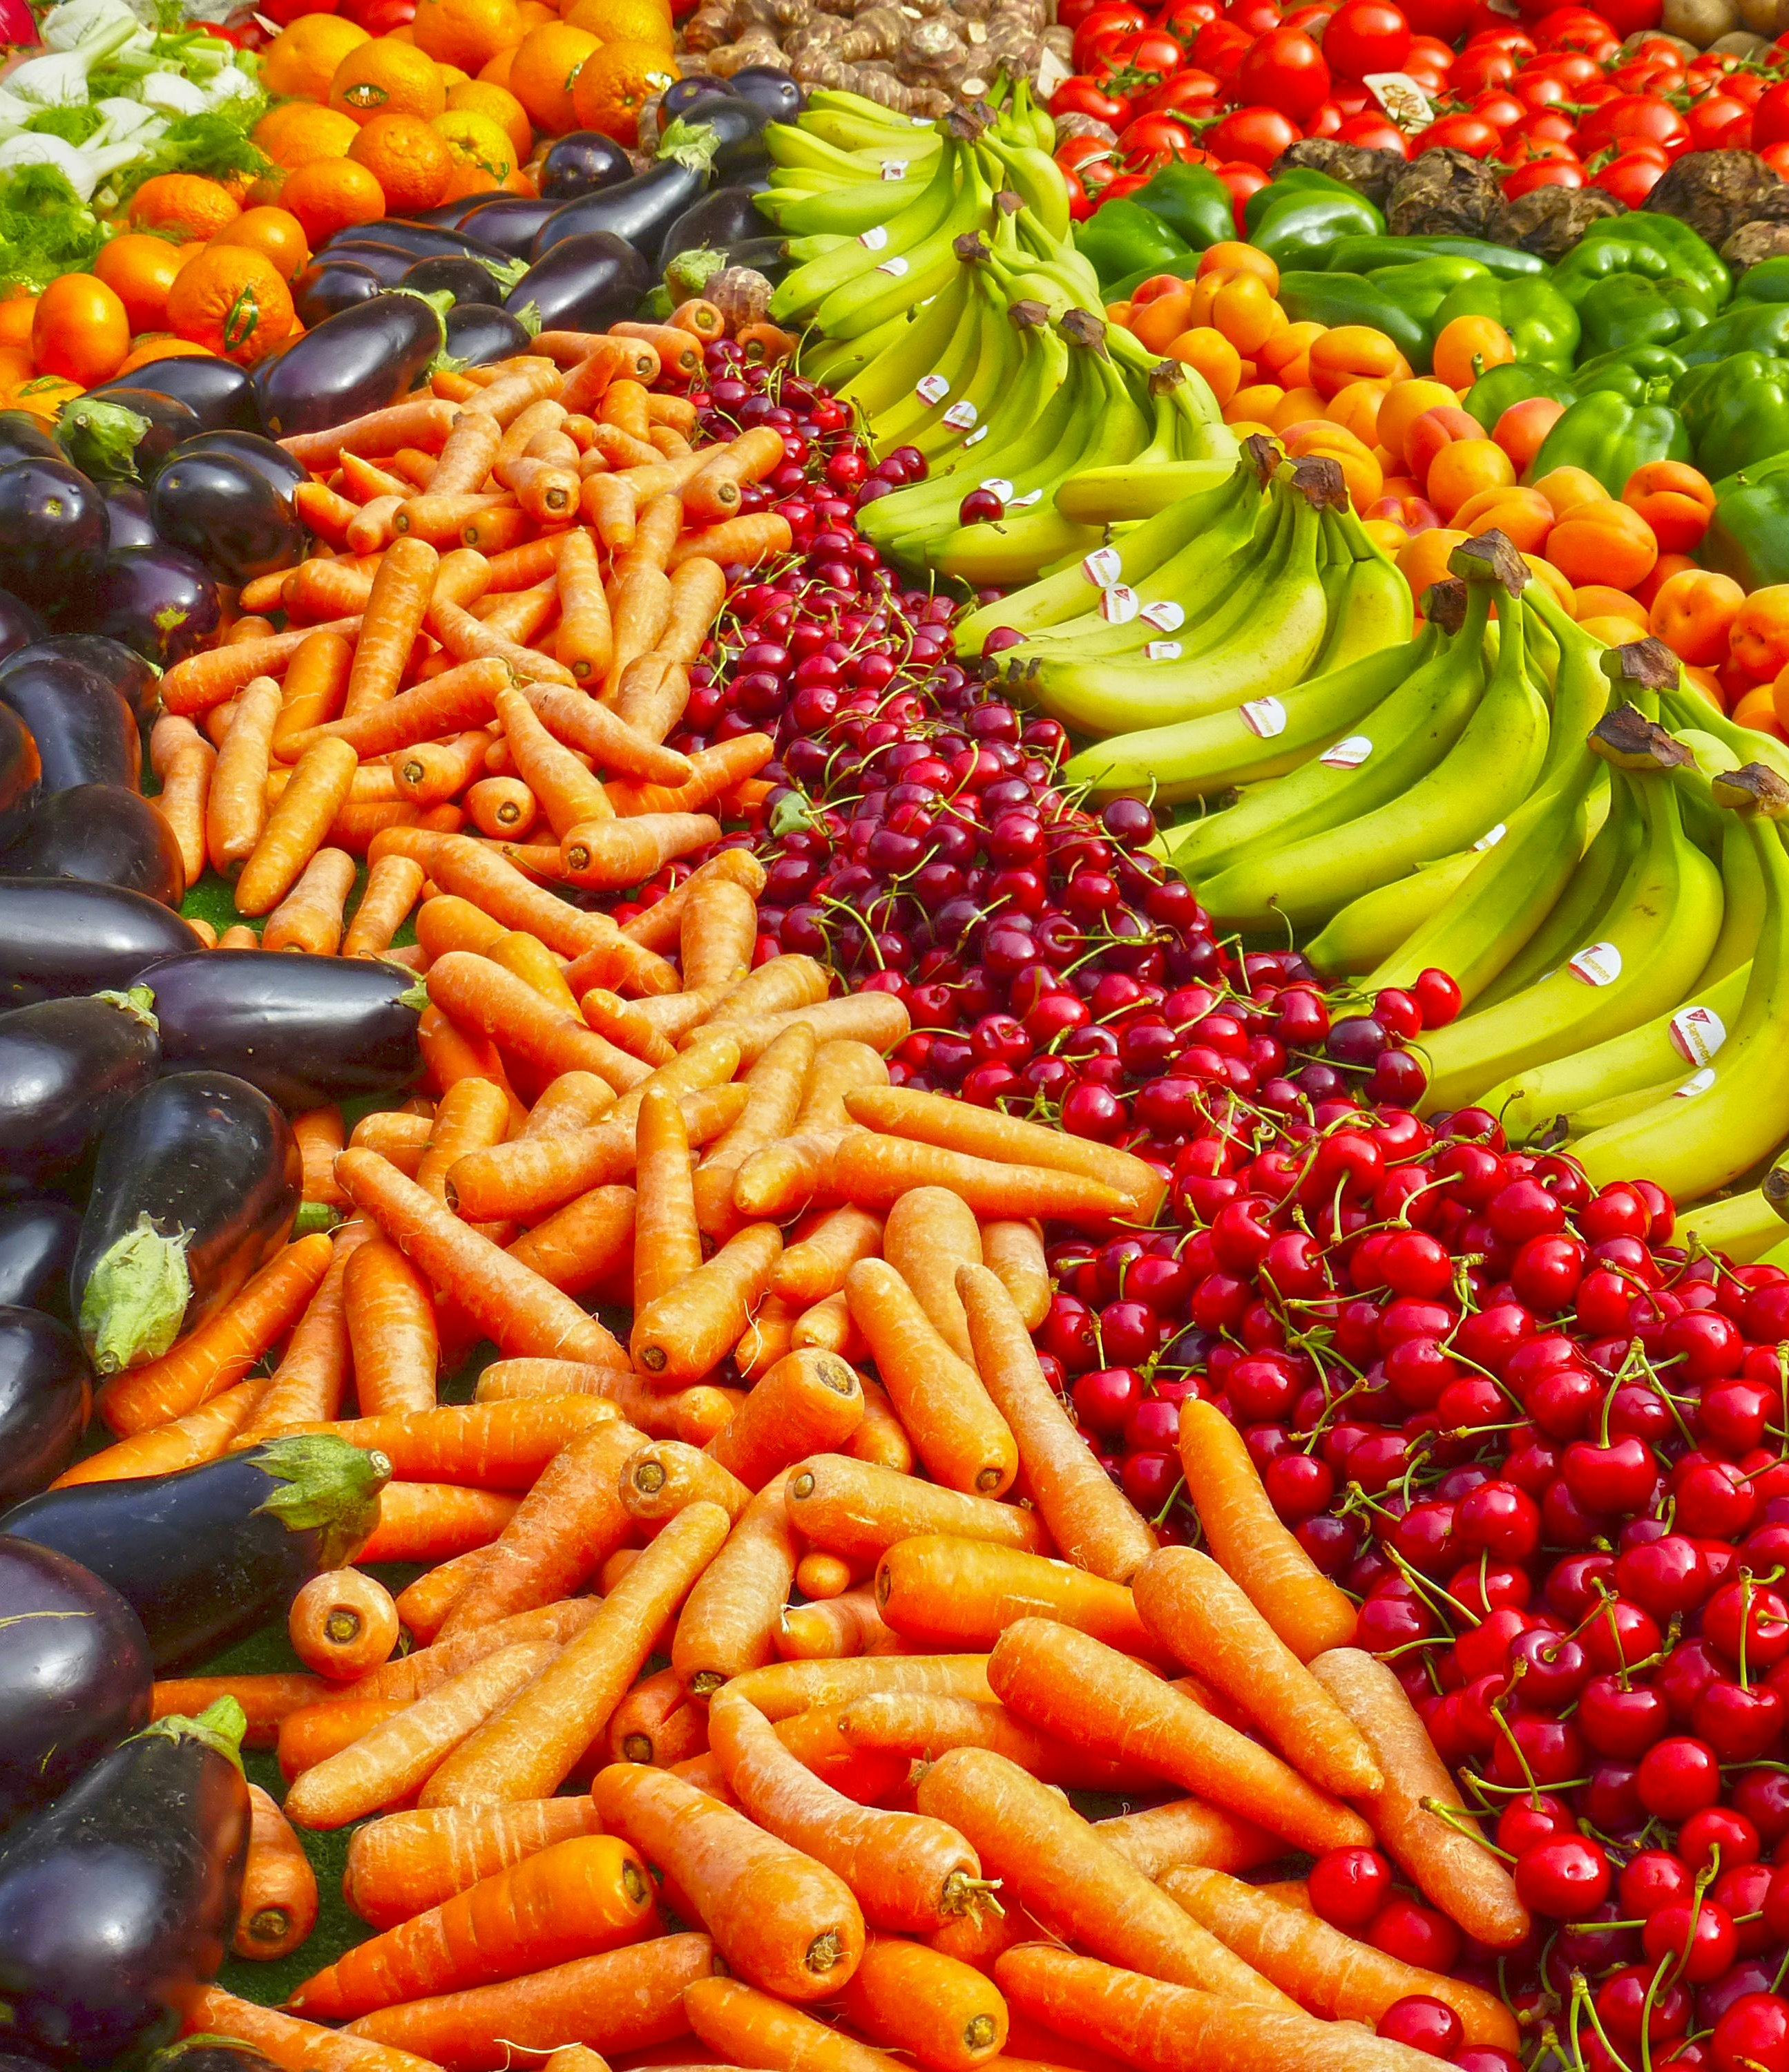
Ephesians 3:20
²⁰ Now unto him that is able to do exceeding abundantly above all that we ask or think, according to the power that worketh in us,

Slide 32
10. How is this aid brought to us?
2 Peter 1:3 (last part)

Slide 33
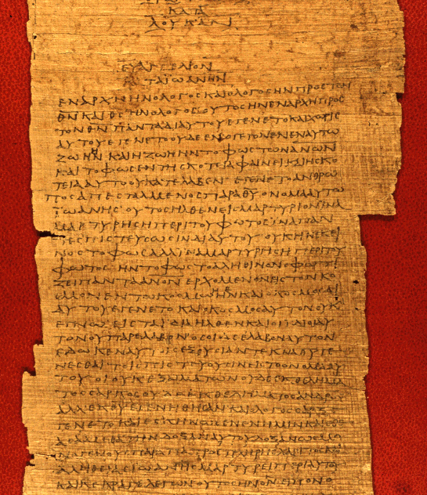
2 Peter 1:3
³ According as his divine power hath given unto us all things that pertain unto life and godliness, through the knowledge of him that hath called us to glory and virtue:

Slide 34
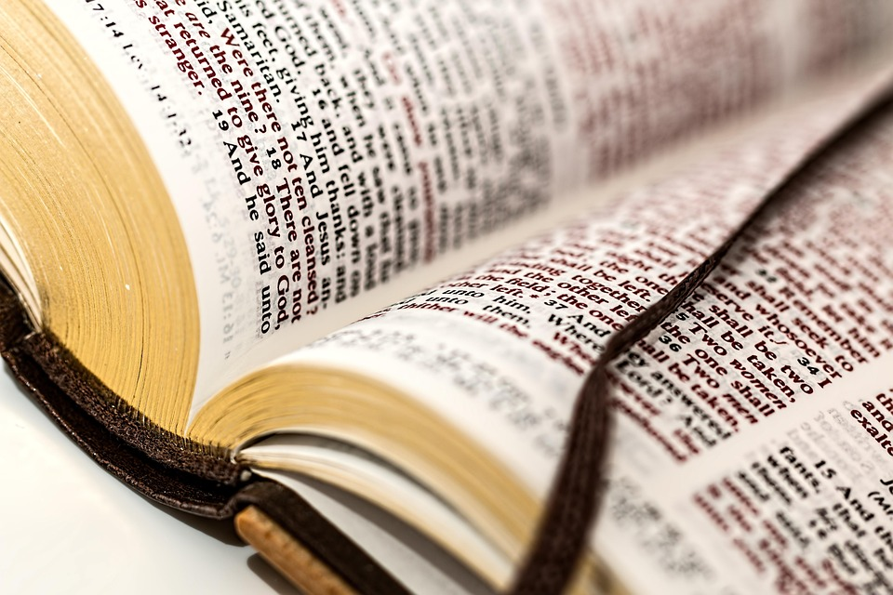
You are not lacking what you need to live a godly life.

Slide 35
11. What else is given by His divine power?
2 Peter 1:4 (first part)

Slide 36

2 Peter 1:4
⁴ Whereby are given unto us exceeding great and precious promises: that by these ye might be partakers of the divine nature, having escaped the corruption that is in the world through lust.

Slide 37
12. What may we gain by these “exceeding great and precious promises”?

Slide 38
12. What may we gain by these “exceeding great and precious promises”?
We may become “partakers of the divine nature.”

Slide 39
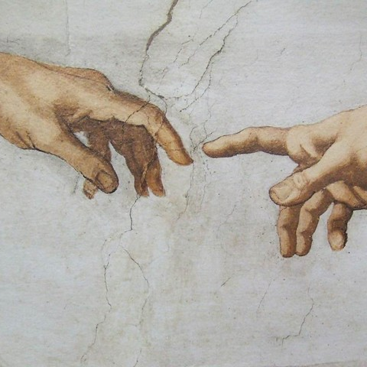
SDABC: Vol. 7,
2 Peter 1:4
Adam was created “in the image of God” (Gen. 1 :27), but sin came, and the divine image was marred. Christ came to restore that which was lost, and the Christian may therefore expect to have the divine image restored in his life.

Slide 40
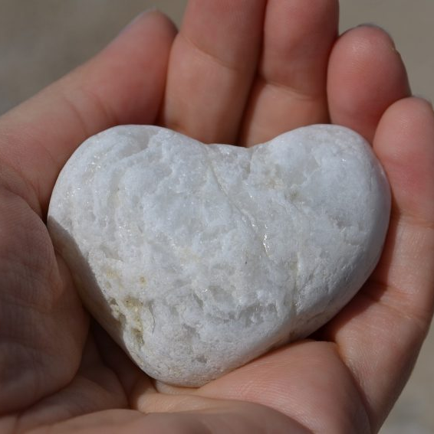
SDABC: Vol. 7,
2 Peter 1:4
This restoration should always be before the believer’s eyes to encourage him to perfect Christ-likeness. He will attain to this goal insofar as he accepts and uses the powers latent in the spiritual gifts Christ has made available to him.

Slide 41
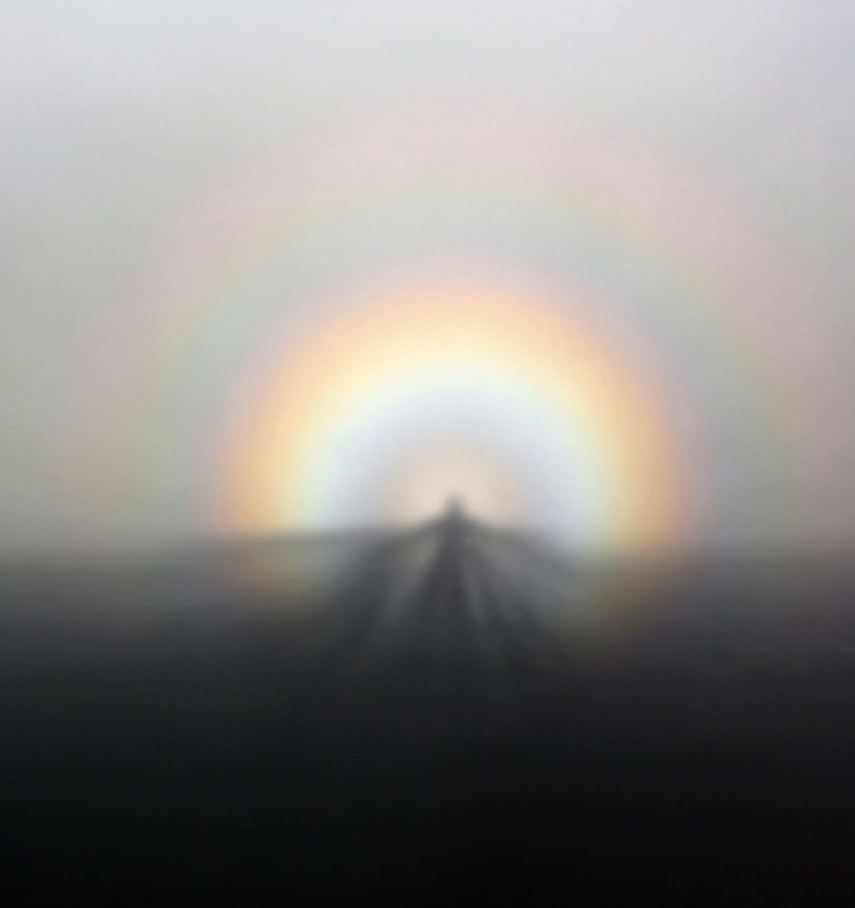
2 Corinthians 3:18
¹⁸ But we all, with open face beholding as in a glass the glory of the Lord, are changed into the same image from glory to glory, even as by the Spirit of the Lord.

Slide 42

Hebrews 3:14
¹⁴ For we are made partakers of Christ, if we hold the beginning of our confidence stedfast unto the end;

Slide 43
13. What must we escape, in order to be made partakers of the divine nature?
2 Peter 1:4 (last part)

Slide 44
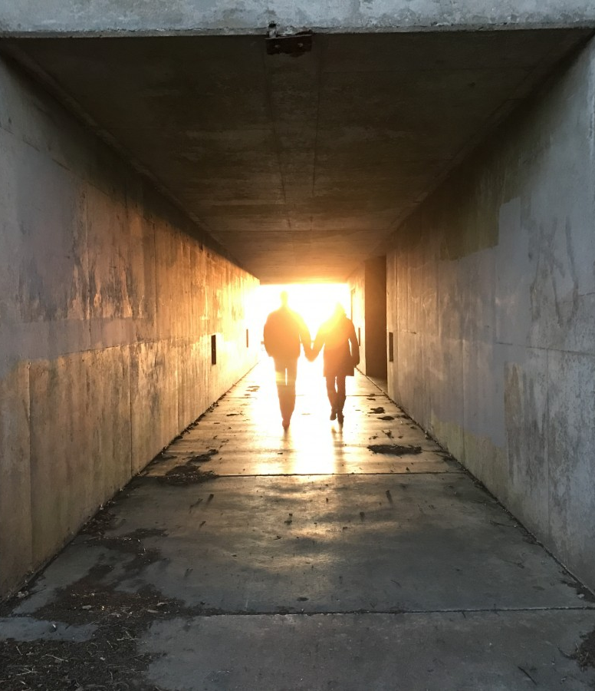
2 Peter 1:4
⁴ Whereby are given unto us exceeding great and precious promises: that by these ye might be partakers of the divine nature, having escaped the corruption that is in the world through lust.

Slide 45

SDABC: Vol. 7,
2 Peter 1:4
The form of the word given here as “escaped” is in the Greek, apopheugo, “to flee away from.” This implies not a rescue in which the Christian is a passive object, but an active flight from evil.

Slide 46
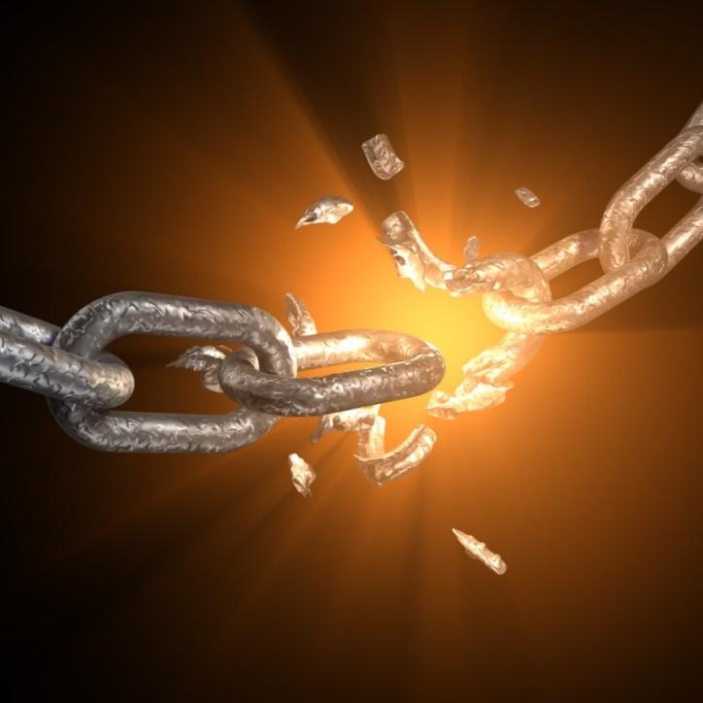
SDABC: Vol. 7,
2 Peter 1:4
This stresses an important truth: the believer is not saved in sin, but is given power to turn from sin, to escape from its clutches and thus to live free from its corrupting influence.

Slide 47
14. Mention the greatest of these exceeding great and precious promises.
2 Corinthians 6:17, 18

Slide 48
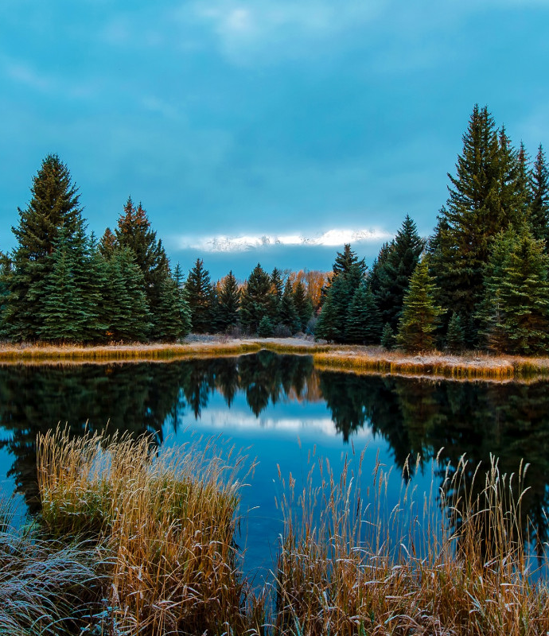
2 Corinthians 6:17, 18
¹⁷ Wherefore come out from among them, and be ye separate, saith the Lord, and touch not the unclean thing; and I will receive you.

Slide 49
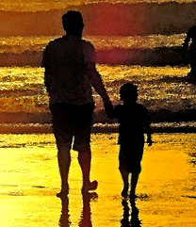
2 Corinthians 6:17, 18
¹⁸ And will be a Father unto you, and ye shall be my sons and daughters, saith the Lord Almighty.

Slide 50
15. What does Paul say that we should do, in view of these promises?
2 Corinthians 7:1

Slide 51
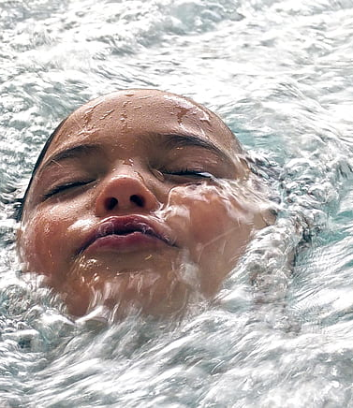
2 Corinthians 7:1
7 Having therefore these promises, dearly beloved, let us cleanse ourselves from all filthiness of the flesh and spirit, perfecting holiness in the fear of God.

Slide 52
16. Having become sons of God, what other promise necessarily follows?
Romans 8:16, 17;
1 John 3:2

Slide 53
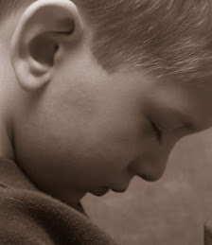
Romans 8:16, 17
¹⁶ The Spirit itself beareth witness with our spirit, that we are the children of God:

Slide 54
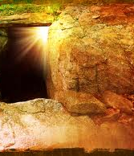
Romans 8:16, 17
¹⁷ And if children, then heirs; heirs of God, and joint-heirs with Christ; if so be that we suffer with him, that we may be also glorified together.

Slide 55
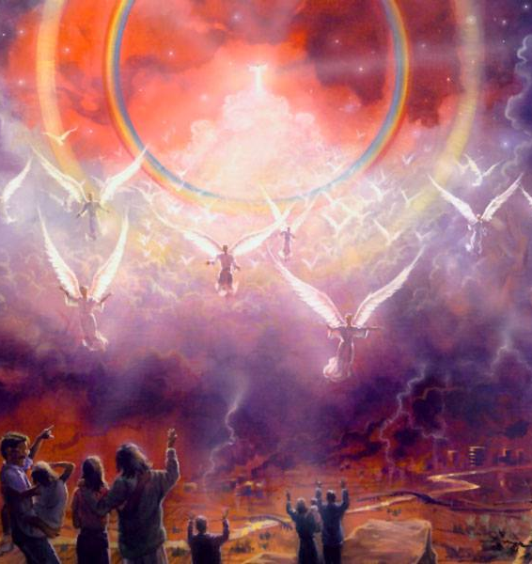
1 John 3:2
² Beloved, now are we the sons of God, and it doth not yet appear what we shall be: but we know that, when he shall appear, we shall be like him; for we shall see him as he is.

Slide 56
17. What must follow if a man really has this hope in him?
1 John 3:3

Slide 57
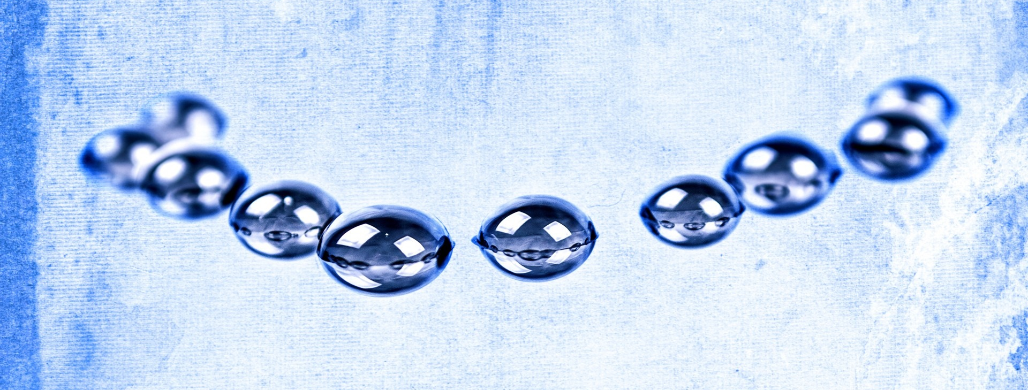
1 John 3:3
³ And every man that hath this hope in him purifieth himself, even as he is pure.

Slide 58
18. What is “the corruption that is in the world through lust”?
1 John 2:15, 16; Matthew 15:19, 20.

Slide 59
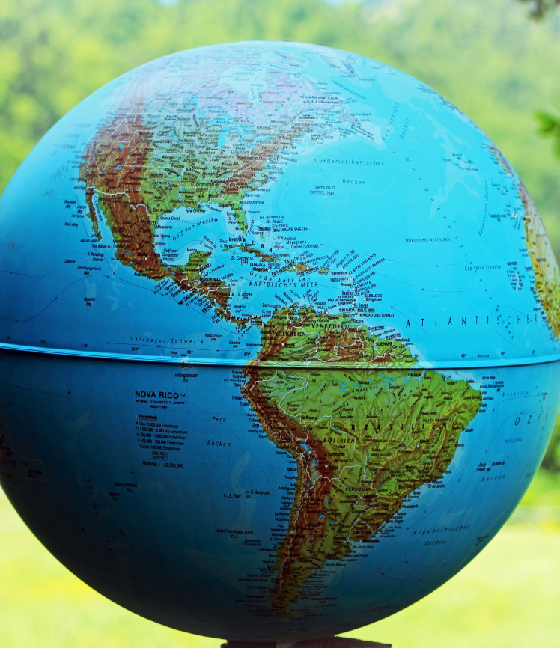
1 John 2:15, 16
¹⁵ Love not the world, neither the things that are in the world. If any man love the world, the love of the Father is not in him.

Slide 60
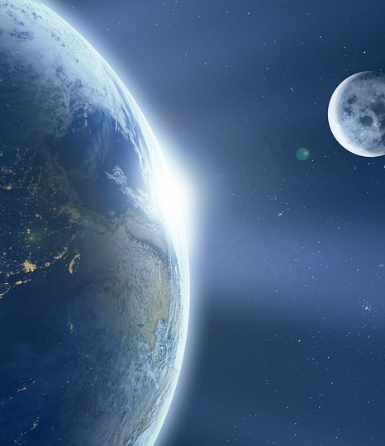
1 John 2:15, 16
¹⁶ For all that is in the world, the lust of the flesh, and the lust of the eyes, and the pride of life, is not of the Father, but is of the world.

Slide 61
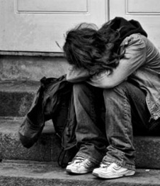
Matthew 15:19, 20
¹⁹ For out of the heart proceed evil thoughts, murders, adulteries, fornications, thefts, false witness, blasphemies:

Slide 62
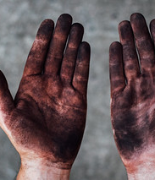
Matthew 15:19, 20
²⁰ These are the things which defile a man: but to eat with unwashen hands defileth not a man.

Slide 63
19. Then what change must take place to constitute one a “partaker of the divine nature,” a son of God?
Psalm 51:10;
Ezekiel 36:26, 27

Slide 64

Psalm 51:10
¹⁰ Create in me a clean heart, O God; and renew a right spirit within me.

Slide 65

Ezekiel 36:26, 27
²⁶ A new heart also will I give you, and a new spirit will I put within you: and I will take away the stony heart out of your flesh, and I will give you an heart of flesh.

Slide 66
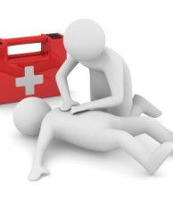
Ezekiel 36:26, 27
²⁷ And I will put my spirit within you, and cause you to walk in my statutes, and ye shall keep my judgments, and do them.

Slide 67
20. What encouragement may we gain from a contemplation of the glory of God, which He will bestow upon His children?
Ephesians 3:16-18

Slide 68

Ephesians 3:16-18
¹⁶ That he would grant you, according to the riches of his glory, to be strengthened with might by his Spirit in the inner man;

Slide 69
21. Then how greatly may grace and peace be multiplied to us “through the knowledge of God and of Jesus our Lord”?
Ephesians 3:16–19.

Slide 70
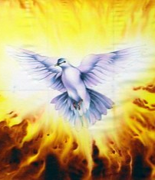
Ephesians 3:16-19
¹⁶ That he would grant you, according to the riches of his glory, to be strengthened with might by his Spirit in the inner man;
¹⁷ That Christ may dwell in your hearts by faith; that ye, being rooted and grounded in love,

Slide 71
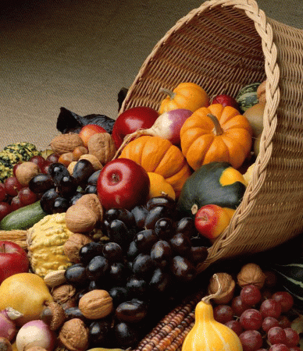
Ephesians 3:16-19
¹⁸ May be able to comprehend with all saints what is the breadth, and length, and depth, and height;
¹⁹ And to know the love of Christ, which passeth knowledge, that ye might be filled with all the fulness of God.

Slide 72
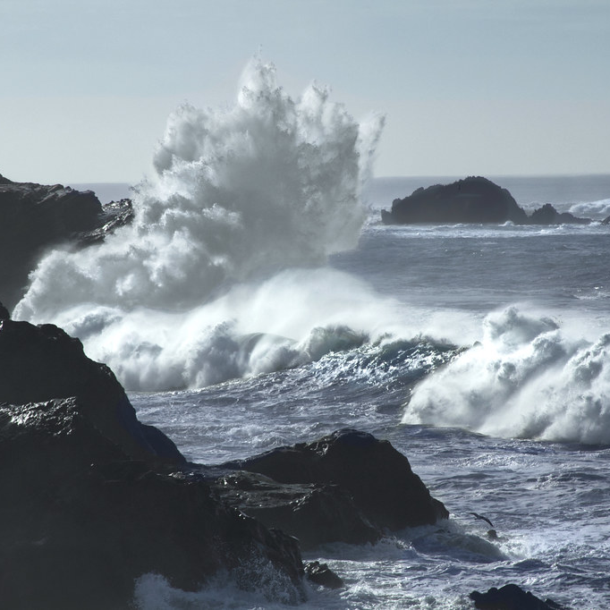
God’s promises don’t just comfort—they change us.

Slide 73


Slide 74
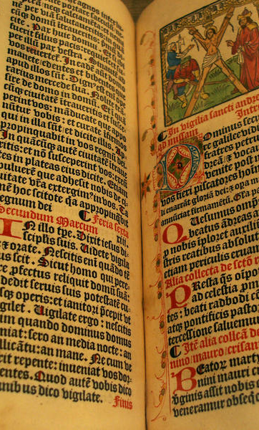
NOTE: The stress which the apostle Peter lays upon a knowledge of God is quite noticeable. Twice in this lesson it is mentioned. He would evidently impress upon our minds the necessity of a personal acquaintance with God—of knowing Him as we would an intimate friend—and of loving Him not simply because of what He does, but because of what He is.

Slide 75
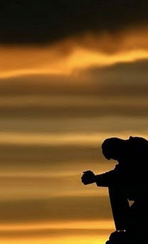
“God is love,” and “we love Him because He first loved us.” It is this perception of His character which first draws us to Him—“the goodness of God leadeth thee to repentance.” Romans 2:4.

Slide 76
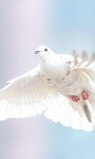
By this we are made partakers of the divine nature, that is, adopted into the family of God. As sons of God, it necessarily follows that our acquaintance with Him must become more and more intimate. It is this intimate acquaintance with God which multiplies peace to us.
“Acquaint now thyself with Him, and be at peace.” Job 22:21.

Slide 77
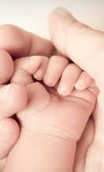
In Galatians 4:6–9 the apostle Paul makes a knowledge of God equivalent to a state of sonship. It is evident, therefore, that the knowledge of God, of which the apostles speak, is far more than the simple knowledge and belief that God exists as Creator of the world.

Slide 78
Thank you!
…and Happy Sabbath!!

Slide 79


