Slide 1


Slide 2


Slide 3
Lesson 2:
2 Peter 1:5-7
November 3, 1888

Slide 4

1. What is done for us through the great promises of God?
2 Peter 1:4
This Photo by Unknown Author is licensed under CC BY-NC-ND

Slide 5

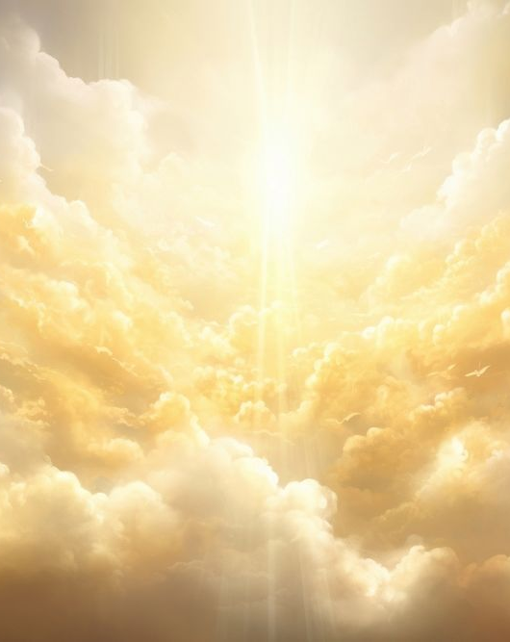
2 Peter 1:4
⁴ Whereby are given unto us exceeding great and precious promises: that by these ye might be partakers of the divine nature, having escaped the corruption that is in the world through lust.

Slide 6

2. Because of this, what are we to do?
2 Peter 1:5-7

Slide 7
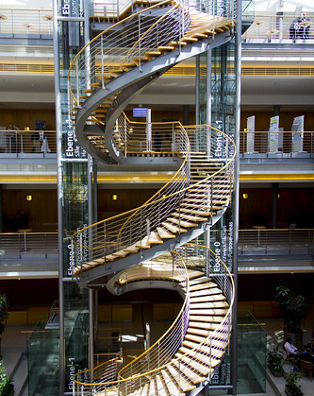
2 Peter 1:5-7
⁵ And beside this, giving all diligence, add to your faith virtue; and to virtue knowledge;
This Photo by Unknown Author is licensed under CC BY-NC-ND

Slide 8
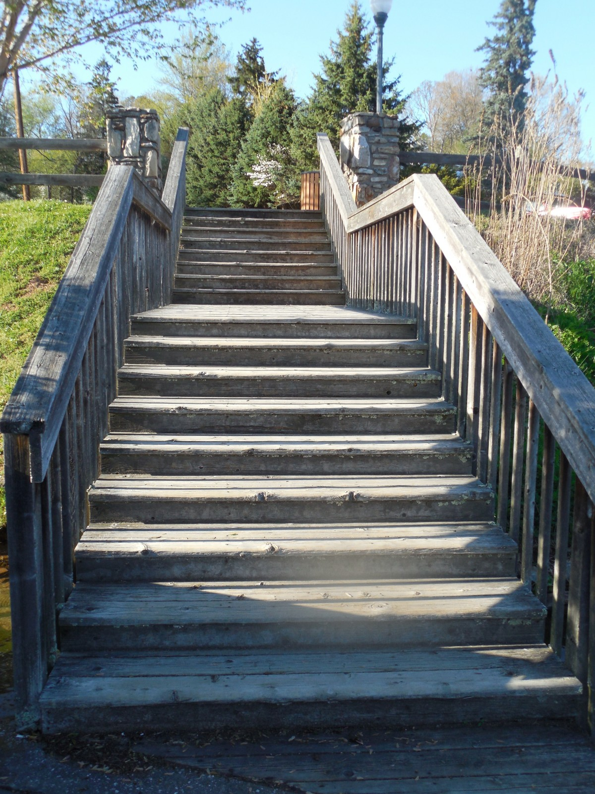
2 Peter 1:5-7
⁶ And to knowledge temperance; and to temperance patience; and to patience godliness;

Slide 9

2 Peter 1:5-7
⁷ And to godliness brotherly kindness; and to brotherly kindness charity.
This Photo by Unknown Author is licensed under CC BY-SA

Slide 10
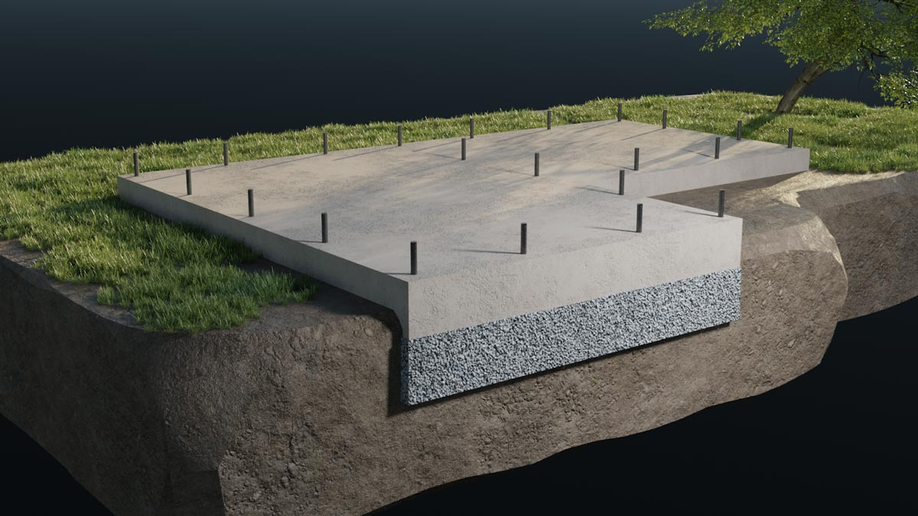
3. What is the foundation of all graces?
2 Peter 1:5

Slide 11

2 Peter 1:5
⁵ And beside this, giving all diligence, add to your faith virtue; and to virtue knowledge;

Slide 12

4. What is the first thing that faith accomplishes for us?
Romans 5:1

Slide 13

Romans 5:1
5 Therefore being justified by faith, we have peace with God through our Lord Jesus Christ:

Slide 14

5. Being justified by faith, what do we become?
Galatians 3:26

Slide 15
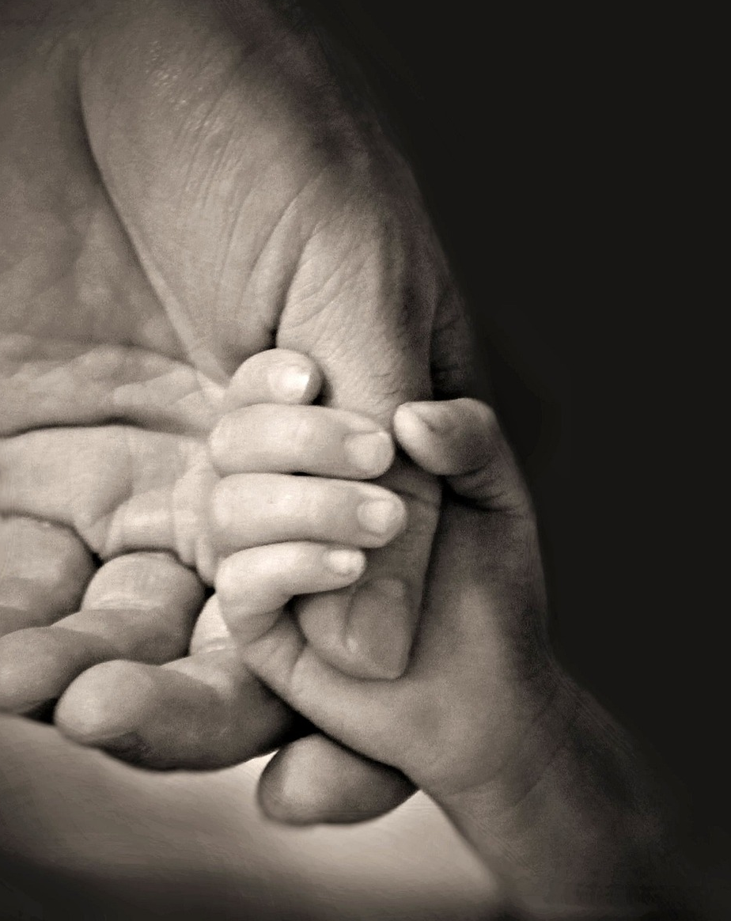
Galatians 3:26
²⁶ For ye are all the children of God by faith in Christ Jesus.

Slide 16

6. Having become children of God, may we settle down in self-satisfaction?
Ephesians 5:1

Slide 17

Ephesians 5:1
²⁶ For ye are all the children of God by faith in Christ Jesus.

Slide 18

7. What must we do?
Ephesians 5:2

Slide 19

Ephesians 5:2
² And walk in love, as Christ also hath loved us, and hath given himself for us an offering and a sacrifice to God for a sweetsmelling savour.

Slide 20
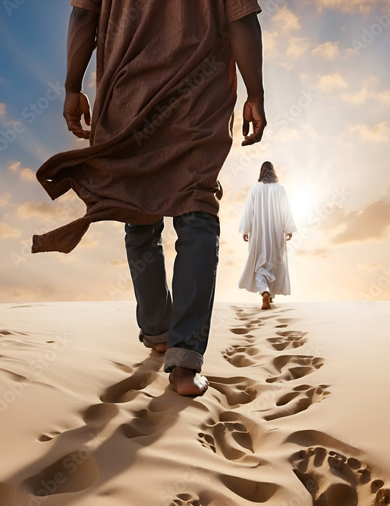
8. Whose example are we to follow?
Ephesians 5:2,
1 John 2:6,
1 Peter 2:21

Slide 21

Ephesians 5:2
² And walk in love, as Christ also hath loved us, and hath given himself for us an offering and a sacrifice to God for a sweetsmelling savour.

Slide 22
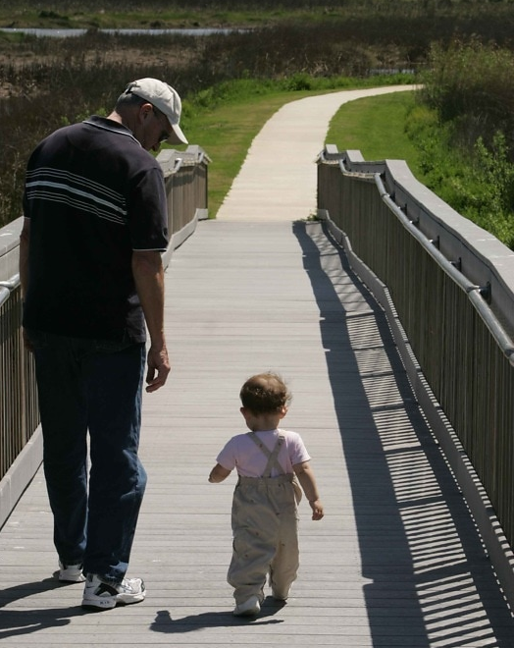
1 John 2:6
⁶ He that saith he abideth in him ought himself also so to walk, even as he walked.

Slide 23
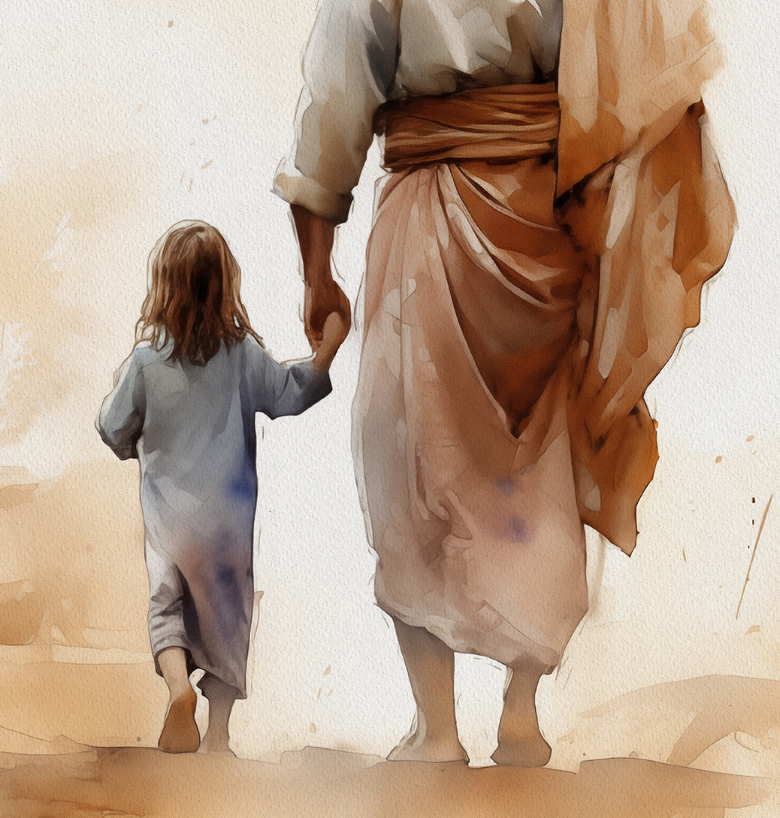
1 Peter 2:21
²¹ For even hereunto were ye called: because Christ also suffered for us, leaving us an example, that ye should follow his steps:

Slide 24

9. Could we without faith do the things that God requires?
Hebrews 11:6; Romans 14:23, last part.

Slide 25

Hebrews 11:6
⁶ But without faith it is impossible to please him: for he that cometh to God must believe that he is, and that he is a rewarder of them that diligently seek him.

Slide 26

Romans 14:23
²³ And he that doubteth is damned if he eat, because he eateth not of faith: for whatsoever is not of faith is sin.

Slide 27
10. Having been justified, how alone can we remain in that state?
Habakkuk 2:4

Slide 28

Habakkuk 2:4
⁴ Behold, his soul which is lifted up is not upright in him: but the just shall live by his faith.

Slide 29

11. What does true faith always do?
Galatians 5:6, last clause

Slide 30

Galatians 5:6
⁶ For in Jesus Christ neither circumcision availeth any thing, nor uncircumcision; but faith which worketh by love.

Slide 31

12. How alone can faith be shown to be perfect?
James 2:21, 22

Slide 32
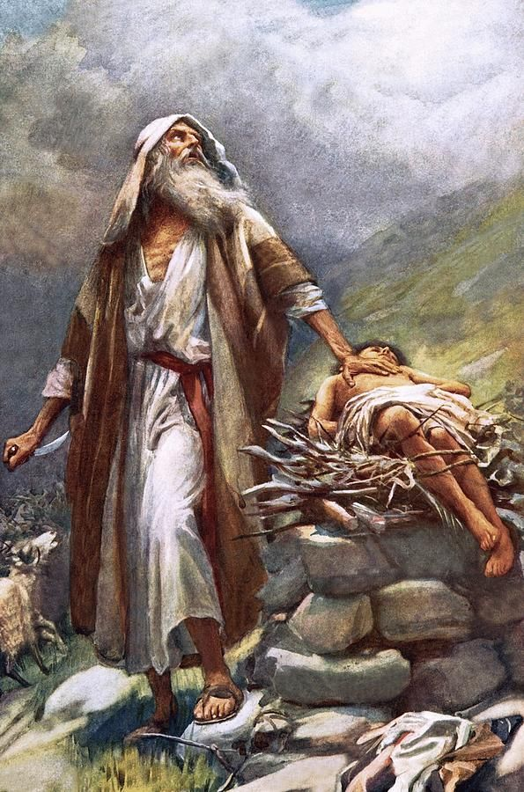
James 2:21-22
²¹ Was not Abraham our father justified by works, when he had offered Isaac his son upon the altar?

Slide 33
James 2:21-22
²² Seest thou how faith wrought with his works, and by works was faith made perfect?

Slide 34
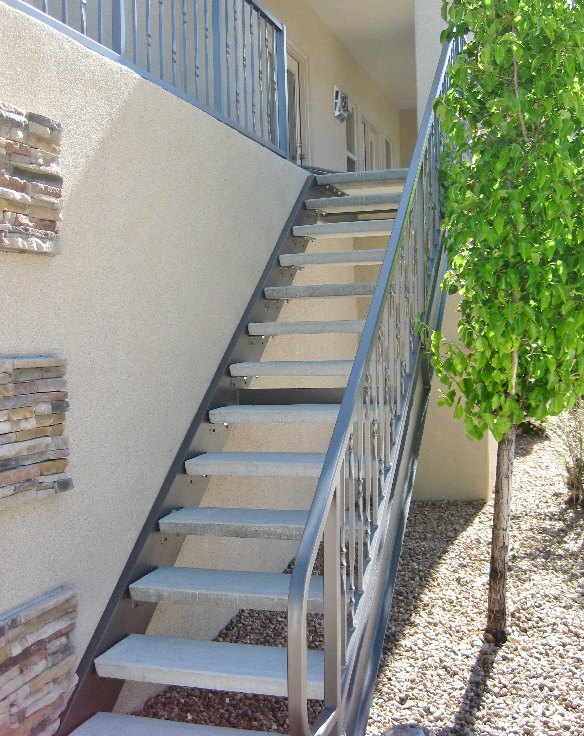
13. What is said of a faith from which no works proceed?
James 2:17, 26

Slide 35

James 2:17, 26
¹⁷ Even so faith, if it hath not works, is dead, being alone.

Slide 36
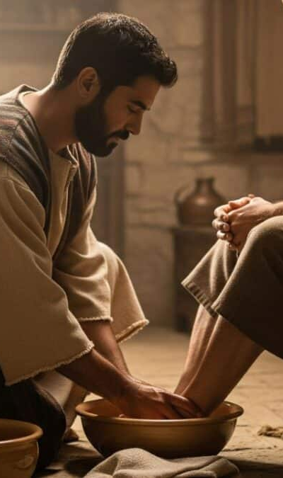
James 2:17, 26
²⁶ For as the body without the spirit is dead, so faith without works is dead also.

Slide 37
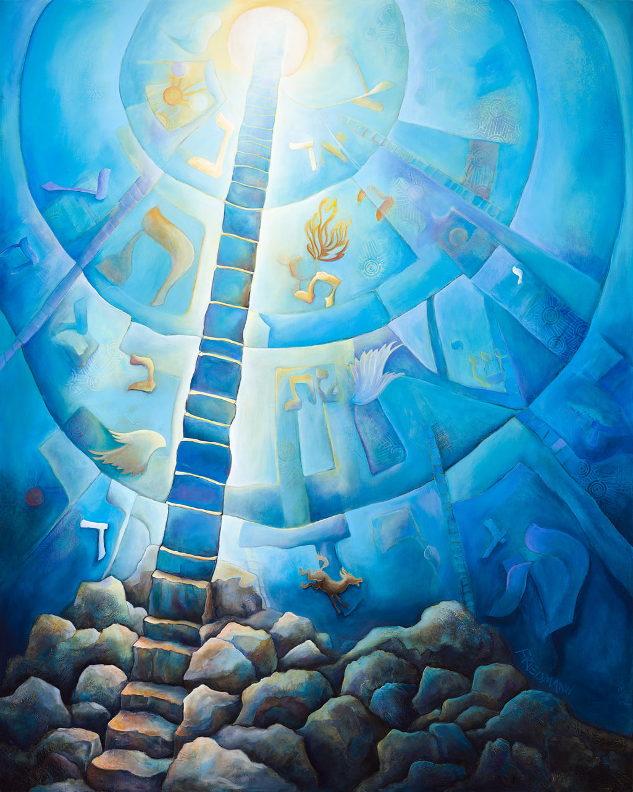
14. What is to be added to faith?

Slide 38

2 Peter 1:5
⁵ And beside this, giving all diligence, add to your faith virtue; and to virtue knowledge;

Slide 39

“The word here rendered virtue is the same which is used in verse 3. … All the things which the apostle specifies, unless knowledge be an exception, are virtues in the sense in which that word is commonly used, and it can hardly be supposed that the apostle here meant to use a general term which would include all of the others.

Slide 40
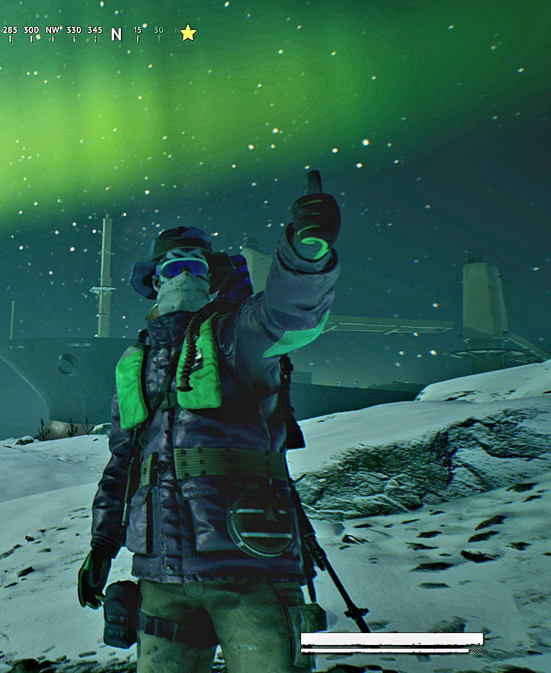
The probability is, therefore, that by the word here he has reference to the common meaning of the Greek word, as referring to manliness, courage, vigor, energy; and the sense is that he wished them to evince whatever firmness or courage might be necessary in maintaining the principles of their religion, and in enduring the trials to which their faith might be subjected.

Slide 41
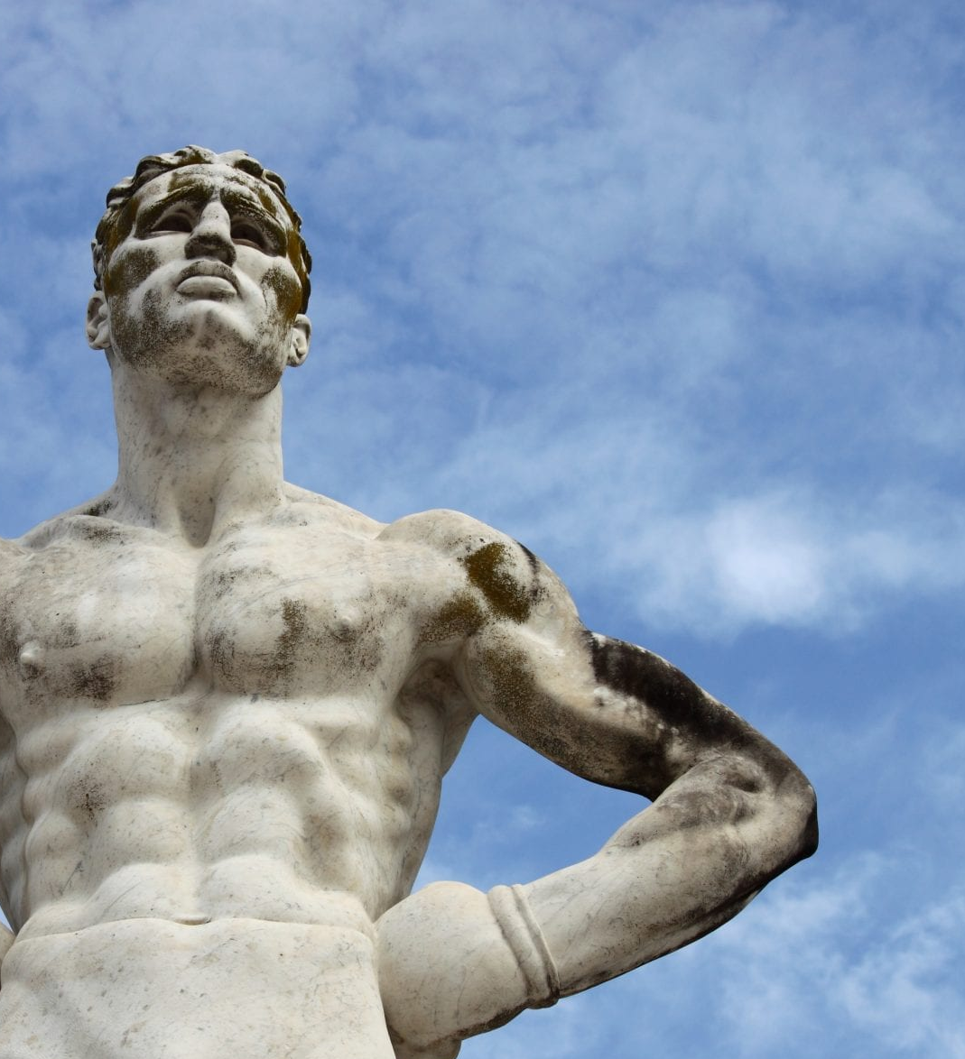
True virtue is not a tame and passive thing. It requires great energy and boldness, for its very essence is firmness, manliness, and independence.”

Slide 42

15. And what to virtue?

Slide 43
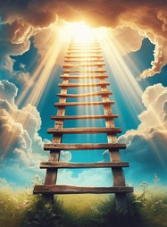
2 Peter 1:5
⁵ And beside this, giving all diligence, add to your faith virtue; and to virtue knowledge;

Slide 44

16. What knowledge must be added?
Colossians 1:9, 10

Slide 45
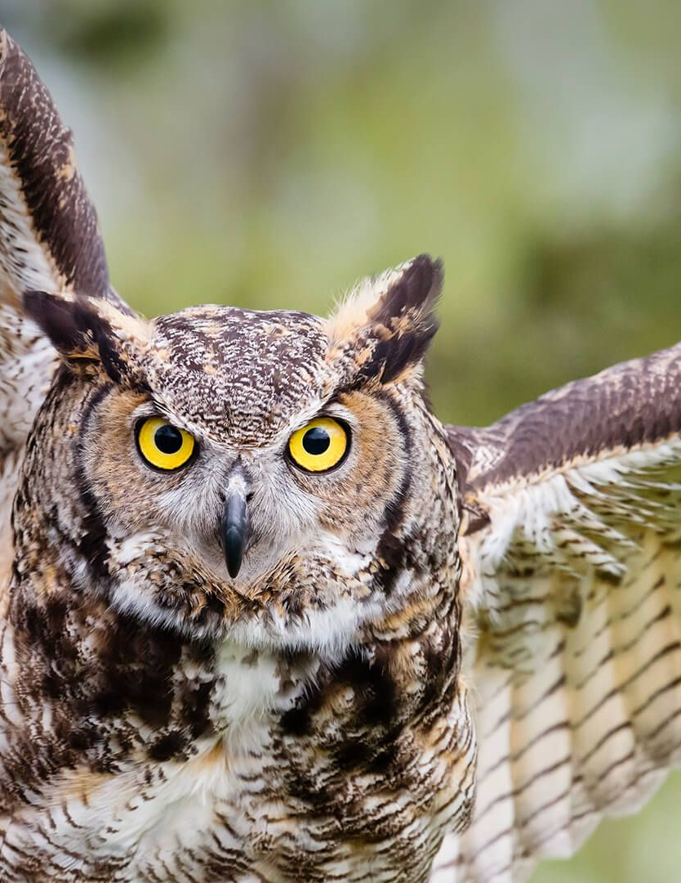
Colossians 1:9-10
⁹ For this cause we also, since the day we heard it, do not cease to pray for you, and to desire that ye might be filled with the knowledge of his will in all wisdom and spiritual understanding;

Slide 46

Colossians 1:9-10
¹⁰ That ye might walk worthy of the Lord unto all pleasing, being fruitful in every good work, and increasing in the knowledge of God;

Slide 47
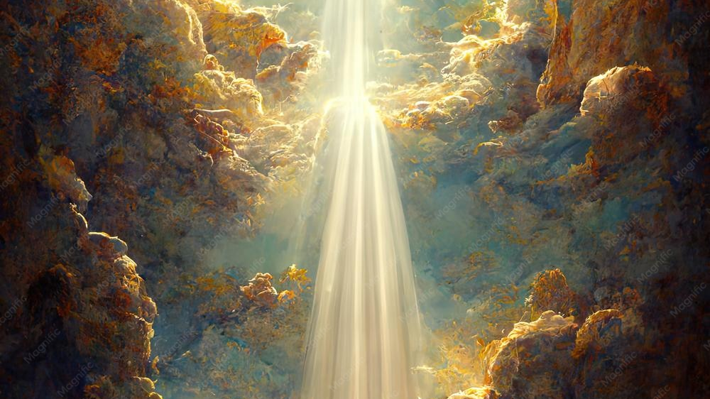
17. What is the nature of this knowledge?
James 3:17

Slide 48

James 3:17
¹⁷ But the wisdom that is from above is first pure, then peaceable, gentle, and easy to be intreated, full of mercy and good fruits, without partiality, and without hypocrisy.

Slide 49

18. What will be the result if we do not obtain this knowledge?
Hosea 4:6, first clause

Slide 50
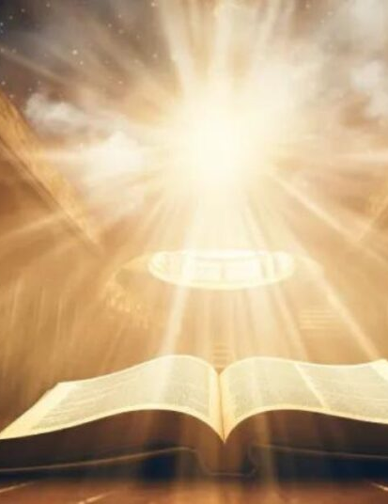
Hosea 4:6
⁶ My people are destroyed for lack of knowledge: because thou hast rejected knowledge, I will also reject thee, that thou shalt be no priest to me: seeing thou hast forgotten the law of thy God, I will also forget thy children.

Slide 51

19. What must be added to knowledge?

Slide 52

2 Peter 1:6
⁶ And to knowledge temperance; and to temperance patience; and to patience godliness;

Slide 53

20. In what respect must we be temperate?
1 Corinthians 9:25

Slide 54

1 Corinthians 9:25
²⁵ And every man that striveth for the mastery is temperate in all things. Now they do it to obtain a corruptible crown; but we an incorruptible.

Slide 55

21. What is the meaning of temperance?
Answer: Mastery of self; self-control.
1 Corinthians 9:27

Slide 56

1 Corinthians 9:27
²⁷ But I keep under my body, and bring it into subjection: lest that by any means, when I have preached to others, I myself should be a castaway.

Slide 57

22. Does religion have anything to do with one’s eating and drinking?
1 Corinthians 10:31

Slide 58

1 Corinthians 10:31
³¹ Whether therefore ye eat, or drink, or whatsoever ye do, do all to the glory of God.

Slide 59
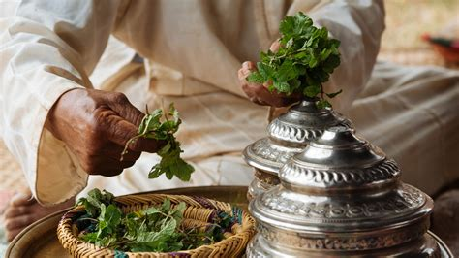
23. If a man eats and drinks simply for the gratification of his appetite, what does he worship?
Philippians 3:18, 19

Slide 60
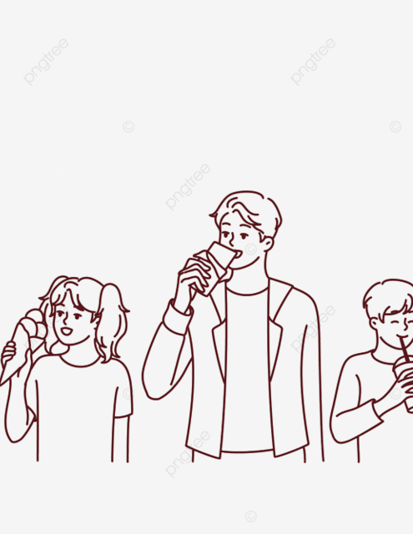
Philippians 3:18, 19
¹⁸ (For many walk, of whom I have told you often, and now tell you even weeping, that they are the enemies of the cross of Christ:

Slide 61

Philippians 3:18, 19
¹⁹ Whose end is destruction, whose God is their belly, and whose glory is in their shame, who mind earthly things.)

Slide 62
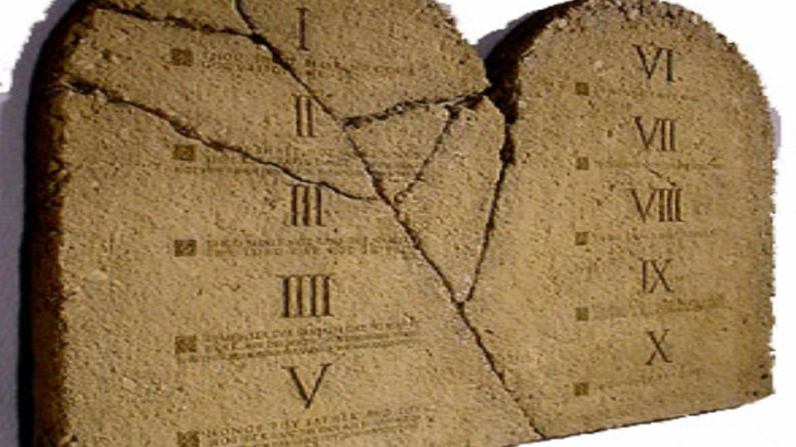
24. What great commandment does he break?
Exodus 20:3; Matthew 22:37, 38

Slide 63

Exodus 20:3
³ Thou shalt have no other gods before me.

Slide 64
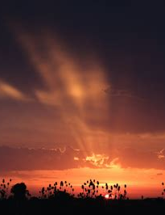
Matthew 22:37-38
³⁷ Jesus said unto him, Thou shalt love the Lord thy God with all thy heart, and with all thy soul, and with all thy mind.

Slide 65
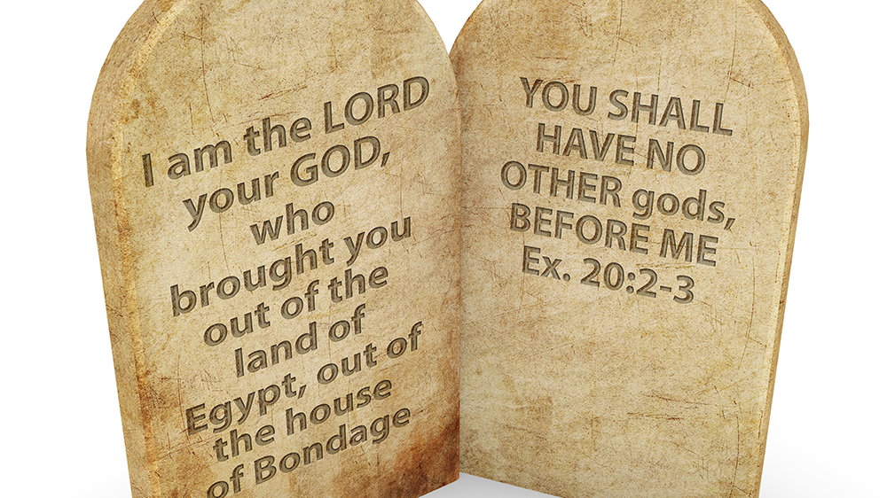
Matthew 22:37-38
³⁸ This is the first and great commandment.

Slide 66
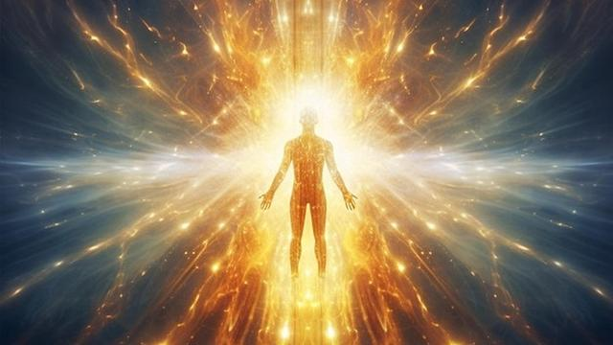
25. How are we to glorify God?
1 Corinthians 6:20.

Slide 67
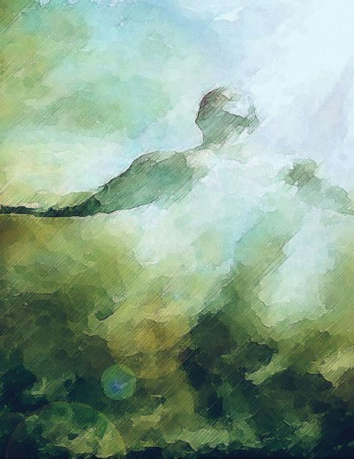
1 Corinthians 6:20
²⁰ For ye are bought with a price: therefore glorify God in your body, and in your spirit, which are God's.

Slide 68

26. What will be the fate of those who give themselves up to indulgence in appetite?
Luke 21:34;
Philippians 3:18, 19

Slide 69

Luke 21:34
³⁴ And take heed to yourselves, lest at any time your hearts be overcharged with surfeiting, and drunkenness, and cares of this life, and so that day come upon you unawares.

Slide 70

Philippians 3:18-19
¹⁸ (For many walk, of whom I have told you often, and now tell you even weeping, that they are the enemies of the cross of Christ:

Slide 71
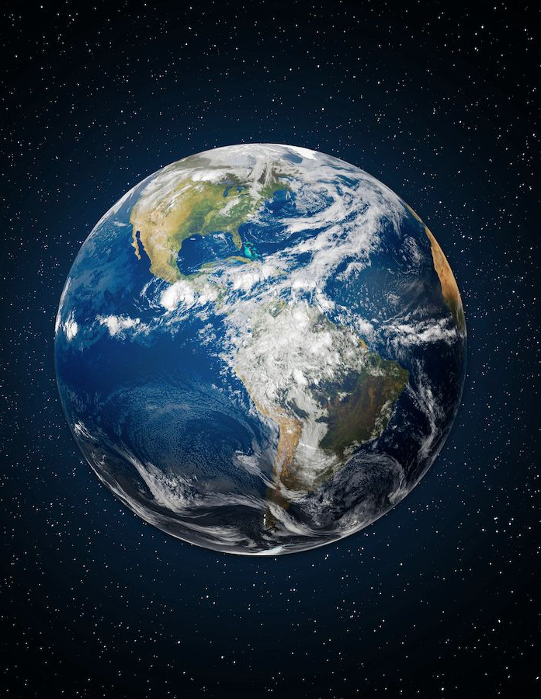
Philippians 3:18-19
¹⁹ Whose end is destruction, whose God is their belly, and whose glory is in their shame, who mind earthly things.)

Slide 72
Thank you!
…and Happy Sabbath!!

Slide 73


