Slide 1


Slide 2


Slide 3

Lesson 3:
2 Peter 1:6-7
November 10, 1888

Slide 4

1. What grace in Peter’s list follows next after temperance?
2 Peter 1:6

Slide 5

2 Peter 1:6
⁶ And to knowledge temperance; and to temperance patience; and to patience godliness;

Slide 6
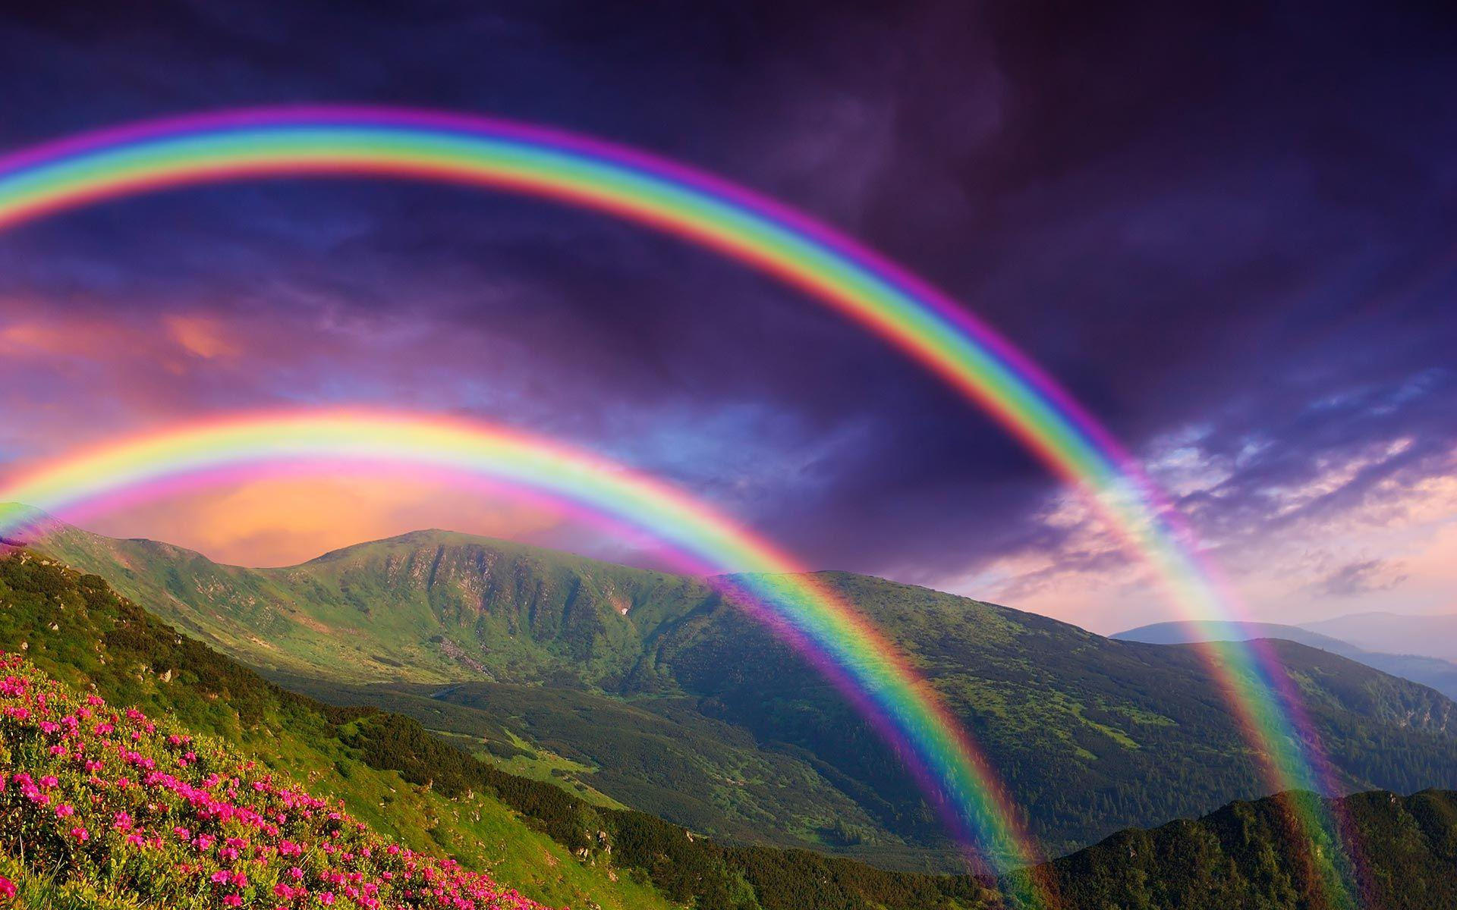
2. How are we to inherit the promises of God?
Hebrews 6: 11, 12

Slide 7

Hebrews 6:11-12
¹¹ And we desire that every one of you do shew the same diligence to the full assurance of hope unto the end:

Slide 8

Hebrews 6:11-12
¹² That ye be not slothful, but followers of them who through faith and patience inherit the promises.

Slide 9

3. How alone can we inherit eternal life?
Romans 2:7

Slide 10

Romans 2:7
⁷ To them who by patient continuance in well doing seek for glory and honour and immortality, eternal life:

Slide 11

4. Under what circumstances must we be patient?
Romans 12:12

Slide 12

Romans 12:12
¹² Rejoicing in hope; patient in tribulation; continuing instant in prayer;

Slide 13

5. What alone can produce patience?
Romans 5:3; James 1: 2,3

Slide 14

Romans 5:3
³ And not only so, but we glory in tribulations also: knowing that tribulation worketh patience;

Slide 15

James 1:2-3
² My brethren, count it all joy when ye fall into divers temptations;

Slide 16

James 1:2-3
³ Knowing this, that the trying of your faith worketh patience.

Slide 17

1 Thessalonians 5:16;
Philippians 4:4
6. If we are to glory in tribulation, and rejoice in the midst of trials, what time shall we take for doubting, fears, and discouragement?

Slide 18

1 Thessalonians 5:16
¹⁶ Rejoice evermore.

Slide 19
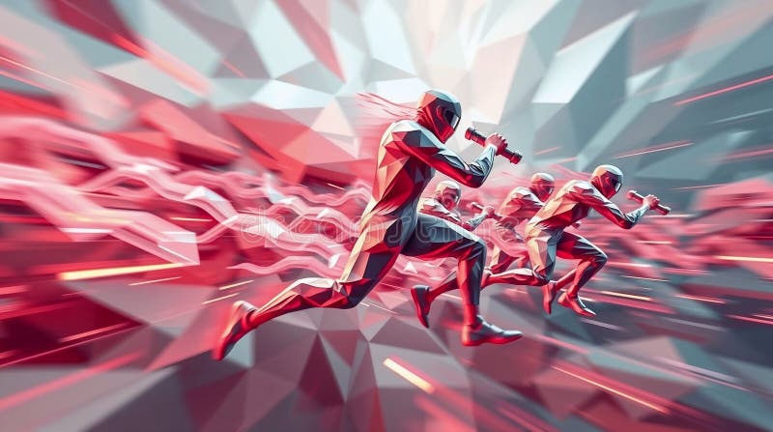
Philippians 4:4
⁴ Rejoice in the Lord always: and again I say, Rejoice.

Slide 20
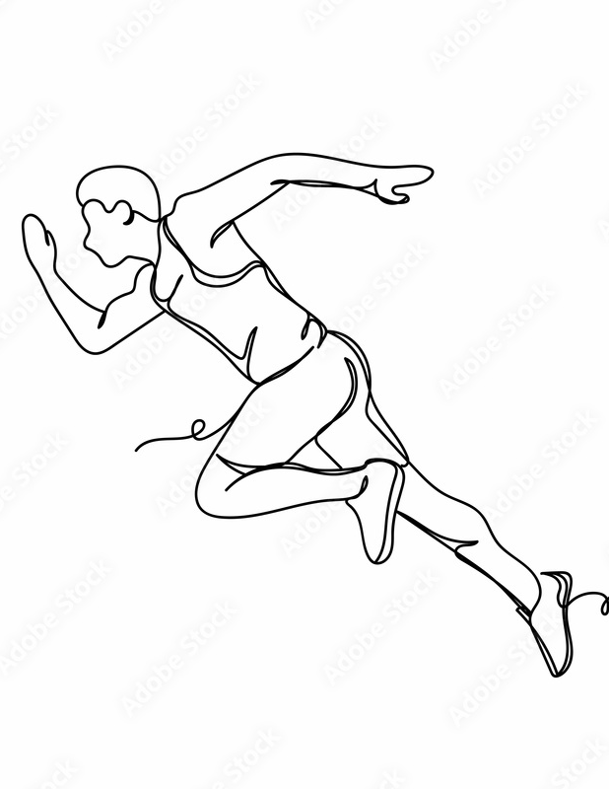
James 1:4
7. If we have the grace of patience in perfection, what shall we lack that is necessary to a perfect character?

Slide 21

James 1:4
⁴ But let patience have her perfect work, that ye may be perfect and entire, wanting nothing.

Slide 22

8. When trials shall have perfected patience in us, what will await us?
James 1:12; Hebrews 10:36

Slide 23

James 1:12
¹² Blessed is the man that endureth temptation: for when he is tried, he shall receive the crown of life, which the Lord hath promised to them that love him.

Slide 24

Hebrews 10:36
³⁶ For ye have need of patience, that, after ye have done the will of God, ye might receive the promise.

Slide 25
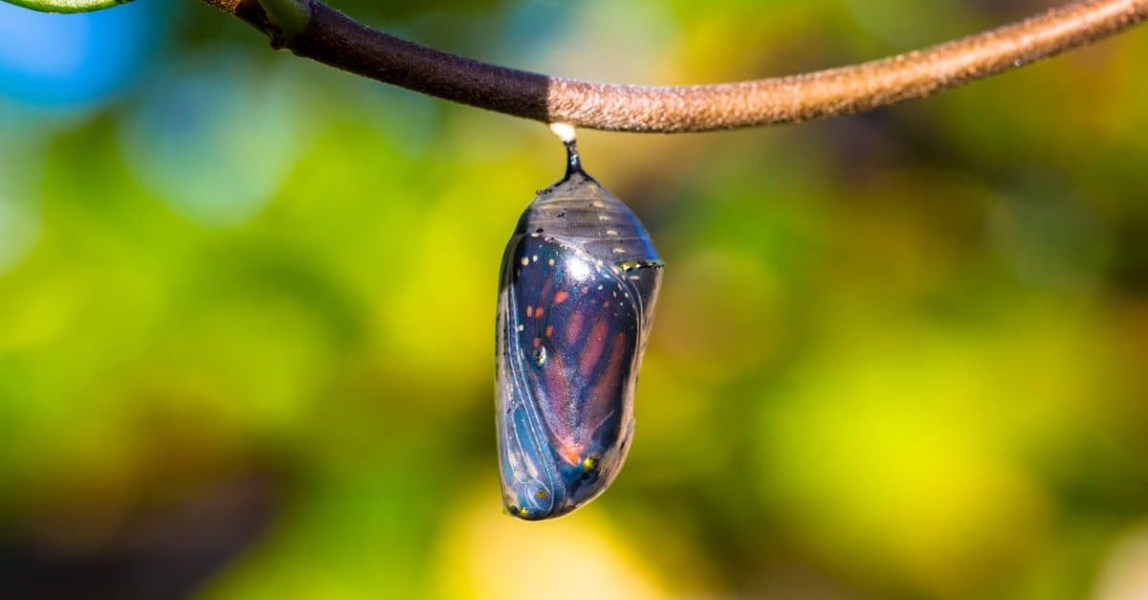
9. What does Peter mention next after patience?

Slide 26
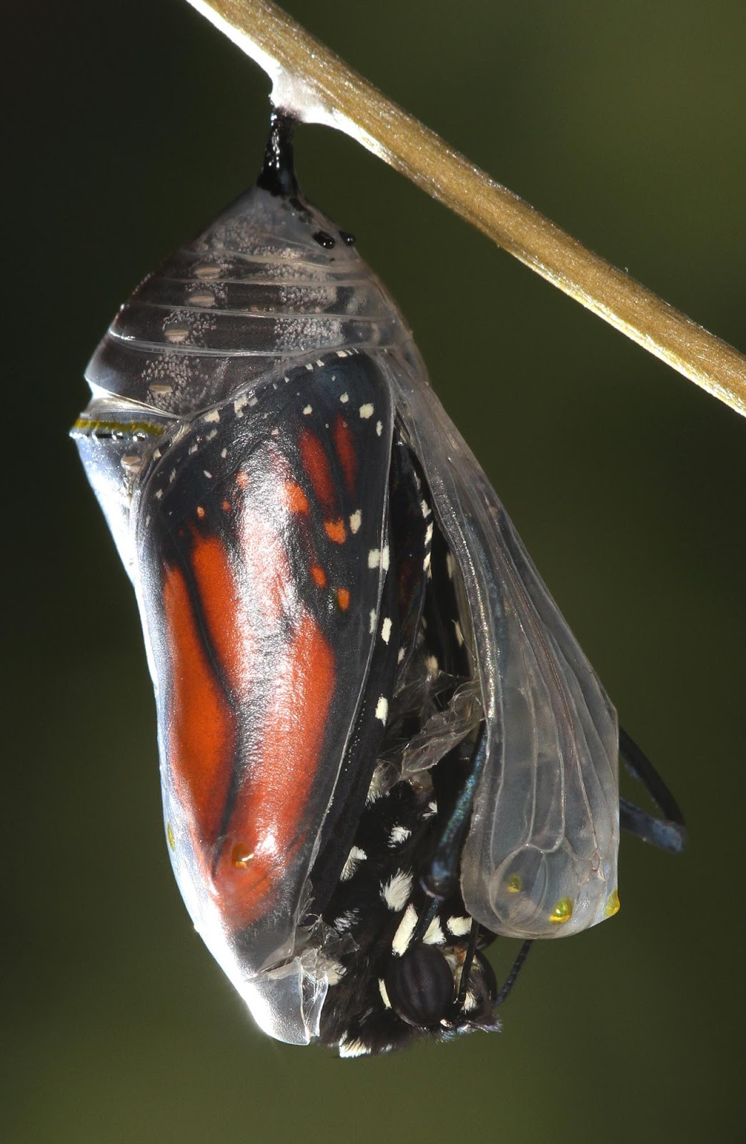
2 Peter 1:6
⁶ And to knowledge temperance; and to temperance patience; and to patience godliness;

Slide 27
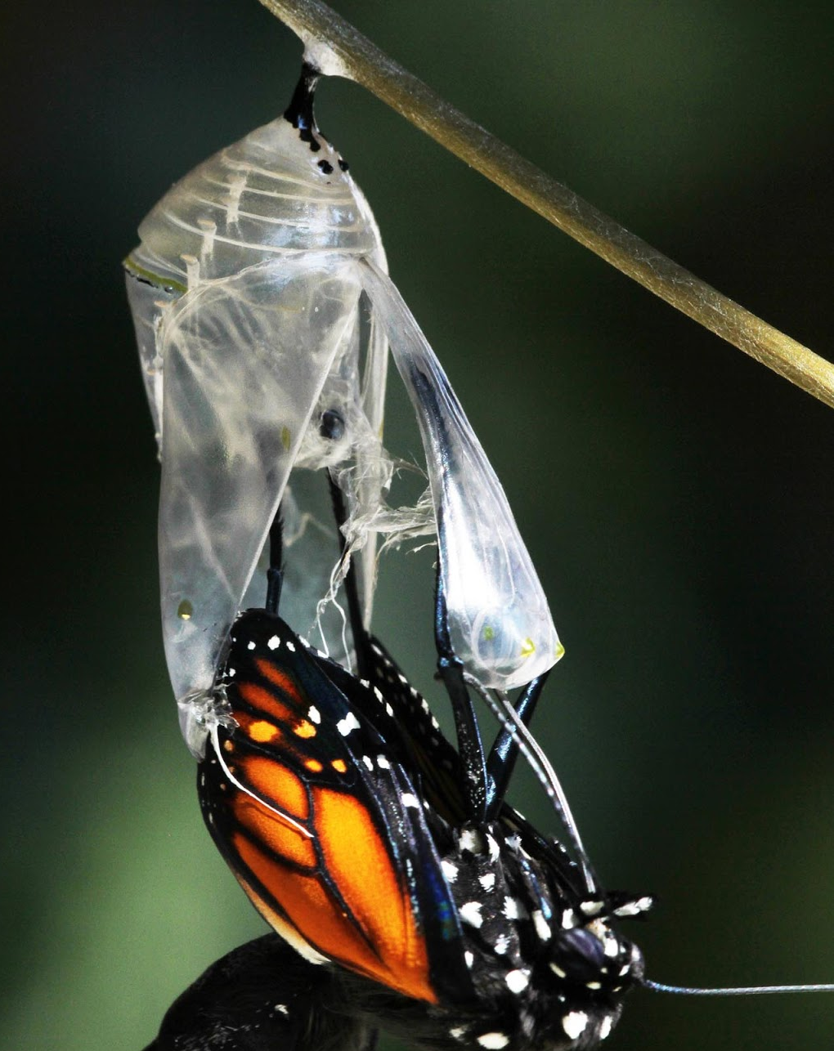
10. What is declared to be “great gain”?
1 Timothy 6:6

Slide 28
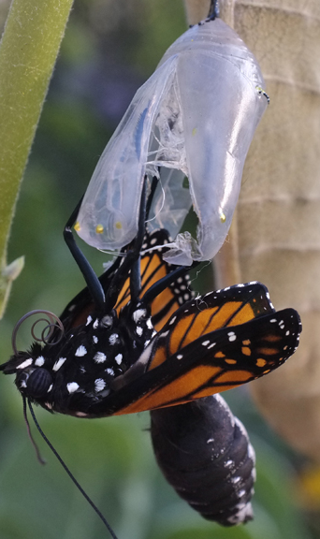
1 Timothy 6:6
⁶ But godliness with contentment is great gain.

Slide 29
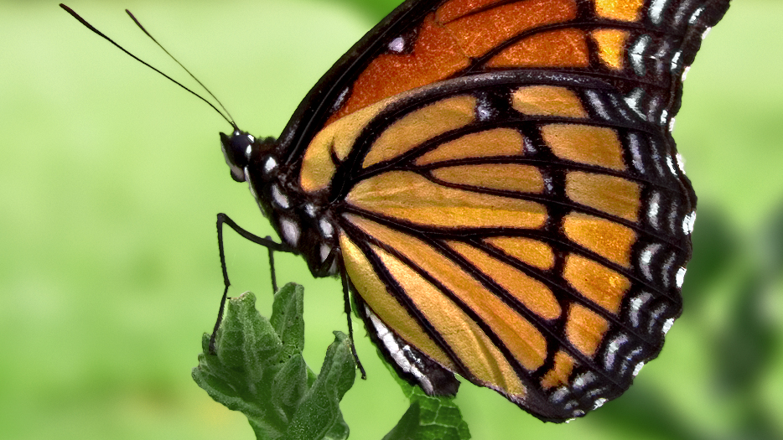
11. What follows godliness?

Slide 30
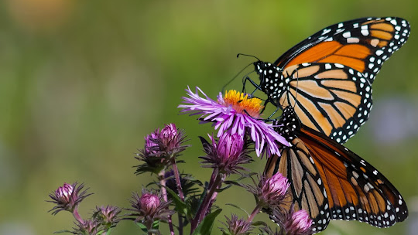
2 Peter 1:6
⁶ And to knowledge temperance; and to temperance patience; and to patience godliness;

Slide 31
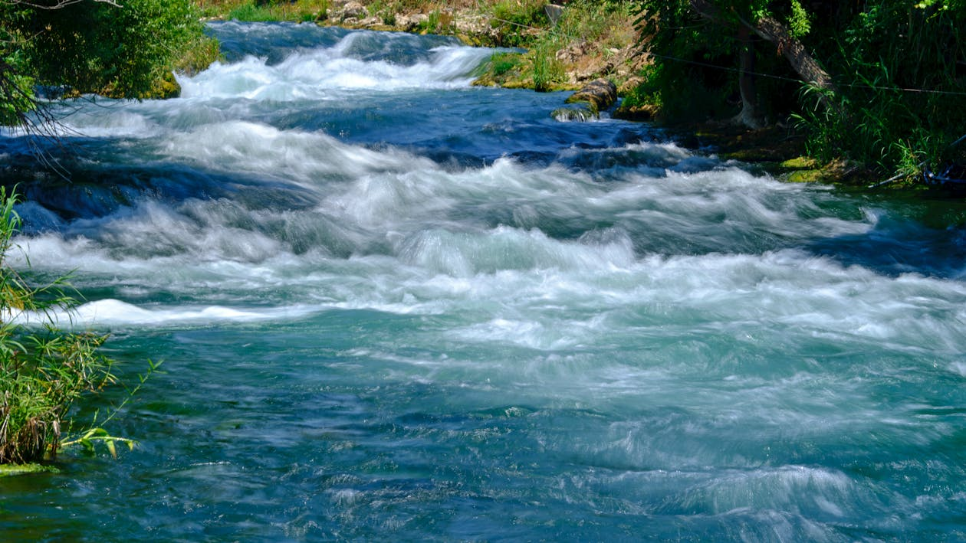
12. What commandment have we received that shows the fitness of saying that brotherly kindness must be added to godliness?
1 John 4:21

Slide 32
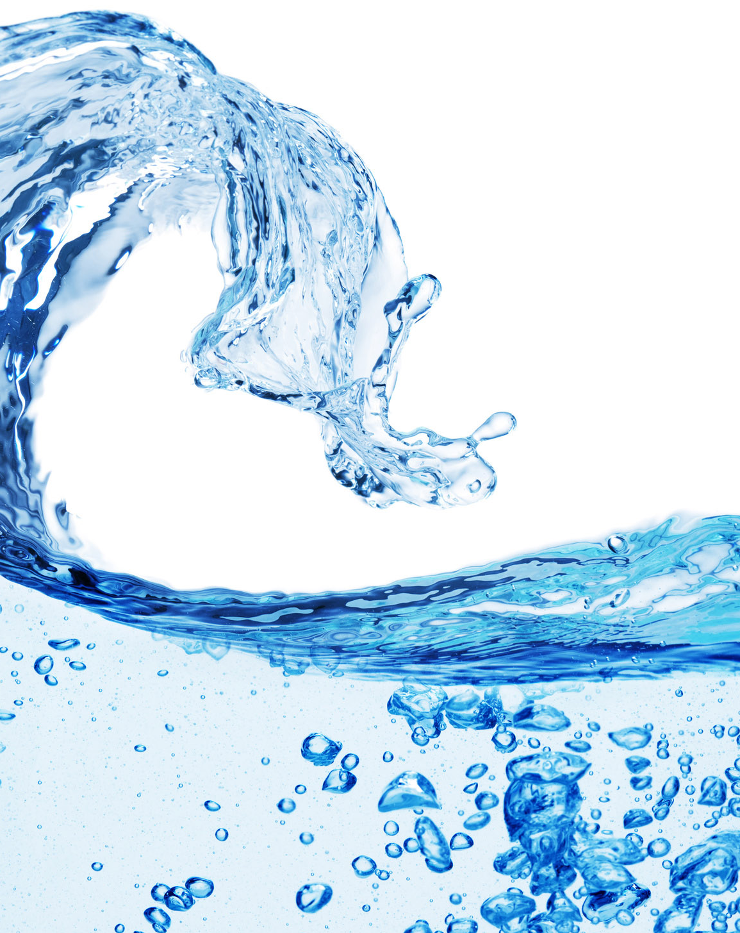
1 John 4:21
²¹ And this commandment have we from him, That he who loveth God love his brother also.

Slide 33
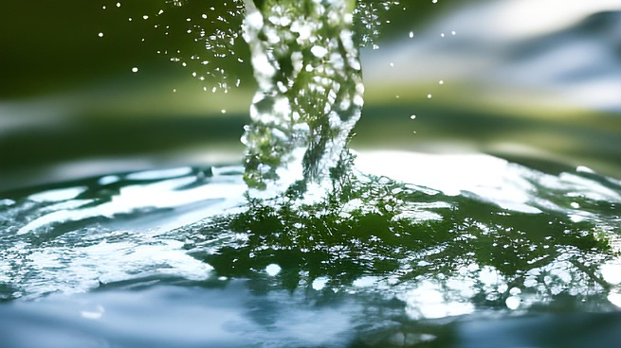
13. How alone may we know how we ought to love one another?
1 John 4:7-11

Slide 34
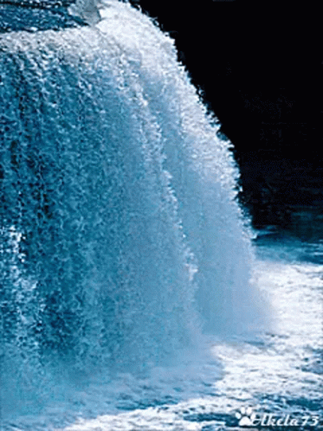
1 John 4:7-11
⁷ Beloved, let us love one another: for love is of God; and every one that loveth is born of God, and knoweth God

Slide 35
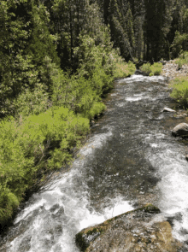
1 John 4:7-11
⁸ He that loveth not knoweth not God; for God is love.

Slide 36

1 John 4:7-11
⁹ In this was manifested the love of God toward us, because that God sent his only begotten Son into the world, that we might live through him.

Slide 37

1 John 4:7-11
¹⁰ Herein is love, not that we loved God, but that he loved us, and sent his Son to be the propitiation for our sins.

Slide 38
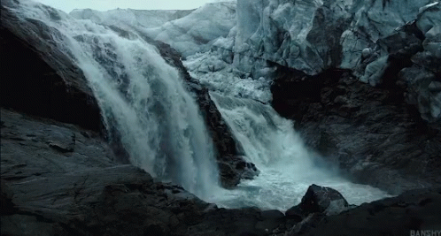
1 John 4:7-11
¹¹ Beloved, if God so loved us, we ought also to love one another.

Slide 39
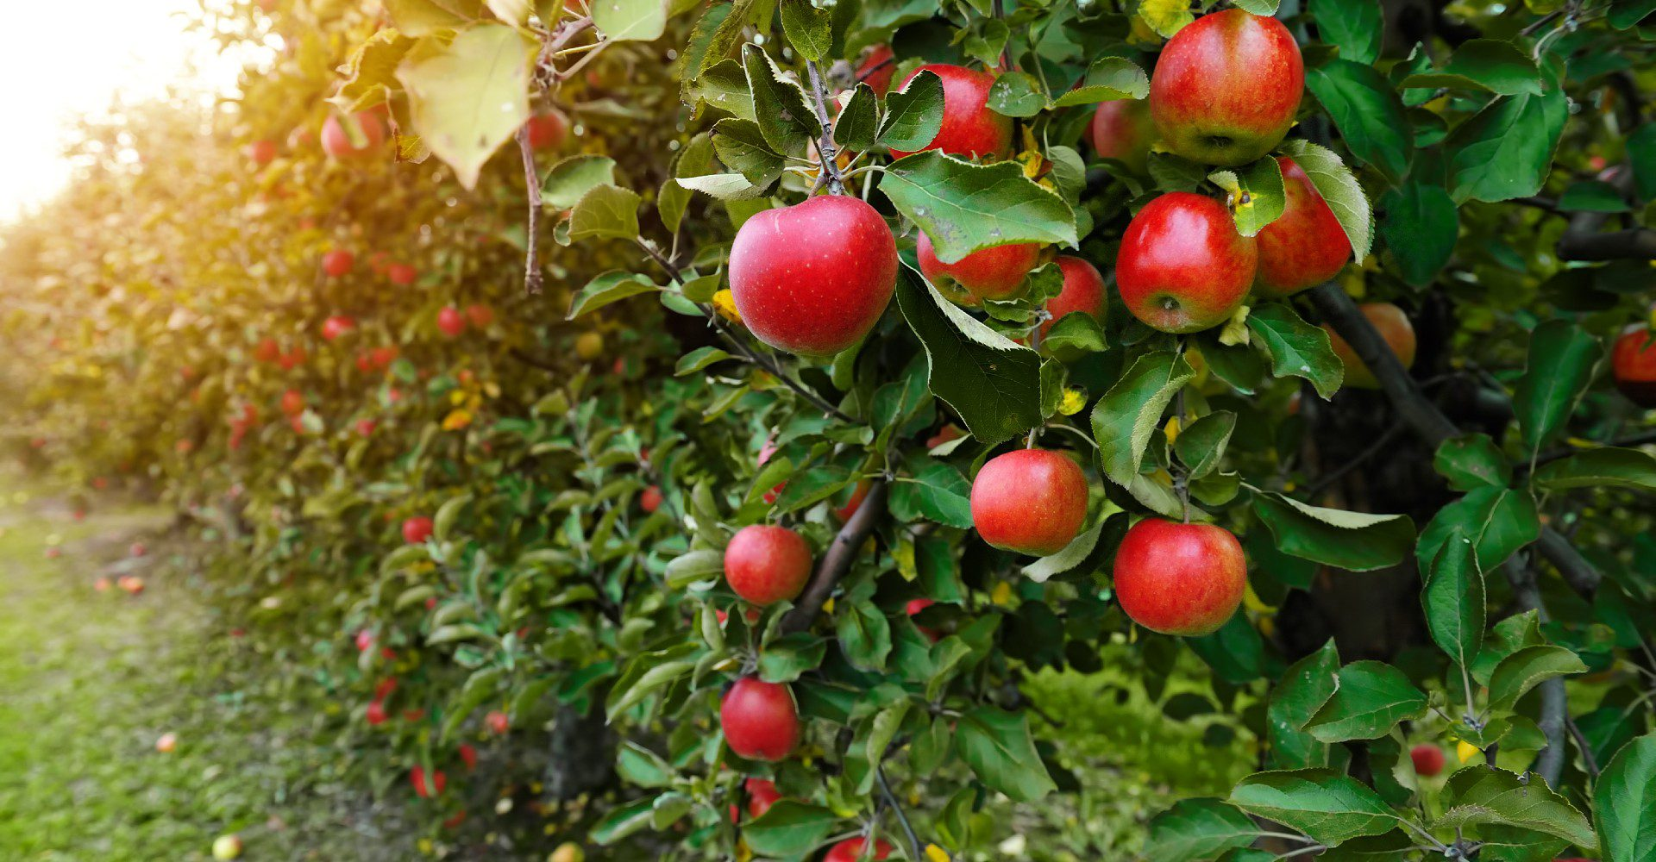
14. What is the evidence that one has been converted?
1 John 3:14

Slide 40
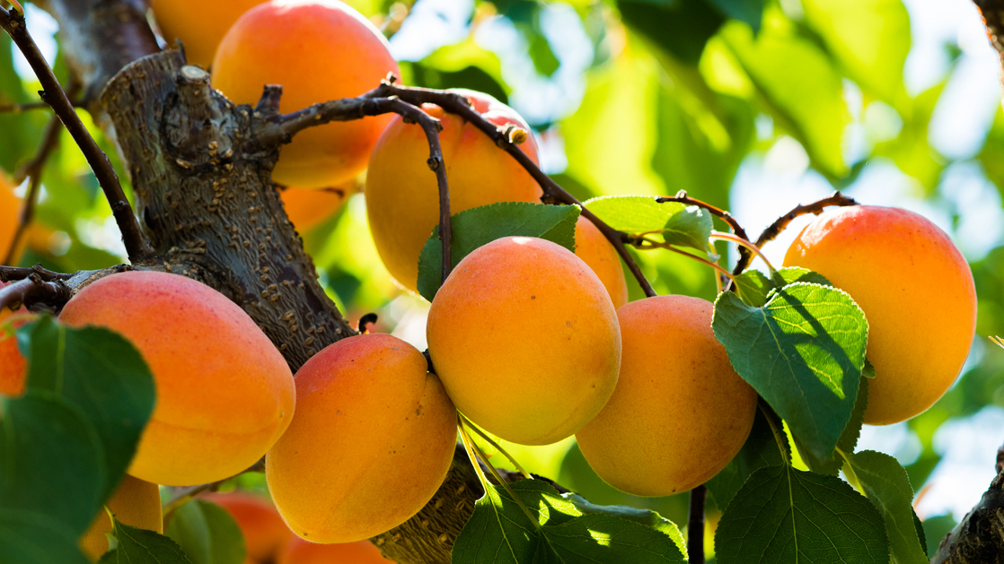
1 John 3:14
¹⁴ We know that we have passed from death unto life, because we love the brethren. He that loveth not his brother abideth in death.

Slide 41
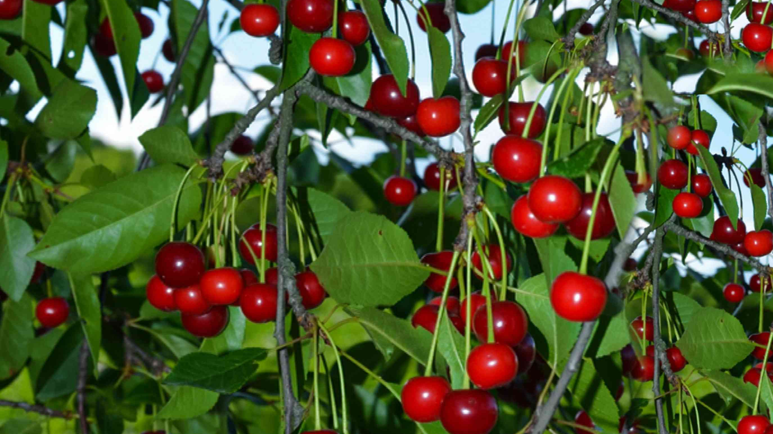
15. Is the measure of love that the new convert feels for the brethren sufficient for all time?
1 Thessalonians 3:12; 4:9, 10.

Slide 42
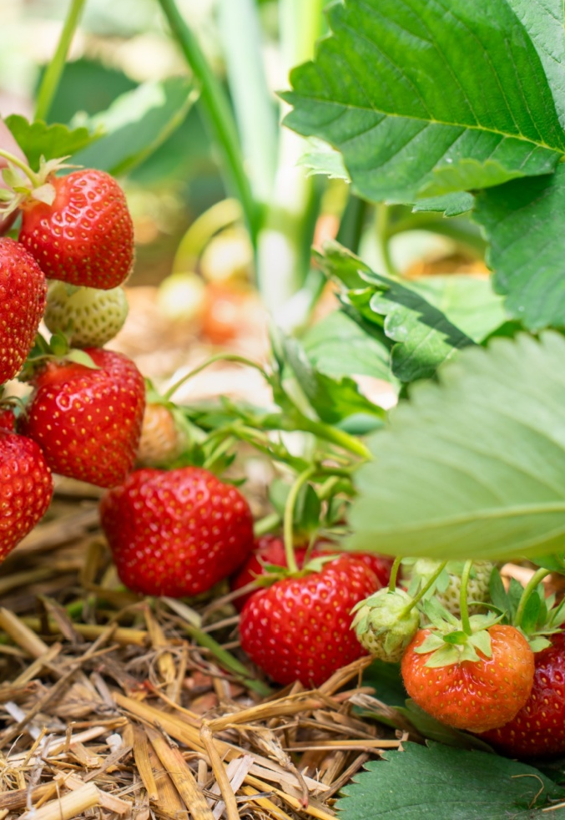
1 Thessalonians 3:12
¹² And the Lord make you to increase and abound in love one toward another, and toward all men, even as we do toward you:

Slide 43
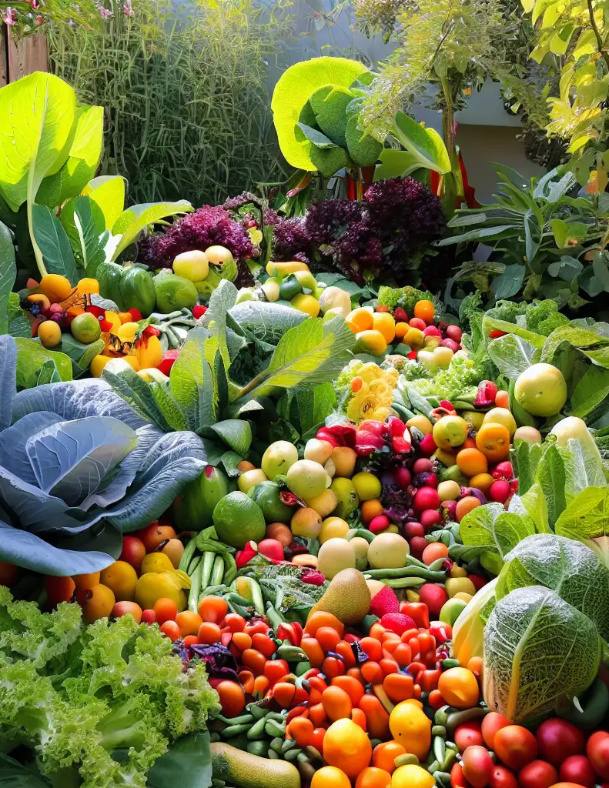
1 Thessalonians 4:9-10
⁹ But as touching brotherly love ye need not that I write unto you: for ye yourselves are taught of God to love one another.

Slide 44
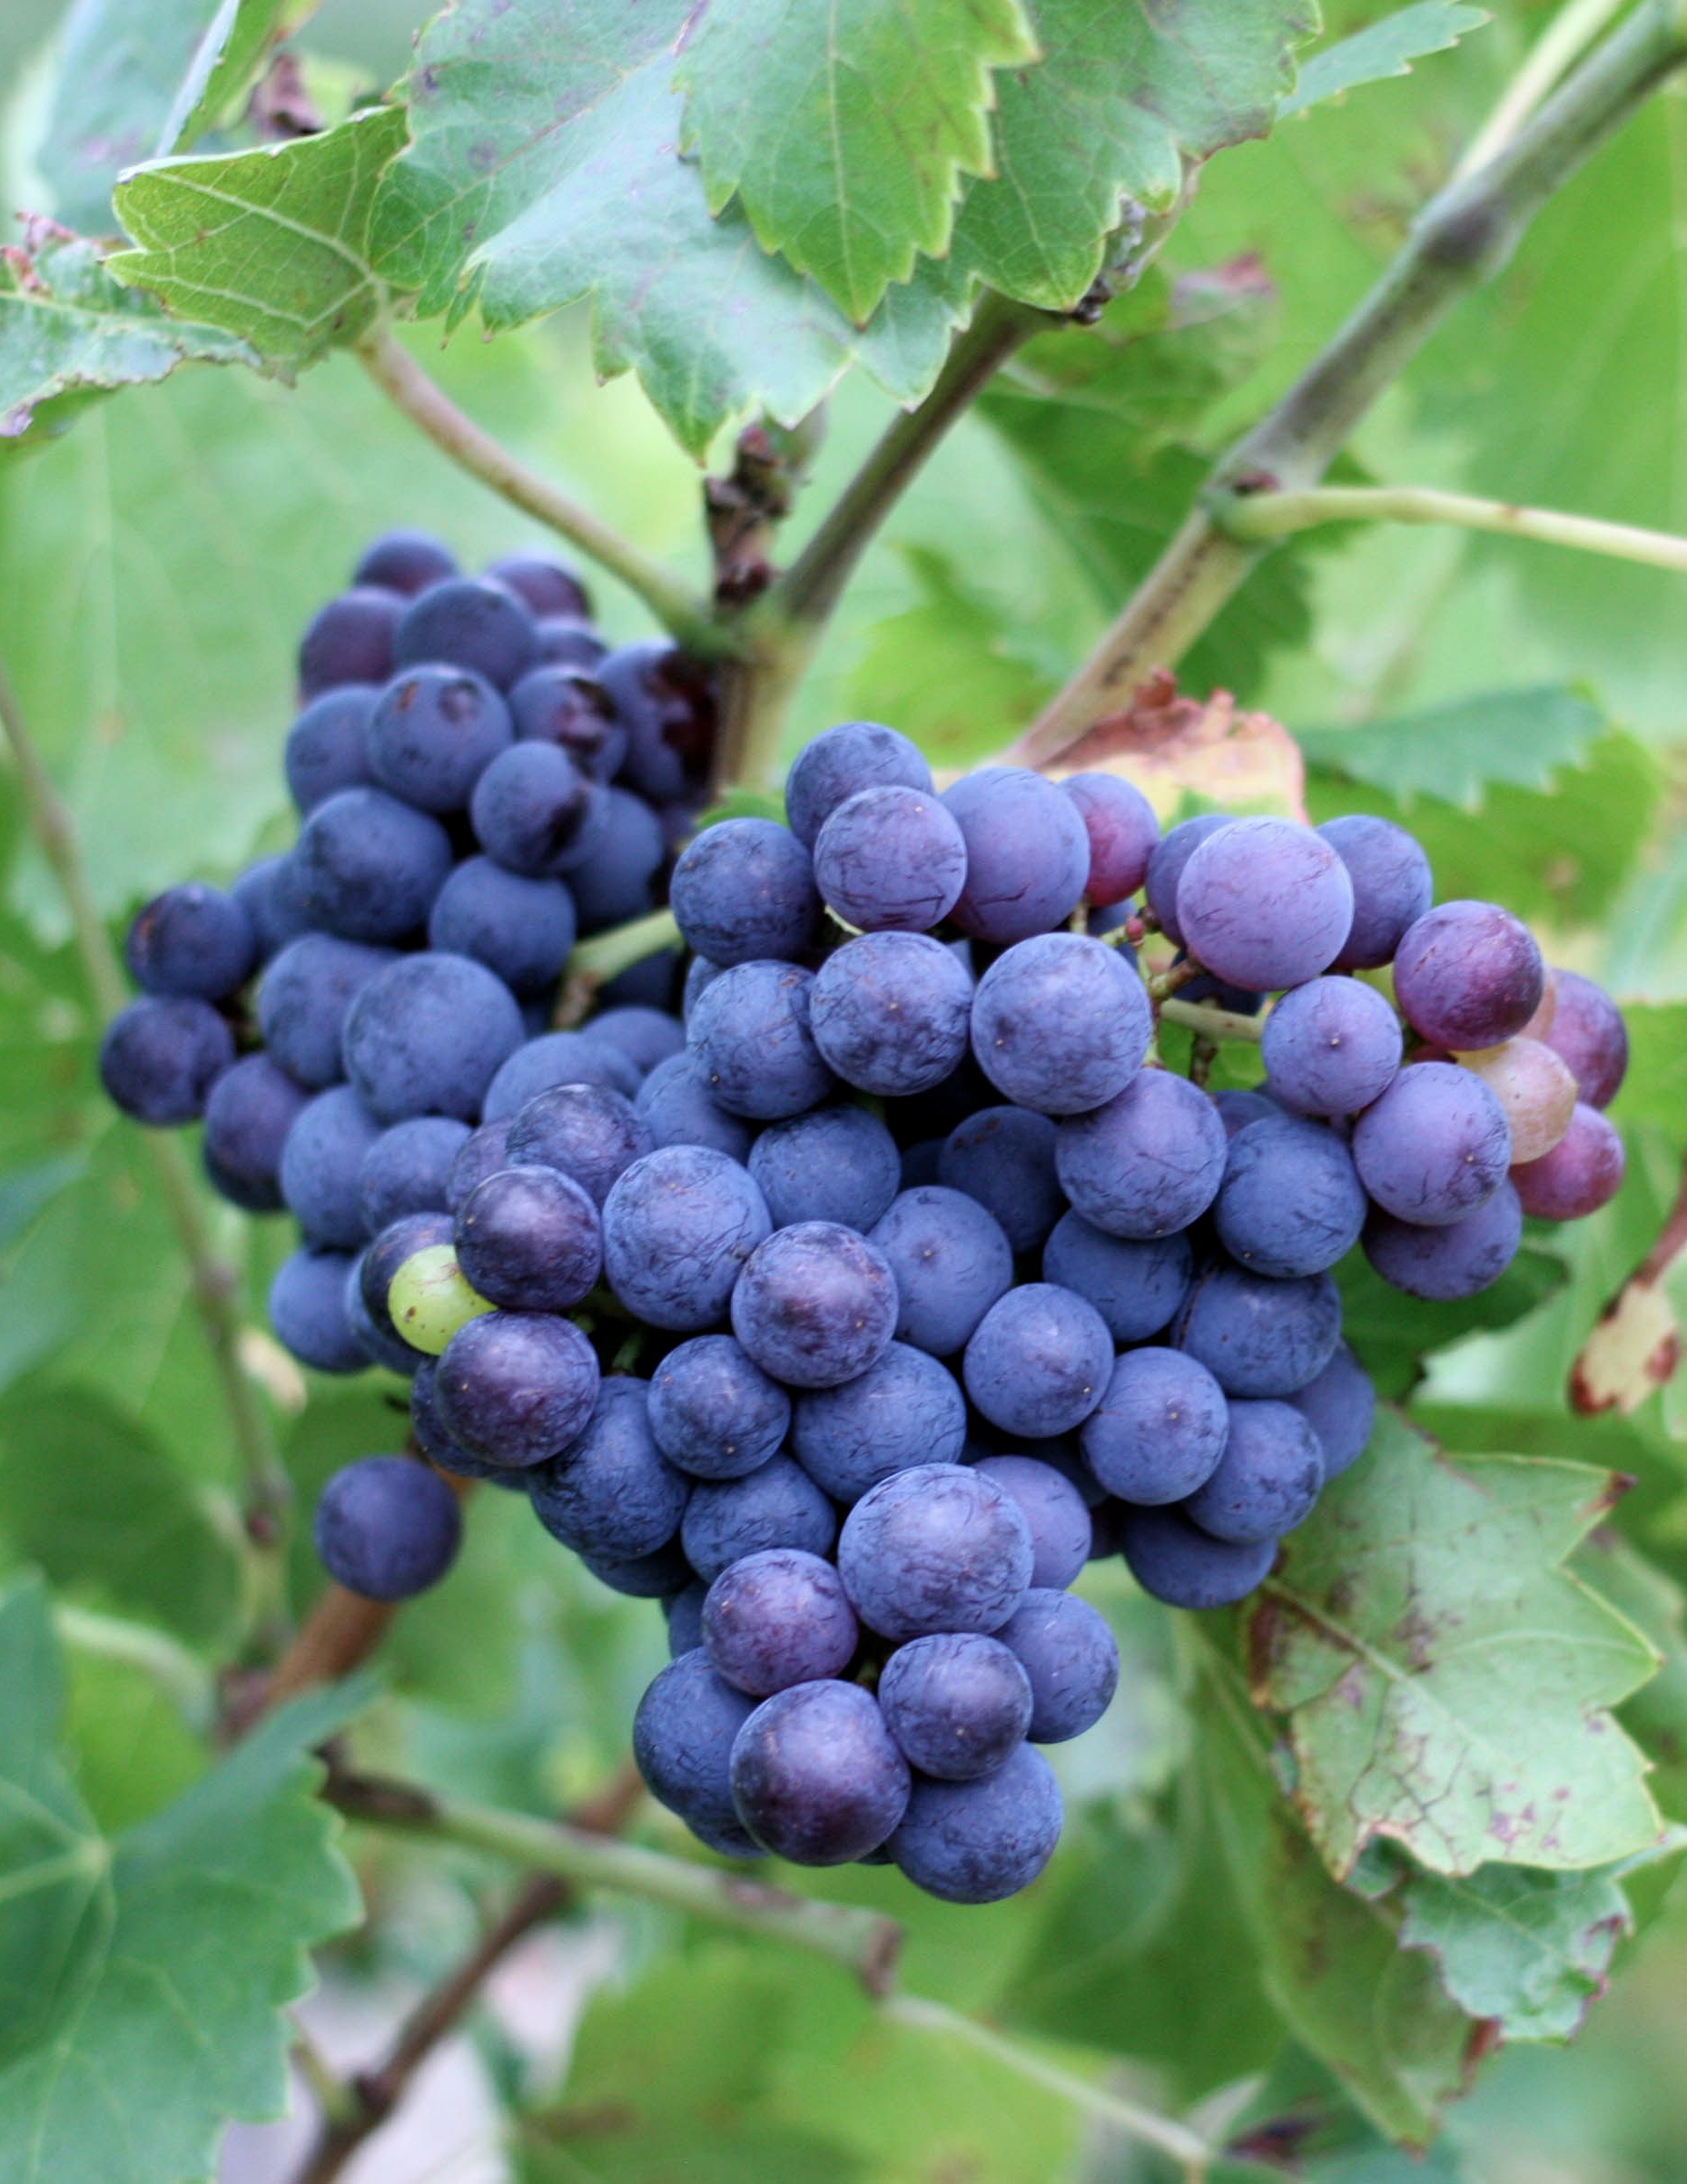
1 Thessalonians 4:9-10
¹⁰ And indeed ye do it toward all the brethren which are in all Macedonia: but we beseech you, brethren, that ye increase more and more;

Slide 45
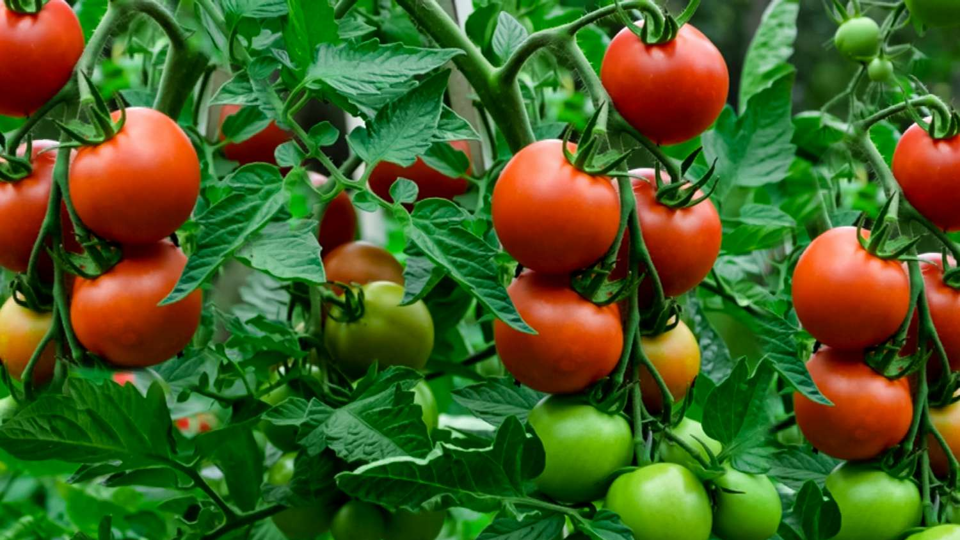
16. How should we love one another?
John 15:12; 13:34

Slide 46
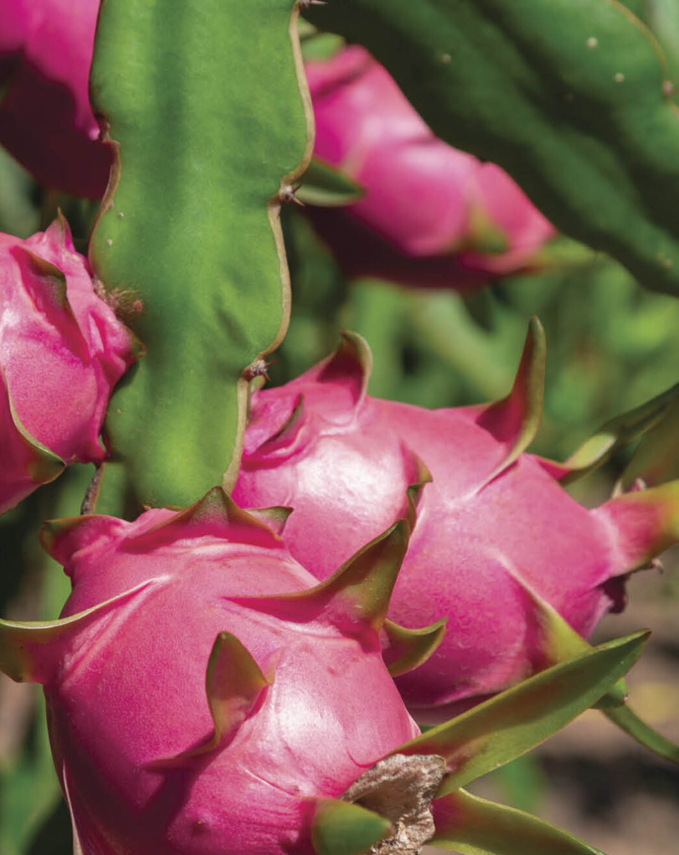
John 15:12
¹² This is my commandment, That ye love one another, as I have loved you.

Slide 47
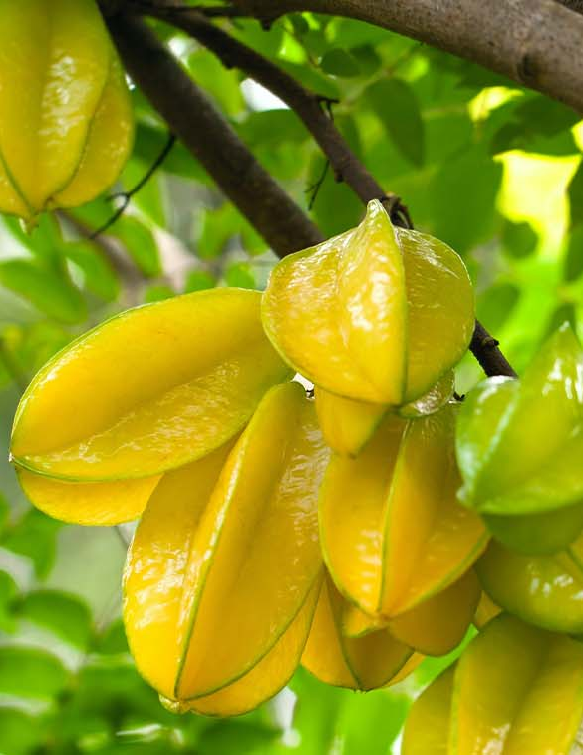
John 13:34
³⁴ A new commandment I give unto you, That ye love one another; as I have loved you, that ye also love one another.

Slide 48
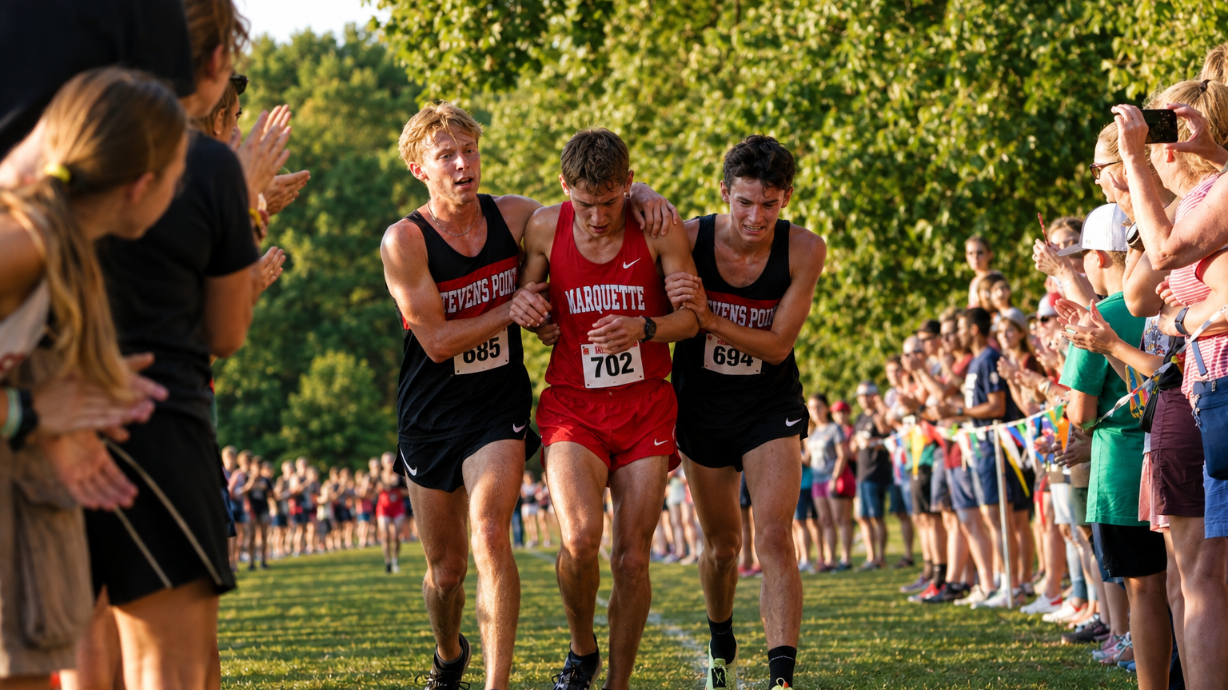
17. What is the greatest measure of love that a man can possess?
John 15:13

Slide 49
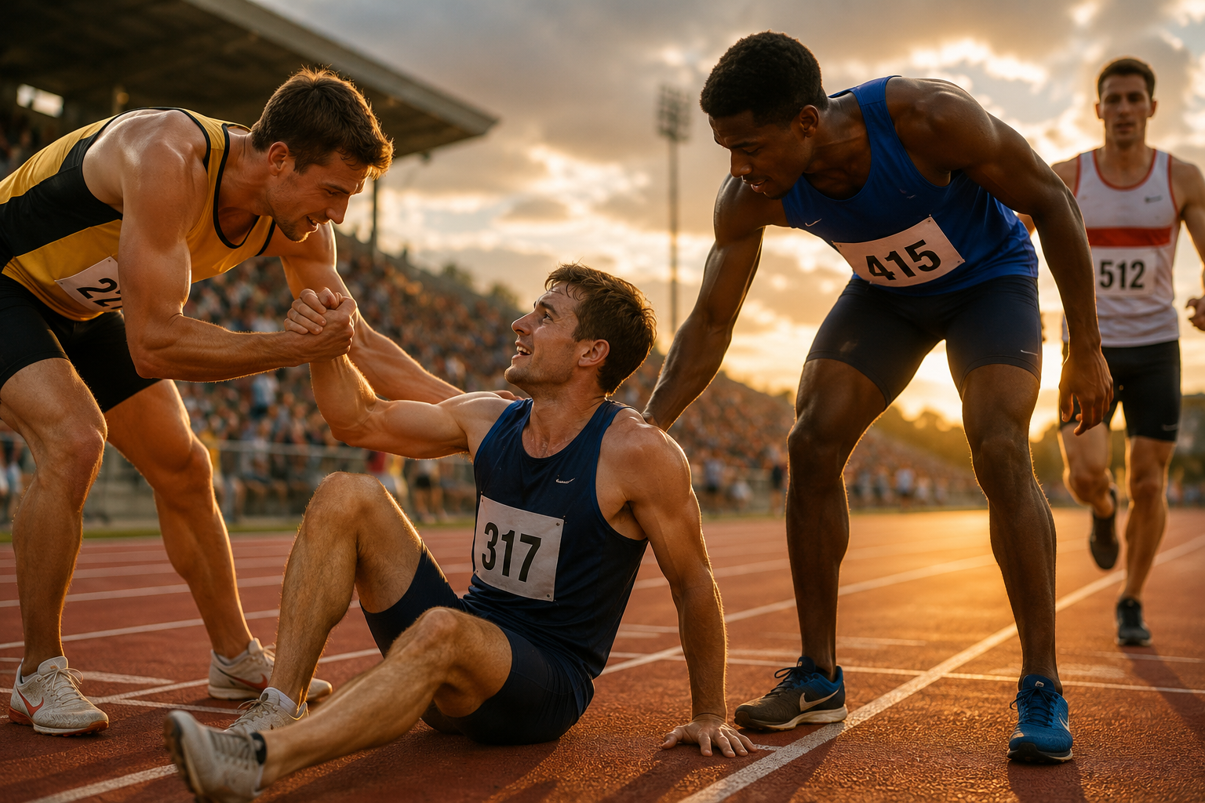
John 15:13
¹³ Greater love hath no man than this, that a man lay down his life for his friends.

Slide 50
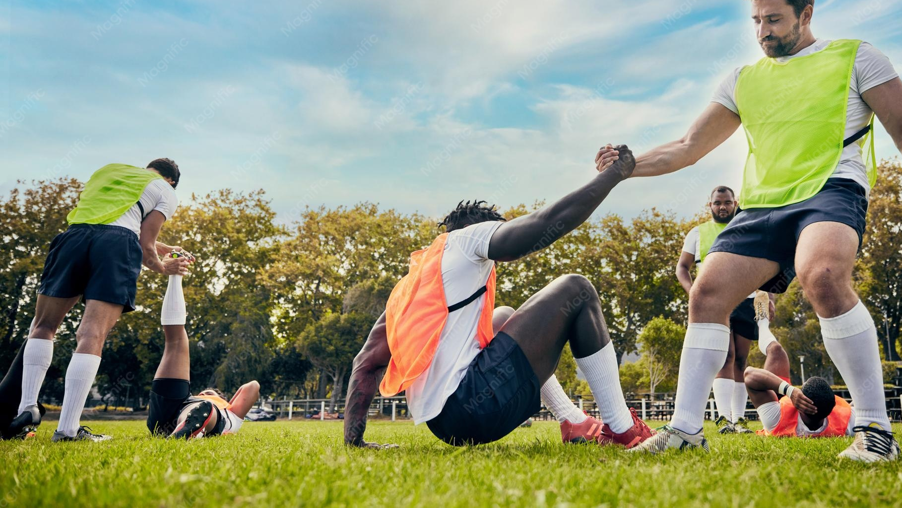
18. Ought we to love the brethren to that extent?
1 John 3:16

Slide 51
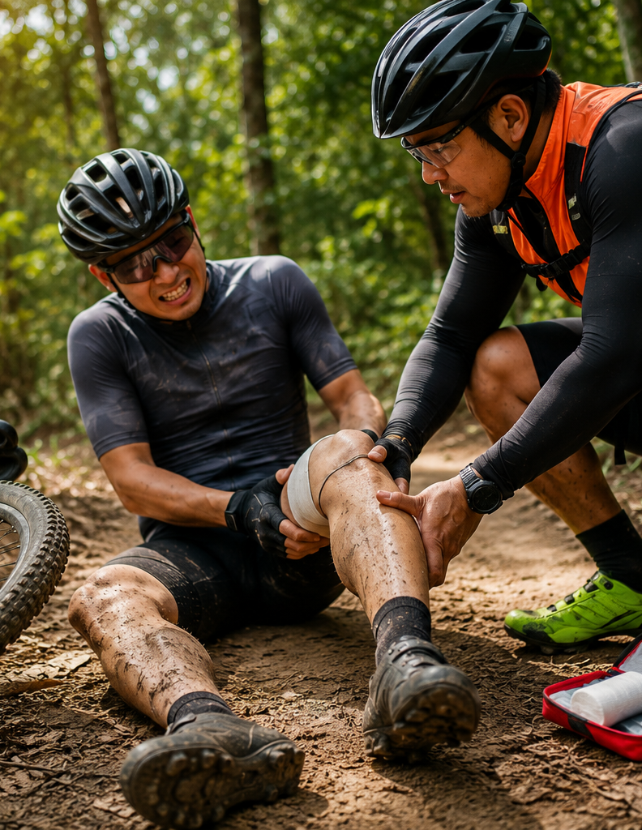
1 John 3:16
¹⁶ Hereby perceive we the love of God, because he laid down his life for us: and we ought to lay down our lives for the brethren.

Slide 52

19. What state of mind will render this less difficult than it would naturally be?
Philippians 2:3

Slide 53
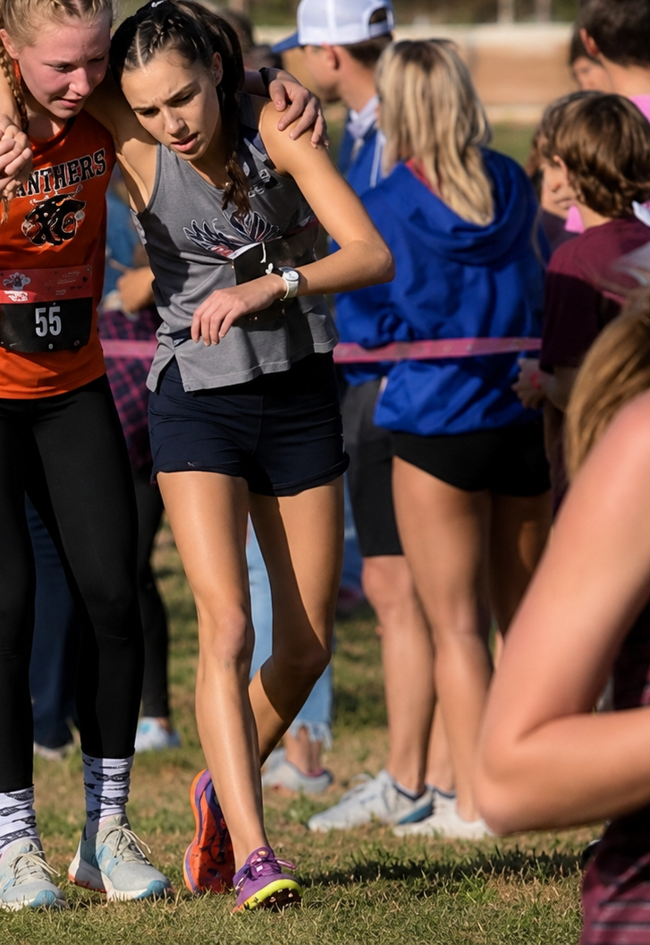
Philippians 2:3
³ Let nothing be done through strife or vainglory; but in lowliness of mind let each esteem other better than themselves.

Slide 54

Repeat the apostle Paul’s specific description of perfect brotherly kindness.
Ephesians 4:31, 32

Slide 55

Ephesians 4:31-32
³¹ Let all bitterness, and wrath, and anger, and clamour, and evil speaking, be put away from you, with all malice:

Slide 56

Ephesians 4:31-32
³² And be ye kind one to another, tenderhearted, forgiving one another, even as God for Christ's sake hath forgiven you.

Slide 57
Thank you!
…and Happy Sabbath!!

Slide 58


