Slide 1


Slide 2


Slide 3

Lesson 4:
2 Peter 1:7-15
November 17, 1888

Slide 4

A Ladder Leading to Love
1. Repeat the list of virtues sometimes called “Peter’s ladder.”
2 Peter 1:5–7

Slide 5

A Ladder Leading to Love
2 Peter 1:5–7
⁵ And beside this, giving all diligence, add to your faith virtue; and to virtue knowledge;

Slide 6

A Ladder Leading to Love
2 Peter 1:5–7
⁶ And to knowledge temperance; and to temperance patience; and to patience godliness;

Slide 7

A Ladder Leading to Love
2 Peter 1:5–7
⁷ And to godliness brotherly kindness; and to brotherly kindness charity.

Slide 8

A Ladder Leading to Love
2. What is the crowning grace?
2 Peter 1:7

Slide 9

A Ladder Leading to Love
2 Peter 1:7
And to godliness brotherly kindness; and to brotherly kindness charity.

Slide 10

Love Lessons
3. What is charity?
Colossians 3:14

Slide 11

Love Lessons
Colossians 3:14
And above all these things put on charity, which is the bond of perfectness.

Slide 12

Love Lessons
4. What other very common word is equivalent to charity?
Colossians 3:14
(Revised Version)

Slide 13

Love Lessons
Colossians 3:14 (RV 1885)
and above all these things put on love, which is the bond of perfectness.

Slide 14
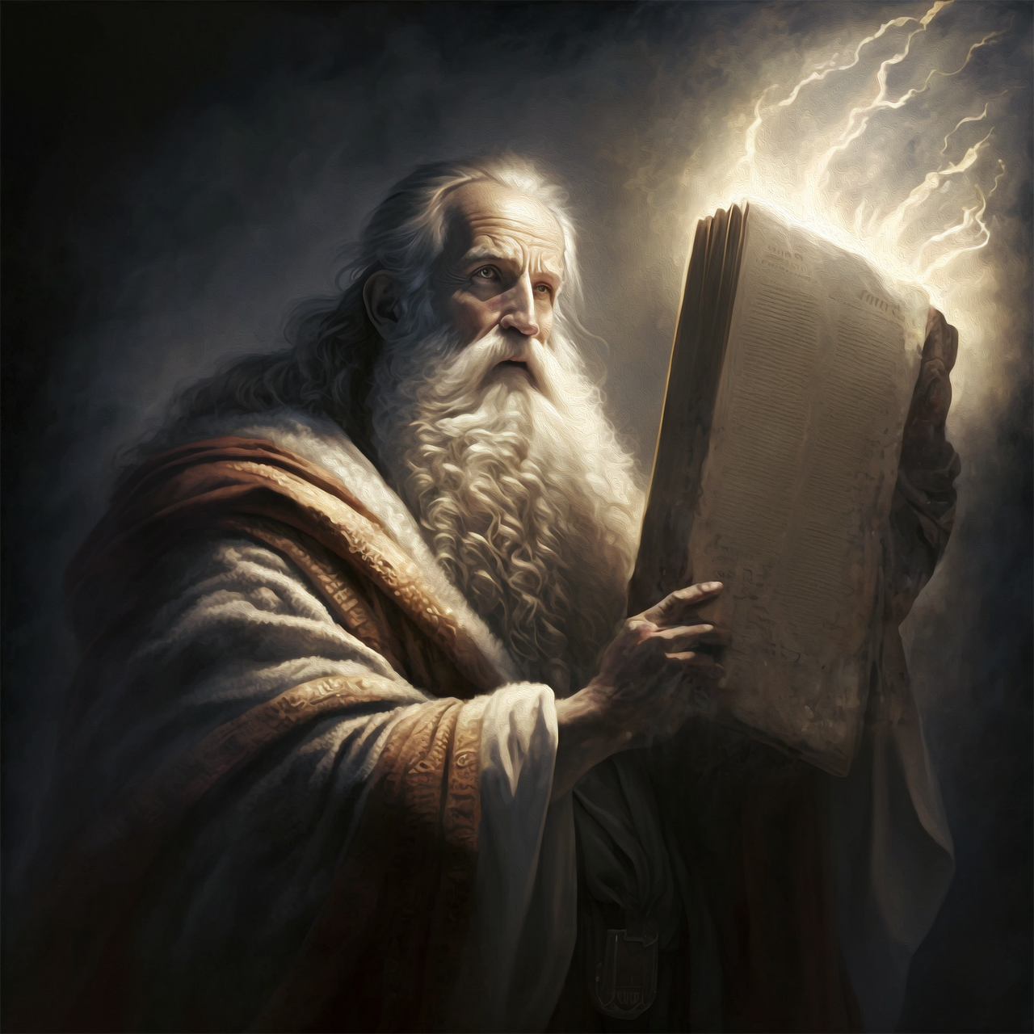
Love Lessons
5. What is the end or object of the commandment, or law, of God?
1 Timothy 1:5

Slide 15

Love Lessons
1 Timothy 1:5
Now the end of the commandment is charity out of a pure heart, and of a good conscience, and of faith unfeigned:

Slide 16

Love Lessons
6. What, indeed, is Bible charity or love?
Romans 13:10, 1JOhn 5:2-3

Slide 17

Love Lessons
Romans 13:10
Love worketh no ill to his neighbour: therefore love is the fulfilling of the law.

Slide 18

Love Lessons
1 John 5:2–3
² By this we know that we love the children of God, when we love God, and keep his commandments.

Slide 19
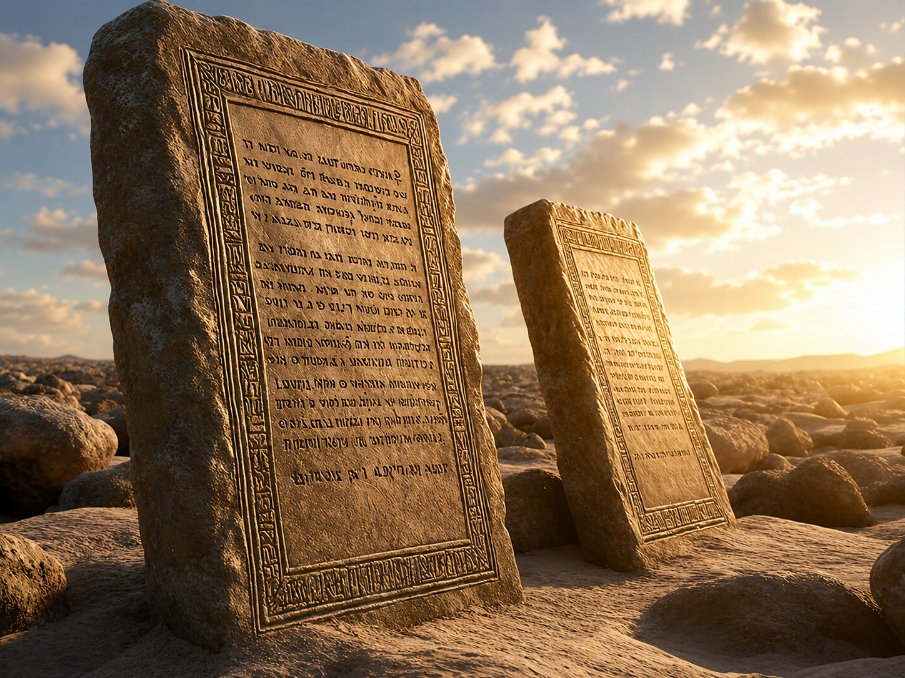
LOVE LESSONS
1 John 5:2–3
³ For this is the love of God, that we keep his commandments: and his commandments are not grievous.

Slide 20
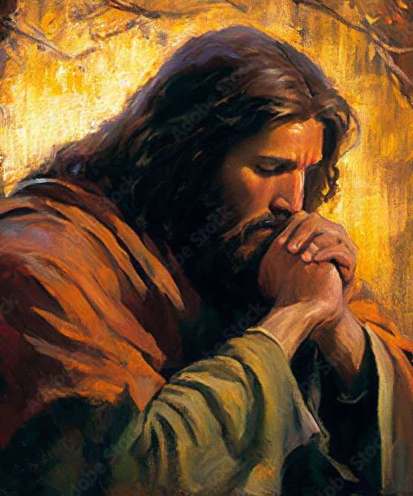
Love Lessons
7. What is the whole duty of man?
Ecclesiastes 12:13

Slide 21
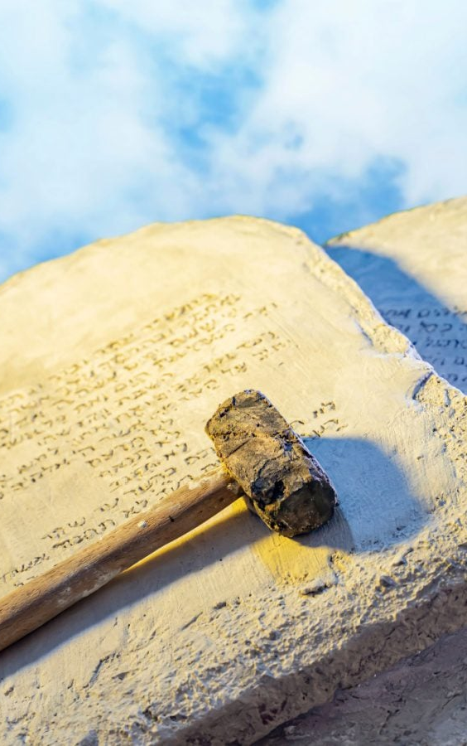
Love Lessons
Ecclesiastes 12:13
Let us hear the conclusion of the whole matter: Fear God, and keep his commandments: for this is the whole duty of man.

Slide 22
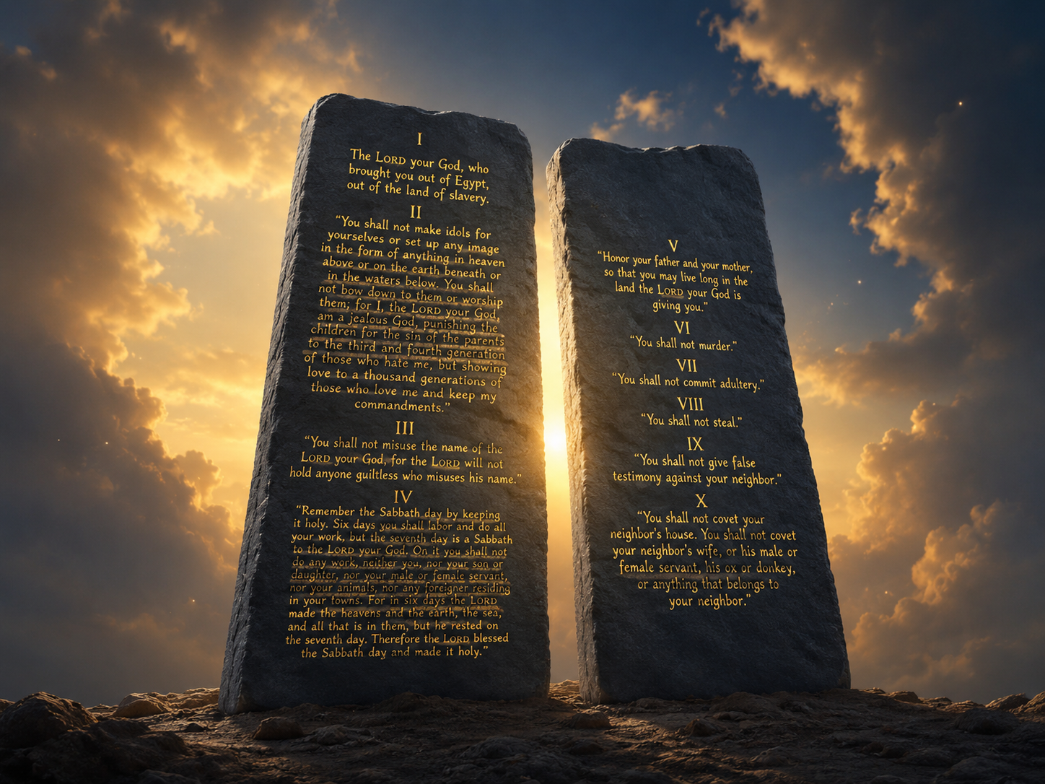
Love Lessons
8. Then since the keeping of the commandments is charity, how does charity compare with the other graces?
1 Corinthians 13:13

Slide 23
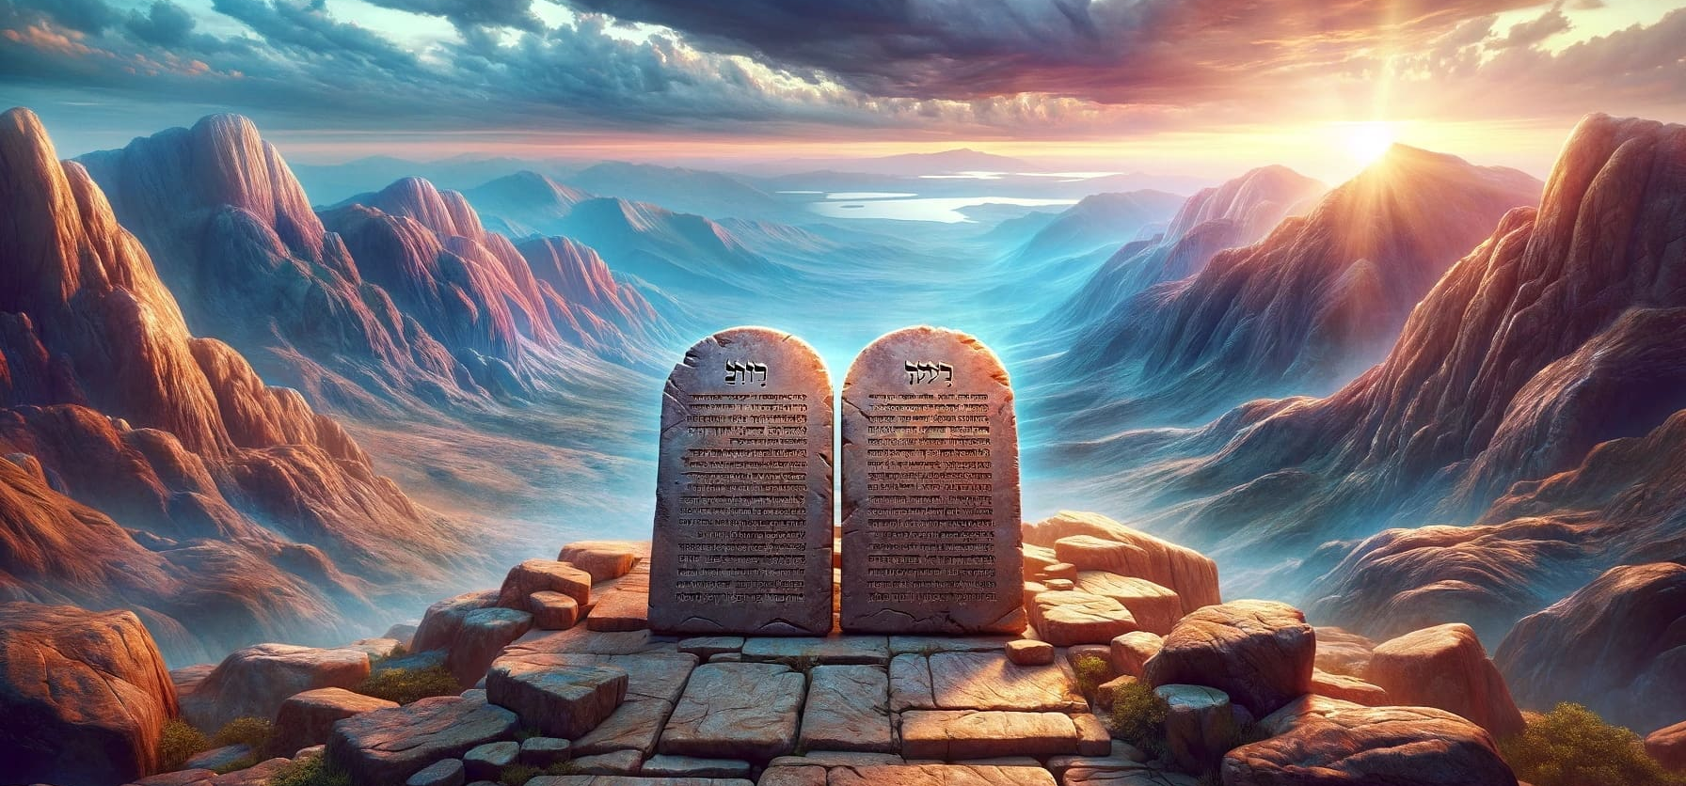
Love Lessons
1 Corinthians 13:13
And now abideth faith, hope, charity, these three; but the greatest of these is charity.

Slide 24

Love Lessons
9. Into how much of our actions should charity enter?
1 Corinthians 16:14

Slide 25

Love Lessons
1 Corinthians 16:14
Let all your things be done with charity.

Slide 26
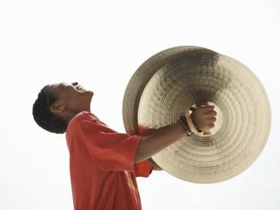
Love Lessons
10. Without charity, what is the most eloquent man like?
1 Corinthians 13:1

Slide 27
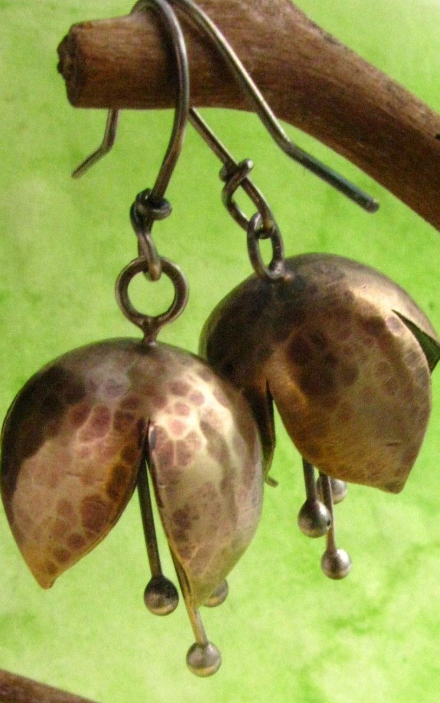
Love Lessons
1 Corinthians 13:1
Though I speak with the tongues of men and of angels, and have not charity, I am become as sounding brass, or a tinkling cymbal.

Slide 28

Love Lessons
11. Will the possession of great faith and deep knowledge of the mysteries of God make up in any degree for lack of charity?
1 Corinthians 13:2

Slide 29

Love Lessons
1 Corinthians 13:2
And though I have the gift of prophecy, and understand all mysteries, and all knowledge; and though I have all faith, so that I could remove mountains, and have not charity, I am nothing.

Slide 30

Love Lessons
12. Show that charity does not consist simply in making great sacrifices and giving to the poor.
1 Corinthians 13:3

Slide 31

Love Lessons
1 Corinthians 13:3
And though I bestow all my goods to feed the poor, and though I give my body to be burned, and have not charity, it profiteth me nothing.

Slide 32

Love Lessons
13. What are the characteristics of charity?
1 Corinthians 13:4–6

Slide 33
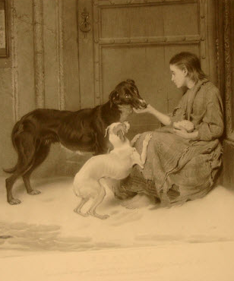
Love Lessons
1 Corinthians 13:4–6
⁴ Charity suffereth long, and is kind; charity envieth not; charity vaunteth not itself, is not puffed up,

Slide 34

Love Lessons
1 Corinthians 13:4–6
⁵ Doth not behave itself unseemly, seeketh not her own, is not easily provoked, thinketh no evil;

Slide 35

Love Lessons
1 Corinthians 13:4–6
⁶ Rejoiceth not in iniquity, but rejoiceth in the truth;

Slide 36
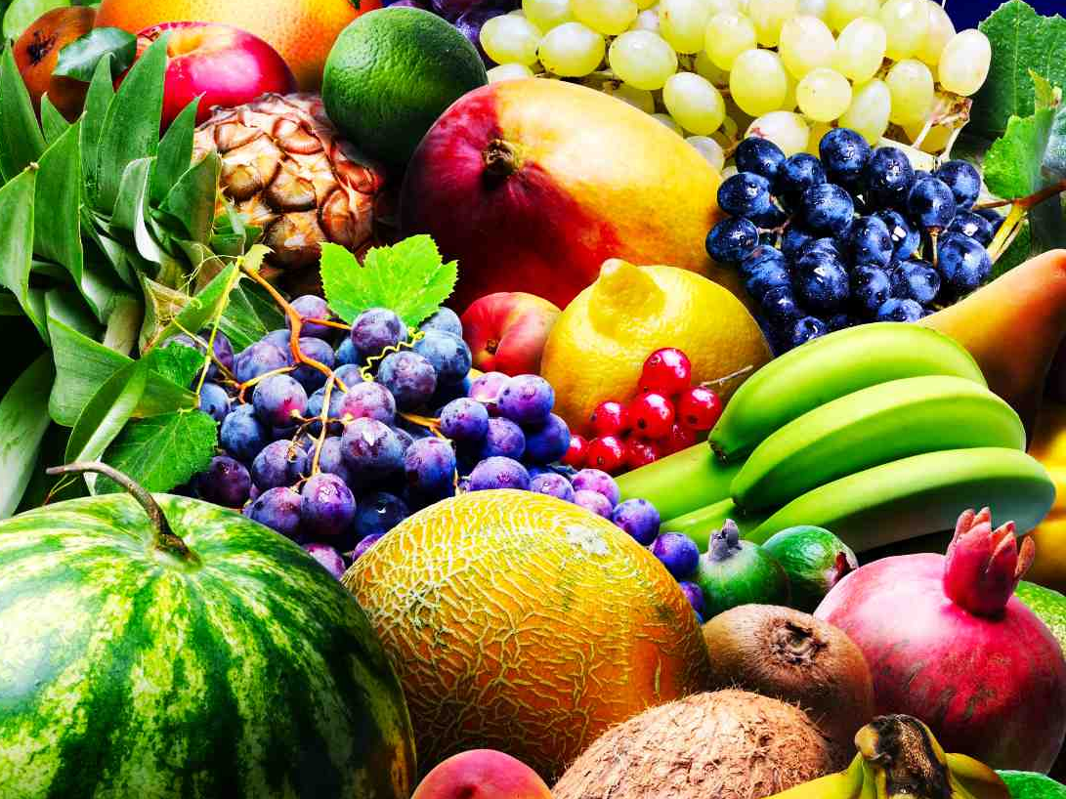
A Life of Love
14. If all these graces abound in any person, what will be his condition?
2 Peter 1:8

Slide 37

A Life of Love
2 Peter 1:8
For if these things be in you, and abound, they make you that ye shall neither be barren nor unfruitful in the knowledge of our Lord Jesus Christ.

Slide 38
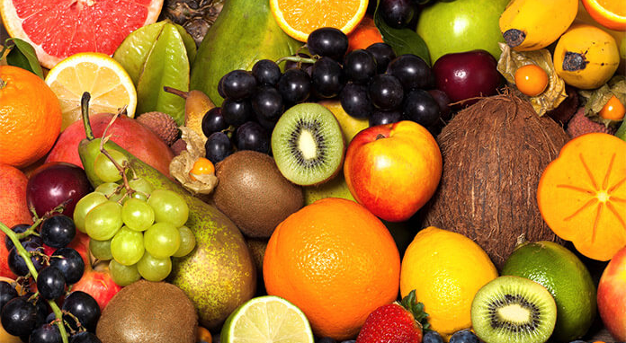
A Life of Love
15. Name some of the fruits that are equivalent to the above graces.
Galatians 5:22–23

Slide 39
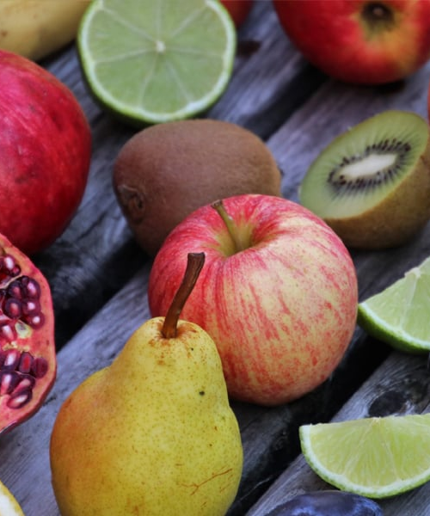
A Life of Love
Galatians 5:22–23
²² But the fruit of the Spirit is love, joy, peace, longsuffering, gentleness, goodness, faith,

Slide 40
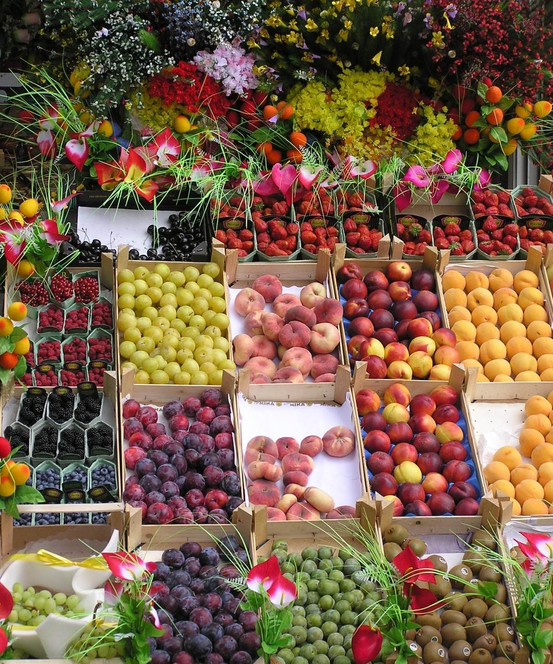
A Life of Love
Galatians 5:22–23
²³ Meekness, temperance: against such there is no law.

Slide 41

A Life of Love
16. What is the condition of one who lacks these things?
2 Peter 1:9

Slide 42

A Life of Love
2 Peter 1:9
But he that lacketh these things is blind, and cannot see afar off, and hath forgotten that he was purged from his old sins.

Slide 43
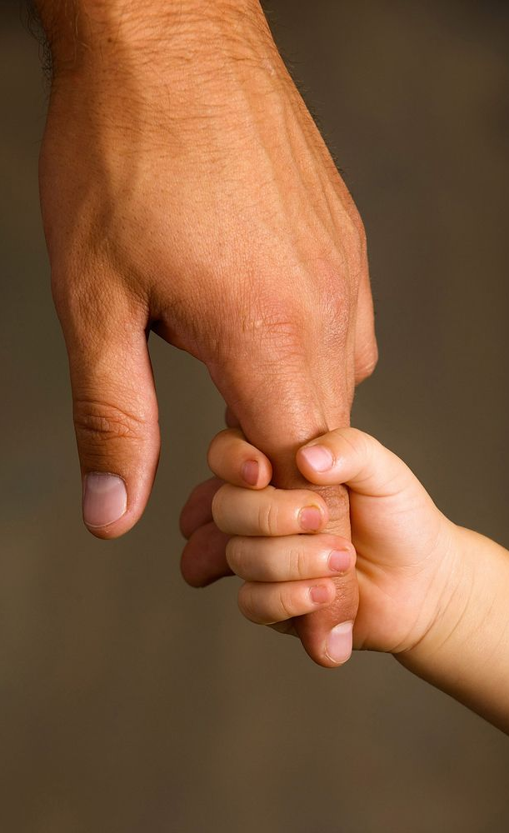
A Life of Love
17. Then what should we do?
2 Peter 1:10

Slide 44

A Life of Love
2 Peter 1:10
Wherefore the rather, brethren, give diligence to make your calling and election sure: for if ye do these things, ye shall never fall:

Slide 45

A Life of Love
18. What glorious reward awaits those in whom “these things” abound?
2 Peter 1:11

Slide 46

A Life of Love
2 Peter 1:11
For so an entrance shall be ministered unto you abundantly into the everlasting kingdom of our Lord and Saviour Jesus Christ.

Slide 47
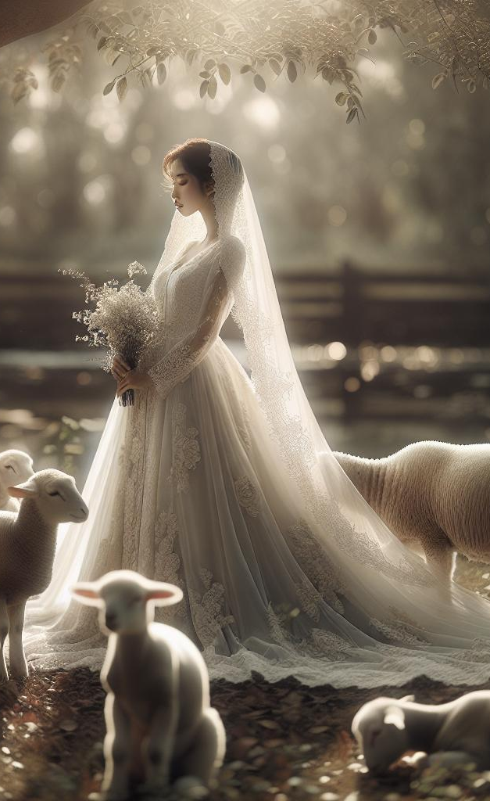
Love that Lasts
19. What must be the nature of those who inherit that eternal kingdom?
Titus 2:13–14, Revelation 21:27

Slide 48
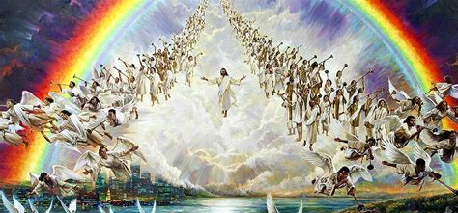
Love that Lasts
Titus 2:13–14
¹³ Looking for that blessed hope, and the glorious appearing of the great God and our Saviour Jesus Christ;

Slide 49
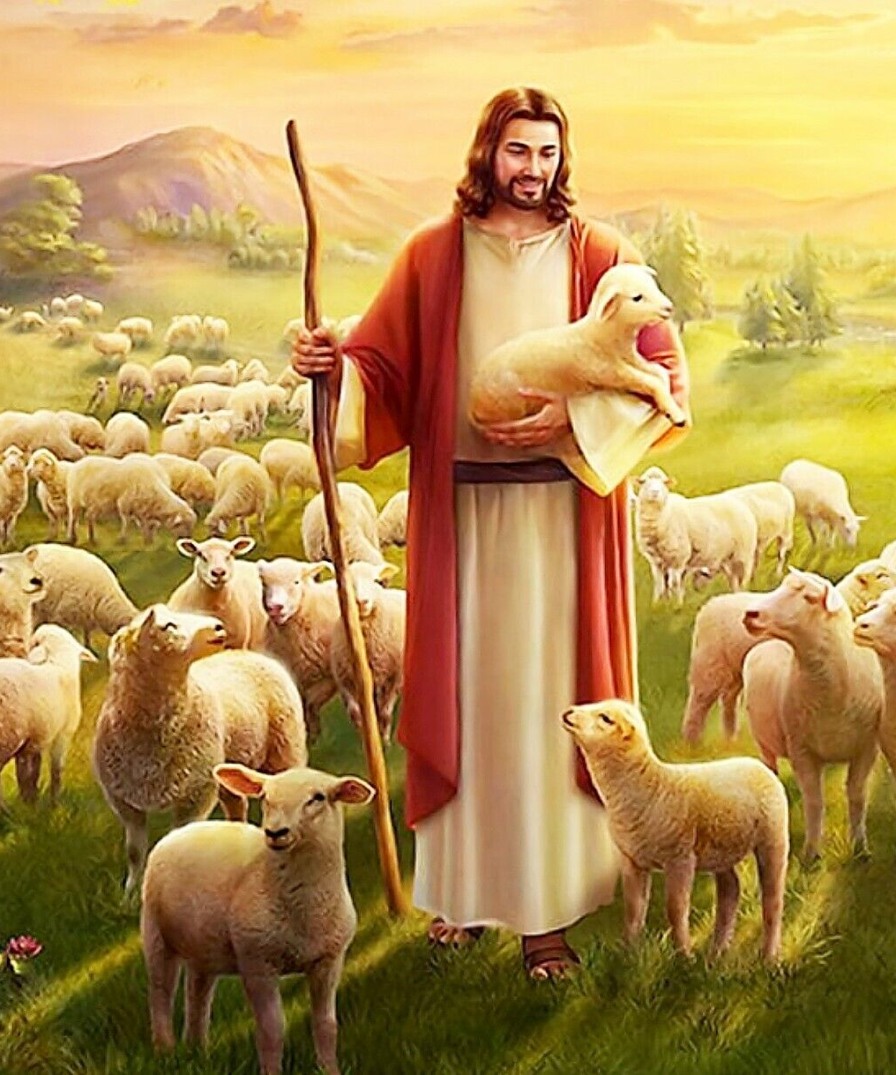
Love that Lasts
Titus 2:13–14
¹⁴ Who gave himself for us, that he might redeem us from all iniquity, and purify unto himself a peculiar people, zealous of good works.

Slide 50

Love that Lasts:
Revelation 21:27
²⁷ And there shall in no wise enter into it any thing that defileth, neither whatsoever worketh abomination, or maketh a lie: but they which are written in the Lamb's book of life.

Slide 51

Love that Lasts
20. Is the fact that we know these things any reason why we should not study them diligently?
2 Peter 1:12

Slide 52
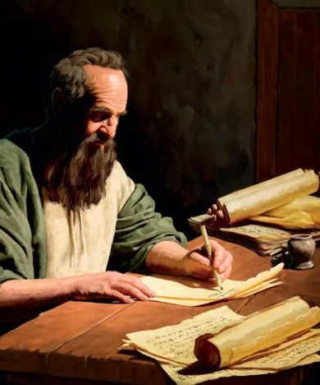
Love that Lasts
2 Peter 1:12
Wherefore I will not be negligent to put you always in remembrance of these things, though ye know them.

Slide 53
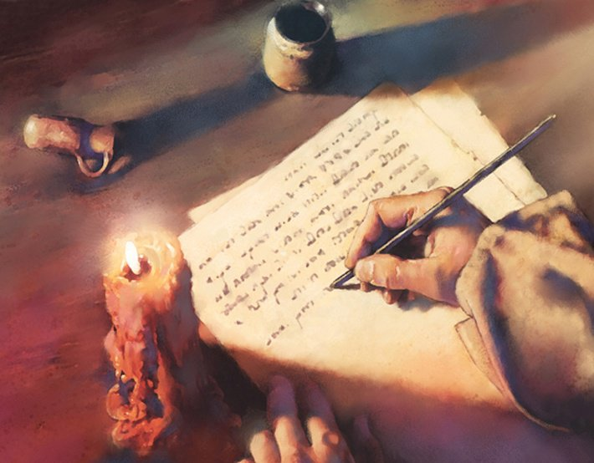
Love that Lasts
21. Why was the apostle so zealous in stirring up the minds of the people concerning these great truths?
2 Peter 1:13–14

Slide 54
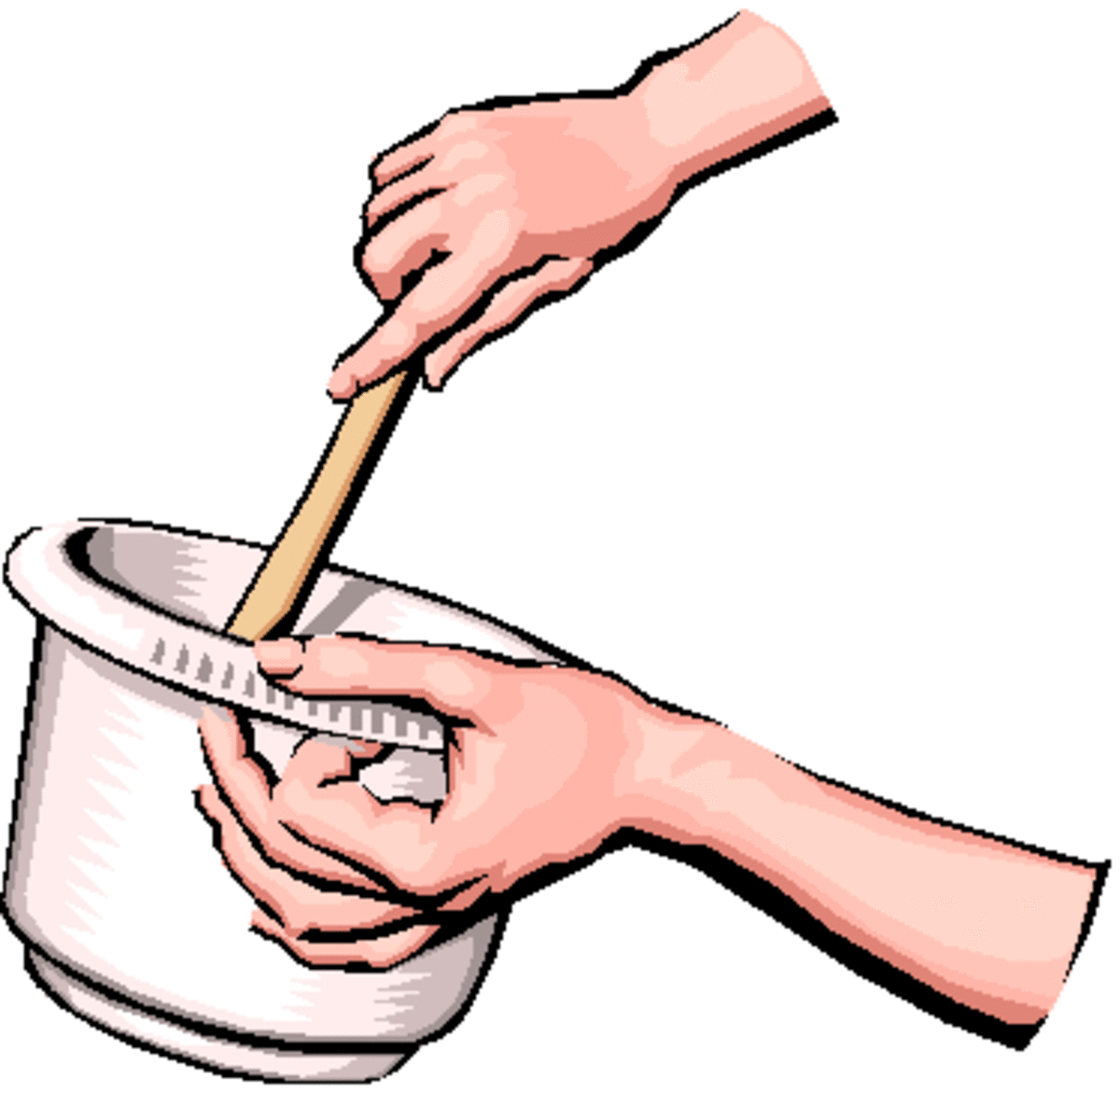
Love that Lasts
2 Peter 1:13–14
¹³ Yea, I think it meet, as long as I am in this tabernacle, to stir you up by putting you in remembrance;

Slide 55

Love that Lasts
2 Peter 1:13–14
¹⁴ Knowing that shortly I must put off this my tabernacle, even as our Lord Jesus Christ hath shewed me.

Slide 56

Love that Lasts
22. What had the Lord shown him concerning his death?
John 21:18–19

Slide 57
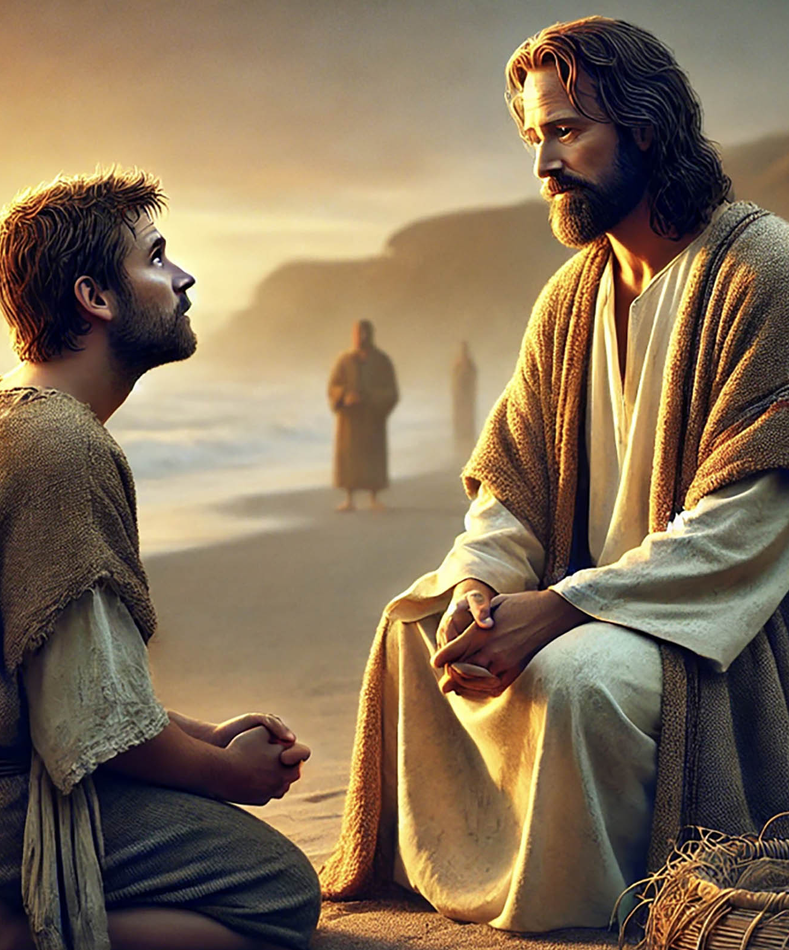
Love that Lasts
John 21:18–19
¹⁸ Verily, verily, I say unto thee, When thou wast young, thou girdest thyself, and walkedst whither thou wouldest: but when thou shalt be old, thou shalt stretch forth thy hands, and another shall gird thee, and carry thee whither thou wouldest not.

Slide 58
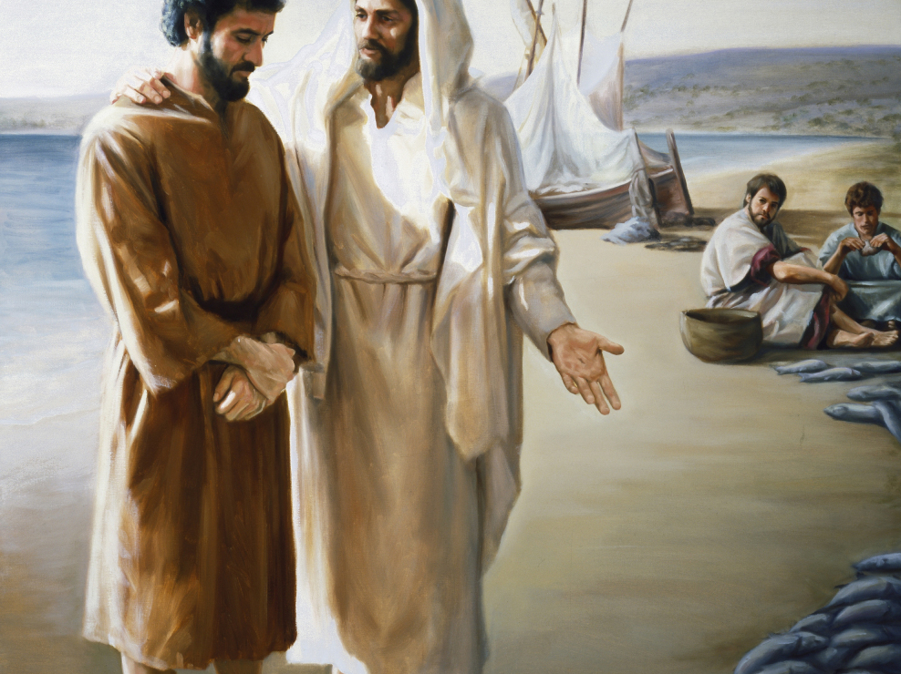
Love that Lasts
John 21:18–19
¹⁹ This spake he, signifying by what death he should glorify God. And when he had spoken this, he saith unto him, Follow me.

Slide 59
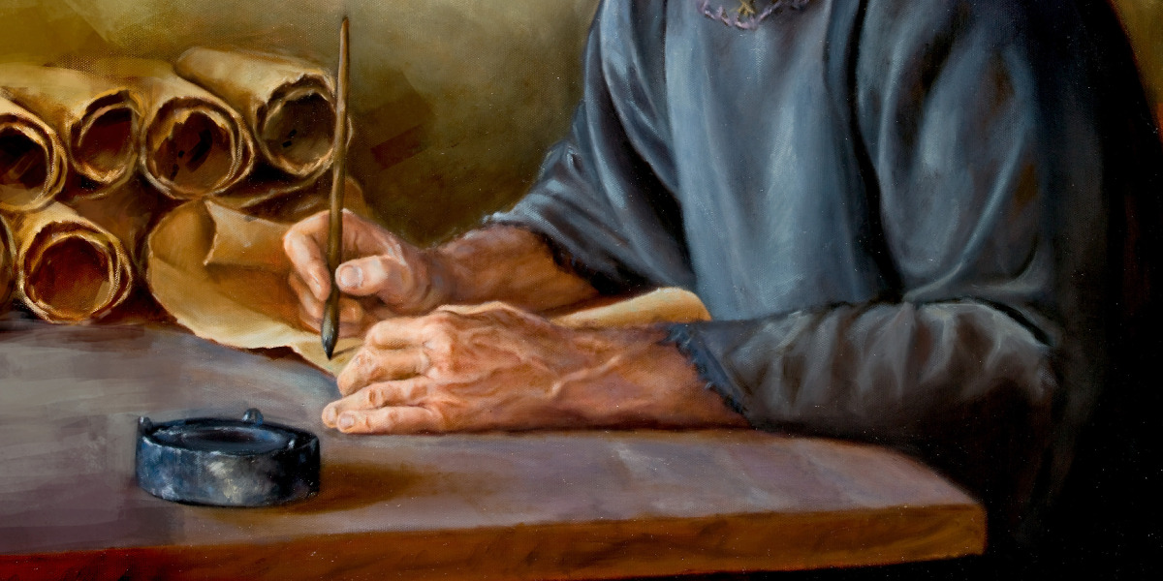
Love that Lasts
23. What was Peter’s earnest desire that we should do?
2 Peter 1:15

Slide 60
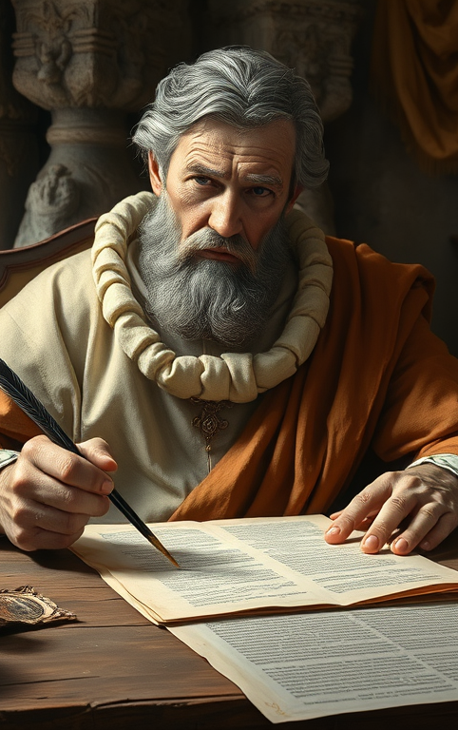
Love that Lasts
2 Peter 1:15
Moreover I will endeavour that ye may be able after my decease to have these things always in remembrance.

Slide 61
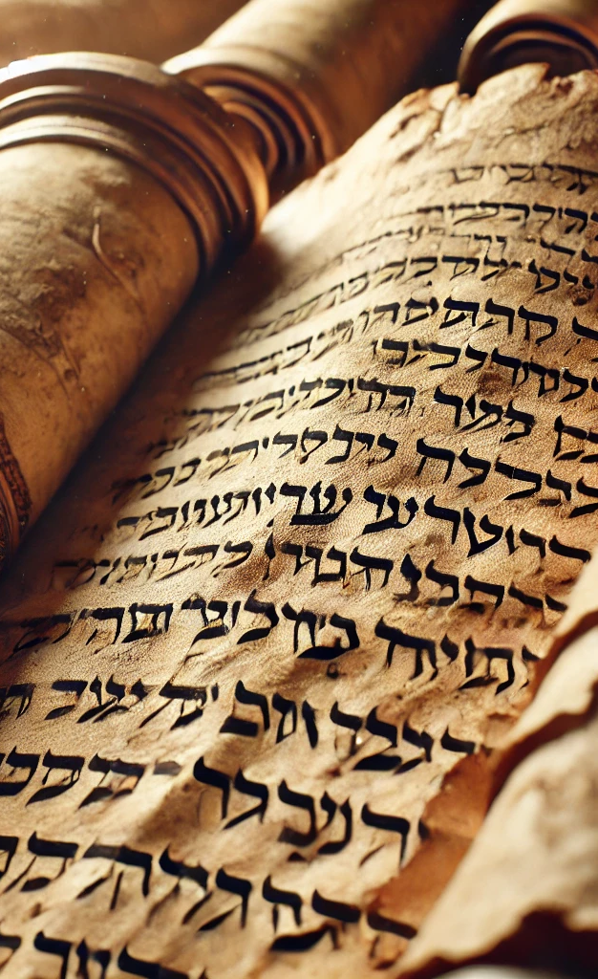
Love that Lasts
24. If these things are always in our mind, what prayer may we offer?
Psalm 5:1

Slide 62

Love that Lasts
Psalm 5:1
Give ear to my words, O Lord, consider my meditation.

Slide 63
Thank you!
…and Happy Sabbath!!

Slide 64


