Slide 1


Slide 2


Slide 3
Lesson 5:
2 Peter 1:16-21
Nov. 10, 1888

Slide 4
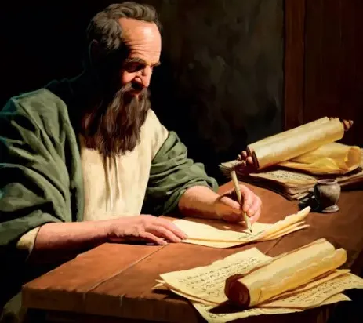
An Eye-Witness
1. In his second epistle, what does Peter say that he had previously made known to the people?
2 Peter 1:16

Slide 5
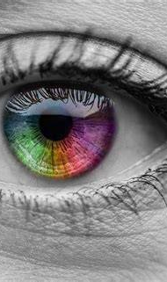
An Eye-Witness
2 Peter 1:16
For we have not followed cunningly devised fables, when we made known unto you the power and coming of our Lord Jesus Christ, but were eyewitnesses of his majesty.

Slide 6
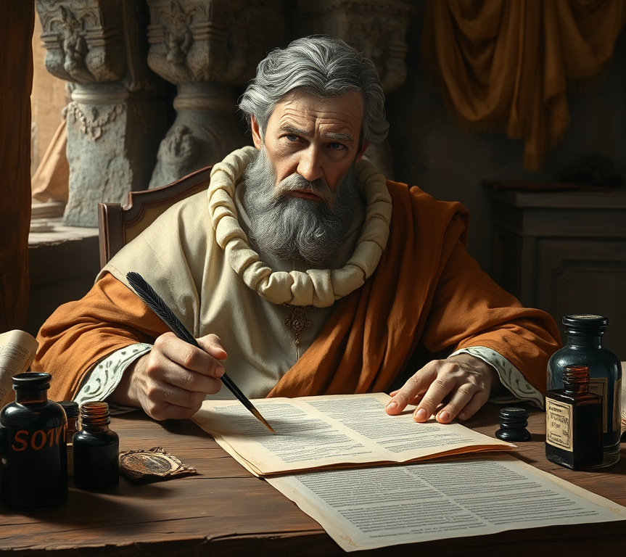
An Eye-Witness
2. With what positiveness could Peter speak of the glory of Christ’s coming?
2 Peter 1:16

Slide 7
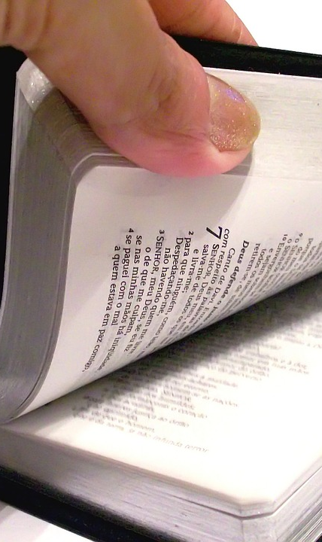
An Eye-Witness
2 Peter 1:16
For we have not followed cunningly devised fables, when we made known unto you the power and coming of our Lord Jesus Christ, but were eyewitnesses of his majesty.

Slide 8
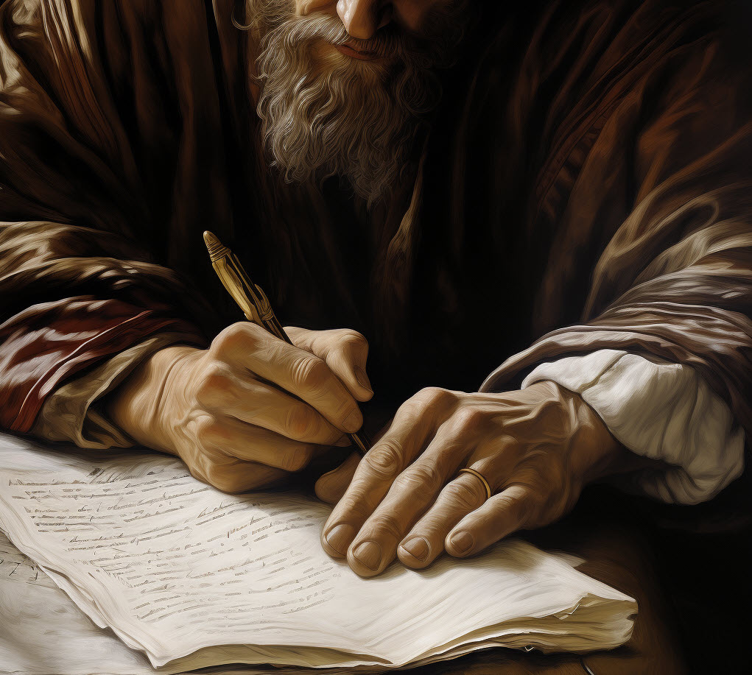
An Eye-Witness
3. When had he been an eye-witness of Christ’s majesty as it will be displayed at His second coming?
2 Peter 1:17–18

Slide 9
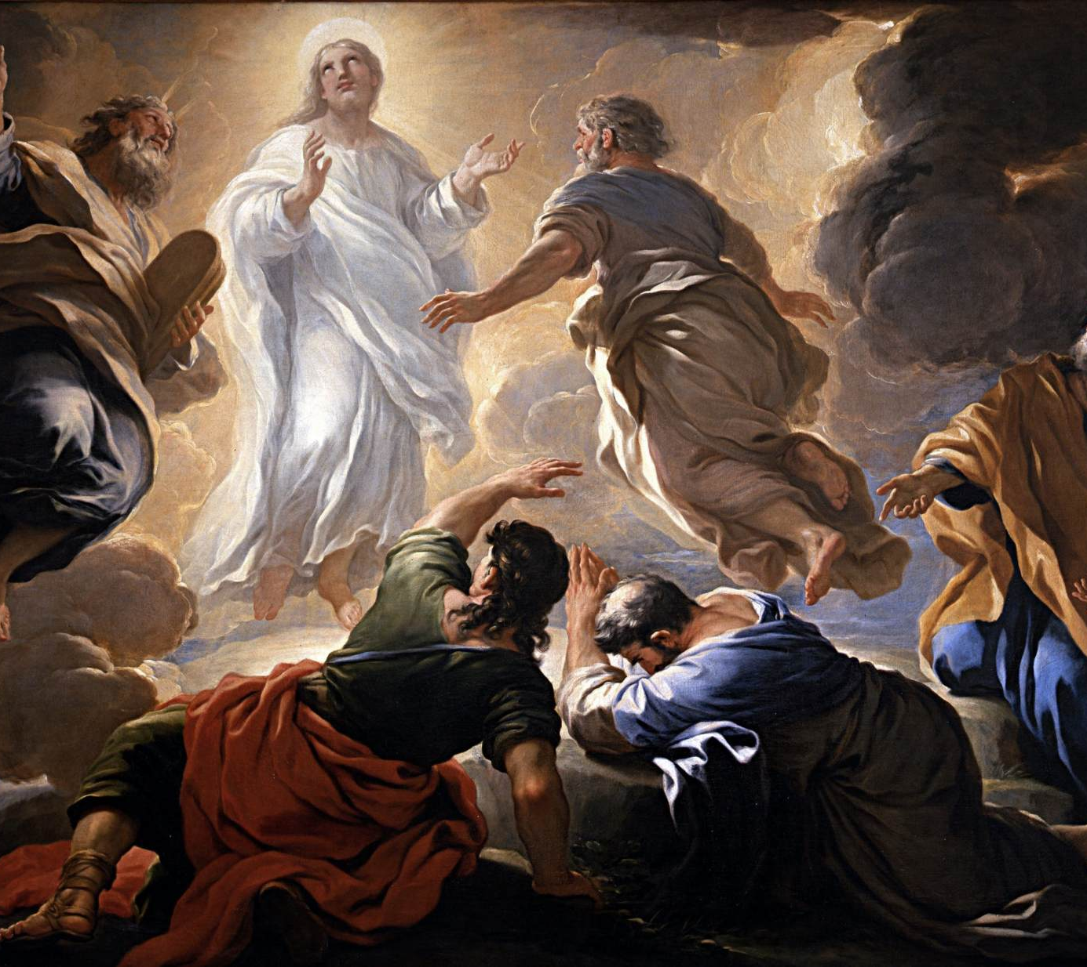
An Eye-Witness
2 Peter 1:17
For he received from God the Father honour and glory, when there came such a voice to him from the excellent glory, This is my beloved Son, in whom I am well pleased.

Slide 10
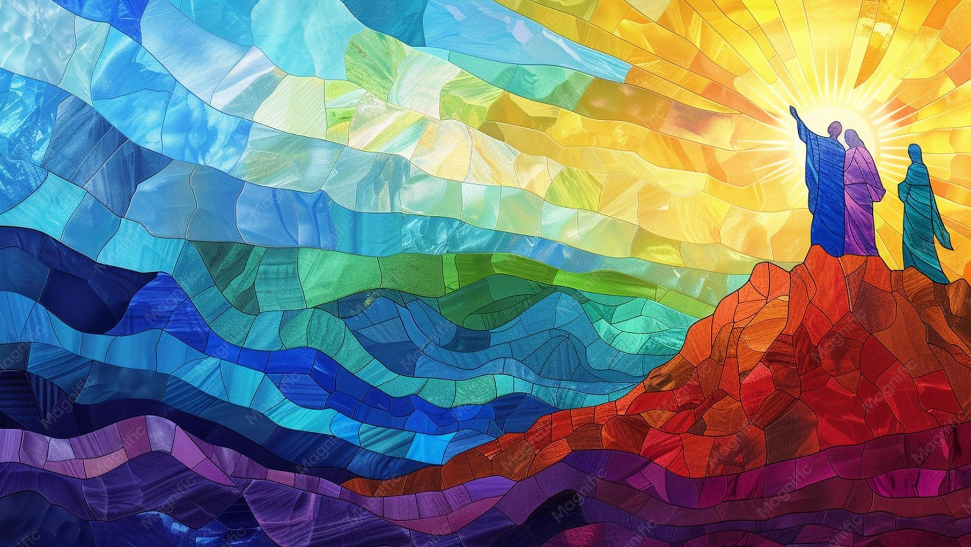
An Eye-Witness
2 Peter 1:18
And this voice which came from heaven we heard, when we were with him in the holy mount.

Slide 11
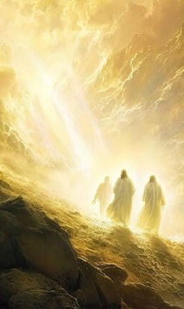
An Eye-Witness
4. State the details of this occurrence.
Matthew 17:1–5;
Mark 9:2–8;
Luke 9:28–36

Slide 12
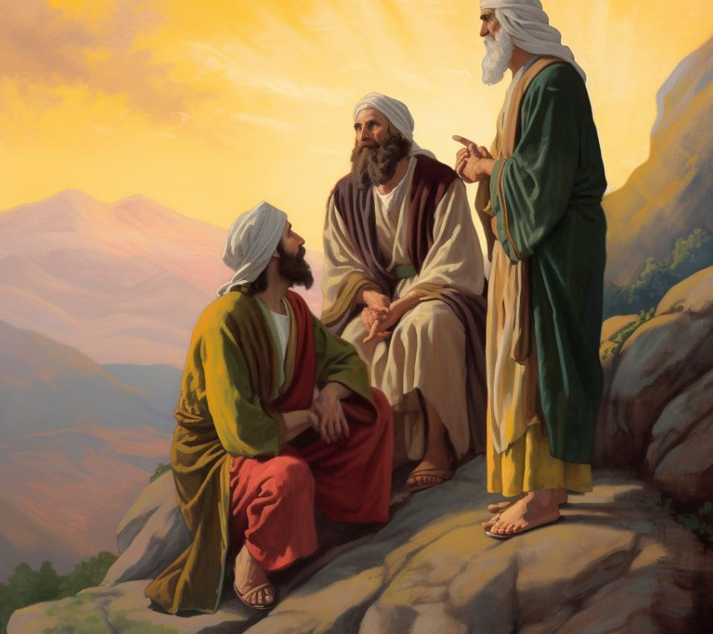
An Eye-Witness
Matthew 17:1
And after six days Jesus taketh Peter, James, and John his brother, and bringeth them up into an high mountain apart,

Slide 13
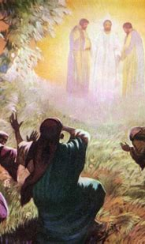
An Eye-Witness
Matthew 17:2
And was transfigured before them: and his face did shine as the sun, and his raiment was white as the light.

Slide 14
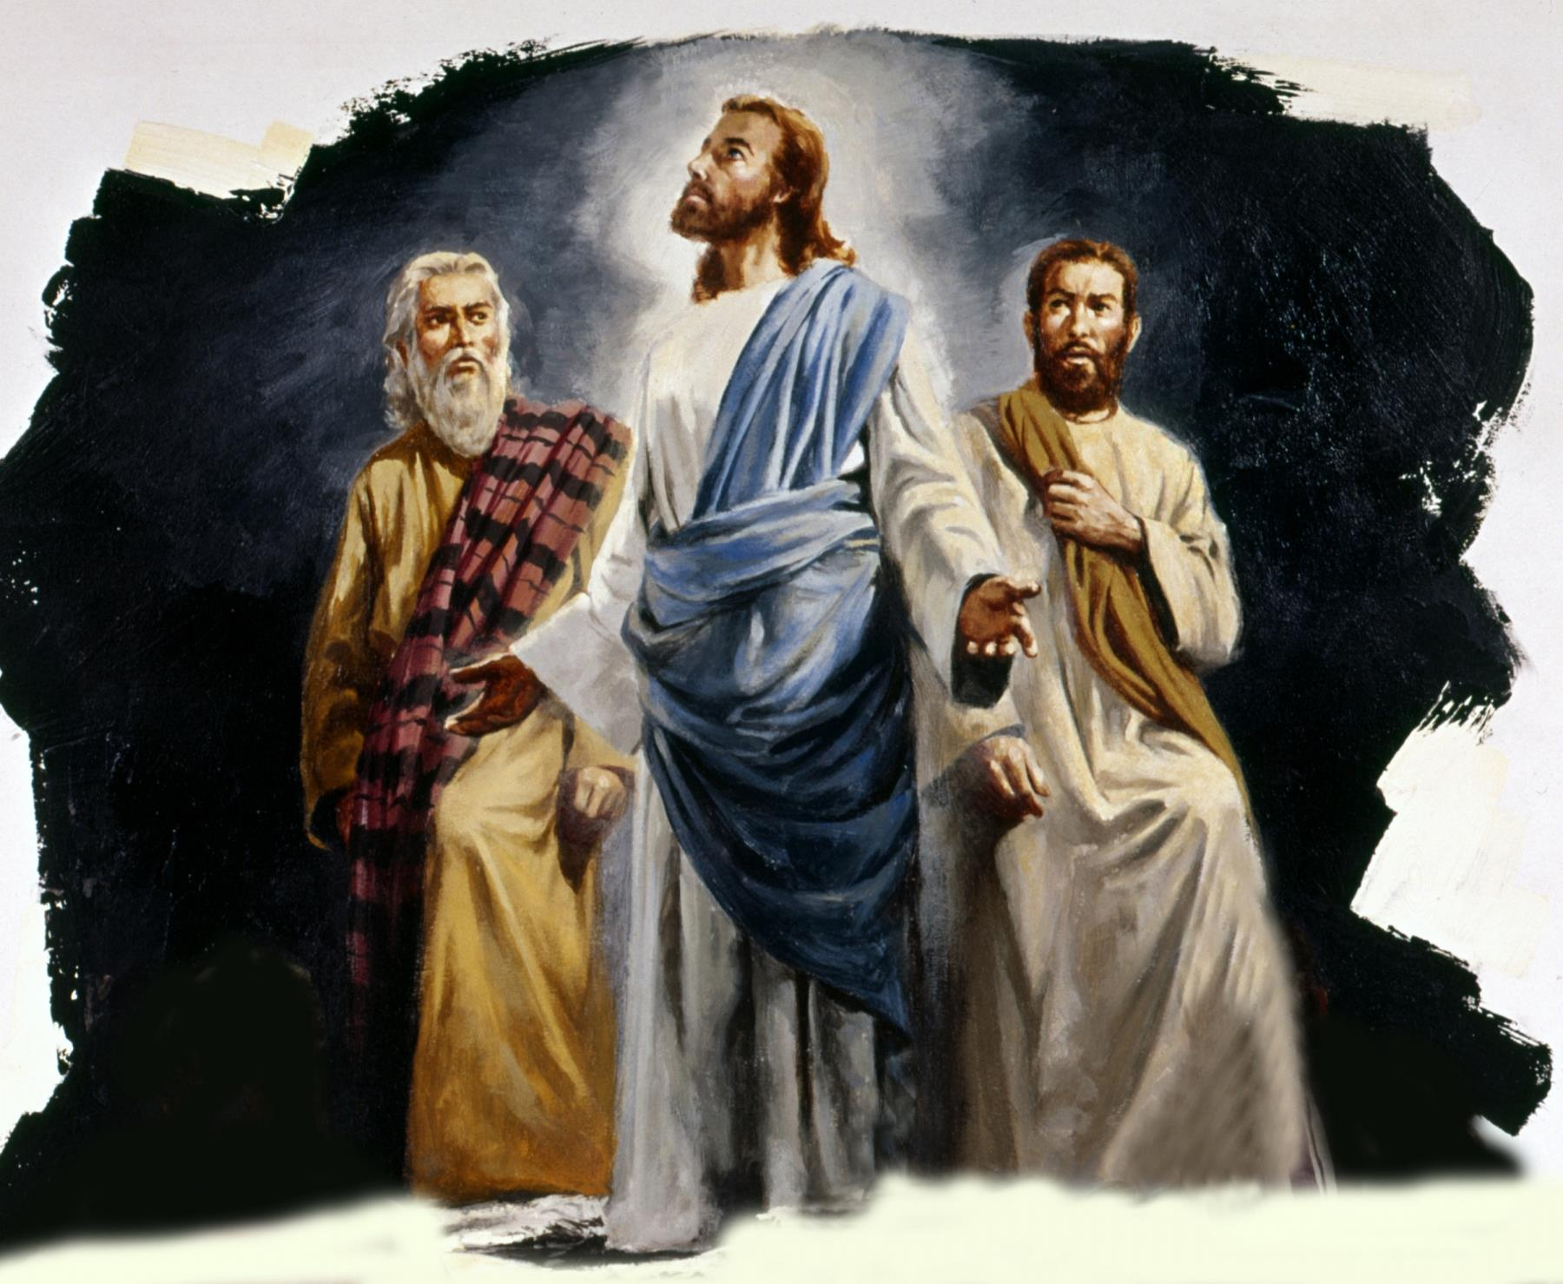
An Eye-Witness
Matthew 17:3
And, behold, there appeared unto them Moses and Elias talking with him.

Slide 15
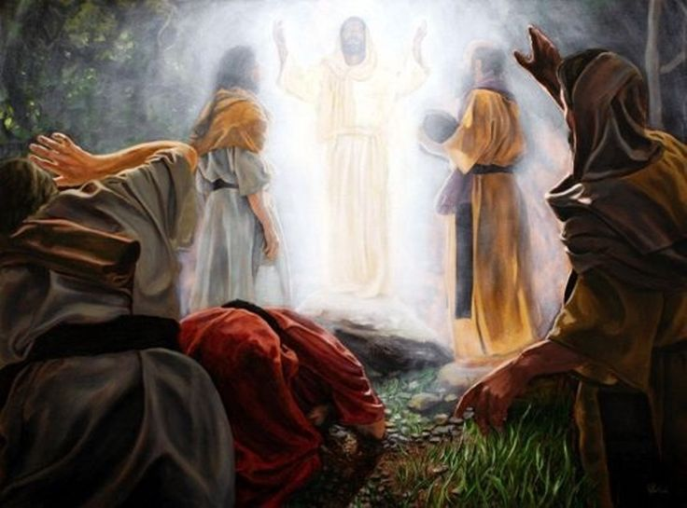
An Eye-Witness
Matthew 17:4
⁴ Then answered Peter, and said unto Jesus, Lord, it is good for us to be here: if thou wilt, let us make here three tabernacles; one for thee, and one for Moses, and one for Elias.

Slide 16
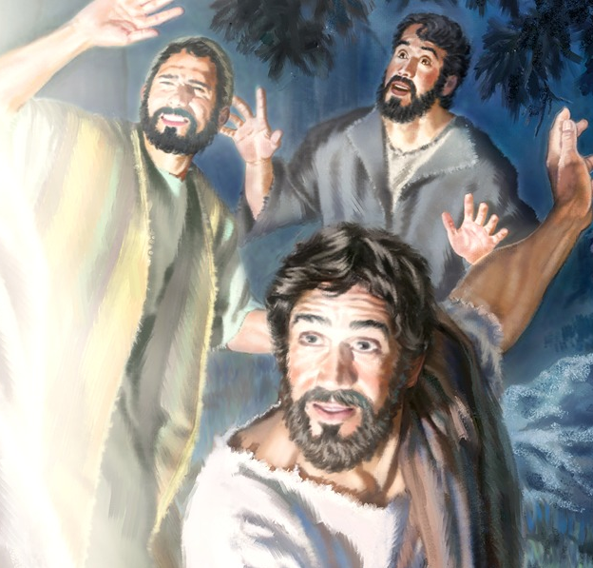
An Eye-Witness
Matthew 17:5
While he yet spake, behold, a bright cloud overshadowed them: and behold a voice out of the cloud, which said, This is my beloved Son, in whom I am well pleased; hear ye him.

Slide 17

An Eye-Witness
Mark 9:2-8
² And after six days Jesus taketh with him Peter, and James, and John, and leadeth them up into an high mountain apart by themselves: and he was transfigured before them.

Slide 18
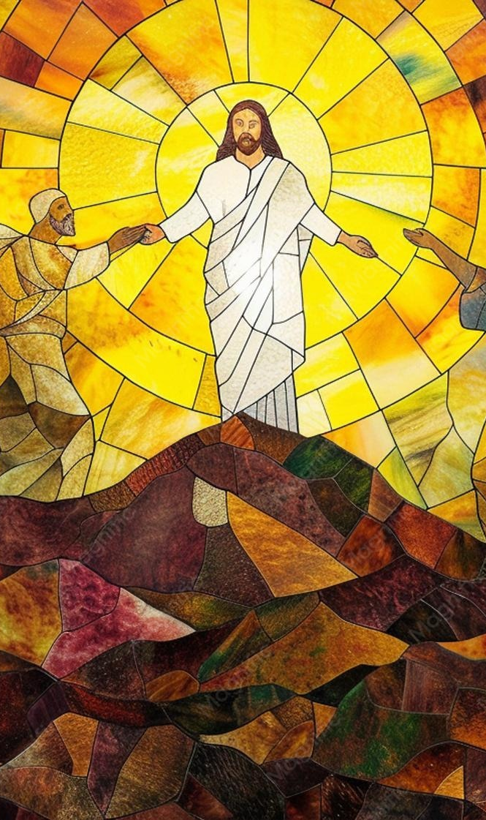
An Eye-Witness
Mark 9:2-8
³ And his raiment became shining, exceeding white as snow; so as no fuller on earth can white them.
⁴ And there appeared unto them Elias with Moses: and they were talking with Jesus.

Slide 19
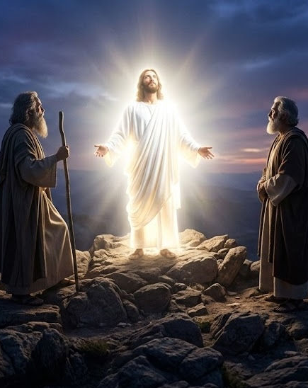
An Eye-Witness
Mark 9:2-8
⁵ And Peter answered and said to Jesus, Master, it is good for us to be here: and let us make three tabernacles; one for thee, and one for Moses, and one for Elias.
⁶ For he wist not what to say; for they were sore afraid.

Slide 20
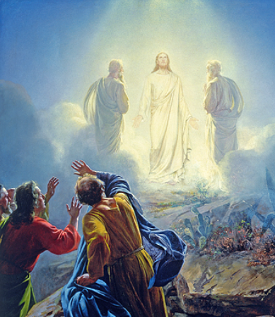
An Eye-Witness
Mark 9:2-8
⁷ And there was a cloud that overshadowed them: and a voice came out of the cloud, saying, This is my beloved Son: hear him.

Slide 21
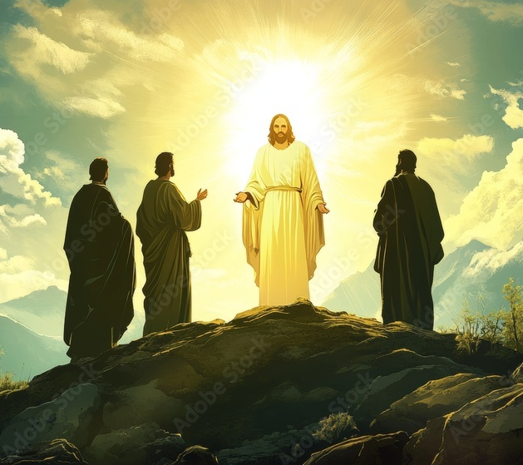
An Eye-Witness
Mark 9:2-8
⁸ And suddenly, when they had looked round about, they saw no man any more, save Jesus only with themselves.

Slide 22
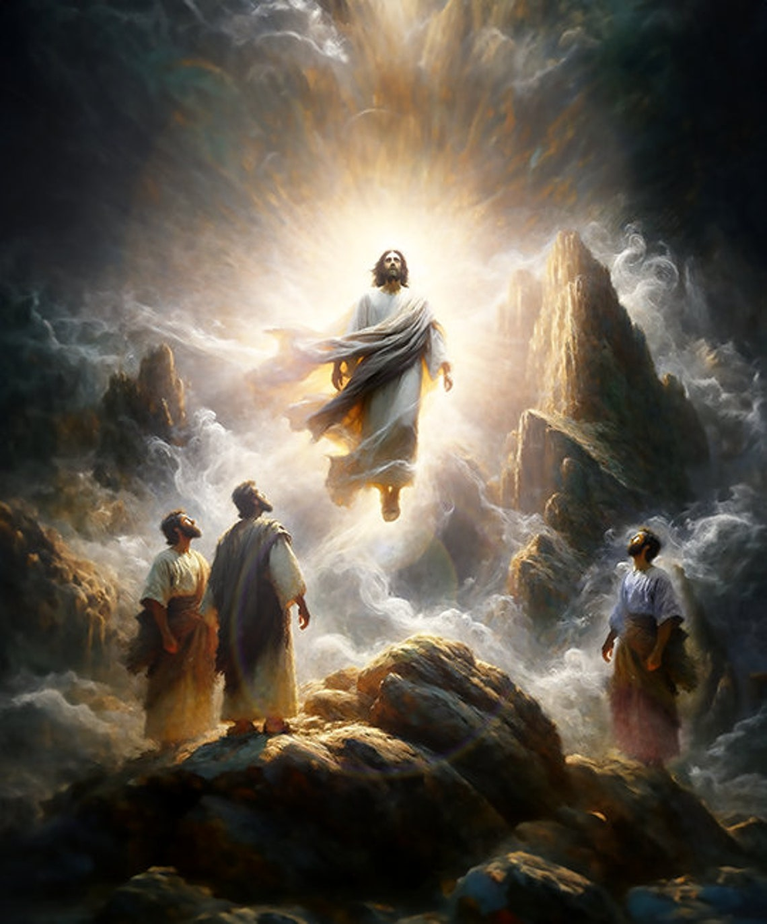
An Eye-Witness
Luke 9:28-36
²⁸ And it came to pass about an eight days after these sayings, he took Peter and John and James, and went up into a mountain to pray.
²⁹ And as he prayed, the fashion of his countenance was altered, and his raiment was white and glistering.

Slide 23
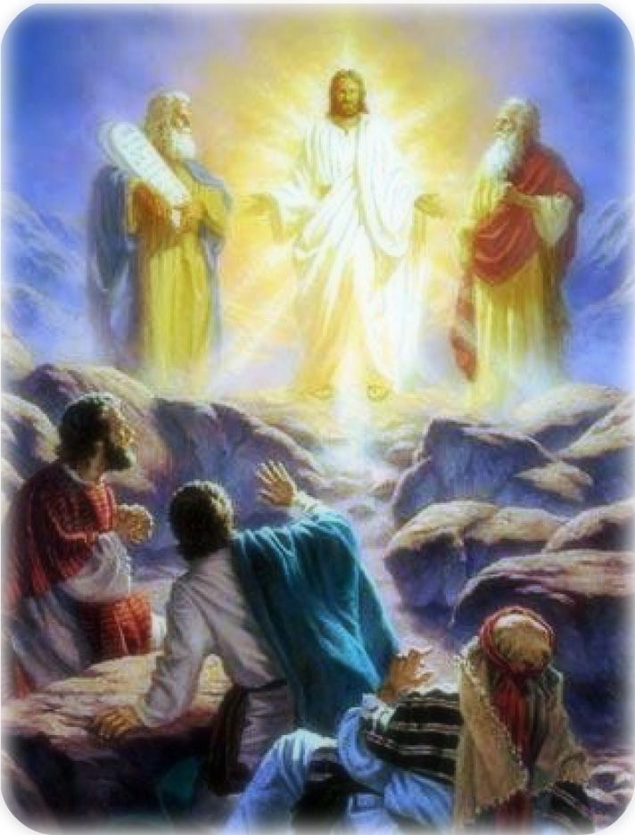
An Eye-Witness
Luke 9:28-36
³⁰ And, behold, there talked with him two men, which were Moses and Elias:
³¹ Who appeared in glory, and spake of his decease which he should accomplish at Jerusalem.

Slide 24
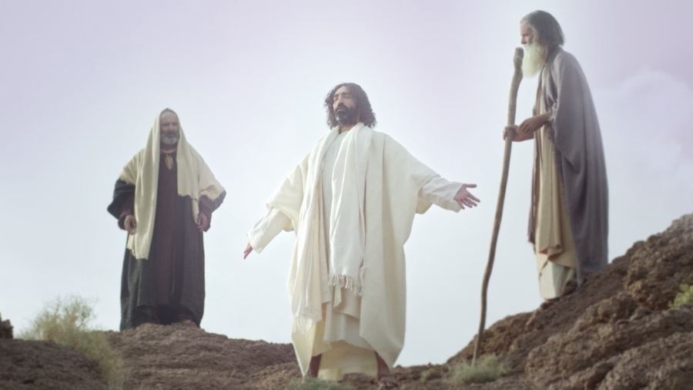
An Eye-Witness
Luke 9:28-36
³² But Peter and they that were with him were heavy with sleep: and when they were awake, they saw his glory, and the two men that stood with him.

Slide 25
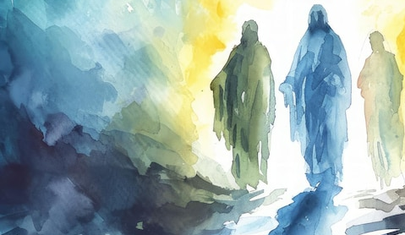
An Eye-Witness
Luke 9:28-36
³³ And it came to pass, as they departed from him, Peter said unto Jesus, Master, it is good for us to be here: and let us make three tabernacles; one for thee, and one for Moses, and one for Elias: not knowing what he said.

Slide 26
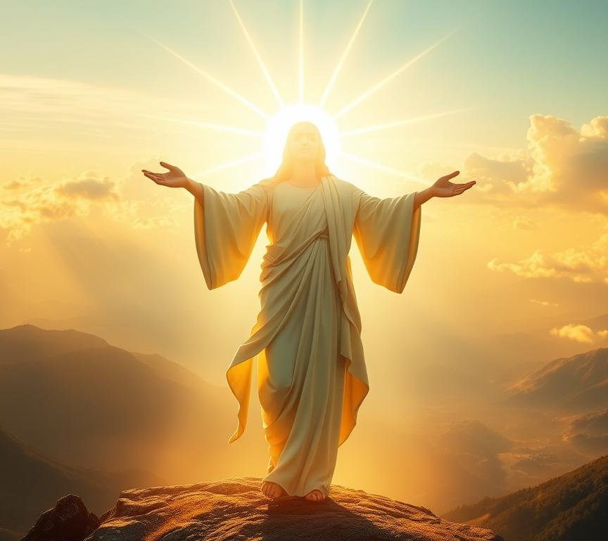
An Eye-Witness
Luke 9:28-36
³⁴ While he thus spake, there came a cloud, and overshadowed them: and they feared as they entered into the cloud.
³⁵ And there came a voice out of the cloud, saying, This is my beloved Son: hear him.

Slide 27
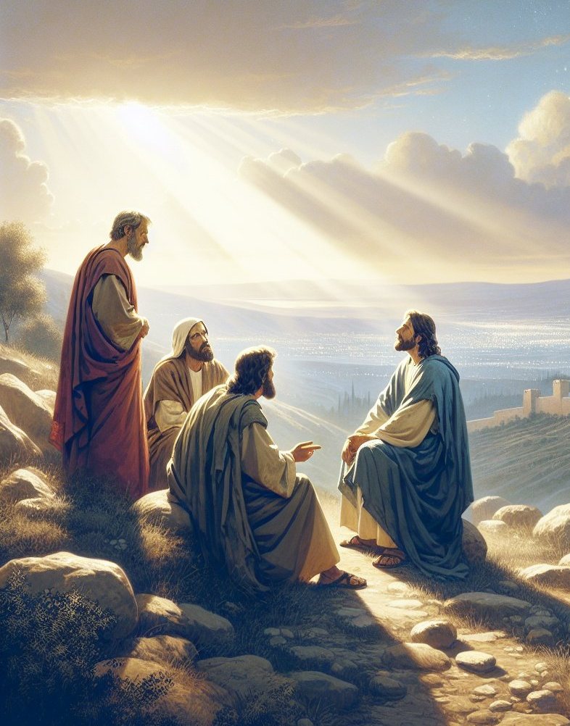
An Eye-Witness
Luke 9:28-36
³⁶ And when the voice was past, Jesus was found alone. And they kept it close, and told no man in those days any of those things which they had seen.

Slide 28
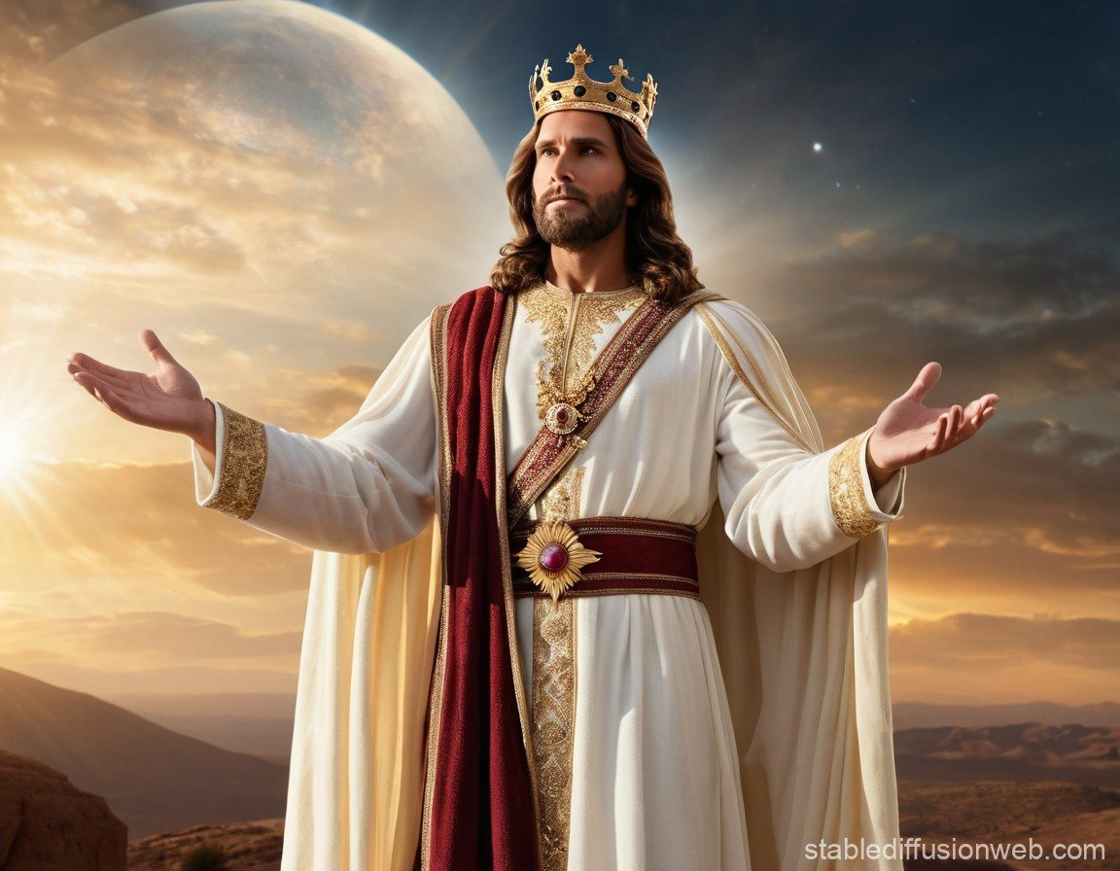
An Eye-Witness
5. What had Jesus previously said which also shows that the transfiguration was a representation of the second coming of Christ?
Matthew 16:28; Mark 9:1

Slide 29
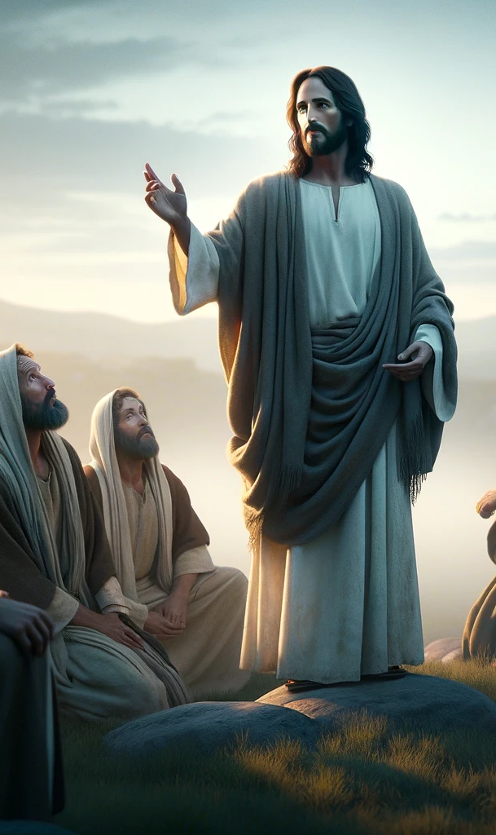
An Eye-Witness
Matthew 16:28
Verily I say unto you, There be some standing here, which shall not taste of death, till they see the Son of man coming in his kingdom.

Slide 30
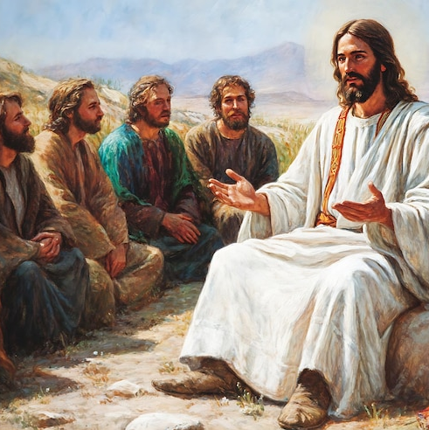
An Eye-Witness
Mark 9:1
And he said unto them, Verily I say unto you, That there be some of them that stand here, which shall not taste of death, till they have seen the kingdom of God come with power.

Slide 31
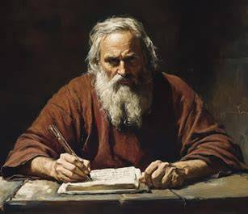
More Sure
6. Is it possible to have any better evidence than that given to Peter, James, and John?
2 Peter 1:19

Slide 32
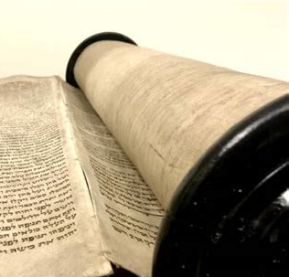
More Sure
2 Peter 1:19
¹⁹ We have also a more sure word of prophecy; whereunto ye do well that ye take heed, as unto a light that shineth in a dark place, until the day dawn, and the day star arise in your hearts:

Slide 33
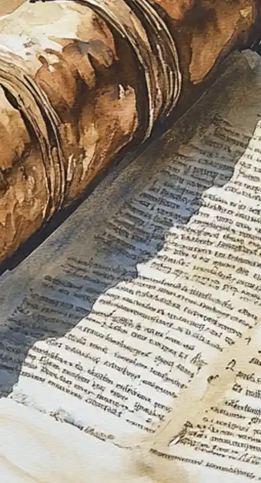
More Sure
7. What office does the word of prophecy serve to us?
2 Peter 1:19;
Psalm 119:105

Slide 34
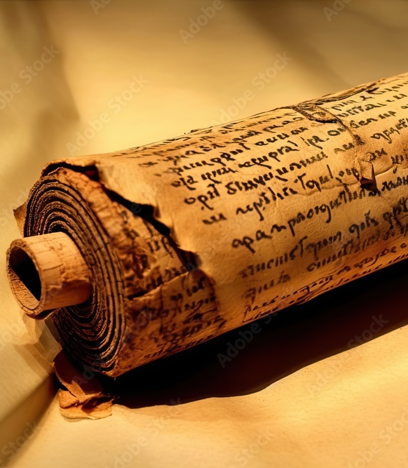
More Sure
2 Peter 1:19
¹⁹ We have also a more sure word of prophecy; whereunto ye do well that ye take heed, as unto a light that shineth in a dark place, until the day dawn, and the day star arise in your hearts:

Slide 35
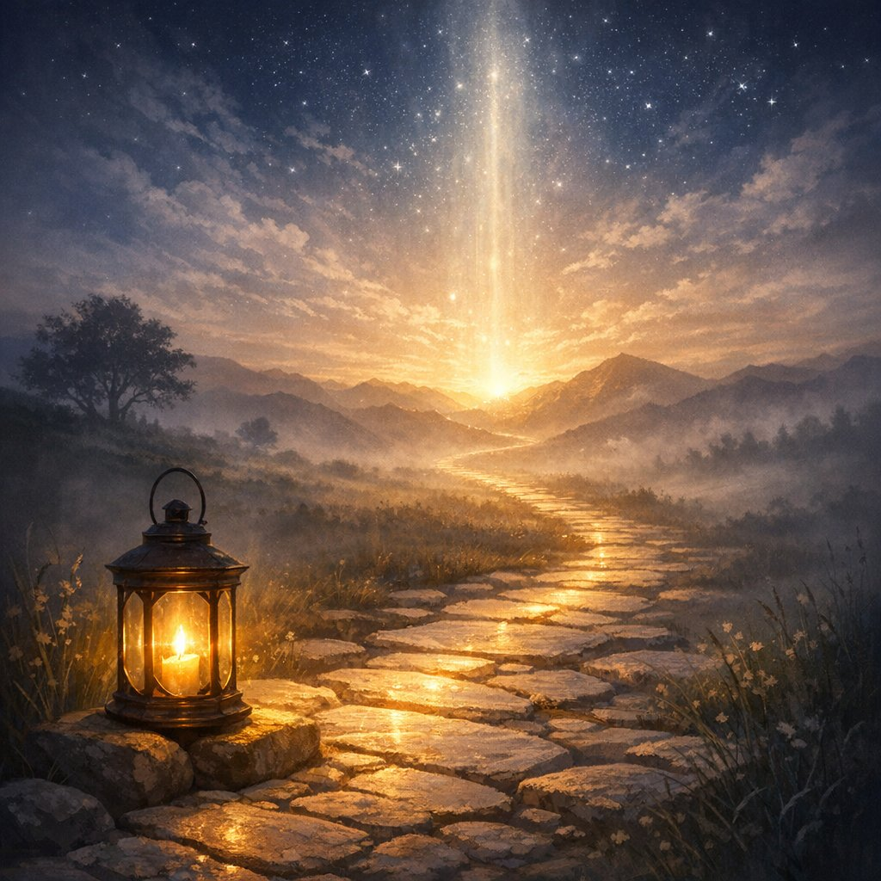
More Sure
Psalm 119:105
Thy word is a lamp unto my feet, and a light unto my path.

Slide 36
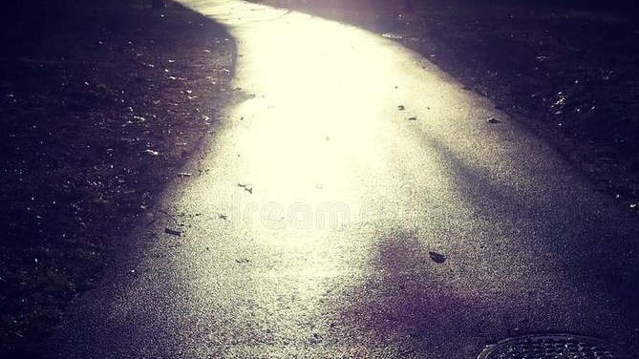
More Sure
8. How long will it shine to show us the way?
2 Peter 1:19

Slide 37

More Sure
2 Peter 1:19
¹⁹ We have also a more sure word of prophecy; whereunto ye do well that ye take heed, as unto a light that shineth in a dark place, until the day dawn, and the day star arise in your hearts:

Slide 38
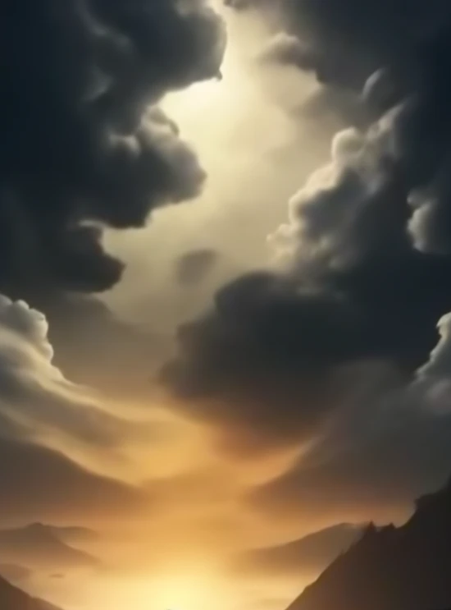
Day Star
9. In what period are we living, that a light should be necessary?
Romans 13:12;
Isaiah 60:2

Slide 39
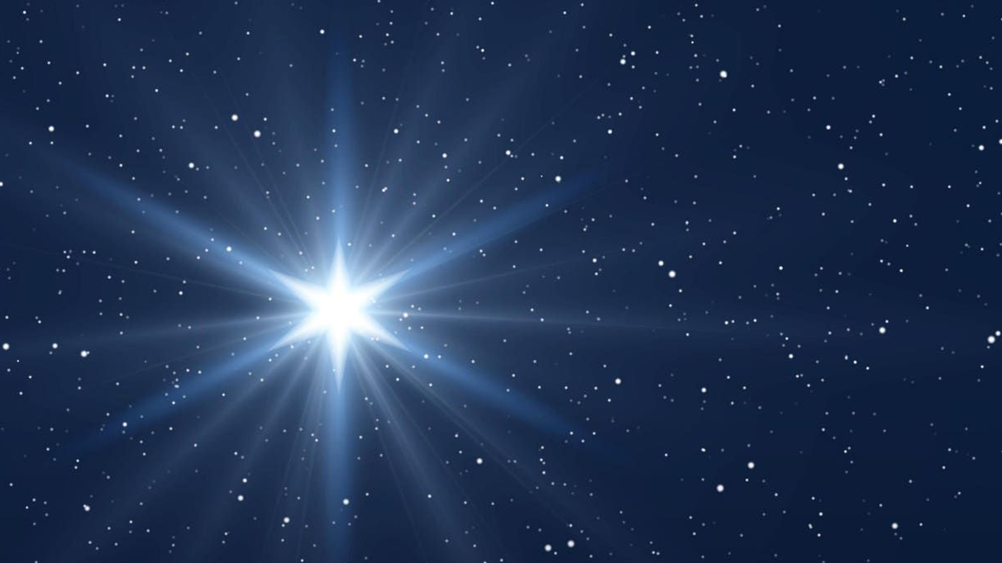
Day Star
Romans 13:12
¹² The night is far spent, the day is at hand: let us therefore cast off the works of darkness, and let us put on the armour of light.

Slide 40
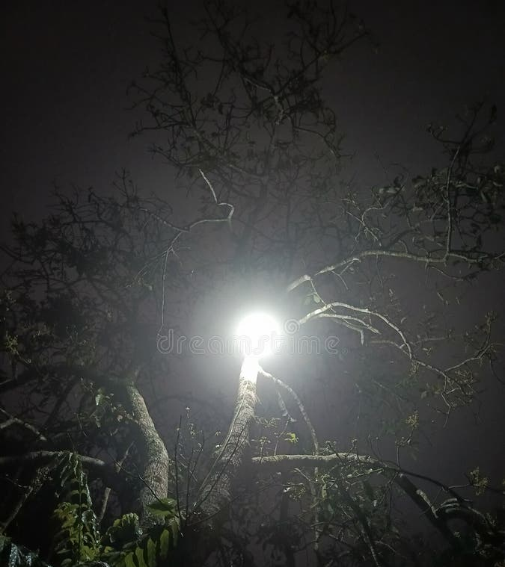
Day Star
Isaiah 60:2
² For, behold, the darkness shall cover the earth, and gross darkness the people: but the Lord shall arise upon thee, and his glory shall be seen upon thee.

Slide 41
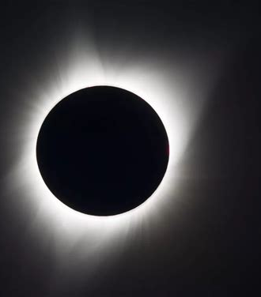
Day Star
10. What has brought about this night of darkness?
Romans 1:21

Slide 42
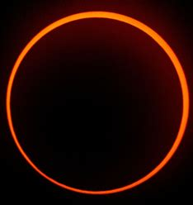
Day Star
Romans 1:21
²¹ Because that, when they knew God, they glorified him not as God, neither were thankful; but became vain in their imaginations, and their foolish heart was darkened.

Slide 43
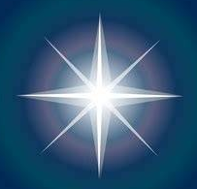
Day Star
11. Who is the day-star?
Revelation 22:16; John 8:12

Slide 44
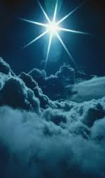
Day Star
Revelation 22:16
¹⁶ I Jesus have sent mine angel to testify unto you these things in the churches. I am the root and the offspring of David, and the bright and morning star.

Slide 45
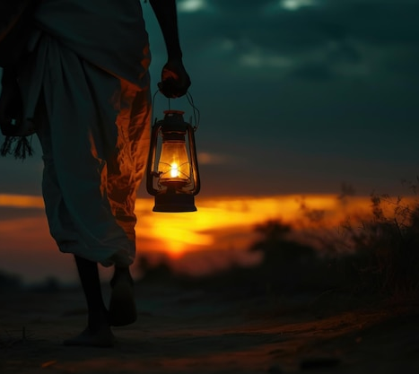
Day Star
John 8:12
¹² Then spake Jesus again unto them, saying, I am the light of the world: he that followeth me shall not walk in darkness, but shall have the light of life.

Slide 46

The Sure Word
12. Can any prophecy be interpreted by the unaided knowledge of any man?
2 Peter 1:20

Slide 47
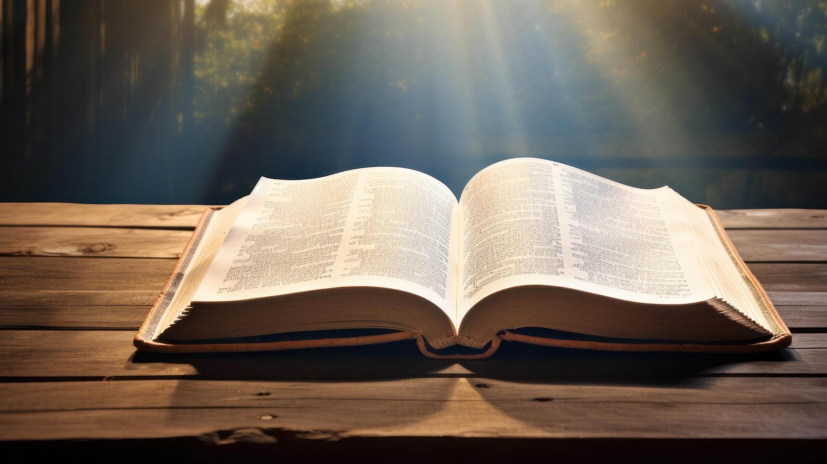
The Sure Word
2 Peter 1:20
²⁰ Knowing this first, that no prophecy of the scripture is of any private interpretation.

Slide 48

The Sure Word
13. Why not?
2 Peter 1:21

Slide 49
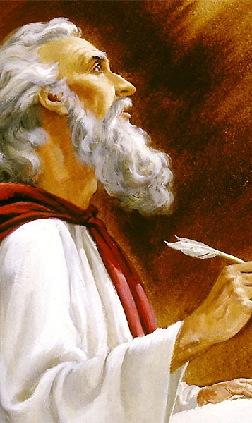
The Sure Word
2 Peter 1:21
²¹ For the prophecy came not in old time by the will of man: but holy men of God spake as they were moved by the Holy Ghost.

Slide 50

The Sure Word
14. What connection has the light of prophecy with the day-star, the light of the world?
2 Peter 1:19–21; 1 Peter 1:10–11

Slide 51
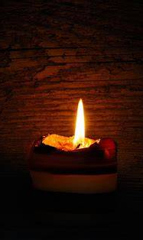
More Sure
2 Peter 1:19
¹⁹ We have also a more sure word of prophecy; whereunto ye do well that ye take heed, as unto a light that shineth in a dark place, until the day dawn, and the day star arise in your hearts:

Slide 52
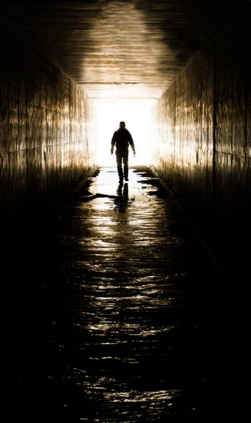
The Sure Word
2 Peter 1:20
²⁰ Knowing this first, that no prophecy of the scripture is of any private interpretation.

Slide 53
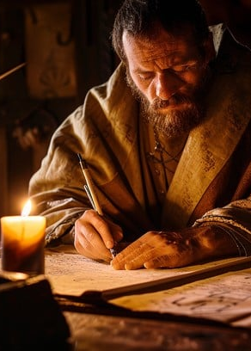
The Sure Word
2 Peter 1:21
²¹ For the prophecy came not in old time by the will of man: but holy men of God spake as they were moved by the Holy Ghost.

Slide 54
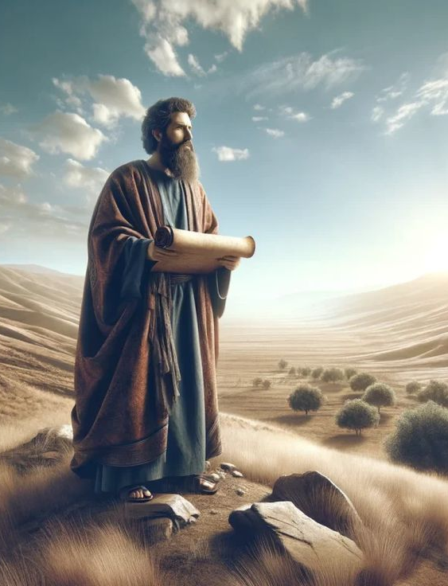
The Sure Word
1 Peter 1:10
¹⁰ Of which salvation the prophets have enquired and searched diligently, who prophesied of the grace that should come unto you:

Slide 55
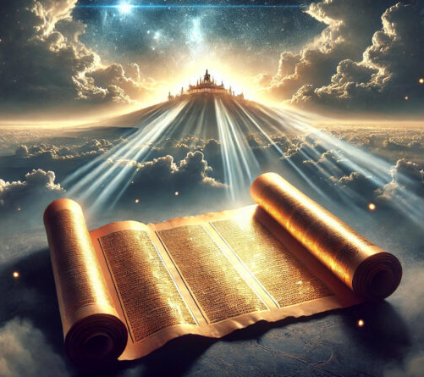
The Sure Word
1 Peter 1:11
¹¹ Searching what, or what manner of time the Spirit of Christ which was in them did signify, when it testified beforehand the sufferings of Christ, and the glory that should follow.

Slide 56
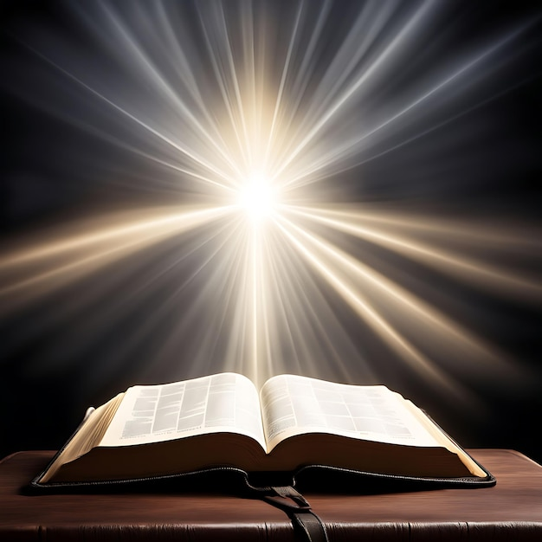
The Sure Word
15. Why cannot all the world see this light?
1 Corinthians 2:14;
2 Corinthians 4:3–4

Slide 57

The Sure Word
1 Corinthians 2:14
¹⁴ But the natural man receiveth not the things of the Spirit of God: for they are foolishness unto him: neither can he know them, because they are spiritually discerned.

Slide 58
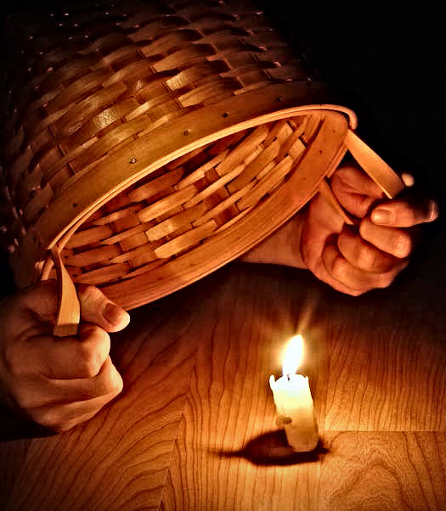
The Sure Word
2 Corinthians 4:3-4
³ But if our gospel be hid, it is hid to them that are lost:

Slide 59
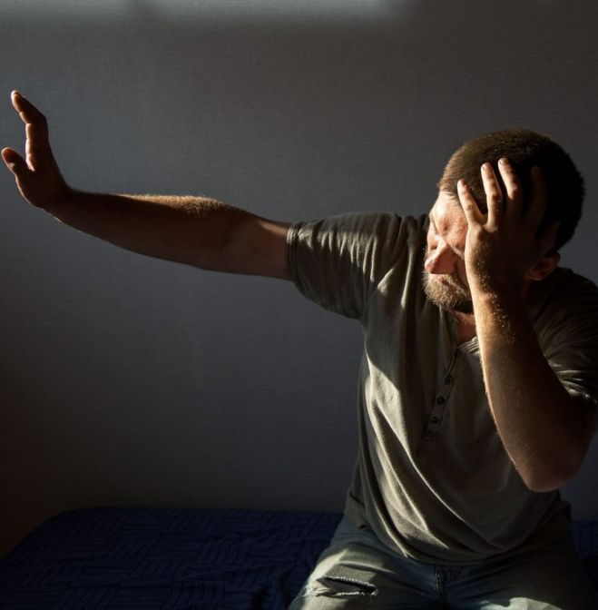
The Sure Word
2 Corinthians 4:3-4
⁴ In whom the god of this world hath blinded the minds of them which believe not, lest the light of the glorious gospel of Christ, who is the image of God, should shine unto them.

Slide 60

The Sure Word
16. What aid must we have in order to understand it?
1 Corinthians 2:9–10

Slide 61

The Sure Word
1 Corinthians 2:9
⁹ But as it is written, Eye hath not seen, nor ear heard, neither have entered into the heart of man, the things which God hath prepared for them that love him.

Slide 62

The Sure Word
1 Corinthians 2:10
¹⁰ But God hath revealed them unto us by his Spirit: for the Spirit searcheth all things, yea, the deep things of God.

Slide 63

The Sure Word
17. Having the aid of the Spirit, how must we proceed in our study?
1 Corinthians 2:13

Slide 64

The Sure Word
1 Corinthians 2:13
¹³ Which things also we speak, not in the words which man's wisdom teacheth, but which the Holy Ghost teacheth; comparing spiritual things with spiritual.

Slide 65
Thank you!
…and Happy Sabbath!!

Slide 66


