Slide 1


Slide 2


Slide 3
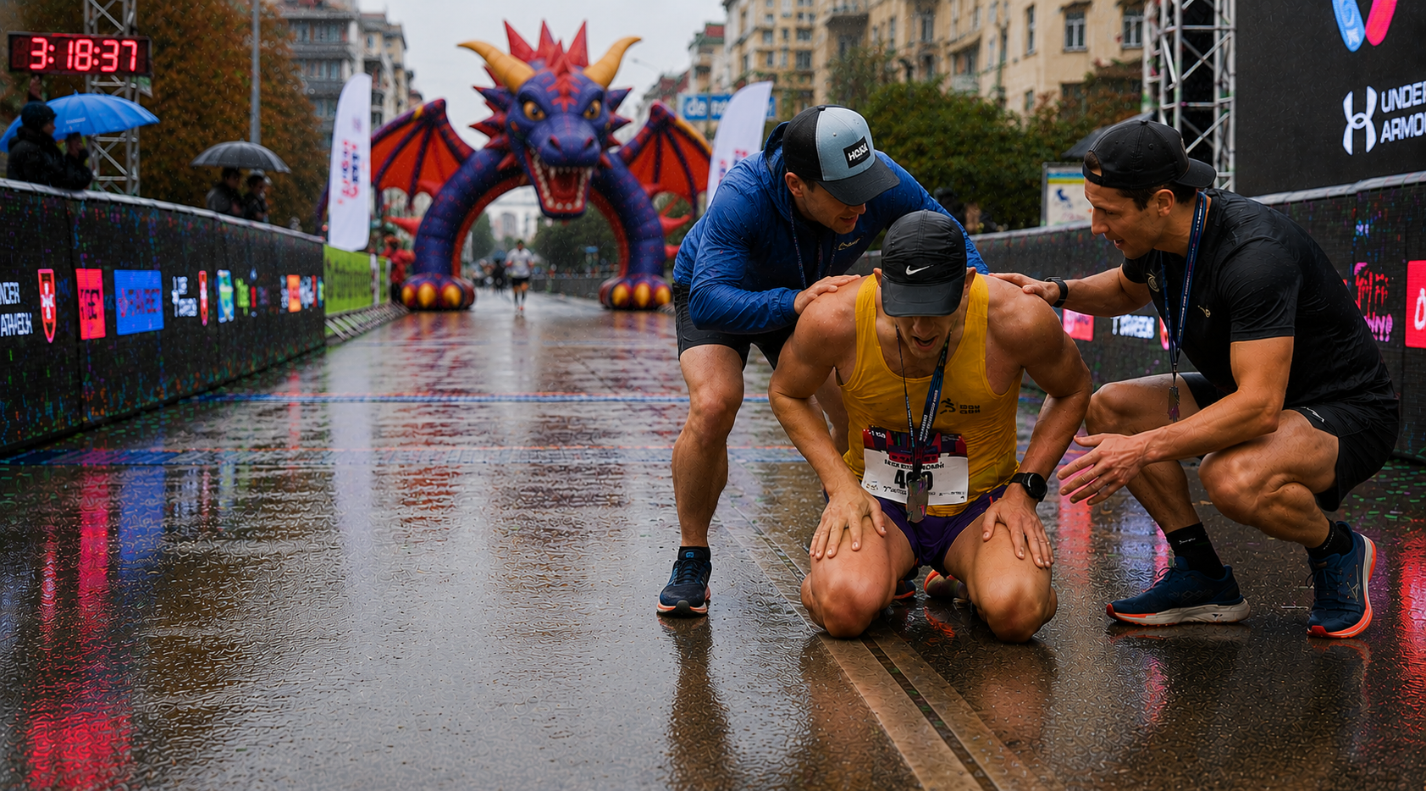

Slide 4
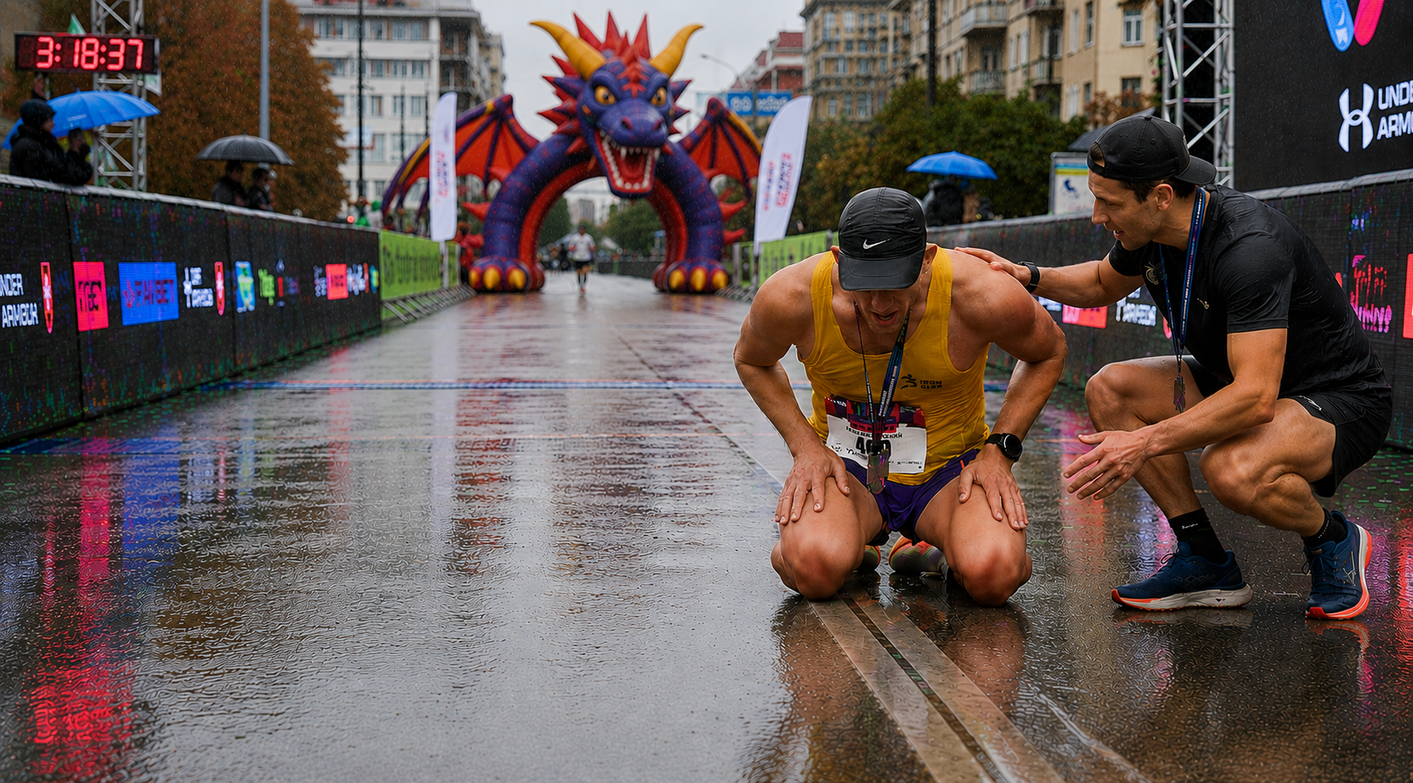

Slide 5
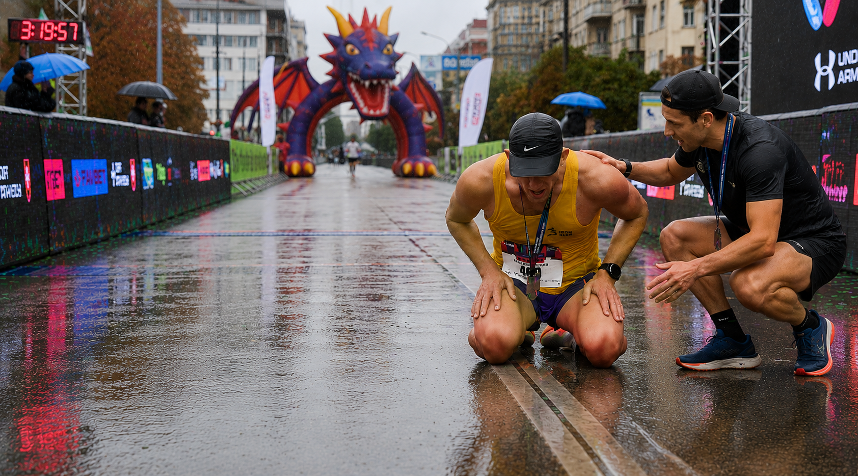

Slide 6


Slide 7


Slide 8


Slide 11
Lesson 6:
2 Peter 2:1-10
December 1, 1888

Slide 12

Ravenous wolves
1. What obstacles hindered the progress of truth "in old time"?
2 Peter 2:1, first clause

Slide 13
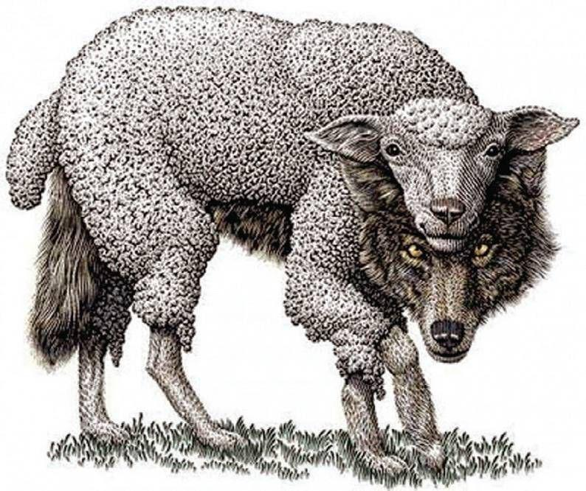
Ravenous wolves
2 Peter 2:1
2 But there were false prophets also among the people, even as there shall be false teachers among you, who privily shall bring in damnable heresies, even denying the Lord that bought them, and bring upon themselves swift destruction.

Slide 14
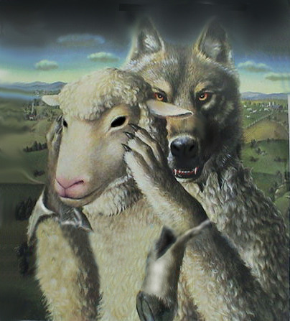
Ravenous wolves
2. What did Peter say there should still be among the people?
2 Peter 2:1

Slide 15
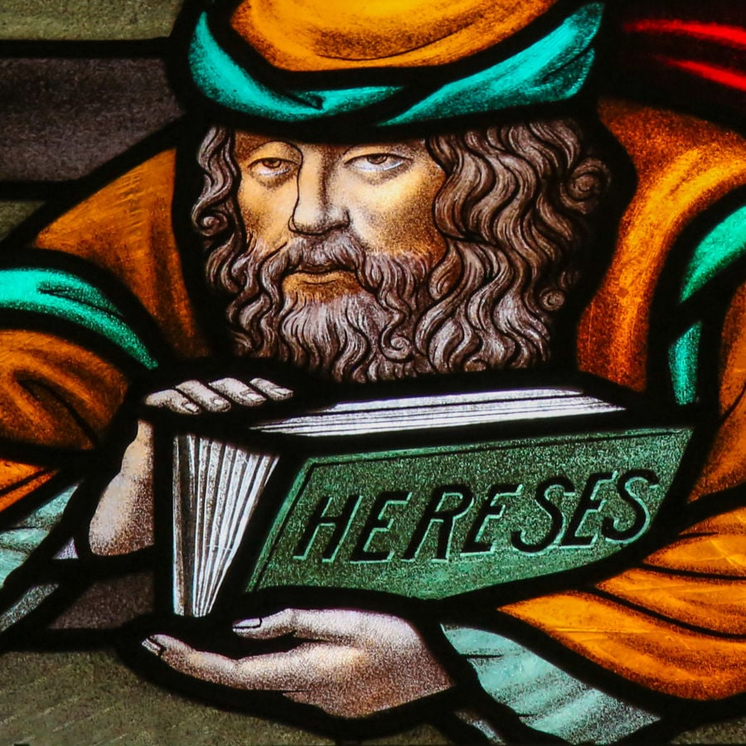
Ravenous wolves
2 Peter 2:1
2 But there were false prophets also among the people, even as there shall be false teachers among you, who privily shall bring in damnable heresies, even denying the Lord that bought them, and bring upon themselves swift destruction.

Slide 16
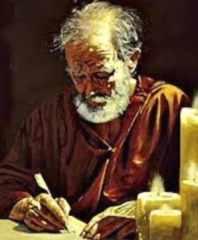
Ravenous wolves
3. What does he say of the character and work of these false teachers?
2 Peter 2:1

Slide 17
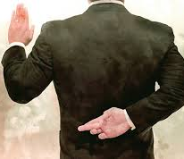
Ravenous wolves
2 Peter 2:1
2 But there were false prophets also among the people, even as there shall be false teachers among you, who privily shall bring in damnable heresies, even denying the Lord that bought them, and bring upon themselves swift destruction.

Slide 18

Ravenous wolves
4. Is it necessary that these false teachers who deny the Lord should be avowed disbelievers in him?
Titus 1:16

Slide 19

Ravenous wolves
Titus 1:16
¹⁶ They profess that they know God; but in works they deny him, being abominable, and disobedient, and unto every good work reprobate.

Slide 20
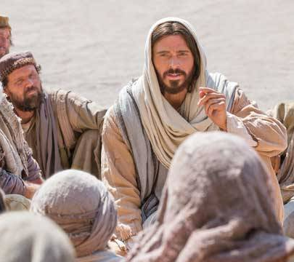
Ravenous wolves
5. What does Christ say will be the fate of such?
Matthew 7:22, 23.

Slide 21
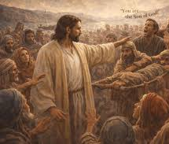
Ravenous wolves
Matthew 7:22-23
²² Many will say to me in that day, Lord, Lord, have we not prophesied in thy name? and in thy name have cast out devils? and in thy name done many wonderful works?

Slide 22
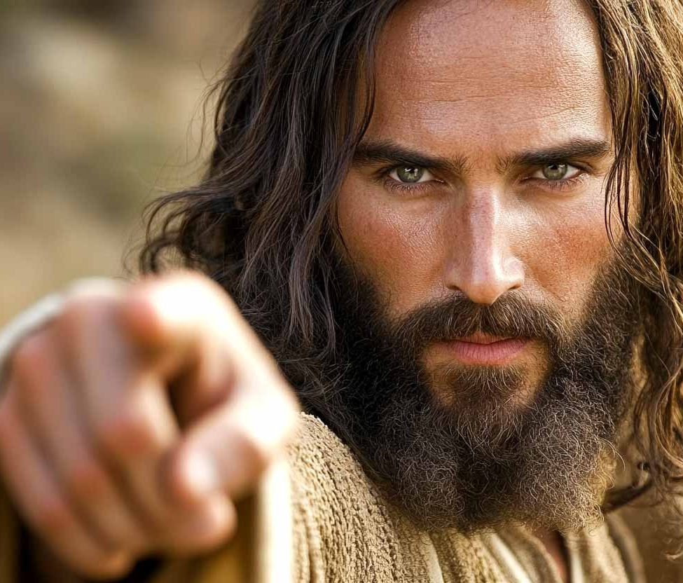
Ravenous wolves
Matthew 7:22-23
²³ And then will I profess unto them, I never knew you: depart from me, ye that work iniquity.

Slide 23
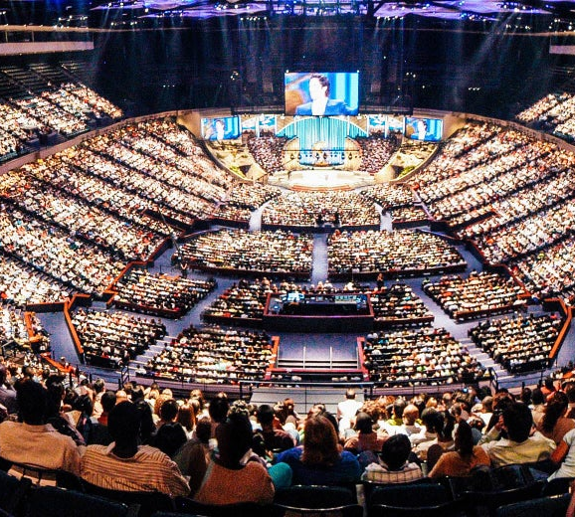
Ravenous wolves
6. How much following will such ones have?
2 Peter 2:2.

Slide 24
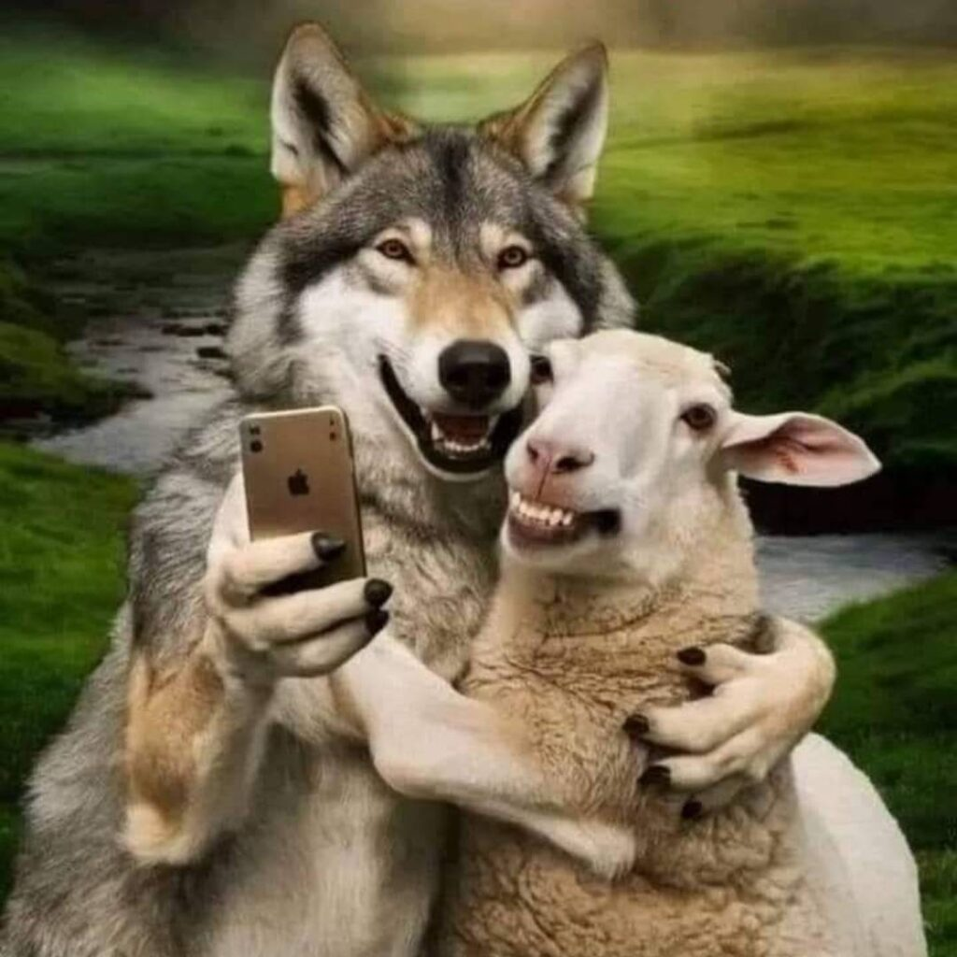
Ravenous wolves
2 Peter 2:2
² And many shall follow their pernicious ways; by reason of whom the way of truth shall be evil spoken of.

Slide 25

Ravenous wolves
7. What will be the result to the truth?
2 Peter 2:2.

Slide 26
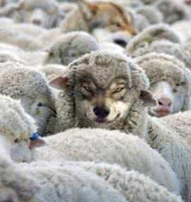
Ravenous wolves
2 Peter 2:2
² And many shall follow their pernicious ways; by reason of whom the way of truth shall be evil spoken of.

Slide 27
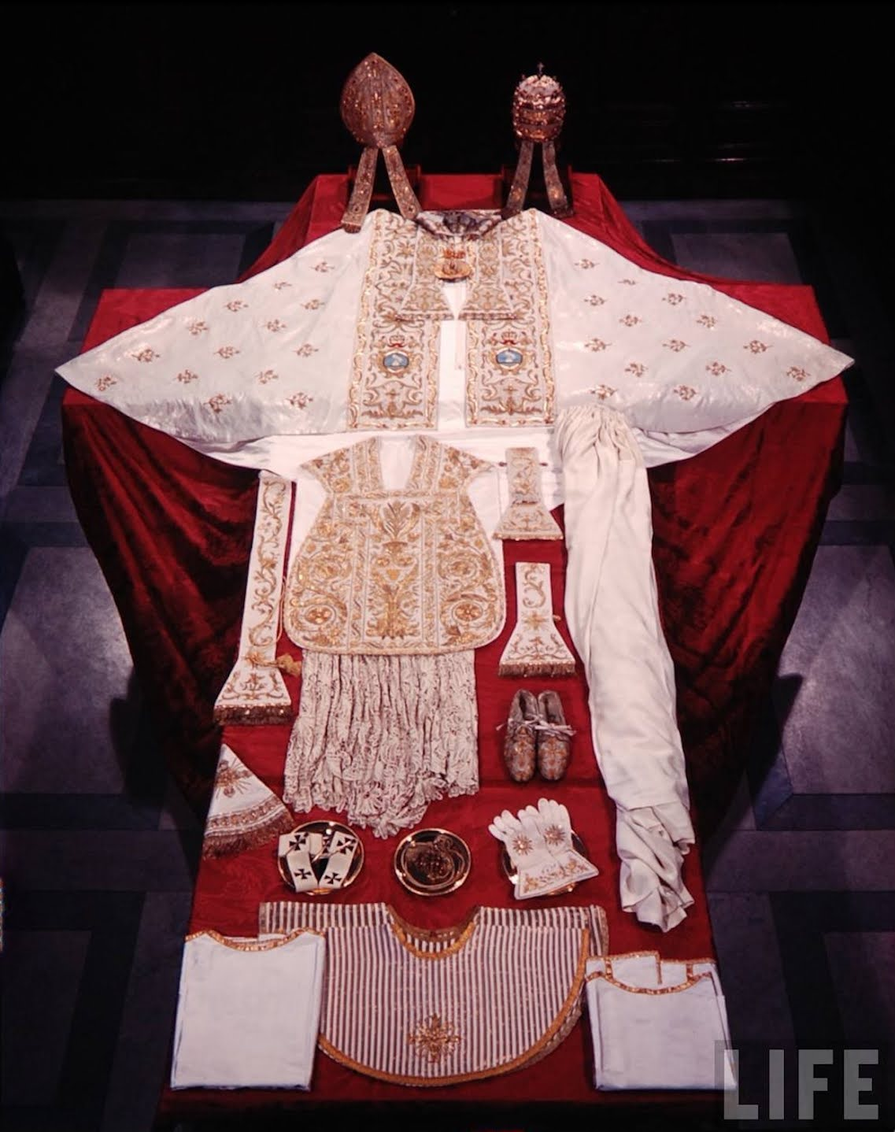
Ravenous wolves
8. What principle is it that leads these men to cover their licentiousness with the garb of religion?
2 Peter 2:3.

Slide 28
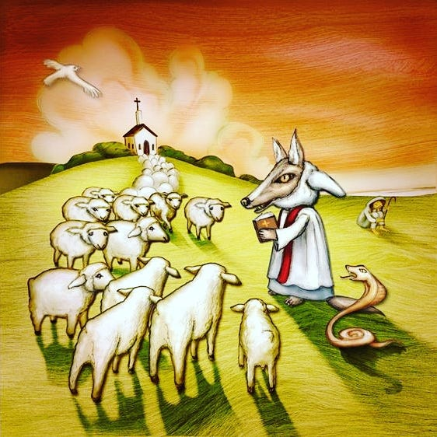
Ravenous wolves
2 Peter 2:3
³ And through covetousness shall they with feigned words make merchandise of you: whose judgment now of a long time lingereth not, and their damnation slumbereth not.

Slide 29

Ravenous wolves
9. When such ones flourish the most, what may we know concerning the time of retribution?
2 Peter 2:1, 3, last part of each.

Slide 30
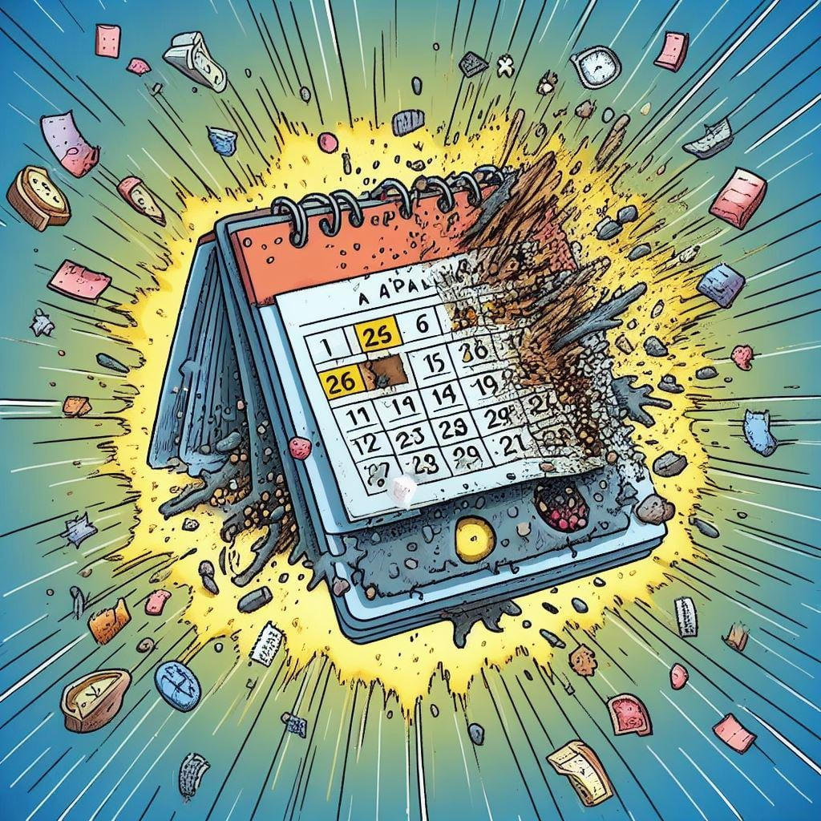
Ravenous wolves
2 Peter 2:1
2 But there were false prophets also among the people, even as there shall be false teachers among you, who privily shall bring in damnable heresies, even denying the Lord that bought them, and bring upon themselves swift destruction.

Slide 31

Ravenous wolves
2 Peter 2:3
³ And through covetousness shall they with feigned words make merchandise of you: whose judgment now of a long time lingereth not, and their damnation slumbereth not.

Slide 32
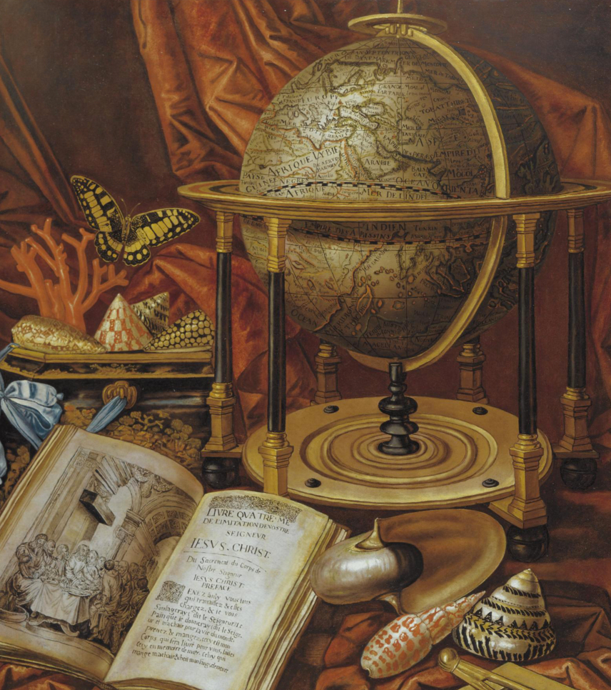
The History
10. What three great events of the past assure us that God will not allow them to go unpunished?
2 Peter 2:4-7, 9.

Slide 33
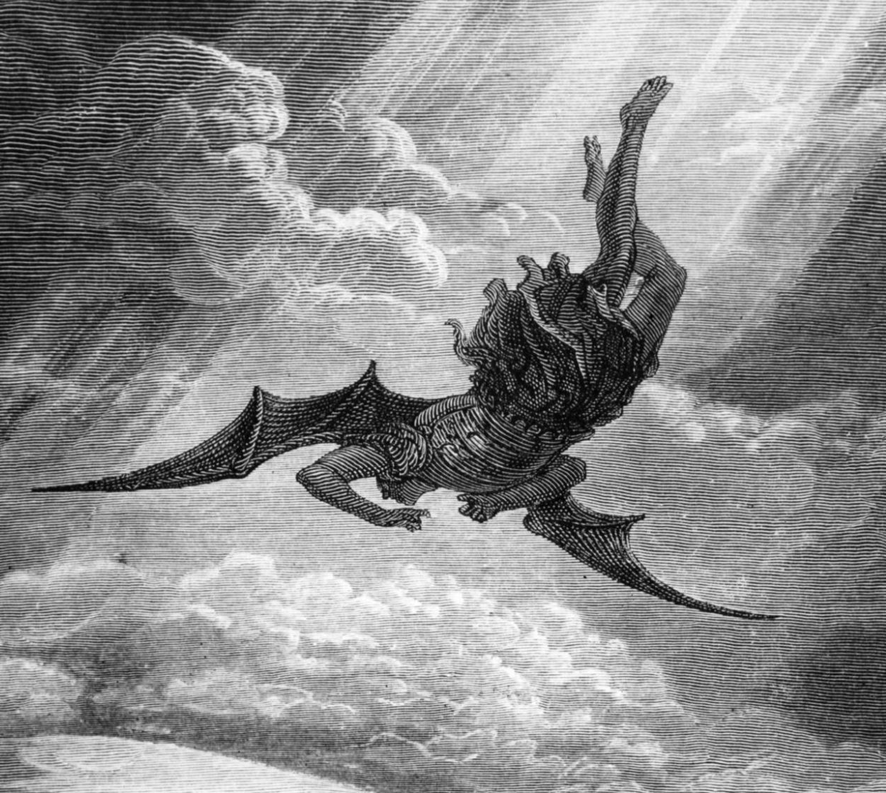
The History
2 Peter 2:4-7, 9
⁴ For if God spared not the angels that sinned, but cast them down to hell, and delivered them into chains of darkness, to be reserved unto judgment;

Slide 34
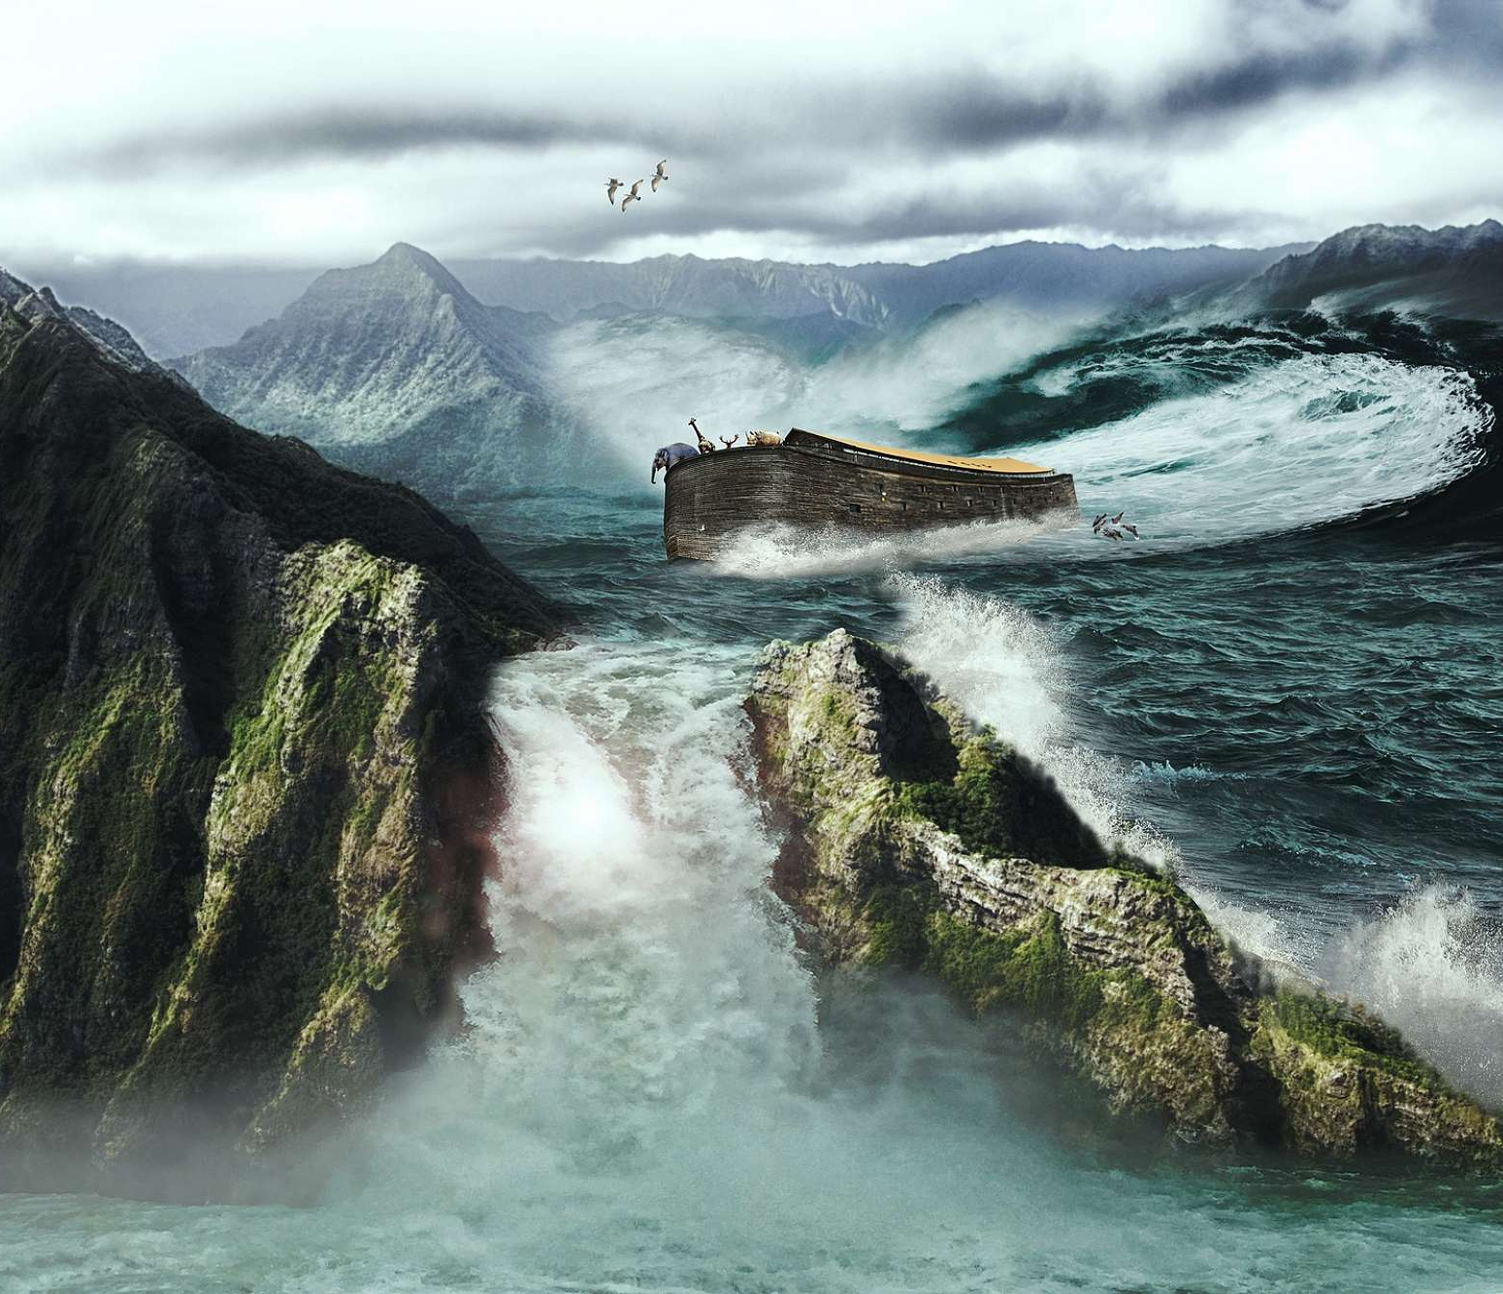
The History
2 Peter 2:4-7, 9
⁵ And spared not the old world, but saved Noah the eighth person, a preacher of righteousness, bringing in the flood upon the world of the ungodly;

Slide 35
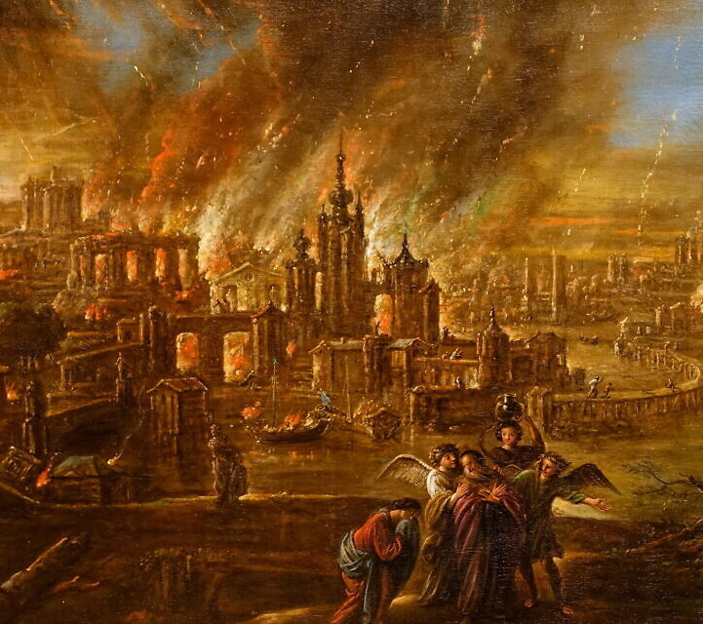
The History
2 Peter 2:4-7, 9
⁶ And turning the cities of Sodom and Gomorrha into ashes condemned them with an overthrow, making them an ensample unto those that after should live ungodly;

Slide 36
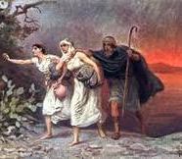
The History
2 Peter 2:4-7, 9
⁷ And delivered just Lot, vexed with the filthy conversation of the wicked:

Slide 37
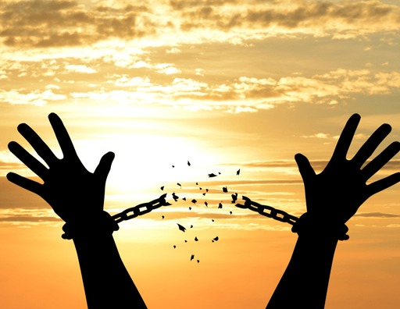
The History
2 Peter 2:4-7, 9
⁹ The Lord knoweth how to deliver the godly out of temptations, and to reserve the unjust unto the day of judgment to be punished:

Slide 38
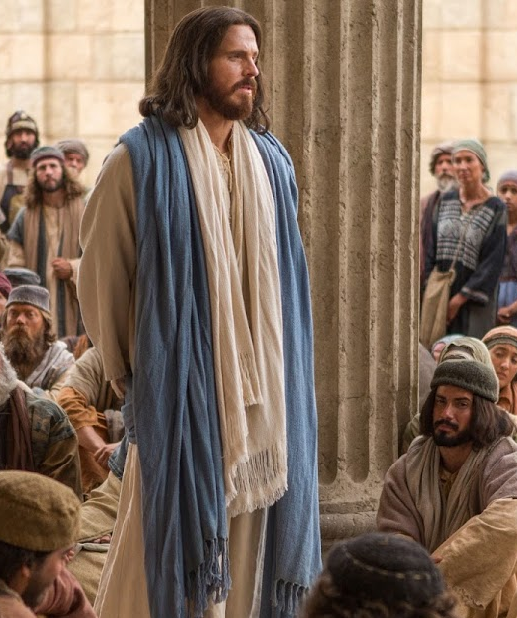
History of the Future
11. When will there be a parallel to the wickedness of men in the days of Noah and Lot?
Luke 17:26-30.

Slide 39
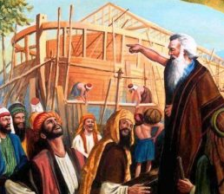
History of the Future
Luke 17:26-30
²⁶ And as it was in the days of Noe, so shall it be also in the days of the Son of man.

Slide 40
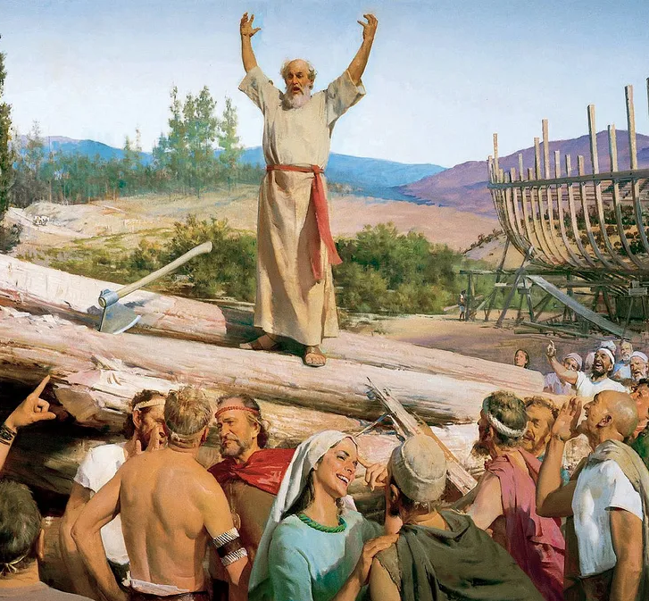
History of the Future
Luke 17:26-30
²⁷ They did eat, they drank, they married wives, they were given in marriage, until the day that Noah entered into the ark, and the flood came, and destroyed them all.

Slide 41
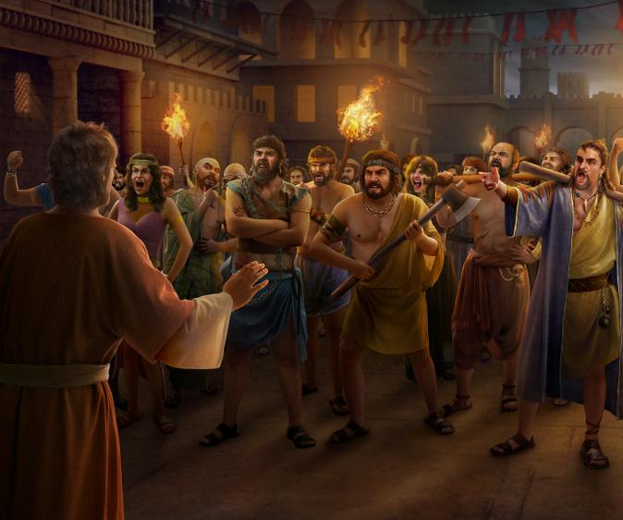
History of the Future
Luke 17:26-30
²⁸ Likewise also as it was in the days of Lot; they did eat, they drank, they bought, they sold, they planted, they builded;

Slide 42
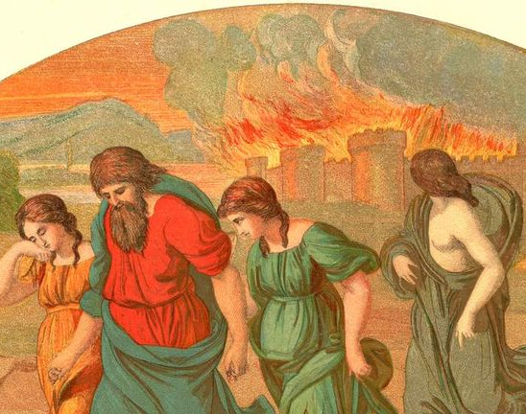
History of the Future
Luke 17:26-30
²⁹ But the same day that Lot went out of Sodom it rained fire and brimstone from heaven, and destroyed them all.

Slide 43
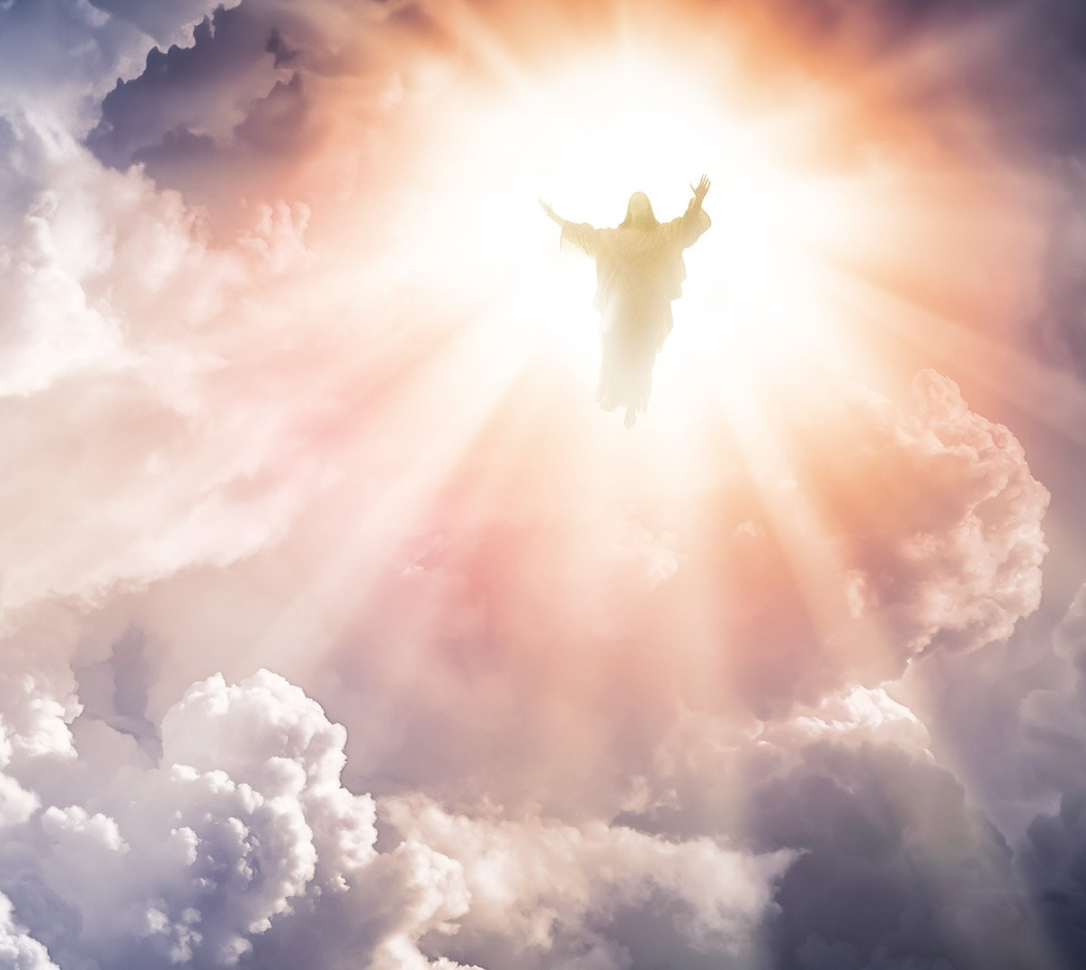
History of the Future
Luke 17:26-30
³⁰ Even thus shall it be in the day when the Son of man is revealed.

Slide 44
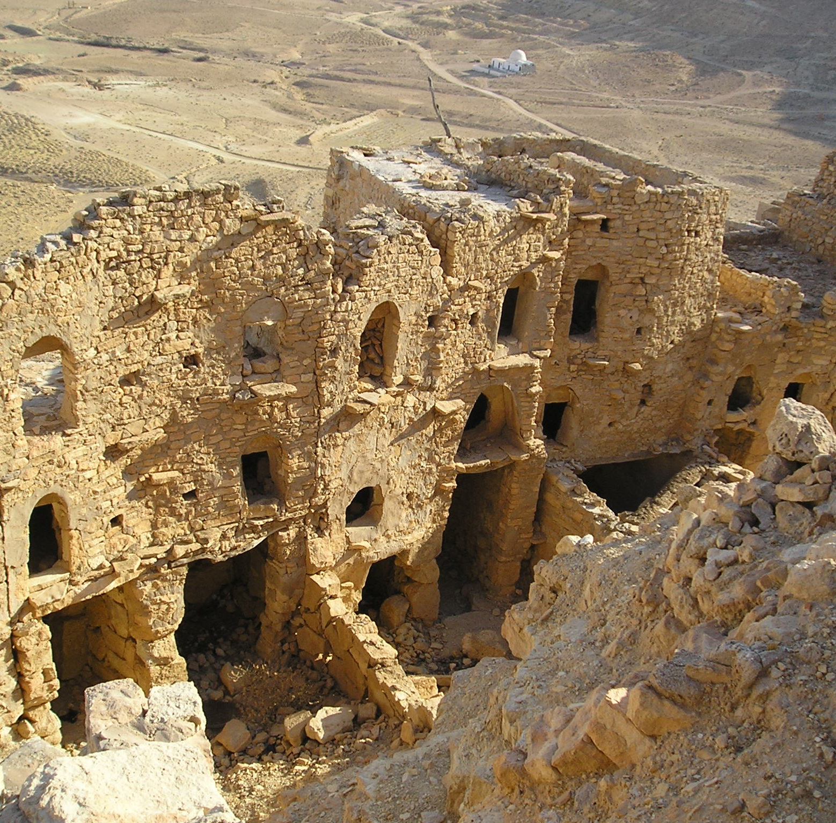
History of the Future
12. In what did the great sin of the people in those times consist?
Genesis 6:2, 5, 12; Jude 7.

Slide 45
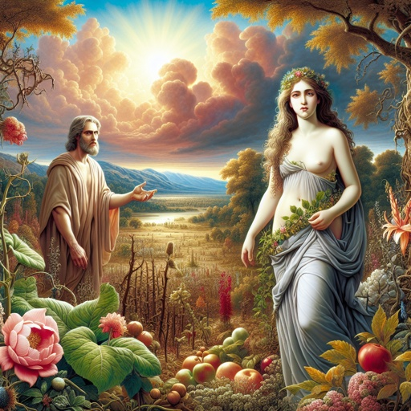
History of the Future
Genesis 6:2, 5, 12
² That the sons of God saw the daughters of men that they were fair; and they took them wives of all which they chose.

Slide 46
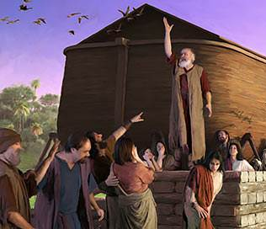
History of the Future
Genesis 6:2, 5, 12
⁵ And God saw that the wickedness of man was great in the earth, and that every imagination of the thoughts of his heart was only evil continually.

Slide 47
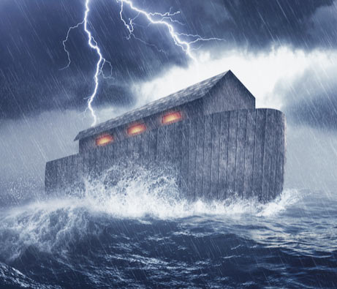
History of the Future
Genesis 6:2, 5, 12
¹² And God looked upon the earth, and, behold, it was corrupt; for all flesh had corrupted his way upon the earth.

Slide 48
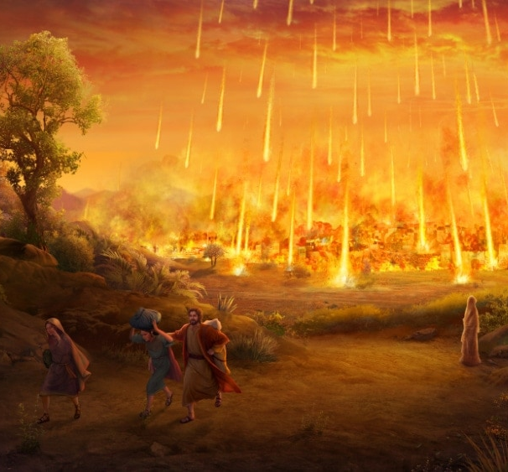
History of the Future
Jude 7
⁷ Even as Sodom and Gomorrha, and the cities about them in like manner, giving themselves over to fornication, and going after strange flesh, are set forth for an example, suffering the vengeance of eternal fire.

Slide 49
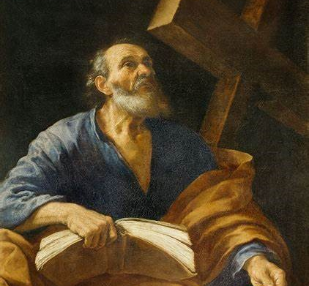
History of the Future
13. What does Peter say of these last-day false professors?
2 Peter 2:10, first part.

Slide 50
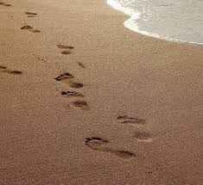
History of the Future
2 Peter 2:10
¹⁰ But chiefly them that walk after the flesh in the lust of uncleanness, and despise government. Presumptuous are they, selfwilled, they are not afraid to speak evil of dignities.

Slide 51
Reserved
14. To what time are all the wicked reserved for punishment?
2 Peter 2:4, 9, last part of each.

Slide 52
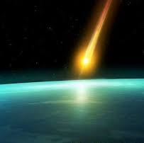
Reserved
2 Peter 2:4, 9
⁴ For if God spared not the angels that sinned, but cast them down to hell, and delivered them into chains of darkness, to be reserved unto judgment;

Slide 53

Reserved
2 Peter 2:4, 9
⁹ The Lord knoweth how to deliver the godly out of temptations, and to reserve the unjust unto the day of judgment to be punished:

Slide 54
Delivered
15. What was the character of those who escaped the judgments that have been brought upon the earth in the past?
2 Peter 2:5, 7, 8.

Slide 55
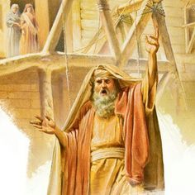
Delivered
2 Peter 2:5, 7, 8
⁵ And spared not the old world, but saved Noah the eighth person, a preacher of righteousness, bringing in the flood upon the world of the ungodly;

Slide 56
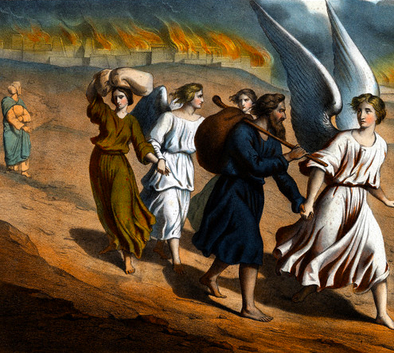
Delivered
2 Peter 2:5, 7, 8
⁷ And delivered just Lot, vexed with the filthy conversation of the wicked:

Slide 57
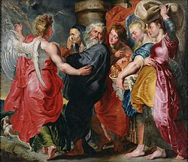
Delivered
2 Peter 2:5, 7, 8
⁸ (For that righteous man dwelling among them, in seeing and hearing, vexed his righteous soul from day to day with their unlawful deeds;)

Slide 58
Delivered
16. What encouragement can the righteous find in the account of past judgments?
2 Peter 2:9

Slide 59
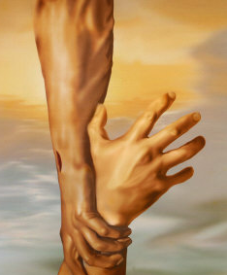
Delivered
2 Peter 2:9
⁹ The Lord knoweth how to deliver the godly out of temptations, and to reserve the unjust unto the day of judgment to be punished:

Slide 60
Thank you!
…and Happy Sabbath!!

Slide 61


