Slide 1


Slide 2


Slide 3
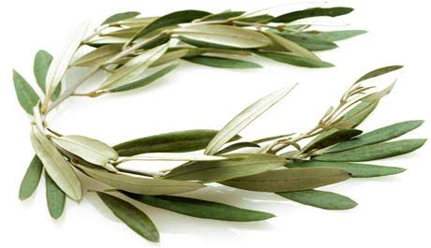
Lesson 7
2 Peter 2:10-22
December 8, 1888

Slide 4


Slide 5
What is LIBERTY?
the state of being free within society from oppressive restrictions imposed by authority on one's way of life, behavior, or political views.
the power or scope to act as one pleases.
  "individuals should enjoy the liberty to pursue their own interests and preferences”
the ability to act without hindrance or outside control
the opportunity to make choices about what to do or what to say

Slide 6
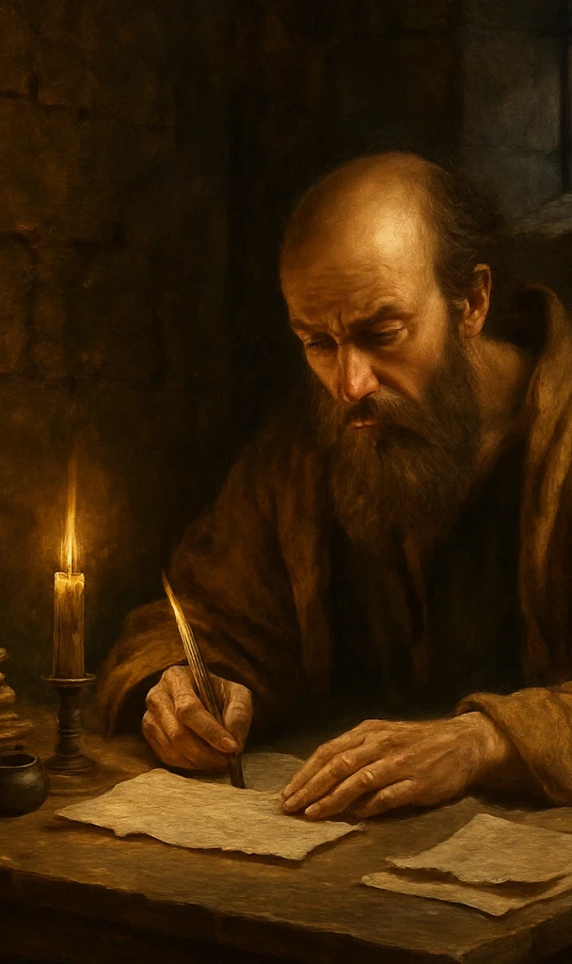
1. What does the apostle Peter say of the character of the false teachers who in the last days shall cause many to err from the truth?
2 Peter 2:10, 12, 13, 14.

Slide 7
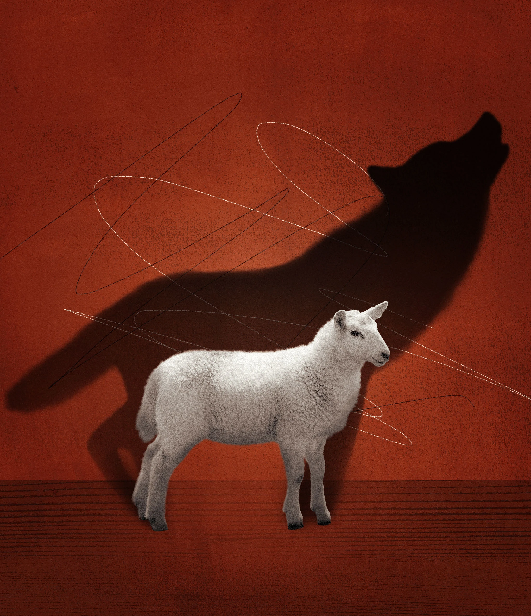
2 Peter 2:10, 12, 13, 14
¹⁰ But chiefly them that walk after the flesh in the lust of uncleanness, and despise government. Presumptuous are they, selfwilled, they are not afraid to speak evil of dignities.

Slide 8
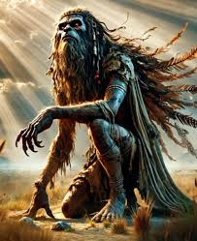
2 Peter 2:10, 12, 13, 14
¹² But these, as natural brute beasts, made to be taken and destroyed, speak evil of the things that they understand not; and shall utterly perish in their own corruption;

Slide 9

2 Peter 2:10, 12, 13, 14
¹³ And shall receive the reward of unrighteousness, as they that count it pleasure to riot in the day time. Spots they are and blemishes, sporting themselves with their own deceivings while they feast with you;

Slide 10

2 Peter 2:10, 12, 13, 14
¹⁴ Having eyes full of adultery, and that cannot cease from sin; beguiling unstable souls: an heart they have exercised with covetous practices; cursed children:

Slide 11
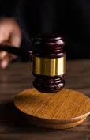
2. What shows their contempt for authority?
2 Peter 2:10;
Jude 8, 10

Slide 12
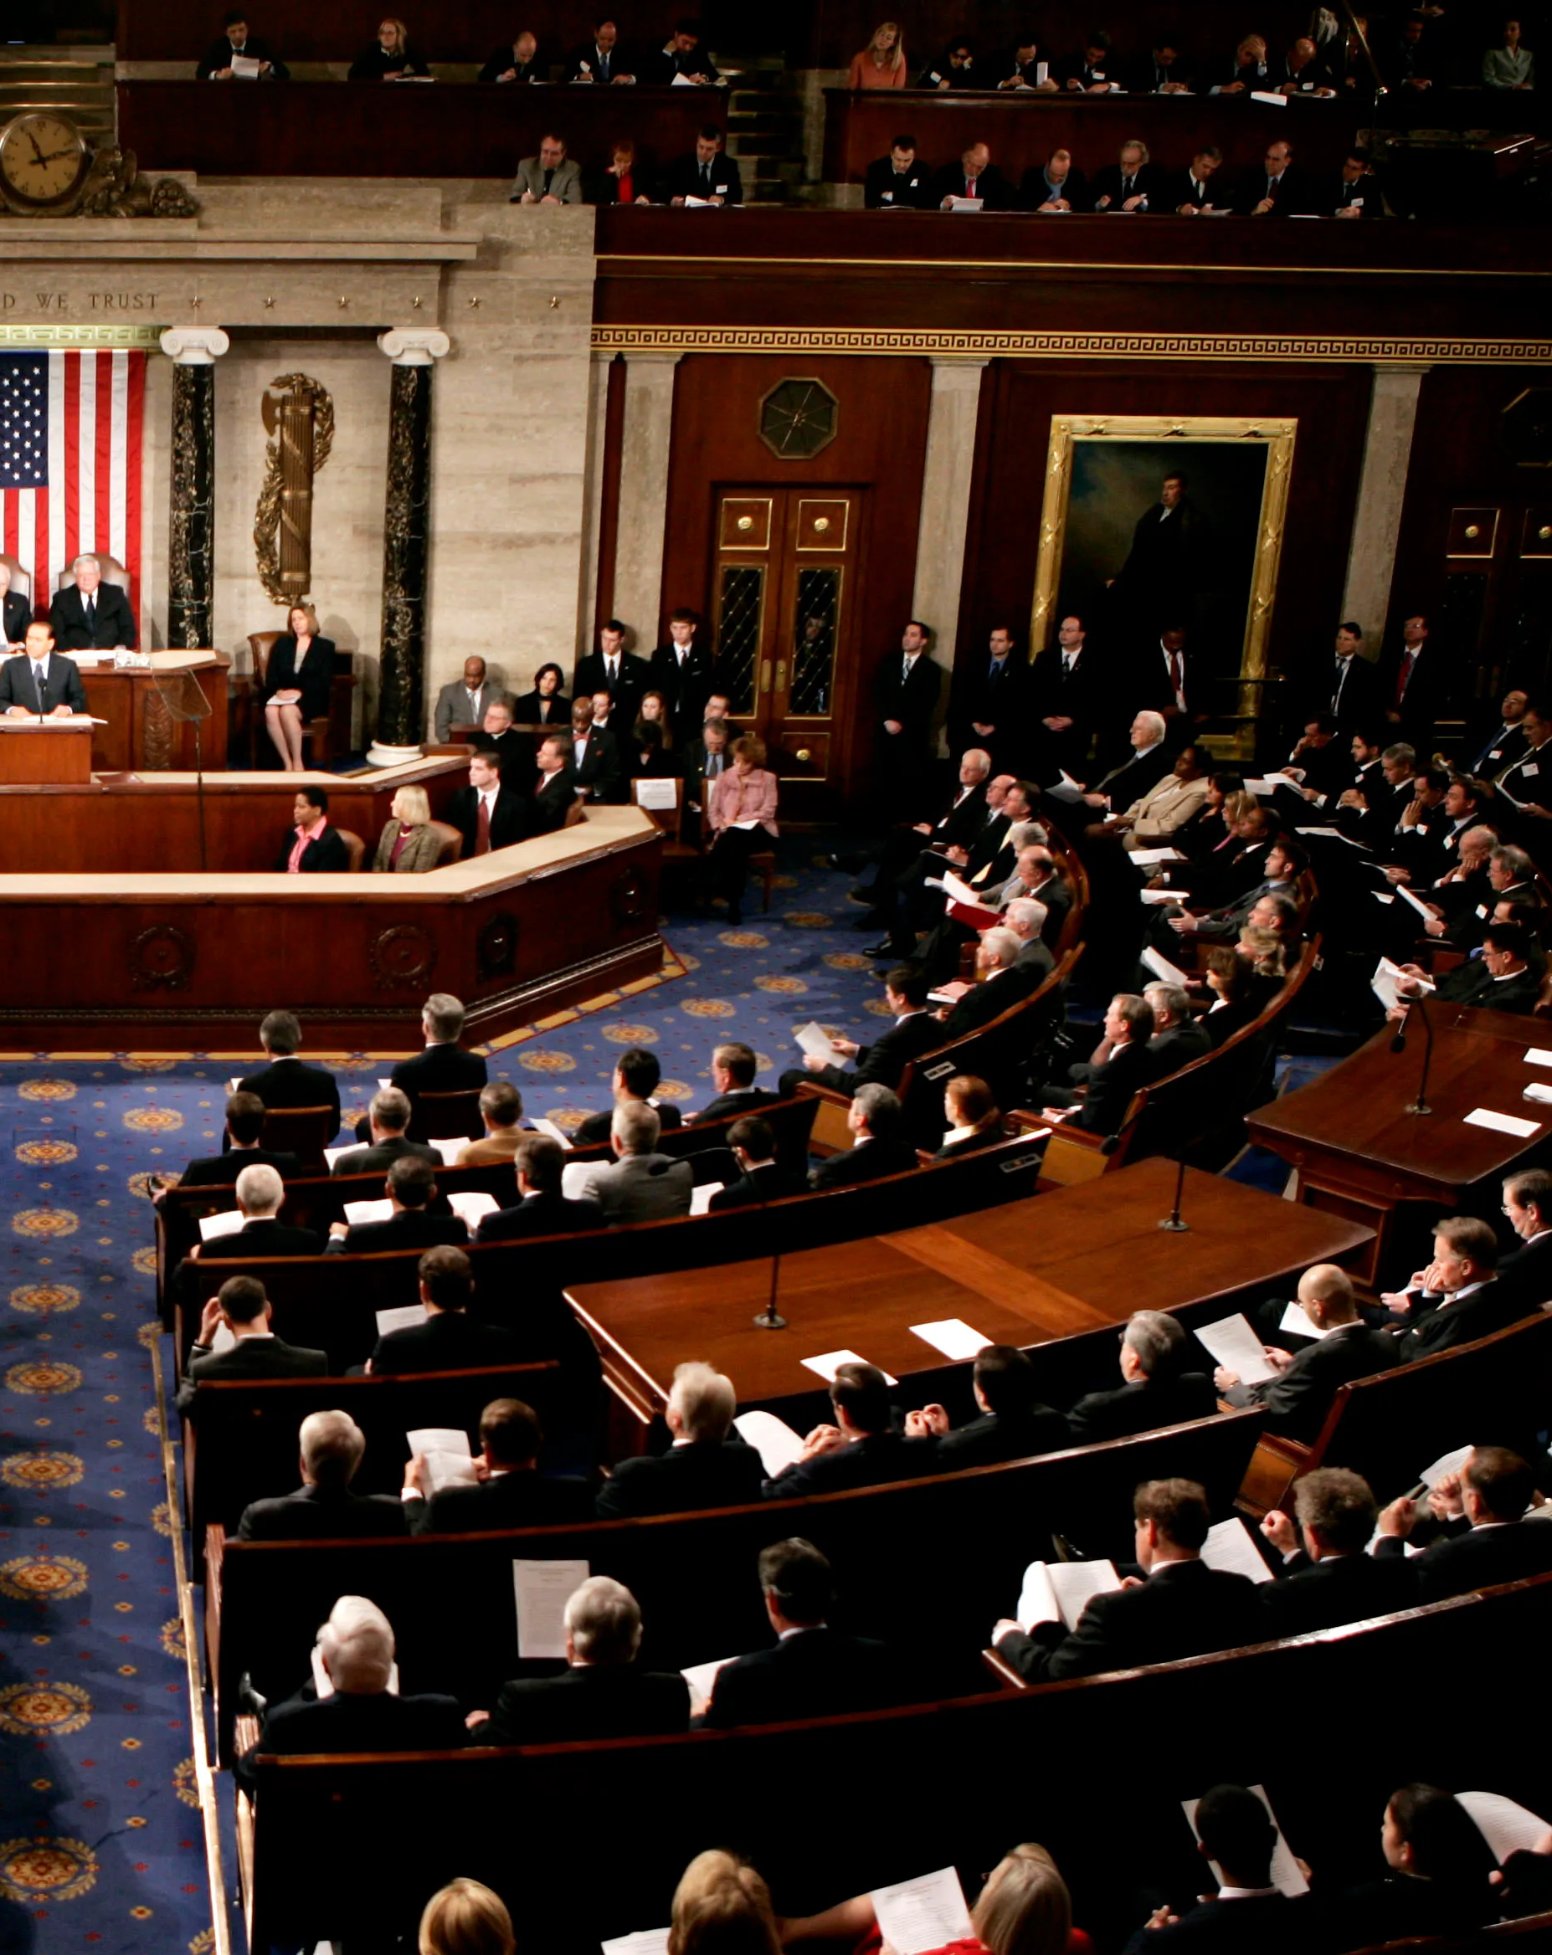
2 Peter 2:10
¹⁰ But chiefly them that walk after the flesh in the lust of uncleanness, and despise government. Presumptuous are they, selfwilled, they are not afraid to speak evil of dignities.

Slide 13
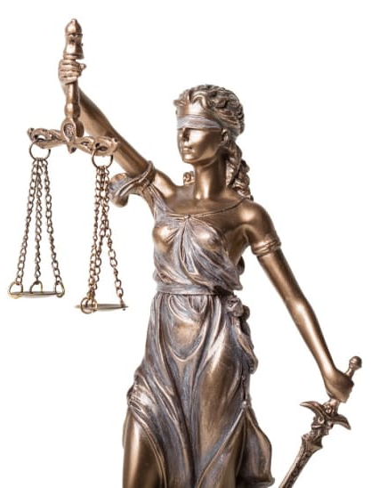
Jude 8, 10
⁸ Likewise also these filthy dreamers defile the flesh, despise dominion, and speak evil of dignities.

Slide 14

Jude 8, 10
¹⁰ But these speak evil of those things which they know not: but what they know naturally, as brute beasts, in those things they corrupt themselves.

Slide 15
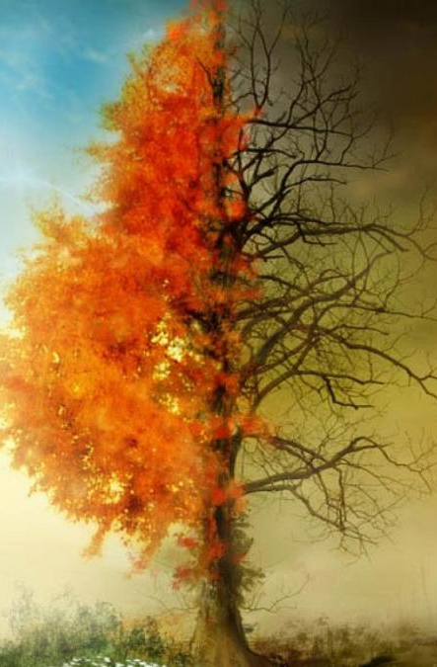
3. How does their conduct in this respect contrast with that of beings who are really great?
2 Peter 2:11

Slide 16
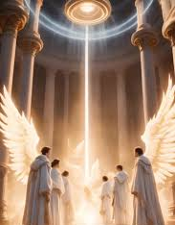
2 Peter 2:11
¹¹ Whereas angels, which are greater in power and might, bring not railing accusation against them before the Lord.

Slide 17
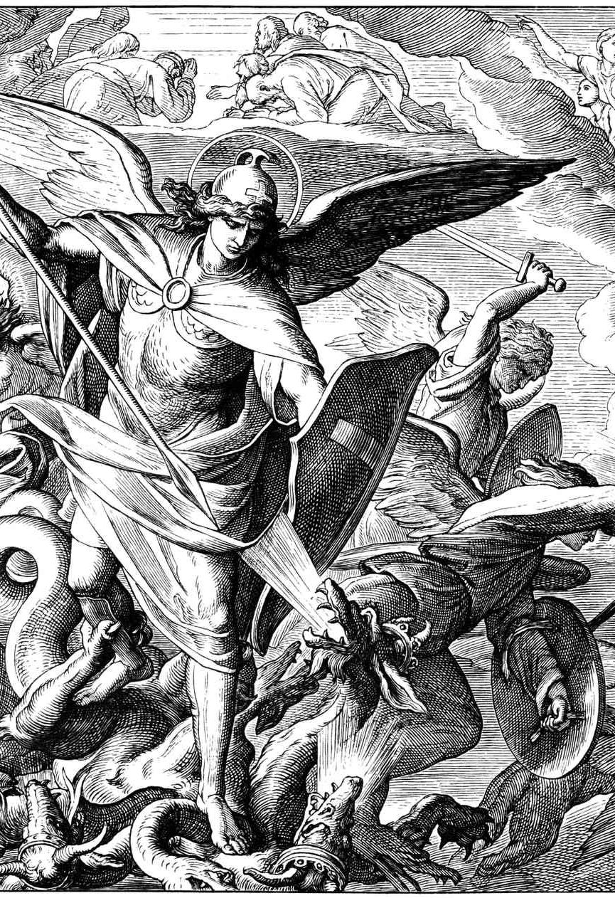
4. What example of Christ's have we concerning speaking evil even of the wicked?
Jude 9

Slide 18
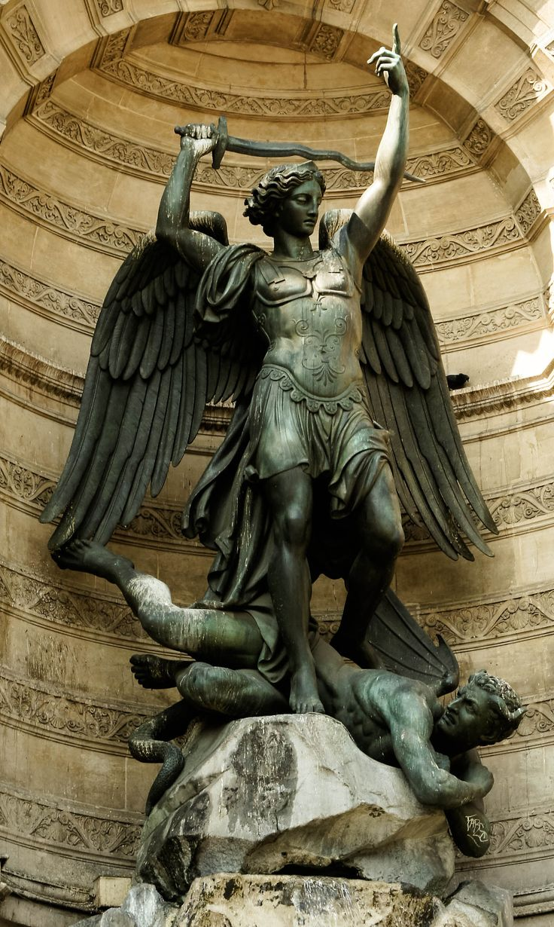
Jude 9
⁹ Yet Michael the archangel, when contending with the devil he disputed about the body of Moses, durst not bring against him a railing accusation, but said, The Lord rebuke thee.

Slide 19
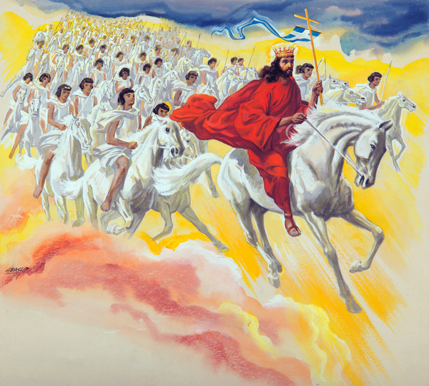
Micheal the Archangel
Michael, “mî·ḵā·’êl,” translates,
“Who is like God.”

Slide 20
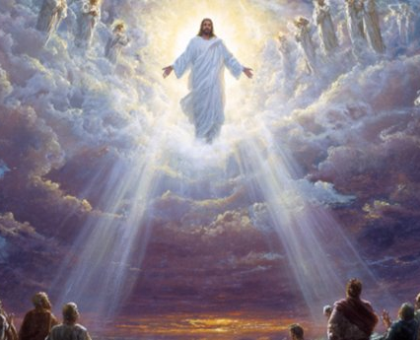
Micheal the Archangel
In Daniel 10:21, an angel sent to bring understanding to Daniel speaks of “Michael, your prince.”

Slide 21
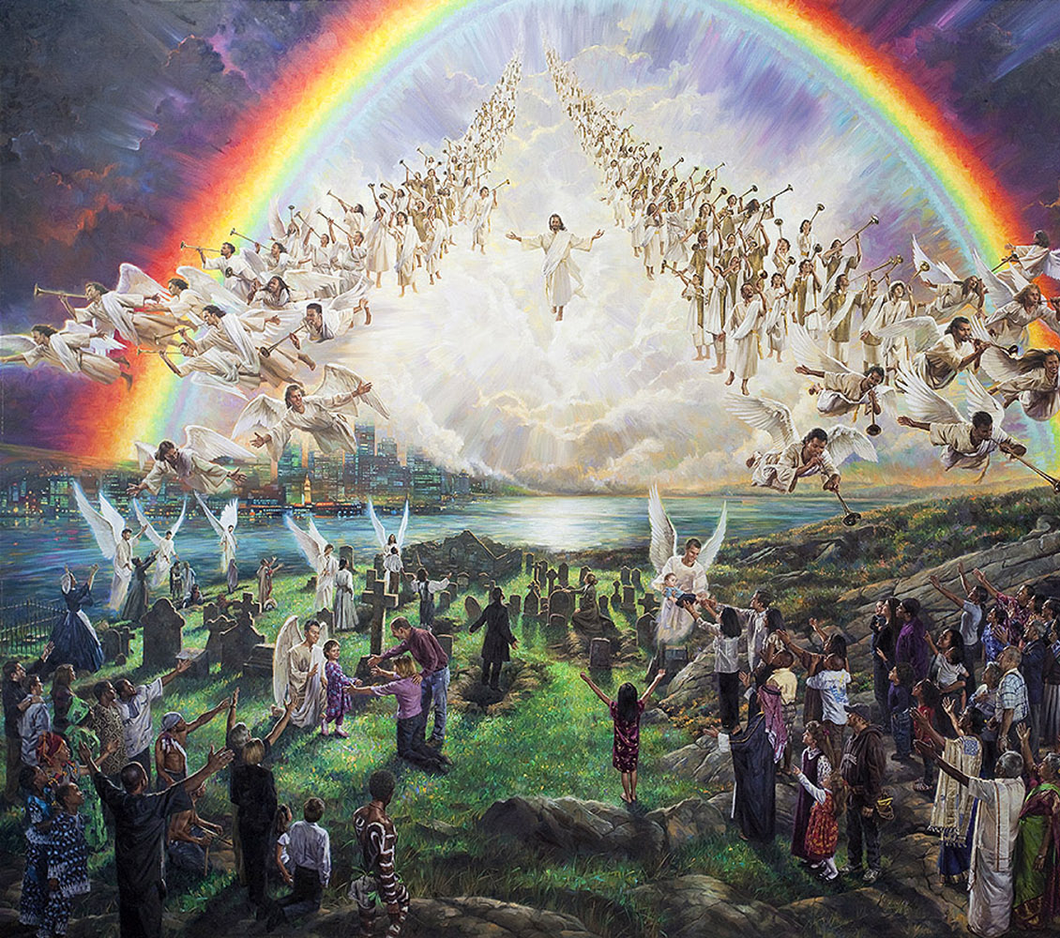
Micheal the Archangel
The same angel is still speaking in Daniel 12:1, when he tells Daniel, “And at that time shall Michael stand up, the great prince which standeth for the children of thy people…and thy people shall be delivered…”

Slide 22
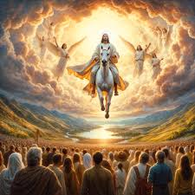
Micheal the Archangel
Michael’s name honors God
Michael is prince to Daniel’s people
Michael “stands up” for God’s people, particularly during the time of trouble and the time of their deliverance

Slide 23
Jude 9
⁹ Yet Michael the archangel, when contending with the devil he disputed about the body of Moses, durst not bring against him a railing accusation, but said, The Lord rebuke thee.

Slide 24
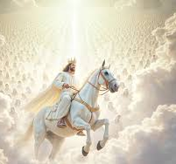
Micheal the Archangel
1 Thessalonians 4:16
¹⁶ For the Lord himself shall descend from heaven with a shout, with the voice of the archangel, and with the trump of God: and the dead in Christ shall rise first:

Slide 25
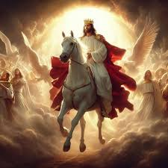
Micheal the Archangel
John 5:25 (Jesus speaking)
²⁵ Verily, verily, I say unto you, The hour is coming, and now is, when the dead shall hear the voice of the Son of God: and they that hear shall live.

Slide 26
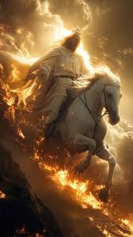
Micheal the Archangel
John 5:28-29
²⁸ Marvel not at this: for the hour is coming, in the which all that are in the graves shall hear his voice,
²⁹ And shall come forth; they that have done good, unto the resurrection of life; and they that have done evil, unto the resurrection of damnation.

Slide 27
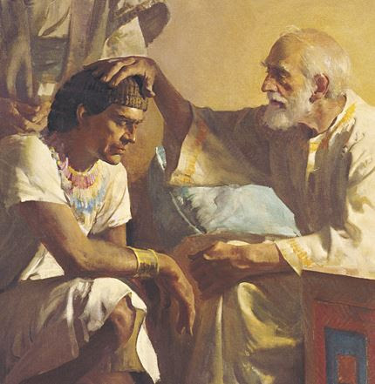
Micheal the Archangel
Israel’s Blessing
Genesis 48:15-16
¹⁵ And he blessed Joseph, and said, God, before whom my fathers Abraham and Isaac did walk, the God which fed me all my life long unto this day,

Slide 28
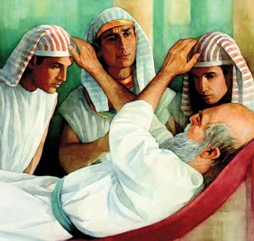
Micheal the Archangel
Israel’s Blessing
Genesis 48:15-16
¹⁶ The Angel which redeemed me from all evil, bless the lads; and let my name be named on them, and the name of my fathers Abraham and Isaac; and let them grow into a multitude in the midst of the earth.

Slide 29
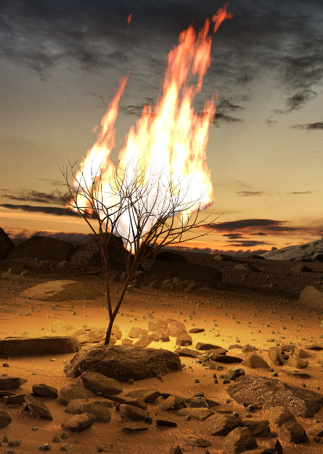
Micheal the Archangel
The Burning Bush
Exodus 3:2, 6
² And the angel of the Lord appeared unto him in a flame of fire out of the midst of a bush: ….
⁶ Moreover he said, I am the God of thy father, the God of Abraham, the God of Isaac, and the God of Jacob. And Moses hid his face; for he was afraid to look upon God.

Slide 30
Micheal the Archangel
The Burning Bush
Exodus 3:2, 6
² And the angel of the Lord appeared unto him in a flame of fire out of the midst of a bush: ….
⁶ Moreover he said, I am the God of thy father, the God of Abraham, the God of Isaac, and the God of Jacob. And Moses hid his face; for he was afraid to look upon God.

Slide 31
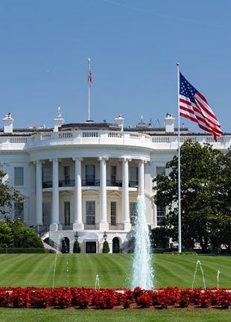
5. What positive commandment have we concerning our attitude toward those holding high positions?
Romans 13:1; 1 Timothy 2:1, 2

Slide 32
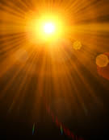
Romans 13:1
13 Let every soul be subject unto the higher powers. For there is no power but of God: the powers that be are ordained of God.

Slide 33
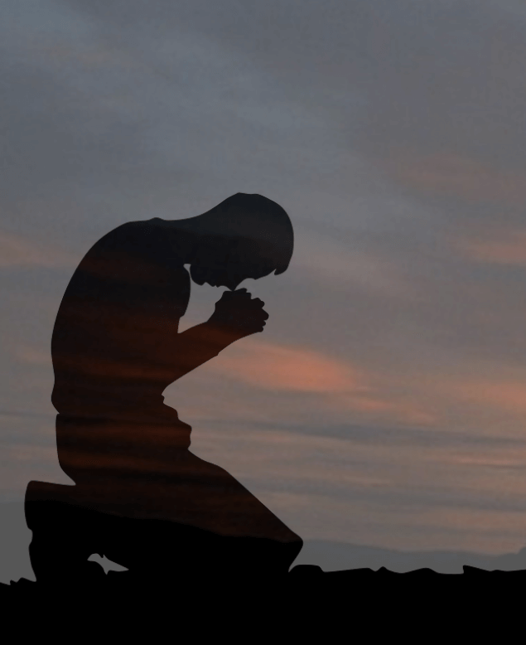
1 Timothy 2:1, 2
2 I exhort therefore, that, first of all, supplications, prayers, intercessions, and giving of thanks, be made for all men;

Slide 34

1 Timothy 2:1, 2
² For kings, and for all that are in authority; that we may lead a quiet and peaceable life in all godliness and honesty.

Slide 35
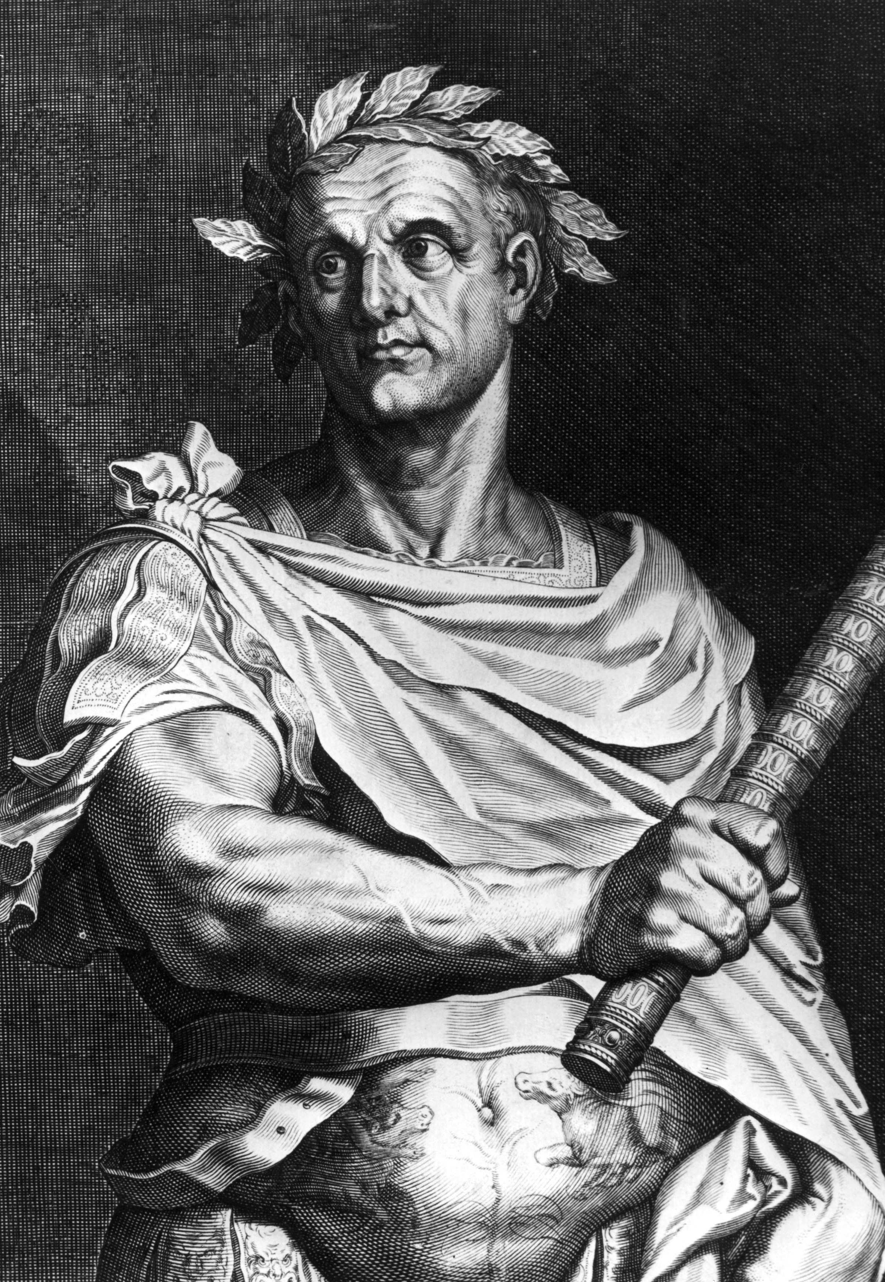
6. Are we at liberty to make an exception in the case of wicked rulers?
1 Timothy 2:1, 2; Titus 3:1, 2

Slide 36
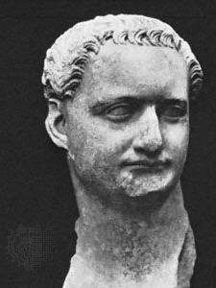
1 Timothy 2:1, 2
2 I exhort therefore, that, first of all, supplications, prayers, intercessions, and giving of thanks, be made for all men;

Slide 37
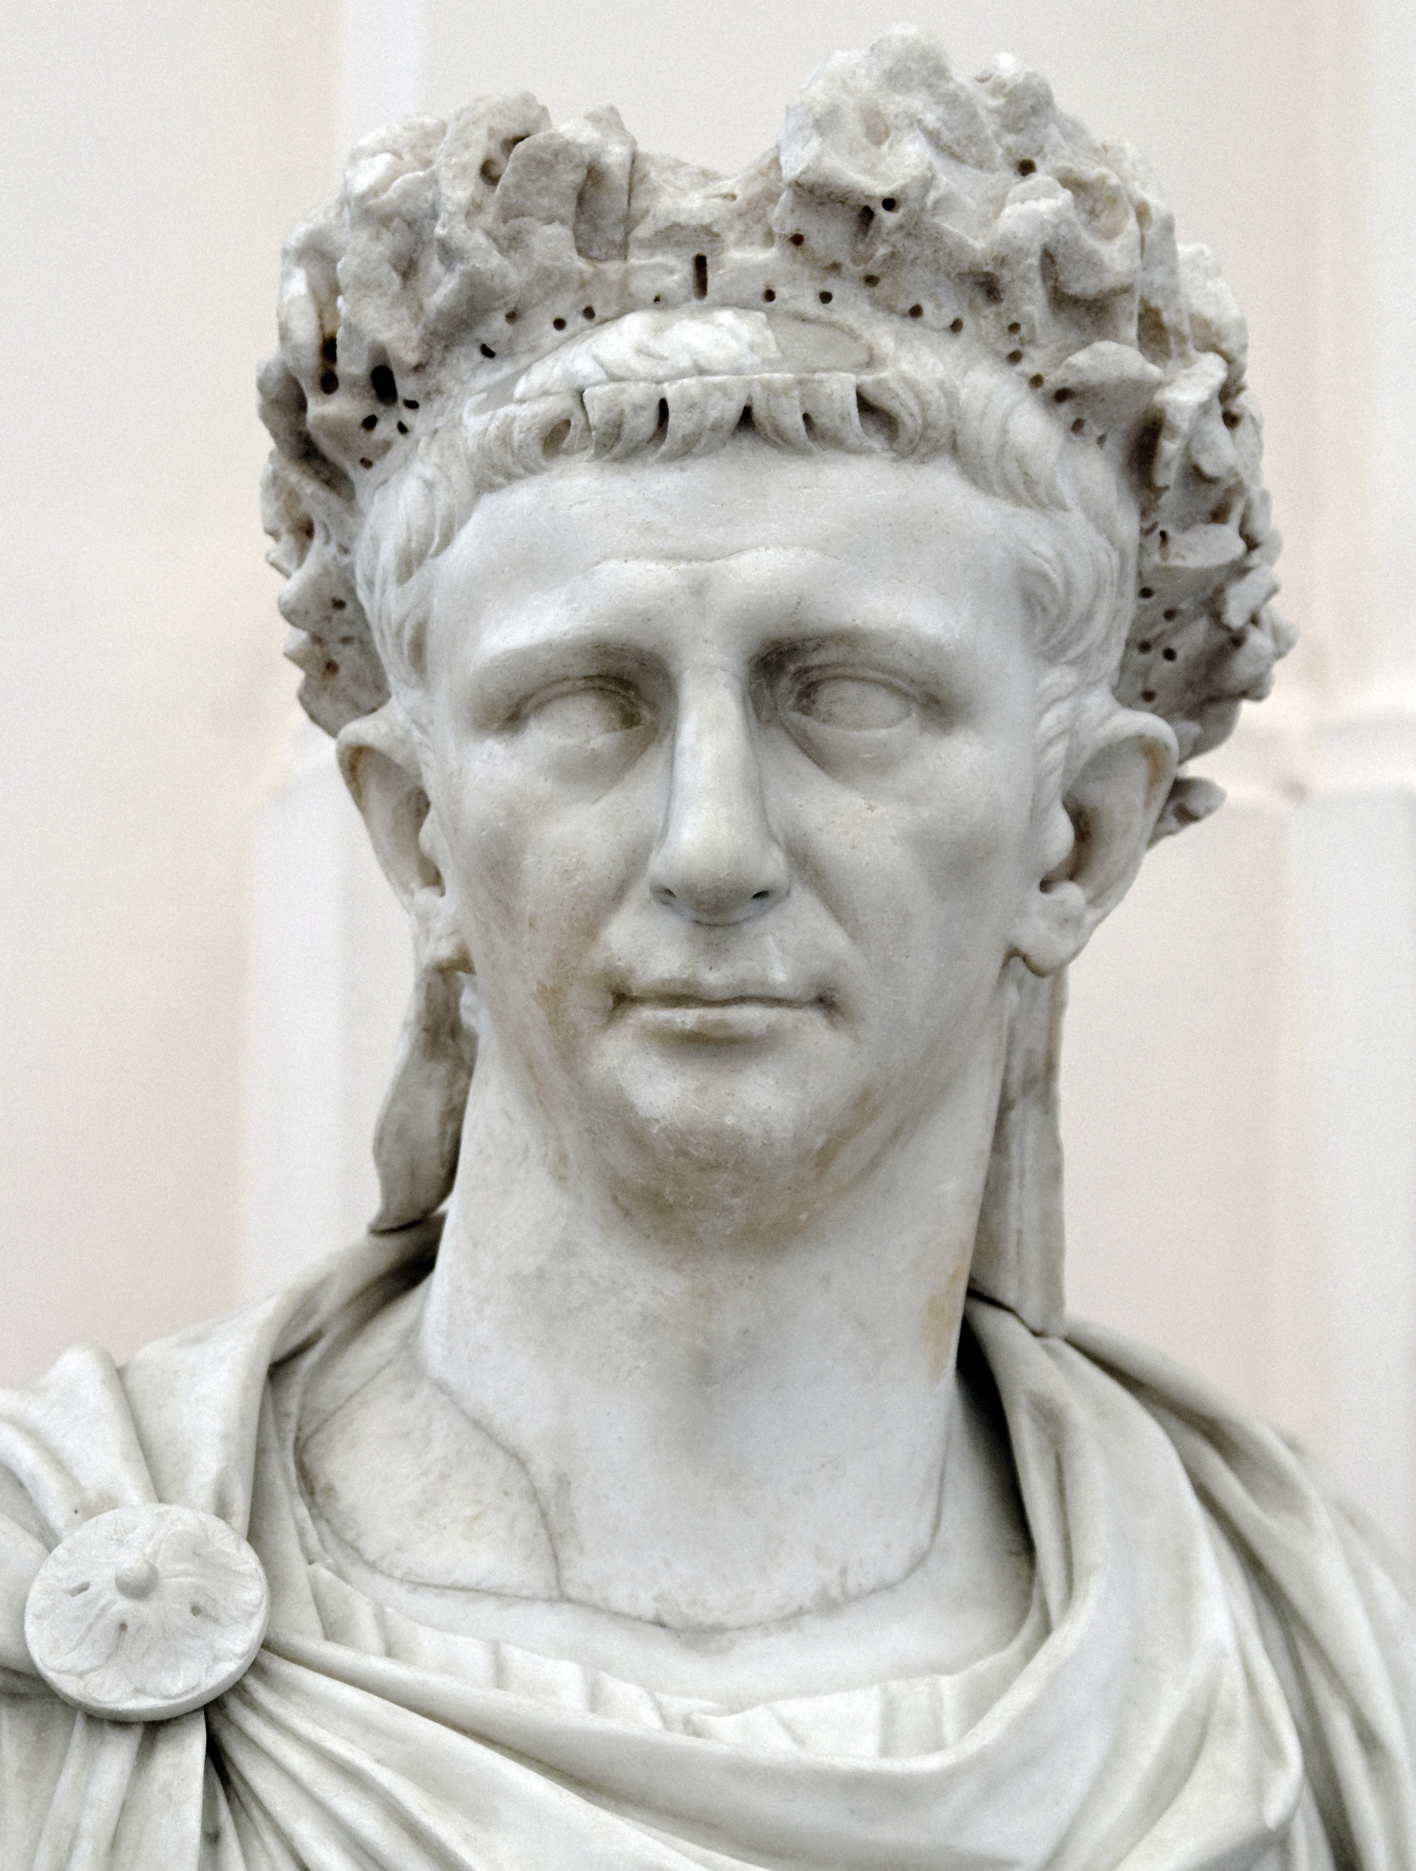
1 Timothy 2:1, 2
² For kings, and for all that are in authority; that we may lead a quiet and peaceable life in all godliness and honesty.

Slide 38
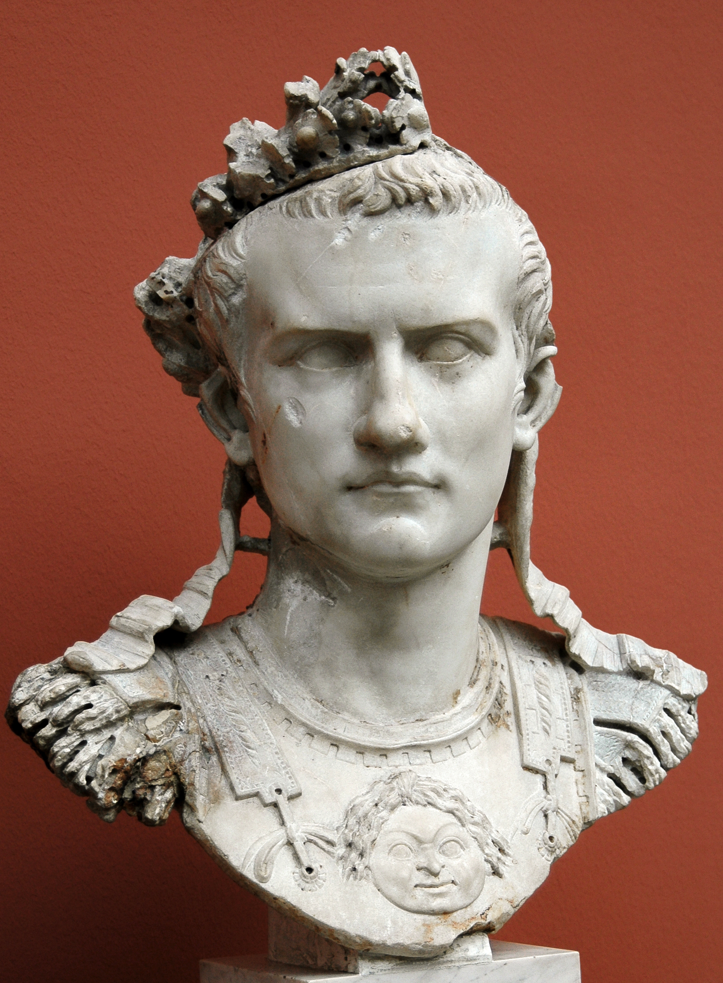
Titus 3:1, 2
3 Put them in mind to be subject to principalities and powers, to obey magistrates, to be ready to every good work,

Slide 39
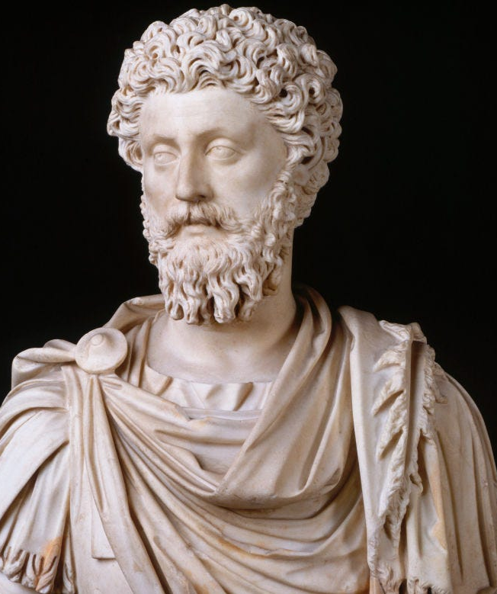
Titus 3:1, 2
² To speak evil of no man, to be no brawlers, but gentle, shewing all meekness unto all men.

Slide 40
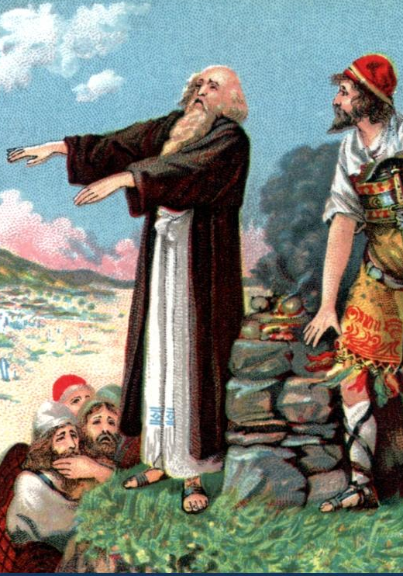
7. Whose example does the apostle say these false teachers follow?
2 Peter 2:15;
Jude 11

Slide 41
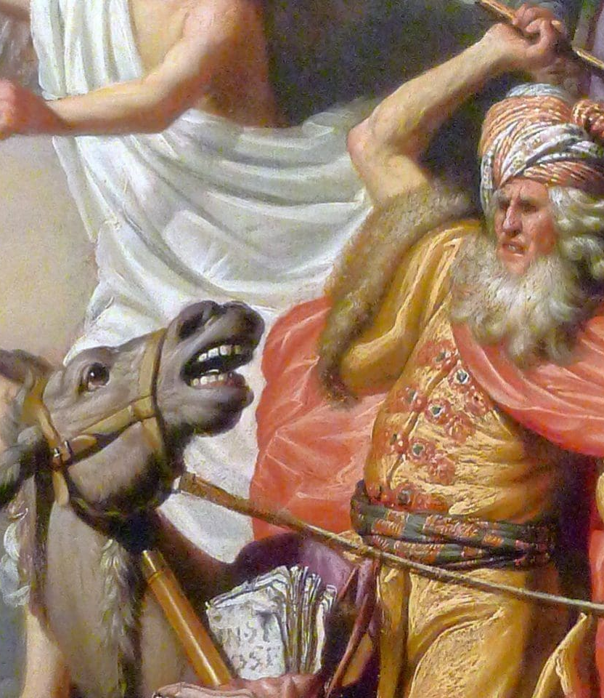
2 Peter 2:15
¹⁵ Which have forsaken the right way, and are gone astray, following the way of Balaam the son of Bosor, who loved the wages of unrighteousness;

Slide 42
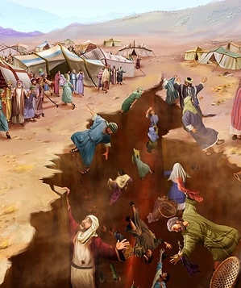
Jude 11
¹¹ Woe unto them! for they have gone in the way of Cain, and ran greedily after the error of Balaam for reward, and perished in the gainsaying of Core.

Slide 43
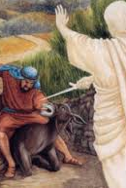
8. Relate in brief the circumstances of Balaam's connection with the children of Israel.
Numbers 22-24

Slide 44
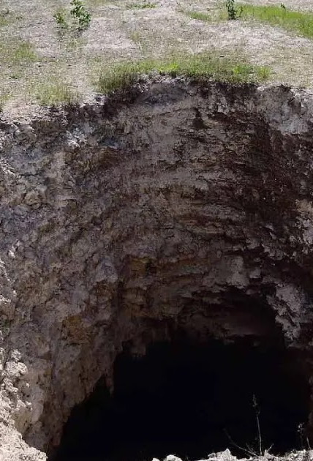
9. What is said of the instability of such ones, and of their final end?
2 Peter 2:17;
Jude 12, 13

Slide 45
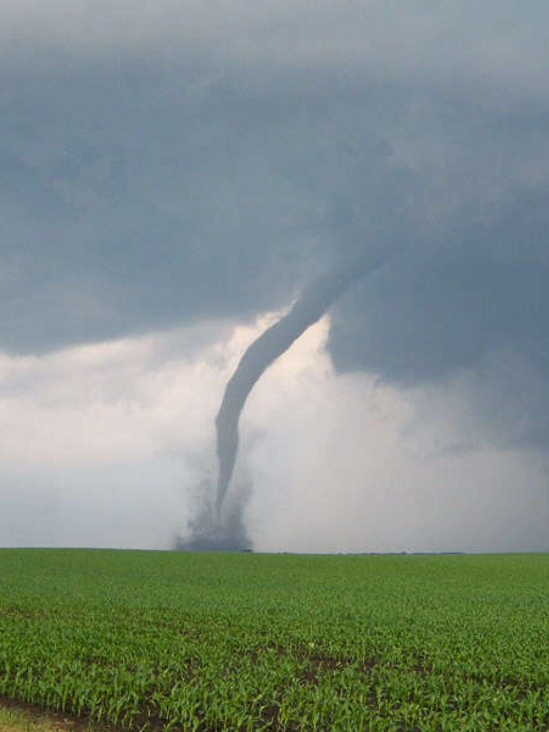
2 Peter 2:17
¹⁷ These are wells without water, clouds that are carried with a tempest; to whom the mist of darkness is reserved for ever.

Slide 46
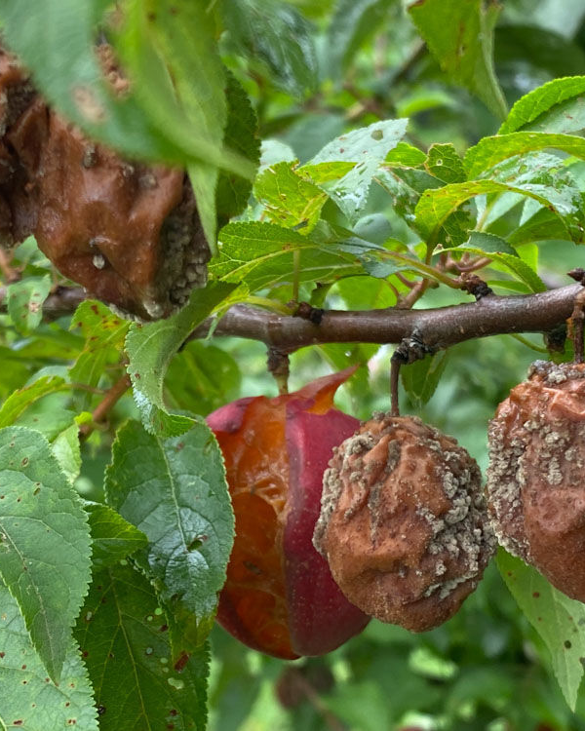
Jude 12
¹² These are spots in your feasts of charity, when they feast with you, feeding themselves without fear: clouds they are without water, carried about of winds; trees whose fruit withereth, without fruit, twice dead, plucked up by the roots;

Slide 47
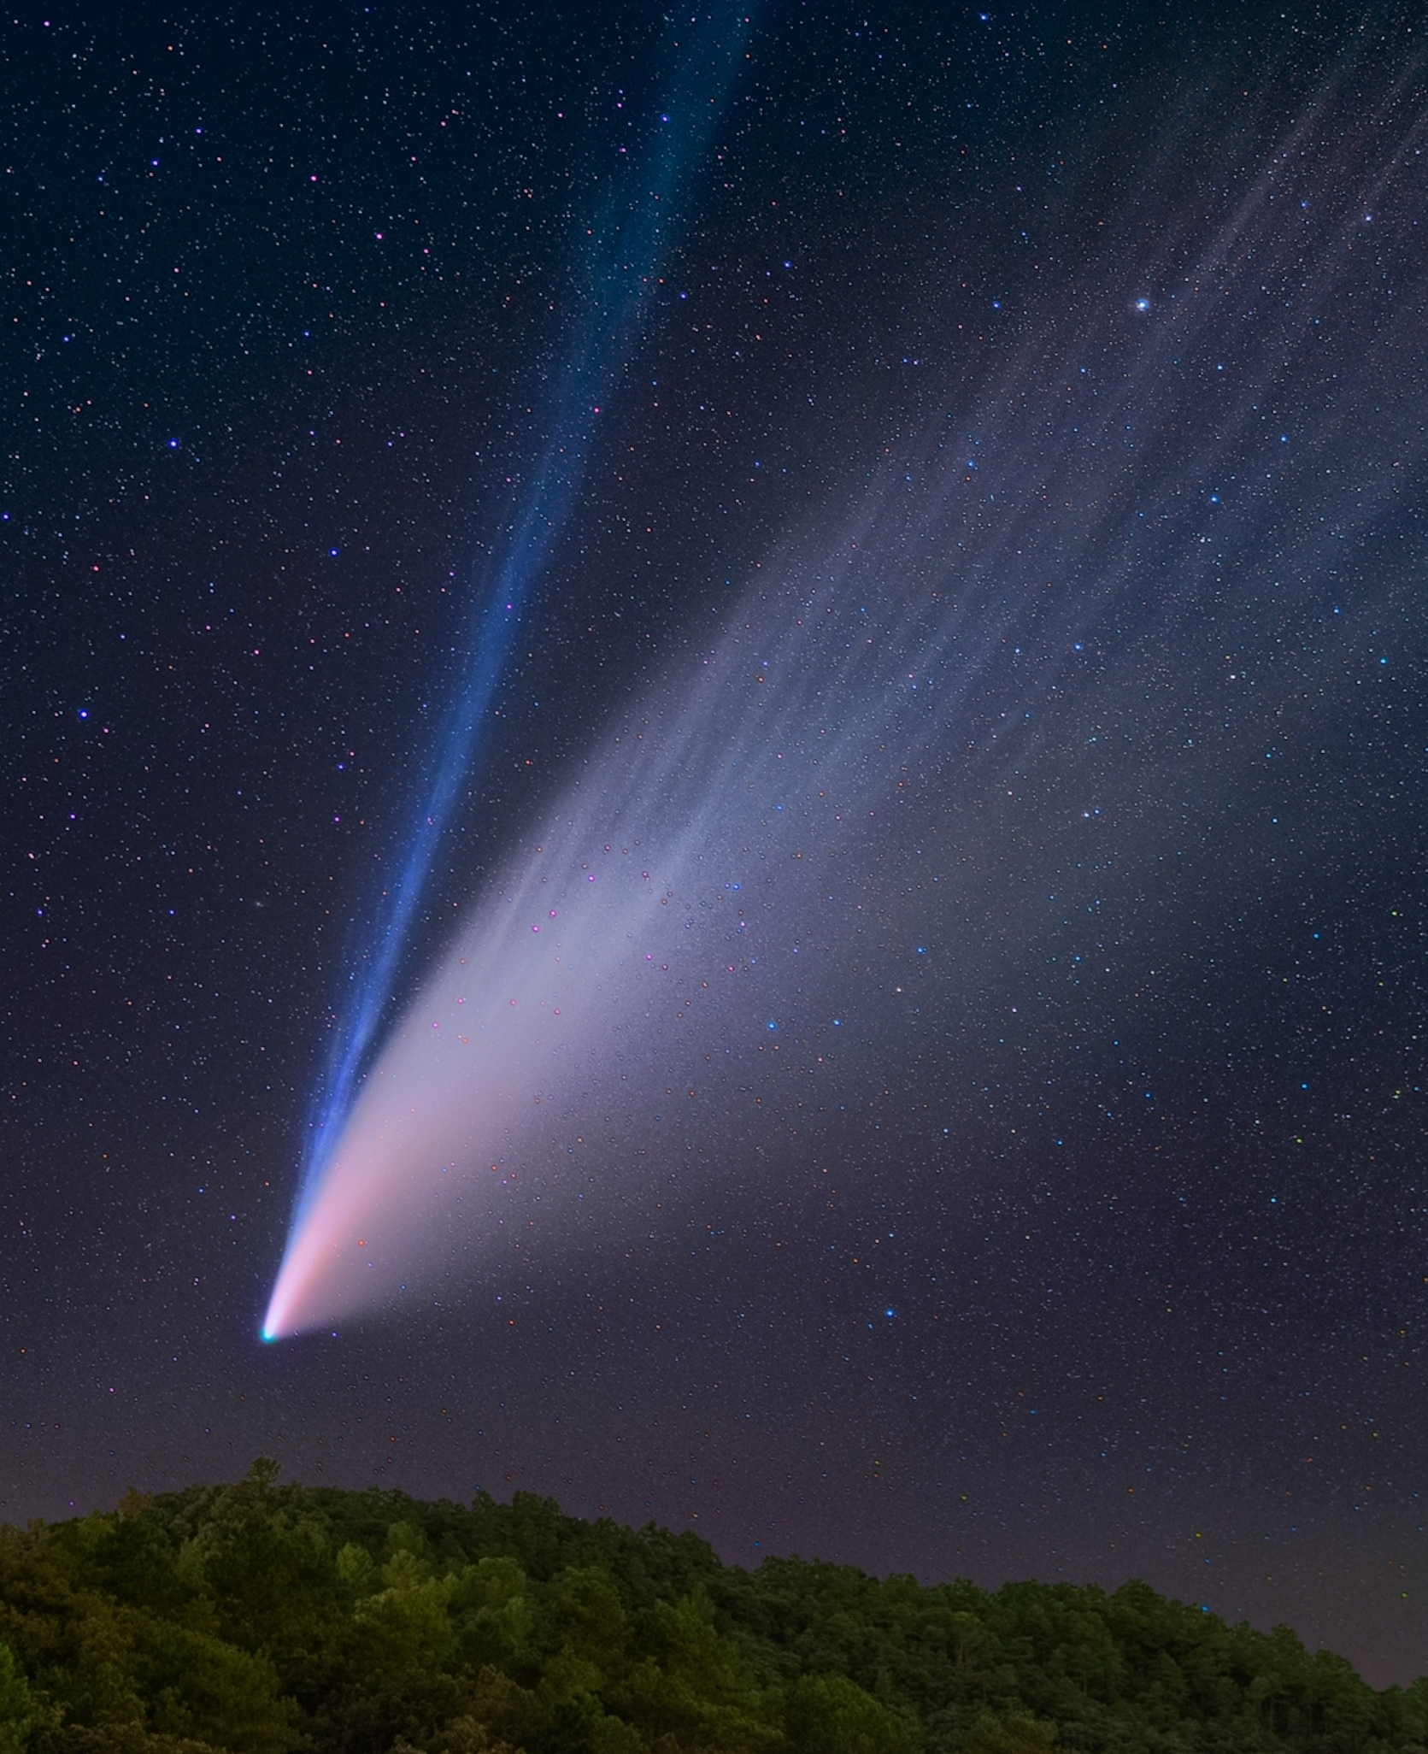
Jude 13
¹³ Raging waves of the sea, foaming out their own shame; wandering stars, to whom is reserved the blackness of darkness for ever.

Slide 48
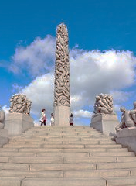
10. By what means do they allure souls to destruction?
2 Peter 2:18

Slide 49
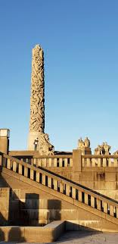
2 Peter 2:18
¹⁸ For when they speak great swelling words of vanity, they allure through the lusts of the flesh, through much wantonness, those that were clean escaped from them who live in error.

Slide 50
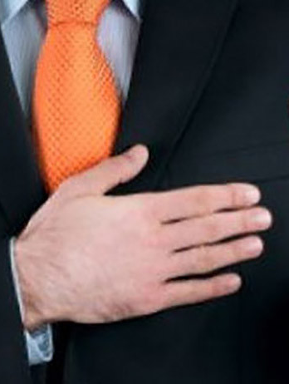
11. What do they promise those who follow them?
2 Peter 2:19

Slide 51

2 Peter 2:19
¹⁹ While they promise them liberty, they themselves are the servants of corruption: for of whom a man is overcome, of the same is he brought in bondage.

Slide 52
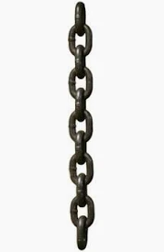
12. Yet into what bondage do they bring their dupes?
John 8:34

Slide 53
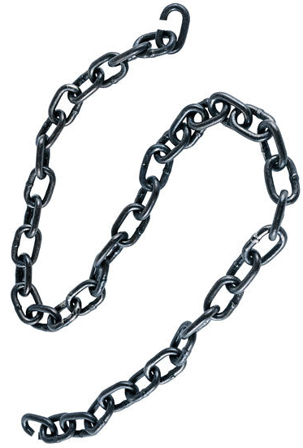
John 8:34
³⁴ Jesus answered them, Verily, verily, I say unto you, Whosoever committeth sin is the servant of sin.

Slide 54
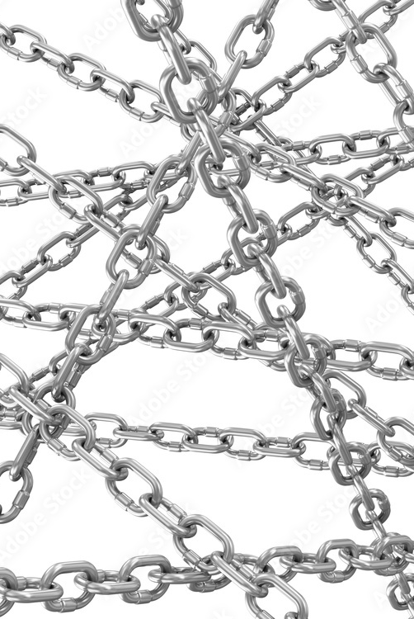
13. To what are people made subject through fear of death?
Hebrews 2:14, 15

Slide 55
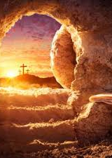
Hebrews 2:14, 15
¹⁴ Forasmuch then as the children are partakers of flesh and blood, he also himself likewise took part of the same; that through death he might destroy him that had the power of death, that is, the devil;

Slide 56
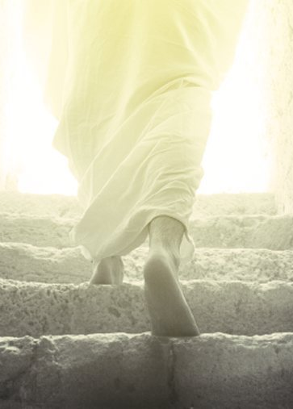
Hebrews 2:14, 15
And deliver them who through fear of death were all their lifetime subject to bondage.

Slide 57
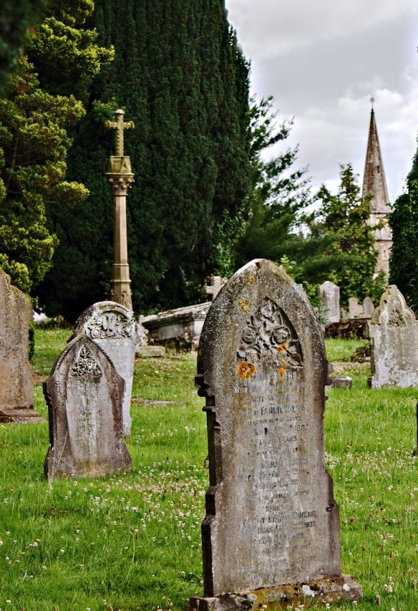
14. What is it that causes death and the fear of it?
Romans 5:12

Slide 58
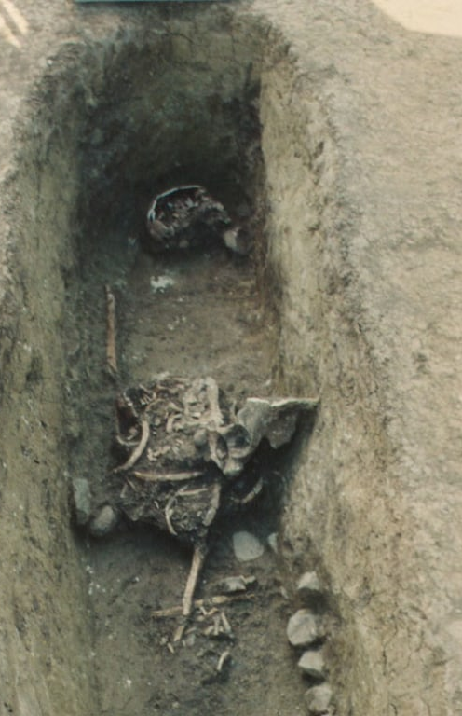
Romans 5:12
¹² Wherefore, as by one man sin entered into the world, and death by sin; and so death passed upon all men, for that all have sinned:

Slide 59
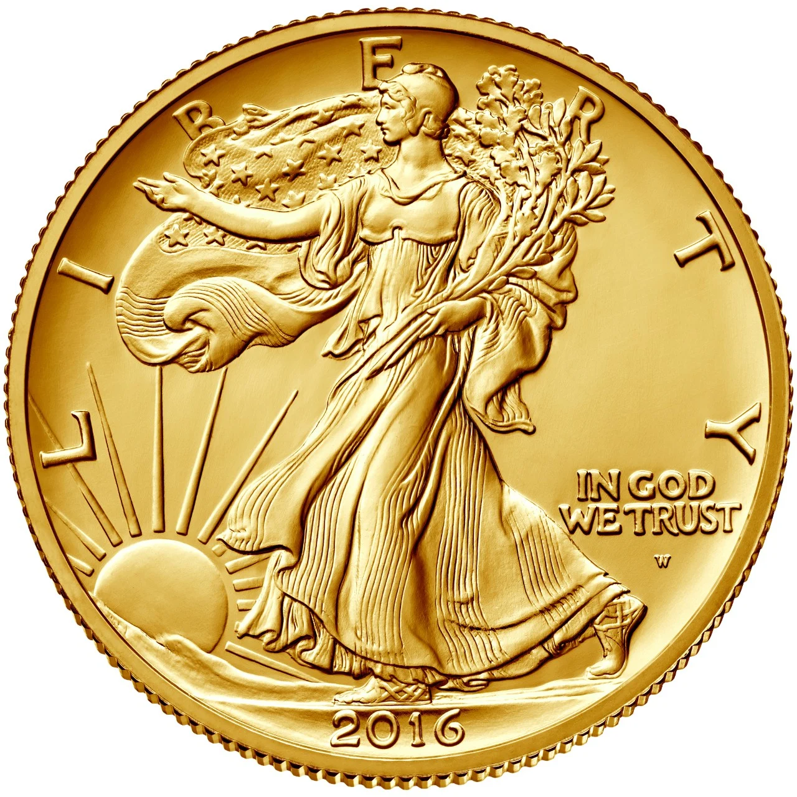
15. Then what is it that brings men into bondage?

Slide 60
What is LIBERTY?
the state of being free within society from oppressive restrictions imposed by authority on one's way of life, behavior, or political views.
the power or scope to act as one pleases.
  "individuals should enjoy the liberty to pursue their own interests and preferences”
the ability to act without hindrance or outside control
the opportunity to make choices about what to do or what to say

Slide 61
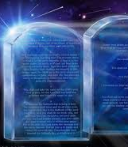
16. Who alone can give freedom?
Psalm 102:19, 20; Isaiah 61:1.

Slide 62
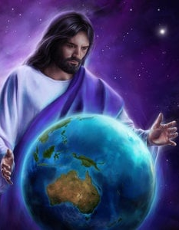
Psalm 102:19, 20
¹⁹ For he hath looked down from the height of his sanctuary; from heaven did the Lord behold the earth;

Slide 63

Psalm 102:19, 20
²⁰ To hear the groaning of the prisoner; to loose those that are appointed to death;

Slide 64

Isaiah 61:1
61 The Spirit of the Lord God is upon me; because the Lord hath anointed me to preach good tidings unto the meek; he hath sent me to bind up the brokenhearted, to proclaim liberty to the captives, and the opening of the prison to them that are bound;

Slide 65

17. Where alone is true liberty found?
Psalm 119:45;
John 8:32

Slide 66

Psalm 119:45
⁴⁵ And I will walk at liberty: for I seek thy precepts.

Slide 67

John 8:32
³² And ye shall know the truth, and the truth shall make you free.

Slide 68

18. What profit is it to a man to be freed from the pollutions of the world, if he afterwards returns to them?
2 Peter 2:20, 21

Slide 69

2 Peter 2:20, 21
²⁰ For if after they have escaped the pollutions of the world through the knowledge of the Lord and Saviour Jesus Christ, they are again entangled therein, and overcome, the latter end is worse with them than the beginning.

Slide 70

2 Peter 2:20, 21
²¹ For it had been better for them not to have known the way of righteousness, than, after they have known it, to turn from the holy commandment delivered unto them.

Slide 71

19. Then what should be done by each one who has come to the knowledge of Christ?
2 Peter 1:10

Slide 72

2 Peter 1:10
¹⁰ Wherefore the rather, brethren, give diligence to make your calling and election sure: for if ye do these things, ye shall never fall:

Slide 73

Thank you!
Happy Sabbath!!

Slide 74


