Slide 1


Slide 2


Slide 3
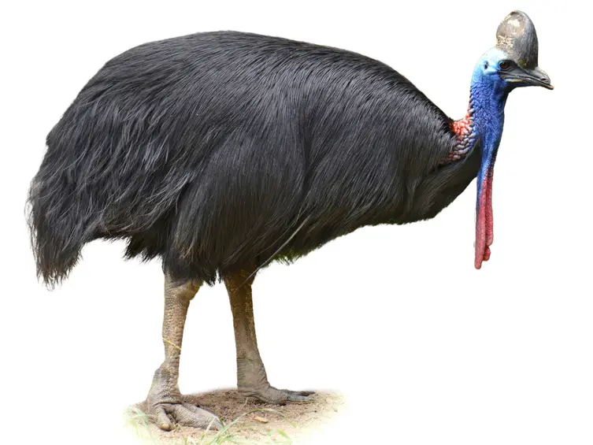

Slide 4
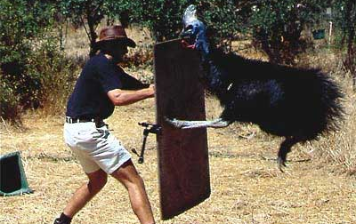

Slide 5
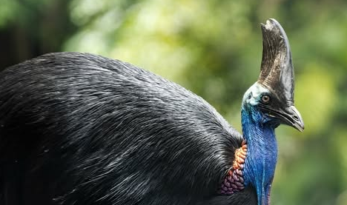

Slide 6
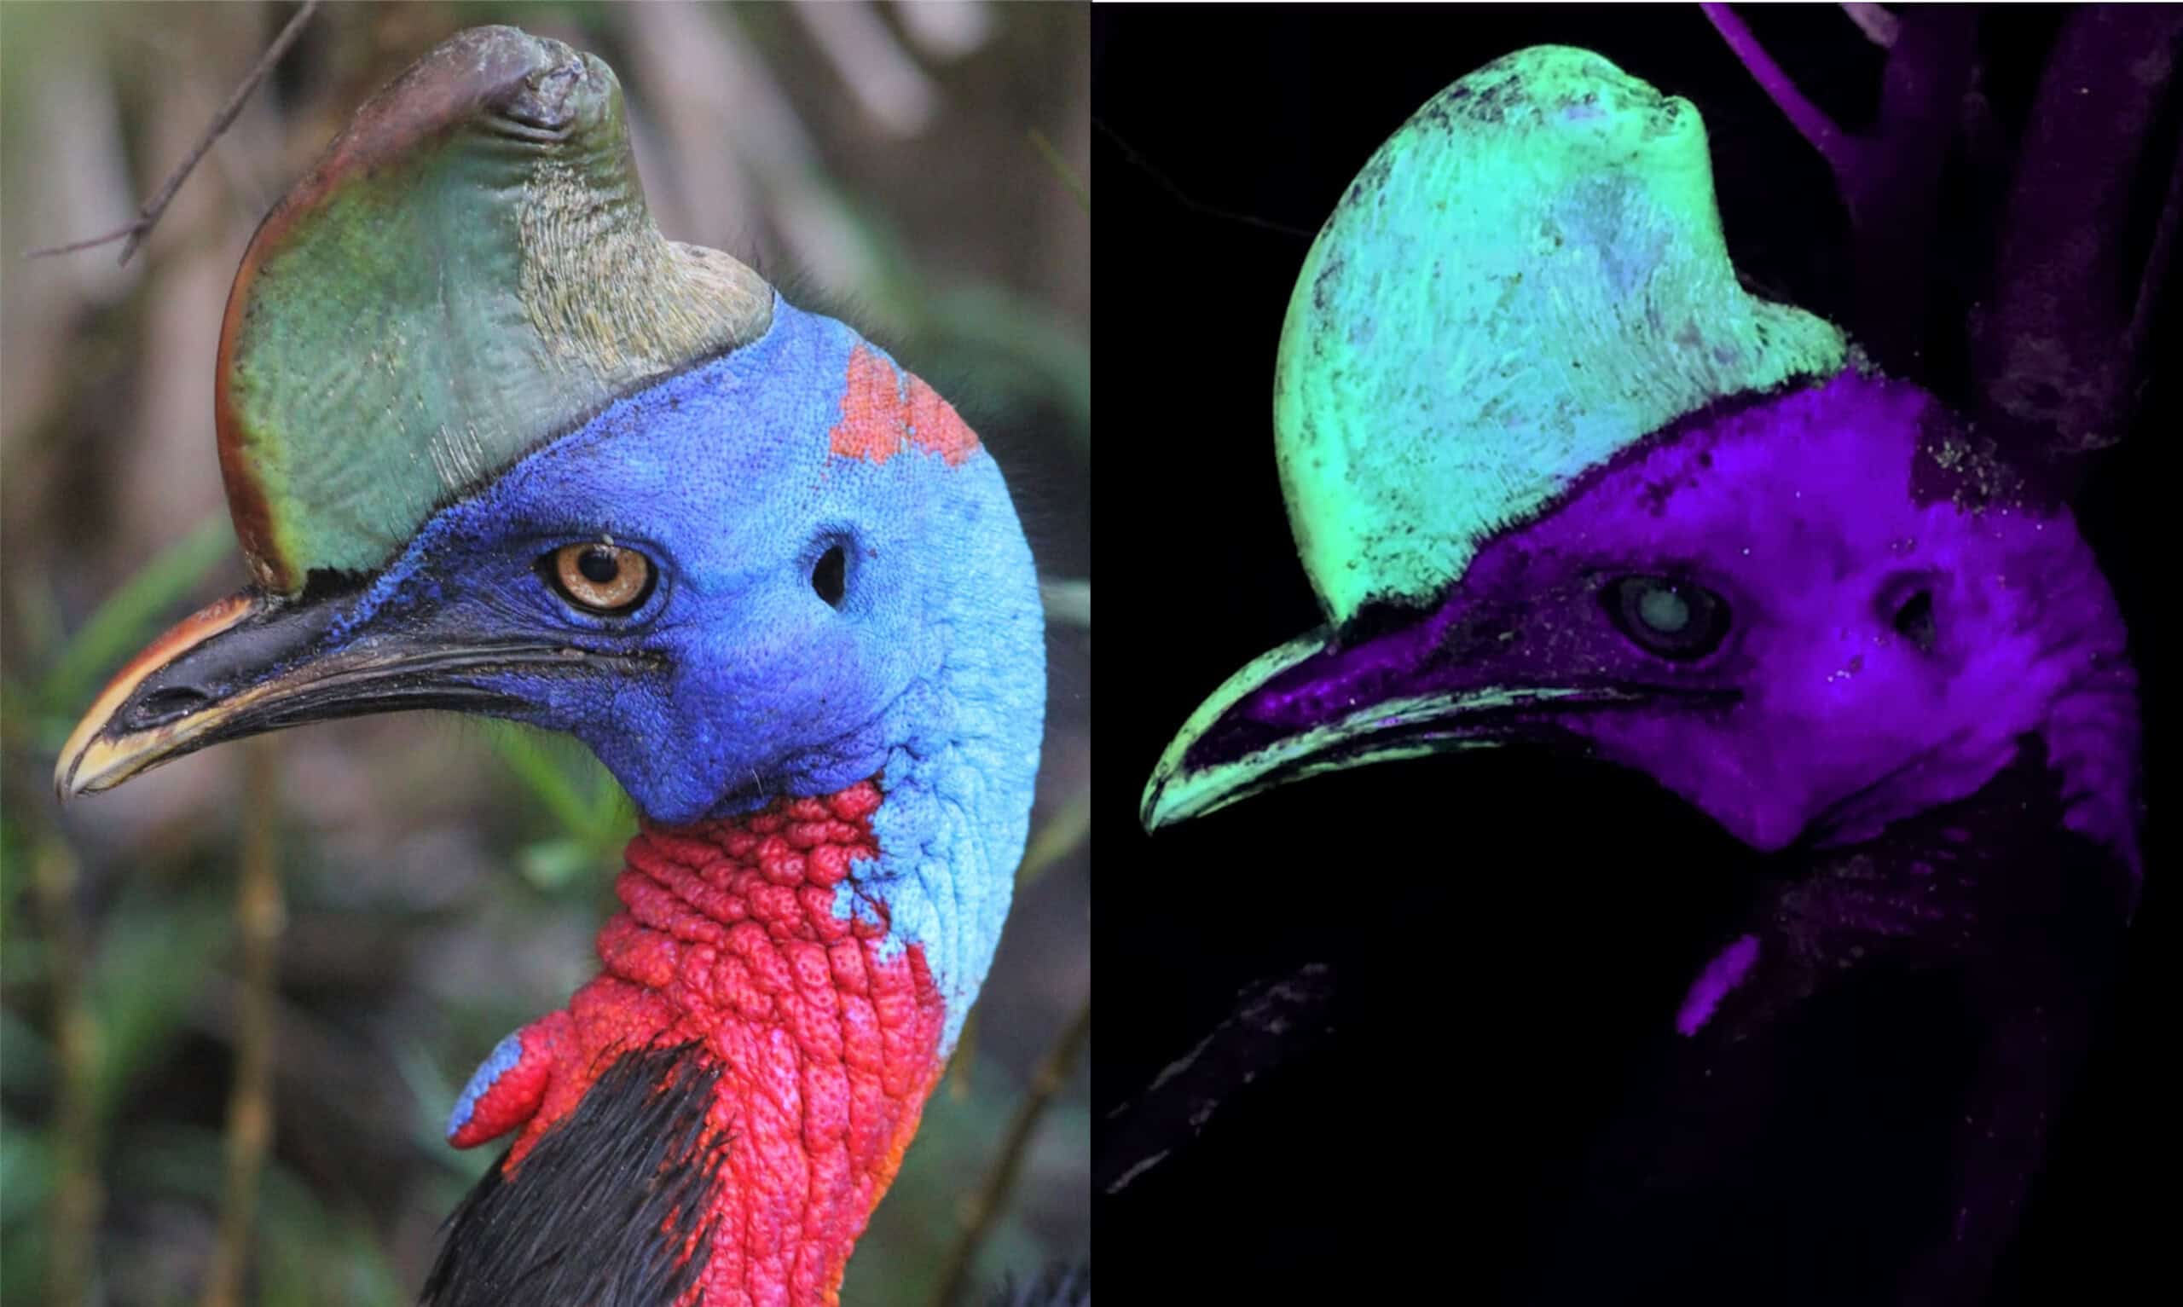

Slide 7
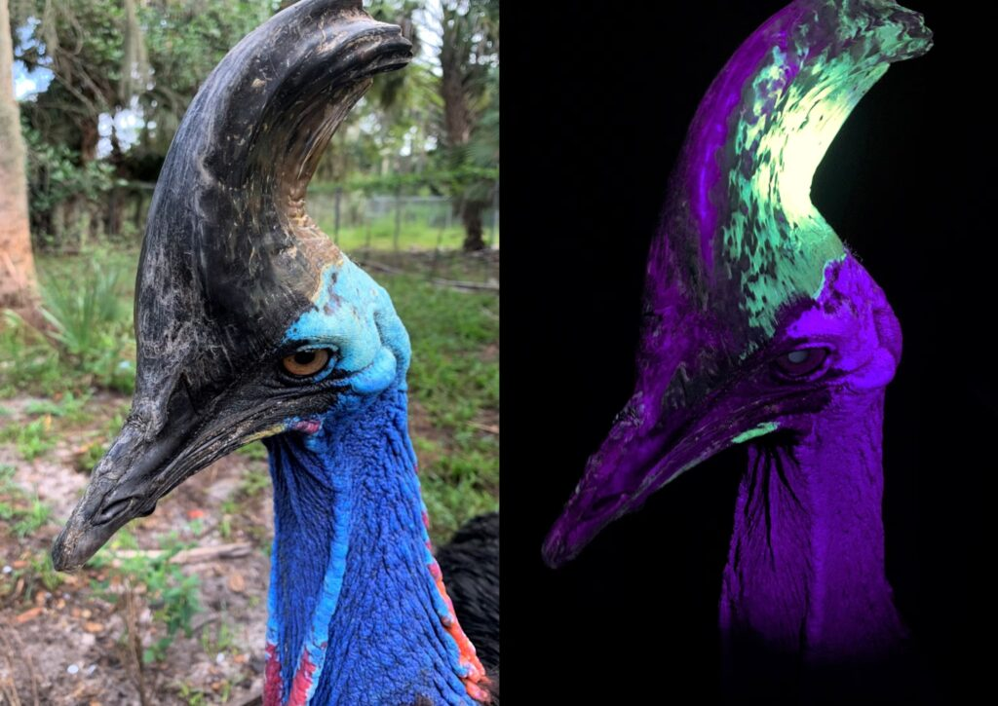

Slide 8

Lesson 8
2 Peter 3:1-7
December 8, 1888

Slide 9
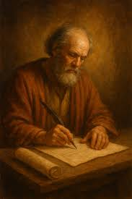
Remember the truth
1. To whom was the second epistle of Peter addressed?
2 Peter 1:1.

Slide 10
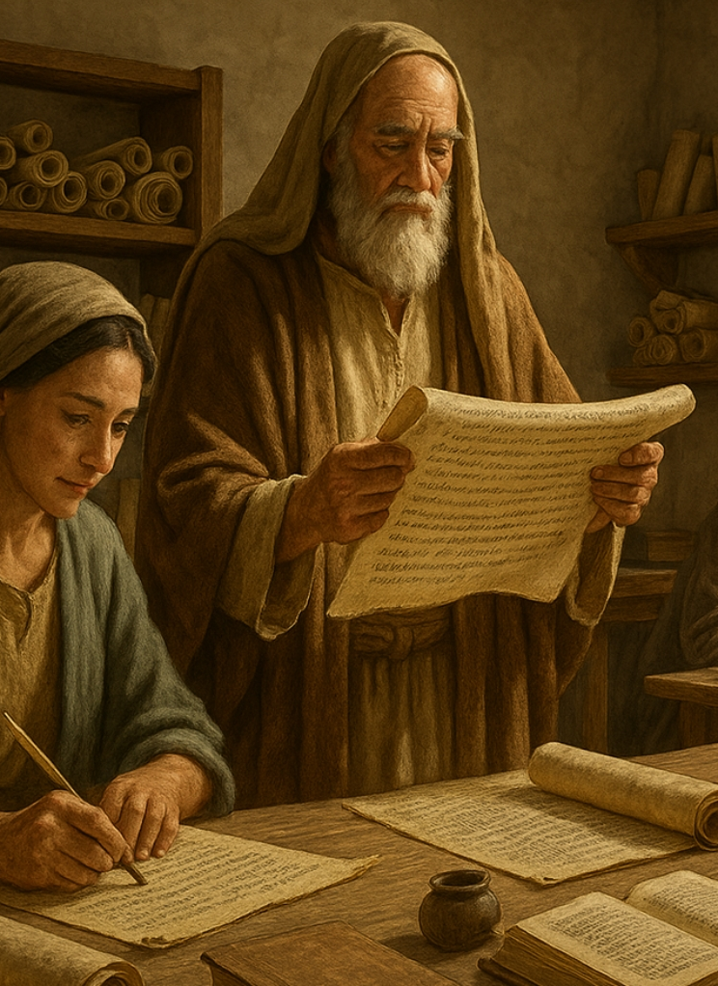
Remember the truth
2 Peter 1:1
1 Simon Peter, a servant and an apostle of Jesus Christ, to them that have obtained like precious faith with us through the righteousness of God and our Saviour Jesus Christ:

Slide 11
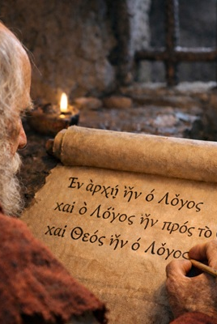
Remember the truth
2. Why was it written?
2 Peter 3:1.

Slide 12
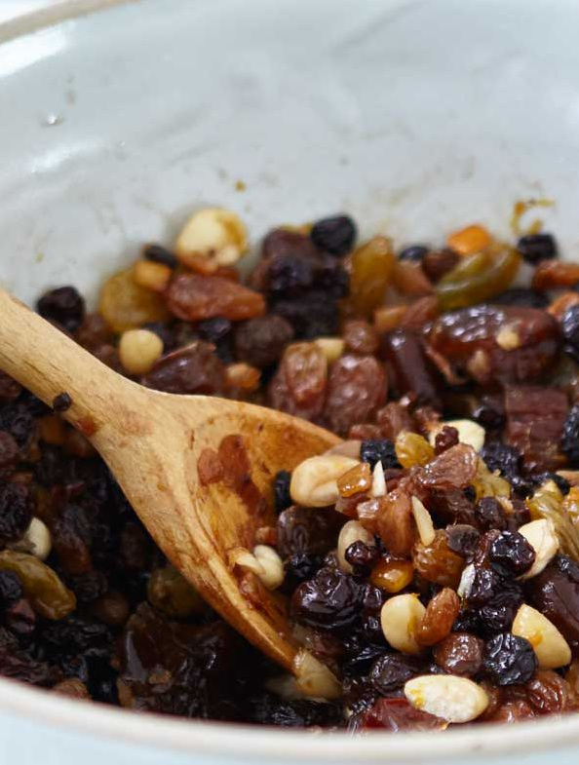
Remember the truth
2 Peter 3:1
3 This second epistle, beloved, I now write unto you; in both which I stir up your pure minds by way of remembrance:

Slide 13
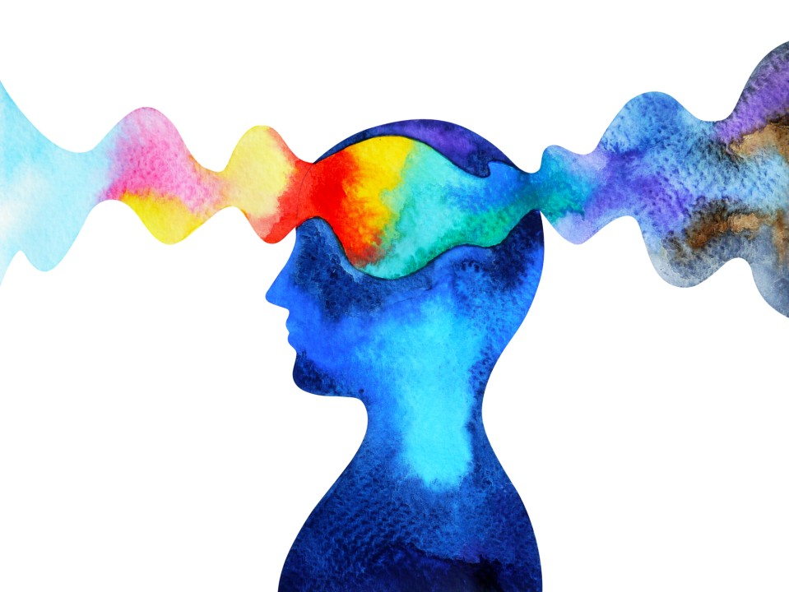
Remember the truth
3. Of what does the apostle wish us to be mindful?
2 Peter 3:2.

Slide 14
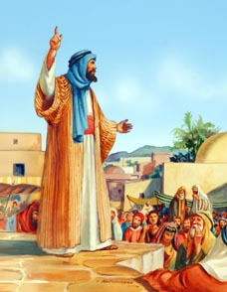
Remember the truth
2 Peter 3:2
² That ye may be mindful of the words which were spoken before by the holy prophets, and of the commandment of us the apostles of the Lord and Saviour:

Slide 15

Remember the truth
4. What purpose does prophecy serve?
2 Peter 1:19.

Slide 16
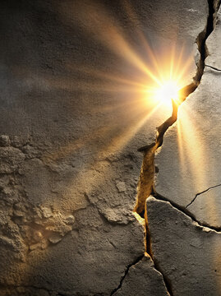
Remember the truth
2 Peter 1:19
¹⁹ We have also a more sure word of prophecy; whereunto ye do well that ye take heed, as unto a light that shineth in a dark place, until the day dawn, and the day star arise in your hearts:

Slide 17
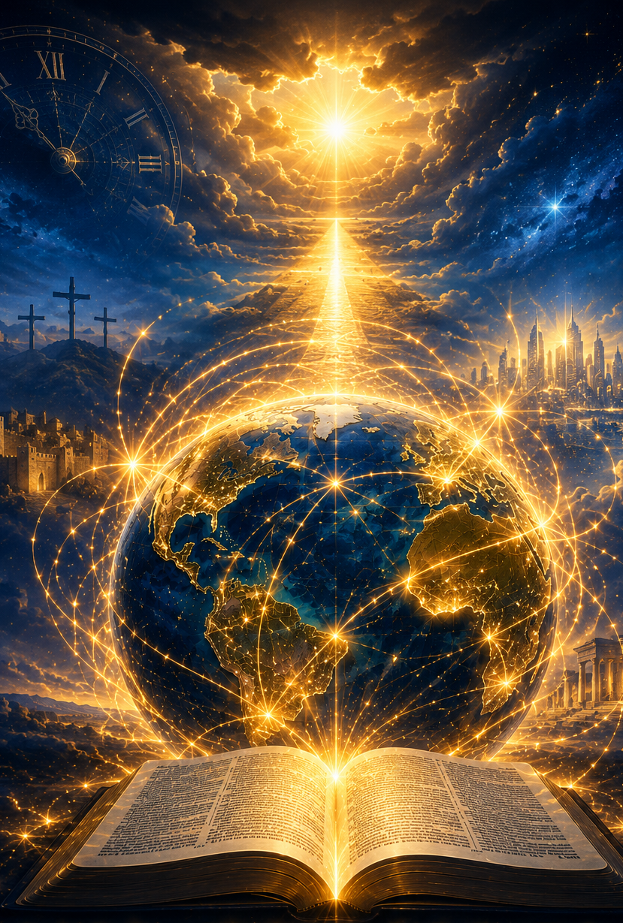
Remember the truth
5. Upon what is special light given by the prophecy?
1 Peter 1:11, last part;
Daniel 2:28.

Slide 18
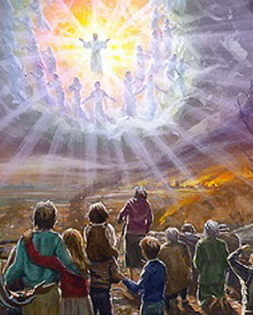
Remember the truth
1 Peter 1:11
¹¹ Searching what, or what manner of time the Spirit of Christ which was in them did signify, when it testified beforehand the sufferings of Christ, and the glory that should follow.

Slide 19
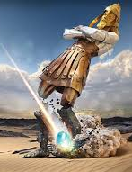
Remember the truth
Daniel 2:28
²⁸ But there is a God in heaven that revealeth secrets, and maketh known to the king Nebuchadnezzar what shall be in the latter days. Thy dream, and the visions of thy head upon thy bed, are these;

Slide 20
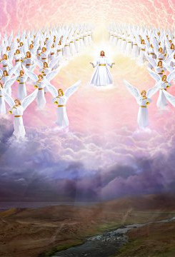
Remember the truth
6. Give reference to some prophecies which foretell the final glory of Christ, and give the substance of each.
Psalm 50:1-3; Habakkuk 3:3-6; Isaiah 63:1-6, etc.

Slide 21
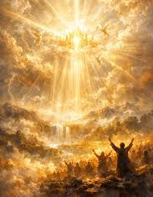
Remember the truth
Psalm 50:1-3
50 The mighty God, even the Lord, hath spoken…³ Our God shall come, and shall not keep silence: a fire shall devour before him, and it shall be very tempestuous round about him.

Slide 22
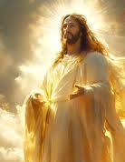
Remember the truth
Habakkuk 3:3-6
³ God came from Teman, and the Holy One from mount Paran. Selah. His glory covered the heavens, and the earth was full of his praise.

Slide 23
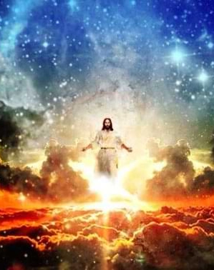
Remember the truth
Habakkuk 3:3-6
⁴ And his brightness was as the light; he had horns coming out of his hand: and there was the hiding of his power.

Slide 24
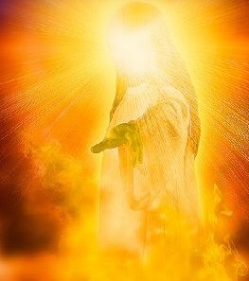
Remember the truth
Habakkuk 3:3-6
⁵ Before him went the pestilence, and burning coals went forth at his feet.

Slide 25
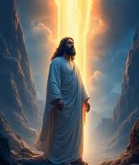
Remember the truth
Habakkuk 3:3-6
⁶ He stood, and measured the earth: he beheld, and drove asunder the nations; and the everlasting mountains were scattered, the perpetual hills did bow: his ways are everlasting.

Slide 26
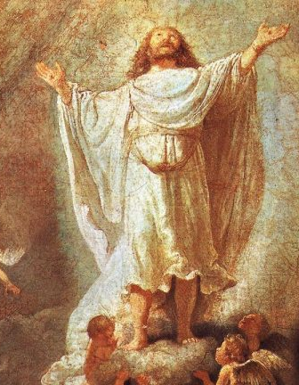
Remember the truth
Isaiah 63:1-6
63 Who is this that cometh from Edom, with dyed garments from Bozrah? this that is glorious in his apparel, travelling in the greatness of his strength? I that speak in righteousness, mighty to save...

Slide 27
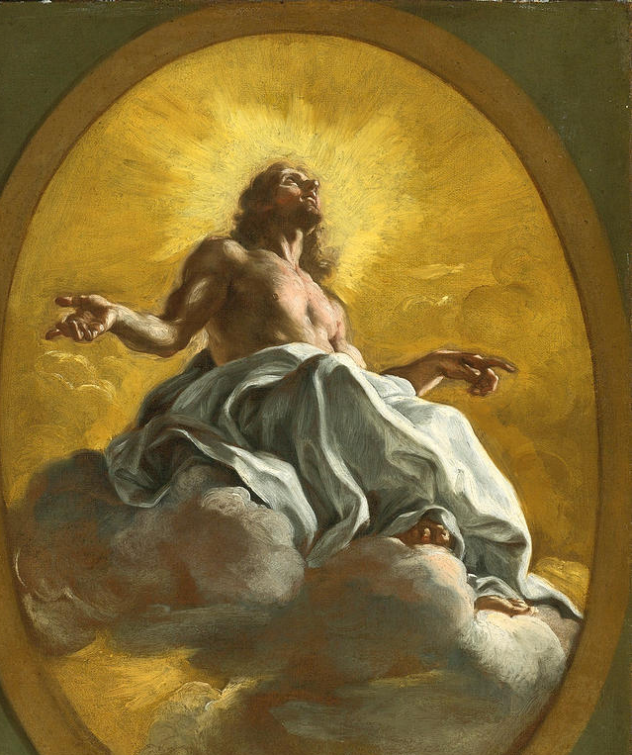
Remember the truth
Isaiah 63:1-6
³ I have trodden the winepress alone; and of the people there was none with me: for I will tread them in mine anger, and trample them in my fury; and their blood shall be sprinkled upon my garments, and I will stain all my raiment…

Slide 28
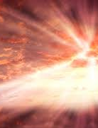
Remember the truth
Isaiah 63:1-6
⁴ For the day of vengeance is in mine heart, and the year of my redeemed is come… ⁶ And I will tread down the people in mine anger, and make them drunk in my fury, and I will bring down their strength to the earth.

Slide 29
Scoffers
7. What must we look for just before the end?
2 Peter 3:3;
Jude 17, 18.

Slide 30
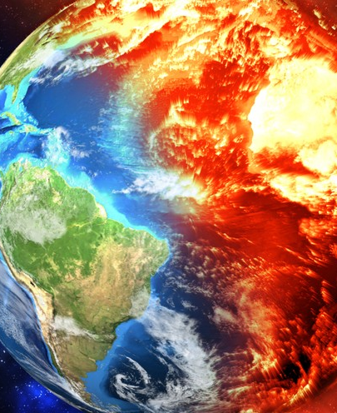
Scoffers
2 Peter 3:3
³ Knowing this first, that there shall come in the last days scoffers, walking after their own lusts,

Slide 31
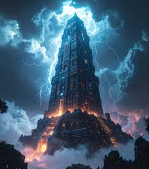
Scoffers
Jude 17, 18
¹⁷ But, beloved, remember ye the words which were spoken before of the apostles of our Lord Jesus Christ;
¹⁸ How that they told you there should be mockers in the last time, who should walk after their own ungodly lusts.

Slide 32
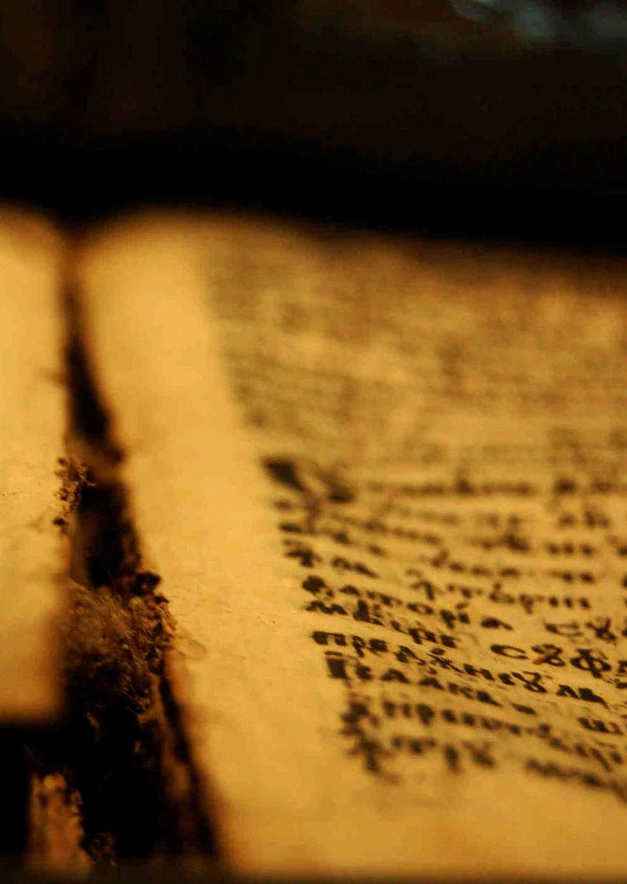
Scoffers
8. Mention some other places in the writings of the apostles where this is foretold.
1 Timothy 4: I, 2;
2 Timothy 3:1-5, 13; 4:1-4;
2 Thessalonians 2:8-10.

Slide 33
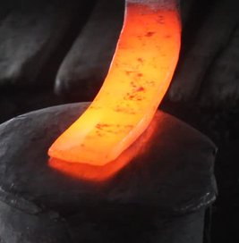
Scoffers
1 Timothy 4:1, 2
4 Now the Spirit speaketh expressly, that in the latter times some shall depart from the faith, giving heed to seducing spirits, and doctrines of devils;
² Speaking lies in hypocrisy; having their conscience seared with a hot iron;

Slide 34
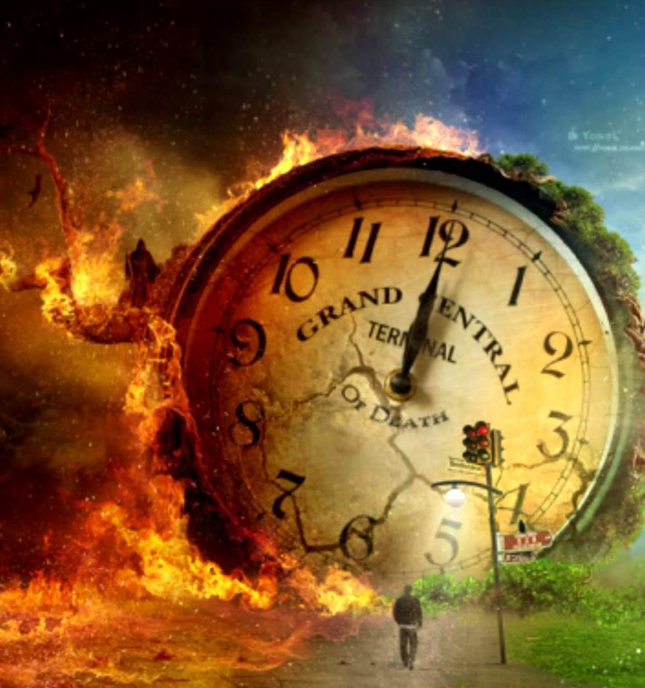
Scoffers
2 Timothy 3:1-5, 13
3 This know also, that in the last days perilous times shall come.
² For men shall be lovers of their own selves, covetous, boasters, proud, blasphemers, disobedient to parents, unthankful, unholy,

Slide 35
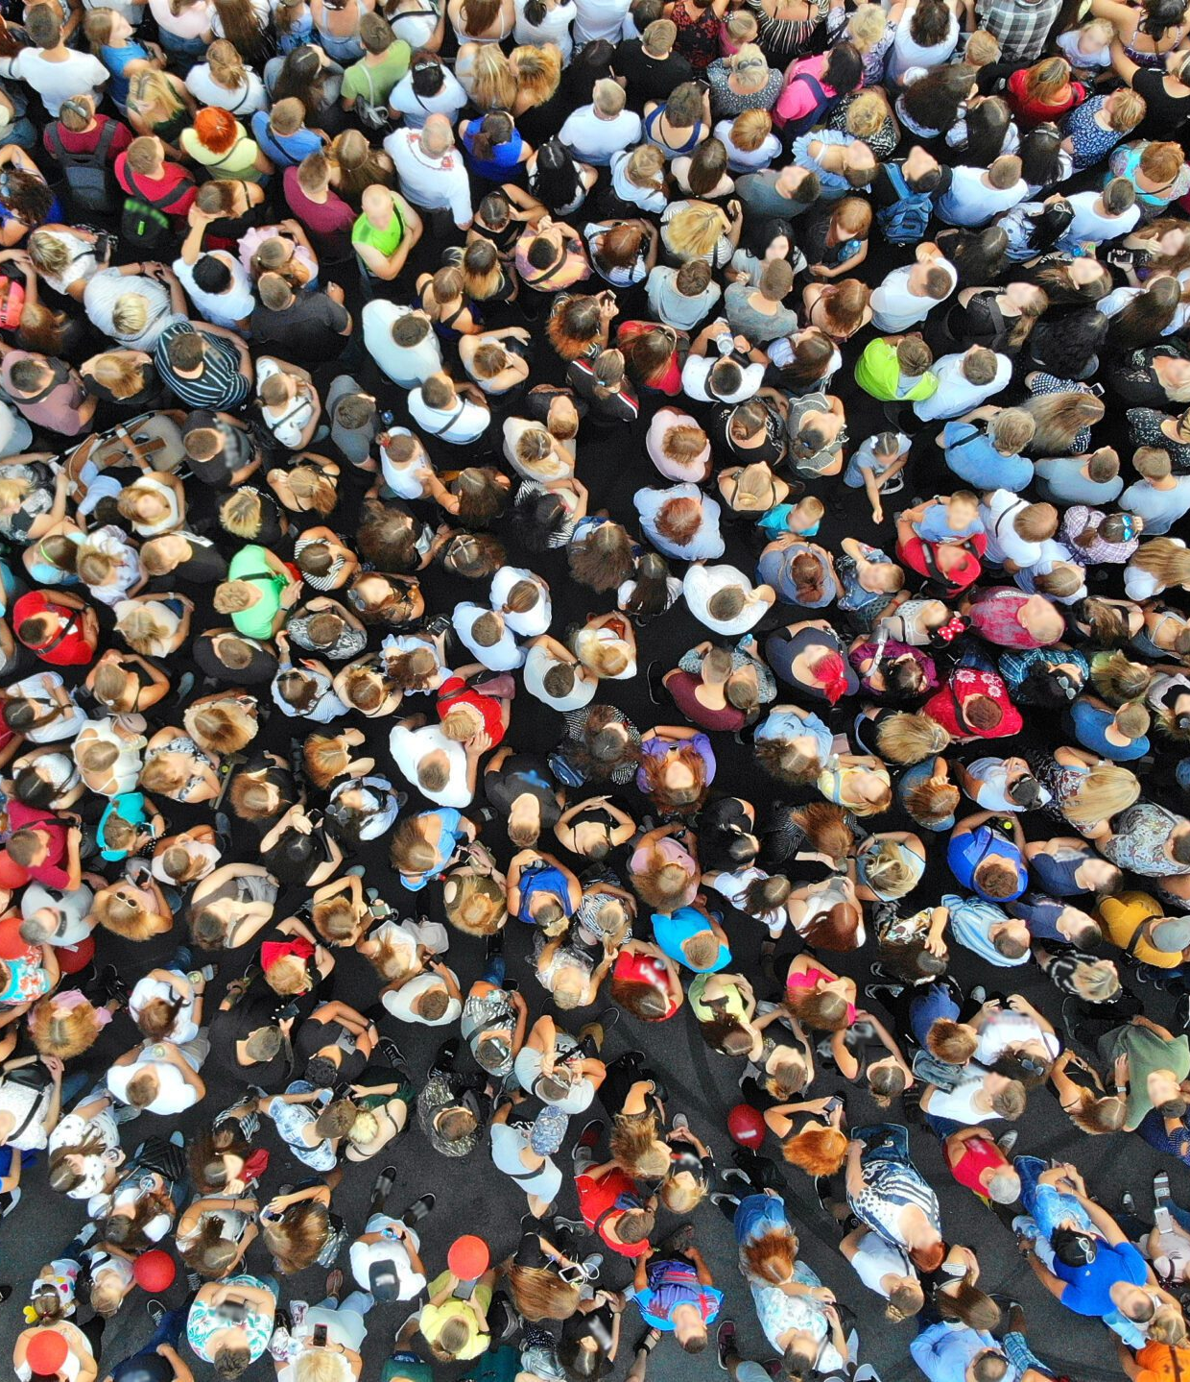
Scoffers
2 Timothy 3:1-5, 13
³ Without natural affection, trucebreakers, false accusers, incontinent, fierce, despisers of those that are good,
⁴ Traitors, heady, highminded, lovers of pleasures more than lovers of God;

Slide 36

Scoffers
2 Timothy 3:1-5, 13
⁵ Having a form of godliness, but denying the power thereof: from such turn away.

Slide 37

Scoffers
2 Timothy 3:1-5, 13
¹³ But evil men and seducers shall wax worse and worse, deceiving, and being deceived.

Slide 38
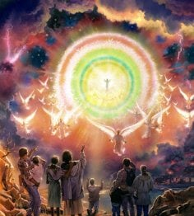
Scoffers
2 Timothy 4:1-4
4 I charge thee therefore before God, and the Lord Jesus Christ, who shall judge the quick and the dead at his appearing and his kingdom;

Slide 39
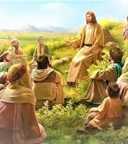
Scoffers
2 Timothy 4:1-4
² Preach the word; be instant in season, out of season; reprove, rebuke, exhort with all long suffering and doctrine.

Slide 40

Scoffers
2 Timothy 4:1-4
³ For the time will come when they will not endure sound doctrine; but after their own lusts shall they heap to themselves teachers, having itching ears;

Slide 41
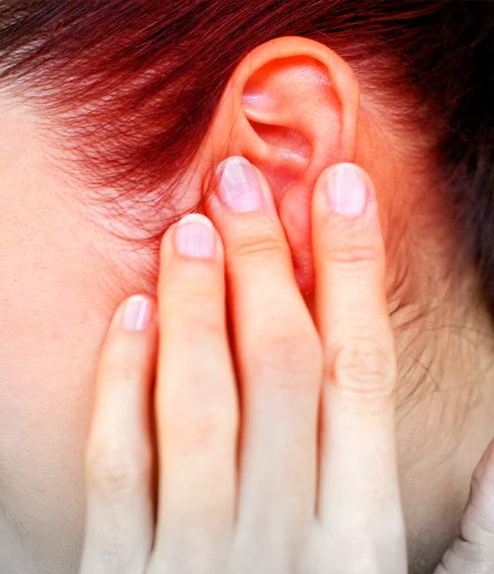
Scoffers
2 Timothy 4:1-4
⁴ And they shall turn away their ears from the truth, and shall be turned unto fables.

Slide 42
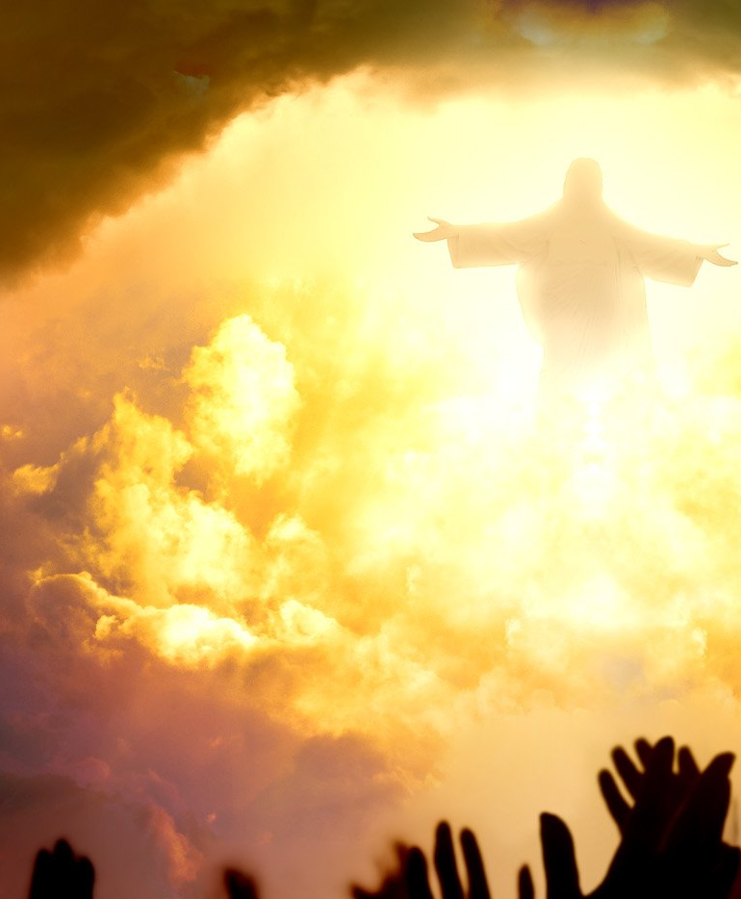
Scoffers
2 Thessalonians 2:8-10
⁸ And then shall that Wicked be revealed, whom the Lord shall consume with the spirit of his mouth, and shall destroy with the brightness of his coming:

Slide 43
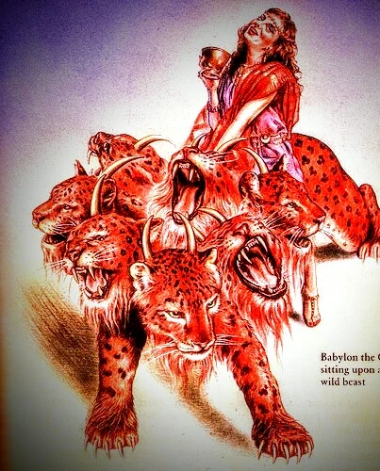
Scoffers
2 Thessalonians 2:8-10
⁹ Even him, whose coming is after the working of Satan with all power and signs and lying wonders,

Slide 44
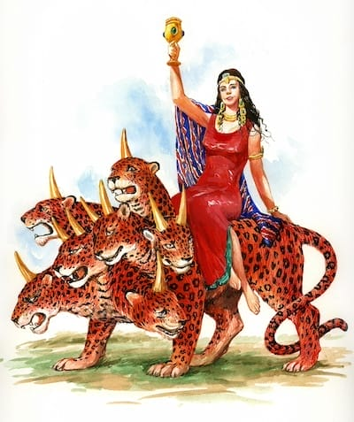
Scoffers
2 Thessalonians 2:8-10
¹⁰ And with all deceivableness of unrighteousness in them that perish; because they received not the love of the truth, that they might be saved.

Slide 45
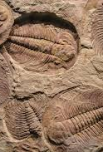
Scoffers
9. Of what do these scoffers profess to be ignorant?
2 Peter 3:4.

Slide 46
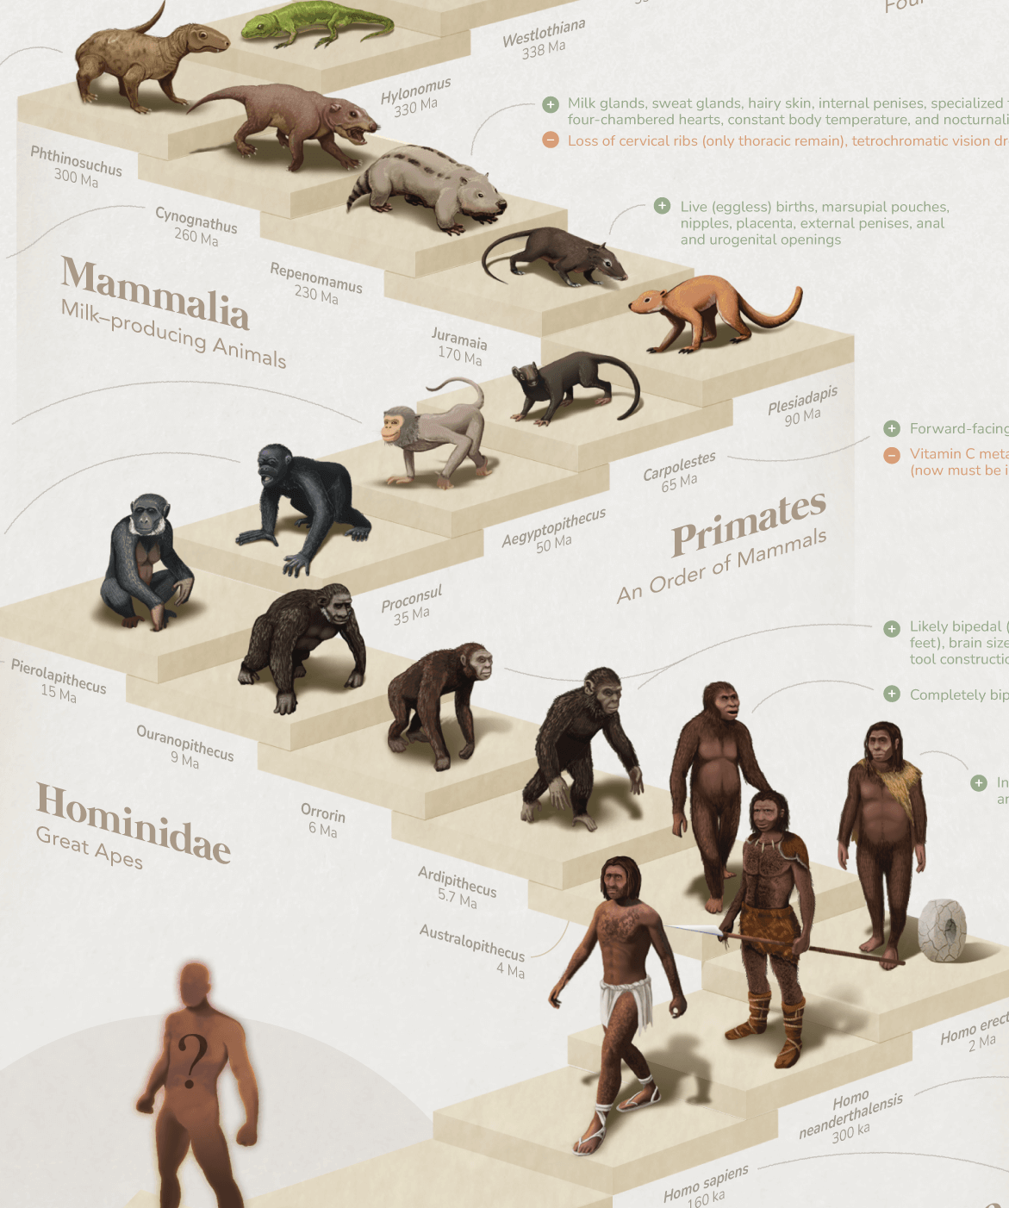
Scoffers
2 Peter 3:4
⁴ And saying, Where is the promise of his coming? for since the fathers fell asleep, all things continue as they were from the beginning of the creation.

Slide 47
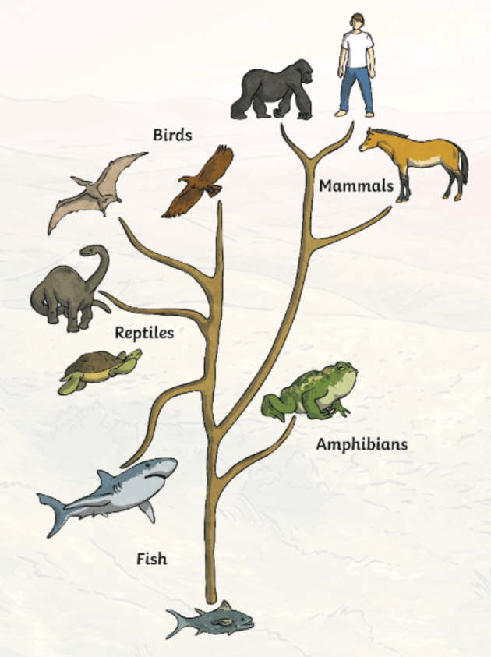
Scoffers
10. Is there any excuse for such ignorance?
2 Peter 3:5.

Slide 48
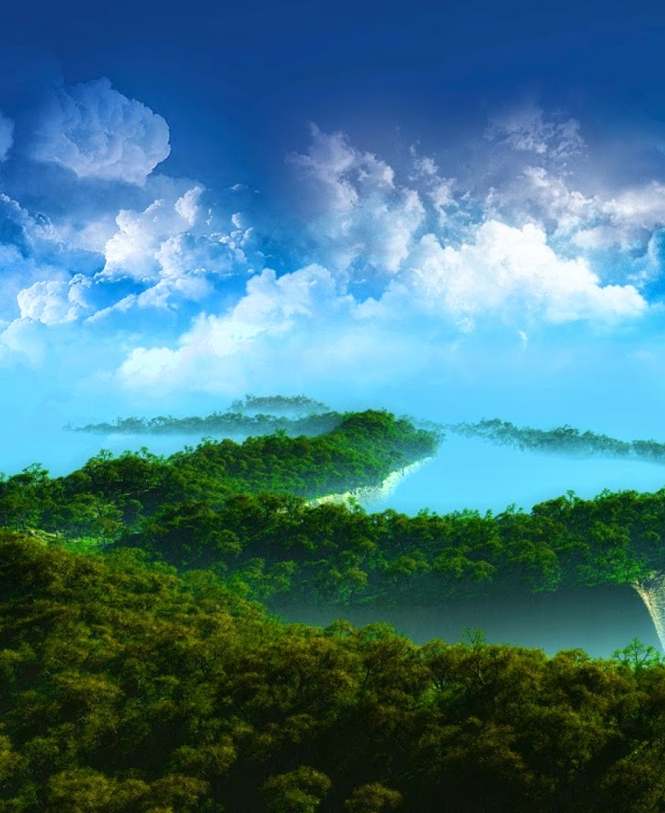
Scoffers
2 Peter 3:5
⁵ For this they willingly are ignorant of, that by the word of God the heavens were of old, and the earth standing out of the water and in the water:

Slide 49
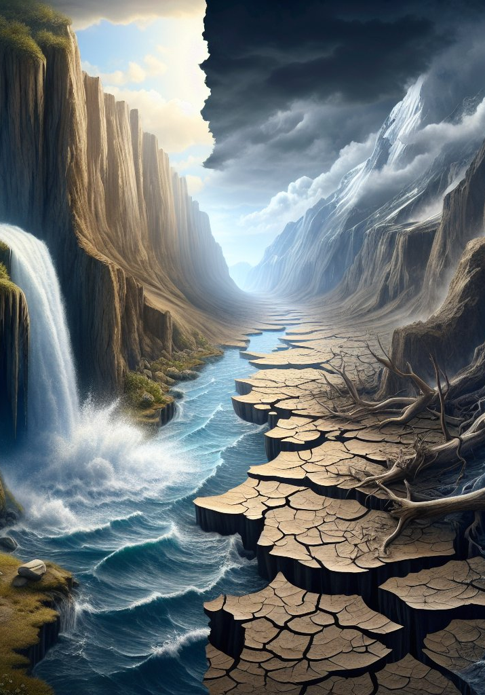
Recall the Flood
11. What notable event recorded in Scripture shows that all things have not continued as they were from the beginning of the creation?
2 Peter 3:5-6.

Slide 50
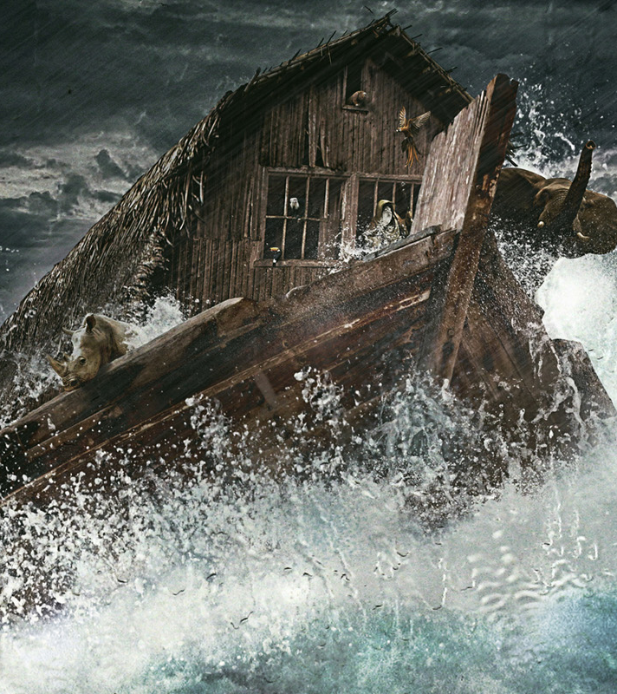
Recall the Flood
2 Peter 3:5
⁵ For this they willingly are ignorant of, that by the word of God the heavens were of old, and the earth standing out of the water and in the water:

Slide 51
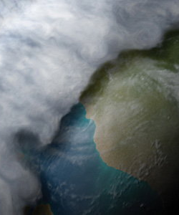
Recall the Flood
2 Peter 3:6
⁶ Whereby the world that then was, being overflowed with water, perished:

Slide 52
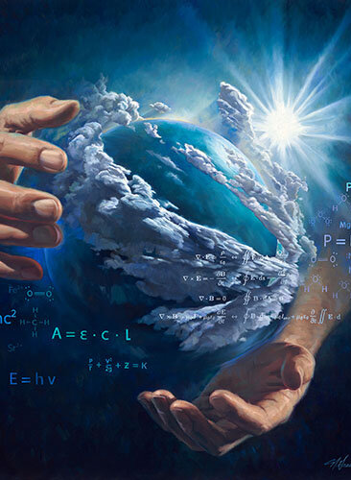
Recall the Flood
12. How did the earth come into existence?
Psalm 33:6, 8, 9

Slide 53
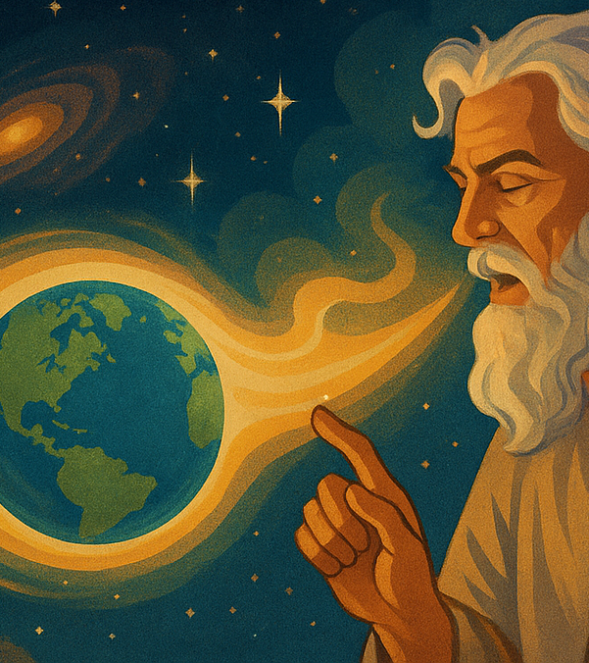
Recall the Flood
Psalm 33:6, 8, 9
⁶ By the word of the Lord were the heavens made; and all the host of them by the breath of his mouth.

Slide 54
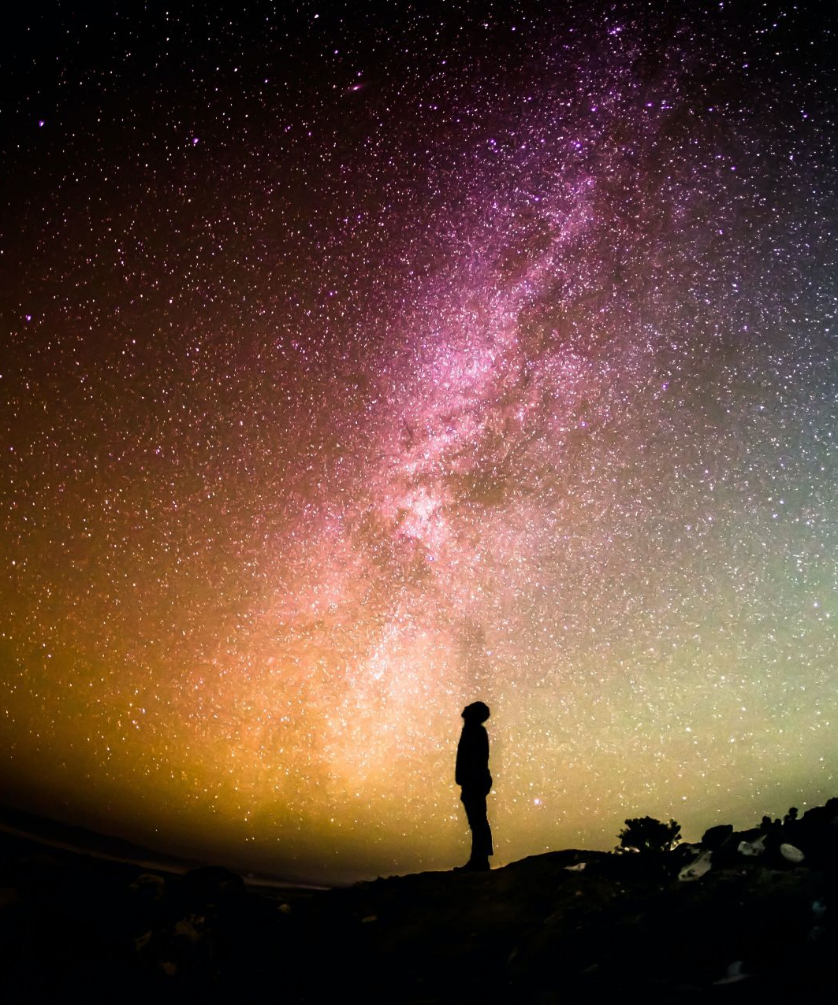
Recall the Flood
Psalm 33:6, 8, 9
⁸ Let all the earth fear the Lord: let all the inhabitants of the world stand in awe of him.

Slide 55
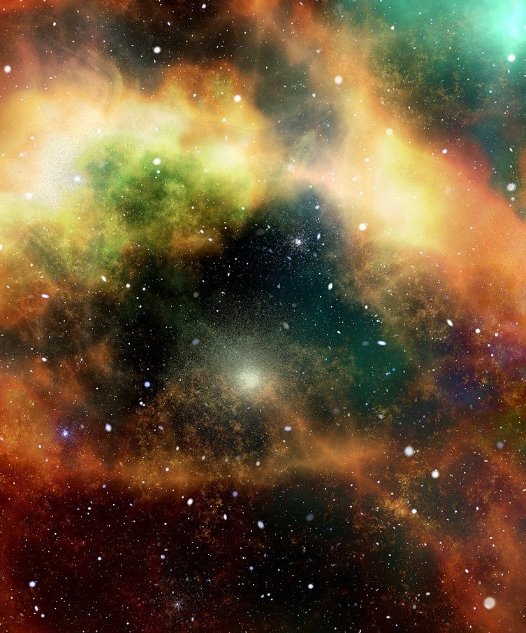
Recall the Flood
Psalm 33:6, 8, 9
⁹ For he spake, and it was done; he commanded, and it stood fast.

Slide 56
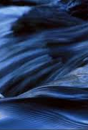
Recall the Flood
13. In what condition was the earth at first?
Genesis 1:2

Slide 57
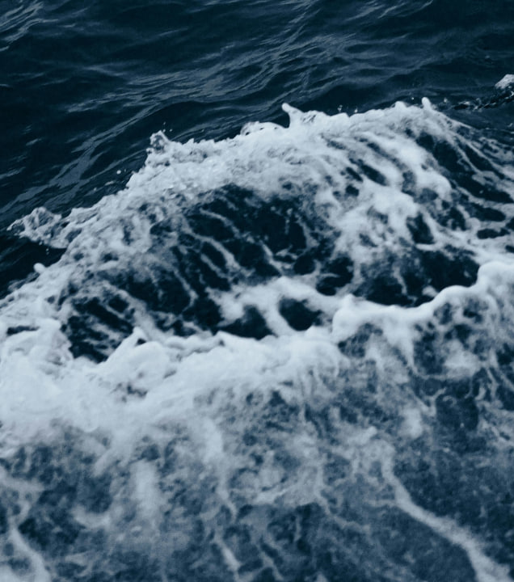
Recall the Flood
Genesis 1:2
² And the earth was without form, and void; and darkness was upon the face of the deep. And the Spirit of God moved upon the face of the waters.

Slide 58
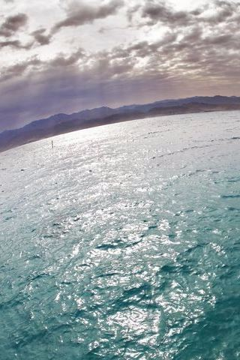
Recall the Flood
14. What division was first made in this watery mass?
Genesis 1:6-7

Slide 59

Recall the Flood
Genesis 1:6
⁶ And God said, Let there be a firmament in the midst of the waters, and let it divide the waters from the waters.

Slide 60

Recall the Flood
Genesis 1:7
⁷ And God made the firmament, and divided the waters which were under the firmament from the waters which were above the firmament: and it was so.

Slide 61

Recall the Flood
15. What was done with the waters that were beneath the firmament?
Genesis 1:9; Psalm 33:7

Slide 62

Recall the Flood
Genesis 1:9
⁹ And God said, Let the waters under the heaven be gathered together unto one place, and let the dry land appear: and it was so.

Slide 63

Recall the Flood
Psalm 33:7
⁷ He gathereth the waters of the sea together as an heap: he layeth up the depth in storehouses.

Slide 64

Recall the Flood
16. When, by the word of the Lord, the flood destroyed the earth, how did the waters that were stored up in the earth contribute to that result?
Genesis 7:11

Slide 65

Recall the Flood
Genesis 7:11
¹¹ In the six hundredth year of Noah's life, in the second month, the seventeenth day of the month, the same day were all the fountains of the great deep broken up, and the windows of heaven were opened.

Slide 66

Scientists discover a massive underground reservoir of water three times larger than all the oceans combined. This hidden "ocean" is located 400 miles beneath Earth's surface, trapped within a mineral called “ringwoodite.”

Slide 67


Slide 68


Slide 69

This water is not in a form familiar to us — it is not liquid, ice or vapor. High pressure, along with temperatures above 2,000 degrees Fahrenheit, cause water molecules to split, forming a hydroxyl radical (OH), which can be bound into a mineral's crystal structure.

Slide 70

Scientists discovered a piece of the mineral ringwoodite inside a diamond brought up from a depth of 400 miles by a volcano in Brazil. That tiny piece of ringwoodite — the only sample in existence from within the Earth — contained a surprising amount of water bound in solid form in the mineral.

Slide 71


Slide 72

"The ringwoodite is like a sponge, soaking up water," Jacobsen said. "There is something very special about the crystal structure of ringwoodite that allows it to attract hydrogen and trap water. This mineral can contain a lot of water under conditions of the deep mantle."

Slide 73

The Days of Noah
17. What fate, by the same authority, now awaits the earth?
2 Peter 3:7

Slide 74

The Days of Noah
2 Peter 3:7
⁷ But the heavens and the earth, which are now, by the same word are kept in store, reserved unto fire against the day of judgment and perdition of ungodly men.

Slide 75

The Days of Noah
18. Where has the word of the Lord declared this?
Nahum 1:5;
Isaiah 34:8-10;
Deuteronomy 32:22

Slide 76

The Days of Noah
Nahum 1:5
⁵ The mountains quake at him, and the hills melt, and the earth is burned at his presence, yea, the world, and all that dwell therein.

Slide 77

The Days of Noah
Isaiah 34:8-10
⁸ For it is the day of the Lord's vengeance, and the year of recompences for the controversy of Zion.

Slide 78

The Days of Noah
Isaiah 34:8-10
⁹ And the streams thereof shall be turned into pitch, and the dust thereof into brimstone, and the land thereof shall become burning pitch.

Slide 79

The Days of Noah
Isaiah 34:8-10
¹⁰ It shall not be quenched night nor day; the smoke thereof shall go up for ever: from generation to generation it shall lie waste; none shall pass through it for ever and ever.

Slide 80

The Days of Noah
Deuteronomy 32:22
²² For a fire is kindled in mine anger, and shall burn unto the lowest hell, and shall consume the earth with her increase, and set on fire the foundations of the mountains.

Slide 81

The Days of Noah
19. What positive assurance have we that this will be done?
Answer: We have the word of Him who spoke the earth into existence, and who caused the water that constituted a portion of the earth, to contribute to its destruction. See 2 Peter 3:5-7.

Slide 82

The Days of Noah
2 Peter 3:5-7
⁵ For this they willingly are ignorant of, that by the word of God the heavens were of old, and the earth standing out of the water and in the water:

Slide 83

The Days of Noah
2 Peter 3:5-7
⁶ Whereby the world that then was, being overflowed with water, perished:

Slide 84

The Days of Noah
2 Peter 3:5-7
⁷ But the heavens and the earth, which are now, by the same word are kept in store, reserved unto fire against the day of judgment and perdition of ungodly men.

Slide 85
The Days of Noah
20. Show the analogy between the destruction of the earth by water, and its destruction by fire.
See note on 2 Peter 3:5-7.

Slide 86

The Days of Noah
The idea of the passage in Peter's epistle is that one of the very elements from which the earth was formed, was made to contribute to its destruction.

Slide 87

The Days of Noah
Now the comparison is at once apparent. By the word of God, the earth, in the beginning, was formed from the watery mass which God had spoken into existence. Part of this water was stored up in the earth, and by the word of God was afterward caused to overflow the earth, and contribute to its destruction.

Slide 88

The Days of Noah
And the same word of God, which performed this, has stored the interior of this present earth with fire, and is keeping it till the day of Judgment, when, as in the case of the waters of the flood, the fire within the earth, uniting with that which comes down from God out of Heaven (Rev. 20:9) will destroy it.

Slide 89

The Days of Noah
Particular attention should be given to the word "kept." Instead of all things continuing as they were from the beginning of the creation, the earth has within it the elements of its destruction, and it is only the power of God that stays the catastrophe.

Slide 90


Slide 91


