Slide 1


Slide 2


Slide 3
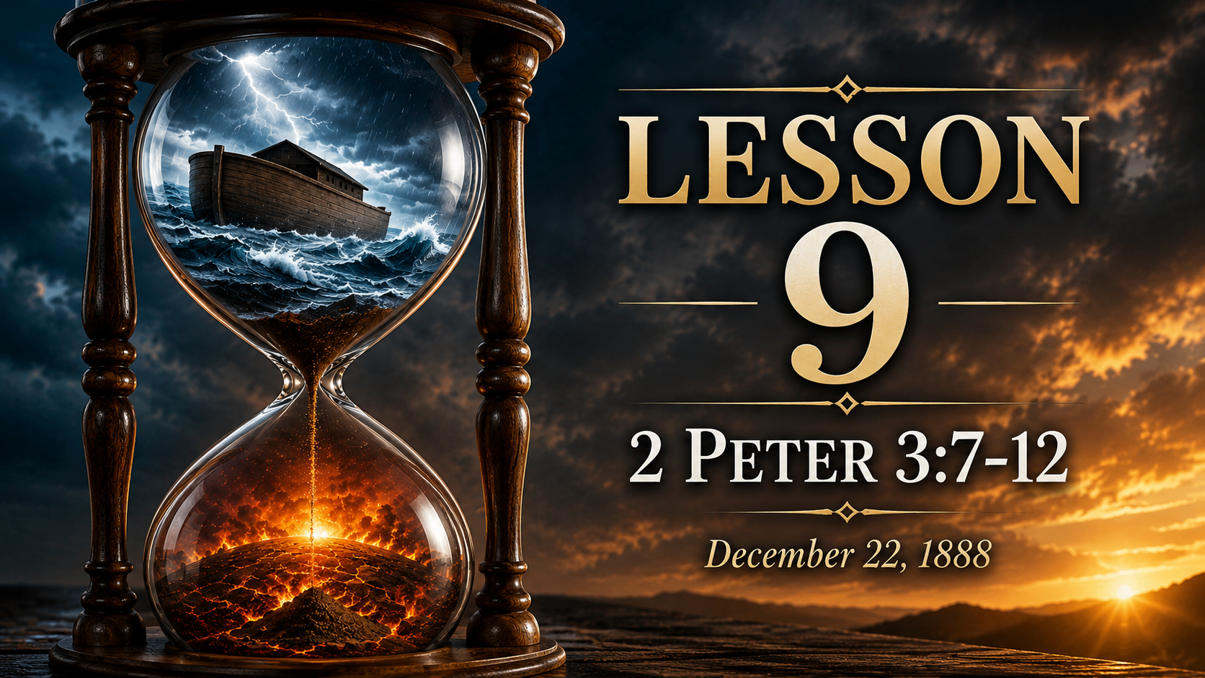

Slide 4
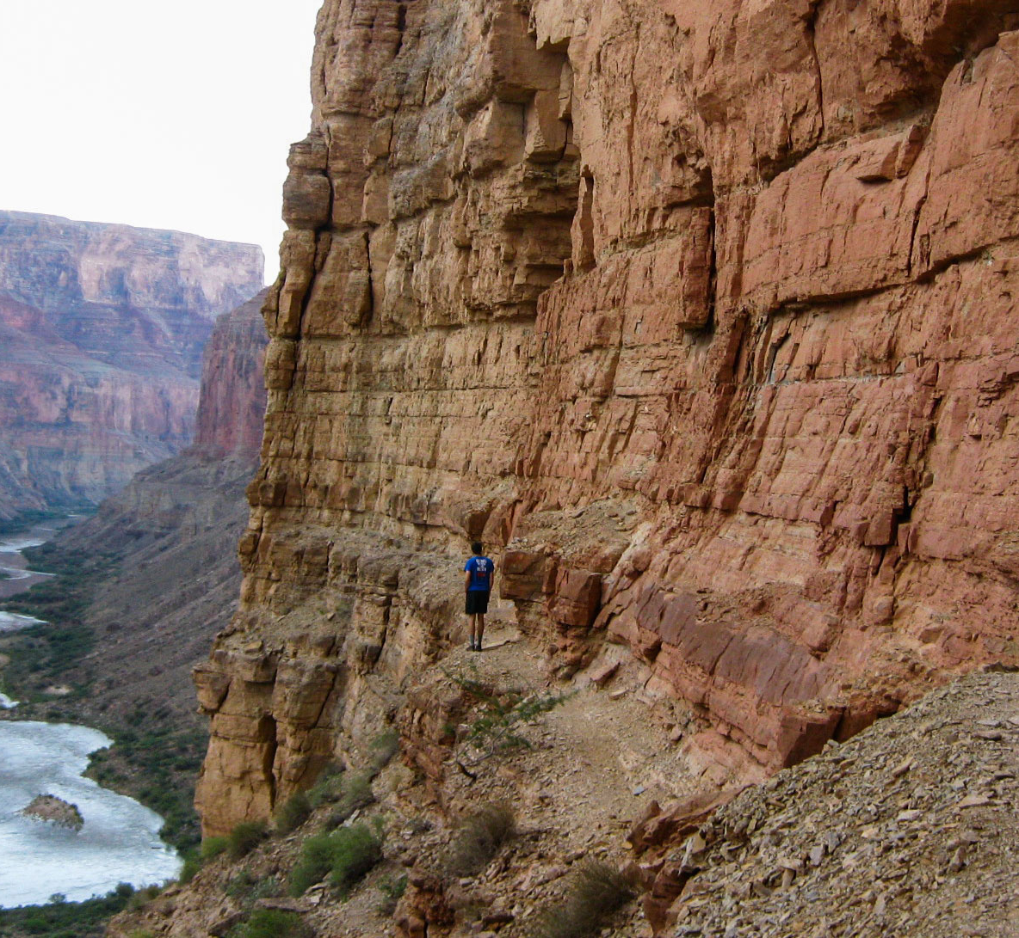
Rejecting the promise
1. State the argument which the apostle Peter says the last-day scoffers will urge against the doctrine of Christ’s second coming.

Slide 5

2 Peter 3:3
³ Knowing this first, that there shall come in the last days scoffers, walking after their own lusts,

Slide 6
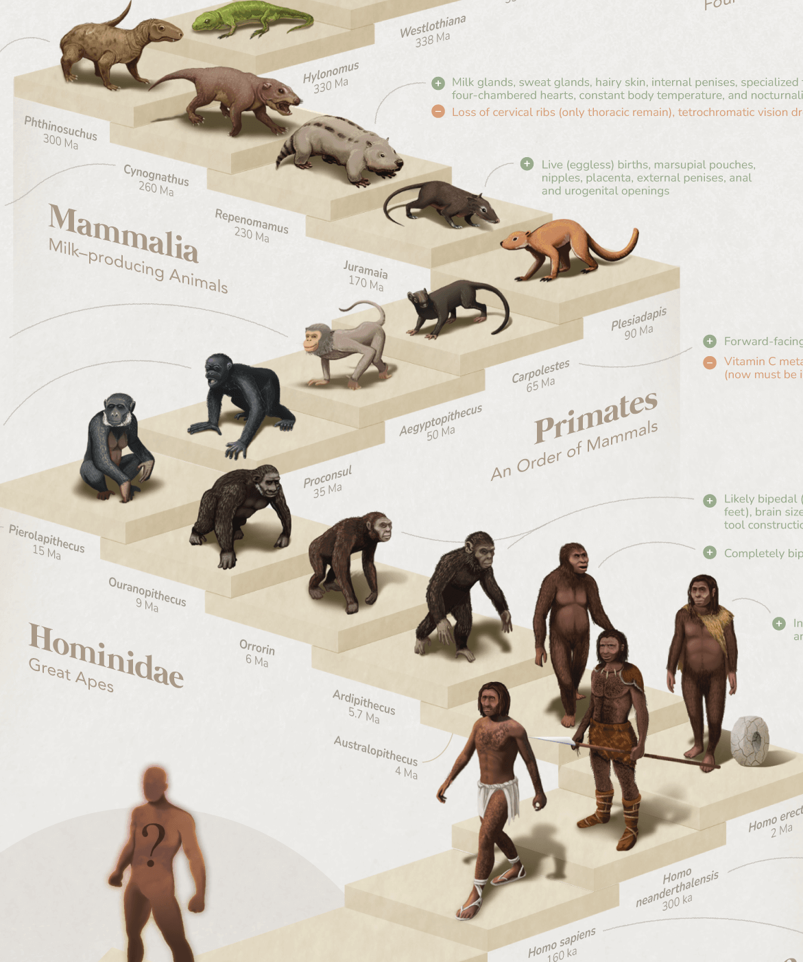
2 Peter 3:4
⁴ And saying, Where is the promise of his coming? for since the fathers fell asleep, all things continue as they were from the beginning of the creation.

Slide 7

Rejecting the promise
2. Show the falsity of their statement.

Slide 8
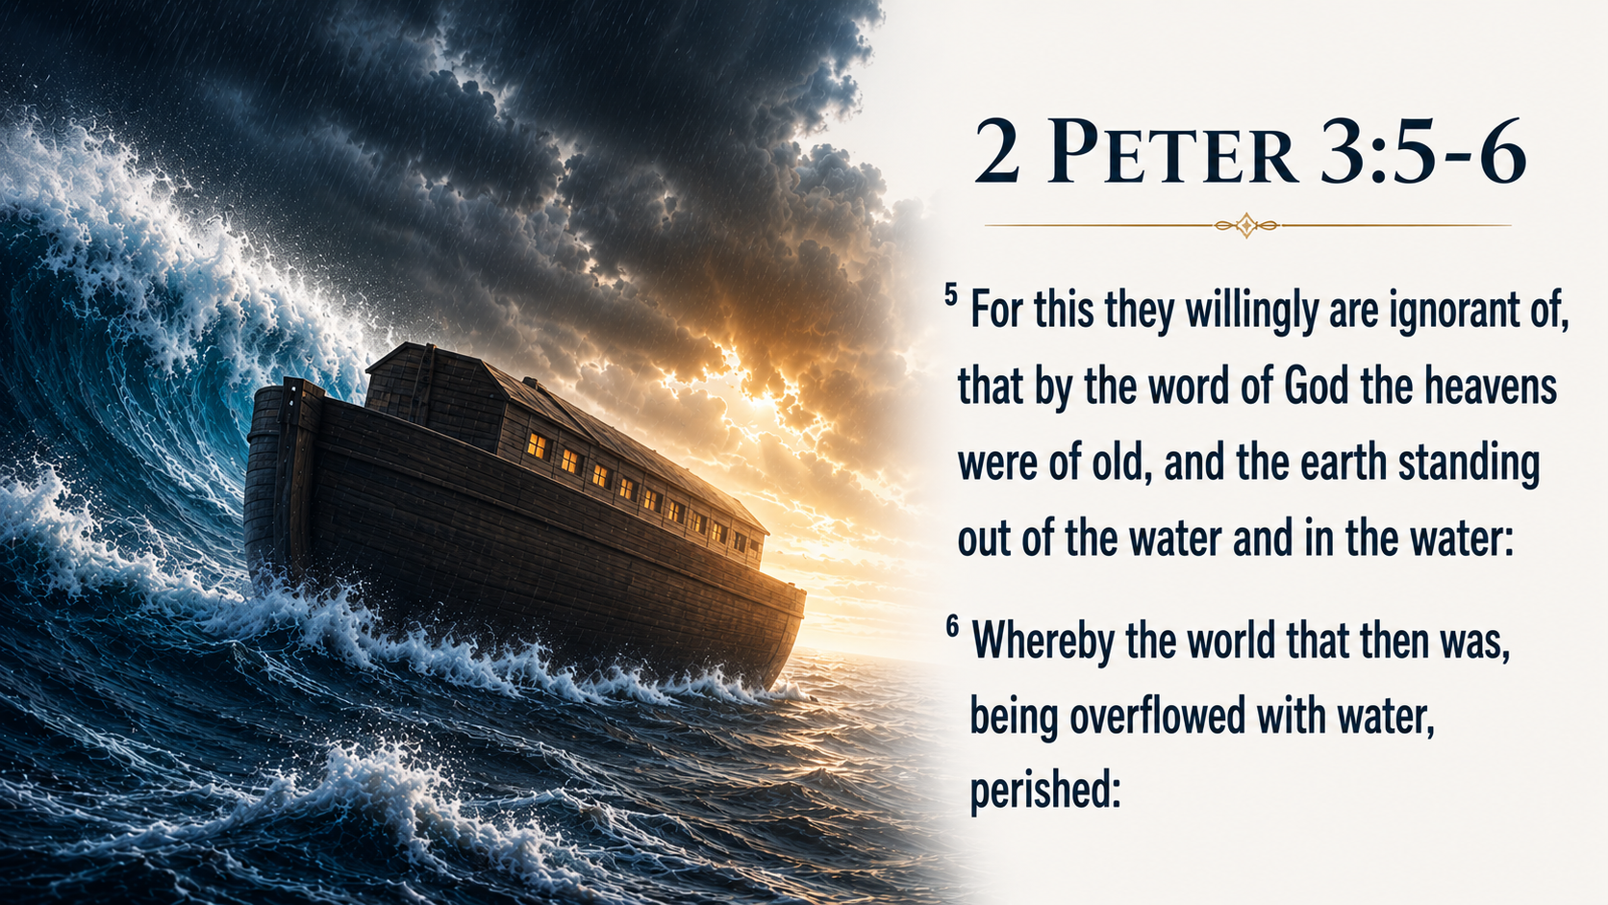

Slide 9
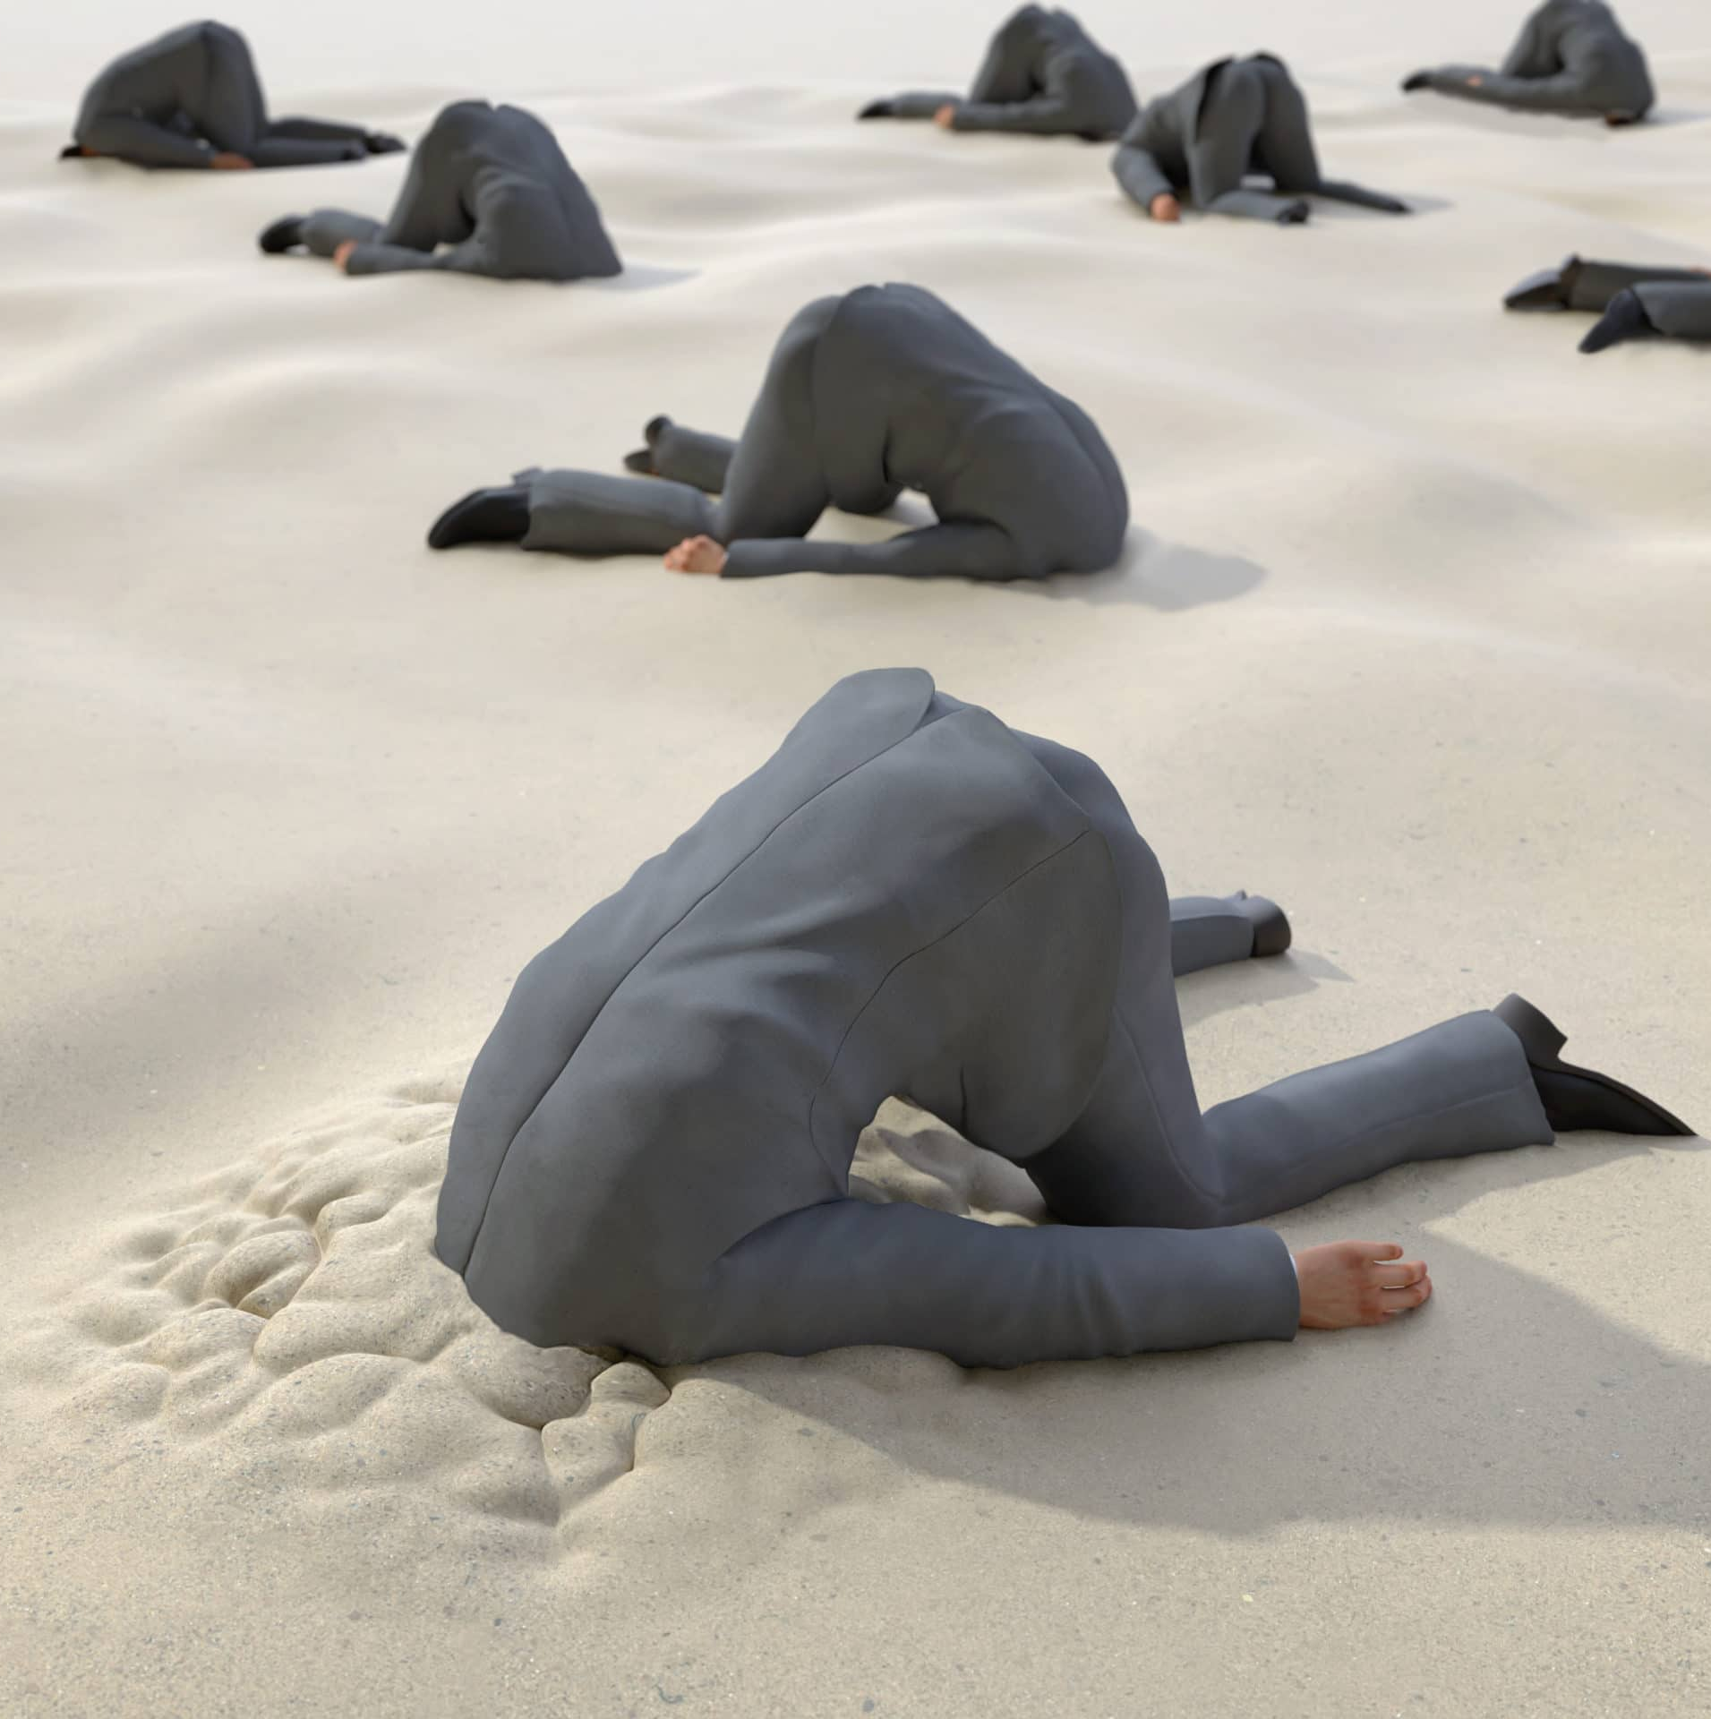
Rejecting the promise
3. How is it that these scoffers are so blind?
Compare 2 Peter 3:3, last part, with 2 Thessalonians 2:10-12 and Hebrews 3:13. See note.

Slide 10
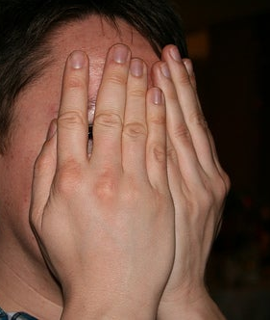
2 Peter 3:3
³ Knowing this first, that there shall come in the last days scoffers, walking after their own lusts,

Slide 11

2 Thessalonians 2:10-12
¹⁰ And with all deceivableness of unrighteousness in them that perish; because they received not the love of the truth, that they might be saved.

Slide 12

2 Thessalonians 2:10-12
¹¹ And for this cause God shall send them strong delusion, that they should believe a lie:
¹² That they all might be damned who believed not the truth, but had pleasure in unrighteousness.

Slide 13

Hebrews 3:13
¹³ But exhort one another daily, while it is called To day; lest any of you be hardened through the deceitfulness of sin.

Slide 14
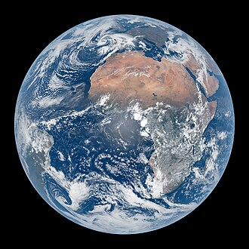
A Merciful Delay
4. What has the word of the Lord spoken concerning the fate of this earth?
2 Peter 3:7.

Slide 15
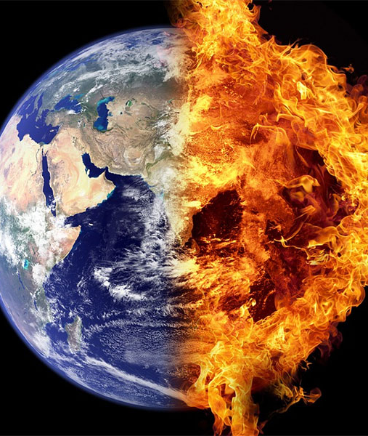
2 Peter 3:7
⁷ But the heavens and the earth, which are now, by the same word are kept in store, reserved unto fire against the day of judgment and perdition of ungodly men.

Slide 16
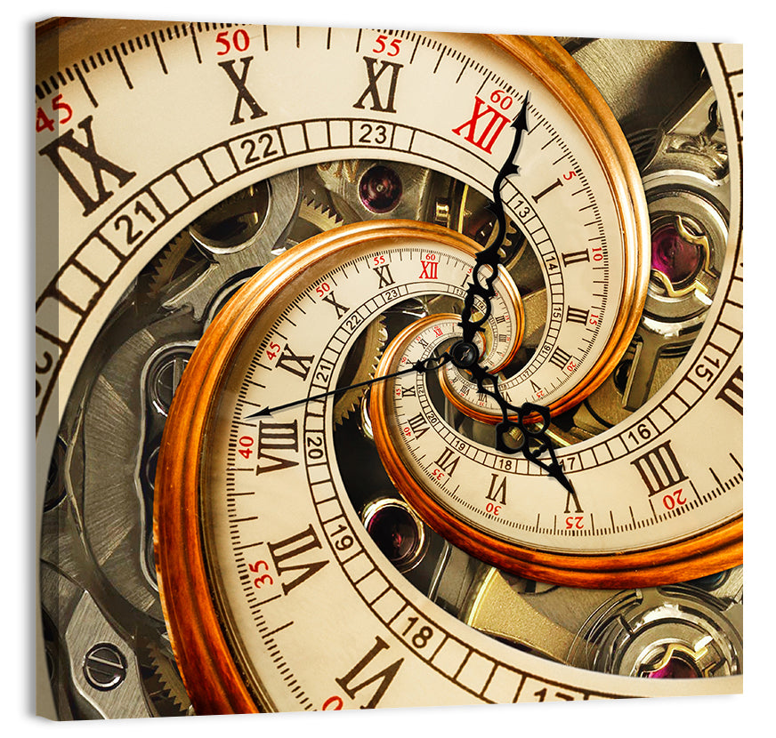
A Merciful Delay
5. What is said of God's relation to time?
2 Peter 3:8;
Psalm 90:4.

Slide 17
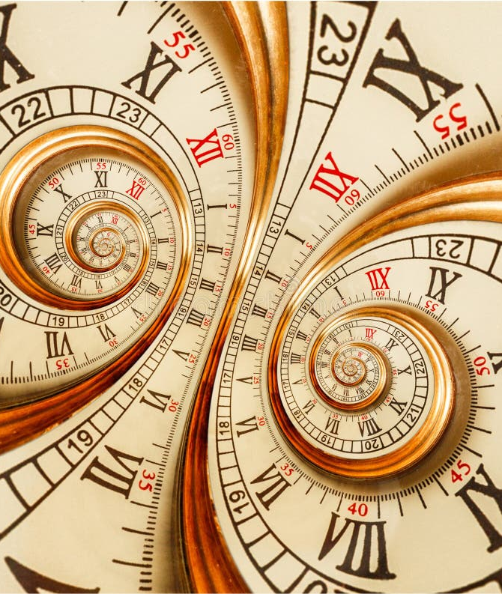
2 Peter 3:8
⁸ But, beloved, be not ignorant of this one thing, that one day is with the Lord as a thousand years, and a thousand years as one day.

Slide 18
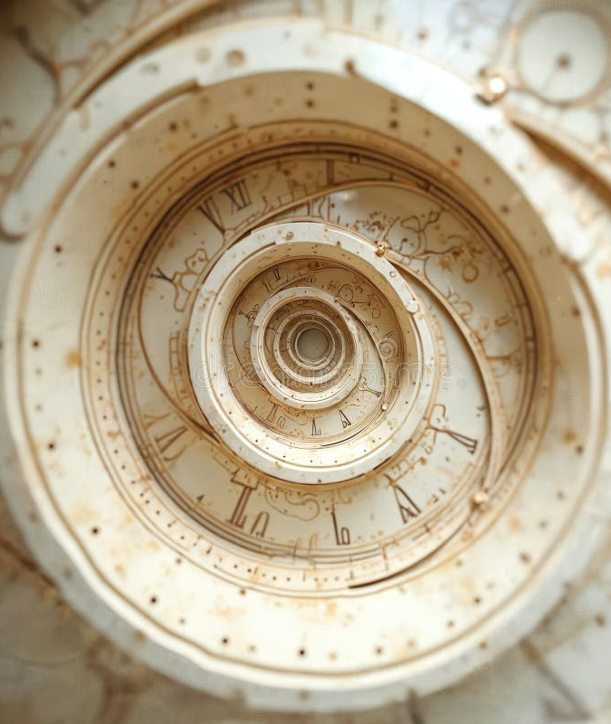
Psalm 90:4
⁴ For a thousand years in thy sight are but as yesterday when it is past, and as a watch in the night.

Slide 19

A Merciful Delay
6. What important lesson may we learn from this?
See note.

Slide 20
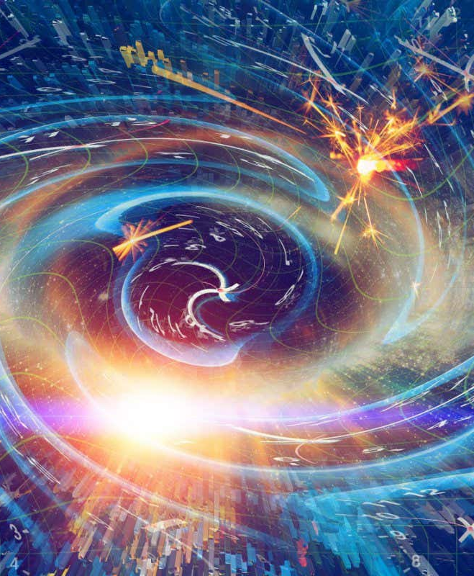
God "inhabiteth eternity." The flight of time makes no difference with his plans. Compared with his eternity, the entire 6,000 years of earth's existence is but a span.

Slide 21

While he may take a thousand years for the fulfillment of a promise, and then it will be the same as though performed the next day, he can do in one day the work of a thousand years.

Slide 22

Therefore there is no warrant for settling down to carnal ease, thinking that it will necessarily be a long time yet before the work of God on earth can be accomplished:

Slide 23

"For he will finish the work, and cut it short in righteousness; because a short work will the Lord make upon the earth." Romans 9:28.

Slide 24
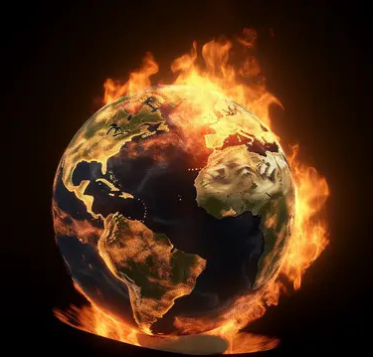
A Merciful Delay
7. Why is it that God has so long delayed his threatened judgments?
2 Peter 3:9.

Slide 25
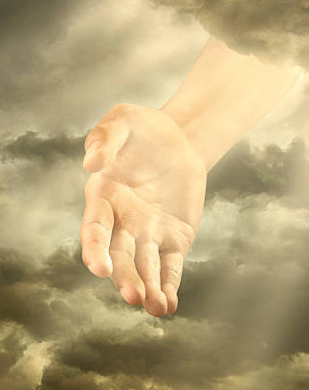
2 Peter 3:9
⁹ The Lord is not slack concerning his promise, as some men count slackness; but is longsuffering to us-ward, not willing that any should perish, but that all should come to repentance.

Slide 26

A Merciful Delay
8. Yet how are the majority of wicked men affected by his merciful patience?
Ecclesiastes 8:II.

Slide 27
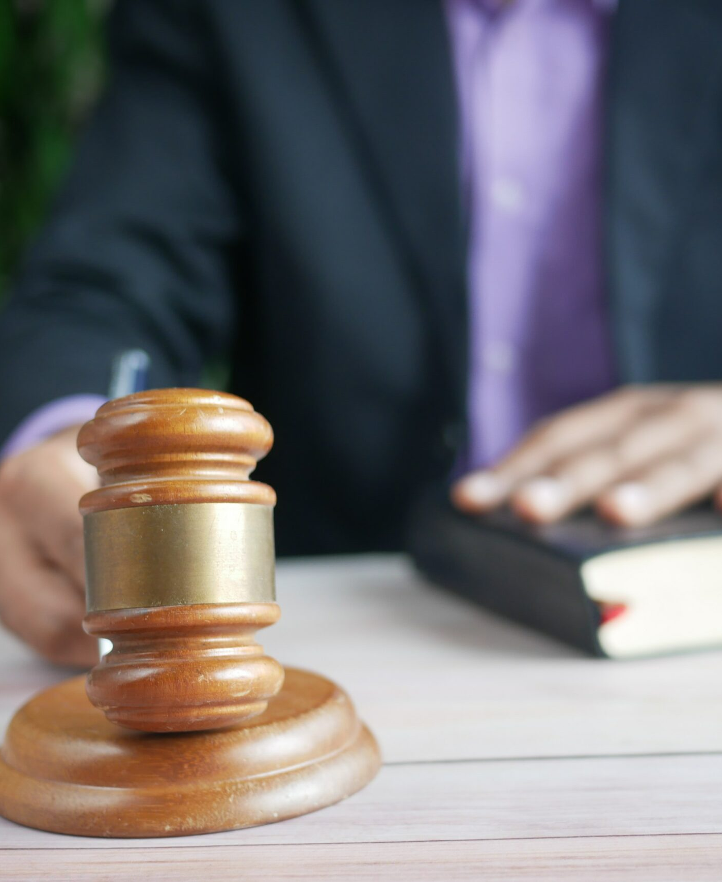
Ecclesiastes 8:11
¹¹ Because sentence against an evil work is not executed speedily, therefore the heart of the sons of men is fully set in them to do evil.

Slide 28

A Merciful Delay
9. What effect does the favor of God have upon these wicked scoffers?
Isaiah 26:10.

Slide 29
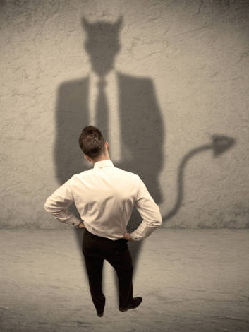
Isaiah 26:10
¹⁰ Let favour be shewed to the wicked, yet will he not learn righteousness: in the land of uprightness will he deal unjustly, and will not behold the majesty of the Lord.

Slide 30
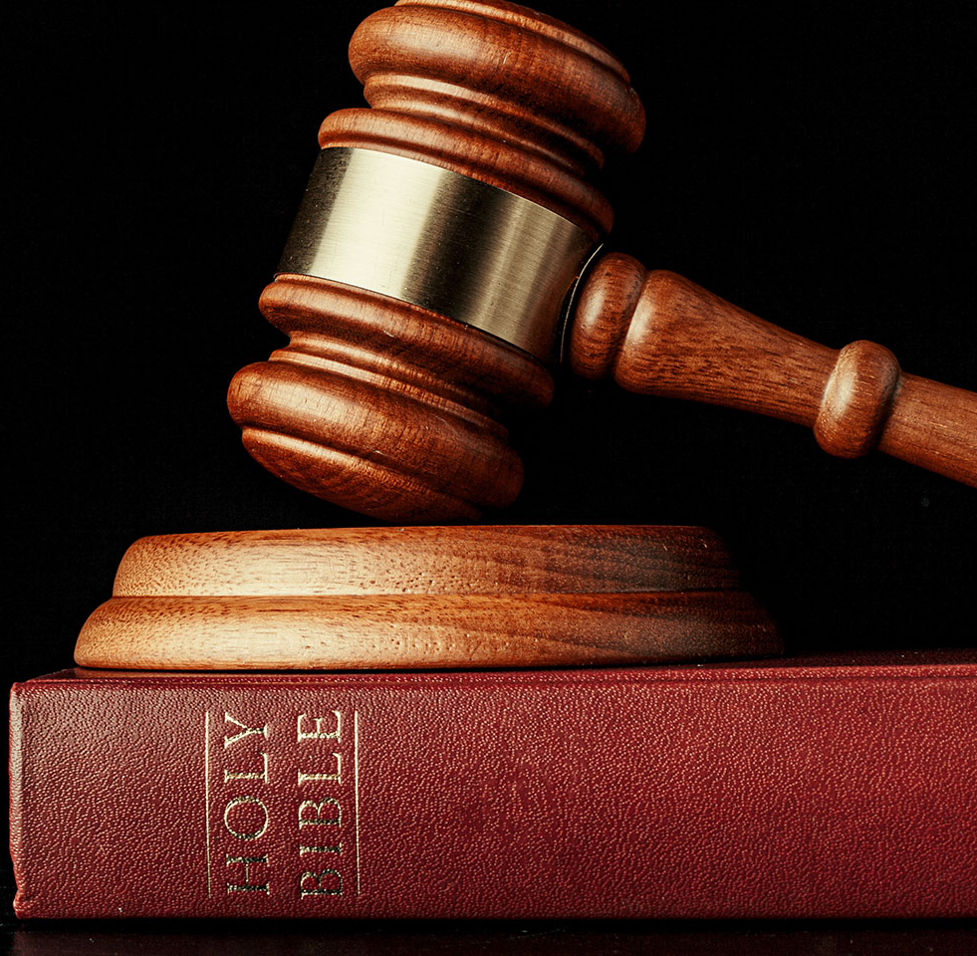
A Prosperity that Lasts
10. Because the judgments of God are delayed, how does the condition of the wicked often appear, as compared with that of the righteous?
Psalm 73:3, 4, 12, 13.

Slide 31
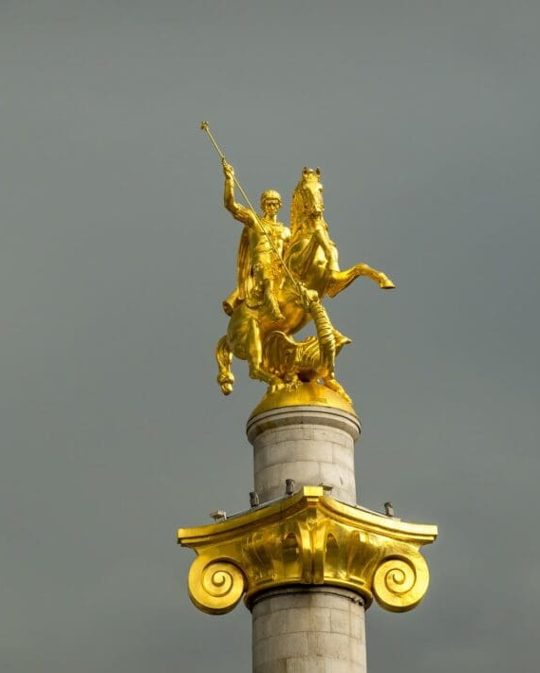
Psalm 73:3, 4, 12, 13
³ For I was envious at the foolish, when I saw the prosperity of the wicked.
⁴ For there are no bands in their death: but their strength is firm.

Slide 32

Psalm 73:3, 4, 12, 13
¹² Behold, these are the ungodly, who prosper in the world; they increase in riches.
¹³ Verily I have cleansed my heart in vain, and washed my hands in innocency.

Slide 33

A Prosperity that Lasts
11. What do they themselves think?
Psalm 49:11.

Slide 34
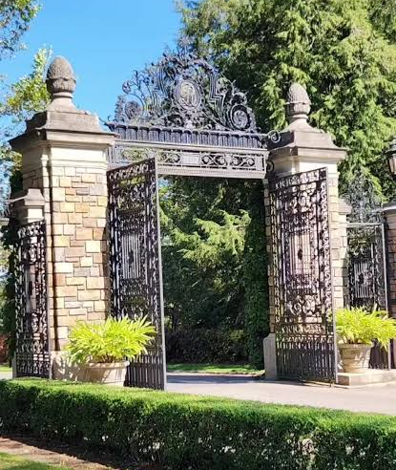
Psalm 49:11
¹¹ Their inward thought is, that their houses shall continue for ever, and their dwelling places to all generations; they call their lands after their own names.

Slide 35
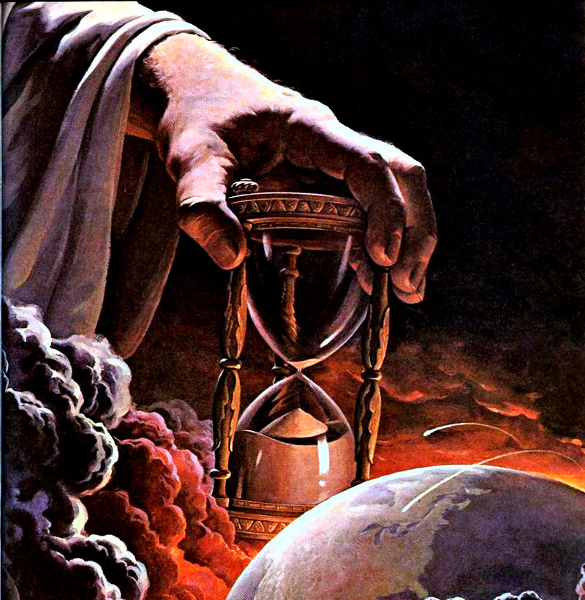
A Prosperity that Lasts
12. But how will it be in reality?
Ecclesiastes 8:12, 13.

Slide 36

Ecclesiastes 8:12, 13
¹² Though a sinner do evil an hundred times, and his days be prolonged, yet surely I know that it shall be well with them that fear God, which fear before him:

Slide 37
Ecclesiastes 8:12, 13
¹³ But it shall not be well with the wicked, neither shall he prolong his days, which are as a shadow; because he feareth not before God.

Slide 38
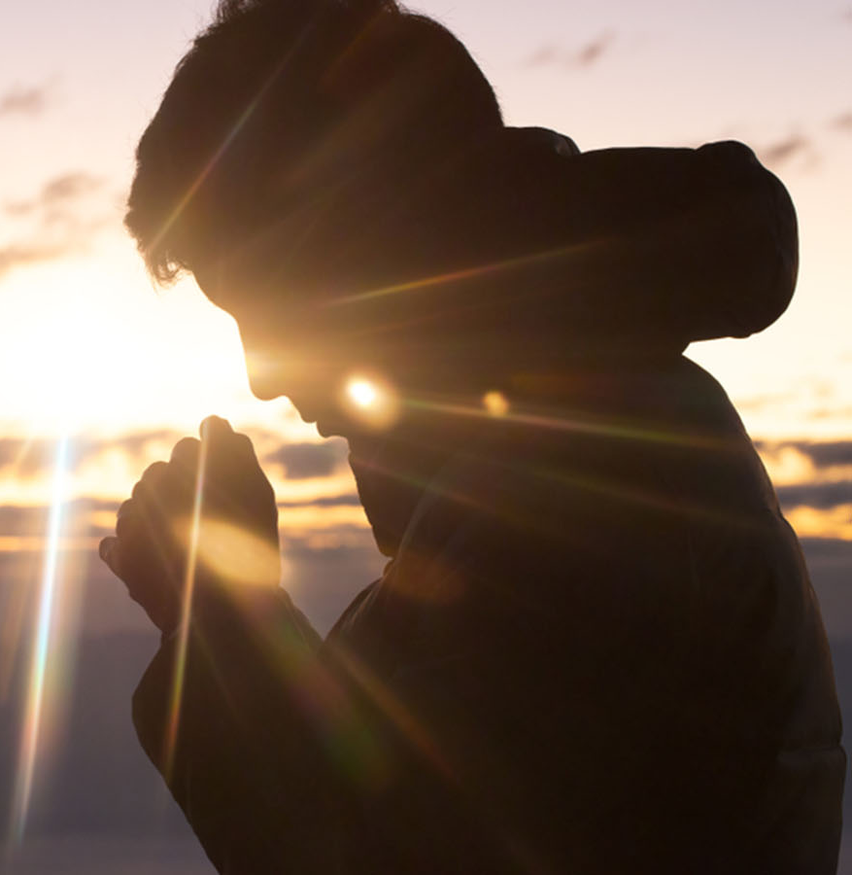
A Prosperity that Lasts
13. At what time shall the proud be humbled?
Isaiah 2:12.

Slide 39
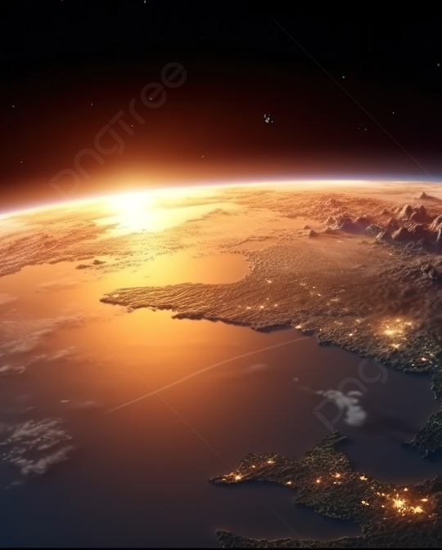
Isaiah 2:12
¹² For the day of the Lord of hosts shall be upon every one that is proud and lofty, and upon every one that is lifted up; and he shall be brought low:

Slide 40
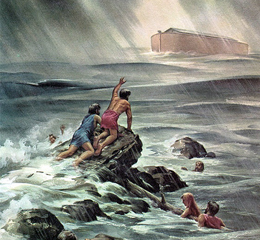
The Day of the Lord
14. How will the day of the Lord come upon them?
2 Peter 3:10.

Slide 41
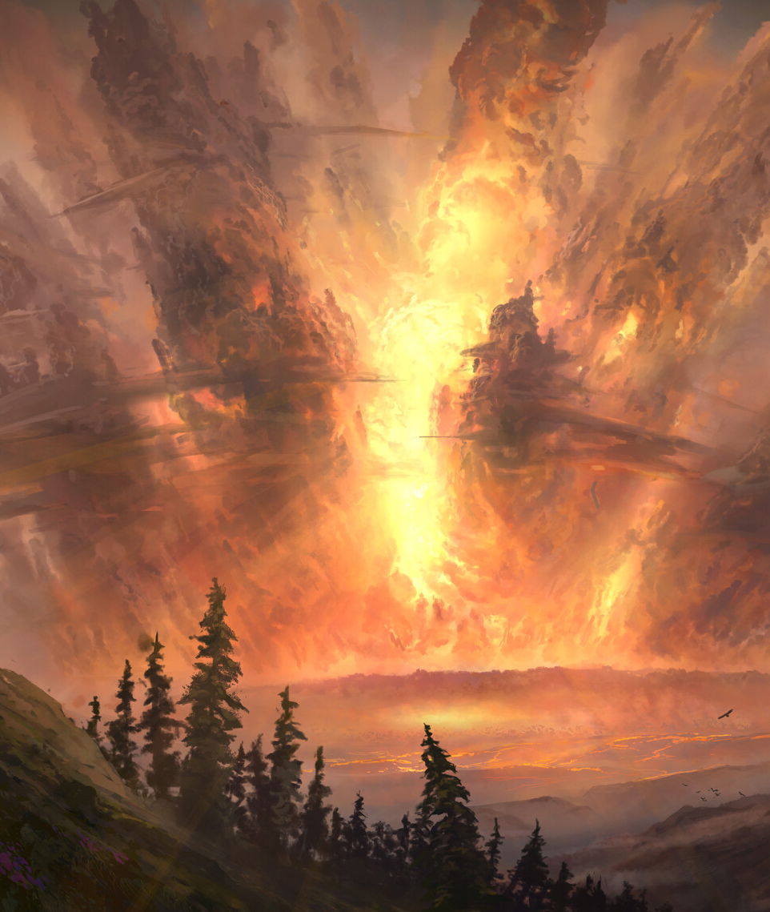
2 Peter 3:10
¹⁰ But the day of the Lord will come as a thief in the night; in the which the heavens shall pass away with a great noise, and the elements shall melt with fervent heat, the earth also and the works that are therein shall be burned up.

Slide 42
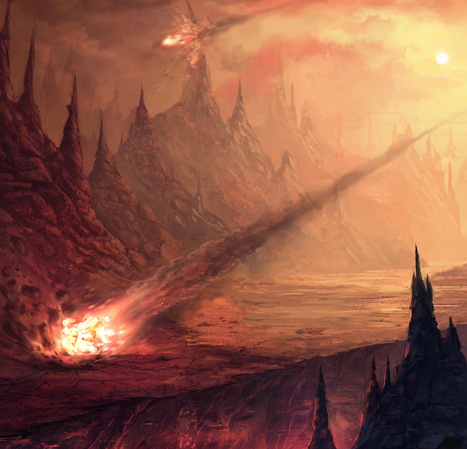
The Day of the Lord
16. What will they be saying when the time of their destruction thus suddenly bursts upon them?
I Thessalonians 5:2, 3.

Slide 43

1 Thessalonians 5:2, 3
² For yourselves know perfectly that the day of the Lord so cometh as a thief in the night.

Slide 44

1 Thessalonians 5:2, 3
³ For when they shall say, Peace and safety; then sudden destruction cometh upon them, as travail upon a woman with child; and they shall not escape.

Slide 45
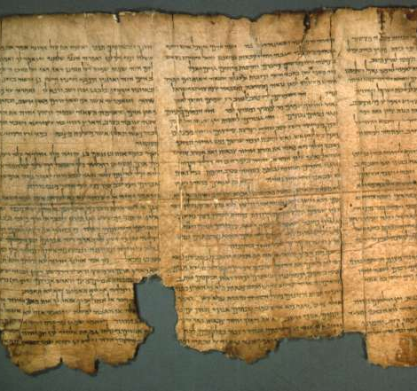
The Day of the Lord
17. What does the prophet Isaiah say of that day?
Isaiah 13: 6, 7, 9, 10.

Slide 46
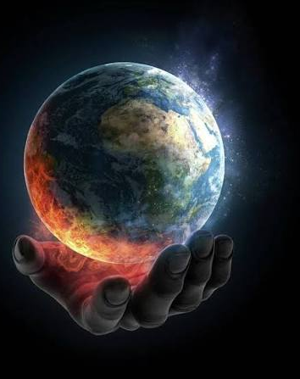
Isaiah 13:6, 7, 9, 10
⁶ Howl ye; for the day of the Lord is at hand; it shall come as a destruction from the Almighty.
⁷ Therefore shall all hands be faint, and every man's heart shall melt:

Slide 47
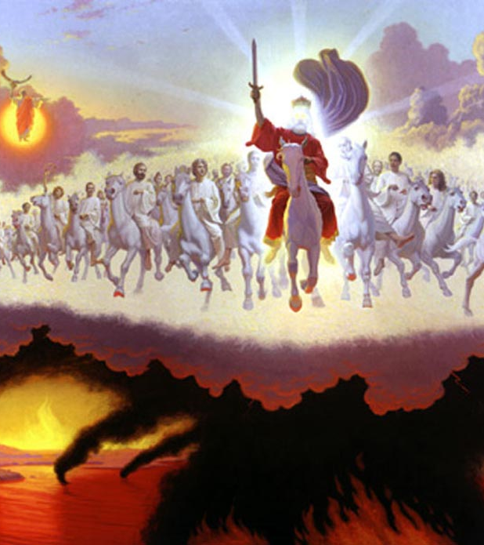
Isaiah 13:6, 7, 9, 10
⁹ Behold, the day of the Lord cometh, cruel both with wrath and fierce anger, to lay the land desolate: and he shall destroy the sinners thereof out of it.

Slide 48
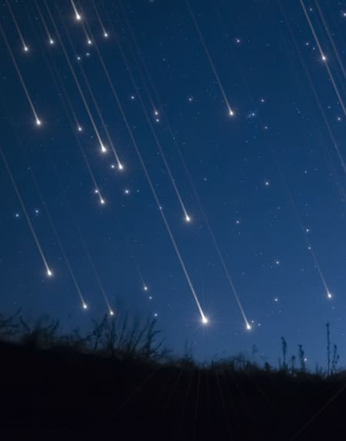
Isaiah 13:6, 7, 9, 10
¹⁰ For the stars of heaven and the constellations thereof shall not give their light: the sun shall be darkened in his going forth, and the moon shall not cause her light to shine.

Slide 49
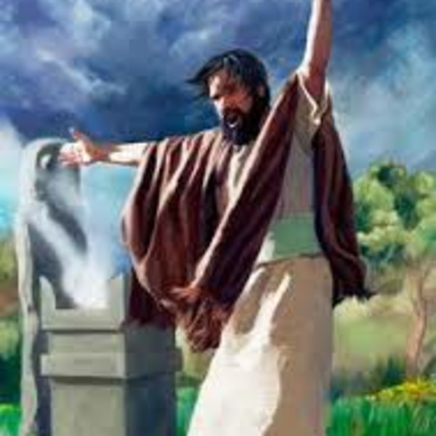
The Day of the Lord
18. What is the testimony of Zephaniah?
Zephaniah 1:14-18.

Slide 50
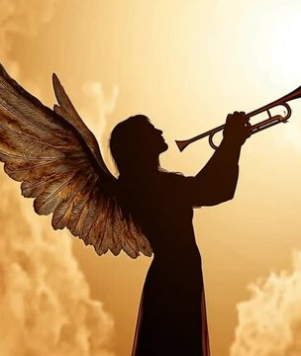
Zephaniah 1:14-18
¹⁴ The great day of the Lord is near, it is near, and hasteth greatly, even the voice of the day of the Lord: the mighty man shall cry there bitterly.

Slide 51
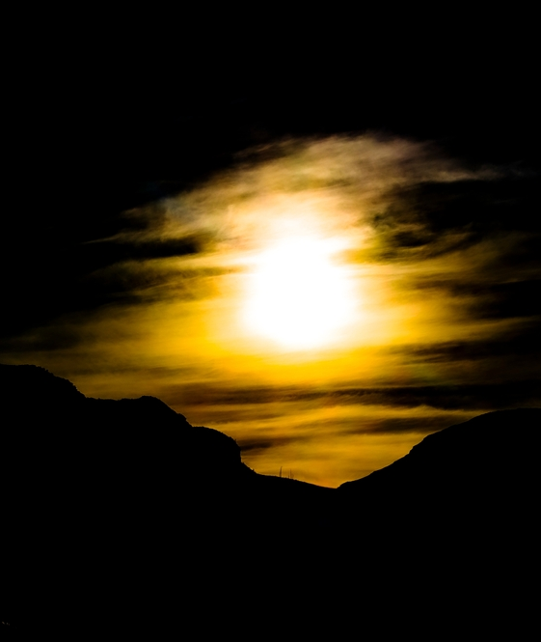
Zephaniah 1:14-18
¹⁵ That day is a day of wrath, a day of trouble and distress, a day of wasteness and desolation, a day of darkness and gloominess, a day of clouds and thick darkness,

Slide 52
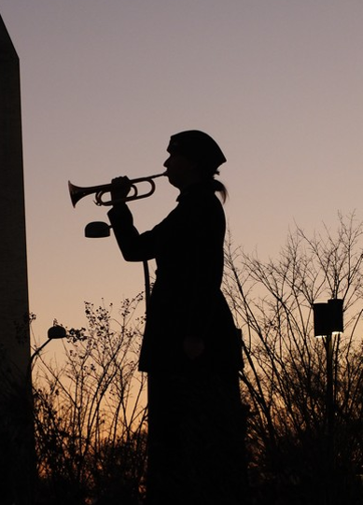
Zephaniah 1:14-18
¹⁶ A day of the trumpet and alarm against the fenced cities, and against the high towers.

Slide 53
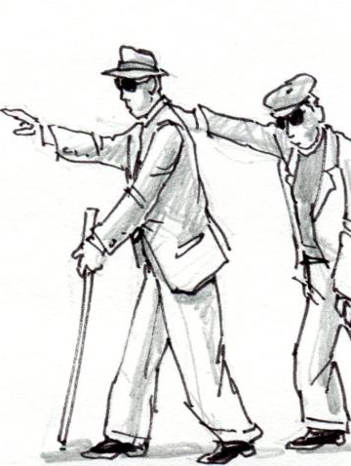
Zephaniah 1:14-18
¹⁷ And I will bring distress upon men, that they shall walk like blind men, because they have sinned against the Lord: and their blood shall be poured out as dust, and their flesh as the dung.

Slide 54
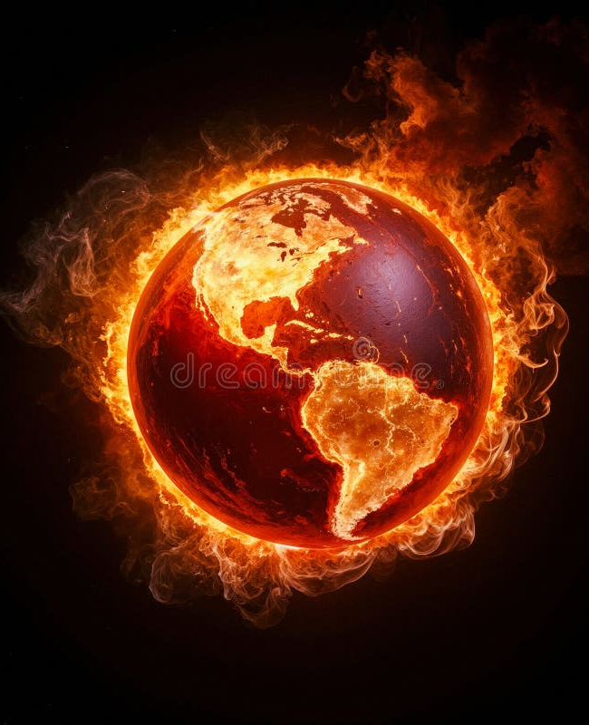
Zephaniah 1:14-18
¹⁸ Neither their silver nor their gold shall be able to deliver them in the day of the Lord's wrath; but the whole land shall be devoured by the fire of his jealousy: for he shall make even a speedy riddance of all them that dwell in the land.

Slide 55
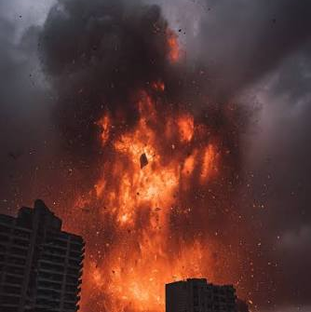
The Day of the Lord
19. Is it a time to be desired?
Amos 5:18-20.

Slide 56
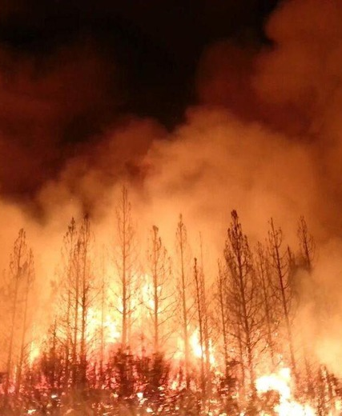
Amos 5:18-20
¹⁸ Woe unto you that desire the day of the Lord! to what end is it for you? the day of the Lord is darkness, and not light.

Slide 57
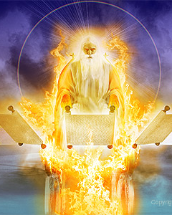
Amos 5:18-20
¹⁹ As if a man did flee from a lion, and a bear met him; or went into the house, and leaned his hand on the wall, and a serpent bit him.
²⁰ Shall not the day of the Lord be darkness, and not light? even very dark, and no brightness in it?

Slide 58
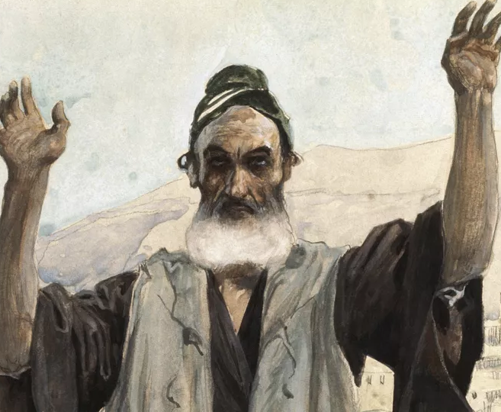
The Day of the Lord
20. What was said about it by a righteous man to whom the Lord granted a prophetic view of it?
Habakkuk 3:16.

Slide 59
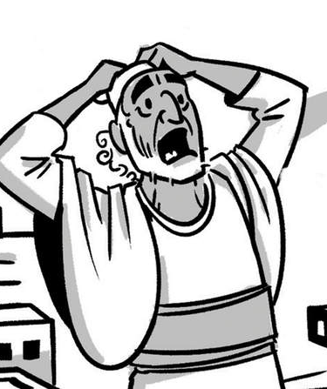
Habakkuk 3:16
¹⁶ When I heard, my belly trembled; my lips quivered at the voice: rottenness entered into my bones, and I trembled in myself, that I might rest in the day of trouble: when he cometh up unto the people, he will invade them with his troops.

Slide 60
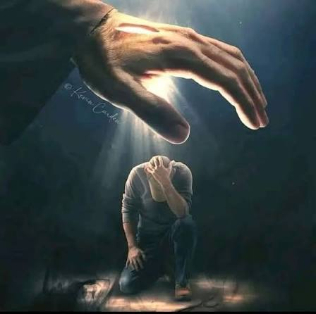
Who Will Stand?
21. Who will pass through that terrible time unharmed?
Psalm 91:1, 5-10.

Slide 61
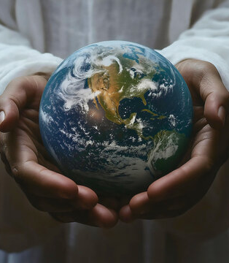
Psalm 91:1, 5-10
91 He that dwelleth in the secret place of the most High shall abide under the shadow of the Almighty.

Slide 62

Psalm 91:1, 5-10
⁵ Thou shalt not be afraid for the terror by night; nor for the arrow that flieth by day;
⁶ Nor for the pestilence that walketh in darkness; nor for the destruction that wasteth at noonday.

Slide 63
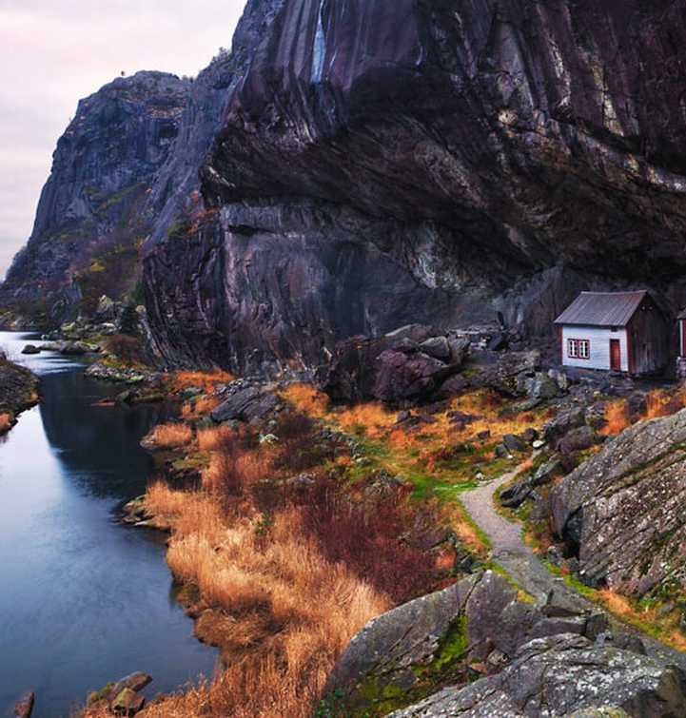
Psalm 91:1, 5-10
⁷ A thousand shall fall at thy side, and ten thousand at thy right hand; but it shall not come nigh thee.
⁸ Only with thine eyes shalt thou behold and see the reward of the wicked.

Slide 64
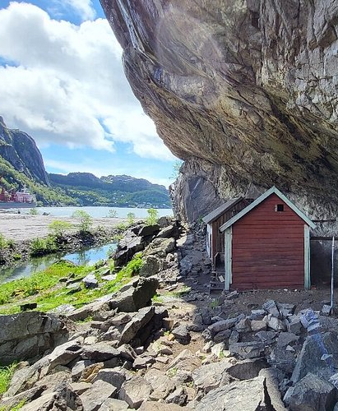
Psalm 91:1, 5-10
⁹ Because thou hast made the Lord, which is my refuge, even the most High, thy habitation;
¹⁰ There shall no evil befall thee, neither shall any plague come nigh thy dwelling.

Slide 65
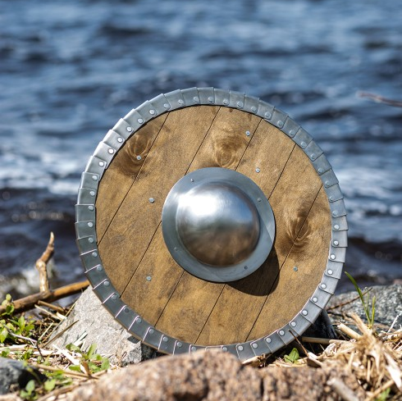
Who will Stand?
22. What will protect them?
Psalm 91:2-4.

Slide 66
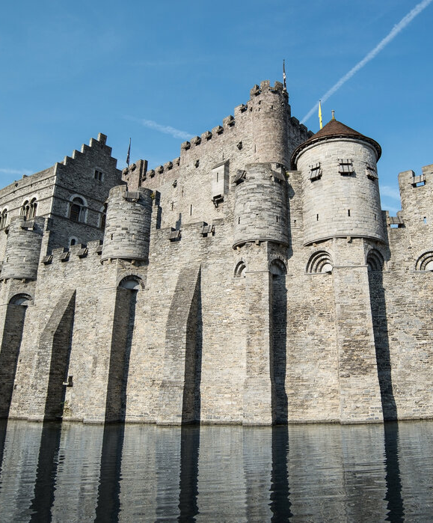
Psalm 91:2-4
² I will say of the Lord, He is my refuge and my fortress: my God; in him will I trust.
³ Surely he shall deliver thee from the snare of the fowler, and from the noisome pestilence.

Slide 67
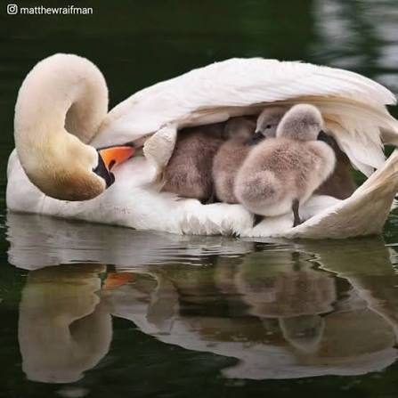
Psalm 91:2-4
⁴ He shall cover thee with his feathers, and under his wings shalt thou trust: his truth shall be thy shield and buckler.

Slide 68

Who will Stand?
23. In view of the great events that are surely coming, what should be our constant thought?
2 Peter 3:11,12.

Slide 69

2 Peter 3:11, 12
¹¹ Seeing then that all these things shall be dissolved, what manner of persons ought ye to be in all holy conversation and godliness,

Slide 70
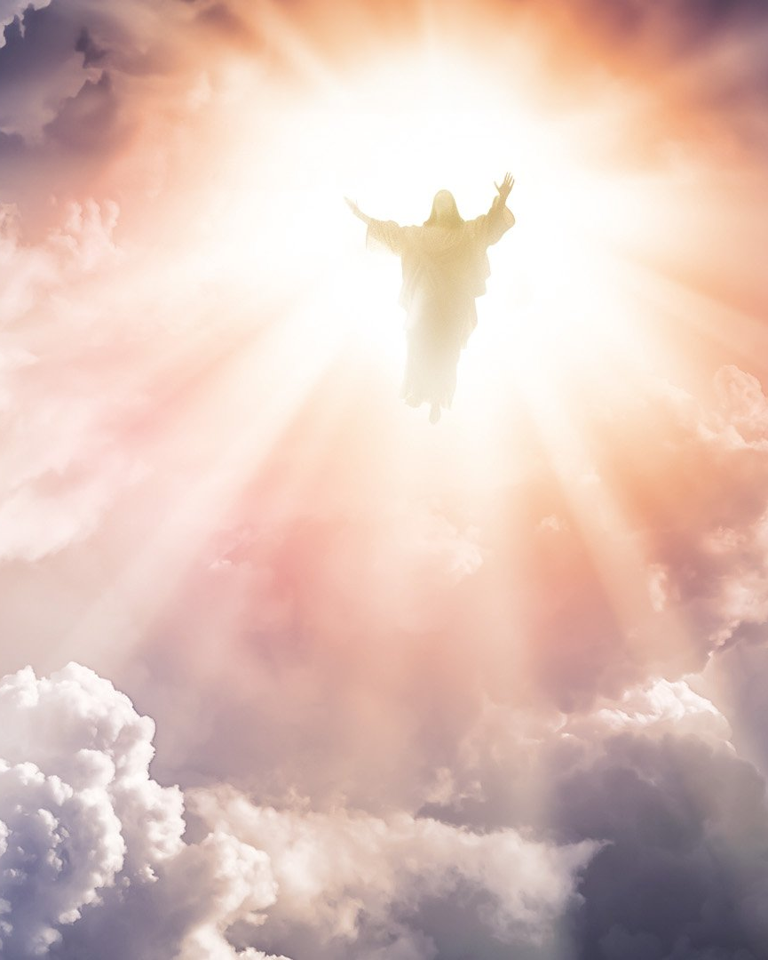
2 Peter 3:11, 12
¹² Looking for and hasting unto the coming of the day of God, wherein the heavens being on fire shall be dissolved, and the elements shall melt with fervent heat?

Slide 71


Slide 72


