Slide 1


Slide 2


Slide 3
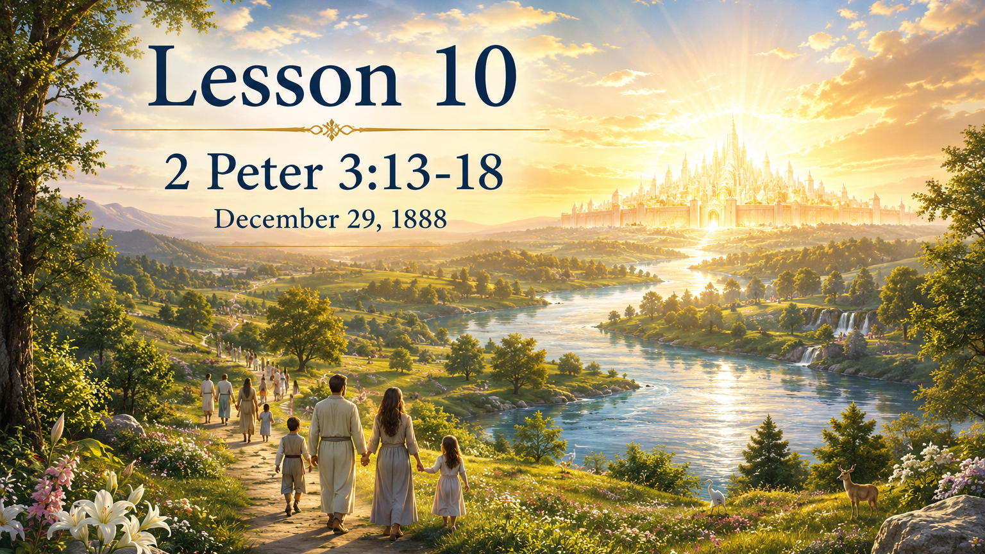

Slide 4
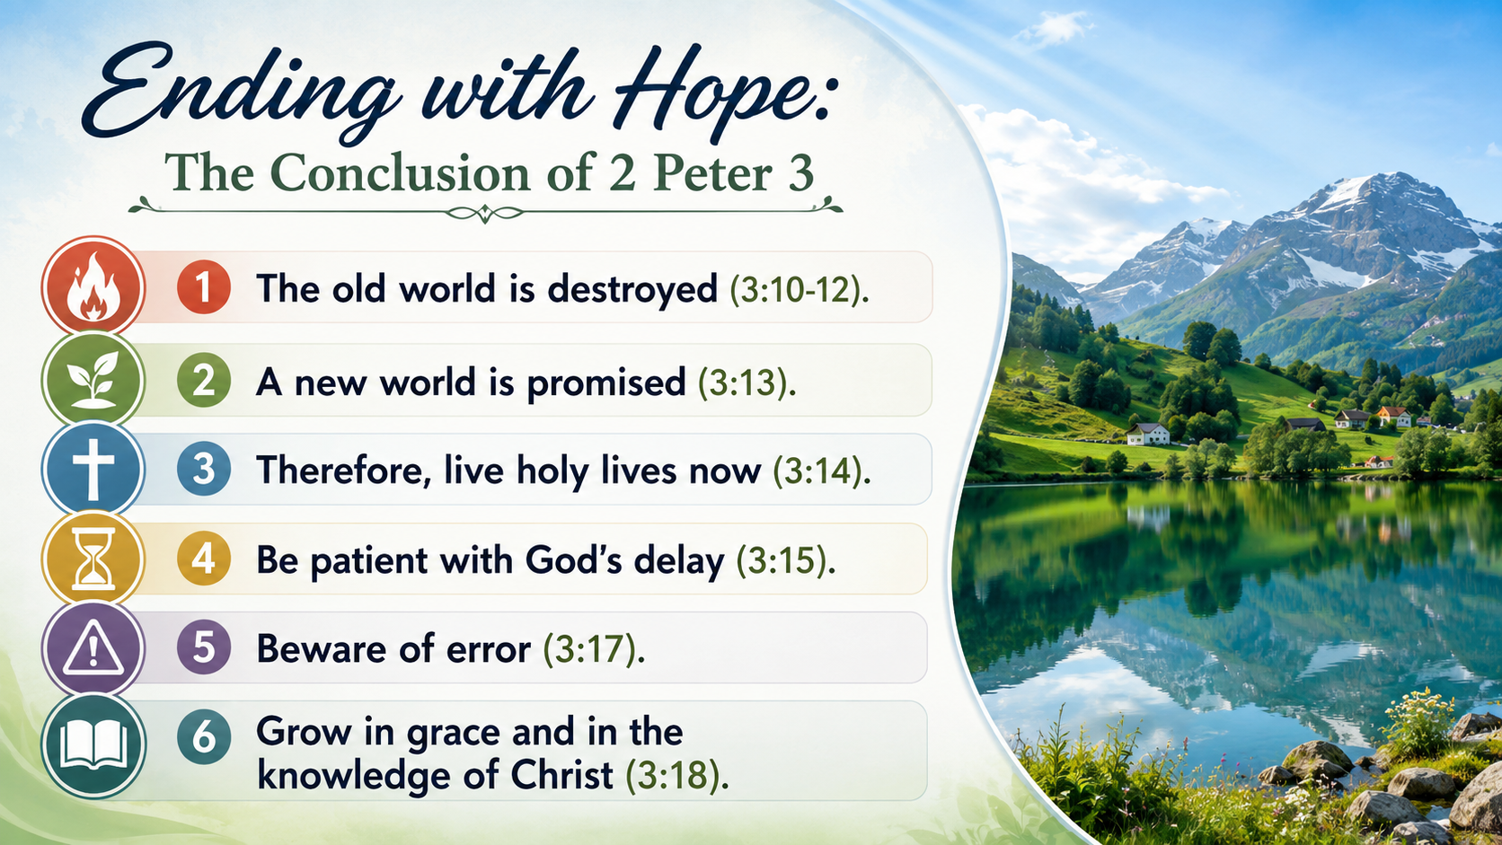

Slide 5
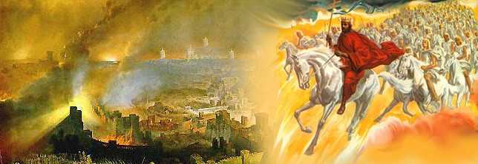

1. Give a statement of some of the things that will take place in the day of the Lord.

Slide 6

As a surprise (As a thief in the night)
Destruction of the wicked
Deliverance of God’s people
The end of the present world

Slide 7
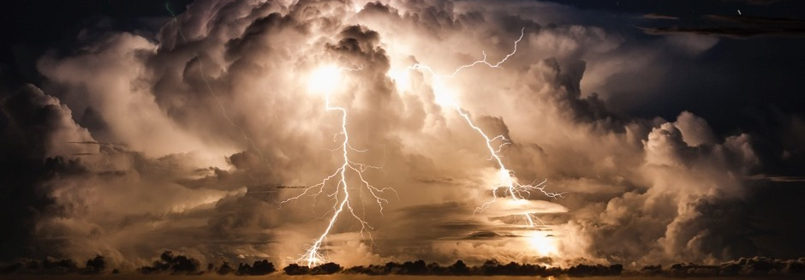
2. To what condition will the earth be reduced?
2 Peter 3:10, 12

Slide 8
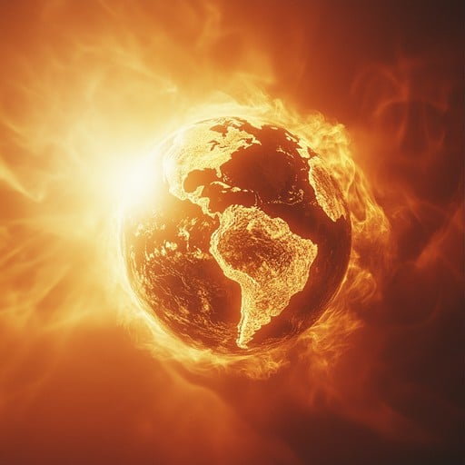
The Promise: 2 Peter 3:10, 12
¹⁰ But the day of the Lord will come as a thief in the night; in the which the heavens shall pass away with a great noise, and the elements shall melt with fervent heat, the earth also and the works that are therein shall be burned up.

Slide 9
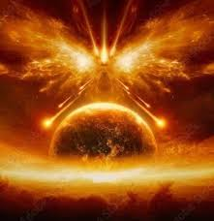
The Promise: 2 Peter 3:10, 12
¹² Looking for and hasting unto the coming of the day of God, wherein the heavens being on fire shall be dissolved, and the elements shall melt with fervent heat?

Slide 10

3. Notwithstanding this, for what may we confidently look?
2 Peter 3:13.

Slide 11
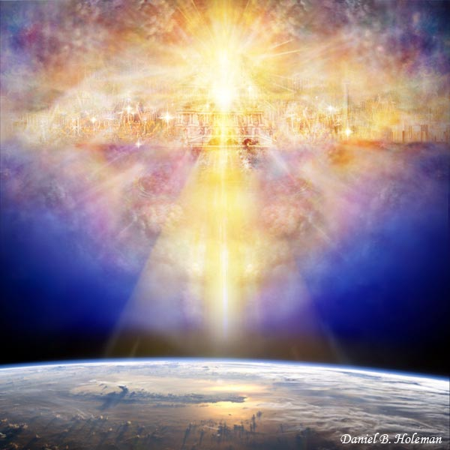
The Promise: 2 Peter 3:13
¹³ Nevertheless we, according to his promise, look for new heavens and a new earth, wherein dwelleth righteousness.

Slide 12
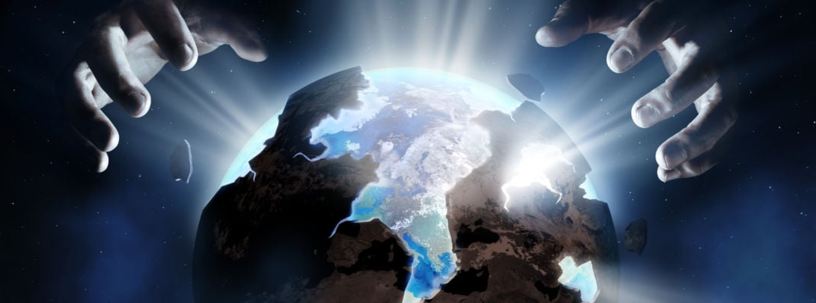
4. Where is this promise recorded?
Isaiah 65:17.

Slide 13
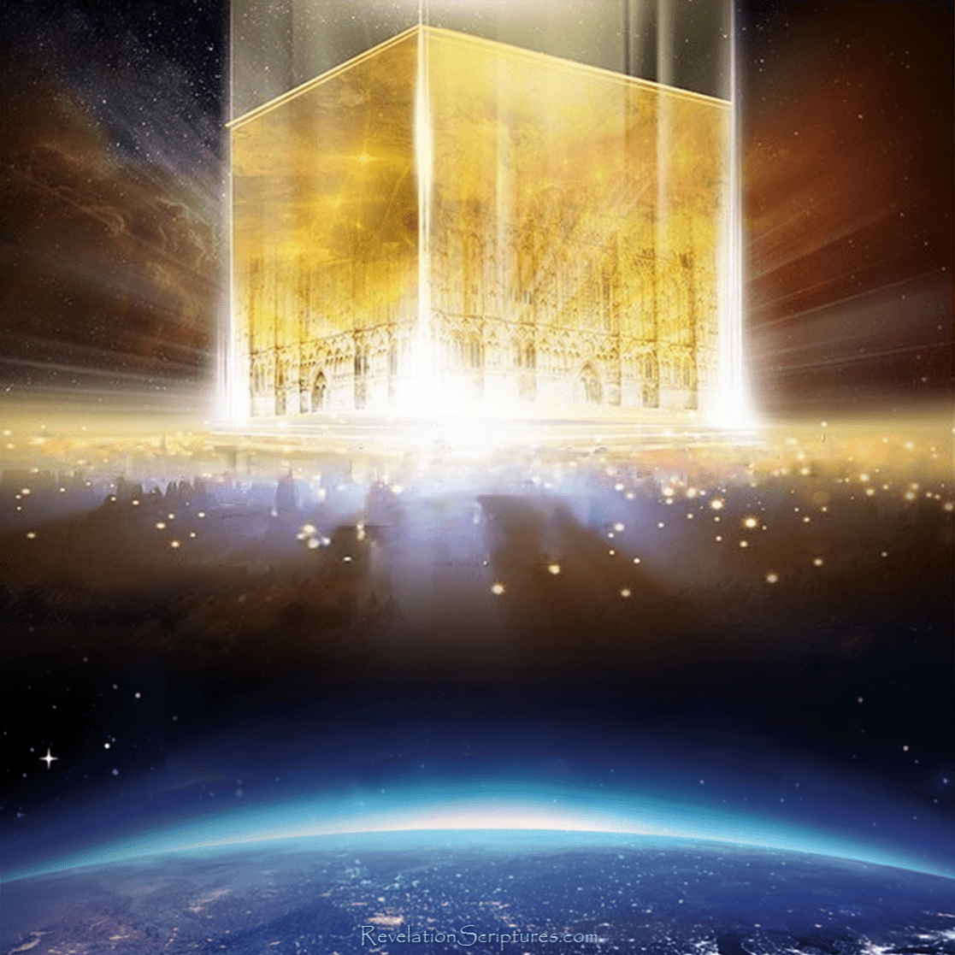
The Promise: Isaiah 65:17
¹⁷ For, behold, I create new heavens and a new earth: and the former shall not be remembered, nor come into mind.

Slide 14

5. What is said of the beauty of the new earth?
Isaiah 35:1, 2; 51:3.

Slide 15
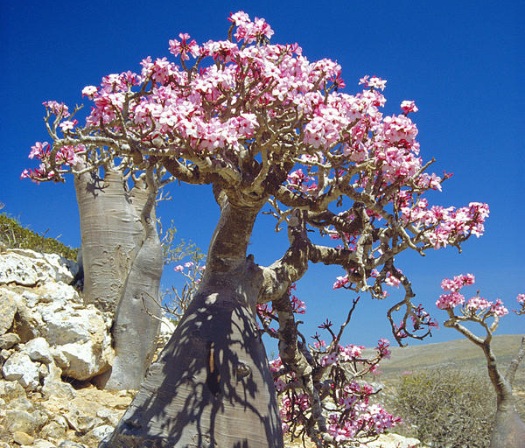
The Promise: Isaiah 35:1, 2
The wilderness and the solitary place shall be glad for them; and the desert shall rejoice, and blossom as the rose.

Slide 16

The Promise: Isaiah 35:1, 2
² It shall blossom abundantly, and rejoice even with joy and singing: the glory of Lebanon shall be given unto it, the excellency of Carmel and Sharon, they shall see the glory of the Lord, and the excellency of our God.

Slide 17
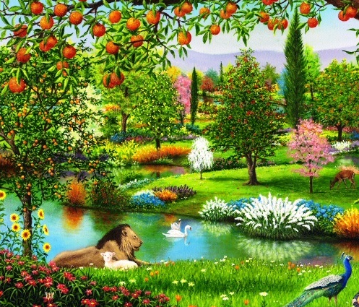
The Promise: Isaiah 51:3
³ For the Lord shall comfort Zion: he will comfort all her waste places; and he will make her wilderness like Eden, and her desert like the garden of the Lord; joy and gladness shall be found therein, thanksgiving, and the voice of melody.

Slide 18
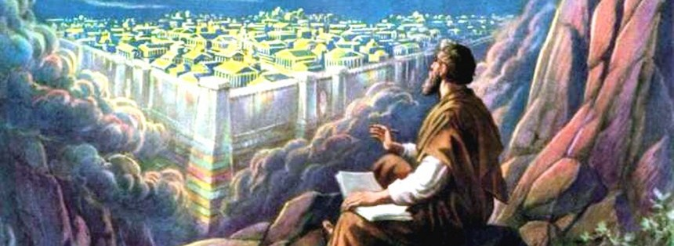
6. What class of people shall live in it?
Isaiah 60:21; 2 Peter 3:13.

Slide 19
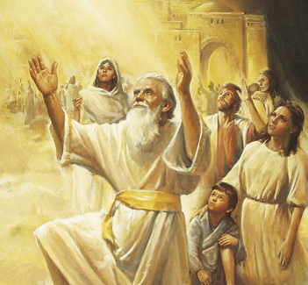
The Promise: Isaiah 60:21
²¹ Thy people also shall be all righteous: they shall inherit the land for ever, the branch of my planting, the work of my hands, that I may be glorified.

Slide 20
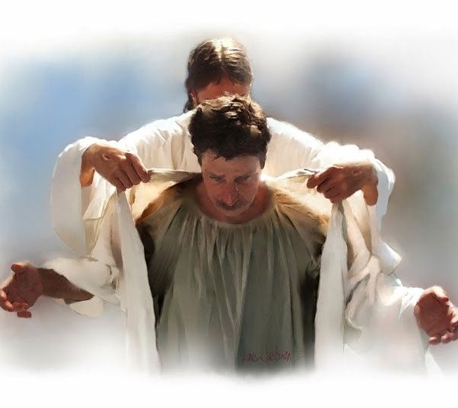
The Promise: 2 Peter 3:13
¹³ Nevertheless we, according to his promise, look for new heavens and a new earth, wherein dwelleth righteousness.

Slide 21

7. How long will they possess it?
Isaiah 60:21; Psalm 37:29; Daniel 7:18.

Slide 22
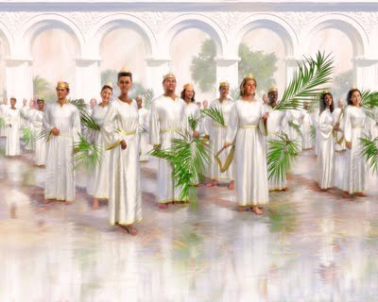
The Promise: Isaiah 60:21
²¹ Thy people also shall be all righteous: they shall inherit the land for ever, the branch of my planting, the work of my hands, that I may be glorified.

Slide 23
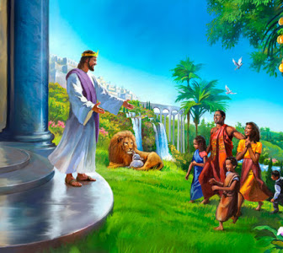
The Promise: Psalm 37:29
²⁹ The righteous shall inherit the land, and dwell therein for ever.

Slide 24
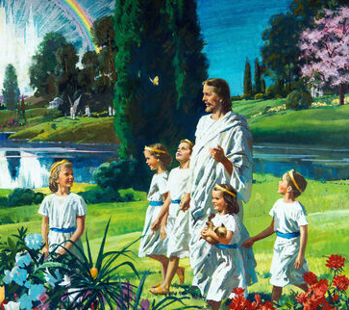
The Promise: Daniel 7:18
¹⁸ But the saints of the most High shall take the kingdom, and possess the kingdom for ever, even for ever and ever.

Slide 25

8. Will they be troubled by disease?
Isaiah 33:24.

Slide 26
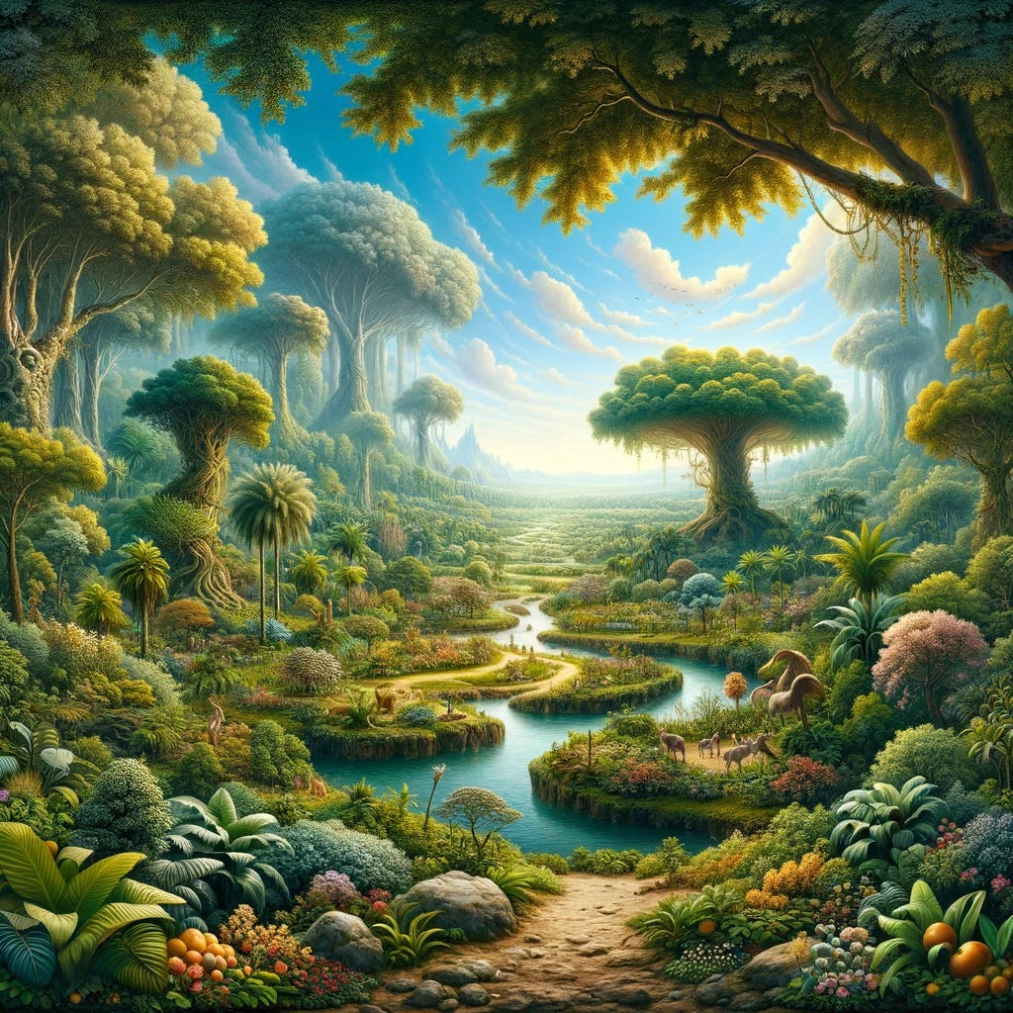
The Promise: Isaiah 33:24
²⁴ And the inhabitant shall not say, I am sick: the people that dwell therein shall be forgiven their iniquity.

Slide 27
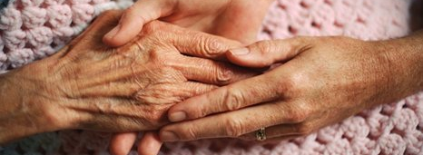
9. What change will be wrought in the righteous ones who now are afflicted?
Isaiah 35:5, 6.

Slide 28
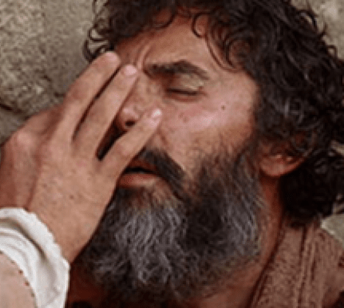
The Promise: Isaiah 35:5-6
⁵ Then the eyes of the blind shall be opened, and the ears of the deaf shall be unstopped.

Slide 29
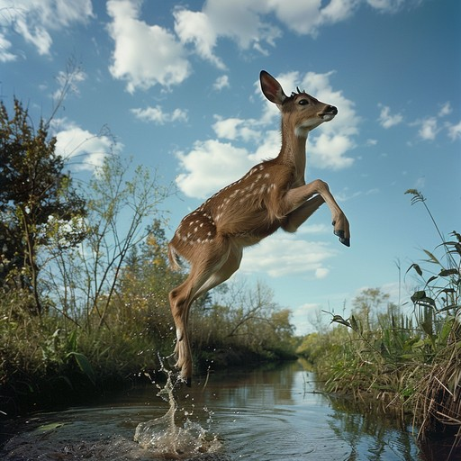
The Promise: Isaiah 35:5-6
⁶ Then shall the lame man leap as an hart, and the tongue of the dumb sing: for in the wilderness shall waters break out, and streams in the desert.

Slide 30
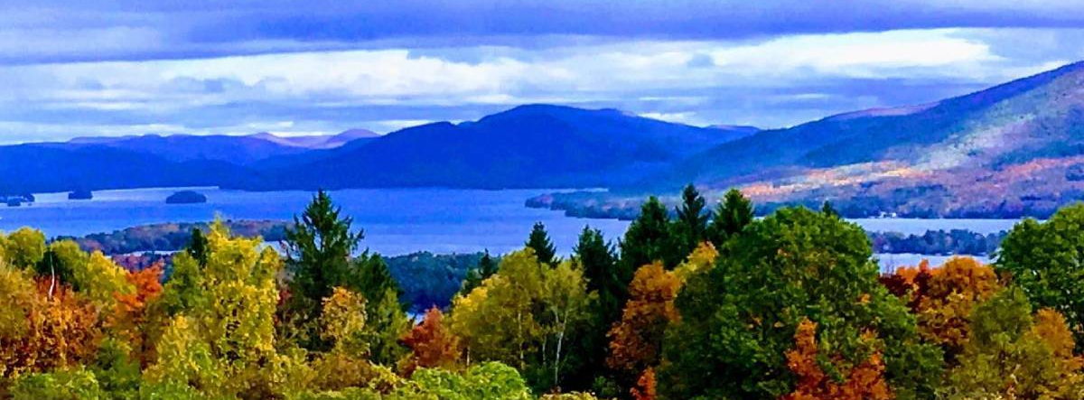
10. What is said of the peace and quiet of that land?
Isaiah 32:17, 18; 54:13, 14; 60:18.

Slide 31
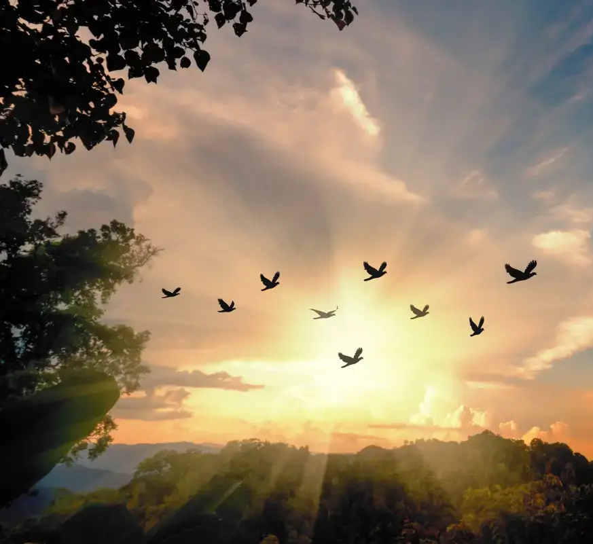
The Promise: Isaiah 32:17, 18
¹⁷ And the work of righteousness shall be peace; and the effect of righteousness quietness and assurance for ever.

Slide 32
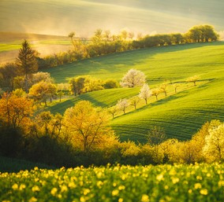
The Promise: Isaiah 32:17, 18
¹⁸ And my people shall dwell in a peaceable habitation, and in sure dwellings, and in quiet resting places;

Slide 33
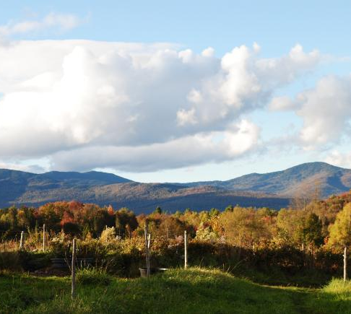
The Promise: Isaiah 54:13, 14
¹³ And all thy children shall be taught of the Lord; and great shall be the peace of thy children.

Slide 34
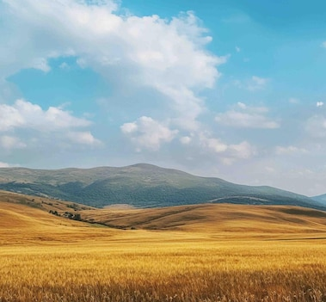
The Promise: Isaiah 54:13, 14
¹⁴ In righteousness shalt thou be established: thou shalt be far from oppression; for thou shalt not fear: and from terror; for it shall not come near thee.

Slide 35
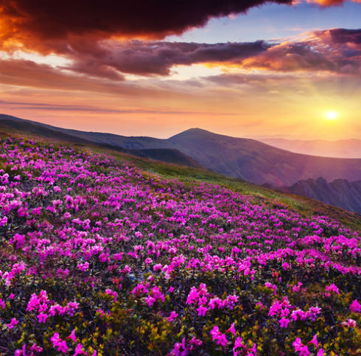
The Promise: Isaiah 60:18
¹⁸ Violence shall no more be heard in thy land, wasting nor destruction within thy borders; but thou shalt call thy walls Salvation, and thy gates Praise.

Slide 36
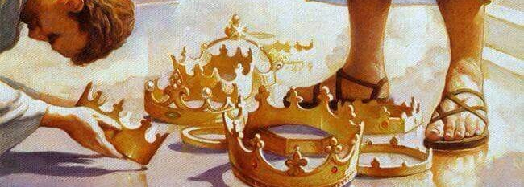
11. How will the people stand related to the great Source of wisdom and peace?
Isaiah 54:13; Revelation 21:3, 4; 22:3, 4.

Slide 37
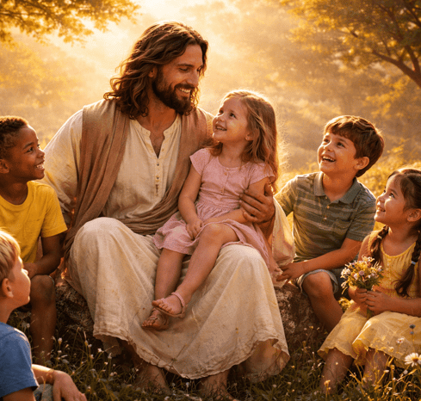
The Promise: Isaiah 54:13
¹³ And all thy children shall be taught of the Lord; and great shall be the peace of thy children.

Slide 38
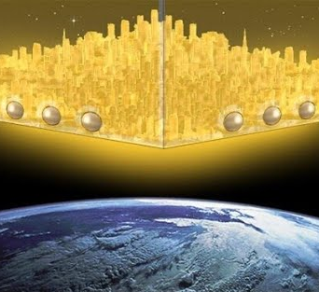
The Promise: Revelation 21:3, 4
³ And I heard a great voice out of heaven saying, Behold, the tabernacle of God is with men, and he will dwell with them, and they shall be his people, and God himself shall be with them, and be their God.

Slide 39
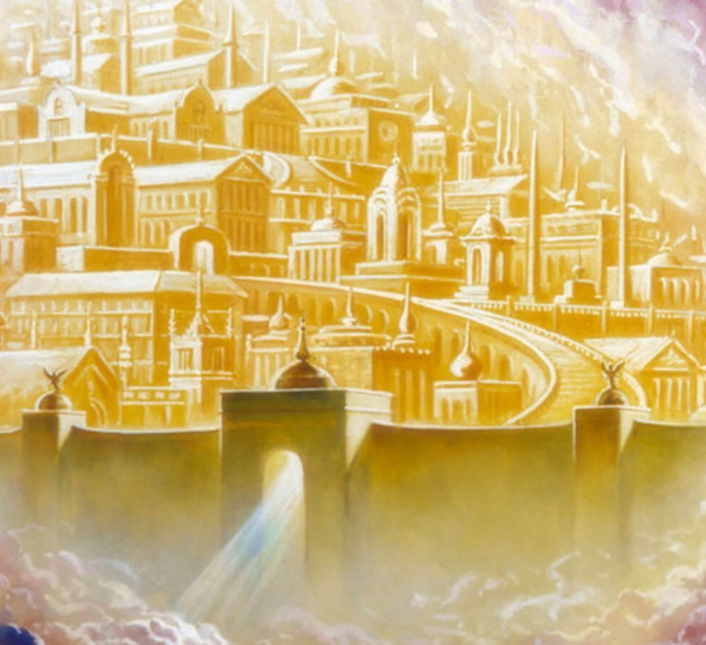
The Promise: Revelation 21:3, 4
⁴ And God shall wipe away all tears from their eyes; and there shall be no more death, neither sorrow, nor crying, neither shall there be any more pain: for the former things are passed away.

Slide 40
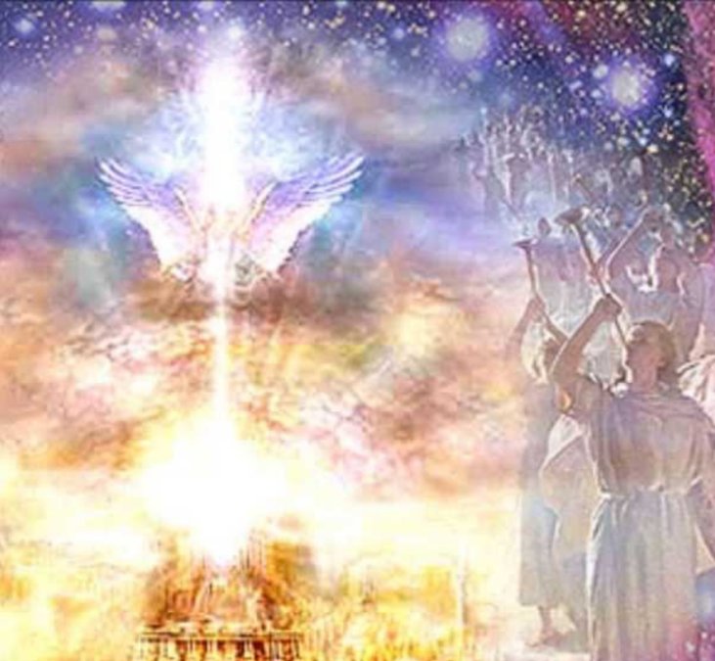
The Promise: Revelation 22:3, 4
³ And there shall be no more curse: but the throne of God and of the Lamb shall be in it; and his servants shall serve him:

Slide 41
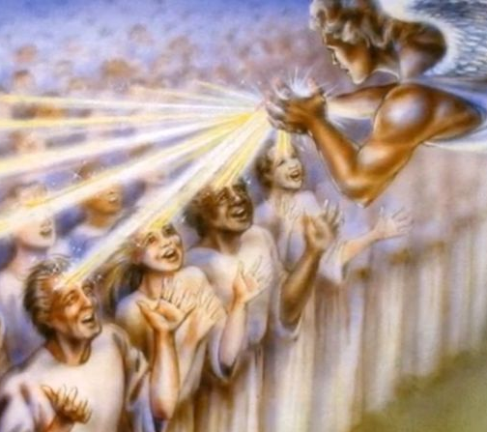
The Promise: Revelation 22:3, 4
⁴ And they shall see his face; and his name shall be in their foreheads.

Slide 42
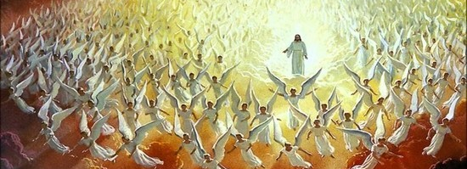
12. Seeing we look for such glorious things when Christ comes, what should we do?
2 Peter 3:14.

Slide 43
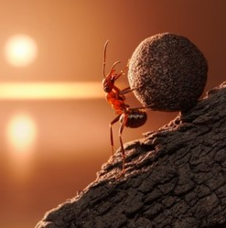
Our Response: 2 Peter 3:14
¹⁴ Wherefore, beloved, seeing that ye look for such things, be diligent that ye may be found of him in peace, without spot, and blameless.

Slide 44
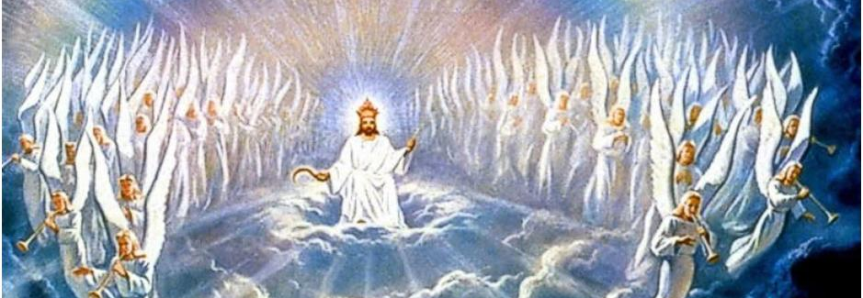
13. How should we regard the fact that God has so long delayed the great consummation?
2 Peter 3:9, 15.

Slide 45
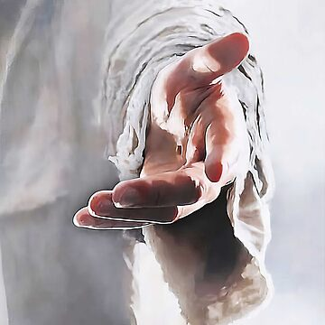
Our Response: 2 Peter 3:9, 15
⁹ The Lord is not slack concerning his promise, as some men count slackness; but is longsuffering to us-ward, not willing that any should perish, but that all should come to repentance.

Slide 46

Our Response: 2 Peter 3:9, 15
¹⁵ And account that the longsuffering of our Lord is salvation; even as our beloved brother Paul also according to the wisdom given unto him hath written unto you;

Slide 47
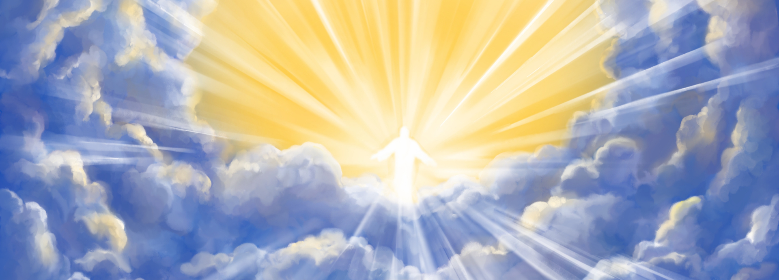
14. What apostle besides Peter has said much about the second coming of Christ?
2 Peter 3:15, last part.

Slide 48
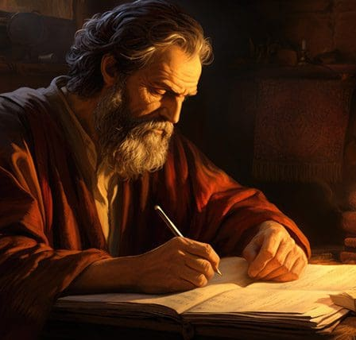
Our Response: 2 Peter 3:15
¹⁵ And account that the longsuffering of our Lord is salvation; even as our beloved brother Paul also according to the wisdom given unto him hath written unto you;

Slide 49
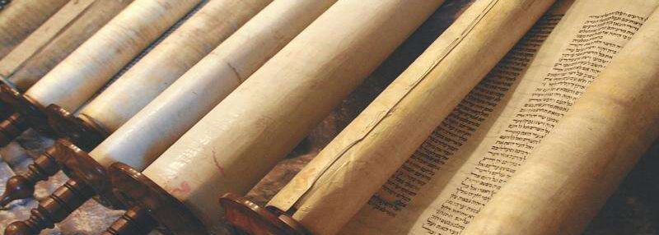
15. How extensively does Peter say that Paul has spoken of these things?
2 Peter 3:16.

Slide 50

Our Response: 2 Peter 3:16
¹⁶ As also in all his epistles, speaking in them of these things; in which are some things hard to be understood, which they that are unlearned and unstable wrest, as they do also the other scriptures, unto their own destruction.

Slide 51
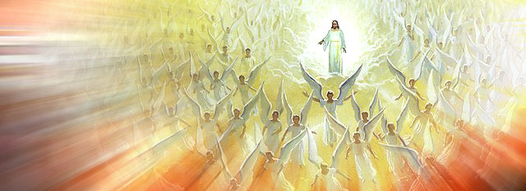
16. Is there one of Paul's epistles which does not refer to the second coming of Christ and the Judgment?

Slide 52
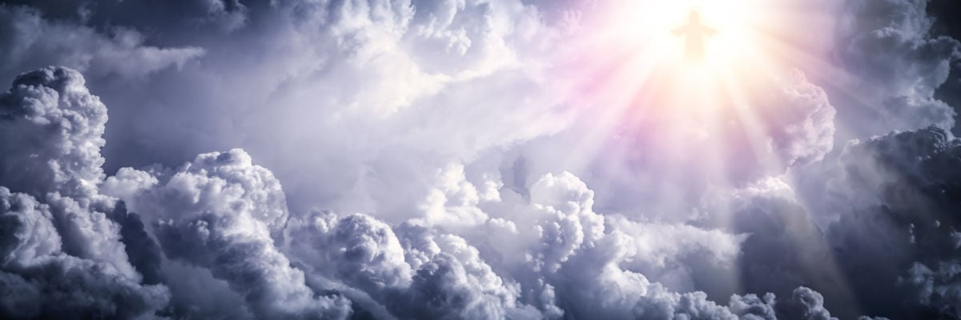
17. What epistles contain a mention of this event in every chapter?

Slide 53
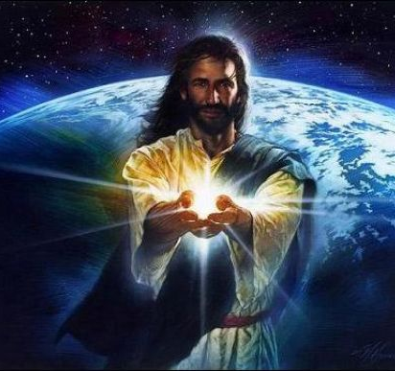
Our Response
Answer: The epistles to the Thessalonians.

Slide 54

18. In view of the glorious future that is promised to the righteous, and the great wickedness that will prevail just before the Lord comes, of what should we beware?
2 Peter 3:17

Slide 55

Our Response: 2 Peter 3:17
¹⁷ Ye therefore, beloved, seeing ye know these things before, beware lest ye also, being led away with the error of the wicked, fall from your own stedfastness.

Slide 56

19. In view of the failures of God's people in the past, what warning is given us?
1 Corinthians 10:12.

Slide 57
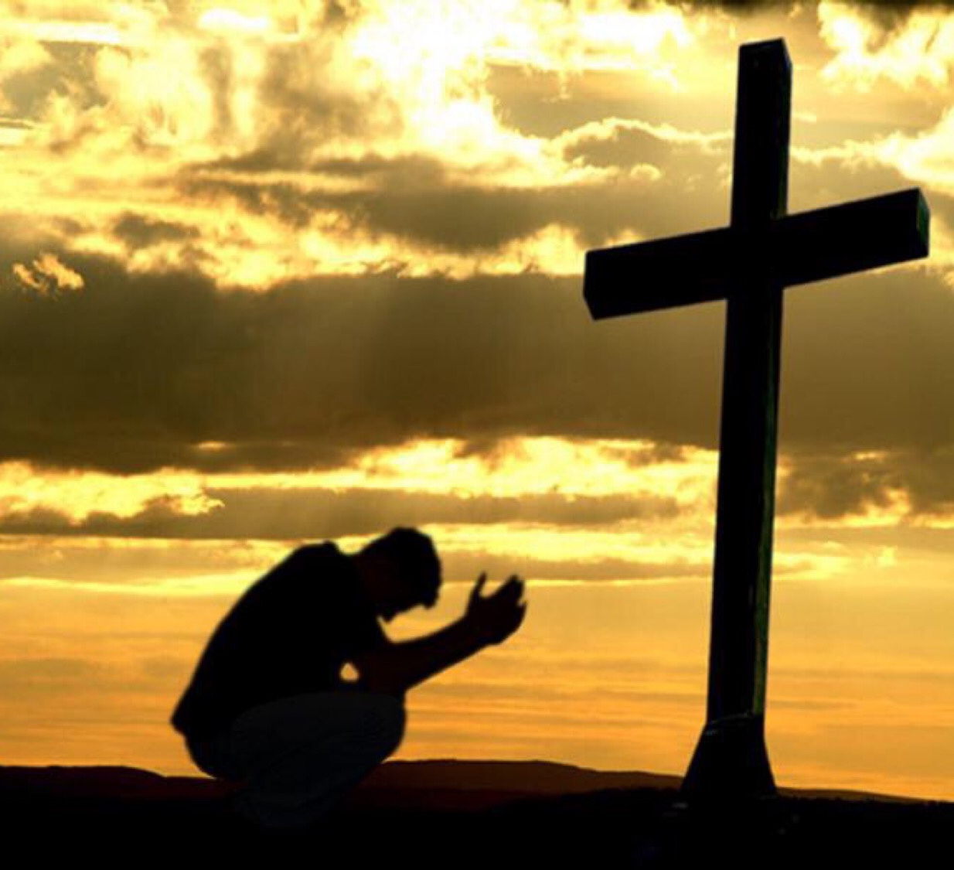
2 Warnings & a Command: 1 Corinthians 10:12
¹² Wherefore let him that thinketh he standeth take heed lest he fall.

Slide 58

20. How alone can we keep from being led away by the error of the wicked?
2 Peter 3:18.

Slide 59

2 Warnings & a Command: 2 peter 3:18
¹⁸ But grow in grace, and in the knowledge of our Lord and Saviour Jesus Christ. To him be glory both now and for ever. Amen.

Slide 60
21. To whom and for what should we ascribe glory?
2 Peter 3:18; Jude 24, 25.

Slide 61
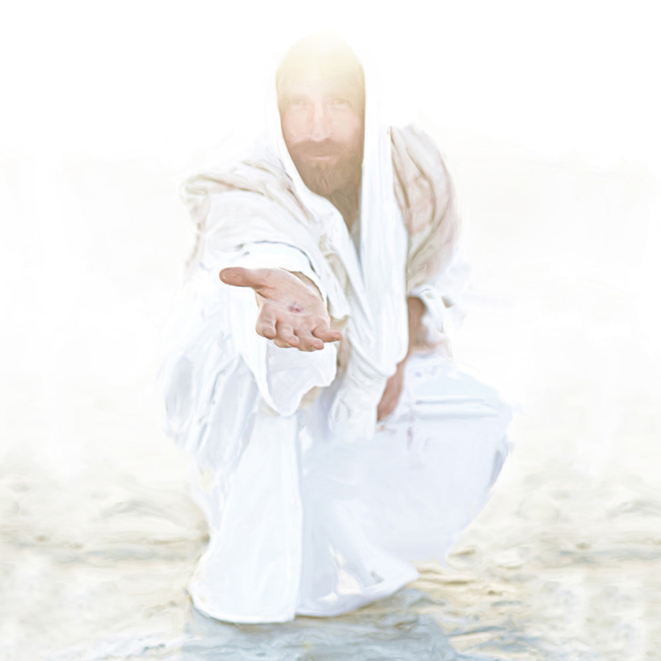
2 Warnings & a Command: 2 peter 3:18
¹⁸ But grow in grace, and in the knowledge of our Lord and Saviour Jesus Christ. To him be glory both now and for ever. Amen.

Slide 62
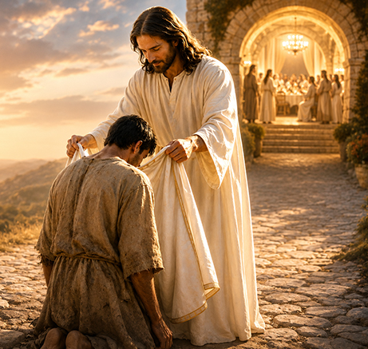
2 Warnings & a Command: Jude 24, 25
²⁴ Now unto him that is able to keep you from falling, and to present you faultless before the presence of his glory with exceeding joy,

Slide 63
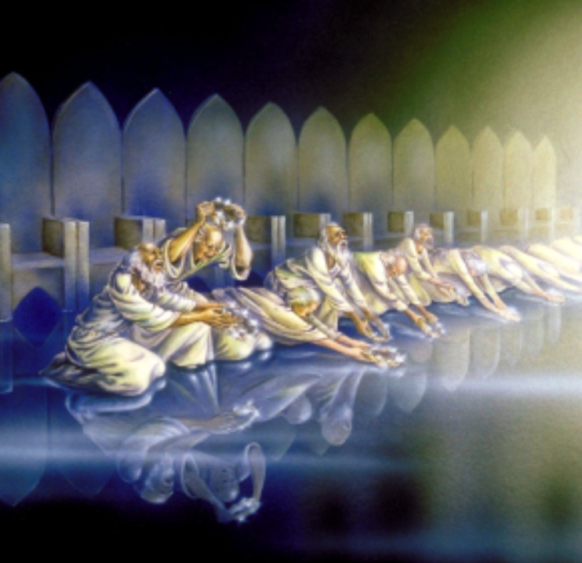
2 Warnings & a Command: Jude 24, 25
²⁵ To the only wise God our Saviour, be glory and majesty, dominion and power, both now and ever. Amen.

Slide 64
The Knowledge of Our Lord
2 Peter 1:2
² Grace and peace be multiplied unto you through the knowledge of God, and of Jesus our Lord,
2 Peter 3:18
¹⁸ But grow in grace, and in the knowledge of our Lord and Saviour Jesus Christ. To him be glory both now and for ever. Amen.

Slide 65

Peter begins with grace and knowledge, and he ends with grace and knowledge. The Christian life is not merely waiting for a new world; it is growing into friendship with the King who will make that new world.

Slide 66
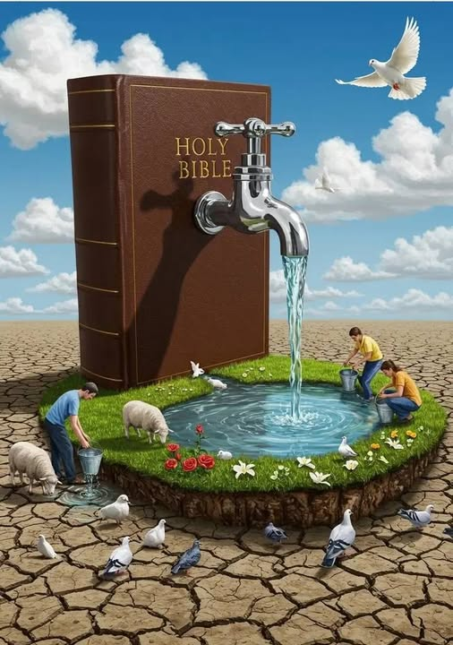
Everything in between Peter’s introductory statement and his conclusion—faith, virtue, knowledge, temperance, patience, prophecy, false teachers, scoffers, judgment, and the new earth—is really about helping believers know Christ more fully!

Slide 67


Slide 68


